Slide 1





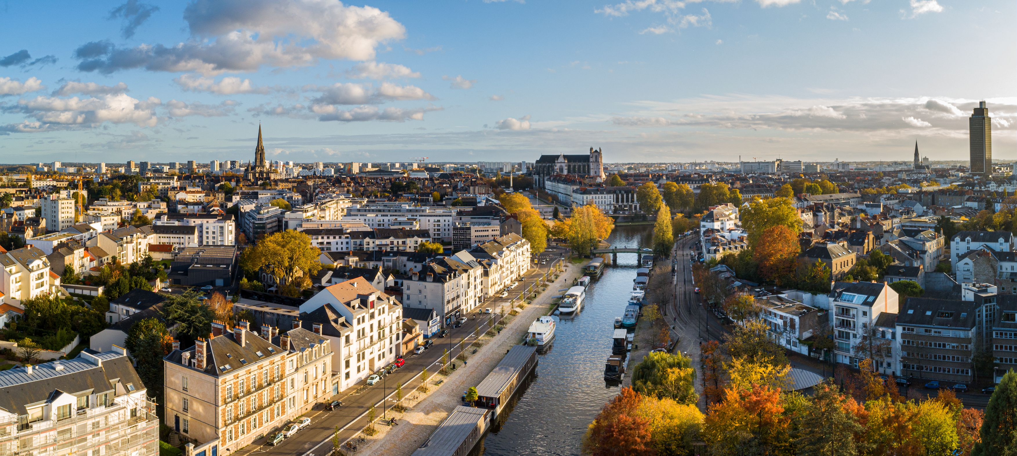









19 – 22 May, 2026
Nantes, France
PLATINUM SPONSOR GOLD SPONSORS SILVER SPONSORS BRONZE SPONSORS

Slide 2

Plenary Lecture 4
22 May 2026, 17:00 – 17:40
Sophia Haussener
EPFL, Switzerland
Multi-physical transport in porous media for energy applications
Chair: Chaozhong Qin
Chongqing University, China

Slide 3

May 22, 2026
AWARD CEREMONY 4
Chaired by:
Azita Ahmadi
InterPore Treasurer
PLATINUM SPONSOR GOLD SPONSORS SILVER SPONSORS BRONZE SPONSORS

Slide 4


InterPore - PoreLab Award
for Young Researchers
In recognition of outstanding contributions in porous media research.
The research may be theoretical, computational, or experimental.
Notes:
Laura asks Majid to present this award; Majid takes over

Slide 5

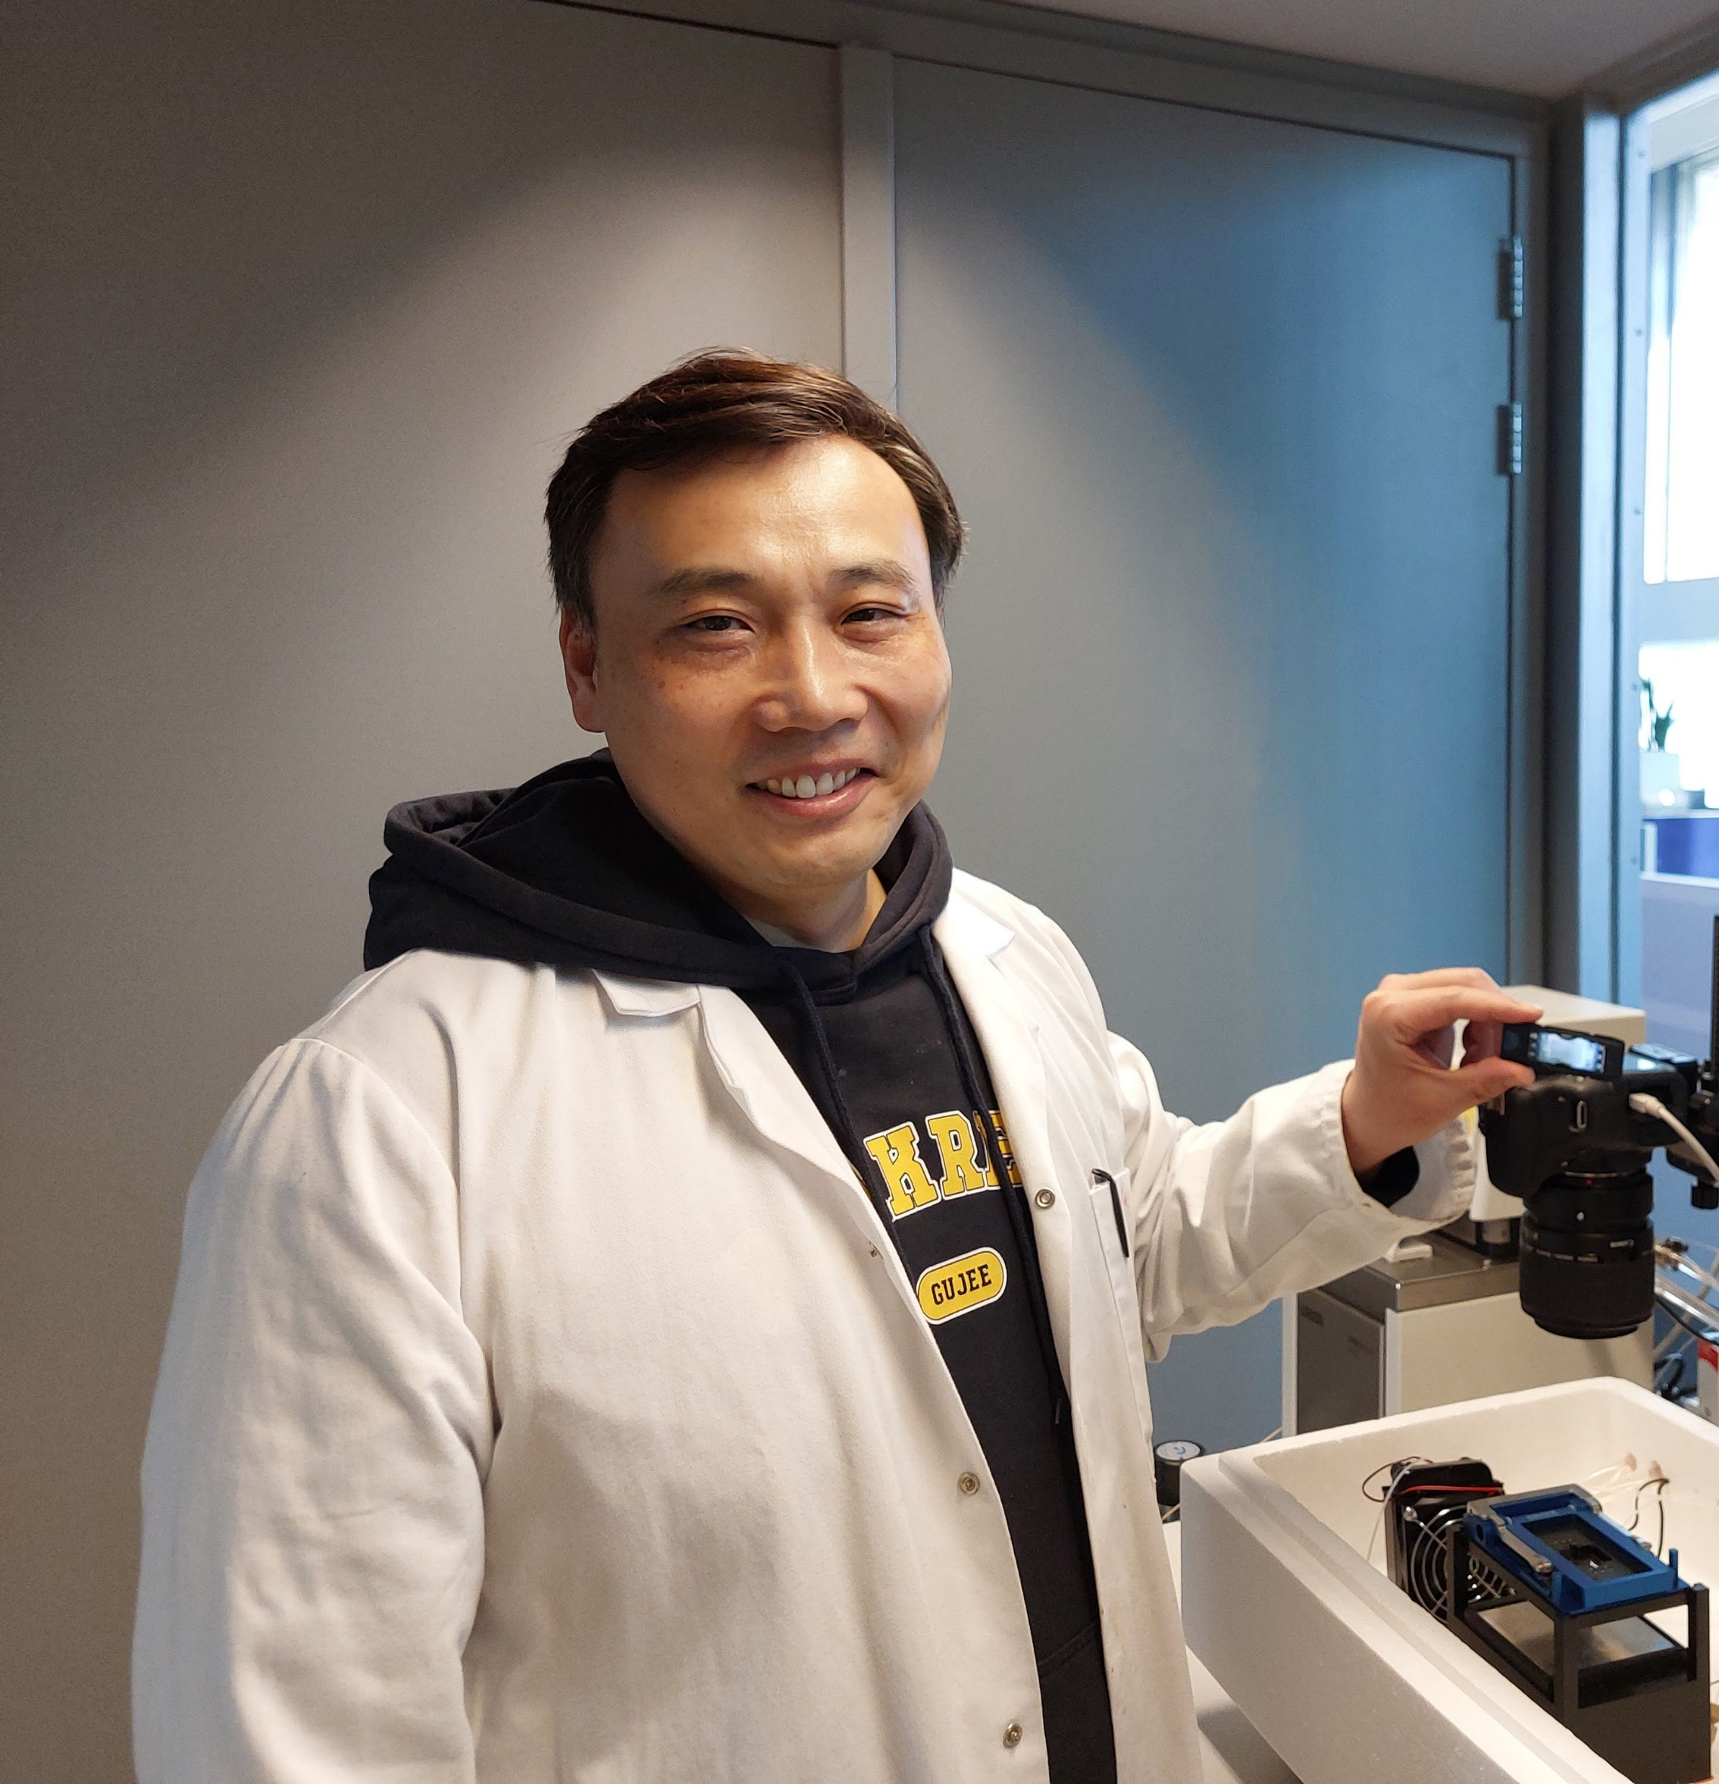
InterPore – PoreLab Award for Young Researchers 2026
Lifei Yan
Postdoctoral Researcher at Delft University of Technology, The Netherlands
Notes:
Majid

Slide 6
InterPore – PoreLab Award for Young Researchers 2026
Lifei Yan
Recognized for tackling complex problems in:
Porous media
CO₂ storage
Notes:
Majid

Slide 7


Student Poster Award
In recognition of outstanding student poster presentations at the annual InterPore conference.
This award has been made possible by generous grants from Earth Energy Science (EES) and Capillarity.
Notes:
Laura asks Majid to present this award; Majid takes over

Slide 8
Earth Energy Science and Capillarity Best Student Poster Award
The Student Grant Committee reviews outstanding posters and chooses four winners, based on:
Scientific content and novelty
Presentation and appearance
Impact of the research
Performance in live presentation session
Notes:
Laura asks Majid to present this award; Majid takes over

Slide 9
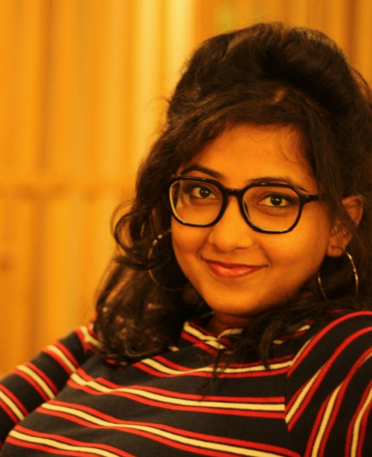

Earth Energy Science and Capillarity Best Student Poster Award 2026
Rima Manik
Indian Institute of Technology, Hyderabad, India
For the poster entitled:
„Co-transport of ZnO and TiO2 nanoparticle aggregates with bacteria in soil: A coupled experimental and modeling approach “

Slide 10
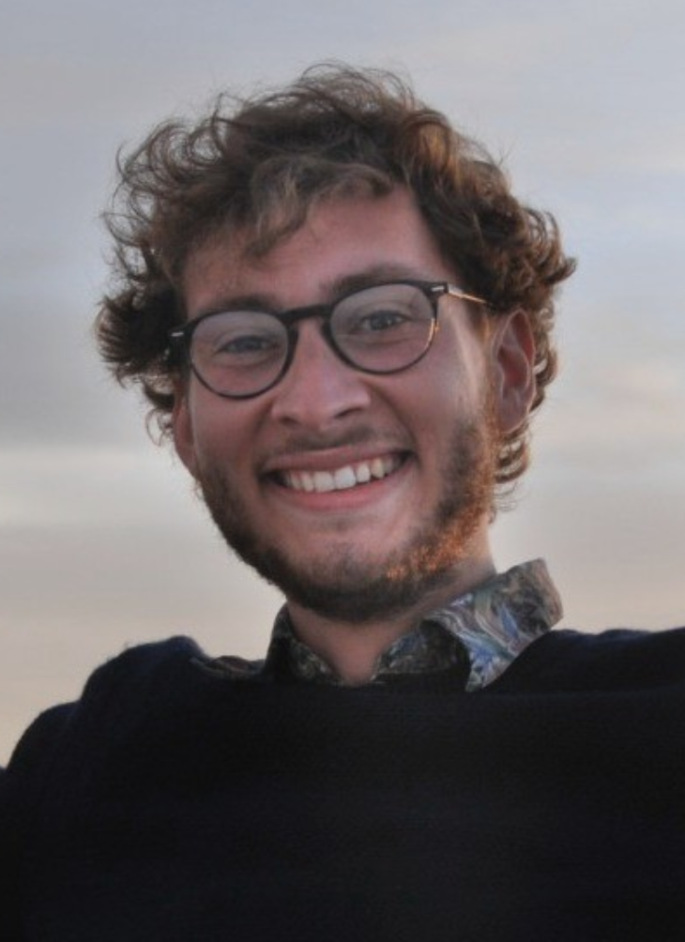
Earth Energy Science and Capillarity Best Student Poster Award 2026
Clément Petitjean Université de Rennes, France
For the poster entitled:
„Mixing enhancement in porous media with impermeable inclusions “

Slide 11
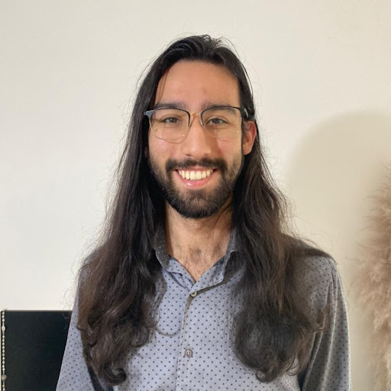
Earth Energy Science and Capillarity Best Student Poster Award 2026
Berilo de Oliveira Santos
Federal University of Juiz de Fora, Brazil
For the poster entitled:
„Impacts of permeability heterogeneities on foam flow in porous media: uncertainty quantification and sensitivity analysis “

Slide 12
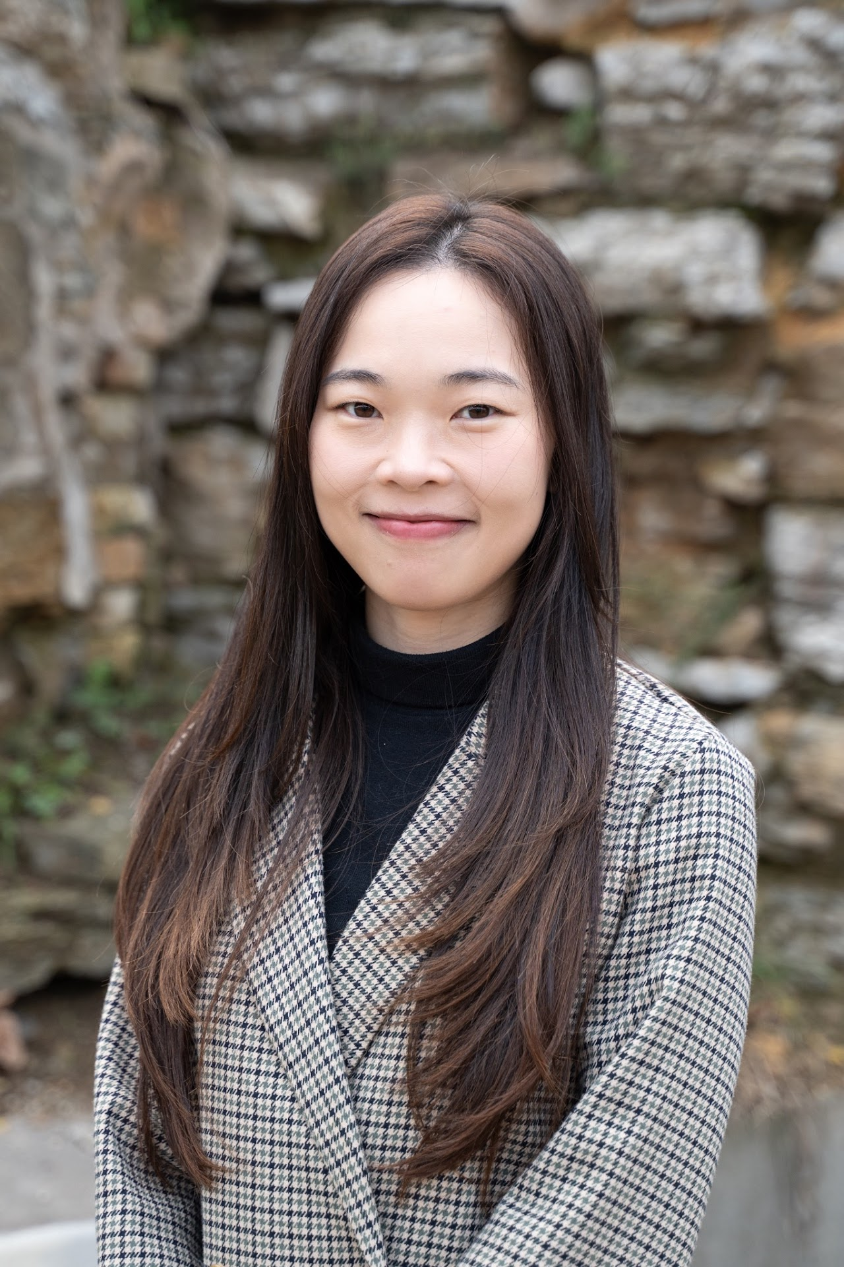
Earth Energy Science and Capillarity Best Student Poster Award 2026
Jingxuan Deng University of Minnesota, USA
For the poster entitled:
„Geologic stress modulates fluid mixing at fracture intersections “

Slide 13
Recognizes dedication and leadership
Honors exceptional contributions to InterPore activities
Awarded annually
Recipients are selected by the InterPore Executive Committee
InterPore Rosette 2026
Notes:
Laura asks Majid to present this award; Majid takes over

Slide 14
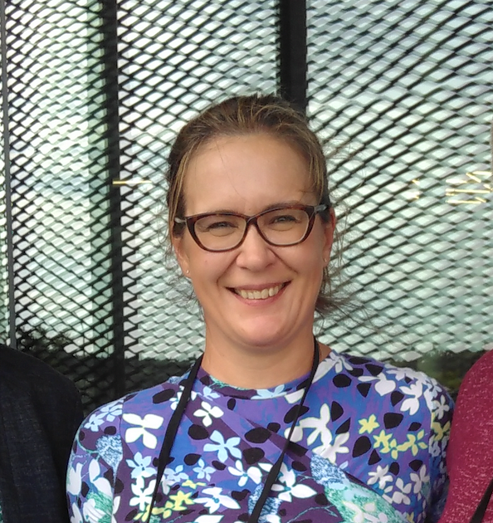
InterPore Rosette 2026
Tiina Roose
Professor of Biological and Environmental Modelling, School of Engineering, Faculty of Engineering and Physical Sciences (FEPS) University of Southampton, UK
Founder of the InterPore DEI Committee
Former chair now member of the DEI Committee
Member of the Program Committee
DEI speaker at InterPore2025
Plenary Speaker at InterPore2019

Slide 15
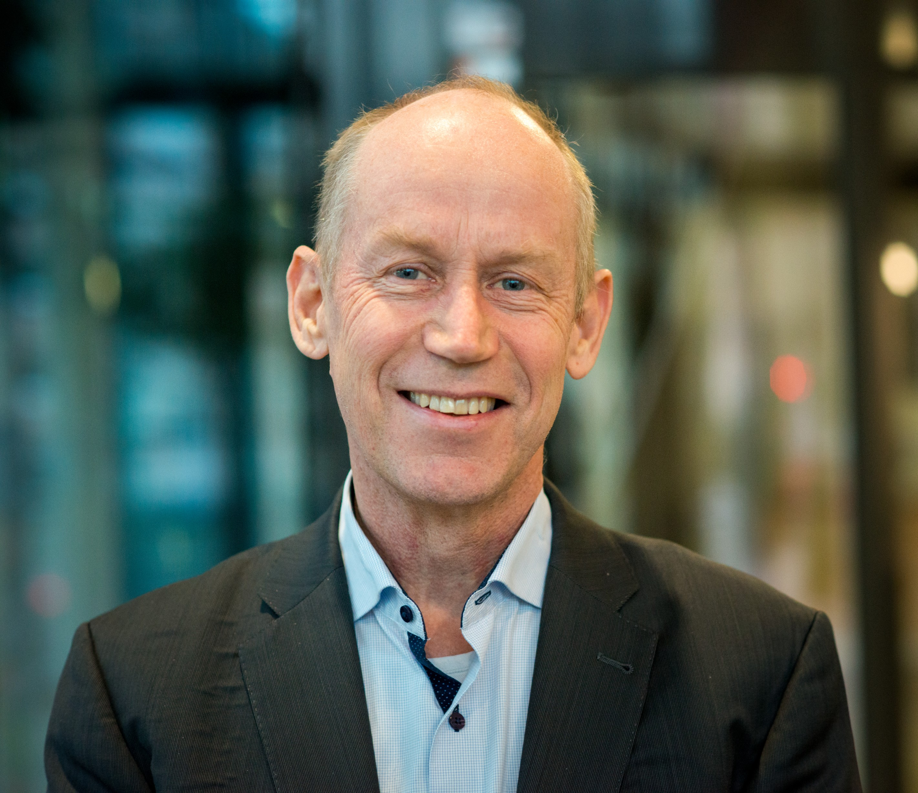
InterPore Rosette 2026
Olaf Kolditz
Professor for Applied Environmental Systems Analysis
Technische Universität Dresden, Germany
Longstanding supporter of InterPore since 2016
Facilitated institutional membership of Helmholtz-Zentrum für Umweltforschung – UFZ
Instrumental in securing support for the InterPore newsletter

Slide 16
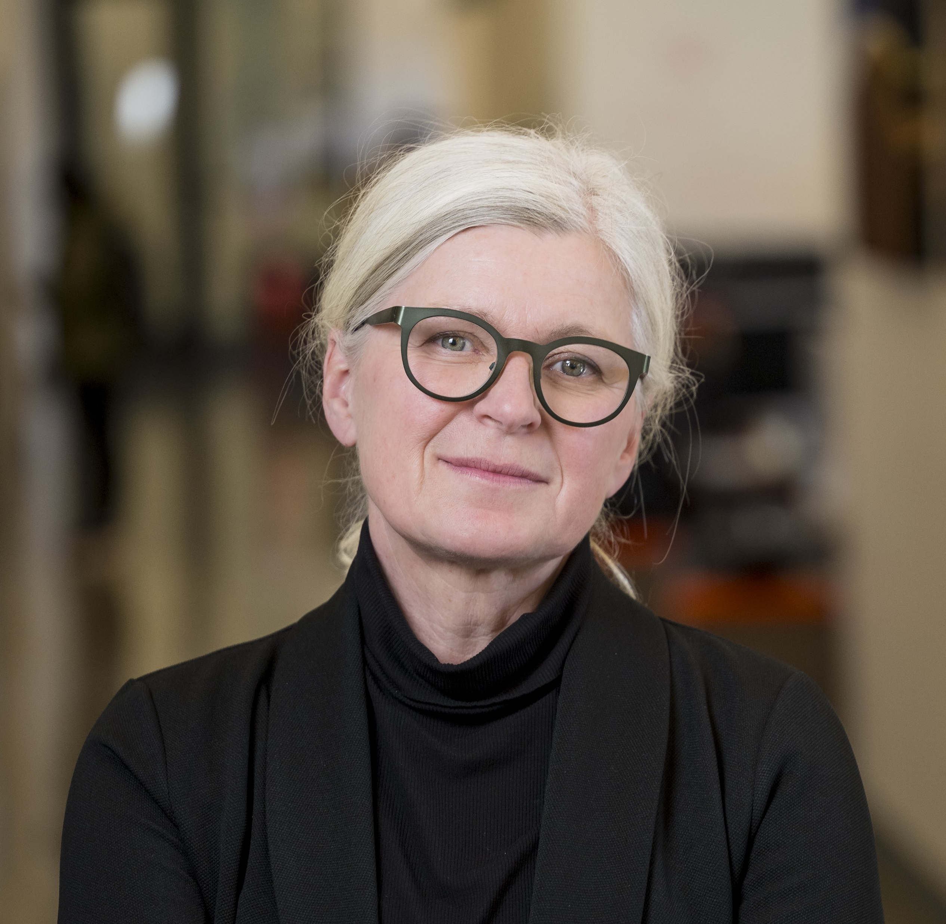
InterPore Rosette 2026
Dorthe Wildenschild
Professor of Environmental Engineering
Oregon State University, USA
Chair of the Honors & Awards Committee 2024 & 2025
Member of the Editorial Board of the InterPore Journal during its inaugural year
InterPore Council Member from 2015 to 2017

Slide 17
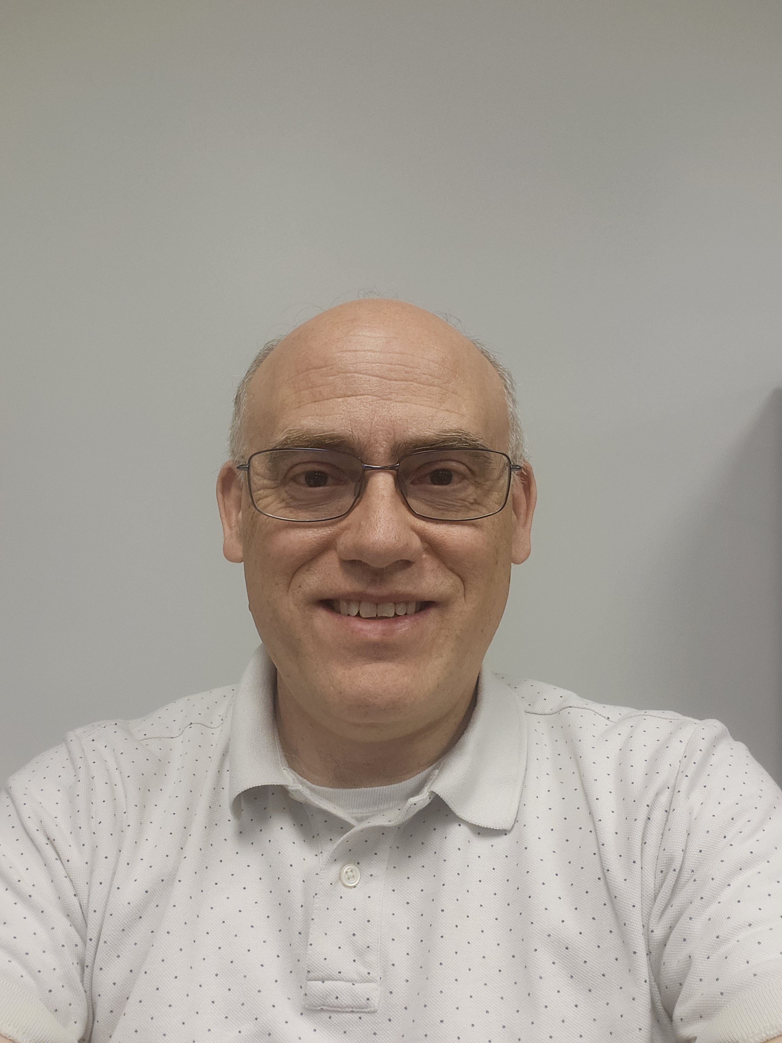
InterPore Rosette 2026
Andrew Baker
Senior Scientist and Technical Leader
Kimberly-Clark, USA
Vice Chair of the InterPore Foundation (2022–2024)
Chair of the InterPore Foundation (2024–present)
Key contributor to the success and continuation of the Kimberly-Clark Distinguished Lectureship Award (2018–2025)
Played a leading role in establishing the new Kimberly-Clark Distinguished Fellowship Award

Slide 18
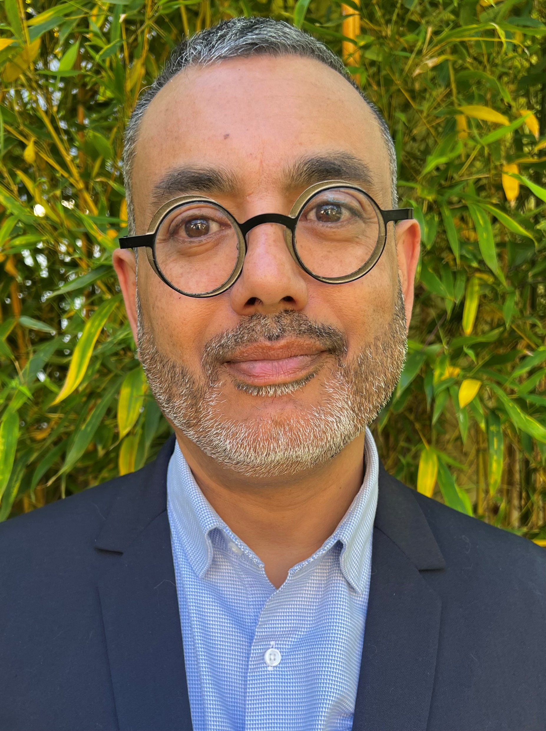
InterPore Rosette 2026
Benoit Rousseau
Director, CNRS Research Federation TAMARYS
Nantes Universit, France
Chair of the Local Organizing Committee of InterPore2026
Demonstrated outstanding dedication to the successful organization of the conference
Instrumental in ensuring the smooth planning and execution of InterPore2026
Contributed significantly to the conference’s success and participants’ experience

Slide 19
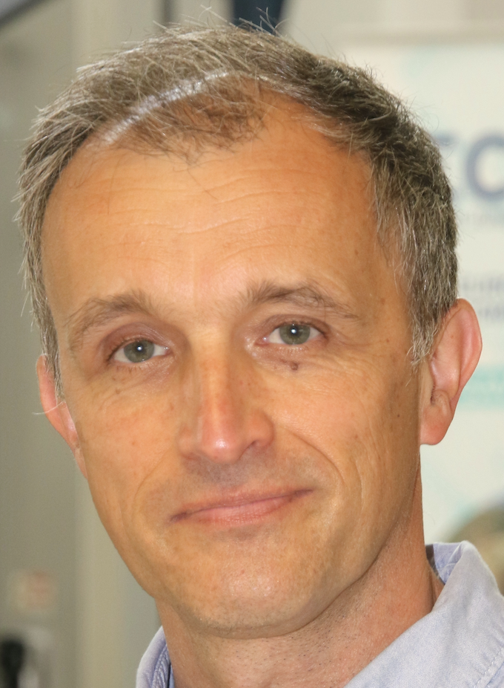
InterPore Rosette 2026
Christophe Binetruy
Centrale Nantes, Nantes Université, France
Co-Chair of the Local Organizing Committee of InterPore2026
Provided invaluable support with visa requests and participants’ coordination
Played a key role in engaging potential exhibitors and sponsors

Slide 20
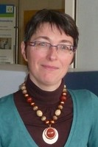
InterPore Rosette 2026
Béatrice Béchet
Université Gustave Eiffel, France
Co-Chair of the Local Organizing Committee of InterPore2026
Organized and secured funding for the lab tour
Coordinated “Sightseeing Hunt in Nantes” features for the newsletter
Coordinated contributions to conference bulletins, sections on “Scientific Activities in the Field of Porous Media in Nantes”

Slide 21
May 22, 2026
Closing Ceremony
Chaired by:
Azita Ahmadi
InterPore Treasurer

Slide 22

JOIN US IN 2027 IN RIO DE JANEIRO, BRAZIL!

Slide 23





Featured Speakers
Marcio da Silveira Carvalho Pontifícia Universidade do Rio de Janeiro, Brazil
Tito José Bonagamba University of Sao Paulo, Brazil
Malgorzata Peszynska Oregon State University, USA
Yoel Forterre CNRS, France
Harry Westfahl Jr. Brazilian Synchrotron Light Laboratory (LNLS), Brazil
Inga Berre University of Bergen, Norway
Nathaly Lopes Brazilian Center for Research in Energy and Materials (CNPEM) – Brazilian Synchrotron Light Source, Brazil
Suzanne Hangx Utrecht University, The Netherlands
Bill Ristenpart UC Davis, USA
Daniel Lester RMIT University, Australia
Dachamir Hotza Federal University of Santa Catarina, Brazil
Ryan Armstrong UNSW, Australia
Henk Huinink Eindhoven University of Technology, The Netherlands
19th Annual Meeting & Conference Courses
📍 Rio de Janeiro, Brazil 📅 10–13 May 2027
Conference Courses: 9 & 14 May 2027
Focus Theme
Imaging of Porous Materials
Key Topics
CO₂ storage • Hydrogen • Smart materials • Soil health • Energy transition
Global Community
Leading researchers, industry partners, courses & technical tours
Rio de Janeiro welcomes you with open arms!
www.interpore.org/2027

Slide 24
Thank you for joining us!
InterPore2026 is sponsored by:

