Slide 1







Stochastic Upscaling of Hydraulic Properties in Natural Shear Fractures
Perez et al. (2026), ArXiv Preprint
“Probabilistic Upscaling of Hydrodynamics
in Geological Fractures Under Uncertainty”
S. Perez†, F. Doster*, H. Menke*, A. ElSheikh* & A. Busch†
† The Lyell Centre, GeoEnergy Group
* Institute of GeoEnergy Engineering
Subsurface Energy Transition & Innovation Centre (SET-IT)
Heriot-Watt University, Edinburgh, UK
Perez et al. (2025), Geophysical Research Letters
“When Cubic Law and Darcy Fail: Bayesian Correction
of Model Misspecification in Fracture Conductivities”

Slide 2
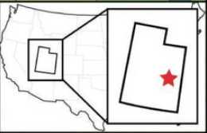
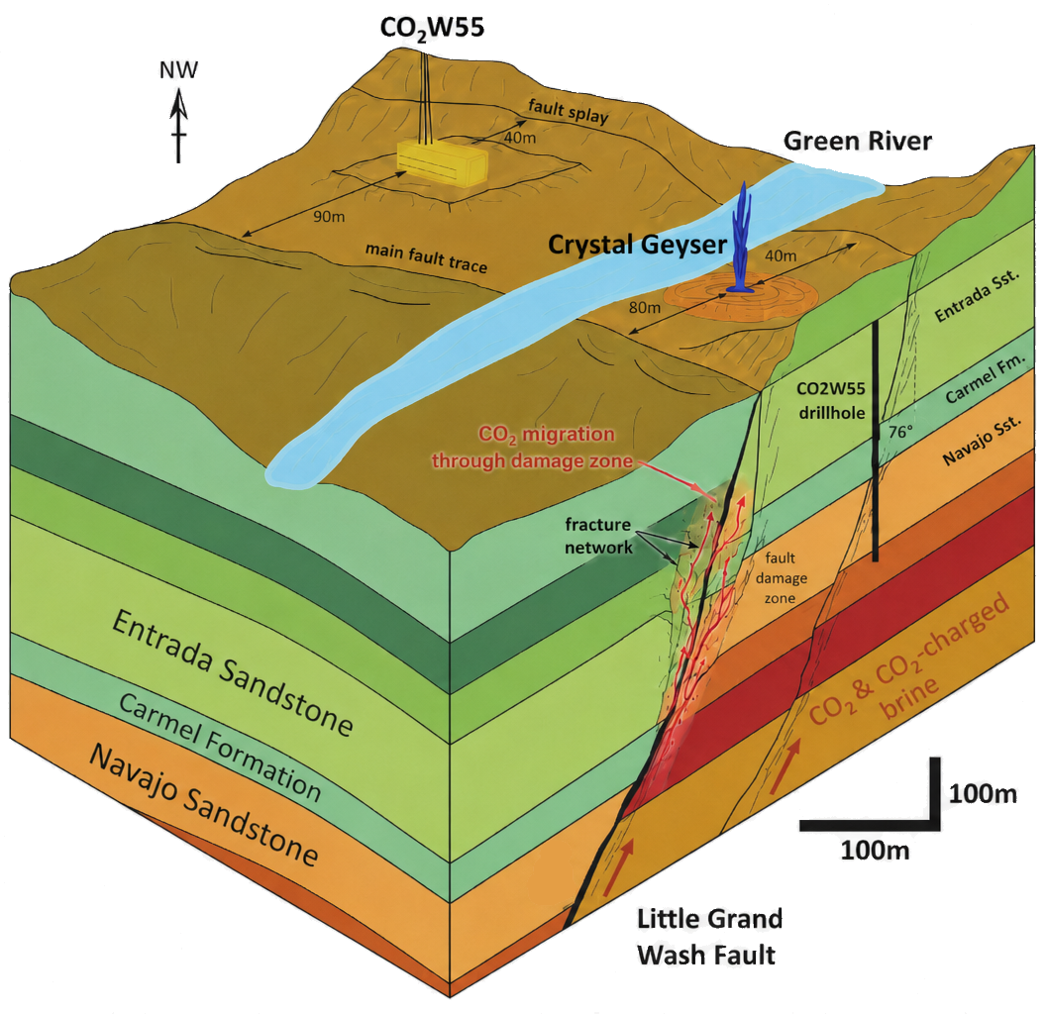
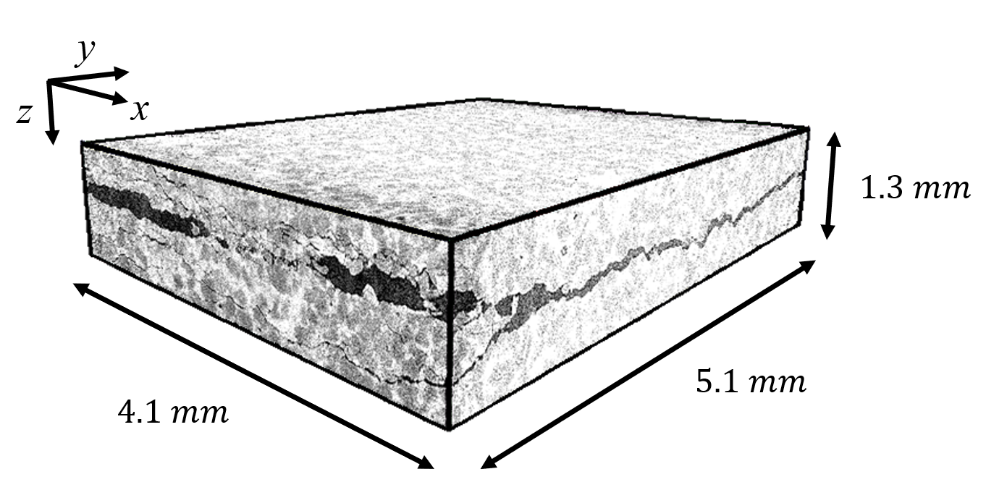
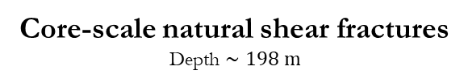
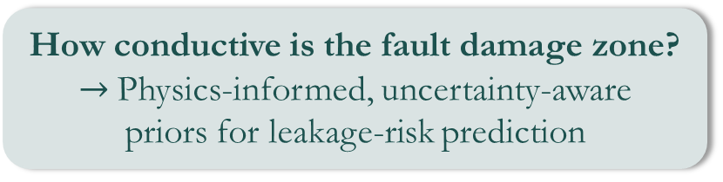
Uncertainty Propagation in Fractured Systems Fault Damage Zones as uncertain leakage pathways
How conductive is the fault damage zone?
$→$Physics-informed, uncertainty-aware
priors for leakage-risk prediction
Data Uncertainty
Limited observations
Model Uncertainty
Conductivity priors
Scale Transfer
Core-scale natural shear fractures
Depth $∼198 m$
Kampman et al. (2013)
Notes:
The natural fractures analysed in this study were extracted from core material recovered within the damage zone of the Little Grand Wash Fault near Green River Basin, Utah [31, 33]. The fractured sample plugs originate from the Jurassic Carmel Formation, representing a shallow-marine succession of claystone, siltstone and evaporite layers, acting as a caprock for the underlying Navajo Formation.
Several fractures in the samples exhibit clear indicators of shear displacement, including mismatched surface geometries and locally interlocked asperities. Such features provide strong evidence that the fractures formed in situ during fault activity.
Fault-zone leakage risk is sensitive to properties that are not directly observed – data uncertainties.

Slide 3
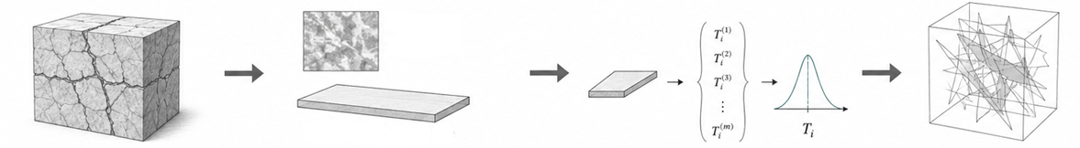
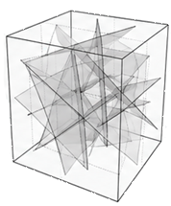
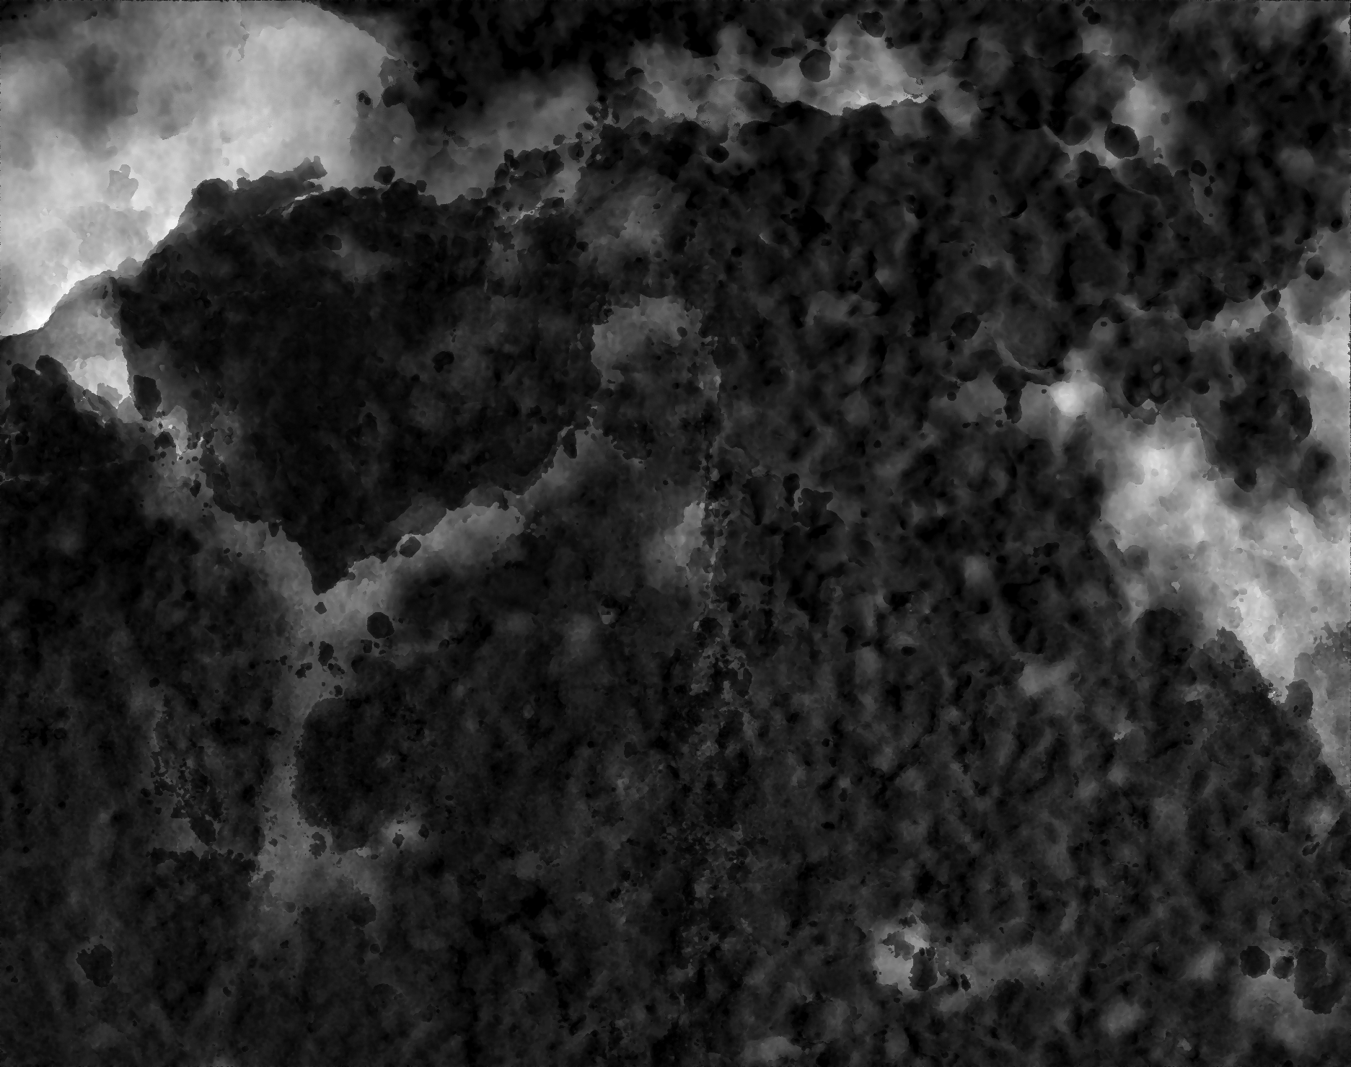



From Fracture-Scale Physics to Network-Scale Modelling UncertaintY GAp & model Bias in fracture properties
1
Detailed fracture physics
1
Common reduced models
2
Fracture Networks models
Mechanical
aperture map
OR
$$T_{i}$$
Physically consistent
Capture intra-fracture variability
Expensive for large networks
Mechanical aperture $∼$ mm a hydraulic proxy (Cubic Law)
Within-fracture variability mm often discarded
Fast for network models
Model bias,
No physically-grounded uncertainty

Slide 4
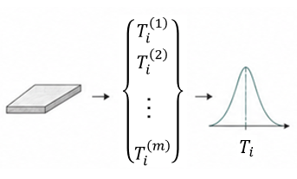


From Fracture-Scale Physics to Network-Scale Modelling Uncertainty propagation with AI-enhanced reduced models
1
Detailed fracture physics
1
Target reduced models
2
Fracture Networks models
Physically consistent
Capture intra-fracture variability
Expensive for large networks
Physically-calibrated properties
Retain intra-fracture uncertainty
Fast enough for network-scale use
Physics-calibrated, uncertainty-aware, AI-enhanced closures for network models
Notes:
My aim is to retain the useful physical information from detailed fracture simulations, but compress it into a fast, uncertainty-aware reduced closure for network-scale modelling
Physics-calibrated reduced models for network-scale uncertainty propagation

Slide 5
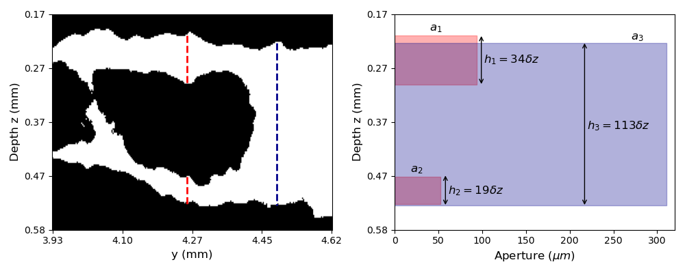
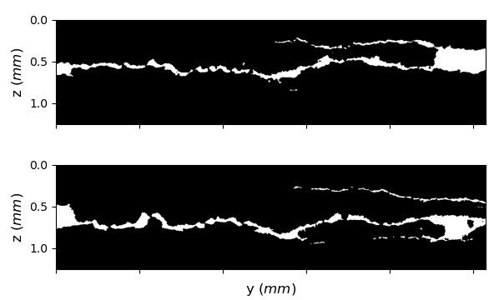
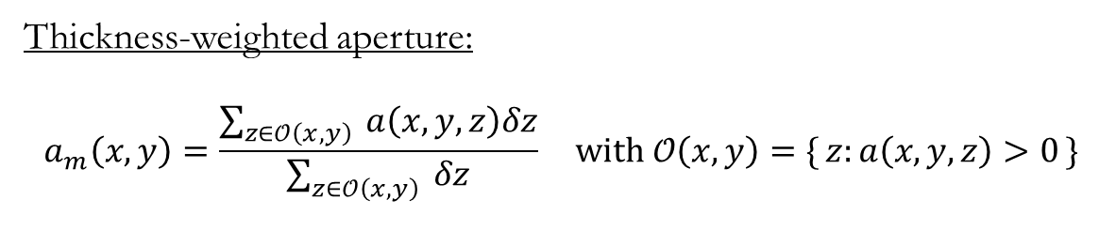
Thickness-weighted mechanical aperture A Probabilistic Formulation of the aperture
Complex void structures,
coexisting branches, roughness…
Mechanical aperture as an uncertain geometric descriptor, rather than hydraulic proxy
Thickness-weighted aperture:
$$a_{m}\left(x,y\right)=\frac{\sum_{z∈𝒪\left(x,y\right)}{ a\left(x,y,z\right)δz}}{\sum_{z∈𝒪\left(x,y\right)}{ δz}} with 𝒪\left(x,y\right)=\{ z:a\left(x,y,z\right)>0 \}$$
Notes:
This definition offers several advantages. First, it yields a geometric aperture measured only where the fracture is actually open, and therefore reduces to the standard vertical aperture for synthetic fractures that contain a single connected channel. Second, unlike the maximum-aperture criterion applied to partially cemented fractures in Landry et al. (2024) [4], it accounts for the contribution of all coexisting branches to
the hydraulic behaviour.
By weighting each branch by its local open thickness, the definition naturally blends their influence in a manner consistent with their volumetric importance. In fact, (12) corresponds to the expected gap encountered when sampling a point uniformly within the open sub-volume, thereby providing a probabilistic interpretation of the local mechanical aperture in complex fracture geometries.

Slide 6

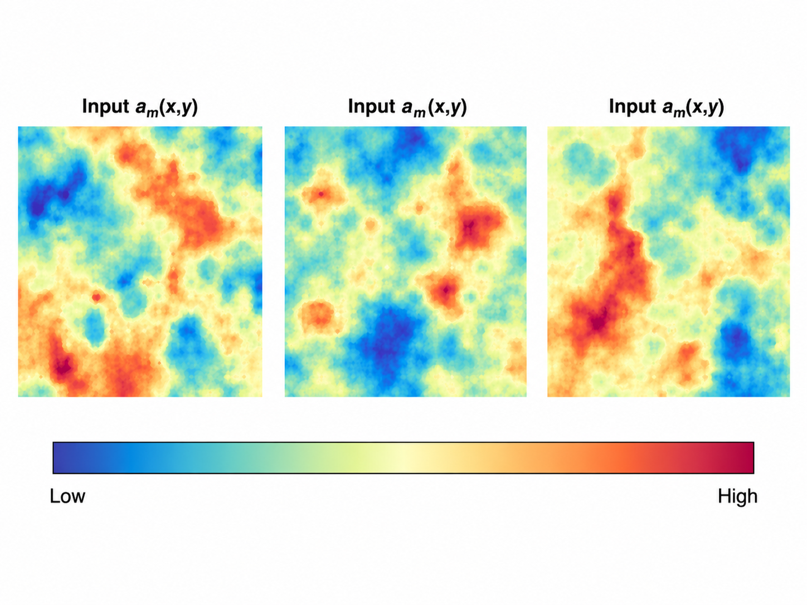
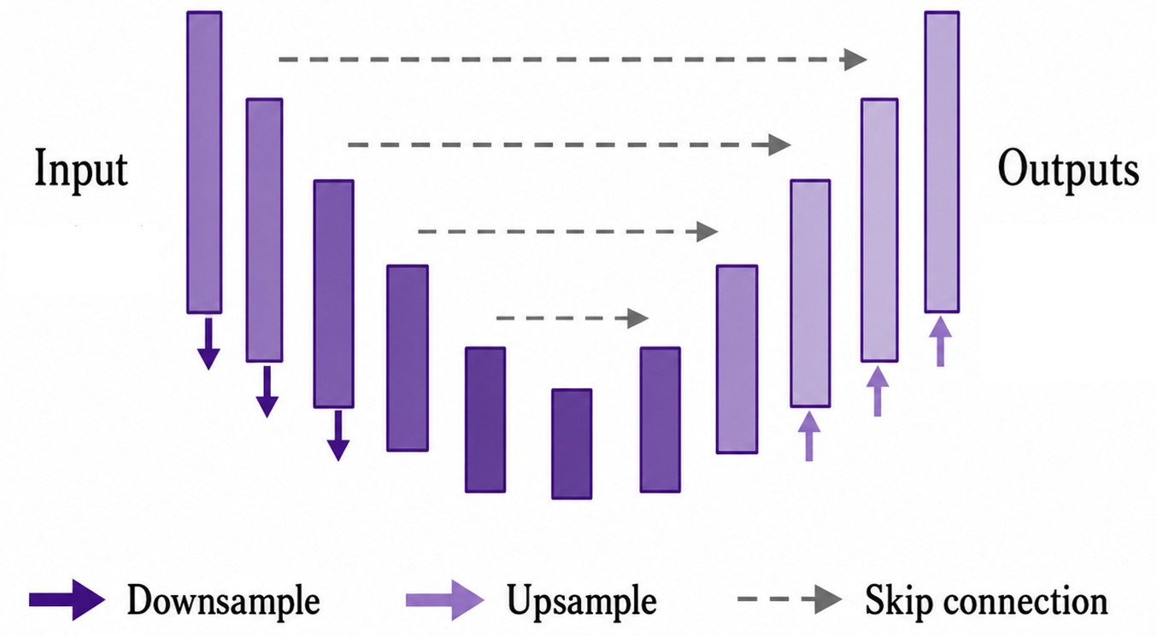



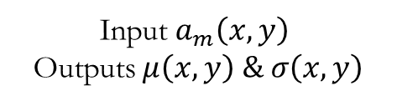
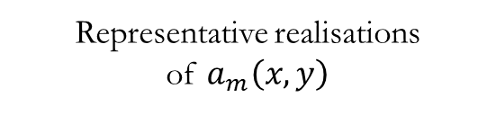


Probabilistic Workflow for Uncertainty Propagation Learning Hydraulic properties from Physics & Data
Local mechanical aperture
patches
Bayesian correction of aperture-permeability bias
Residual U-Net
(Data-driven surrogate)
2
3
$$𝔼\left[K(x,y)|𝓓\right] \& Var\left[K(x,y)|𝓓\right]$$
Data $𝒟$
Training data
with
Low
High
$$K\left(x,y\right)∼\text{Log} 𝓝\left(μ\left(x,y\right),σ^{2}\left(x,y\right)\right)$$
$$N_{x}=128; N_{y}=128$$
Representative realisations
of $a_{m}\left(x,y\right)$
Physical hydraulic
response $K_{NS}$
Input $a_{m}\left(x,y\right)$
Outputs $μ\left(x,y\right) \& σ\left(x,y\right)$
Training Phase: Learn local probabilistic permeability statistics from mechanical aperture data
Notes:
This is the strength of the hybrid approach: the Bayesian correction provides the physically grounded information, while the U-Net provides scalability.
Fast surrogate-based uncertainty propagation from mechanical aperture geometry to upscaled effective permeability

Slide 7
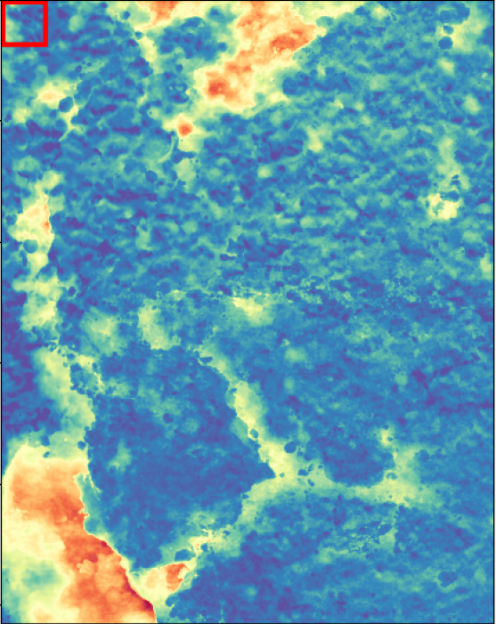
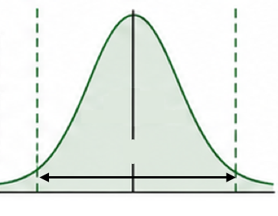
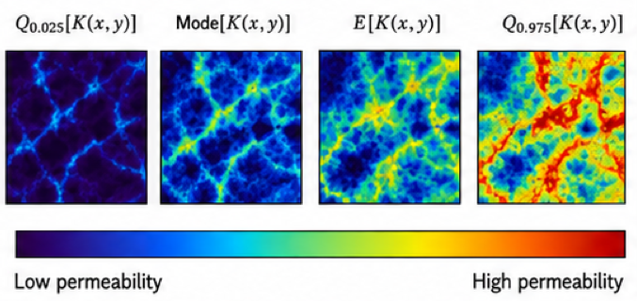
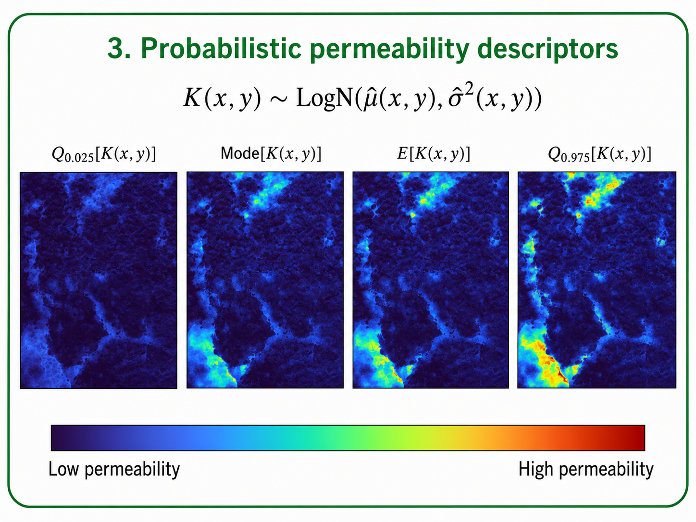







Probabilistic Workflow for Uncertainty Propagation Learning Hydraulic properties from Physics & Data
Trained Residual U-Net
$$\hat{μ}\left(x,y\right)$$
$$\hat{σ}(x,y)$$
New natural
fractures
Probabilistic permeability descriptors
Effective permeability distributions
$$K\left(x,y\right)∼\text{Log} 𝒩\left(\hat{μ}\left(x,y\right),{\hat{σ}}^{2}\left(x,y\right)\right)$$
$$2.5\%$$
$$Mode$$
$$97.5\%$$
Flow-based
upscaling
Low
High
$$95\% CI$$
Uncertainty bounds
on upscaled $K_{eff}$
$$N_{x}=1480; N_{y}=1873$$
Low permeability
High permeability
Application Phase:
Generate uncertainty-aware fracture conductivity estimates for network-scale modelling
Notes:
The workflow goes from uncertain fracture geometry to probabilistic permeability fields, to upscaled hydraulic uncertainty.

Slide 8
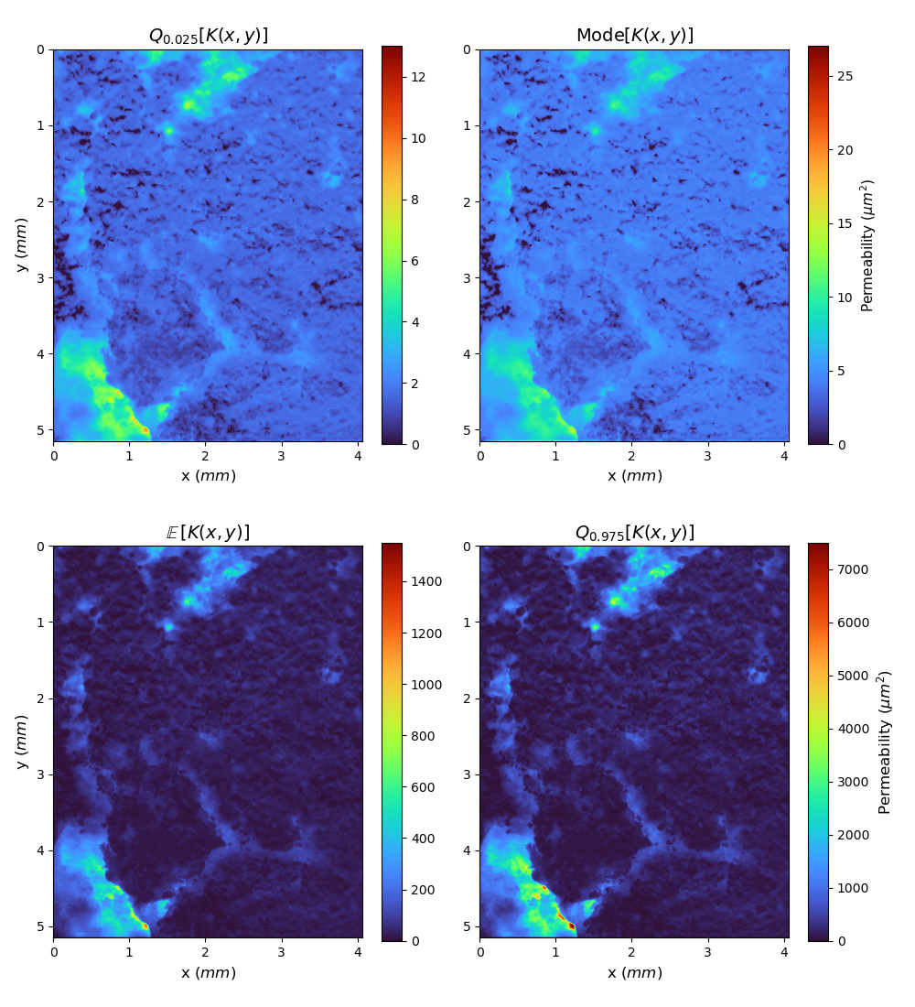
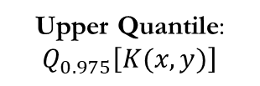
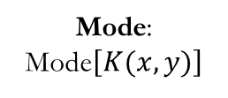
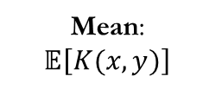
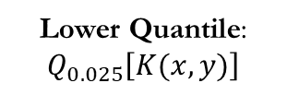
Uncertainty-Aware Permeability Fields Posterior Permeability Descriptors – Natural Fracture #1
Lower Quantile: $Q_{0.025}\left[K(x,y)\right]$
Mode:
Mode$\left[K(x,y)\right]$
Mean:
$$𝔼\left[K(x,y)\right]$$
Upper Quantile: $Q_{0.975}\left[K(x,y)\right]$
Uncertainty is spatially structured
Mean & Upper Quantile emphasise high-permeability tails
Notes:
Moving to some results, the first output is a set of uncertainty-aware permeability fields.
Here, we show four descriptors of the local permeability distribution for a natural shear fracture at full resolution.
The key point is that uncertainty is spatially structured. The mean and upper quantile emphasise regions with high-permeability tails, which can then impact the connectivity of flow pathways.

Slide 9
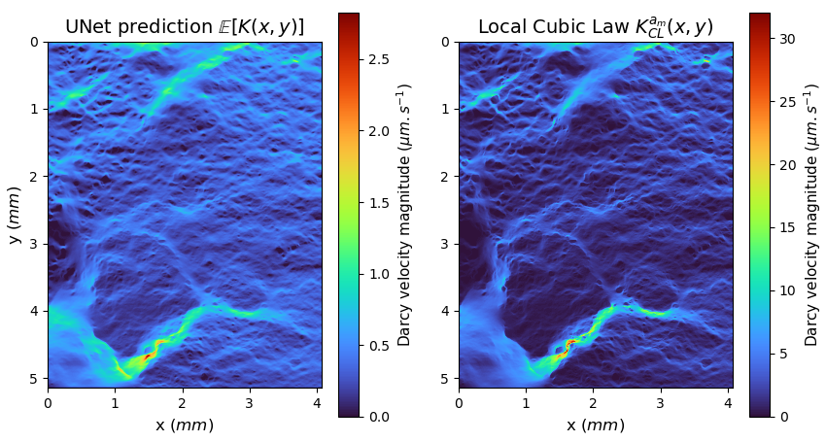

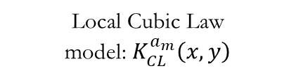
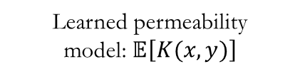
Uncertainty-Aware Upscaling Affects Flow Predictions Darcy Flow-BASED Upscaling – Natural Fracture #1
Learned permeability
model: $𝔼\left[K(x,y)\right]$
Local Cubic Law
model: $K_{CL}^{a_{m}}\left(x,y\right)$
Local Cubic Law amplifies aperture extremes
Preferential pathways are preserved
Physically-grounded flux redistribution from learned permeability
Notes:
These differences arise because deterministic aperture-permeability mappings emphasise local aperture extremes, whereas the probabilistic framework redistributes flow across competing pathways.
More importantly, these differences directly influence the propagation of uncertainty at the fracture scale, as flow redistribution can amplify or attenuate the impact of local permeability variability based on the connectivity and organisation of flow pathways.

Slide 10
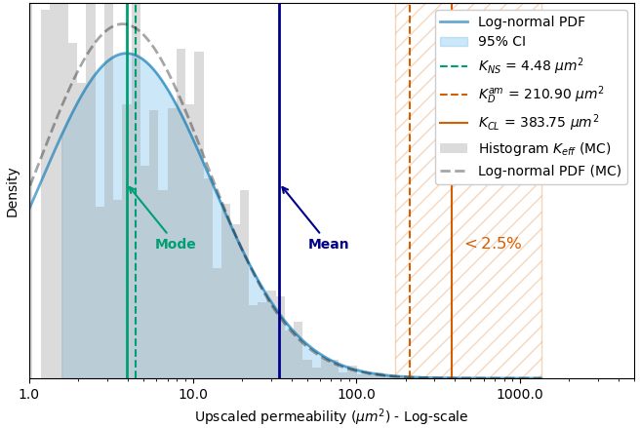

Uncertainty on Upscaled Permeability Analytical upscaling vs Monte Carlo sampling
Natural Fracture #1
Analytical distribution $𝓟$from descriptor fields
$$95\% CI =\left[1.58 , 172.5\right] μm^{2}$$
Monte Carlo sampled distribution $𝓟_{MC}$
$$K^{\left(n\right)}\left(x,y\right)=e^{\hat{μ}\left(x,y\right)+\hat{σ}\left(x,y\right) Z_{n}} with Z_{n}∼𝒩\left(0,1\right)$$
$$95\% CI =\left[1.48 , 152.2\right] μm^{2}$$
$D_{KL}(𝓟_{MC}||𝓟)=𝓞\left(10^{−3}\right)$
Reference physical permeability VS Cubic Law
$$K_{NS}=4.48 μm^{2} VS K_{CL}=383.75 μm^{2}$$

Slide 11
Scalable Uncertainty Propagation COMPUTATIONAL EFFICIENCY
 | Computational time
U-Net: Training on patches (128x128) | 1h25min
U-Net: Full Permeability Distribution (1873x1480) | 1.3 seconds
Flow-based Upscaling: Full Uncertainty Range | 4min
Physical Solver in 3D | A few hours for deterministic output !

Slide 12
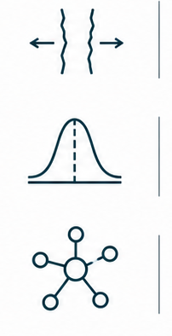
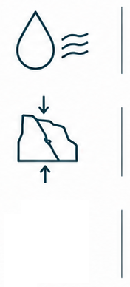

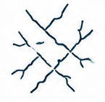
Take Home Messages Uncertainty-aware reduced models for fractured systems
CONTRIBUTIONS
OUTLOOKS
Physics-calibrated properties
Lower-scale fracture physics calibrates
hydraulic properties
Solute transport
Uncertainty on residence time, breakthrough curves, …
Scalable uncertainty propagation
Uncertainty is propagated to upscaled transmissivity
Geomechanics
Stress-sensitive conductivity
evolution, opening/closure, …
Fracture network-scale coupling
Efficient priors for fault damage-zone conductivity
Coupled risk assessment
Integrated priors for flow,
transport & mechanics
Notes:
To conclude, this workflow replaces direct aperture-based conductivity estimates with physics-calibrated probabilistic properties. It propagates uncertainty to upscaled transmissivity distributions and provides a route for coupling these properties with network-scale models.
More broadly, the same strategy can be extended to solute transport and geomechanics, supporting coupled risk assessment in fractured reservoirs.

Slide 13
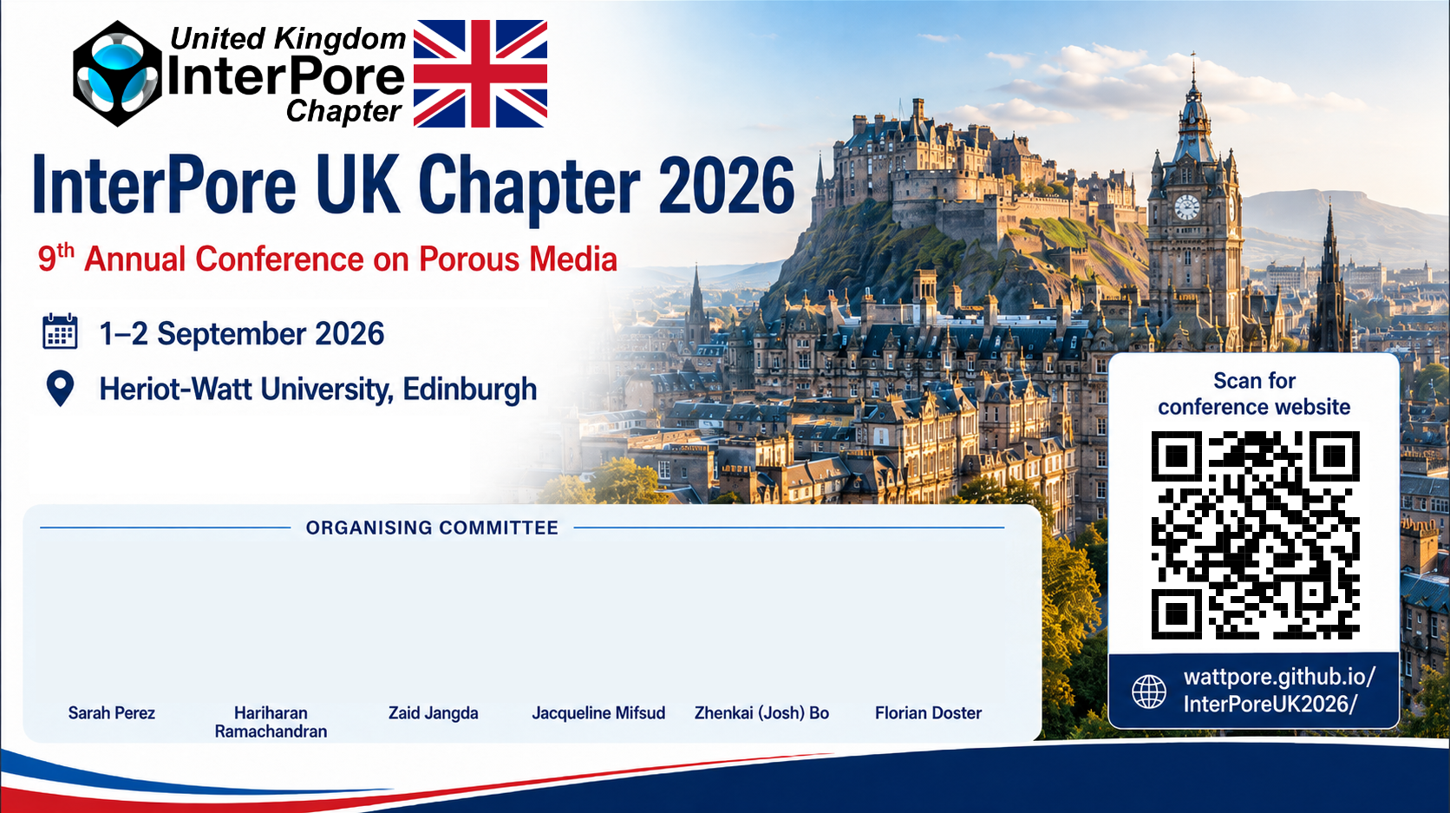



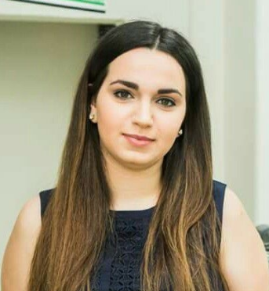


InterPore UK Chapter Annual Conference

Slide 14
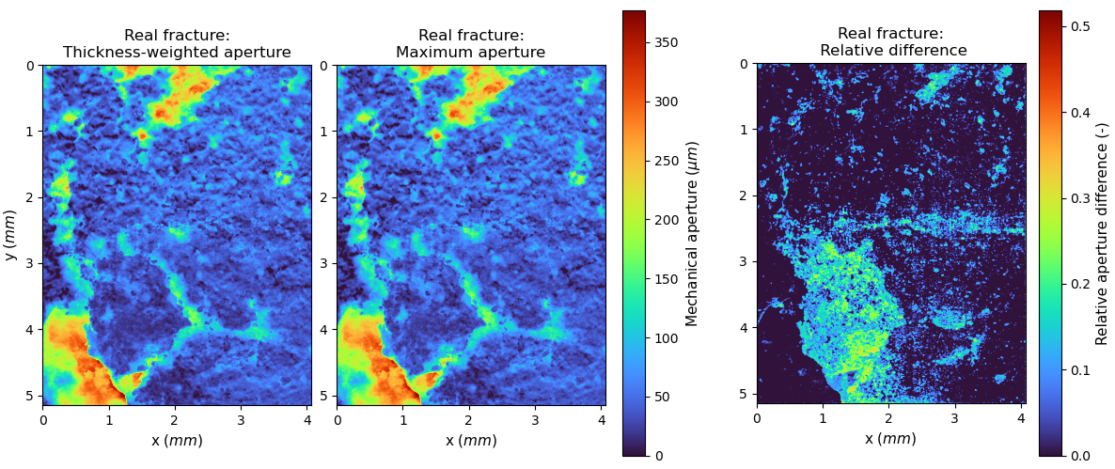
Thickness-weighted mechanical aperture A Probabilistic Formulation of the aperture
Natural Fracture #1
Comparison with maximum aperture
Account for contribution of all coexisting branches
Weight the influence of branches w.r.t their volumetric importance
Probabilistic interpretation

Slide 15
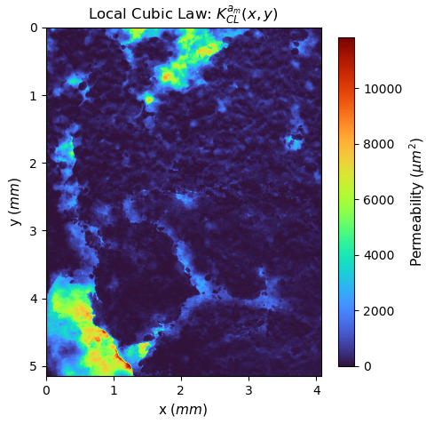

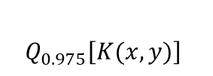

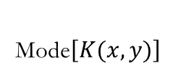
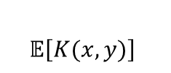
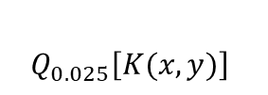
Uncertainty-Aware Permeability Fields Posterior Permeability Descriptors – Natural Fracture #1
Local Cubic Law
Mean, Mode and Quantiles (95% CI) based on $\hat{μ}\left(x,y\right)$ and$\hat{σ}\left(x,y\right)$
$$Mode\left[K(x,y)\right]={e^{\hat{μ}\left(x,y\right)−{\hat{σ}(x,y)}^{2}} }_{ }$$
$$𝔼\left[K(x,y)\right]={e^{\hat{μ}(x,y)+0.5{\hat{σ}(x,y)}^{2}} }_{ }$$
$$Q_{p}\left[K(x,y)\right]=e^{\hat{μ}\left(x,y\right)+\hat{σ}\left(x,y\right)φ^{−1}(p)}$$
$$with φ^{−1}\left(p\right) the p\% quantile of the standard normal distribution$$
$$Q_{0.025}\left[K(x,y)\right]$$
Mode$\left[K(x,y)\right]$
$$𝔼\left[K(x,y)\right]$$
$$Q_{0.975}\left[K(x,y)\right]$$

Slide 16
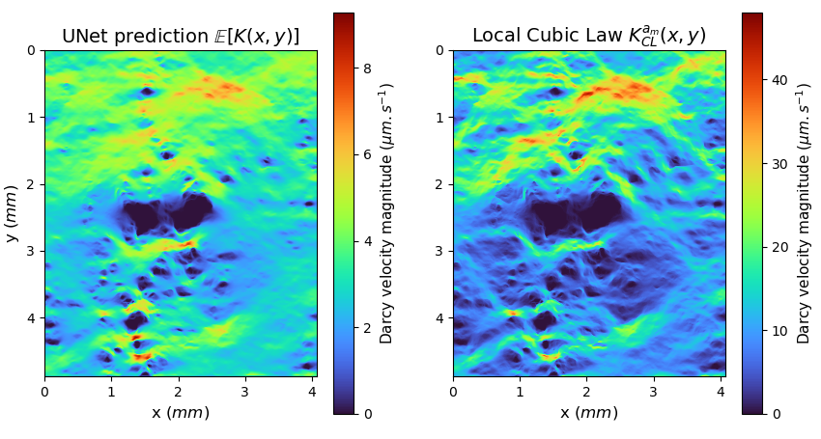
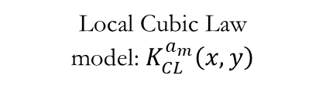
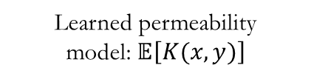
Uncertainty-Aware Upscaling Affects Flow Predictions Darcy Flow-BASED Upscaling – Natural Fracture #2
Learned permeability
model: $𝔼\left[K(x,y)\right]$
Local Cubic Law
model: $K_{CL}^{a_{m}}\left(x,y\right)$
Local Cubic Law amplifies aperture extremes
Preferential pathways are preserved
Physically-grounded flux redistribution from learned permeability

Slide 17
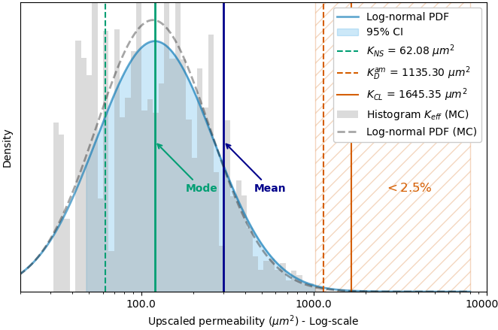

Uncertainty on Upscaled Permeability Analytical upscaling vs Monte Carlo sampling
Natural Fracture #2
Analytical distribution $𝓟$from descriptor fields
$$95\% CI =\left[47.83 , 1020.8\right] μm^{2}$$
Monte Carlo sampled distribution $𝓟_{MC}$from log-normal parameters
$$95\% CI =\left[47.10 , 907.3\right] μm^{2}$$
Reference Stokes permeability VS Cubic Law
$$K_{NS}=62.08 μm^{2} VS K_{CL}=1645.35 μm^{2}$$

Slide 18
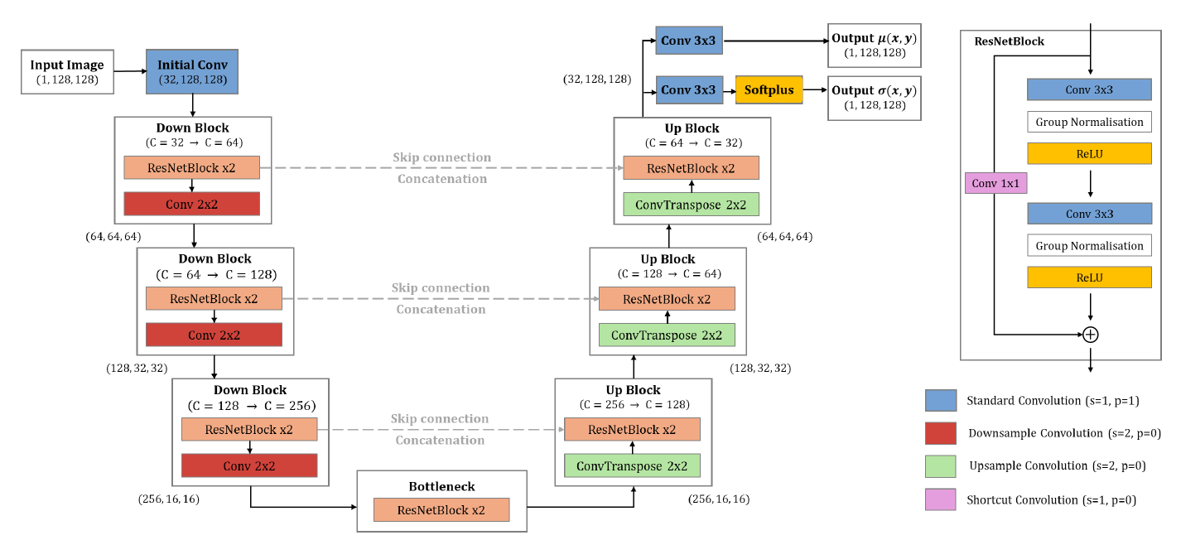
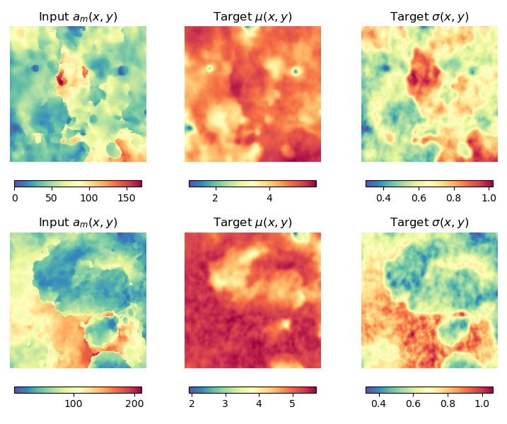
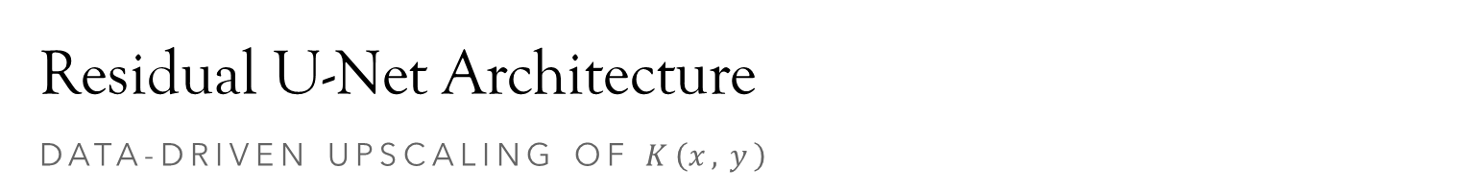

Residual U-Net Architecture DAta-Driven UPSCALING of $K\left(x,y\right)$
Training on 448 Paired Images (80% of full dataset)
$$σ\left(x,y\right)=\sqrt{ln\left(1+{\left( \frac{\sqrt{Var\left[K(x,y)\right]}}{𝔼\left[K(x,y)\right]} \right)}^{2}\right)}$$
$μ\left(x,y\right)=ln\left(𝔼\left[K(x,y)\right]\right)−0.5σ^{2}(x,y)$

Slide 19
Residual U-Net Architecture DAta-Driven UPSCALING of $K\left(x,y\right)$

Slide 20

Scalable Uncertainty Propagation COMPUTATIONAL EFFICIENCY & GENERALISATION
 | Computational time
U-Net: Training on patches (128x128) | 1h25min
U-Net: Full Posterior Distribution (1873x1480) | 1.3 seconds
MRST Upscaling: Full Uncertainty Range | 4min
Stokes - GeoChemFoam | A few hours for deterministic output !
Notes:
The next question is scalability.
The key point is that the expensive physics-based correction is confined to the training stage. After that, the U-Net predicts full permeability distributions in a single forward pass, and Darcy upscaling is only applied to a few representative descriptors. This makes uncertainty propagation much cheaper than repeated high-fidelity simulations.
Besides, the graph on the left supports the generalisation capability, as the upscaled permeability of the natural shear fracture lies outside the permeability range covered by the training patches.

Slide 21





AI driven Uncertainty Quantification Robust UQ for the Bayesian PINNS
Enhanced stability & accuracy
Faster convergence & Pareto front exploration
Hand-tuning of
${ λ}_{k}$ parameters
Objective 2
Data constraint
Pareto-optimal
front
Objective 1
Physics-based constraint
S. Perez, S. Maddu, I. F. Sbalzarini, P. Poncet (2023)
“Adaptive weighting of Bayesian physics informed neural networks
for multitask and multiscale forward and inverse problems” Journal of Computational Physics

Slide 22










Understanding Local Scale Uncertainties Model Misspecification on Fracture Conductivity
Darcy flow-based
upscaling
$$K_{CL}=\frac{<a_{m}>^{ 2}}{12}$$
$$K_{CL}^{ a_{m}}(x,y)=\frac{a_{m}^{ }{\left(x,y\right)}^{2}}{12}$$
$$K_{D}^{ a_{m}}$$
Mechanical aperture
map $a_{m}^{ }(x,y)$
No roughness effects & Overestimation of fracture conductivity
Cubic Law Assumptions Fail !
Increase Roughness
$$<a_{m}>≃50 μm^{ }$$

Slide 23


Understanding Local Scale Uncertainties Correct model Misspecification On Fracture Conductivity
Bayesian Inference Problem:
Infer latent hydraulic aperture field $a_{h}(x,y)$
such that $a_{m}(x,y)=a_{h}(x,y)+ξ_{d}$
with ${a_{h}\left(x,y\right)≤a}_{m}(x,y)$and
$$K_{NS}=\frac{1}{|Ω^{ 2D}|} \int_{Ω^{ 2D}}^{ }{K_{NN}^{ a_{h}}(x,y)}dx dy+ ξ_{m}$$
where $K_{NN}^{ a_{h}}\left(x, y\right)=\frac{a_{h}{\left(x,y\right)}^{2}}{12}\left( 1+α \frac{| a_{h}\left(x,y\right) − <a_{m}>|}{σ_{a_{m}}} \right)$
Data
uncertainty
Model
uncertainty
Local
Cubic Law
Local
Relative roughness
Perez et al. (2025), Geophysical Research Letters

Slide 24







Understanding Local Scale Uncertainties Correct model Misspecification On FRacture Conductivity
Adaptive correction given mechanical aperture maps
Data-based, Geometric & Local
Uncertainties on hydraulic aperture $a_{h}\left(x,y\right)$
Automatically account for roughness
Automatic
distribution shift
$$JRC=10.31$$

Slide 25






Understanding Local Scale Uncertainties Correct model Misspecification On Fracture Conductivity
Original Local Cubic Law
Permeability map $K_{CL}^{ a_{m}}\left(x,y\right)$
Posterior Predictive Mean on
Permeability map $K_{NN}^{ a_{h}}\left(x,y\right)$
Posterior Uncertainty on
Permeability map $K_{NN}^{ a_{h}}\left(x,y\right)$
Probabilistic & local permeability field $K_{NN}^{ a_{h}}\left(x,y\right)$ Compatible with Stokes and Darcy upscaling
Uncertainties on effective permeability values Automatically account for roughness
Increase Roughness

Slide 26


Understanding Local Scale Uncertainties Correct model Misspecification On Fracture Conductivity
$K_{CL}>K_{D}^{{ a}_{m}}>K_{NS}≃K_{NN}^{{ a}_{h}}≃$ $K_{D}^{{ a}_{h}}$

