Slide 1






Fluid-calcite interface tracking by X-ray micro-tomography of bio-cemented sand samples exposed to acidic conditions
Interpore2026 – Nantes – 20th May 2026
M. la Bella^{1,4}, L. Schröer², V. Cnudde², F. Emeriault¹, C. Geindreau¹ , C. Noiriel³ and A. Naillon¹
¹ Univ. Grenoble Alpes, CNRS, Grenoble INP, 3SR, Grenoble, F-38000 France
² UGCT, Department of Physics, Ghent University, Ghent, Belgiumn
³ Géosciences Environnement Toulouse, Observatoire Midi-Pyrénées, Université de Toulouse CNRS, IRD, CNES, Toulouse, France
⁴ Department of Physics, Technical University of Denmark, Kongens Lyngby, 2800 Denmark

Slide 2
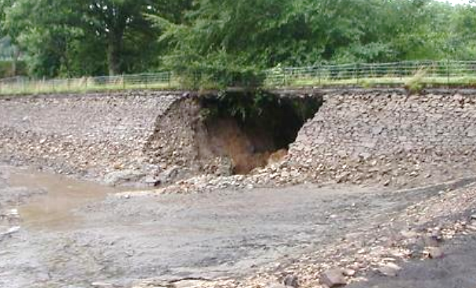
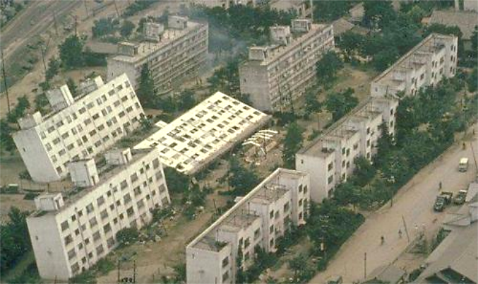
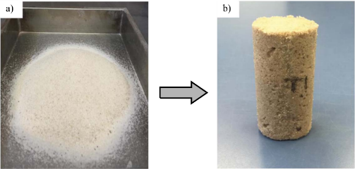
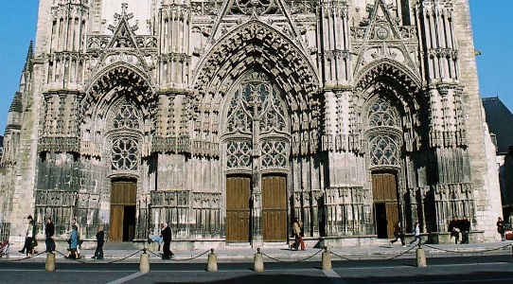
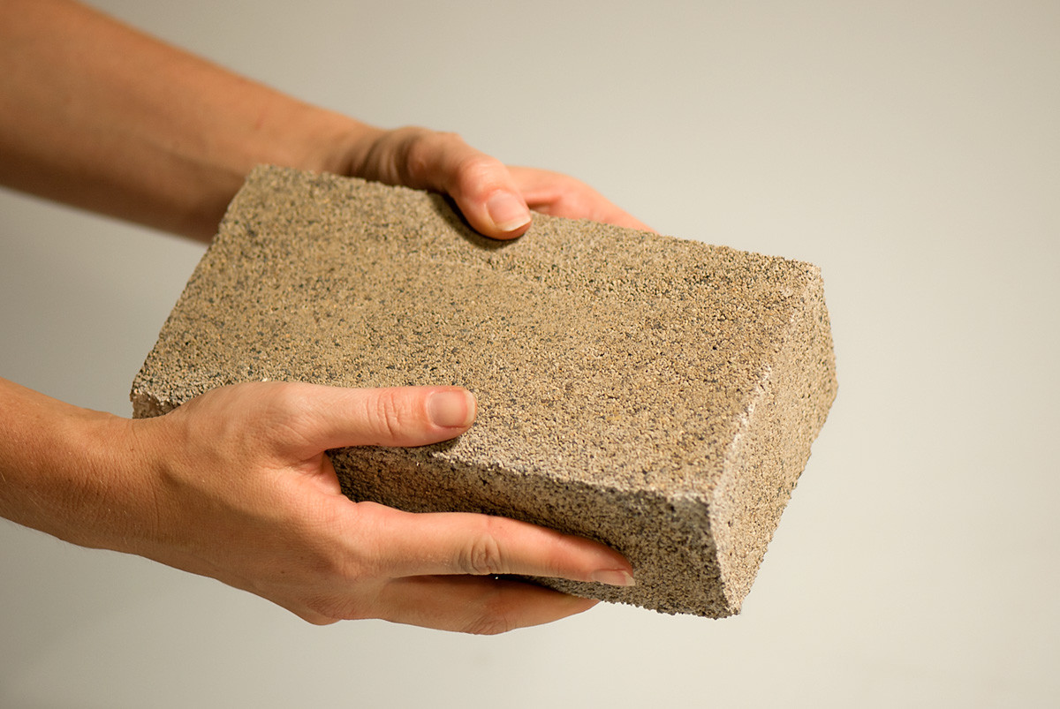
Motivations for new reinforcement technics
Dike reinforcement
Prevention of natural hazard
Classical technics
Use of high carbon foot print materials
Some toxic materials
Energy consuming technics
Ex. Internal erosion [L. Peyras]
Ex. soil liquefaction
Late 20th : emergence of bio-cementation
Heritage conservation
Manufacturing of construction materials
+ environmental friendly
- low energy consumption
↗ mechanical properties
✓ permeabilities
Ex. Tours cathedral
Ex. building blocks

Slide 3


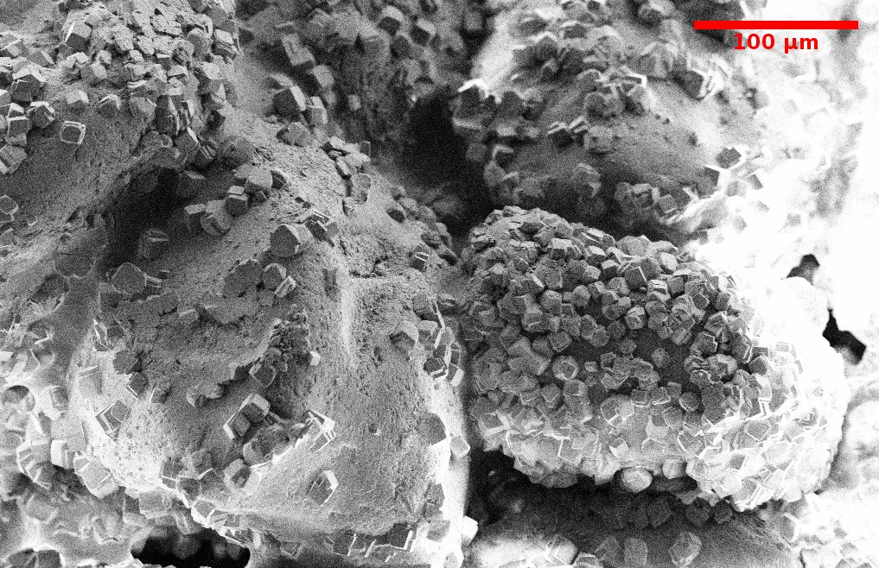
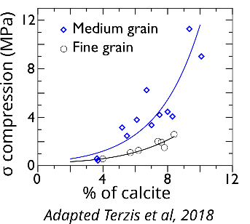
How does bio-cementation work ?
Reactant
Urea CO(NH₂)₂)
Bacteria (S. Pasteurii)
Calcium source (CaCl₂)
injection
injection
Sand
100 µm
A low fraction of calcite is sufficient
Mechanical properties depend on the contacts

Slide 4
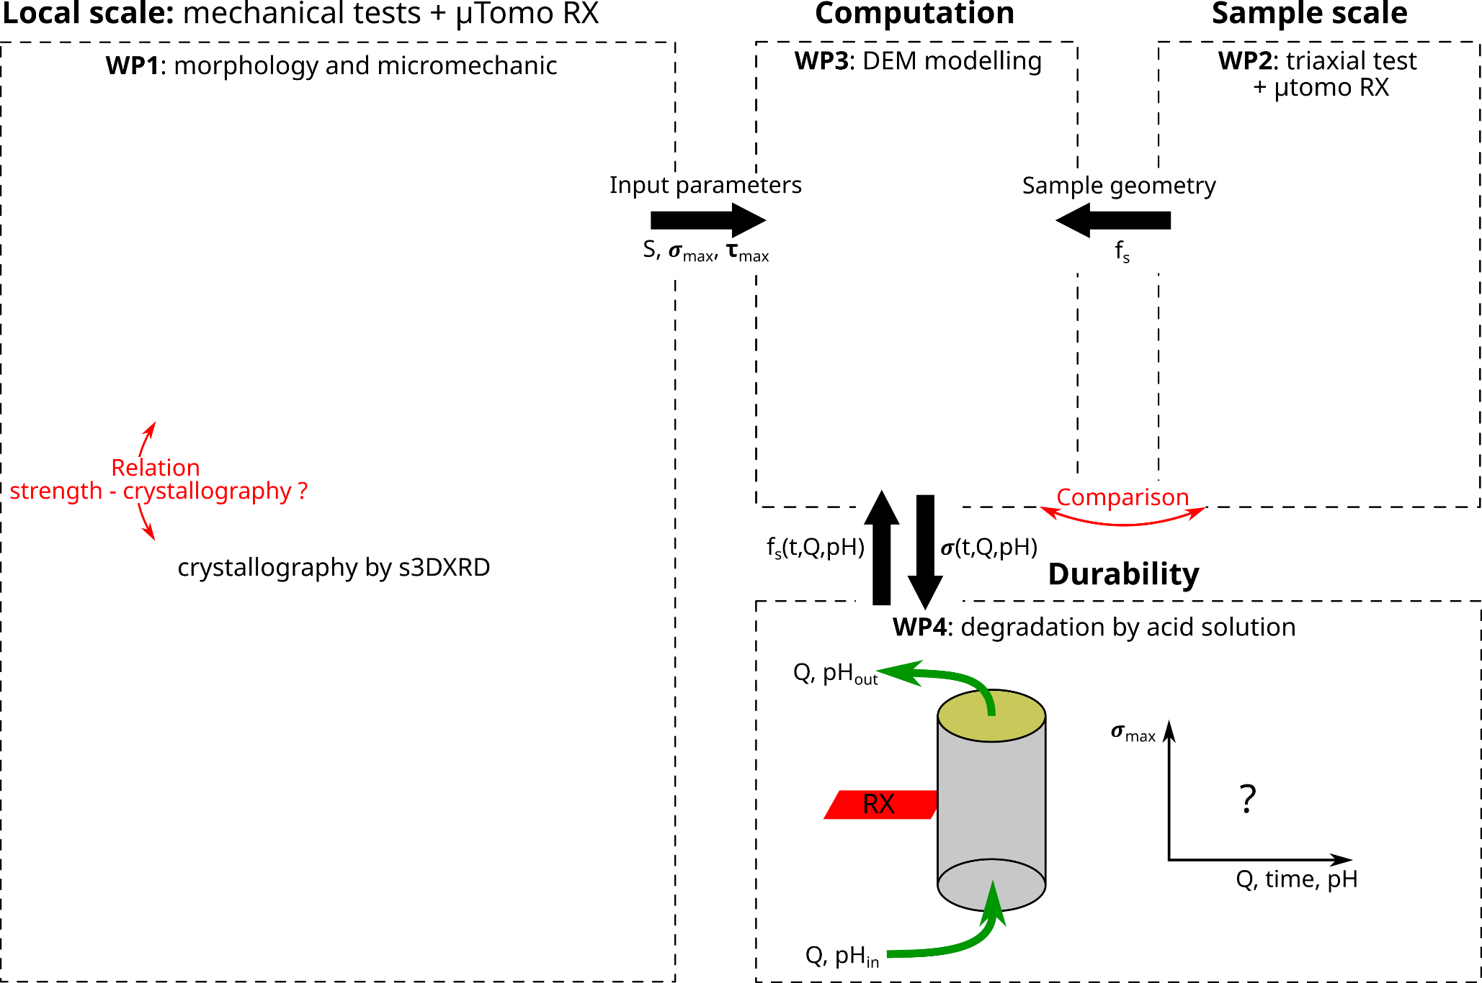
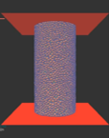
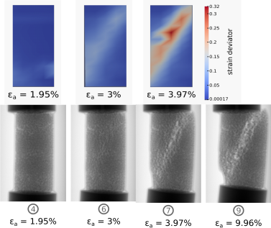
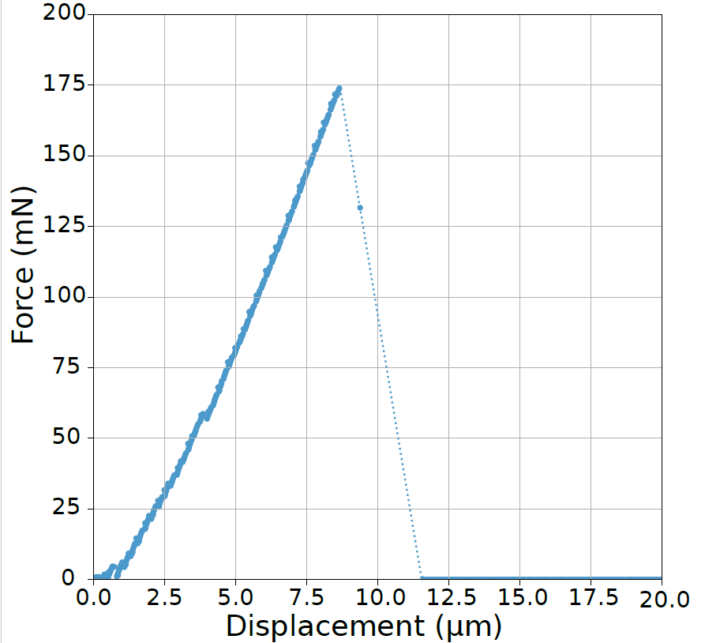
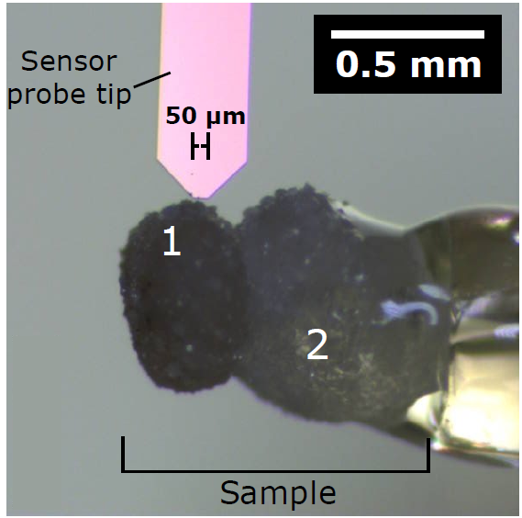
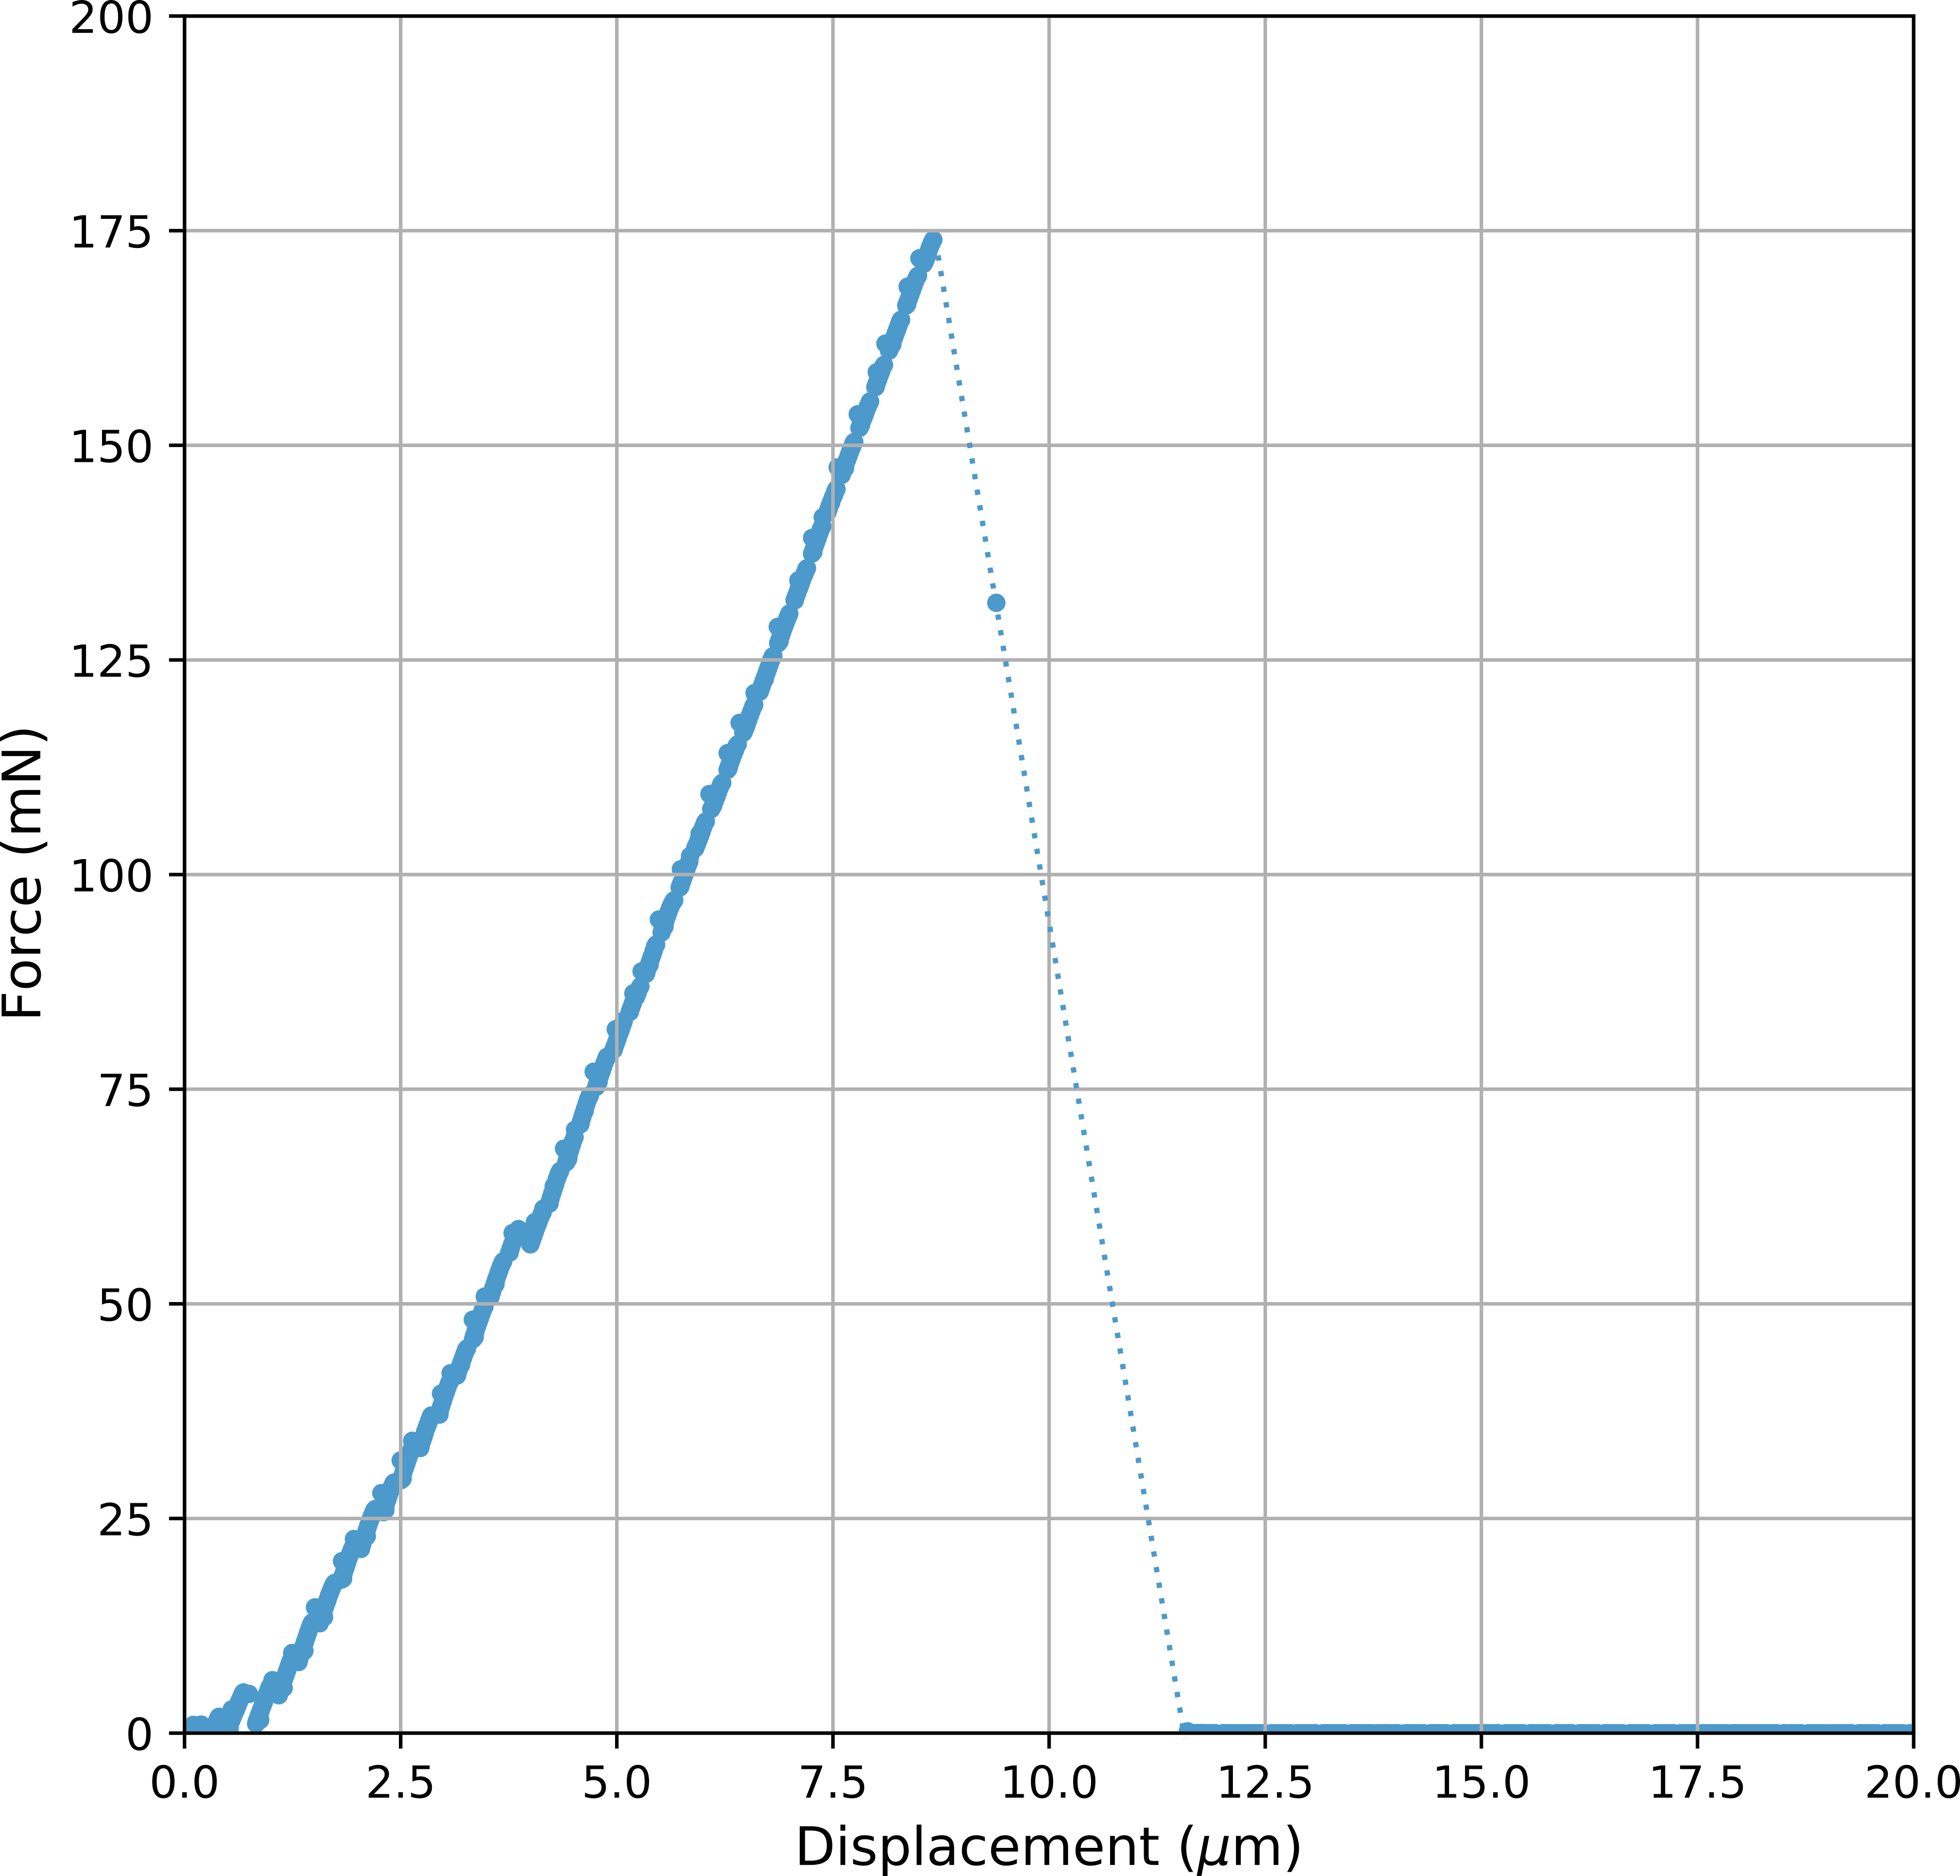
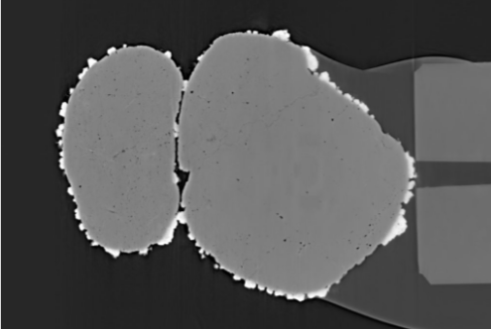
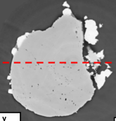


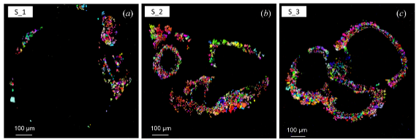
Global project : micromechanical characterization of biocemented contacts to predict macroscopic mechanical properties
How do biocalcite distribution and mechanical properties evolve under acidic conditions?
[Sarkis et al. 2024]
[Sarkis et al. 2023]
[Sarkis et al. 2025]
[Dumas - stage 2023]
[Collab. B. Chareyre (YADE)]
200 µm
[La Bella et al. 2025 Collaboration M. Sarkis (ESRF), C. Noiriel (GET), ESRF ID11, ]
[Collaborations TUGent, C. Noiriel (GET Toulouse)]

Slide 5
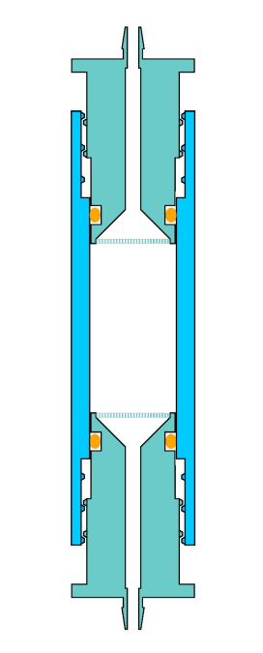


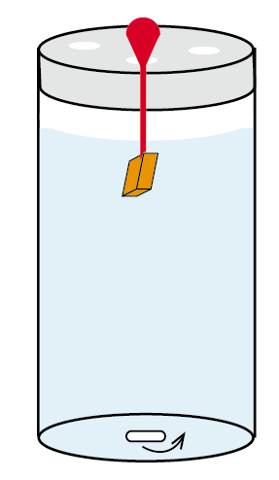
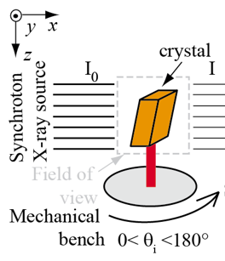


Two scale experiments
Granular columns
Biocementation in the fluid cell
Dissolution with buffered acetic acid with :
pH = 4, 5, and 6.4
Q = 50 ml/h, and 2 ml/h
Tracking of pH and conductivity
Flushing with water before taking tomography scan
Acquisition of several dissolution timesteps
Vx size = 7³ µm³ (3.5³ µm³ binned x2)
Two-grain and crystal experiments
Same solution and pH as in granular columns
Comparison between
Biocalcite
Abiogenic calcite
Vx size = 1.3³ µm³
Outlet
Sand D = 0.18 – 0.35 mm
18 mm
9.1 mm
Filter 60 µm
Inlet

Slide 6
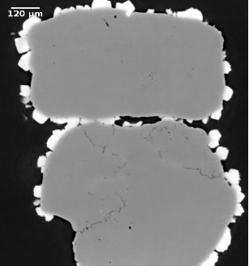
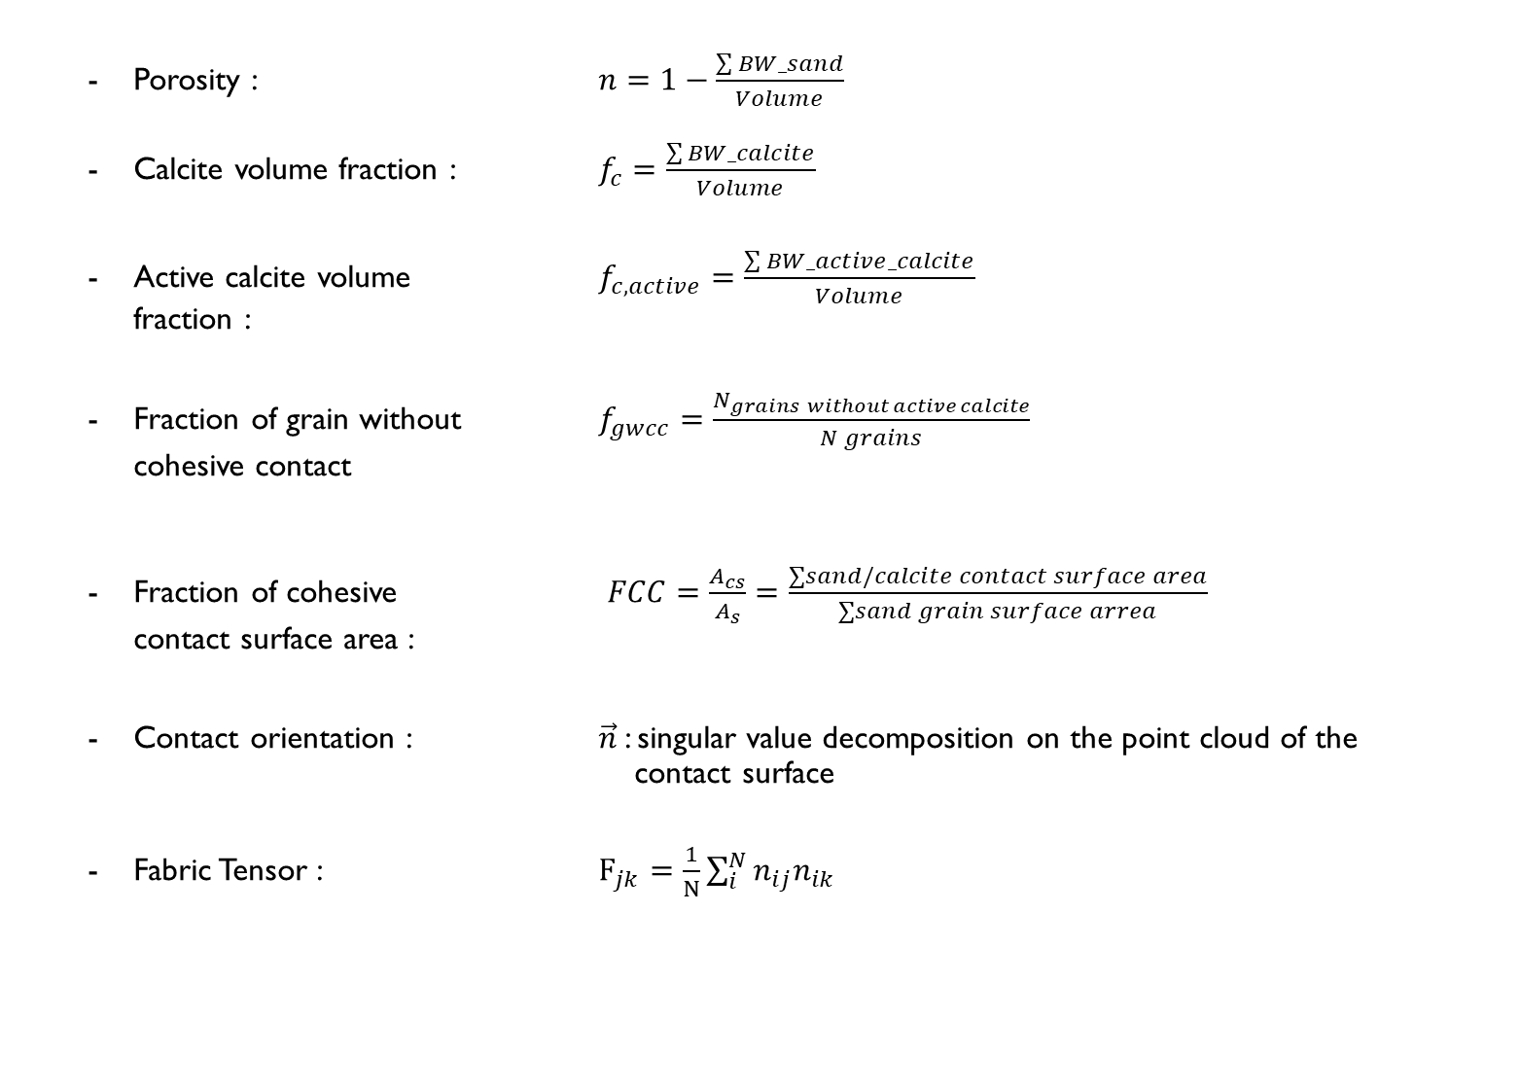
Granular column: target indicators
Porosity : $n=1−\frac{\sum{BW_sand}}{Volume}$
Calcite volume fraction : $f_{c}=\frac{\sum{BW_calcite}}{Volume}$
Active calcite volume $f_{c,active}=\frac{\sum{BW_active_calcite}}{Volume}$ fraction :
Fraction of grain without $f_{gwcc}=\frac{N_{grains without active calcite}}{N grains}$ cohesive contact
Fraction of cohesive $FCC=\frac{A_{cs}}{A_{s}}=\frac{∑sand/calcite contact surface area}{∑sand grain surface arrea}$ contact surface area :
Contact orientation : $\vec{n}$: singular value decomposition on the point cloud of the contact surface
Fabric Tensor : $F_{jk}=\frac{1}{N}\sum_{i}^{N}{n_{ij}n_{ik}}$
Inactive crystal
Active crystal

Slide 7
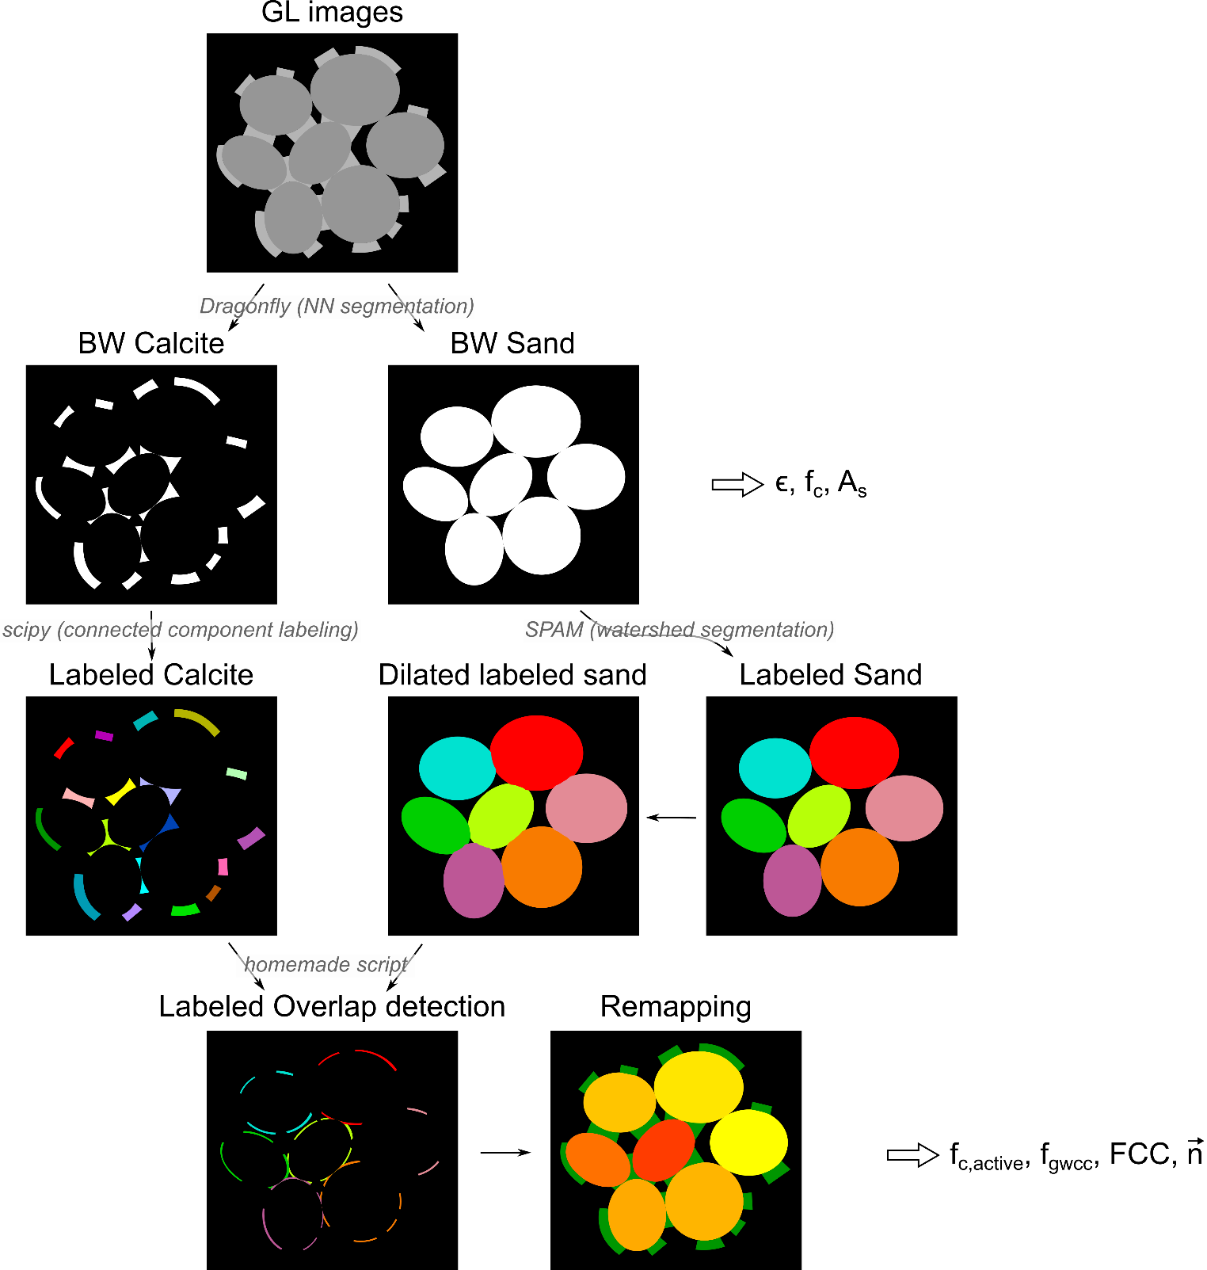
Granular column: image analysis flowchart

Slide 8
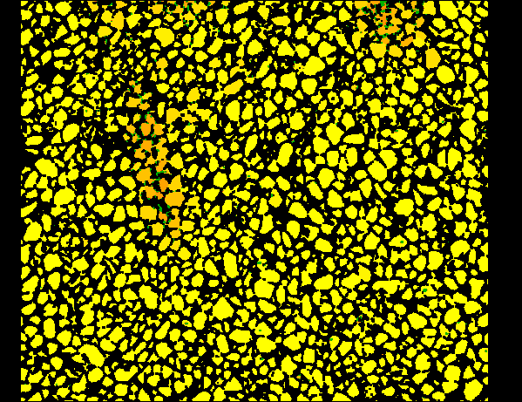
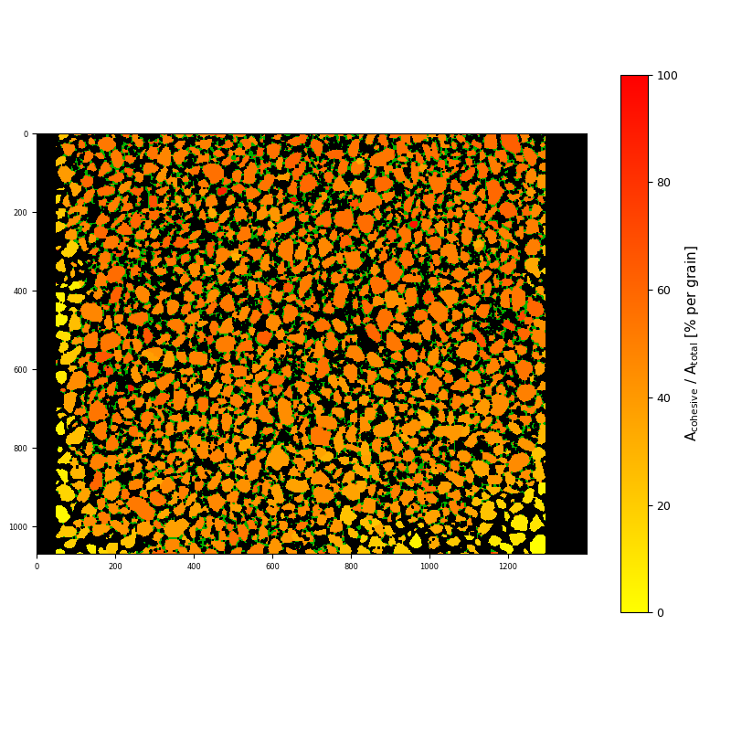
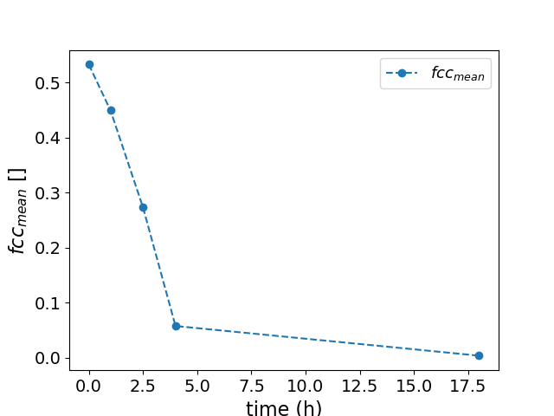
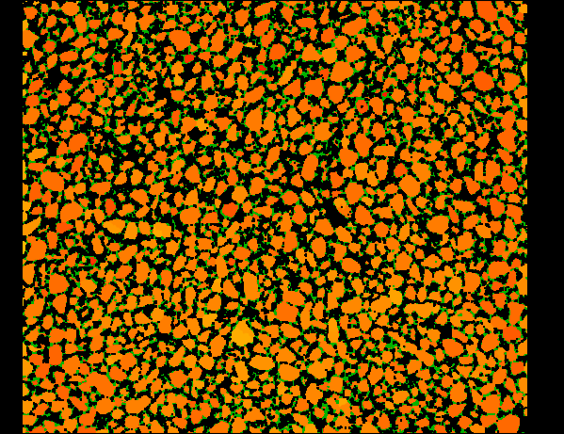
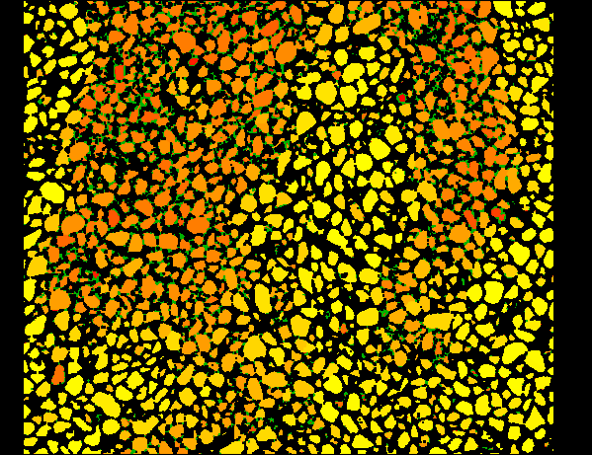
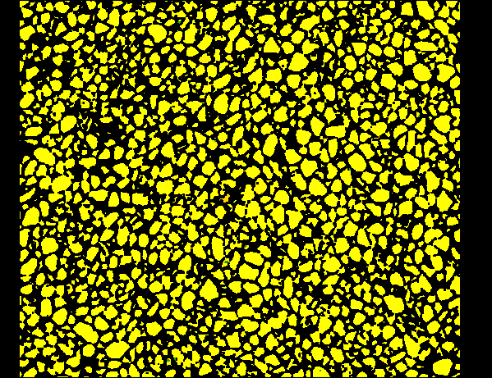
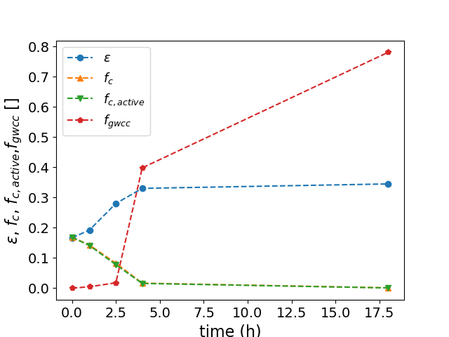
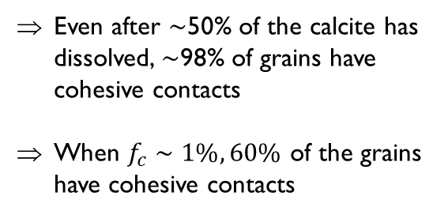
Granular column: results at pH5
1 mm
100
80
60
40
20
0
FCC : A_{cohesive} / A_{sand}
t = 18h
t = 0h
t = 2.5h
t = 1h
t = 4h
Even after $∼$50% of the calcite has dissolved, $∼$98% of grains have cohesive contacts
When $f_{c}∼1\%, 60\%$ of the grains have cohesive contacts

Slide 9
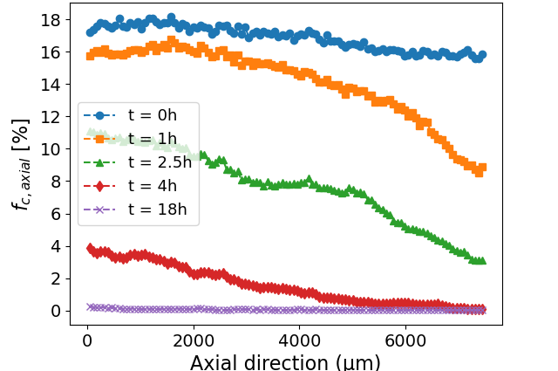
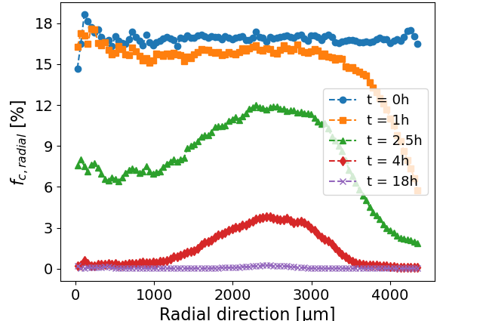
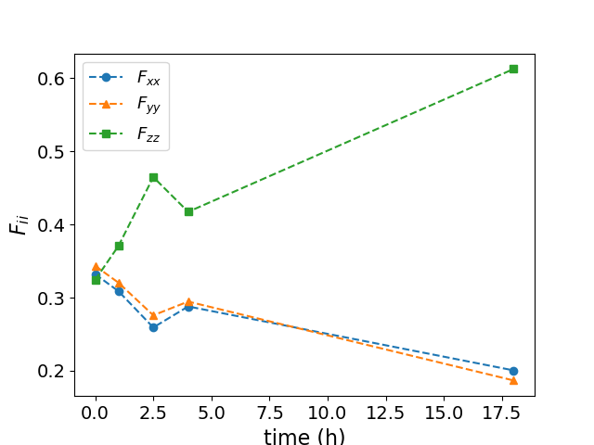
Granular column: results at pH5
Heterogeneity develop in the material.
Dissolution occurs mainly from the inlet to the outlet but fingering patterns develop.
Anisotropy develop in the material.
Contacts whose normal vectors are parallel to the flow dissolve last.

Slide 10
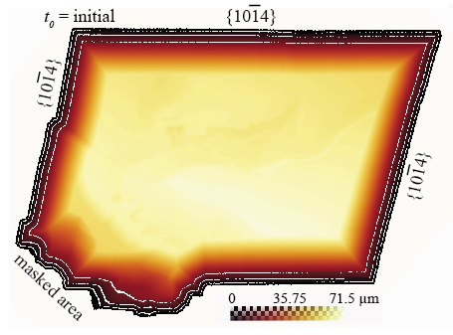
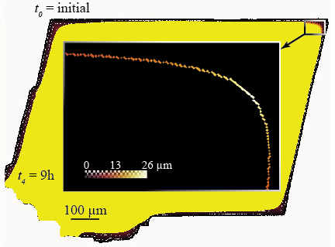


Two-grain and crystal experiments
Target indicators:
Dissolution rate: $\overline{v_{d}}$
Comparison between biogenic and abiogenic calcite
Preferential dissolution sites in two-grain experiments
Flow chart
Distance map inside
the crystal at t₀
Location of the crystal liquide interface at t₁
Determination of $\overline{v_{d}}=\frac{dl}{dt}$

Slide 11
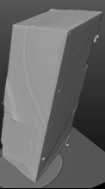
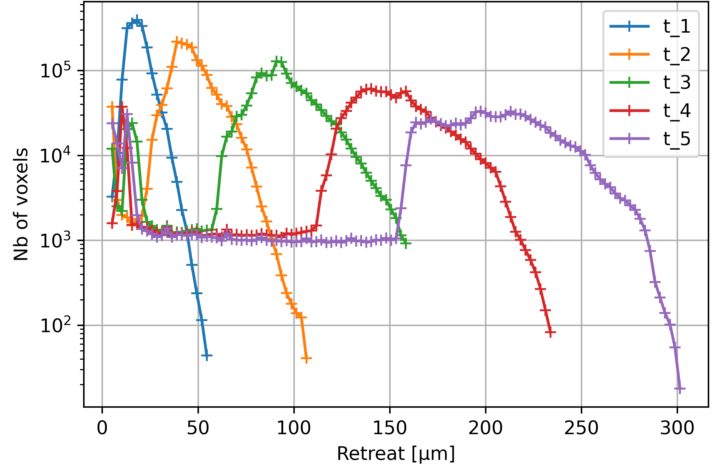
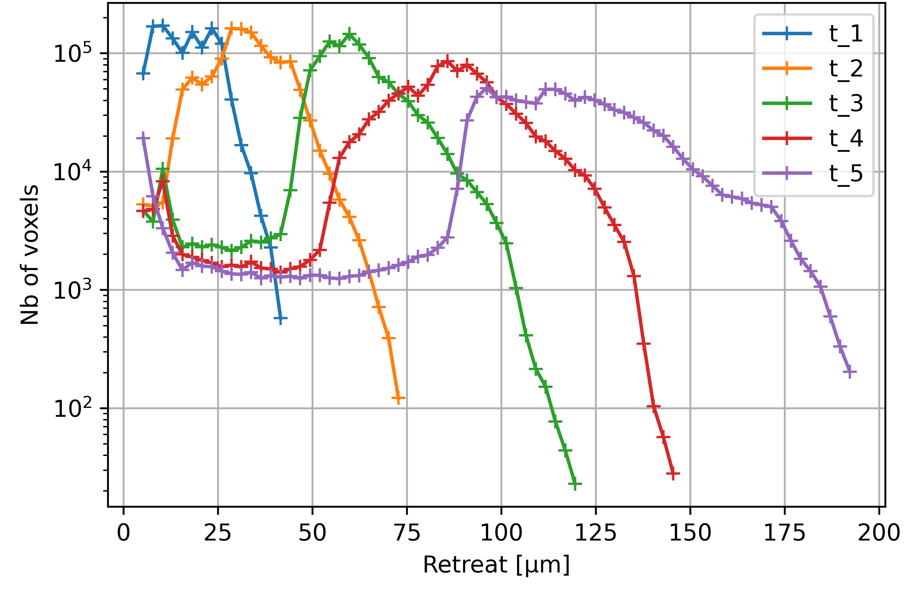
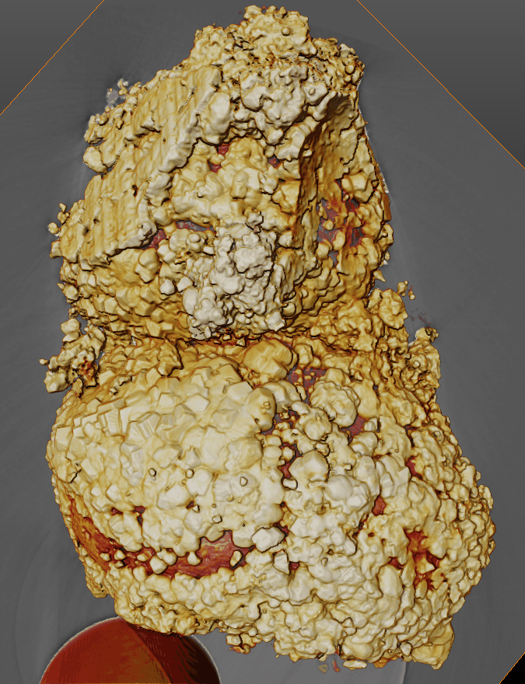
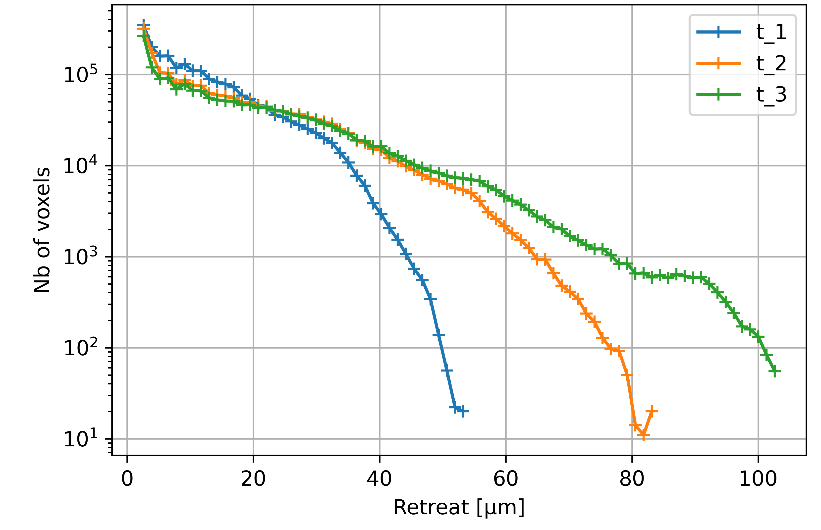
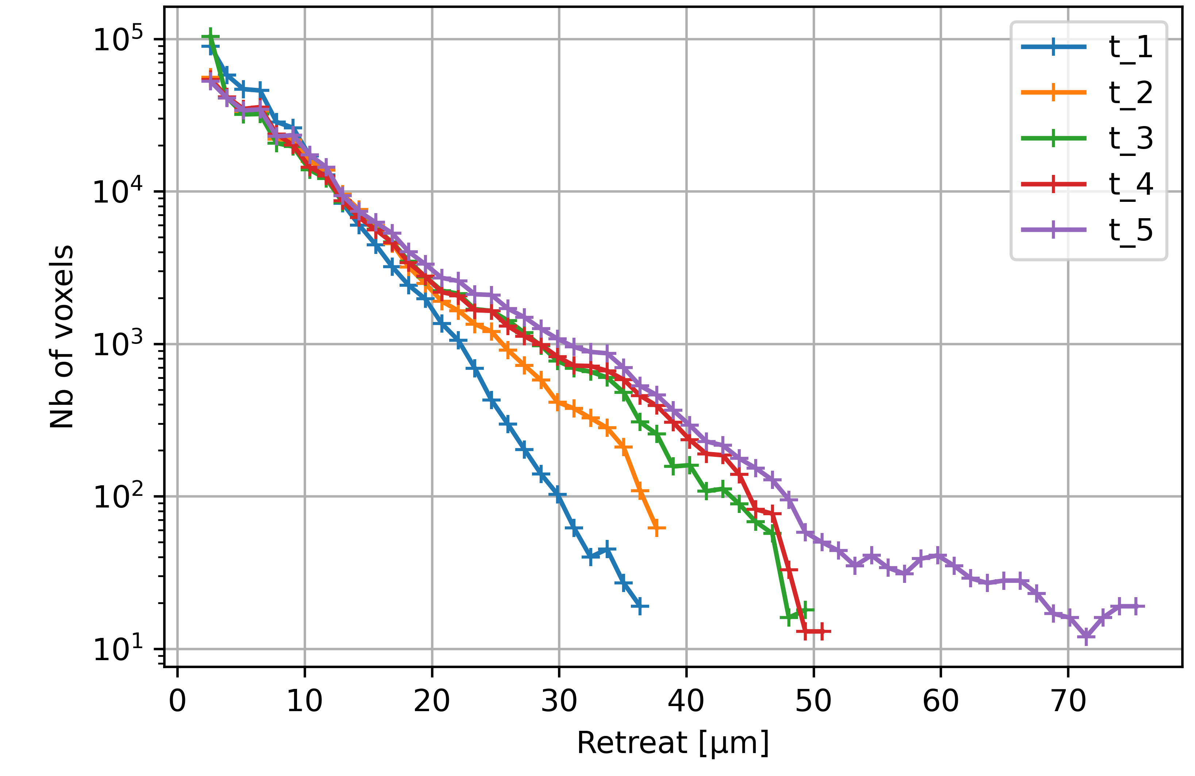




Two-grain and crystal experiments : results in batch
Dissolution of calcite monocrystal proceeds with rounding the edges and the corners
Calcite is more persistent at the contact due to reduced fluid accessibility to the surface area (transport advective vs diffusive)
pH 4 : $\overline{v_{d}}∼65 μm/h$
pH 5 : $\overline{v_{d}}∼45 μm/h$
500 µm
20min
40min
1h20
2h
2h45
20min
40min
1h20
2h
2h45
Surface retreat with time
pH 5
30 times greater than in HCl
100 µm
pH 4 : $\overline{v_{d}}∼24 μm/h$
pH 5 : $\overline{v_{d}}∼15 μm/h$
20min
40min
1h20
20min
40min
1h20
2h
2h45
Dissolution only at the contact
pH 4

Slide 12
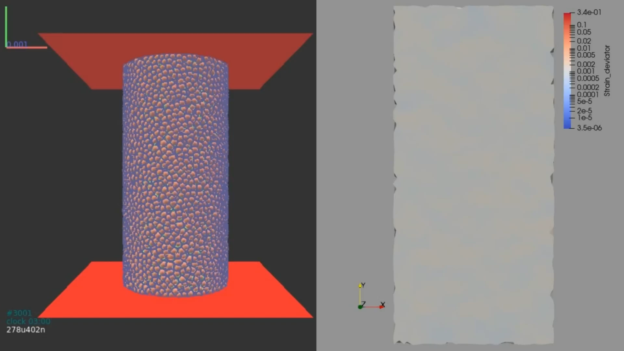
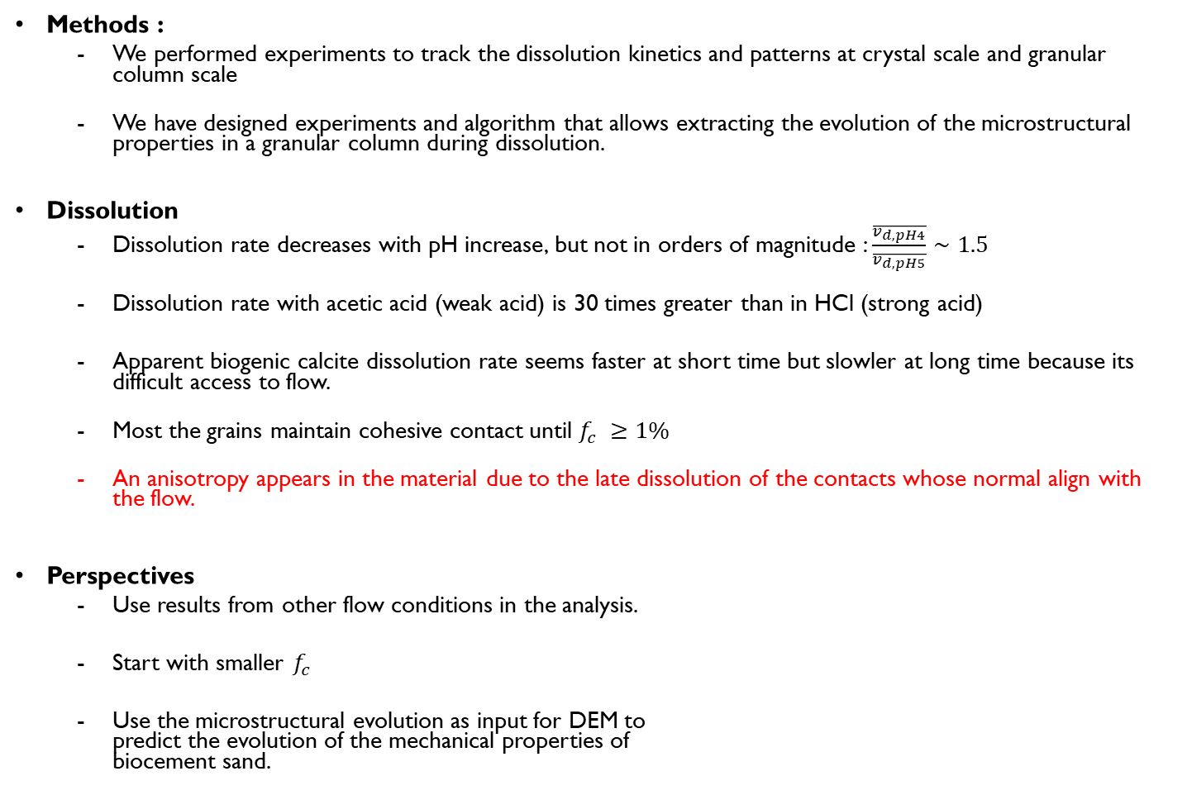
Conclusion
Methods :
We performed experiments to track the dissolution kinetics and patterns at crystal scale and granular column scale
We have designed experiments and algorithm that allows extracting the evolution of the microstructural properties in a granular column during dissolution.
Dissolution
Dissolution rate decreases with pH increase, but not in orders of magnitude : $\frac{\overline{v_{d,pH4}}}{\overline{v_{d,pH5}}}∼1.5$
Dissolution rate with acetic acid (weak acid) is 30 times greater than in HCl (strong acid)
Apparent biogenic calcite dissolution rate seems faster at short time but slowler at long time because its difficult access to flow.
Most the grains maintain cohesive contact until $f_{c} ≥1\%$
An anisotropy appears in the material due to the late dissolution of the contacts whose normal align with the flow.
Perspectives
Use results from other flow conditions in the analysis.
Start with smaller $f_{c}$
Use the microstructural evolution as input for DEM to predict the evolution of the mechanical properties of biocement sand.

Slide 13
Thank you for you attention

