Slide 1

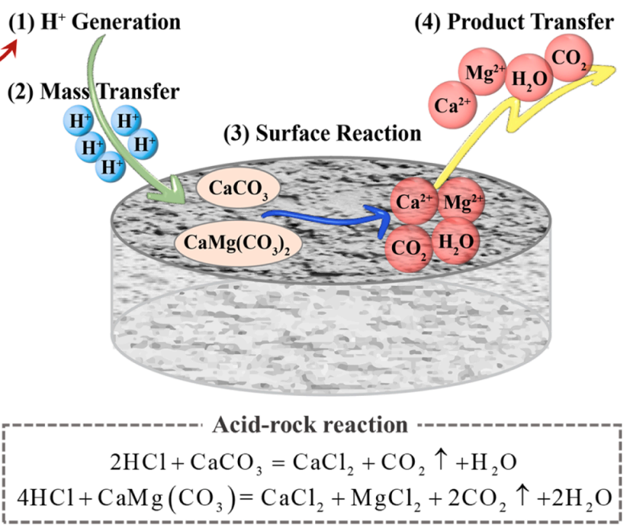
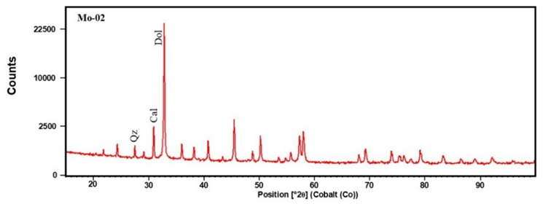
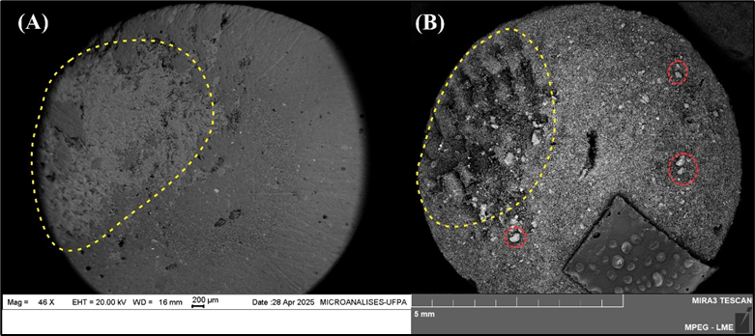
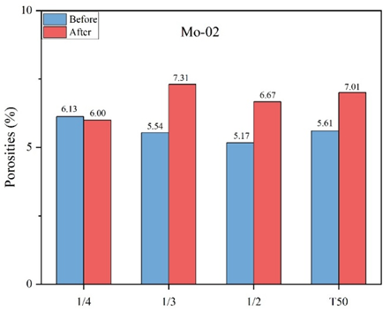
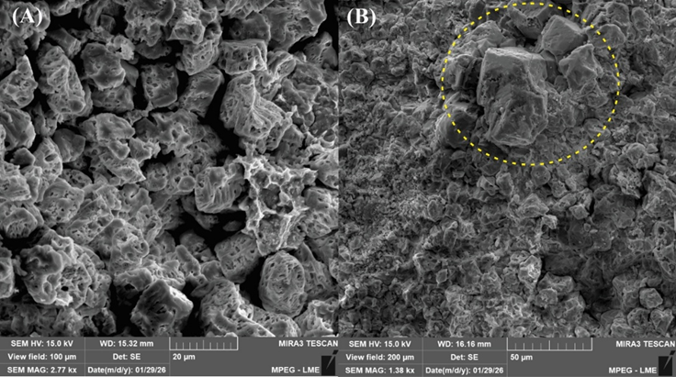
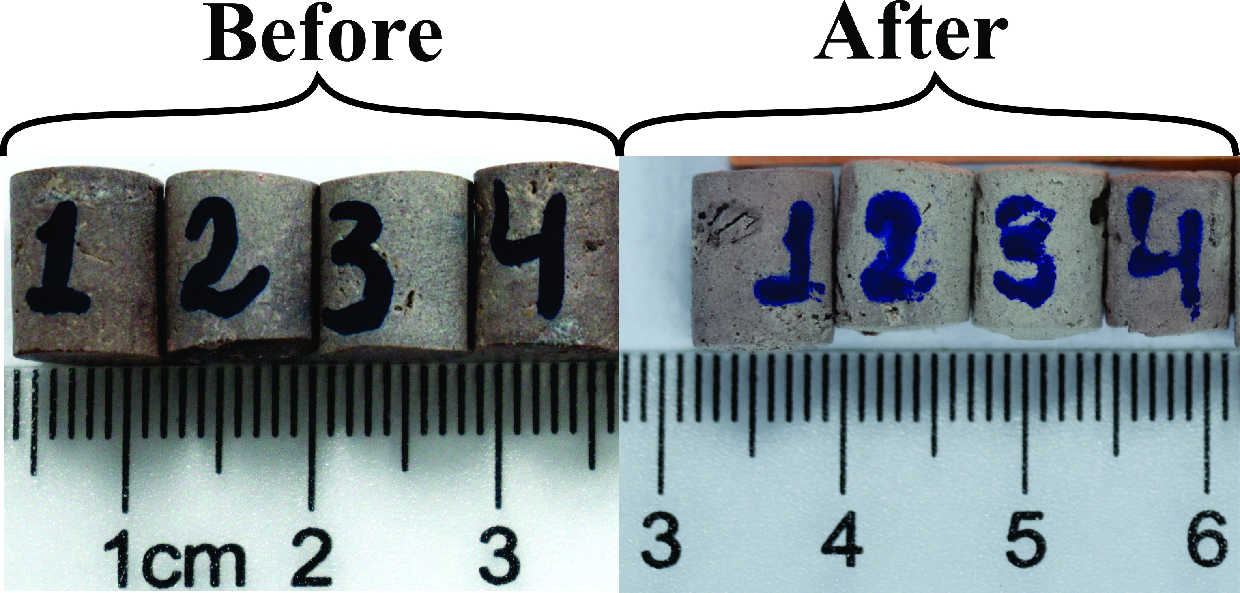
Impact of Mineralogical Heterogeneity on Porosity Enhancement in Carbonates During Acidizing
Pereira J. N.^{a∗}, Souza N. da S.ª, Barreto I. A. R.ª, Medeiros R. S. P. deª, Aum P. T. P.^{b}, and Lucas C. R. dos S.^{ab}.
ªProgram in Geology and Geochemistry, Geoscience Institute, Federal University of Pará (UFPA), Belém, Pará, Brazil; ^{b}School of Engineering, Federal University of Pará (UFPA), Salinópolis, Pará, Brazil.
*jessicanascimento608@gmail.com
Introduction
Results and discussions
Figure 3. Mineralogical comparison of the samples obtained by X-ray diffraction (XRD).
Figure 4. Porosities before and after acid dissolution.
Figure 1 – Reaction process between in-situ generated acid and carbonate rock [5].
Figure 5. BSE-SEM images of mini-plug 1 before (A) and after (B) acid dissolution.
Figure 6. SEM images of mini-plugs after acid dissolution, showing pore formation and crystal dissolution features.
Materials and methods
Conclusion
Porosity
SEM
Porosity evolution during acid dissolution was controlled by mineralogical composition and textural heterogeneity. Calcite-rich and finer-grained regions showed greater dissolution, while resistant phases limited porosity development, resulting in heterogeneous behavior.
References
1- K. C. Taylor, A. H. Al-Ghamdi, H. A. Nasr-El-Din, Effect of additives on the acid dissolution rates of calcium and magnesium carbonates, SPE Production & Facilities 19 (2004) 122–127.
2- K. Lund, H. S. Fogler, C. C. McCune, Acidization—ii. The dissolution of calcite in hydrochloric acid, Chemical Engineering Science 30 (1975) 825–835.
3- M. Z. Jora, R. N. d. Souza, E., Lucas-Oliveira, C. Speglich, T. J. Bonagamba, E. Sabadini, Static acid dissolution of carbonate outcrops investigated by 1H NMR and x-ray tomography, Journal of Petroleum Science and Engineering 207 (2021) 109124.
4- P. Xu, M. Sheng, T. Y. Lin, Q. Liu, X. G. Wang, W. A. Khan, Q. Xu, Influences of rock microstructure on acid dissolution at a dolomite surface, Geothermics 100 (2022) 102324.
5- LIU, PingLi et al. Reaction between in-situ generated acid and carbonate rock at ultra-high temperatures: A fusion of kinetic mechanisms and experiments. Geothermics, v. 131, p. 103357, set. 2025.
Acid dissolution (HCl- 1M)
Agreements
Figure 2 – Overview of the Experimental Methodology.
We thank the UFPA–Petrobras Project (FADESP-5599) for the financial support and for providing the materials and infrastructure necessary for this study.
Notes:
1

