Slide 1

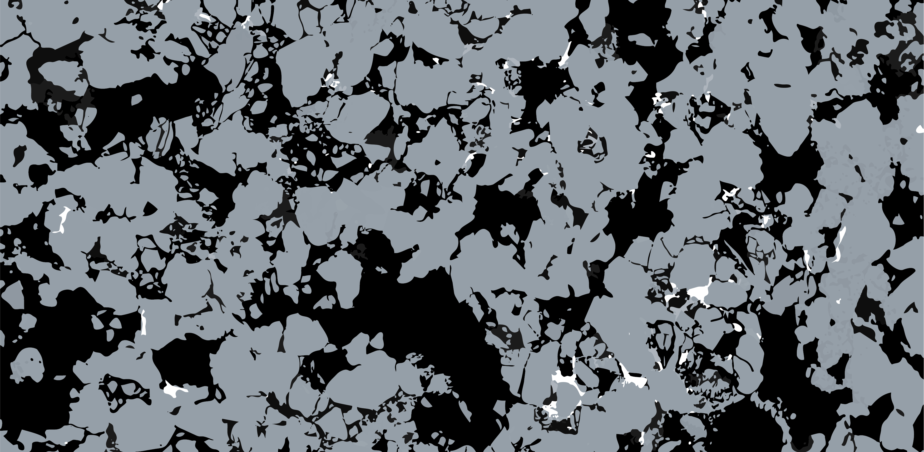
Regime-Dependent Reactive Mixing Across a Mineral Precipitation Boundary
Anna Kottsova
Jianqi Rong, Chao-Zhong Qin, Xiang-Zhao Kong
May 20, 2026

Slide 2
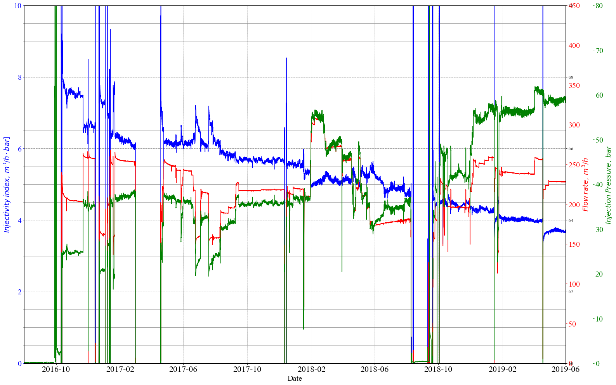
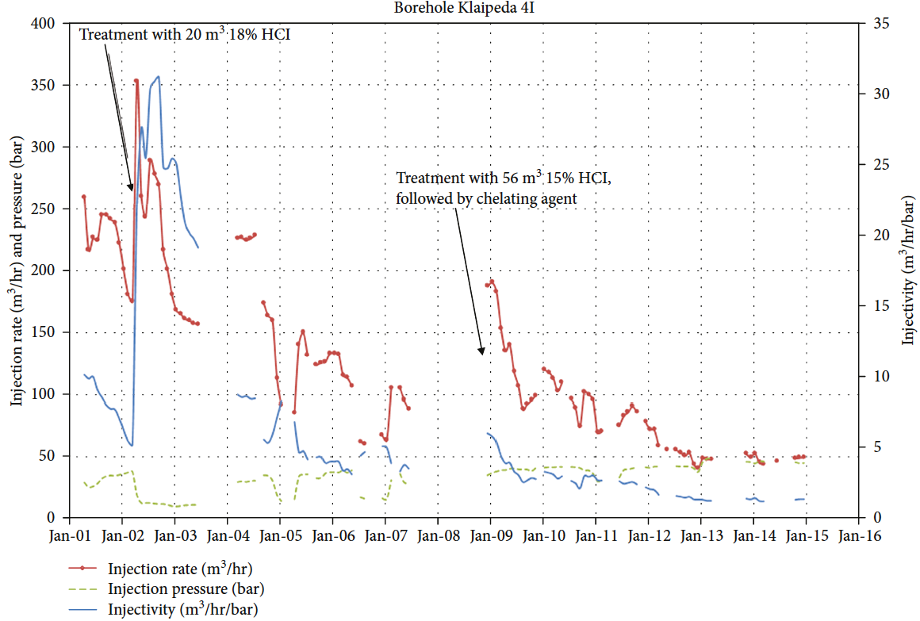
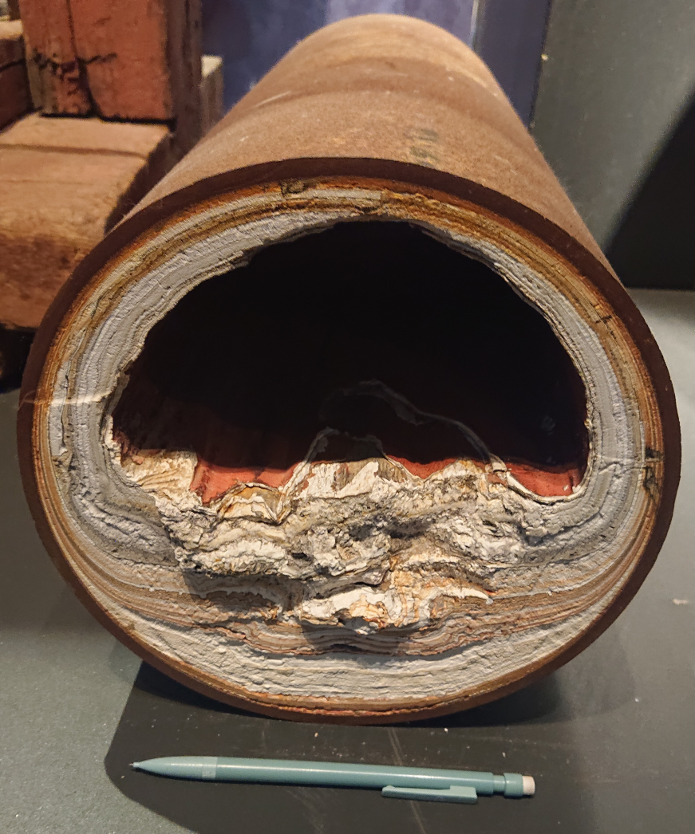
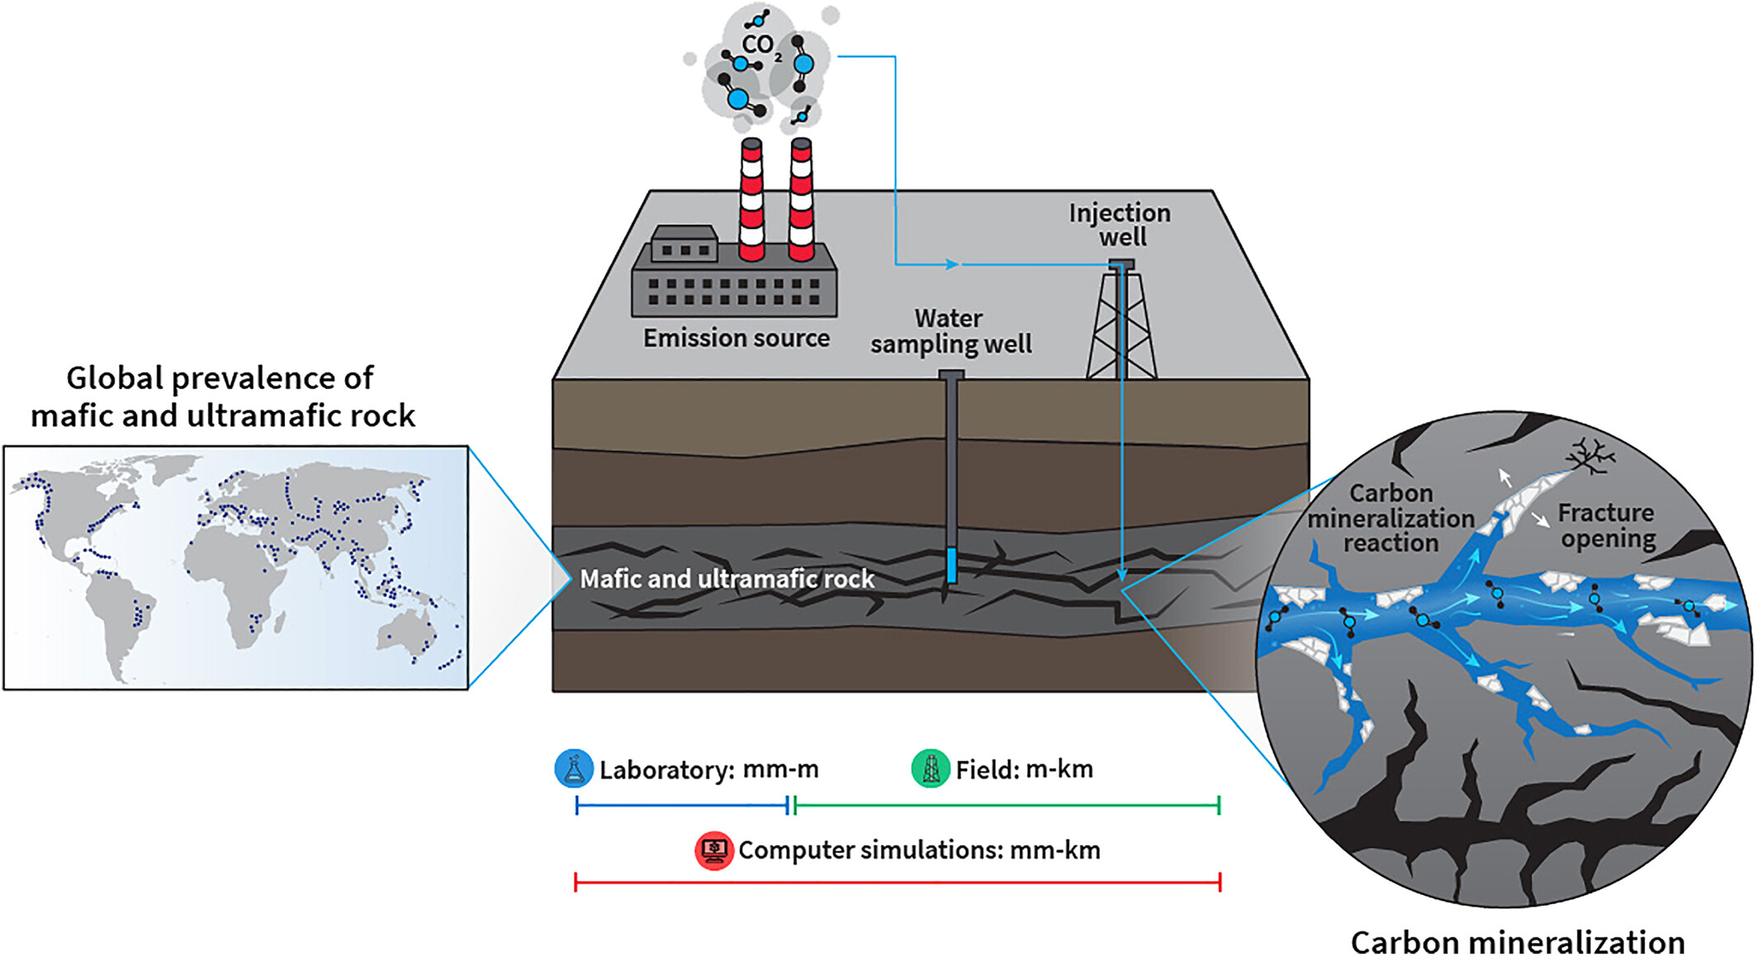
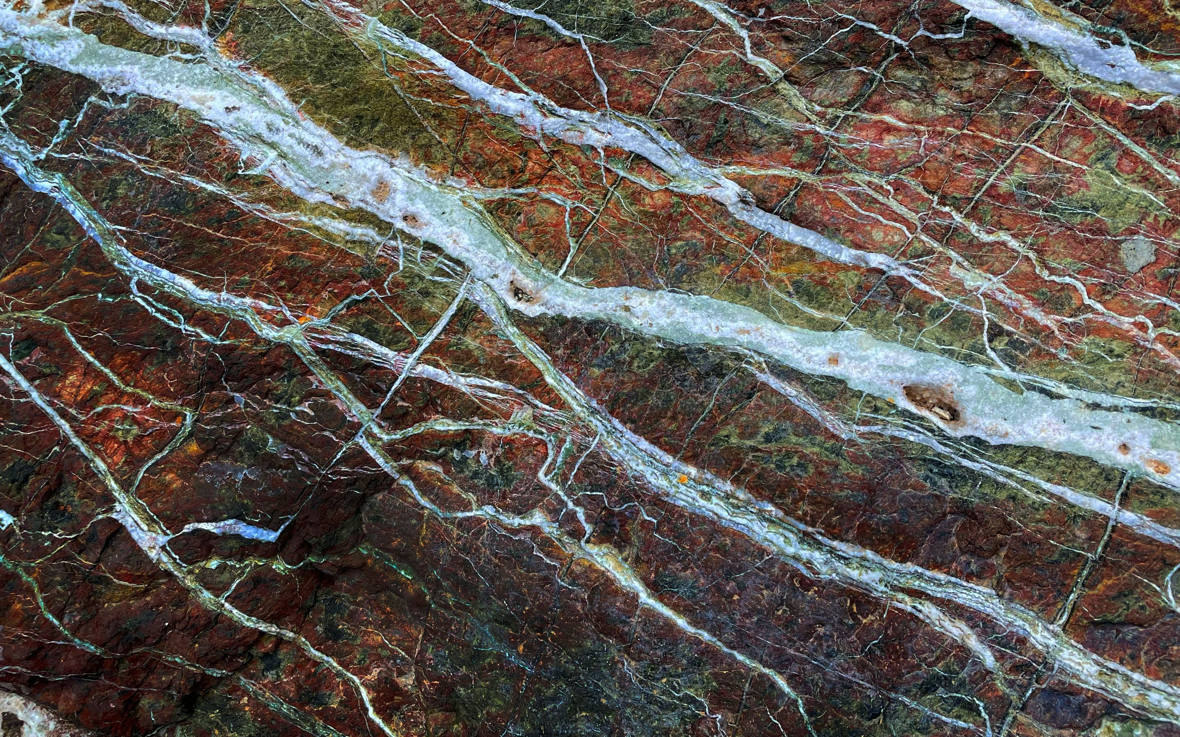
Introduction: Mineral Precipitation
Unintended – Chemical clogging in geothermal operations
There is a need to characterize mineral precipitation processes in the subsurface
We need to be able to predict where it forms, how it affects the rock properties and how to detect it.
(Kottsova et al., 2022)
(Brehme et al., 2019)
Scaling in a pipe in Larderello
Intended – Carbon Mineralization
(Nisbet et al., 2024)
(44.01.earth)

Slide 3
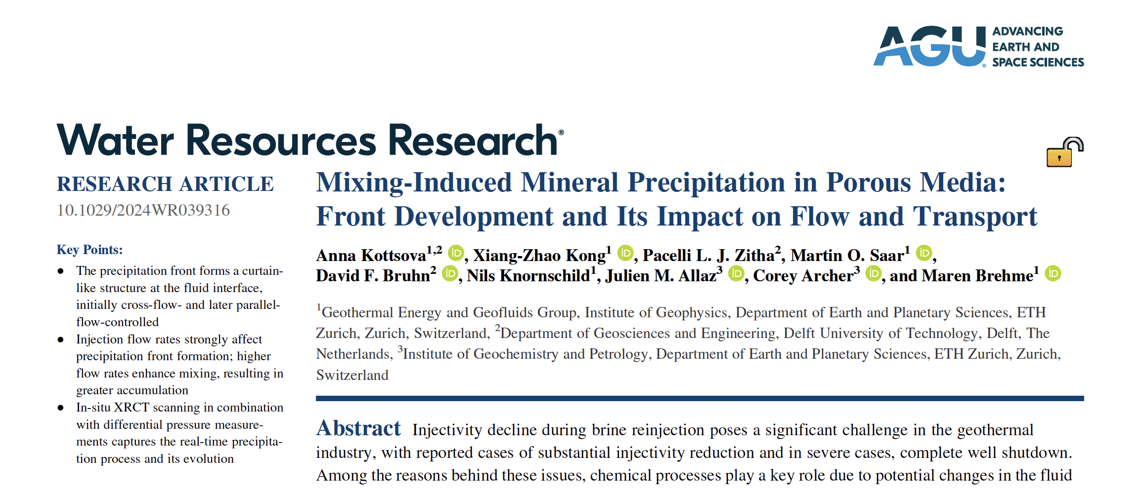
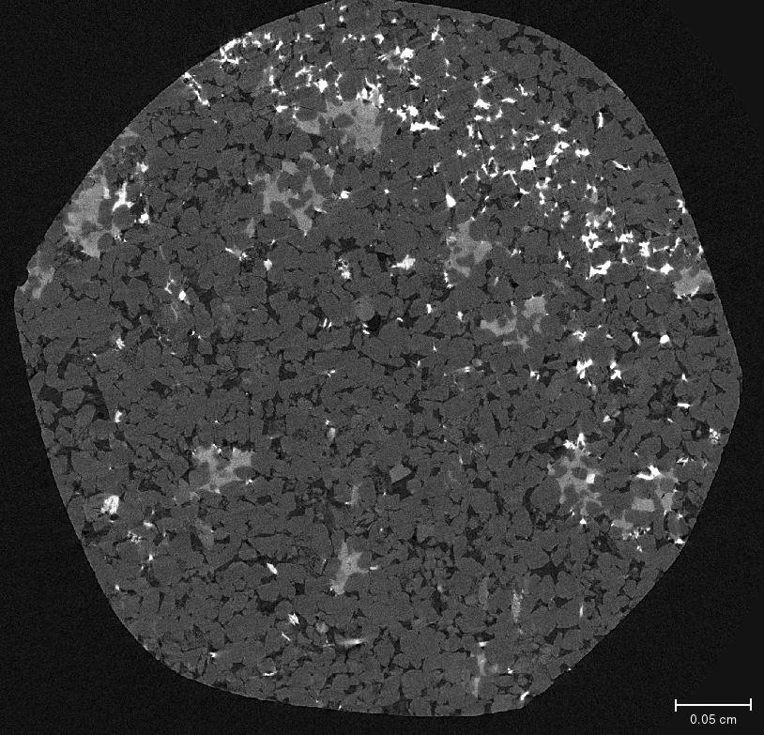
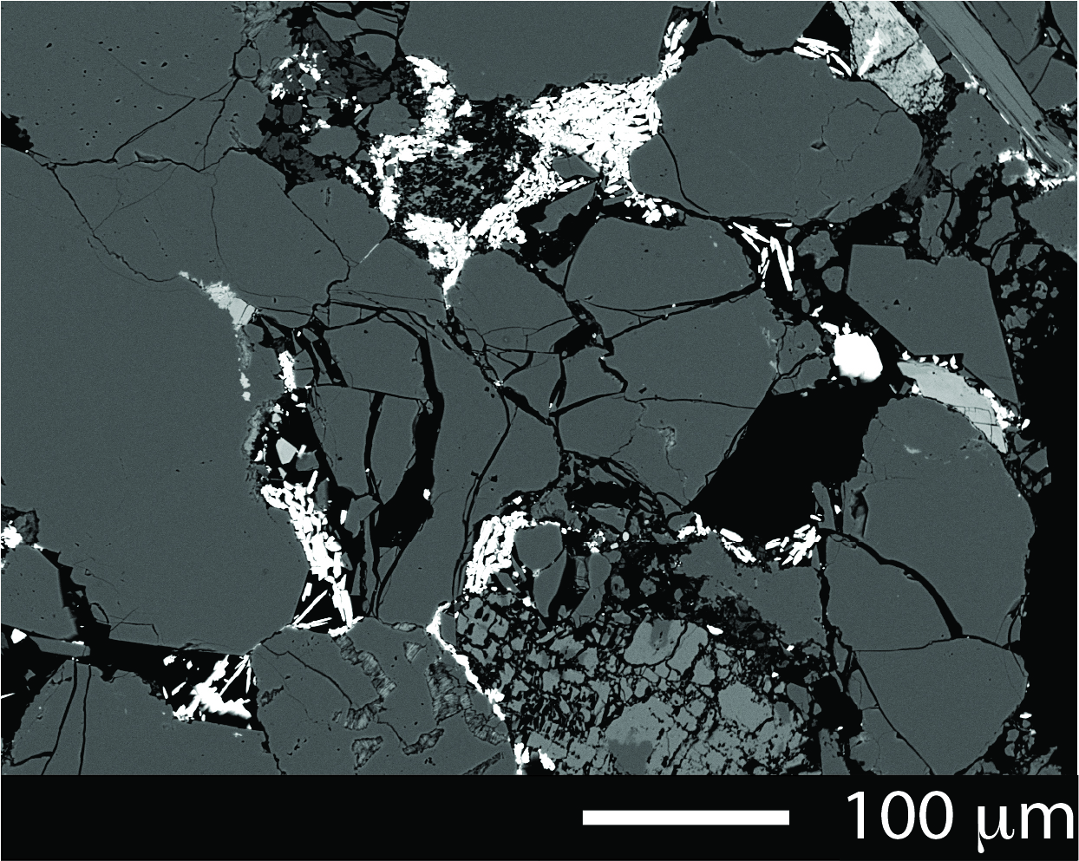
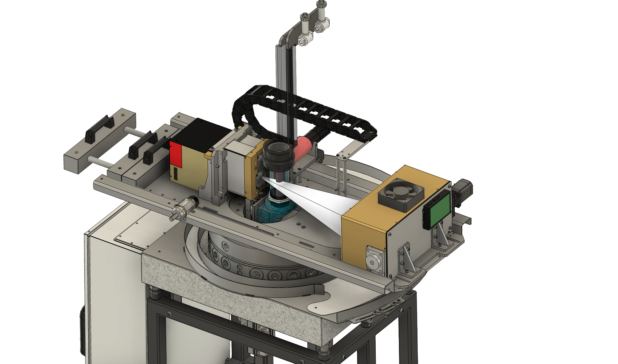
Prior Experimental Research
XRCT-assisted core-flooding experiments
SEM image
0.05 cm
XRCT scan, 2.2 μm res.
Residual micro-porosity allows for continued transport after initial front establishment

Slide 4
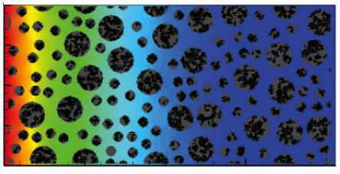
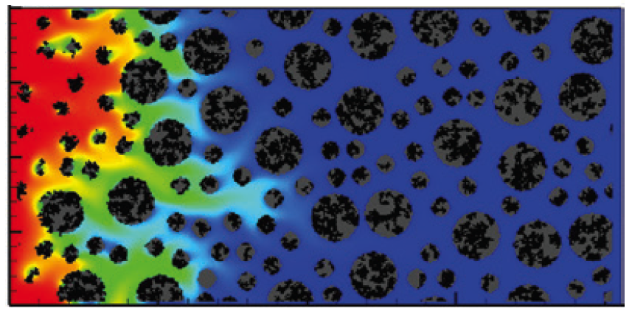



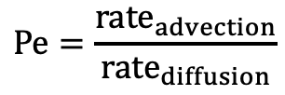
Research Questions
Does residual micro-porosity allow for further reactive transport?
How does the precipitation barrier modify mixing efficiency and reactive transport compared to the unaltered pore space?
How does this change vary across transport regimes?
$$Pe=1$$
Transition
$$Pe=0.1$$
$$Pe=10$$
0.05 cm
Diffusion
Advection
$$Pe=\frac{rate_{advection}}{rate_{diffusion}}$$
Seigneur et al. (2019)

Slide 5

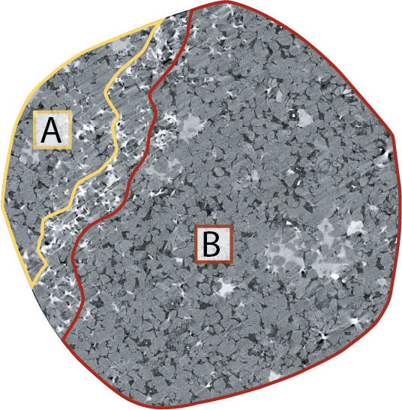
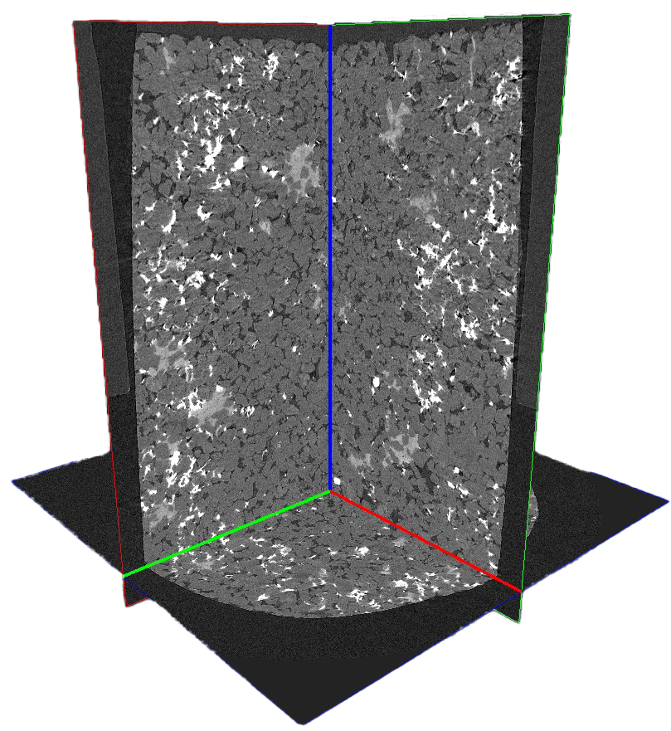
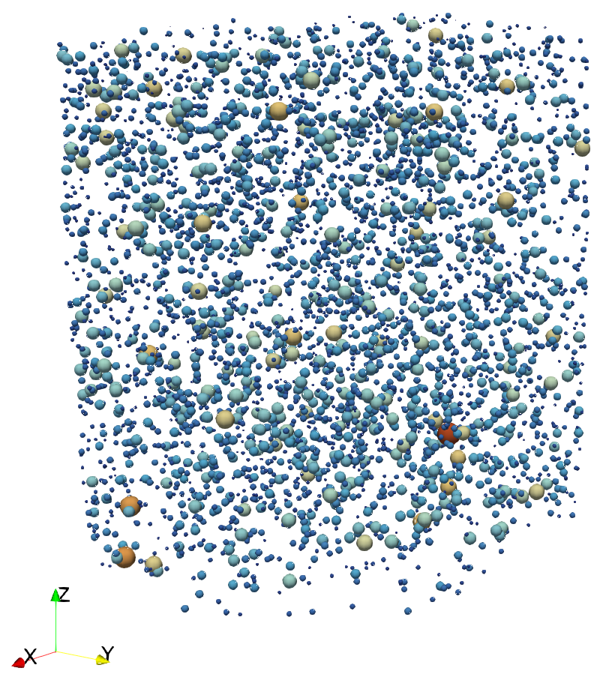
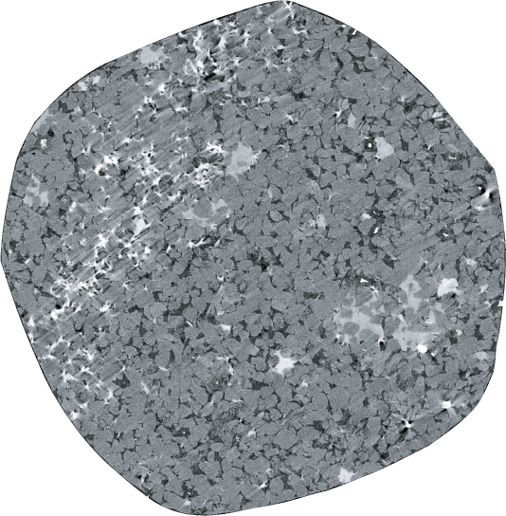
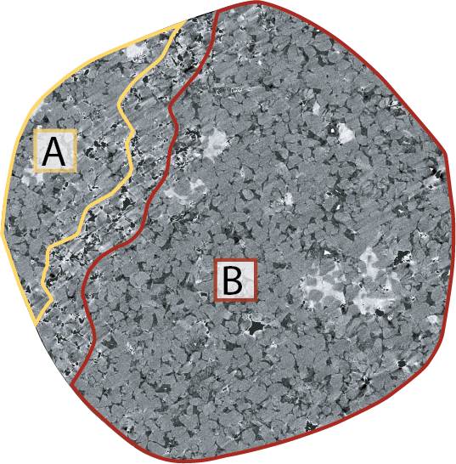
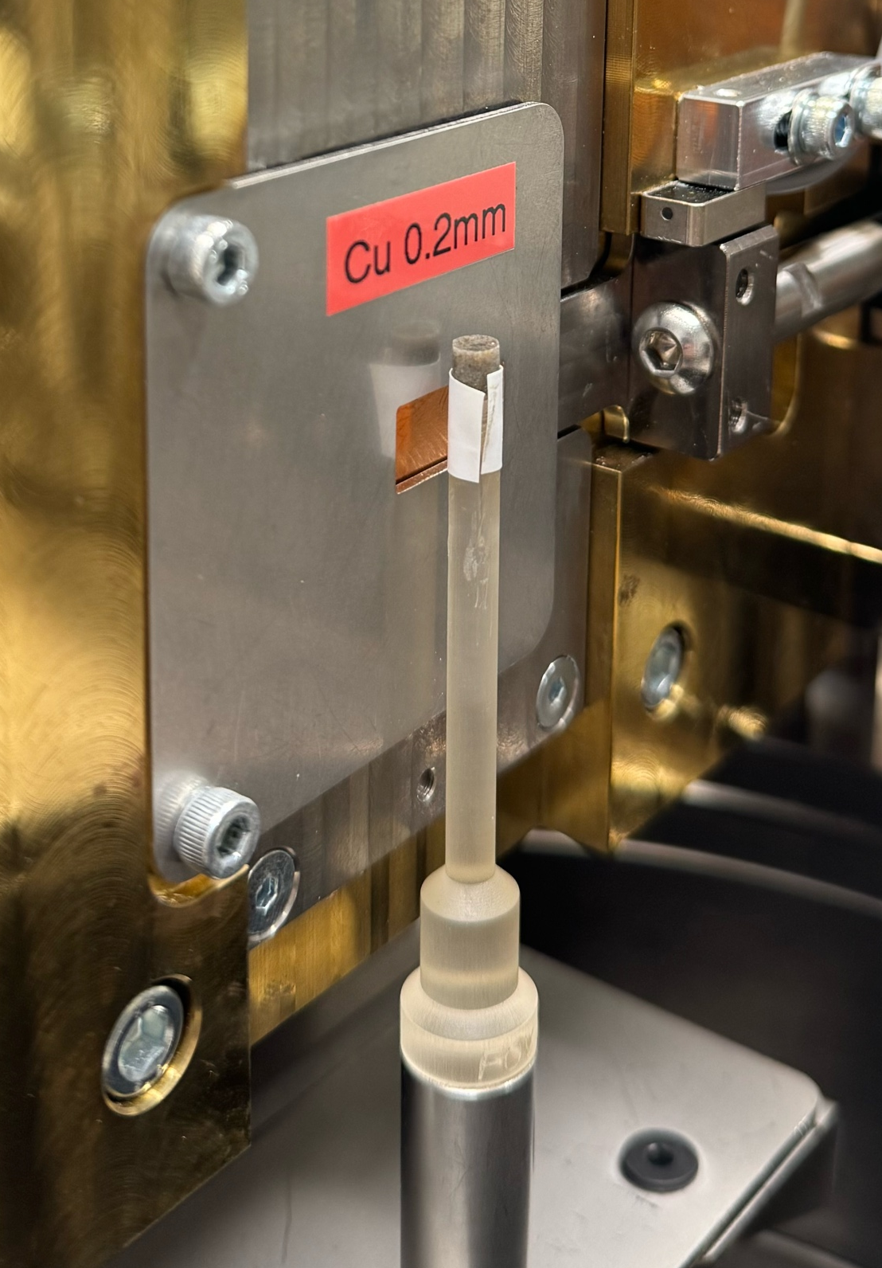

Pore Network Modeling Approach
ETH Zürich
Chongqing University
XRCT scan
⌀4×4.5 mm
2.2 μm res.
reconstruction
Dual-network representation
Obstructed
network
Pristine
network
A + B → C↓
Scenario | Configuration | Pe | PV injected
1 | Pristine | 0.1 | 50
2 | Pristine | 1 | 50
3 | Pristine | 10 | 50
4 | Obstructed | 0.1 | 50
5 | Obstructed | 1 | 50
6 | Obstructed | 10 | 50
Where A and B are transported and C ”precipitates” immediately
$$C_{C}=min⁡(C_{A}, C_{B})$$

Slide 6

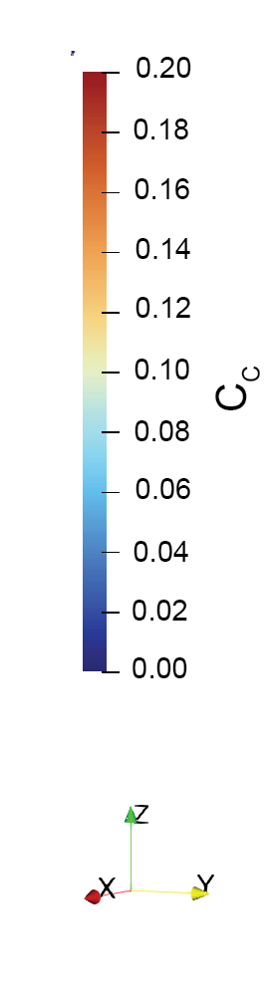
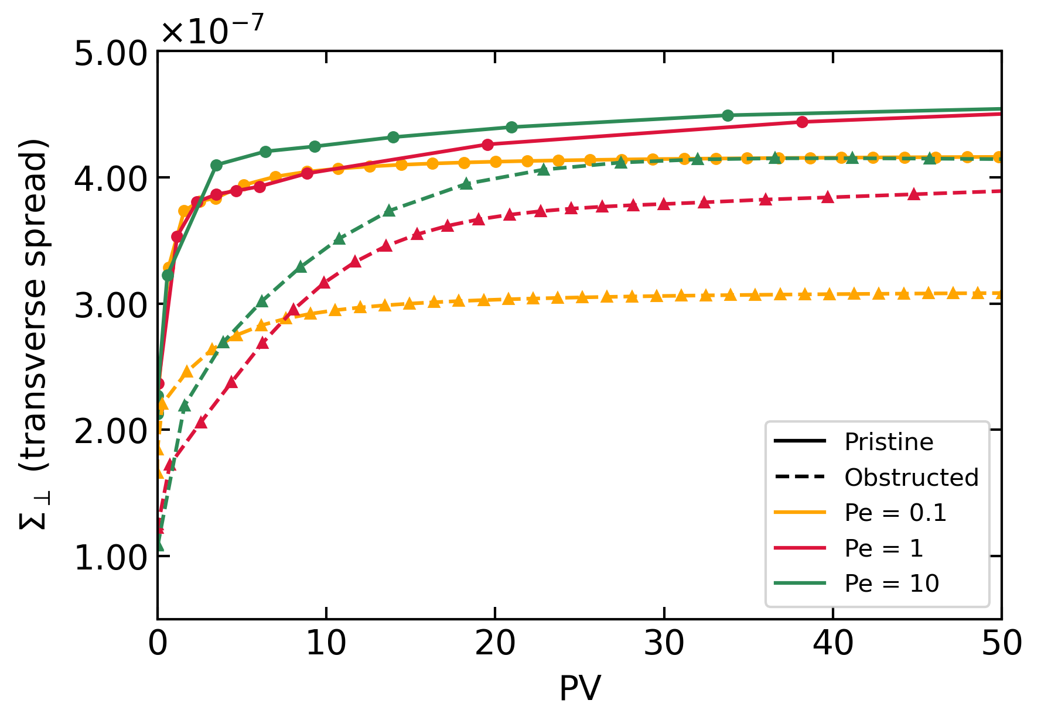

Regime-Dependent Mixing Suppression
Diffusion
Advection
Transverse spread of mean concentration of the precipitate
Pristine
Obstructed
Pristine VS Obstructed:
Boundary suppresses transverse mixing ⇨ reduced spread, lower total precipitate amount
Diffusion VS Advection:
Low Pe: Strongest suppressive effect on fluid mixing
High Pe: Boundary effect is marginal due to strong advection

Slide 7
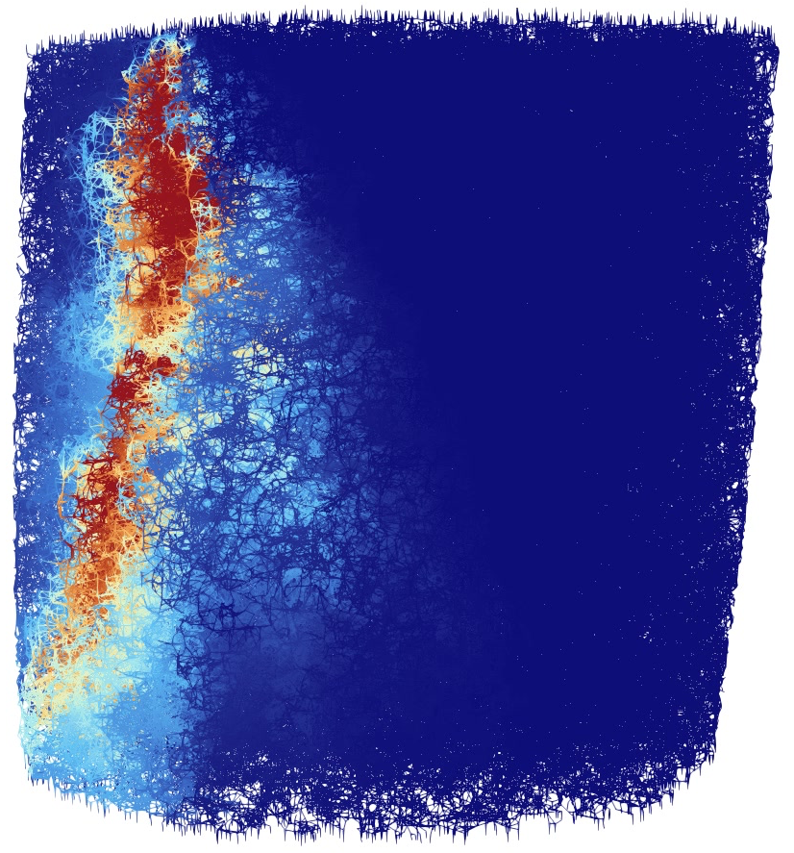
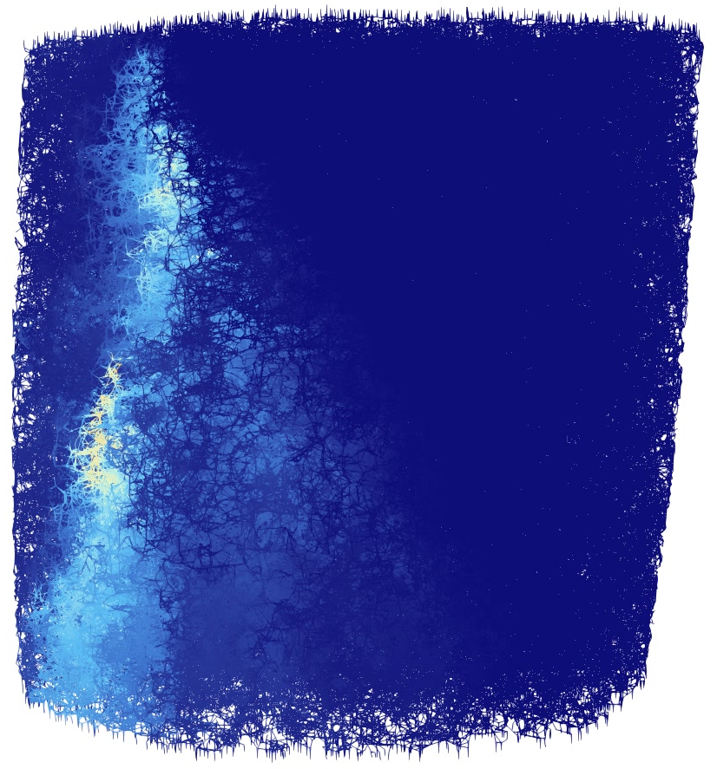

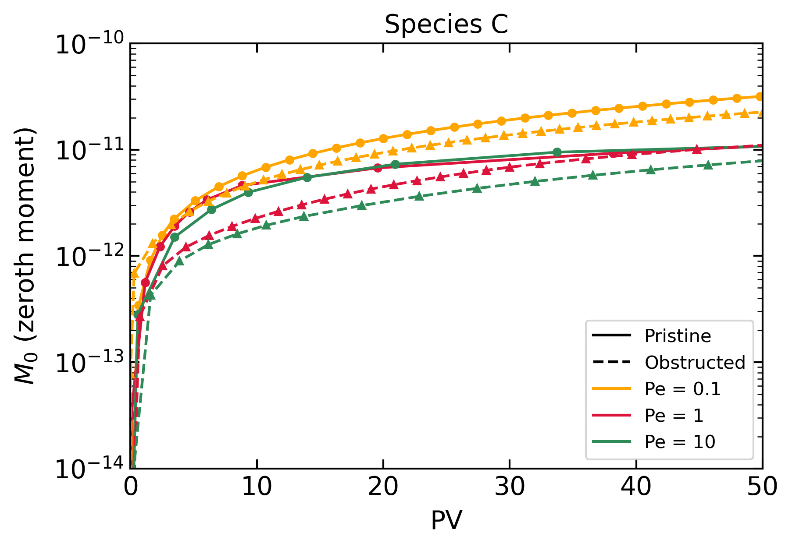
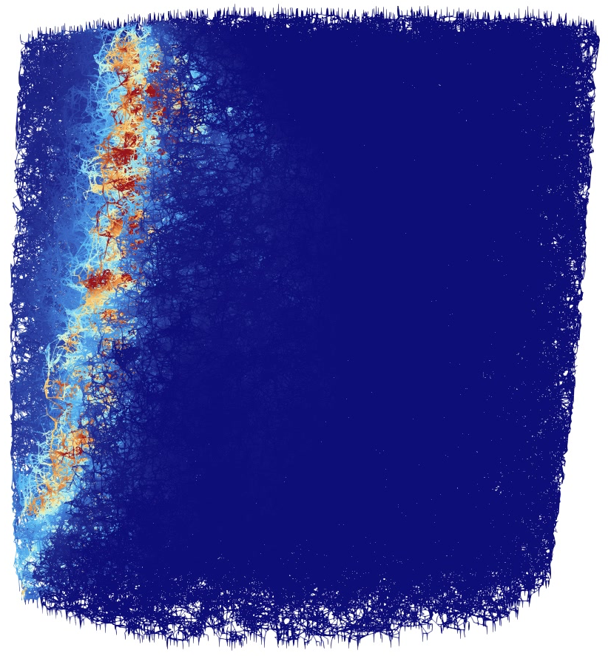
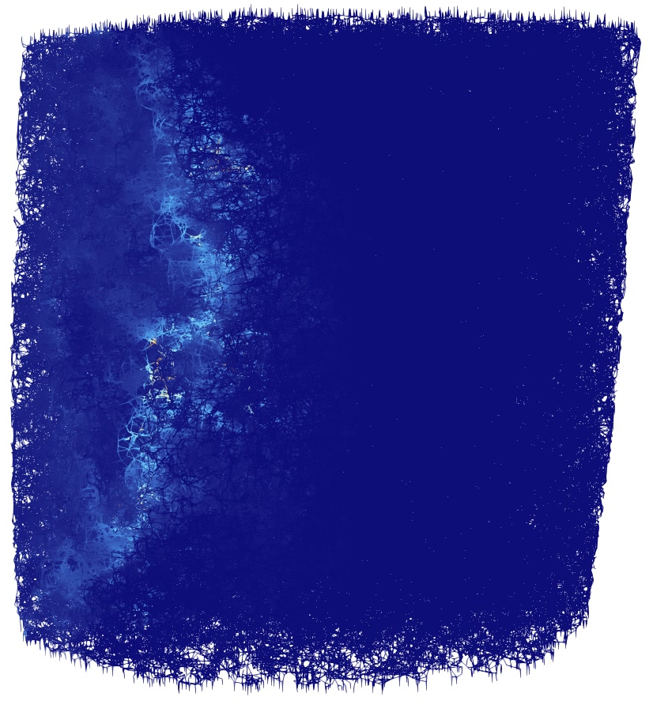
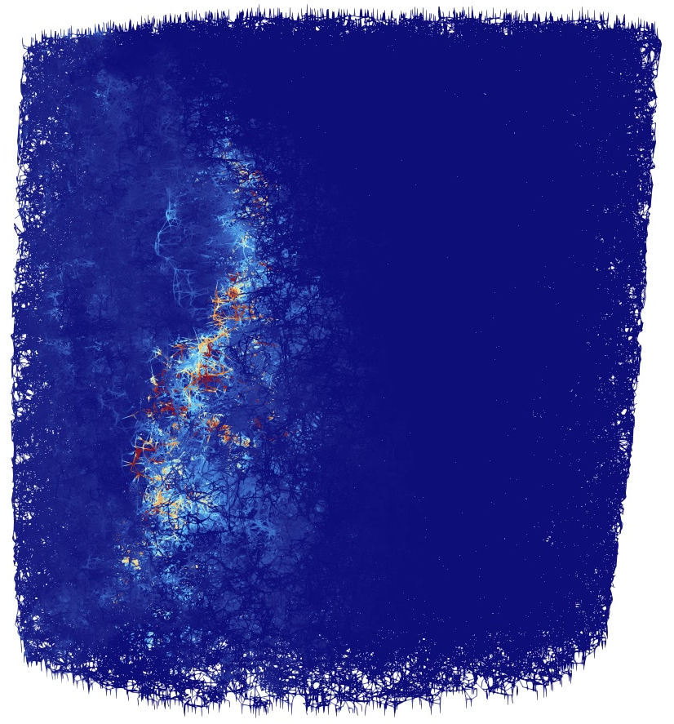
Self-regulating Feedback of the Precipitation Boundary
Diffusion
Advection
Total mass of the precipitate produced
Pristine
Obstructed
Boundary slows down early reaction but sustains high concentration gradient at later stages
Mineral precipitation boundary acts as a temporal regulator of mixing

Slide 8
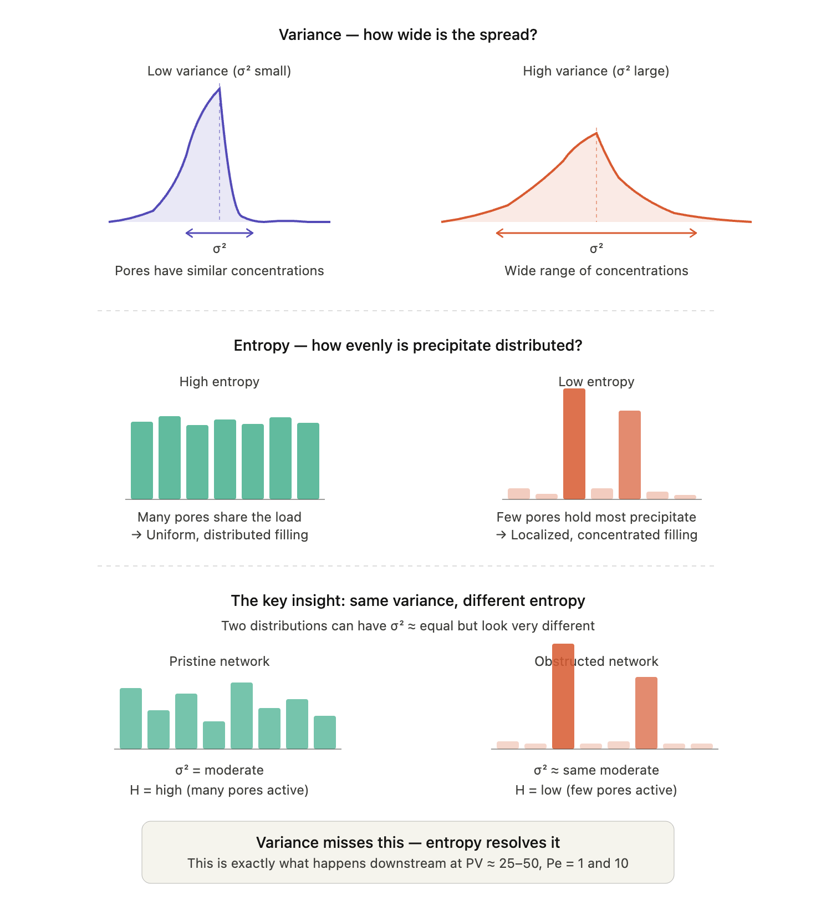
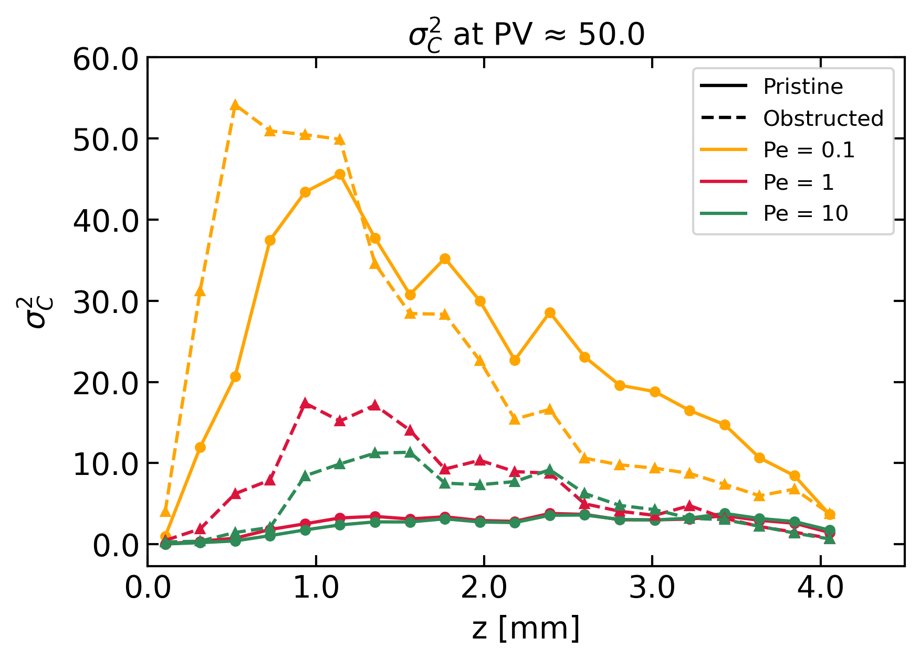
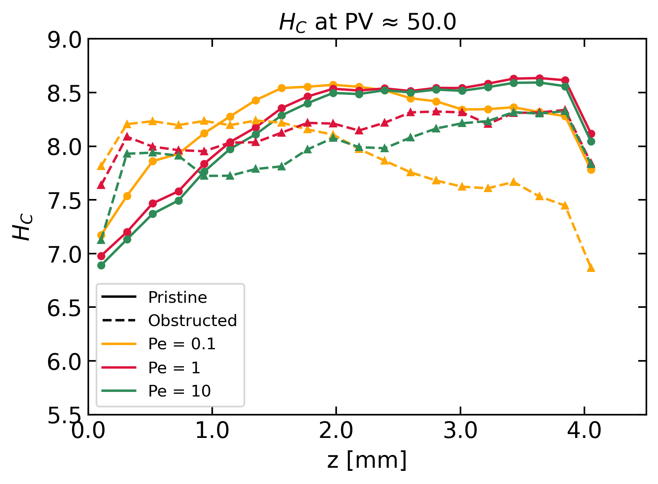
Spatial Distribution Analysis
Variance – how wide is the precipitation spread?
Concentration variance at 50 PV
Concentration entropy at 50 PV
Entropy – Within the affected pores, how evenly is the precipitate distributed?
Obstructed VS Pristine:
Systematically higher variance and lower entropy at all Pe — more localized deposition
Diffusion VS Advection:
Low Pe: broad range of pores affected but high concentration variability within
High Pe: fewer pores involved, but more equally affected

Slide 9
Conclusions
Boundary suppresses mixing at all flow regimes
Strongest spread suppression at low Pe (diffusion is impeded directly)
Marginal at high Pe (advection already segregates reactive streams)
Self-regulating, not self-arresting behavior
Boundary slows early reaction but sustains high concentration gradients
Flow regime controls not just how much mineral precipitate but how it is distributed
Low Pe: larger area occupied, broadly distributed with larger variability
High Pe: fewer pores affected but more uniformly (strongly) occupied ⇨ potentially more damaging per unit volume

Slide 10
Thank you for attention! Anna Kottsova akottsova@ethz.ch ETH Zürich Geothermal Energy and Geofluids group

Slide 11
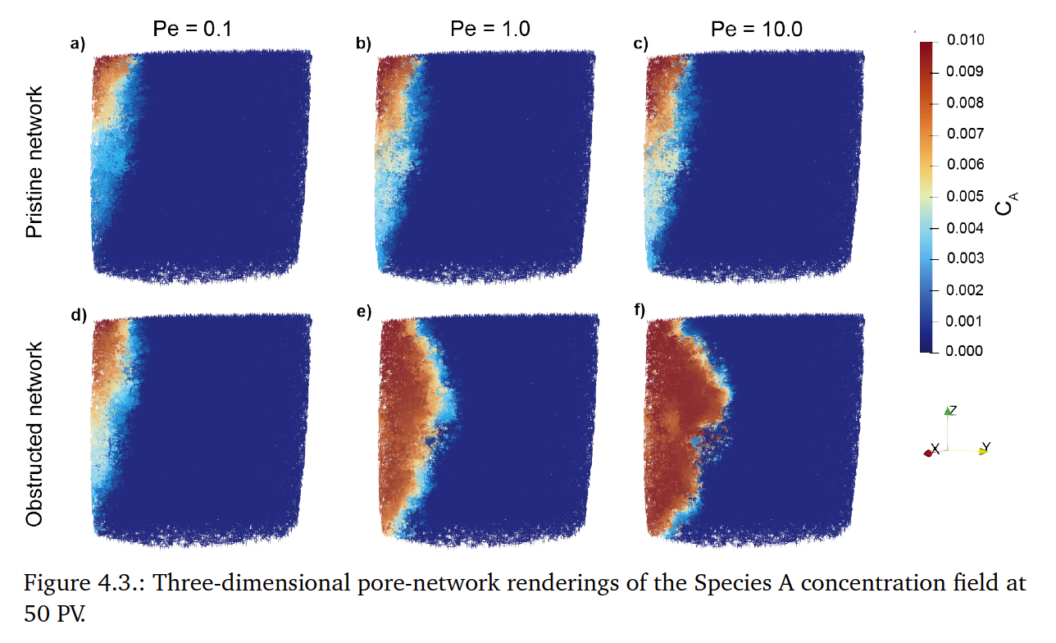

Slide 12
