Slide 1
InterPore 26
Mechanisms of Extraordinary Organic Matter Enrichment and Organic Pore Development Model of the Gufeng Member Shale, Maokou Formation, Permian, Northern Sichuan Basin
四川盆地北部二叠系茅口组孤峰段页岩有机质超常富集机制及有机孔隙发育模式
Presenter: Zimeng Wang
Supervisor: Prof. Guang Hu
State Key Laboratory of Oil and Gas Reservoir Geology and Exploitation, Southwest Petroleum University
School of Geoscience and Technology, Southwest Petroleum University
2026.5，interpore26, nante
Notes:
Hello, esteemed faculty and fellow students! I’m Wang Zimeng from the School of Geoscience and Technology, Southwest Petroleum University. Today, I will present our research progress on the Mechanisms of Extraordinary Organic Matter Enrichment and Organic Pore Development Model of the Gufeng Member Shale, Maokou Formation, Permian, Northern Sichuan Basin

Slide 2
Presentation Outline
01
Research Objectives and Significance
02
Geological Background of Gufeng Fm.
03
Organic Matter Enrichment Mechanisms
04
Organic Pore Evolution Models
05
Conclusions and Implications
Notes:
The presentation is structured into the following five parts.

Slide 3
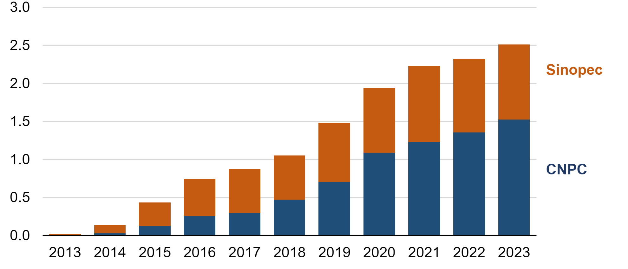
1. Research Objectives and Significance
Unconventional Energy Share
Shale Gas Exploration Status
Gufeng Shale Prospects
billion cubic feet per day
Structural Belt | Stratigraphic (Fm.) | Area (km²) | Resources (10⁹ m³)
Weiyuan Structure | Qiongzhusi | 3,600 | 23,878
Longmen Structure | Wujiaping | 30,000 | 60,000
Xuanhan Area | Dalong | 4,220 | 12,000
Hongxing Area | Wujiaping | 9,480 | 47,600
Northern Sichuan Area | Gufeng | 1,220 | 1,750
(Source: China Natural Gas Development Report, 2024)
China shale gas production from the Sichuan Basin by company (eia, 2024)
Shale Gas Resources in New Plays, Sichuan Basin (zou et al., 2024)
High TOC vs. Low Pore Volume paradox hinders Permian shale exploration.
Gufeng
Fm.
Qiongzhusi
Fm.
15.7E-3
Longmaxi
Fm.
10.1E-3
1.1E-3
TOC Distribution in Major Shale Gas Intervals (Chen et al., 2023; Xu et al., 2024)
Pore whith Distribution in Major Shale Gas Intervals
Notes:
As of 2024, unconventional energy has accounted for 43% of China's energy mix, with shale gas growing particularly fast. Daily production in the Sichuan Basin alone has exceeded 250 million cubic feet. As a key replacement target, the Permian marine shale, especially the Gufeng Member, holds a resource potential of up to 1.75 trillion cubic meters. However, its exploration faces practical challenges. As indicated by the yellow diamond symbols in the lower-left figure, the Gufeng shale has an extremely high TOC content, reaching over 30%, far exceeding that of shales such as LMX and QZS. Yet, as the primary reservoir space for shale gas, its pore volume is extremely low, as shown by the yellow area in the pore size distribution in the lower-right figure, which is significantly lower than that of the reference formations. This "high TOC, low pore volume" characteristic directly constrains the exploration progress of the Permian shale. To explain this anomaly, this presentation will address it from two aspects: the mechanisms of organic matter enrichment and the organic pore evolution patterns.

Slide 4
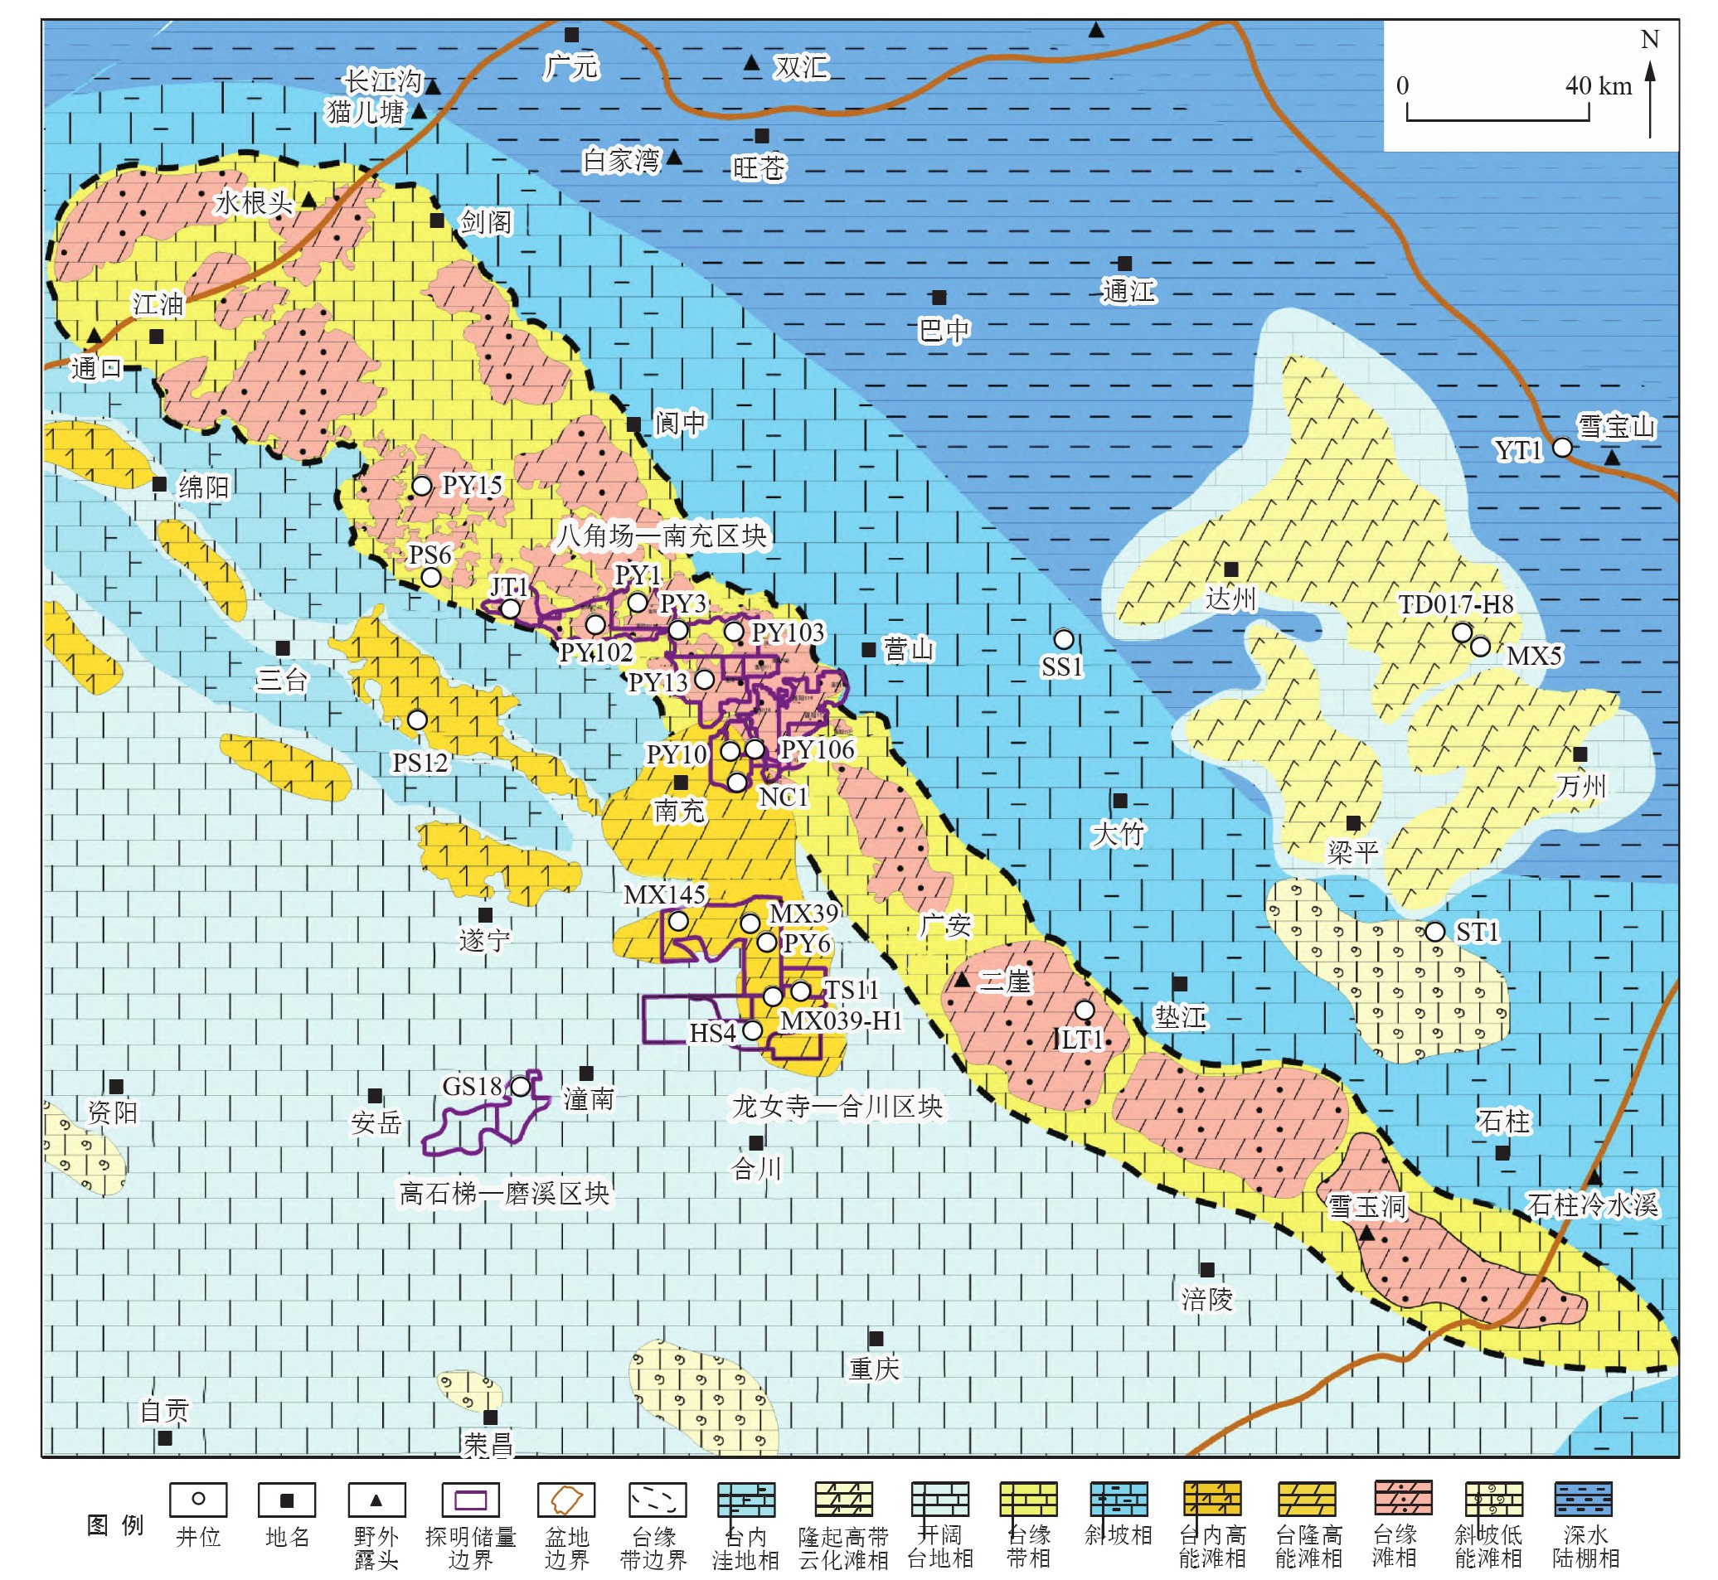
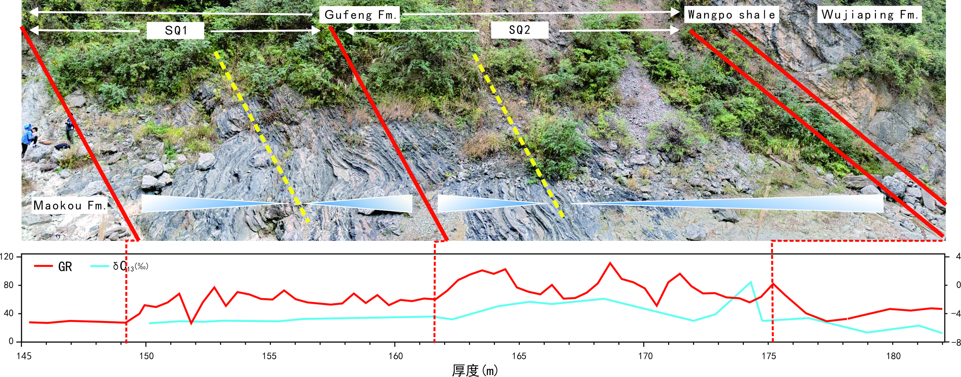
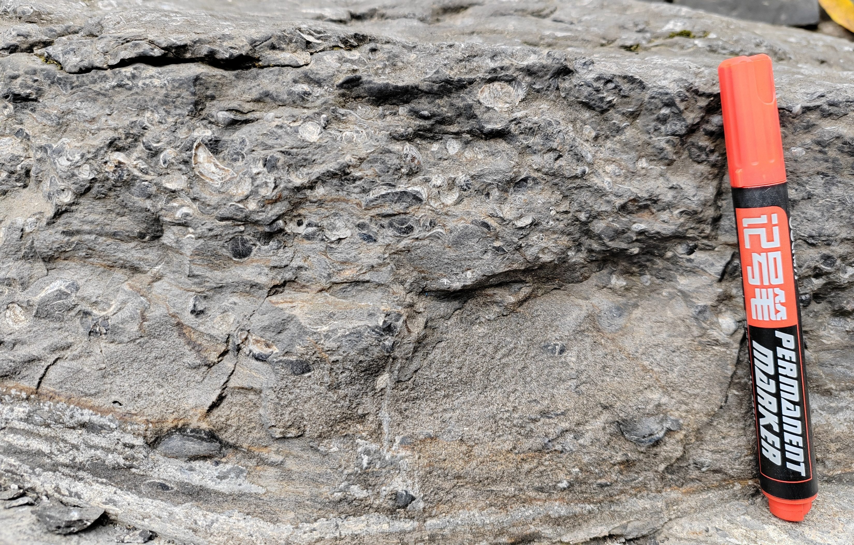
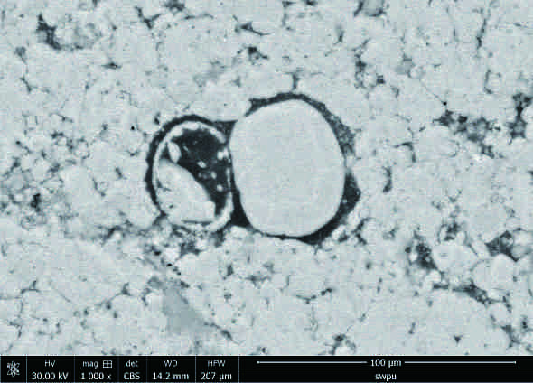
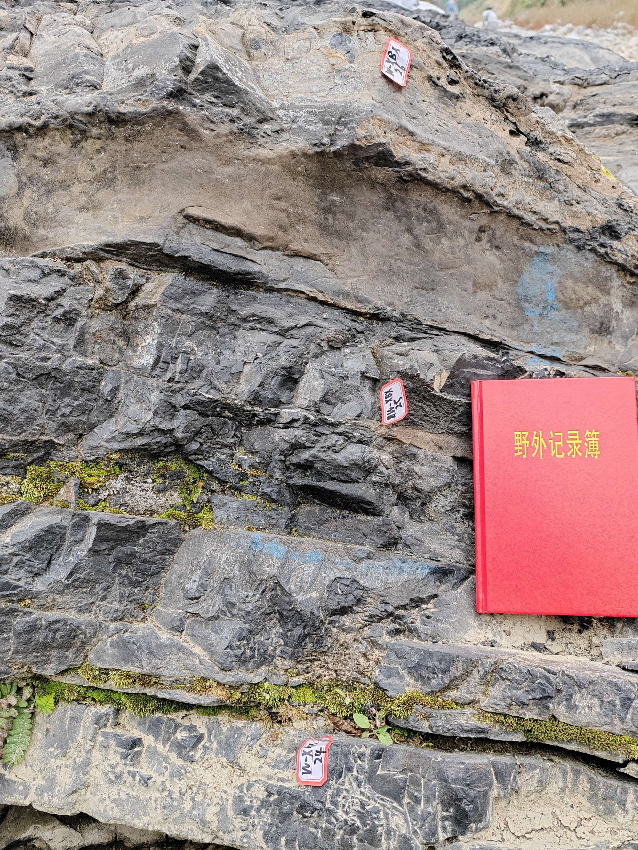
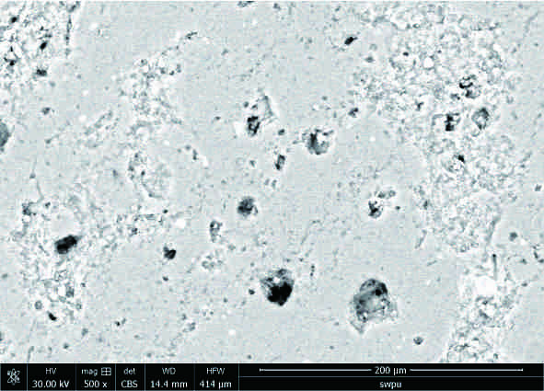
2. Geological Background of Gufeng Fm.
Deposition: Platform-Slope-Basin
Sequence Stratigraphy: 1 third-order & 2 fourth-order sequences
Marg.
Plat.
Slope
Basin
Gufeng Sedimentary Framework, NE Sichuan (Wen et al., 2025)
Typical Slope-Basin Facies of Gufeng Member: Xibeixiang Section
Main Lithology: Organic-rich calcareous shale
Main Lithology: Siliceous shale
SEM
SEM
Notes:
Next, let’s look at the basic geological setting of the Gufeng Member. From the perspective of macroscopic depositional architecture, as shown in the upper-left figure, the Sichuan Basin during the Gufeng period exhibited a typical "platform–slope–basin" configuration. Our study focuses on the slope and basin facies belts, which are favorable for the development of organic-rich shale. In terms of sequence stratigraphy, based on lithology, cyclicity, biostratigraphy, well logs, and geochemical proxies, we have subdivided the Gufeng Member into one third-order sequence and two fourth-order sequences. Lithologically, the Gufeng Member is dominated by two rock types. The first is organic-rich calcareous shale, where abundant calcareous bioclasts are visible in outcrop and SEM images. The second is siliceous shale, with bed thickness generally less than 10 cm; under SEM, numerous moldic pores after radiolarians are observed.

Slide 5
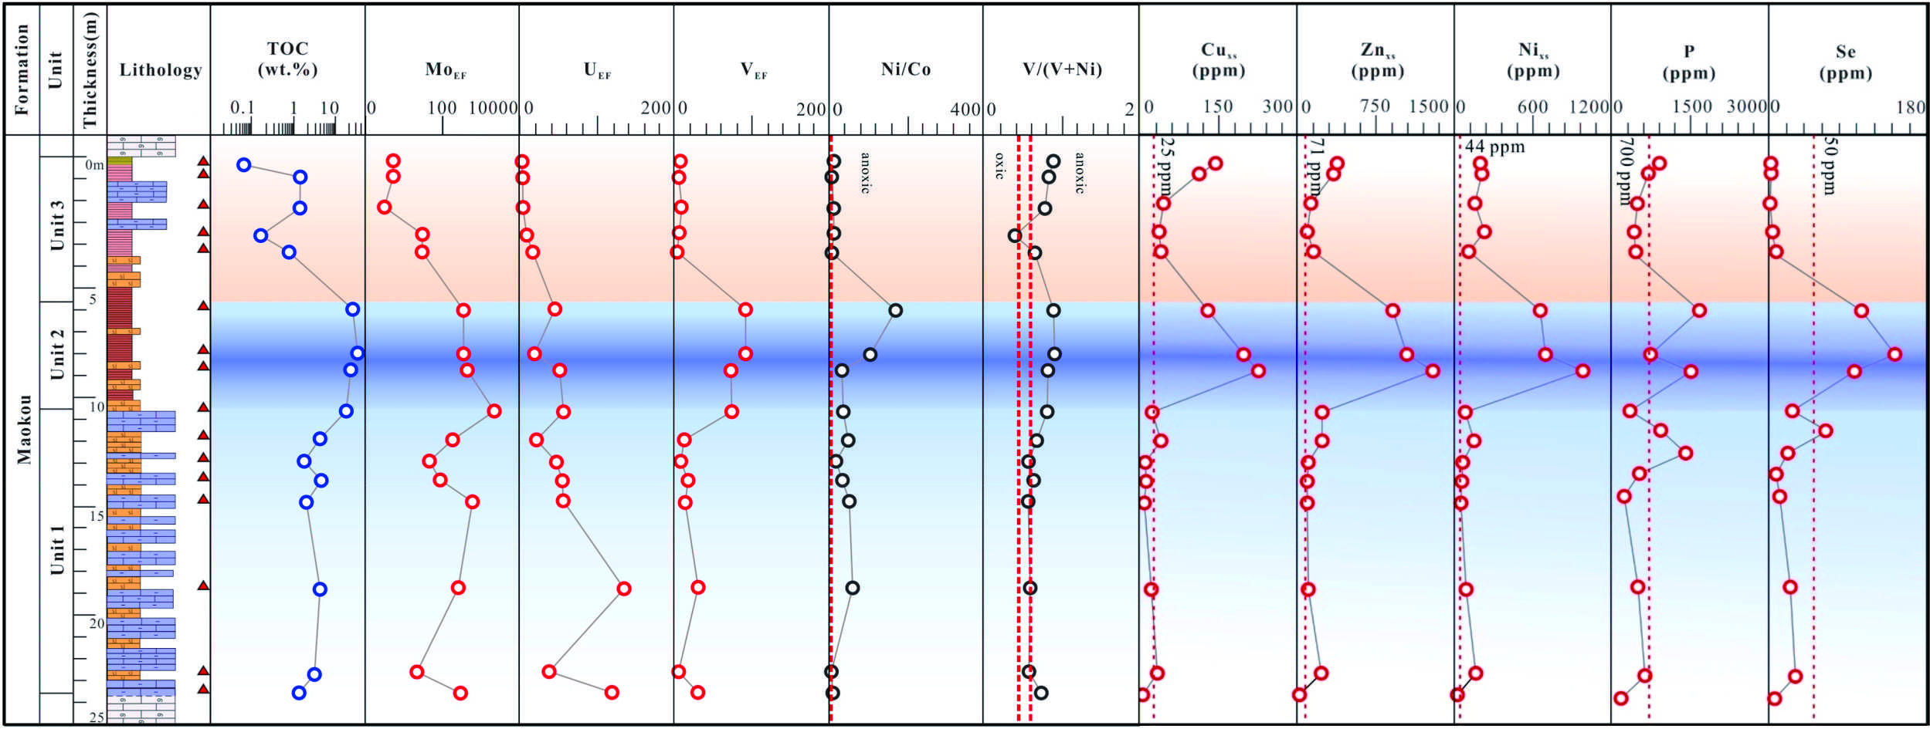
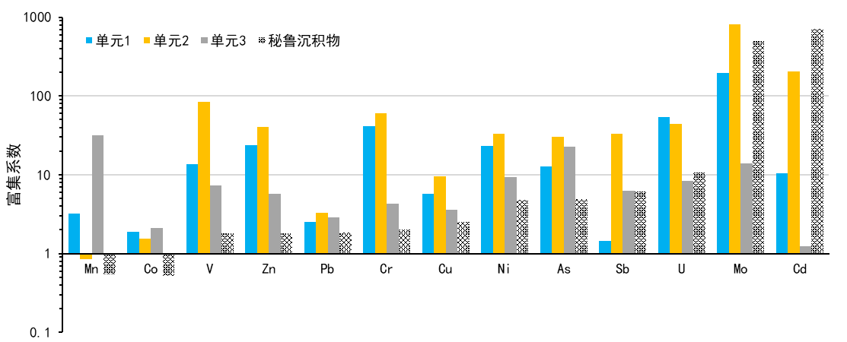
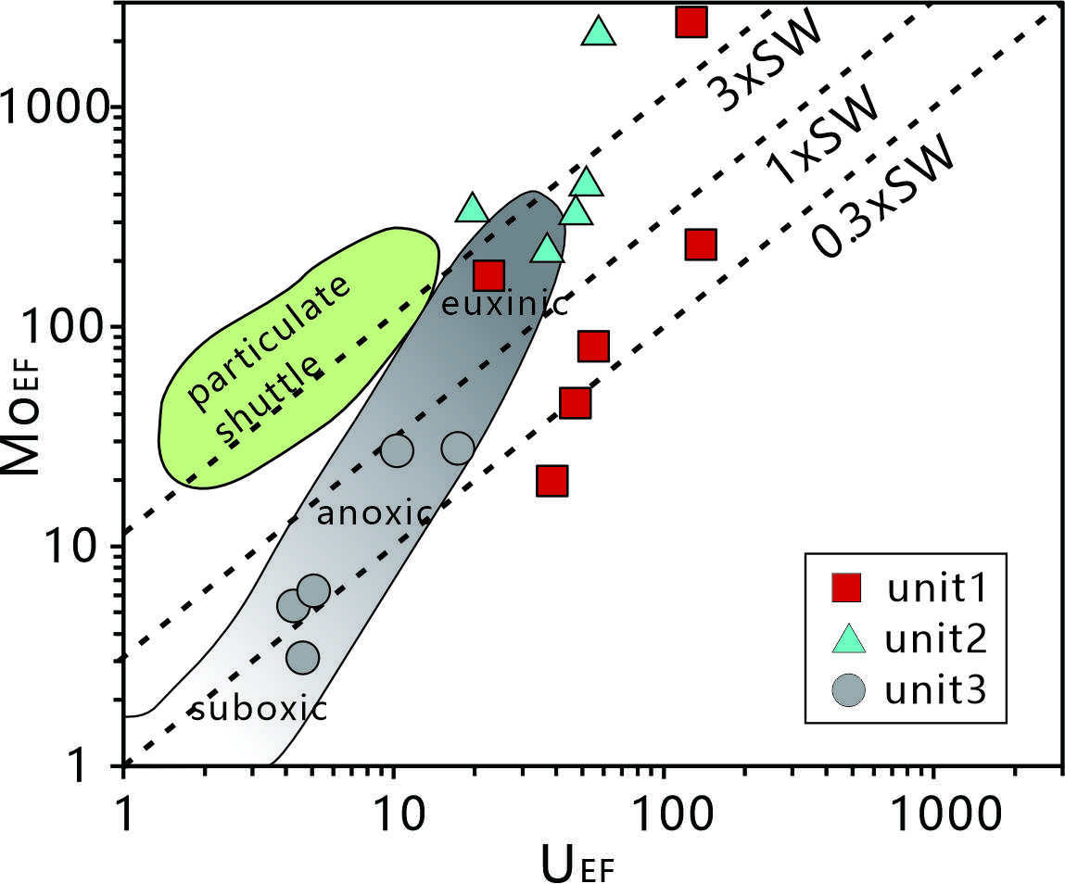

3. Organic Matter Enrichment Mechanisms
Unit3：
0.01%-2.06%
(0.61%)
Unit2：
0.46%-4.81%
(9.15%)
UNIT1
UNIT2
UNIT3
Peruvian
Unit1：
0.46%-4.81%
(2.58%)
Trace Element Enrichment Factors of Top Maokou Shales, Xibeixiang Section (Peruvian standard after Böning et al., 2004, 2009)
Notes:
Next, we discuss the mechanisms of organic matter enrichment. As shown in the TOC histogram on the left, the Gufeng Member can be divided into three units from bottom to top. Unit 2 has the highest average TOC, reaching 9.15%, making it the most organic-rich interval. In the comprehensive geochemical profile on the right, we observe that multiple redox-sensitive elements (e.g., Mo, U, V) and productivity-indicating elements (e.g., Cu, Zn, Ni) all show positive co-varying trends with TOC content. This preliminarily suggests that organic matter enrichment was jointly controlled by preservation conditions and primary productivity. To further verify this, we employed the Mo-U covariation diagram, as shown in the lower-left figure. Unit 2 sample points (blue triangles) mostly plot in the euxinic field, strongly indicating that the bottom water was under euxinic anoxic conditions. The trace-element enrichment factor diagram on the lower right reveals that the enrichment patterns of the Gufeng samples are geochemically similar to those of Peru upwelling sediments, suggesting that intense upwelling at that time delivered abundant nutrients, thereby sustaining extremely high primary productivity.

Slide 6
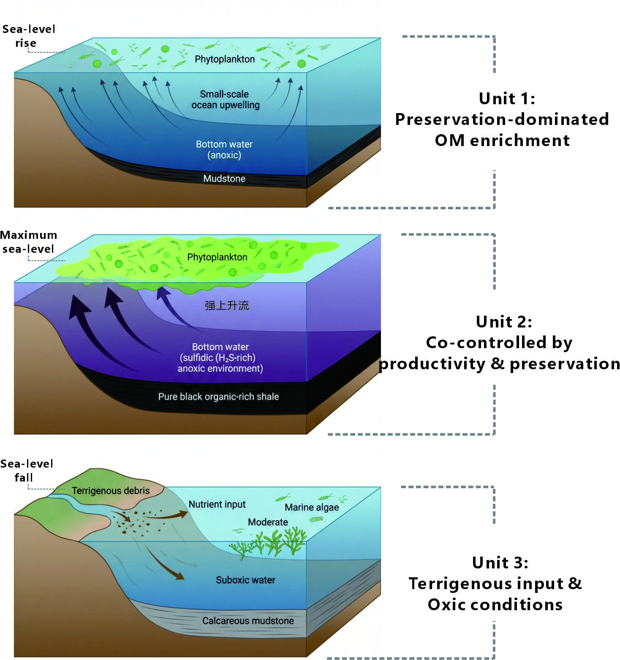
3. Organic Matter Enrichment Mechanisms
Sea-level rise
Upwelling-driven
Enhanced productivity
Sulfidic preservation
Regional transgression: Carbonate platform → Deep basin
Persistent upwelling: Enriched P-Cu-Zn-Ni
Plankton bloom: Extremely high paleo-productivity
Sulfidic bottom water: Efficient organic matter burial
 | Unit 1 | Unit 2 | Unit 1
Paleo-productivity | Low | High | Moderate
Redox | Anoxic | Euxinic-sulfidic | Anoxic-suboxic
TOC content | Relatively moderate | High | Relatively low
Geological events | transgressive; Upwelling | Maximum sea-level; Upwelling; | Sea-level fall; Terrestrial detrital input
Critical enrichment mechanism | Preservation conditions | preservation conditions and productivity | Restricted environment
Notes:
Based on the sequence stratigraphic division and geochemical analyses, we have established an evolutionary model of organic matter enrichment for the Gufeng Member. As shown in the schematic on the right, the organic matter enrichment, particularly in Unit 2, represents the spatiotemporal coupling of high productivity and strong preservation conditions. First, sustained intense upwelling delivered abundant nutrients, triggering algal blooms and resulting in extremely high paleoproductivity. Second, the high sea level combined with a restricted basin environment kept the bottom water in a state of long-term euxinic anoxia, providing excellent preservation conditions. In contrast, Unit 1 had not yet reached peak productivity, while Unit 3 experienced increased terrigenous input due to regression; consequently, neither formed large-scale organic matter enrichment.

Slide 7
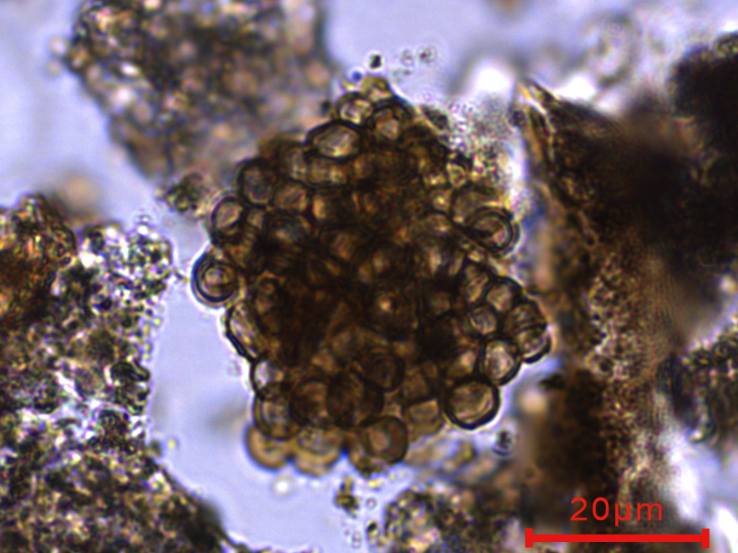
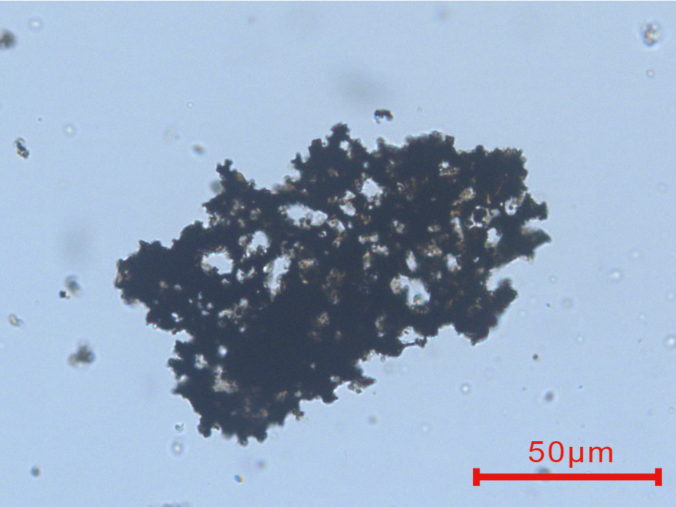
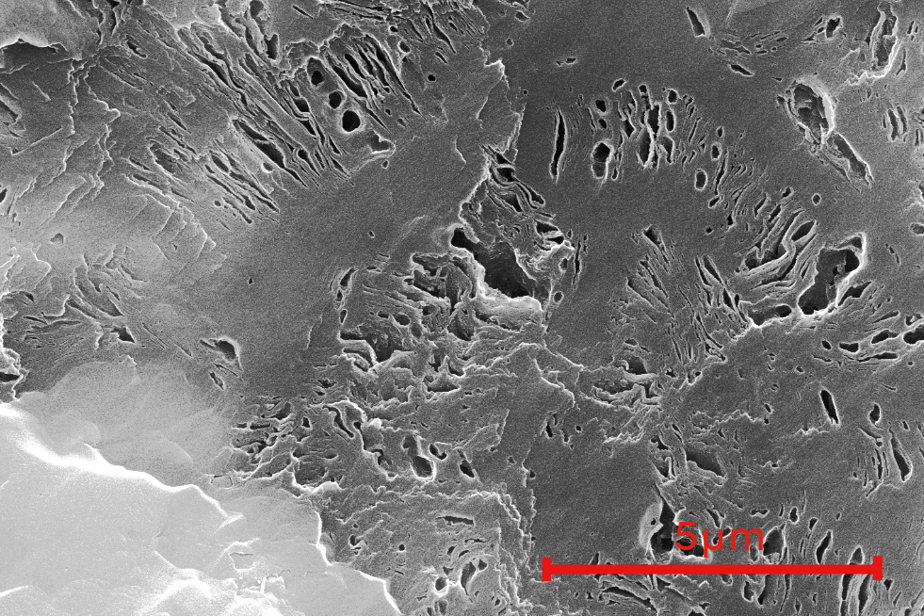
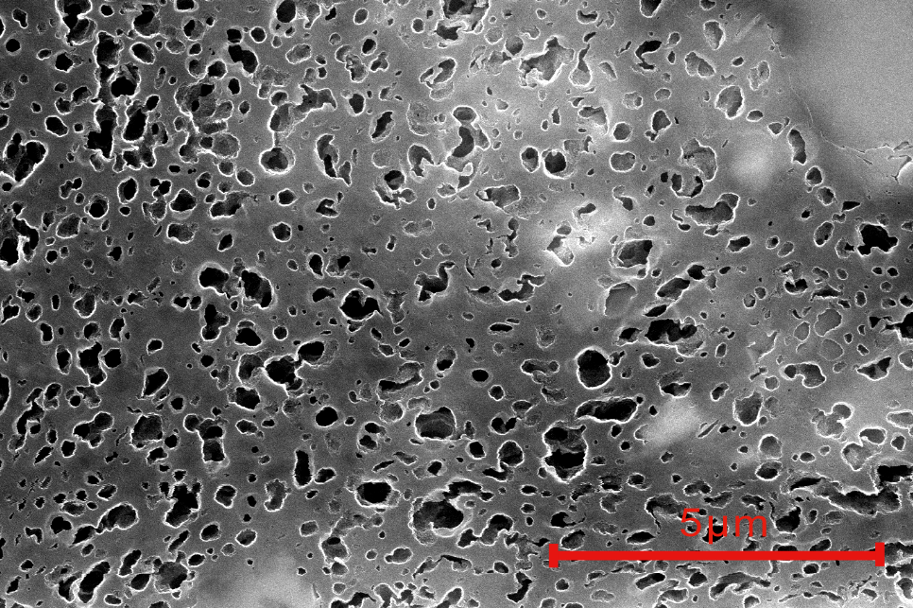
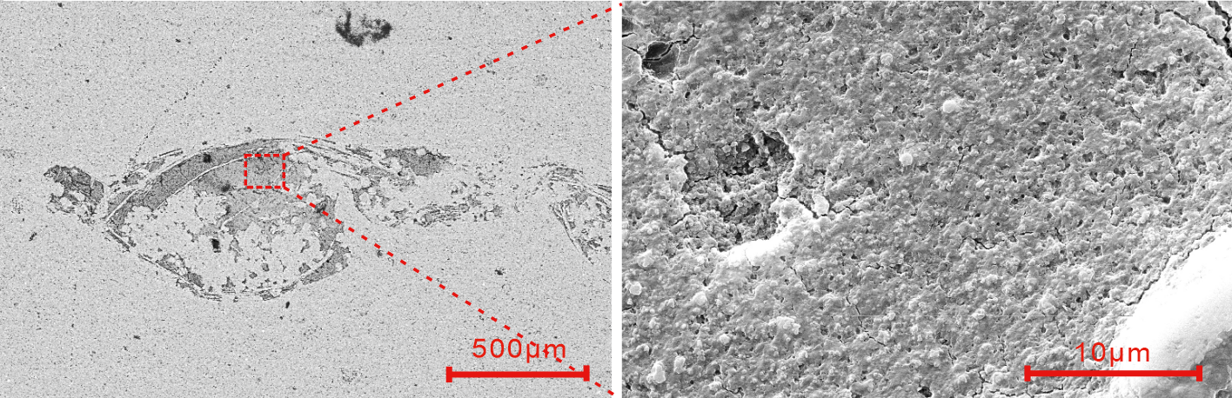
4. Organic Pore Characteristics
Biological Precursors: Planktonic & Benthic Algae
Pore Size Distribution: Tri-modal, low pore volume
Micropores:
2-5nm
Mesopores:
5-30nm
Macropores:
5-30nm
Planktonic algae (XBX-1)
Benthic algae (XBX-7)
Pore Hosts: Algal organic matter & bitumen
Calcitic Fossils: Negligible pores
Organic pores in algal OM (XBX-6)
Organic pores in bitumen (XBX-6)
Organic pores in large foraminifera (XBX-2)
Notes:
Having covered organic matter enrichment, we now examine, based on microscopic characterization, the types of pores into which the organic matter has been transformed. First, we identified two main types of biological precursors in the samples: planktonic algae and benthic algae. Second, the pore size distribution of the Gufeng Member exhibits a relatively uniform three-stage pattern, with low overall pore volume. Finally, in terms of organic matter hosts, organic pores are mainly developed in algal organic matter and bitumen, whereas biogenic organic matter such as foraminifera contains only a few tiny pores.

Slide 8
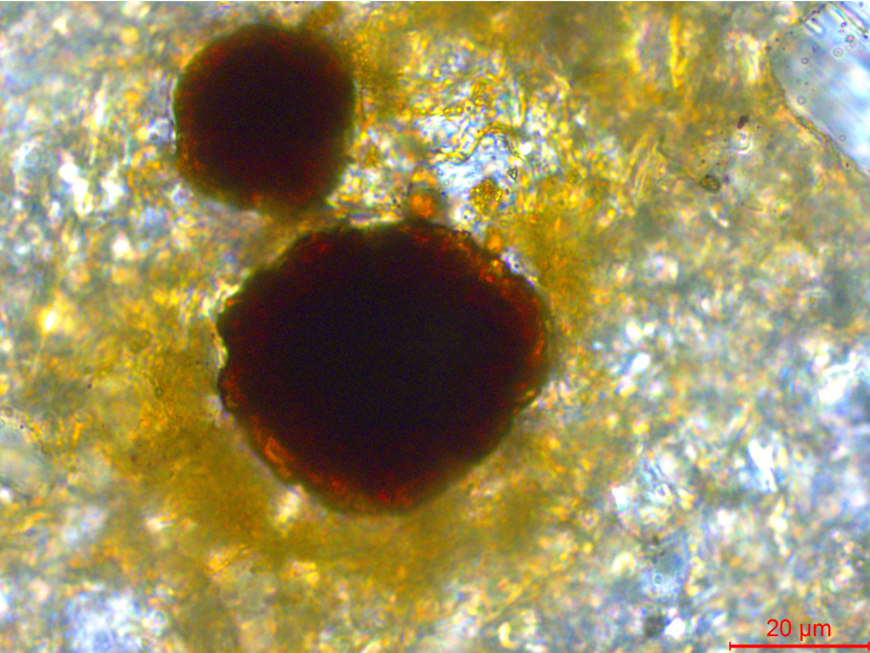
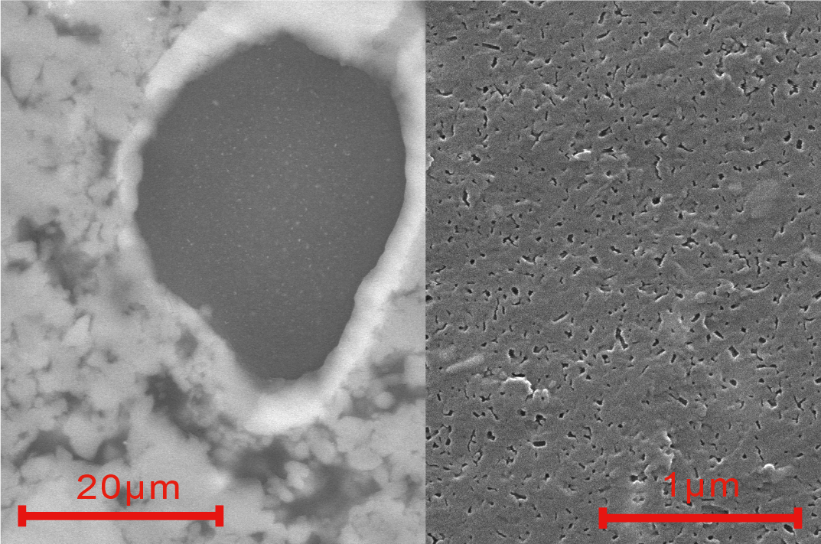
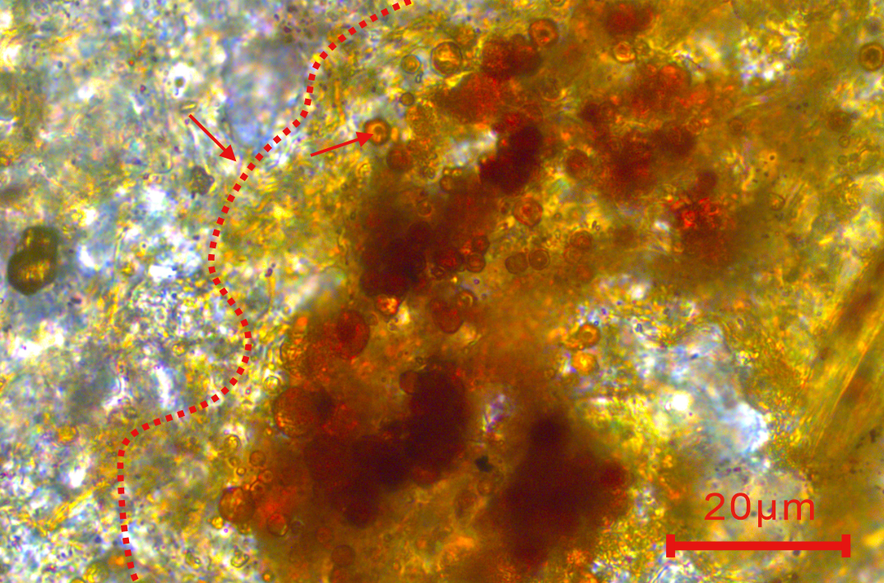
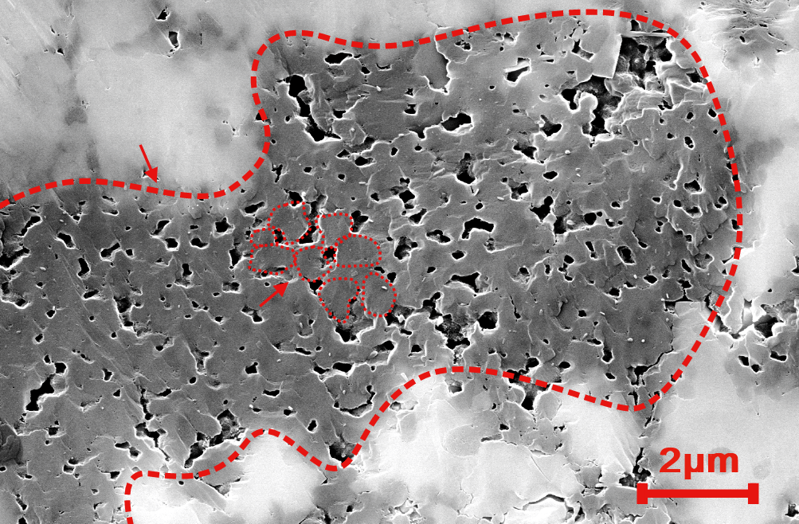
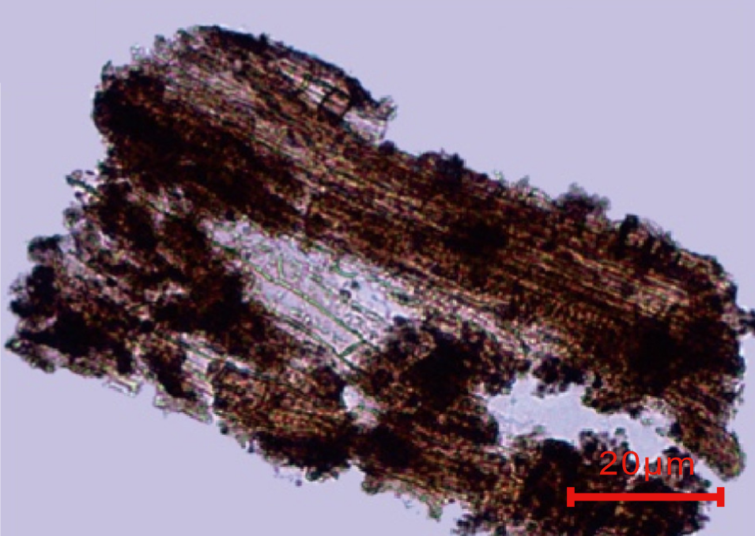
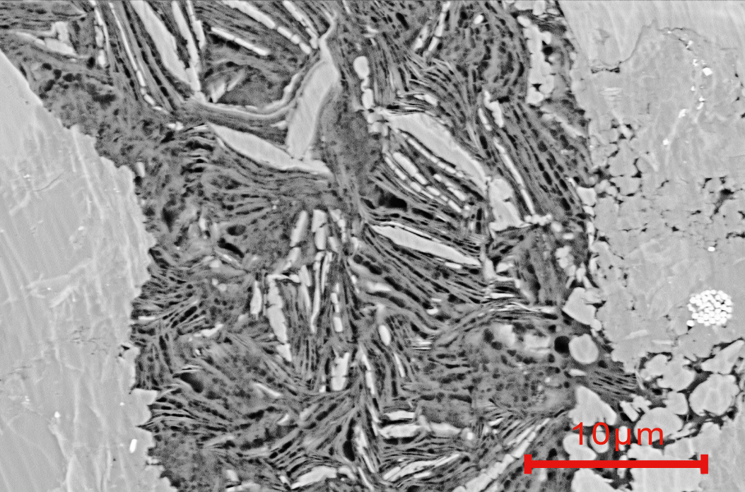
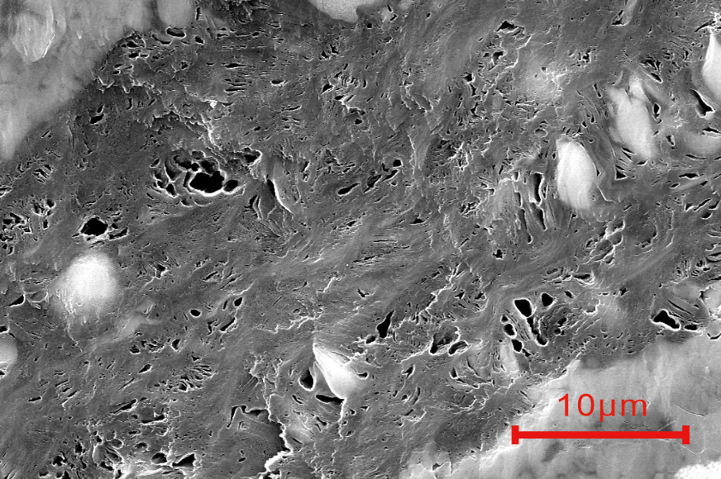
4. Biological precursors control initial organic pore volume
Unicellular planktonic algae: Minor intracellular pores
Multicellular planktonic algae: Pores in extracellular sheaths
Gelatinous sheath
Gelatinous sheath
Unicellular planktonic algae (XBX-2)
Multicellular planktonic algae (XBX-3)
plate-like benthic algae: Abundant slit & bead-like pores
net-like benthic algae: Abundant slit & bead-like pores
Tabular benthic algae (XBX-6)
Reticulate benthic algae (XBX-6)
Notes:
Next, we discuss the control of biological precursor types on organic pore development. By comparing the microstructures of different algae, we observed marked differences in pore development.
The unicellular planktonic algae (upper left) have a dense structure with very limited pores. In contrast, the multicellular planktonic algae (upper right) contain abundant pores within their extracellular gelatinous sheaths, substantially improving the storage space. However, the most developed pores are found in the benthic algae below. Whether platy or reticular in structure, they naturally contain abundant slit-shaped and beaded pores, providing the best material basis for the formation of high-quality reservoirs.

Slide 9
4. Biological precursors control initial organic pore volume
Benthic algal OM: Well-developed pores (30-150 nm); Planktonic algal OM: Low pore abundance (<50 nm)
Gufeng Formation: Dominance of planktonic algae leads to low pore volume
Bio-precursor assemblage of the Gufeng Formation
Bio-precursor assemblage of the Longmaxi Formation
Notes:
We quantitatively assessed the influence of biological precursor types on pore development.
As shown in the bar chart above, which compares the pore size distributions of different biological precursors, the pores of benthic algal organic matter (orange bars) are mainly concentrated between 30 and 150 nm—both larger in size and wider in distribution. In contrast, those of planktonic algal organic matter (blue bars) are predominantly below 50 nm. This indicates that benthic algae are the primary contributors to porosity.
Building on this, we compared the biological assemblages of the Gufeng Member and the Longmaxi Formation. It can be seen that the proportion of planktonic algae (blue area) in the Gufeng Member is significantly higher (>30%). This explains why, despite its high TOC content, the Gufeng Member has a relatively low overall pore volume—its benthic algae content is insufficient and is diluted by the abundant planktonic algae.

Slide 10
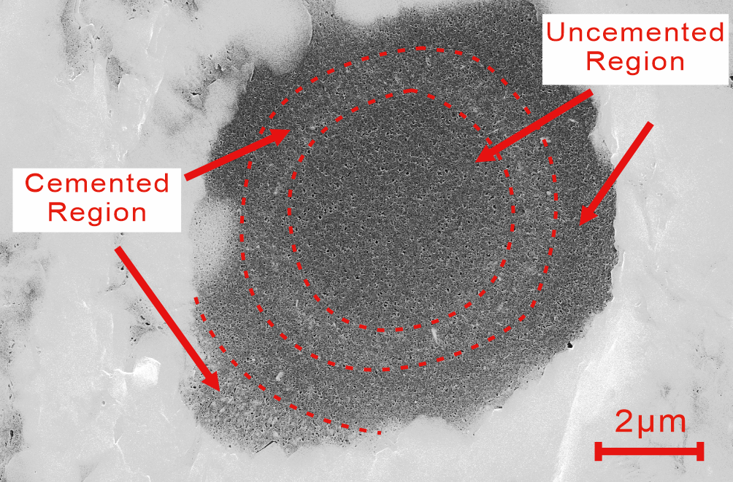
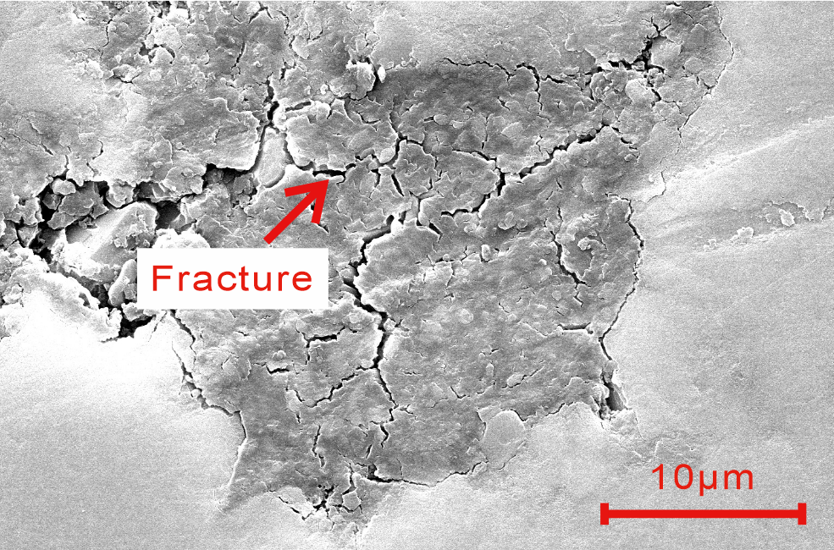
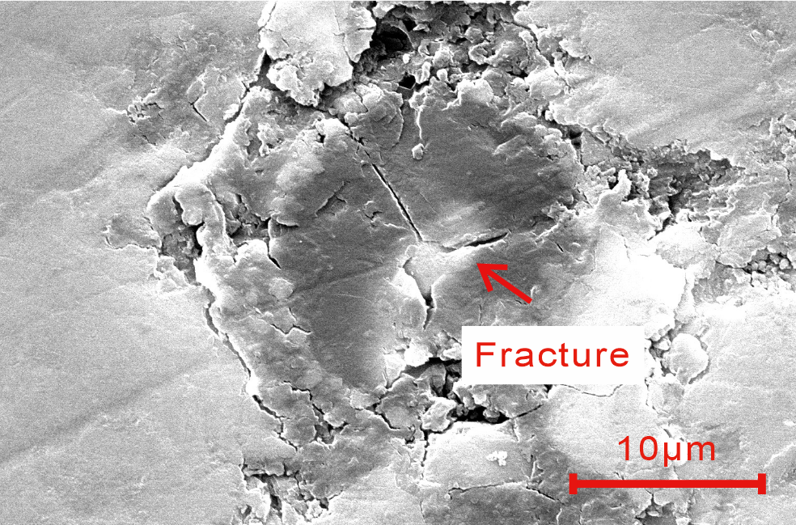
4. Diagenetic alteration constrains organic pore preservation
Cemented zones: Reduced organic pore abundance
Quantified pore occlusion by cementation and bitumen infilling
Unicellular planktonic algae affected by partial cementation (XBX-2)
After extraction, new microfractures and pores were released within the organic matter
Pore size distribution of initial, extracted, and acidified samples (XBX-7 & XBX-8)
Notes:
In addition to biological precursor types, post-depositional diagenetic modification also exerts a decisive influence on pore preservation.
First, looking at the upper-left panel: cementation significantly reduces pore abundance; the pore area ratio in cemented zones is much lower than in uncemented zones. This is the first cause of pore loss.
Second, referring to the lower-left panel: after extraction experiments, the organic matter volume shrinks, and pores and micro-fractures previously filled by bitumen reappear. This indicates that bitumen filling is the second important cause of pore loss.
Finally, examine the pore size distribution plot on the right. The blue portion represents the pore volume of the natural sample, while the orange and gray portions represent the pore volumes of extracted and acidified samples, respectively. By removing bitumen filling and calcite cementation, we have quantified the destructive effects of diagenetic modification on pores. Cementation affected over 70% of the pores, while bitumen filled 7–12% of them. This demonstrates that intense post-depositional modification has offset the pore-volume advantage brought by the extremely high TOC content.

Slide 11
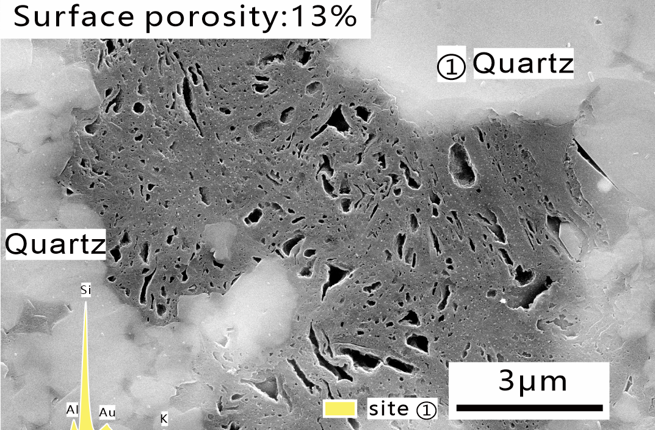
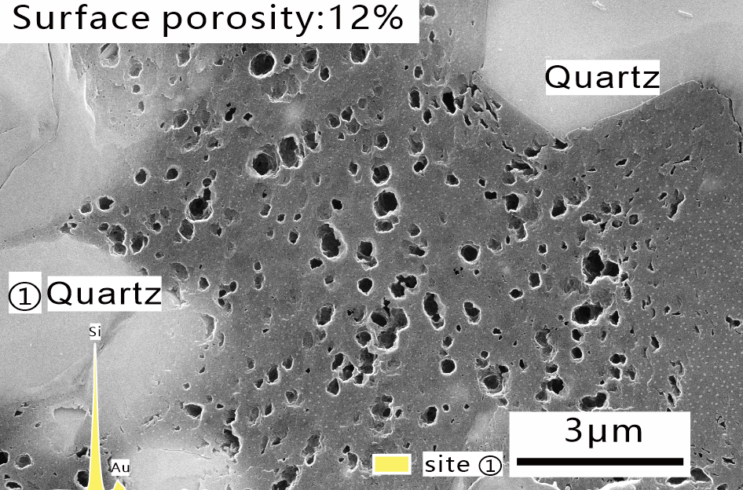
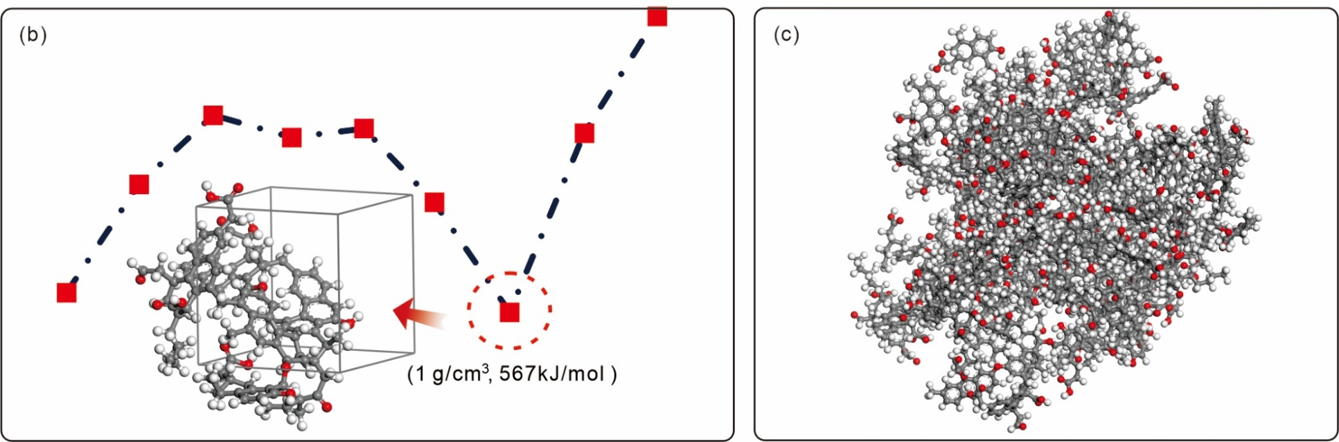
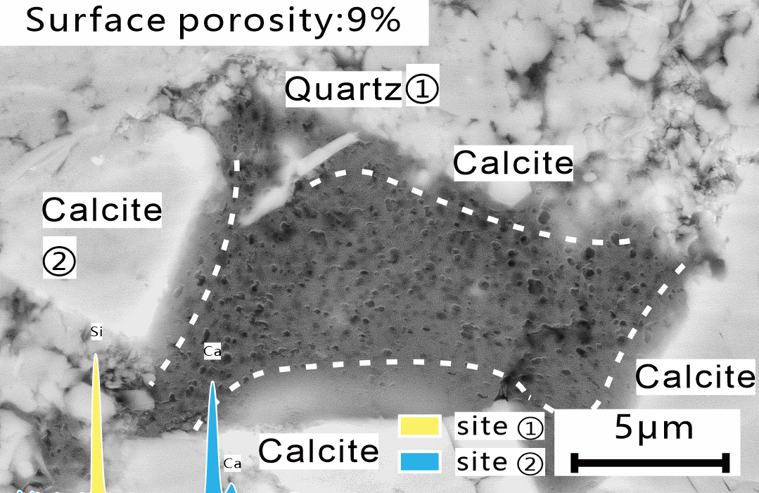
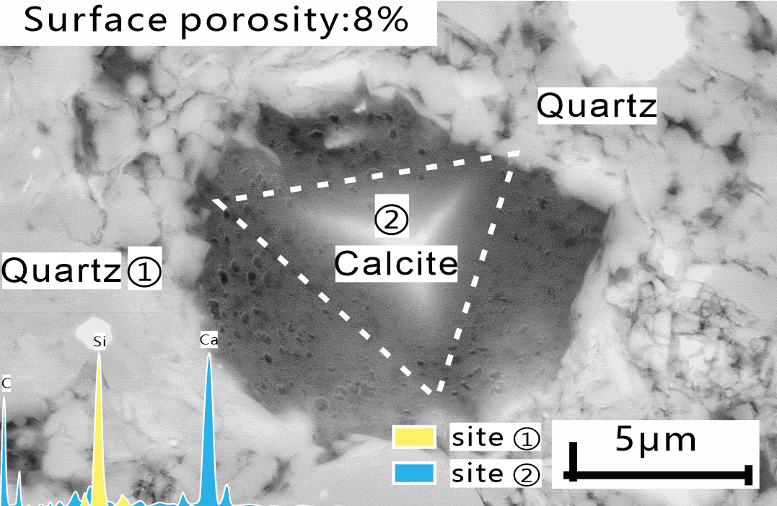
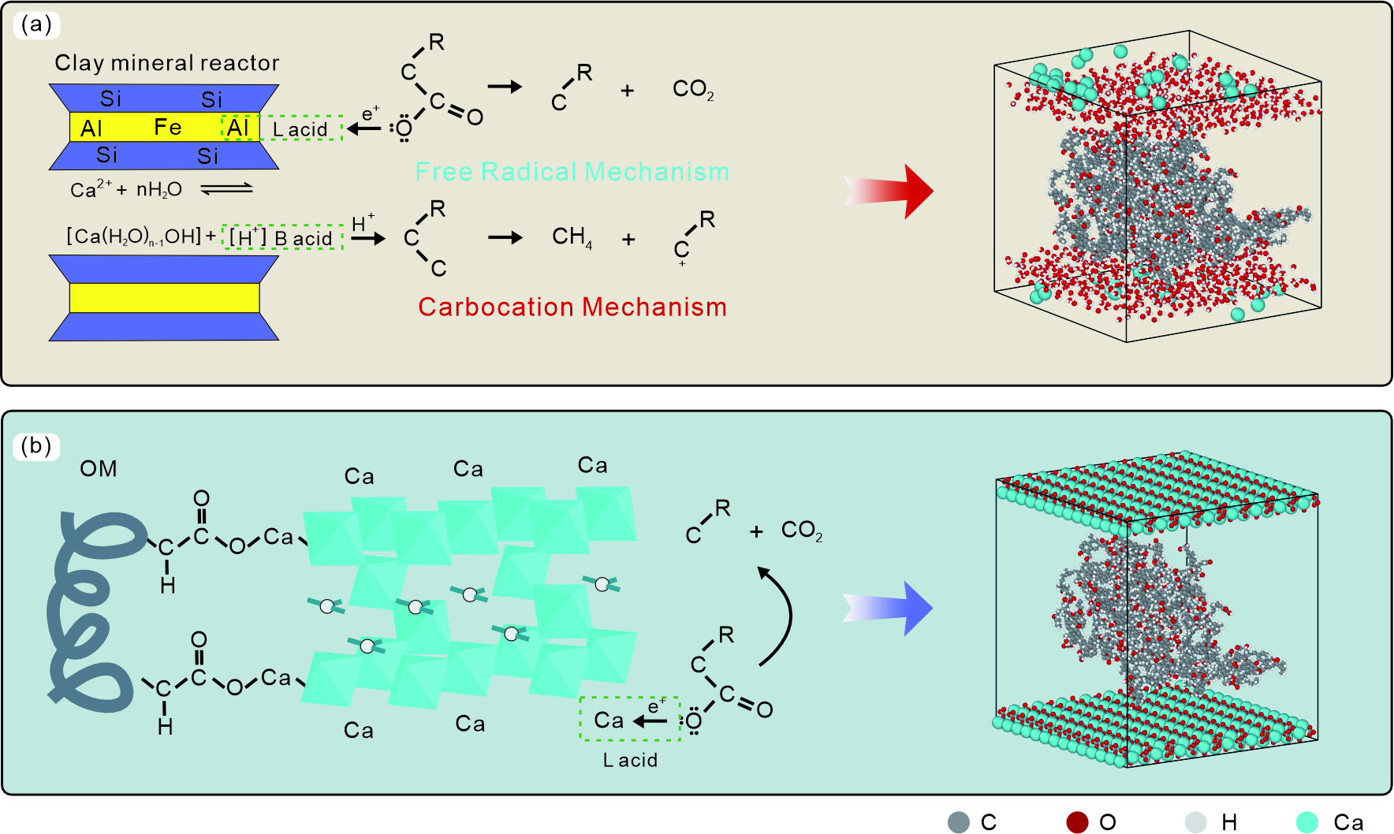
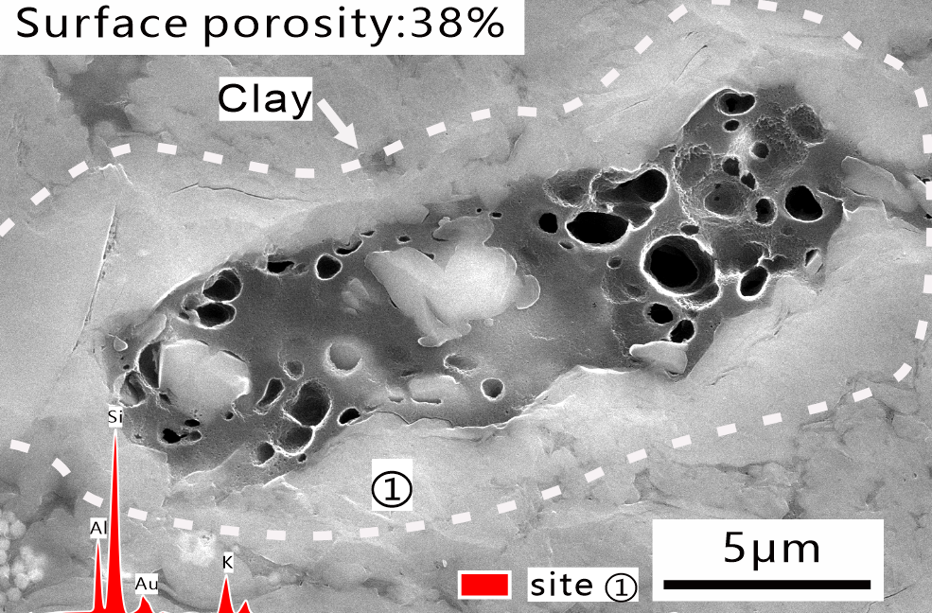
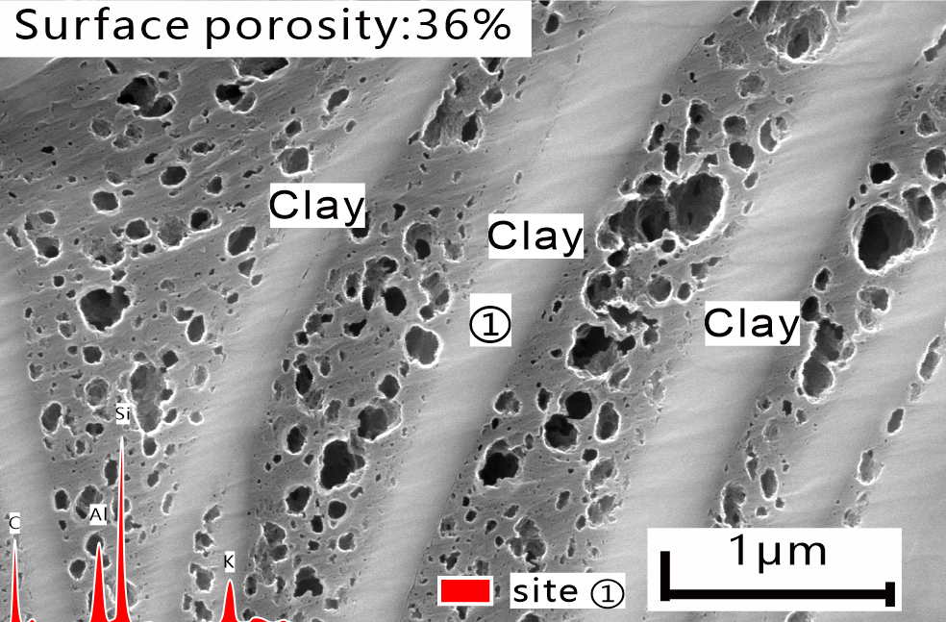
4. Mineral-organic reactions regulate pore generation efficiency
Quartz
Calcite
Clay
Notes:
A notable feature of the Gufeng Formation shale is its extremely high carbonate mineral content, which clearly distinguishes it from shales in the mainstream successions. Does mineralogy, then, influence organic pore development?
We observed the pore development of organic matter in contact with different minerals under SEM. When in contact with quartz, the porosity is only about 12%; with calcite, it drops further to about 8%; but with clay minerals, the porosity reaches as high as 36%.
These observations indicate that inorganic minerals significantly affect the pore development of the associated organic matter. To clarify the micro-mechanisms of mineral–organic interactions, we established a molecular model of Gufeng Member kerogen, constructed two types of pyrolysis environments—with clay minerals and with calcite—and performed numerical pyrolysis simulations based on ReaxFF.

Slide 12
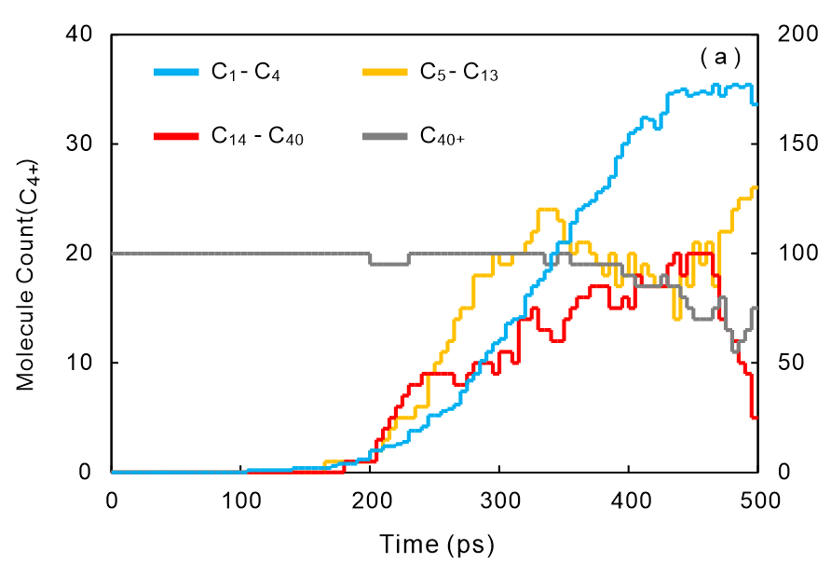
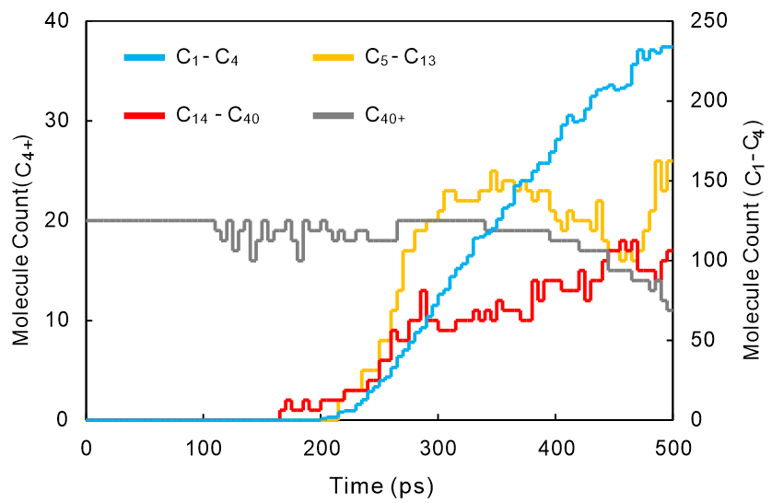
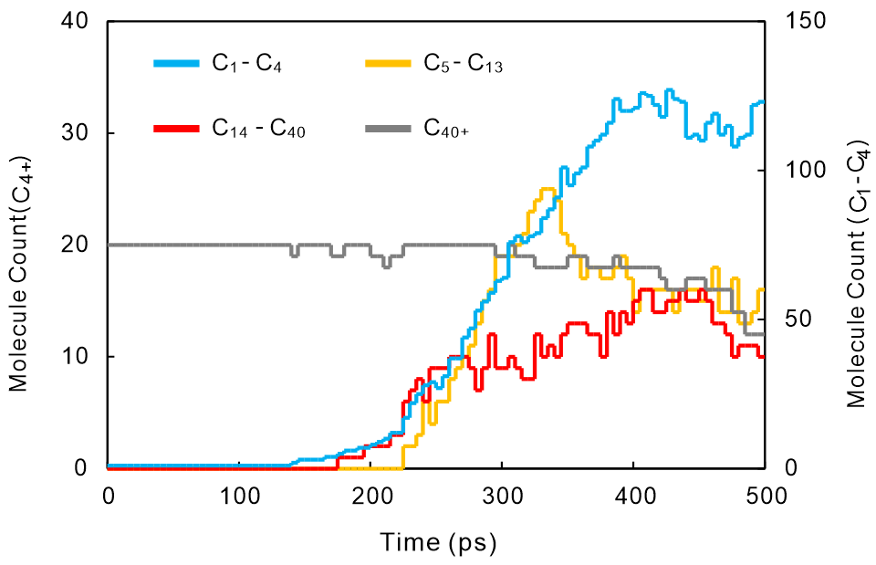
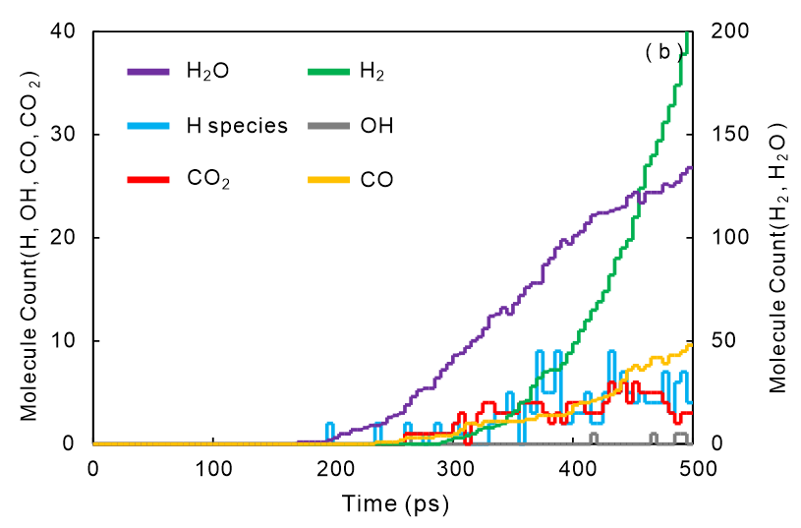
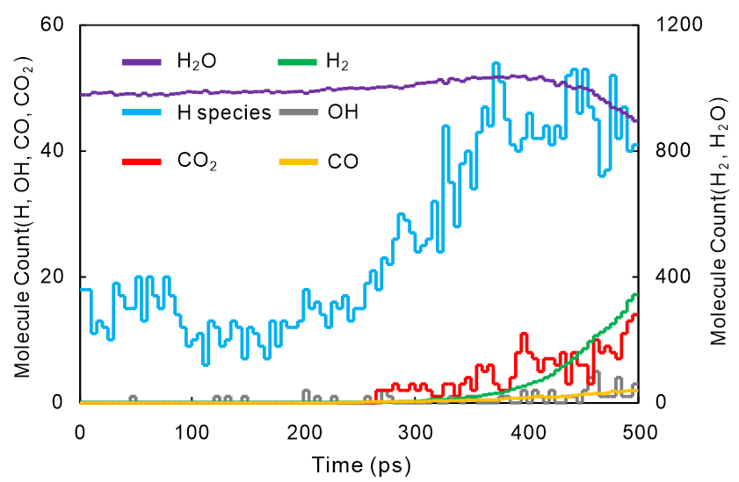
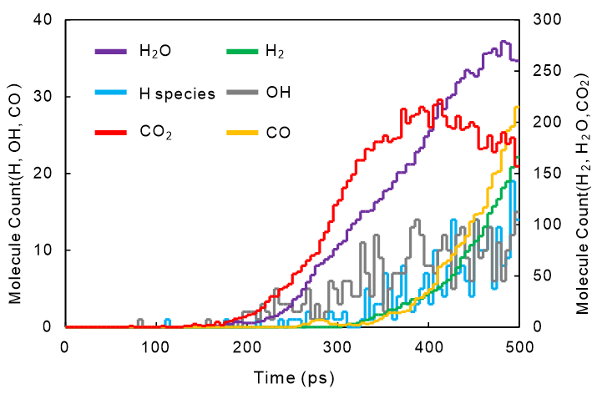
4. Mineral-organic reactions regulate pore generation efficiency
Pyrolysis in Pure Kerogen
Pyrolysis in Clay Minerals
Pyrolysis in Calcite
Moderate hydrocarbon
Moderate non-hydrocarbon yields
Lowest free H yield
Highest hydrocarbon yield
Lowest non-hydrocarbon yield
Lowest free H yield
Lowest hydrocarbon yield
Highest non-hydrocarbon yield
Moderate free H yield
Hydrocarbons
Hydrocarbons
Hydrocarbons
Non-hydrocarbons
Non-hydrocarbons
Non-hydrocarbons
Notes:
The numerical simulation results explain the regulatory mechanisms of minerals on the hydrocarbon generation process of organic matter. In the clay mineral interlayer environment, the hydrocarbon product content is the highest, non-hydrocarbon products are the fewest, and the free hydrogen content—serving as an indicator of system reactivity—is the highest. In contrast, during pyrolysis in the calcite environment, the hydrocarbon product content is the lowest, non-hydrocarbon products are the most abundant, and the free hydrogen content is moderately low. So, what specific mechanisms influence the pyrolysis products of our organic matter?

Slide 13
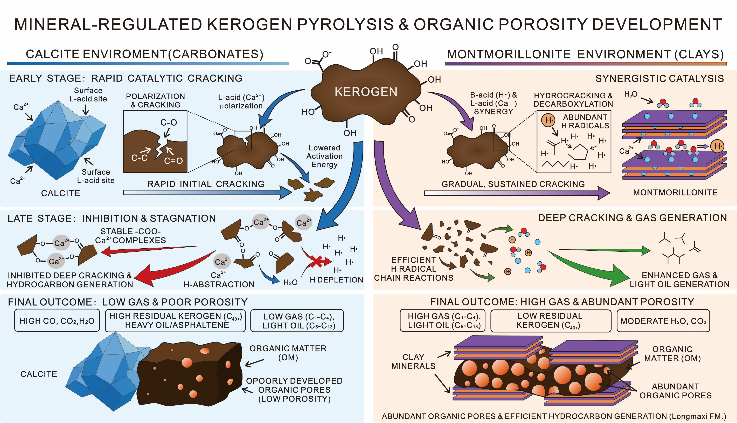
4. Mineral-organic reactions regulate pore generation efficiency
Notes:
In the calcite environment, during the oil generation stage, Ca²⁺ ions mainly act as Lewis acids, promoting the cleavage of polar chemical bonds in kerogen and generating abundant bitumen. However, in the gas generation stage, Ca²⁺ ions form stable complexes with bitumen, hindering its further cracking into gas. Meanwhile, Ca²⁺ ions also induce hydrogen from the organic matter into inorganic products, resulting in a scarcity of free hydrogen within the pyrolysis system, which is unfavorable for the hydrogenation reactions required for gaseous hydrocarbon generation. Consequently, organic matter pyrolysis is relatively retarded, producing more bitumen and non-hydrocarbons, following an "oil-rich, gas-poor" pyrolysis pathway with poorly developed organic pores.
In the clay mineral environment, although pyrolysis initiates more slowly, the interlayer hydrated cations provide abundant free hydrogen. This free hydrogen participates in the deep cracking during the gas generation stage, producing more gaseous hydrocarbons and following a "gas-rich, porous" pyrolysis pathway, where organic pores are more fully developed.

Slide 14
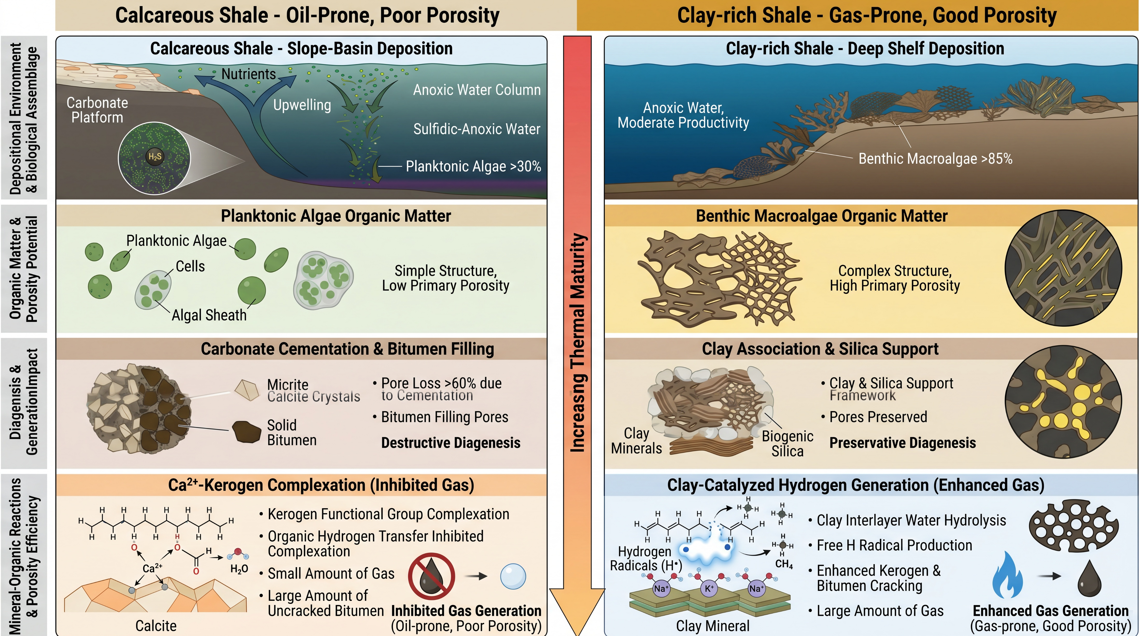
4. Organic Pore Evolution Models
Notes:
Based on the above research, we have summarized the organic pore development model as influenced by the mineral environment.
On the left is the calcareous shale. Deposited in a carbonate platform margin slope environment and influenced by the water mass and upwelling, its planktonic algae content exceeds 30%, resulting in low pore volume. During diagenesis, intense cementation and abundant bitumen generation destroyed 70% and 12% of the pores, respectively. Due to the extremely high calcite content, gaseous hydrocarbon generation was suppressed, leading to an "oil-rich, gas-poor" outcome with poor pore development.
On the right is the clay-rich shale. Deposited in a deep-water shelf environment, its large benthic algae content exceeds 85%, giving it inherently high porosity. Subsequently, relatively weak diagenesis primarily formed a supportive framework that effectively preserved the pores. Finally, the moderate clay mineral content enhanced the cracking efficiency of organic matter into gas, ultimately forming a "gas-rich, well-developed pore" high-quality reservoir.

Slide 15
5. Conclusions and Implications
Pore evolution model of calcareous shale
Depositional environment
Biological precursors
Initial pore volume
Diagenetic alteration
Mineral-organic reactions
Organic pore development
Calcareous shale (Gufeng Fm.): Oil-rich, gas-poor, low pore abundance
Clayey shale (Longmaxi Fm.): Gas-rich, porous, high pore abundance
Platform-slope facies → Planktonic algae >30%
Low pore-forming potential (simple biological structure)
Early cementation → >60% loss of meso- and macropores
Bitumen filling → 7-12% loss of micropores
Ca²⁺ complexation & hydrogen abstraction → Free H scarcity → Gaseous hydrocarbons only 123 units
→ Pore volume 0.002-0.004 cm³/g
Deep-water shelf facies → Benthic algae >85%
High pore-forming potential (complex biological structure)
Rigid biogenic silica framework protects pores
Clay adsorption & catalysis → Abundant free H (44 units)
Synergy of Brønsted & Lewis acids → Gaseous hydrocarbons up to 234 units
→ Pore volume 0.015-0.021 cm³/g
15
Notes:
Integrating the above findings, we have established a pore evolution model for calcareous shale that couples depositional environment, hydrocarbon-generating organism composition, diagenetic alteration, and mineral-organic reactions. This model systematically explains the origin of low porosity in high-TOC calcareous shale, provides a new theoretical perspective for the reservoir evaluation of carbonate source rocks, and holds important guiding significance for the deployment of Permian shale gas exploration in the Sichuan Basin.

Slide 16
Thanks!

