Slide 1

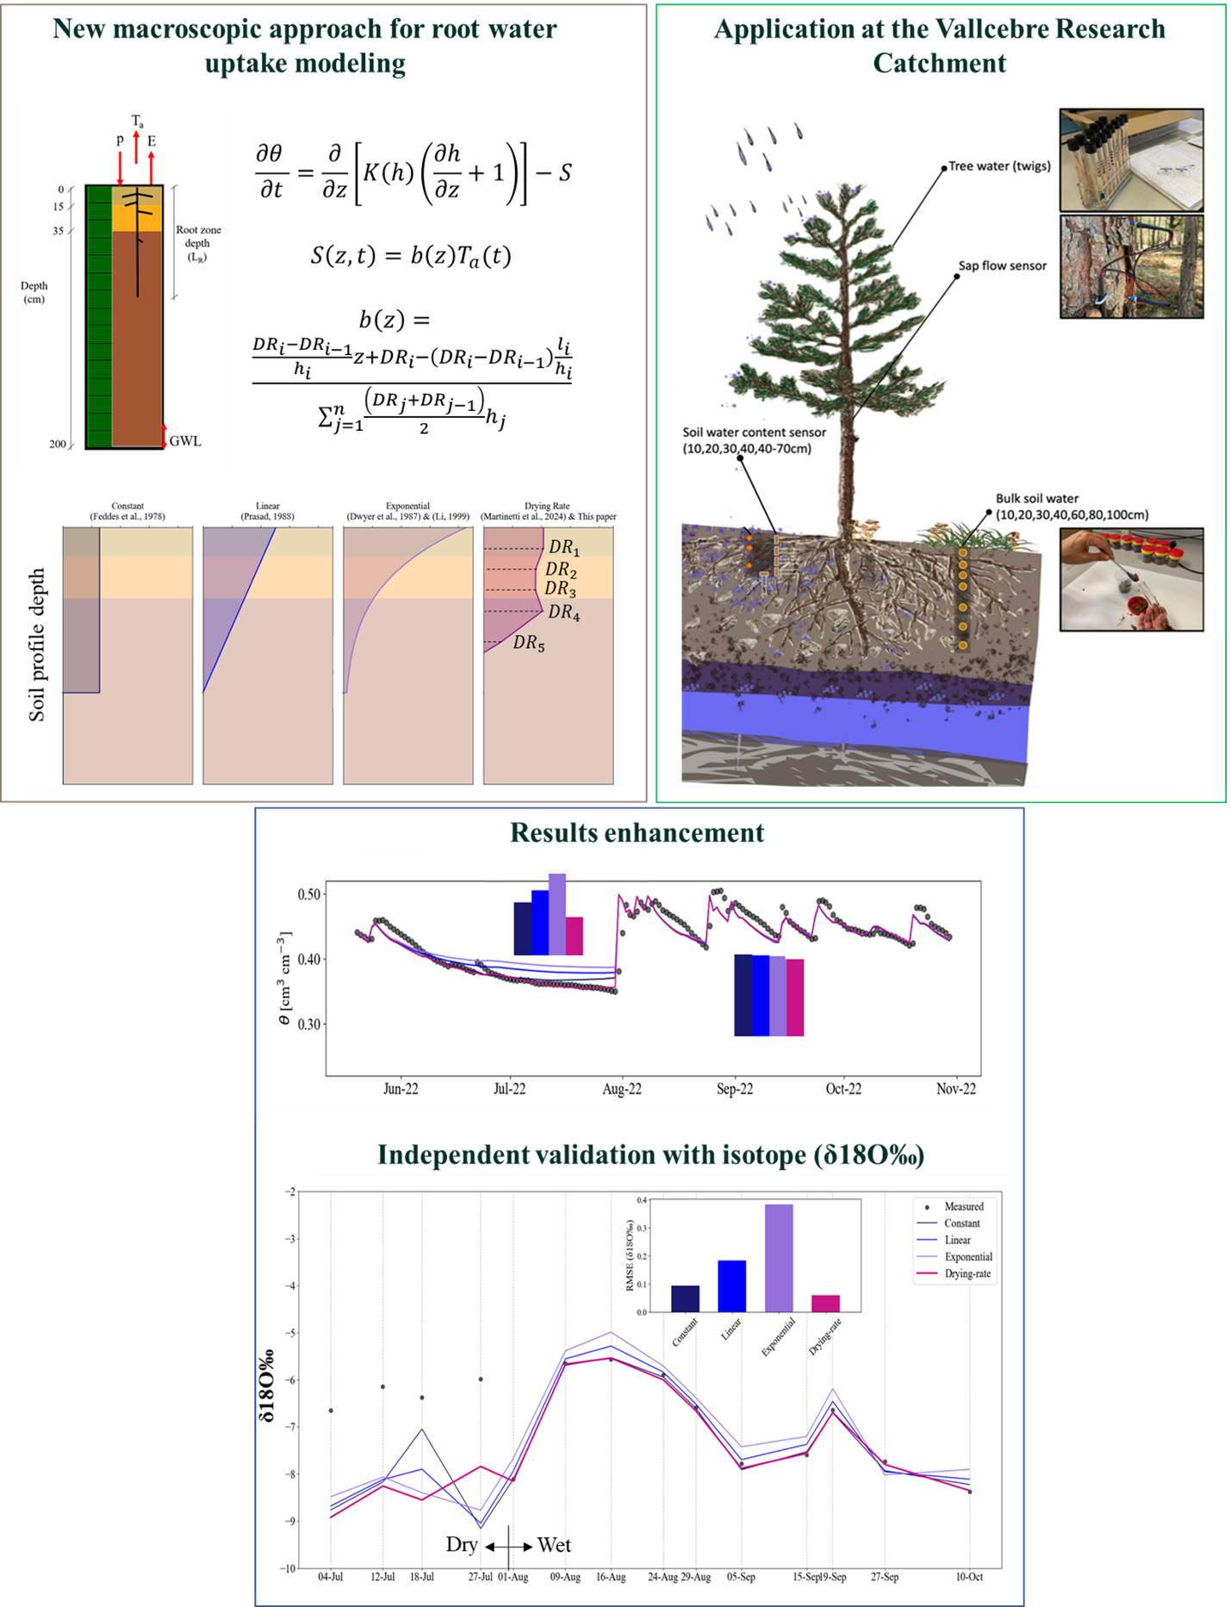





May 21, 2026
Abstract ID:950
Field data driven root density distribution to enhance tree water uptake predictions in numerical models
Loujain Alharfouch
Joaquin Jimenez-Martinez, Marius G. Floriancic,
J.A. Castro-Lopez, Pilar Llorens, Jérôme Latron and Juan J. Hidalgo
loujain.a@csic.es

Slide 2
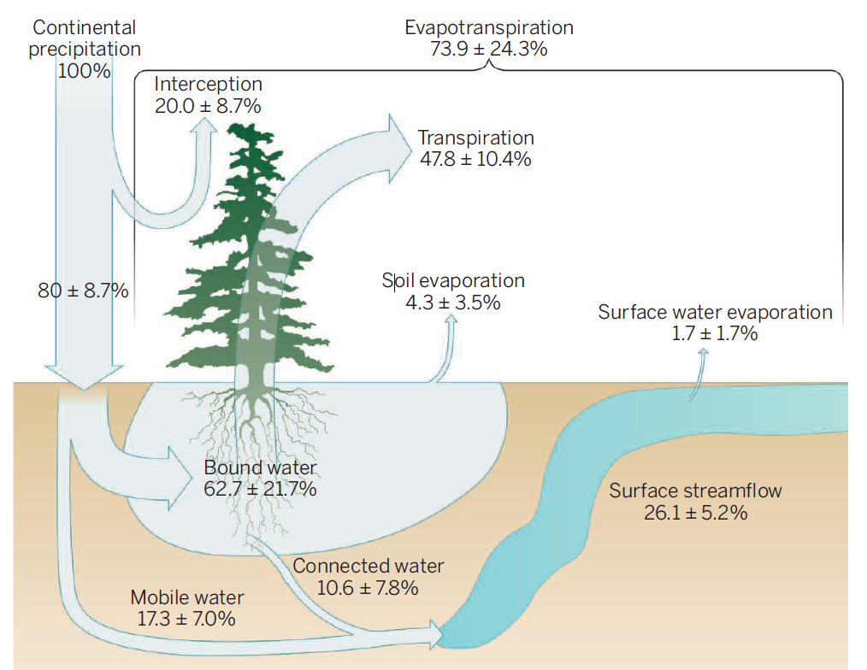
Root water uptake
A critical but uncertain process in ecohydrological models
Continental
precipitation
100%
Roots couple the aboveground vegetation with the subsurface water reservoir
Transpiration returns nearly half of continental precipitation back to the atmosphere (~48%)
Transpiration
47.8±10.4%
RWU
Global hydrologic fluxes inferred from global water isotope data (Adapted from Brooks (2015), based on Good et al. (2015))
Interpore2026
Loujain Alharfouch
1/10

Slide 3
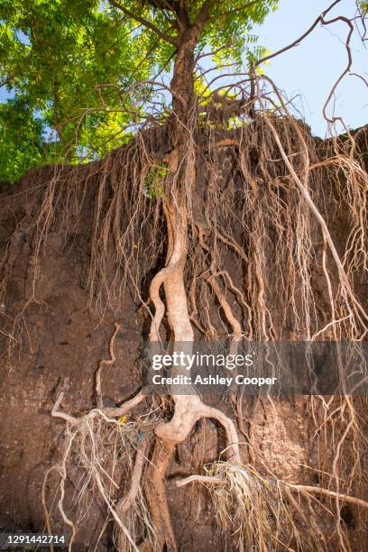
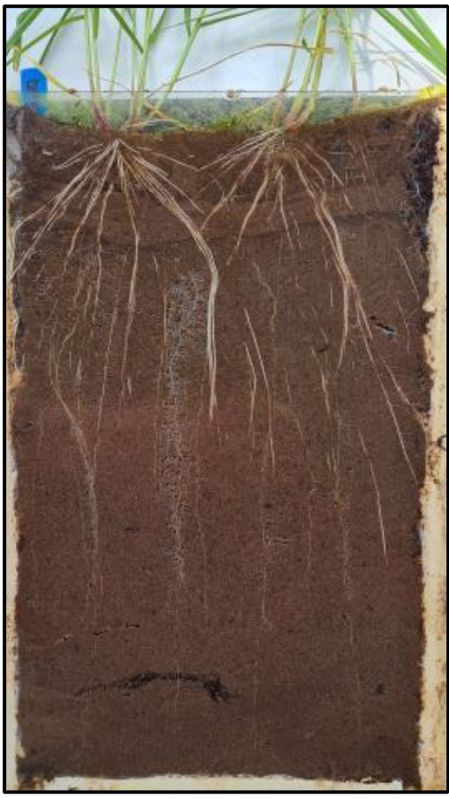
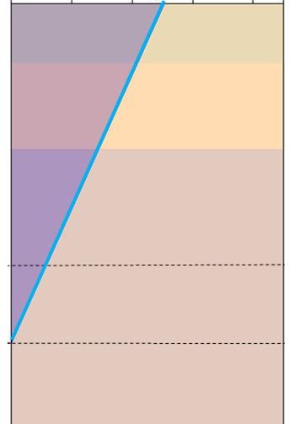
Root water uptake
A critical but uncertain process in ecohydrological models
Continental
precipitation
100%
Roots couple the aboveground vegetation with the subsurface water reservoir
Transpiration returns nearly half of continental precipitation back to the atmosphere (~48%)
Modelling root water uptake remains a challenge
Transpiration
47.8±10.4%
A classic root density distribution
Non-uniform root distribution?
RWU
Soil layers effect?
Global hydrologic fluxes inferred from global water isotope data (Adapted from Brooks (2015), based on Good et al. (2015))
Interpore2026
Loujain Alharfouch
1/10

Slide 4
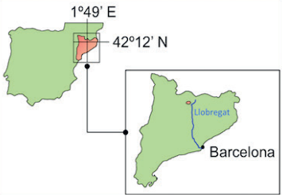
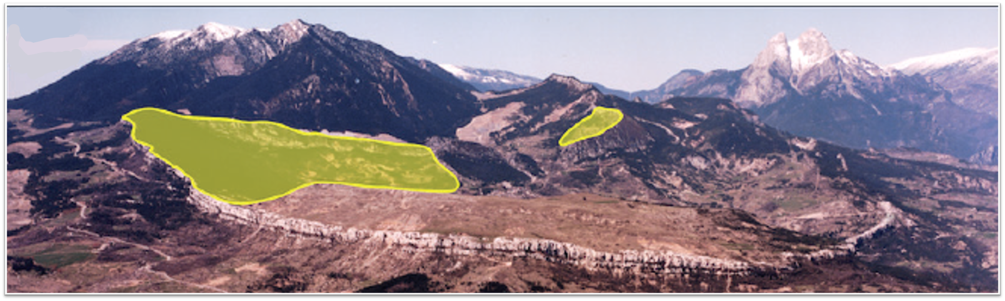
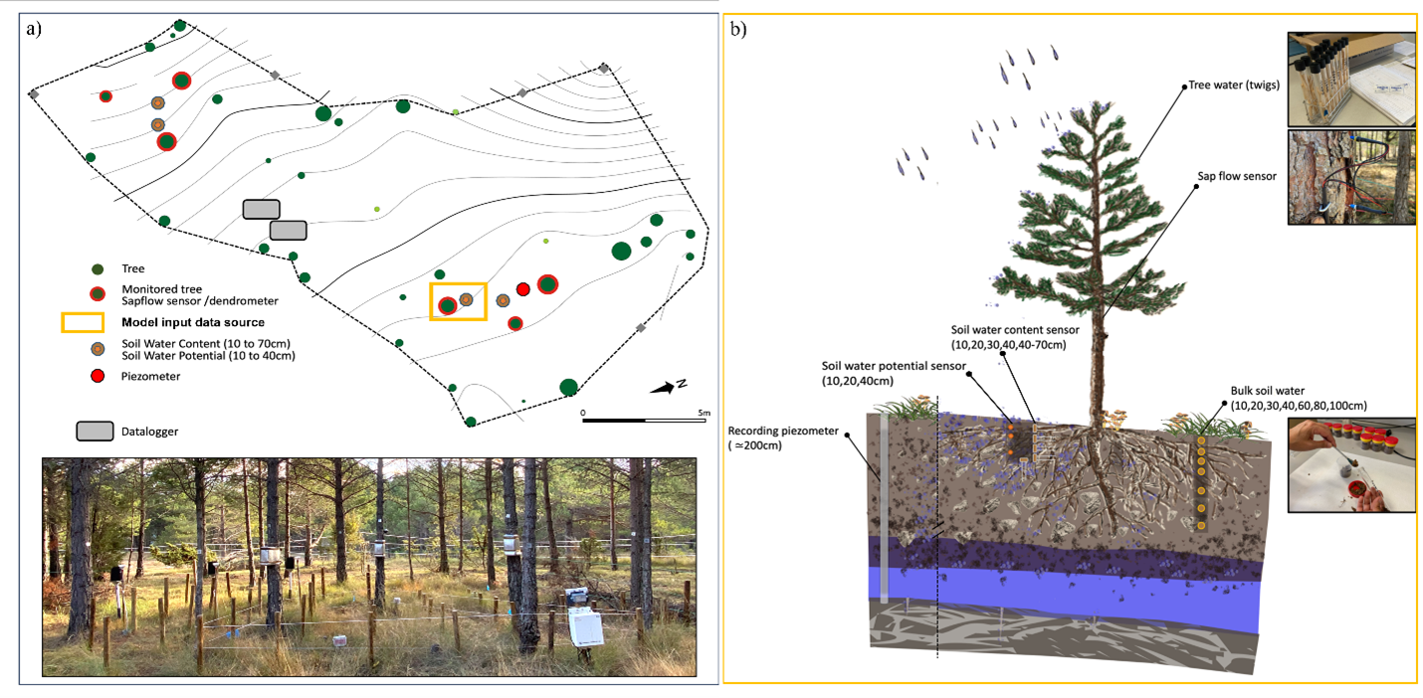
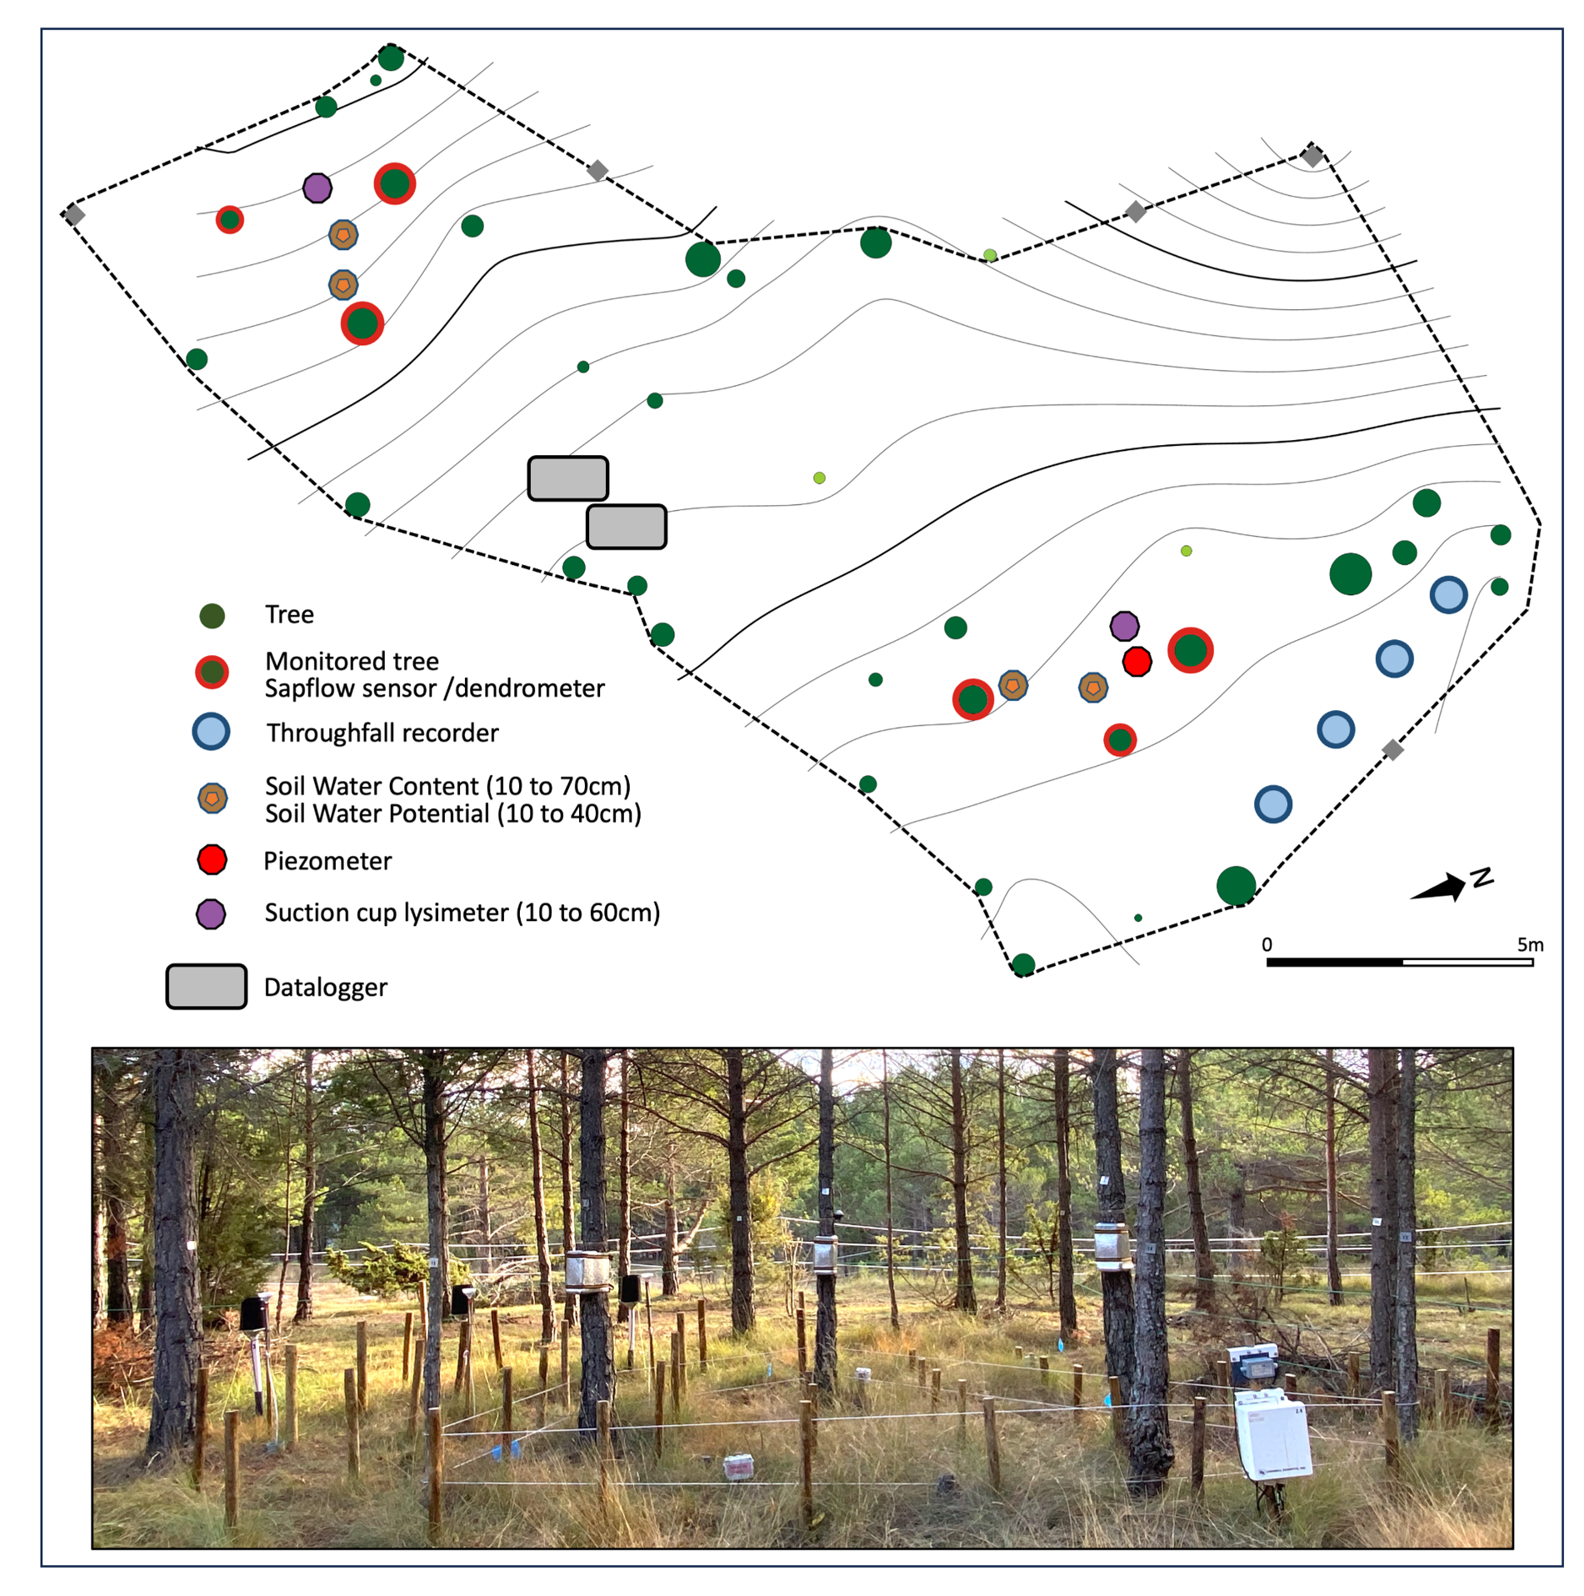
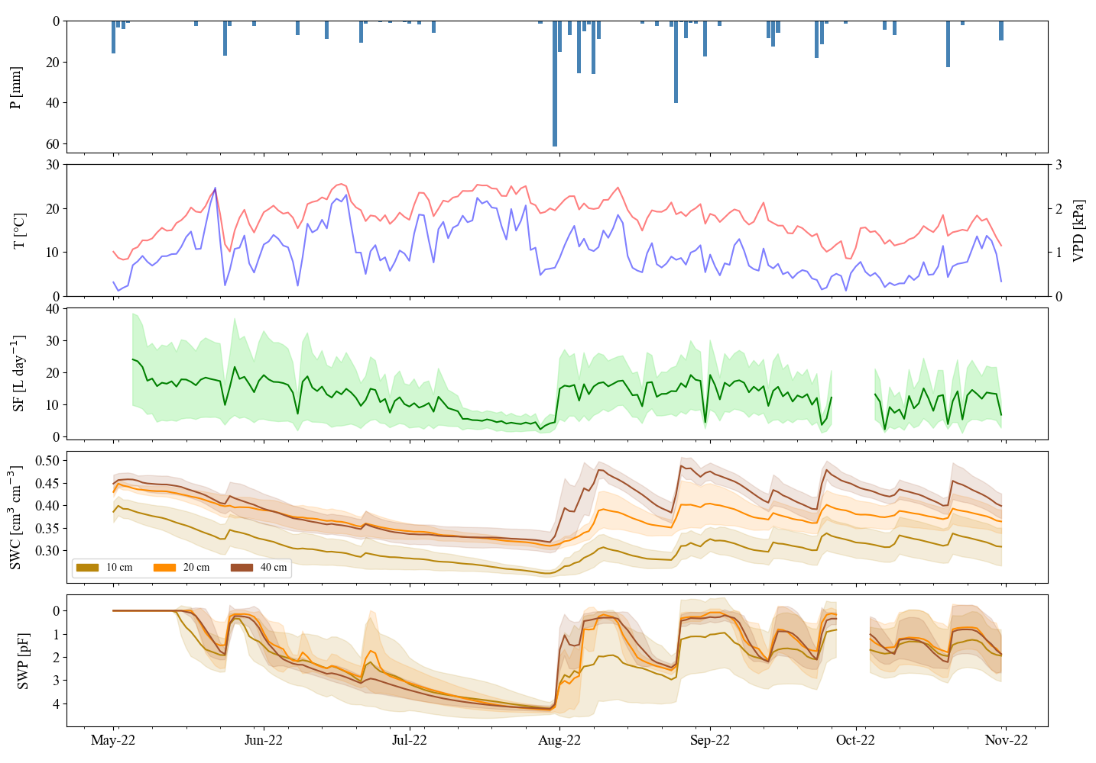
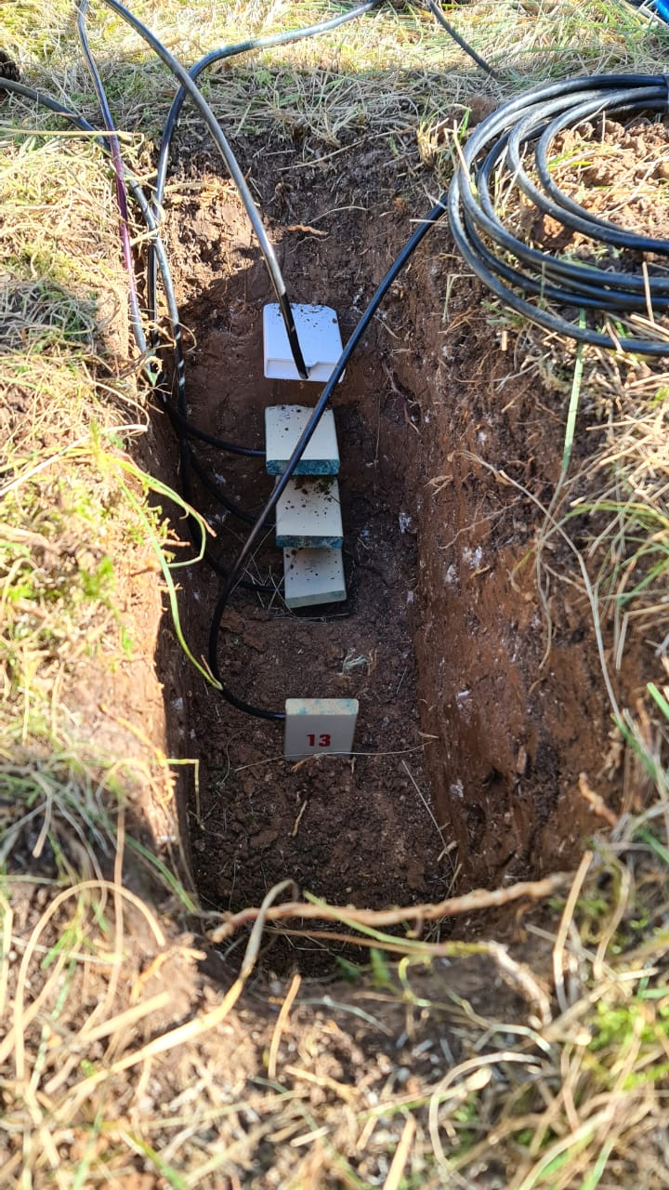
Field data
Vallcebre research catchment, NE Spain
Spain
Our experimental plot is here
at 1300 m a.s.l.
Field work goodies!
- Meteorological data
- Physiological data
- Soil hydraulic properties
- Stable isotopes of water
P [mm]
Temperature [⸰C]
Sap flow [L day⁻¹]
θ [cm³ cm⁻³]
Log₁₀(∣h∣)
May
October-2022
Interpore2026
Loujain Alharfouch
2/10

Slide 5
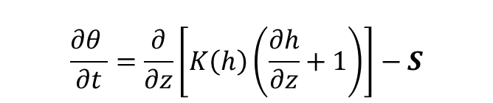
Modelling approach
Solving the water balance in the unsaturated zone
1D Richards equation
$$\frac{∂θ }{∂t}=\frac{∂}{∂z}\left[K\left(h\right)\left(\frac{∂h}{∂z}+1\right)\right]−S$$
Interpore2026
Loujain Alharfouch
3/10

Slide 6
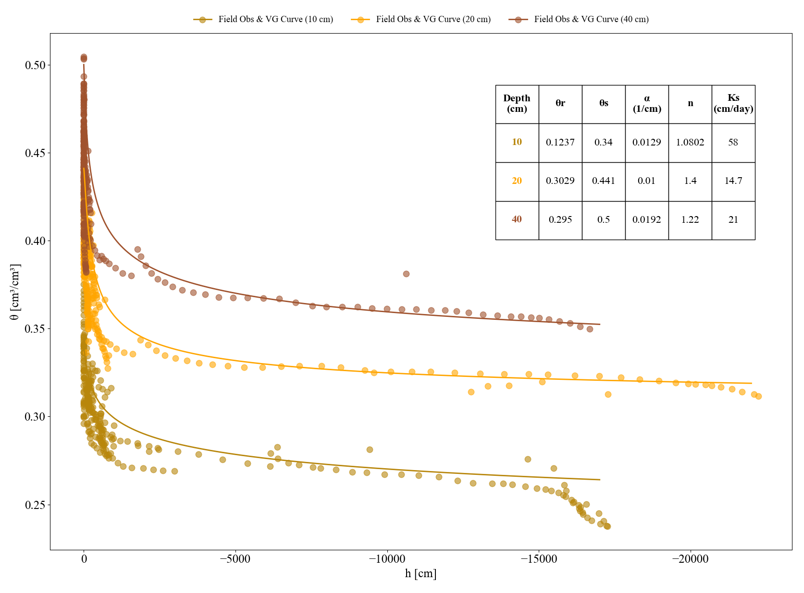
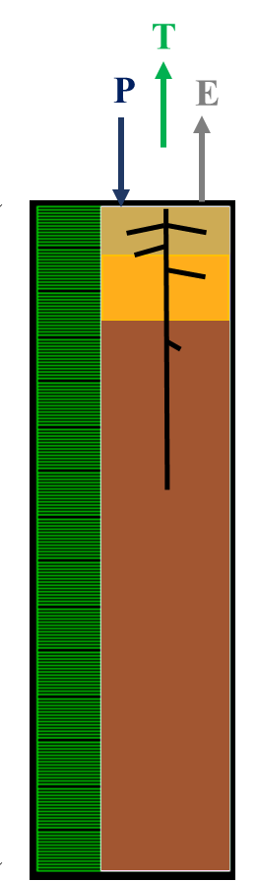
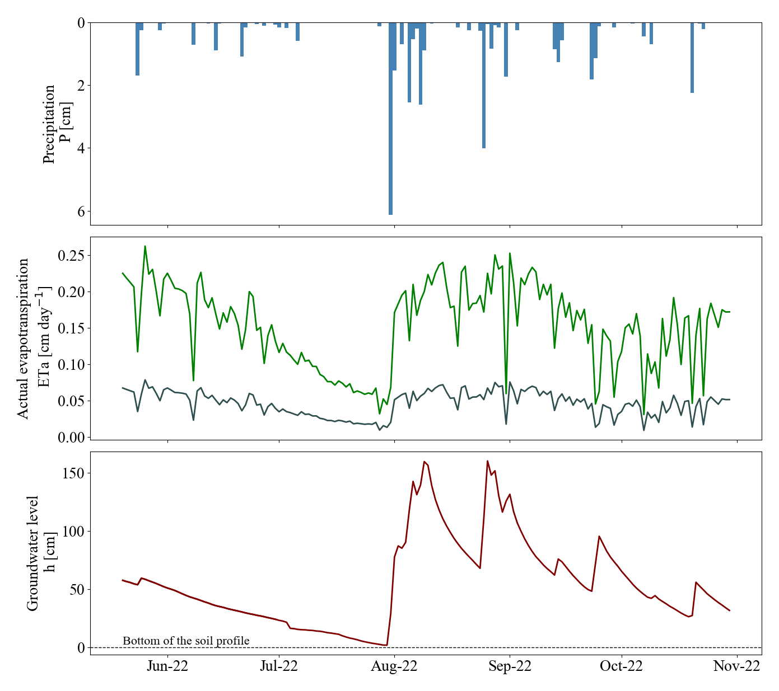
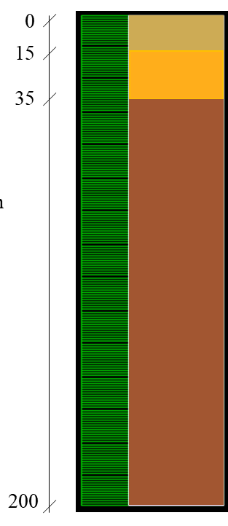
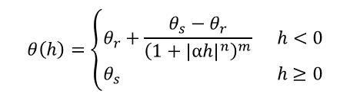
Modelling approach
Solving the water balance in the unsaturated zone
1D Richards equation
$$\frac{∂θ }{∂t}=\frac{∂}{∂z}\left[K\left(h\right)\left(\frac{∂h}{∂z}+1\right)\right]−S$$
Soil water retention curve parameters
T_{a}
Upper and lower BC
$$θ\left(h\right)=\left\{\begin{aligned}&θ_{r}+\frac{θ_{s}−θ_{r}}{{\left(1+{\left|αh\right|}^{n}\right)}^{m}} h<0 \\ &θ_{s} h≥0\end{aligned}\right.$$
P [cm]
(van Genuchten, 1980)
ET_{a}[cm day⁻¹]
Soil profile depth [cm]
Lower layer
θ
Intermediate layer
Top layer
h_{lower}[cm]
h_{lower}
h [cm]
Interpore2026
Loujain Alharfouch
3/10

Slide 7
Modelling approach
Solving the water balance in the unsaturated zone
1D Richards equation
$$\frac{∂θ }{∂t}=\frac{∂}{∂z}\left[K\left(h\right)\left(\frac{∂h}{∂z}+1\right)\right]−S$$
Soil water retention curve parameters
T_{a}
Upper and lower BC
$$θ\left(h\right)=\left\{\begin{aligned}&θ_{r}+\frac{θ_{s}−θ_{r}}{{\left(1+{\left|αh\right|}^{n}\right)}^{m}} h<0 \\ &θ_{s} h≥0\end{aligned}\right.$$
P [cm]
(van Genuchten, 1980)
ET_{a}[cm day⁻¹]
Soil profile depth [cm]
Lower layer
θ
Intermediate layer
Top layer
h_{lower}[cm]
h_{lower}
h [cm]
Interpore2026
Loujain Alharfouch
3/10

Slide 8
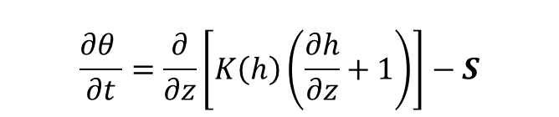
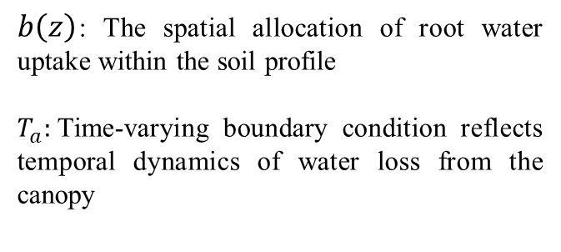

Modelling approach
The sink term components
$$\frac{∂θ }{∂t}=\frac{∂}{∂z}\left[K\left(h\right)\left(\frac{∂h}{∂z}+1\right)\right]−S$$
$$S\left(z,t\right)= b\left(z\right)T_{a}\left(t\right)$$
$b\left(z\right)$: The spatial allocation of root water uptake within the soil profile
$T_{a}:$Time-varying boundary condition reflects temporal dynamics of water loss from the canopy
Interpore2026
Loujain Alharfouch
4/10

Slide 9
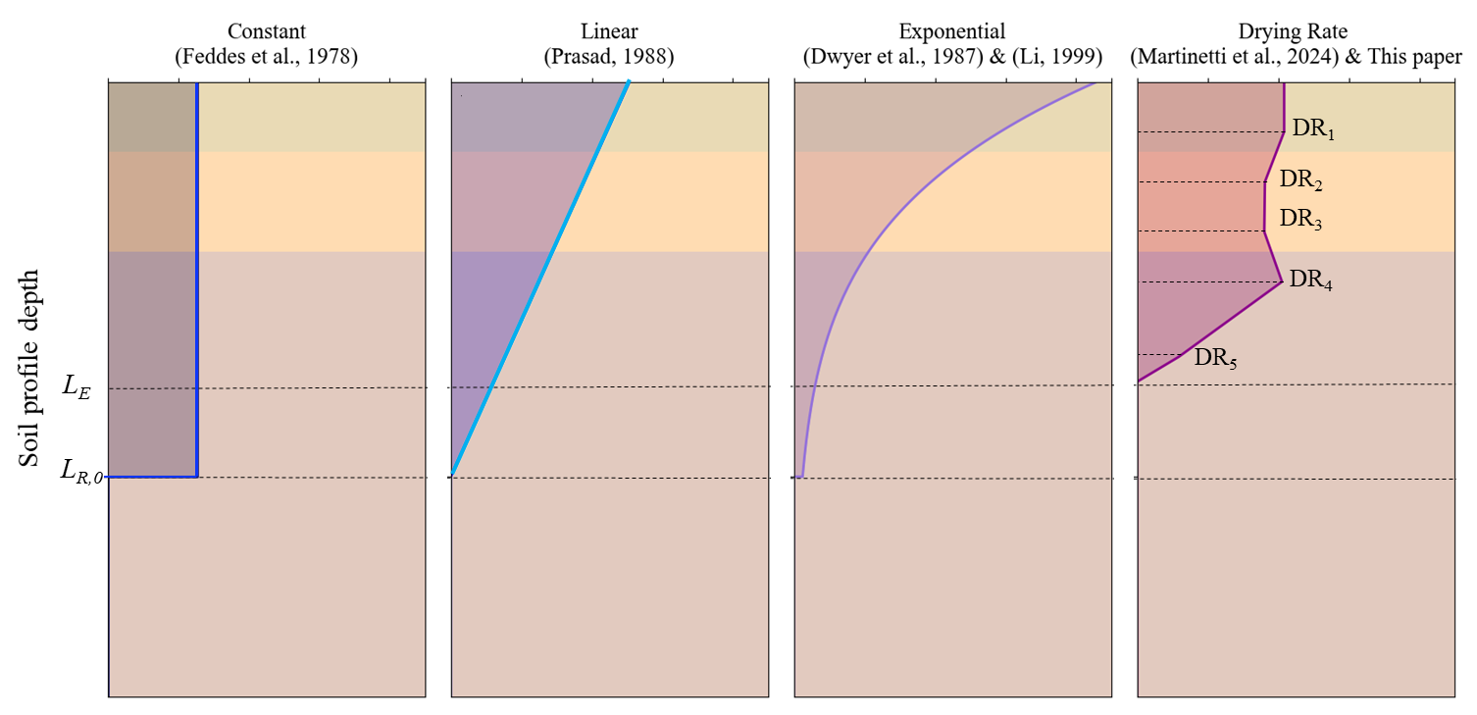

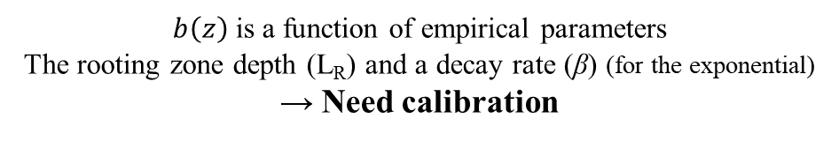



Modelling approach
The sink term components: $b\left(z\right)$
Classical $b\left(z\right)$
New $b\left(z\right)$
$$\frac{∂θ }{∂t}=\frac{∂}{∂z}\left[K\left(h\right)\left(\frac{∂h}{∂z}+1\right)\right]−S$$
$$S\left(z,t\right)= b\left(z\right)T_{a}\left(t\right)$$
$b\left(z\right)$: The spatial allocation of root water uptake within the soil profile
$T_{a}:$Time-varying boundary condition reflects temporal dynamics of water loss from the canopy
$b\left(z\right)$ is a function of empirical parameters
The rooting zone depth (L_{R}) and a decay rate (β) (for the exponential)
→ Need calibration
Not needed 😏
Interpore2026
Loujain Alharfouch
5/10

Slide 10

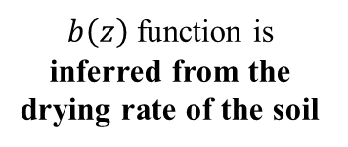
Modelling approach
The sink term components: $b\left(z\right)$
Classical $b\left(z\right)$
New $b\left(z\right)$
$$\frac{∂θ }{∂t}=\frac{∂}{∂z}\left[K\left(h\right)\left(\frac{∂h}{∂z}+1\right)\right]−S$$
$$S\left(z,t\right)= b\left(z\right)T_{a}\left(t\right)$$
$b\left(z\right)$: The spatial allocation of root water uptake within the soil profile
$T_{a}:$Time-varying boundary condition reflects temporal dynamics of water loss from the canopy
$b\left(z\right)$ is a function of empirical parameters
The rooting zone depth (L_{R}) and a decay rate (β) (for the exponential)
→ Need calibration
$b\left(z\right)$ function is inferred from the drying rate of the soil
Interpore2026
Loujain Alharfouch
5/10

Slide 11
Modelling approach
Depth-dependent root activity from temporal variations in θ profile
The assumption
  The soil layers with higher drying rates correspond to zones of greater root water uptake
    A proxy for a functional root density distribution
Interpore2026
Loujain Alharfouch
6/10

Slide 12
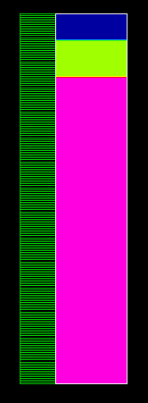
Modelling approach
Depth-dependent root activity from temporal variations in θ profile
The assumption
  The soil layers with higher drying rates correspond to zones of greater root water uptake
    A proxy for a functional root density distribution
Soil water content (θ)
sensors
10 cm
20 cm
30 cm
40 cm
55 cm
Interpore2026
Loujain Alharfouch
6/10

Slide 13
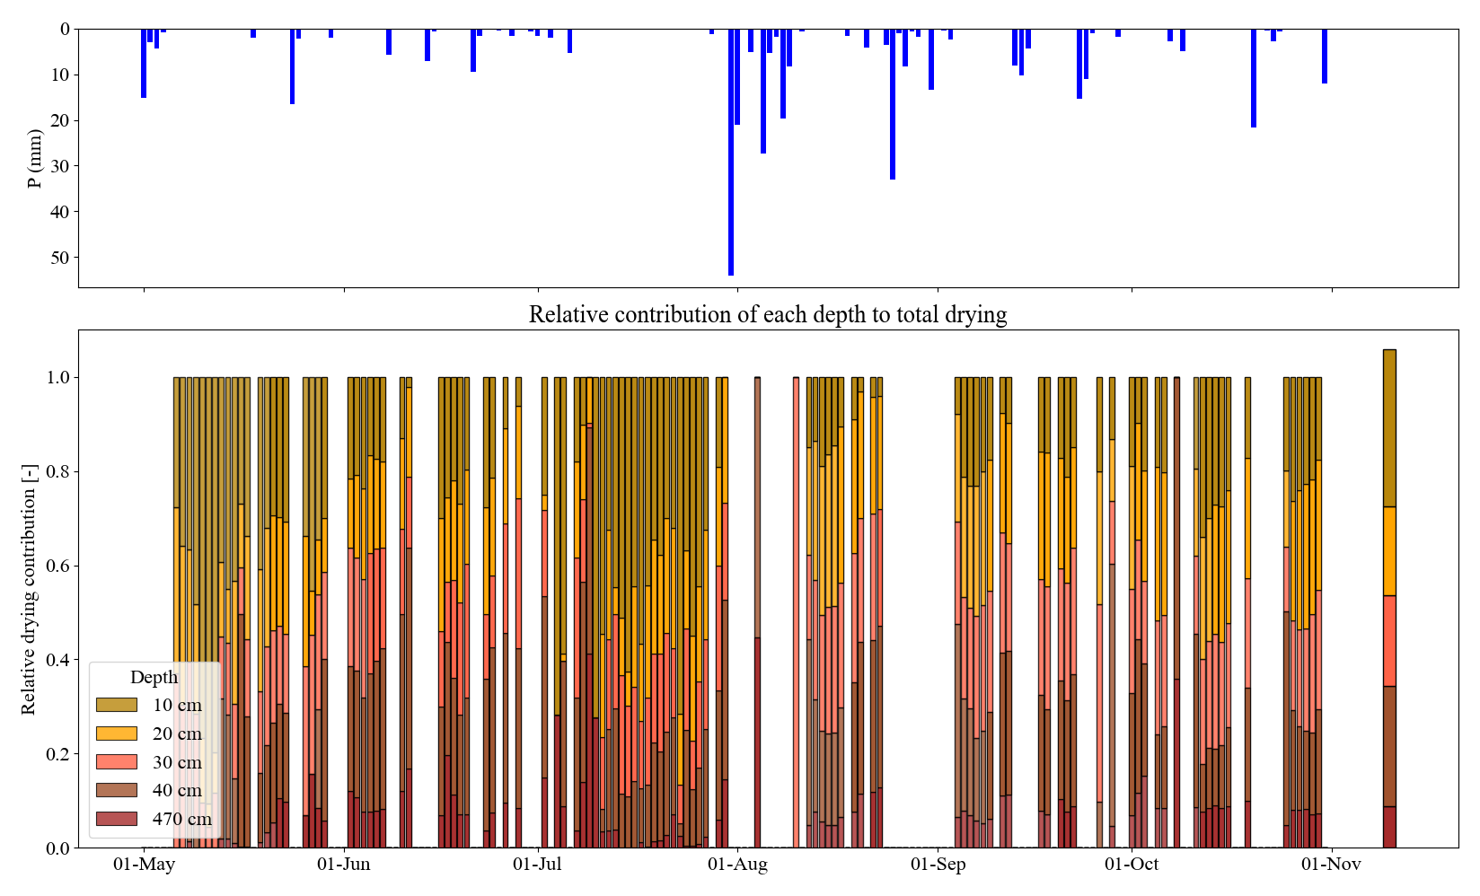
Modelling approach
Depth-dependent root activity from temporal variations in θ profile
The assumption
  The soil layers with higher drying rates correspond to zones of greater root water uptake
    A proxy for a functional root density distribution
Soil water content (θ)
sensors
10 cm
20 cm
P [mm]
30 cm
40 cm
layer
55 cm
55 cm
Interpore2026
Loujain Alharfouch
6/10
Notes:
The drying rate the decrease of wáter content in a day

Slide 14
Modelling approach
Depth-dependent root activity from temporal variations in θ profile
The assumption
  The soil layers with higher drying rates correspond to zones of greater root water uptake
    A proxy for a functional root density distribution
Soil water content (θ)
sensors
10 cm
20 cm
P [mm]
30 cm
Seasonal
average
40 cm
layer
55 cm
DR₁
DR₂
DR₃
DR₄
55 cm
DR₅
Interpore2026
Loujain Alharfouch
6/10
Notes:
The drying rate the decrease of wáter content in a day

Slide 15
Modelling approach
Depth-dependent root activity from temporal variations in θ profile
The assumption
  The soil layers with higher drying rates correspond to zones of greater root water uptake
    A proxy for a functional root density distribution
Soil water content (θ)
sensors
10 cm
DR₀=DR₁
20 cm
P [mm]
30 cm
Seasonal
average
40 cm
layer
55 cm
DR₁
DR₂
DR₃
DR₄
55 cm
DR₅
Interpore2026
Loujain Alharfouch
6/10
Notes:
The drying rate the decrease of wáter content in a day

Slide 16
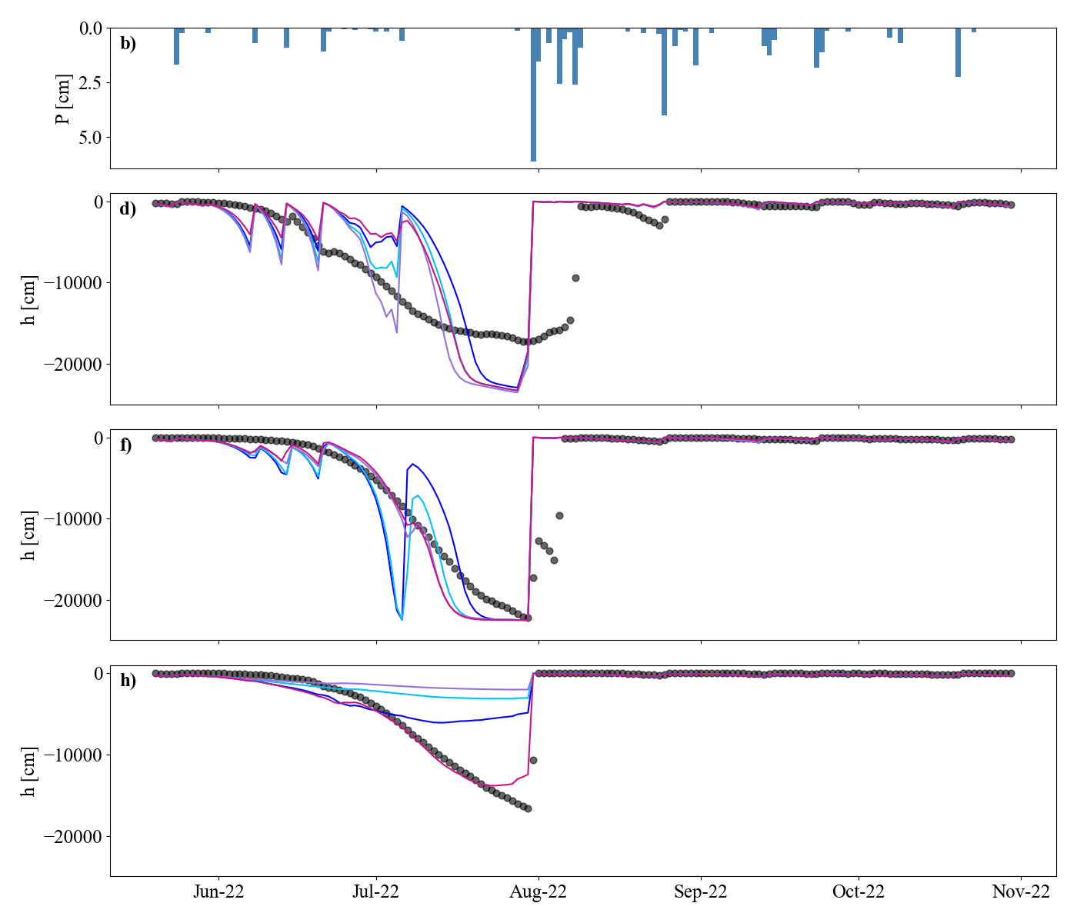
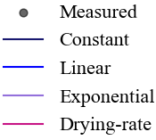
Temporal evolution of the simulated pressure head vs. measured
The drying-rate-based root systematically preformed better
P [cm]
h at 10 cm
h at 20 cm
h at 40 cm
Interpore2026
Loujain Alharfouch
7/10

Slide 17
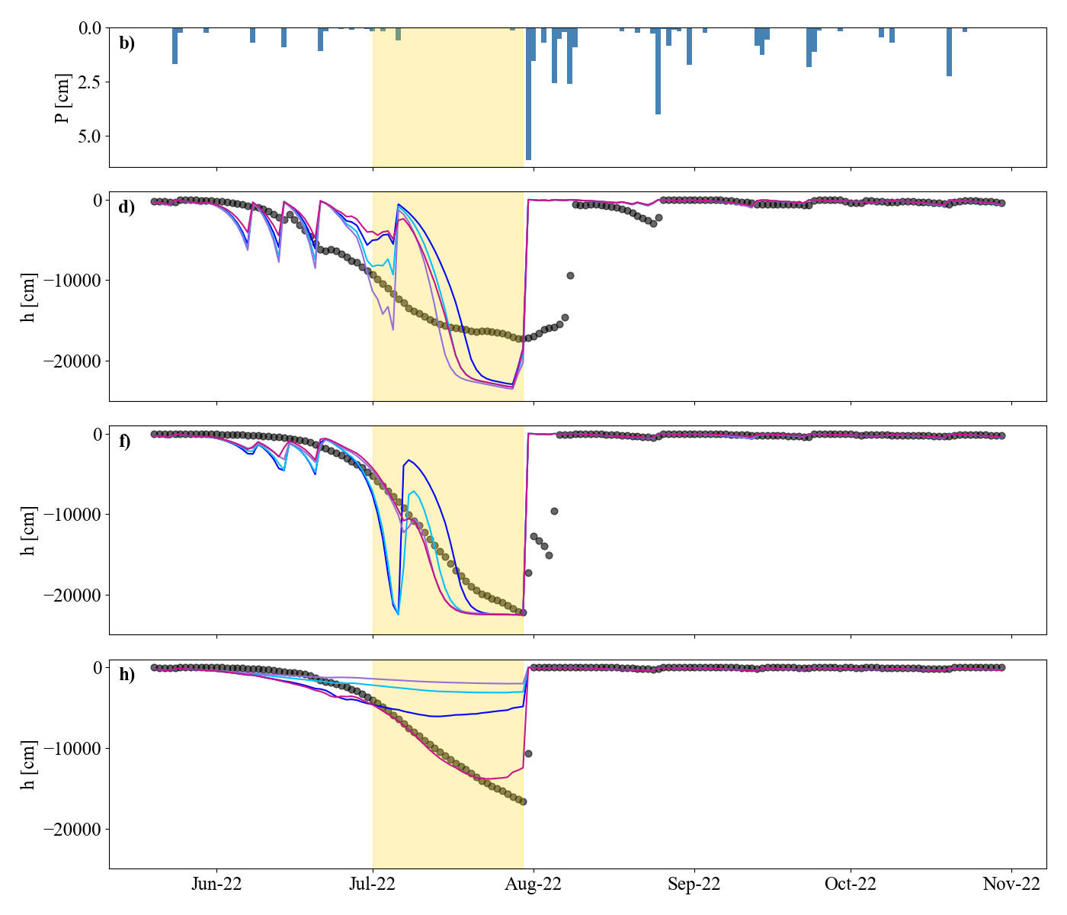
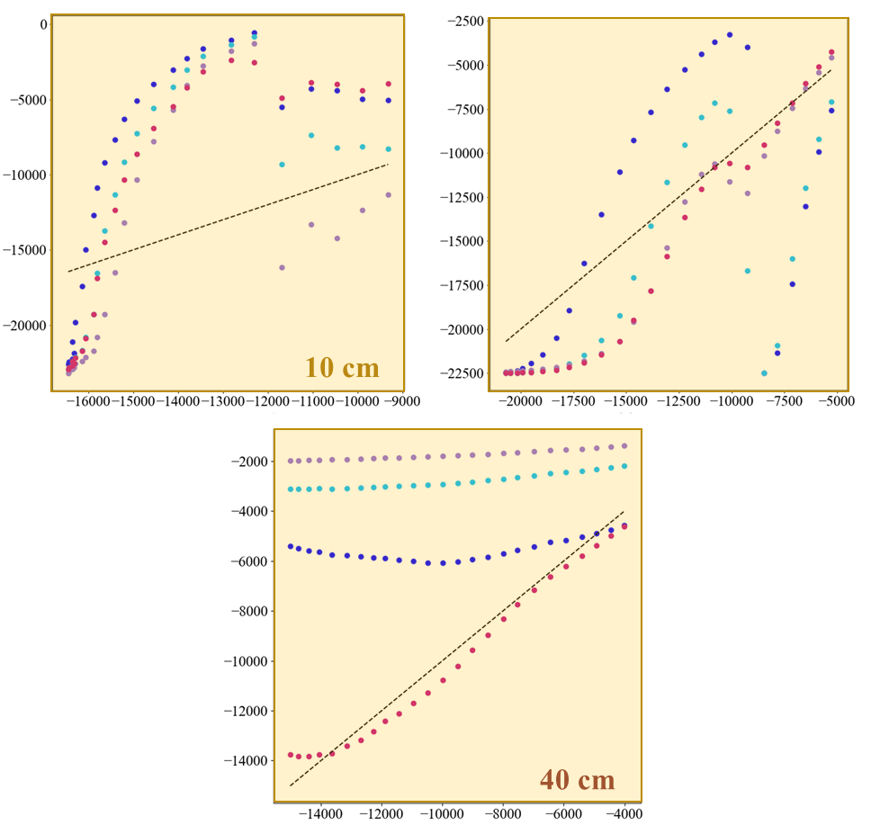
Temporal evolution of the simulated pressure head vs. measured
The drying-rate-based root systematically preformed better
Measured vs. modeled values
P [cm]
P [cm]
h at 10 cm
h at 10 cm
20 cm
h at 20 cm
h at 20 cm
h at 40 cm
h at 40 cm
Interpore2026
Loujain Alharfouch
7/10

Slide 18
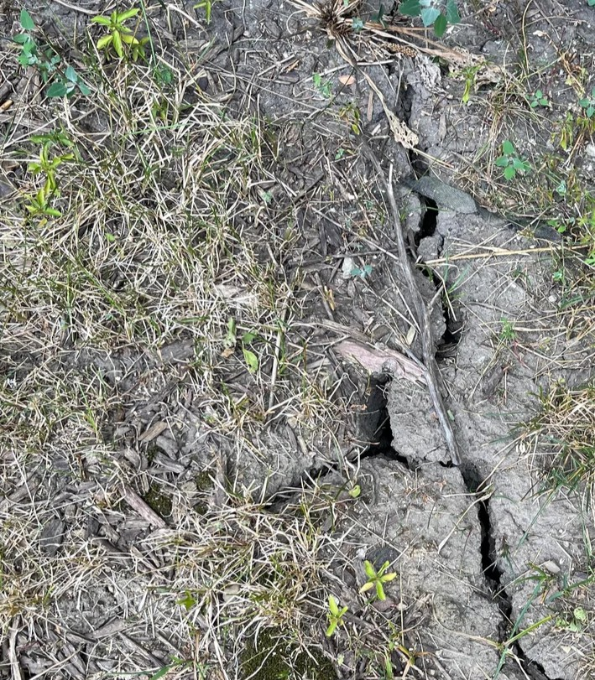
Temporal evolution of the simulated pressure head vs. measured
Model-field discrepancies
The fraction of clay in our soil is high cracks form in dry periods
Preferential flow
Possible lateral flow that feeds the groundwater
Capillary rise
P [cm]
h at 10 cm
h at 20 cm
h at 40 cm
Interpore2026
Loujain Alharfouch
8/10

Slide 19
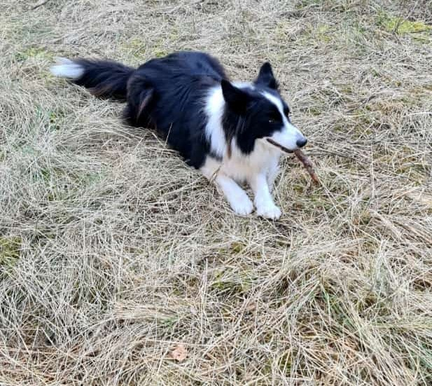
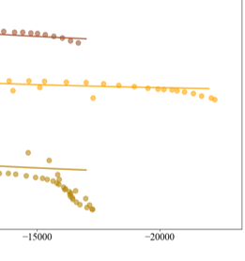

Temporal evolution of the simulated pressure head vs. measured
Model-field discrepancies
The fraction of clay in our soil is high cracks form in dry periods
Preferential flow
Possible lateral flow that feeds the groundwater
Capillary rise
P [cm]
h at 10 cm
Retention curve model
can’t capture very dry value
Grass that could retain water →Lag in the saturation
h at 20 cm
Darwin here is for reference. He doesn’t obstruct infiltration!
$$\int_{o}^{L}{Δθ(z)dz}=P−E−D −{ T}_{a}$$
h at 40 cm
At the shallow layers, evaporation and drainage represent larger fraction of the water balance
Interpore2026
Loujain Alharfouch
8/10

Slide 20

Validation with an independent dataset
Stable isotope of water, δ¹⁸O‰
Will our model predict the isotopic signal of the tree?
$δ_{Model}≈$ $δ_{Measured}$?
Interpore2026
Loujain Alharfouch
9/10

Slide 21
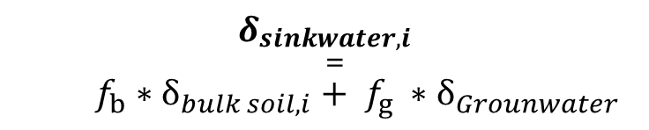
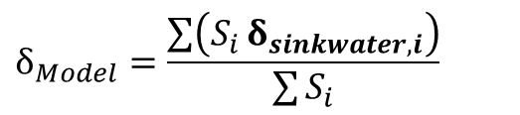
Validation with an independent dataset
Stable isotope of water, δ¹⁸O‰
Will our model predict the isotopic signal of the tree?
$δ_{Model}≈$ $δ_{Measured}$?
A simple mixing model
$$δ_{Model}=\frac{\left.\sum{\left(S_{i}\right.}δ_{sinkwater,i}\right)}{\sum{S_{i}}}$$
$$δ_{\begin{aligned}sinkwater,i \\ =\end{aligned}}$$
$$f_{b}∗δ_{bulk soil,i}+ f_{g} ∗δ_{Grounwater}$$
Interpore2026
Loujain Alharfouch
9/10

Slide 22
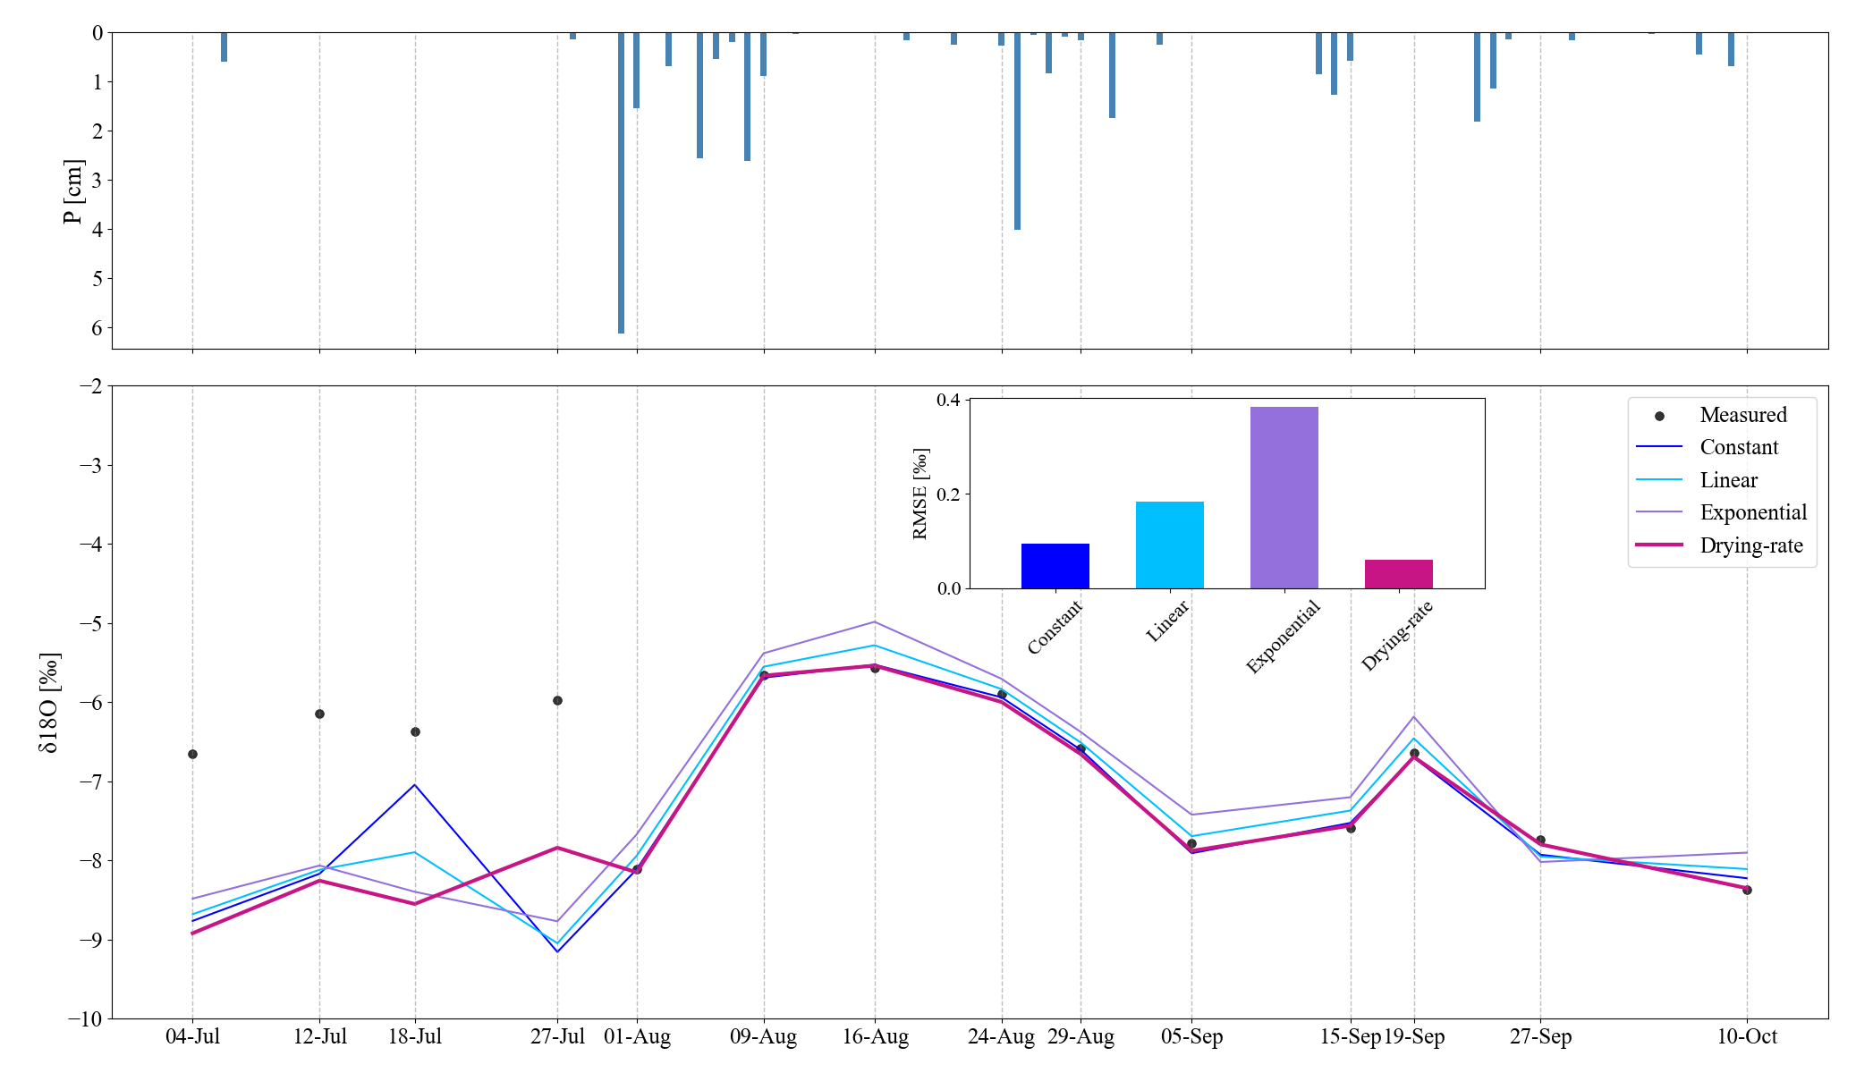
Validation with an independent dataset
Stable isotope of water, δ¹⁸O‰
Will our model predict the isotopic signal of the tree?
$δ_{Model}≈$ $δ_{Measured}$?
P [cm]
A simple mixing model
δ¹⁸O‰
$$δ_{Model}=\frac{\left.\sum{\left(S_{i}\right.}δ_{sinkwater,i}\right)}{\sum{S_{i}}}$$
$$δ_{\begin{aligned}sinkwater,i \\ =\end{aligned}}$$
$$f_{b}∗δ_{bulk soil,i}+ f_{g} ∗δ_{Grounwater}$$
Dry
Dry
Wet
Wet
Interpore2026
Loujain Alharfouch
9/10

Slide 23
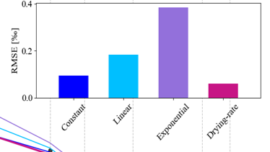
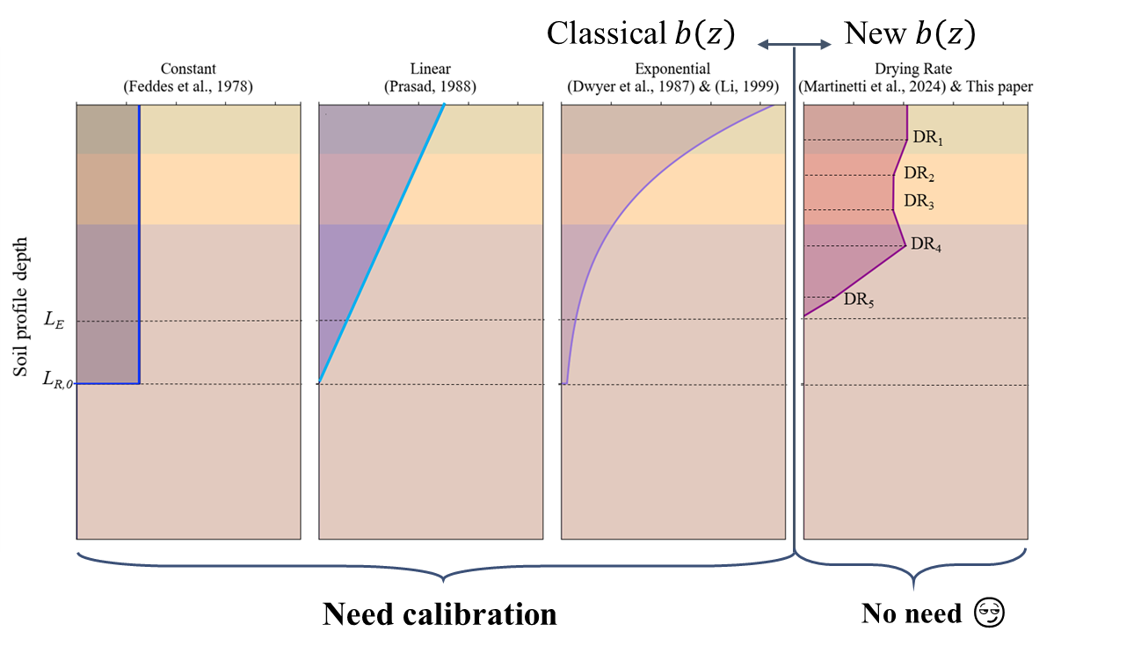
The choice of root distribution affect the accuracy and predictive performance in ecohydrological models
Drying-rate-based root distribution reduced model uncertainty
We confirmed the goodness of the drying-rate distribution with an independent dataset
Future outlook
Test the drying-rate-based root at more sites
Consider evaporation and drainage effect in the drying rate
To have time varying root distribution
Use a new improved retention curve (Ghorbani et al., 2025)
Need calibration
No need
😏
Interpore2026
Loujain Alharfouch
10/10

Slide 24


May 21, 2026
Abstract ID:950
Thank you
This work was supported by the Spanish State Research Agency (10.13039/501100011033) and Spanish Ministry of Science and Innovation through the projects HydroPore II (PID2022-137652NB-C41 and C42), and WARMed (PID2022-141868NB-I00).

Slide 25
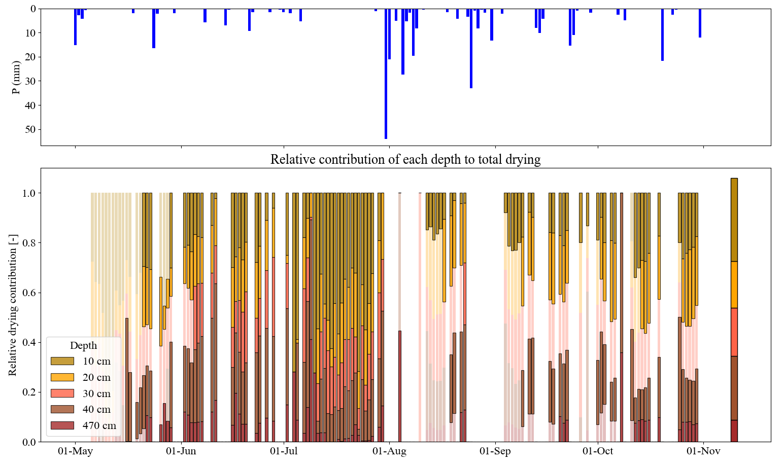
Modelling approach
Depth-dependent root activity from temporal variations in θ profile
The assumption
  The soil layers with higher drying rates correspond to zones of greater root water uptake
    A proxy for a functional root density distribution
DR₀=DR₁
DR₁
DR₂
DR₃
DR₄
P [mm]
DR₅
Seasonal
average
DR₁
DR₂
DR₃
DR₄
55 cm
DR₅

Slide 26
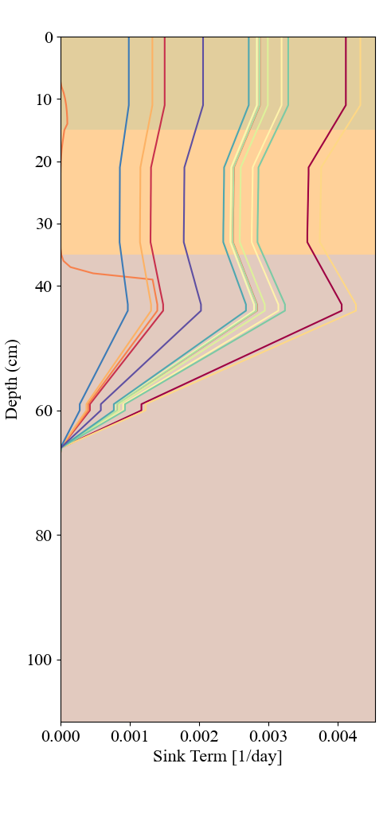
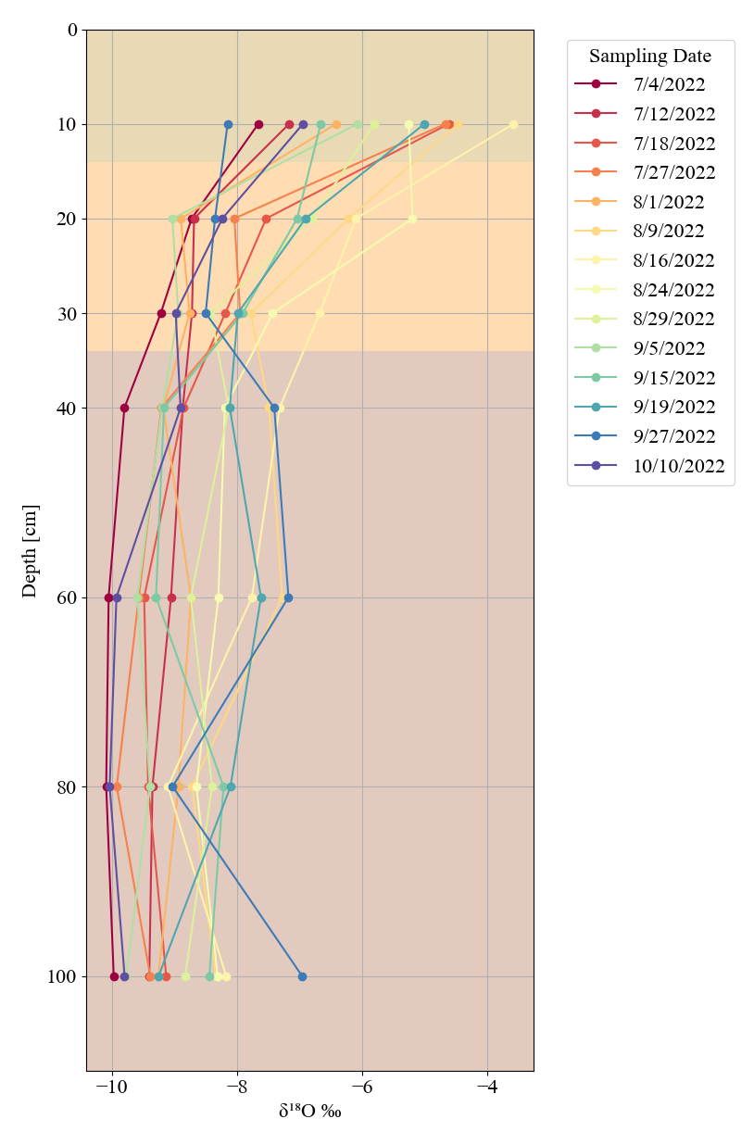
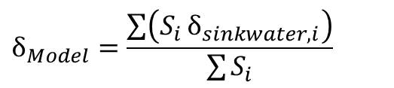

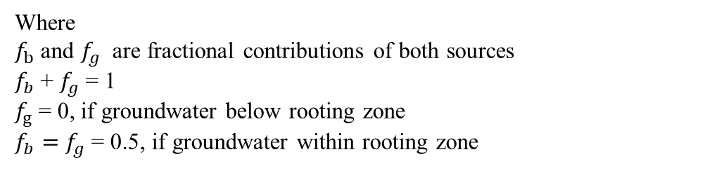

Water stable isotope as an independent validation tool
For each sampling date (14 in total):
$$f_{b}∗δ_{bulk soil,i}+ f_{g} ∗δ_{groundwater}=δ_{sinkwater,i}$$
Simple mixing model of a single tracer (δ¹⁸O) in two sources (Bulk soil water & Groundwater) and a mixture (Tree water) (Hayes, 2004; Floriancic et al., 2024)
Where
$f_{b}$and $f_{g}$ are fractional contributions of both sources
$f_{b}$+ $f_{g}$= 1
$f_{g}$= 0, if groundwater below rooting zone
$f_{b}=$ $f_{g}$= 0.5, if groundwater within rooting zone
$$δ_{Model}=\frac{\left.\sum{\left(S_{i}\right.}δ_{sinkwater,i}\right)}{\sum{S_{i}}}$$
$δ_{Model}≈$ $δ_{Measured}$
?
S_{i}
$$δ_{sinkwater}$$

Slide 27
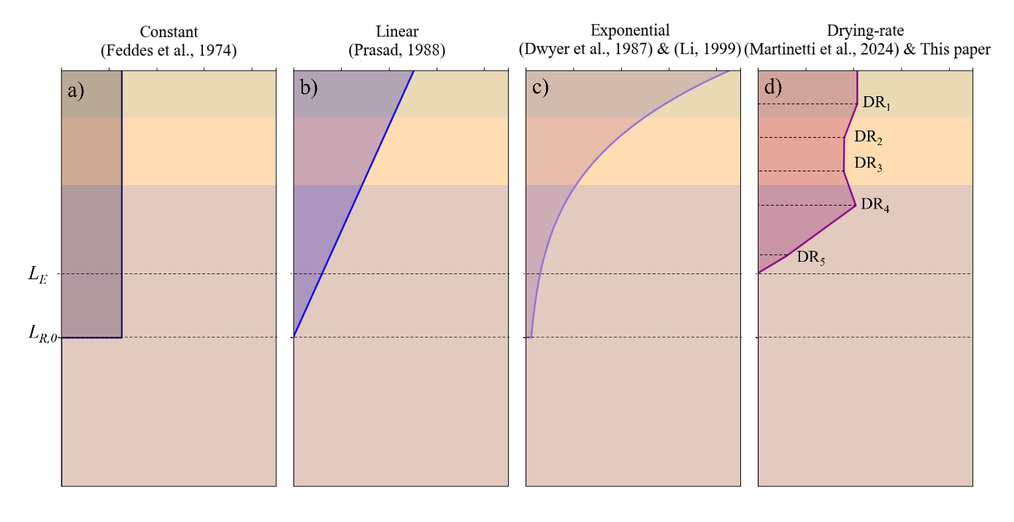
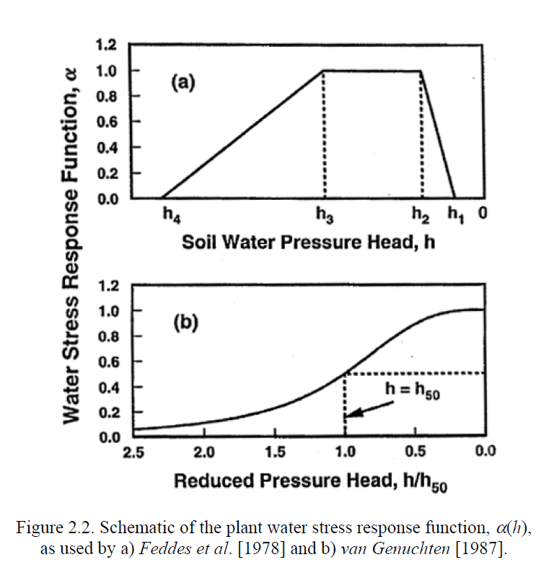
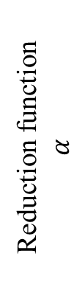


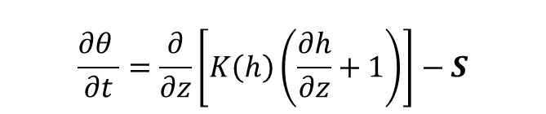
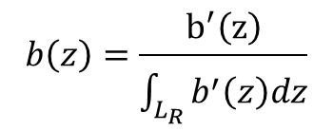
Classical Root water uptake model
T
p
E
$$\frac{∂θ }{∂t}=\frac{∂}{∂z}\left[K\left(h\right)\left(\frac{∂h}{∂z}+1\right)\right]−S$$
The sink term
Root zone depth
(L_{R})
$$S\left(h\right)= α(h)b\left(z\right)T_{p}$$
Depth
Reduction function
$$α$$
Root density distribution
$$b\left(z\right)=\frac{b^{′}\left(z\right)}{\int_{L_{R}}{b^{′}\left(z\right)dz}}$$
$$\int_{L_{R}}{b\left(z\right)dz=1}$$

