Slide 1






X-ray Computed Tomography-informed models of preferential macropore flow in soils.
Hamza Chaif, François Lafolie, Chloé Caurel, Stéphane Sammartino, Nicolas Beudez,
Anne-Sophie Lissy, Stéphane Ruy, Nathalie Moitrier, Eric Michel
Funded in part by SmartFertiReuse ( ) and Département AgroEcoSystem ( )
Notes:
Hi, I’m Eric,
The story I’m gonna tell you today is about preferential flow in soils
And how X-ray CT can help to test the models of preferential flow to their very limits

Slide 2
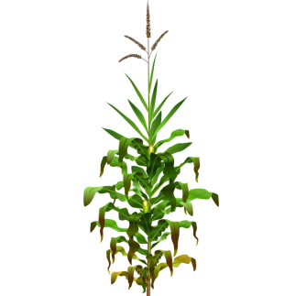

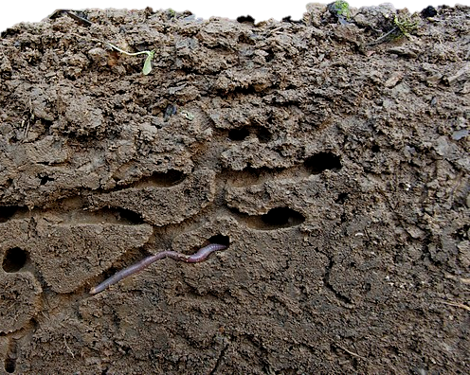
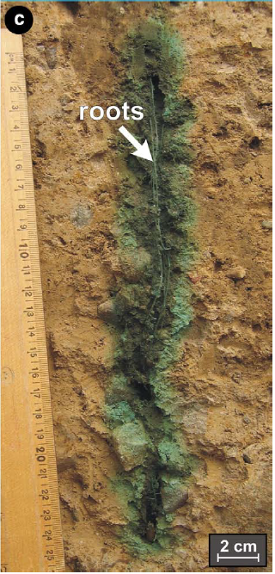
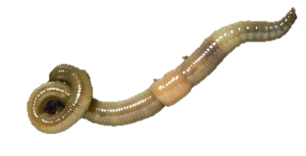
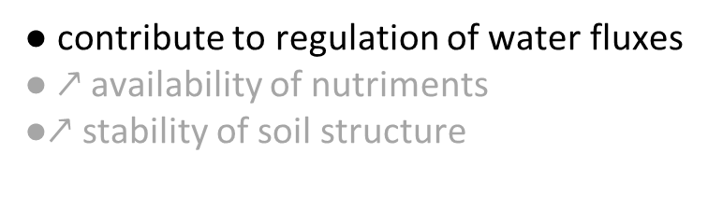
Context
● Earthworms and plants
● contribute to regulation of water fluxes
● $↗$ availability of nutriments
●$↗$ stability of soil structure
Modified from Christophe Salin
Notes:
In the soil, there are plants above ground and earthworms below
Both contribute to one of the services provided by soils,
Whic is the regulation of water fluxes by creating …

Slide 3
Context
● Earthworms and plants
● contribute to regulation of water fluxes
● $↗$ availability of nutriments
●$↗$ stability of soil structure
Macropores (> 300 µm)
Modified from Christophe Salin
Notes:
… MACROPORES …
In decayed root channels and earthworm b[eu]rrows

Slide 4

Context
● Earthworms and plants
● contribute to regulation of water fluxes
● $↗$ availability of nutriments
●$↗$ stability of soil structure
Macropores (> 300 µm)
Fast, gravity-driven, preferential flow
Modified from Christophe Salin
Notes:
Where water can flow very quickly
under the action of gravity and bypasses most of the soil matrix

Slide 5
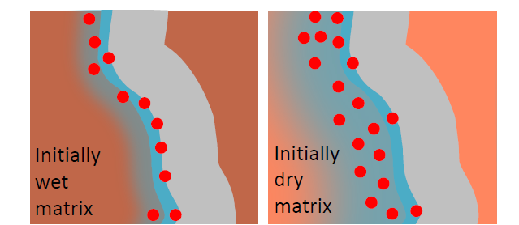
Context
● Earthworms and plants
● contribute to regulation of water fluxes
● $↗$ availability of nutriments
●$↗$ stability of soil structure
Macropores (> 300 µm)
Fast, gravity-driven, preferential flow
● Macropore – matrix exchanges
Modified from Christophe Salin
increasing macropore matrix transfers
van den Bogaert et al. Geoderma., 2016
Notes:
Some exchanges of water between the macropores and the surrounding matrix are possible,
as evidenced by this blue dye that sorbs to soils
And by other studies in my group.

Slide 6

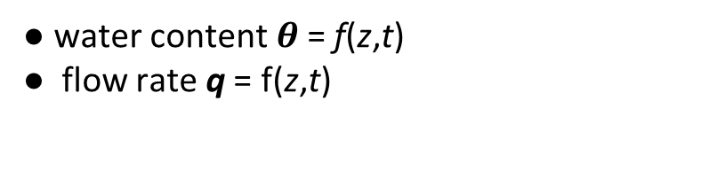



Current operational models of macropore & matrix flow
● 1D compartment models “Double permeability”
● Outputs of model:
●matrix and macropore characterized by effective parameters
● water content $θ$= f(z,t)
● flow rate q = f(z,t)
● Interface macropore—matrix not described explicitly
in each compartment
macropores
matrix
≈
$$θ_{ma}$$
$$θ_{mi}$$
z
$$q_{ma}$$
$$q_{mi}$$
Cey et al.
J. Cont. Hydrol., 2009
Notes:
This complicated macropore network is modeled with 1D compartment models

Slide 7

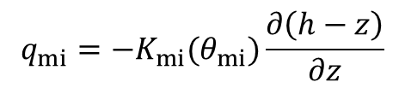

Current operational models of macropore & matrix flow
● 1D compartment models “Double permeability”
● Outputs of model:
●matrix and macropore characterized by effective parameters
● water content $θ$= f(z,t)
● flow rate q = f(z,t)
● Interface macropore—matrix not described explicitly
in each compartment
macropores
matrix
$$q_{mi}=−K_{mi}(θ_{mi})\frac{∂\left(h−z\right)}{∂z}$$
$$\frac{∂θ_{mi}}{∂z}=−\frac{∂q_{mi}}{∂z}±S$$
z
$$\frac{∂θ_{mi}\left(h\right)}{∂t}+\frac{∂}{∂z}\left(−K_{mi}\left(h\right)\frac{∂\left(h−z\right)}{∂z}\right)−S=0$$
Darcy-Richards: K($θ$), $θ$(h)

Slide 8
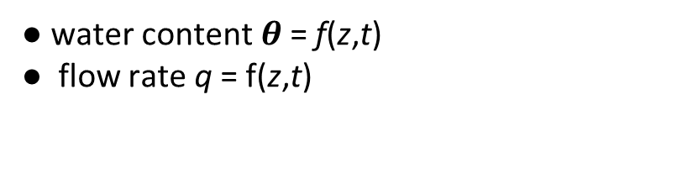


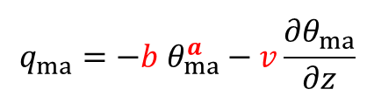
Current operational models of macropore & matrix flow
● 1D compartment models “Double permeability”
● Outputs of model:
●matrix and macropore characterized by effective parameters
● water content $θ$= f(z,t)
● flow rate q = f(z,t)
● Interface macropore—matrix not described explicitly
in each compartment
macropores
matrix
$$q_{ma}=−b{ θ}_{ma}^{a}−v\frac{{∂θ}_{ma}^{}}{∂z}$$
$$q_{mi}=−K_{mi}(θ_{mi})\frac{∂\left(h−z\right)}{∂z}$$
$$\frac{∂θ_{mi}}{∂z}=−\frac{∂q_{mi}}{∂z}±S$$
$$\frac{∂θ_{mi}}{∂z}=−\frac{∂q_{mi}}{∂z}±S$$
z
$$\frac{∂θ_{ma}\left(h\right)}{∂t}+ab θ_{ma}^{a−1}\frac{∂θ_{ma}\left(h\right)}{∂z}−ν\frac{∂^{2}θ_{ma}\left(h\right)}{∂z^{2}}+S=0$$
$$\frac{∂θ_{mi}\left(h\right)}{∂t}+\frac{∂}{∂z}\left(−K_{mi}\left(h\right)\frac{∂\left(h−z\right)}{∂z}\right)−S=0$$
Kinematic (Dispersive) Wave
Darcy-Richards: K($θ$), $θ$(h)
Germann & Beven, Water Resources Research, 1985.
Jarvis et al., Journal of Soil Science, 1991).
Di Pietro et al., Journal of Hydrology, 2003.
Notes:
In the macropores, the Richards equation does not apply
And Germann at the begining of the eighties
popul[eu]rized the idea of using a Kinematic Wave to describe the fast preferential flow
This [eu]mounts to say that the flow rate out of the macropores is proportional to a power law of the of the macropore water content.

Slide 9
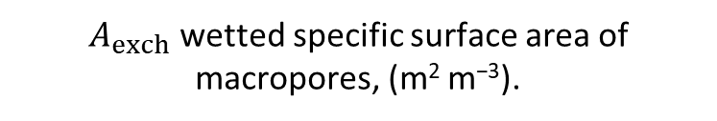
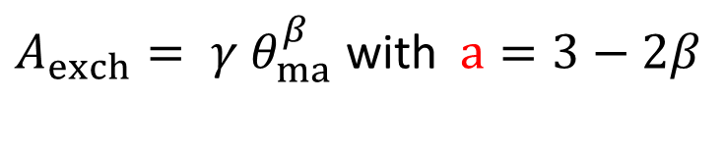
Current operational models of macropore & matrix flow
$A_{exch}$wetted specific surface area of macropores, (m² m⁻³).
● 1D compartment models “Double permeability”
● Outputs of model:
$A_{exch}= γ{ θ}_{ma}^{β}$ with $a=3−2β$
●matrix and macropore characterized by effective parameters
● water content $θ$= f(z,t)
● flow rate q = f(z,t)
● Interface macropore—matrix not described explicitly
Jarvis, Vadose Zone J., 2017
in each compartment
macropores
matrix
$$q_{ma}=−b θ_{ma}^{a}−v\frac{{∂θ}_{ma}^{}}{∂z}$$
$$q_{mi}=−K_{mi}(θ_{mi})\frac{∂\left(h−z\right)}{∂z}$$
$$\frac{∂θ_{mi}}{∂z}=−\frac{∂q_{mi}}{∂z}±S$$
$$\frac{∂θ_{mi}}{∂z}=−\frac{∂q_{mi}}{∂z}±S$$
z
$$\frac{∂θ_{ma}\left(h\right)}{∂t}+ab θ_{ma}^{a−1}\frac{∂θ_{ma}\left(h\right)}{∂z}−ν\frac{∂^{2}θ_{ma}\left(h\right)}{∂z^{2}}+S=0$$
$$\frac{∂θ_{mi}\left(h\right)}{∂t}+\frac{∂}{∂z}\left(−K_{mi}\left(h\right)\frac{∂\left(h−z\right)}{∂z}\right)−S=0$$
Kinematic (Dispersive) Wave
Darcy-Richards: K($θ$), $θ$(h)
Germann & Beven, Water Resources Research, 1985.
Jarvis et al., Journal of Soil Science, 1991).
Di Pietro et al., Journal of Hydrology, 2003.
Notes:
It is possible to show that this hypotesis implies that
The wettedspecific surface are of the macropores is also proportional to a power law — with a different exponent — of the macropore water content.
The two exponents are linked by this relationship.
We ‘ll come back to that later on.

Slide 10
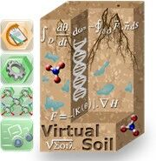
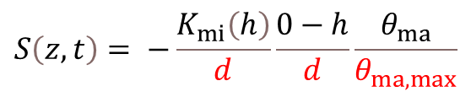
Current operational models of macropore & matrix flow
● 1D compartment models “Double permeability”
● Outputs of model:
●matrix and macropore characterized by effective parameters
● water content $θ$= f(z,t)
● flow rate q = f(z,t)
● Interface macropore—matrix not described explicitly
in each compartment
macropores
matrix
$$q_{ma}=−b{ θ}_{ma}^{a}−v\frac{{∂θ}_{ma}^{}}{∂z}$$
$$q_{mi}=−K_{mi}(θ_{mi})\frac{∂\left(h−z\right)}{∂z}$$
$$\frac{∂θ_{mi}}{∂z}=−\frac{∂q_{mi}}{∂z}±S$$
$$\frac{∂θ_{mi}}{∂z}=−\frac{∂q_{mi}}{∂z}±S$$
z
$$\frac{∂θ_{ma}\left(h\right)}{∂t}+ab{ θ}_{ma}^{a−1}\frac{∂θ_{ma}\left(h\right)}{∂z}−ν\frac{∂^{2}θ_{ma}\left(h\right)}{∂z^{2}}+S=0$$
$$\frac{∂θ_{mi}\left(h\right)}{∂t}+\frac{∂}{∂z}\left(−K_{mi}\left(h\right)\frac{∂\left(h−z\right)}{∂z}\right)−S=0$$
Kinematic (Dispersive) Wave
exchange term
Darcy-Richards: K($θ$), $θ$(h)
$$S\left(z,t\right)= −\frac{K_{mi}\left(h\right)}{d}\frac{0−h}{d}\frac{θ_{ma}}{θ_{ma,max}}$$
$d(z)=$ mean half distance between macropores (m)
Notes:
Simplified, physic based equations
In which characteristics of the macropore network are used as parameters :
One is the macropore volume by volume of soil;
The second is the mean half distance between macropores

Slide 11
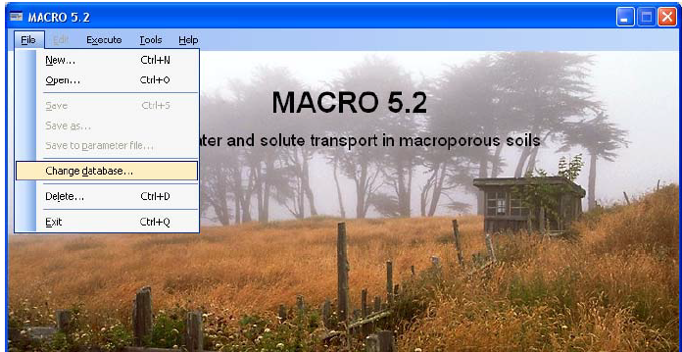
Current operational models of macropore & matrix flow
● Issue with “d ”
“The initial "values of d for the different layers
based on visual observations of the soil structure were increased considerably to obtain a better fit” (Larsson & Jarvis, J. Hydrol., 1999)
“A value of 10 cm for d is considered large in relation to the size and scale of aggregation in the Lanna clay soil.” (Saxena, Jarvis, Bergström, J. Hydrol., 1994)
d has a physical meaning,
but is calibrated to fit experimental data.
exchange term
$$S\left(z,t\right)= −\frac{K_{mi}\left(h\right)}{d}\frac{0−h}{d}\frac{θ_{ma}}{θ_{ma,max}}$$
$d(z)=$ mean half distance between macropores (m)

Slide 12
Current coupled models of macropore & matrix flow
● Issue with “d”
“The initial "values of d for the different layers
based on visual observations of the soil structure were increased considerably to obtain a better fit” (Larsson & Jarvis, J. Hydrol., 1999)
“A value of 10 cm for d is considered large in relation to the size and scale of aggregation in the Lanna clay soil.” (Saxena, Jarvis, Bergström, J. Hydrol., 1994)
d has a physical meaning,
but is calibrated to fit experimental data.
Why ? Can we fix that ?
Notes:
We wuld like in the near future model eathworms population dynamics
How they create macropore and
How that affets wayrt transferts

Slide 13
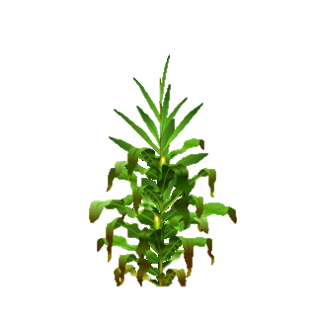


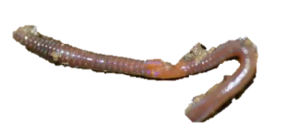
Material and methods — simulated rainfall on undisturbed soil cores
4 undisturbed soil columns: 2 of a loamy calcisol,
2 of a silty calcaric luvisol.
2 initial conditions :
initially wet : matrix saturated, macropores empty,
initialy dry : all pores above ~ 8 µm are empty .
Rainfall of 20 mm h⁻¹, duration 90 minutes
Simulated
rainfalls
rain
//////////////////////
////////////////////////
12.5 cm
15 cm
soil
Effluent
scale
Outflow rate (m s⁻¹)
scale
Water accumulated in the column (m)
Notes:
Parmi la biodiversité du sol, les vers de terre constituent 80% de la biomasse des sols.
Ils rendent aussi un certains nombre de fonctions et de services
Ils accroissent la DISPONIBILITE des nutriments pour les plantes et les autres organismes du sol, la stabilité de la structure
et ils contribuent à la régulation des flux d’eau
en creusant des galeries suffisamment larges…

Slide 14
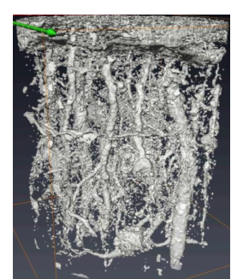
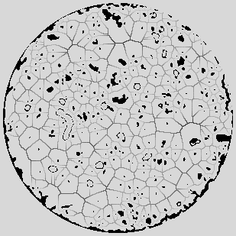
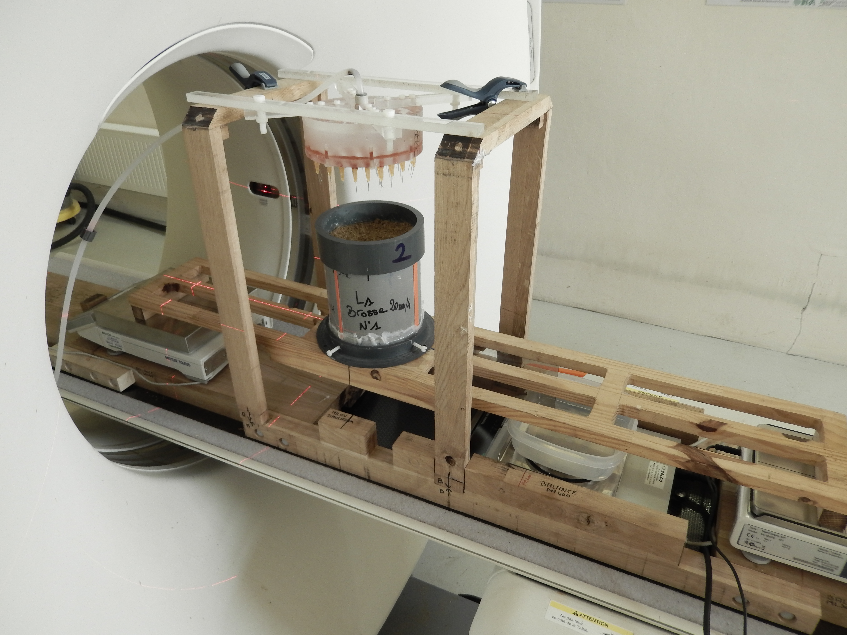
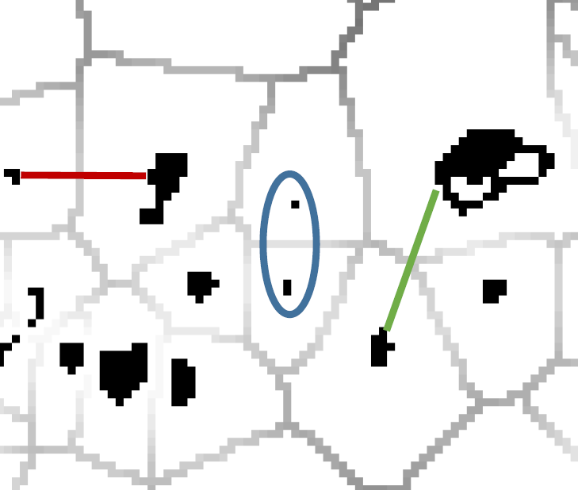
Material and methods — 3D X-ray CT: characterization of macropores
Voxel size 400 µm
400
horizontal
slices
macroporosity

Slide 15
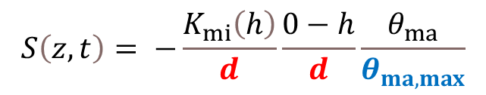
Material and methods — 3D X-ray CT: characterization of macropores
Voxel size 400 µm
400
horizontal
slices
macroporosity
$$S\left(z,t\right)= −\frac{K_{mi}\left(h\right)}{d}\frac{0−h}{d}\frac{θ_{ma}}{θ_{ma,max}}$$
half distance between
macropores (m)
macroporosity
(m³ m⁻³_{soil})
Lissy et al. Geoderma., 2020
Notes:
Dans ce projet, nous proposons d’aborder 2 questions : fondamentale et appliquée
La 1ere, ...on se propose ici d’étudier la cascade d’effets depuis les effets sub individuels jusqu’au ES en passant par les effets sur les THV nivo individus/pop
La 2eme...appui aux politiques publiques et décisions réglementaires

Slide 16
Material and methods — 4D X-ray CT : where is water flowing ?
Scan duration 10 s
30 images per rainfall
Water (t_{i}) = image (t_{i}) – image (t₀)
Notes:
At each time step: the local changes in grey levels
are thresholded and intersected with the macropore network.

Slide 17
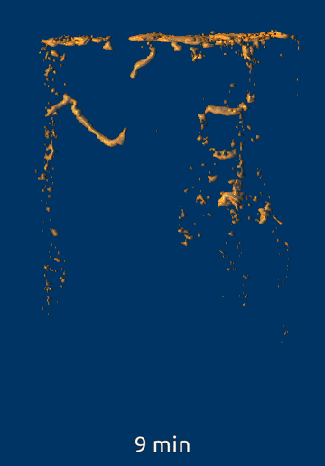
Material and methods — 4D X-ray CT : where is water flowing ?
Scan duration 10 s
30 images per rainfall
Water (t_{i}) = image (t_{i}) – image (t₀)
Loamy soil, initially dry
Notes:
At each time step: the local changes in grey levels
are thresholded and intersected with the macropore network.

Slide 18
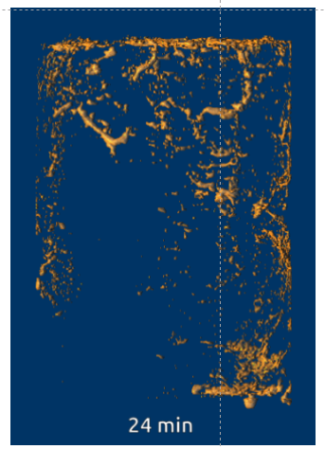
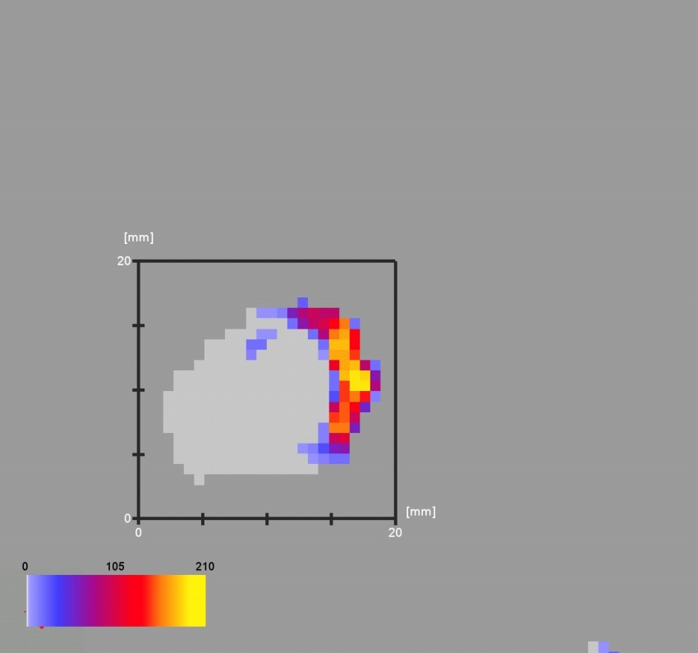
Material and methods — 4D X-ray CT : where is water flowing ?
matrix
10 mm
macropore
Cross section of an active macropore
Scan duration 10 s
30 images per rainfall
Loamy soil, initially dry
Sammartino et al. AGU Fall Meeting, 2015
Notes:
At each time step: the local changes in grey levels
are thresholded and intersected with the macropore network.

Slide 19
Material and methods — 4D X-ray CT : where is water flowing ?
matrix
10 mm
macropore
wetted
macropore
specific
surface area
macropore
water content.
Scan duration 10 s
30 images per rainfall
Loamy soil, initially dry
Sammartino et al. AGU Fall Meeting, 2015
Notes:
At each time step: the local changes in grey levels
are thresholded and intersected with the macropore network.

Slide 20
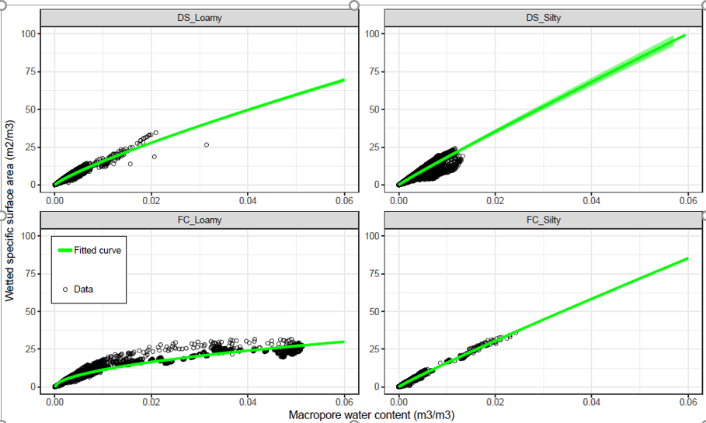

Material and methods — 4D X-ray CT : where is water flowing ?
matrix
β = 0.831 ± 0.002
$$A_{exch}= γ {θ_{ma}}^{β}$$
10 mm
a =3- 2 β = 1.34
macropore
wetted
macropore
specific
surface area
macropore
water content.
Wetted specific surface area (m²m⁻³)
β = 0.544 ± 0.002
a =3- 2 β = 1.91
Determined from
X-ray CT
Determined from
specific exp.
Calibrated
d(z), θ_{ma,max}(z), a, K(𝜃), 𝜃(h), b, ν
Macropore water content (m³ m⁻³)
Notes:
We have constrained the model the best we could and we’re going to see how it is doing.

Slide 21
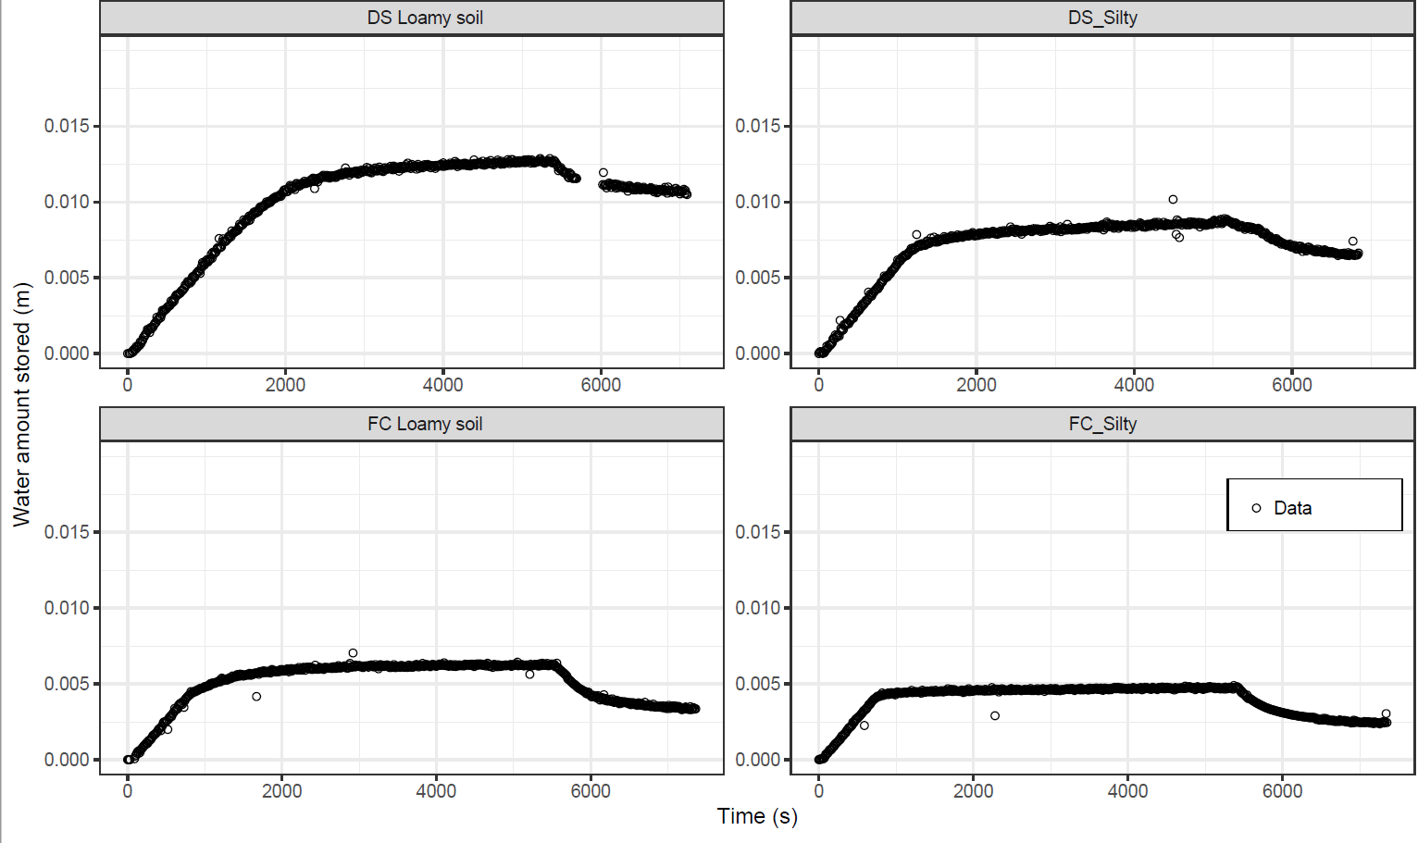
Test of the model
initially dry
Water amount stored in the soil (m)
initially wet
Time (s)

Slide 22
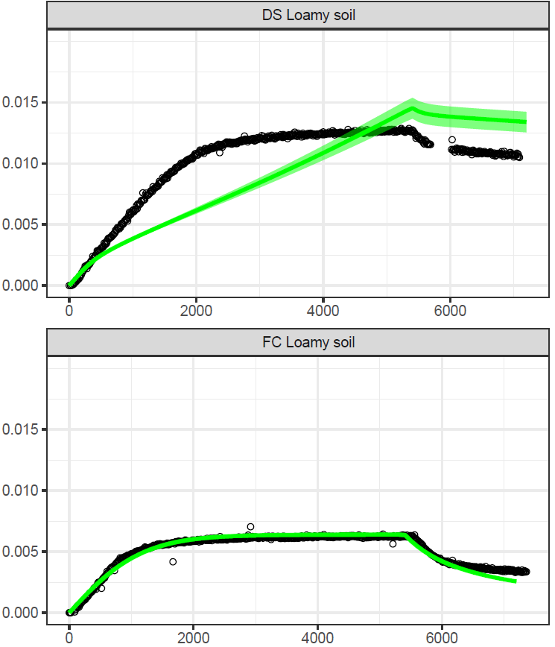
Test of the model
initially dry
Water amount stored in the soil (m)
initially wet
Time (s)

Slide 23
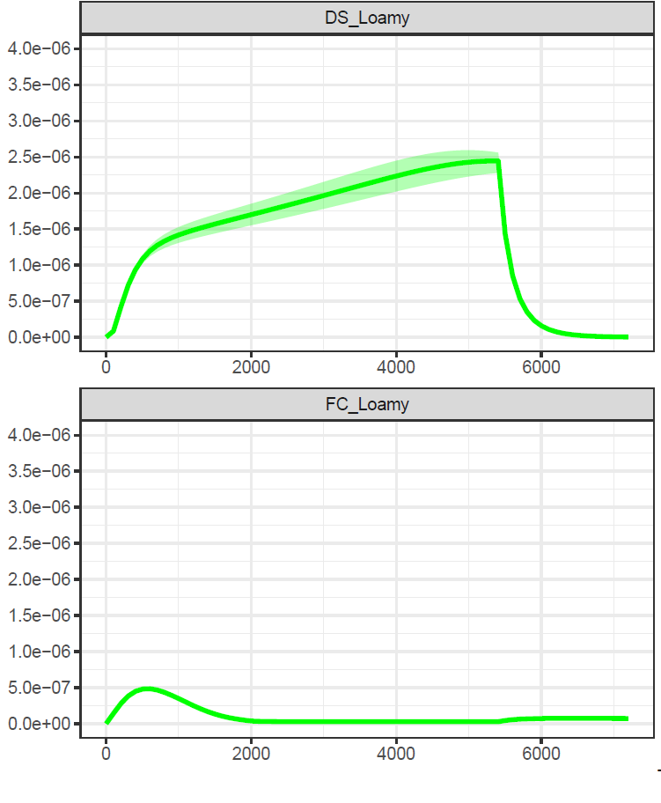
Test of the model
initially dry
Water amount stored in the soil (m)
Profile cumulated exchanged flux density
from macropores to the matrix (m s⁻¹)
initially wet
Time (s)
Time (s)
The first-order exchange term does not capture properly the exchange dynamics.

Slide 24

A new — pseudo 2D — model of macropore & matrix flow
macropores
matrix
$$S$$
z

Slide 25



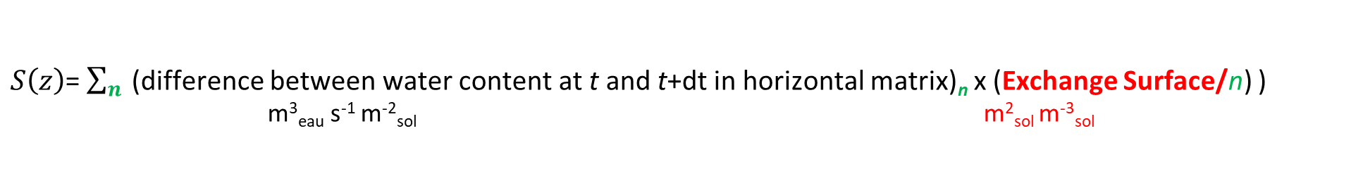


A new, pseudo 2D, macropore – matrix exchange term
● The total specific surface area of the macropore–matrix interface is discretized in $n$ sections
● Each section corresponds to a horizontal représentation of the matrix where the horizontal Richards equation is solved
to keep track of the horizontal distribution of water in the soil matrix
$$d$$
$$n$$
2
update
$$θ_{mi,horiz}^{}$$
$$S$$
4
compute S
z
macropores
matrix
matrix
Kinematic
Dispersive Wave
$n$ horizontal
Vertical
Richards
equations
Richards equation
$S\left(z\right)$= $\sum_{n}{\text{(}}$difference between water content at t and t+dt in horizontal matrix)_{n} x (Exchange Surface/n) ) m³_{eau} s⁻¹ m⁻²_{sol} m²_{sol} m⁻³_{sol}

Slide 26
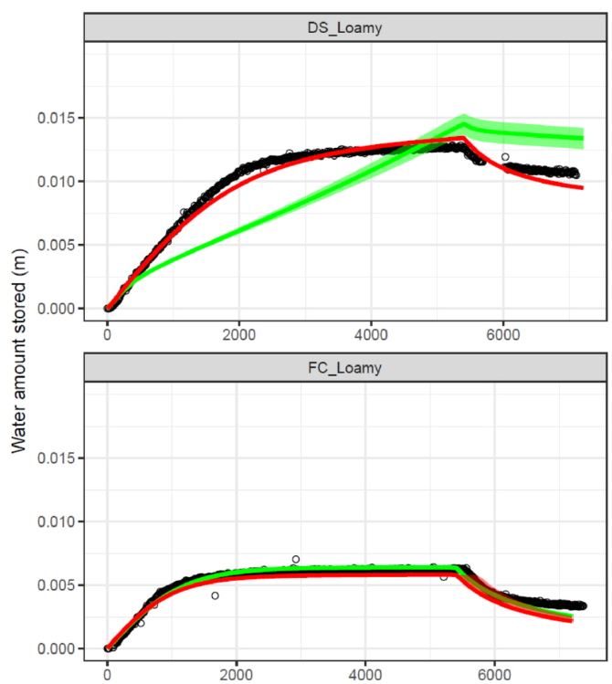
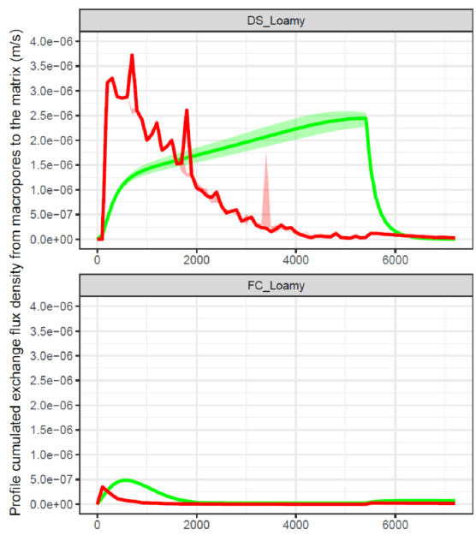

A new — pseudo 2D — model of macropore & matrix flow
initially dry
new model
old model
Profile cumulated exchanged flux density
from macropores to the matrix (m s⁻¹)
Water amount stored in the soil (m)
initially wet

Slide 27
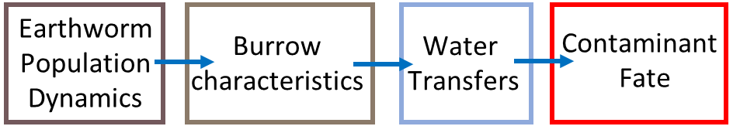

Conclusion
● 3D and 4D X-ray CT data were used for the first time to determine the parameters of a permeability model that were to date calibrated to fit the experimental data.
Wetted specific surface area
Macropore water content (m³ m⁻³)
● Made it possible to test the model and propose an improved version.
● The new model opens up the possibility to use measured or modeled d values
● Both models will be made available in the Vsoil platform
vsoil.hub.inrae.fr/
Link to the related paper

Slide 29
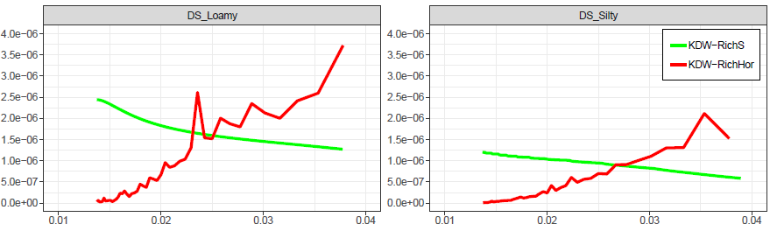

Link between total water amount exchanged and time
$${time}^{−\frac{1}{2}}$$

Slide 30
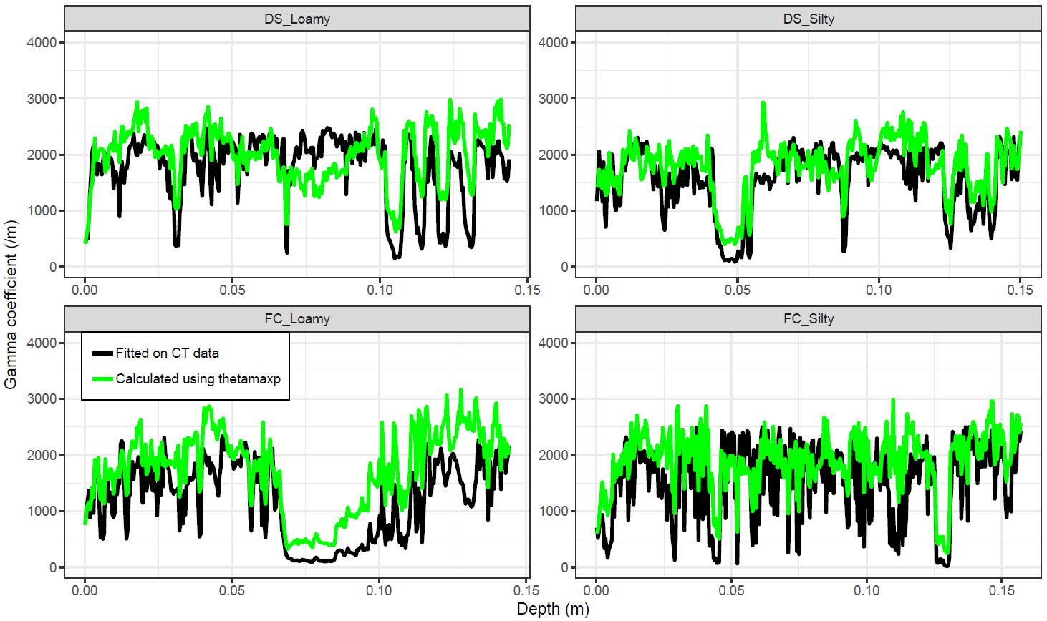

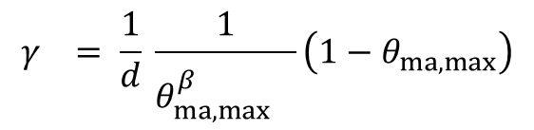
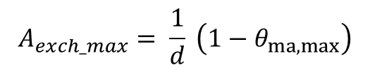
$$A_{exch}= γ{θ_{ma}}^{β}$$
$$γ_{}= \frac{1}{d} \frac{1}{{θ_{ma, max}^{β}}^{}}\left(1−θ_{ma, max}^{}\right)$$
$$A_{exch_max}= \frac{1}{d} \left(1−θ_{ma, max}^{}\right)$$

Slide 31
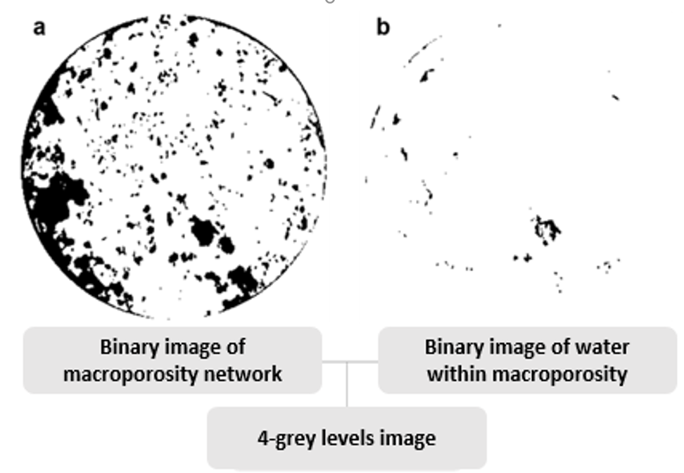

Slide 32
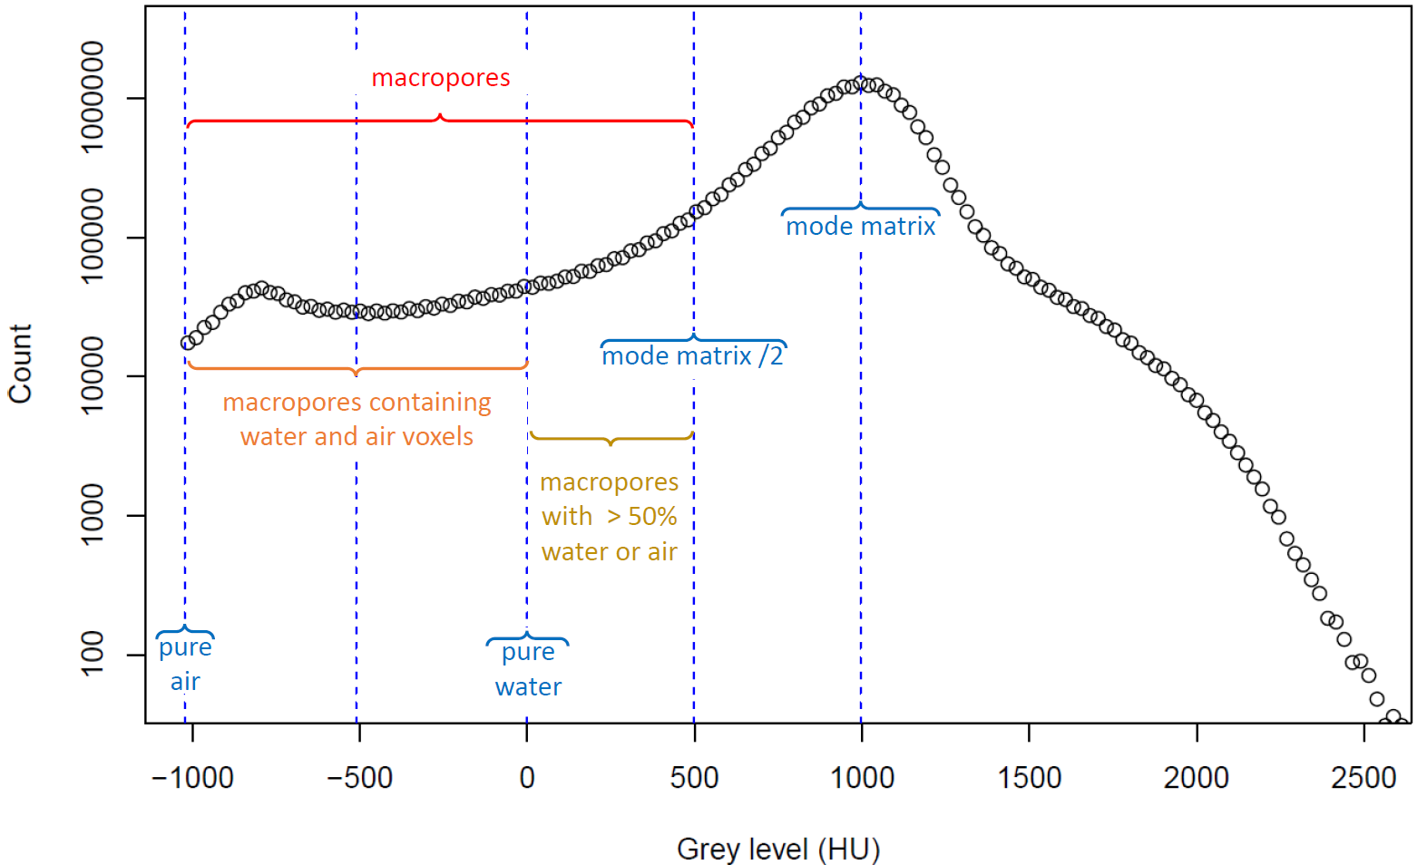
Grey-level histogram

Slide 33
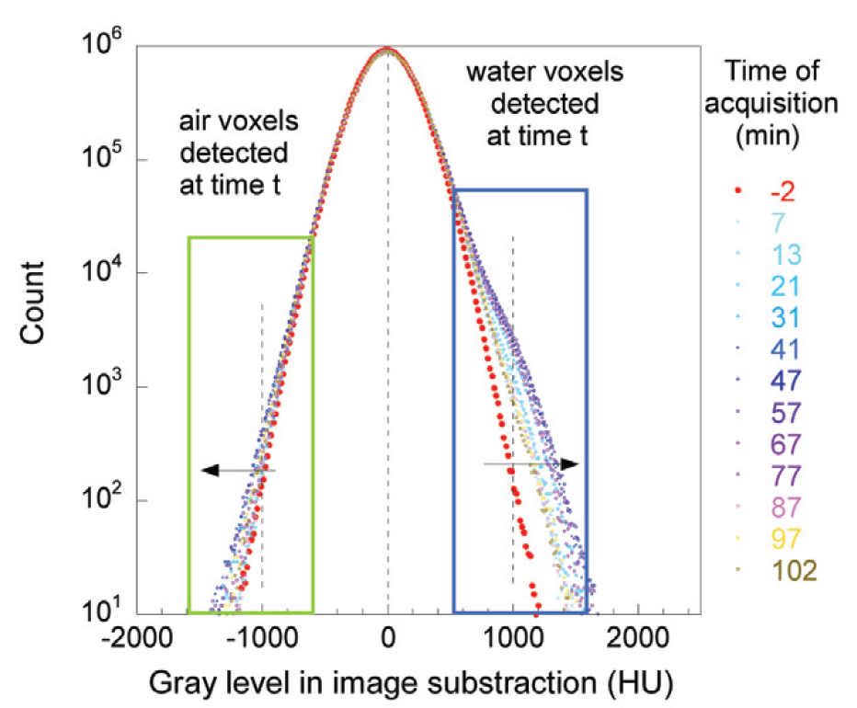
Grey-level histogram of subtracted images

Slide 34
