Slide 1





The Interception History Paradigm
A New Way to Look at Colloid Transport in Porous Media
Bashar M. Al-Zghoul
Luis Ullauri
Sabrina Volponi
William P. Johnson
Diogo Bolster

Slide 2
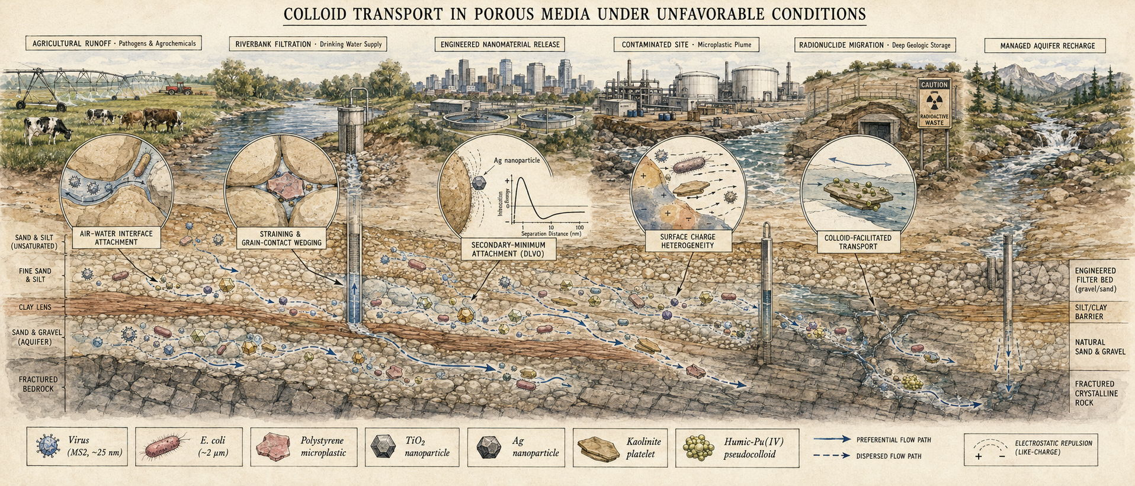
Why Unfavorable Conditions? — the rule, not the exception

Slide 3
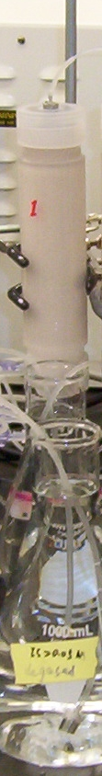
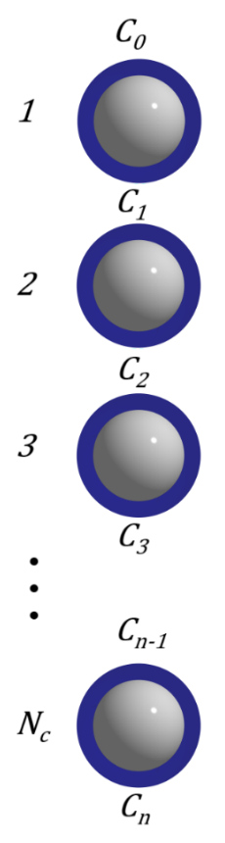



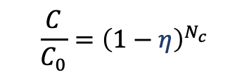
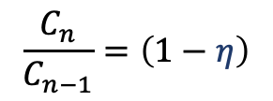
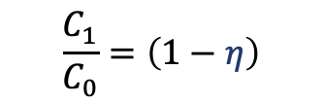
Favorable Conditions: Constant fractional loss (η) per collector passed (compounded loss)
1
η = 0
BTEC
$$\frac{C}{C_{0}}={\left(1−η\right)}^{N_{c}}$$
η = # attach/#approach
$$\frac{C_{1}}{C_{0}}=\left(1−η\right)$$
Log C/C₀
(at L)
(at N_{c})
Compounded loss per collector:
C and C_{sed} decrease exponentially with distance per collector passed (N_{c}).
Favorable
$$N_{c}Ln\left(1−η\right)$$
0
Time
Works well under favorable conditions.
RP
Favorable
$$Ln\frac{C}{C_{0}}=N_{c}Ln\left(1−η\right)$$
LogC_{att} at t
$$\frac{C_{n}}{C_{n−1}}=\left(1−η\right)$$
But what happens when conditions are unfavorable?
The compounded-loss story breaks down — that’s where this work picks up.
$$Ln\left(1−η\right)$$
Distance (N_{c}) from source

Slide 4
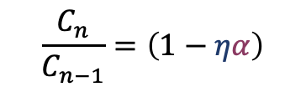
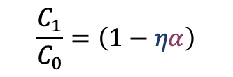

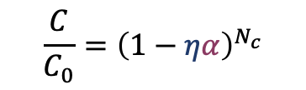


Unfavorable Conditions: Reduced fractional loss (ηα) – per collector passed
1
η = 0
Still compounded loss — but reduced:
C and C_{sed} still decrease exponentially per collector passed (N_{c}) — but with shallower slope.
$$\frac{C_{1}}{C_{0}}=\left(1−ηα\right)$$
Log C/C₀
(at L)
(at N_{c})
Unfavorable
$$N_{c}Ln\left(1−ηα\right)$$
Works only for the steady-state plateau.
0
Time
$$Ln\frac{C}{C_{0}}=N_{c}Ln\left(1−ηα\right)$$
Favorable
So is ηα really constant?
Experiments say no — the slope flattens further down the column.
LnC_{att}
$$\frac{C_{n}}{C_{n−1}}=\left(1−ηα\right)$$
Unfavorable
$$Ln\left(1−ηα\right)$$
$$\frac{C}{C_{0}}={\left(1−ηα\right)}^{N_{c}}$$
Distance from source
Notes:
Under unfavorable conditions, e.g., a repulsive barrier from repulsive electric double layer interactions …
Breakthrough is higher, and the retention profile is expected to be lower and shallower
Alpha was introduced to account for these impacts

Slide 5
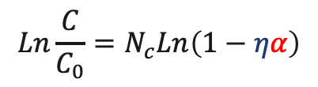

Constant fractional loss per collector passed doesn’t work under unfavorable conditions
Non-exponential even when these are negligible:
Colloid size & surface variation • Collector size & surface variation • Straining • Detachment
And observed for:
Bacteria • Viruses • Protozoa • Clays • Engineered nanomaterials • Engineered nano- and microplastics
Favorable
LogC_{att}
Unfavorable multiexponential
Distance from source
So what’s going on?
The single-collector fractional-loss picture cannot explain what experiments routinely show. We need a different paradigm.
Favorable
LogC_{att} at t
Unfavorable nonmonotonic
$$\frac{C}{C_{0}}={\left(1−ηα\right)}^{N_{c}}$$
Distance from source
$$Ln\frac{C}{C_{0}}=N_{c}Ln\left(1−ηα\right)$$

Slide 6
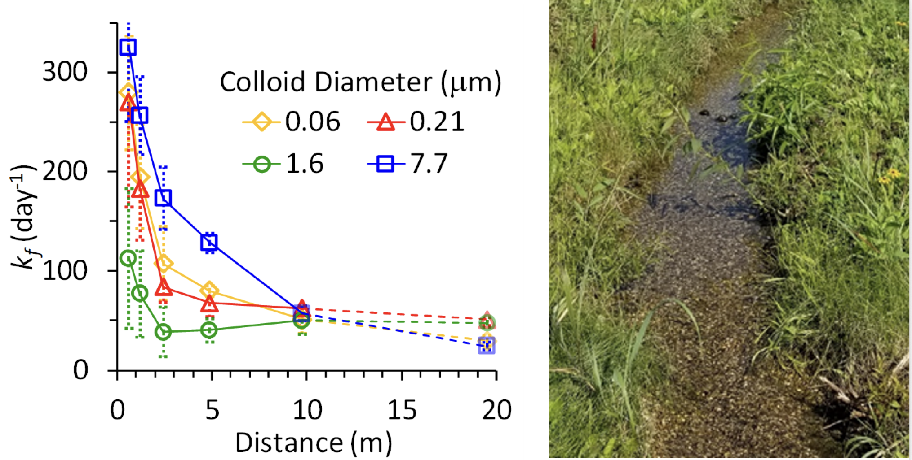
Modest distance of the non-exponential portion –does it deserve attention?
1
Why this matters:
Governs downstream concentrations
Scales with grain size — longer in gravel than sand (Johnson et al., ES&T 2020)
Reflects attachment stochastics driving extended BTEC tailing
The underlying mechanism:
Interception history via stochastics of attachment.
The key insight:
Only nanoscale heterogeneity creates attachment stochastics with contrasting outcomes for identical colloids.
k_{f} = 0
Unfavorable
Log C/C₀
(at L)
Favorable
0
Time
Unfavorable
Log C_{sed}
(at t)
Favorable
Distance from source

Slide 7
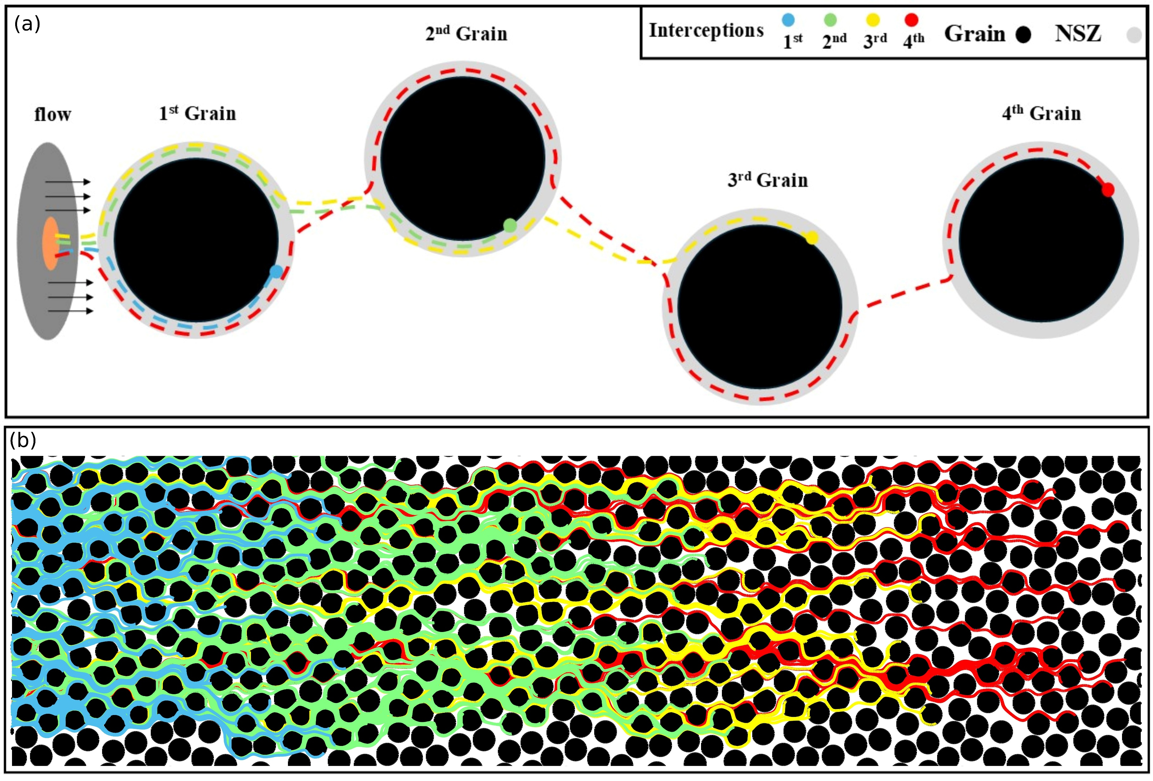
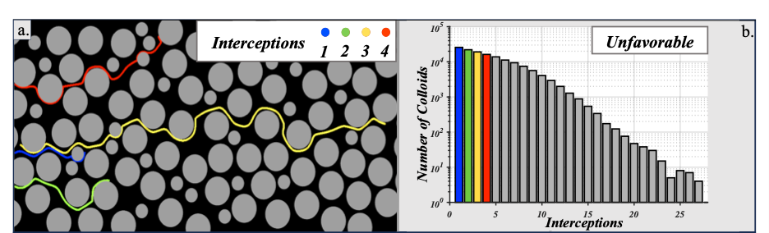
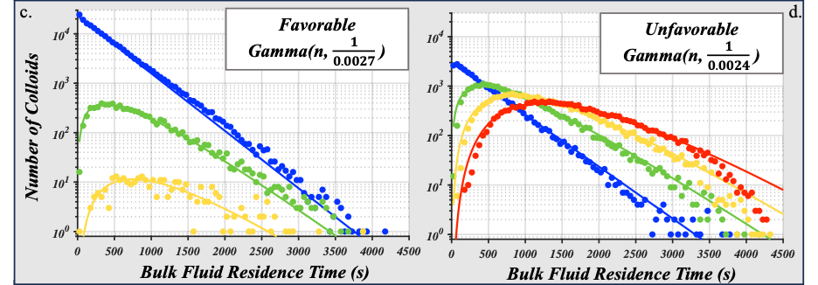
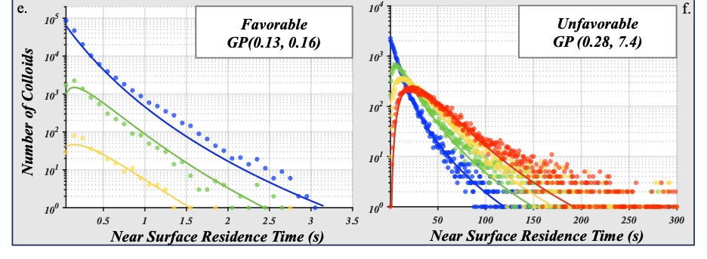








New View: Interception history drives colloid transport variance in porous media
Volponi et al. (2025)
1St
2nd
3rd
4th
$k_{f}$, s=1, $α$
# Attached Colloids
$k_{f}$, s=2
=
$k_{f}$, s=1, $α$
$k_{f}$, s=1, $α$
+
$k_{f}$, s=3
+
+
$k_{f}$, s=1, $α$
=
$k_{f}$, s=1, $α$
$k_{f}$, s=1, $α$
Distance or Bulk Time

Slide 8


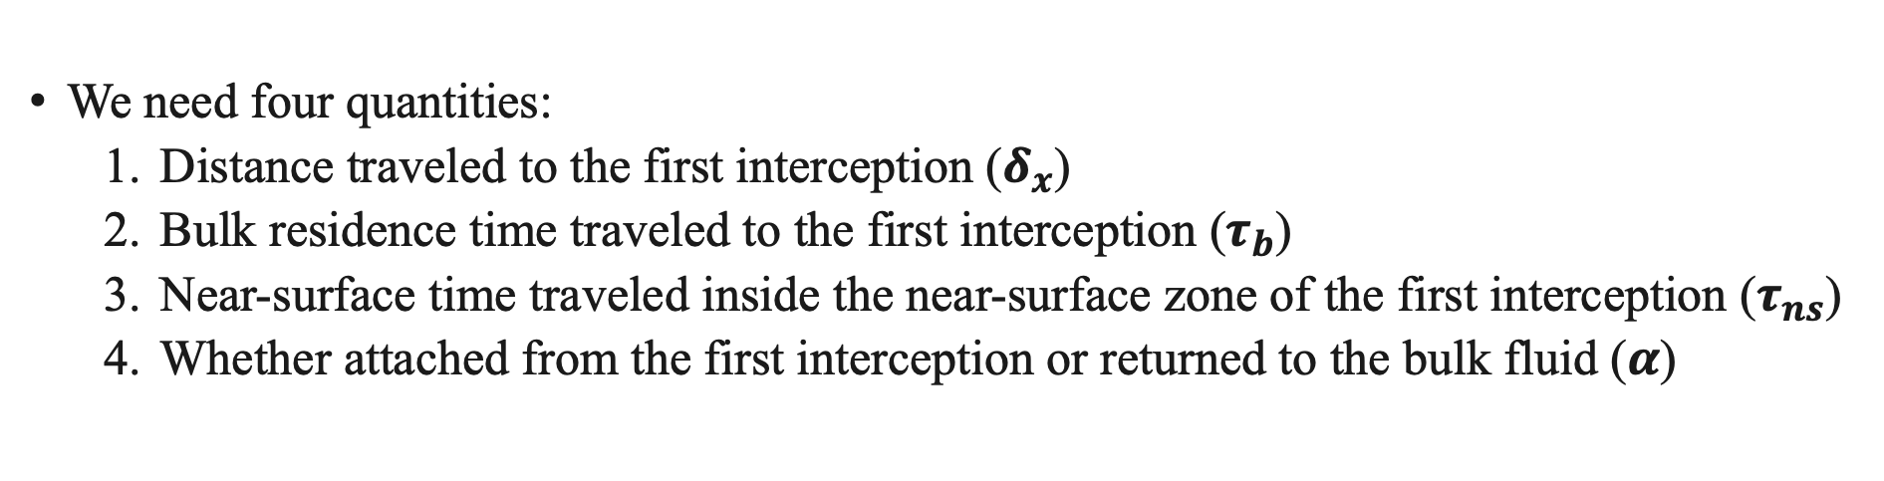

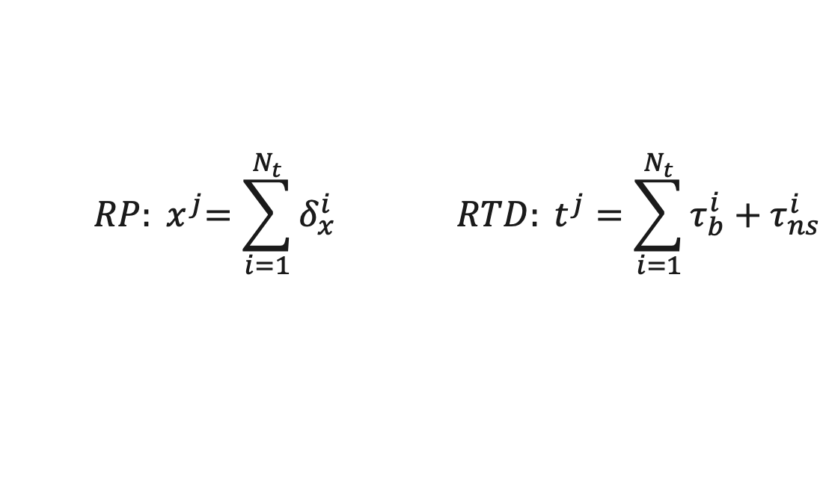






How to Model This
We need four quantities:
  Distance traveled to the first interception ($δ_{x}$)
  Bulk residence time traveled to the first interception ($τ_{b}$)
  Near-surface time traveled inside the near-surface zone of the first interception ($τ_{ns}$)
  Whether attached from the first interception or returned to the bulk fluid ($α$)
$${ RP: x}^{j}=\sum_{i=1}^{N_{t}}{δ_{x}^{i}} RTD: t^{j}=\sum_{i=1}^{N_{t}}{τ_{b}^{i}+τ_{ns}^{i}}$$
$k_{f}$, s=1, $α$
$k_{f}$, s=2
=
$k_{f}$, s=1, $α$
$k_{f}$, s=1, $α$
+
$$j=1,2,…,N_{s} i=1,2,…, N_{t}$$
$k_{f}$, s=3
=
+
+
$k_{f}$, s=1, $α$
$k_{f}$, s=1, $α$
$k_{f}$, s=1, $α$

Slide 9
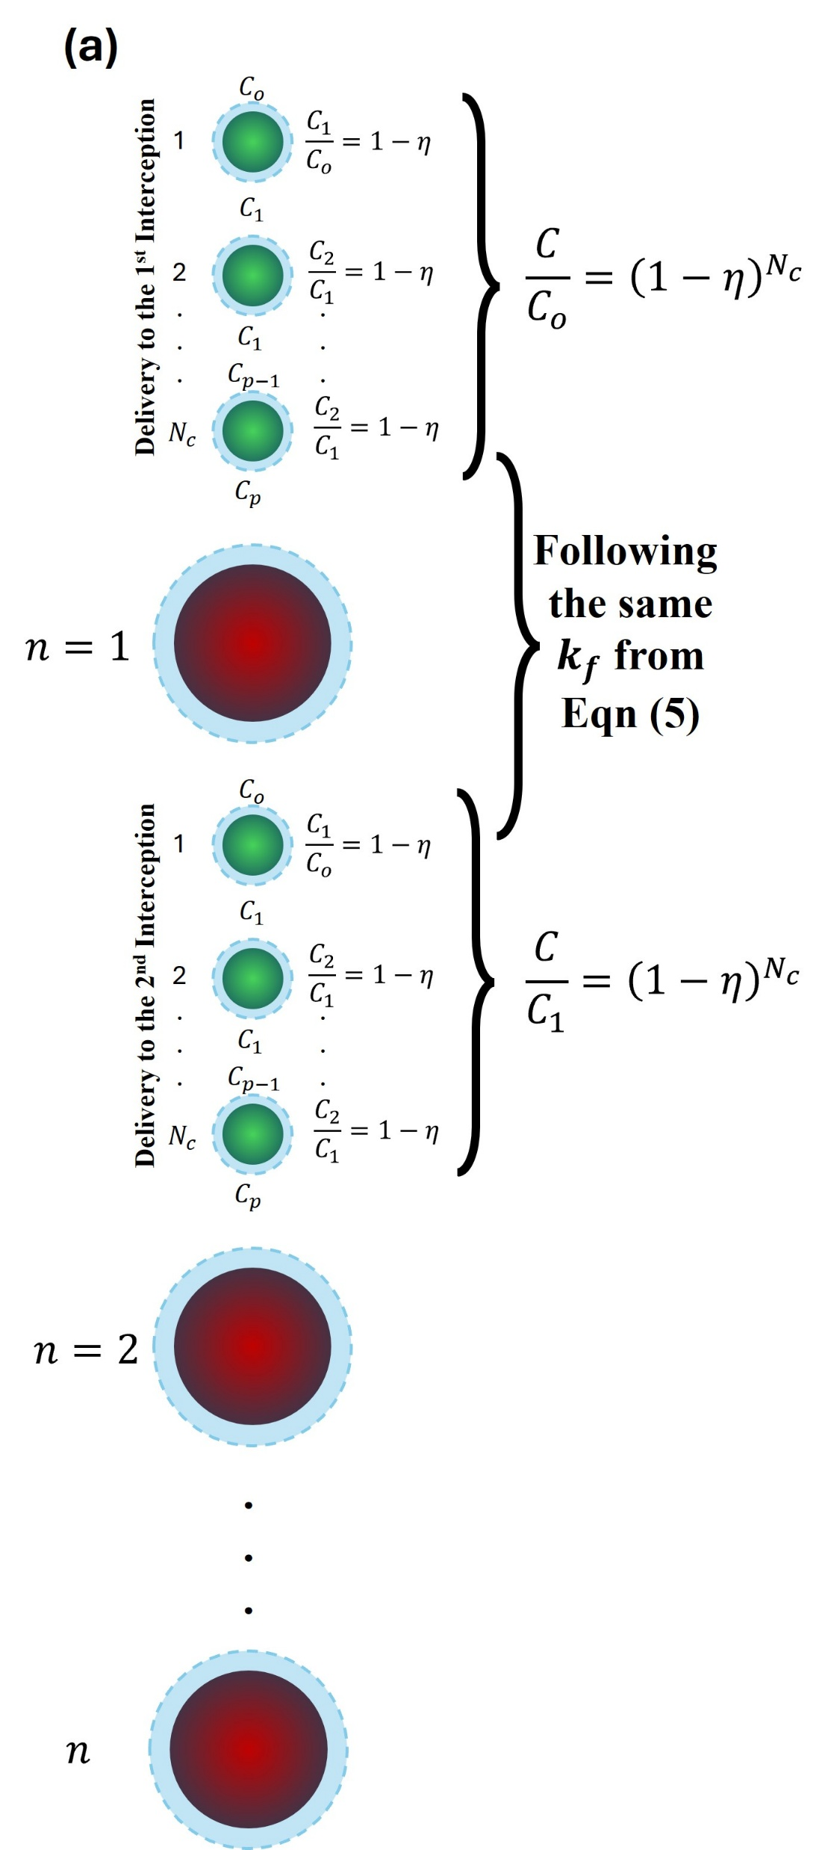
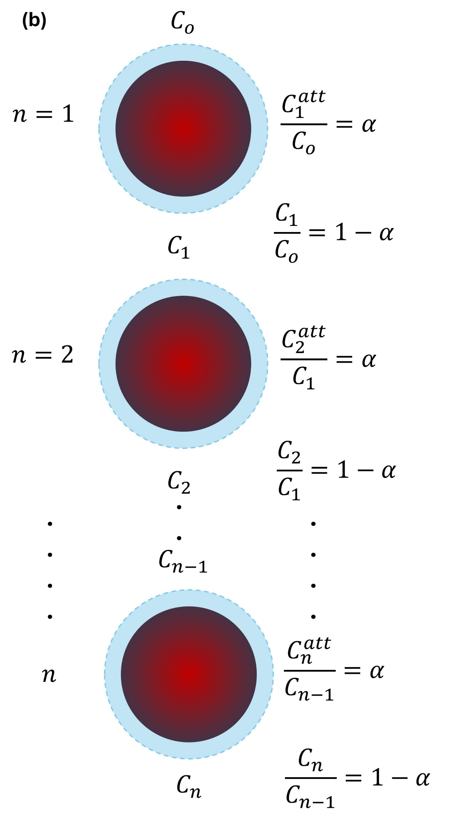
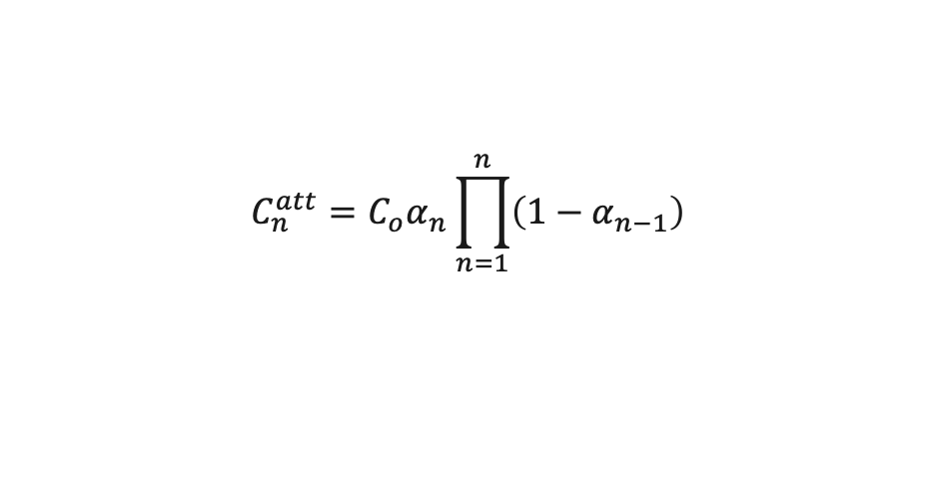
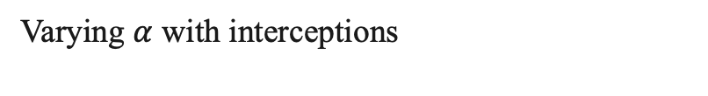
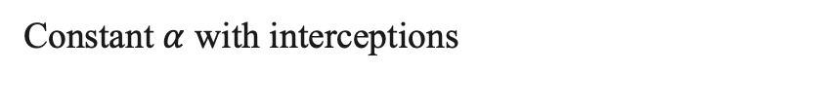

Model Formulation
Upscaling from single interception scale to Darcy scale: repeat the first stage across multi-interceptions, removing a fraction α at each interception.
Constant $α$ with interceptions
$$C_{n}^{att}={C_{o} α\left(1−α\right)}^{n−1}$$
Varying $α$ with interceptions
$$C_{n}^{att}={C_{o}α}_{n}\prod_{n=1}^{n}{\left(1−α_{n−1}\right)}$$

Slide 10
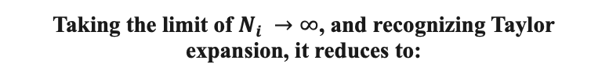
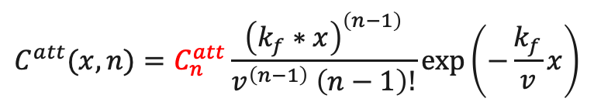
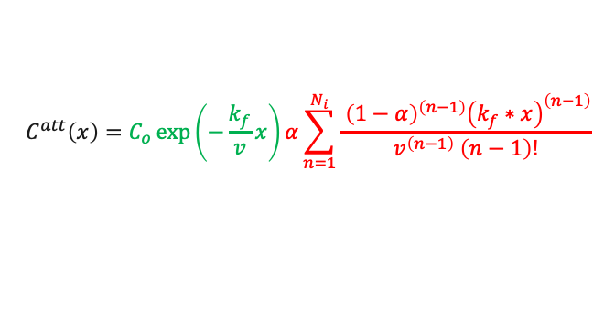
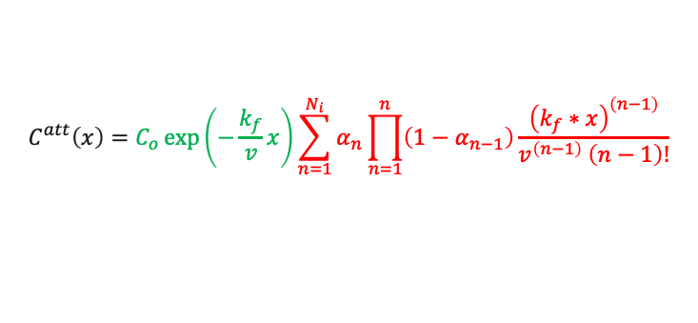
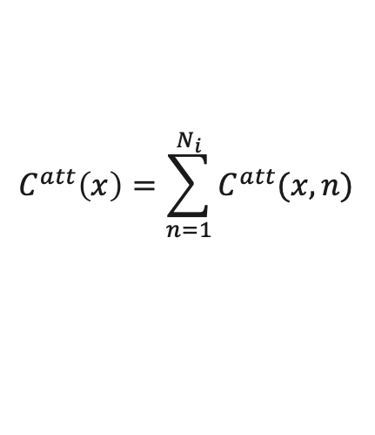
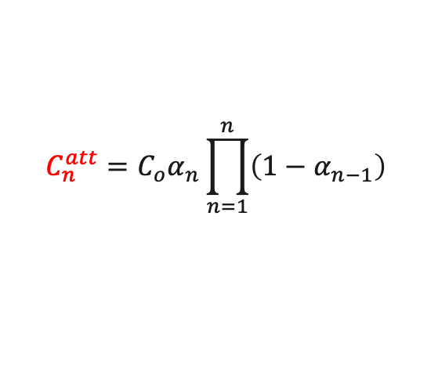

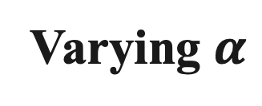
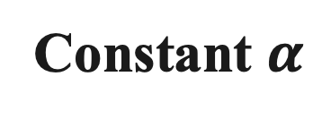
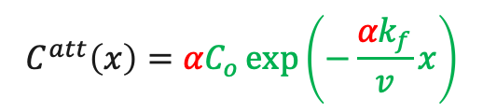
Model Formulation
Upscaling from single interception scale to Darcy scale.
Gamma Distribution
Retention Profile
$$C^{att}(x,n)=C_{n}^{att}\frac{{\left(k_{f}∗x\right)}^{\left(n−1\right)}}{v^{\left(n−1\right)} \left(n−1\right)!}exp⁡\left(−\frac{k_{f}}{v}x\right)$$
$$C^{att}\left(x\right)=\sum_{n=1}^{N_{i}}{C^{att}(x,n)}$$
Constant $α$
Varying $α$
$$C_{n}^{att}={C_{o} α\left(1−α\right)}^{n−1}$$
$$C_{n}^{att}={C_{o}α}_{n}\prod_{n=1}^{n}{\left(1−α_{n−1}\right)}$$
$$C^{att}\left(x\right)=C_{o}\exp\left(−\frac{k_{f}}{v}x\right)α\sum_{n=1}^{N_{i}}{\frac{{ \left(1−α\right)}^{\left(n−1\right)}{\left(k_{f}∗x\right)}^{\left(n−1\right)}}{v^{\left(n−1\right)} \left(n−1\right)!}}$$
$$C^{att}\left(x\right)=C_{o}\exp\left(−\frac{k_{f}}{v}x\right)\sum_{n=1}^{N_{i}}{α_{n}\prod_{n=1}^{n}{\left(1−α_{n−1}\right)}\frac{{\left(k_{f}∗x\right)}^{\left(n−1\right)}}{v^{\left(n−1\right)} \left(n−1\right)!}}$$
CFT
New Terms
CFT
New Terms
Taking the limit of $N_{i} →∞$, and recognizing Taylor expansion, it reduces to:
$$C^{att}\left(x\right)={αC}_{o}\exp\left(−\frac{{αk}_{f}}{v}x\right)$$
Exponential RPs
Non-Exponential RPs

Slide 11
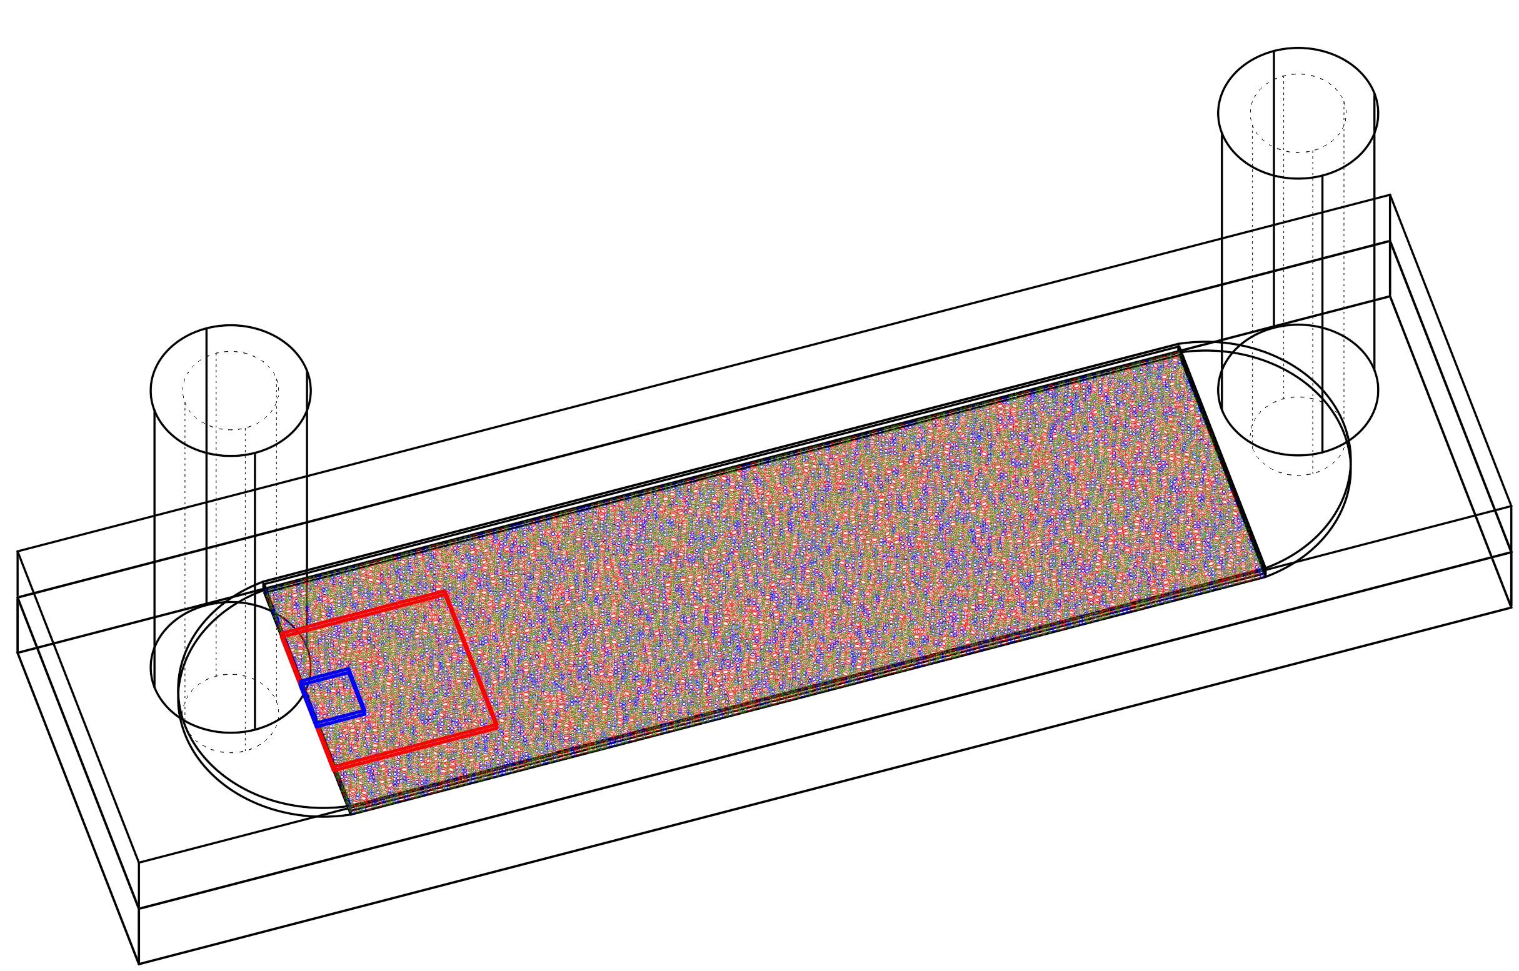
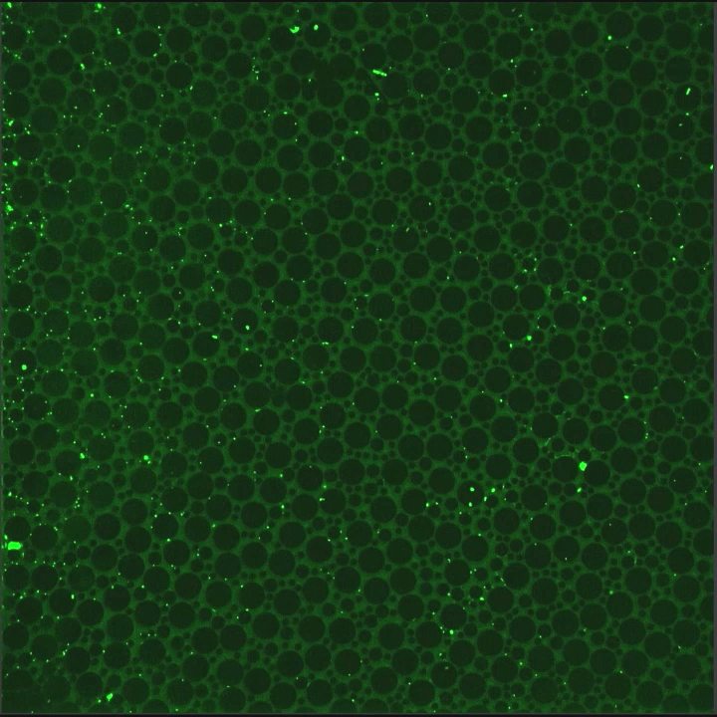
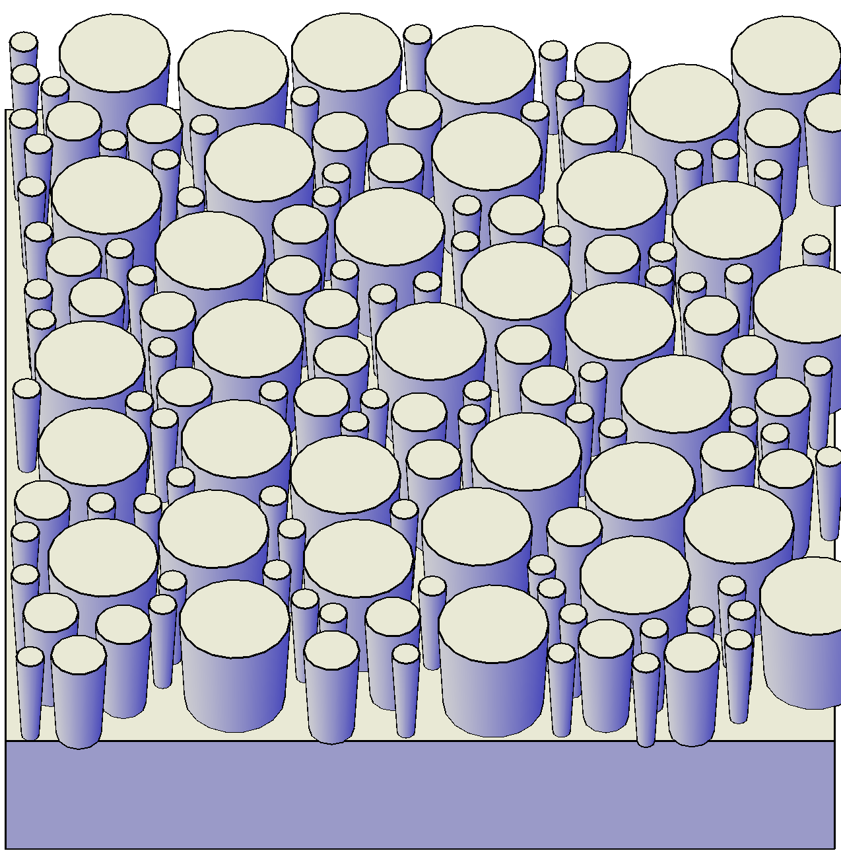
Experimental Confirmation
Outlet
Inlet
Pore network — interception history
Setup
Silica 2-D porous media (n = 0.37) with 200, 100, and 50 μm diameter cylinders in a 200 μm-thick chamber.
1 μm fluorescent carboxylate-modified polystyrene microspheres.
IS = 5.4 mM • pH = 6.5

Slide 12
Confirmation
SIMULATIONS · interceptions from separation distance
EXPERIMENTS · interceptions from velocity
Outlet
Inlet
1
Interception order
2
3
Log # colloids
4
Distance (μm)
Volponi et al., ES&T,
59(6) 2025
Johnson et al.,2025 ES&T,
Distance
Single interception attachers: exponential · Multiple interception attachers: gamma

Slide 13
Attached colloid profiles
Favorable
Unfavorable
Experiments
Johnson et al., ES&T,
2025
Simulations

Slide 14
Attached colloid profiles
Favorable
Unfavorable
Experiments
Johnson et al., ES&T,
2025
Simulations

Slide 15

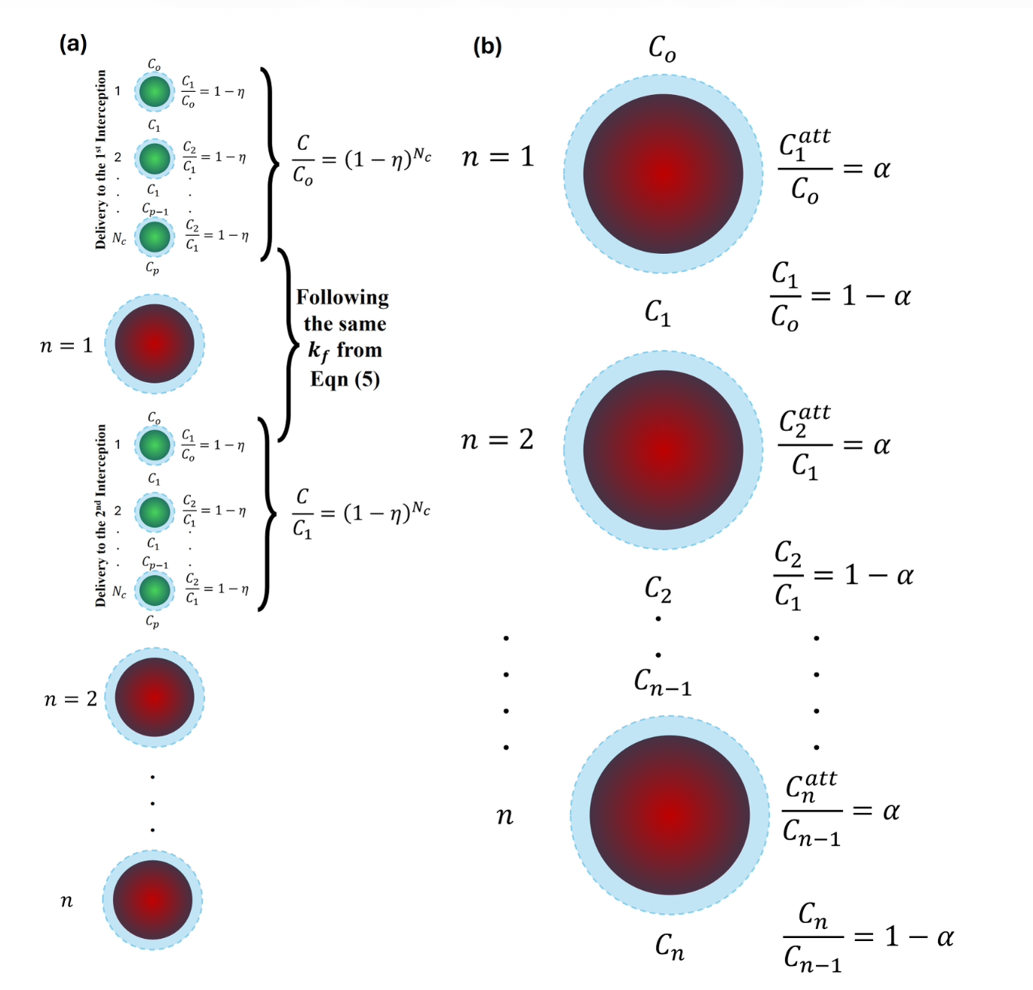
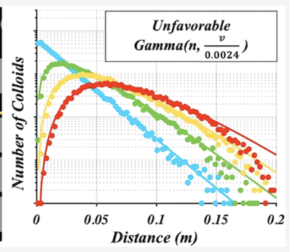
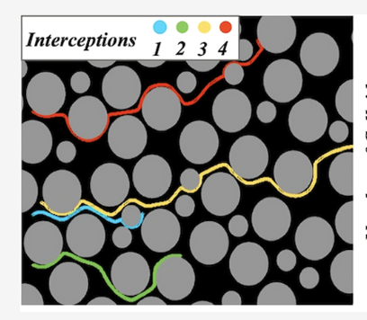
Questions?
Interception history drives colloid transport variance in porous media
Volponi, Al-Zghoul, Porta, Bolster, Johnson
Environ. Sci. Technol. 59(6), 3165–3171 (2025)
1
A training trajectory random walk model for upscaling colloid transport under favorable and unfavorable conditions
Al-Zghoul, Johnson, Bolster
Advances in Water Resources 196, 104878 (2025)
2
A paradigm shift in colloid filtration: upscaling from grain to Darcy scale
Al-Zghoul, Johnson, Bolster
ARC Geophysical Research 1(1) (2025)
3
Experimental confirmation of the interception history paradigm for colloid (micro and nanoparticle) transport in porous media
Johnson, Ullauri, Al-Zghoul, Bolster
Environ. Sci. Technol. 59(18), 9275–9284 (2025)
4

