Slide 1
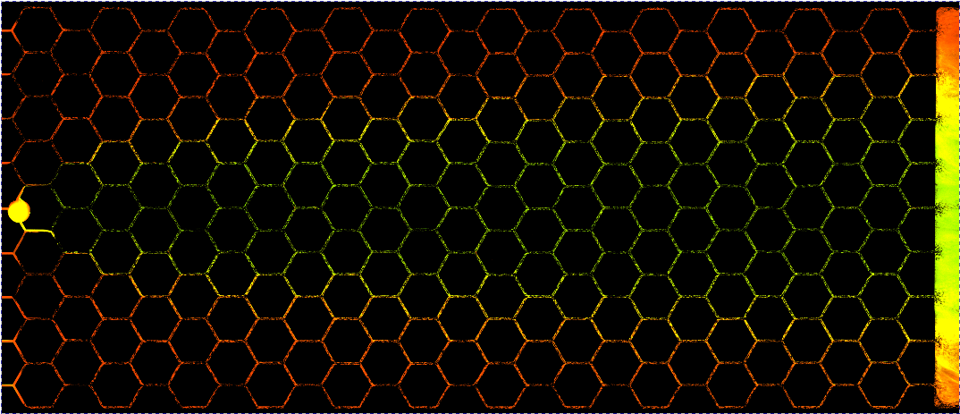










Hydrodynamic dispersion in flowing networks induces bacterial (mis)communication
Despoina Anastasopoulou | Gabriel Ramos | Julien Lefort | Peter Redder | Tanguy Le Borgne | Yohan Davit

Slide 2
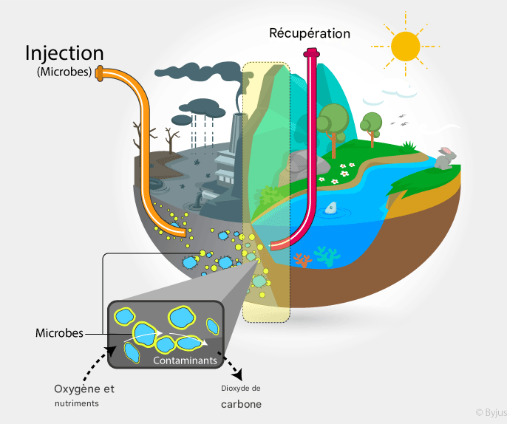
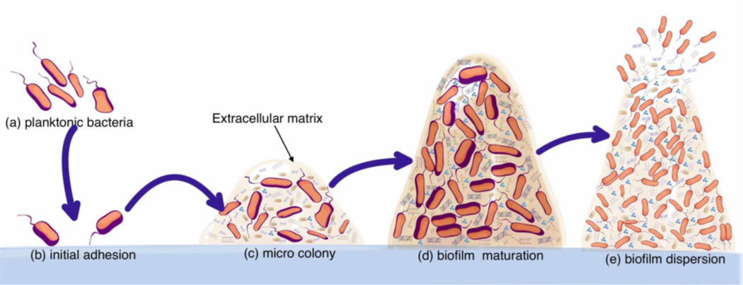
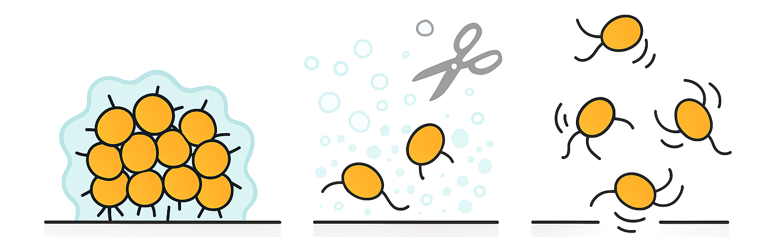
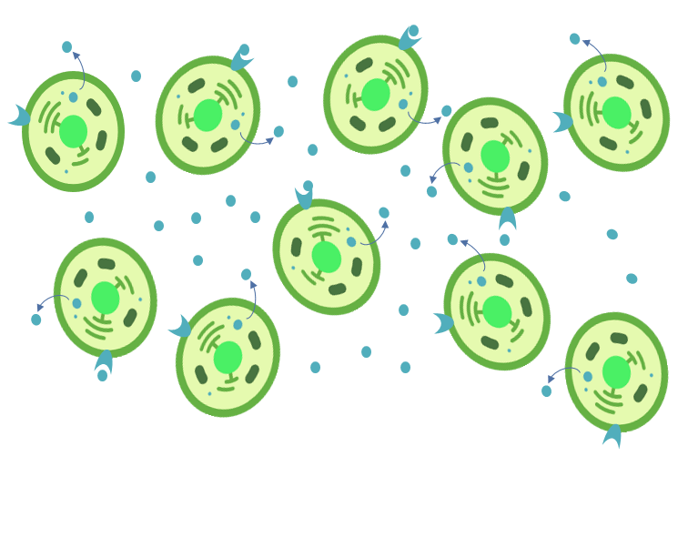
Bacterial Biofilms and Quorum Sensing (QS)
Bioremediation
Formation stages
Ma et al., Front. Cell. Infect. Microbiol., 2022
QS regulates
Alexia Delpont
QS ON:
-High population density
-Gene regulation
-Synchronized behavior
-Emergent properties
EPS
surface adhesins
surfactants degrading enzymes
motility

Slide 3
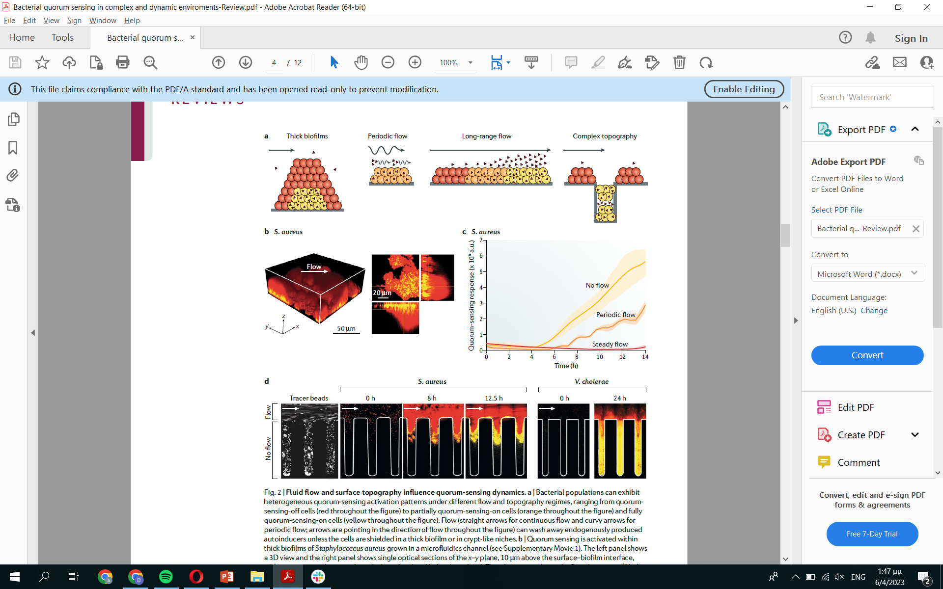
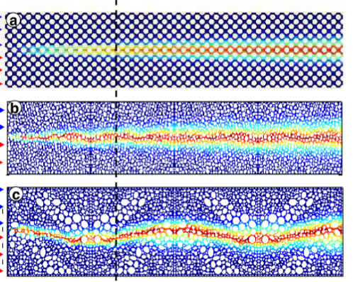
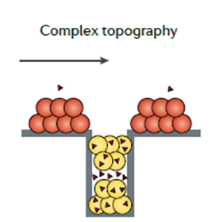
Bacterial Biofilms and Quorum Sensing under flow
Acharya R. et al., Water Resources Research, 2007
Kim et al., Nat. Microbiol., 2016
Heterogeneities in the flow yield a spatially distributed QS response
The heterogeneity of flow paths give rise to dispersion due to velocity variations

Slide 4

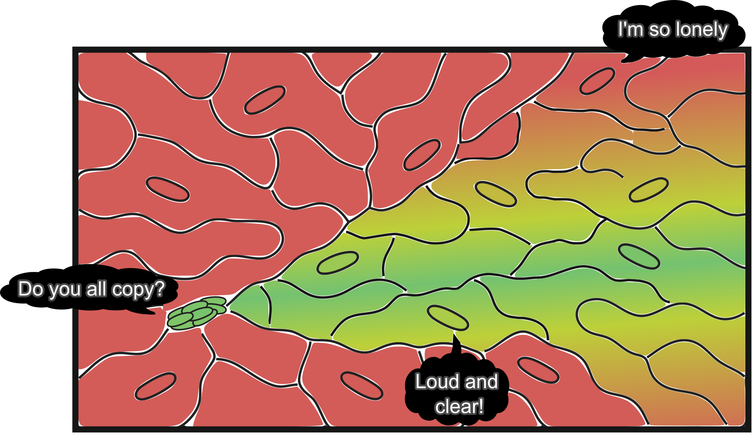
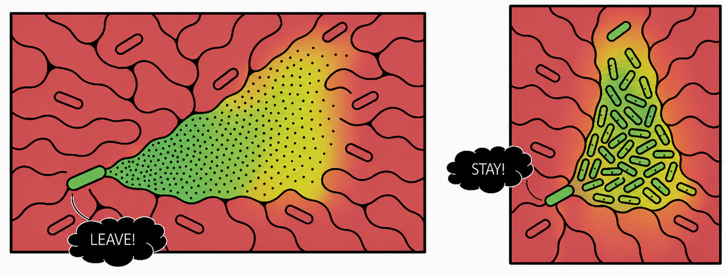
Flow and Mass transport
A
Mass transport phenomena
Quorum Sensing
Dispersion
Biofilm formation
Biofilm dispersal
Bio-clogging
B
How dispersion affects QS in porous media?
B. How dispersion of QS signal affects bio-clogging?

Slide 5
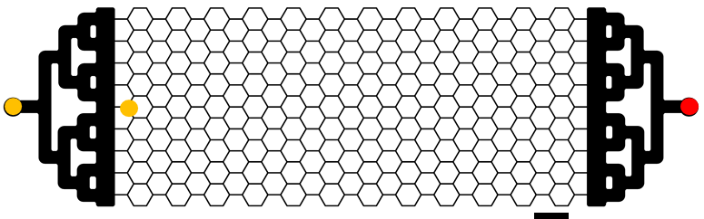
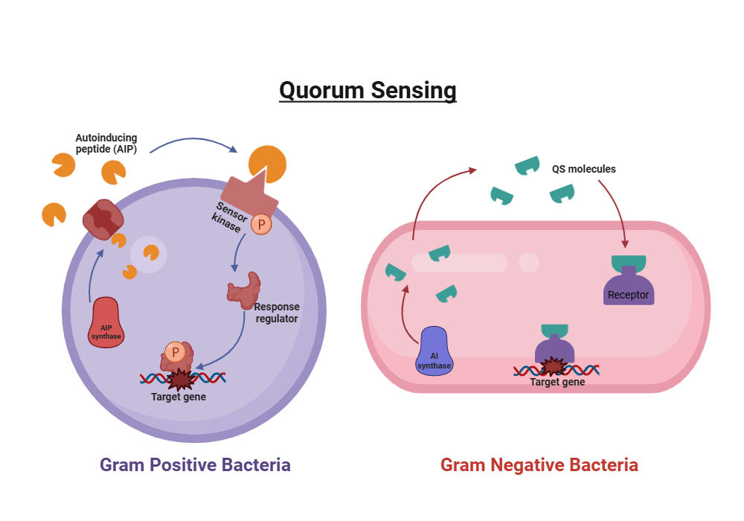

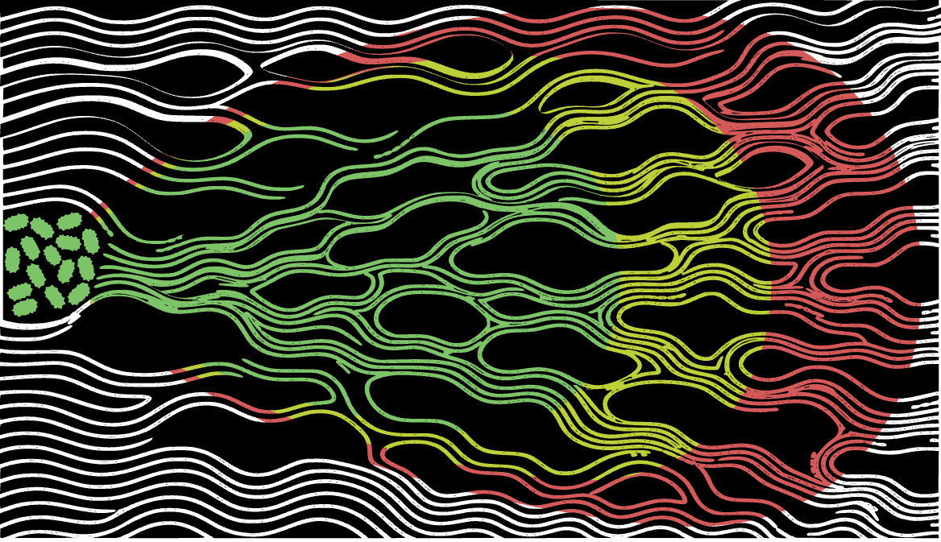



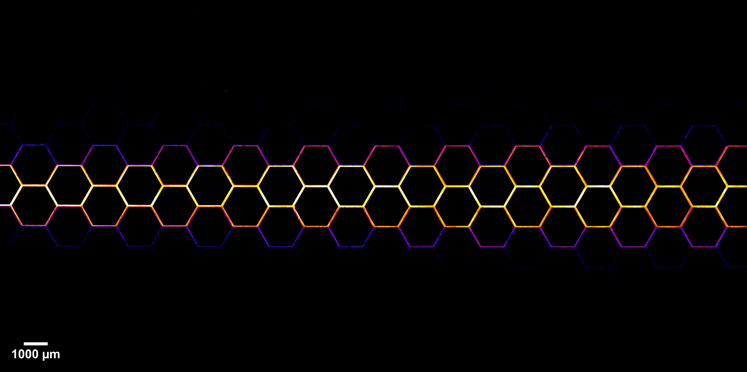
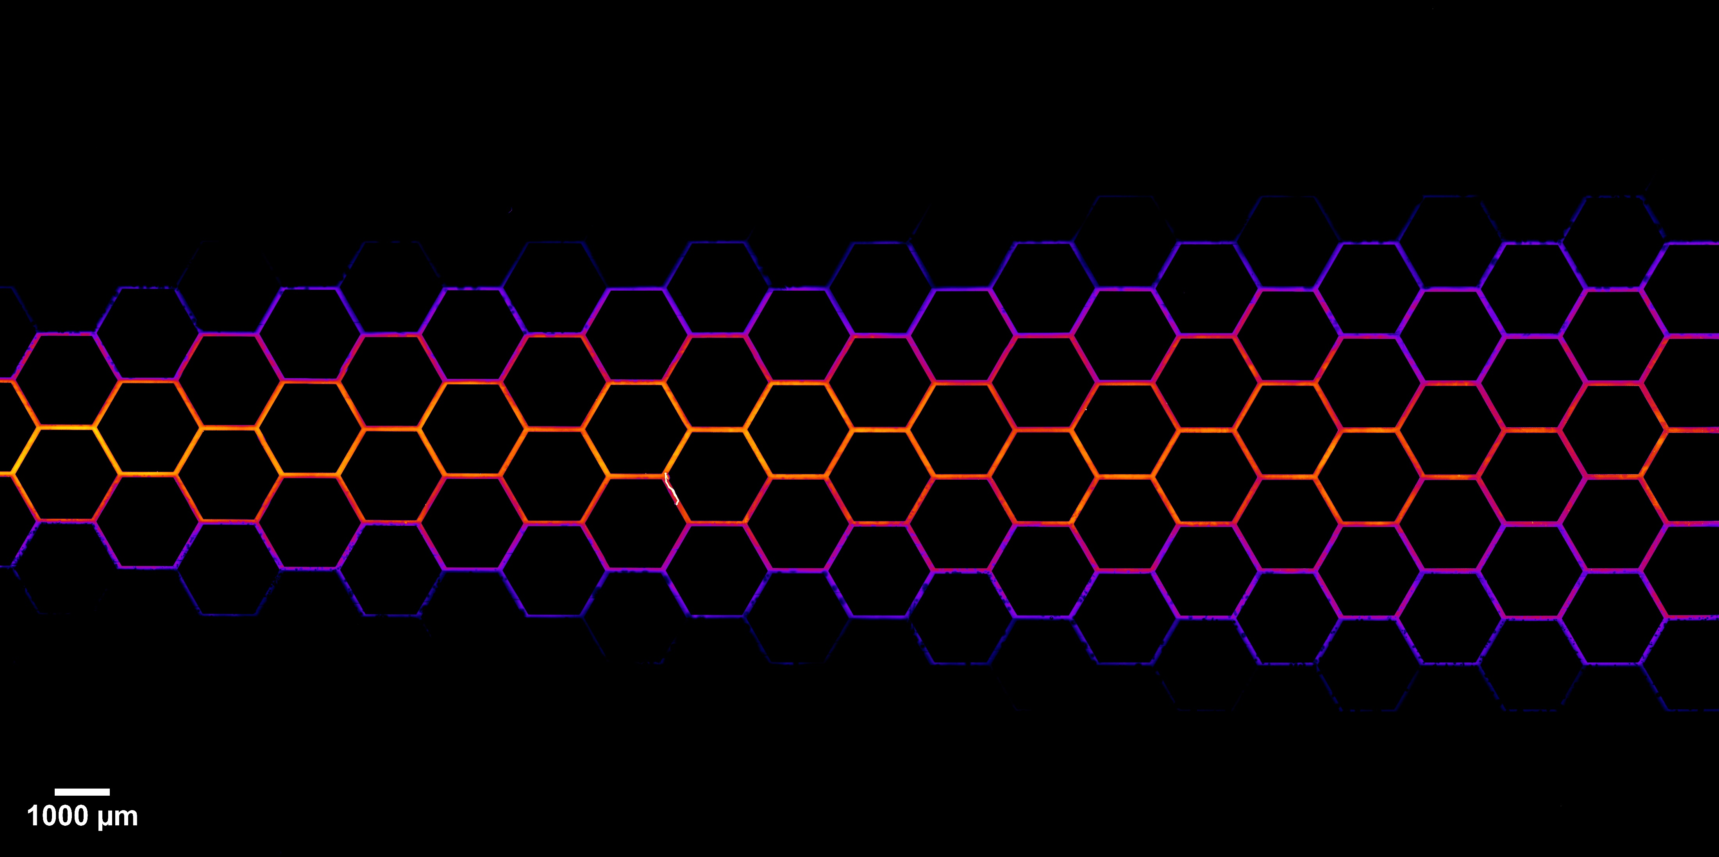
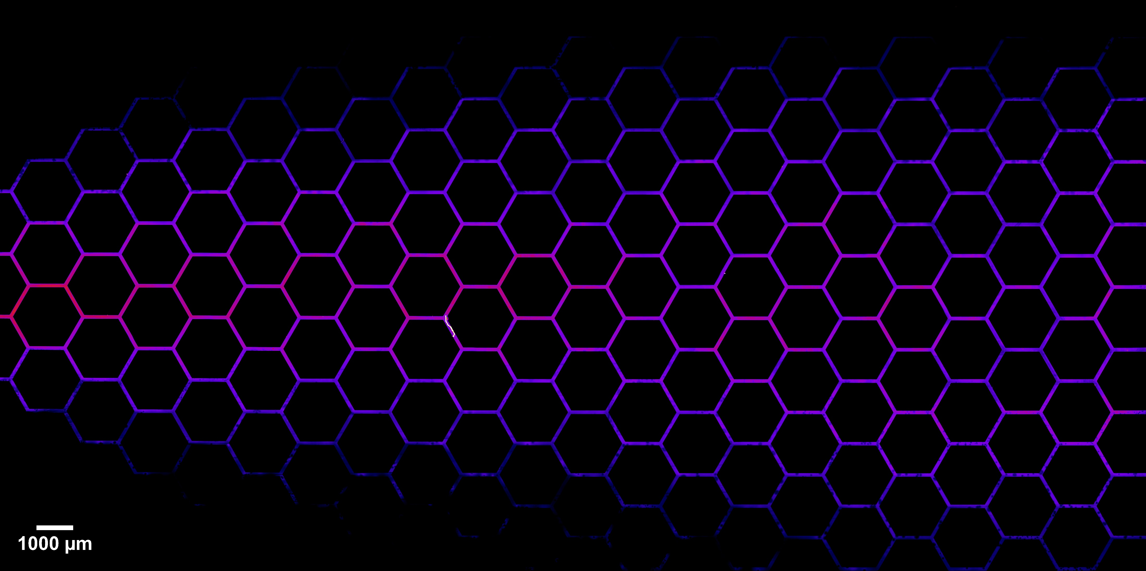
The setup
Staphylococcus aureus
background fluid inlet
outlet
sarAP1-mkate
QS-OFF
agrP3-gfpmut2
QS-ON
colony mimicking inlet
Pe 1000
Pe 100
Pe 10

Slide 6
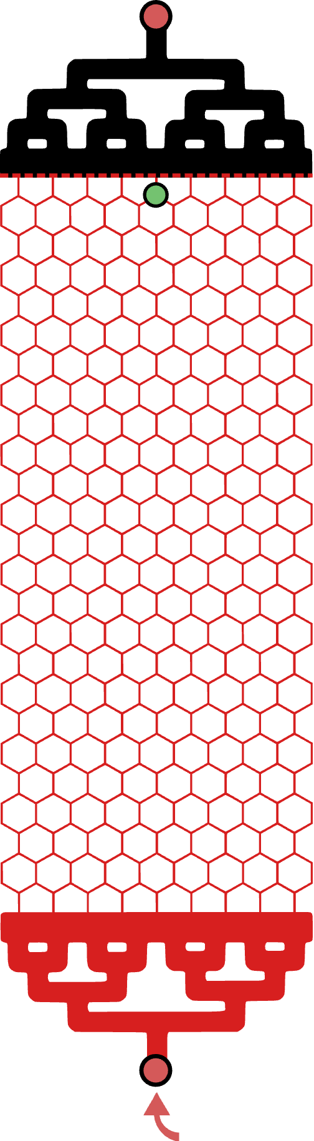
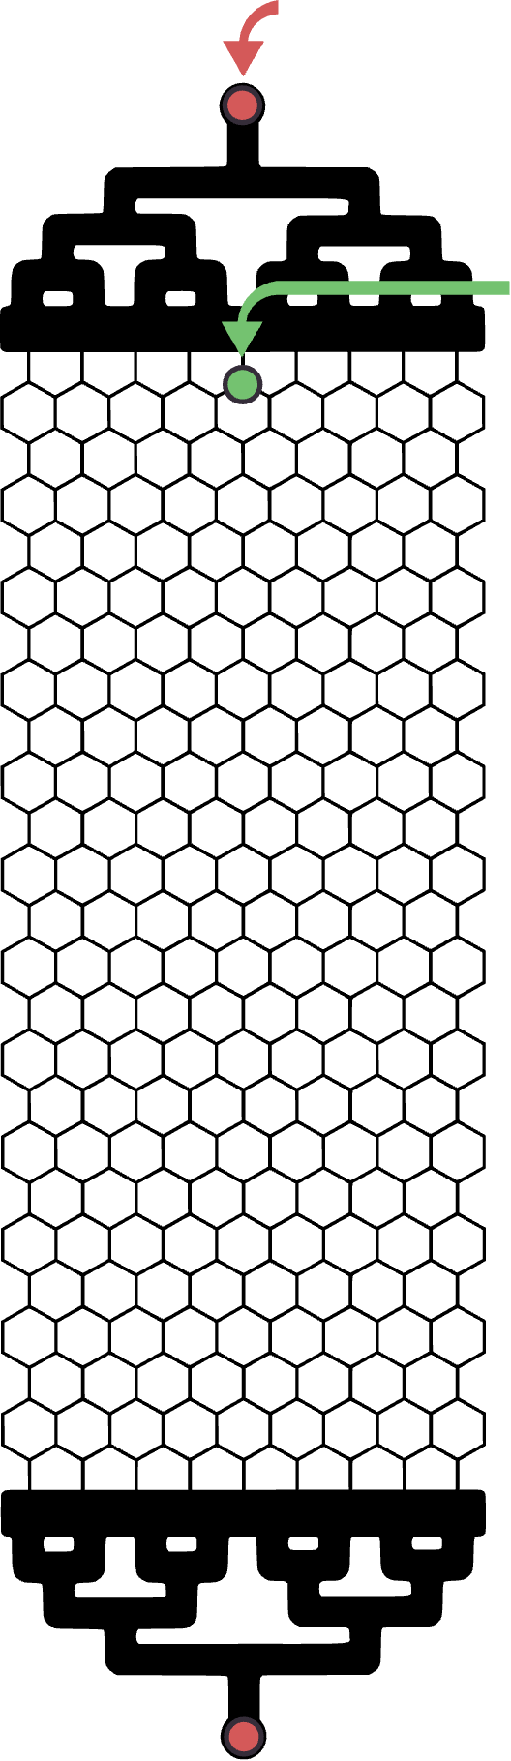

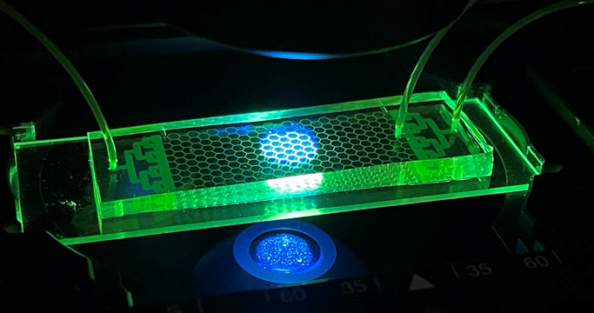
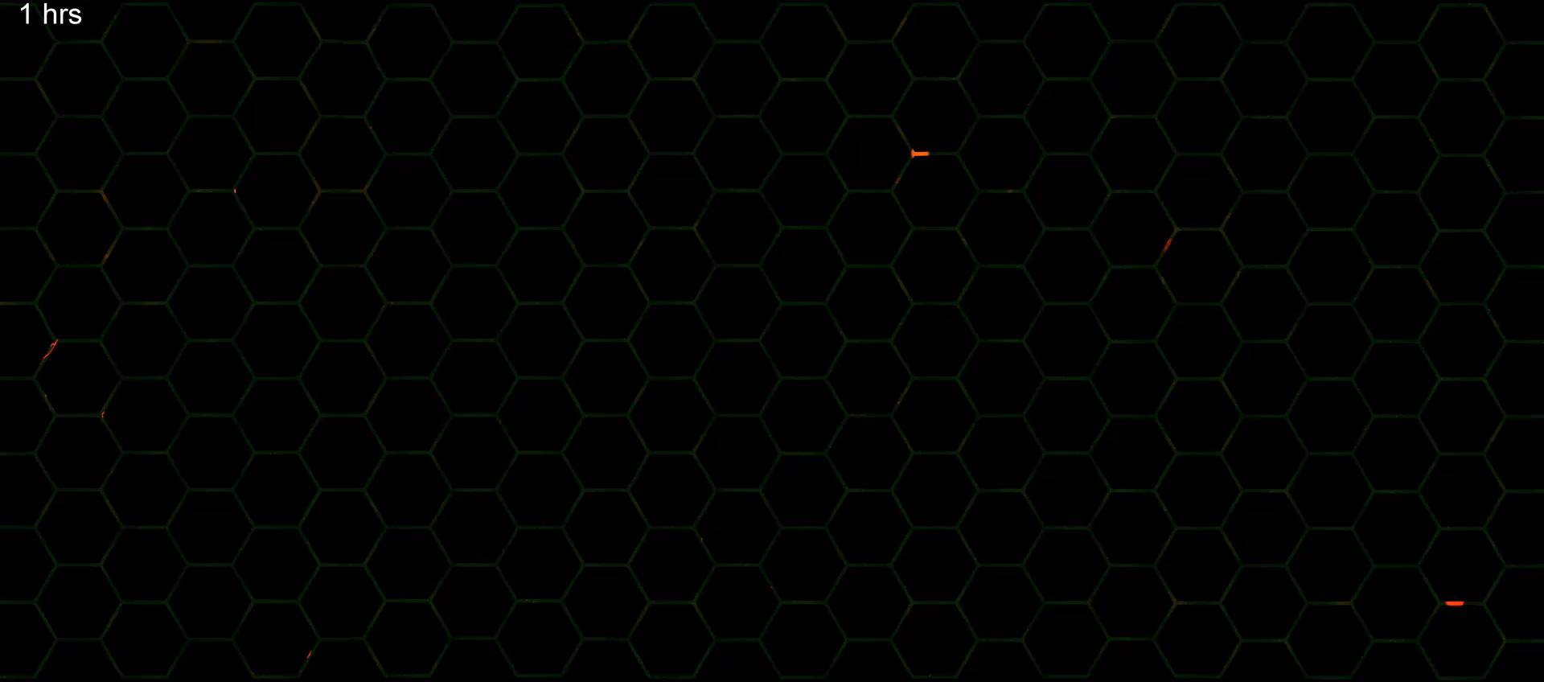
The experiment
LB+antibiotic flow
Seeding with inoculum OD~0.2 for 20min
controlled AIP-I flow
Auto-inducing peptide = communication molecule
Fluorescence microscopy timelapse

Slide 7
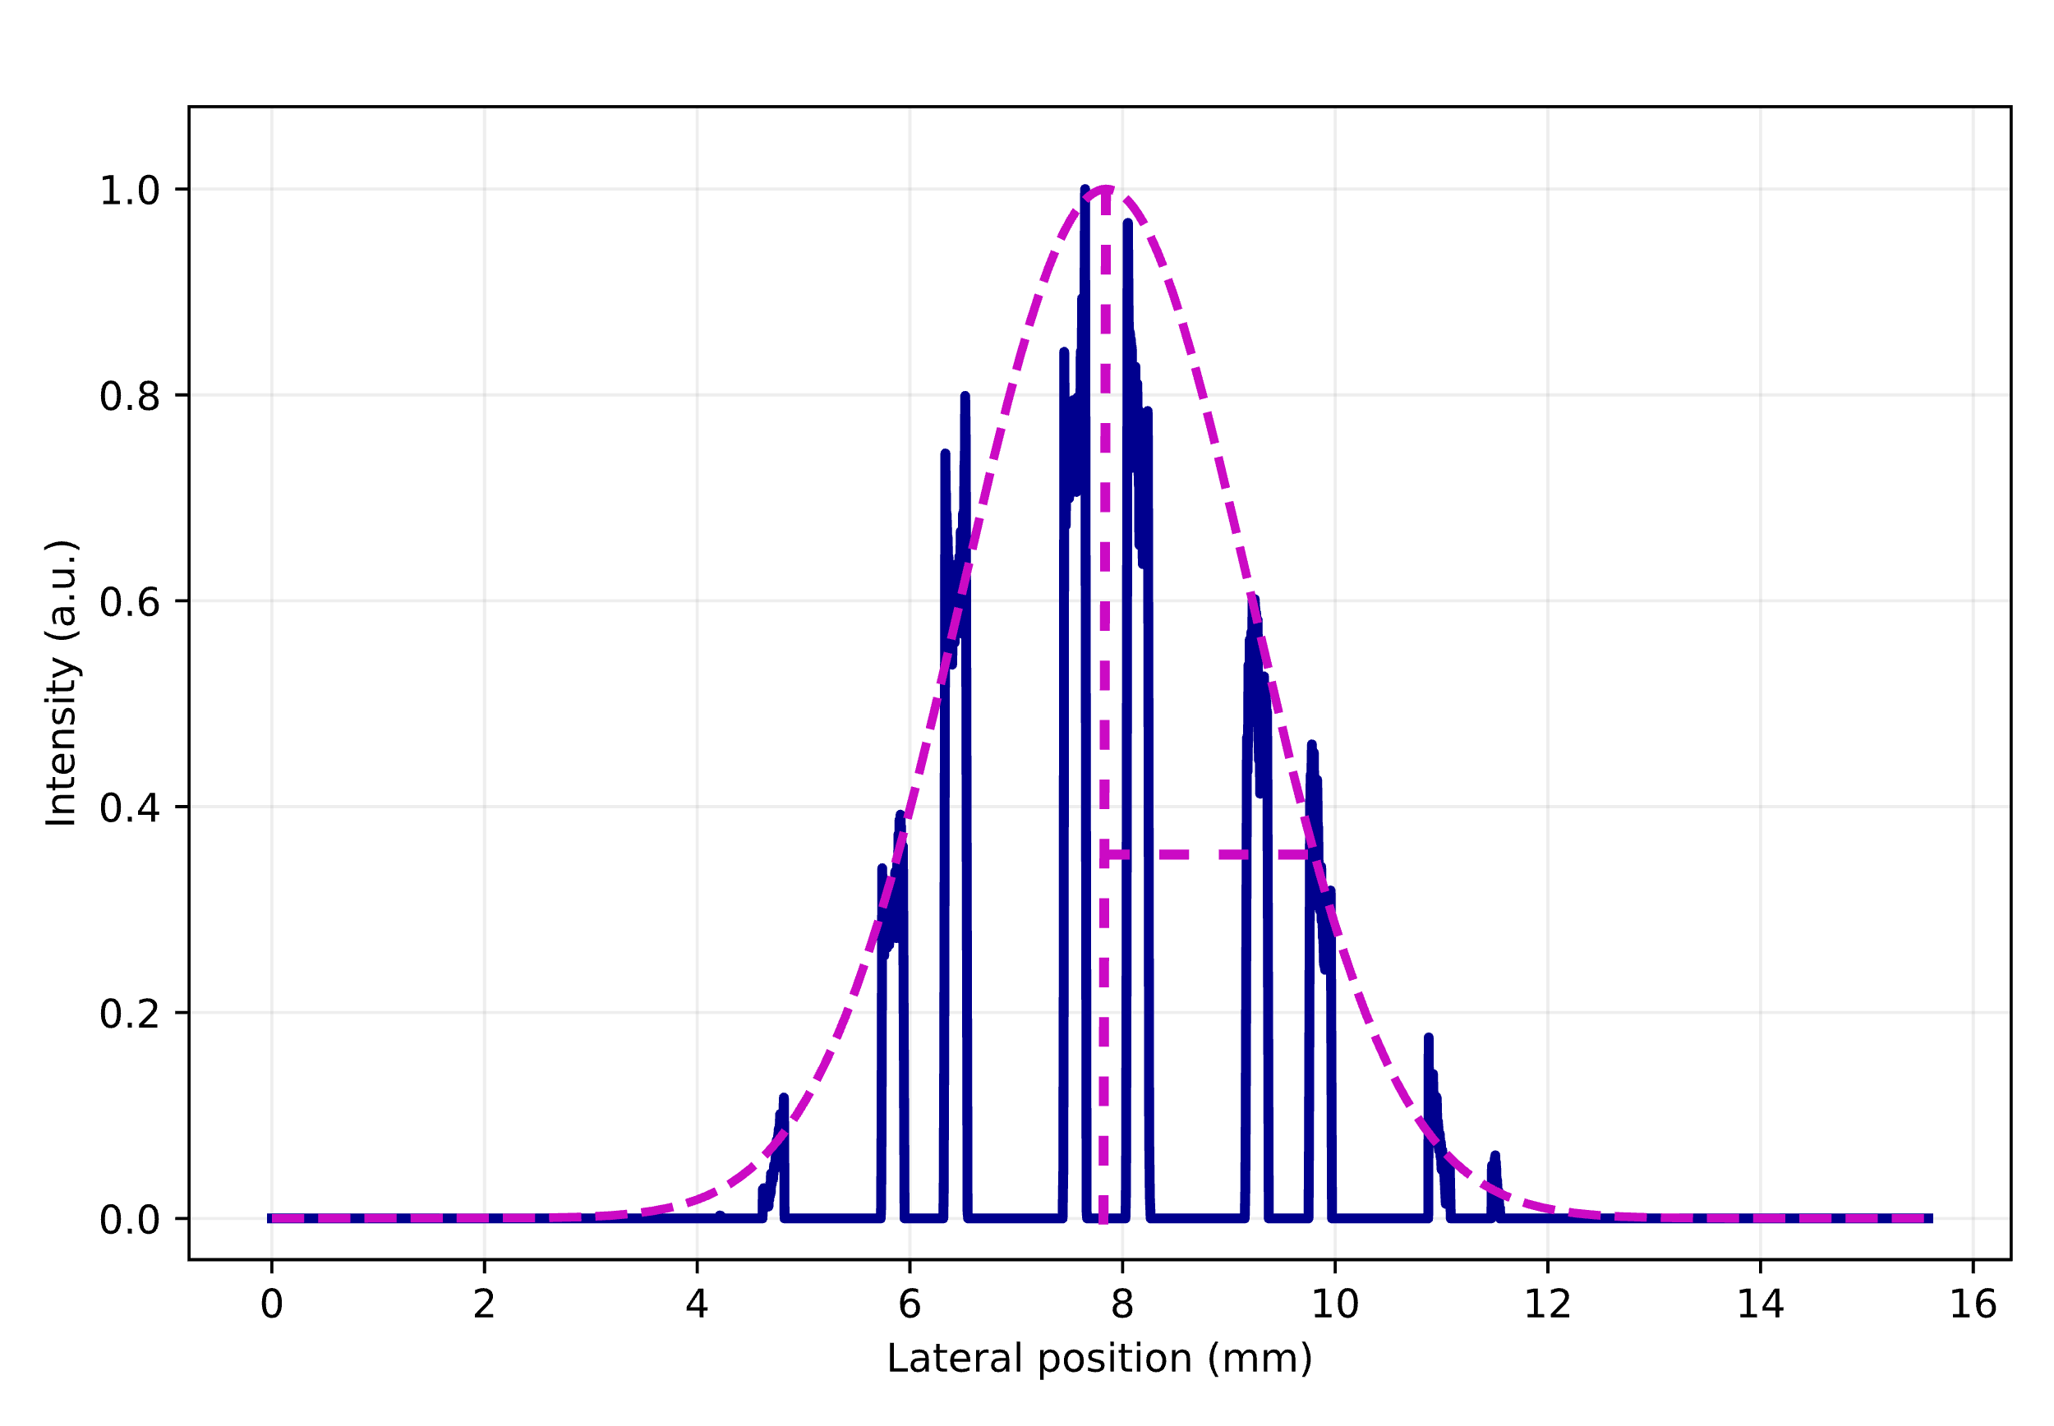



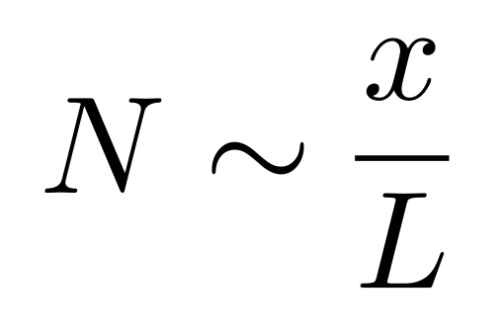
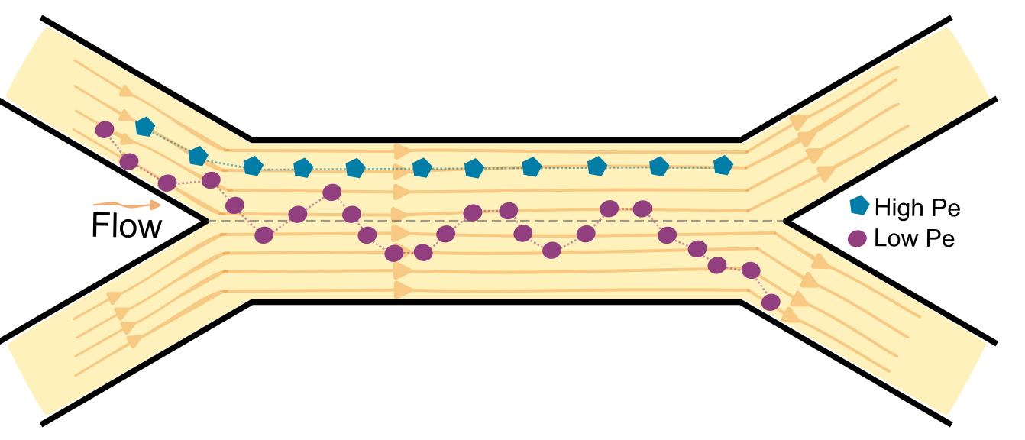
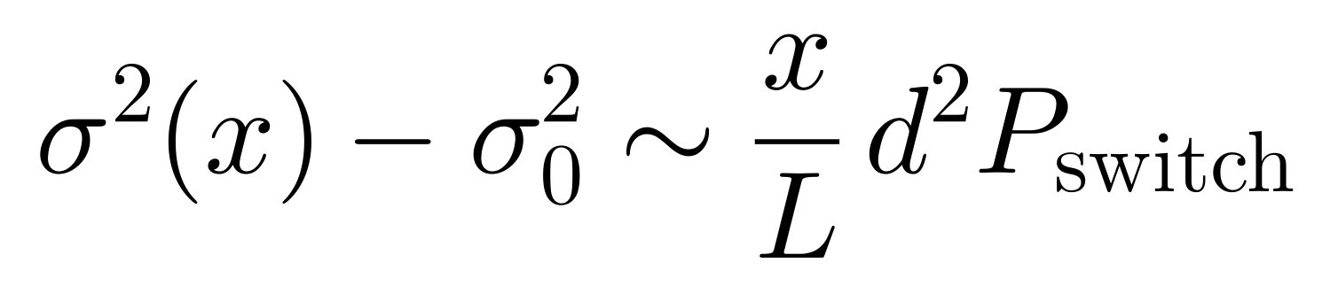
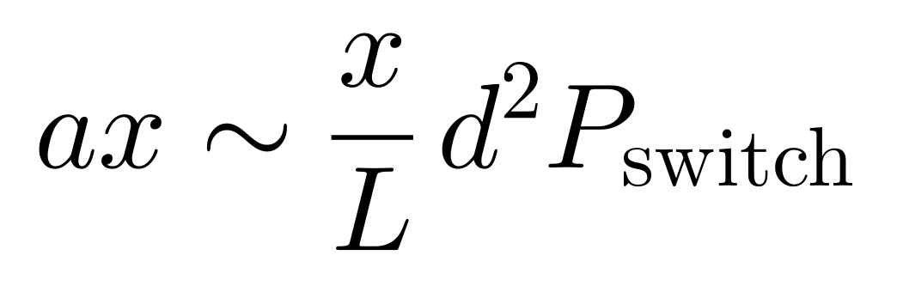
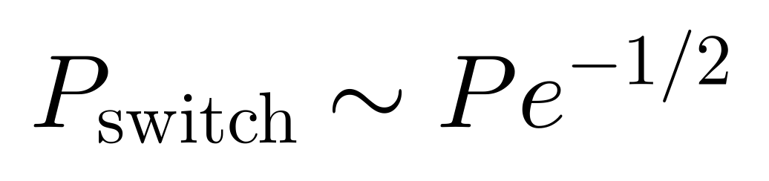
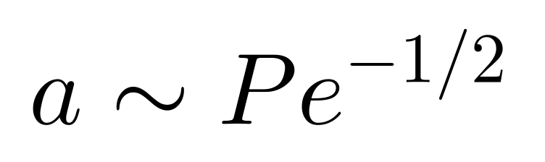
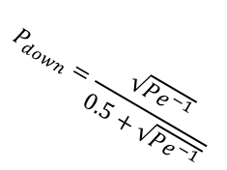
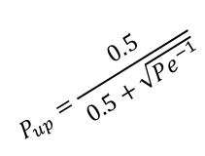
Advection-Dispersion plume model
C_{c}(x)
Gaussian distribution:
for concentration becomes:
σ(x)
spreading:
From Random-Walk with Telegraphic noise stochastic model:
Number of pore steps travelled for x distance:
DOWN branch
$$P_{up}=\frac{0.5}{0.5+\sqrt{{Pe}^{−1}}}$$
From stochastic to dispersivity:
UP branch
$$P_{down}=\frac{\sqrt{{Pe}^{−1}}}{0.5+\sqrt{{Pe}^{−1}}}$$

Slide 8
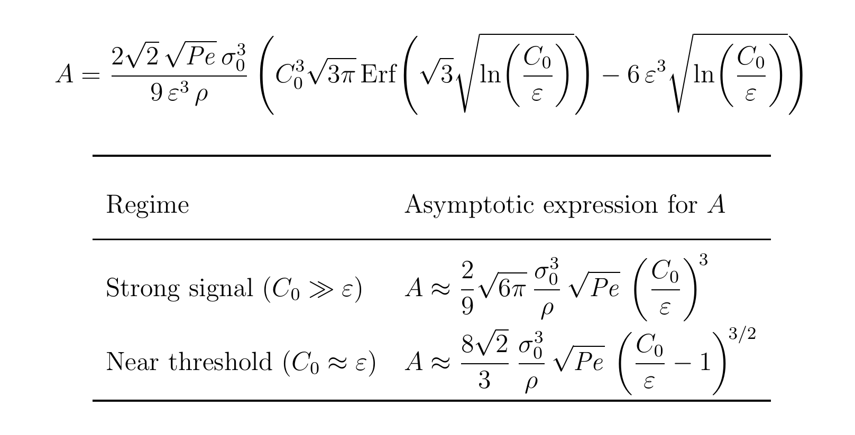
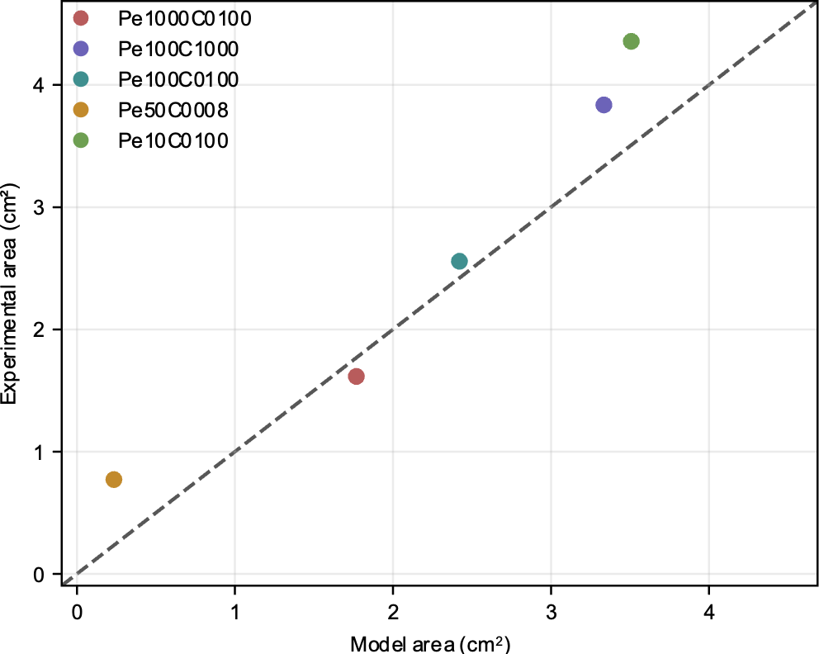
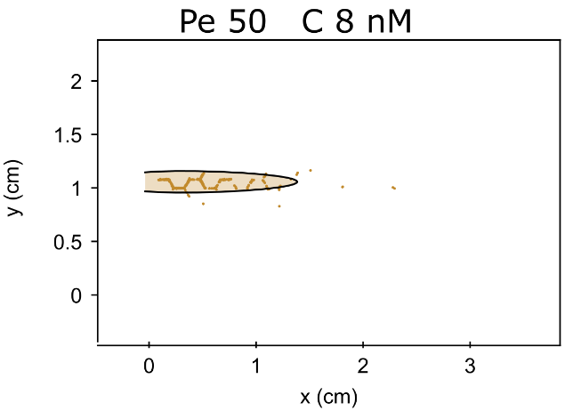
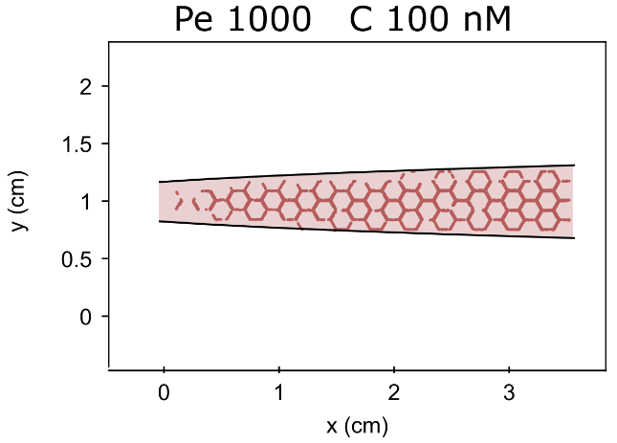
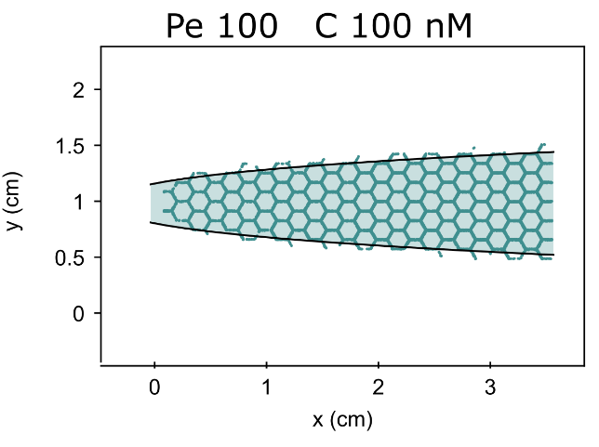
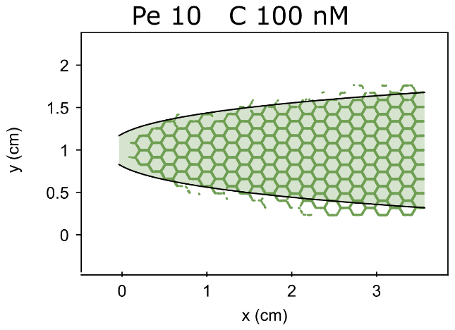
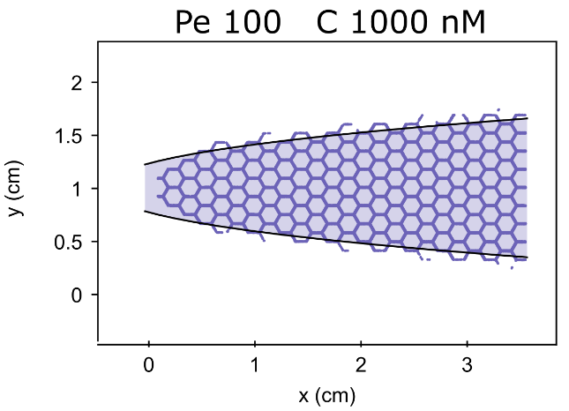
Advection-Dispersion model and cell clusters response

Slide 9
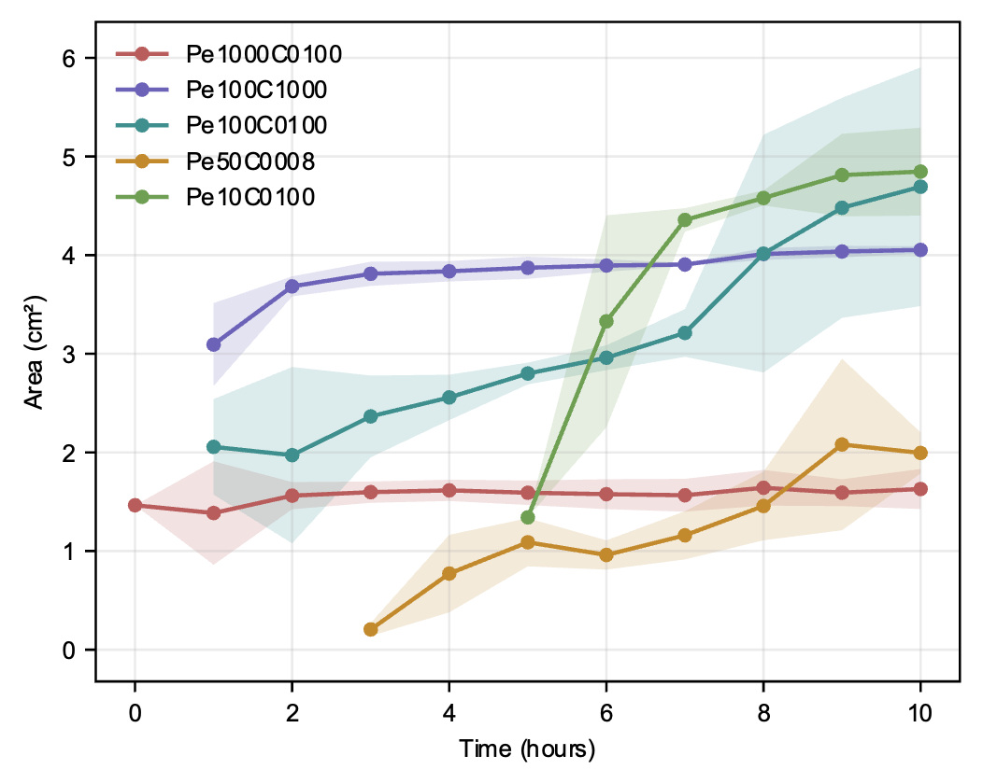
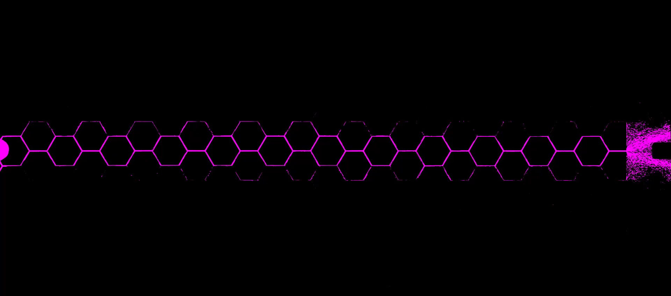
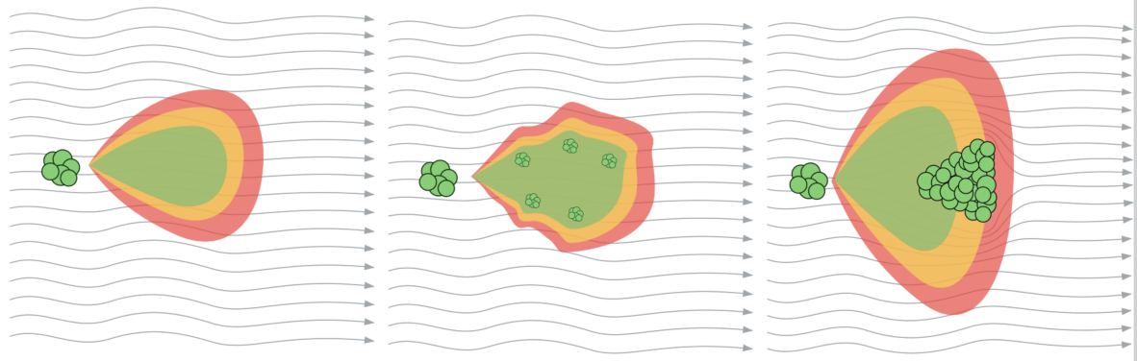
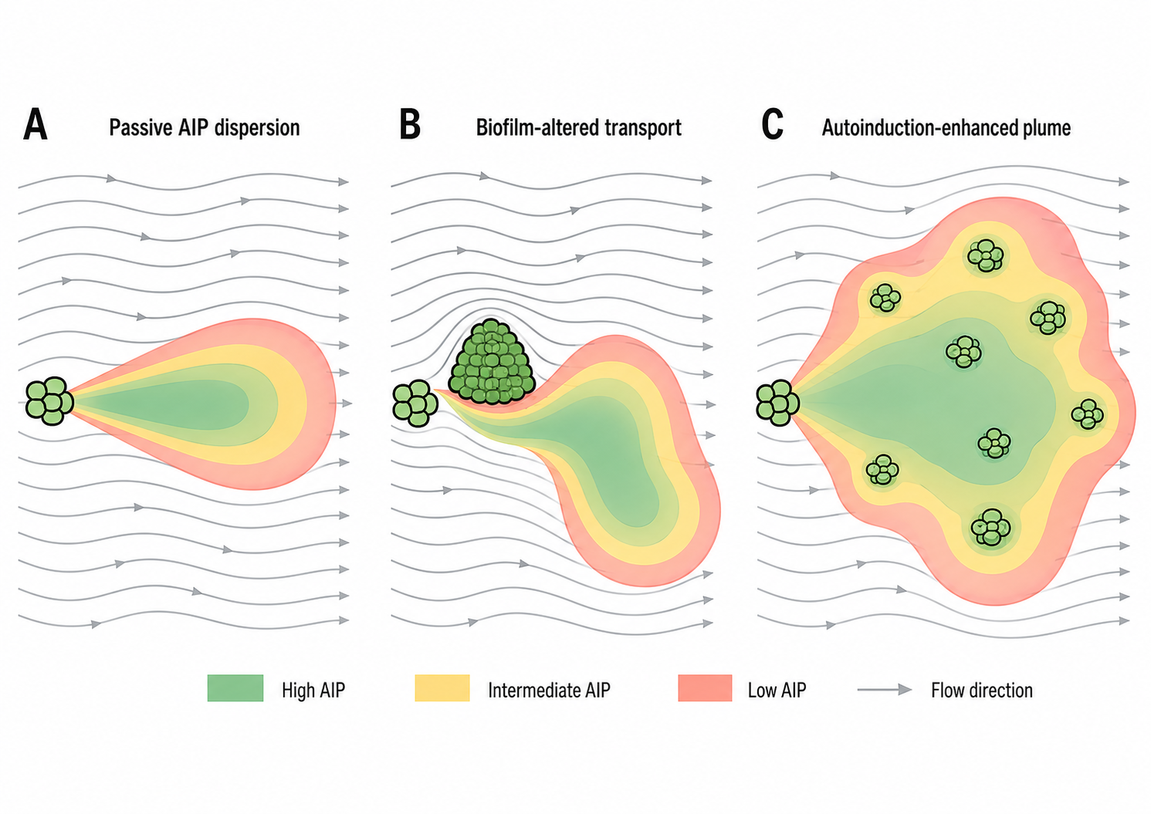
Dynamic plume and biofilm formation
Flow
Bacterial communication plume
AIP dispersion
Autoinduction
Bio-clogging
AIP spreading/dilution
Flow streamlines

Slide 10
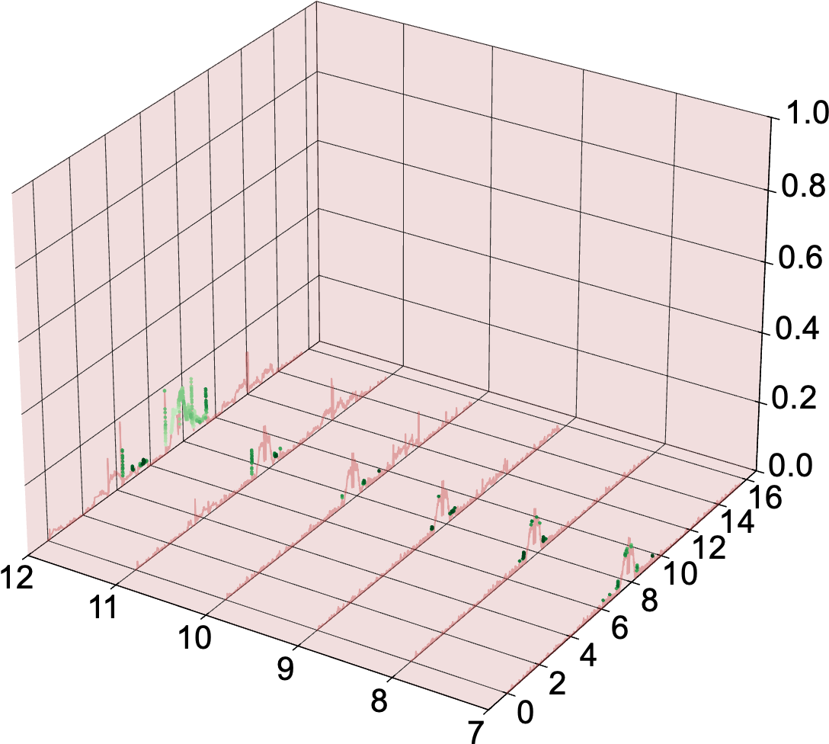
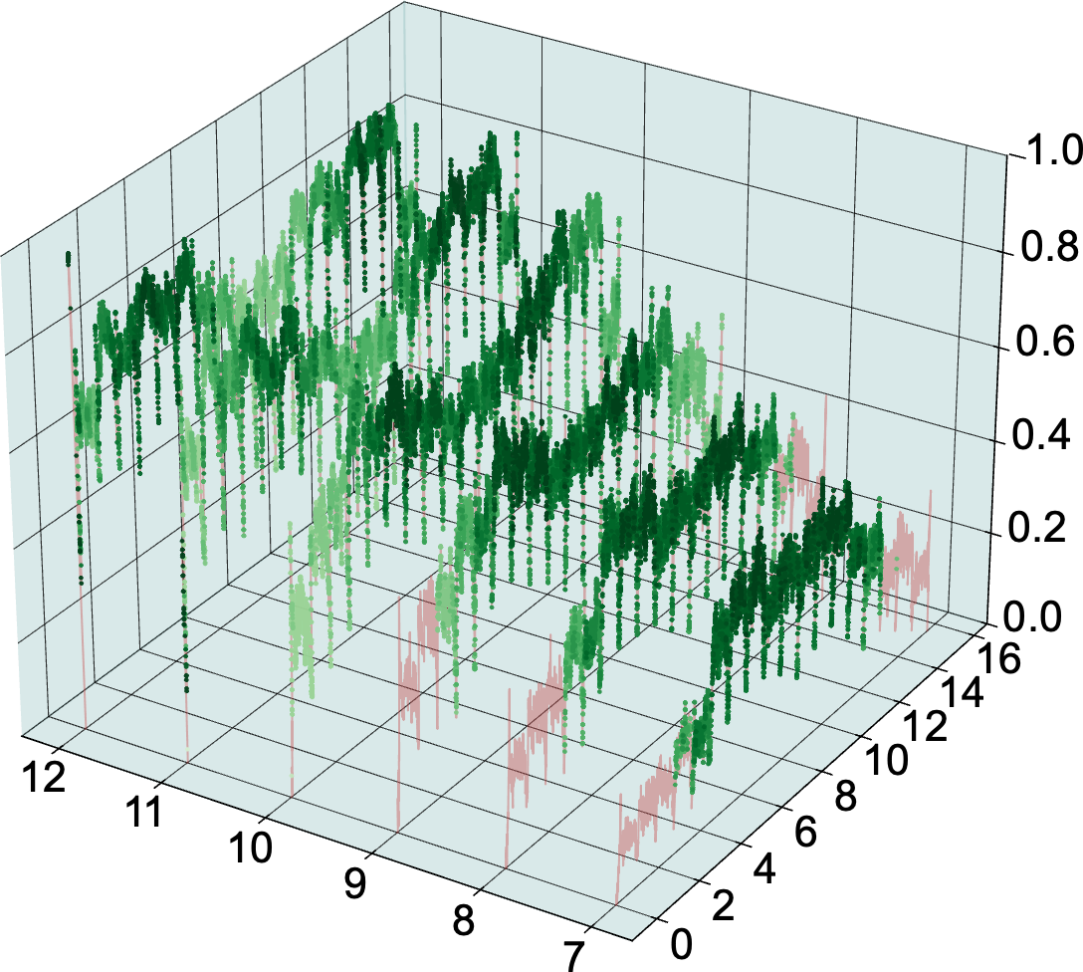
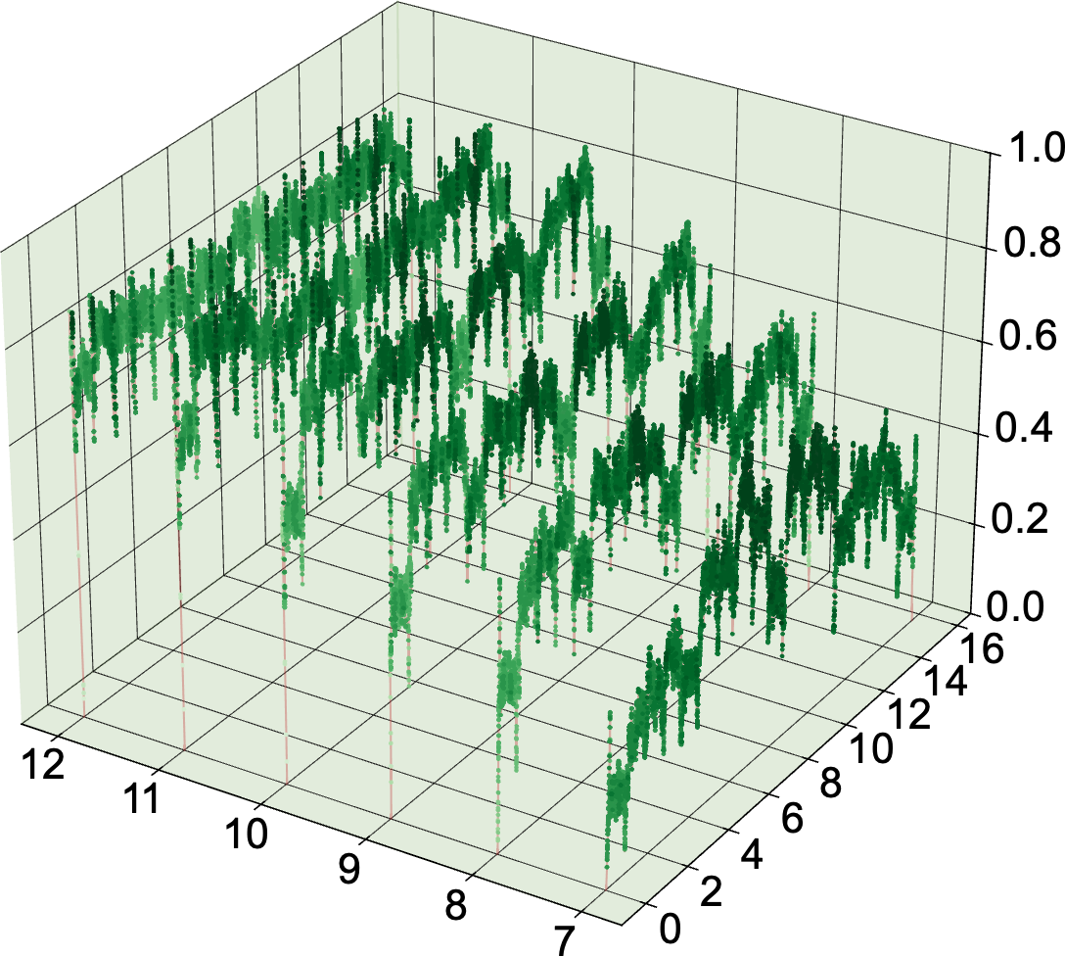
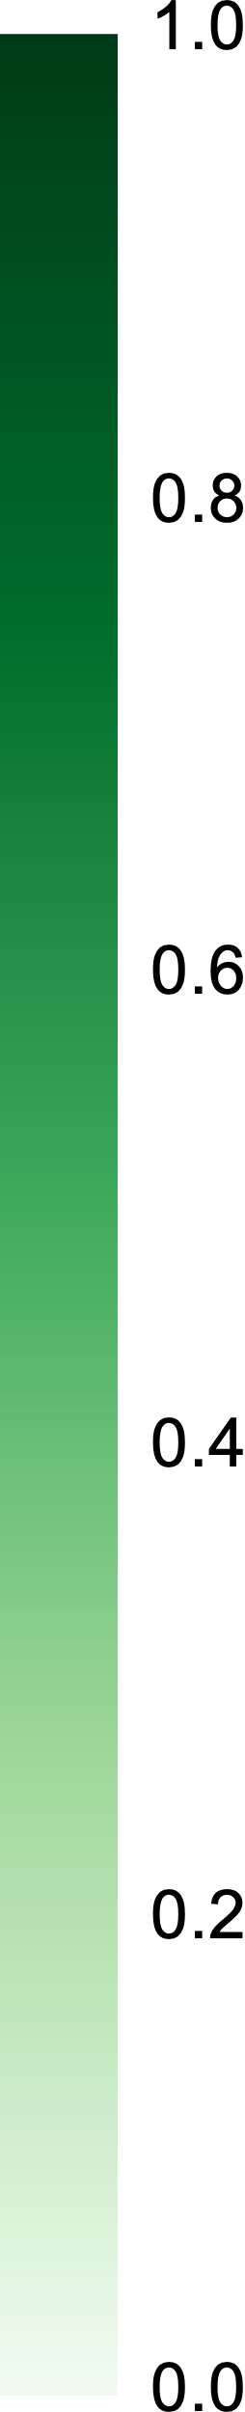
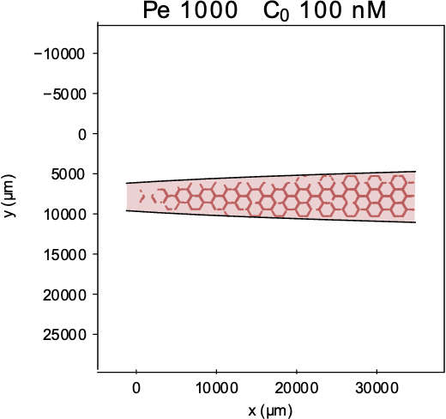
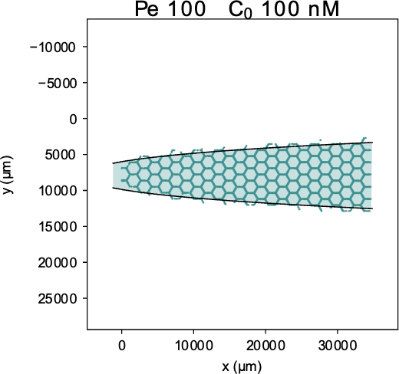
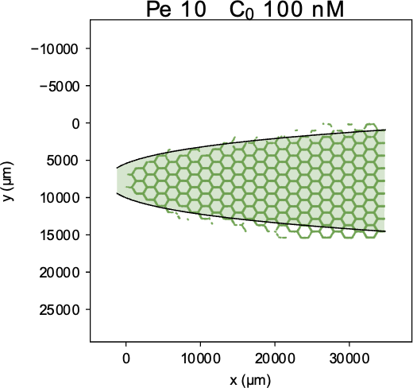
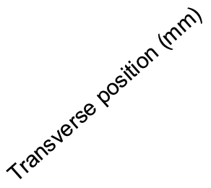

Dynamic plume and biofilm formation
High Pe=High shear
QS activation+shear
QS activation+low shear
Biofilm inhibition
Detachment within the plume
Uniform coverage

Slide 11
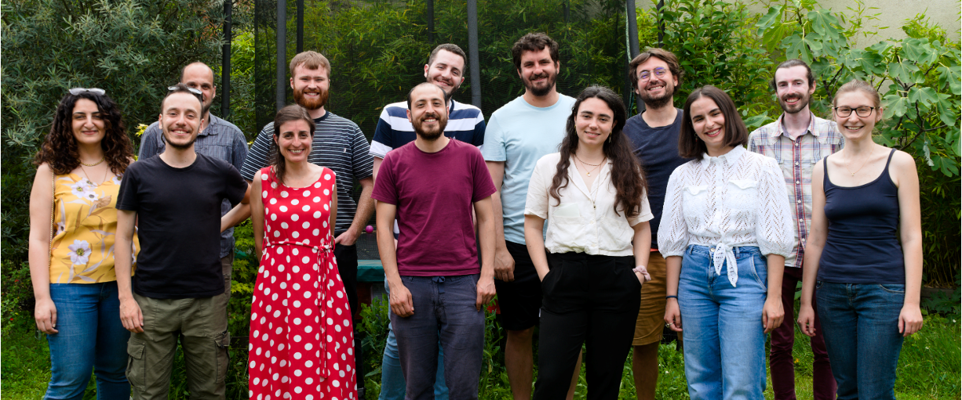
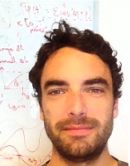


Thank you!
Next time I will try to be there!
Pr. Tanguy Le Borgne
Pr. Peter Redder

