Slide 1

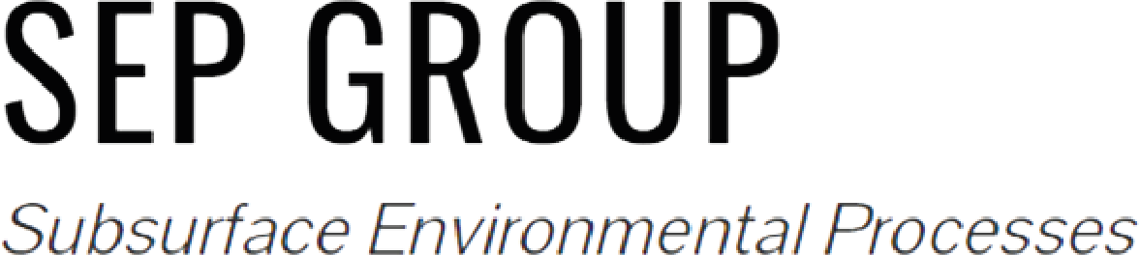
Quantification of Pore-Scale Controls on Bacterial Behavior via Information Theory
Chiara Recalcati, Maximilian F. Stoll,
Roman Stocker, Alberto Guadagnini, & Joaquin Jimenez-Martinez

Slide 2
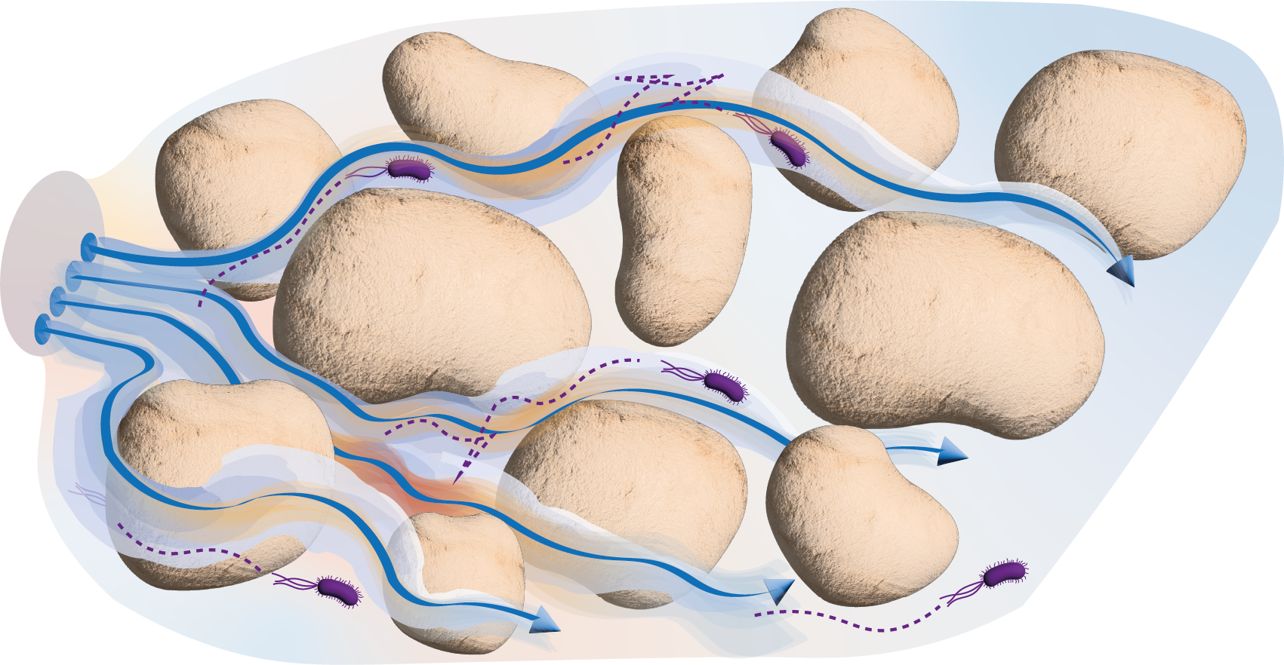

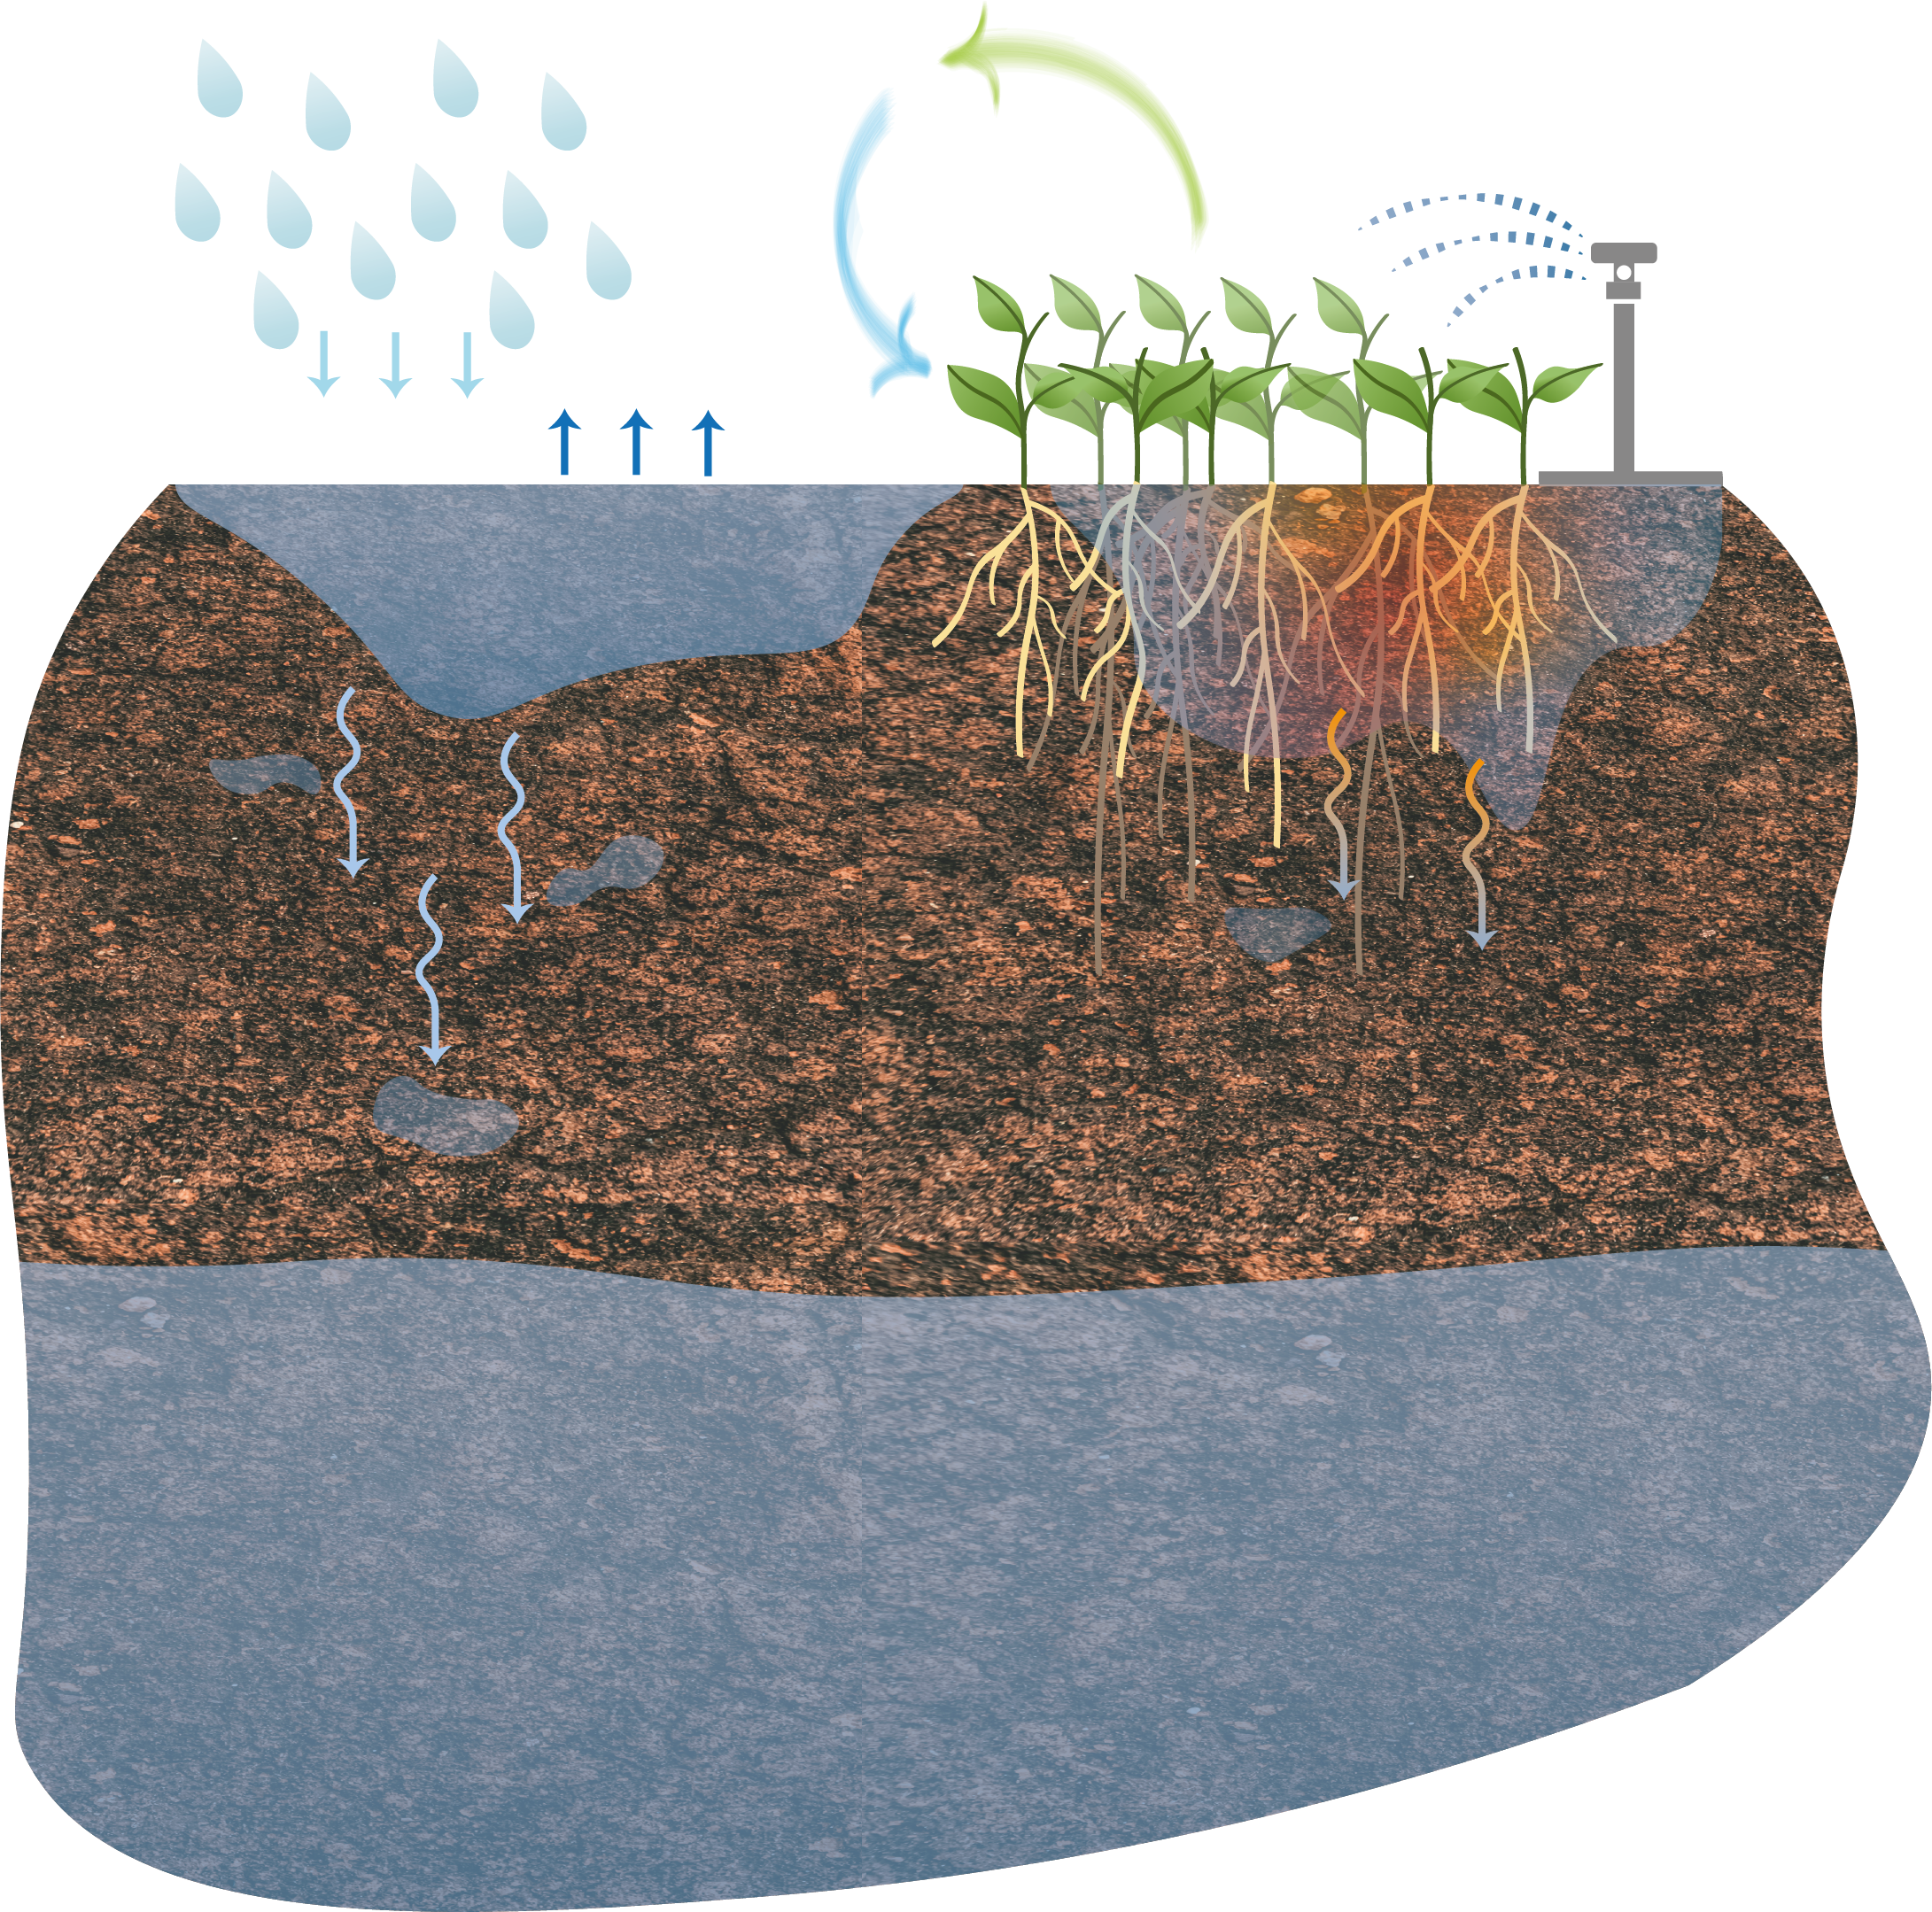


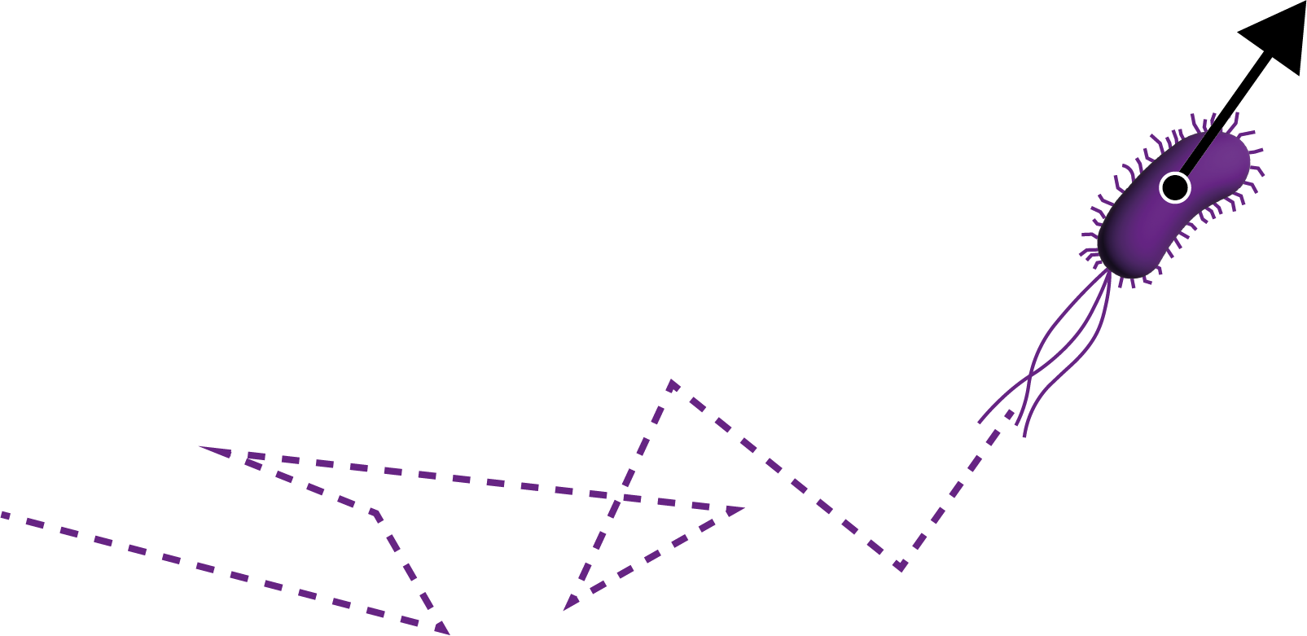


Soil microbial communities live in heterogenous systems
$\sim$µm
precipitation
soil respiration
irrigation
evaporation
percolation
fluid velocity
concentration
bacterial navigation
vadose zone
tumbling
$\sim$km - m
running
saturated zone

Slide 3
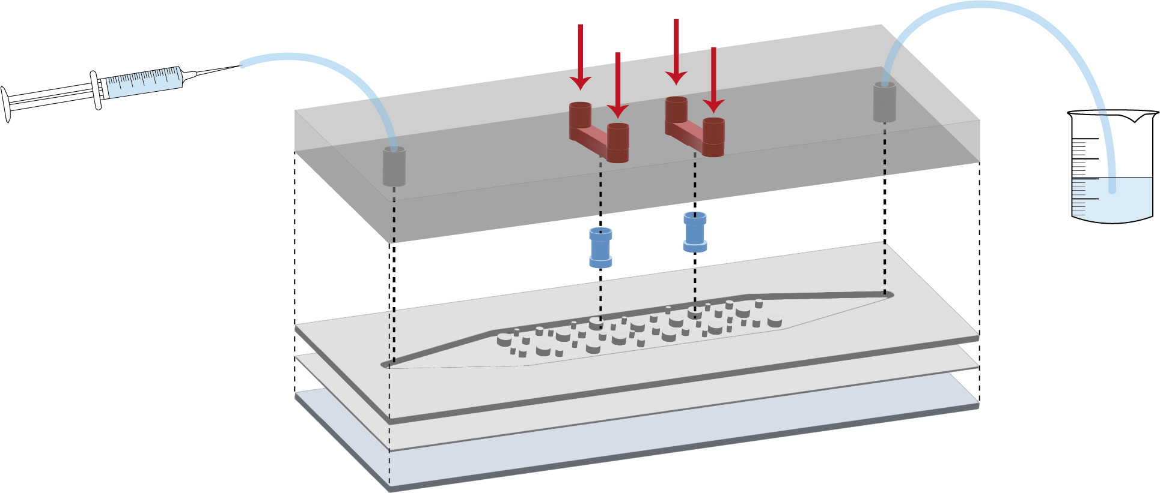
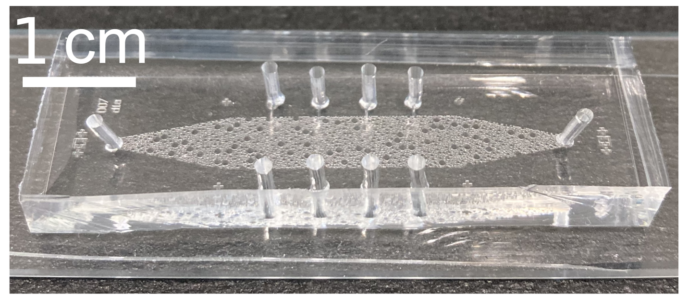
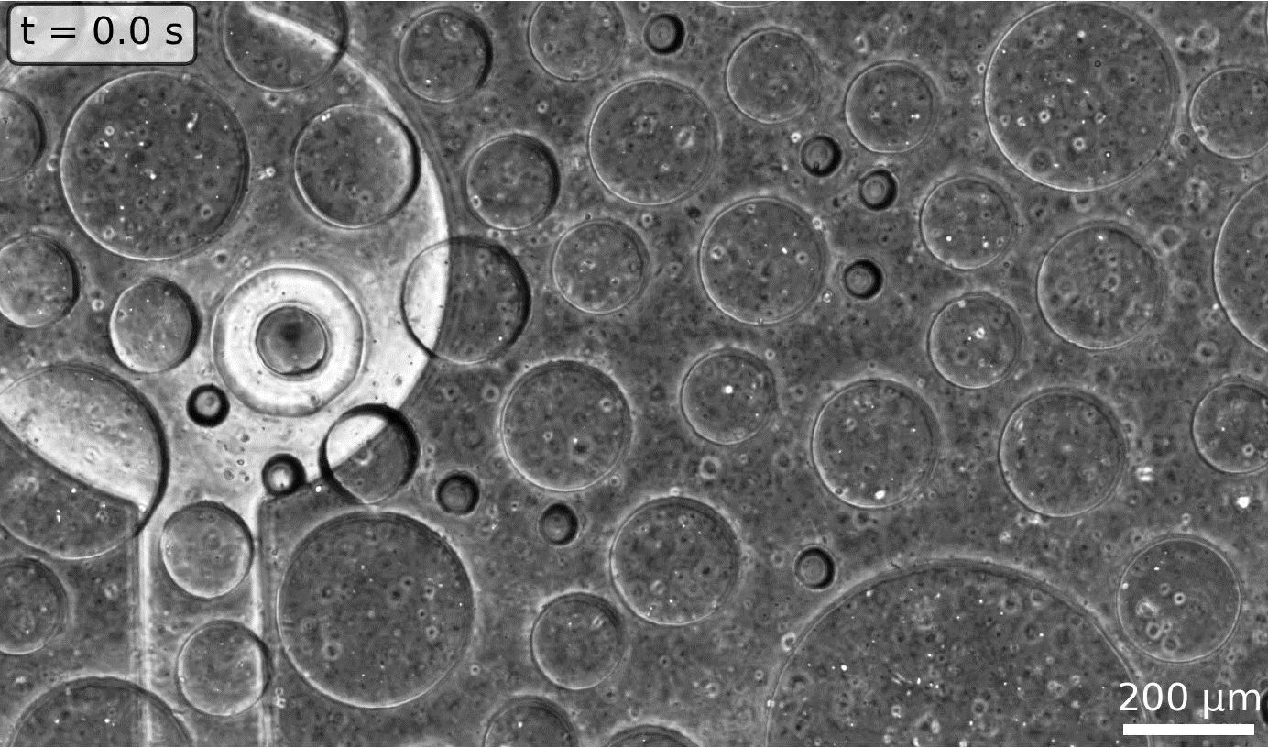
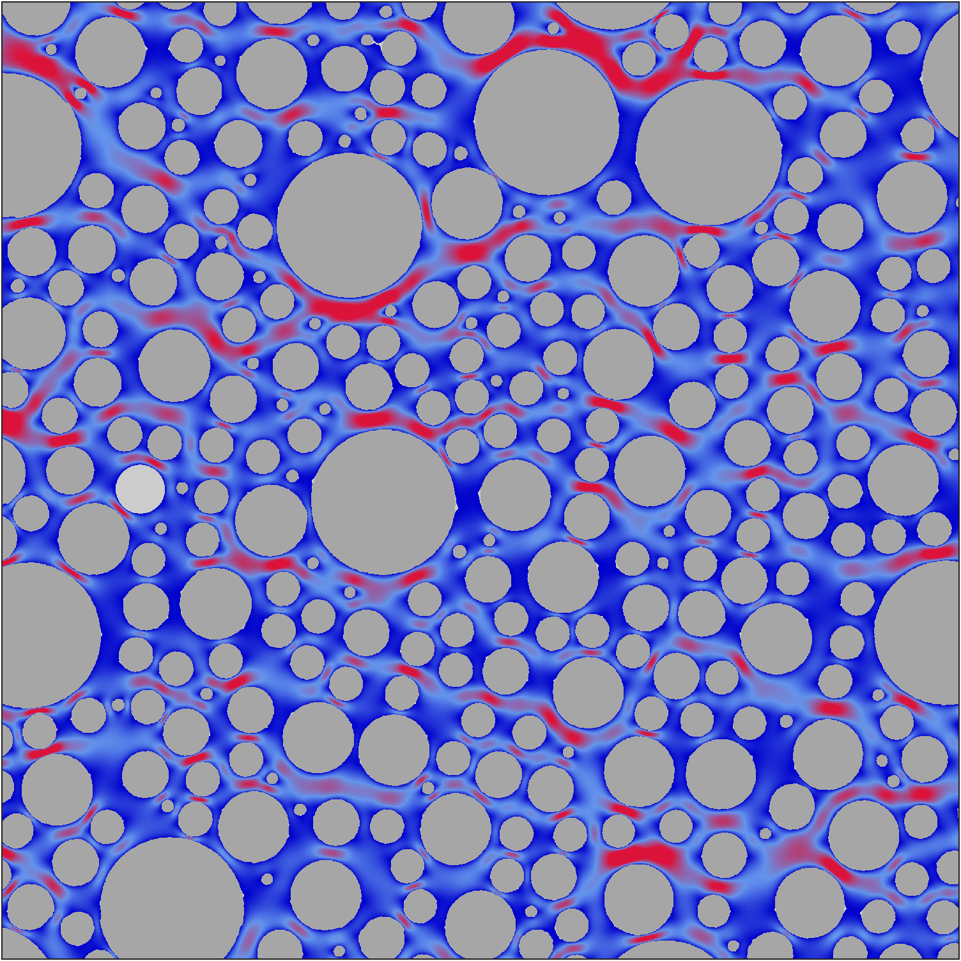
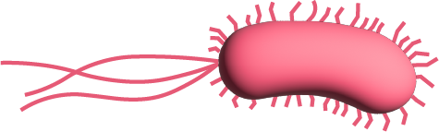

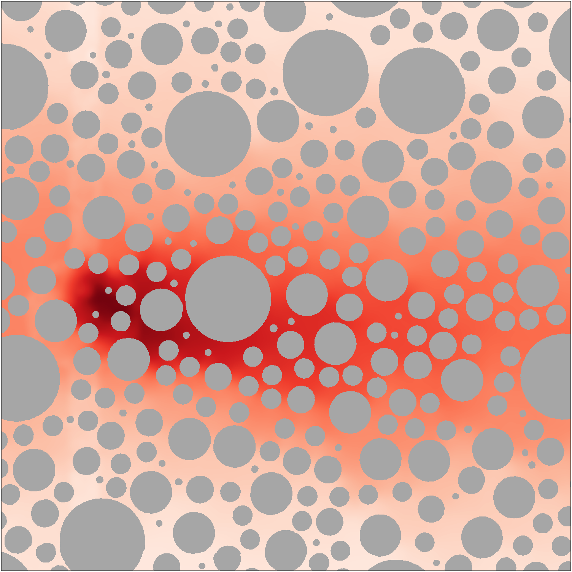

Single-cell tracking through microfluidics
nutrients
constant flow rate
PDMS
hydrogel
microfluidic setup
PDMS
thin PDMS
glass
high
infected with Azospirillum brasilense CheY6
(motile & chemotactic)
low
high
tracking of individuals
nutrient source (hydrogel pillar)
low
Stoll et al. (under review)

Slide 4
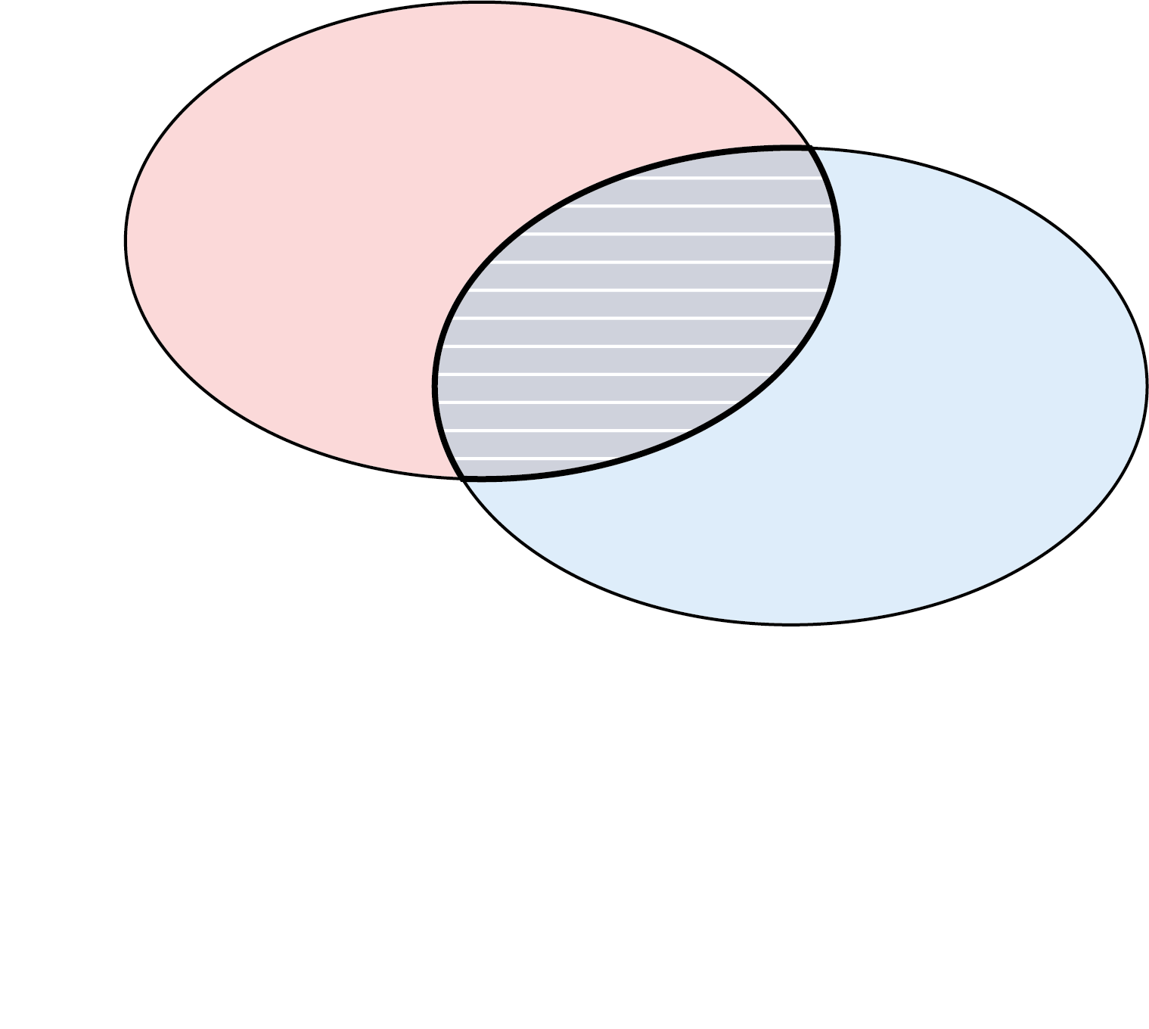
Partitioning information content
Shannon Entropy
Mutual Information

Slide 5
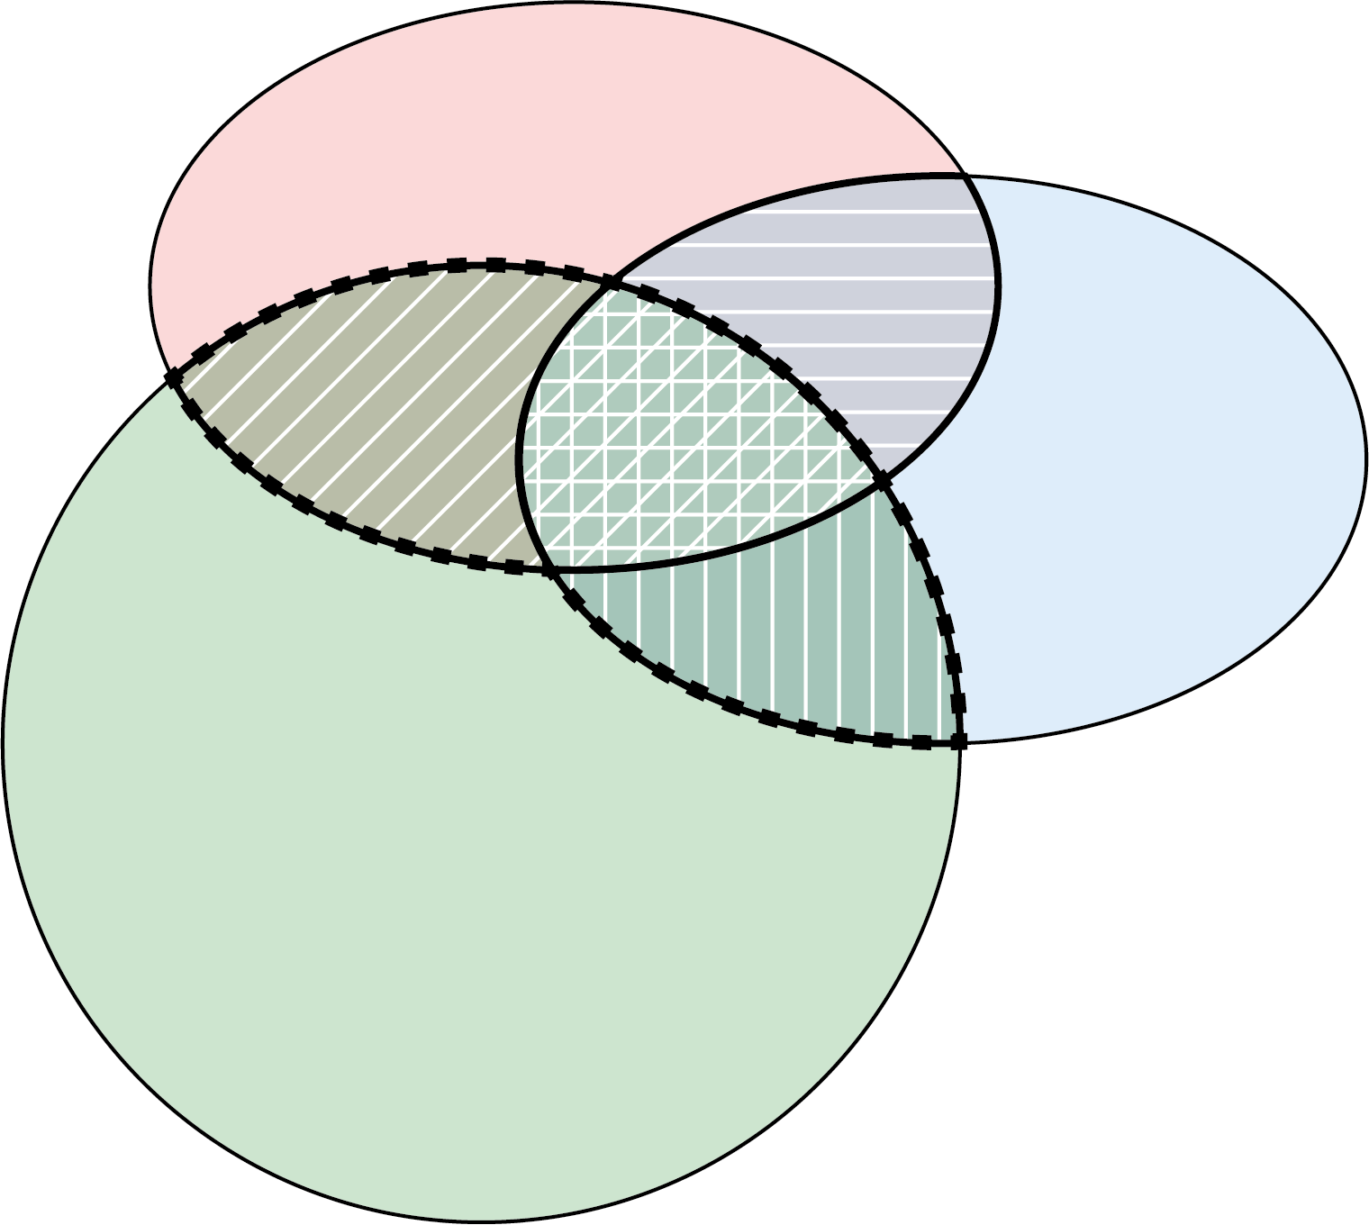
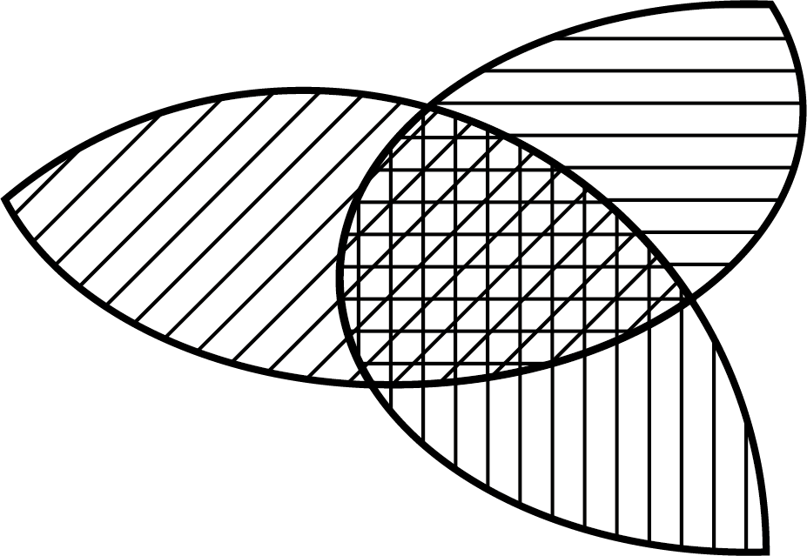
Partitioning information content
modified from Dell’Oca et al. (2020)
Shannon Entropy
Mutual Information
Multivariate Mutual Information
uniqueness
redundancy
synergy
according to Goodwell & Kumar (2017)

Slide 6


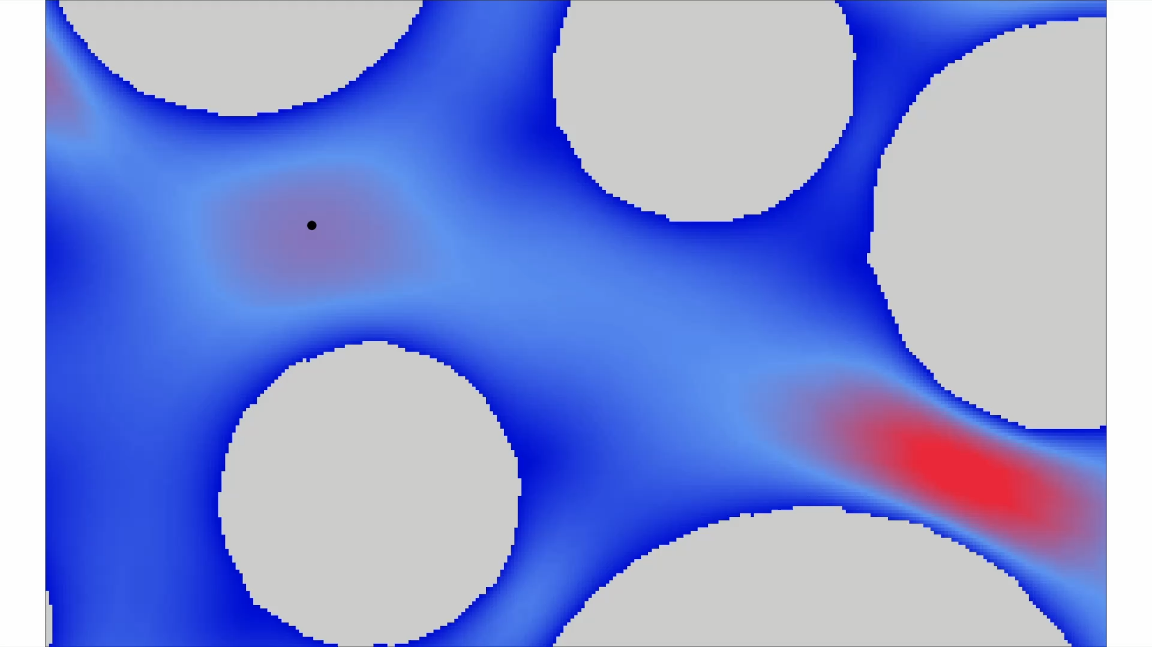

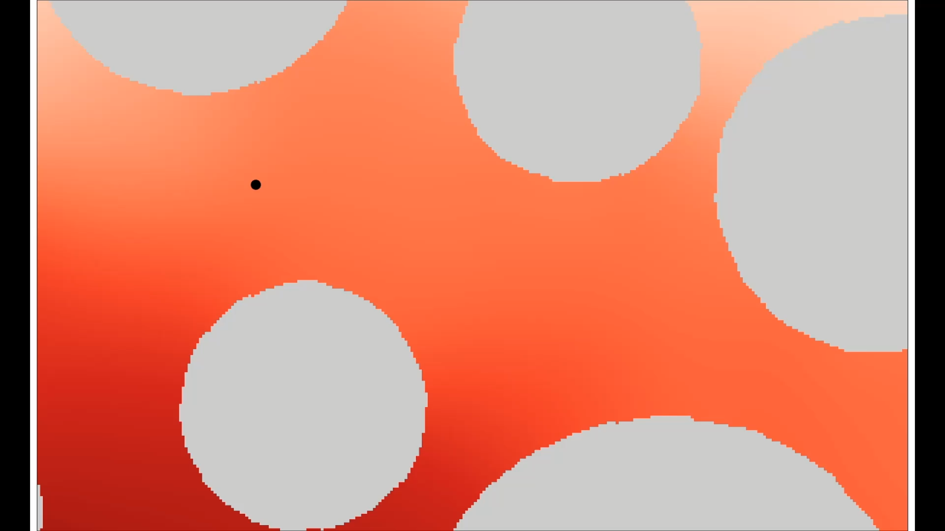

Key abiotic and biotic variables
cell k
flow
fluid velocity field
concentration field
25
0.03
[ - ]
[µm s⁻¹]
0
0.02

Slide 7
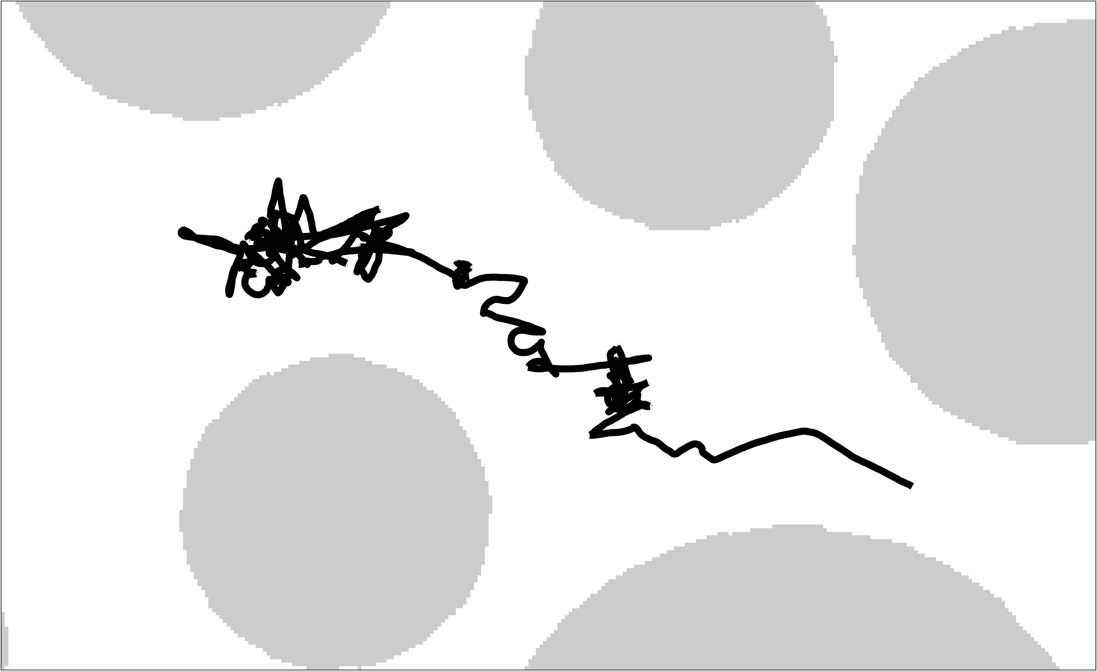
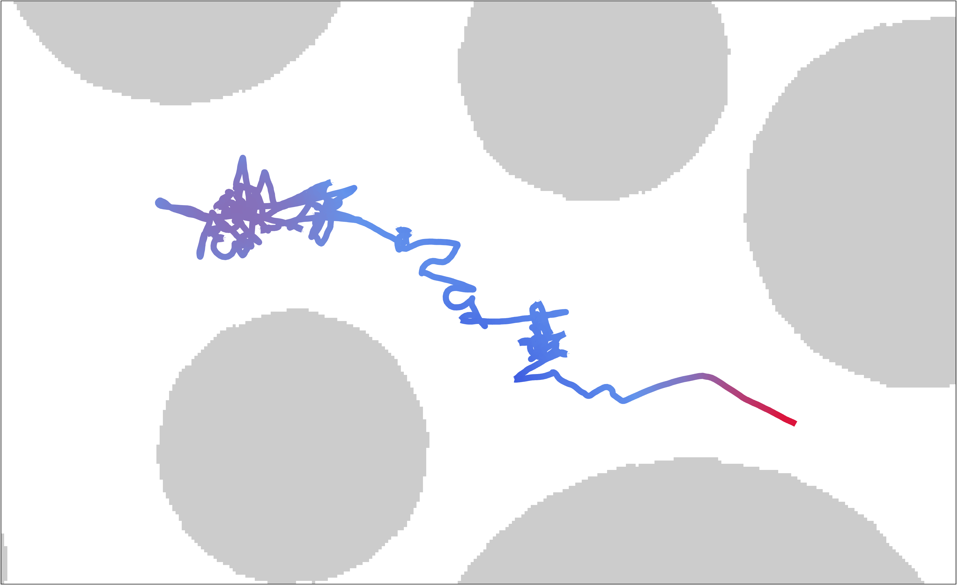
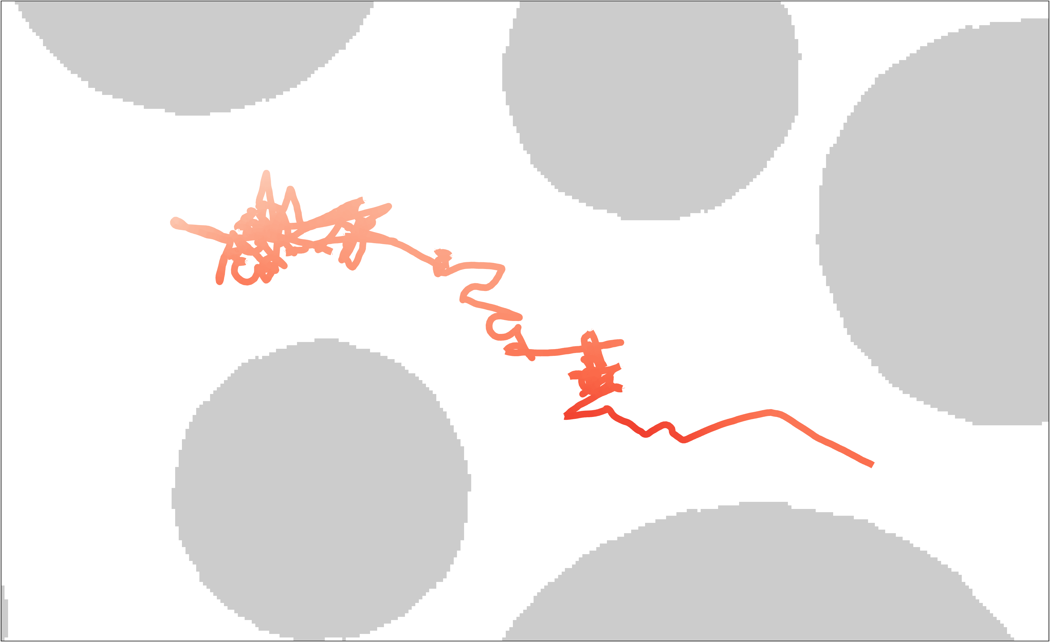

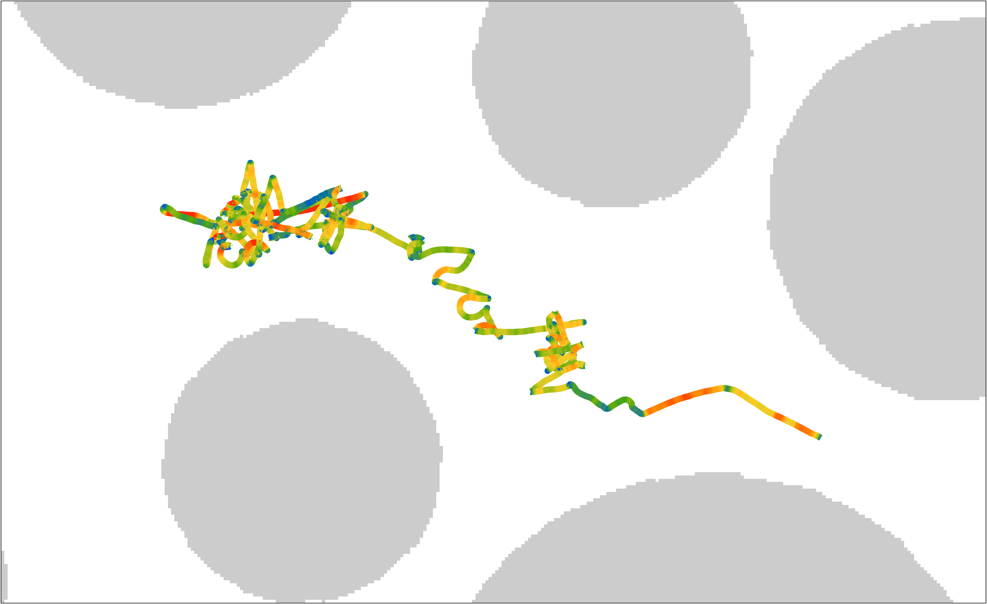
Key abiotic and biotic variables
cell k
flow
fluid velocity along trajectory
concentration along trajectory
swimming velocity along trajectory
25
0.03
40
[µm s⁻¹]
[ - ]
[µm s⁻¹]
0
0.02
0
0
0

Slide 8
Key abiotic and biotic variables
cell k
flow
& tumbling frequency
fluid velocity along trajectory
concentration along trajectory
swimming velocity along trajectory
25
0.03
40
[µm s⁻¹]
[ - ]
[µm s⁻¹]
0
0.02
0
0
0

Slide 9
Key abiotic and biotic variables
cell k
flow
& tumbling frequency
fluid velocity along trajectory
concentration along trajectory
swimming velocity along trajectory
25
0.03
40
[µm s⁻¹]
[ - ]
[µm s⁻¹]
0
0.02
0
0
0
Quantify how distribution of , , , and drive navigation mode ( , , and )

Slide 10
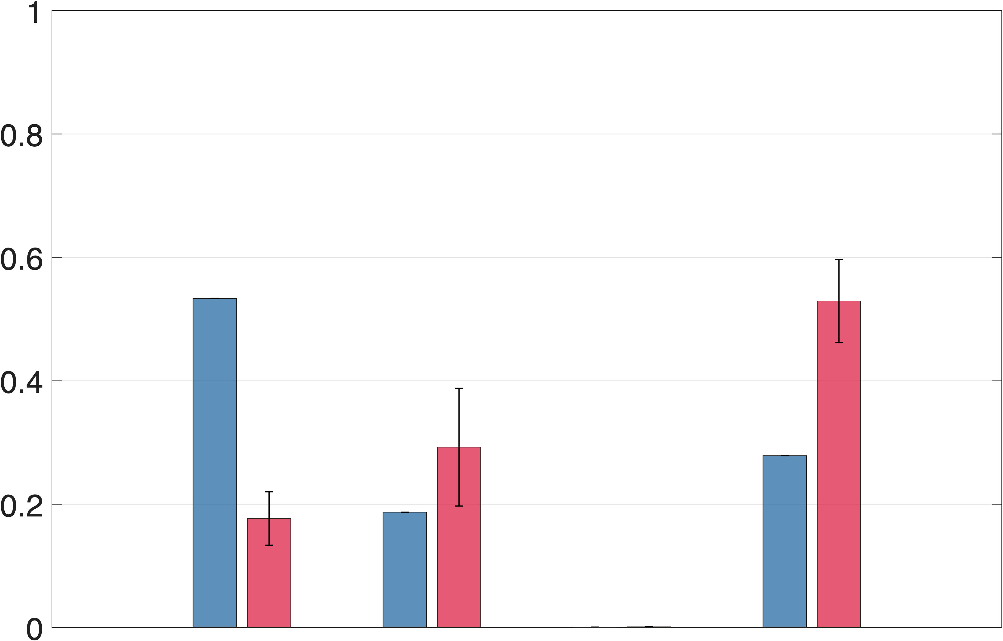
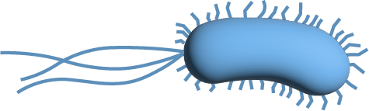
Preliminary results
normalized on
motile
chemotactic
relative contribution to
motile bacteria are mostly influenced by fluid velocity
synergy reflects multivariate correlations for chemotactic bacteria

Slide 11
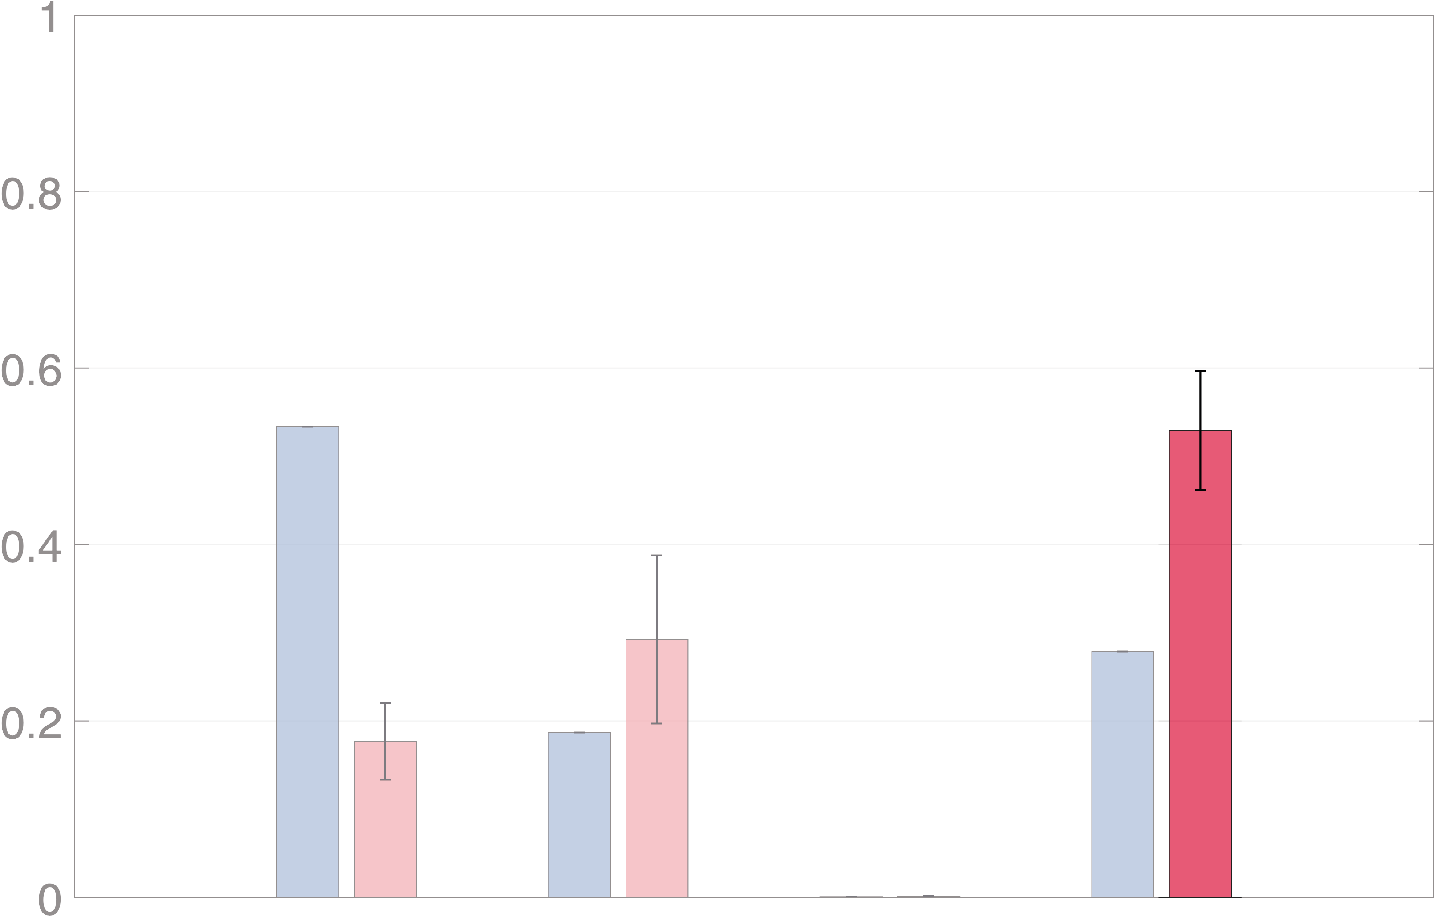
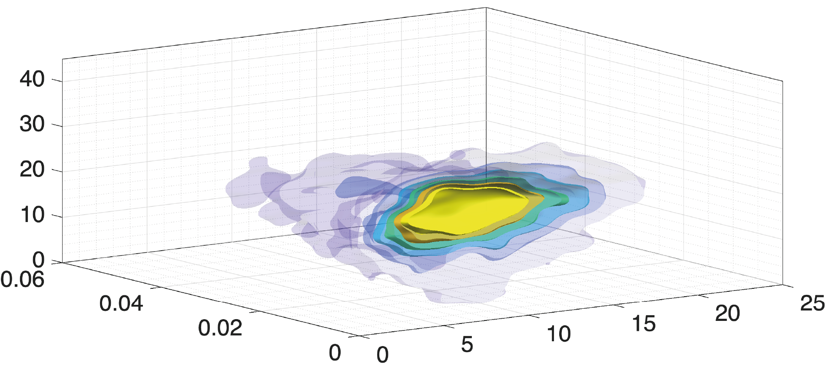
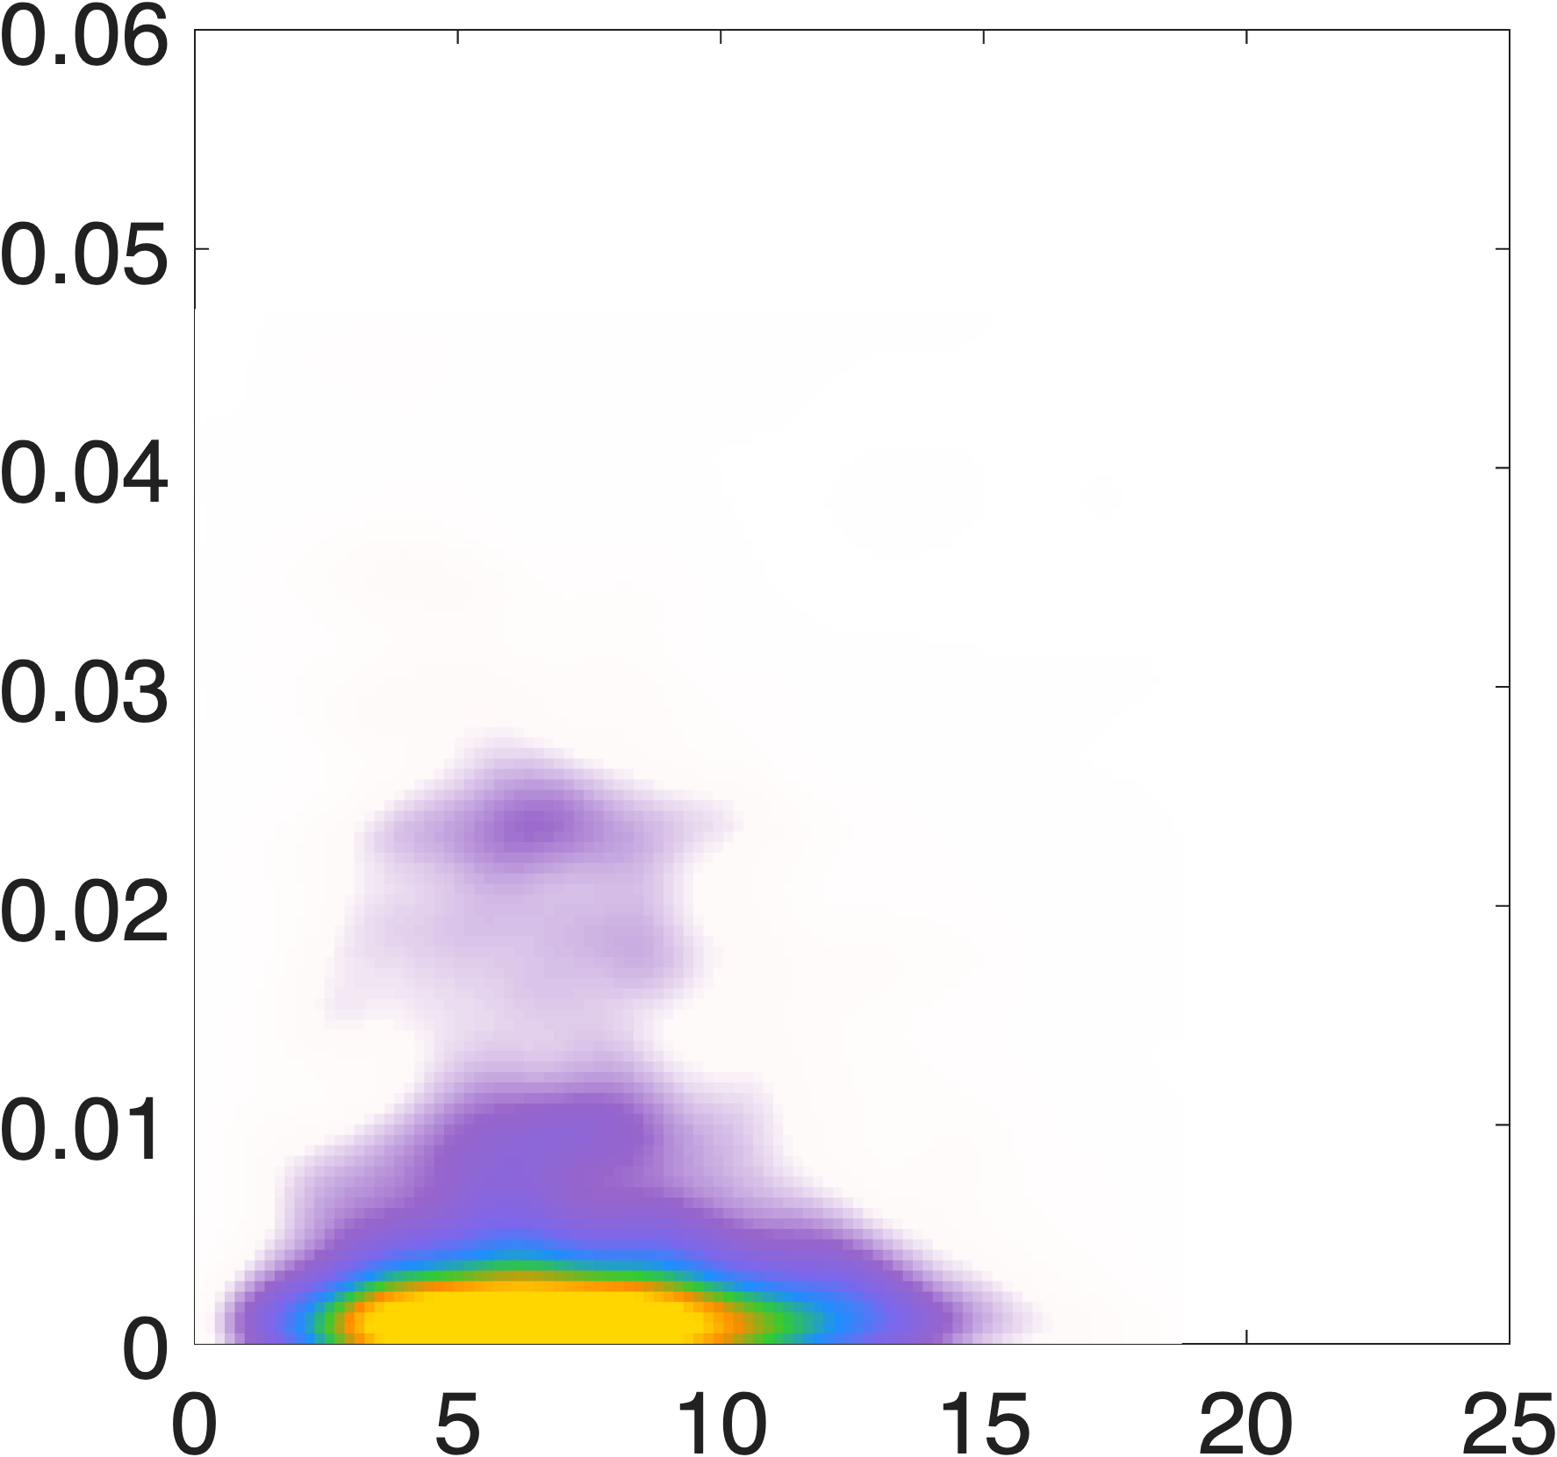
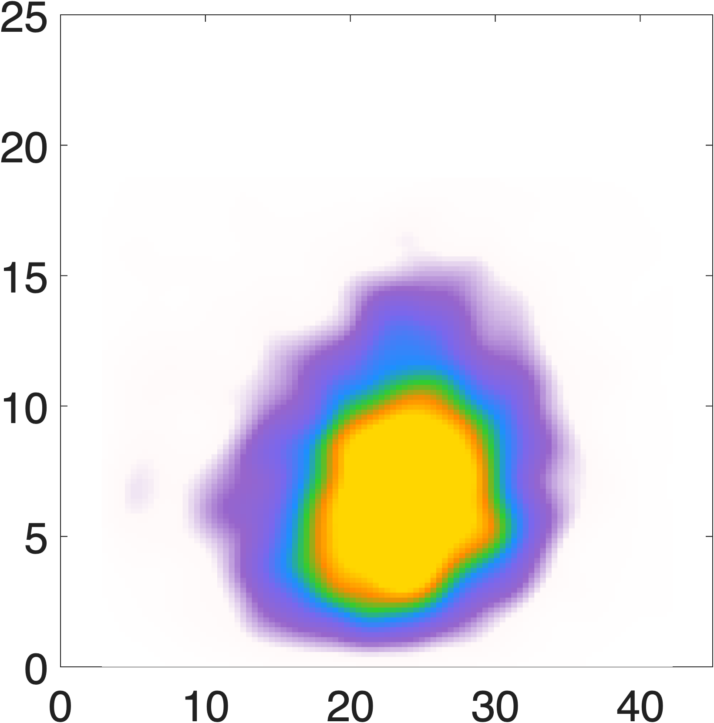
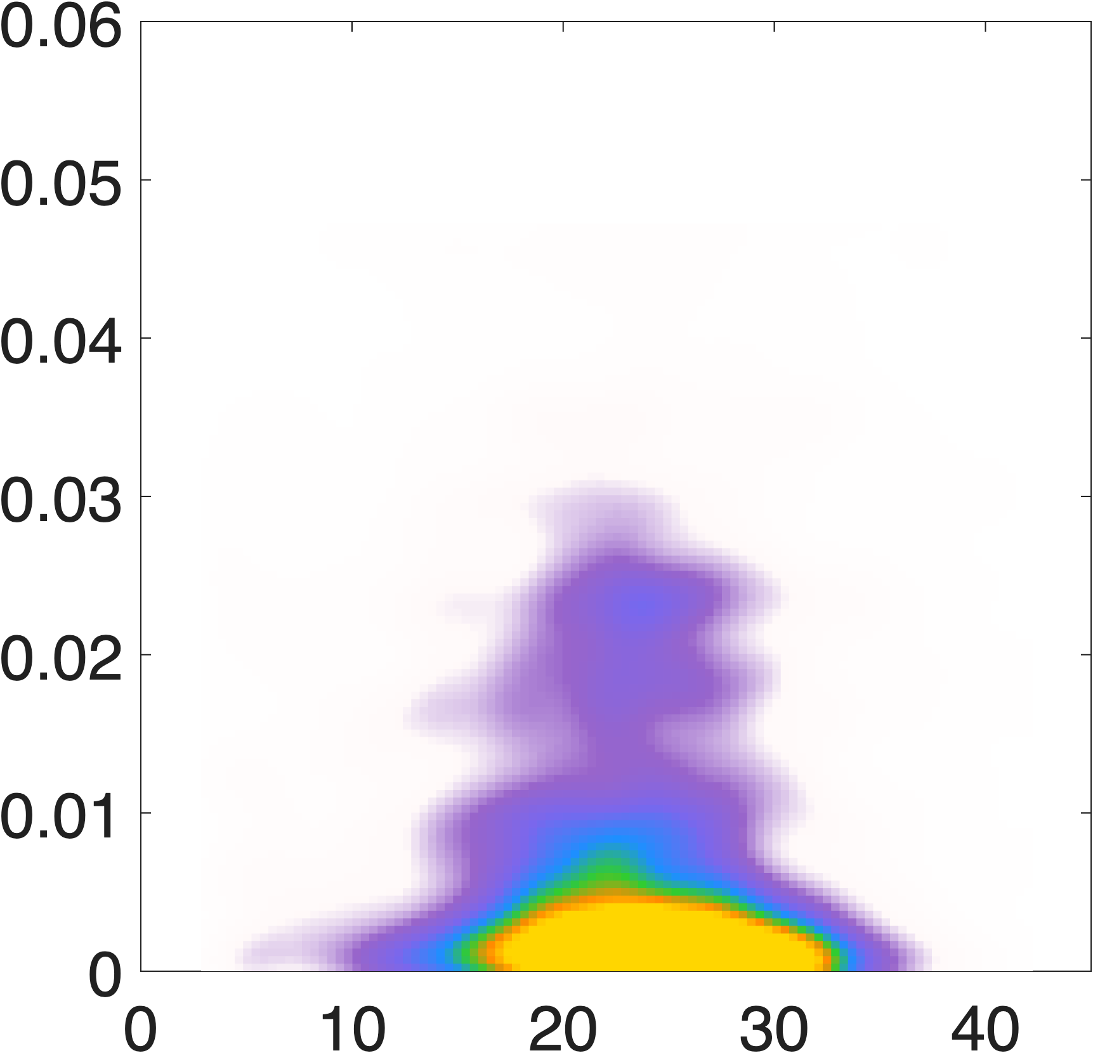


Preliminary results
normalized on
chemotactic
motile
chemotactic
[µm s⁻¹]
relative contribution to
[-]
[µm s⁻¹]
0
8
0
5$⋅$10⁻³
0
3
[-]
[µm s⁻¹]
[-]
[µm s⁻¹]
[µm s⁻¹]
[µm s⁻¹]

Slide 12
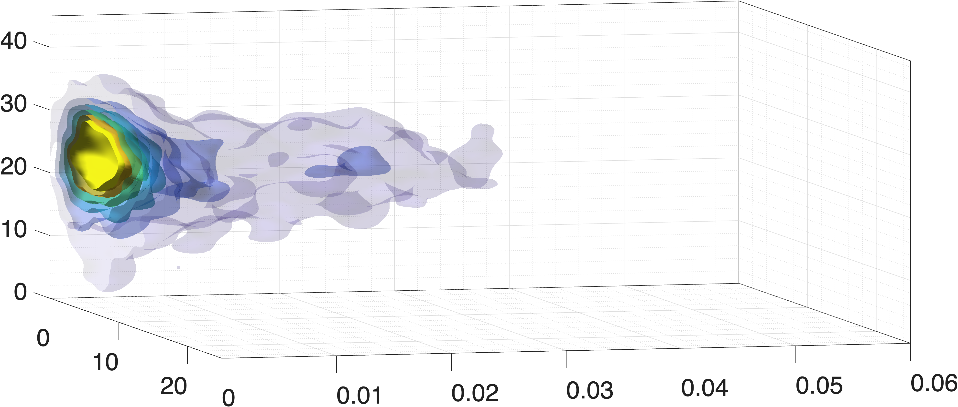
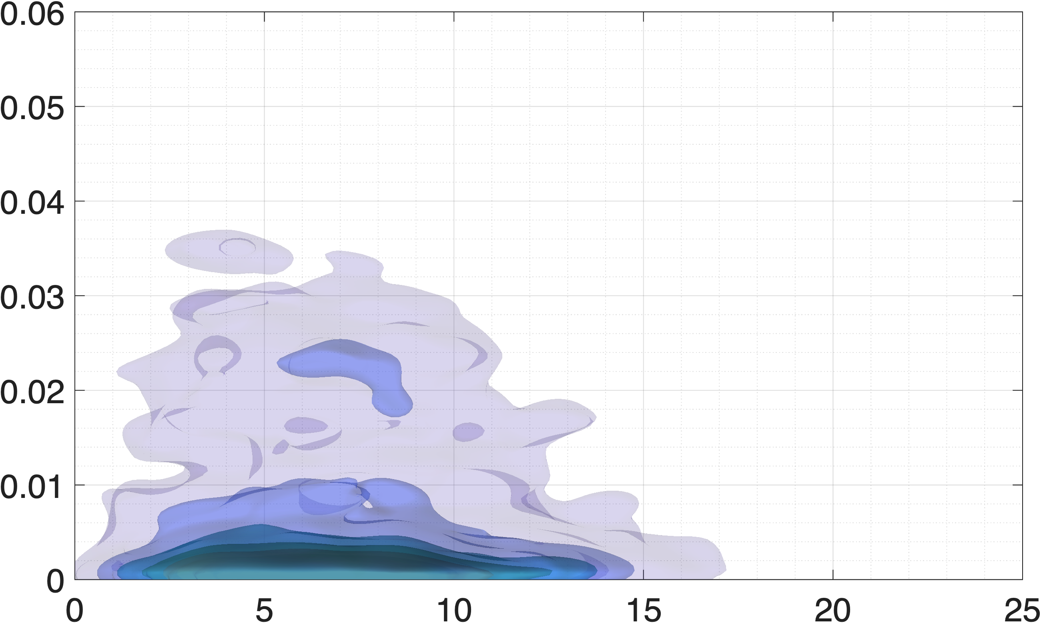
Preliminary results
normalized on
chemotactic
motile
chemotactic
[µm s⁻¹]
relative contribution to
[µm s⁻¹]
[-]
motile bacteria are mostly influenced by fluid velocity
[-]
synergy reflects multivariate correlations for chemotactic bacteria
[µm s⁻¹]

Slide 13
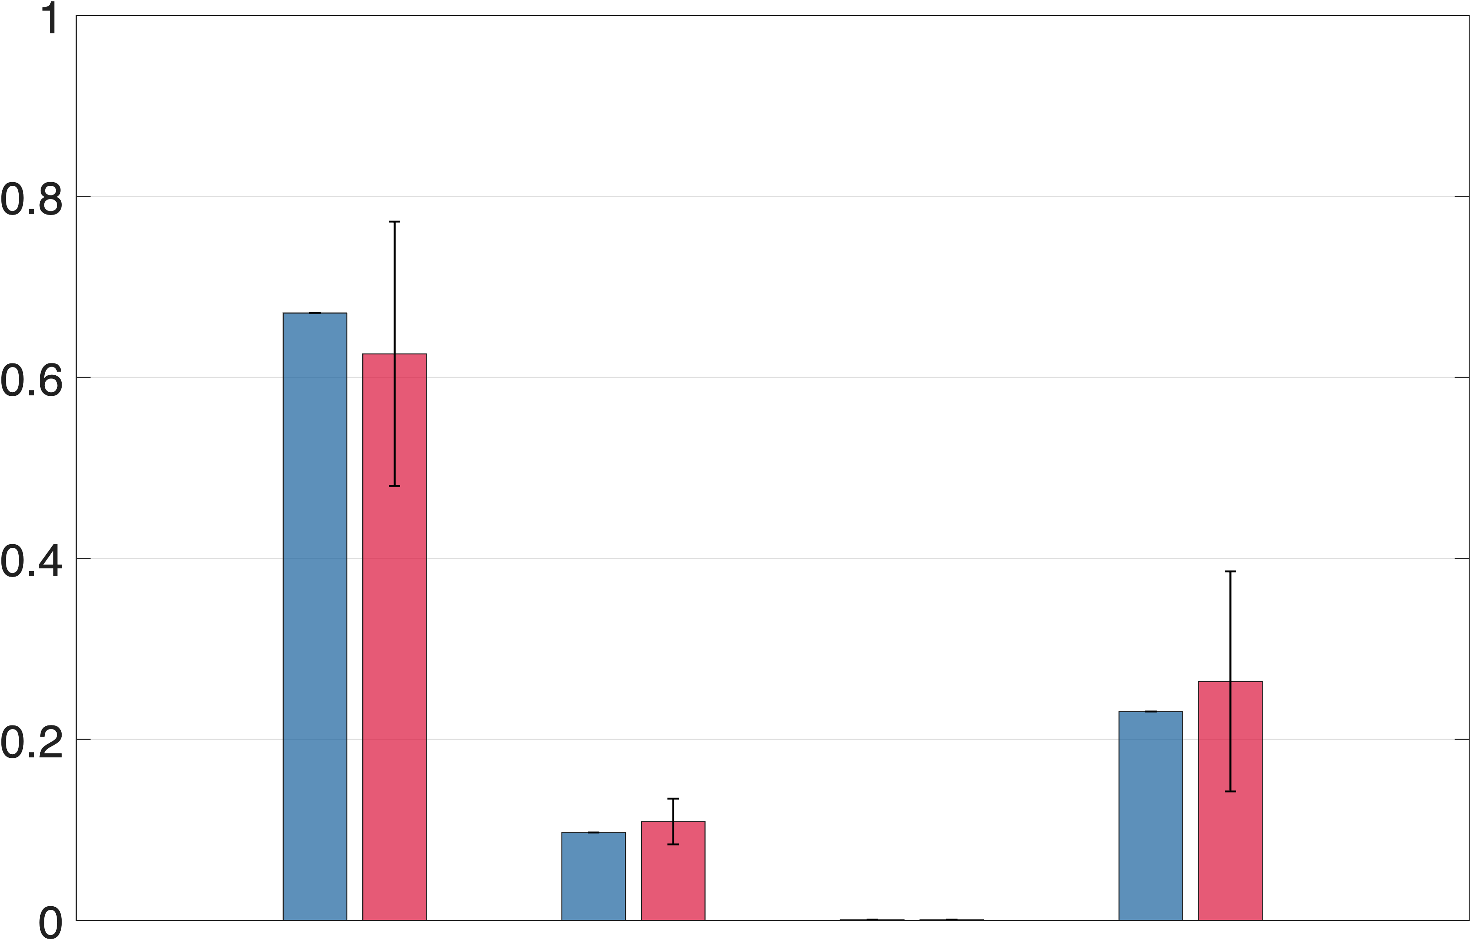
Preliminary results
flow rate increases
normalized on
motile
chemotactic
relative contribution to
relative contribution to
motile bacteria are mostly influenced by fluid velocity
Fluid velocity is dominant for both phenotypes
synergy reflects multivariate correlations for chemotactic bacteria

Slide 14
Conclusions & future perspectives
Information Partitioning can be applied to investigate microbial ecology
differences in behaviors depending on bacterial phenotype are quantified
different combinations of variables
segment trajectories
running segments
segments in pores VS pore-throats

