Slide 1

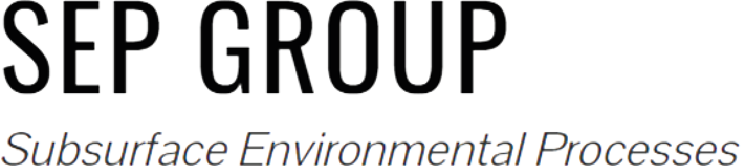
Quantification of Pore-Scale Controls on Bacterial Behavior via Information Theory
Chiara Recalcati, Maximilian F. Stoll,
Roman Stocker, Alberto Guadagnini, & Joaquin Jimenez-Martinez

Slide 2
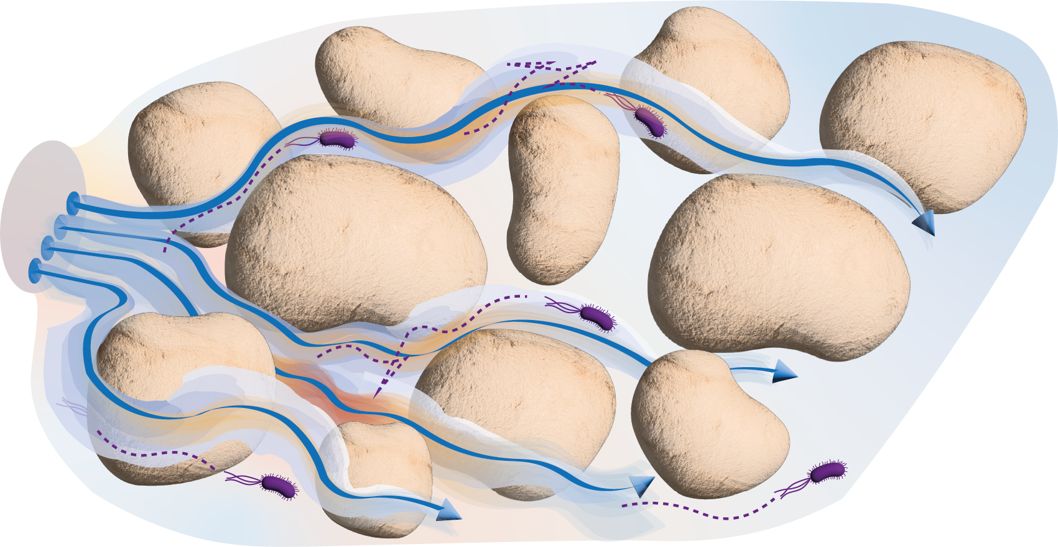

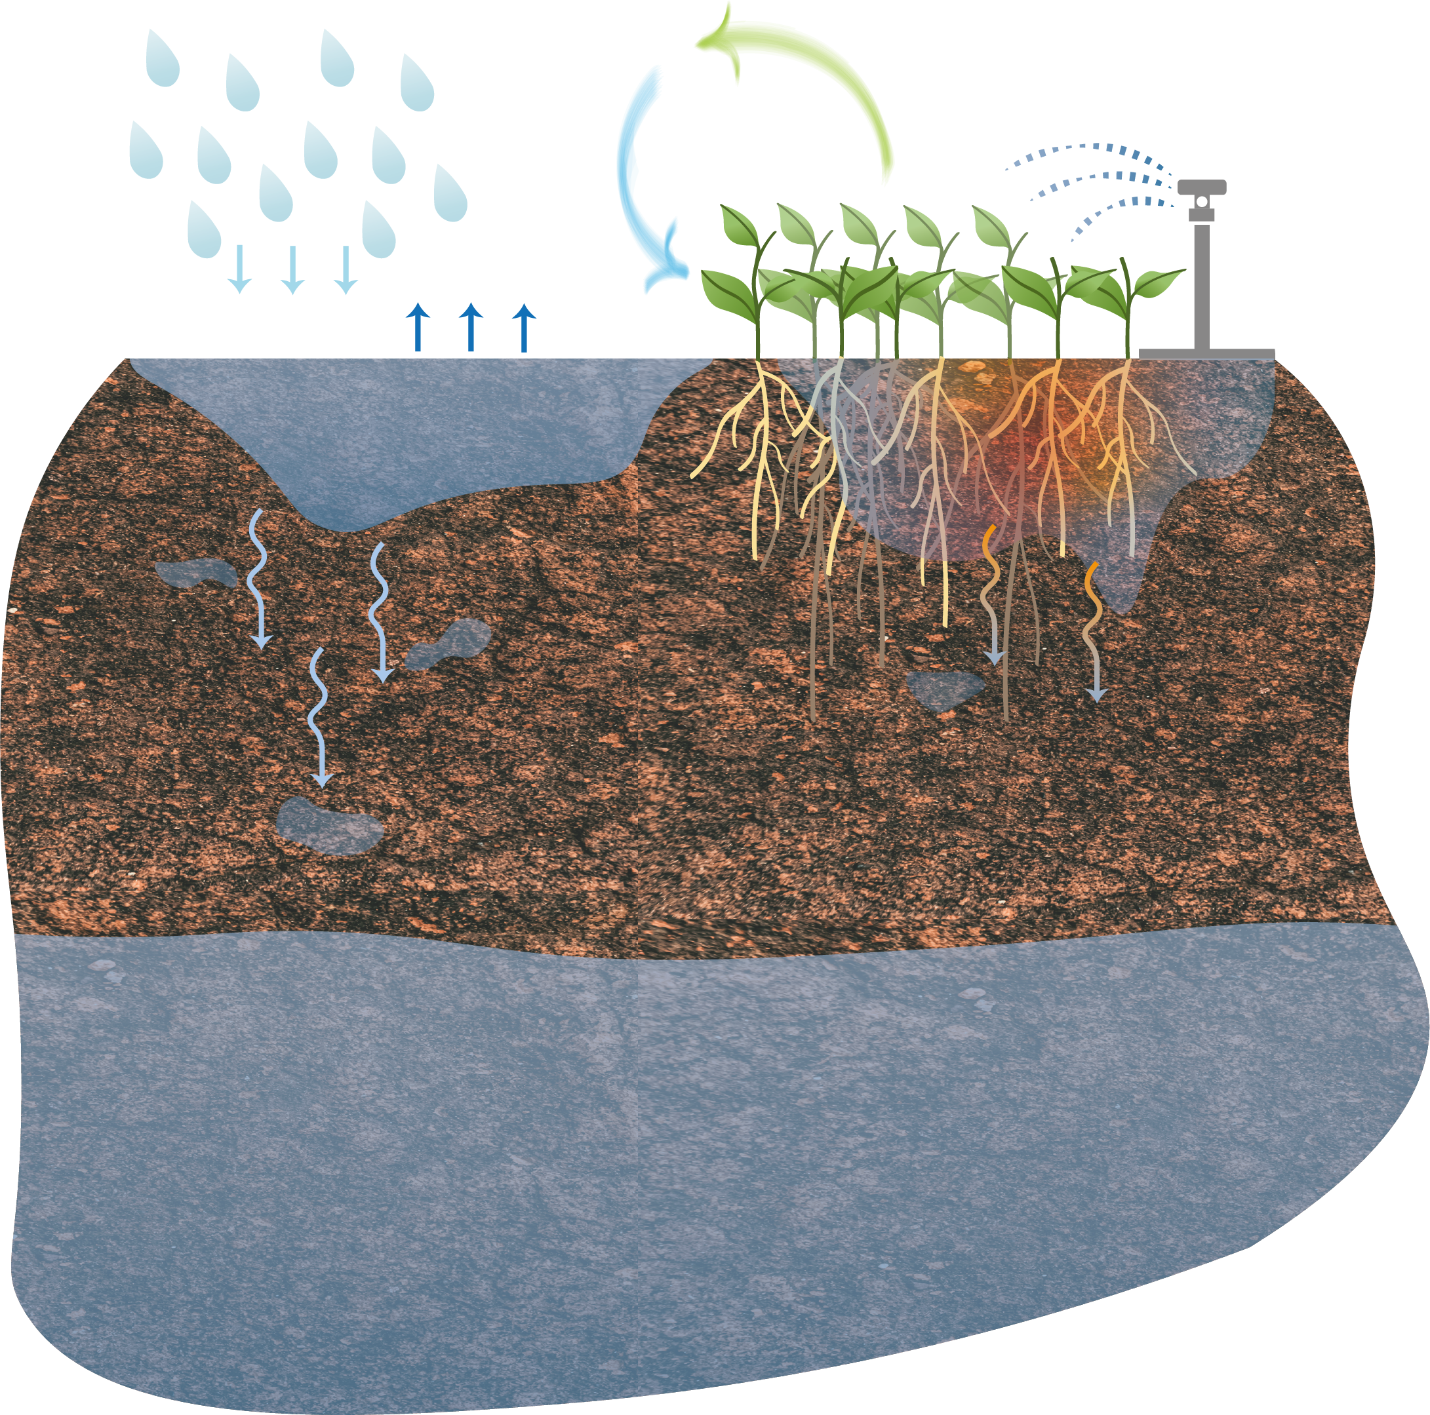




Soil microbial communities live in heterogenous systems
$\sim$µm
precipitation
soil respiration
irrigation
evaporation
percolation
fluid velocity
concentration
vadose zone
$\sim$km - m
saturated zone

Slide 3
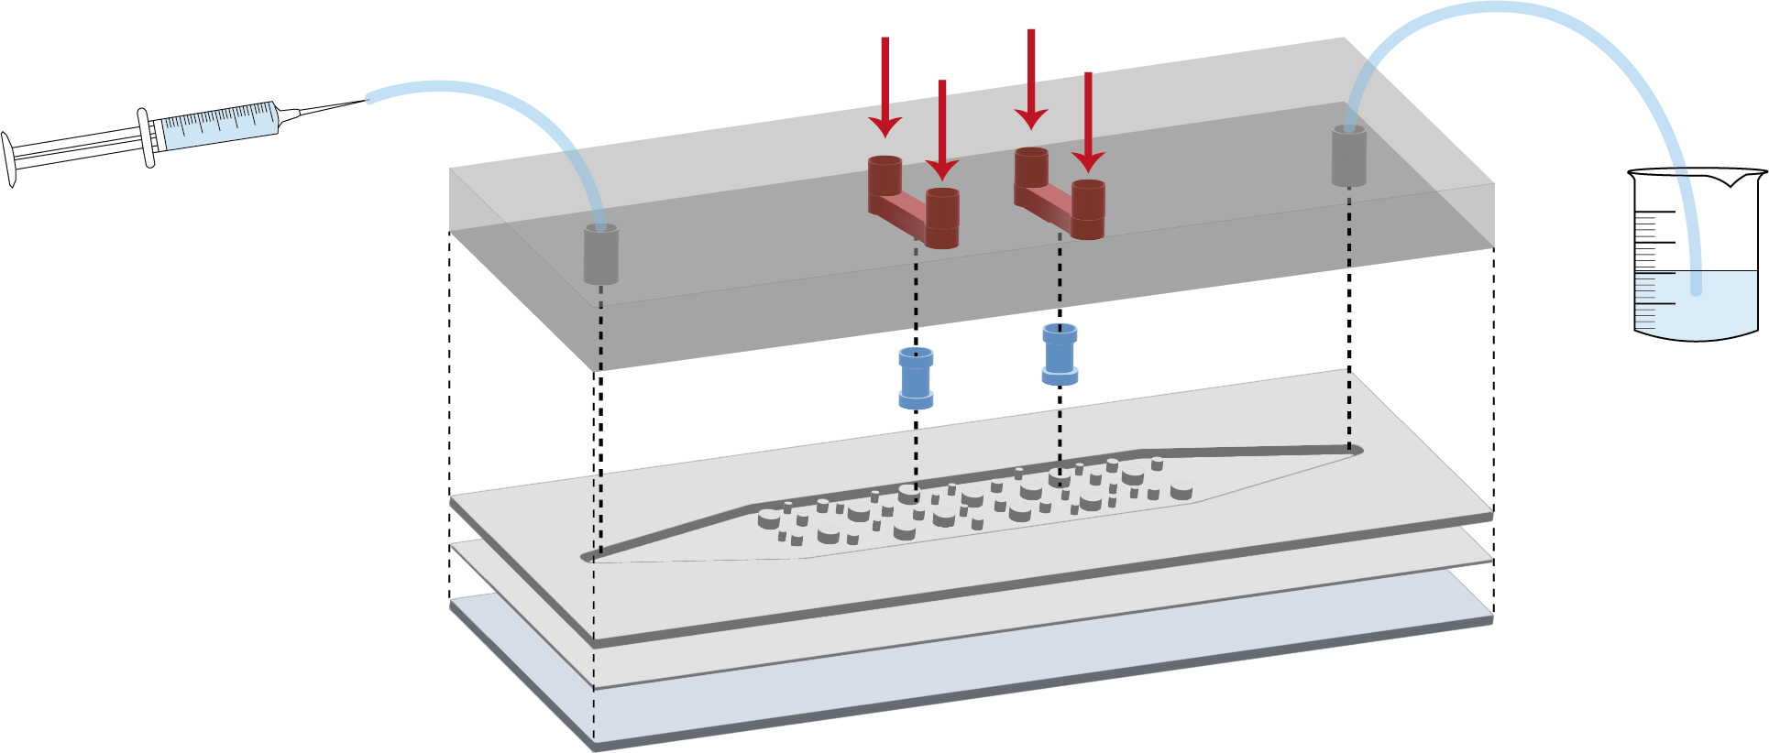
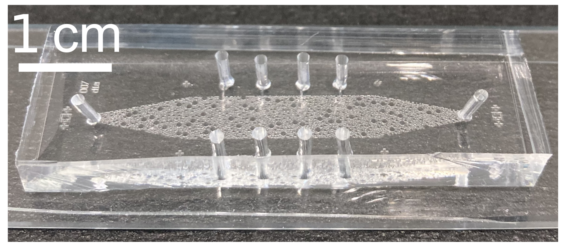
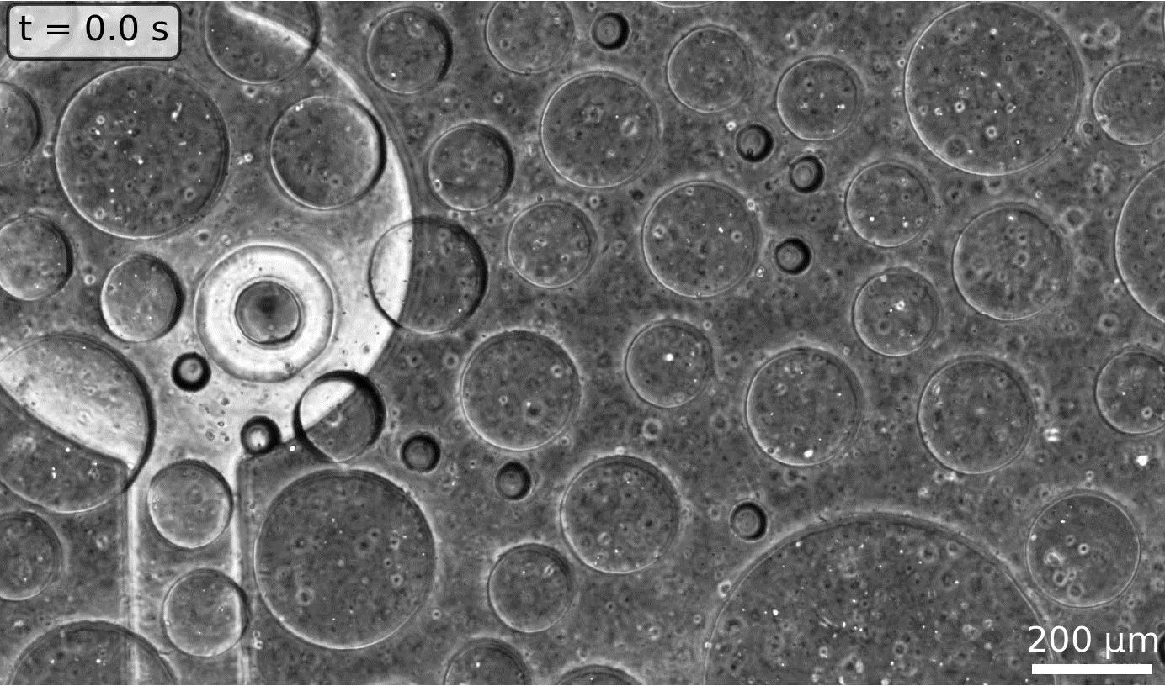
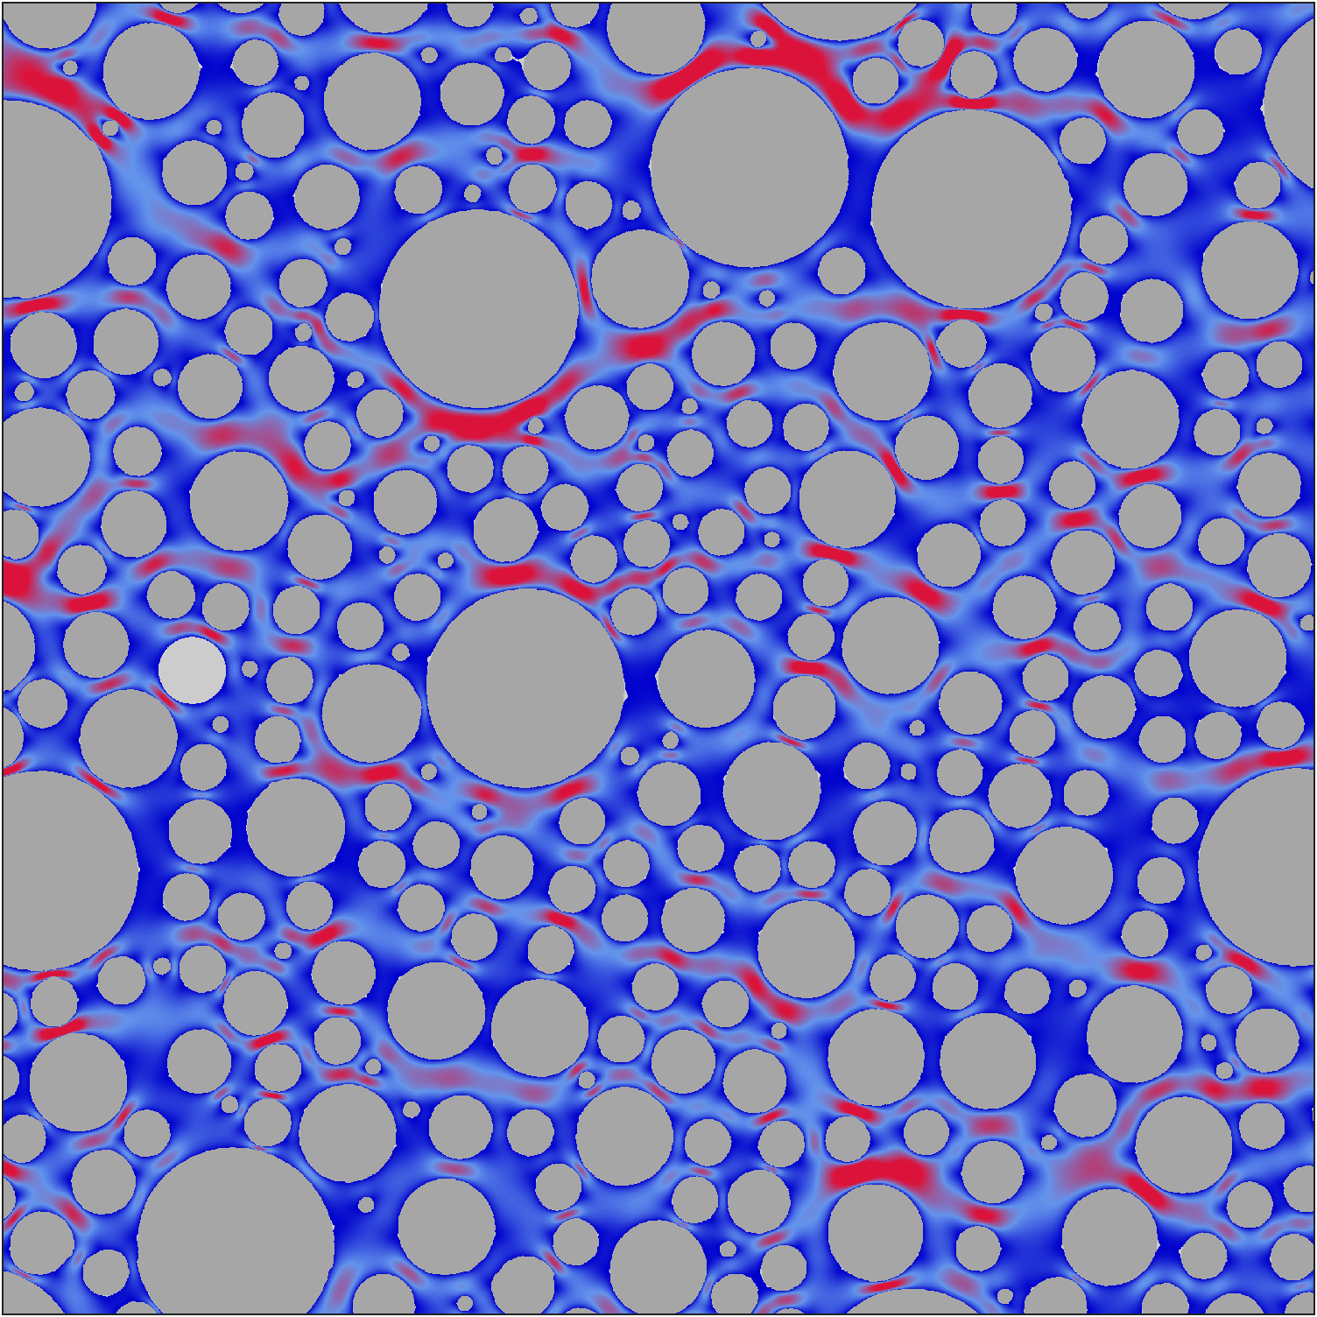

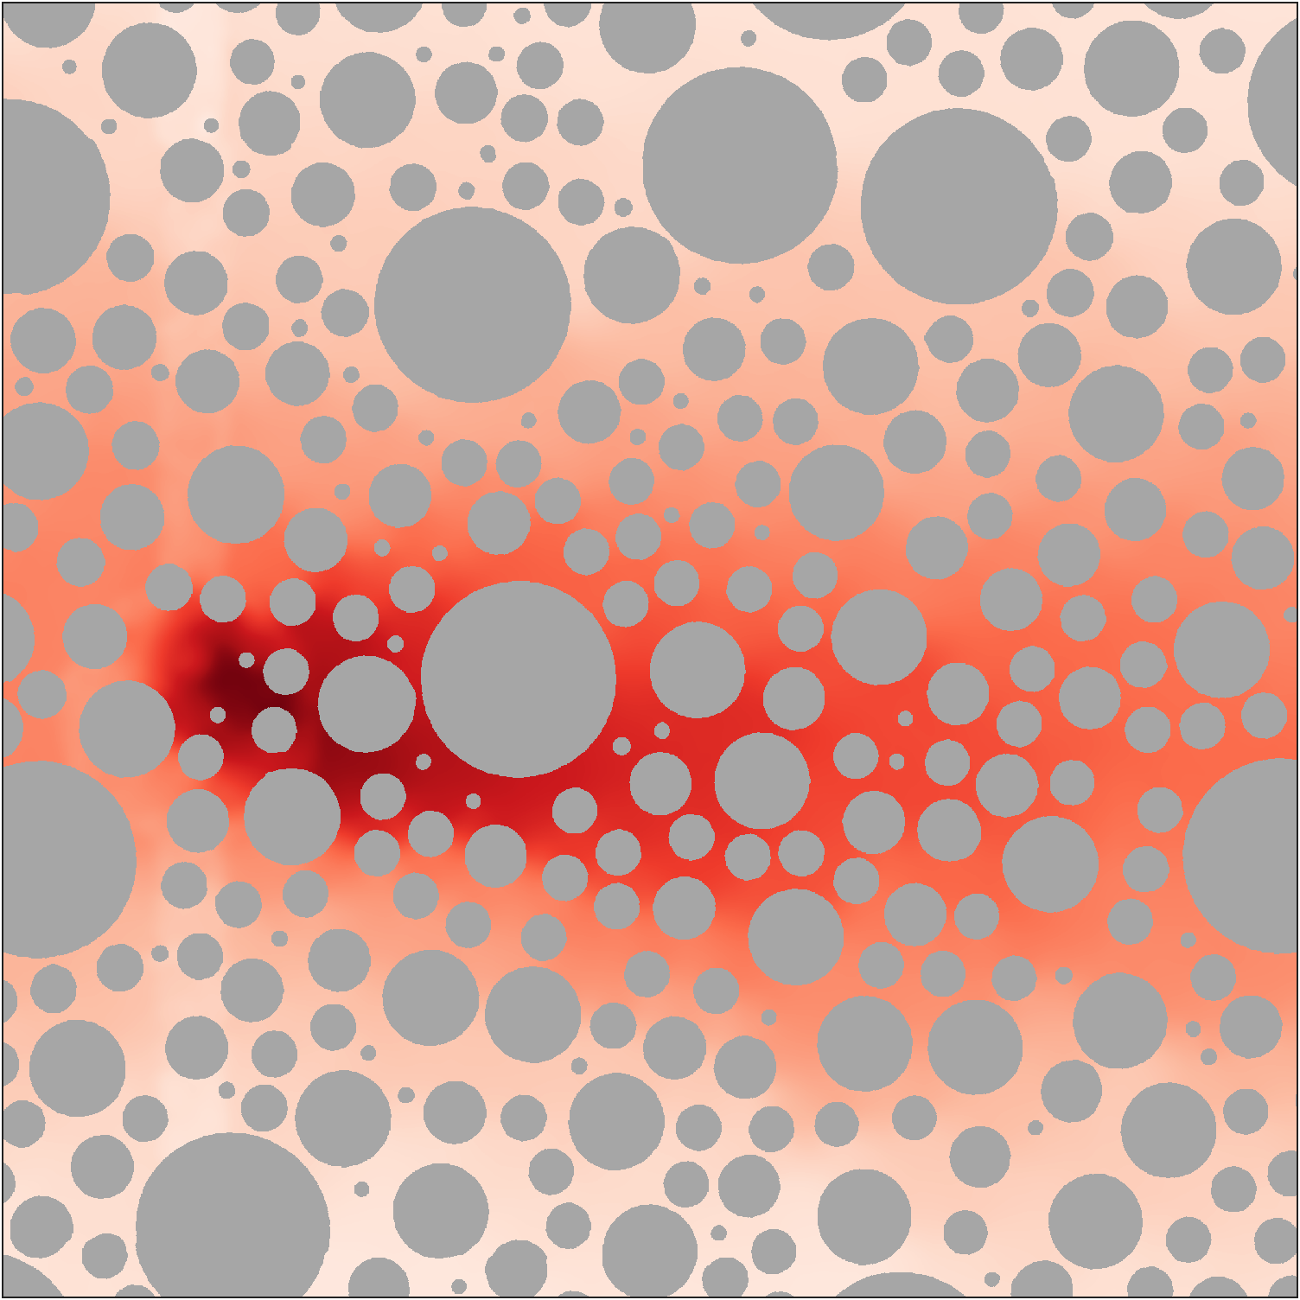

Single-cell tracking through microfluidics
nutrients
constant flow rate
PDMS
hydrogel
PDMS
microfluidic setup
thin PDMS
glass
high
low
high
tracking of individuals
Stoll et al. (under review)
low

Slide 4
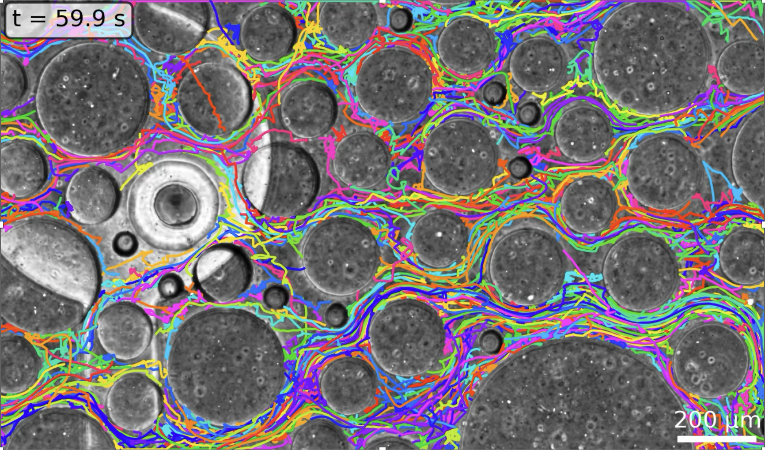
Single-cell tracking through microfluidics
nutrients
H₂O
constant flow rate
PDMS
hydrogel
PDMS
microfluidic setup
Quantify controls of abiotic quantities on bacterial navigation
thin PDMS
glass
high
low
high
tracking of individuals
Stoll et al. (under review)
low

Slide 5
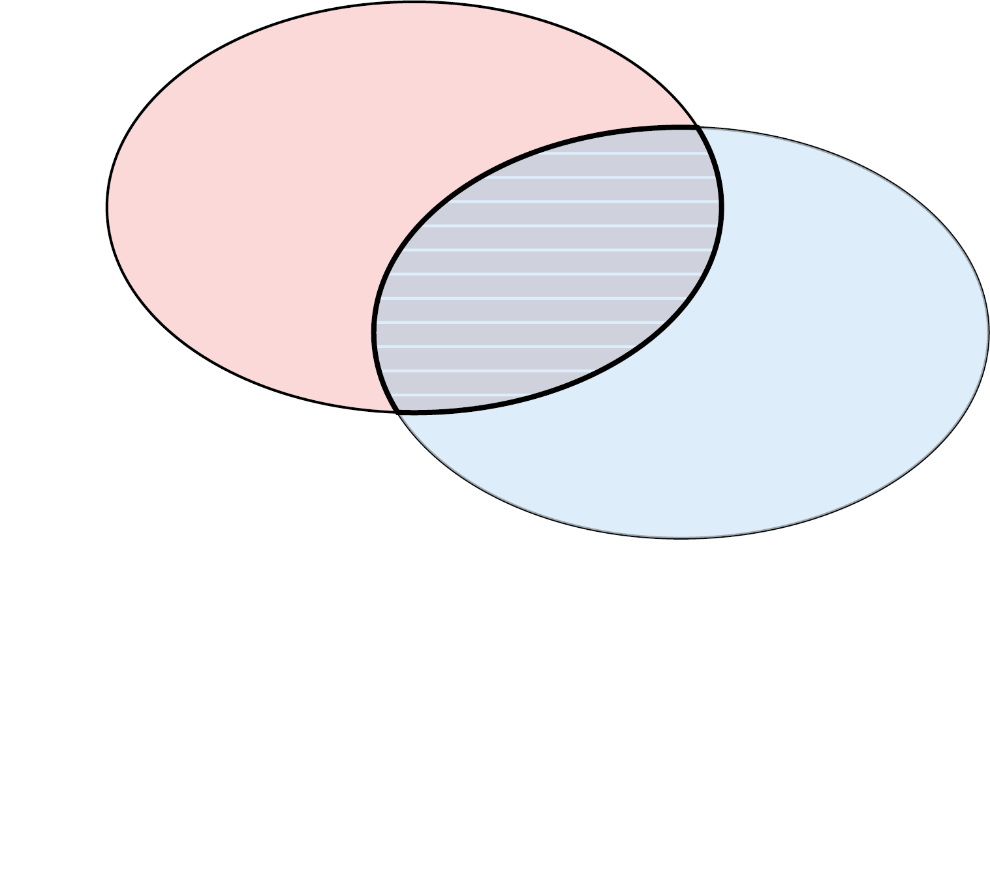
Partitioning information content
Shannon Entropy
Mutual Information

Slide 6
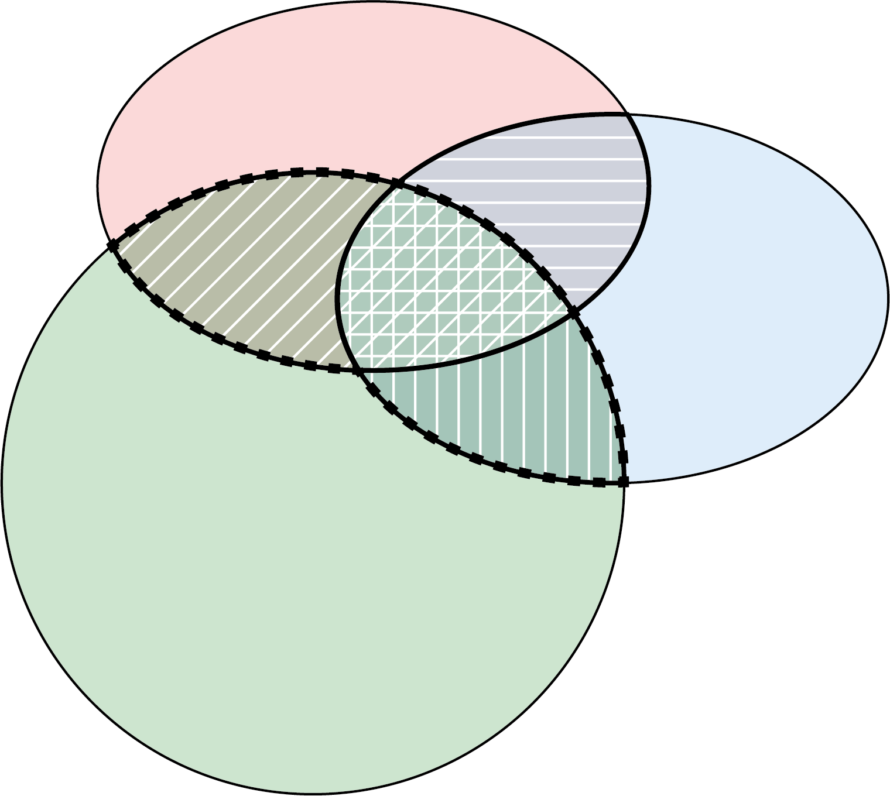
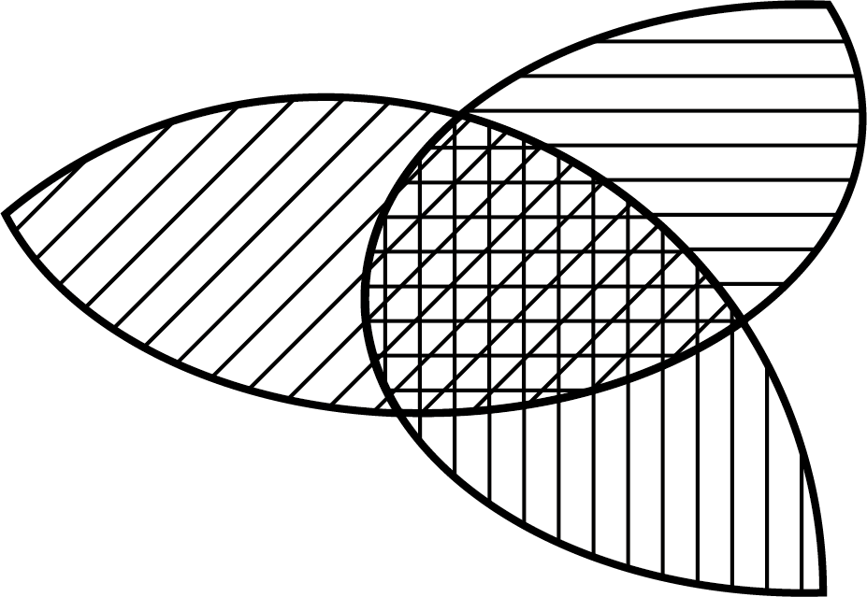
Partitioning information content
modified from Dell’Oca et al. (2020)
Shannon Entropy
Mutual Information
Multivariate Mutual Information
uniqueness
redundancy
synergy
according to Goodwell & Kumar (2017)

Slide 7
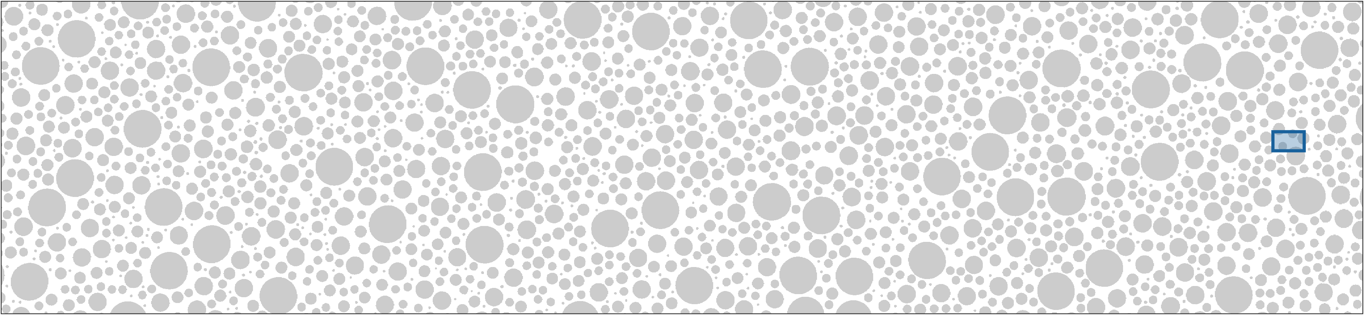

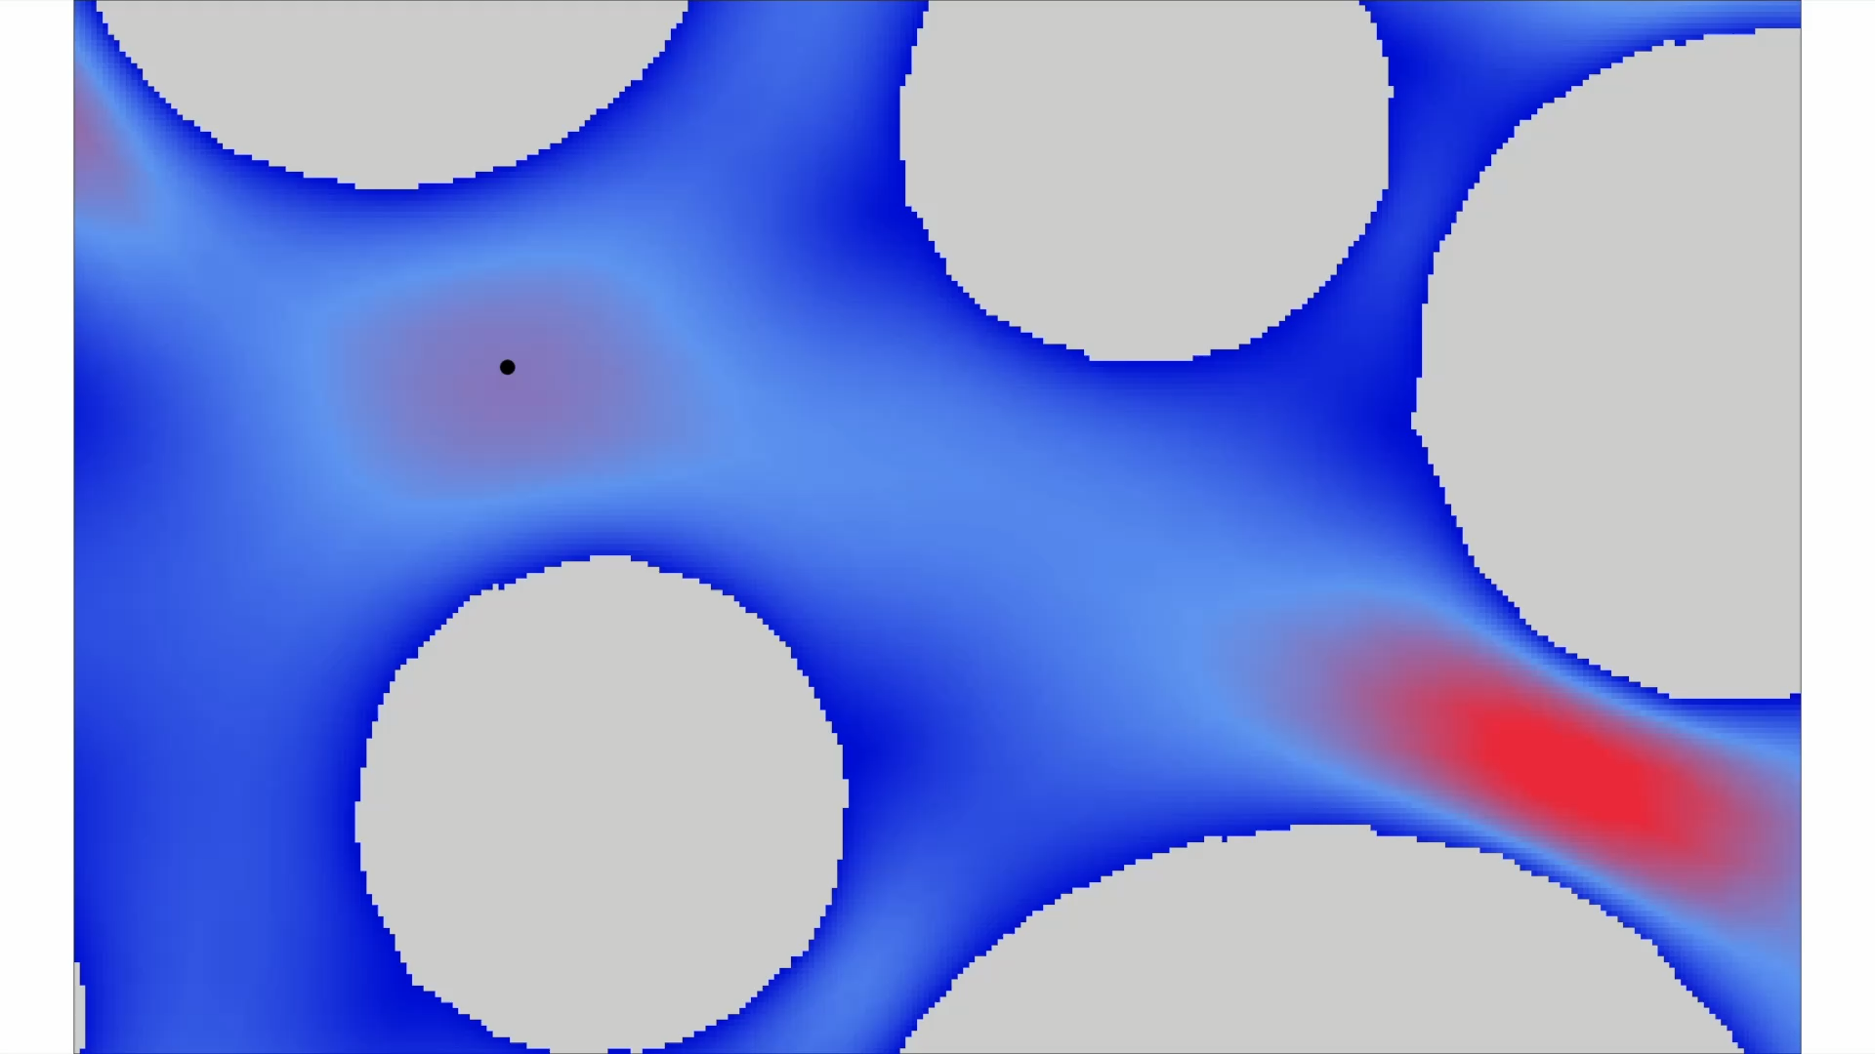

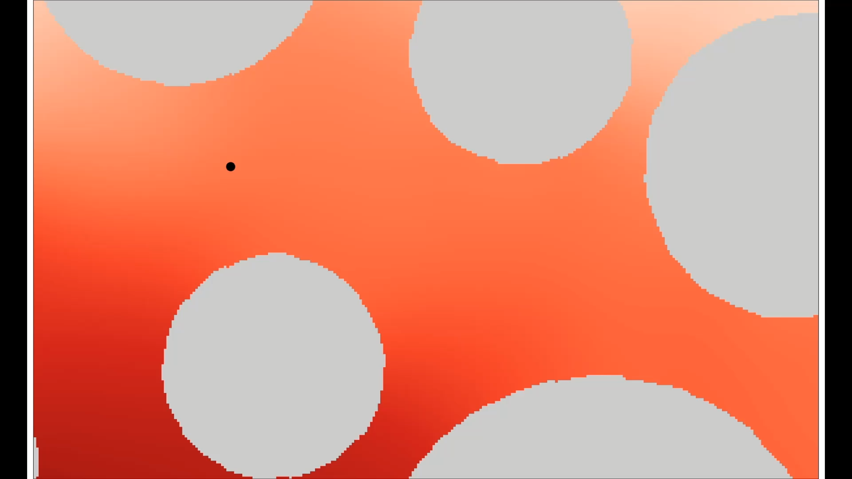

Key abiotic and biotic variables
cell k
flow
fluid velocity field
concentration field
25
0.03
[ - ]
[µm s⁻¹]
0
0.02

Slide 8
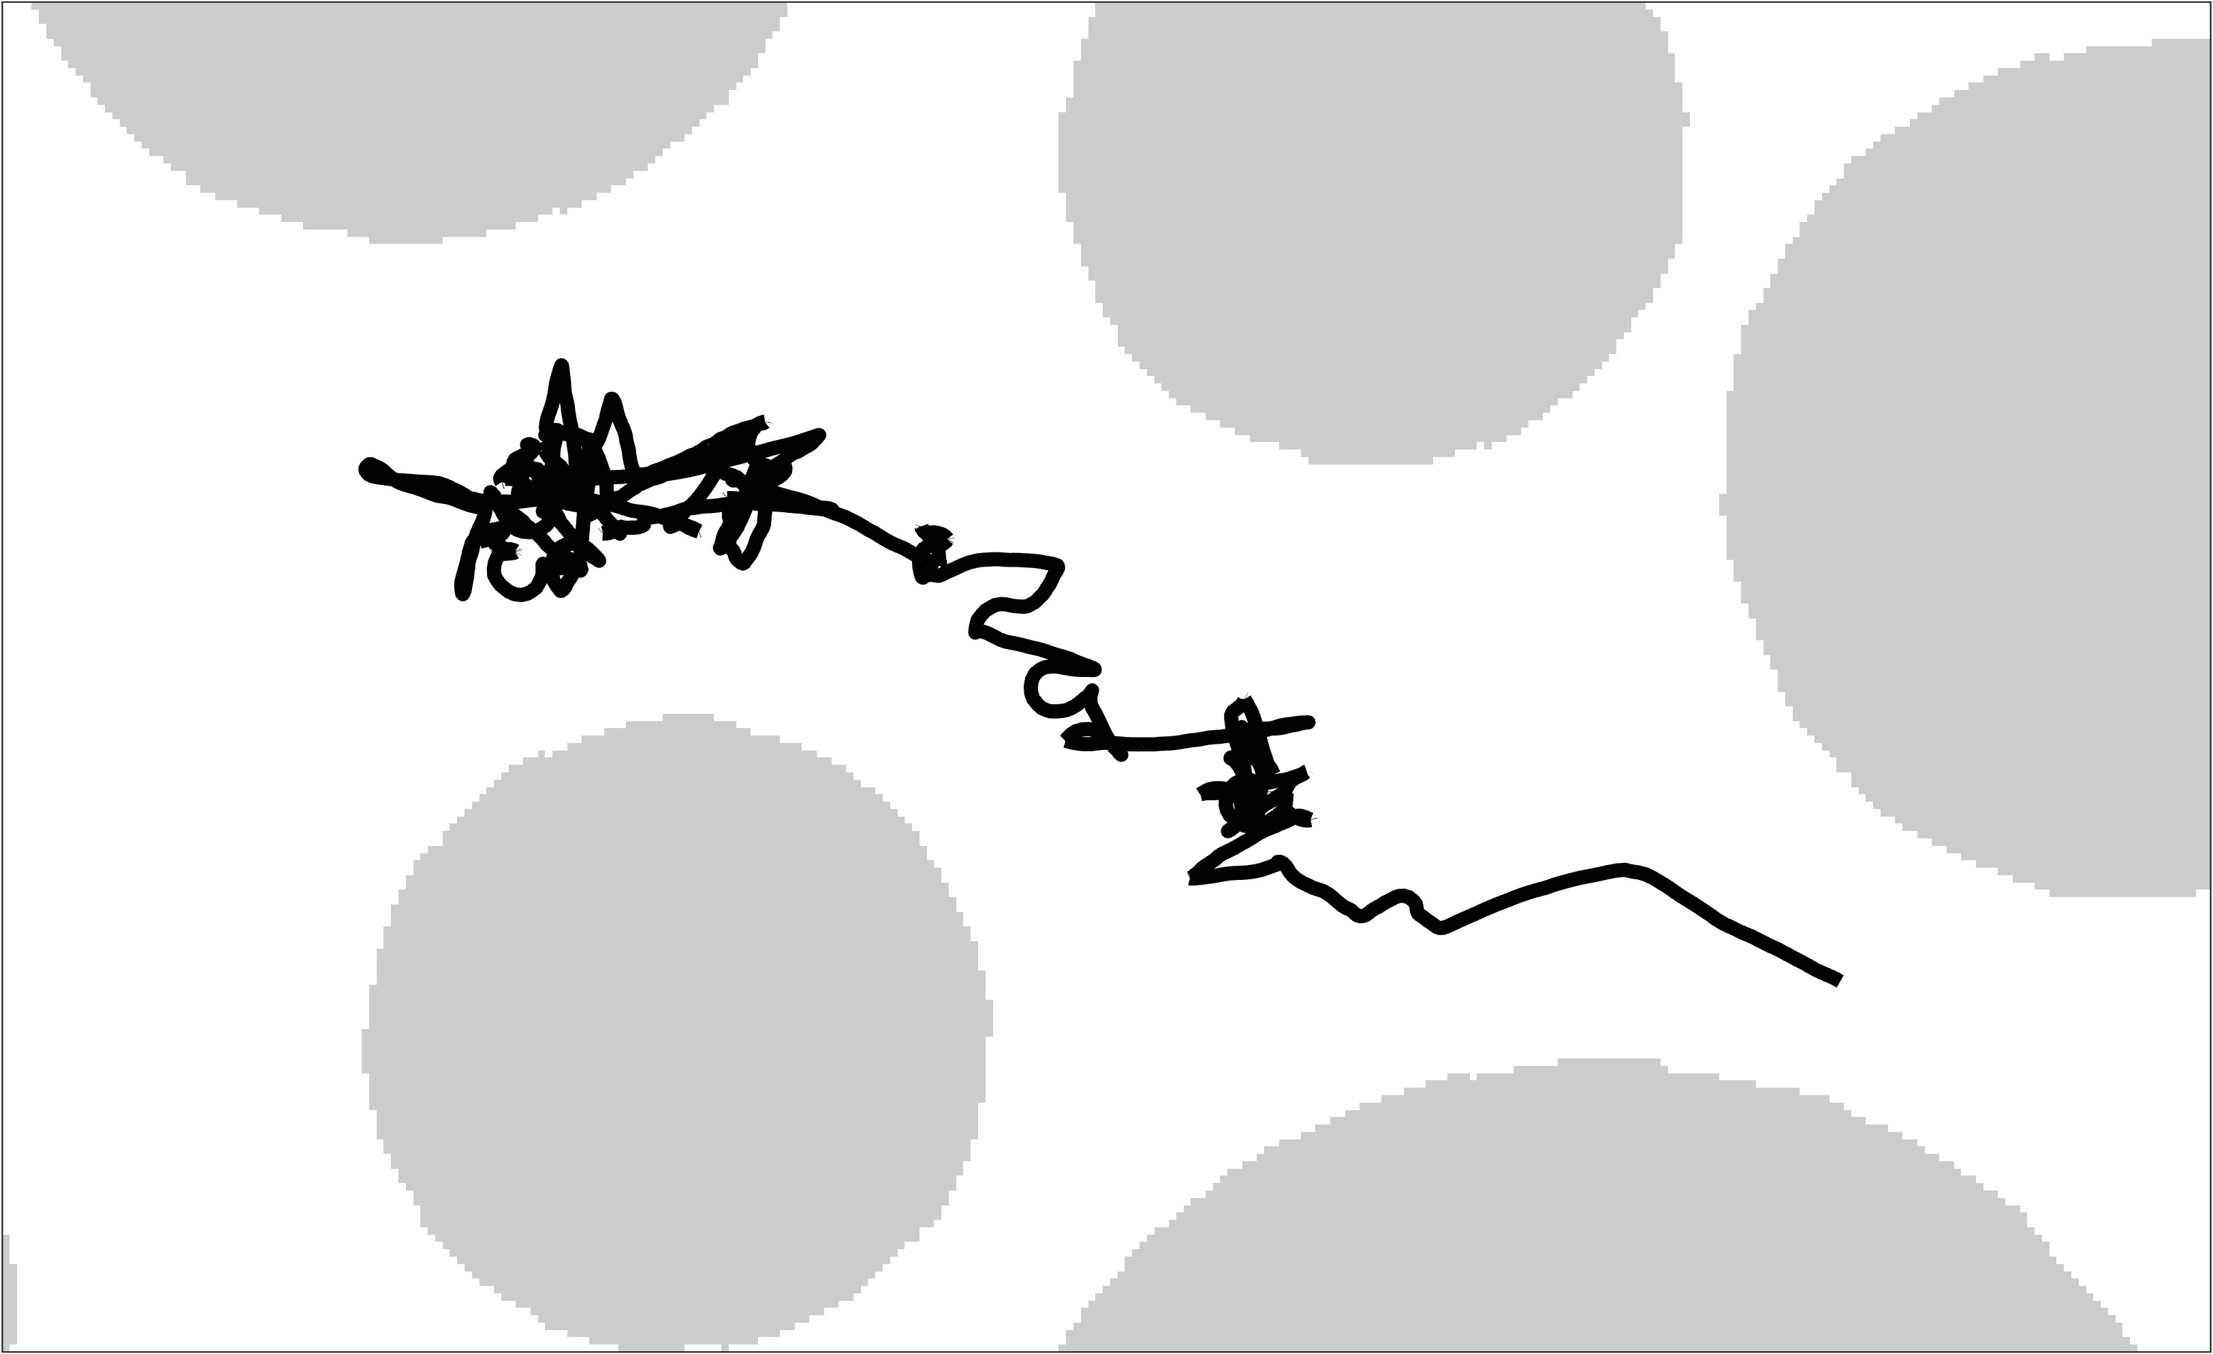
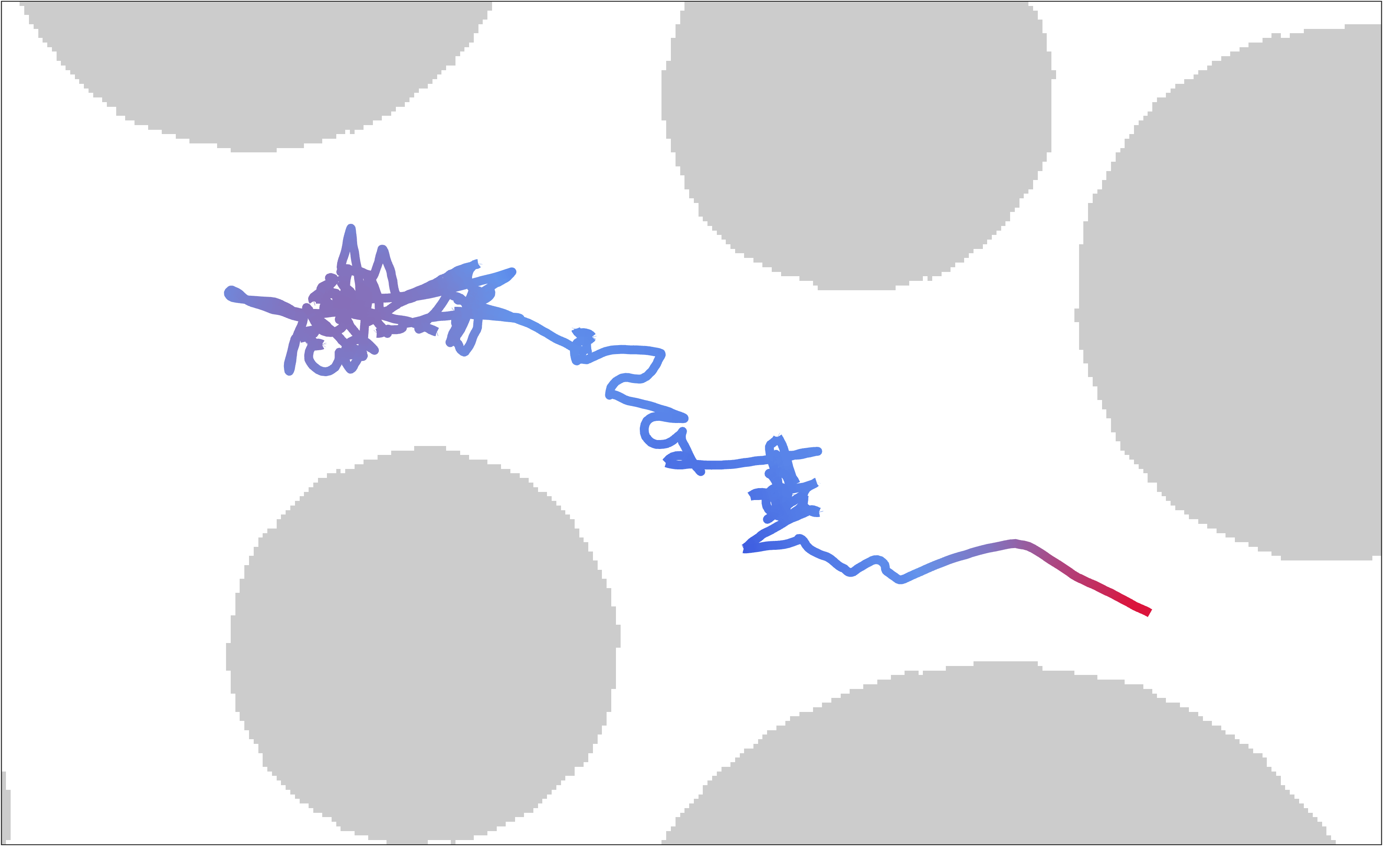
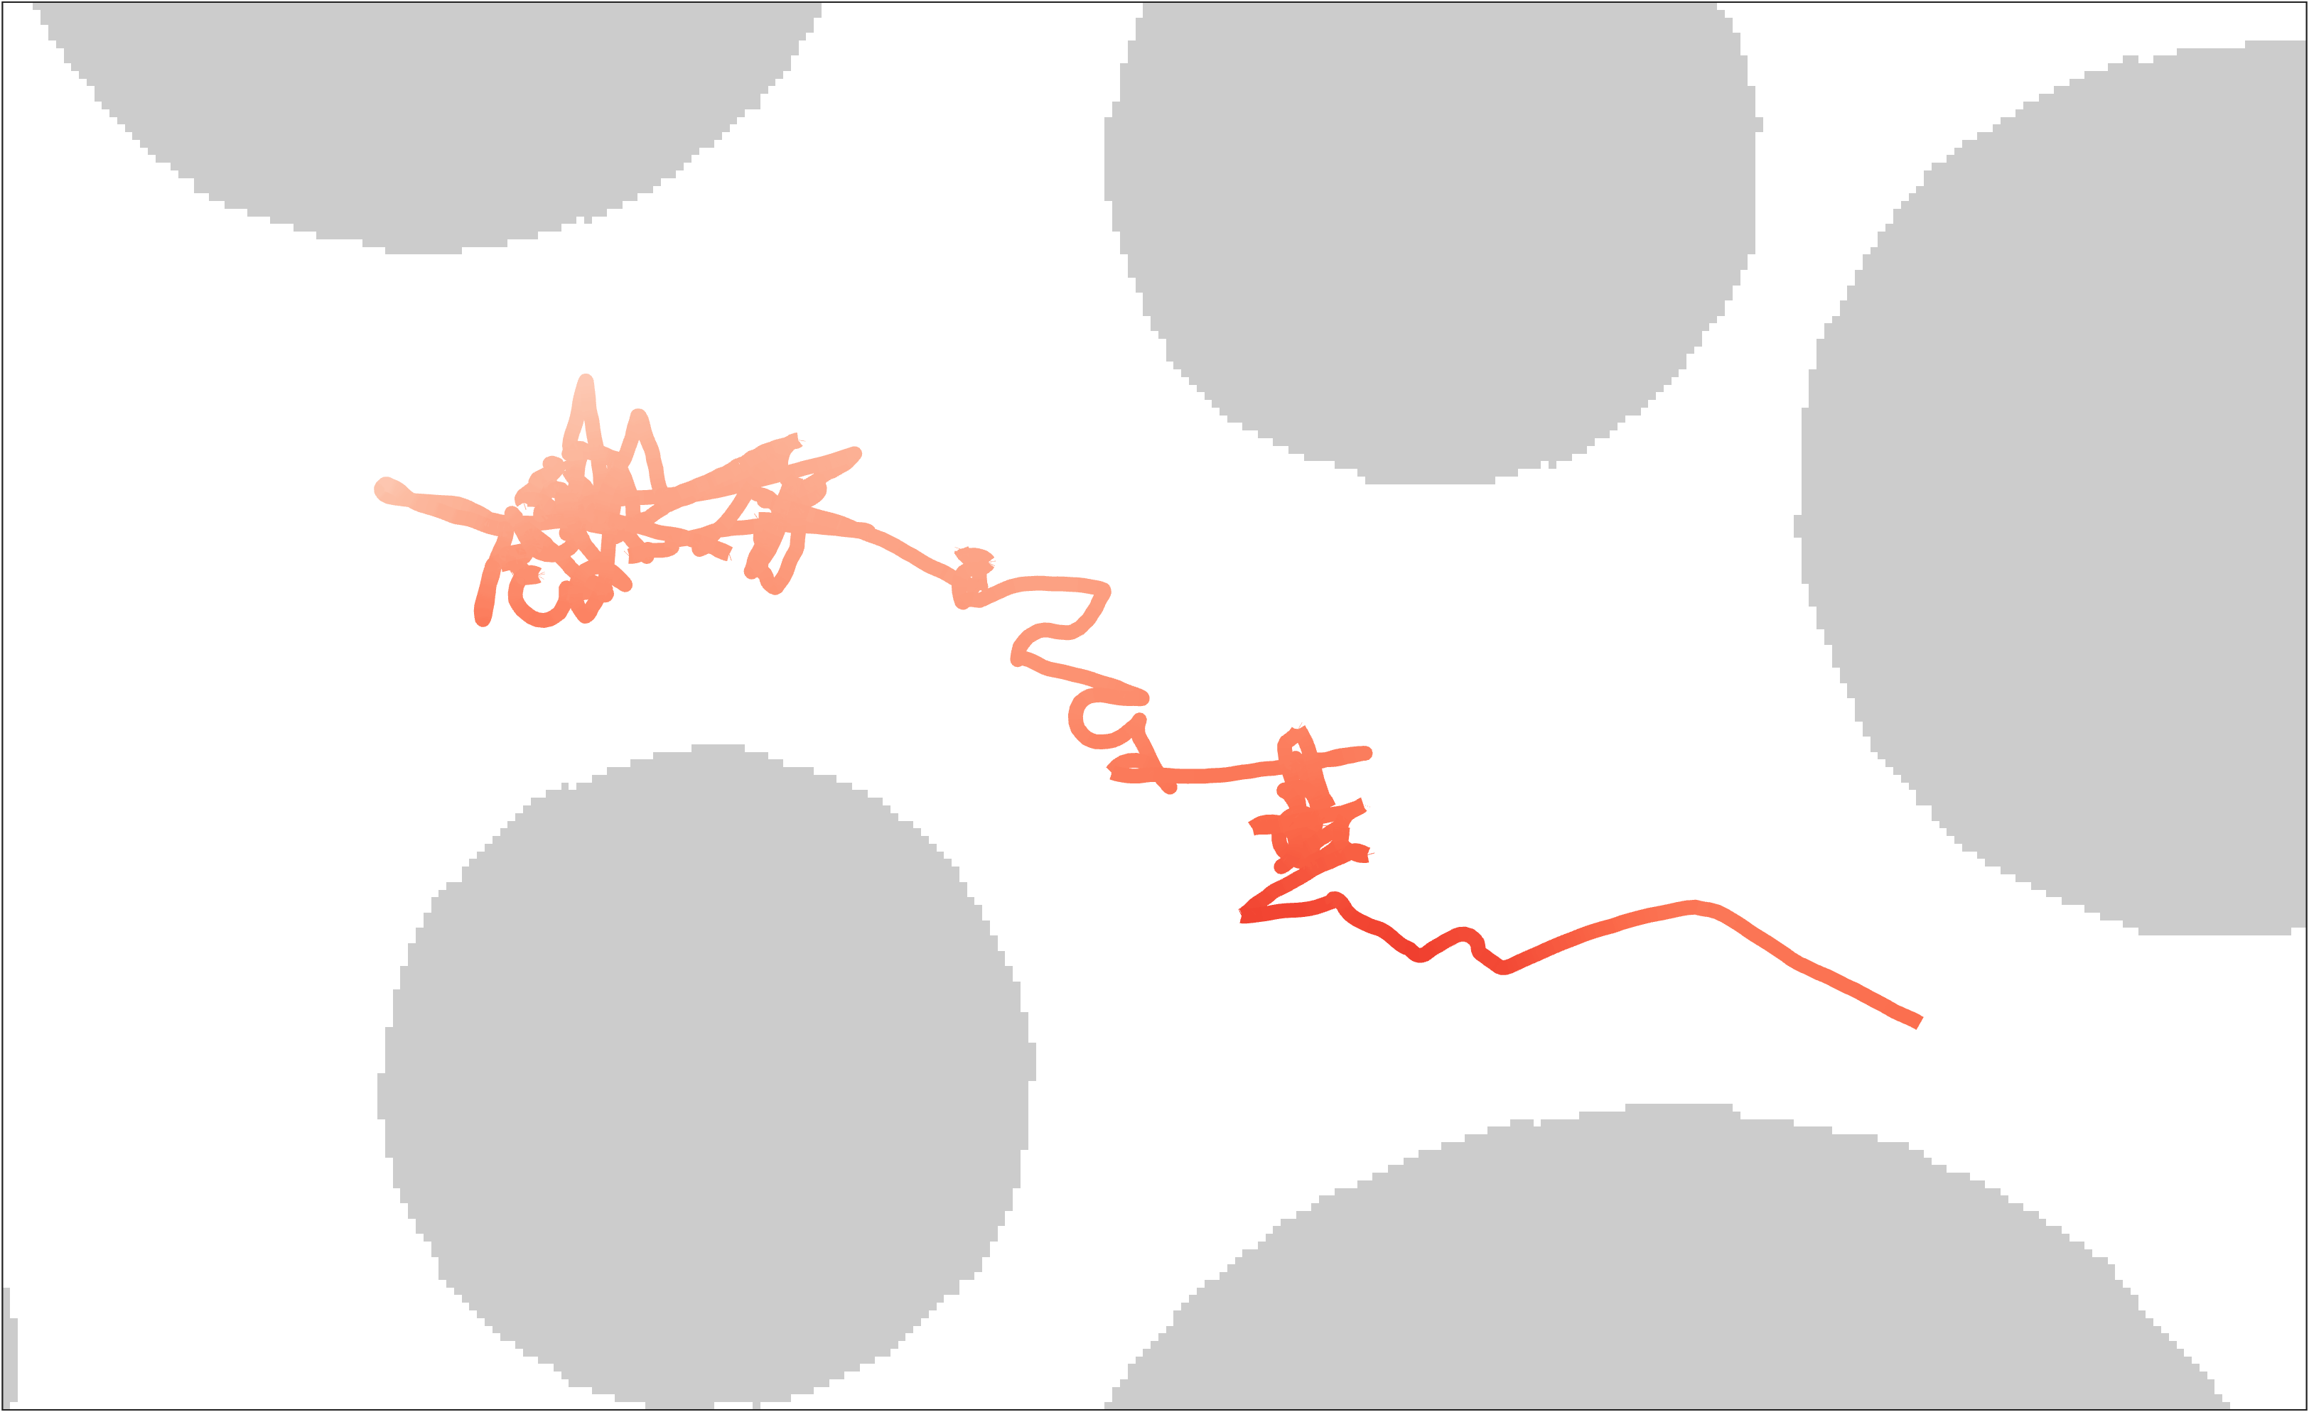

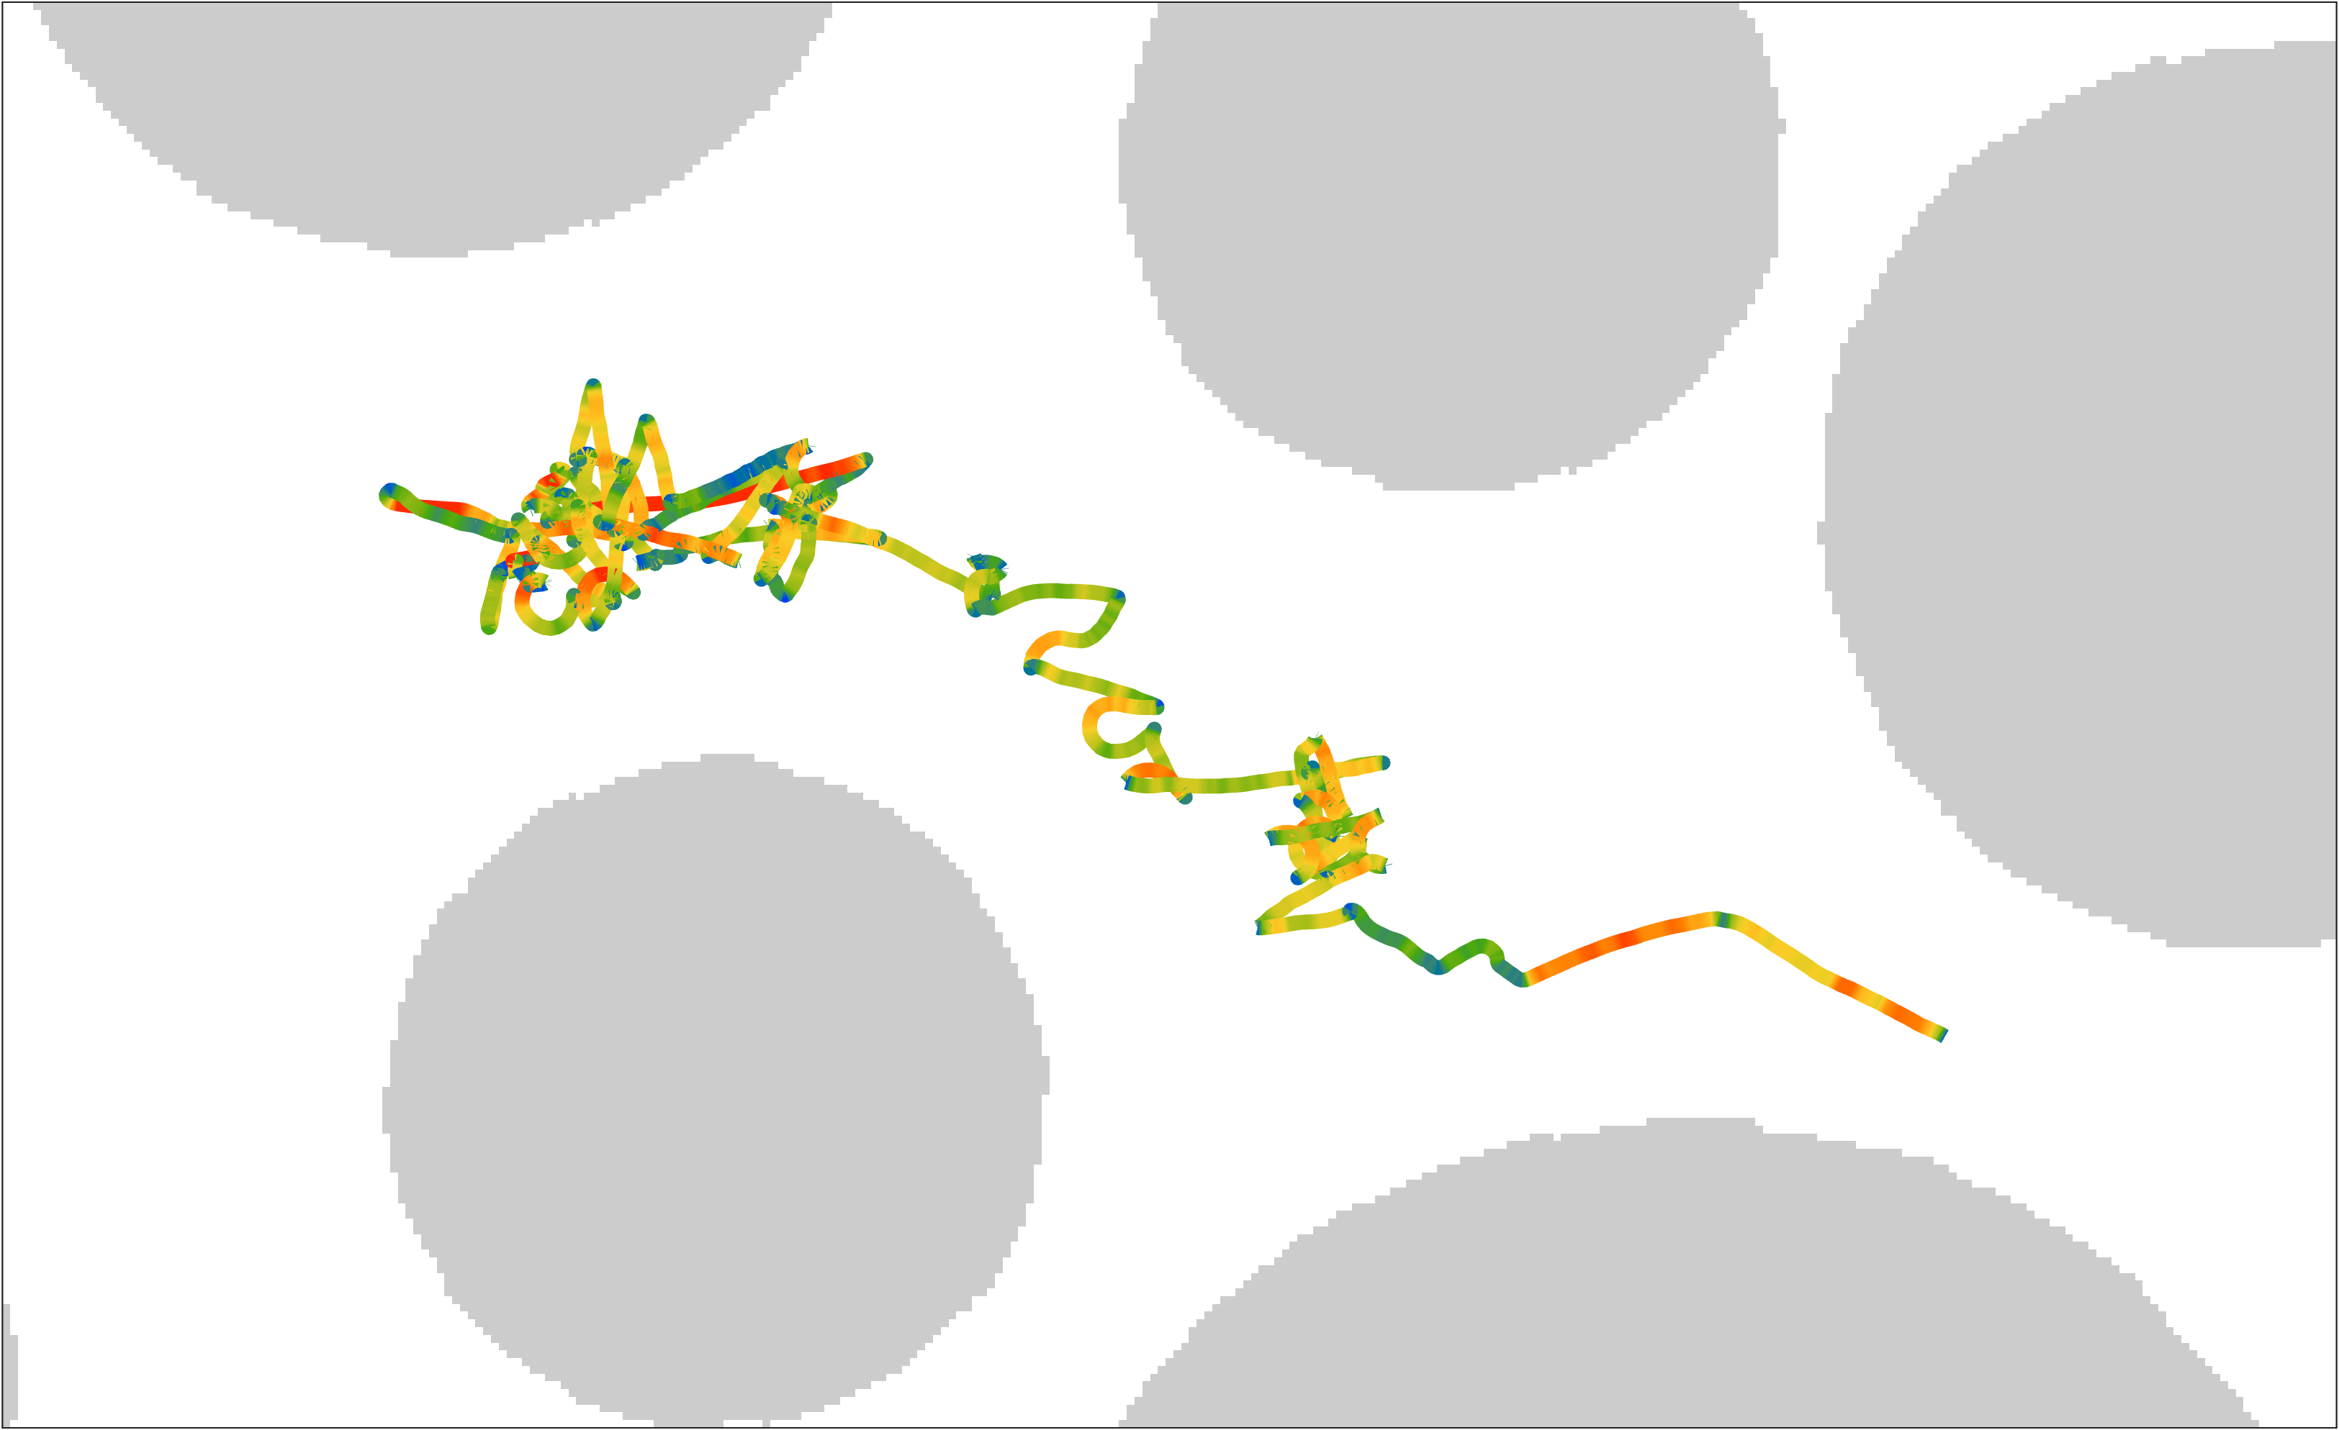
Key abiotic and biotic variables
cell k
flow
fluid velocity along trajectory
concentration along trajectory
swimming velocity along trajectory
25
0.03
40
[µm s⁻¹]
[ - ]
[µm s⁻¹]
0
0.02
0
0
0

Slide 9
Key abiotic and biotic variables
tumbling
event
cell k
flow
& tumbling frequency
fluid velocity along trajectory
concentration along trajectory
swimming velocity along trajectory
25
0.03
40
[µm s⁻¹]
[ - ]
[µm s⁻¹]
0
0.02
0
0
0

Slide 10
Key abiotic and biotic variables
tumbling
event
cell k
flow
& tumbling frequency
fluid velocity along trajectory
concentration along trajectory
swimming velocity along trajectory
25
0.03
40
[µm s⁻¹]
[ - ]
[µm s⁻¹]
0
0.02
0
0
0
Quantify how distribution of , , , and drive navigation mode ( , , and )

Slide 11
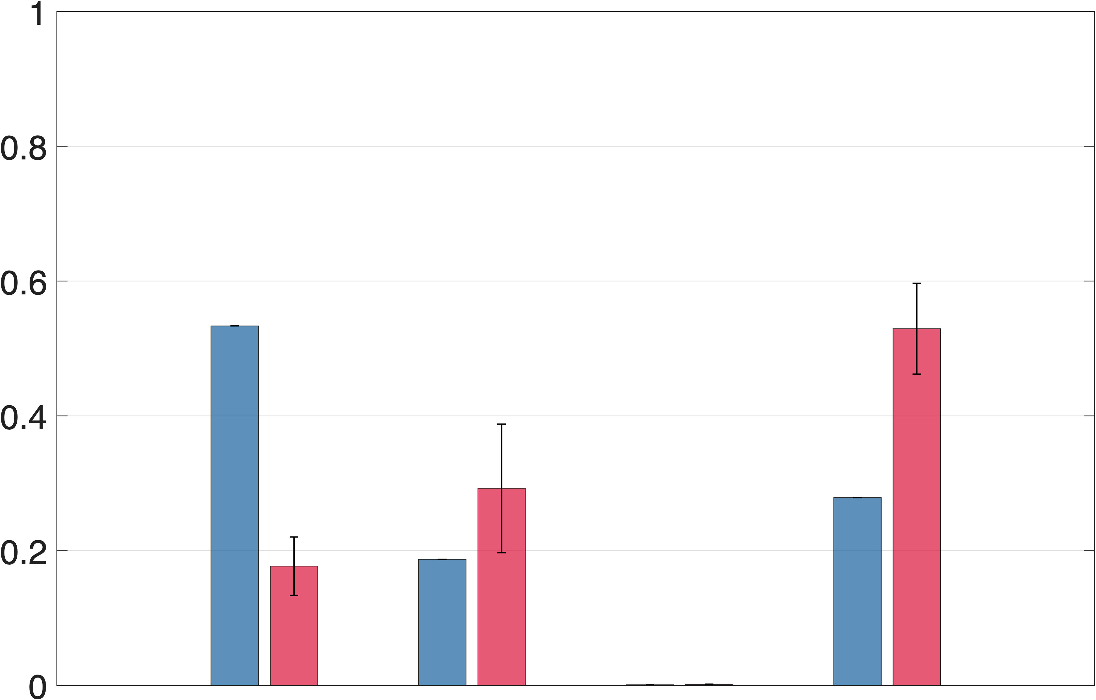
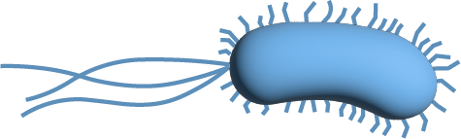
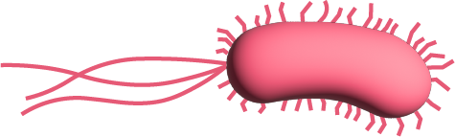
Preliminary results
motile
chemotactic
relative contribution to
motile bacteria are mostly influenced by fluid velocity
synergy reflects multivariate correlations for chemotactic bacteria

Slide 12
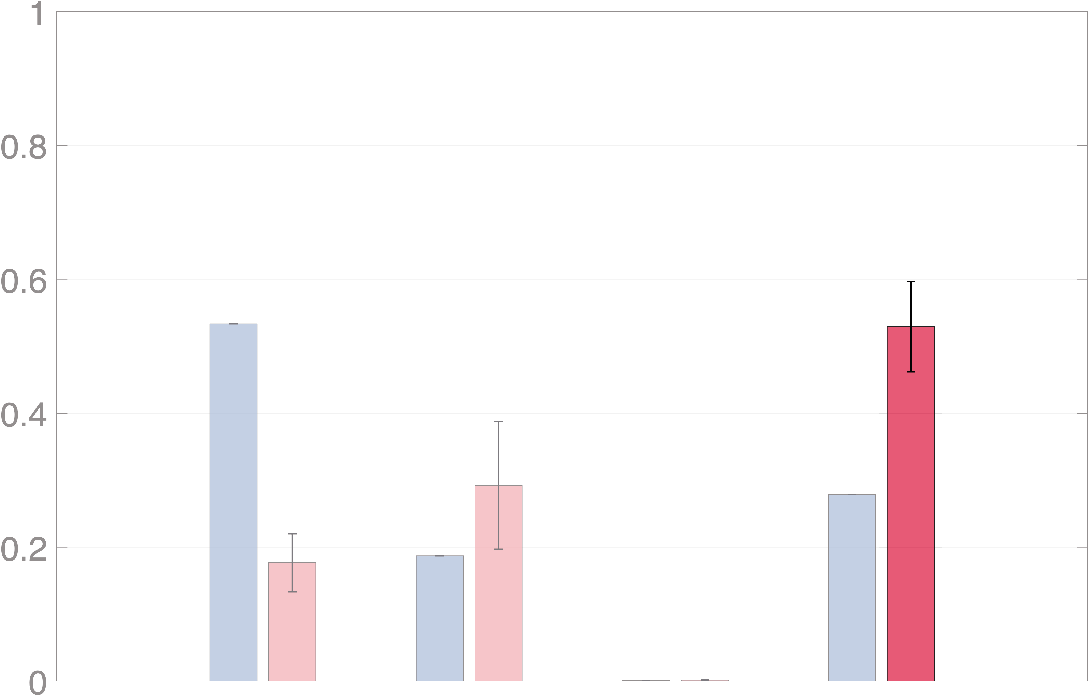
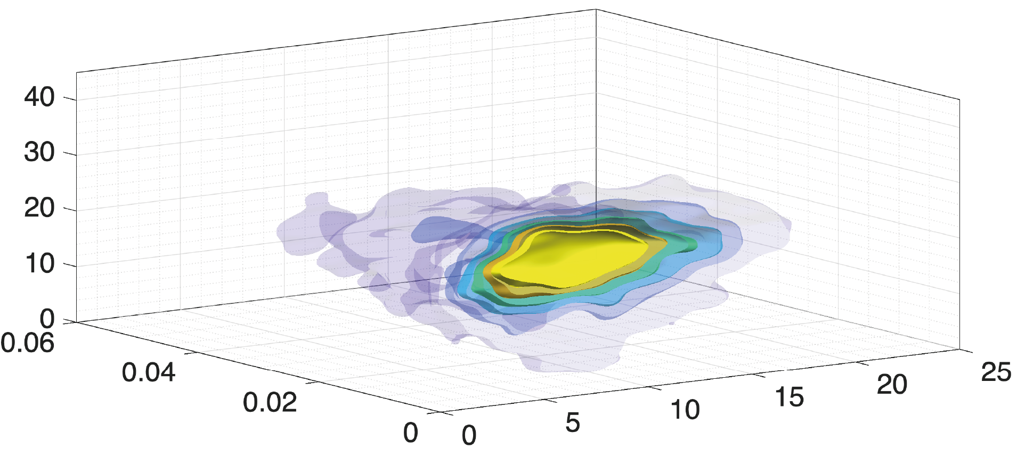
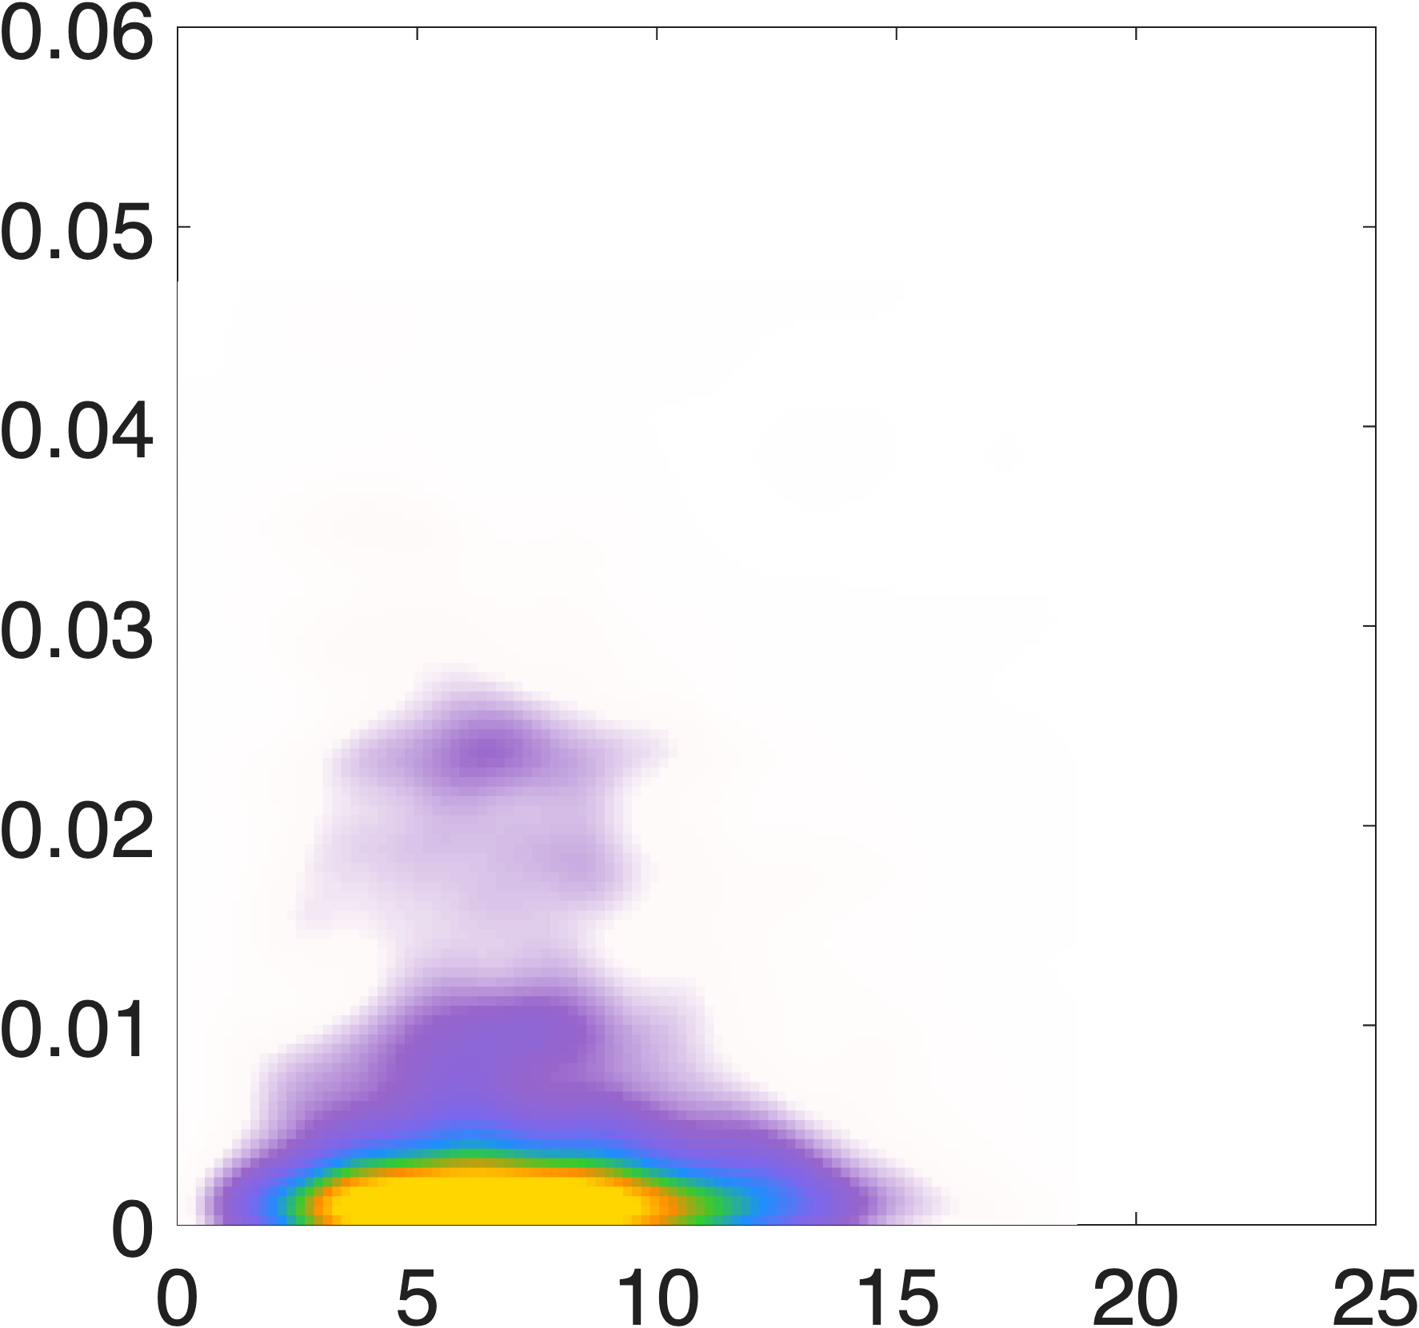
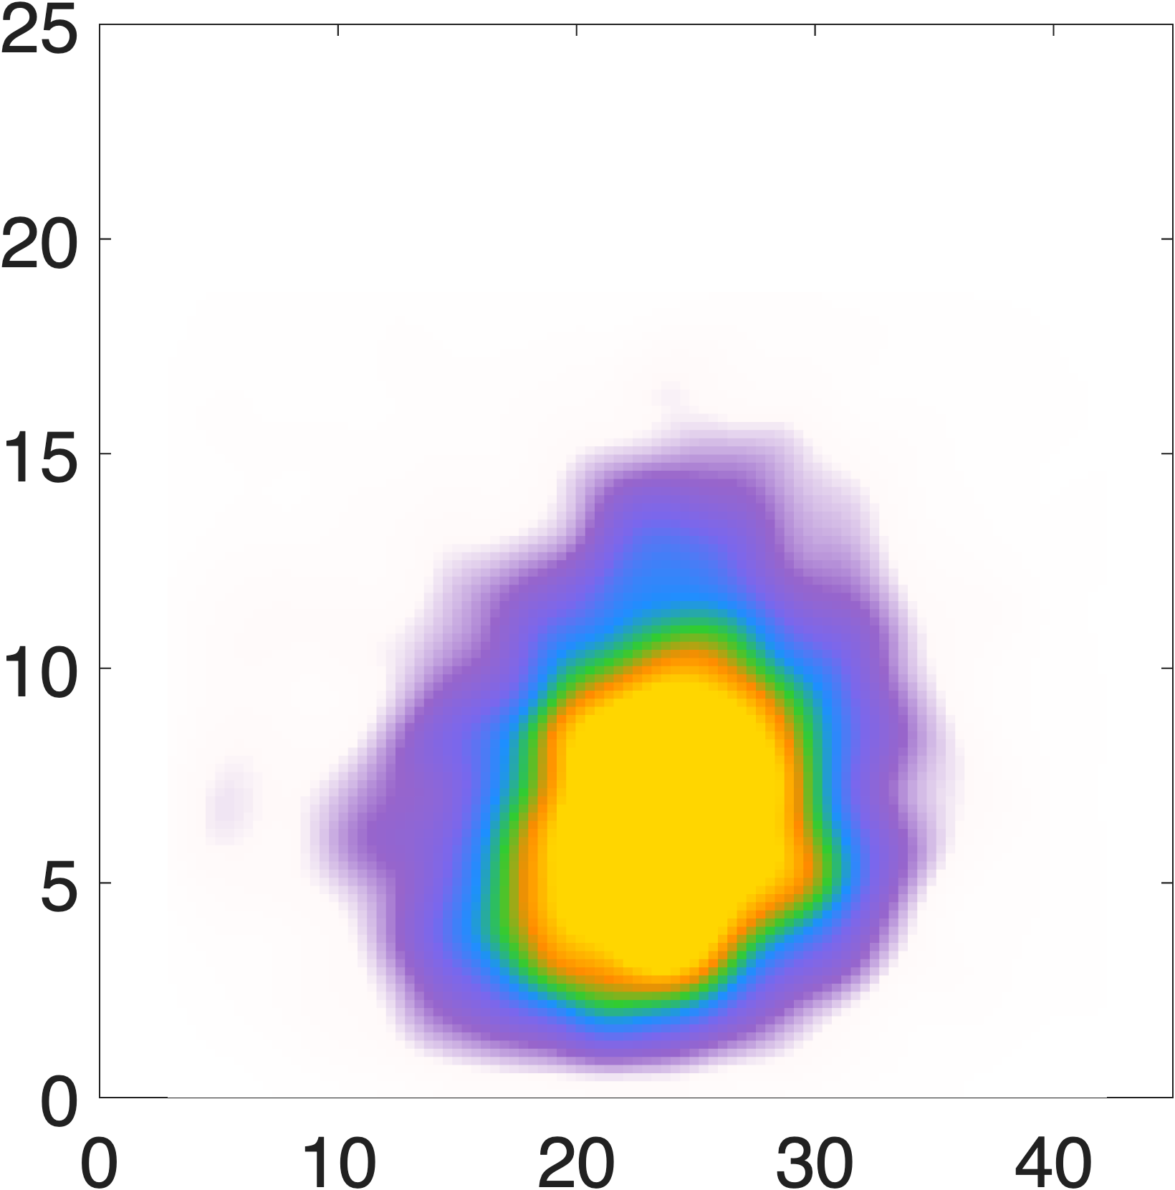
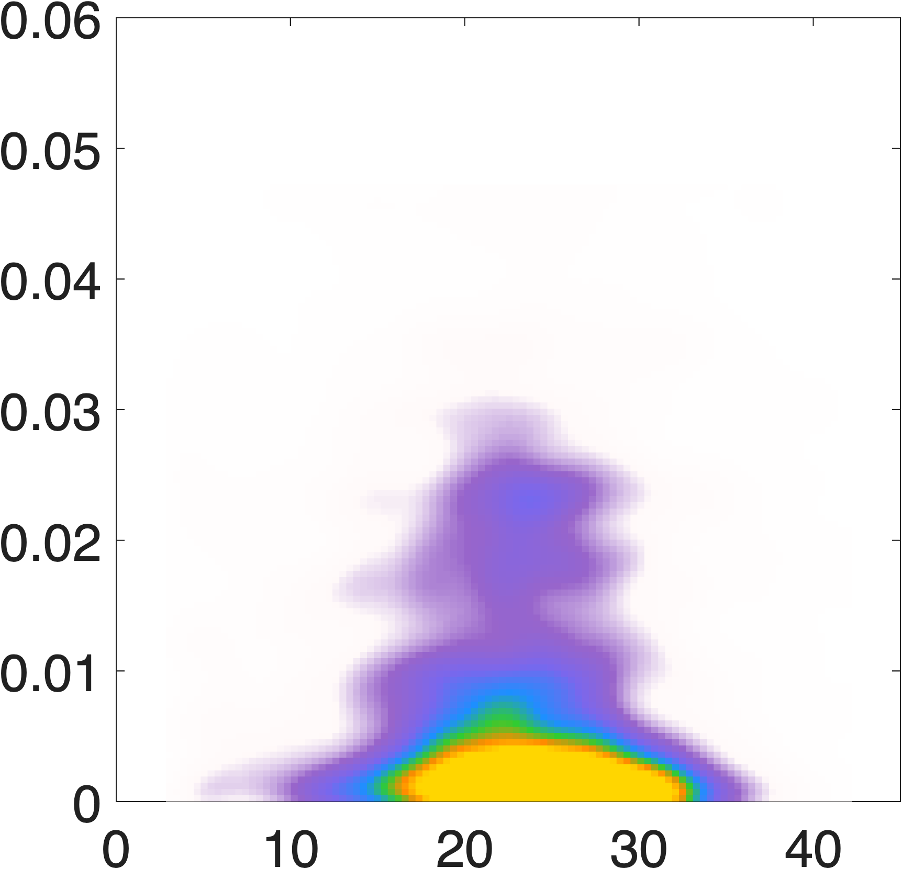


Preliminary results
chemotactic
motile
chemotactic
[µm s⁻¹]
relative contribution to
[-]
[µm s⁻¹]
0
8
0
5$⋅$10⁻³
0
3
[-]
[µm s⁻¹]
[-]
[µm s⁻¹]
[µm s⁻¹]
[µm s⁻¹]

Slide 13
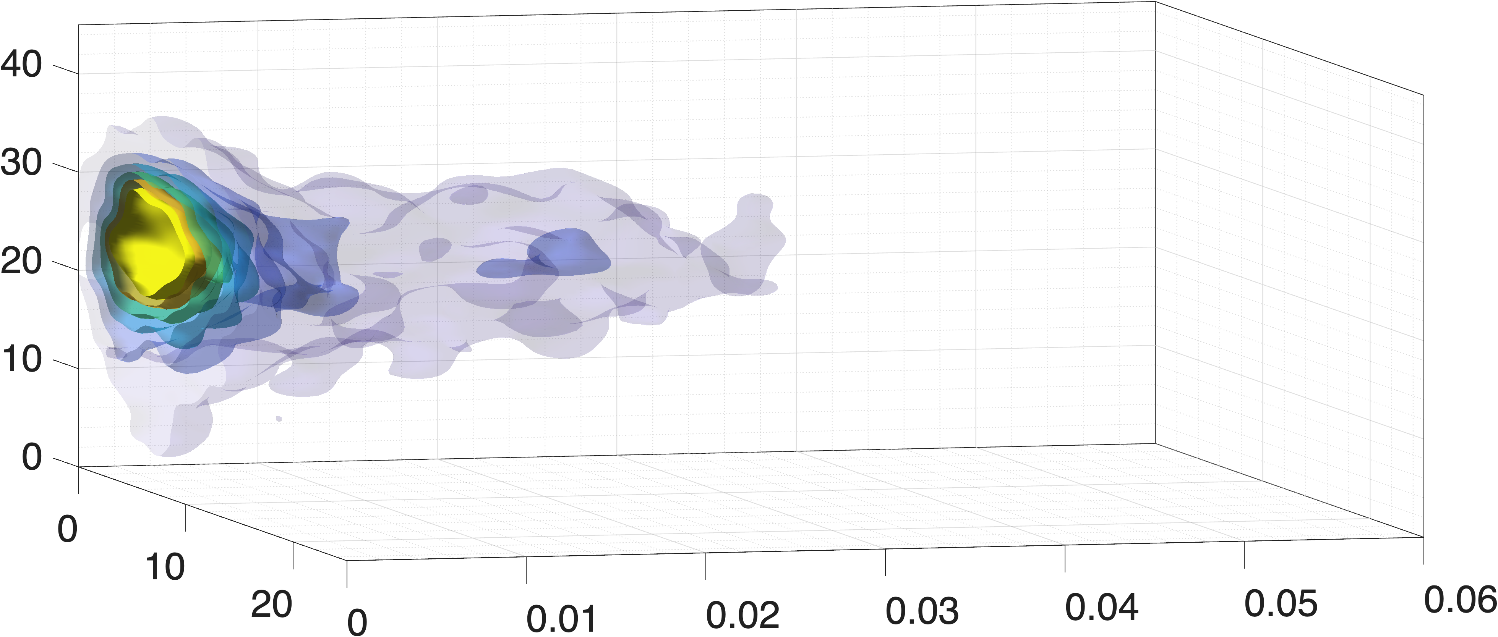
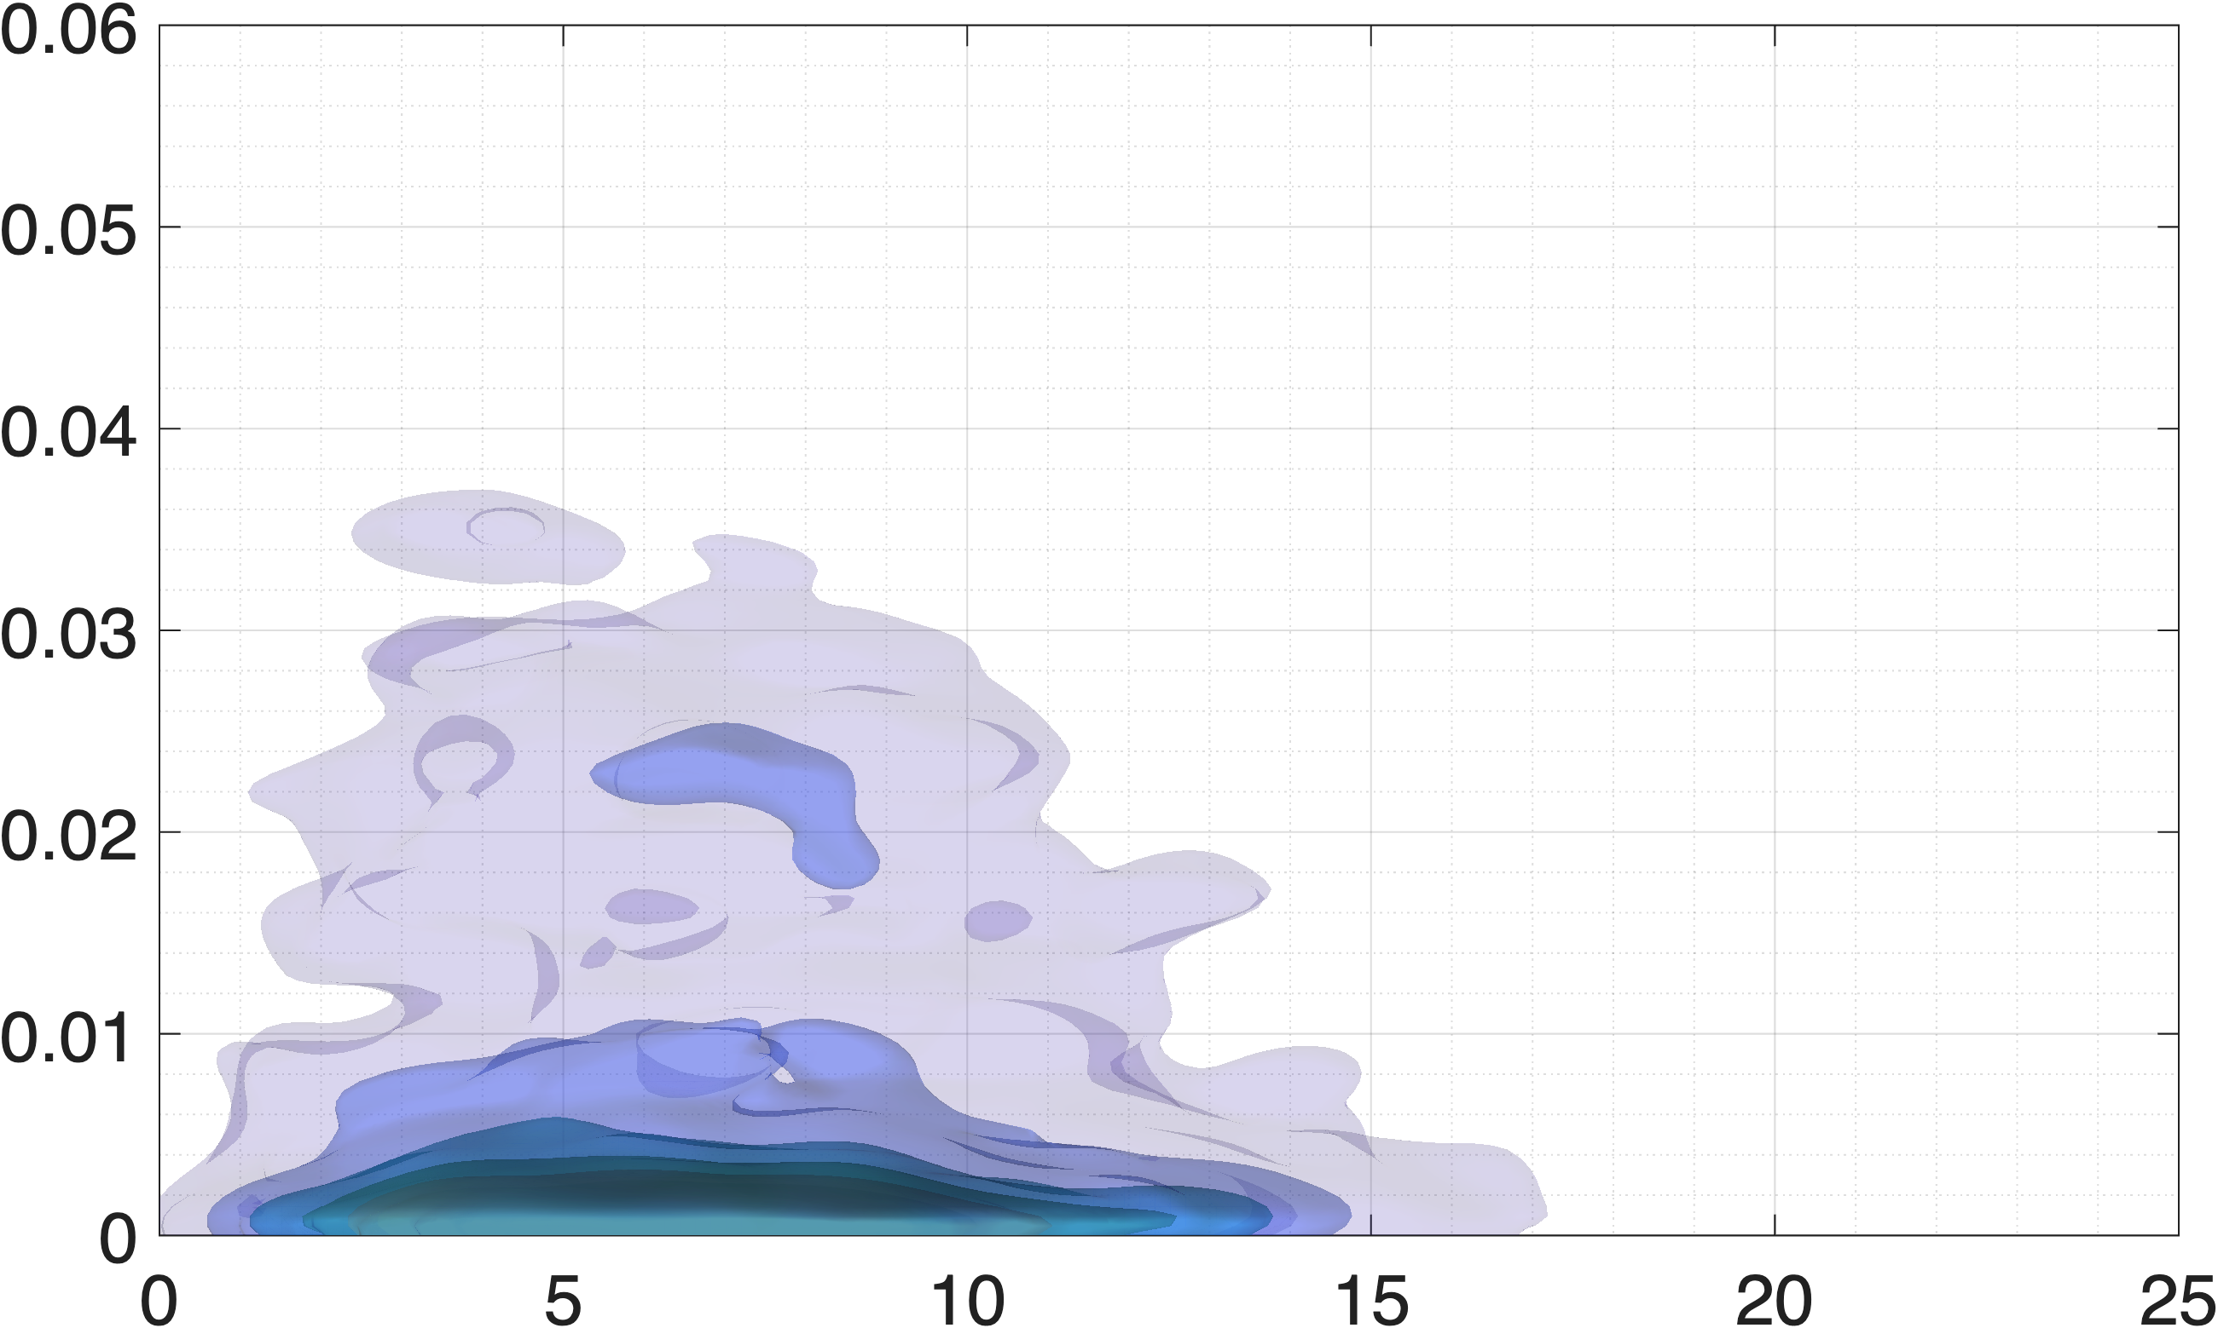
Preliminary results
chemotactic
motile
chemotactic
[µm s⁻¹]
relative contribution to
[µm s⁻¹]
[-]
motile bacteria are mostly influenced by fluid velocity
[-]
synergy reflects multivariate correlations for chemotactic bacteria
[µm s⁻¹]

Slide 14
Conclusions & future perspectives
Information Partitioning can be applied to investigate microbial ecology
differences in behaviors depending on bacterial phenotype are quantified
different combinations of variables
segment trajectories
running segments
segments in pores VS pore-throats

