Slide 1




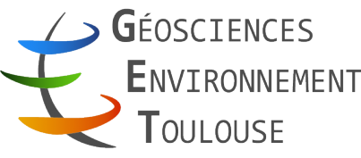

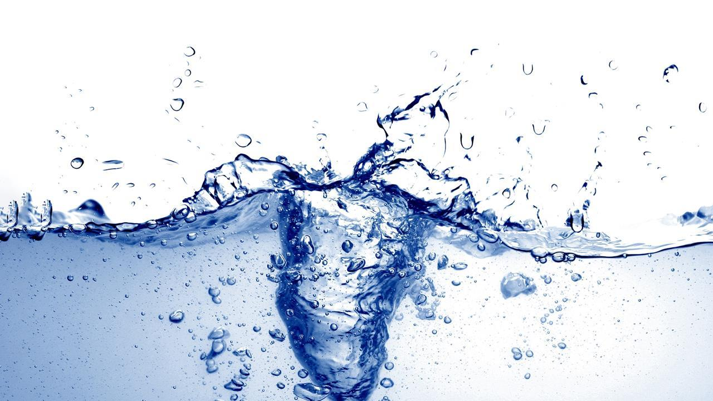


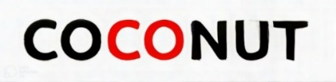
Time-lapse X-ray microtomography: particle transport and retention
M. Iqbal¹, S. Manoorkar², T. Bultreys², C. Noiriel³, S. Roman¹ and C. Soulaine¹
¹Institut des Sciences de la Terre d’Orléans, Université d’Orléans-BRGM-CNRS, France
²Centre for X-ray Tomography (UGCT), Ghent University, Ghent, Belgium
³Géosciences Environnement Toulouse, Université de Toulouse, France
20th May 2026
This work has received funding from European Union’s ERC Consolidator Grant Nº101043288
Notes:
Good morning everyone, I’m Muqeet Iqbal, post doc at the Earth sciences institute of Orleans, France
I will talk about transport of particles through porous media, using time-resolved 3D X-ray micro tomography.

Slide 2
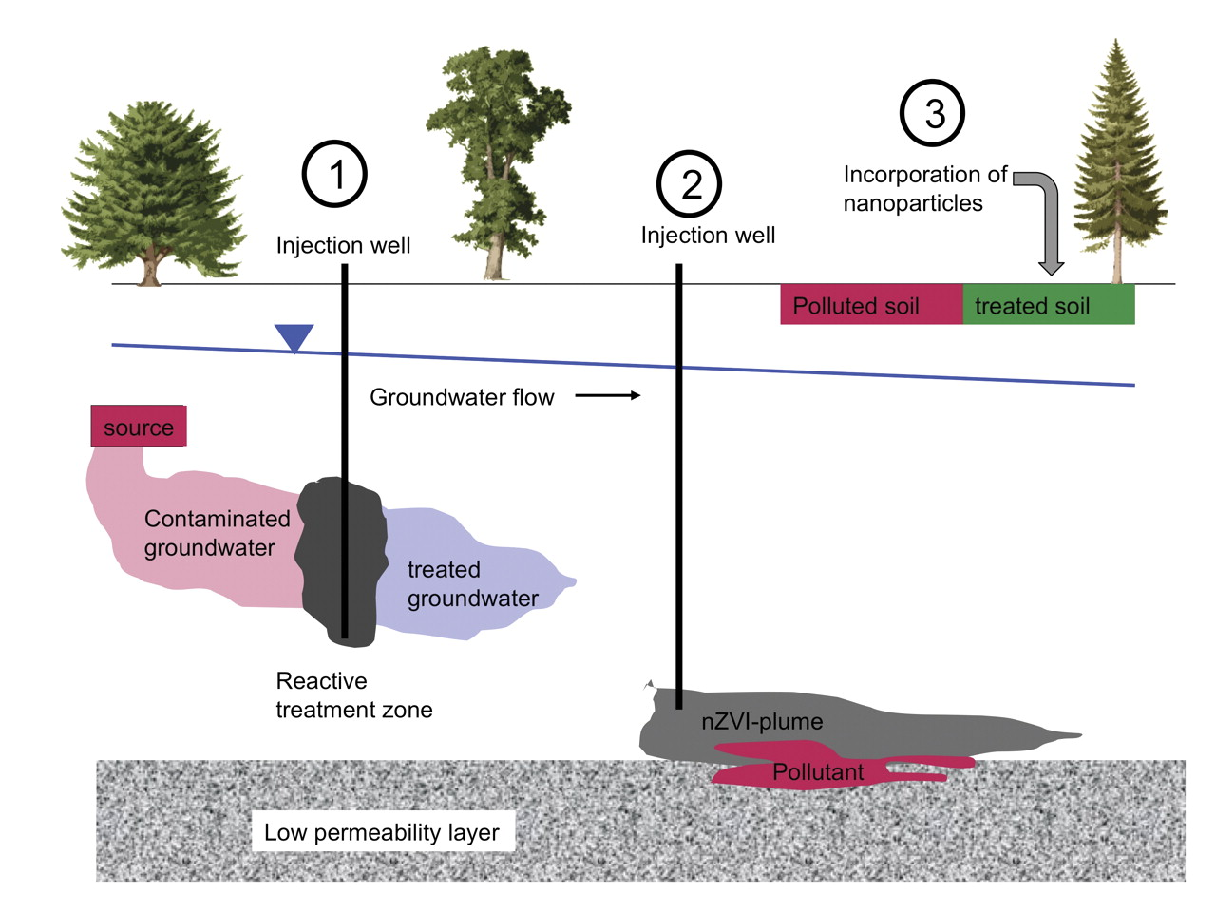
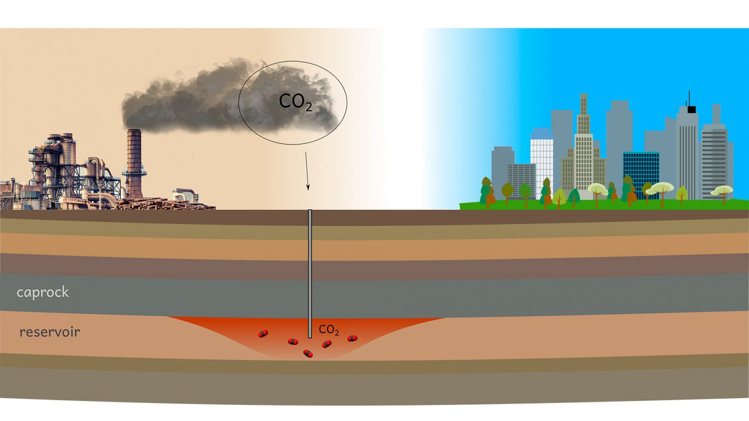
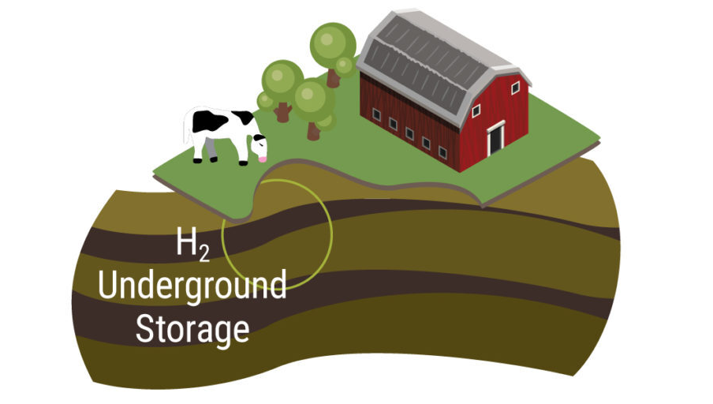
Transport of Colloids
Introduction | Experimental Methodology | Results | Conclusions
Groundwater remediation
Carbon capture and storage
Whether deposition decreases or preserves permeability and under what conditions remain unresolved
Particle injection
Injection well
Injection well
EPFL (2021)
H₂ storage
Yousuf & Agnihotri (2023)
GTI energy (2024)
Notes:
Transport of colloid is important for several research fields: including groundwater remediation, underground H2 storage and for carbon capture and storage.
Colloids can deposit in porous media but
Weather this will increase of decrease permeability is still not resolved

Slide 3
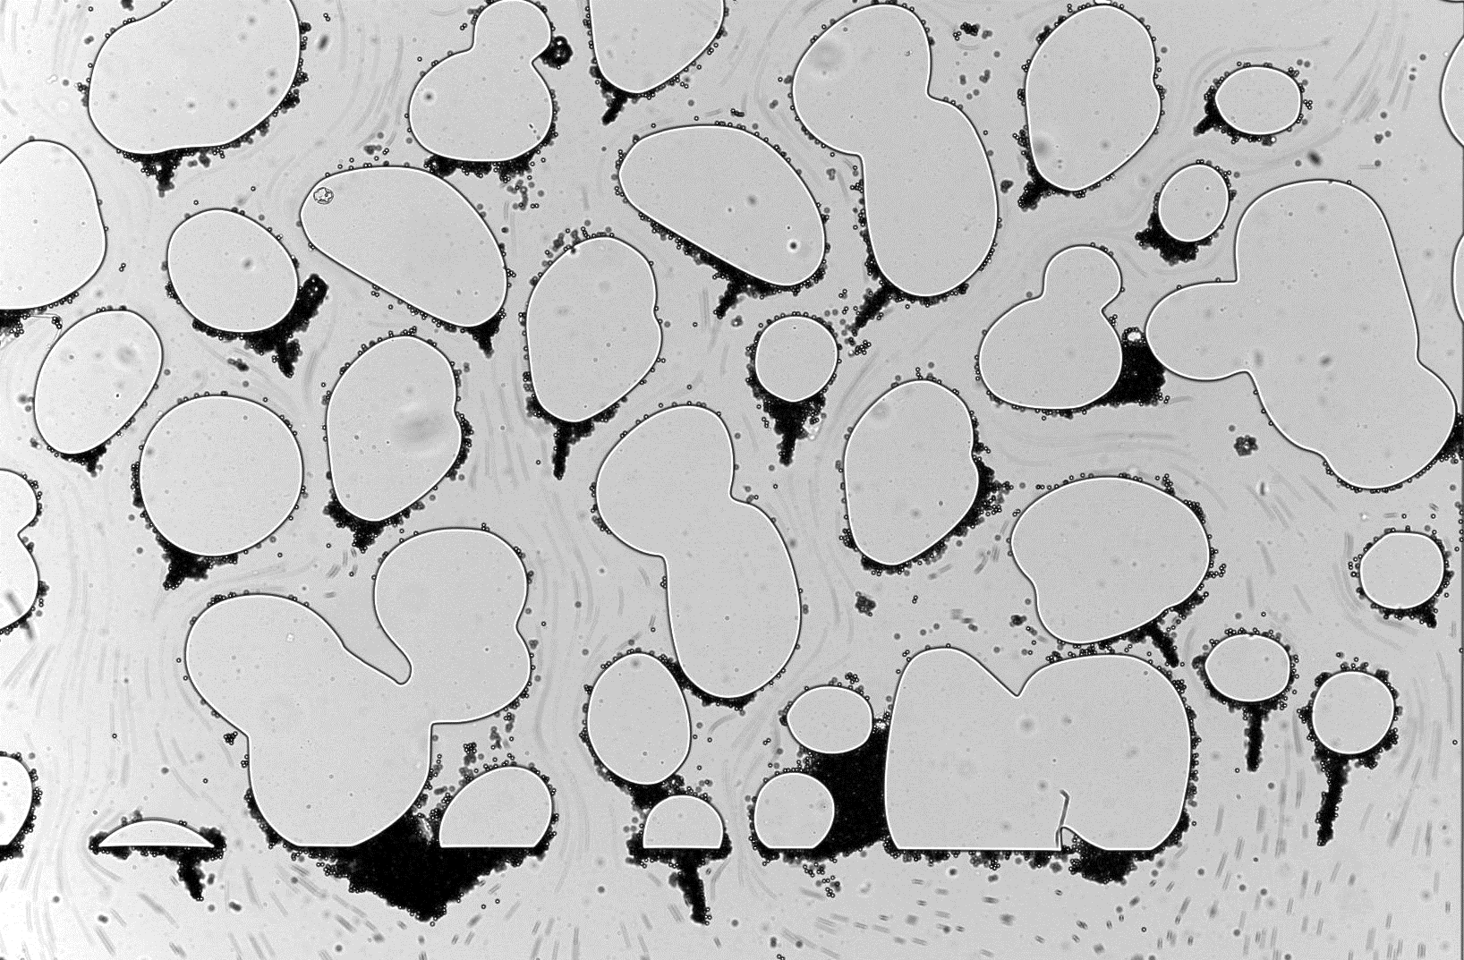
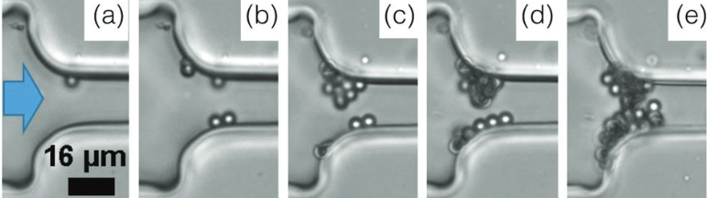
Pore clogging mechanisms
Introduction | Experimental Methodology | Results | Conclusions
Aggregation
Dentritic clogs
Walid Okaybi (2025)
Dressaire and Sauret (2017)
Most studies observe monotonic permeability reduction during deposition
Hydrodynamic bridging
Sieving
Mays, D. C., & Hunt, J. R. (2005)
Adapted from Jeong et al. (2018)
Notes:
We have three main pore clogging mechanisms in the literature which affects the permeability of the porous media
Aggregation- which is due to attractive van der Waal forces
Bridging – when particles arrive simultaneously and form an arch at he pore constrictions
And finally, Sieving – where size of the particle is bigger than the pore constrictions
But most previous studies observe a monotonous permeability decrease during deposition.
For example here’s a video from our team showing dendritic clogs forming in a 2D micromodel leading to permeability reductions

Slide 4
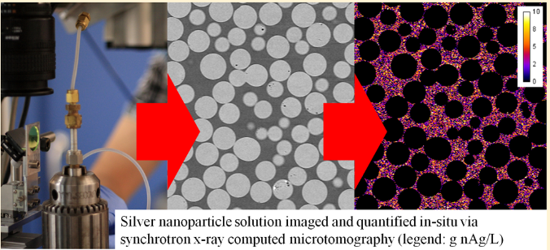
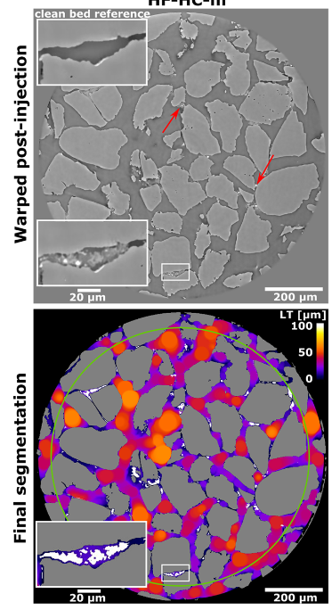
3D porous media studies
Introduction | Experimental Methodology | Results | Conclusions
Molnar et al. (2014)
Schiefler et al. (2022)
Quantified silver particle concentration using synchrotron X-ray CT
Static
No transport dynamics
No permeability evolution
Retention mechanisms
No real-time observation
Time-resolved colloidal deposition is needed for better understanding and prediction of colloids
Notes:
When we move to 3D porous media, it becomes much more complex to visualize these pore clogging mechanisms.
Previous studies have quantified particle concentrations using Synchrotron X-rays.
But they were done using static conditions, without much information on transport dynamics and permeability evolution
In another study, they identified straining and ripening as the retention mechanisms but this was concluded from pre- and post-injection images
without real-time observations
Getting time-resolved colloidal depositions is necessary for better prediction in colloidal transport models

Slide 5
Research gaps
Introduction | Experimental Methodology | Results | Conclusions
Does colloid deposition always reduce permeability monotonically? or can deposition redistribute flow in ways that preserve permeability?
Is there a critical threshold for particle concentration that switches the system from throat-controlled clogging to channelized flow?
No existing study to our knowledge that resolves 3D pore geometry at the spatio-temporal scales required to test these gaps
Notes:
So we have identified two main gaps:
Firstly, Will colloid depositions always lead to permeability reductions in porous media? Or will their deposition lead to flow redistribution in a way that can preserve permeability?
Secondly, Is there a critical threshold for particle concentration that switches the system from throat-controlled clogging to channelized flow?
So far to our knowledge we do not know of my study that resolves 3D pore geometry at the spatio-temporal scales required to test these gaps

Slide 6
Our research question
Can time-lapse (4D) X-ray micro-CT resolve the pore-scale processes that govern non-monotonic permeability evolution during colloid transport?

Slide 7
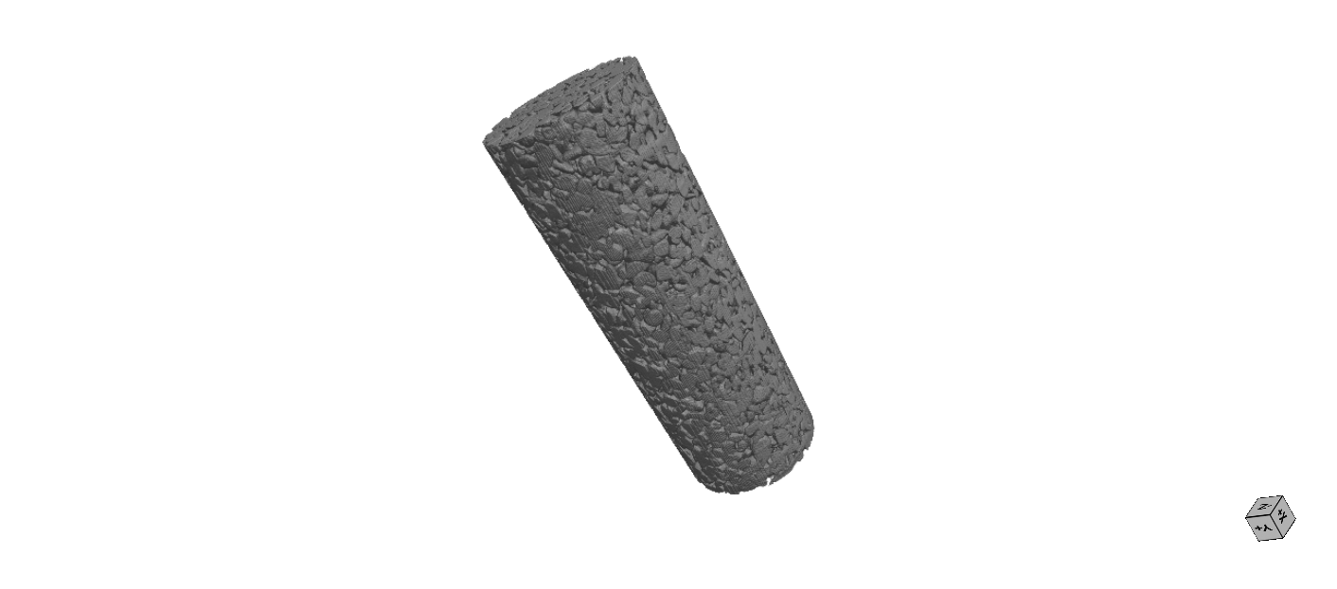

Experimental methodology
Introduction | Experimental Methodology | Results | Conclusions
Ag-HGS
Sintered glass
D_{particle} (D_{p}) | = 10 µm
4 mm
W | 75 µm
φ₀ | 32 % ± 2
K₀ | 4.4 × 10⁻¹² m²
W/D_{p} | ≈ 7.5
Re | ≈ 10⁻⁴ – 10⁻⁵
$$ρ=1400 kg m^{−3}$$
Conditions
Fixed mass injected = 18±0.5 mg
Particle volume fractions – 1% and 2%
Péclet number – 7×10⁸ and 1×10⁹
Flushed with 7 PV of 96 wt.% glycerol
1
20 mm
2
Injection using 96 wt.% glycerol
Notes:
So to answer this, I work on small cylindrical samples made up of sintered glass with a mean thorat size of 75 um
I inject silver coated hollow glass spheres of 10 um from bottom to top
Using a background fluid with 96% glycerol to suspend the particles
We choose these particles to have enough X-ray contrast with the background
In order to compare the results from different experiments we kept a fixed mass injected for the particles
This means that we varied the pore volumes injected according to different combinations of particle volume fraction and Pé
Secondly, after the injection step, we flushed the porous media with background fluid to remove unattached particles from the pore space

Slide 8
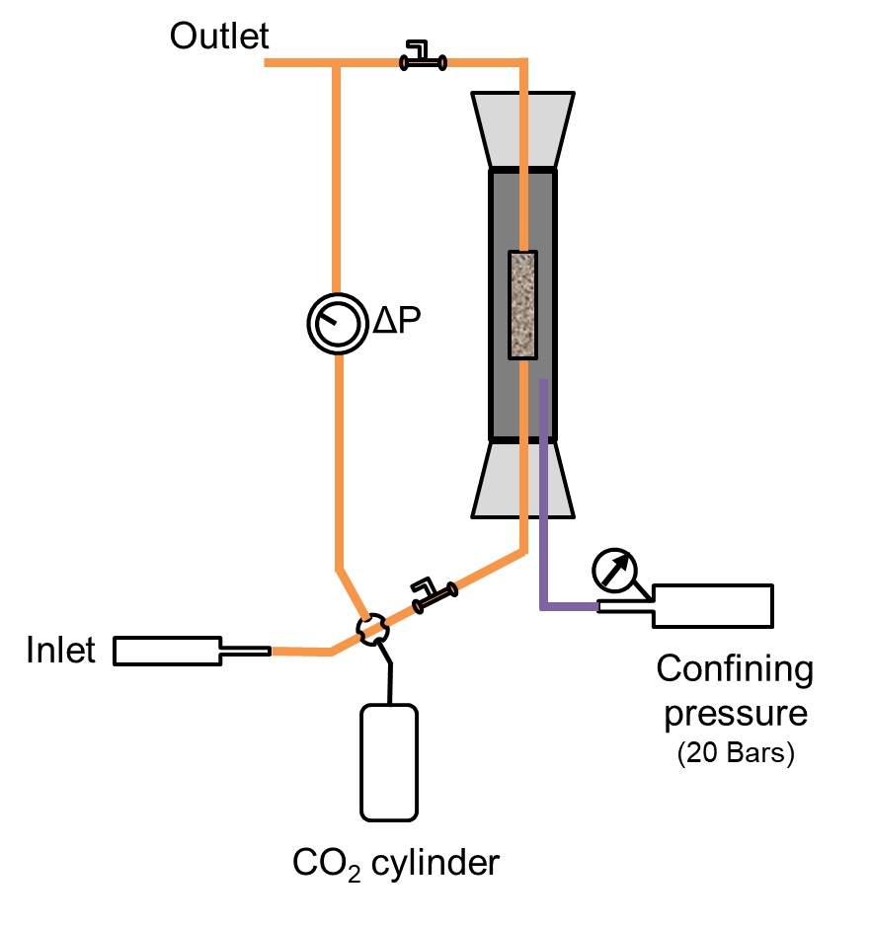
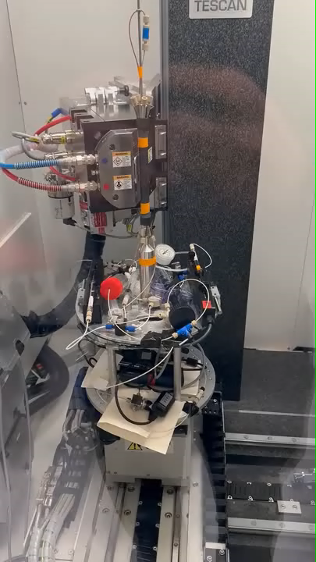

Continuous 4D imaging with 30 s temporal resolution
Introduction | Experimental Methodology | Results | Conclusions
Energy = 60kV
Power =16W
Scan time per 3D image = 30 s
Voxel size = 12 µm
Notes:
Here is my experimental setup, showing continuous 4D imaging with temporal resolution of 30s.
These experiments were conducted at Center for X-ray Tomography Ghent in collaboration with the EXCITE network
We first saturate the samples with CO2 to remove air bubbles and then with background fluid
Before injecting silver particles at a confining pressure of 20 bars
We mounted the setup on the rotating stage of the Tescan CoreTOM scanner in Ghent
We also tracked insitu permeability measurements using inline pressure transducer

Slide 9
Time to clog decreases with Pé & concentration
Introduction | Experimental Methodology | Results | Conclusions
1% vol., Pé = 1×10⁹
0 mins
1 mins
4 mins
7.5 mins
Increase in Pé
1% vol., Pé = 7×10⁸
0 mins
1.5 mins
4 mins
7.5 mins
2% vol., Pé = 7×10⁸
Increase in concentration
0 mins
1.5 mins
4 mins
7.5 mins
Grains (Grey)
Particles(White)
Pore space (Black)
Notes:
We collected about 1 TB of data that we analyzed using imageJ, dragonfly and house-built python scripts
Here I present you the first results which is the time to form first bridges
In our base case which is 1% volume fraction and a Pé number of 10 rasied to the power 8, we observed first bridges appearing within 4 mins of injection
- Now when we shift to the case with higher Pé, we observe faster clog formation, within 1 min of injection
- Lastly when we compare to the case with higher volume fraction of particle but same Pé number, we also observe faster bridge-formations

Slide 10

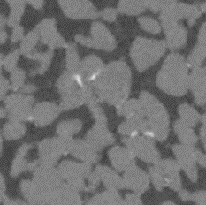
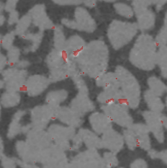
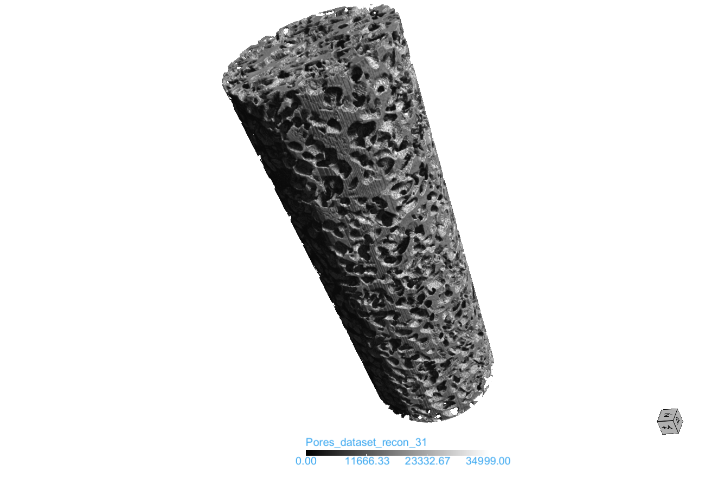
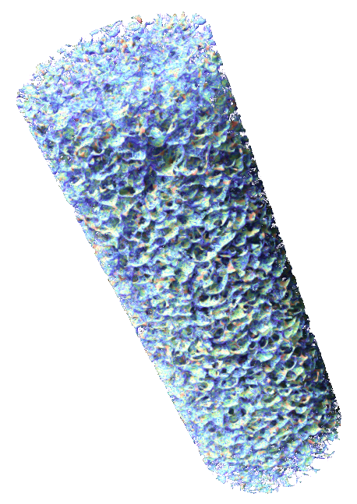
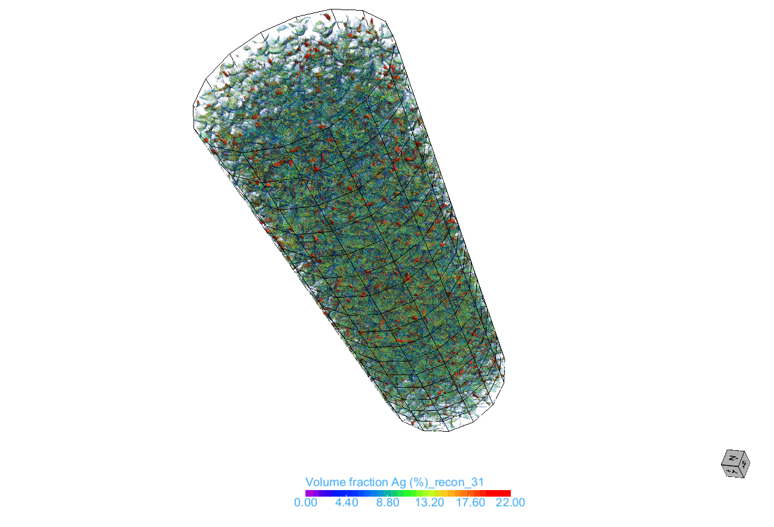
Quantification of particles
Introduction | Experimental Methodology | Results | Conclusions
Pore network
Concentration map
Particles
Raw image
Segmented clogs super-imposed
Grey scale
Volume fraction %
0 10000 20000 35000
0 5 10 15 22
Threshold value > 22% Ag concentration for Ag phase quantification
Notes:
Next we wanted to quantify these clogs, so we calibrated volume fraction of particles to the grey levels.
We choose a threshold concentration of 22% for segmentation of particle phase
As you can see that we when super-impose the segmented clogs on the raw image it does a pretty good job in identifying the particles in the porespace
This allows us convert a 3D pore network from grey scale to 3D concentration maps

Slide 11
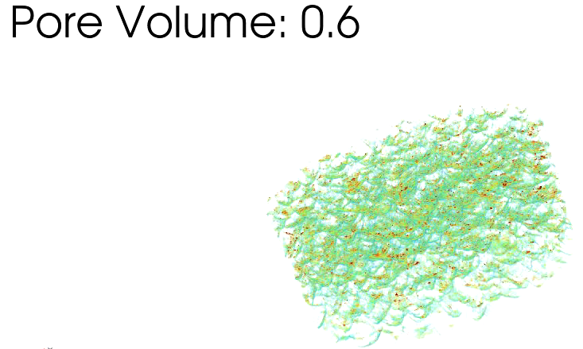
4D concentration mapping
Introduction | Experimental Methodology | Results | Conclusions
Sub volume near inlet for 1% vol., Pé = 7×10⁸
Spatiotemporal information about mobility and retention of particle
0 5 10 15 20
Volume fraction %
1.4 mm
1.6 mm
Notes:
And then when we combine different timesteps to these maps we get a real –time particle concentration inside the pore space
For example here I show you an cylindrical sub volume near column inlet for one of the experiments
Here we can see evolution of particle concentrations with injected pore volumes

Slide 12
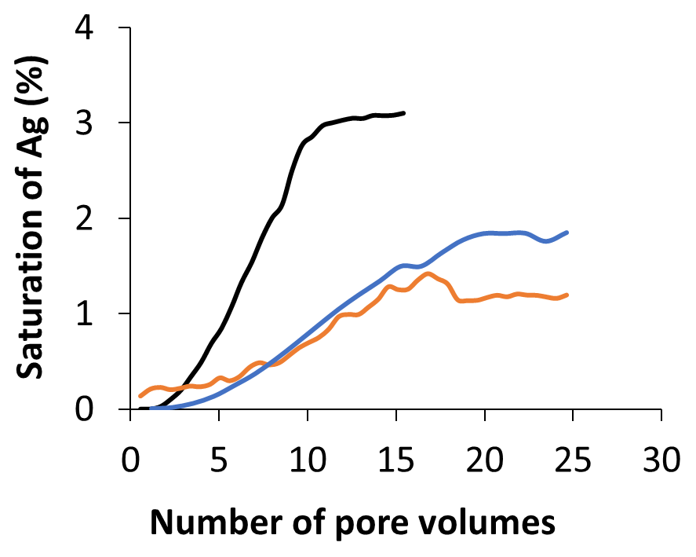
Faster rate of clogging with higher volume fraction
Introduction | Experimental Methodology | Results | Conclusions
1%Vol, Pé=7×10⁸
1%Vol, Pé=1×10⁹
2%Vol, Pé=7×10⁸
Slope 1
Rate of clogging per pore volume (PV) 3× faster with higher volume fraction
0.3 % per PV ➔ 2% Volume fraction
0.1 % per PV ➔ 1%Volume fraction
Slope 2
Flushing started
Flushing started
Flushing started
Notes:
Secondly using our concentration threshold, we can obtain saturation of particles inside the pore space
When we plot it against the pore volume we can derive information about the rate and stability of clogging
For example we can see that the case with higher volume fraction has 3 times faster rate of clogging

Slide 13
Flushing removes attached particles?
Introduction | Experimental Methodology | Results | Conclusions
1%Vol, Pé=7×10⁸
1%Vol, Pé=1×10⁹
2%Vol, Pé=7×10⁸
Flushing started
Particle saturation tends to be stabilized with injection of background fluid
Flushing started
Flushing started
Notes:
Similarly, when we switch to background fluid, particle saturation tends to be stabilized as shown by the plateau in the curves

Slide 14
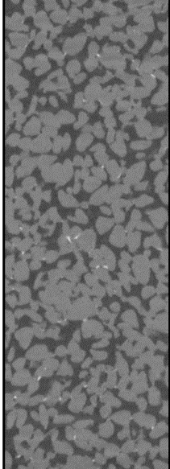
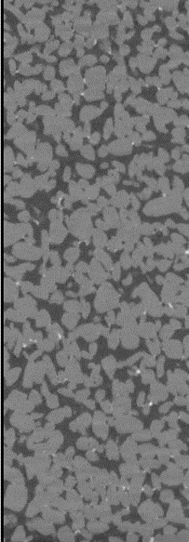
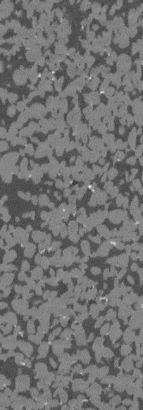
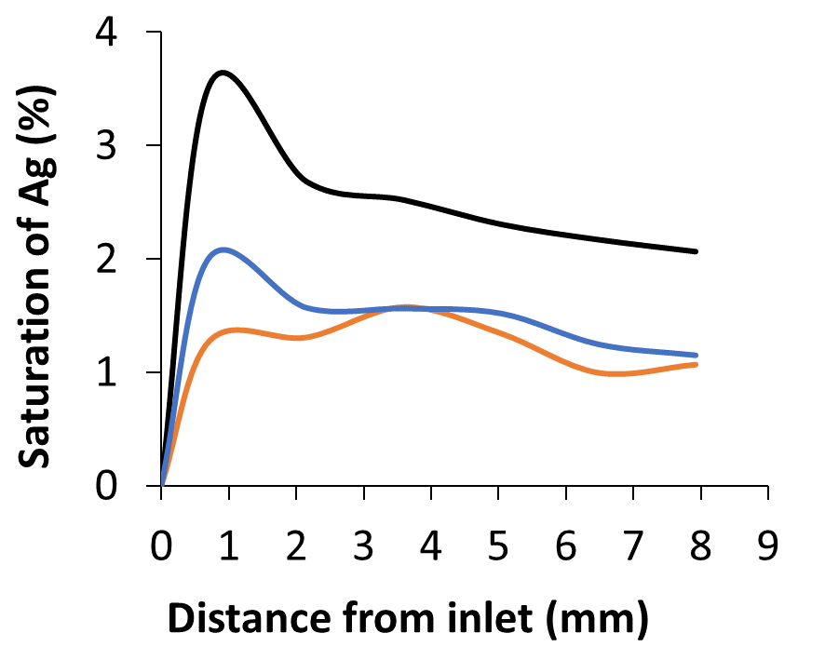
Spatial evolution
Introduction | Experimental Methodology | Results | Conclusions
1% vol., Pé = 7×10⁸
1% vol., Pé = 1×10⁹
2% vol., Pé = 7×10⁸
1%Vol., Pé=7×10⁸
1%Vol., Pé=1×10⁹
2%Vol., Pé=7×10⁸
10 mm
Deeper penetration (1%Vol, Pé=7×10⁸)
Localization near inlet (higher conc. & Pé)
Consistent with probability of clogging (C. Soulaine et al. 2026)
Notes:
We also obtained spatial distribution of particle by extracting 6 subvolumes
We found deeper penetration of particles in our base case
On the other hand cases, with higher concentration and higher Pé number,
we found most of the particles localizing near inlet.
This is consistent with probability of bridge formation that we have developed in our groups using microfluidic experiments

Slide 15
Spatial evolution
Introduction | Experimental Methodology | Results | Conclusions
1% vol., Pé = 7×10⁸
1% vol., Pé = 1×10⁹
2% vol., Pé = 7×10⁸
1%Vol., Pé=7×10⁸
1%Vol., Pé=1×10⁹
2%Vol., Pé=7×10⁸
Laurez Maya Parallel Session 2.3MS09 Salle 300
May 20, 2026
2:35 PM – 2:50 PM
10 mm
Deeper penetration (1%Vol, Pé=7×10⁸)
Localization near inlet (higher conc. & Pé)
Consistent with probability of clogging (C. Soulaine et al. 2026)
Notes:
Laurez Maya will talk in detail about this probability of arch formation so don’t forget to attend his talk

Slide 16
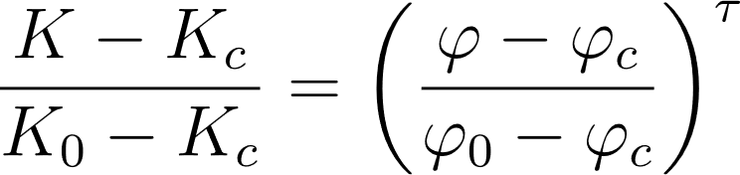
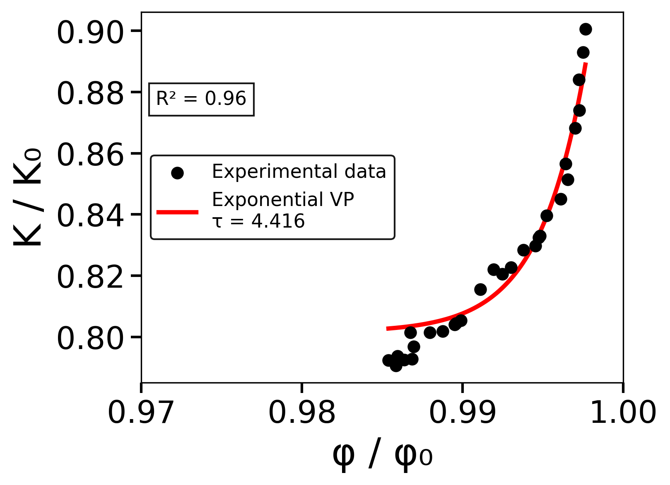
Monotonic decrease in permeability
Introduction | Experimental Methodology | Results | Conclusions
1% volume fraction at Pé = 7×10⁸
Verma-Pruess
ΔK >> Δφ
Throat-controlled
Notes:
Now when we look at the effect of particle injection on permeability by plotting normalized permability against normalized porosity
In our base case we observe a monotonic decrease in the permeability with respect to porosity that can be fiited with verma pruess equation.
A tiny drop in porosity can lead to 20 % decrease in permeability showing that permeability is set by the narrowest throats

Slide 17
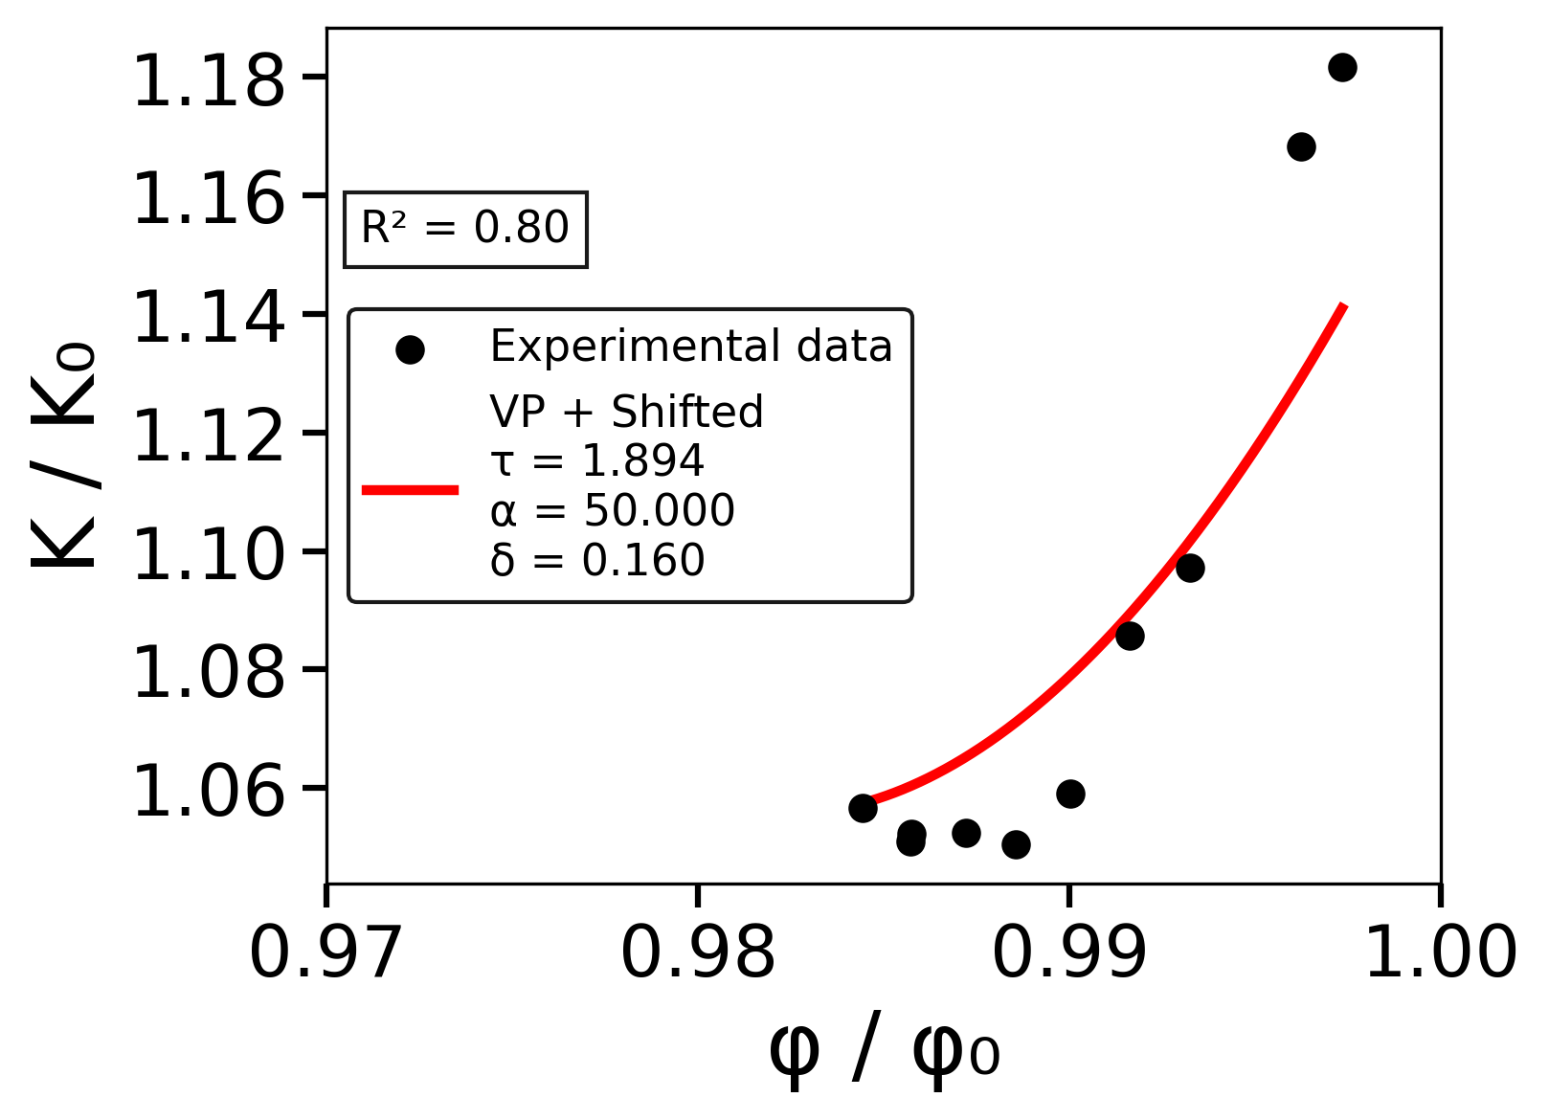
Non-Monotonic K behavior
Introduction | Experimental Methodology | Results | Conclusions
1% volume fraction at Pé = 1×10⁹
Two regimes:
Decrease in permeability starting from K/K₀ > 1
Plateau around K/K₀ ≈ 1.05
Before
After
Deposition preferentially localizes in low-conductance side pathways while maintaining a dominant conductive path
Notes:
Now when we increase the Pé we get a non-monotonic behavior
First we see a a decrease in permeability starting from values greater than 1 and then plateaus at about 1.05
This means that advective forces are so dominant that particle are forced toward low velocity zones while the high velocity channel stays, this leads to a decrease in tortuosity which leades to increase in the permeability
Here when we adapt the verma preuss to fit our experimental data, we get a smaller exponent value
This shows that permeability is less sensitive to porosity loss
We believe it is because most depositions occurs in the side pathways as shown in the schematic.

Slide 18
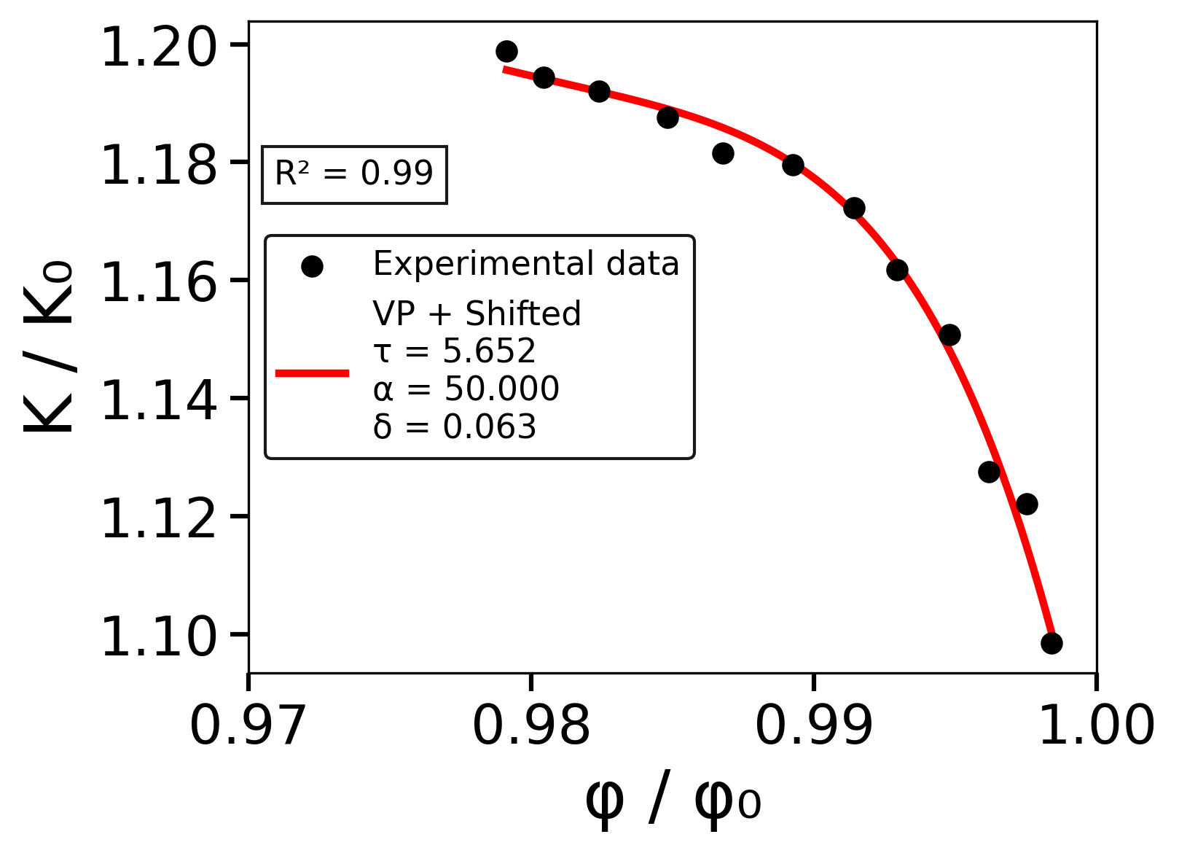
Monotonous Permeability Rise
Introduction | Experimental Methodology | Results | Conclusions
2% volume fraction at Pé = 7×10⁸
K/K₀ rises monotonically as φ/φ₀ falls
1% at Pe= Pé = 7×10⁸
2% at Pe= Pé = 7×10⁸
Highly channelized
Notes:
Now simply doubling the particle loading, we see an inverse trend, which seems surprising at first
K/K₀ rises monotonically as φ/φ₀ falls.
As we deposit the permeability increases suggesting formation of highly channelized (K>K₀) pathways with less tortuosity

Slide 19
Conclusion
Introduction | Experimental Methodology | Results | Conclusions
Colloid deposition dynamically reorganizes hydraulic topology: from throat-controlled to preferential pathways
Depositions does not always lead to monotonous permeability changes
Above a critical threshold (loading and Pé), deposition reorganizes flow pathways
At fixed Pé, concentration controls the transition between throat-blocking (K↓) and channelization (K↑)
Volume fraction %
0 5 10 15 20
Notes:
To conclude,
we saw that depositions dynamically reorganizes hyraulic topology of porous media, from throat-controlled to formation of preferential pathways
Depositions do not always lead to monotonous permeability decrease as observed in most of the previous studies
Above a critical threshold of concentration and Pé number, depositions reorganize flow pathways
And lastly, at a fixed Pé particle concentration controls the transition between troat-blocking that leads to K reduction to channelization that increases permeability

Slide 20


Acknowledgements
This work has received funding from European Union’s ERC Consolidator Grant Nº101043288
This project has received funding from the European Union’s Horizon Europe research and innovation programme under grant agreement no. 101131765 (EXCITE2) for Transnational Access conducted at UGCT, university of Ghent.
Notes:
With that I would like to thank the Excite network and the Center for X-ray Tomography at the Ghent university for the experiments.
Overall this project is funded by the coconut project of European reach council

Slide 21

Thank you!
muqeet.iqbal@cnrs-orleans.fr
www.muqeetiqbal.com
Notes:
Thank you for your attention!

Slide 22
Additional

Slide 23

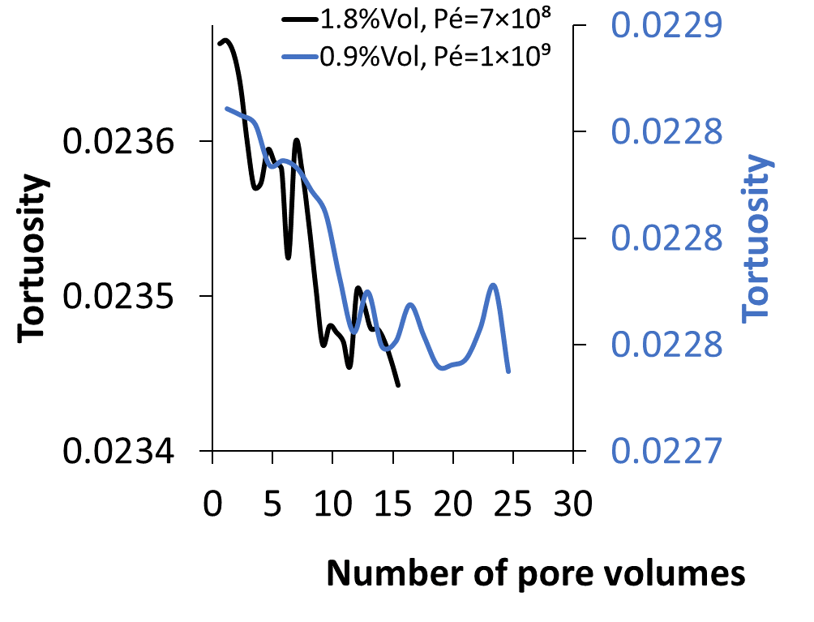
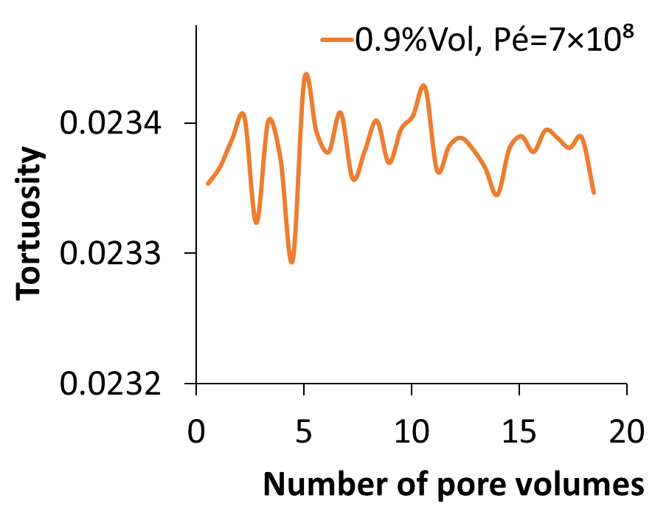
Tortuosity decreases
q_{i} ​= volumetric flow rate in throat i
L_{i} ​= throat length
L = straight sample length
Many parallel throats so weighted average of L_{i} becomes very small

Slide 24
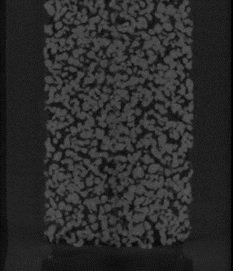
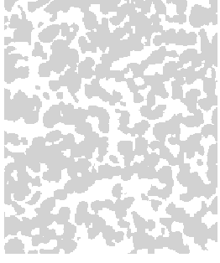
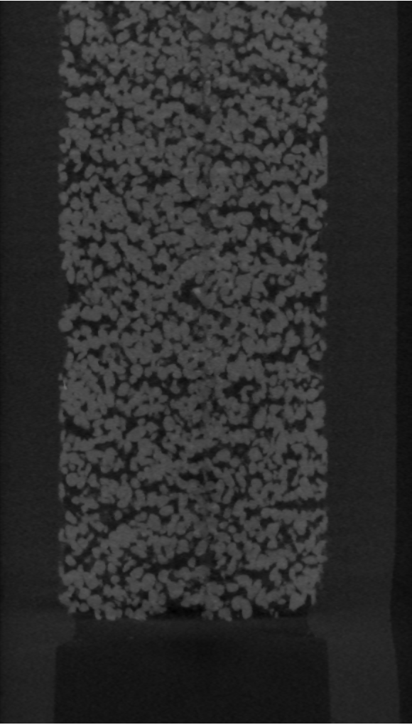
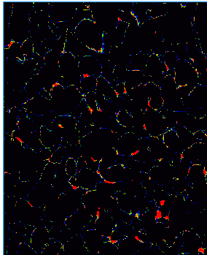
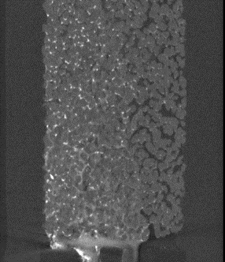
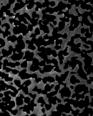
Imaging Methodology
Introduction | Experimental Methodology | Imaging Methodology | Preliminary Results | Conclusions | Perspectives
Image registration
Noise filtering
Image segmentation
And
Image masking
Quantification of particle
Sub volumes extractions
t₀
Grains of dry scan
264×264×120 voxels
Particle phase
10 mm
Particle image
Masked particle image with no grains
Notes:
I present here the workflow of my image processing.
After image registration and noise filtering, I use global thresholding to segment images..
I use grain mask of the initial wet scans on particle image.
I used 4 subvolmes of 150³ voxels with a distance of 2 mm from each other starting from the inlet until 10 mm.
Finally I quantify Gd phase.

Slide 25
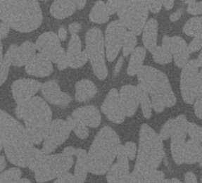
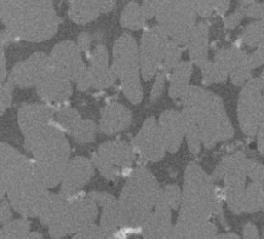
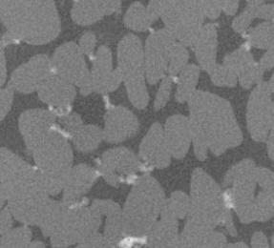
Flushing rearranges & densifies clusters
2% volume fraction at Pé = 7×10⁸
0 mins
7.5 mins
13.5 mins
Flushing appears to:
densify retained clusters
preserve dominant pathways
0 mins
7.5 mins
13.5 mins
Pore filling at low velocity zones

Slide 26
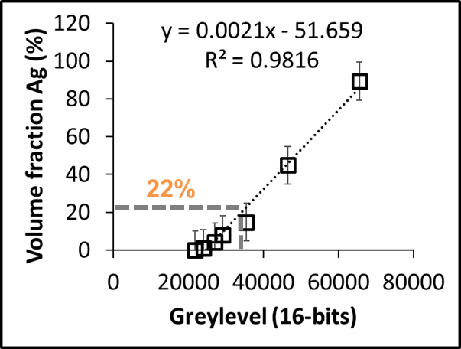
Calibration Curve

Slide 27
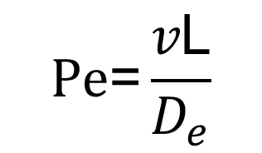
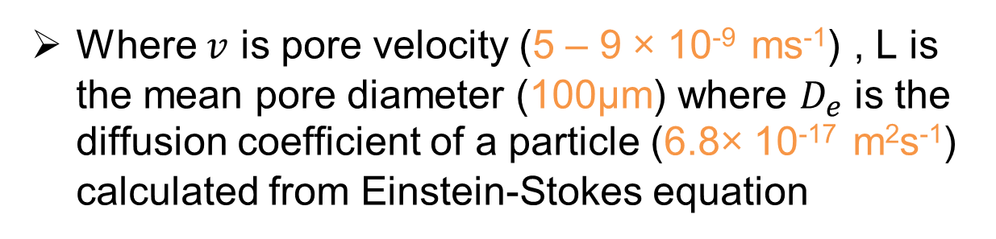
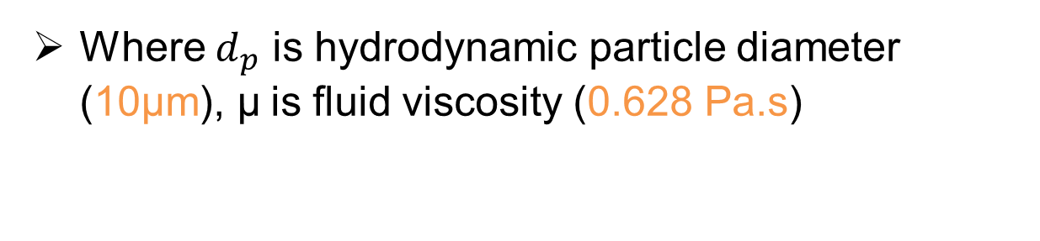
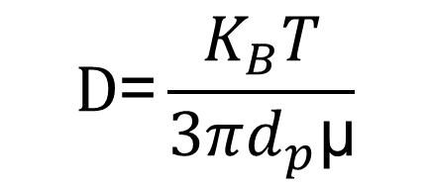
Péclet number
Where $v$ is pore velocity (5 – 9 × 10⁻⁹ ms⁻¹) , L is the mean pore diameter (100µm) where $D_{e}$ is the diffusion coefficient of a particle (6.8× 10⁻¹⁷ m²s⁻¹) calculated from Einstein-Stokes equation
$$\text{P}\text{e}\text{=}\frac{v\text{L}}{D_{e}}$$
Where $d_{p}$ is hydrodynamic particle diameter (10µm), $\text{μ}$is fluid viscosity (0.628 Pa.s)
$$\text{D}\text{=}\frac{K_{B}T}{3πd_{p}\text{μ}}$$

Slide 28
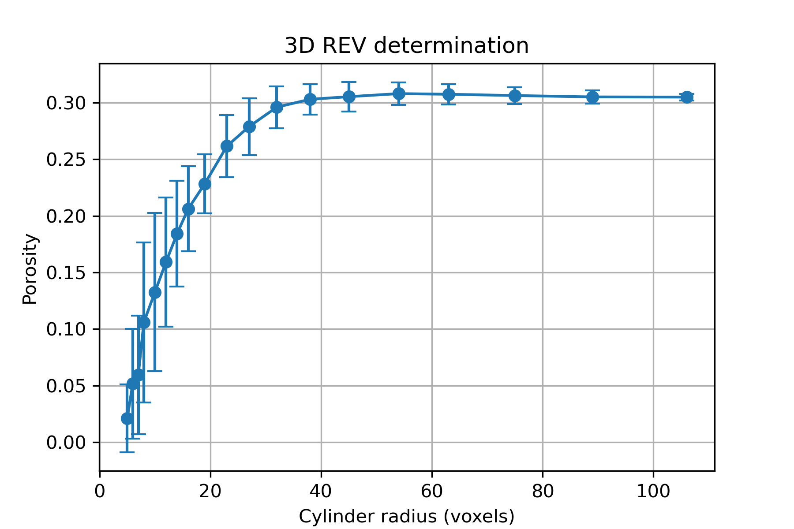
Representative Elementary Volume
REV ≈76³ voxels

