Slide 1




Coupled numerical simulation of electrical geophysics and multiphase flow for monitoring the contamination and remediation of NAPL in porous media
Behshad KOOHBOR, Jacques DEPARIS, Philippe LEROY, Dorian DAVARZANI, Behzad ATAIE-ASHTIANI and Stéfan COLOMBANO
Interpore 2026
22/05/2026
Nantes, France

Slide 2

General overview: Hydro-geophysics (Electrical resistivity)
Water:
NAPL:

Slide 3

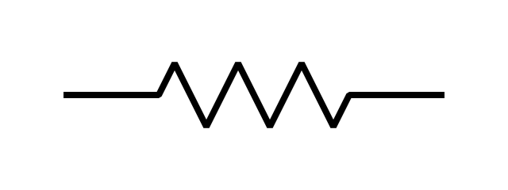
General overview: Hydro-geophysics (Electrical resistivity)
Water:
ΔV
I
I
NAPL:
ΔV
I
I

Slide 4


General overview: Hydro-geophysics (Electrical resistivity)
Water:
ΔV
K: Geometric factor
I
I
$$R_{W}=\frac{∆V}{I}=\frac{ρ_{W}}{K}$$
ρ: Resistivity =1/σ
NAPL:
ΔV
I
I
$$R_{N}=\frac{∆V}{I}=\frac{ρ_{N}}{K}$$

Slide 5

General overview: Hydro-geophysics (Electrical resistivity)
Water:
ΔV
K: Geometric factor
I
I
$$R_{W}=\frac{∆V}{I}=\frac{ρ_{W}}{K}$$
ρ: Resistivity =1/σ
dssdsds
NAPL:
ΔV
$$ρ_{N}≫ρ_{W}$$
I
I
$$R_{N}=\frac{∆V}{I}=\frac{ρ_{N}}{K}$$

Slide 6
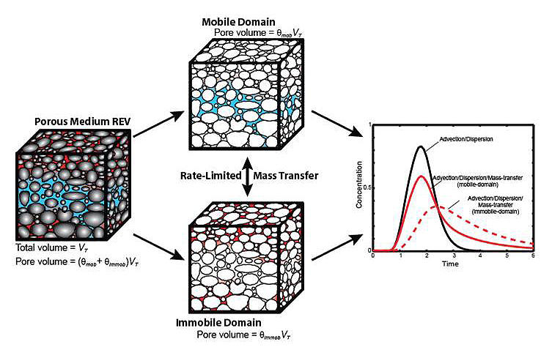
General overview: Hydro-geophysics (Electrical resistivity)
Water:
ΔV
K: Geometric factor
I
I
$$R_{W}=\frac{∆V}{I}=\frac{ρ_{W}}{K}$$
ρ: Resistivity =1/σ
dssdsds
NAPL:
ΔV
$$ρ_{N}≫ρ_{W}$$
A function of:
fluid inherent conductivity,
porosity,
fluid saturation
some exponents and coefficients
Frequency of the current
etc
I
I
$$R_{N}=\frac{∆V}{I}=\frac{ρ_{N}}{K}$$

Slide 7
General overview: Hydro-geophysics (Electrical resistivity)
Water:
ΔV
K: Geometric factor
I
I
$$R_{W}=\frac{∆V}{I}=\frac{ρ_{W}}{K}$$
ρ: Resistivity =1/σ
dssdsds
NAPL:
ΔV
$$ρ_{N}≫ρ_{W}$$
A function of:
fluid inherent conductivity,
porosity,
fluid saturation
some exponents and coefficients
Frequency of the current
etc
Fluid content
I
I
$$R_{N}=\frac{∆V}{I}=\frac{ρ_{N}}{K}$$

Slide 8
Experimental approach and material

Slide 9
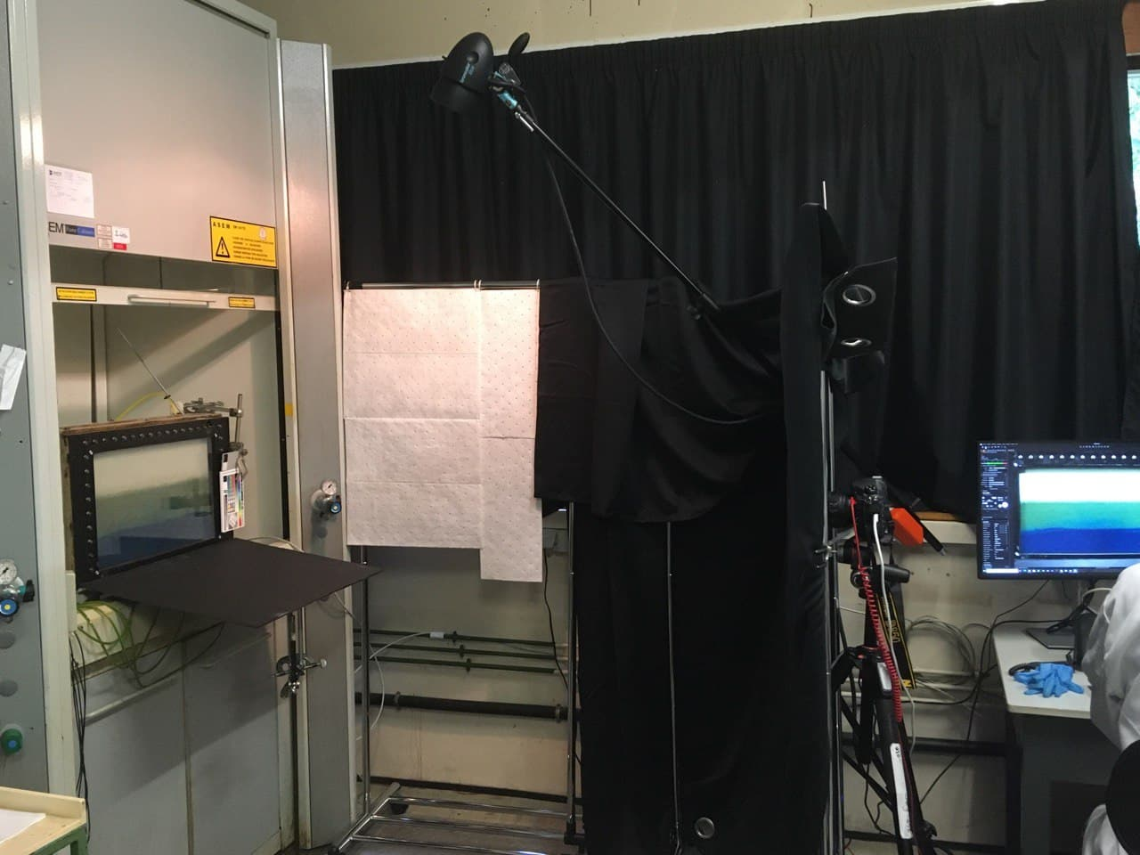
Experimental approach and material
Photos and Image process

Slide 10
Experimental approach and material
Photos and Image process

Slide 11
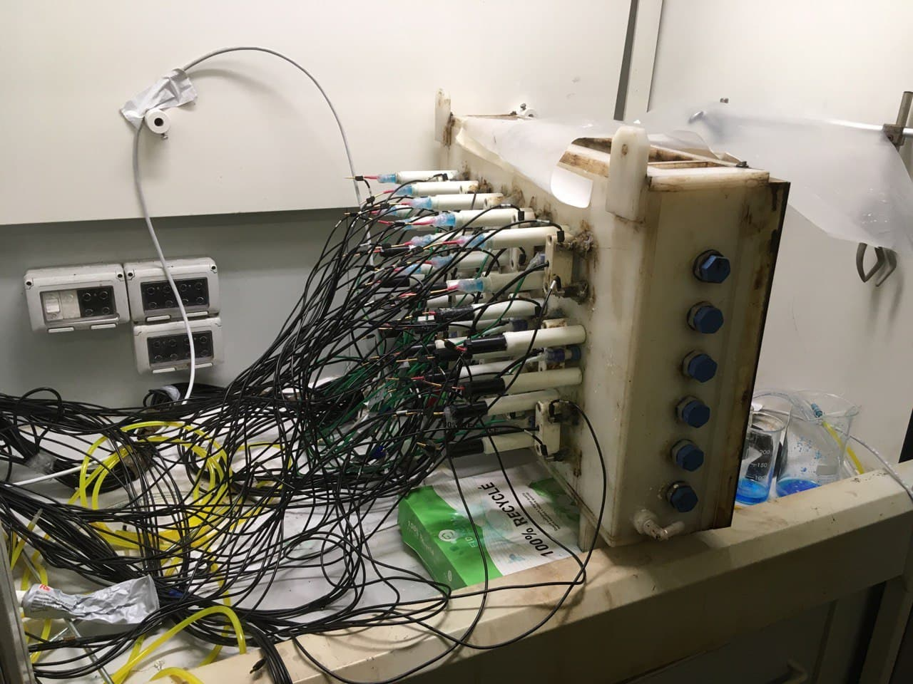
Experimental approach and material
Photos and Image process
Resistivity electrodes

Slide 12
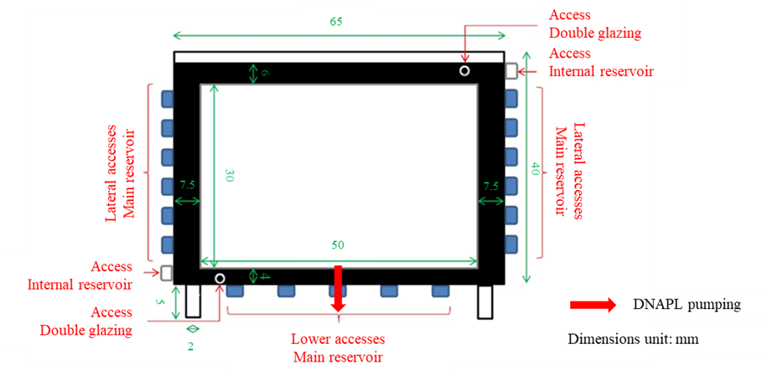

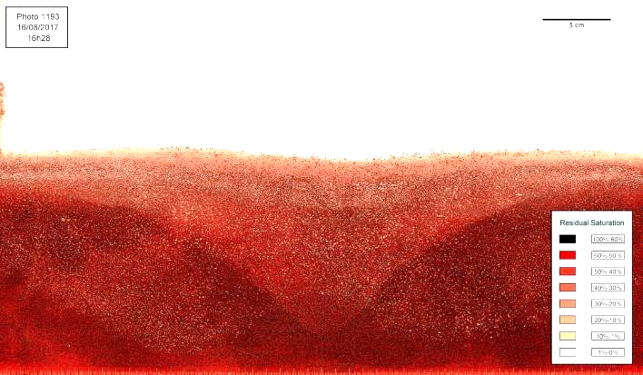
2D tank description : fluid
Sn [-]
Images from Colombano et al. (2020)

Slide 13
2D tank description : fluid
Sn [-]
Images from Colombano et al. (2020)

Slide 14
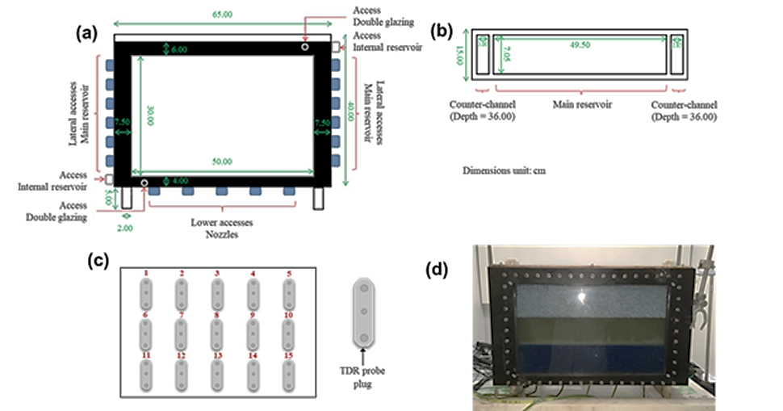
2D tank description : electrical

Slide 15
Scenarios: Colombano et al. (2021)
Fill-up scenario
Time
Sn [-]
0.75
0
Pumping scenario
Time
Sn [-]
0.75
0

Slide 16

Scenarios: Colombano et al. (2021)
Fill-up scenario
Time
Sn [-]
0.75
H_{DNAPL}= 0 cm
0
Pumping scenario
Time
Sn [-]
0.75
0

Slide 17
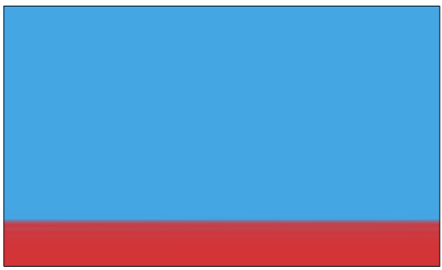
Scenarios: Colombano et al. (2021)
Fill-up scenario
Time
Sn [-]
0.75
H_{DNAPL}= 5 cm
H_{DNAPL}= 0 cm
0
Pumping scenario
Time
Sn [-]
0.75
0

Slide 18
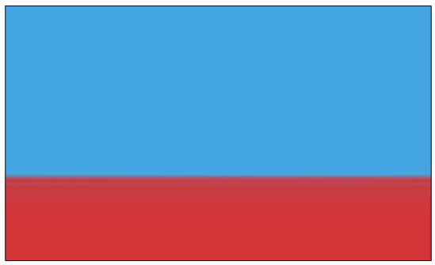
Scenarios: Colombano et al. (2021)
Fill-up scenario
Time
Sn [-]
0.75
H_{DNAPL}= 10 cm
H_{DNAPL}= 5 cm
H_{DNAPL}= 0 cm
0
Pumping scenario
Time
Sn [-]
0.75
0

Slide 19
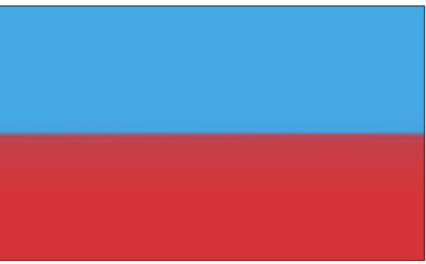
Scenarios: Colombano et al. (2021)
Fill-up scenario
Time
Sn [-]
0.75
H_{DNAPL}= 15 cm
H_{DNAPL}= 10 cm
H_{DNAPL}= 5 cm
H_{DNAPL}= 0 cm
0
Pumping scenario
Time
Sn [-]
0.75
0

Slide 20
Scenarios: Colombano et al. (2021)
Fill-up scenario
Time
Sn [-]
0.75
H_{DNAPL}= 15 cm
H_{DNAPL}= 10 cm
H_{DNAPL}= 5 cm
H_{DNAPL}= 0 cm
0
Pumping scenario
Time
Sn [-]
0.75
H_{DNAPL}= 15 cm
0

Slide 21
Scenarios: Colombano et al. (2021)
Fill-up scenario
Time
Sn [-]
0.75
H_{DNAPL}= 15 cm
H_{DNAPL}= 10 cm
H_{DNAPL}= 5 cm
H_{DNAPL}= 0 cm
0
Pumping scenario
Time
Sn [-]
0.75
H_{DNAPL}= 15 cm
0

Slide 22
Scenarios: Colombano et al. (2021)
Fill-up scenario
Time
Sn [-]
0.75
H_{DNAPL}= 15 cm
H_{DNAPL}= 10 cm
H_{DNAPL}= 5 cm
H_{DNAPL}= 0 cm
0
Pumping scenario
Time
Sn [-]
0.75
H_{DNAPL}= 15 cm
0

Slide 23
Scenarios: Colombano et al. (2021)
Fill-up scenario
Time
Sn [-]
0.75
H_{DNAPL}= 15 cm
H_{DNAPL}= 10 cm
H_{DNAPL}= 5 cm
H_{DNAPL}= 0 cm
0
Pumping scenario
Time
Sn [-]
0.75
H_{DNAPL}= 15 cm
0

Slide 24
Governing equations and Mathematical insight

Slide 25
Governing equations and Mathematical insight
Fluid flow

Slide 26
Governing equations and Mathematical insight
Fluid flow
Van Genuchten Mualem
Pressure-Saturation

Slide 27

Governing equations and Mathematical insight
Fluid flow
Electrical current
Van Genuchten Mualem
Pressure-Saturation

Slide 28
Governing equations and Mathematical insight
Fluid flow
Electrical current
Van Genuchten Mualem
Pressure-Saturation

Slide 29
Governing equations and Mathematical insight
Fluid flow
Electrical current
Van Genuchten Mualem
Pressure-Saturation

Slide 30
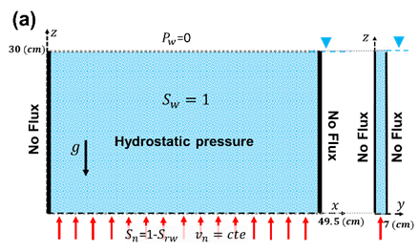
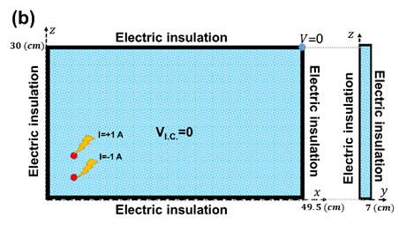
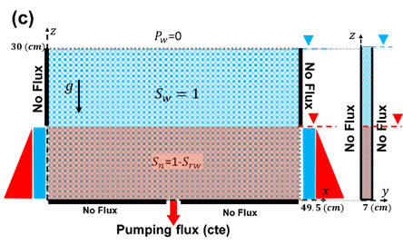
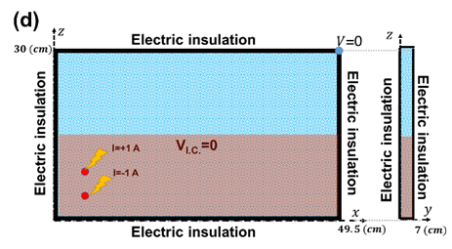
Boundary conditions and domain of solution

Slide 31
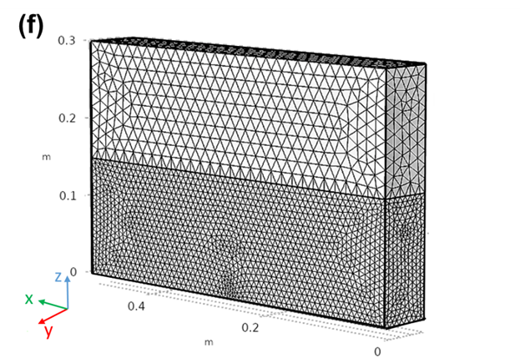
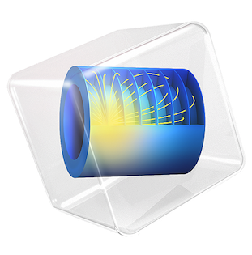
Boundary conditions and domain of solution

Slide 32
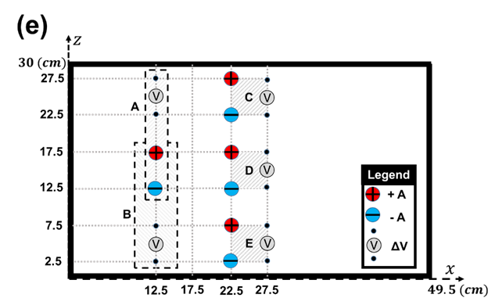

Slide 33
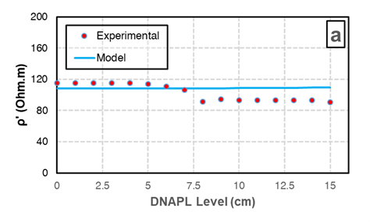
Real part (in-phase)

Slide 34
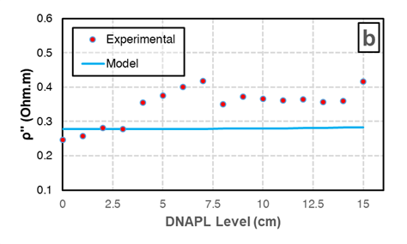
Real part (in-phase)
Imaginary part

Slide 35
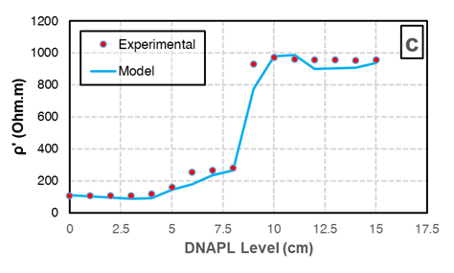
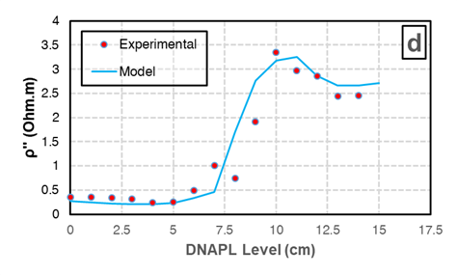
Real part (in-phase)
Imaginary part
Real part (in-phase)
Imaginary part

Slide 36
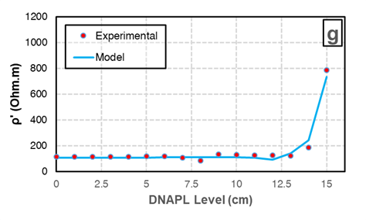
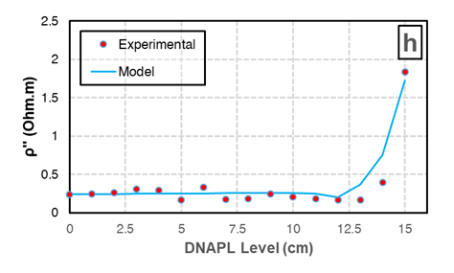
Real part (in-phase)
Real part (in-phase)
Imaginary part
Imaginary part
Real part (in-phase)
Imaginary part

Slide 37
Real part (in-phase)
Real part (in-phase)
Imaginary part
Imaginary part
Real part (in-phase)
Imaginary part

Slide 38
Real part (in-phase)
Real part (in-phase)
Imaginary part
Imaginary part
Real part (in-phase)
Imaginary part

Slide 39
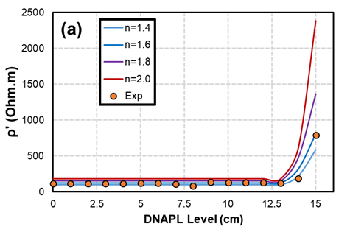
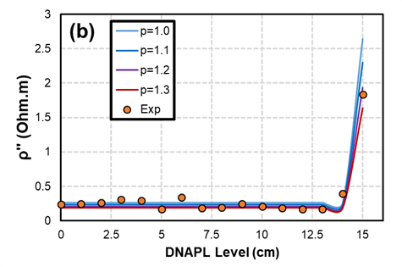
Real part (in-phase)
Real part (in-phase)
Imaginary part
Imaginary part
Real part (in-phase)
Imaginary part

Slide 40
3D results
Phase Transport (fluid)

Slide 41
3D results
Phase Transport (fluid)
In-phase Resistivity

Slide 42
3D results
Phase Transport (fluid)
In-phase Resistivity
Quadrature Resistivity

Slide 43
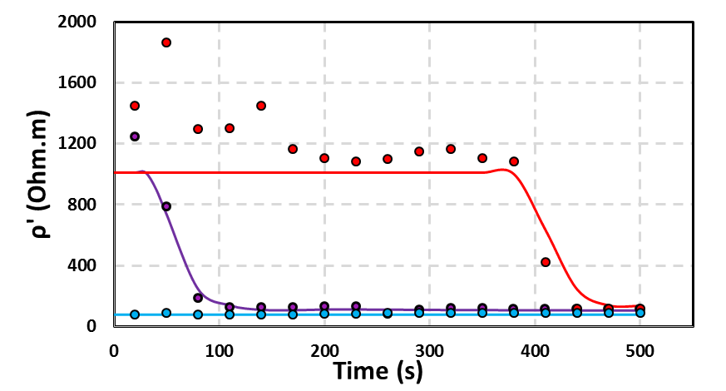
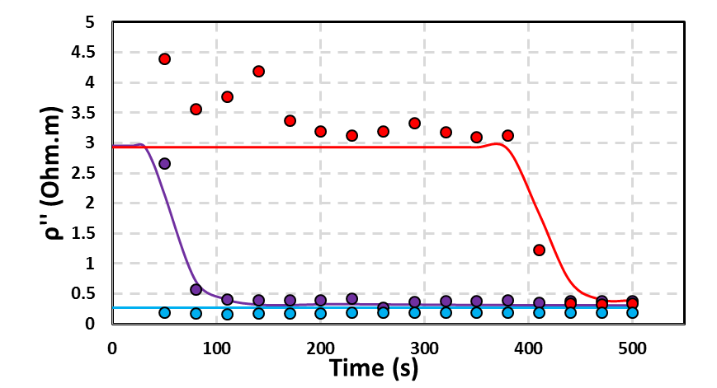
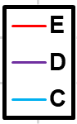
Pumping validation
Real part (in-phase)
Imaginary part (Quadrature)

Slide 44
Conclusions and summary
Electrical geophysical methods can be applied on the monitoring of NAPL contaminants in porous media
…The problem is the interpretation of the results
Combining multiphase flow models with electrical methods (ERT, SIP, etc) can increase the applicability of these geophysical methods and the interpretation of the results.
The accuracy and the efficiency of the electrical model is very sensitive to the accuracy and efficiency of the fluid flow model.
COMSOL Multiphysics® has been applied successfully for forward simulation of coupled multiphase flow and complex electrical resistivity
However, using more robust in-house tools for specific purposes is recommended

Slide 45
Thanks for your attention
+
Questions

