Slide 1
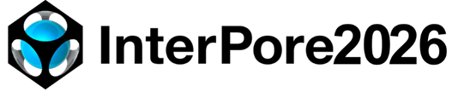
Nanoremediation of porous aquifers: facing mobility and entrapment of nZVI
Daphne S. PINO¹
R. BERTOLO¹; L. F. L. LUZ Jr²; T. TOSCO³; C. BIANCO³; P. KAZAKOVTSEV⁴; N. L. ARCHILHA⁵; T. PAK⁴
¹ Groundwater Research Center, University of Sao Paulo (CEPAS-USP) ² Federal University of Parana (UFPR) ³ Polytechnic of Turin (Polito) ⁴ Teesside University (TU) ⁵ Brazilian Synchrotron Light Laboratory (LNLS-CNPEM)
#356

Slide 2
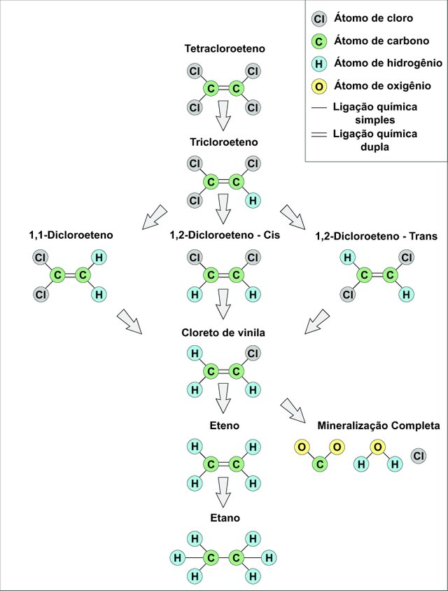
Why nZVI?
Tetrachloroethylene (PCE)
Trichloroethylene (TCE)
Chlorinated solvents: industrial and toxic compounds
1,2-Dicloroethylene
1,2-Dicloroetylhene-Cis
1,2-Dicloroethylene-Trans
Environmental complexity:
transport and fate
Vinyl chloride
Management challenges
doi.org/10.1007/s12665-025-12727-x
(DE)
Degradation of chlorinated solvents

Slide 3
Investigate the pore-scale dynamics of nanoparticle (NP) mobility/retention in the porous media where multiple rounds of NP injections are performed

Slide 4
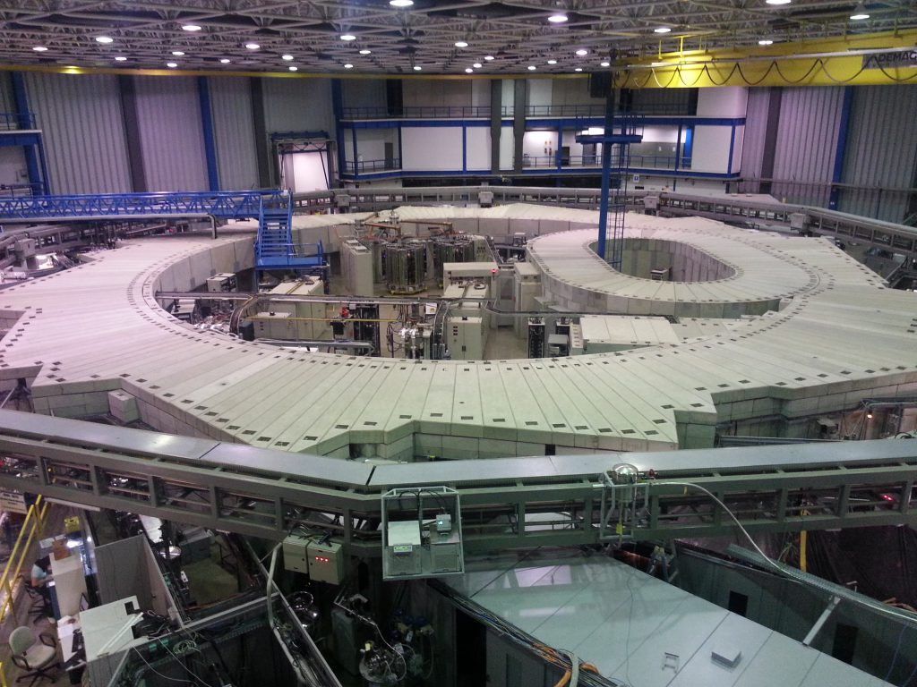
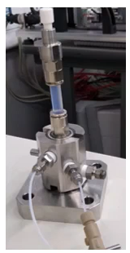
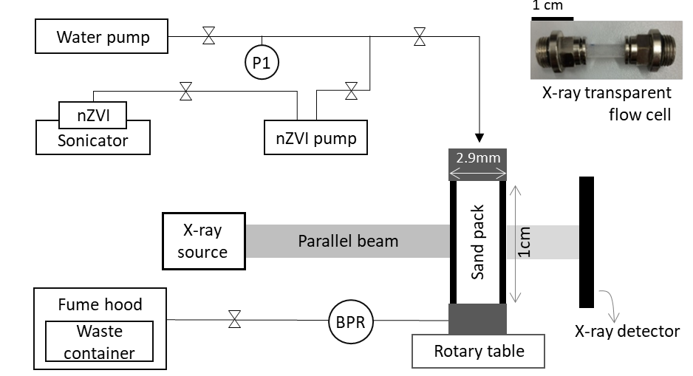
nZVI experiment
UVX (1997-2019) – Brazil
Experiments
1. Water injection | 30 PV | q = 100 μL/min
2. nZVI injection | 15PV | q = 200 μL/min
3. Water injection | 10 PV | q = 20 μL/min
4. nZVI injection | 10 PV | q = 800 μL/min
5. Water injection | 10 PV | q = 20 μL/min
Image resolution: 3.28 µm
Sample holder and flow cell
nZVI particles with organic and biodegradable coating, suspended in water, ≈ 50nm, 50 g/L

Slide 5
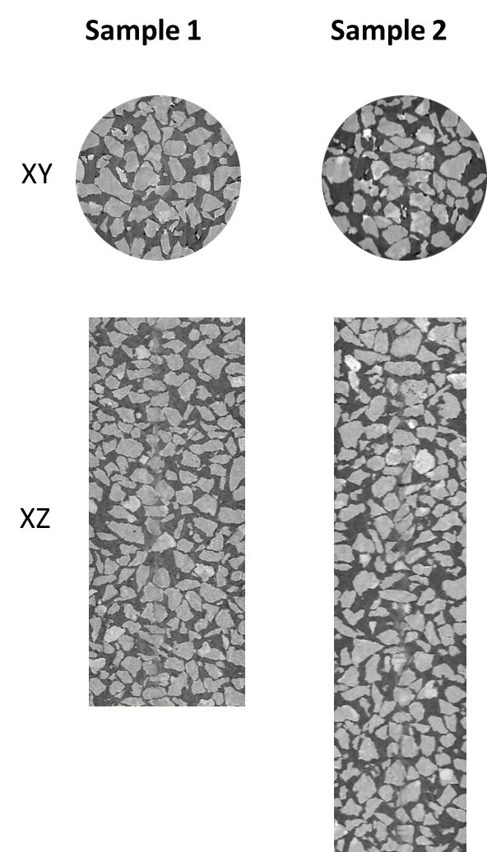
nZVI experiment
2 samples with similar grain size distribution and porosity (~42%)
Vertical movement of the sample: preserve resolution with larger FoV
Vertical images stitched together in post-processing
Sample 1: steps W1 – nZVI1 – W2
2 images stitched together
Sample 2: steps W1 – nZVI1 – W2 – nZVI2 – W3
3 images stitched together
Step W1
Step W1

Slide 6
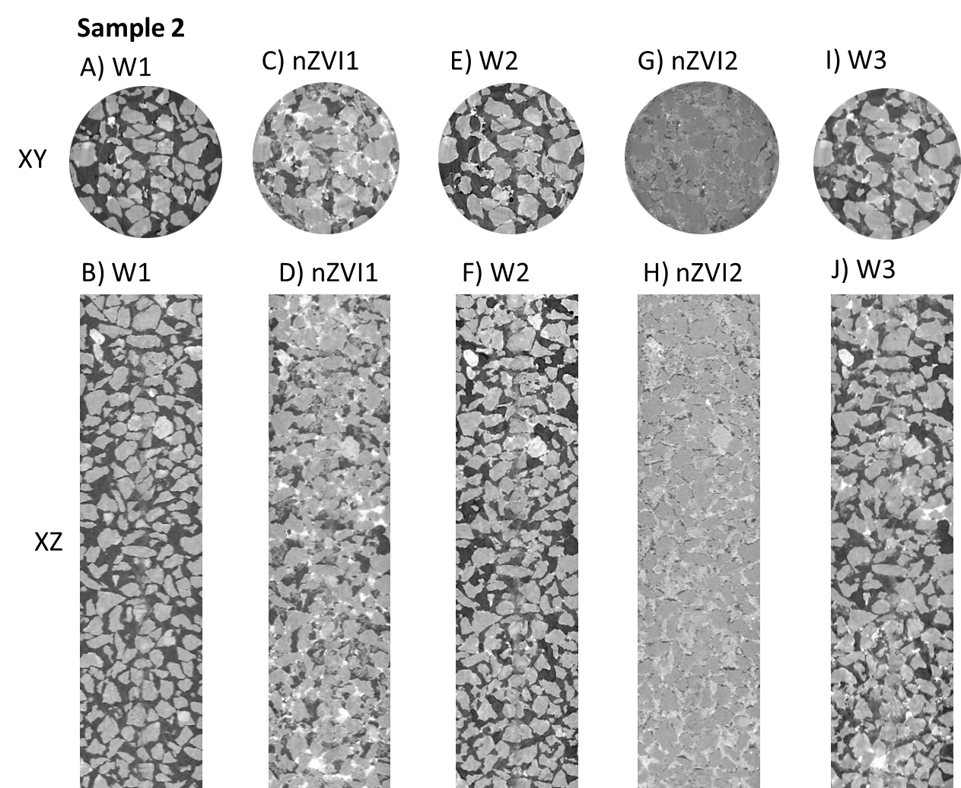
nZVI experiment
Step W1: sample saturation (A-B)
Step nZVI1: NPs unevenly distributed through the sample (C-D);
Step W2: most NPs are washed away (E-F)
Step nZVI2: NPs are more evenly distributed this time (G-H)
Step W3: washed away less NPs than the W2, with visible bright spots of nZVI within pores (I-J)

Slide 7
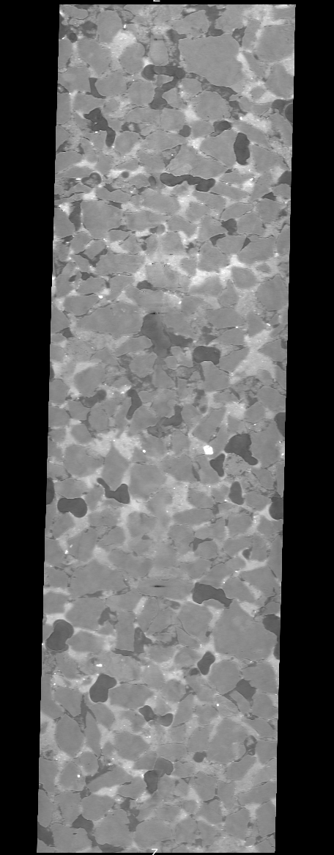
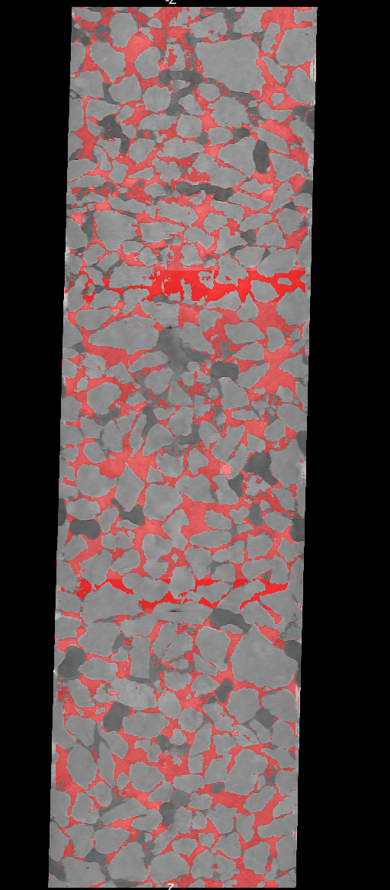
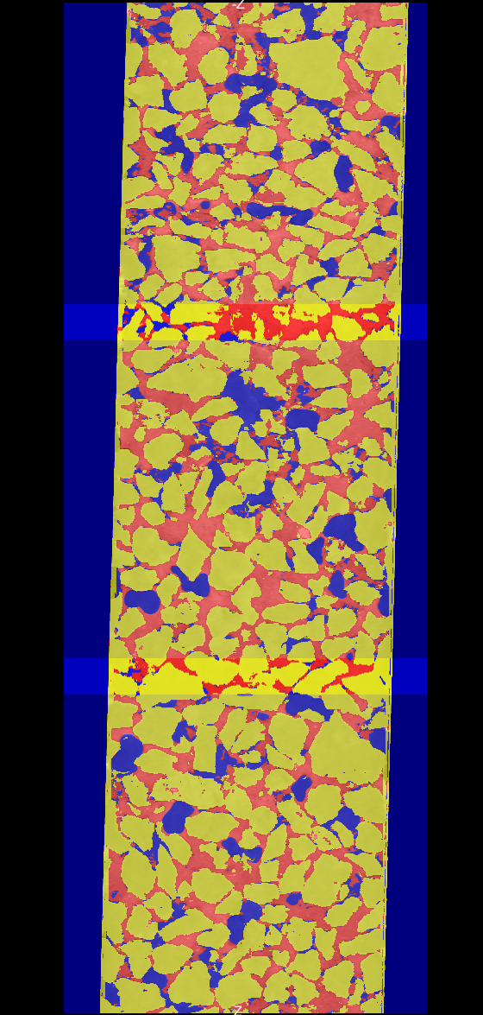
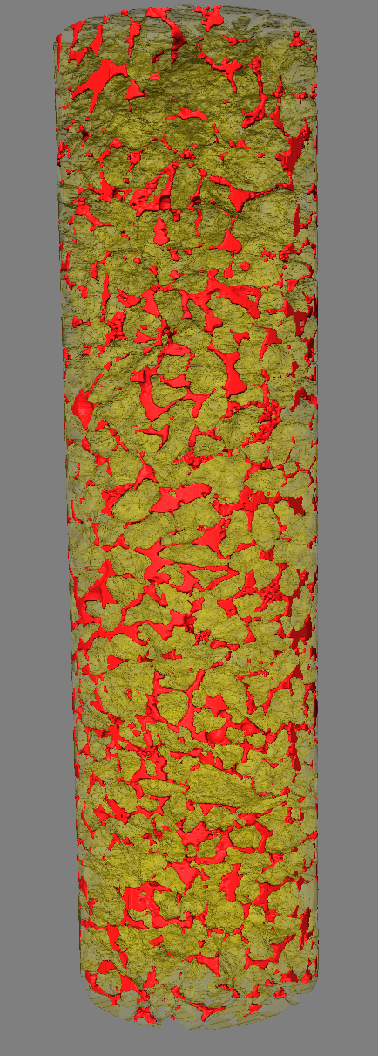
nZVI experiment – nZVI2
Greyscale image
NP segmented
Full segmentation
3D grains and NPs

Slide 8
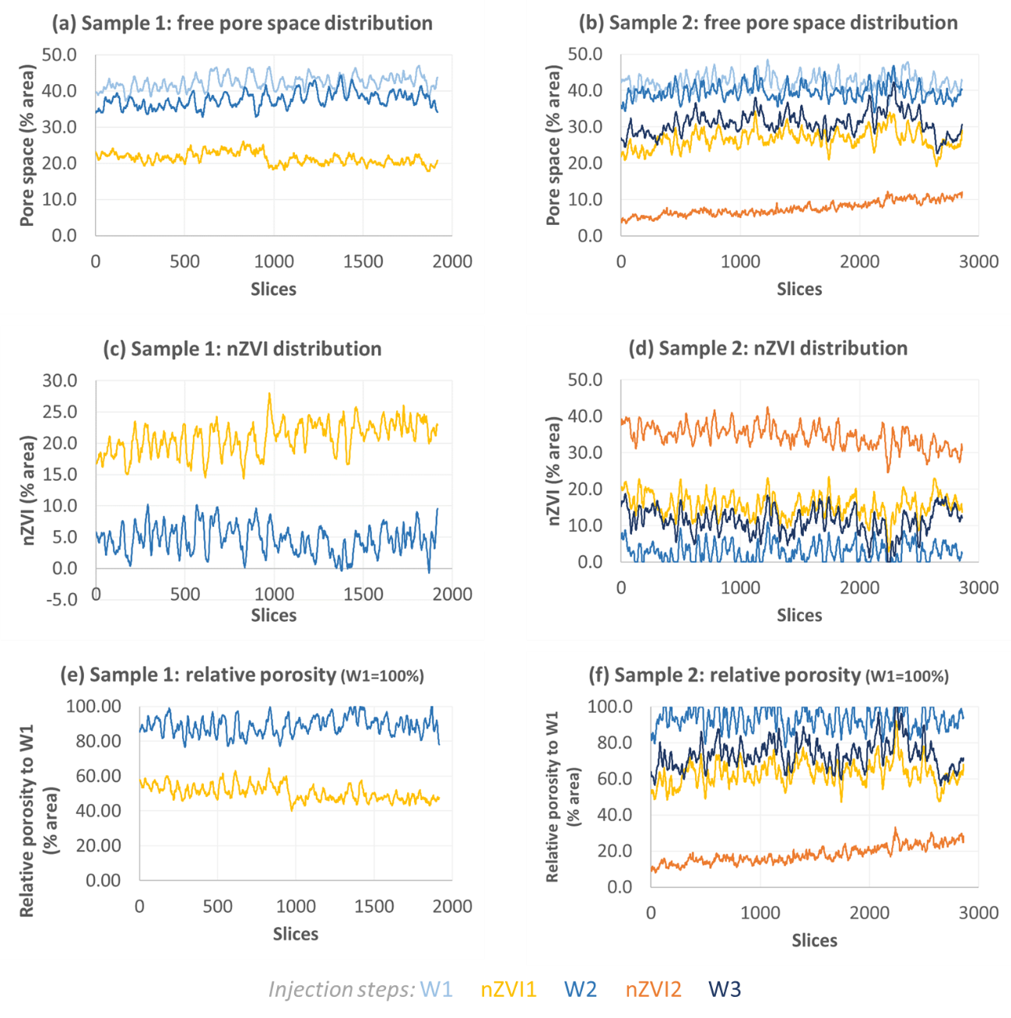
“Free” pore space
= pores occupied by water or gases
Injection steps:
W1
nZVI1
W2
nZVI2
W3
(a, b) Area fraction occupied by the water or gases per slice.
Less free pore space is recovered after
flushing out the second round of nZVI injection.

Slide 9
We are looking into nanoparticle history.

Slide 10
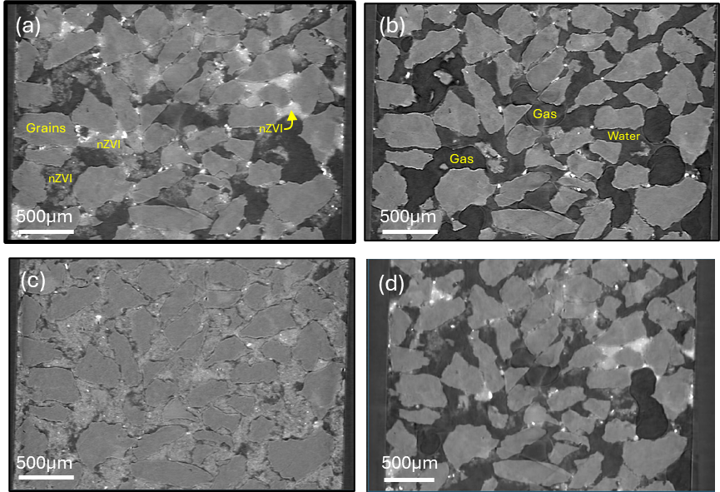
nZVI distribution
W2: few nuggets remain in pore throats
nZVI1: uneven NP distribution
nZVI2: more homogeneous NP distribution
W3: larger nuggets remain in pore throats

Slide 11
nZVI distribution
= pores occupied by nZVI
Injection steps:
W1
nZVI1
W2
nZVI2
W3
(a, b) Area fraction occupied by the NPs per slice
After the 2nd round of injection, more NPs are entrapped in the sample.

Slide 12
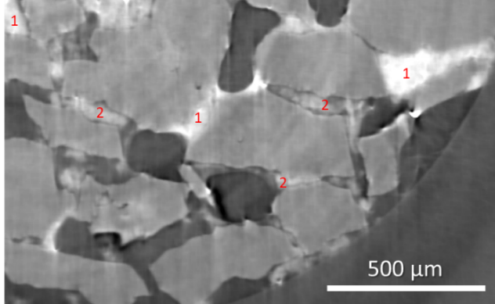
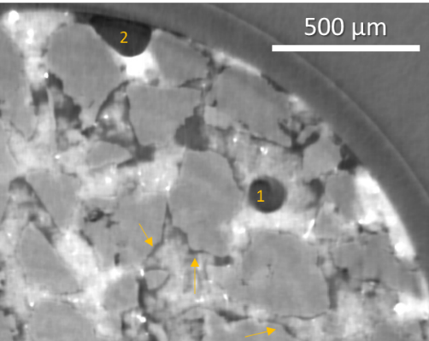
nZVI distribution
Concentrated NP clusters (nuggets) within pore throats (step nZVI2), (1) high and (2) lower concentrations.
Water film on grains in the presence of NPs (arrows). Gas bubbles (1, 2) (step nZVI2).

Slide 13
Take home messages
Nanoremediation is limited by particle mobility;
Mechanisms: matrix-particle (filtering and straining) and particle-particle (ripening);
Ripening mechanism has a key role in nZVI entrapment in porous media;
nZVI history is significant in the mobility and entrapment of NPs;
Insights for flow models in remediation studies, regarding particle mobility and entrapment mechanisms.

Slide 14








Acknowledgements
Process 2013/10311-3
Project 20900047
Proposal 20180726

Slide 15

You can also find me...
Poster session 4: WED 20 May, afternoon #355: Microbiological and pore-structure characterization of an urban aquifer contaminated by sewage leakages
My co-authors:
Poster session 1: TUE 19 May, morning Lívia Freitas, #220
MS10: TUE 19 May, afternoon Nathaly Archilha, #695

