Slide 1
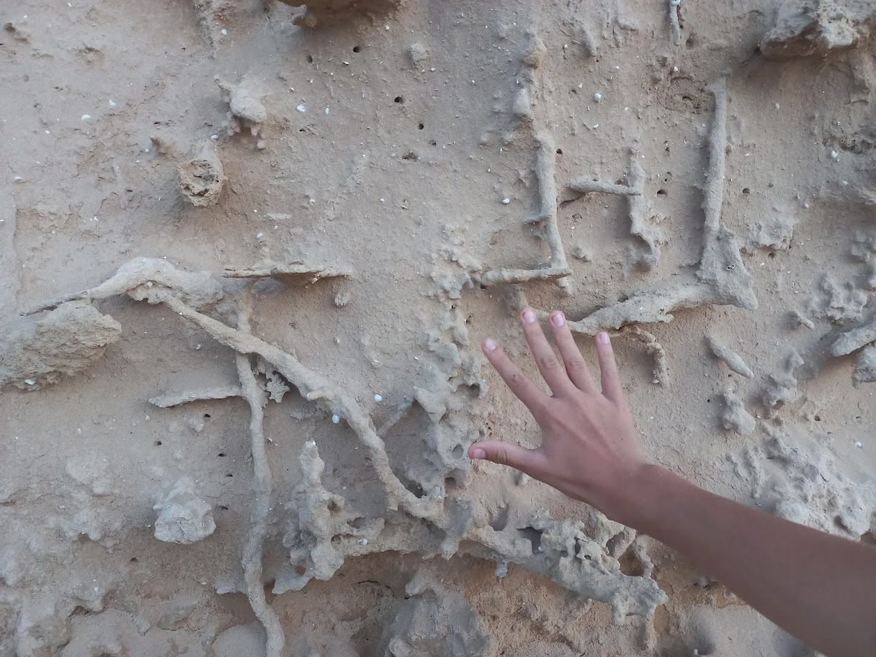


Multi-Scale Dynamics of Root-Induced Soil Compaction (RISC): Sharp Interfaces and Rhizosphere Hydrology
Uri Nachshon, N. Goldberg-Yehuda,
S. Assouline, and Y. Mau

Slide 3
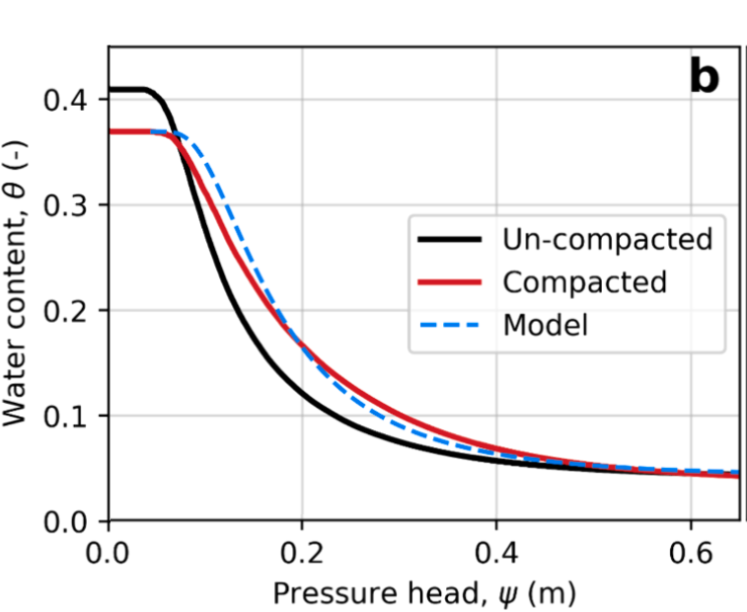

Assouline, S. et al., 1997. Effect of compaction on soil physical and hydraulic properties: experimental results and modeling. Soil Sci. Soc. Am. J. 61(2), 390.

Slide 4
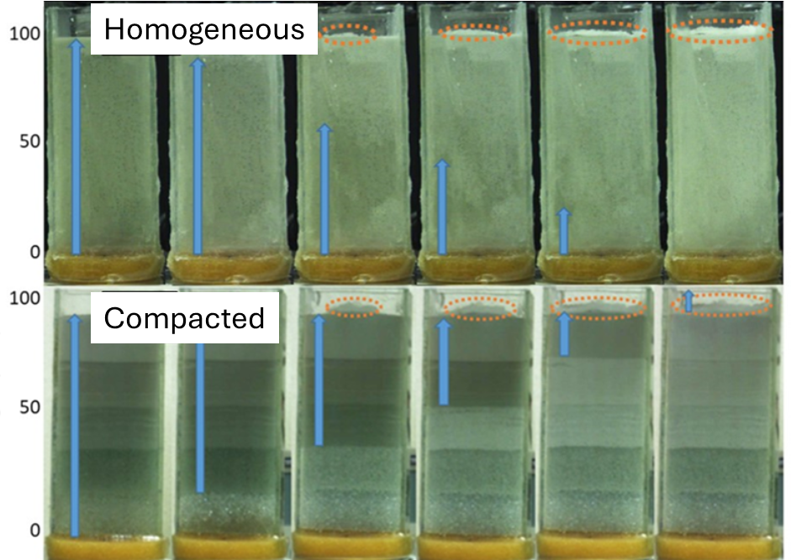

Slide 5
RISC: Will it generate favorable conditions for root water (and nutrients) uptake?

Slide 6

Microscale: 5-10% increase in bulk density of RISC zone

Slide 7
Single root
Model:

Slide 8
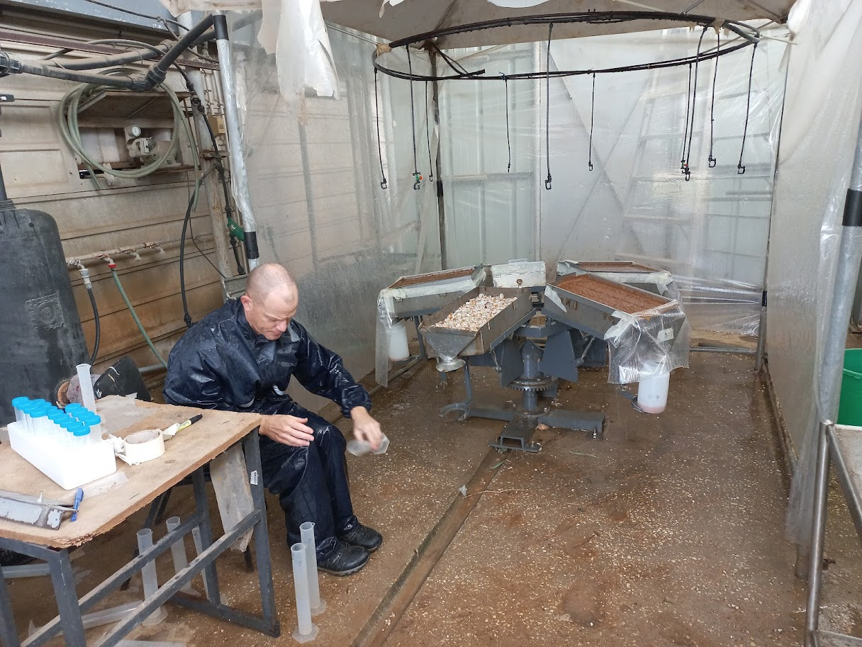
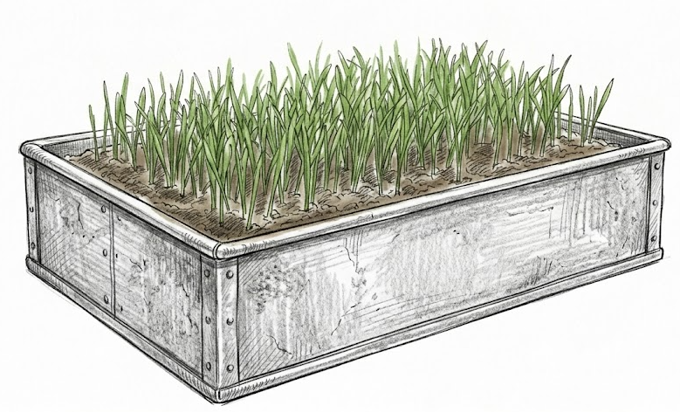
Macroscale – rain simulator experimetns:

Slide 9
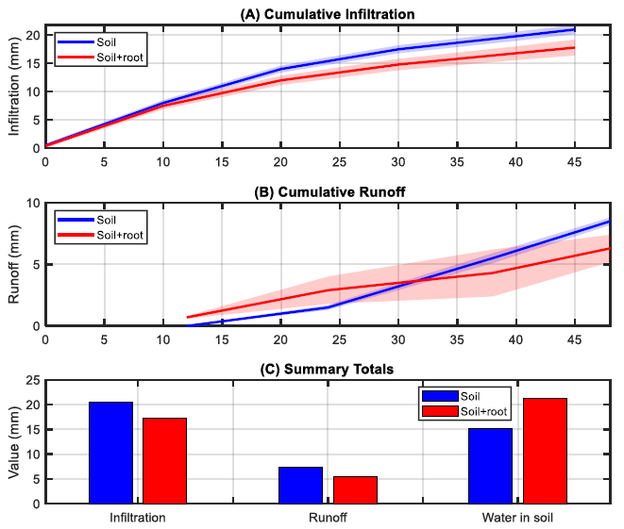
Macroscale – rain simulator experiments: ~40% increase in W.C. for the rooted state.

Slide 10
Macroscale – rain simulator experiments: ~40% increase in W.C. for the rooted state.
In agreement with Assouline’s model.

Slide 11
Aggregated roots model:
Synergetic effect on the RISC spatial distribution.

Slide 12
Field scale observations:

Slide 13
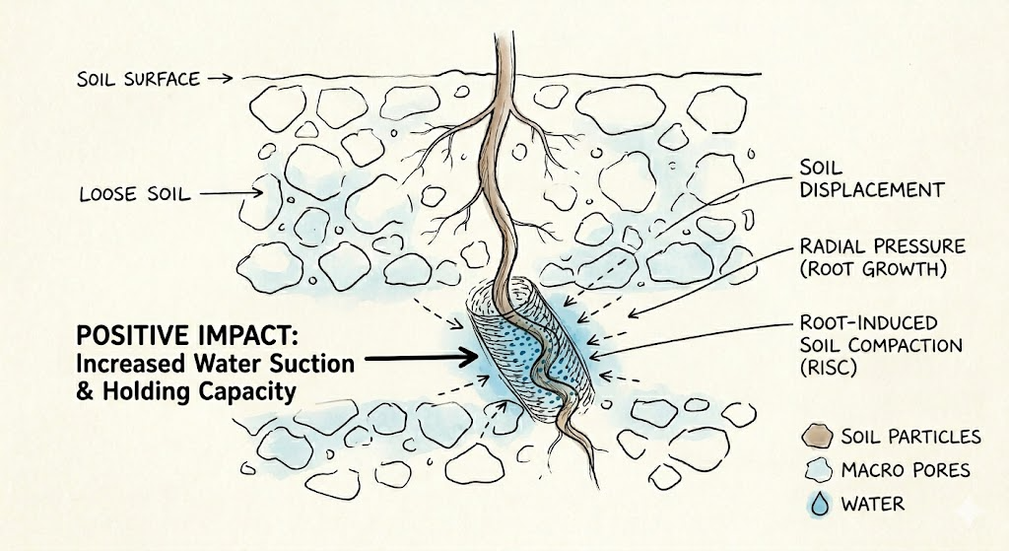
In summary, RISC functions as an adaptive plant mechanism that actively maintains favorable hydrological conditions within the root zone. Future studies should further elucidate the aggregated impact of this phenomenon across the entire root system. Ultimately, a deeper understanding of RISC could allow for the targeted modification of root properties to enhance plant resilience against abiotic stresses.

Slide 14
Thank you!
urina@agri.gov.il
Institute of Soil, Water, and Environmental Sciences – Volcani Center

