Slide 1

Scaling microbial processes in porous media
Tim Scheibe
Pacific Northwest National Laboratory
Earth and Biological Sciences Directorate

Slide 2
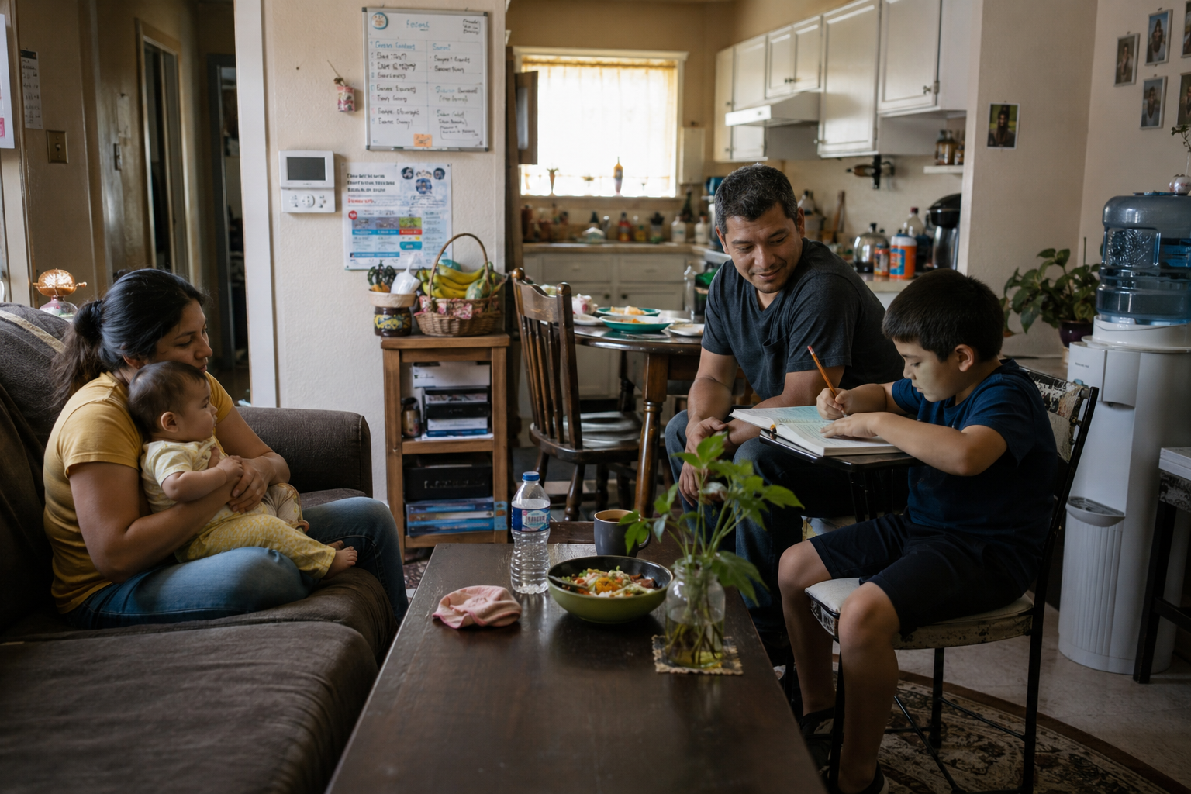
A Simple Observation
Human traits and behavior are shaped by each individual’s local environment:
Who else lives there and how they interact
Environmental conditions (temperature)
What resources are available to the occupants (food, air, water)
What risks exist (pathogens, hazards)
Influence of external factors (media, visitors)
(Image by ChatGPT 5.5)
Notes:
This slide presents a relatable analogy for how microbes experience and respond to their environments.

Slide 3
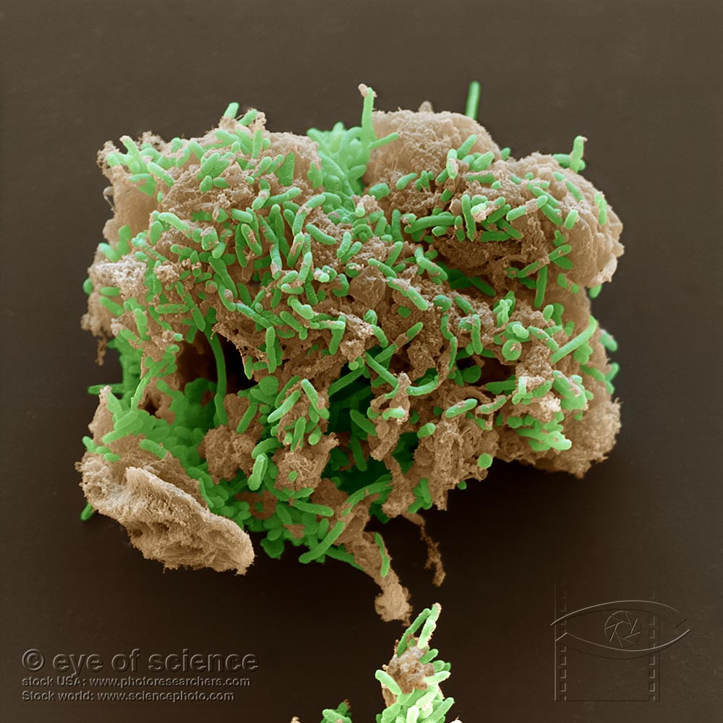
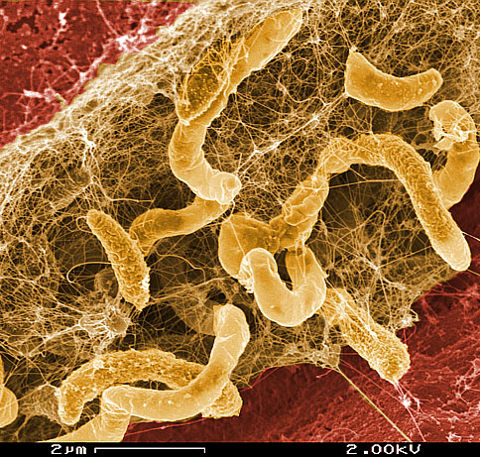
Microbial Life in Pore Spaces
Similarly, microbial traits and behaviors (phenotypes) in a porous medium are also shaped by each individual’s environment.
Who else lives there (microbial community composition) and how they interact (syntrophy or competition)
Environmental conditions (temperature, moisture, pH)
Resource availability (substrates, oxygen)
Risks (predators, viruses)
External influences (hydrologic connectivity and transport, plant roots).
Notes:
This slide completes the analogy started in the previous slide, and lays the foundation for why the scale mismatch (next slide) matters.

Slide 4
Add slide from KH

Slide 5
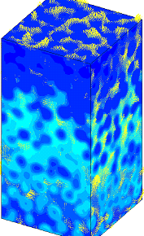

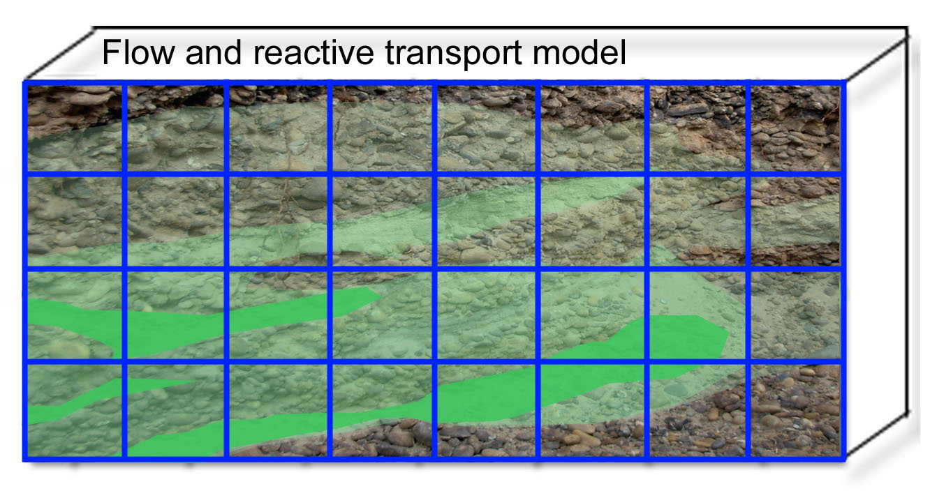
The Scale Mismatch
Pore Scale (microscale – 10’s to 100’s of μm)
Microbes respond to conditions at spatial and temporal scales that are too small, complex, and heterogeneous to be explicitly represented in models used for prediction.
Field Scale (macroscale – decimeters to 100s of m resolution)

Slide 6
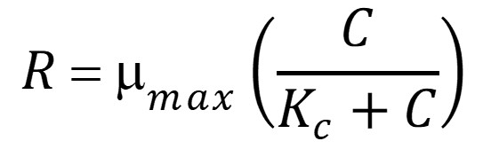
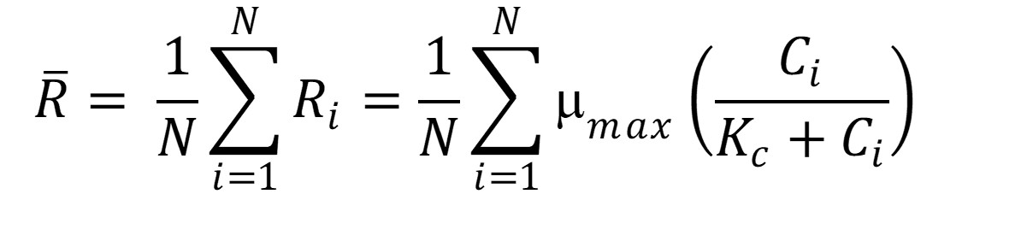
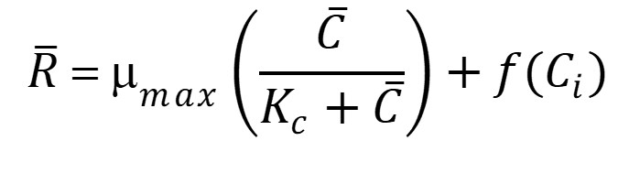

The Multiscale Closure Problem (or why simple averaging fails)
Microscale: Rich in detail, process understanding, govern system behavior (e.g. microbial metabolism, pore-scale mixing, multicomponent reactions)
Macroscale: Predictions of system-level outcomes (e.g. ecosystem fluxes, groundwater reactive transport, mineral dissolution and recovery)
Monod Equation
Closure Term
Notes:
As a very simple example, consider the Monod Equation commonly used to represent microbially-mediated reactions in porous media. The basic problem is that the average of the reaction is not equal to the reaction of the average.

Slide 7
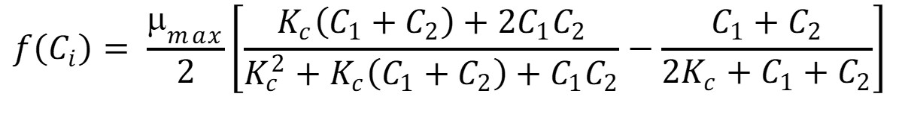
What can we do?
Ignore the closure term – “Calibrate” μ_{max} and K_{c} to match macroscale observations.
Calculate the closure term directly. E.g. for N=2
Derive the closure term based on macroscale observables, some assumed form of microscale variations – requires a “scaling law” that is often violated in real systems
None of these have been fully successful to date
Notes:
Show Battiato et al dimensionless scaling diagram here? May be overkill depending on how the presentation timing works.

Slide 8
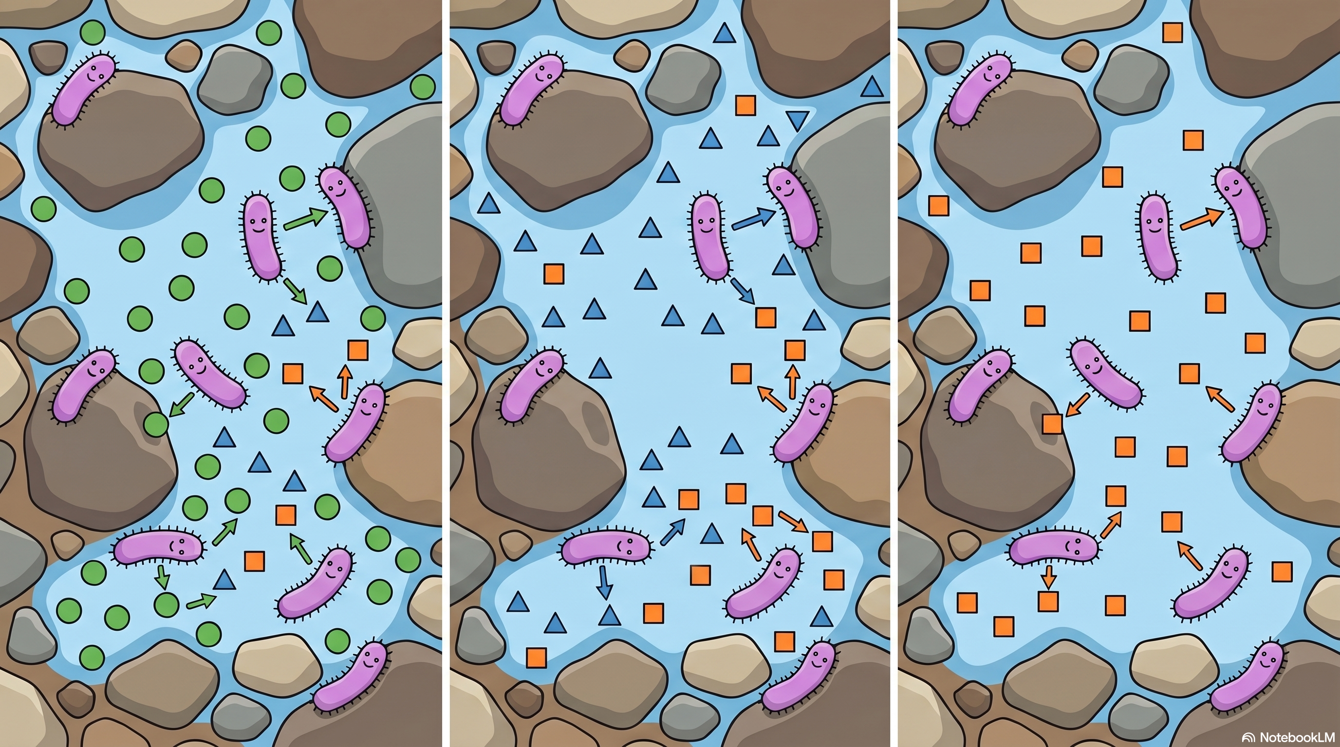

Microbes Dynamically Adapt to Their Environment
Further complicating the matter, microbes can shift their metabolic processes and pathways in response to environmental factors, and they also can dynamically modify their environment.
Notes:
This example shows that within a small domain (much smaller than a typical bulk representation / reactive transport model discretization element) the same microbes might be doing different things metabolically based on their local microenvironment, and as the reactions proceed and conditions change the microbes change their metabolism accordingly. This is very hard to represent in a macroscale model and often confusing experimentally when we see processes occurring simultaneously (at the bulk measurement scale) that don’t make sense thermodynamically.
In fact, the closure relationship itself may evolve over time because the biology adapts to changing conditions.

Slide 9
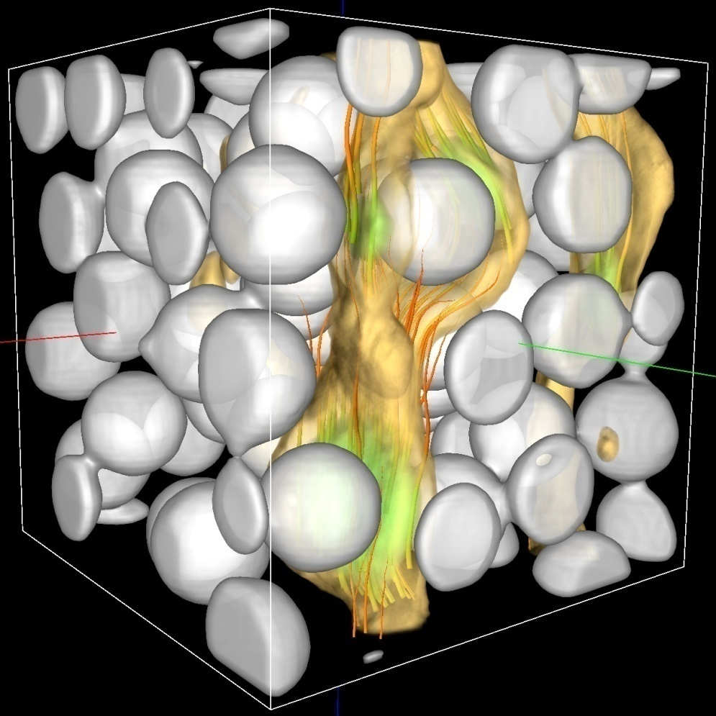
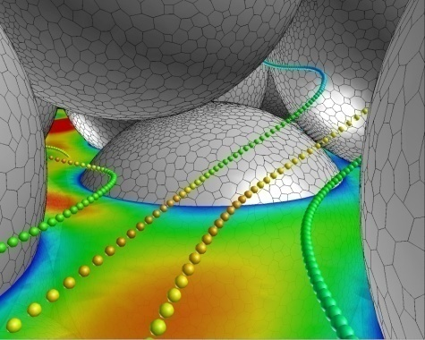
Is There Any Hope? What Has Changed?
Three remarkable developments enable major breakthroughs:
High-resolution pore imaging and reactive transport simulation
Tartakovsky and Scheibe, Advances in Water
Resources, 34(12):1616-1626, 2011
Notes:
We have struggled with this challenge for decade. Refer to my 2010 Darcy lectures – over 15 years ago we were just starting to make progress on modeling shifts in microbial metabolism, and pore-scale / hybrid multiscale modeling.
In these figures:
Smoothed particle hydrodynamics, CFD methods used to simulate pore-scale flow, transport and reaction
Hybrid multi-scale approach couples pore-scale and continuum-scale models in a single simulation
But these simulation capabilities were nascent and pore-scale characterization was very challenging.

Slide 10
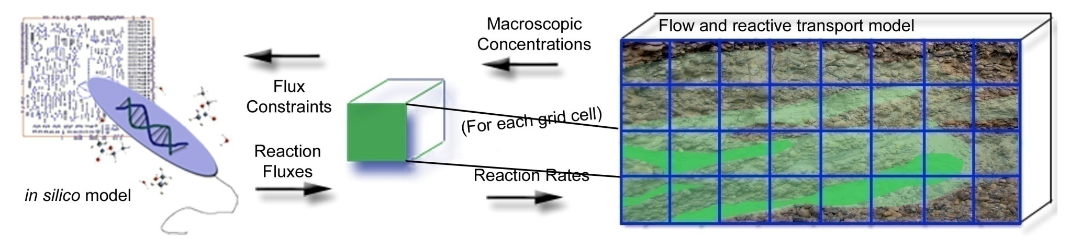
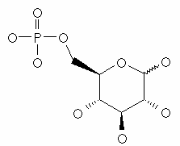
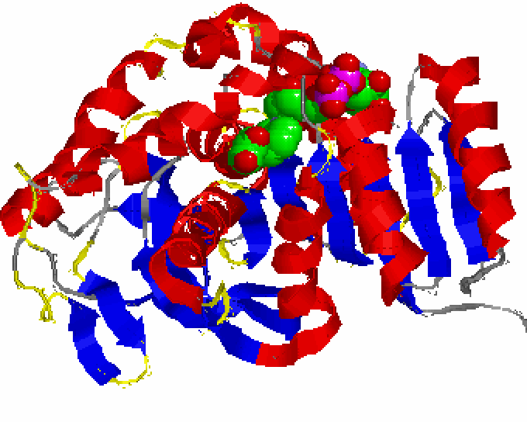


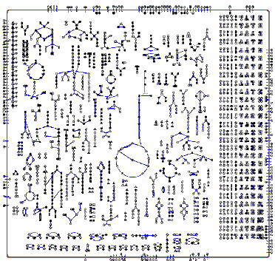

Is There Any Hope? What Has Changed?
Three remarkable developments enable major breakthroughs:
High-resolution pore imaging and reactive transport simulation
Decadal advances in multi-omics characterization and metabolic modeling
Scheibe et al., Microbial Biotechnology, 2(2): 274-286, 2009
[1]
Levels of Increasing Complexity
RNA
Protein/Enzyme
DNA
Reaction
Cell
Reaction Network
Graphics from R. Mahadevan, Univ. of Toronto
Notes:
We have struggled with this challenge for decade. Refer to my 2010 Darcy lectures – over 15 years ago we were just starting to make progress on modeling shifts in microbial metabolism, and pore-scale / hybrid multiscale modeling.
In these figures:
In 2009, we published the first example of a genome-scale metabolic model coupled with a conventional reactive transport simulator – but it was just one organism and computationally was cumbersome.
Again, these simulation capabilities were nascent and microbial process characterization was very challenging.

Slide 11
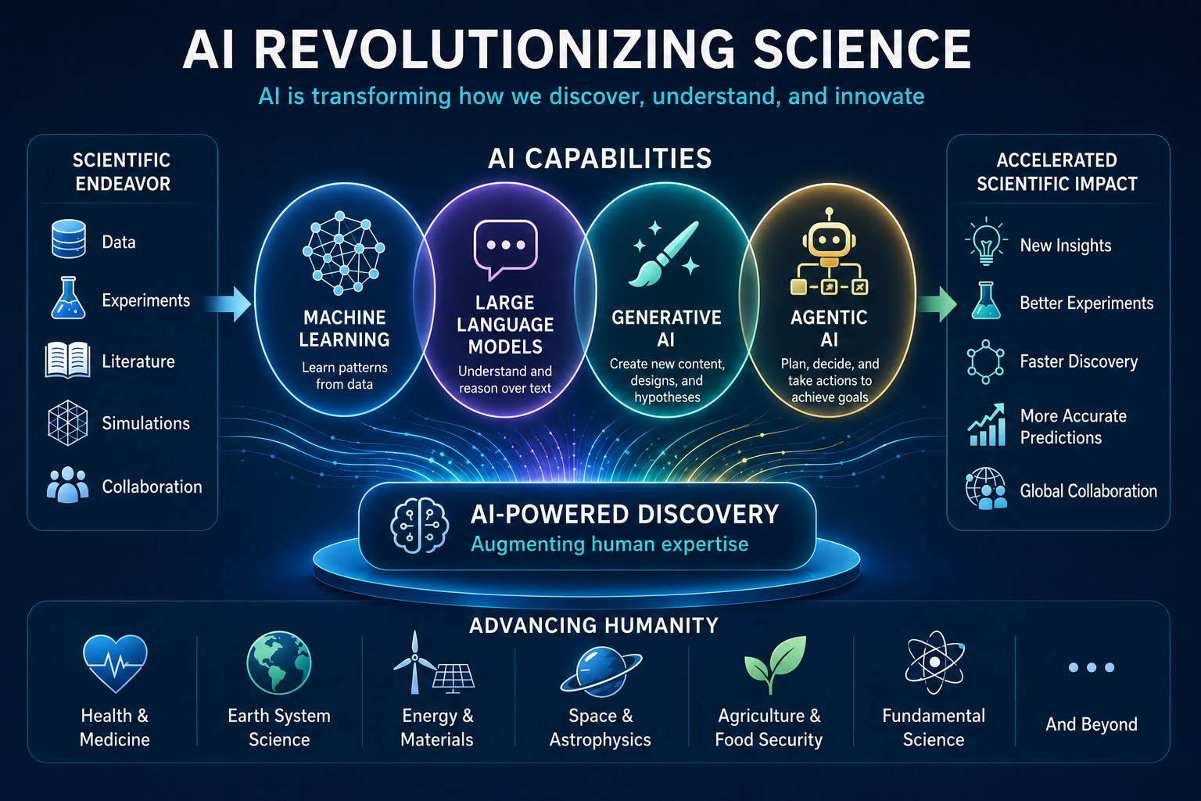
Is There Any Hope? What Has Changed?
Three remarkable developments enable major breakthroughs:
High-resolution pore imaging and reactive transport simulation
Decadal advances in multi-omics characterization and metabolic modeling
Revolution in Artificial Intelligence (AI)
(Image by ChatGPT 5.5)
Notes:
Note that there was really no significant AI/ML in 2010, so this is truly a revolution (compared to decadal advances in the other two areas).
AI advantage spans the other two areas and brings its own unique value to multiscale science. I’ll show you how over the next several slides…

Slide 12

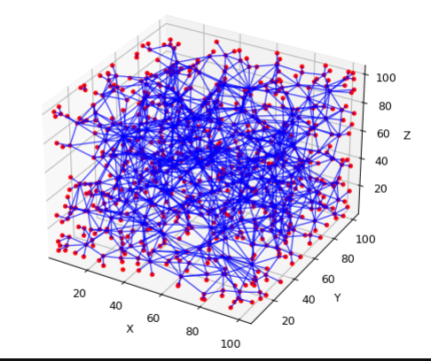
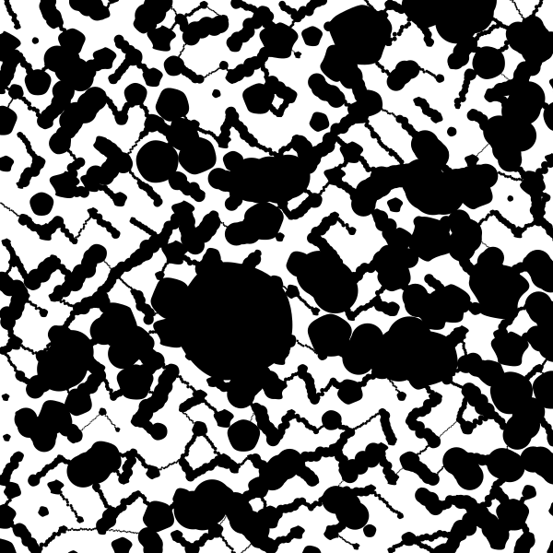
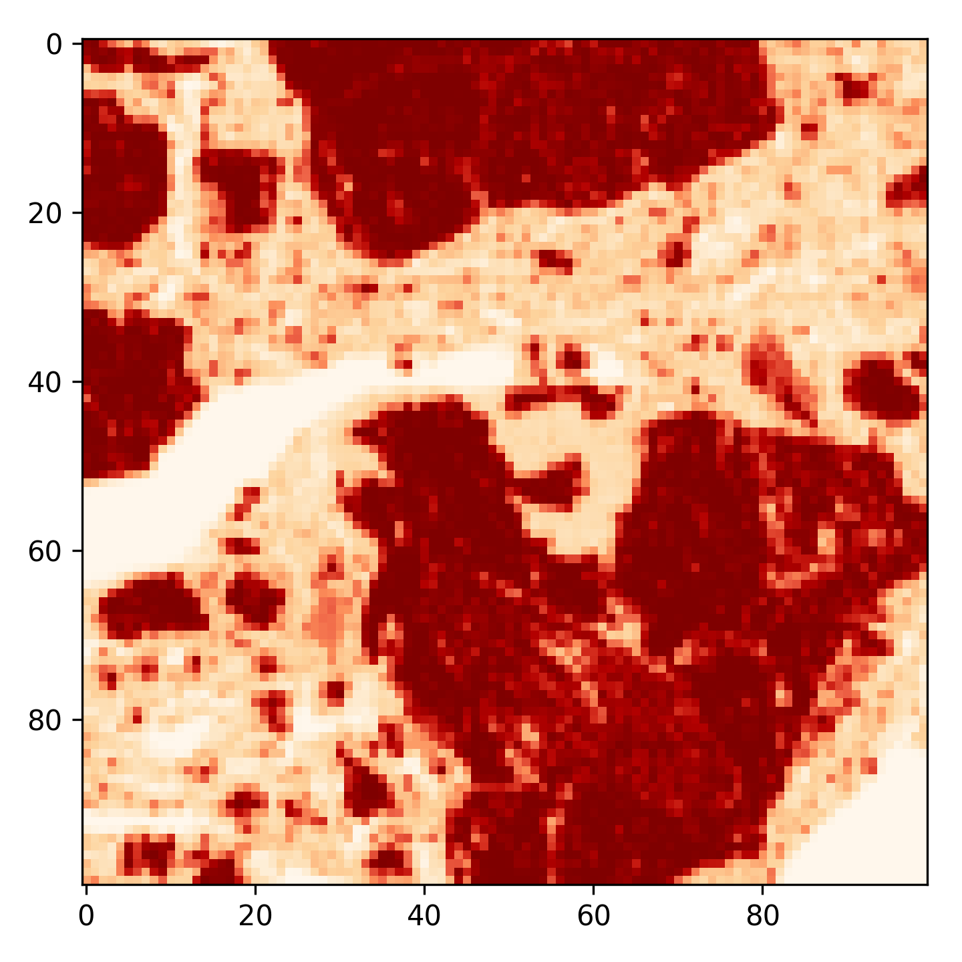
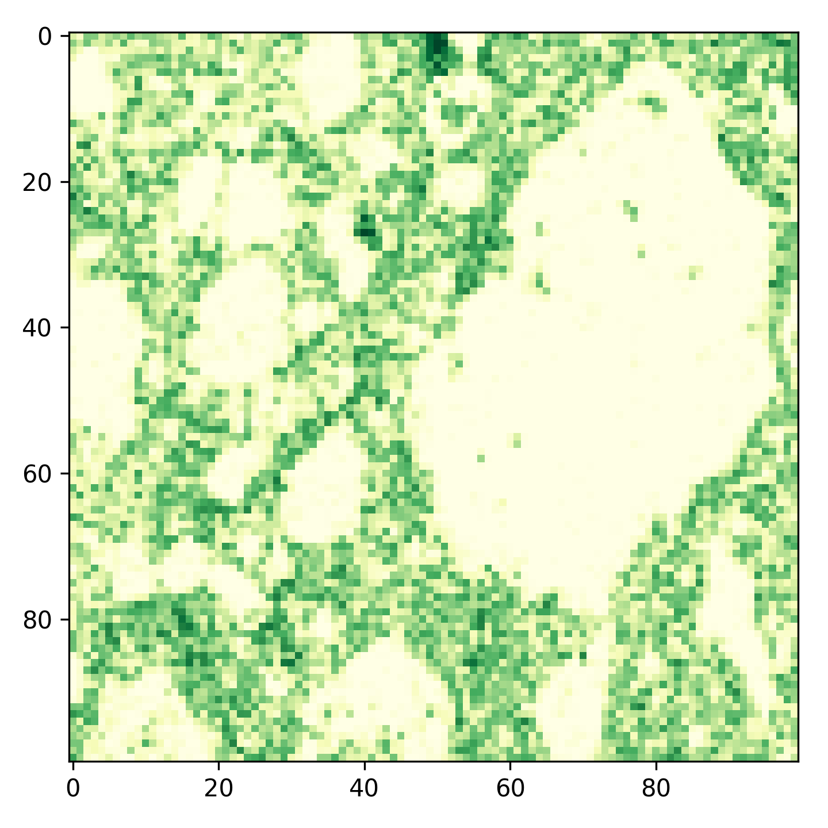
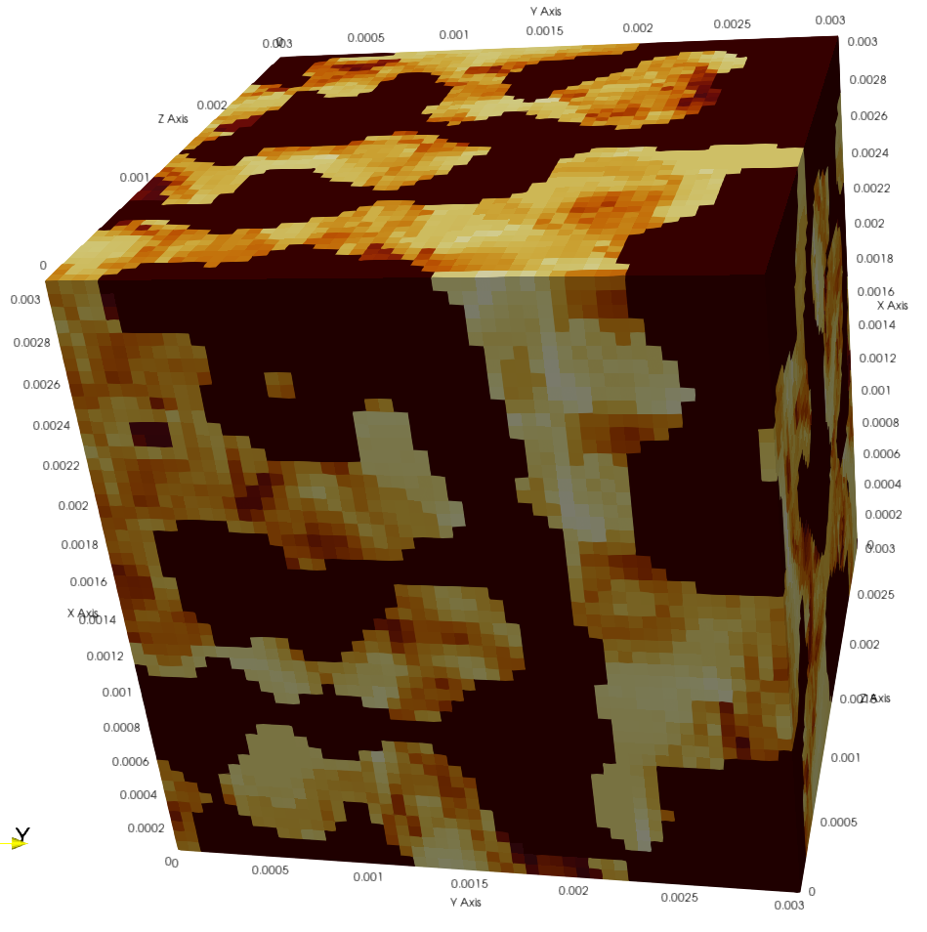
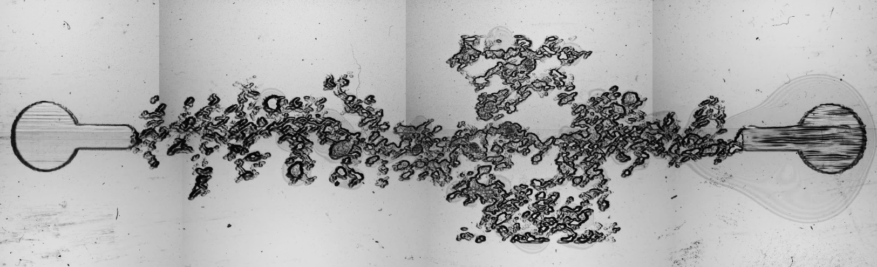
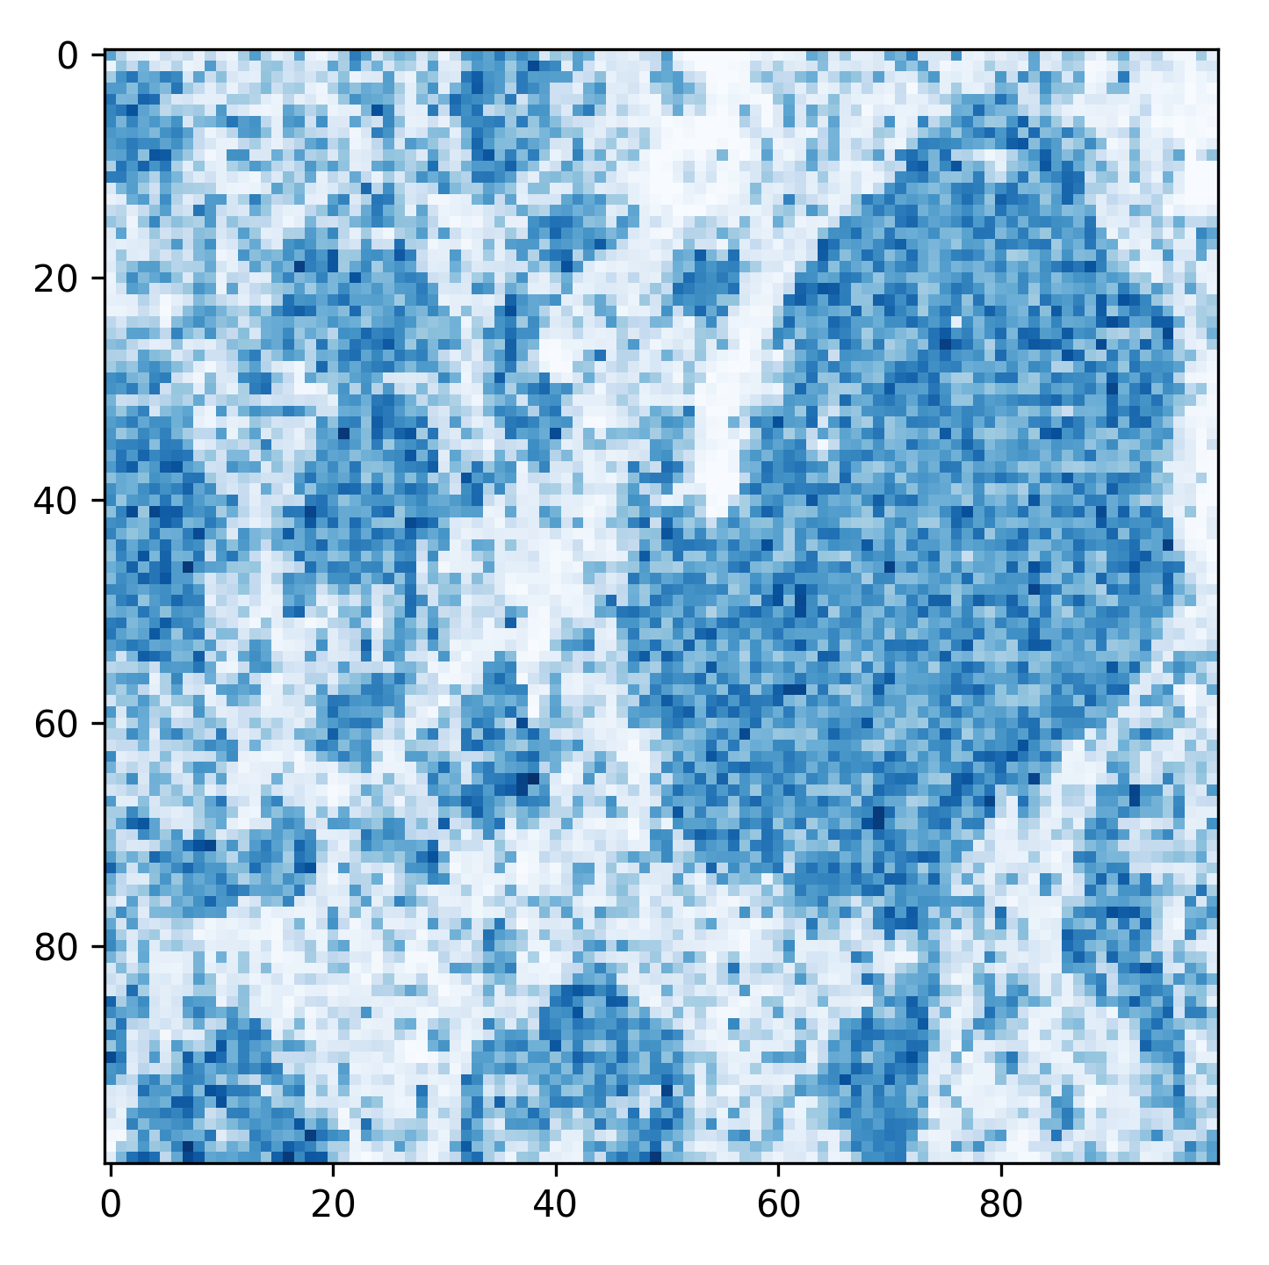
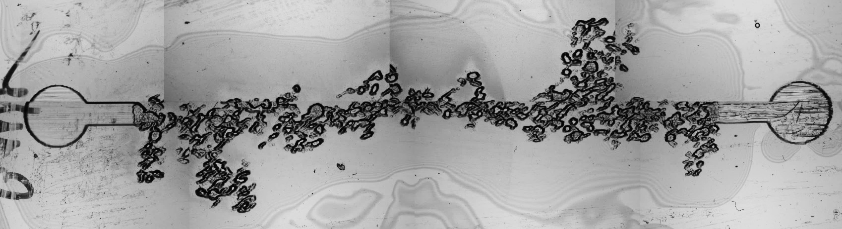
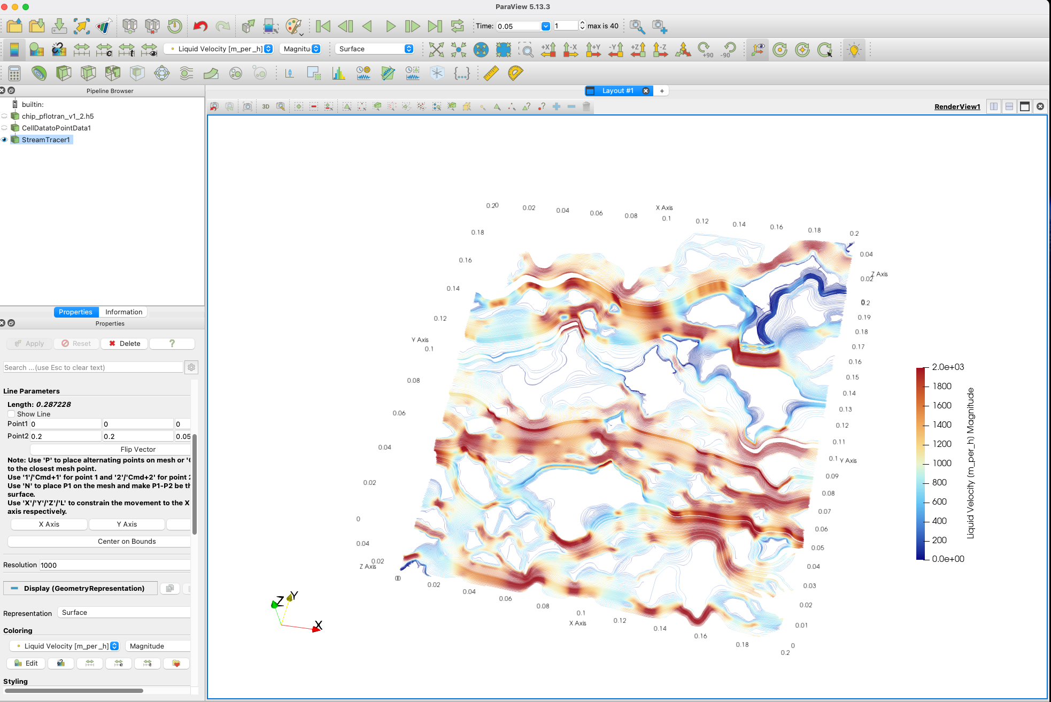
High-Resolution Pore Imaging and Reactive Transport Modeling
3D Segmented
Image Stack Of Soil and CMMs
Network Extraction and Distribution Calculation
Experiment-Ready Lab-on-Chip Mask
2010: Nascent capability for pore-scale characterization and simulation.
2026: High-resolution (sub-micron) geometry and chemistry, TerraForms, PFLOTRAN, integrated experiments, and multiscale simulation workflows.
AI Advantage: Multi-resolution methods
2D chemical imaging data
3D mineral distribution
Massively parallel flow and RT with PFLOTRAN
Secondary flow paths
Outlet
Inlet
Dominant flow paths
Notes:
At EMSL, scientists have developed capabilities to 1) combine 3D dense XCT pore structural information plus 2D slice chemical imaging from SEM/EDX to build 3D chemical/mineral maps 2) the pore structural information and mineral maps can be then used to create lab-on-chip models through 3D printing for controlled flow/RT/bio experiments for hypothesis testing and experimental data generation. 3) The 3D structural/chemical maps can be in parallel used to run ensembles of massively parallel flow/RT simulations towards learning closure models using AI/ML.
Multiresolution AI methods:
Training generative models on co-located high- and low-resolution images to enable high-resolution over larger domains
Performing large ensembles of high-resolution CFD simulations using emulators trained on a small number of paired high- and low-resolution simulations.
Satish will provide talking points and figures for:
3D → 2D representation of pore structure
TerraForms (physical pore-scale models for experiments)
PFLOTRAN pore-scale simulation capabilities

Slide 13
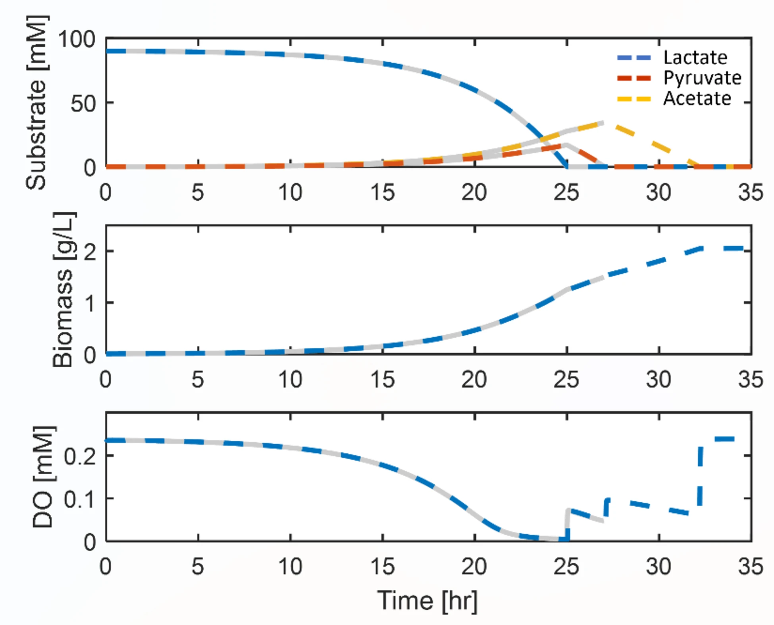

Multi-Omics Characterization and Metabolic Modeling
[Song et al., 2025, 10.1038/s41598-025-89997-9]
2010: Manual curation of a few microbial genome-scale models, computationally intensive solution algorithms
2016: Automated annotation and gap-filling to rapidly create GSMMs (e.g. Kbase)
AI Advantage: Tools for improved annotation of protein function, surrogate representations of GSMMs
Notes:
Contrast 2010 and 2016 capabilities and highlight a couple forms of AI advantage.
CRISPr mutation tests, metagenomic reconstruction (MAGs), multi-omics data

Slide 14
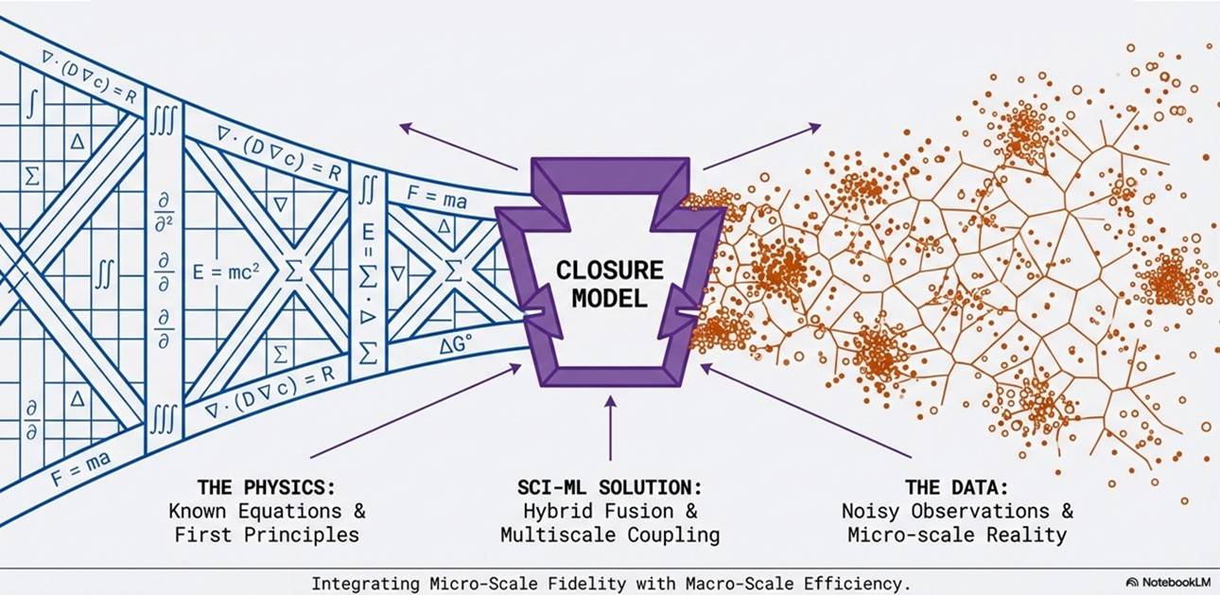
Bridging the Multiscale Gap in Porous Media Science
Image courtesy of Xingyuan Chen, PNNL
Notes:
Now, where AI can be truly the key to transforming multiscale porous media science is in addressing the closure problem we previously introduced. Here, we present a strategy for SciML closure models in heterogeneous porous media flow and reactive transport.

Slide 15
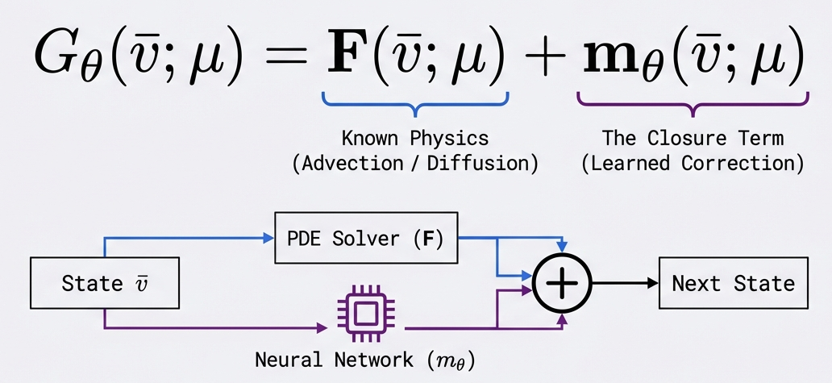
AI-Based Multiscale Closure
Augmenting differential equations with learned corrections:
Image courtesy of Xingyuan Chen, PNNL
Notes:
Again, the key is using AI to learn the closure term – a correction to the macroscale model that represents the effects of microscale processes. “We keep the differential equations for mass and momentum. We use AI only to learn the closure term – the part we can’t efficiently solve.”

Slide 16
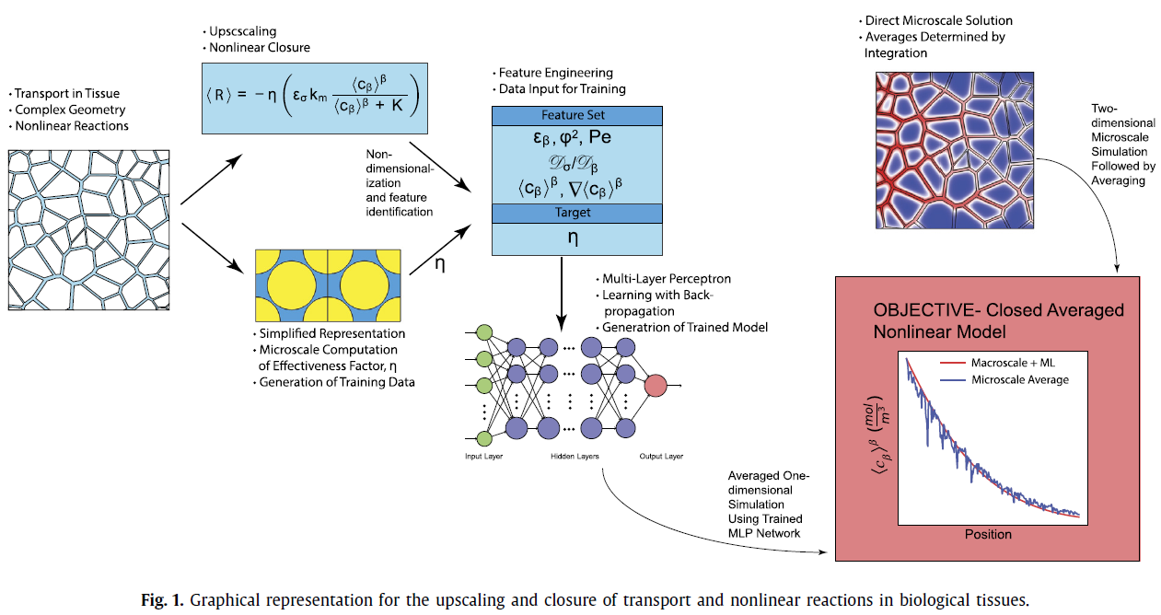
Example: Reactive Transport in Biological Tissues
Taghizadeh et al., 2022, https://doi.org/10.1016/j.jcp.2021.110781
Notes:
Emphasize that this is not a new idea -- Show this example in a “porous medium” (in this case human tissues) – one of the early examples.

Slide 17
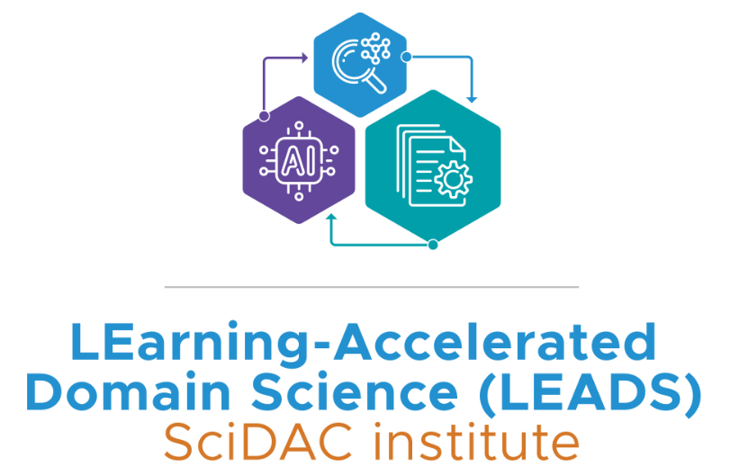
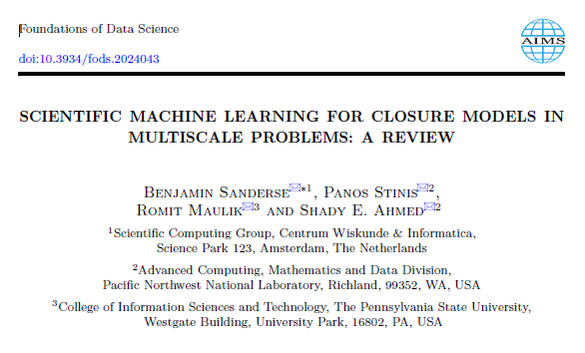
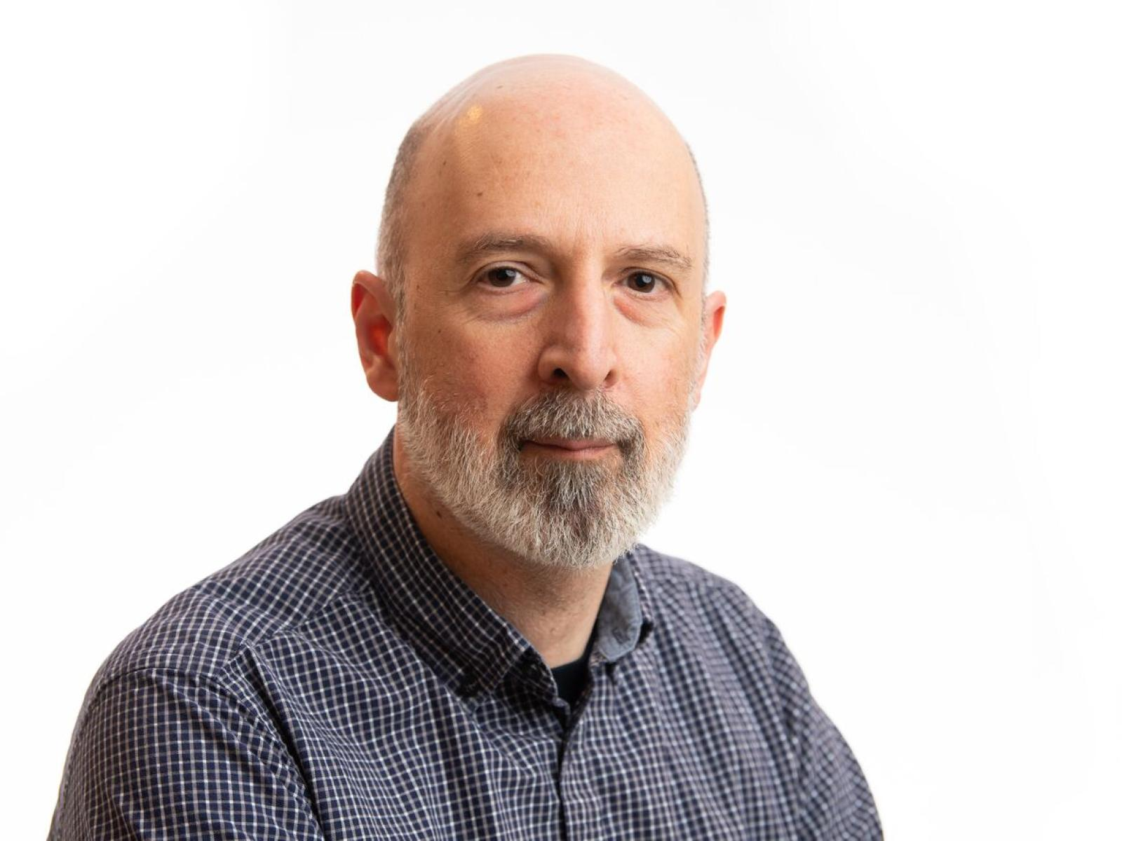
Mathematical Formalization and Evaluation
Sanderse et al., 2024, 10.3934/fods.2024043
Dr. Panos Stinis, PNNL
Notes:
However, although the idea is not new, we have seen significant advances in the mathematical formalization and evaluation of this approach. This 2024 paper provides a review of approaches and associated challenges. The next several slides are formulated based on this paper.
They are working on ways to make the closure more efficient computationally without losing accuracy. The closure is not a static thing for time-dependent, introduces memory terms (convolution), using ML can help make it more efficient.

Slide 18
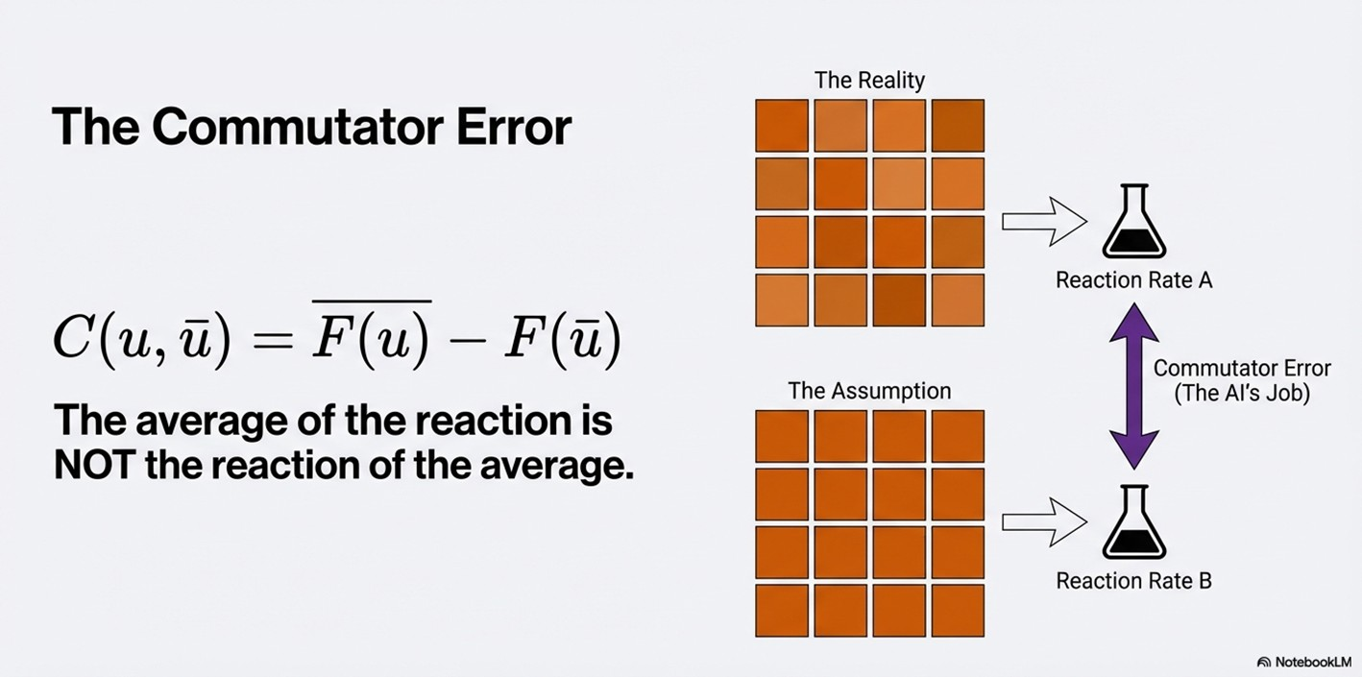
What is the AI Learning?
Image courtesy of Xingyuan Chen, PNNL
Notes:
Again, the term the AI should learn (the closure term) is the commutator error – the error introduced because the averaging process does not commute.

Slide 19
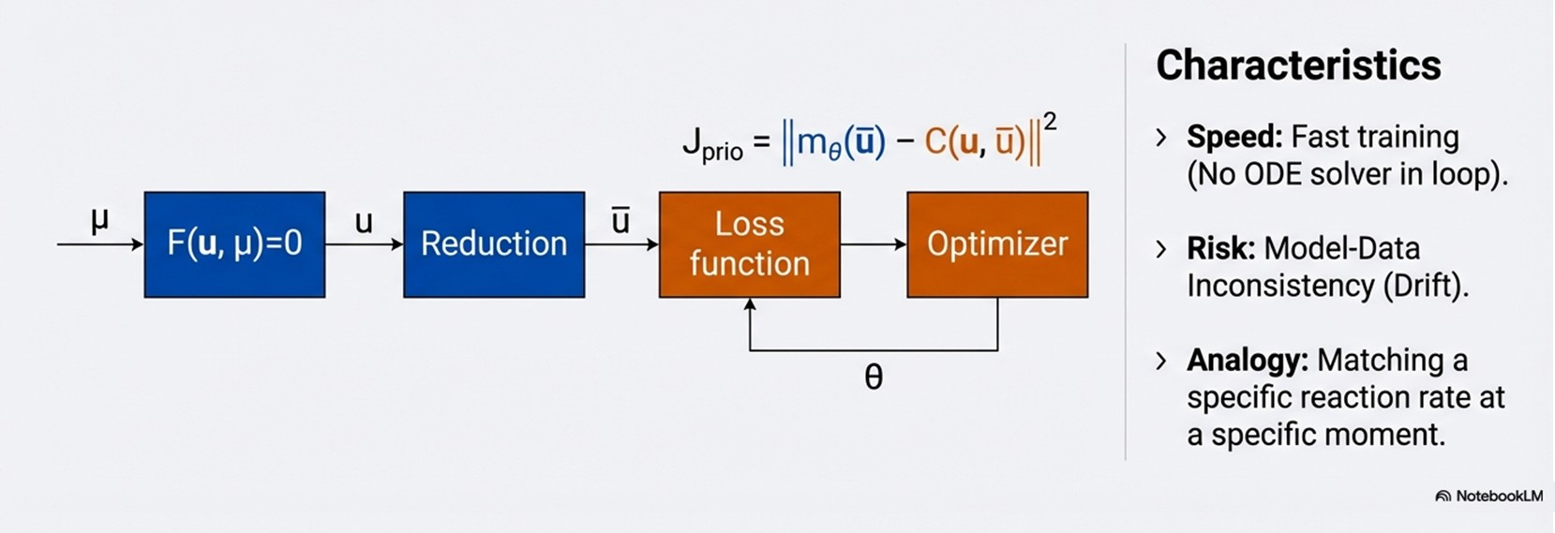
Training Paradigm 1: A Priori Learning (Offline)
Image courtesy of Xingyuan Chen, PNNL

Slide 20
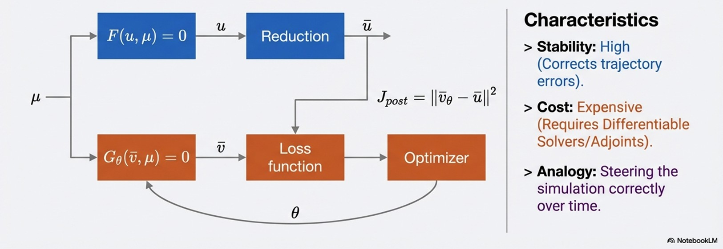
Training Paradigm 2: A Posteriori Learning (Online)
Image courtesy of Xingyuan Chen, PNNL

Slide 21
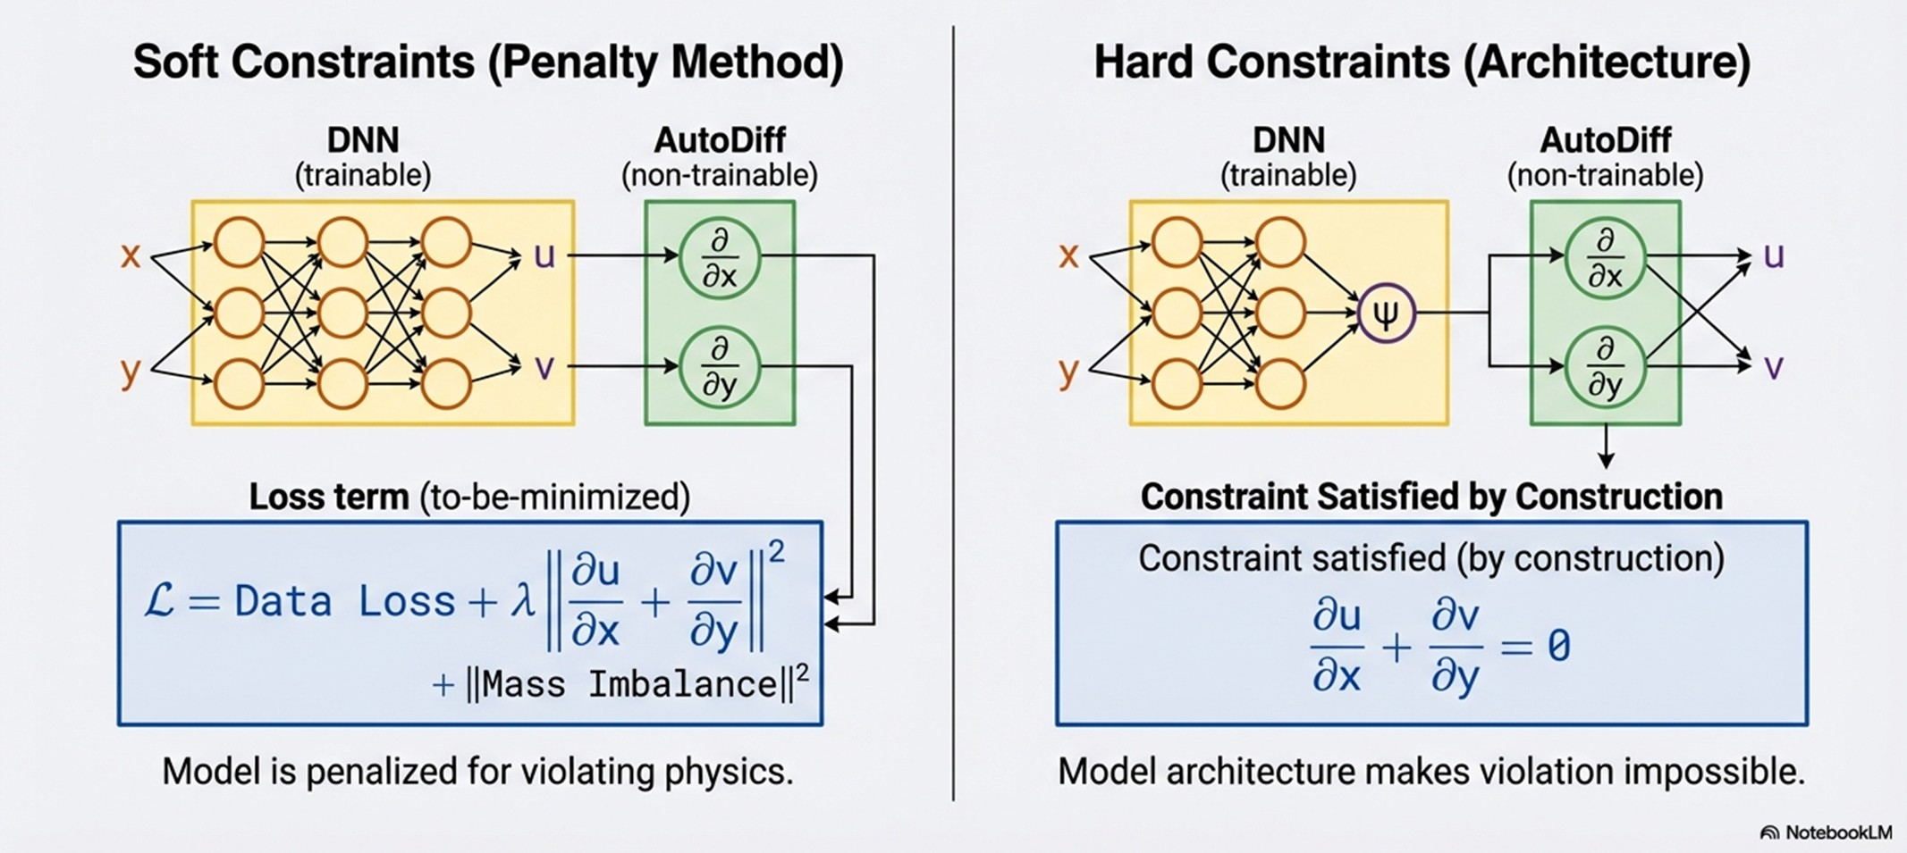
The Guardrails: Embedding Physical Constraints
(E.g., enforcing mass conservation and reaction stoichiometry)
Image courtesy of Xingyuan Chen, PNNL

Slide 22
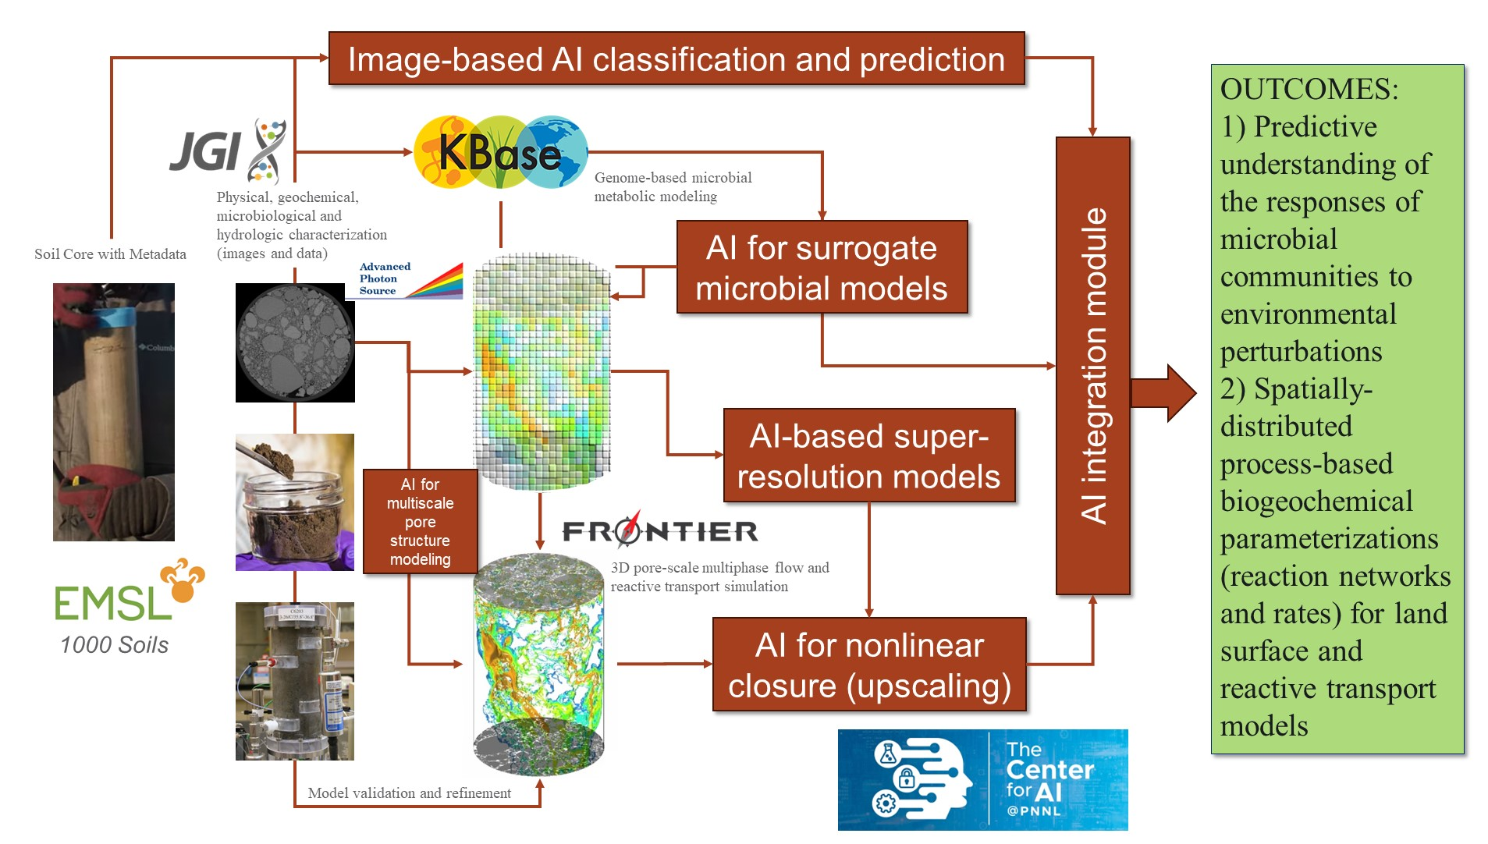
Toward Predictive Porous Media Hydrobiogeochemistry
Notes:
A future vision for adaptive multiscale reactive transport science.

Slide 23
Why this matters…
Examples:
Plant-microbe interactions for plant productivity
Contaminant fate, transport and remediation
Critical minerals extraction and recovery
Ecosystem resilience
Soil health and nutrient cycling
Bioproduction / Bioreactor scale-up

Slide 24
Key Takeaways
Microorganisms do not experience the “average” pore environment.
Multiscale closure remains a central challenge in porous media science.
New experimental, computational, biological, and AI capabilities may finally enable real progress toward predictive multiscale models of reactive transport in porous media.

Slide 25
The ideas in this presentation are based on decades of research by many people, supported mostly by the U.S. Department of Energy, Office of Biological and Environmental Research.

