Slide 1


Reactive Transport Modeling of Soil-Based Carbon Removal: From Reactive Interfaces to Objective Limits
Kate Maher, Stanford University
Notes:
This is one of the most reactive places on Earth, a canyon in southern Iceland (Fjaðrárgljúfur Canyon). You see the immense power of water and tectonics. What you don’t see is the chemistry. CO2-rich groundwaters are dissolving the ca- and Mg-rich rocks, creating alkalinity which enters the ocean, allowing CO2 to form dissolved inorganic carbon, and eventually calcite, permanently locking up CO2. Nature has been doing carbon dioxide removal via enhanced weathering since silicate rocks first met rainwater, 4.5 billion years ago,
Now what companies and countries are proposing, at planetary scale, is to mimic this — deliberately, at speed, and with enough precision to trade it on financial markets. That last part is where the story gets complicated and becomes the problem we are trying to solve:
How can we quantify soil-based carbon removal with the confidence needed to compensate an atmospheric emission?
Why are we doing this?

Slide 2
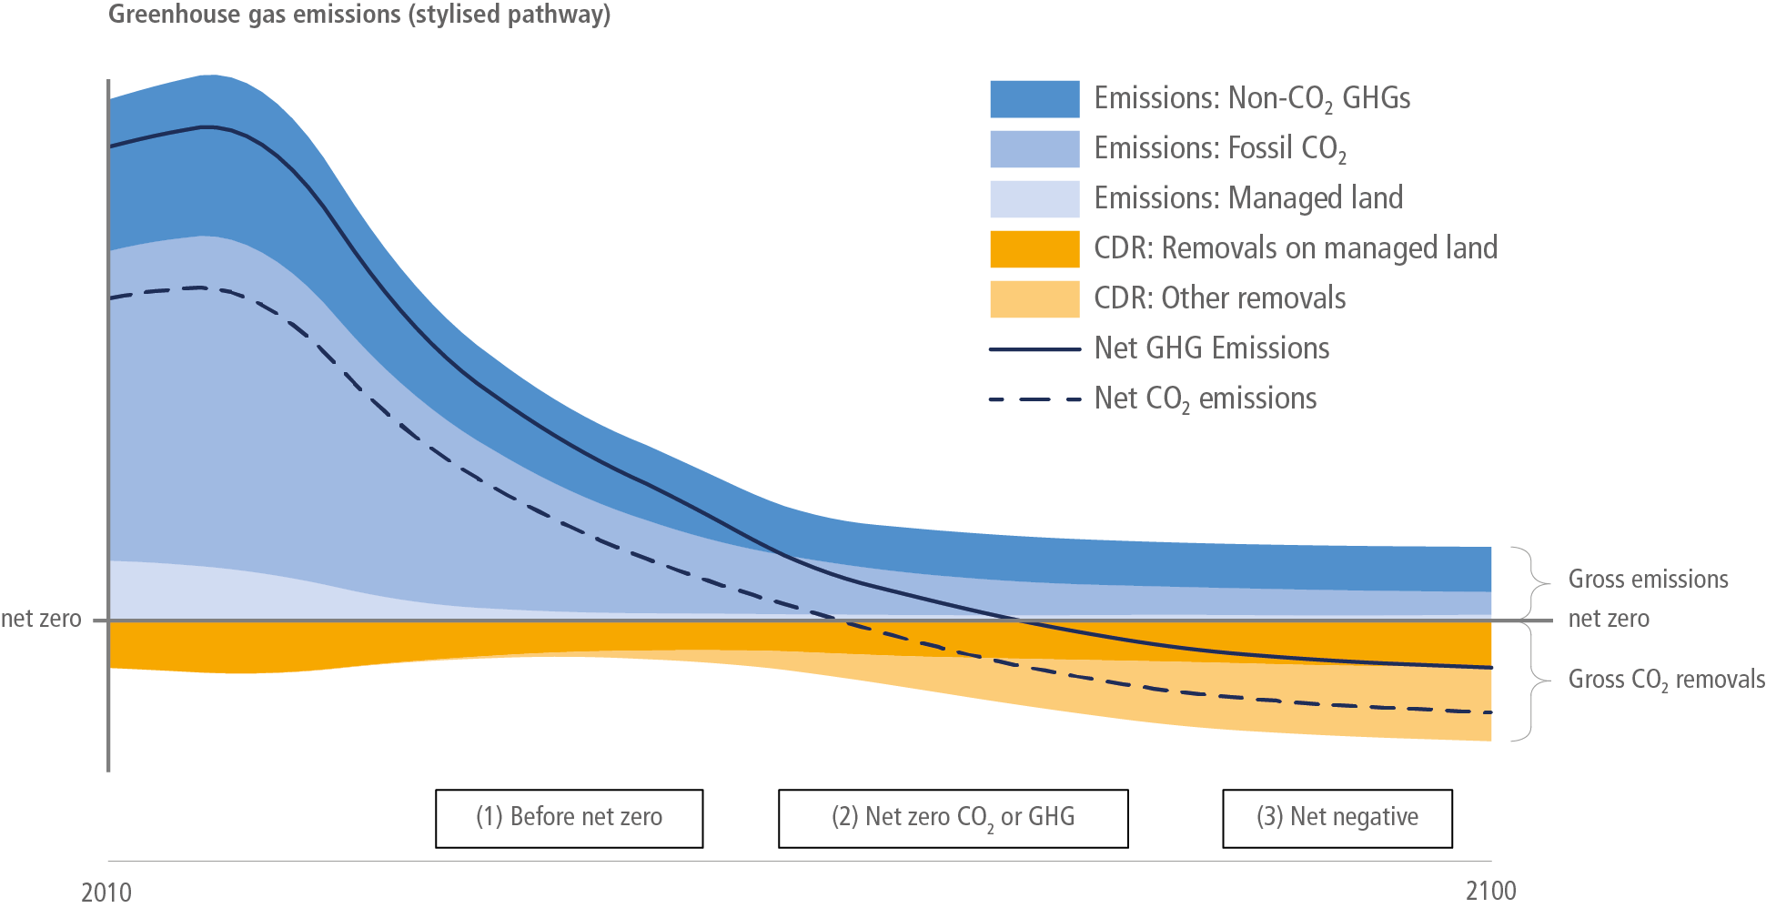
Carbon dioxide removal: a planetary-scale engineering problem
NET CO₂ EMISSIONS (GT CO₂/YR)
DURABLE CDR APPROACHES
Direct Air Capture (DACS)
Bioenergy and CCS (BECCS)
Mineralization
Biochar
Enhanced Weathering
Ocean Alkalinity Enhancement
+40
100–300 Gt CO₂ removal required this century
this talk
+20
IPCC 2018, Summary for Policymakers
AR6 pathways to limiting warming to 1.5˚C
DURABLE: ca. 1,000 yr
Notes:
Because carbon removal is the only way to achieve the temperature goals of the Paris Agreement.
According to the IPCC, the Paris Agreement targets require somewhere between 100 and 300 gigatons of carbon dioxide removal this century to achieve 1.5 to 2C . That's planetary-scale engineering. It is an industry that is bigger than anything that exists today. It is also fundamentally a porous media problem.
And the modifier that matters most is "durable" — by which we mean storage on the order of a thousand years or longer. There's a portfolio of durable approaches — direct air capture, BECCS, biochar, mineralization, ocean alkalinity, enhanced weathering. I'm going to focus on enhanced weathering, but most of what I'll say applies to open-systems CDR any soil-based approach."

Slide 3
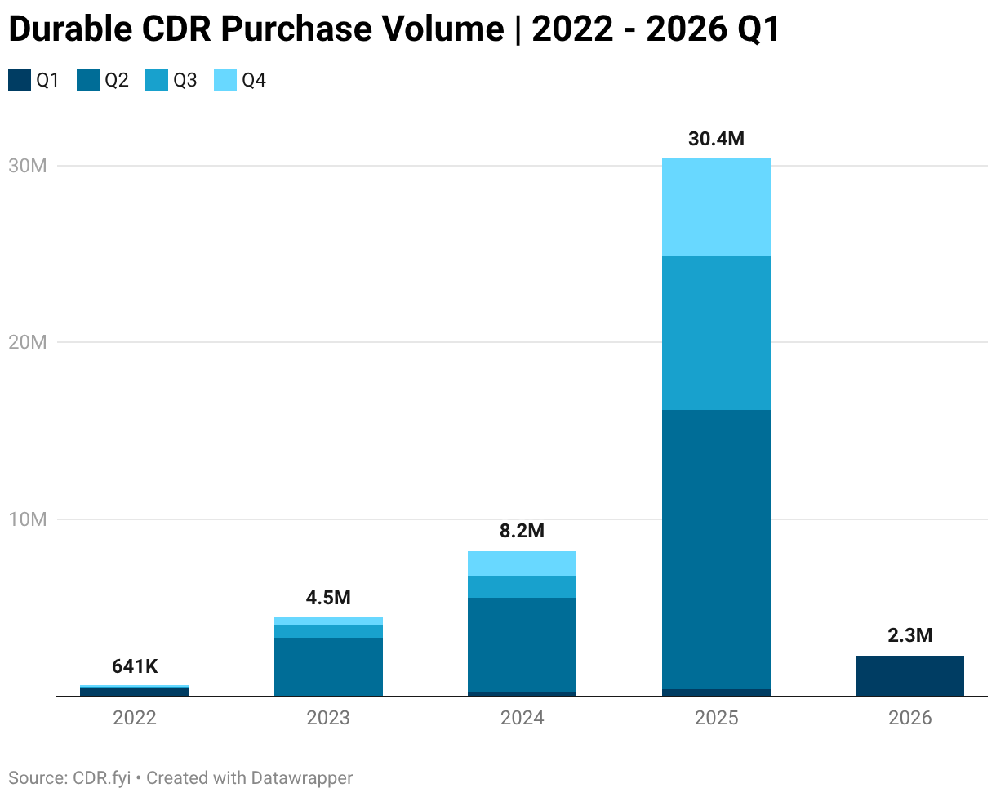
The Voluntary Carbon Market 2.0 (VCM): durable CDR
LOGIC: 1 ton of carbon removed → 1 carbon credit → 1 ton claim against the atmosphere
MEASUREMENT, REPORTING AND VERIFICATION (MRV):
framework used to quantify, document, and validate a carbon removal credit
Direct Air Capture (DACS) | Bioenergy and CCS (BECCS) | Biochar | Mineralization |Enhanced Weathering | Ocean Alkalinity Enhancement
DURABLE: ca. 1,000 yr
Notes:
Our current plan to achieve our CDR requirements is to use carbon markets. Currently these are voluntary markets, with very little durable CDR allowed in compliance markets, Ca/Wa cap-n-invest or EU ETS.
The original voluntary market came out of Kyoto. It collapsed in credibility around 2022 when investigative reporting by the Guardian showed many forestry credits were overstated or even fraudulent. So VCM 2.0 was born to separate out high-quality, durable removals — and that's the part of the market that's grown. The mechanism that makes a credit defensible is MRV: measurement, reporting, and verification.
MRV is the bridge between what happens in a soil and what shows up as a tradeable ton. That bridge is the subject of my talk.

Slide 4
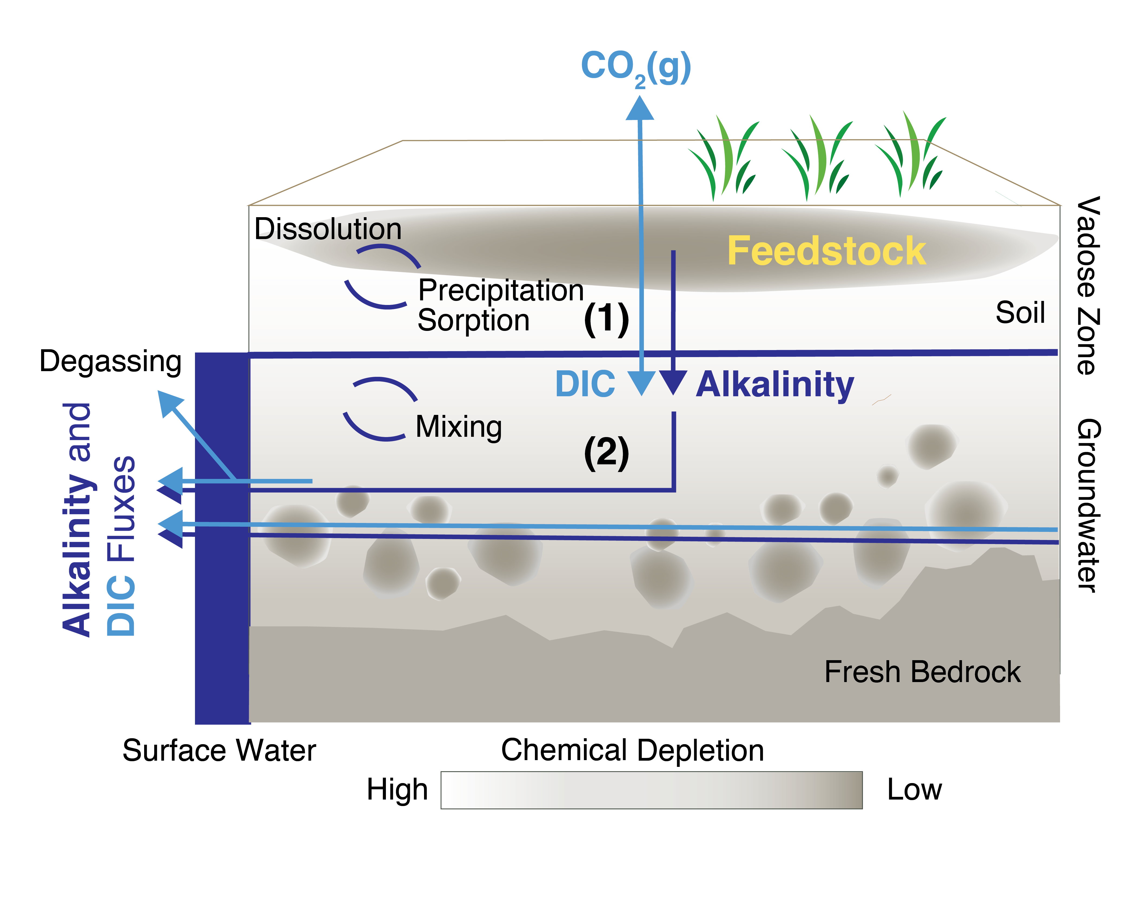
Enhanced weathering (EW): addition of alkaline material to soil
͍
CaSiO₃ + CO₂ CaCO₃ + SiO₂
Urey, 1952
(1) Feedstock dissolves in soil and produces alkalinity
(2) Export of added alkalinity to the ocean results in storage of CO₂ as DIC ca. >~1,000 years
(3) CaCO₃ forms over ca. 10,000 yr timescales
DIC: Dissolved Inorganic Carbon
credits are issued on measured DIC in upper 25 cm, with additional subtractions for downstream losses
Notes:
Let’s start with the basics of EW. Enhanced weathering is 3 stepps:
We apply a silicate mineral to soil where it dissolves and produces alkalinity. We call this near-field zone.
That alkalinity enters downstream waters – groundwater, streams and estuaries and once it enters the ocean, where it increases the levels of DIC. This is where we consider removal to meet the threshold of ”durable removal”
Eventually,a CaCO3 precipitates, removes 1/2 the DIC as caco3.
Today's credits are issued on measured DIC in the upper 25 cm of soil — the near-field zone — with subtractions for assumed downstream losses. Hold onto that — it's going to matter."

Slide 5
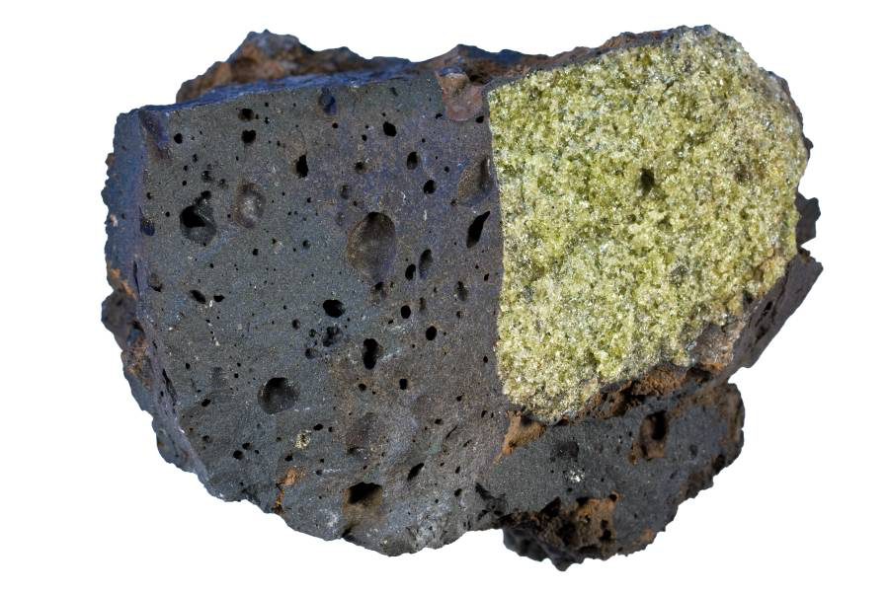
Hawai’ian basalt with olivine xenolith
Plagioclase (CaAl₂Si₂O₈)
Olivine (Mg₂SiO₄)
10x reactivity
More mining + milling
More transport
PERIDOTITE
(blocks of oceanic crust and upper mantle)
Mg-Fe-Silicates
BASALTIC MATERIAL
Ca-Mg-Al-Silicates
8% of Continents
Much of seafloor
Notes:
Two end-members of feedstock
Olivine is 10× more reactive but harder to mine
Quick word on materials. The two end-members are basaltic plagioclase — calcium-magnesium silicates, 8% of continents — and olivine, from peridotites. Olivine is about ten times more reactive but requires more mining and transport. Most of the field deploys basalt; the academic literature loves olivine.

Slide 6
We will use alkalinity as the currency to track EW effectiveness
Flux accounting where the atmospheric reservoir is the reference frame
atmosphere
soil
ocean
CO₂ Conversion
Production of ALK
Feedstock dissolution rates and surface area
Soil Storage
ALK impairment by soil processes
Credible CDR
Export of ALK via River
Ocean DIC equilibration
1,000 yrs
losses
storage
Impairment
ALK loss to soil processes
F_{loss} = 1 – Alk_{act}/Alk_{pot}
Carbonate minerals
Reduces ALK by precipitation
F_{loss} = Alk_{carb}/Alk_{act}
Marine Carbonates
10,000 yrs
Responsible crediting = lower bound of ~95% CI (conservativeness principle, IPCC)
Notes:
Throughout the talk I'm going to use alkalinity as the currency. Why? Because alkalinity is what connects feedstock dissolution to eventual ocean carbon storage it also more conservative.
We can write EW as a book keeping exercise as a supply chain of alkalinity, with a systems boundary that is the atmosphere and a gate at the ocean. Feedstock generates alkalinity, some is impaired in soil by both reverse weathering or formation of secondary minerals or by interactions with protonated clays and oxides resulting in impairment. In the river/estuary, losses can also occur via carbonate precipitation. The rest exports through rivers and equilibrates with the atmosphere in the ocean over a thousand years. The atmospheric reservoir is our reference frame — what reaches the ocean is what gets credited."
One thing I want to flag: Given that we are making a claim against the atmosphere, the lower bound of the 95% confidence interval should be the conservative target for quantification, but in reality the market is incentivized to under report uncertainty and this is a universal probelm. At the same time, you can imagine the difficult and cost of quantifying the uncertainty at percent levels across the alkalinity supply chain.

Slide 7
This sounds hard, right?
Notes:
This sounds hard, right?
Heterogeneous ag systems, multiple reservoirs with signal to noise problems, transport across kilometers, timescales from years to millennia and we need uncertainty quantification at percent levels. And it is hard.
But here's why people are willing to push through the hard.

Slide 8
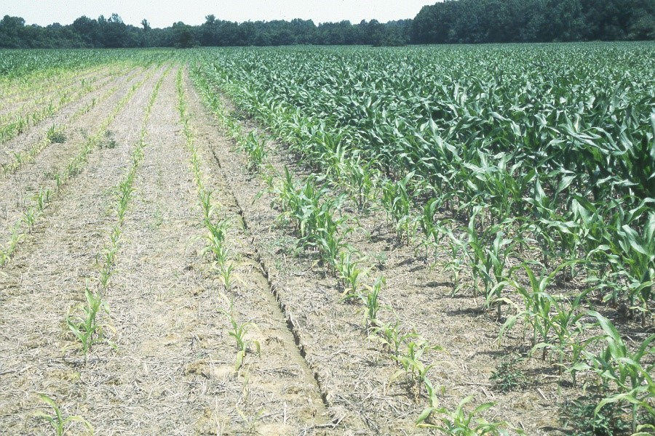
Potential
co-benefits
~$4–9B yr⁻¹ in gross maize value
Revenue and yield increases on small holder farms
CORN ON ACID
pH 4.3
Aluminum and manganese toxicity
Phosphorous and molybdenum lock-up
Poor nitrogen uptake / reduced nitrogen fixation
Reduced costs of inputs to farms.
Photo form Mississippi State University, Lary Oldham
Notes:
Co-benefits.
This is corn on acid
Aluminum toxicity, phosphorus lock-up, poor nitrogen fixation — it's a yield disaster.
Globally, the cost of soil acidity to maize alone runs $4 to 9 billion a year, and the burden falls hardest on small-holder farms with the least access to lime.
When you add rock to soil, it can increase pH – we have been adding lime to soils for decades. So enhanced weathering carries a real agronomic promise: it's pH amendment that also sequesters carbon.
a double bottom line
The co-benefits are real. But if we get the MRV wrong, we either emit CO₂ while crediting removal, or we lock up capital that could fund more durable approaches. The cost of getting this wrong is asymmetric. So I want to circle back to the EW market as a corner within the VCM2.0.

Slide 9
The market evolves more quickly than the science
Beerling et al., 2020, Nature
Model projects
Global EW of 0.5 to 2 Gt CO₂/yr
Frontier Climate launches
(Stripe, Alphabet, Shopify, Meta, etc. commit $1B US to CDR purchases)
First offtake contracts
Lithos Carbon, UNDO, Eion begin commercial operations
First Verified EW removals
InPlanet by Isometric
X-prize $50M
Mati Carbon
Lithos by Puro.earth Delivery (5kt)
First peer-reviewed field trials
0 to >10 t CO₂e/ha
2020
2022
2024
2026
<30 ktons verified, >750 kt contracted
$300M+ IN FUNDING ACROSS ALL SOURCES
$230 TO $400 PER TCO₂E OFFTAKE AGREEMENTS
MODELS TO DECREASE MRV PRICE
Notes:
The history here is important.
Beerling – first capacity esitimate followed by similar numbers for the US Nat Academy and EU.
We went from an idea in a paper to credit issuance in about the lifetime of a PhD student. So it's unsurprising that the science has lagged the market. Six years is not enough time to resolve foundational scientific questions.

Slide 10
The market evolves more quickly than the science
Beerling et al., 2020, Nature
Model projects
Global EW of 0.5 to 2 Gt CO₂/yr
Frontier Climate launches
(Stripe, Alphabet, Shopify, Meta, etc. commit $1B US to CDR purchases)
First offtake contracts
Lithos Carbon, UNDO, Eion begin commercial operations
First Verified EW removals
InPlanet by Isometric
X-prize $50M
Mati Carbon
Lithos by Puro.earth Delivery (5kt)
First peer-reviewed field trials
0 to >10 t CO₂e/ha
2020
2022
2024
2026
MAJOR QUESTIONS
Measurability (MRV)?
Global Capacity?
Governance?
https://carbonplan.org/blog/lithos-first-issuance
Notes:
In particular, both the first peer-reviewed field trials followed by several recent deliveries > 5 tCo2/ha/yr have raised real questions about the MRV, as well as whether these original projections were reasonable.
We wrote a blog post about this at CarbonPlan highlighting our concerns about both high CDR claims and lack of transparency in the market.
All of this market exuberance combined with time for the scientific community to digest and activate has led to major questions:
Can we actually measure this — is MRV viable? Is the global capacity what the models say? And — perhaps most importantly — how is the science being governed?
You might think this is a translational problem. That we know how to do the science, and we just need to operationalize it. That the heuristics and conservatism we apply when we move from research to deployment are the translational challenge. And that's partly true.
But only partly. Because when you actually look at where MRV is struggling, where capacity estimates diverge, where models can't be benchmarked — what you find is that we're hitting up against scientific challenges that this community has been wrestling with for decades. Not implementation gaps. Real, unresolved science.

Slide 11



US DOE Basic Energy Sciences, 2007
National Academy of Sciences, 2008
US DOE Biological/Environmental Research, 2015
2000s Research “Grand Challenges” highlight the numerous challenges in subsurface reactive transport
Notes:
The scientific challenges enhanced weathering is hitting are not new. They're the same challenges this community wrote up as Grand Challenges in the 2000s

Slide 12
The market is operating at a level of confidence that exceeds the scientific consensus
Why do mineral reaction rates differ by orders of magnitude between the laboratory and the field — and can field rates be predicted a priori?
Lab-field discrepancy
How does the complexity of natural mineral-water interfaces govern reactivity in porous media?
Reactive surfaces in complex porous media
How do we upscale from pore-scale processes to continuum predictions in heterogeneous, multiphysics systems?
Pore-to-continuum upscaling
Can mechanistic models be made fit-for-purpose for quantitative decision-making under irreducible uncertainty?
Predictive uncertainty quantification
Notes:
KEY POINTS
I called out a few here: lab-field rate discrepancy, reactive surfaces, upscaling, predictive uncertainty.
Here's the tension is in these novel CDR pathways. The carbon market wants exceptional answers — projects that deliver verified, durable, defensible removals. The scientific community knows that these four questions are still open, that they may stay open for some time, and that the heuristics we apply in the meantime are real and valid — they're not gaps to be papered over.
In short, the market is operating at a level of confidence the science cannot yet support. I'll come back to that at the end.

Slide 13
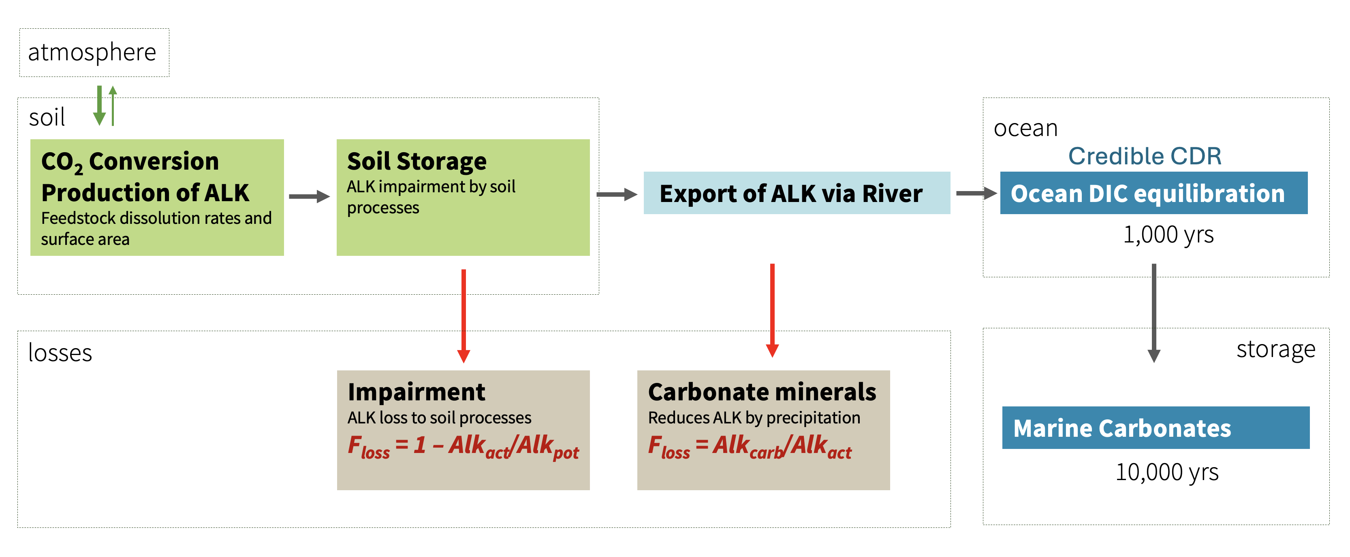
Enhanced weathering as a case study in CDR deployment
Alkalinity accounting framework
PART 1: The “Supply Side ” How much dissolution is actually happening?
PART 2: “Export Side”
Does alkalinity get out of the soil?
CONCLUSION: MRV and Model governance
What does credible carbon accounting require?
Notes:
Roadmap slide
I'm going to structure the rest of the talk in two parts and a conclusion.
Part one — the supply side. How much dissolution is actually happening?
Part two — the export side. Does the alkalinity get out of the soil?
And then we'll close with MRV and model governance. What does credible carbon accounting actually require?"

Slide 14
Hawaii basalt with xenolith
Plagioclase (CaAl₂Si₂O₈)
Olivine (Mg₂SiO₄)
10x reactivity
More mining + milling
More transport
PERIDOTITE
(blocks of oceanic crust and upper mantle)
Mg-Fe-Silicates
BASALTIC MATERIAL
Ca-Mg-Silicates
8% of Continents
Much of seafloor
Notes:
Quick recap: Crushed and applied at 10 t/hectare resulting in about 1% mass enrichment in soils.

Slide 15
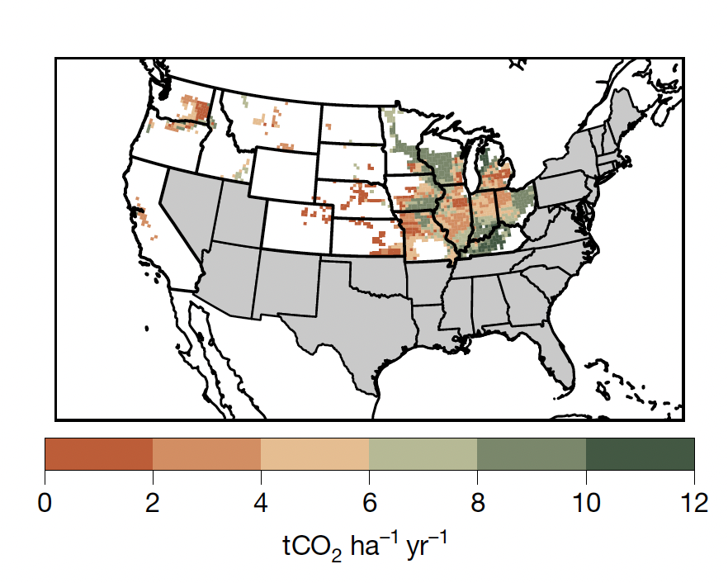
Model projections suggest implausible solute generation and export
Cropland capacity: 0.5 to 2 Gt CO₂e/yr total
(Beerling et al., 2020, Nature)
40 t/ha basalt = 1.2% mass in 25 cm
This requires extremely efficient solute generation and export:
surface areas 1000 x geometric
~ 25 mM HCO₃⁻
Water fluxes (>1 m/yr)
~5 tCO₂/ha/yr
Integrated assessment models adopt this scaling, even though it seems physically implausible
Model simulations using reduced-order RTM approach suggest considerable potential for CDR in major agricultural regions (Beerling et al., 2020).
Notes:
Here's where it started.
Beerling and colleagues used a reduced-order RTM and projected about 2 to 10 – we will give a median of 5 tons per hectare per year of CDR potential across the US corn belt.
The map looks compelling. But to get to those rates, you need
surface areas ~1000 times geometric,
you need bicarbonate concentrations about 20x background (25 mM)
Or water water fluxes greater than a meter a year.
Each one of those is on the edge of physical plausibility. Together, they're a stretch. And yet integrated assessment models have adopted this scaling. So that's the model expectation. Now let me show you what nature actually does.

Slide 16

We analyzed alkalinity (HCO₃) export from major volcanic watersheds
Cumulative reactive surface area >>> EW deployment
(Derry, Maher and Chadwick, in press,)
Earth.com
Notes:
To contextualize this rates, we pulled together alkalinity flux data from major volcanic watersheds globally — Pacific Northwest basalts, Kamchatka, Guadeloupe, the Philippines, Iceland, Hawai'i. These are nature's experiment in basaltic enhanced weathering: fresh rock, real soils, real hydrology, integrated over watersheds. Most of these systems cluster at 0.2 to 0.3 tons CO₂ per hectare per year. Even the Philippines — fresh tropical arc volcanism, high rainfall — averages about one

Slide 17
We analyzed alkalinity (HCO₃) export from major volcanic watersheds
Cumulative reactive surface area >>> EW deployment
(Derry, Maher and Chadwick, in press)
~ BEERLING ET AL. (2020)
> 5 to 20x DISCREPANCY
95% OF BASALTIC WATERSHEDS
HIGH INPUTS OF FRESH ROCK
GLOBAL BASALTIC MEDIAN
Notes:
Now let me overlay the Beerling projection — about 5 tons per hectare per year. The gap between what models project and what natural analogues deliver is somewhere between 5- and 20-fold. This is exactly the lab-field rate discrepancy from the Grand Challenges, except it's now playing out at watershed scale and informing substantial markets

Slide 18
What is causing this discrepancy between model projections and natural analogues?
Lab-field discrepancy
Enhanced weathering is more efficient at generating solutes?
Substantial subsurface and riverine alkalinity losses?
Other
Reactive surfaces in complex porous media
Notes:
What could explain that gap? Several candidates.
Enhanced weathering really is more efficient at generating solutes than natural weathering – surface reactivity enhancement, emplacement in shallow soil
Or there are substantial subsurface and riverine alkalinity losses that the models aren't capturing.
When we looked in detail at the approaches used to compute reactive surface area, we noticed a problem.

Slide 19
What is causing this discrepancy between model projections and natural analogues?
Lab-field discrepancy
Enhanced weathering is more efficient at generating solutes?
Substantial subsurface and riverine alkalinity losses?
Other
Reactive surfaces in complex porous media
Pore-to-continuum upscaling
Lab-field discrepancy
Reactive surfaces in complex porous media
Predictive uncertainty quantification
Notes:
What could explain that gap? Several candidates.
Enhanced weathering really is more efficient at generating solutes than natural weathering – surface reactivity enhancement, emplacement in shallow soil
Or there are substantial subsurface and riverine alkalinity losses that the models aren't capturing.
Here there is something else going on

Slide 20
The main reason models are over predicting CDR_{pot}?
A misapplied interpretation of a reactive surface area argument…
Fractal surface roughness scaling of gas sorption surface areas
Model reactive surface areas that are ~20 to 200x geometric
Favors coarser grain sizes
Never verified experimentally
Earth and Planetary Science Letters, 2007
Basalt weathering across scales
Alexis Navarre-Sitchler
Susan Brantley
coarse → short L
14 studies and 6 bespoke EW models now contain this numerical representation
fine → long L
https://carbonplan.org/research/modeling-bytes-02-roughness
Notes:
The main reason model projections are running so high comes down to one parameter — the reactive surface area of the crushed rock. But, it is also clear that aspects of all them are at work.
Models start from assuming a spherical grain, then multiply by a roughness factor, lambda, to account for the fact that real grains aren't smooth. The question is what lambda should be.
In 2007, Navarre-Sitchler and Brantley proposed a fractal scaling framework — partly to address the lab-field rate discrepancy, partly to handle pore-to-continuum upscaling for reactive surfaces in real porous media across 12 orders of magnitude. It was ambitions but careful
This equation was adapted and misapplied in these early EW papers — they let lambda scale with grain radius, which the original framework didn't support. The result is reactive surface areas that can be 20 to 200 times higher than what observations of fresh, ground mineral surfaces actually support.
The deeper failure is that we now have fourteen studies and six bespoke EW models that inherited this treatment, without benchmarking, with out uncertainty bounds.
So this isn't a story about one paper. It's a story about four unresolved Grand Challenges converging in a single parameterization, and a market system that hasn't built the scaffolding to catch it. That's the diagnosis. And it's why the closing of this talk is going to be about governance as much as science.

Slide 21
Enhanced weathering as a case study in CDR deployment
PART 1: The “Supply Side ” How much dissolution is actually happening?
Less than policy makers and investors anticipated
PART 2: “Export Side”
Does alkalinity get out of the soil?
CONCLUSION: MRV and Model governance
What does credible carbon accounting require?
Notes:
Roadmap slide
So Part 1 — the supply side. How much dissolution is actually happening? Less than policy makers and investors anticipated. Probably not zero, but somewhere between 5 and 20 times less than headline projections — and a big part of that gap comes from a parameterization choice. That's the supply side. Now let's see what happens to the alkalinity does get generated."
Let me start with another real-world analogue..

Slide 22
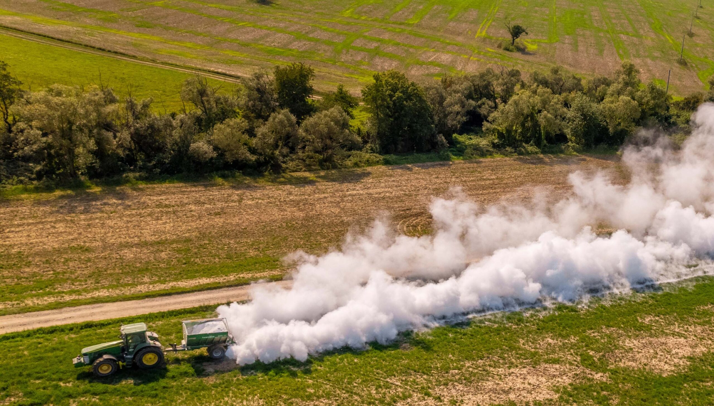
AGRICULTURAL LIME ”AG LIME” USED TO INCREASE SOIL PH
Highly net CO₂ emitting
CO₂(g)
CaCO₃
HCO₃⁻
Life And Land magazine
Notes:
This is agricultural lime — limestone, calcite — spread on fields to raise pH. It's been used for over a century. While it does treat amended soil, ag lime is a net CO₂ source.
The carbonate dissolves, but in acidic soils the bicarbonate gets re-protonated and degasses as CO₂.
We also know that certain soils, particular deeply weathered soils with a high abundance of oxides, tend to “resist” the pH change. Effectively, the soils buffer the pH.

Slide 23
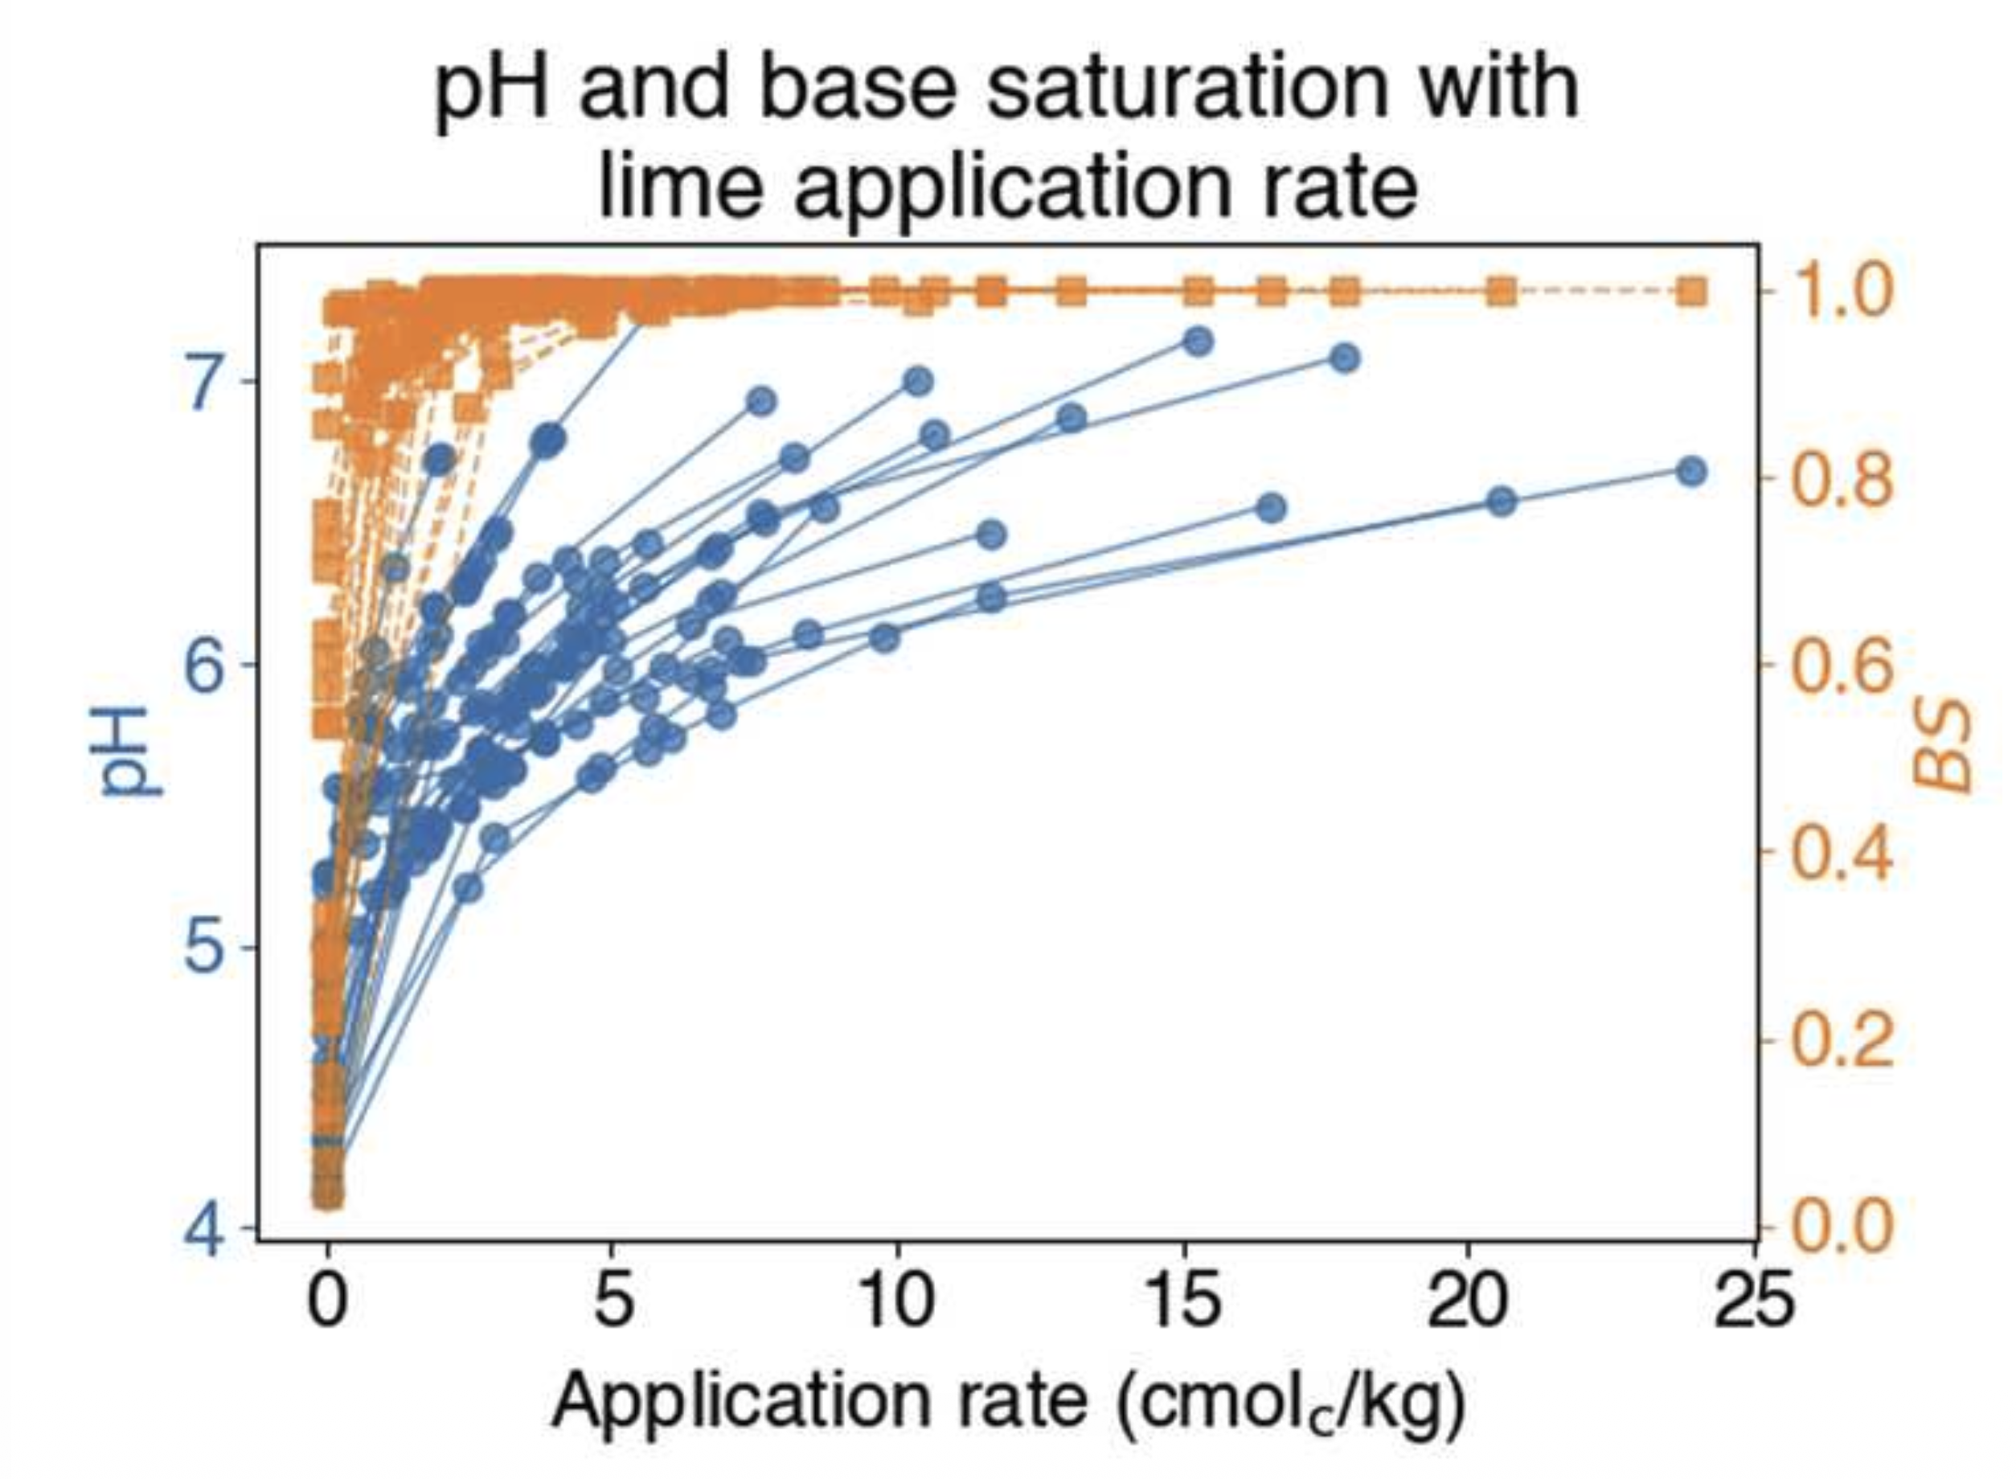
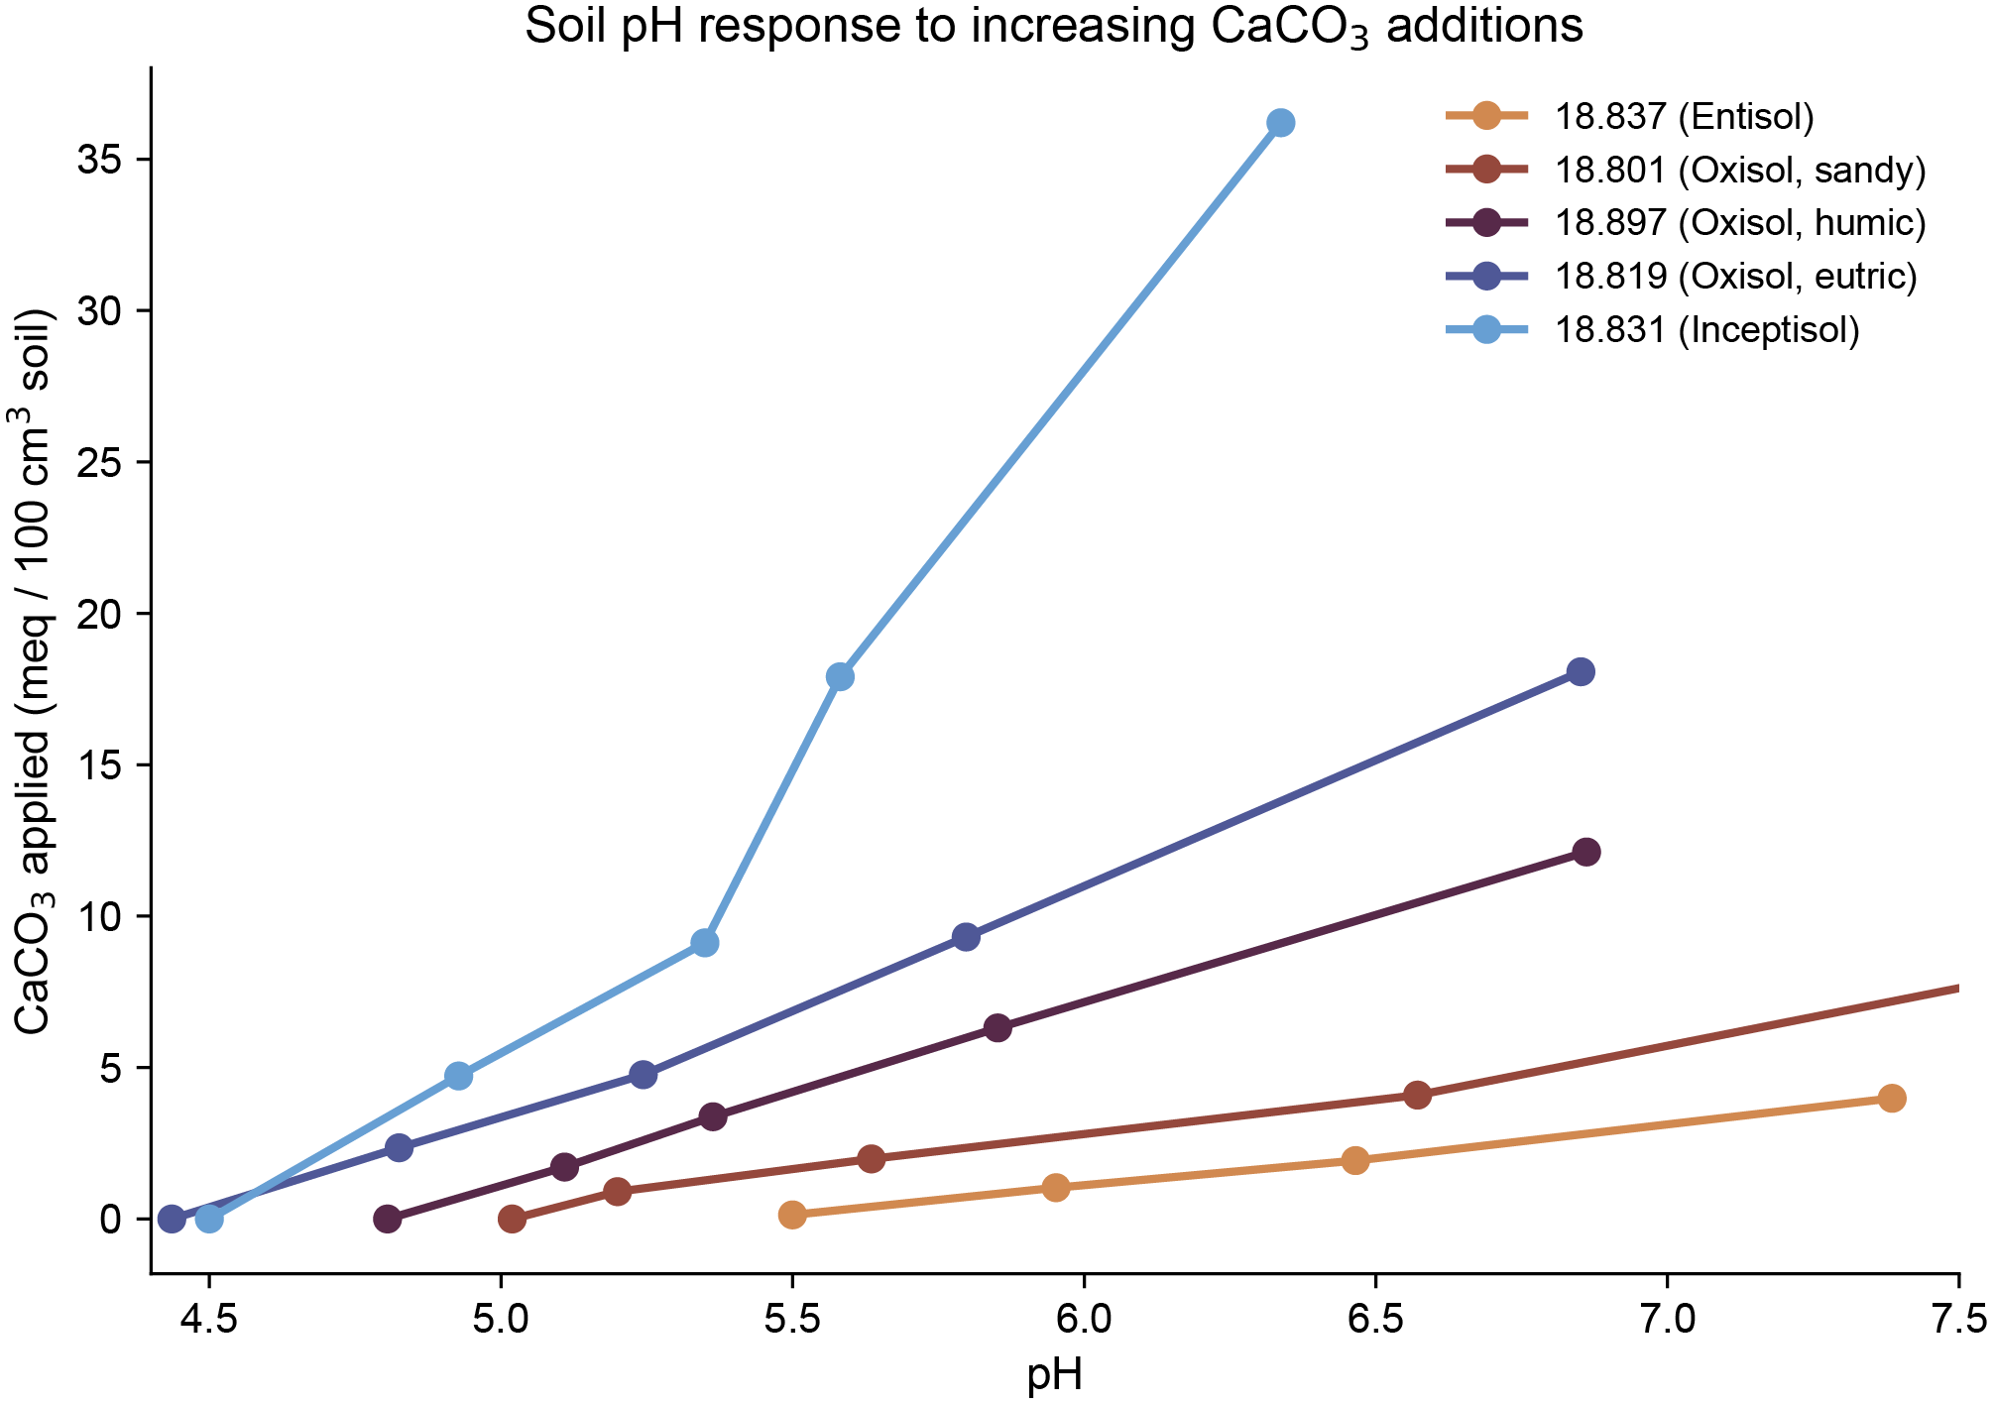
The soil is not a passive conduit: how much do natural surfaces limit alkalinity export from weathering zone?
Rogers and Maher, in review
We don’t yet have models for this behavior because most of the work on soil buffering was in applied agronomic settings.
Base Saturation
Notes:
Here is an example of what that looks like.
The blue is showing pH response and the organge is base saturation – or the fraction of base cations in the overall exchange pool – what you see is some soils require substantial alkalinity addition – upwards of 20 tons/ha to achieve the same pH as other soils that require closer to 1 or 2 tons. This is surface buffering.
The agronomic community has known this for 100 years, but of course farmers need tables not RTMs, so the soil and go community largely developed ad hoc operational descriptions – buffers and incubations - to create regional emiprical “lime requirements”. There isn’t a unified mechanistic explanation let alone a numerical representation.

Slide 24
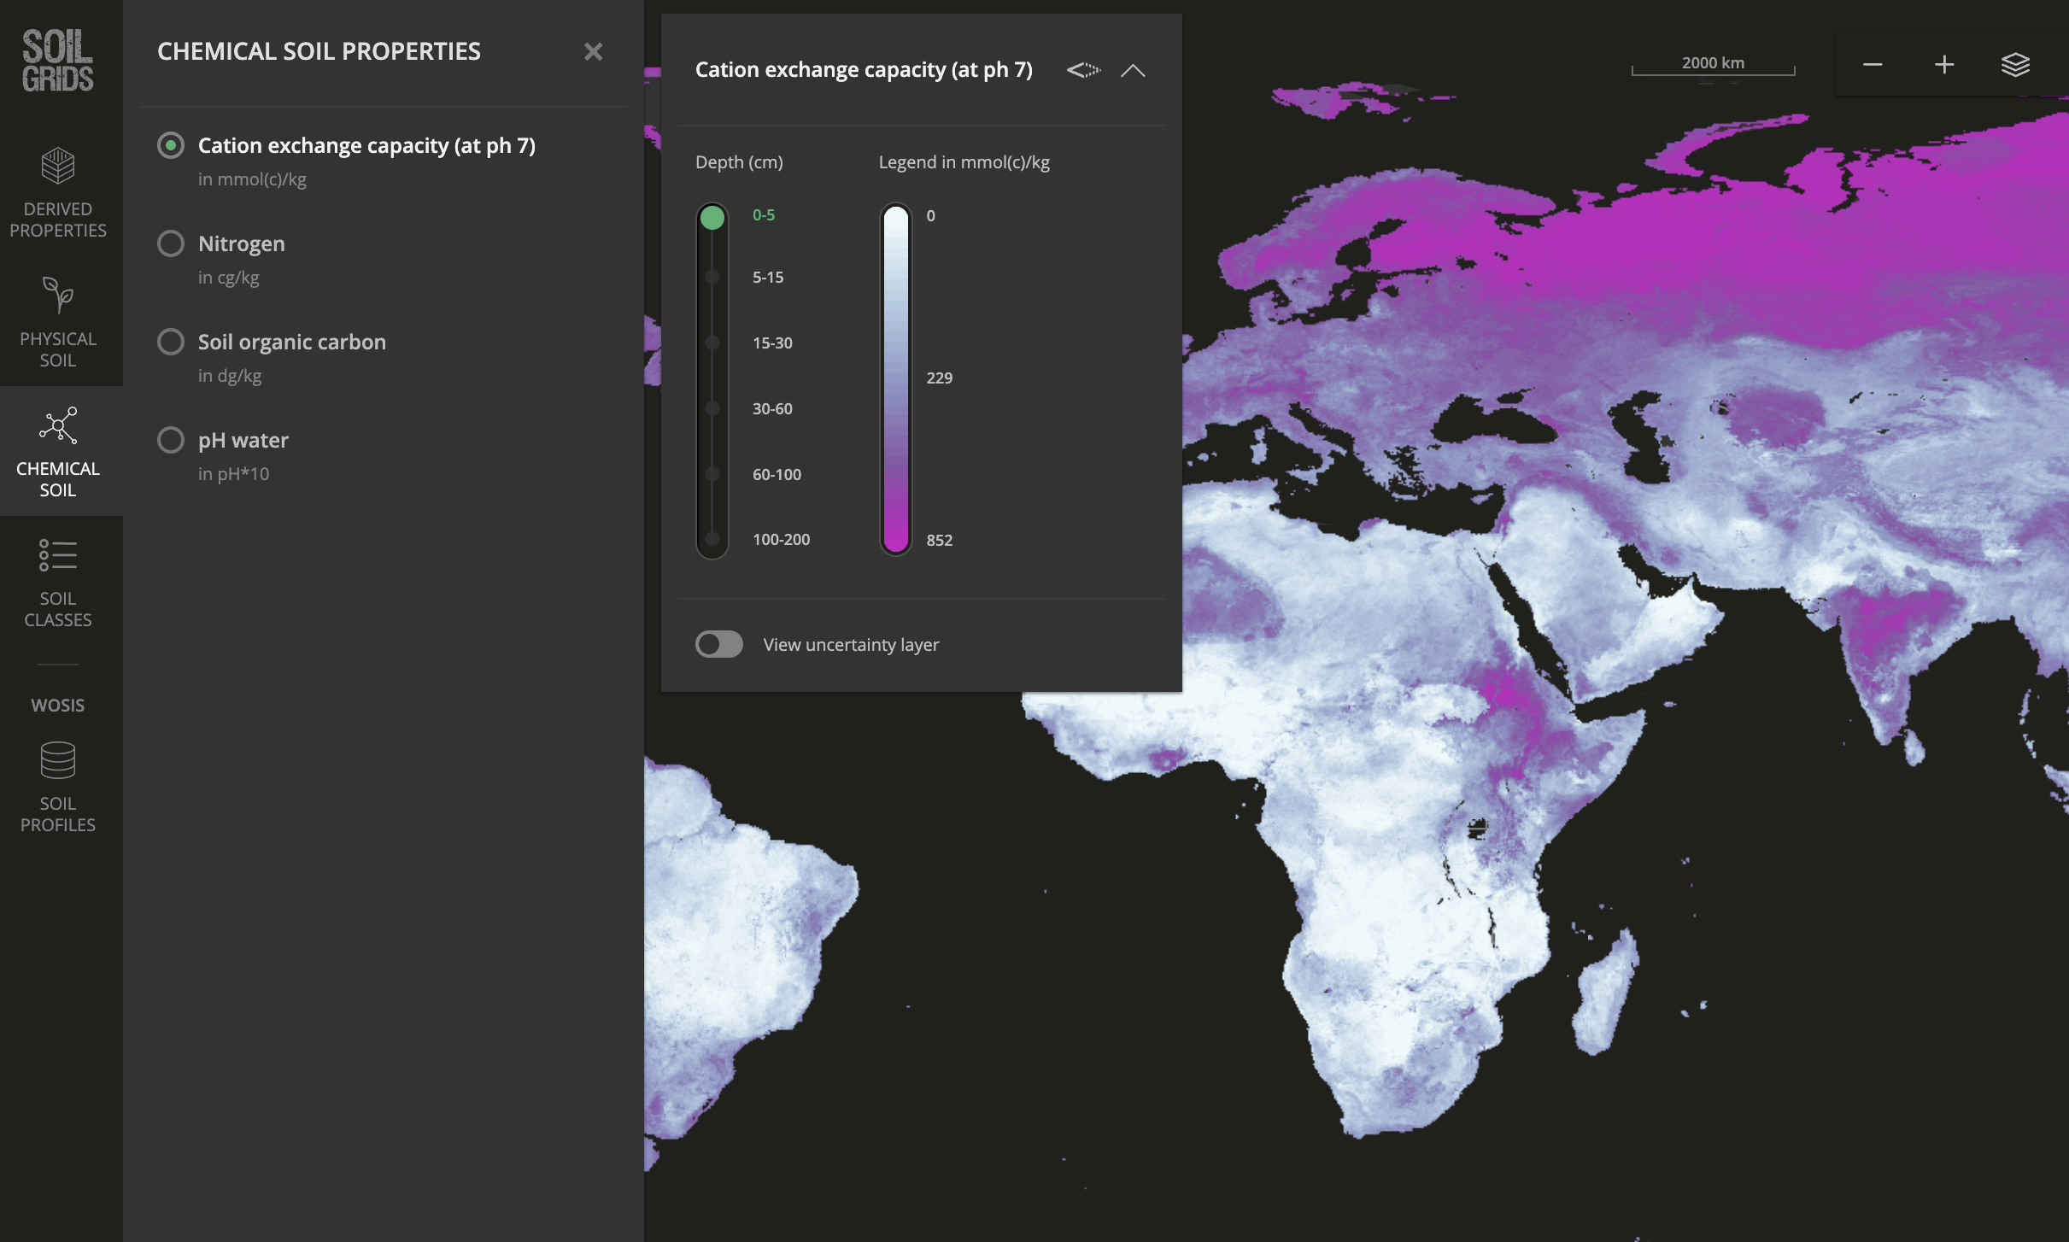
“Operational” Cation Exchange Capacity (CEC @ pH 7) insufficient to capture the proton dynamics that matter for alkalinity
Notes:
There is also a data problem.
When you go look at global soil databases, you can pull cation exchange capacity at pH 7 — beautiful maps, every soil property covered.
The problem is that the operational CEC measurement at pH7 conflates two chemically distinct reservoirs of surface acidity. And only one of them consumes alkalinity when you raise the pH. So the standard measurement is insufficient for what we need to know for a basic assessment of alkalinity neutralization

Slide 25
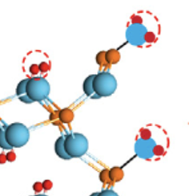
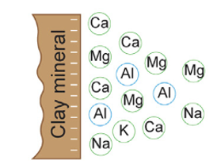
Multiple reservoirs of surface acidity, multiple scientific rules
SPR: Surface Proton Reservoir
Anions
Metals
Inner-sphere complexes
Protonated surfaces
>SOH₂⁺, >SOH⁰
Deprotonated surfaces
>SO-, >SO-cations
0-~20 meq/100g
EA: Exchangeable Acidity
Outer-sphere complexes
Exchangeable Acidity
Aluminum>>H+
Exchangeable Base Cations (Ca, Mg, Na, K)
0-~20 meq/100g
4.5
5.5
6.5
7.0
Soil pH
Notes:
Let me explain. Soil surface acidity lives in two distinct pools.
The bottom one — the green — is outer-sphere exchange. These are permanent charge sites occupied by cations: base cations like calcium, magnesium, sodium, potassium on one side, exchangeable acidity dominated by aluminum on the other. This is the classical cation exchange picture from soil chemistry.
The top one — in teal — is something different. These are pH-dependent inner-sphere sites: protonated surfaces that deprotonate as pH rises, releasing protons that consume alkalinity. This is the Surface Proton Reservoir, or SPR. Each of these reservoirs can carry up to about 20 milliequivalents per hundred grams of soil. They obey different rules. They respond to amendment on different timescales. And — critically — the operational CEC at pH 7 captures parts of both, but doesn't tell you which is which."

Slide 26
New approach that integrates traditional views of surfaces
Anions
Metals
Inner-sphere complexes
Question: What is the role of the Soil Proton Reservoir (SPR) in limiting alkalinity export from soils at pH >5.5?
Protonated surfaces
>SOH₂⁺, >SOH⁰
Deprotonated surfaces
>SO-, >SO-cations
Outer-sphere complexes
Exchangeable Acidity
Aluminum>>H+
Exchangeable Base Cations (Ca, Mg, Na, K)
4.5
5.5
6.5
7.0
Soil pH
Notes:
WE built an approach to integrate these traditional views of soil surfaces— the agronomic CEC literature and the surface complexation literature from environmental chemistry — into a single, mass-balanced representation. The specific question we're asking is: what is the role of the Surface Proton Reservoir, the SPR, in limiting alkalinity export from soils at pH above 5.5? Because pH 5.5 to 7 is exactly where lime and EW operate."

Slide 27
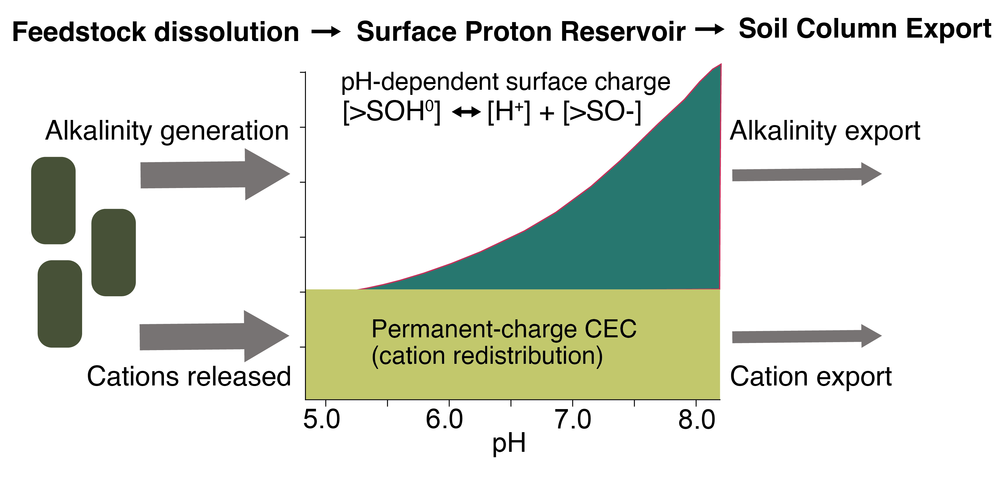
Reactive Transport Modeling: Partition surfaces according to measurements of CEC, a proxy for surface charge.
Model representation
Notes:
Effectively, this is just a surface titration.
Feedstock dissolves, generating alkalinity and releasing cations. The cations flow through the permanent-charge CEC — that's the yellow band — and they get redistributed but the alkalinity isn’t affected. The alkalinity is consumed by the pH-dependent surface charge — the teal curve — which grows as the soil pH rises. So as you push pH up from 5 toward 8, you're not just shifting cations around. You're titrating protons off the SPR, and every one of those protons neutralizes a unit of alkalinity that otherwise would have exported. That's the bookkeeping."

Slide 28
Hawaii basalt with xenolith
Plagioclase (CaAl₂Si₂O₈)
Olivine (Mg₂SiO₄)
10x reactivity
PERIDOTITE
(blocks of oceanic crust and upper mantle)
Mg-Fe-Silicates
BASALTIC MATERIAL
Ca-Mg-Silicates
8% of Continents
Much of seafloor
After crushing, 10 to 50 t/ha applied
~1% mass enrichment in soil
Notes:
In this case, we will look at calcite vs olivine -

Slide 29
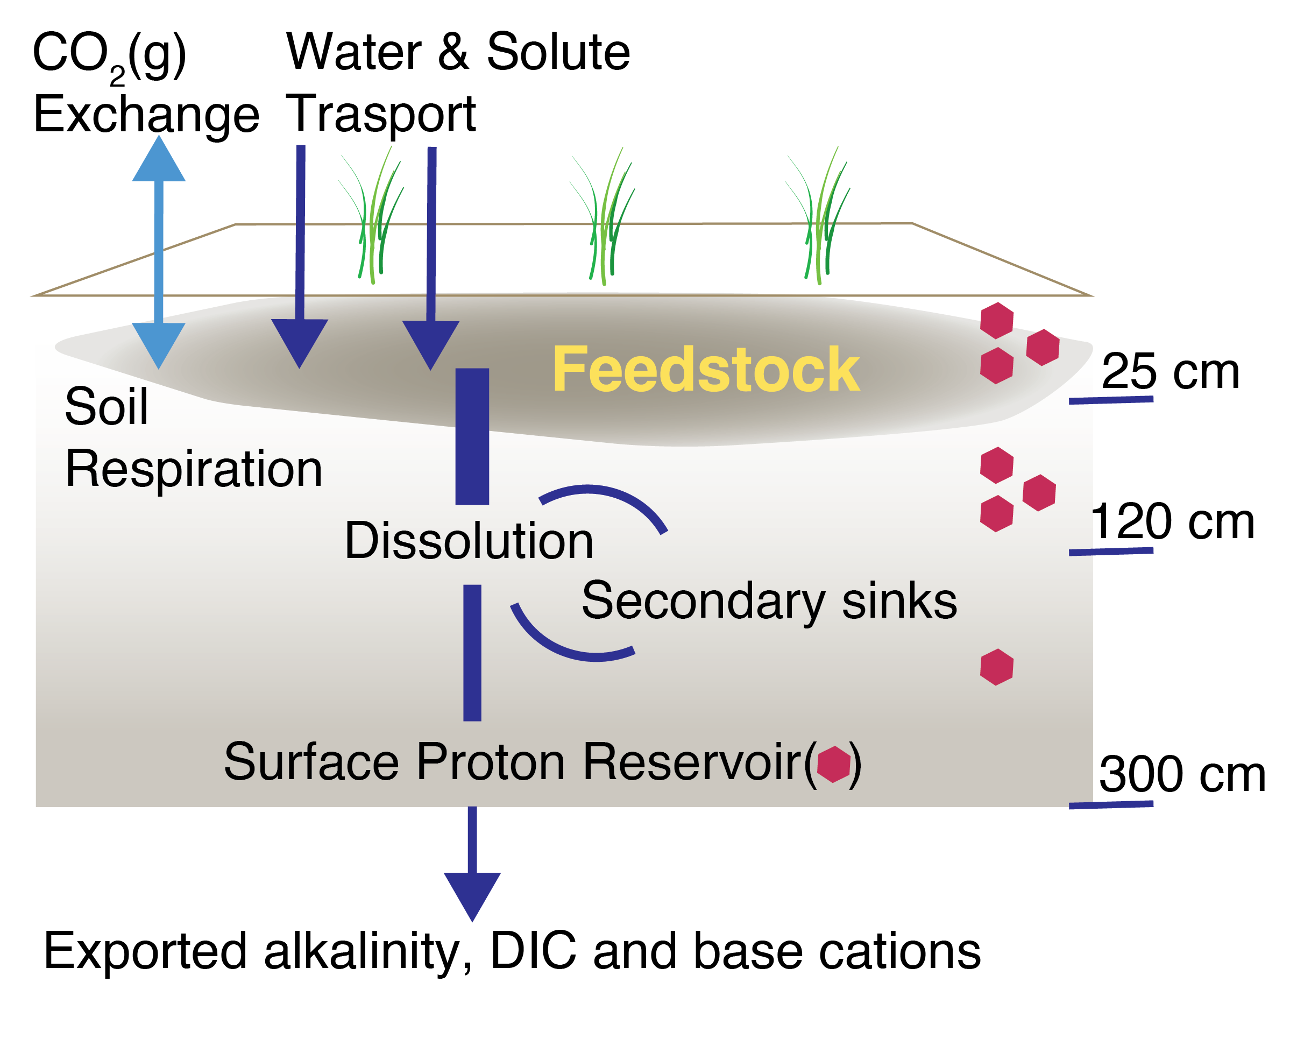
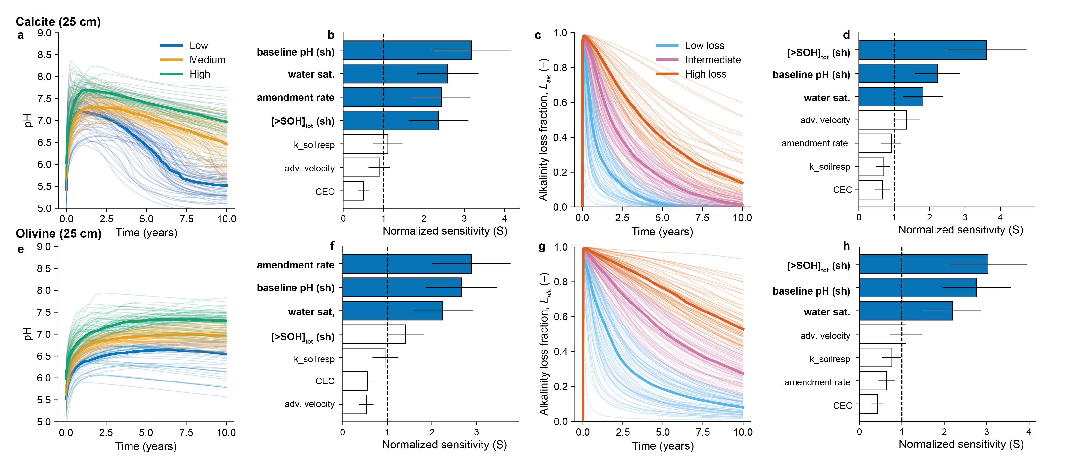
Numerical simulation + sensitivity analysis of amended mineral The pH evolution is partly controlled by amendment rate
Maher et al. in review
pH(t)
Notes:
We built this into a reactive transport model — CrunchTope —layers down to three meters.
We ran 200 simulations per feedstock — calcite and olivine — across a structured ensemble of soil and hydrologic conditions. So this is not one site; this is a virtual experiment that spans the realistic range. The pH does increase on amendment, as you'd expect. Calcite gives a sharper pulse; olivine gives a more sustained response.
But the magnitude of the pH response is partly controlled by the amendment rate, and that's already a hint that supply doesn't translate directly into outcome."

Slide 30
The pH increases, but alkalinity loss is substantial due to SPR
pH(t)
Fraction of alkalinity lost(t)
Maher et al. in review
“Recovery” of alkalinity occurs when soil reacidifies
Maintain pH vs incentivize re-acidification to recover CDR
Notes:
Here is the punchline of Part 2. Now, we will look at the fraction of alkalinity that's been lost — neutralized — as a function of time. Notice that even in the shallow soil, at 25 cm, the alkalinity loss fraction starts near 100% and only slowly declines as the SPR fills up and the soil saturates.
And — this is the paradox — the way you "recover" alkalinity in this picture is by letting the soil reacidify, which gives back some of the alkalinity to the export plane. So you have a tension built into the system: maintain pH for agronomic benefit, or reacidify to recover CDR. You can't do both."

Slide 31
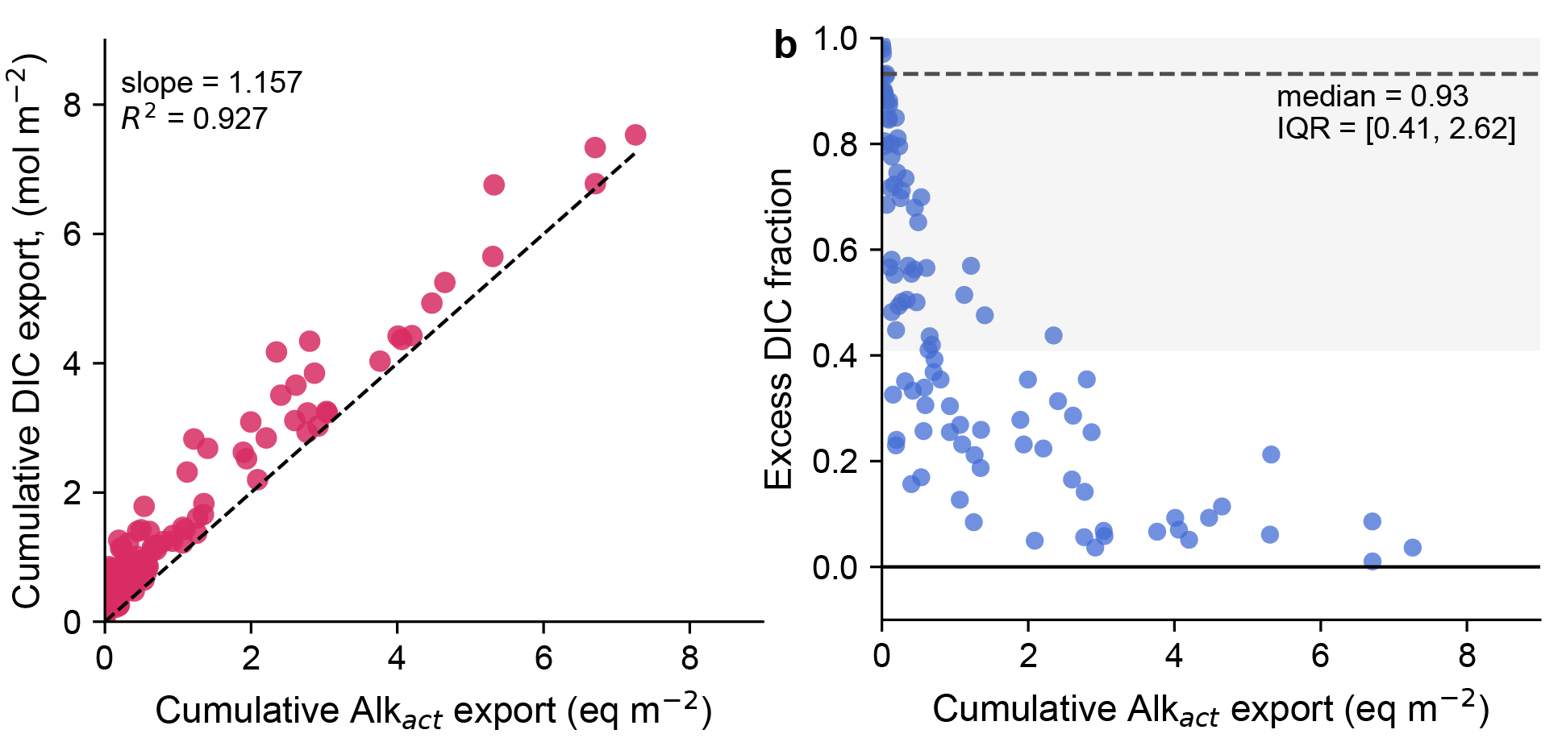
Current MRV proxies, DIC and base cations fail to track alkalinity
Maher et al. in review
High soil CO₂(g) results in excess DIC and cumulative fluxes
When water re-equilibrates with atmosphere, we overestimate actual alkalinity export
Notes:
And here's why this matters for MRV. Current credit issuance is based on shallow DIC measurements — and sometimes base cation fluxes. We took our simulation ensemble and asked: how well does DIC track actual alkalinity export at depth? The left panel — cumulative DIC against cumulative alkalinity — looks pretty good. Slope of 1.16, R² of 0.93. You could fit a line through that and feel reasonable. But the right panel shows the fractional excess: at low export rates — which is most realistic field conditions — DIC overestimates alkalinity export by a median of 93%. Almost double-counting. The reason is that soil CO₂ is enriched, so DIC accumulates without the corresponding alkalinity being durable export. When that water re-equilibrates with the atmosphere — which it must, downstream — the DIC degasses back. We've already counted it as removed."

Slide 32
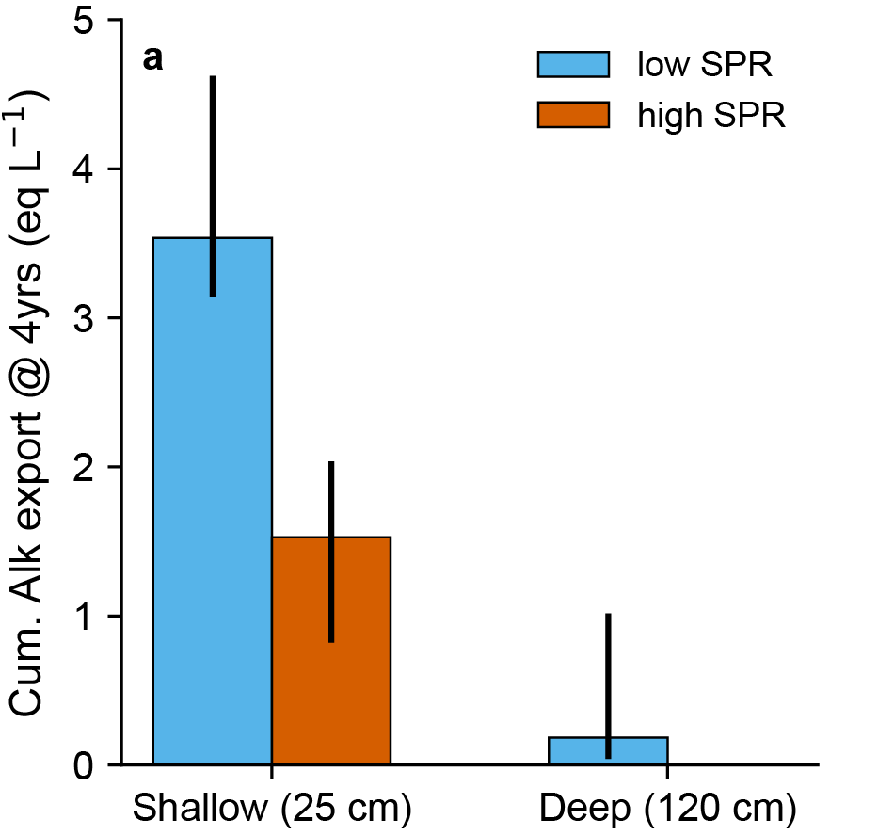
Soil acidity is a debt that EW must pay before CDR begins
Alkalinity impairment
Maher et al. in review
Sharp reaction fronts consume alkalinity via the surface proton reservoir — dynamic, depth-dependent, and exquisitely sensitive to hydrology.
MRV frameworks must be redesigned to account for alkalinity attenuation at depth
Notes:
Here's the headline result for Part 2. Soil acidity is a debt that enhanced weathering has to pay before any CDR begins. The figure shows cumulative alkalinity export at 4 years, at shallow — 25 cm — and deep — 120 cm — control planes. Even in low-SPR soils, deep export is nearly zero over four years. In high-SPR soils, deep export is essentially zero across the entire ensemble. Sharp reaction fronts consume alkalinity via the surface proton reservoir, and these fronts are dynamic, depth-dependent, and exquisitely sensitive to hydrology. The implication is that MRV frameworks built on shallow proxies — which is what the market is doing today — are not measuring durable CDR. They have to be redesigned to account for alkalinity attenuation at depth.

Slide 33
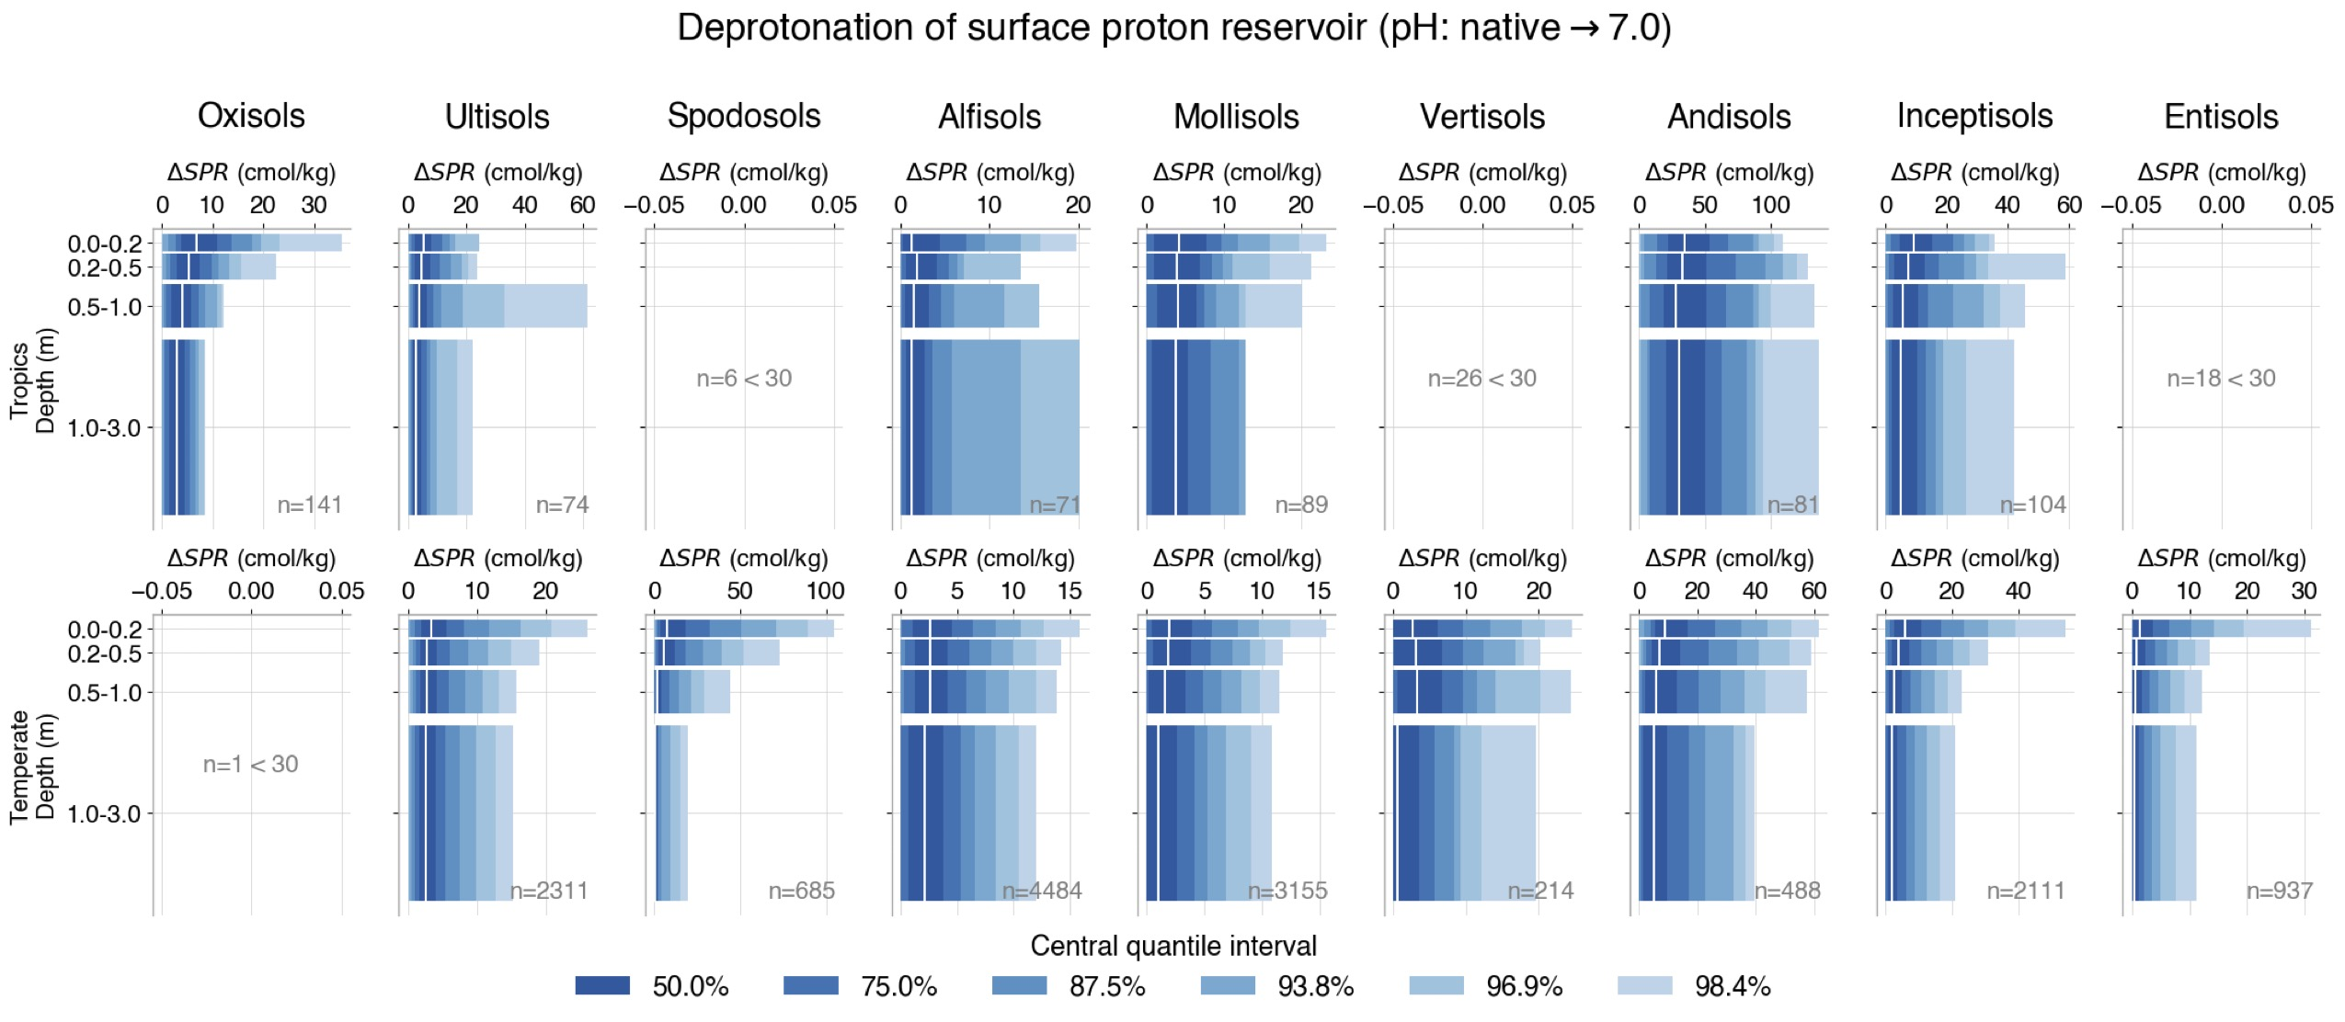
Globally, soils carry tens of t/ha of acidity Crushed rock must neutralize before any alkalinity reaches the export plane.
Rogers et al. in prep.
Notes:
And this isn't a one-site problem. Brian compiled the global SPR from soil databases, by soil order, in tropics versus temperate, depth-resolved. Look at the tropical Ultisols, Andisols, Oxisols — values up to 60, 100, even more centimoles per kilogram of proton deprotonation needed to bring those soils to pH 7. Integrated over a 1.2 meter profile, this translates to tens of tons of calcite or olivine equivalent per hectare that have to be neutralized before any alkalinity reaches the export plane. So this is a global, structural constraint on where and how EW can deliver durable CDR — not just a curiosity of one ensemble."

Slide 34
Potential
co-benefits
~$4–9B yr⁻¹ in gross maize value
Revenue and yield increases on small holder farms
That neutralization is not wasted:
it’s an enormous agronomic co-benefit
But, it should not count as CDR.
Reduced costs of inputs to farms.
Photo form Mississippi State University, Lary Oldham

Slide 35
Enhanced weathering as a case study in CDR deployment
PART 1: The “Supply Side ” How much dissolution is actually happening?
Less than policy makers and investors anticipated
PART 2: “Export Side”
Does alkalinity get out of the soil?
Sometimes. Highly ”location” dependent. EA and SPR matter.
CONCLUSION: MRV and Model governance
What does credible carbon accounting require?
Notes:
To recap. Supply side: less than policy makers anticipated. Export side: sometimes, but highly location-dependent — driven by SPR, baseline pH, and hydrology. Which brings us to the question that should worry all of us.
Remember the three questions I planted at the start — measurability, capacity, governance.

Slide 36
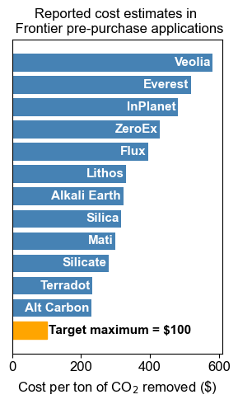
Measurability: project level MRV cannot scale
How and when to achieve model-based MRV?
MRV is costly today (~>$300/ton CO₂)
outcomes highly uncertain, high project risk
Proprietary methods and data
hard to assess individual project CDR claims, benchmark models
Overemphasis on outcome over principles
true CDR from EW will never be measurable at project level
Notes:
Now let me close. Remember the three questions I planted at the start — can we actually measure this? Is the global capacity what the models say? And how is the science being governed? I
First — measurability. Here are reported MRV costs for current EW projects. Most are above $300 per ton. To get to scale, the target is around $100, so MRV cost has to drop at least tenfold.
The current approach — every company runs its own proprietary measurements with no shared benchmark — can't get there.
And I'd argue something stronger: true durable CDR from EW will never be measurable at the individual project level. The signal is downstream, slow, and integrated across catchments. Project-level MRV is the wrong unit of analysis. Model-based MRV is going to be necessary, not optional. Which raises the question:

Slide 37
How should mechanistic models be evaluated, governed, and trusted as part of financial and regulatory infrastructure?
(This is a problem for all aspects of carbon accounting, including emissions accounting)
Notes:
Which raises the question that's the actual hinge of this talk. How should mechanistic models be evaluated, governed, and trusted as part of financial and regulatory infrastructure? This is not just an enhanced weathering problem. This is a problem for all of carbon accounting — including emissions accounting. And the answer comes in two parts."

Slide 38
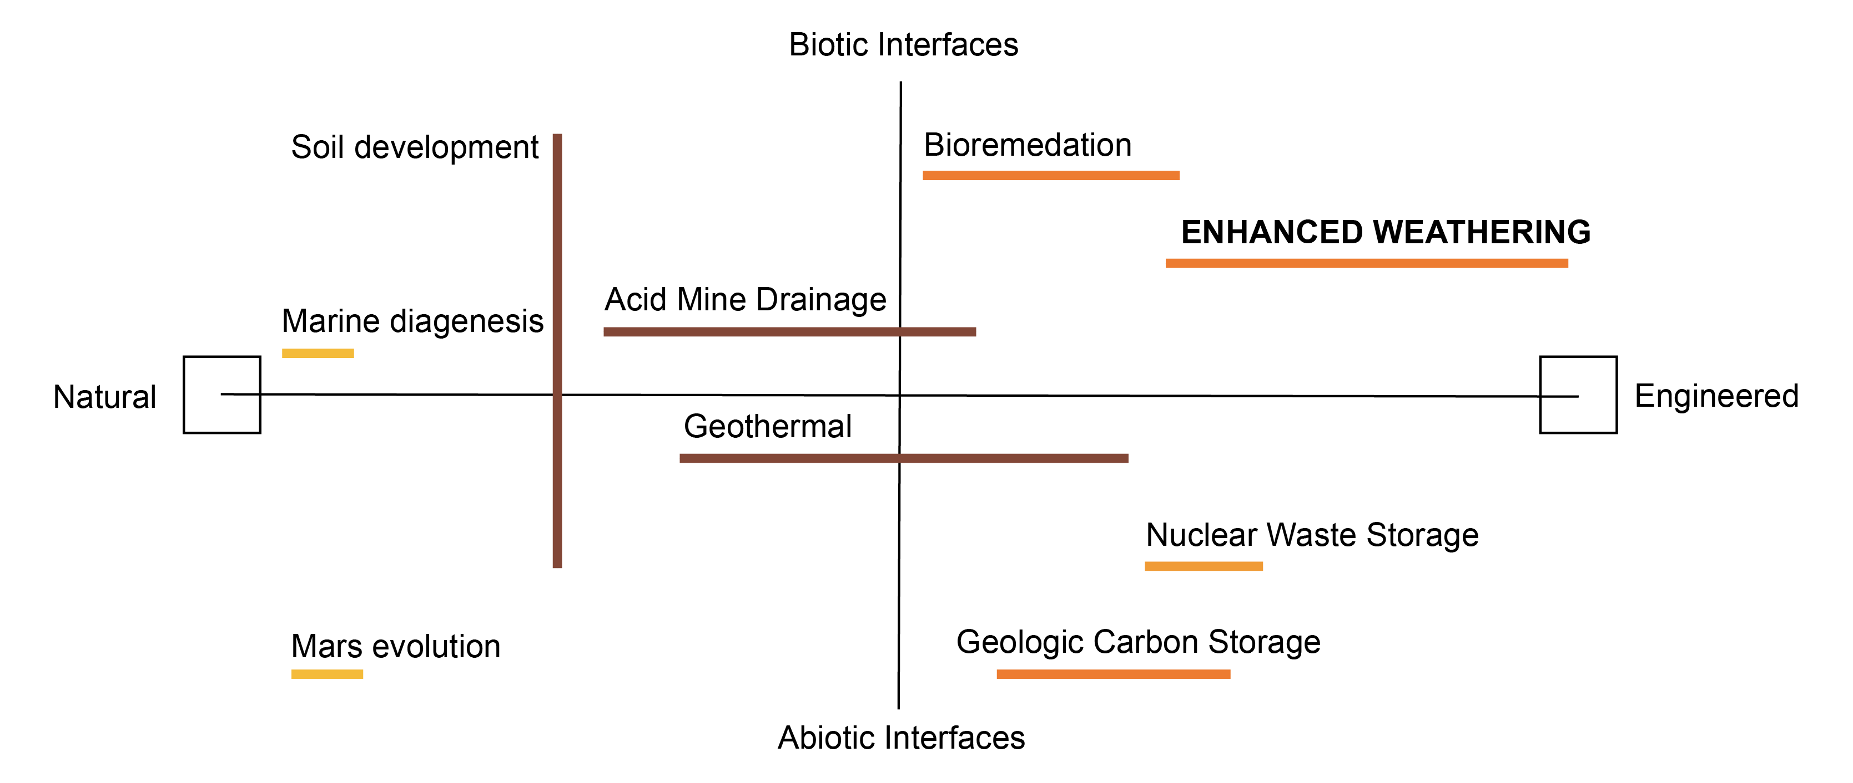
Capacity: the science gaps that constrain credible EW
Reactive interfaces in complex porous media
partitioning of protons, solutes, and organic matter at mineral–water–root interfaces
Coupled biogeochemistry
feedstock effects on soil organic carbon stabilization and microbial community dynamics
Lab-to-field rate discrepancy
in-situ reactive surface areas of granular feedstocks under unsaturated conditions
Secondary phase formation
kinetics and thermodynamics of clay, carbonate, and oxide precipitation under variable saturation
Pore-to-continuum upscaling
alkalinity generation and attenuation in heterogeneous, preferential two-phase flow
everything is transient and heterogeneous at all scales
Applications of RTMs in the geosciences, from Maher and Perzan, 2023 Treatise of Geochemistry
Notes:
"First — the science. This figure is from a Treatise article on reactive transport modeling. RTMs are used across this whole space — natural to engineered, abiotic to biotic. Enhanced weathering sits in the biotic and engineered corner, alongside bioremediation. And here's the second of my three opening questions — capacity.
Whether global EW can deliver what the models project depends on five open scientific problems."
Reactive interfaces in complex porous media. Coupled biogeochemistry. Lab-to-field rate discrepancy. Secondary phase formation. Pore-to-continuum upscaling. These are exactly the Grand Challenges I flagged at the beginning of the talk. They didn't go away. They came back as policy problems. And everything is transient and heterogeneous at all scales, which is the part that makes this hard.
The good news is, this room is where the toolkit lives. Capacity questions get answered when this community works on these problems.

Slide 39
Governance: The institutional scaffolding for accountability
Beerling et al., 2020, Nature
Model projects
Global EW of 0.5 to 2 Gt CO₂/yr
Frontier Climate launches
(Stripe, Alphabet, Shopify, Meta, etc. commit $1B US to CDR purchases)
First offtake contracts
Lithos Carbon, UNDO, Eion begin commercial operations
First Verified EW removals
InPlanet by Isometric
X-prize $50M
Mati Carbon
Lithos by Puro.earth Delivery
First peer-reviewed field trials
2020
2022
2024
2026
🙈 No carbon mass balance closure requirement
🙈 No use of standard measurement procedures (QA/QC)
🙈 No benchmarked models in use
🙈 No data sharing or transparency protocols, esp. statistics
🙈 No public review or input
Notes:
The governance needs are something different. They're failures of scaffolding. Across the entire arc from 2020 to 2025 — billion dollars committed, ten kilotons verified — there's no requirement for carbon mass balance closure. No use of standard measurement procedures with proper QA/QC. No benchmarked models. No data sharing protocols. No public review. The first list — the science — is what this community already knows how to work on. The second list — the governance — is what we have to insist on as the price of entry for model-based MRV. Both are within our reach. Neither is in place today."

Slide 40
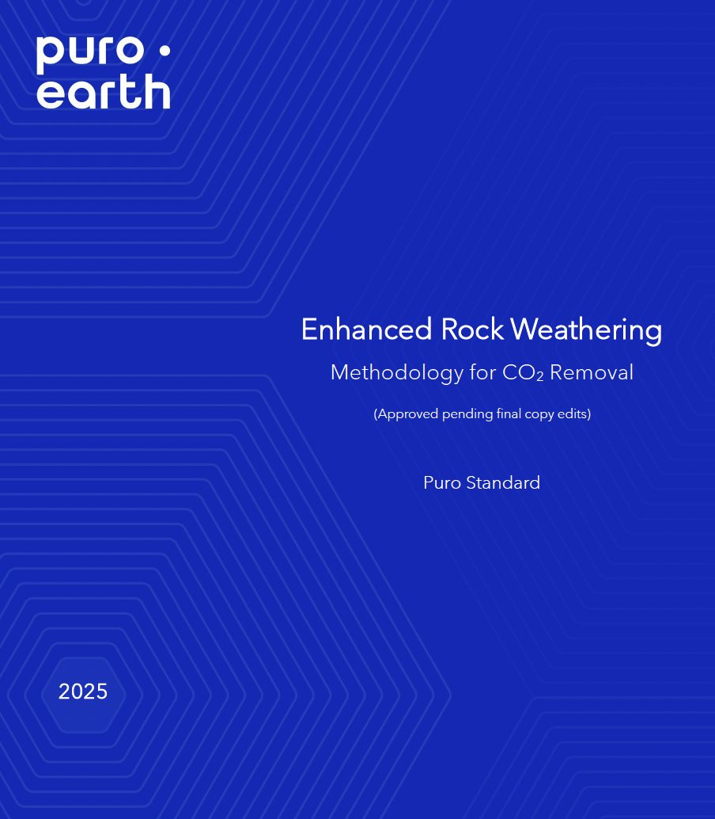
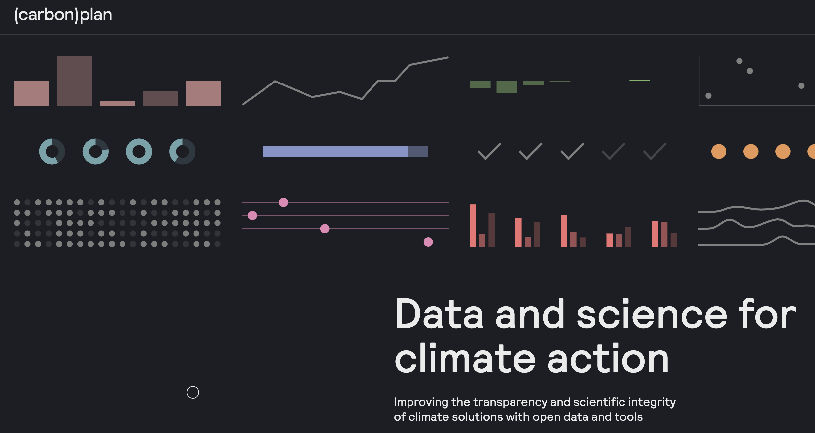
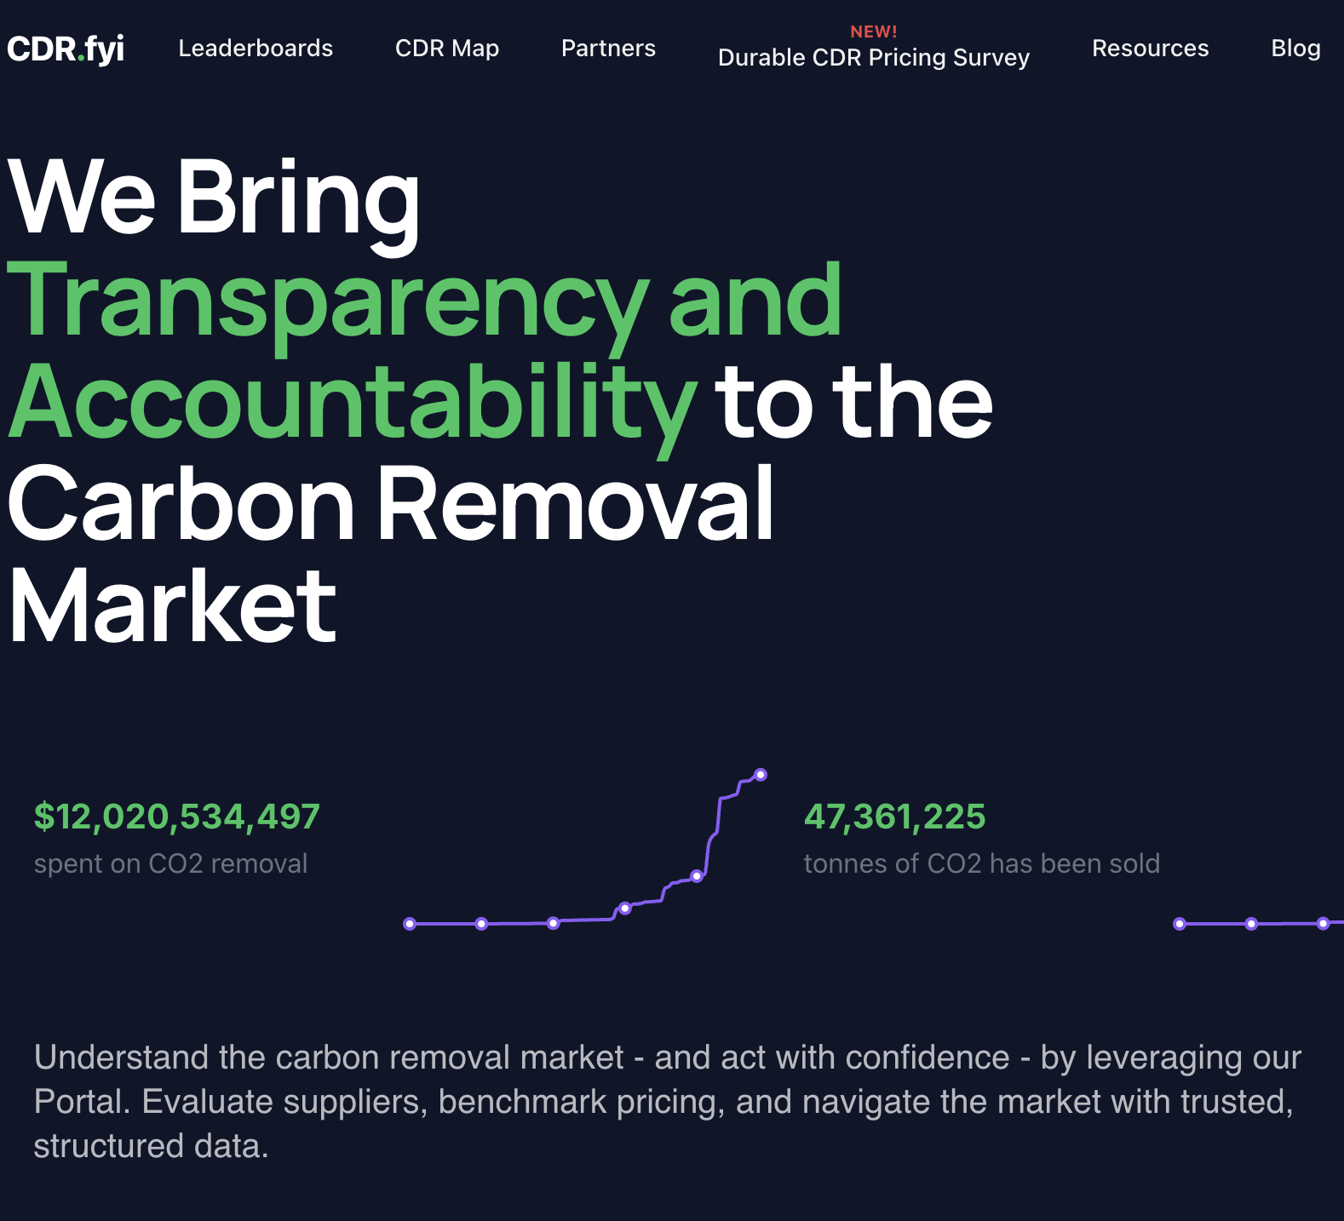

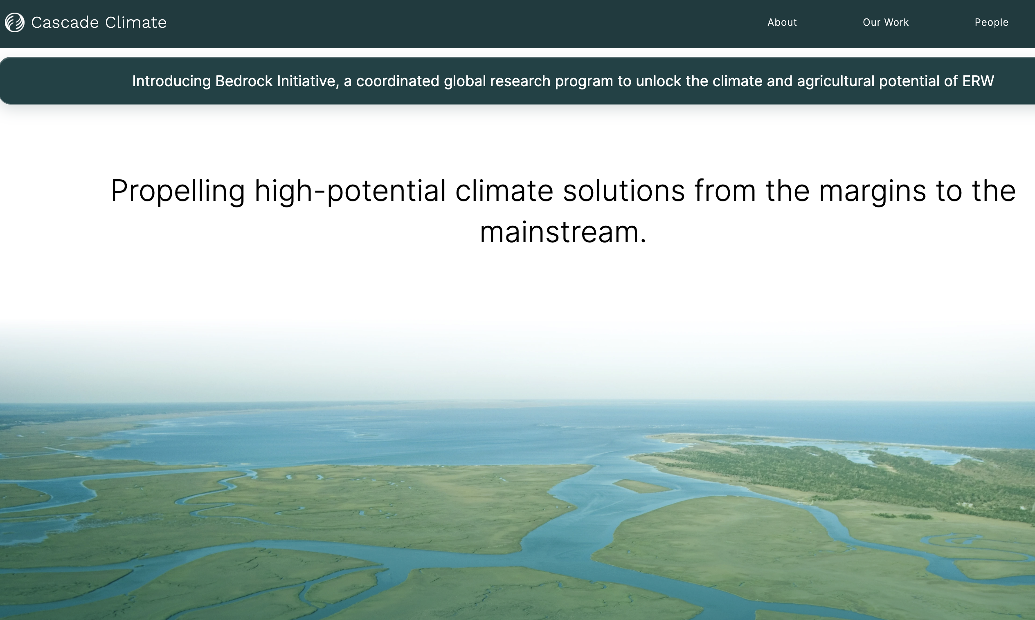
Where to start if you are interested in responsible CDR?
Review the current Methodologies and provide input
Make contact with relevant trade organizations
Watch the verifications and review the (non-redacted) evidence
Notes:
If any of this is provoking the question

Slide 41

THANK YOU. QUESTIONS?
Funding from:
Notes:
This is one of the most reactive places on Earth. Basalt dissolving under rainfall, alkalinity generated at the rock surface, transported by this river to the ocean, stored there for a hundred thousand years. Nature has been doing carbon dioxide removal via enhanced weathering since silicate rocks first met rainwater. What companies are proposing, at planetary scale, is to mimic this — deliberately, at speed, and with enough precision to trade it on financial markets.

Slide 42
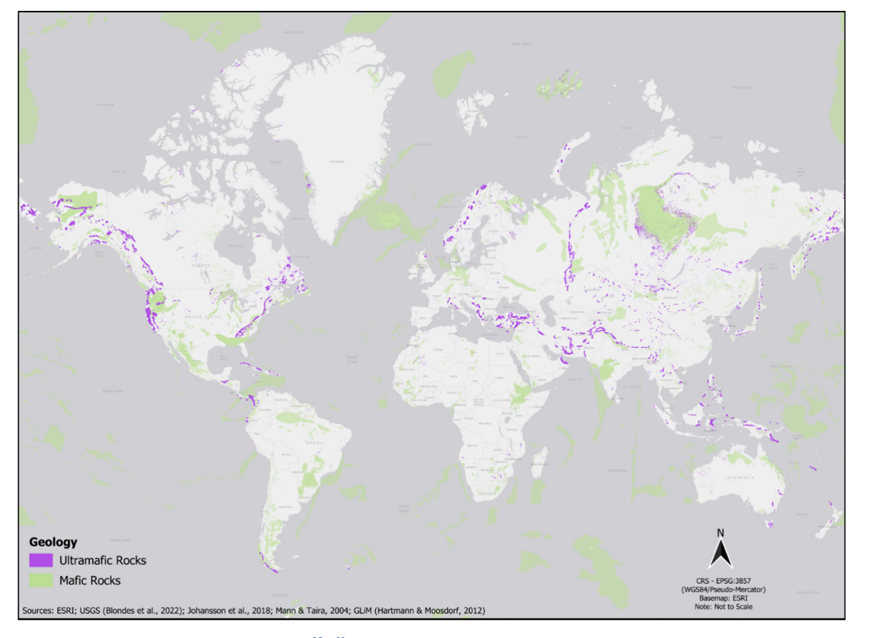
The spatial component? Emissions and feedstock reactivity
Miller et al., 2026, Chemical Reviews
Methodologies include simple attributional LCA (emissions include grinding, transportation)
Many deposits are “pre-weathered” by hydrothermal alteration and not suitable for EW
Engineered materials are growing in interest due to greater reactivity and stoichiometric tunability.
Larnite (MgCaSiO₄)

Slide 43
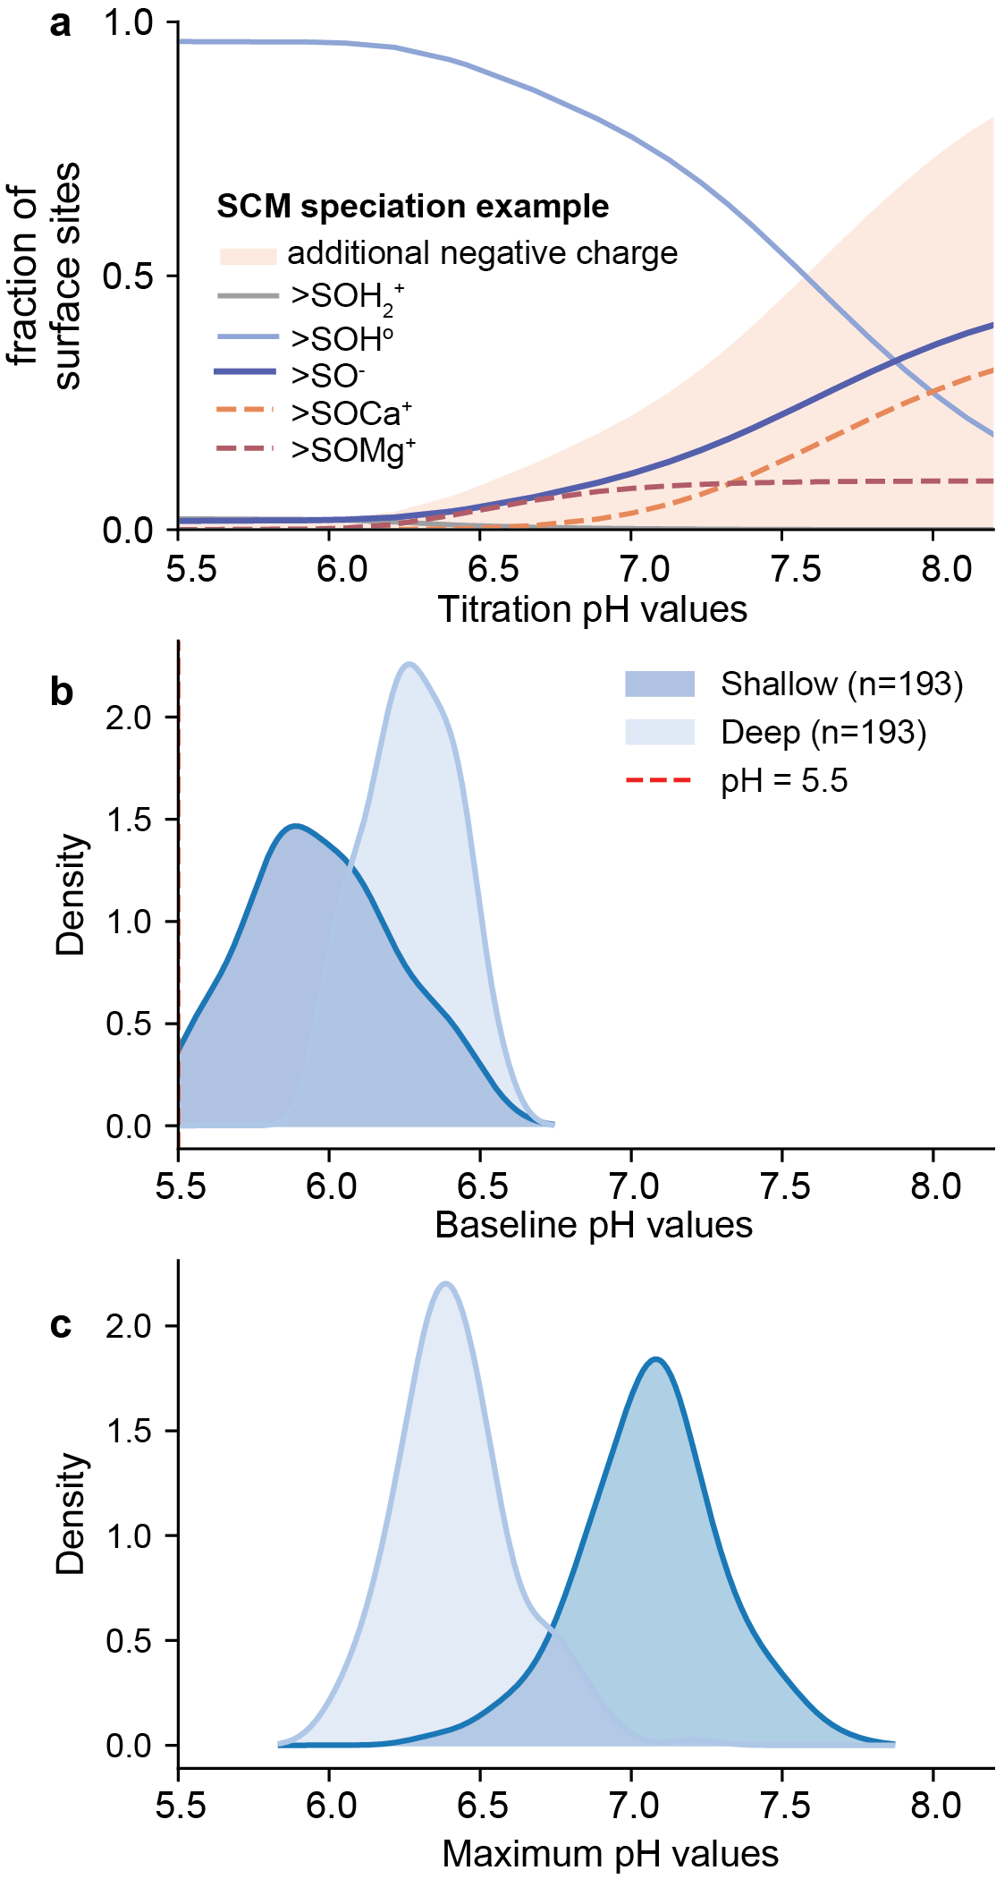
Surface speciation and pH buffering impacts
Deep soil pH resists modification

Slide 44
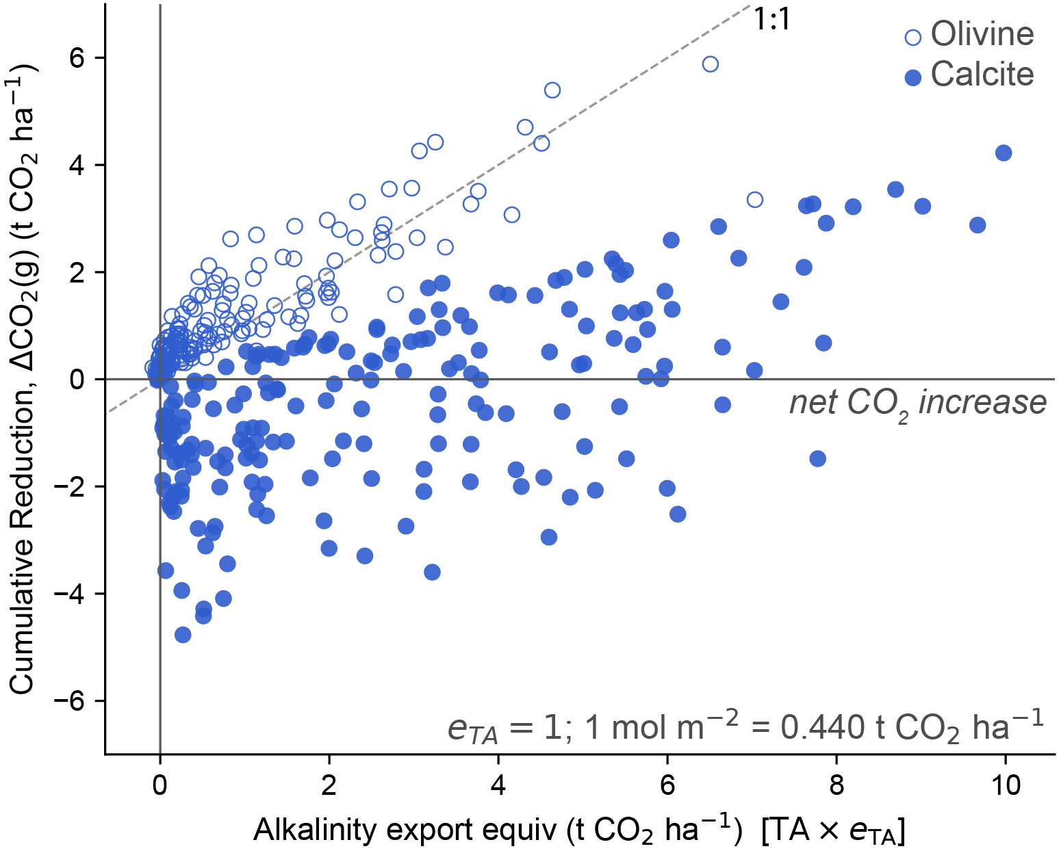
Emissions balances create risk for calcite amendments

Slide 45
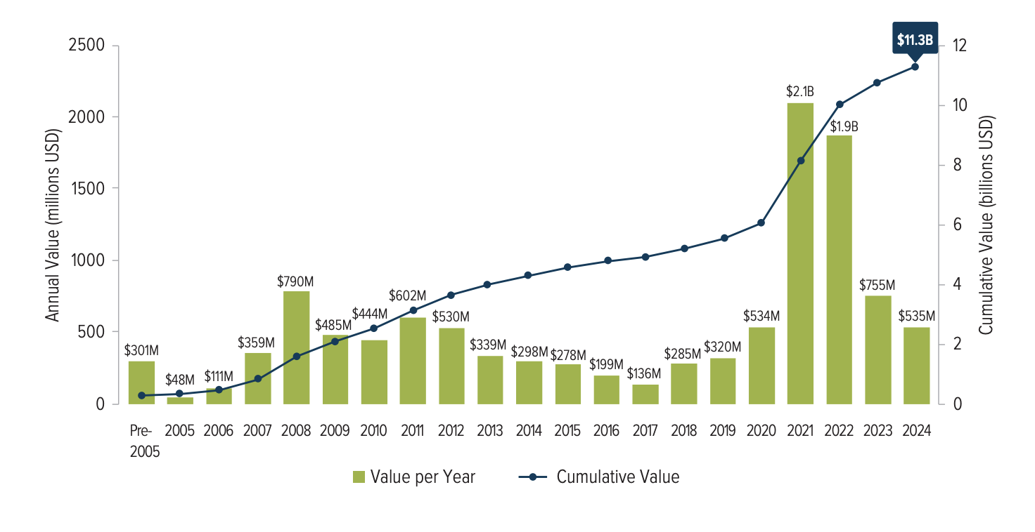
The evolution of the carbon market towards durable CDR
1 ton of carbon removed → 1 carbon credit → 1 standardized, tradable unit for net-zero claims
MEASUREMENT, REPORTING AND VERIFICATION (MRV):
framework used to quantify, document, and validate a carbon removal credit
this talk
“VCM 1.0” from Clean Development Mechanism of Kyoto Protocol
The Guardian story: unethical and overstated offsets
“VCM 2.0” was born to sperate out high quality and durable removals
Cdr.fyi tracks durable market growth, Microsoft dominates corporate investment grows

