Slide 1
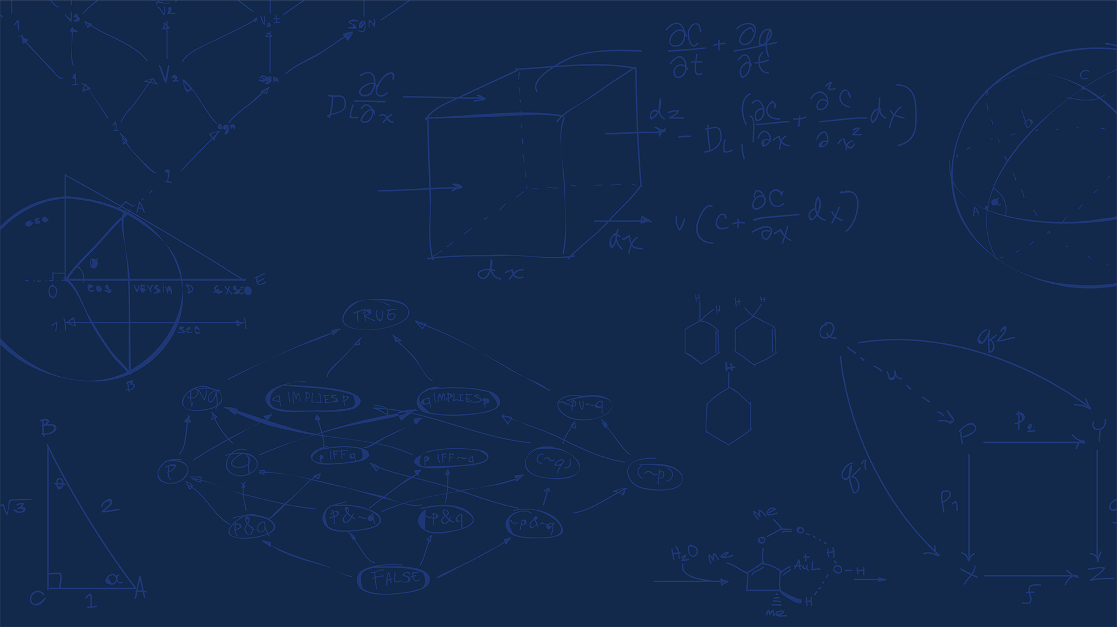


Micro-CT-Based Permeability Characterization of Virgin and Pyrolyzed Wood
InterPore2026 - MS18
High-temperature heat and mass transfer within porous materials for energy and space
Supervisors / co-authors:
Presented by:
Azita Ahmadi Senichault, Abdelaziz Omari, Cécile Gaborieau, Flora Lahouze, Shaolin Liu, Olivier Caty, Andrew King and Jean Lachaud
Abderrahman M'jikou
Univ. Bordeaux · I2M
21/05/2026

Slide 2
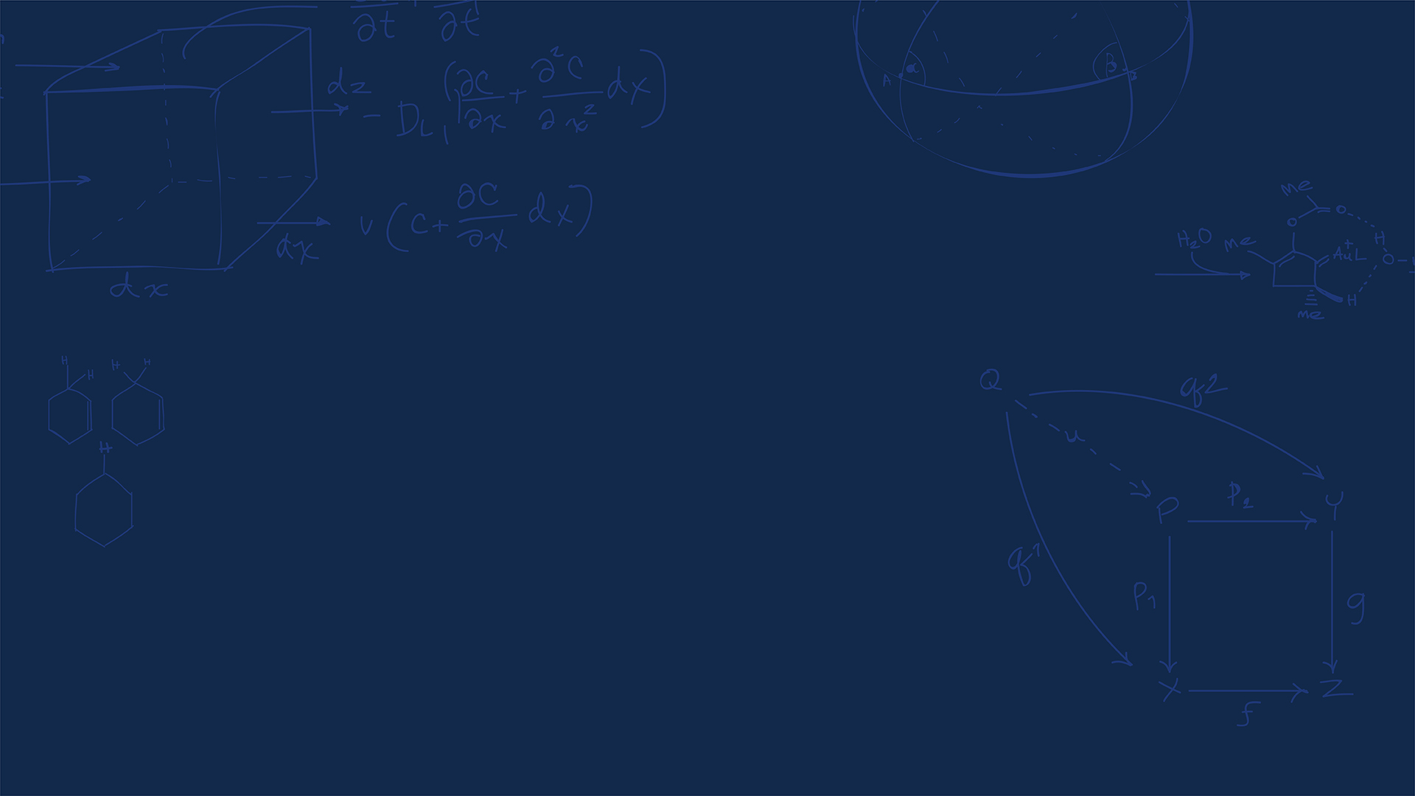
Introduction
InterPore2026 - MS18

Slide 3
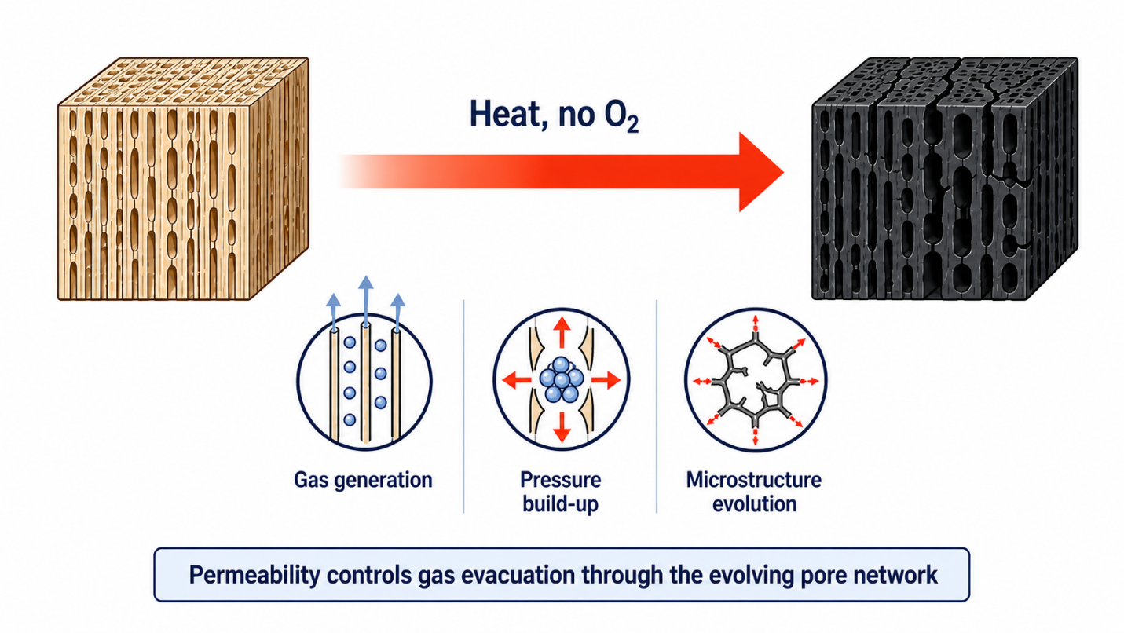
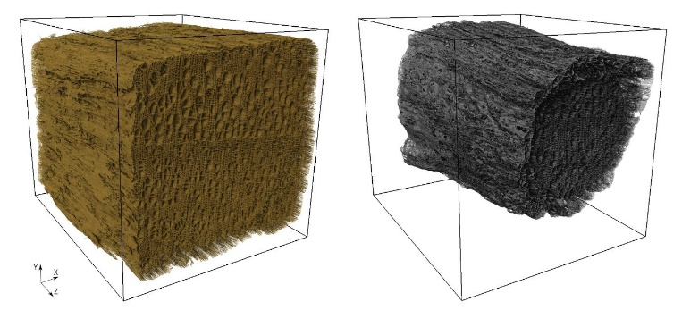
Why permeability matters during pyrolysis
Work package 4 : Volume-averaged mathematical models
Work package 4 : Volume-averaged mathematical models
Pyrolysis
Thermochemical degradation of organic materials under heat in oxygen-free conditions.
Main products
Gases: (CO₂/CO/H₂/CH₄/....)
Solid: char
Liquids: bio-oil / tar
Main effects
Outgassing / blowing pressure build-up
Microstructure change: porosity and permeability evolve
Deformation: shrinkage, cracking
[1]
Main objective
Quantify how pyrolysis modifies the anisotropic permeability tensor of wood from real micro-CT pore geometries.
[1] Scandelli, H. "Multi-Scale Modeling of Wood Shrinkage During Pyrolysis," Arts et Métiers Institute of Technology. Unpublished.
InterPore2026 - MS18

Slide 4
From micro-CT to permeability
InterPore2026 - MS18

Slide 5
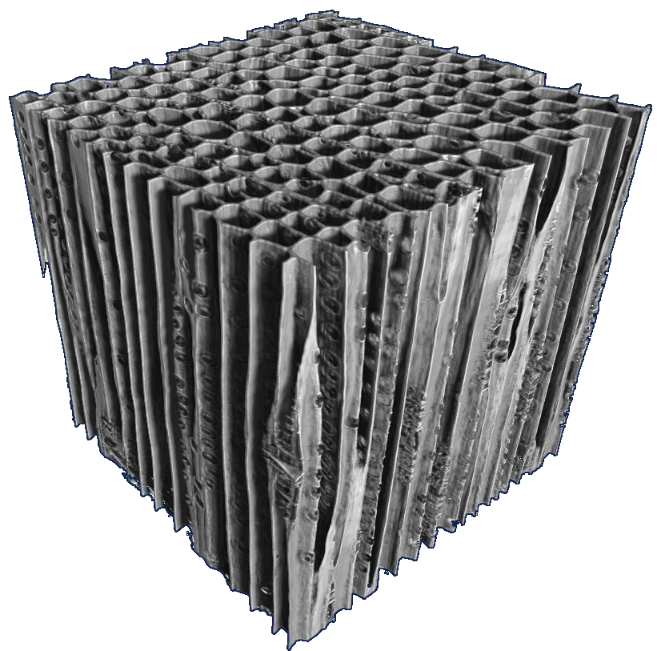
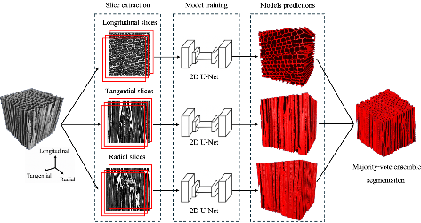
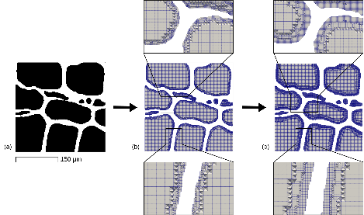
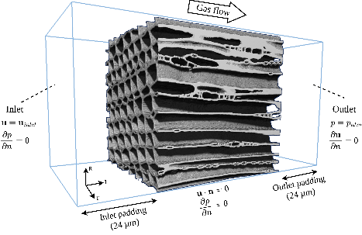
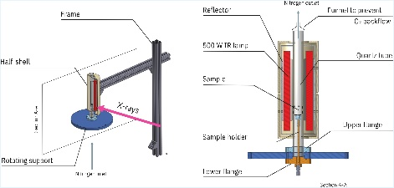
Image-based permeability workflow
Approach
Apply the same image-based workflow to virgin and pyrolyzed microstructures to isolate the effect of pyrolysis on permeability.
Micro-CT
imaging
In-situ
pyrolysis
Deep-learning
segmentation
Adaptive
meshing
CFD
simulation
0.30 µm voxel size
synchrotron micro-CT
N₂ atmosphere,
up to 525 °C
Three-plane U-Net +
majority vote
Adaptive voxel–hex
mesh
Creeping-flow
simulations in L, R, T
Output
Full anisotropic permeability tensor $(K_{L}, K_{R}, K_{T})$ for virgin and pyrolyzed maritime pine earlywood.
InterPore2026 - MS18

Slide 6
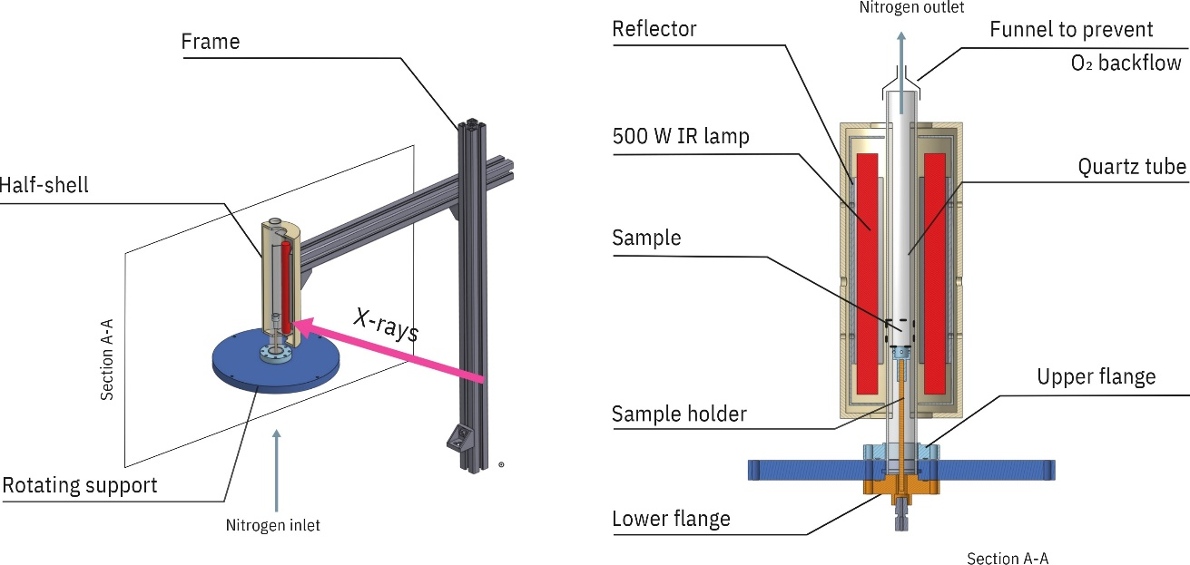
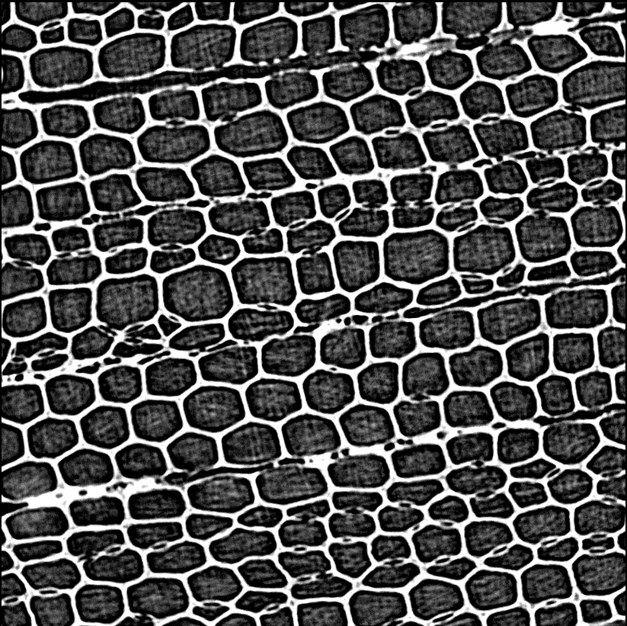
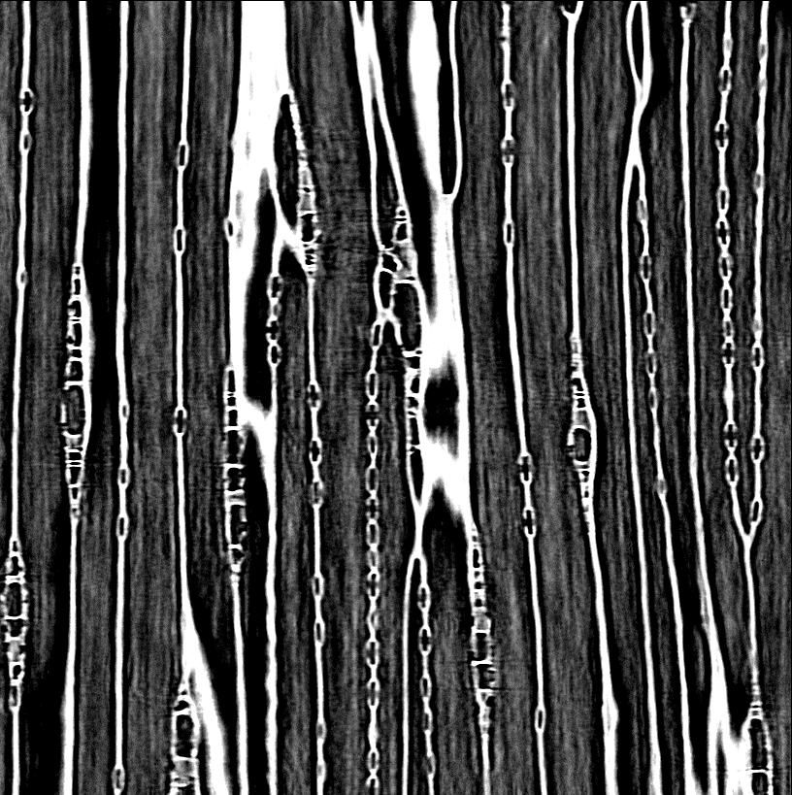
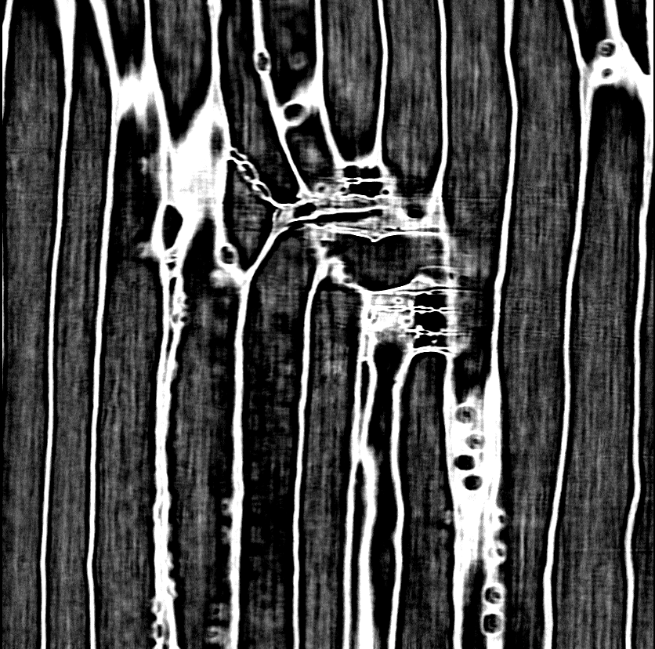
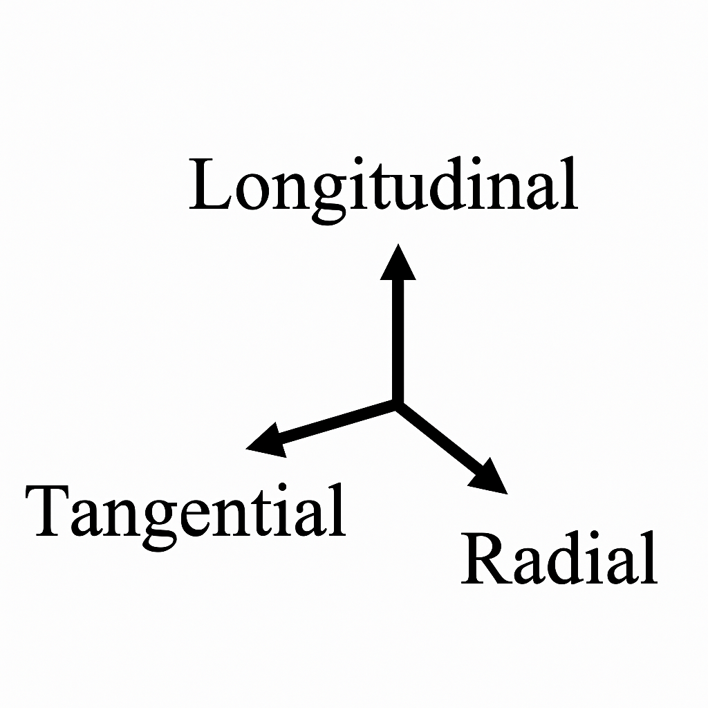
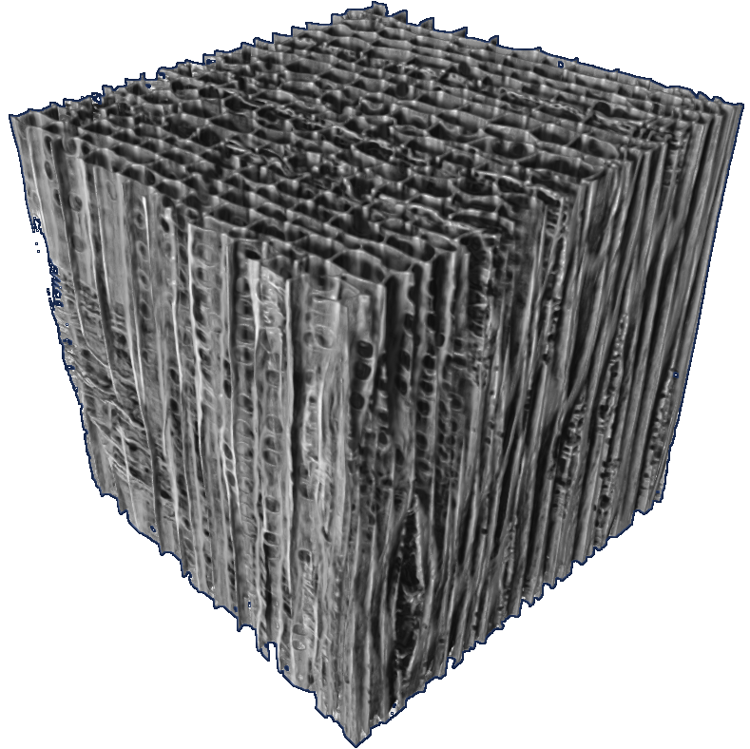
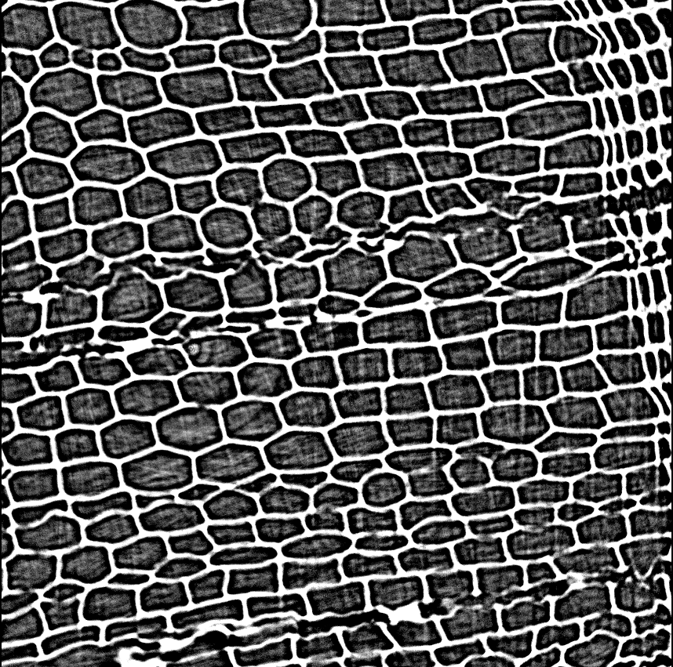
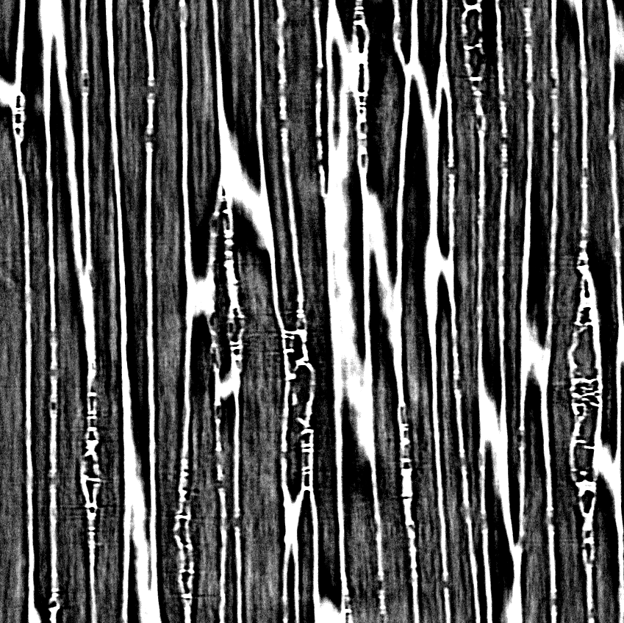
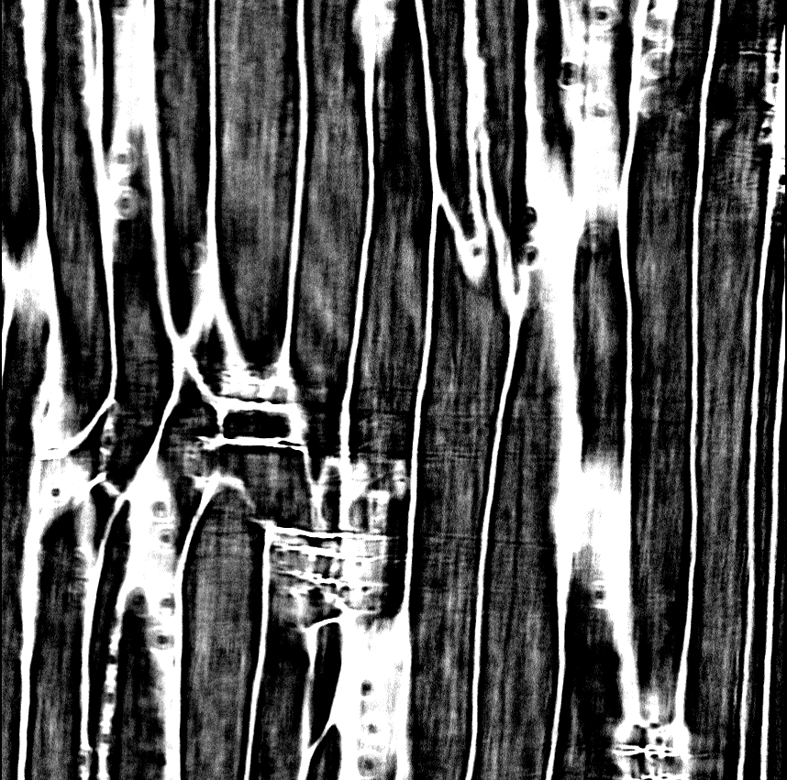
In-situ pyrolysis and synchrotron micro-CT imaging
Work package 4 : Volume-averaged mathematical models
Work package 4 : Volume-averaged mathematical models
Controlled in-situ pyrolysis [2]
Micro-CT volumes before / after pyrolysis
Virgin wood
Longitudinal plane (L)
Tangential plane (T)
Radial plane (R)
Pyrolyzed wood
Longitudinal plane (L)
Tangential plane (T)
Radial plane (R)
Material:
Pinus pinaster earlywood
Atmosphere:
N₂ purge
Beamline:
SOLEIL PSICHÉ
Voxel size:
0.30 µm
Heating:
IR lamps
Peak temperature:
525 °C
Dataset virgin:
2928 × 3144 × 2048
Dataset pyrolyzed:
2332 × 2160 × 2048
Input for simulations
Reconstructed 3D volumes provide the real pore geometries used for segmentation, meshing, and pore-scale flow simulations.
[2] F. Lahouze, Development of a pyromechanical model applied to biomass pyrolysis, PhD thesis in mechanics, University of Bordeaux, Bordeaux, France, defended on October 24, 2025 (2025)
InterPore2026 - MS18

Slide 7
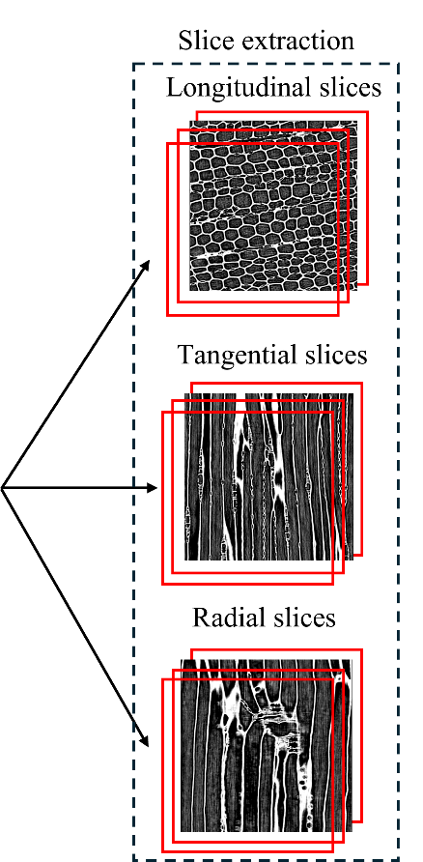
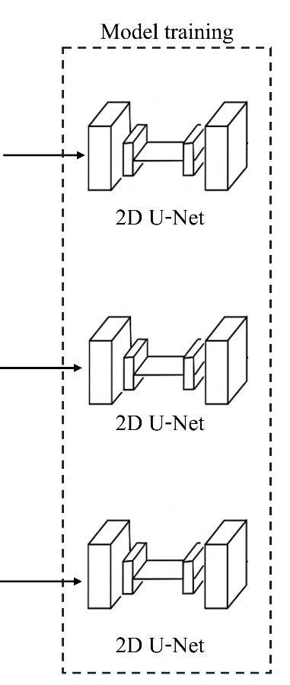
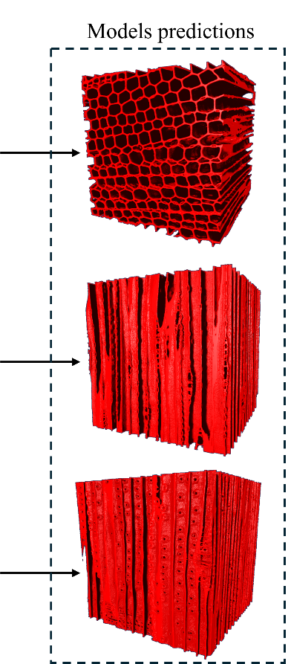

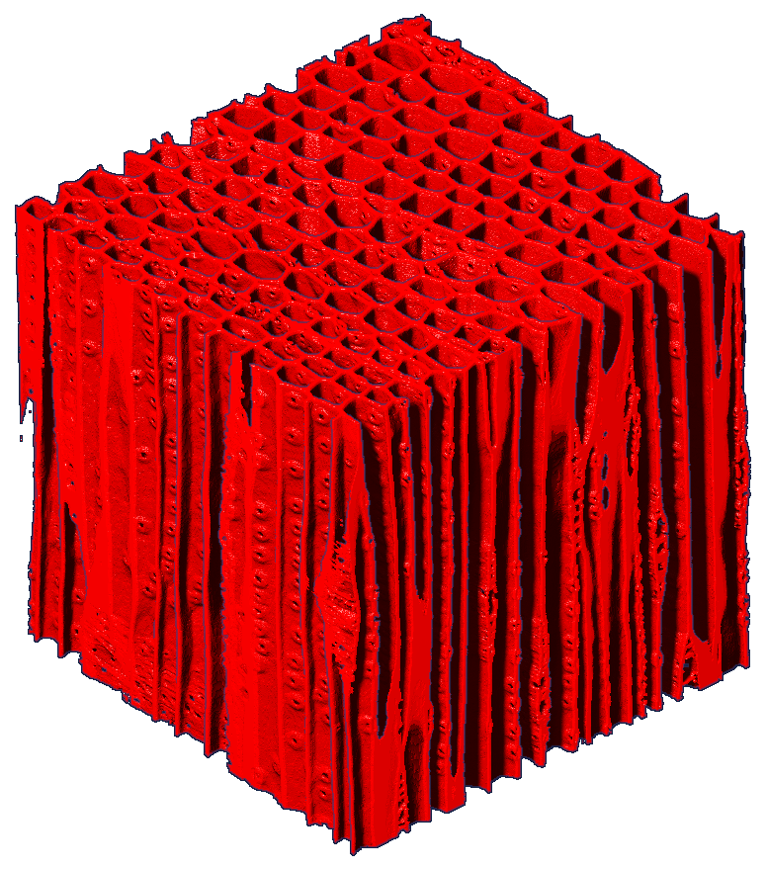
Deep-learning based segmentation of the pore space
Work package 4 : Volume-averaged mathematical models
Work package 4 : Volume-averaged mathematical models
Segmentation challenge
Three-plane U-Net strategy
Low contrast:
solid/pore gray levels overlap
Anisotropic structure:
features depend on slice orientation
Majority-vote ensemble segmentation
Thresholding insufficient:
artifacts and wall-
intensity gradients
1. Train one 2D U-Net per anatomical plane (L, T, R)
2. Predict the full 3D volume with each model
3. Fuse predictions by majority vote
Segmentation output
Majority-vote fusion provides an orientation-robust 3D pore/solid geometry for permeability simulations.
InterPore2026 - MS18

Slide 8
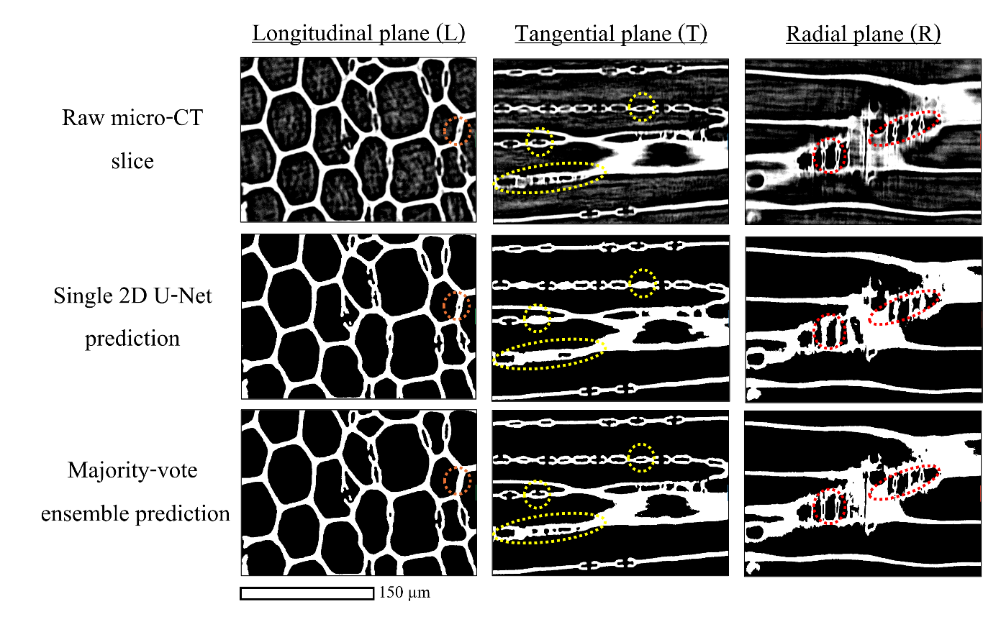
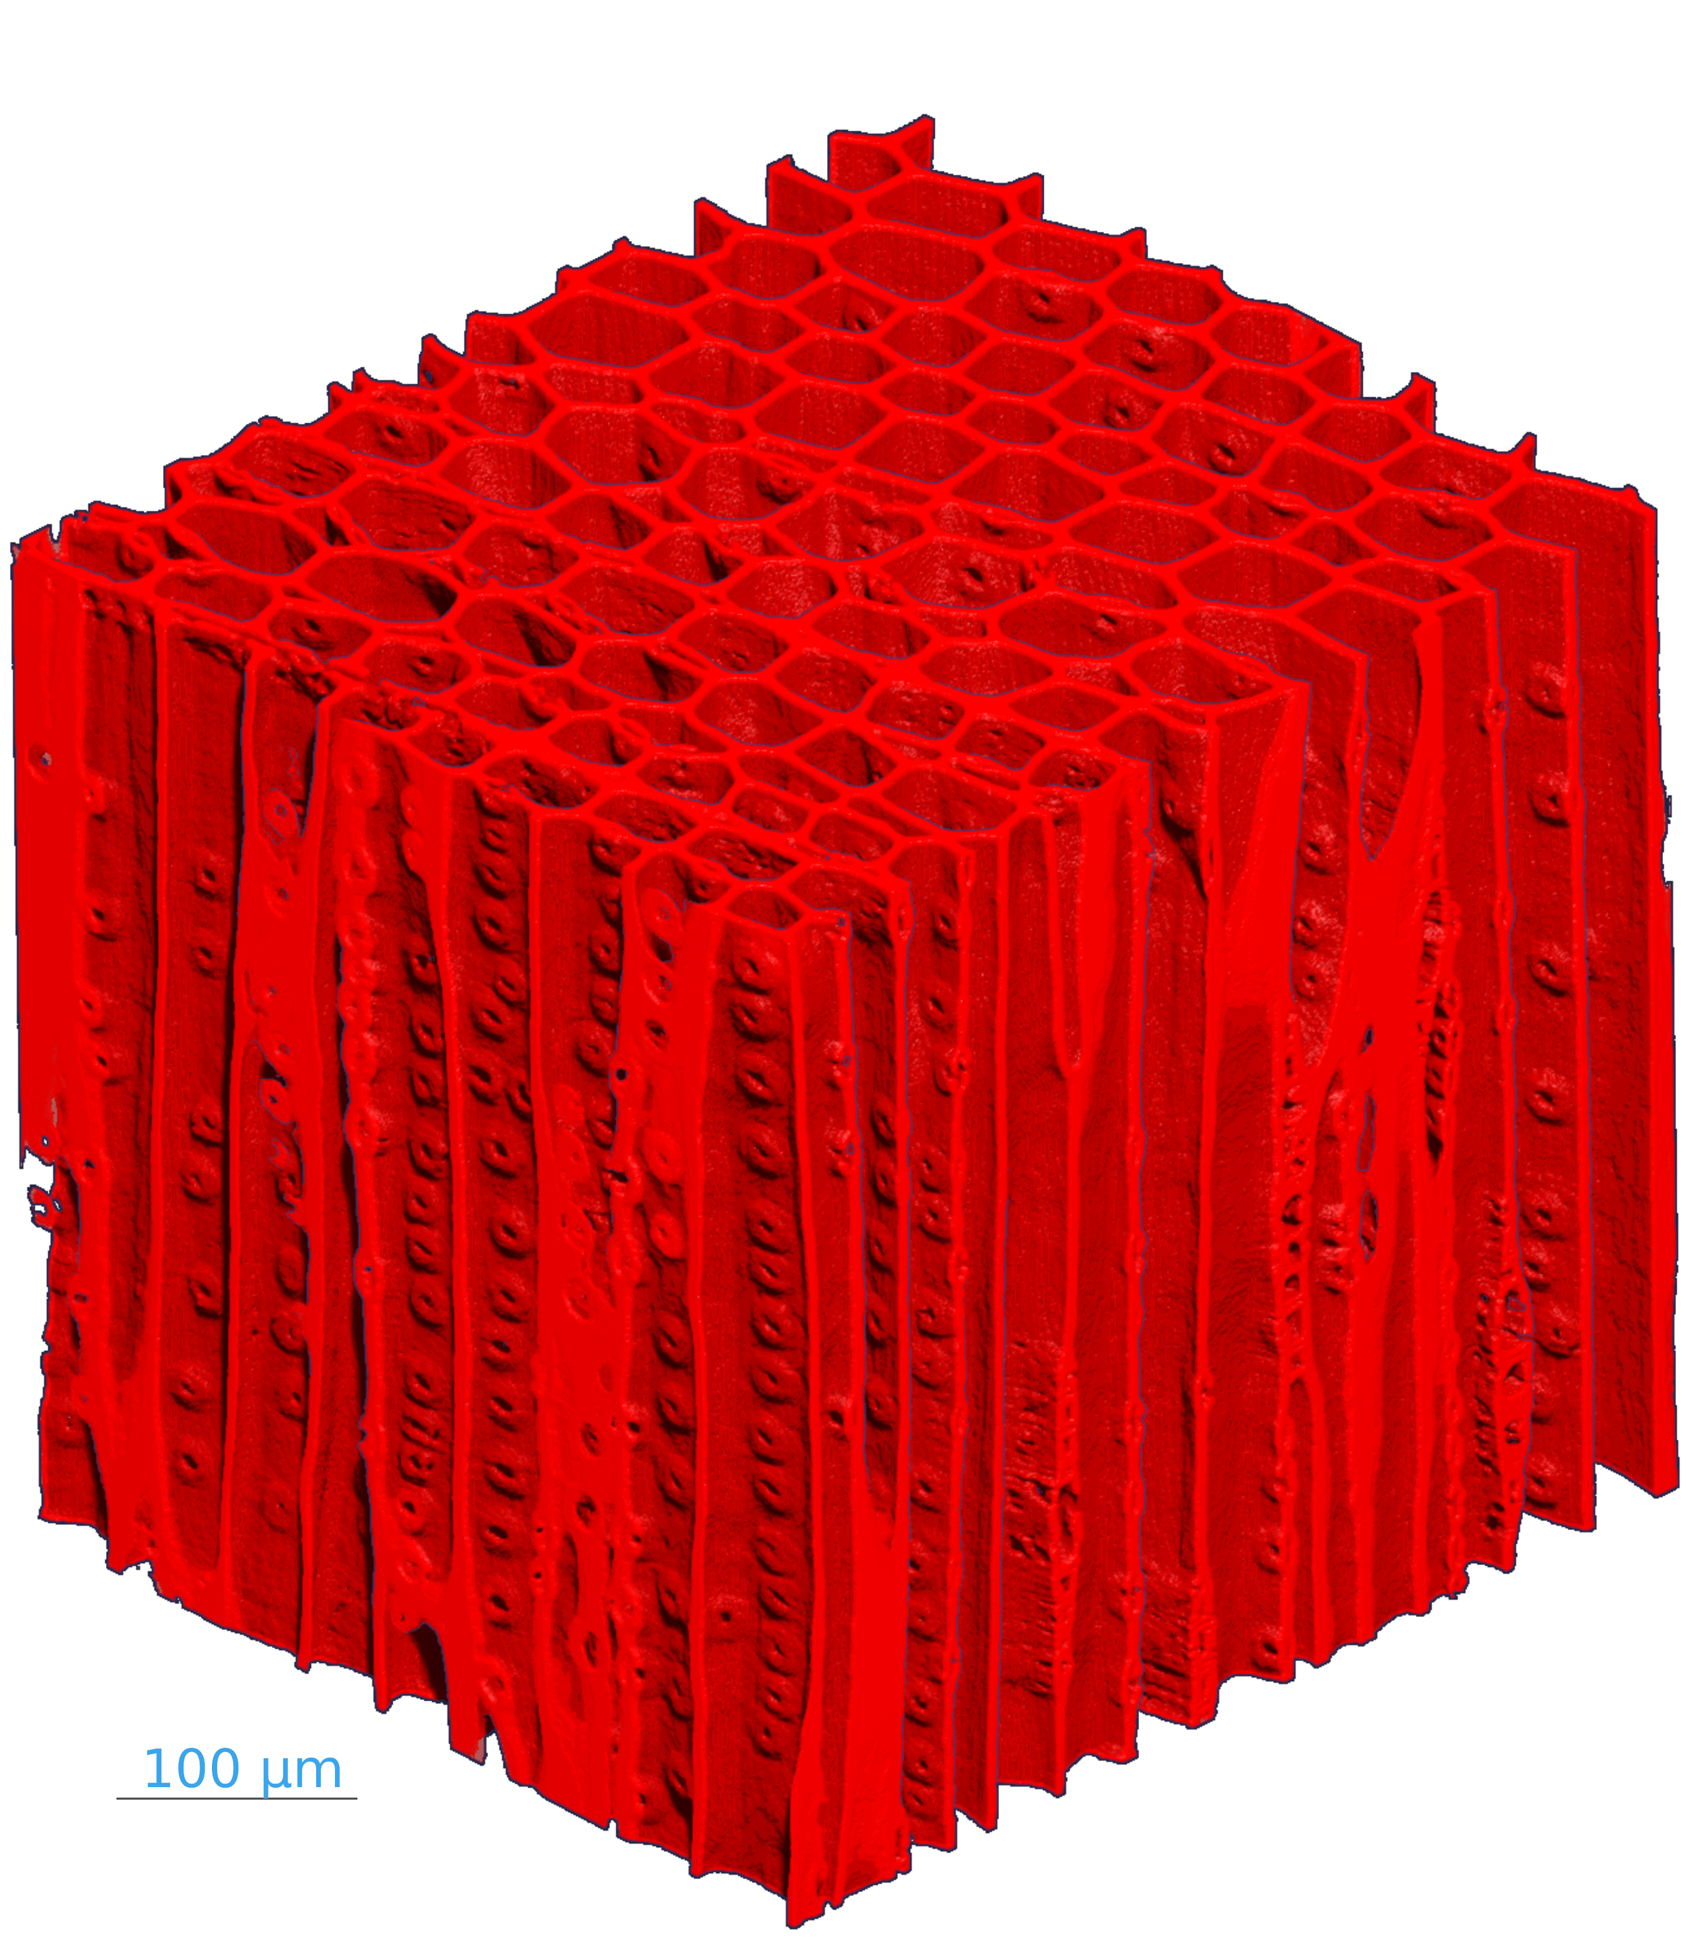
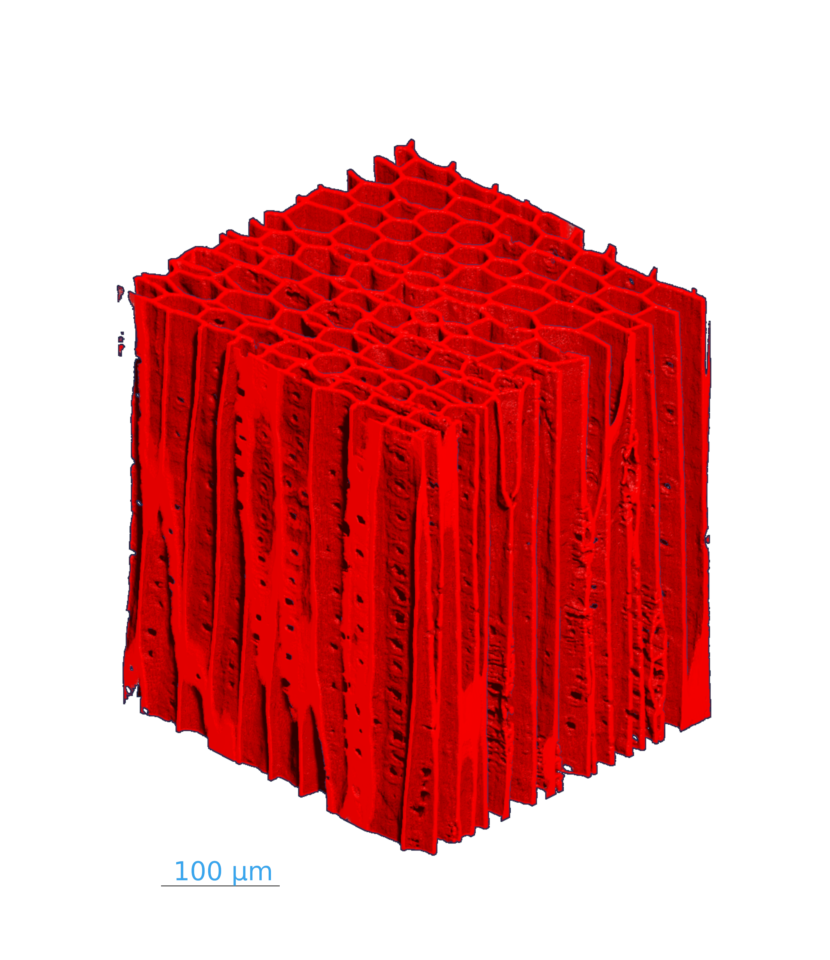
Segmentation results and microstructural changes
Work package 4 : Volume-averaged mathematical models
Work package 4 : Volume-averaged mathematical models
Segmentation consistency
Final 3D pore/solid geometry
Virgin wood
Pyrolyzed wood
Final segmentation preserves pore/wall continuity across anatomical views.
Matched virgin and pyrolyzed geometries used for pore-scale simulations.
Segmentation consistency:
Final masks are coherent across L, T, and R views.
Matched 3D geometries:
Virgin and pyrolyzed volumes represent comparable earlywood regions.
Microstructural changes:
Pyrolysis induces compaction, wall roughening, and modified connectivity.
InterPore2026 - MS18

Slide 9
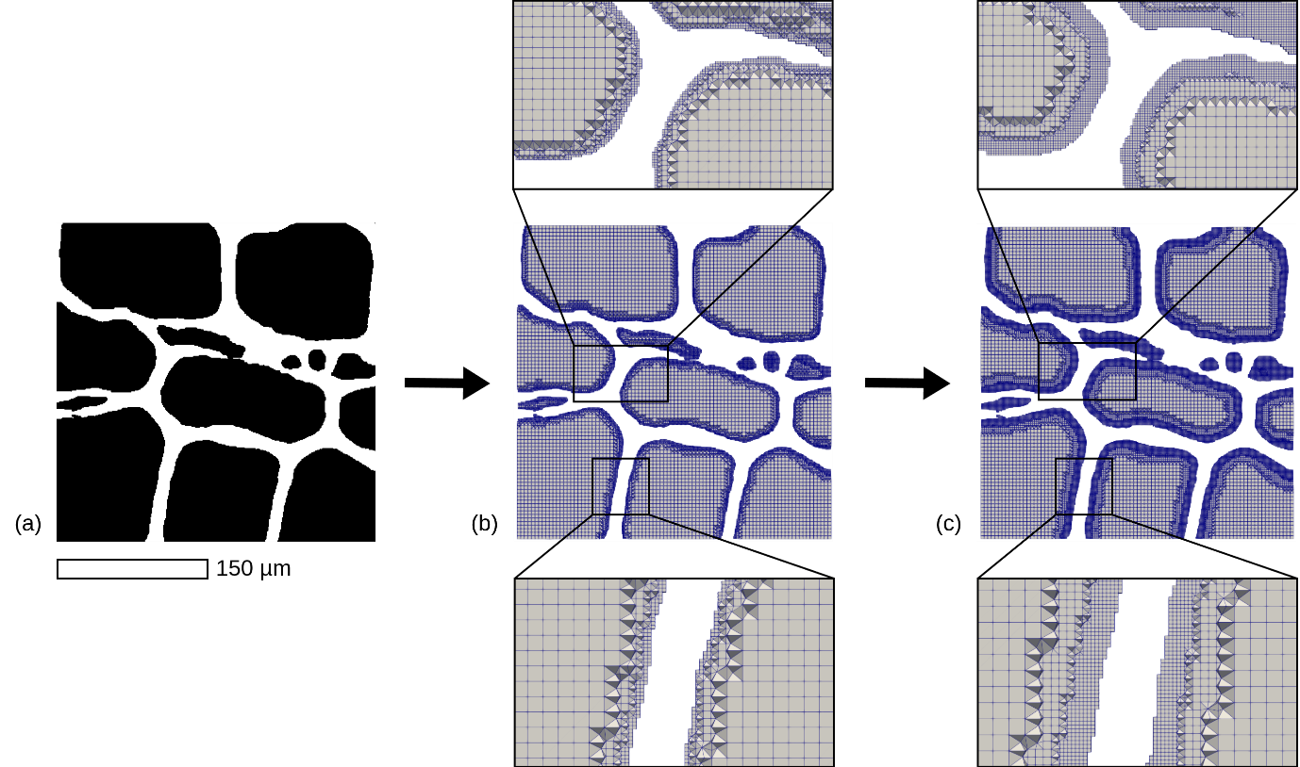
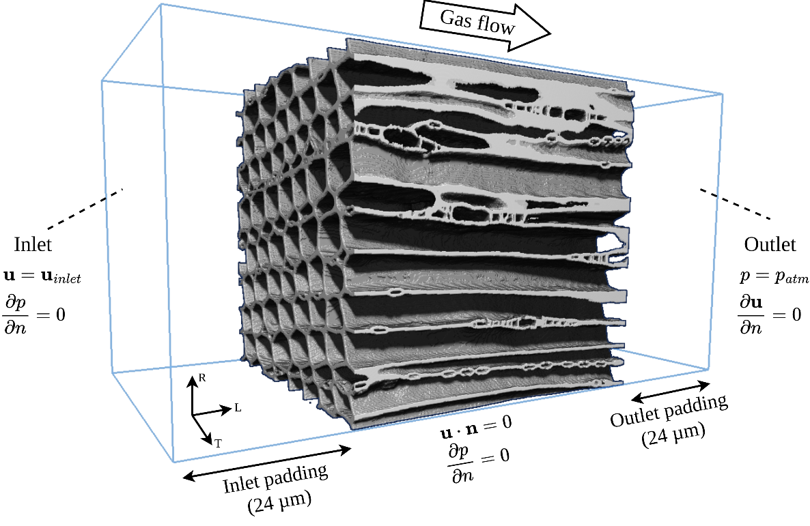

Pore-scale meshing and flow simulations
Work package 4 : Volume-averaged mathematical models
Work package 4 : Volume-averaged mathematical models
Adaptive voxel-hex meshing
Creeping-flow CFD setup
Near-wall resolution
0.30 µm at the solid-fluid interface
Pore-interior coarsening
large cells away from walls
Purpose
preserve geometry at lower cost
Solver
OpenFOAM
simpleFoam
Flow
directions
L, R, T
Boundary condition
no-slip walls + inlet/outlet padding
Permeability evaluation
Output: $K_{L}, K_{R}, K_{T}$
Directional permeabilities are extracted from the volume-averaged velocity and pressure gradient.
InterPore2026 - MS18

Slide 10
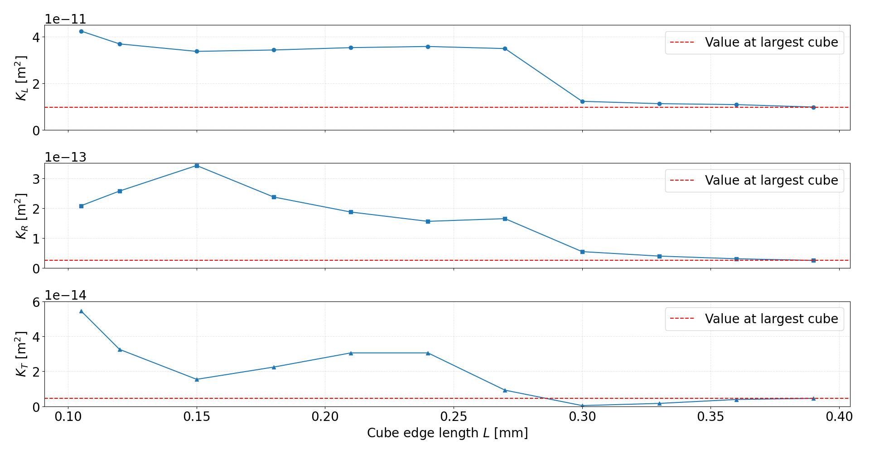
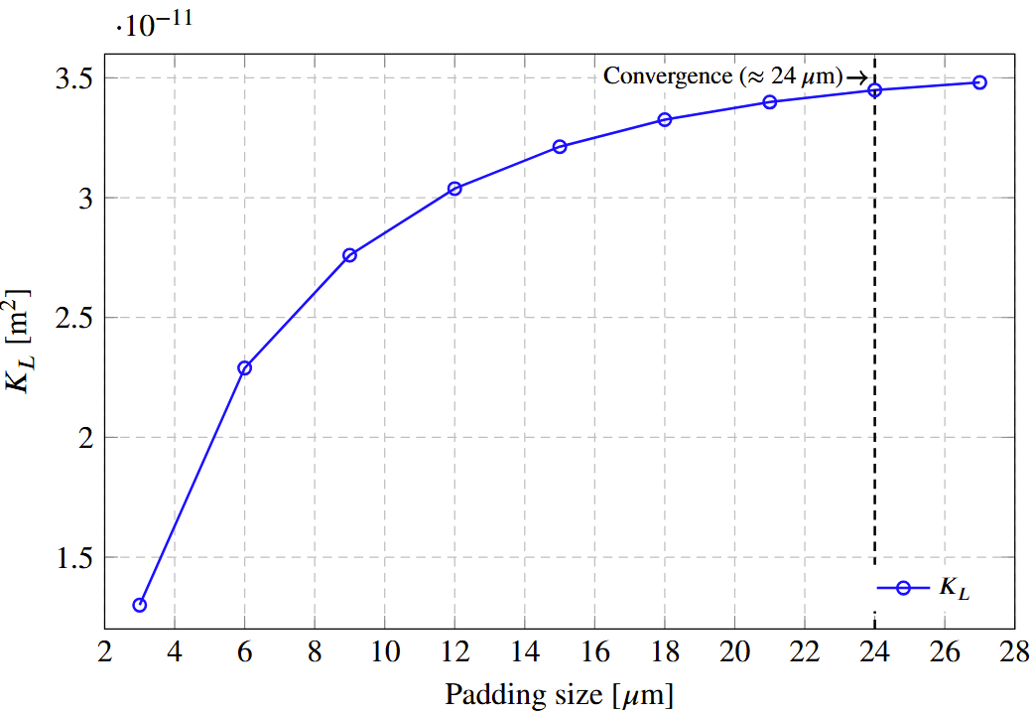
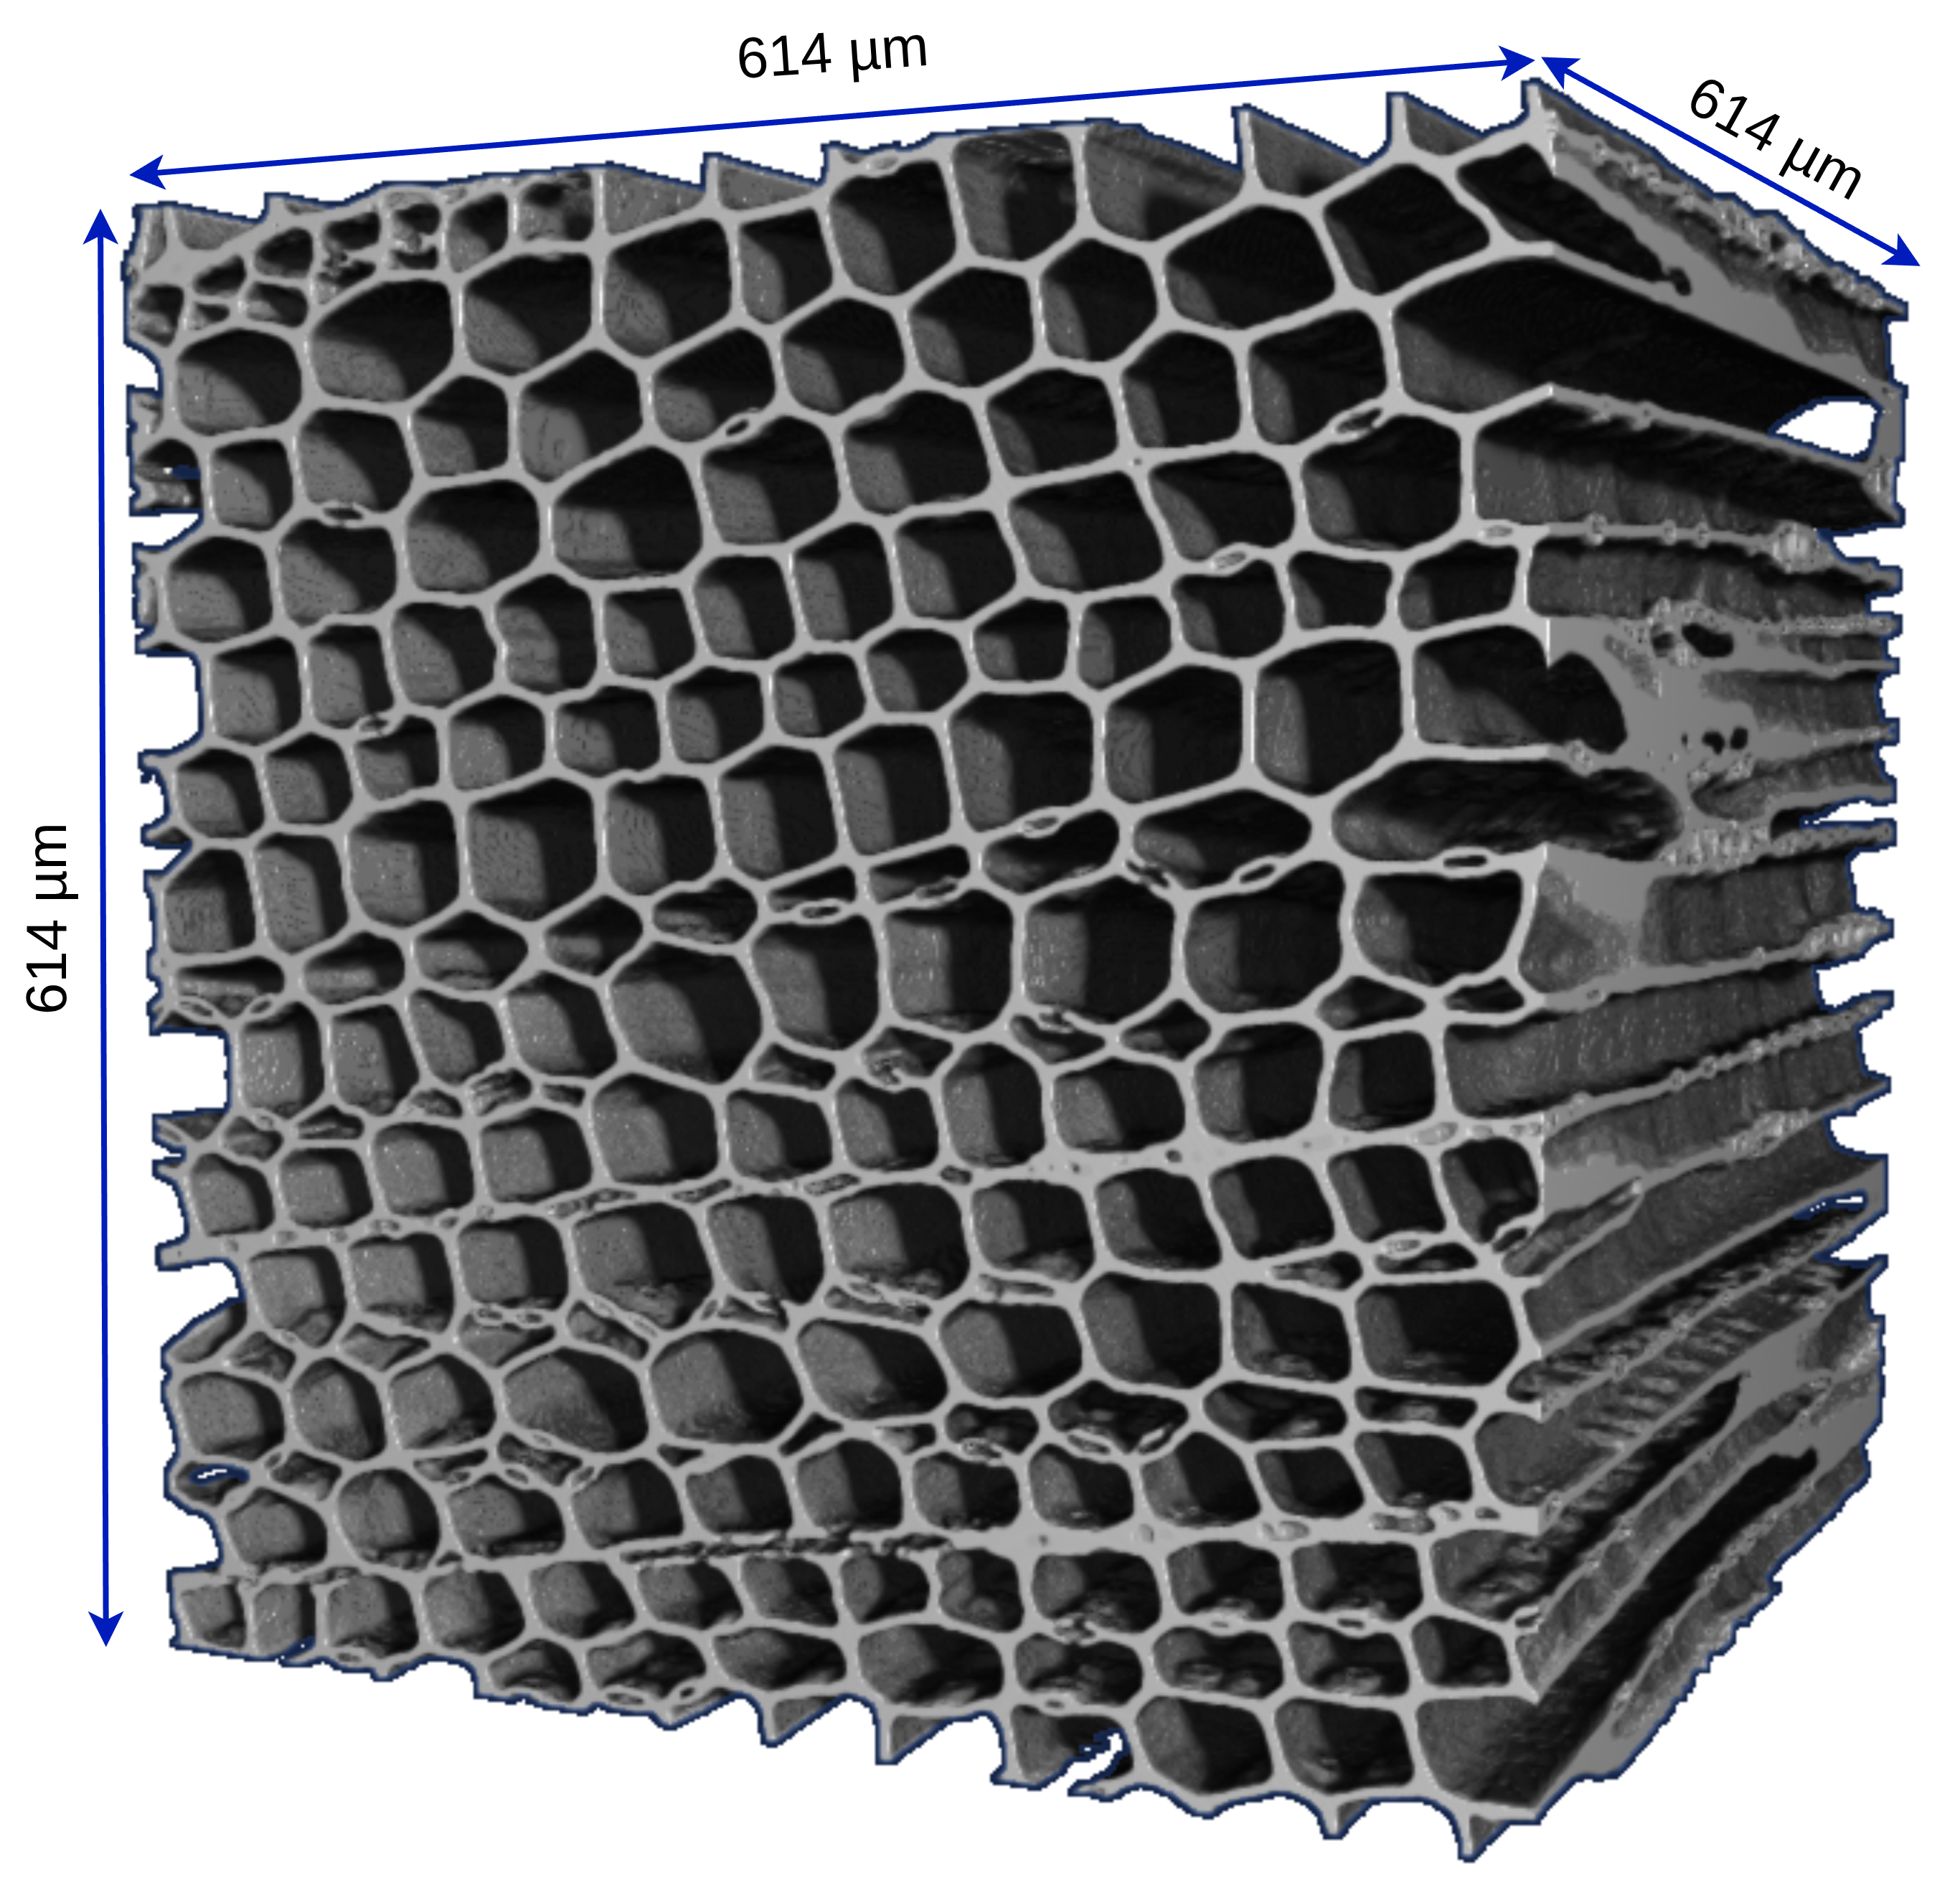
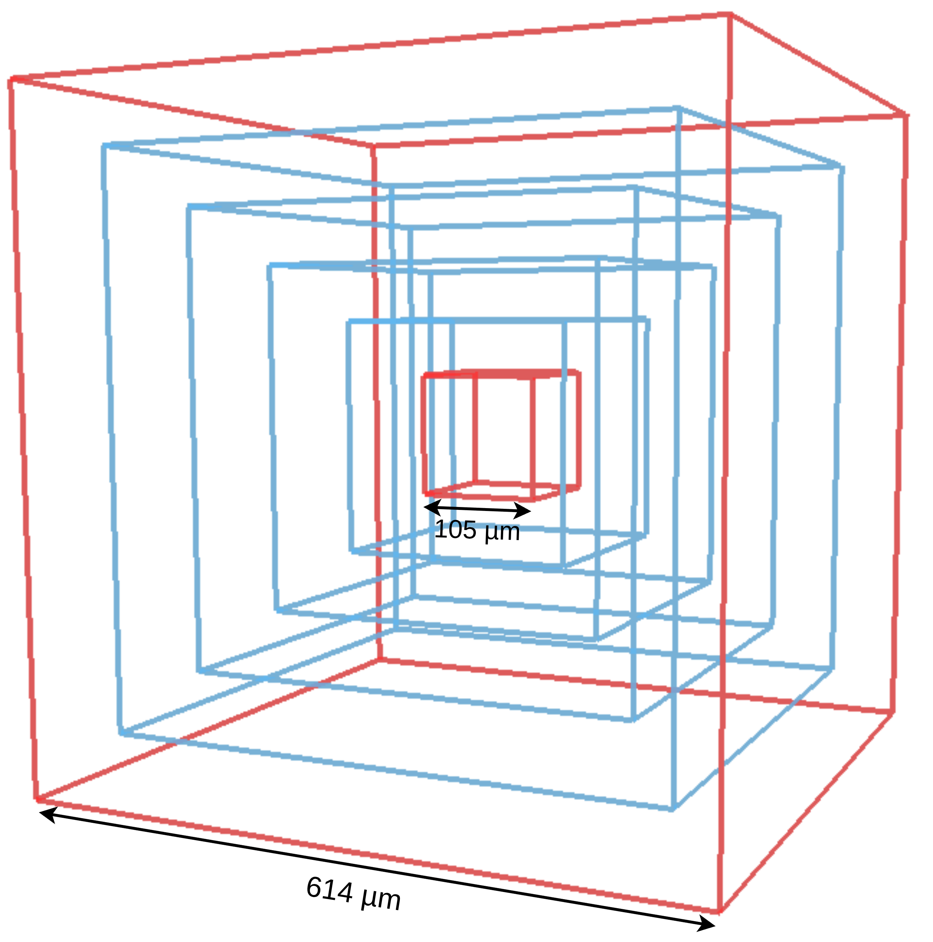
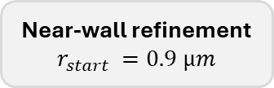

Numerical reliability: mesh, padding and REV
Work package 4 : Volume-averaged mathematical models
Work package 4 : Volume-averaged mathematical models
Mesh convergence
Padding-size convergence
Permeability-based REV
Adaptive mesh parameters selected from sensitivity analysis
Coarsening factor
$$c=4$$
Near-wall refinement
$$r_{start }=0.9 µm$$
Permeability variation
≤ 5%
Selected padding
24 µm inlet / outlet
Selected REV
390 µm cube
Accuracy-cost compromise for all final cases.
Boundary effects become negligible after the plateau.
Directional permeabilities stabilize with increasing cube size.
Final settings for permeability simulations
Adaptive voxel-hex mesh $(c=4, r_{start}=0.9 µm)$ + 24 µm padding + 390 µm REV cube
InterPore2026 - MS18

Slide 11
Results & discussion
InterPore2026 - MS18

Slide 12
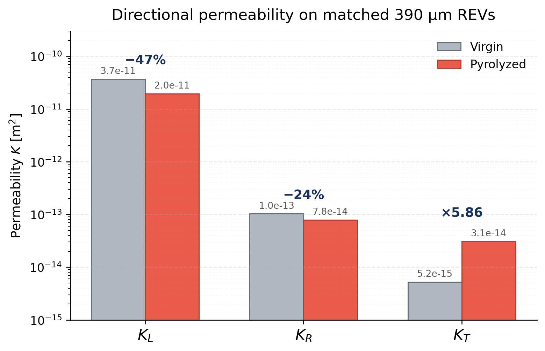









Pyrolysis strongly modifies the permeability tensor
Matched earlywood REVs: same anatomical region, same cube size (390 µm), before and after pyrolysis.
Directional permeability
Directional changes
Longitudinal $K_{L}$
-47%
Decrease
$3.7×{10}^{−11}$ → $2.0×{10}^{−11} m^{2}$
Radial $K_{R}$
-24%
Decrease
$1.0×{10}^{−13}$ → $7.8×{10}^{−14}$ $m^{2}$
Tangential $K_{T}$
×5.86
Increase
$5.2×{10}^{−15}$ → $3.1×{10}^{−14}$ $m^{2}$
Anisotropy is strongly reduced
$K_{L}/K_{R}$: 361 → 250
$K_{L}/K_{T}$: 7060 → 636
$K_{R}/K_{T}$: 19.6 → 2.55
Pyrolysis redistributes transport pathways instead of uniformly increasing permeability.
InterPore2026 - MS18

Slide 13
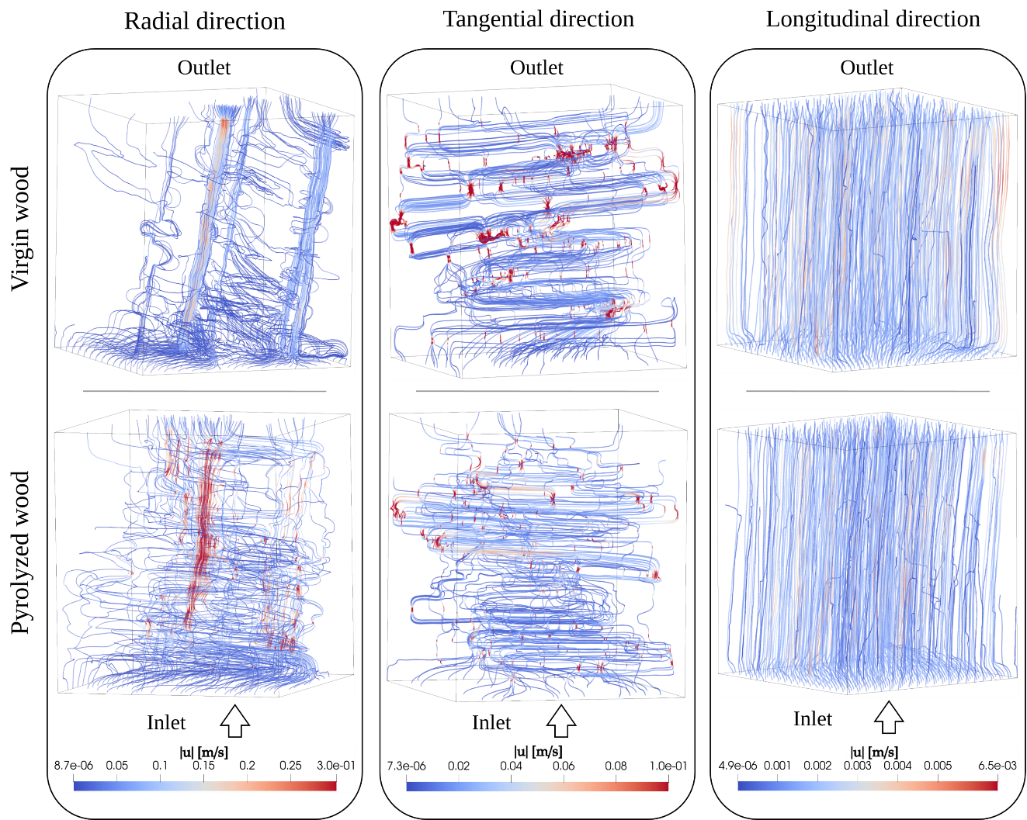
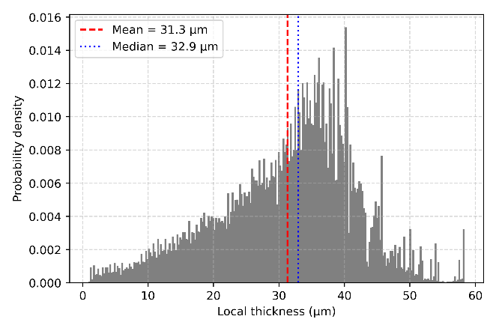
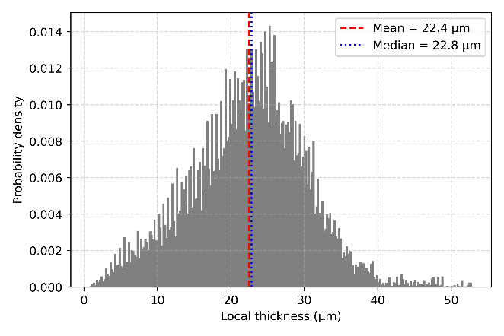
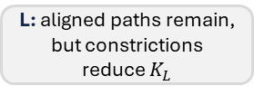
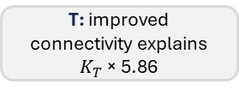

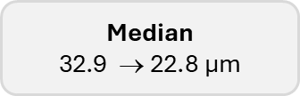
Why does permeability change after pyrolysis?
Work package 4 : Volume-averaged mathematical models
Work package 4 : Volume-averaged mathematical models
Microstructure evolves non-uniformly
Flow paths reorganize by direction
Virgin wood
Pyrolyzed wood
Local pore-opening thickness distribution
Porosity
76.9% → 78.3%
Median
$$\text{32.9} \text{→ }\text{22.8 µ}\text{m}$$
Porosity increases slightly, but pore openings shift toward smaller values
Interpretation
Pyrolysis redistributes pore constrictions and transverse connectivity rather than uniformly increasing permeability.
R: limited transverse links reduce $K_{R}$
T: improved connectivity explains $K_{T}$ × 5.86
L: aligned paths remain, but constrictions reduce $K_{L}$
InterPore2026 - MS18

Slide 14
Conclusions
InterPore2026 - MS18

Slide 15

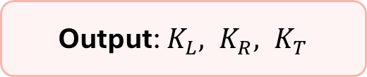


Conclusions
Work package 4 : Volume-averaged mathematical models
Work package 4 : Volume-averaged mathematical models
1. Image-based workflow
2. Anisotropic changes
3. Mechanism
Micro-CT → segmentation →
meshing → CFD
Longitudinal $K_{L}$
-47%
Constrictions
smaller local openings limit flow
Decrease
Radial $K_{R}$
-24%
Connectivity
transverse pathways are redistributed
Permeability tensor extraction from real 3D geometries
Decrease
Output: $K_{L}, K_{R}, K_{T}$
Tangential $K_{T}$
×5.86
Porosity alone does not explain the transport evolution.
Increase
Implication
Pyrolysis-induced permeability evolution must be treated as anisotropic and microstructure-dependent, not as a uniform scalar increase.
InterPore2026 - MS18

Slide 16
Thank you for your attention
InterPore2026 - MS18

Slide 17
Backup slides
InterPore2026 - MS18

Slide 18
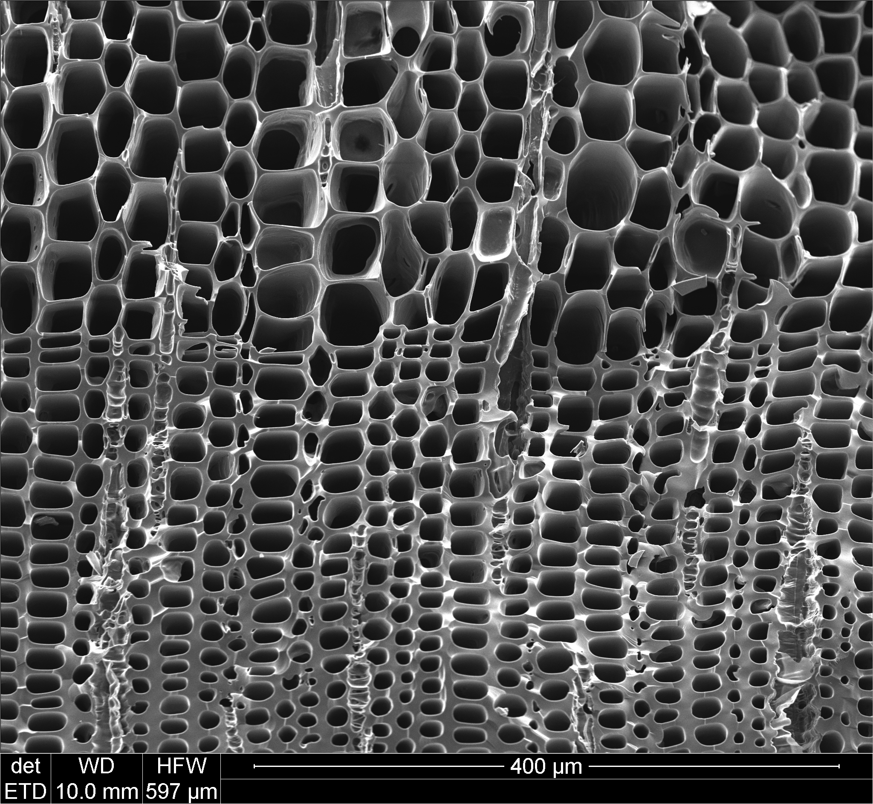
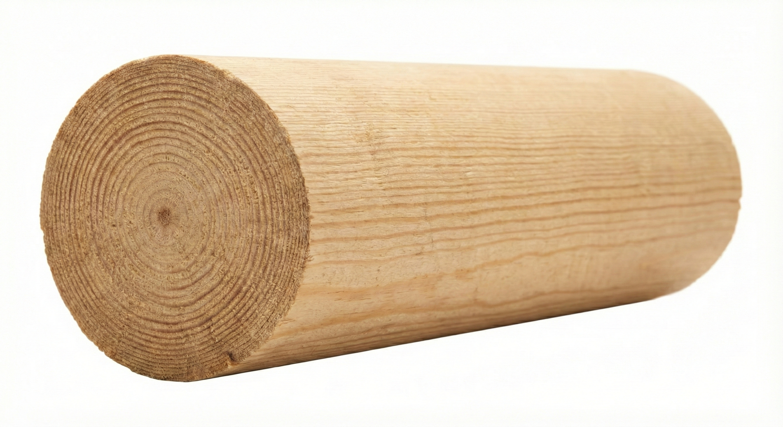
Microscale vs macroscale description
Work package 4 : Volume-averaged mathematical models
Work package 4 : Volume-averaged mathematical models
Pore-scale (micro) description
Macro-scale (engineering) description
Resolve the complex pore geometry and solid/gas interface.
Solve full conservation laws in each phase (mass, momentum, energy, species).
Too expensive for realistic geometries.
Use averaged fields (porosity, pressure, temperature, velocity).
Requires closure laws (e.g., permeability, interfacial transfer, momentum model).
Compute at the scale of the sample / reactor.
Homogenize
InterPore2026 - MS18

Slide 19
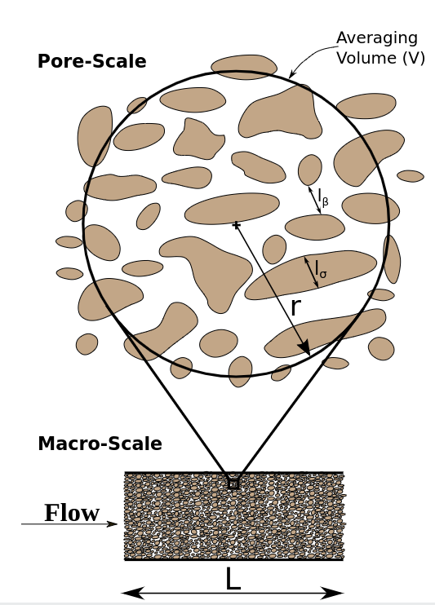

From micro to macro: Volume Averaging
Work package 4 : Volume-averaged mathematical models
Work package 4 : Volume-averaged mathematical models
Idea
Average microscopic conservation equations over a Representative Elementary Volume (REV).
Obtain macroscopic equations with additional terms (dispersion, interfacial source terms, closure parameters).
Requires a scale-separation assumption:
l_{β}: characteristic length of phase β
l_{σ}: characteristic length of phase σ
r: REV size (radius/length)
[1]
[1]: Scandelli, H. "Multi-Scale Modeling of Wood Shrinkage During Pyrolysis," Arts et Métiers Institute of Technology. Unpublished.
InterPore2026 - MS18

Slide 20
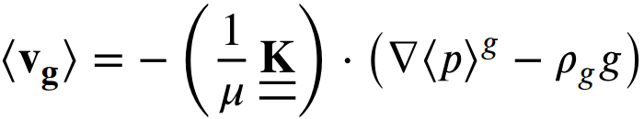
Current macroscopic momentum model: Darcy's law
Work package 4 : Volume-averaged mathematical models
Work package 4 : Volume-averaged mathematical models
In many pyrolysis models, gas momentum conservation in the porous medium is modeled with:
Darcy's law
Typical validity assumptions
Creeping flow (Re << 1), negligible inertia
Rigid porous skeleton, fixed interface
Continuum no-slip valid (Kn << 1)
No mass injection at the solid/gas interface
Steady state
Incompressible flow
Pyrolysis-specific physics
Mass exchange at the solid/gas interface: non-zero normal gas velocity (blowing).
Non-rigid porous medium: evolving pores and moving interfaces.
Possible Re >1 locally: inertia corrections may matter.
Compressible and unsteady flow under strong heating and gas release.
Potential slip-flow effects in small pores (rarefaction effects)
InterPore2026 - MS18

Slide 21

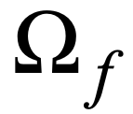
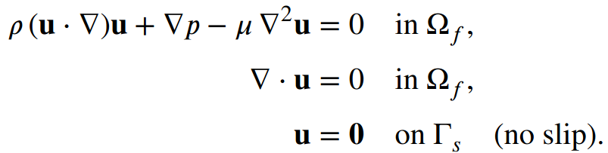


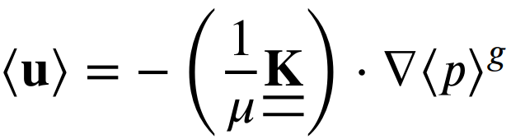
Numerical procedure for evaluating permeability tensor
Work package 4 : Volume-averaged mathematical models
Work package 4 : Volume-averaged mathematical models
Pore scale
Pore-scale problem
Volume averaging
Darcy's law
InterPore2026 - MS18

Slide 22
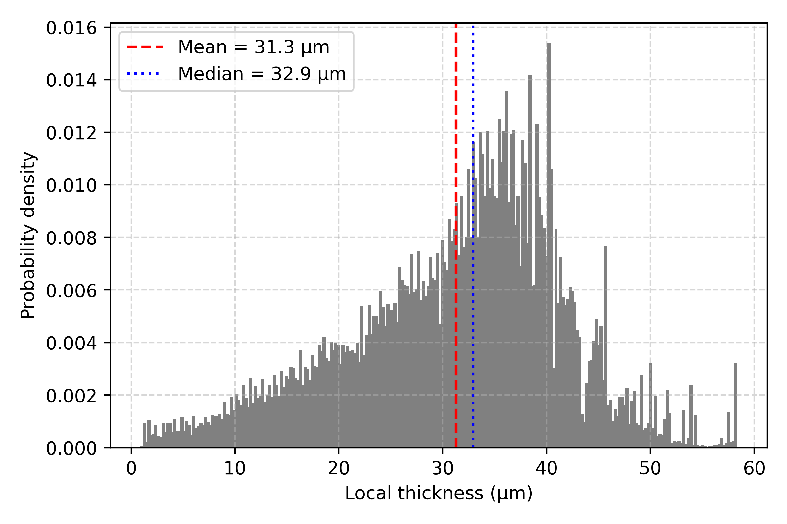
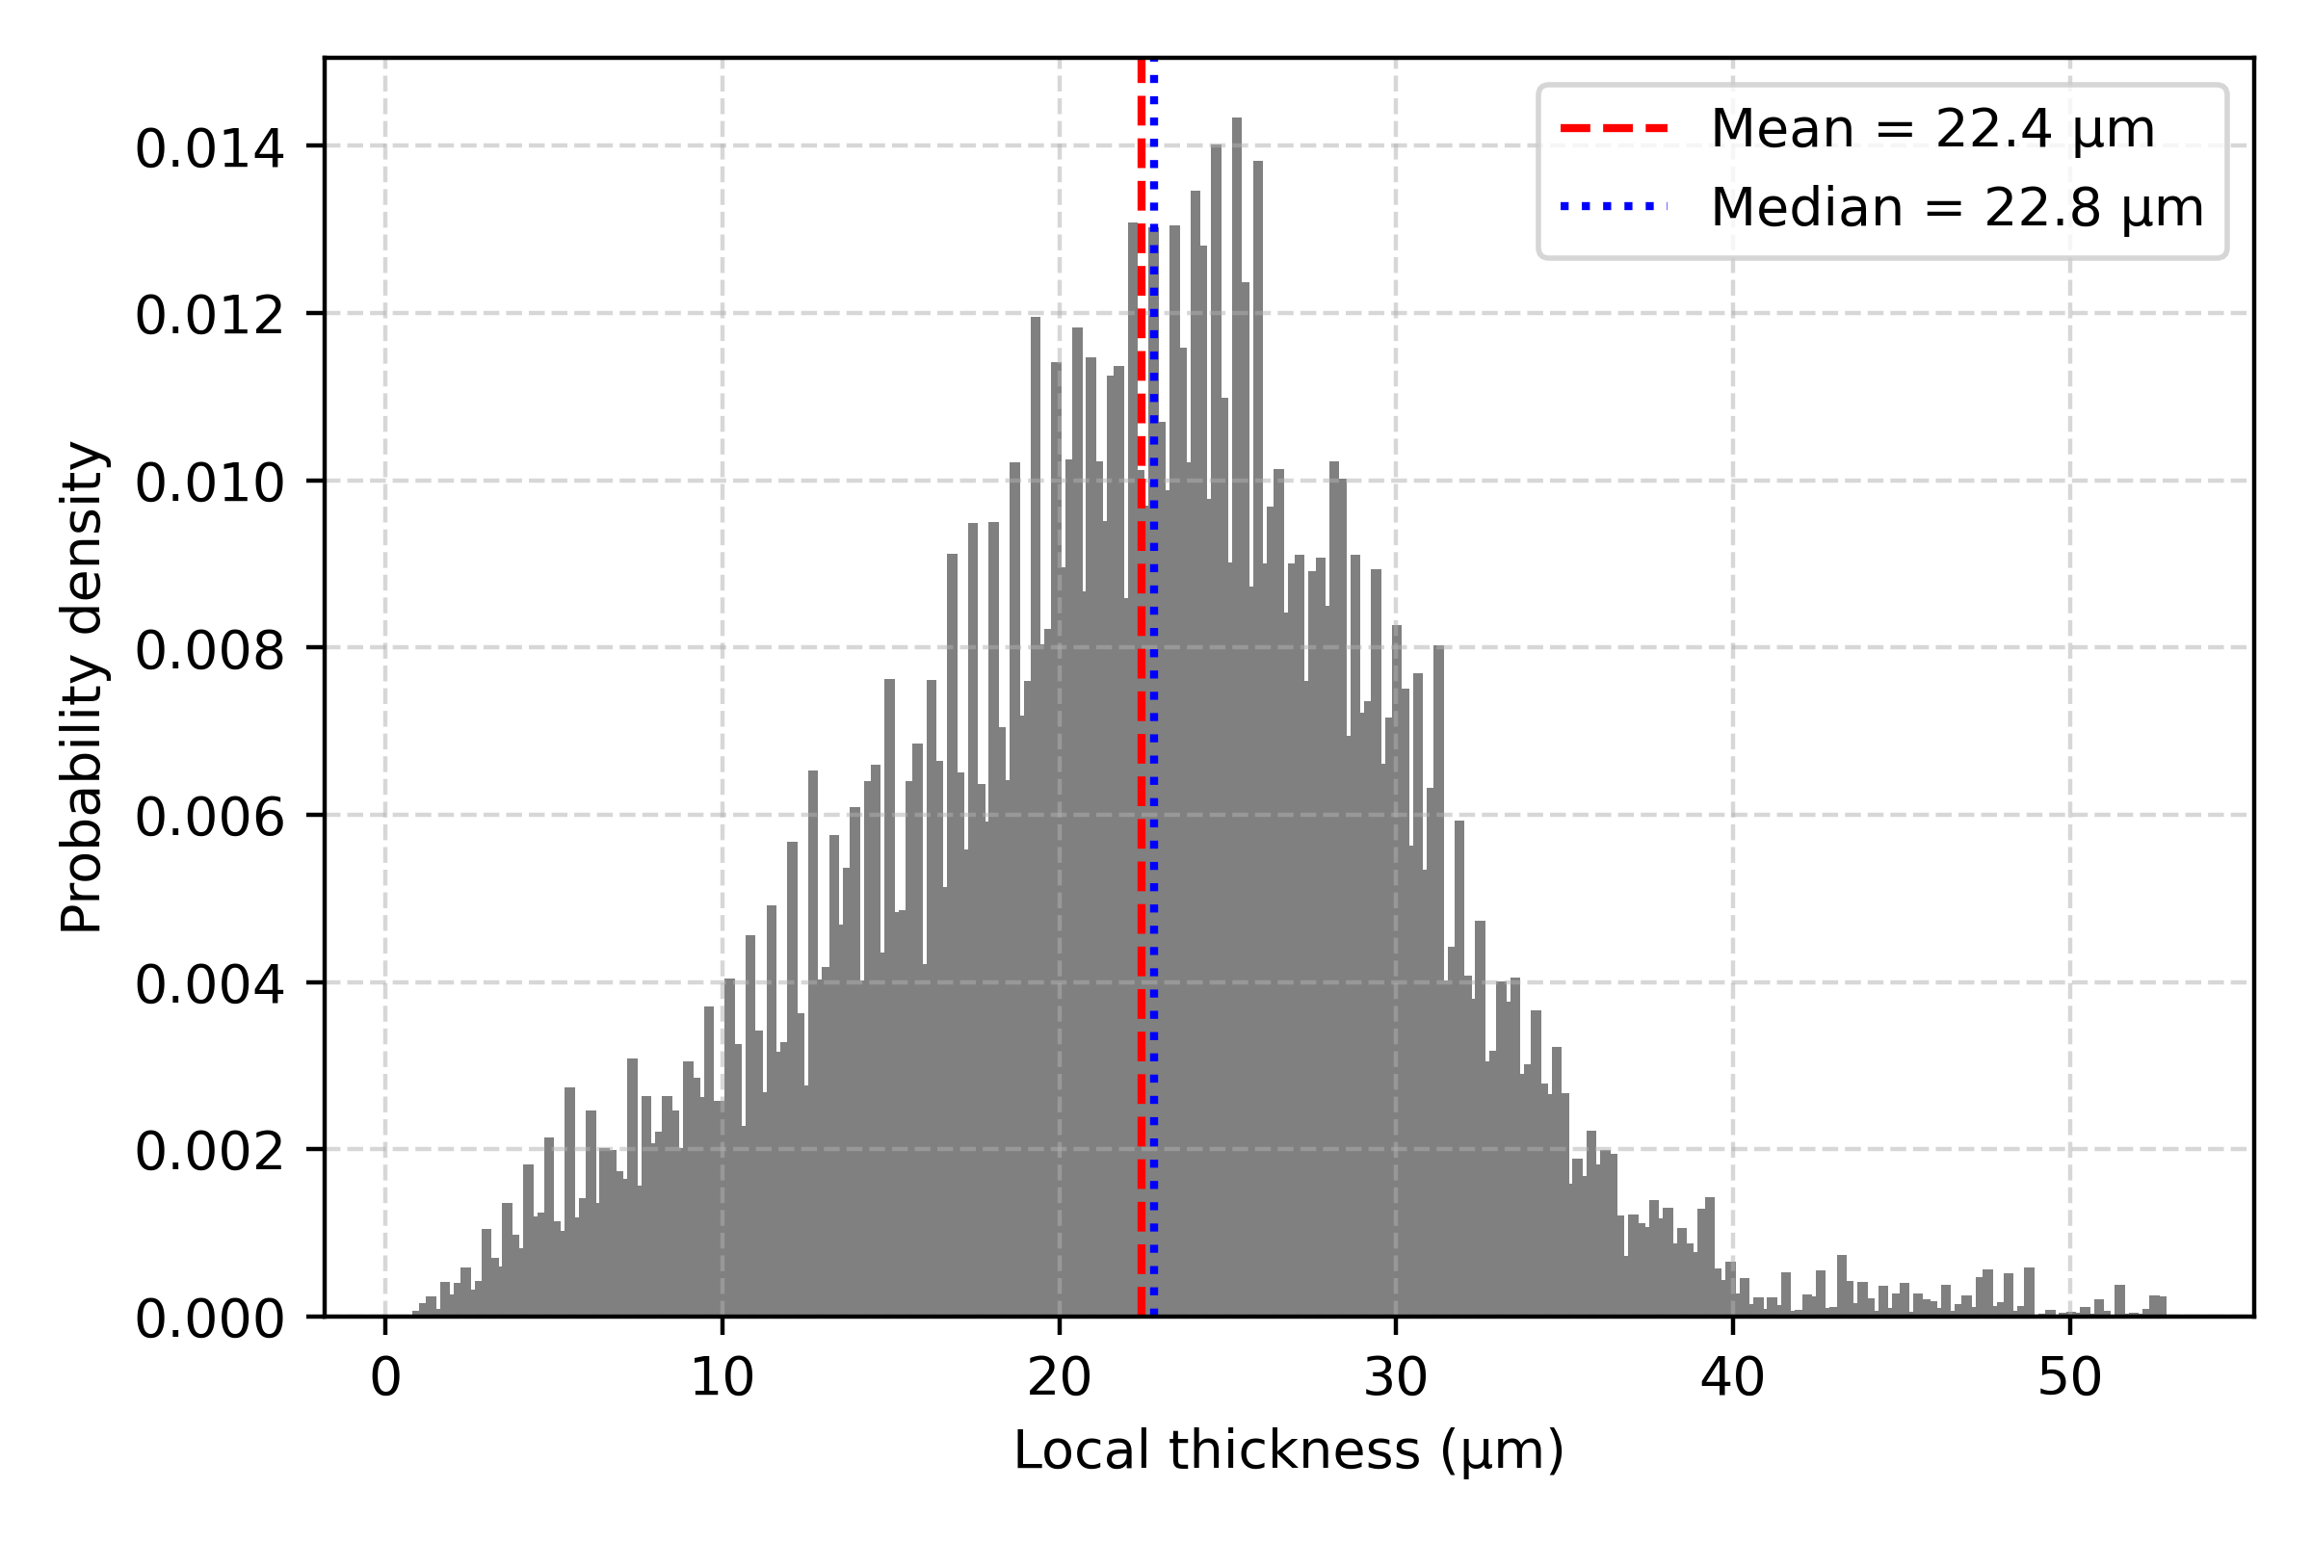
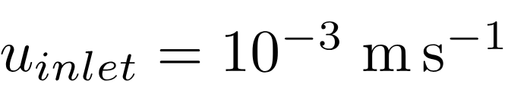


Creeping-flow verification and pore-thickness statistics
Work package 4 : Volume-averaged mathematical models
Work package 4 : Volume-averaged mathematical models
Virgin wood
Pyrolyzed wood
For and the Reynolds number is equal to
InterPore2026 - MS18

Slide 23


Mesh convergence Tables
Work package 4 : Volume-averaged mathematical models
Work package 4 : Volume-averaged mathematical models
Coarsening factor
Near-wall refinement threshold
InterPore2026 - MS18

Slide 24


Comparison with the literature and directional Knudsen number
Work package 4 : Volume-averaged mathematical models
Work package 4 : Volume-averaged mathematical models
Comparison with literature
Directional Knudsen number
InterPore2026 - MS18

Slide 25

Wood Main-orthotropic directions
Work package 4 : Volume-averaged mathematical models
Work package 4 : Volume-averaged mathematical models
Wood orthotropic directions
[3]
[3] Royuela, José Luis & Majano-Majano, Almudena & Lara-Bocanegra, Antonio José & Xavier, José & De Moura, Marcelo. (2022). Evaluation of R -curves and cohesive law in mode I of European beech. Theoretical and Applied Fracture Mechanics. 118. 103220. 10.1016/j.tafmec.2021.103220.
InterPore2026 - MS18

Slide 26

U-Net model training parameters
Work package 4 : Volume-averaged mathematical models
Work package 4 : Volume-averaged mathematical models
U-Net training settings
InterPore2026 - MS18

