Slide 1

RANDOM-WALK SIMULATION METHODS FOR THE MODELING OF BALLISTIC/DIFFUSIVE HEAT AND MASS TRANSFER IN EVOLVING POROUS MEDIA
Gérard Vignoles
Laboratoire des Composites Thermostructuraux
3 allée de la Boétie – Pessac – France
20260520_Vignoles_Interpore_ Nantes

Slide 2
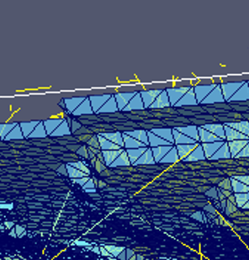
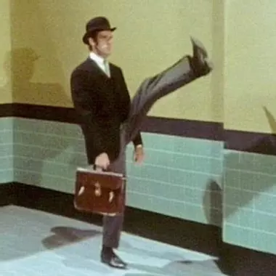
CONTENTS
Context
Problems
Methods
Some results
Outlook
May 20, 2026
Vignoles - Interpore 2026, Nantes
2

Slide 3
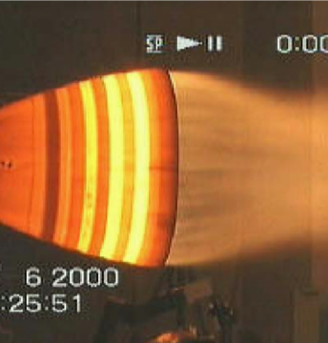
CONTEXT
May 20, 2026
Vignoles - Interpore 2026, Nantes
3

Slide 4
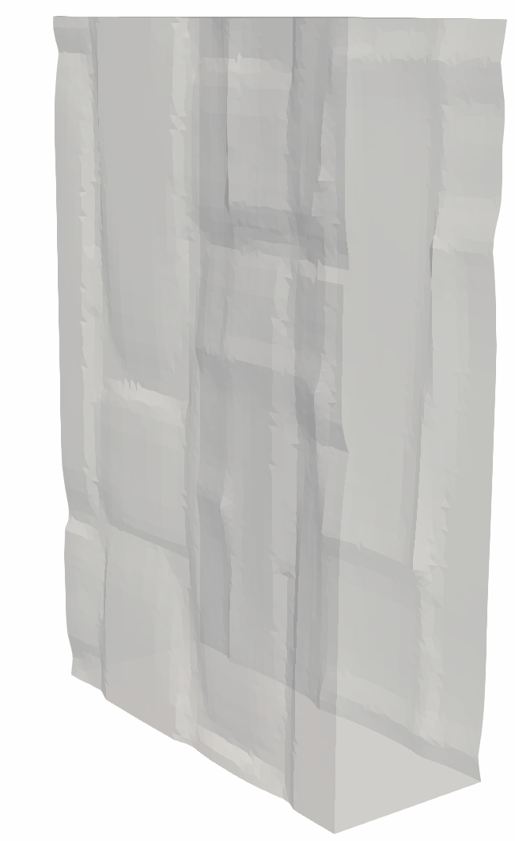
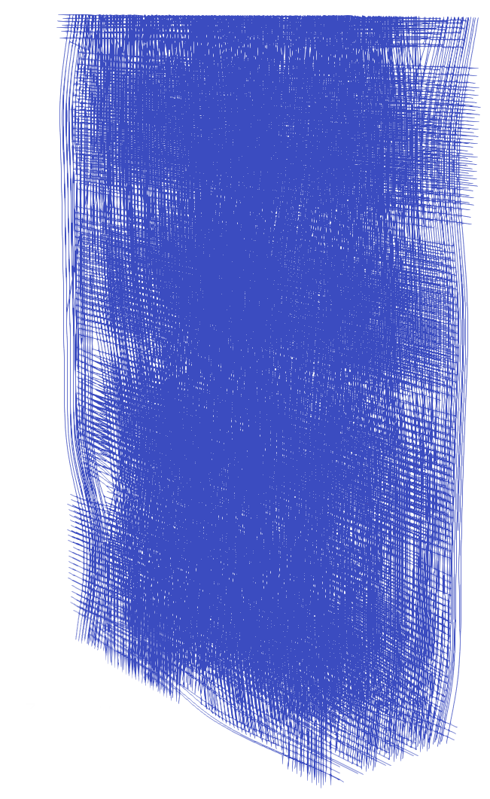
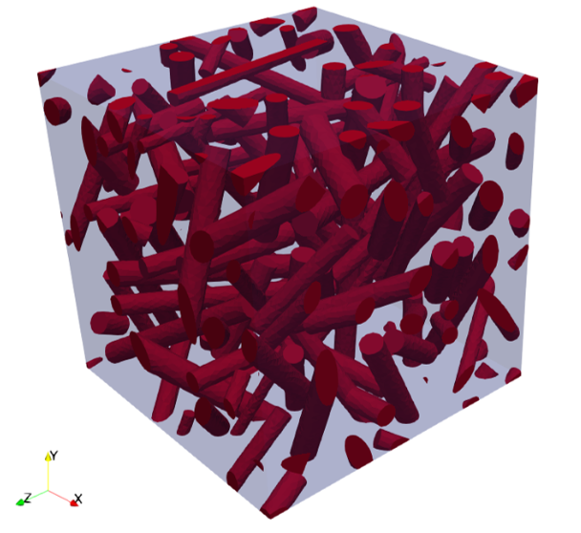
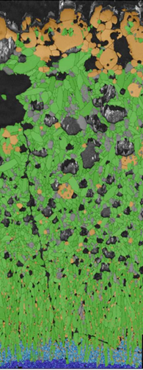
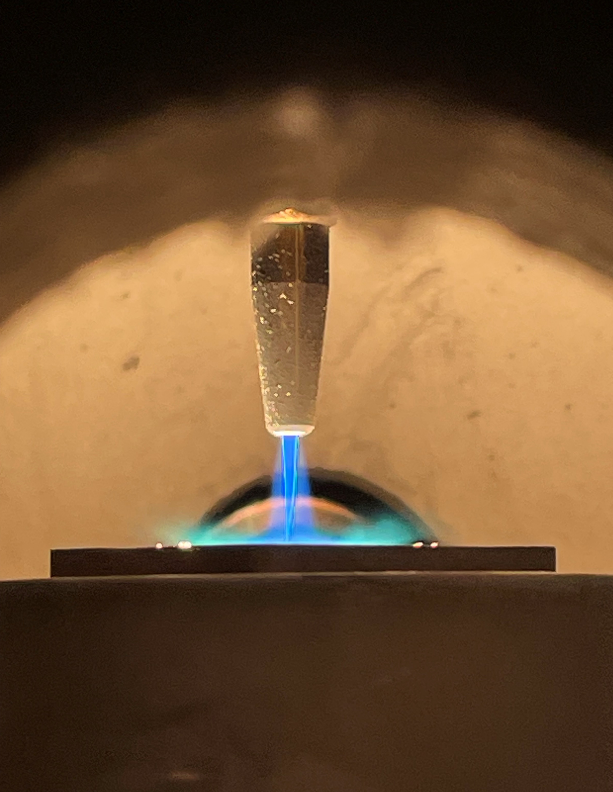
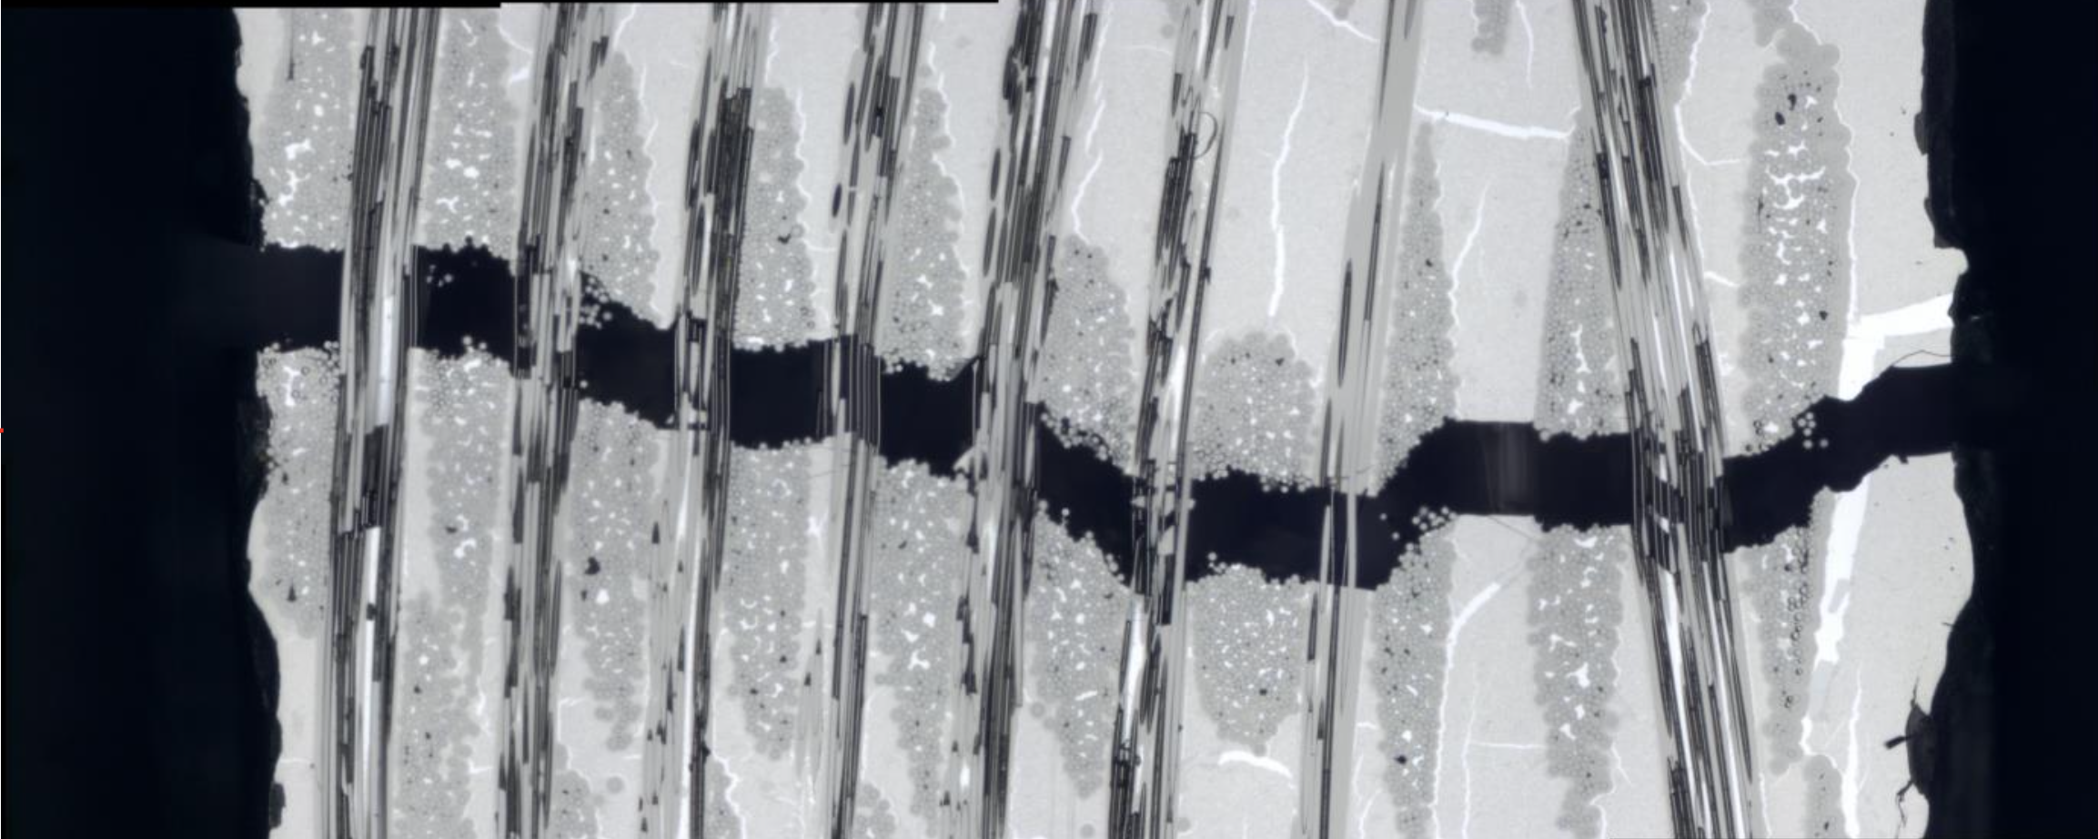

LABORATOIRE DES COMPOSITES THERMOSTRUCTURAUX
LABORATORY FOR THERMOSTRUCTURAL COMPOSITES
38 years of joint research & innovation
May 20, 2026
Vignoles - Interpore 2026, Nantes
4

Slide 5
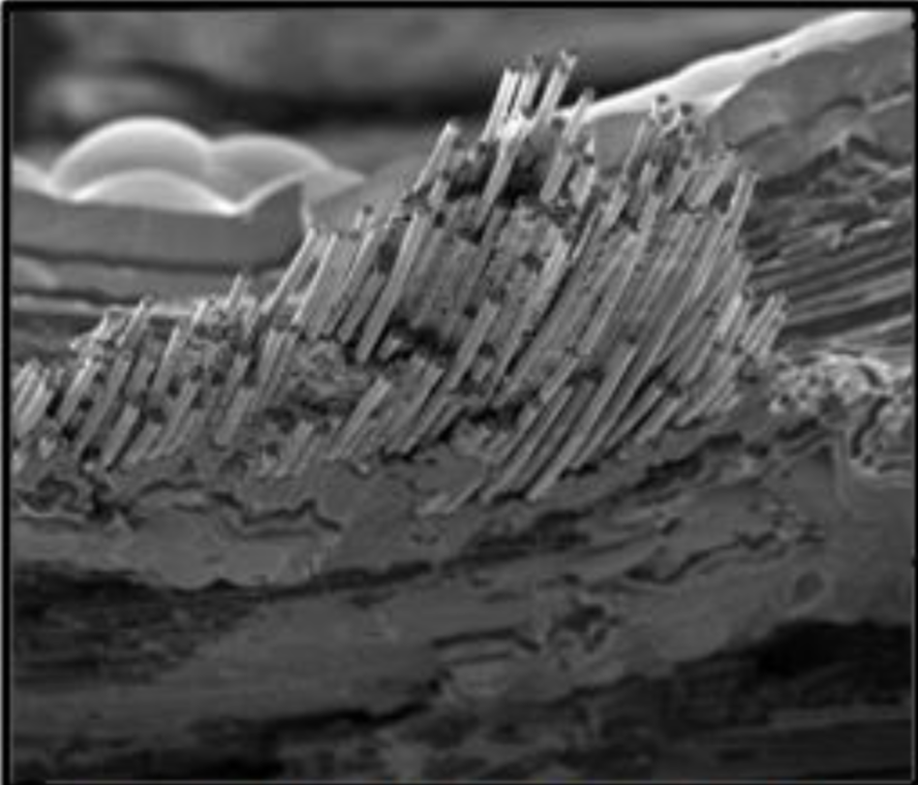
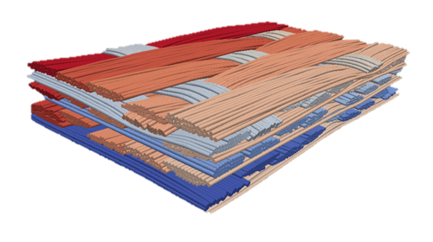
WHAT ARE THERMOSTRUCTURAL COMPOSITES ?
Ceramic-Matrix Composites(CMC)
Reinforced by ceramic fibers
Interphase between fibers and matrix
Non-brittle, even though having brittle components !
And, of course : stiff & refractory
May 20, 2026
Vignoles - Interpore 2026, Nantes
5

Slide 6
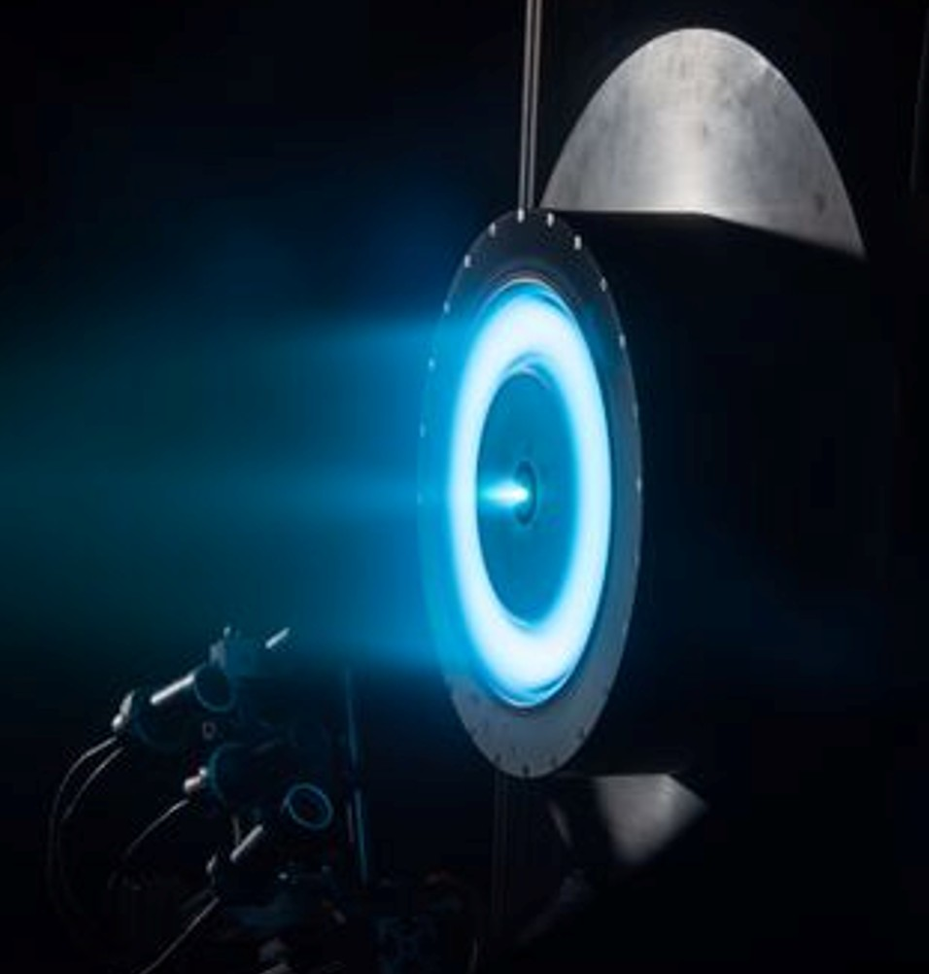
APPLICATIONS
Current
Space propulsion: nozzle throat, divergent
Brakes for aviation and racing cars
Thermal protection systems
Ionic propulsion
Industry
Future
Aircraft propulsion
Nuclear (fission, fusion)
Other energies
May 20, 2026
Vignoles - Interpore 2026, Nantes
6

Slide 7
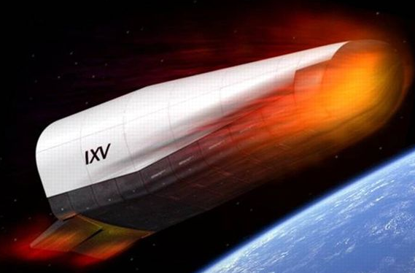
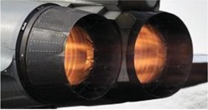
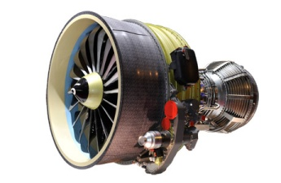
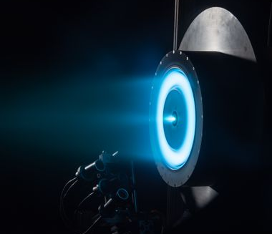
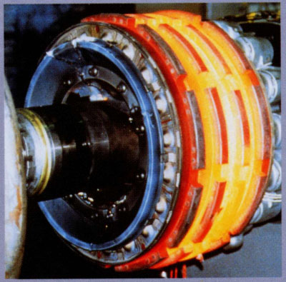
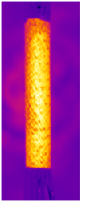
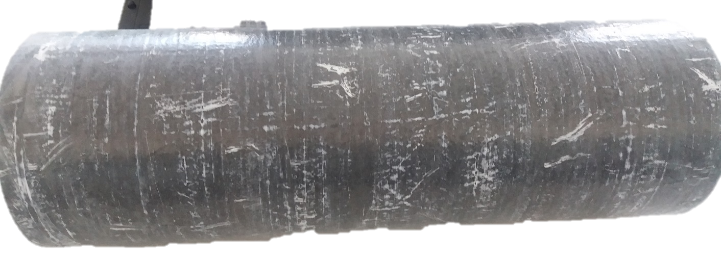
Application spectrum of CMCs
Service temperature (°C)
3000
Space technology
2000
Military aircraft propulsion
Civil aircraft propulsion
1000
Ion thrusters
Brakes
Nuclear, Industrial
Adv. civil eng.
0
Minute
Hour
Day
Month
Year
Decade
Century
Duration
May 20, 2026
Vignoles - Interpore 2026, Nantes
7

Slide 8
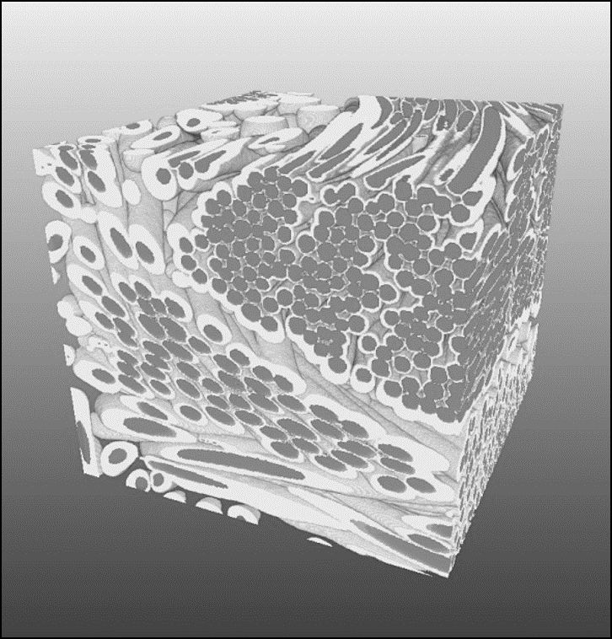
PROBLEMS
May 20, 2026
Vignoles - Interpore 2026, Nantes
8

Slide 9
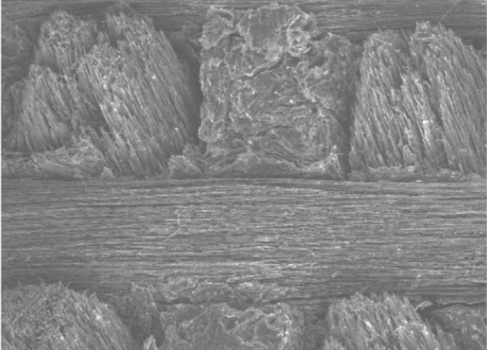
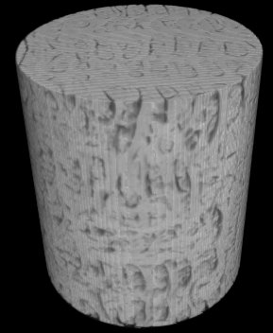
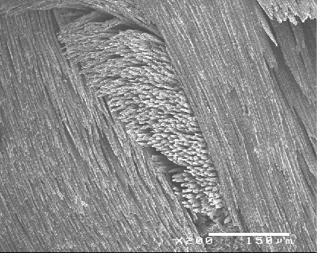
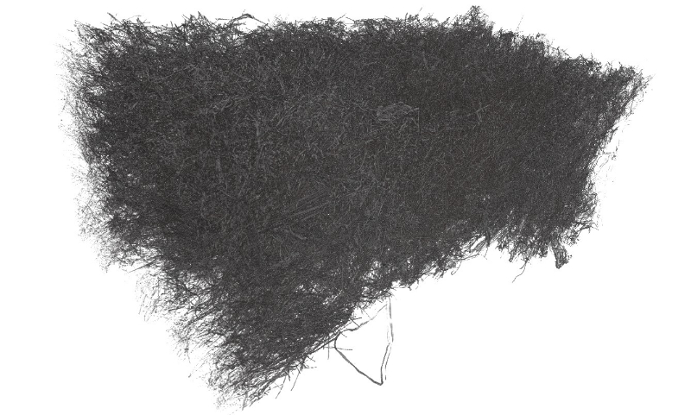
ABLATIVE C_{F}/C MATERIALS
Compact (almost non-porous) materials
  3D C/C
  Needle-punched « 2.5D » C/C
Porous ablators
  Pyrolyzed C/resin
  Felts (eg. Mersen’s Calcarb ®)
  3D C/C
  Needle-punched « 2.5D » C/C
  Pyrolyzed C/resin
Felts (eg. Mersen’s Calcarb ®)
May 20, 2026
Vignoles - Interpore 2026, Nantes
9

Slide 10
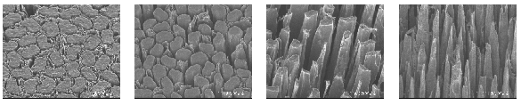
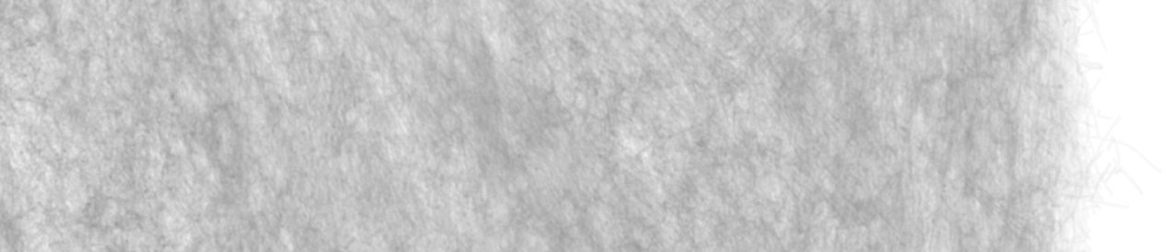
ABLATION
Surface becomes rough
modifies fluxes and ablation rate
Porous ablators acquire an affected depth
linked to effective rate
May 20, 2026
Vignoles - Interpore 2026, Nantes
10

Slide 11
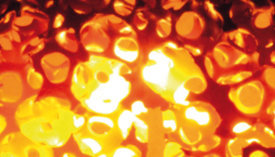
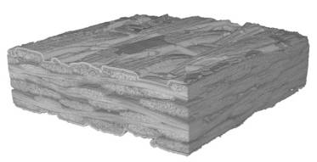
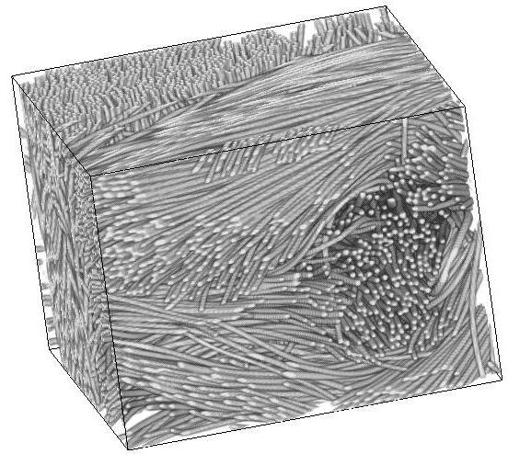
HIGH-TEMPERATURE HEAT TRANSFER
Applications
  Thermal gradients in CVI
  Thermal protection systems for atmospheric reentry
  Heat management in nuclear & CSP power plants
Materials
  Ceramic foams
  Fibrous media
  Ceramic-matrix composites
Very porous, large pores
large contribution of radiation even at moderate temperatures
May 20, 2026
Vignoles - Interpore 2026, Nantes
11

Slide 12
PURPOSE OF THE MODELING APPROACH
Work on 3D images → as close as possible to the « actual material »
Ablation
Account for diffusion/reaction competition
Describe morphological evolution of the material
Obtain information on evolution kinetics & evolving effective properties
Heat transfer
Account for radiation/conduction competition
Obtain morphology/effective properties relationships
Large computational domains :
Memory requirements
Interest of Random-walks methods
May 20, 2026
Vignoles - Interpore 2026, Nantes
12

Slide 13
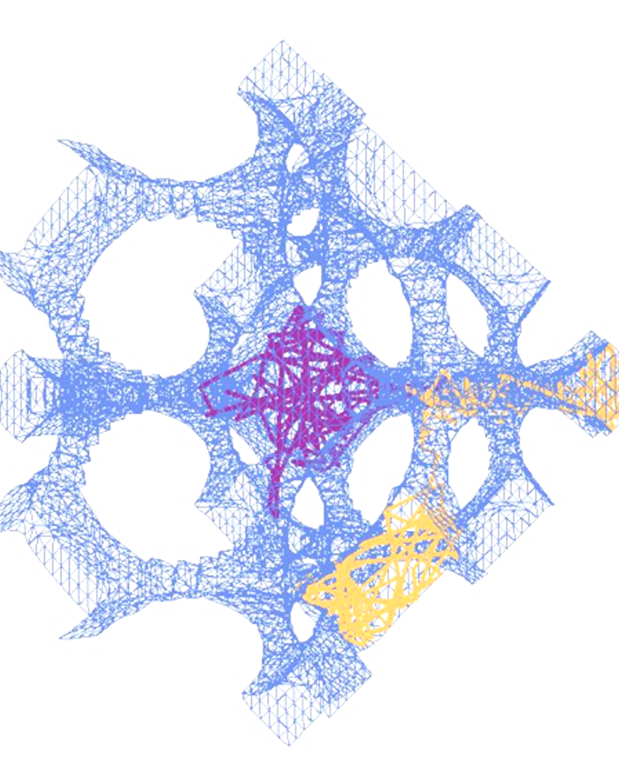
METHODS
May 20, 2026
Vignoles - Interpore 2026, Nantes
13

Slide 14
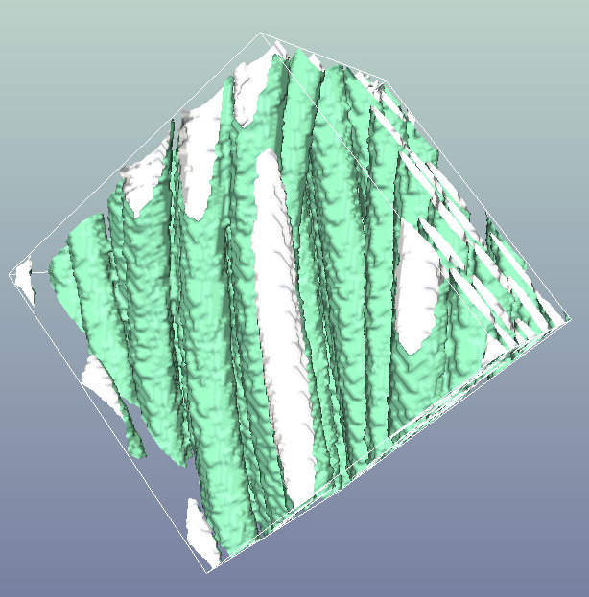
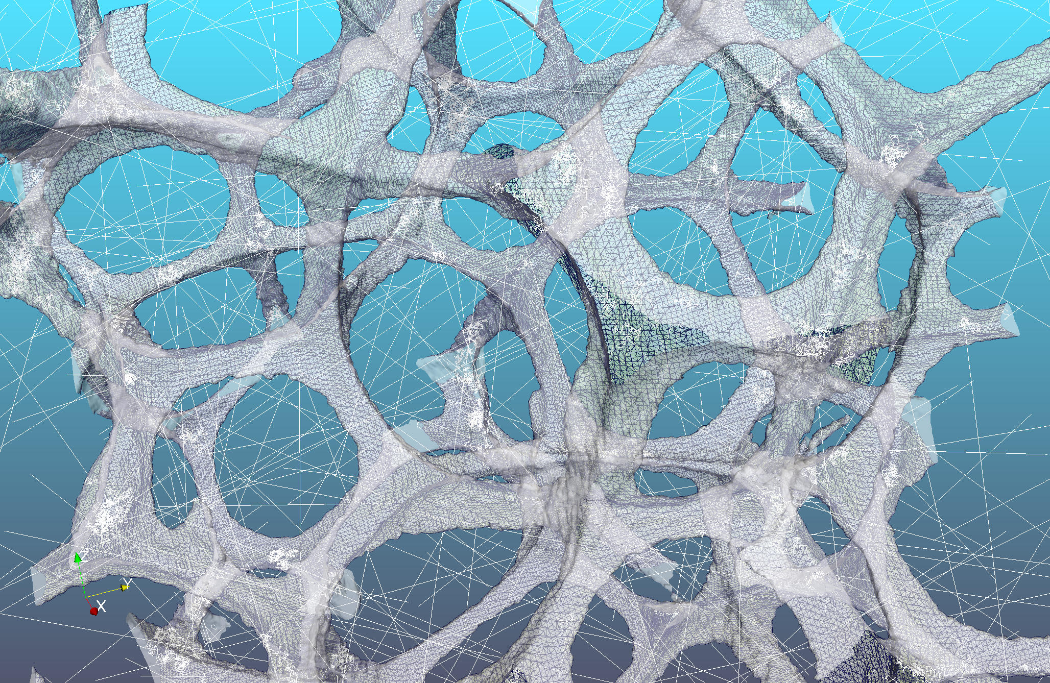
PHENOMENA – « small scale »
Mass transfer
Solid/gas are clearly distinguished
Gas may be rarefied => address kinetic theory of gases
Ordinary diffusion : Brownian motion
Deposition/ablation are interfacial phenomena
Growth/recession: Moving fronts
Heat transfer
Radiative cavities are distinguished
Radiative transfer : analogous to rarefied gas transfer
Conductive transfer : analogous to ordinary gas diffusion
Exchange conditions between void and solid : analogous to « handling sticking events »
May 20, 2026
Vignoles - Interpore 2026, Nantes
14

Slide 15
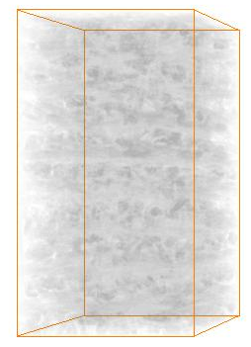
PHENOMENA – « large scale »
Mass transfer
Continuous field of solid mass fraction
Gas described by its effective anisotropic diffusion coefficient
Ordinary diffusion : Brownian motion
Deposition/ablation are volumic and surfacic phenomena
Growth/recession: evolving porosity and moving fronts
Heat transfer
Continuous field of anisotropic conductivity
Radiative transfer : only as a conductivity modifier
Conductive transfer : analogous to ordinary gas diffusion
Exchange conditions between void and solid : analogous to « handling sticking events »
May 20, 2026
Vignoles - Interpore 2026, Nantes
15

Slide 16
EQUATIONS AND METHODS at two scales
Mass transfer
Boltzmann kinetic equation: « Kinetic » (or Pearson) random walk
Diffusion equation for solid : « Brownian » random walk
Reaction: notion of « sticking probability »
Heat transfer
Kinetic equation for radiation : « Kinetic » random walk (or simple ray-tracing)
Diffusion/conduction equation for solid : « Brownian » random walk
Rad./Cond. exchange: « transition probability »
May 20, 2026
Vignoles - Interpore 2026, Nantes
16

Slide 17
Fiber-scale infiltration modeling
Random walk w/ reaction and surface growth
1
Start of time process
Random position
Random direction
Isotropic distribution
1
2
Binary collision
Time until next collision
Random direction
3
Isotropic distribution
3
Wall collision without reaction
2
1
Random direction
4
Knudsen’s cosine law
4
Wall collision with reaction
Random position and direction
+
1
Binary collision
Wall collision
Voxel borders
End of time process
G. L. VIGNOLES, W. ROS, C. MULAT, O. COINDREAU, C. GERMAIN, Comput. Mater. Sci. 50, 1157-1168 (2011)
Notes:
17

Slide 18
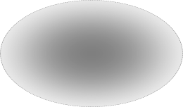

Large-scale Infiltration Modelling
Itô-Taylor random walks
Diffusion tensor D
computed in each voxel from
greyscale value (density)
and local fiber orientation
Diffusive step : random
direction w/ anisotropic
Gaussian distribution
following D
Advective step following
div.D (heterogeneity)
« Russian roulette » for deposition reaction
G. L. VIGNOLES, W. ROS, I. SZELENGOWICZ, C. GERMAIN, Comput.l Mater. Sci. 50, 1871-1878. (2011)

Slide 19
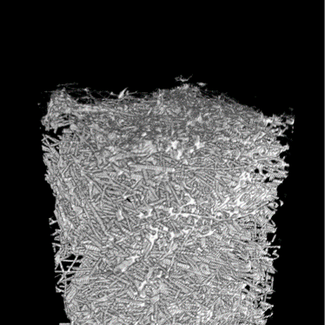
RESULTS - PART 1
Ablation of a fibrous preform
May 20, 2026
Vignoles - Interpore 2026, Nantes
19

Slide 20



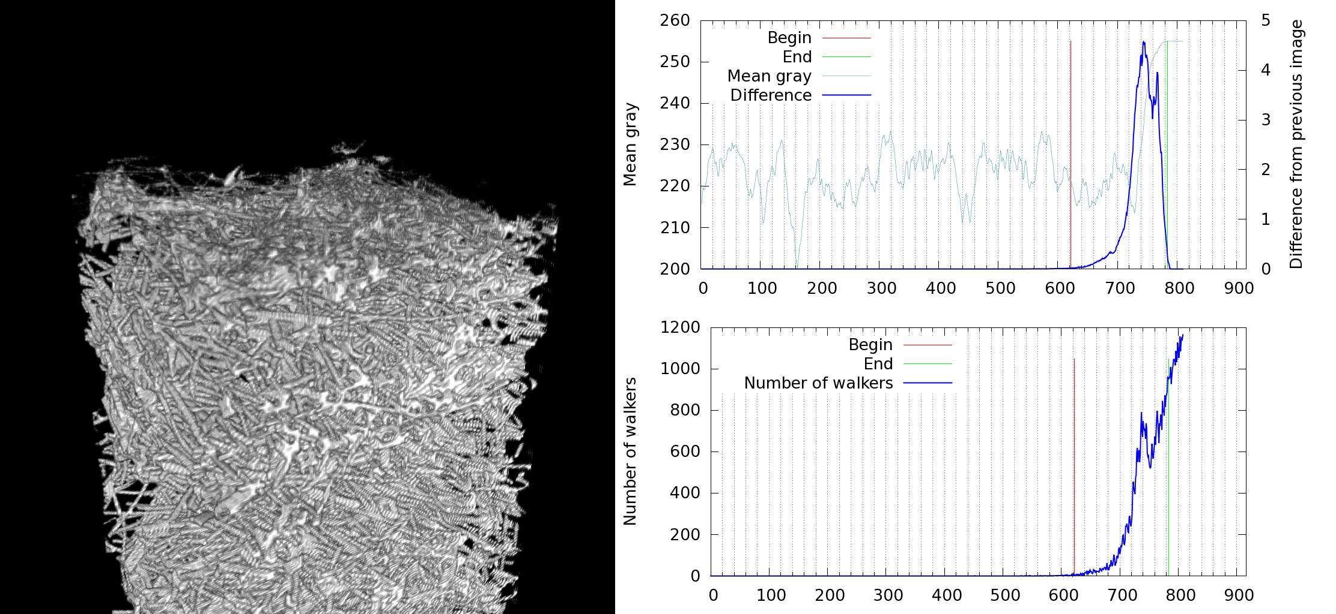
Ablation simulations: porous felts
G. L. VIGNOLES et al., Carbon (2018), vol. 134, pp. 376–390.
Nitrogen plasma ablation testing on carbon preforms
New analytical and numerical models
Affected depth observation
& measurement
Intrinsic rate constants
Rebuilt flow conditions
Measured recession rate
Effective rate constants
May 20, 2026
Vignoles - Interpore 2026, Nantes
20

Slide 21
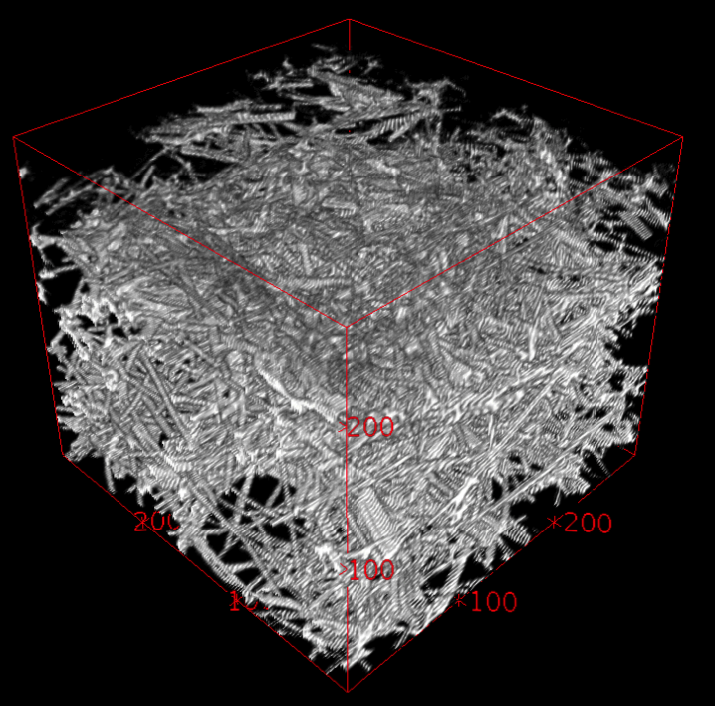
DETAILED NUMERICAL MODEL
FOR ABLATION
G. L. VIGNOLES et al., Carbon (2018), vol. 134, pp. 376–390.
What does it solve ?
Diffusion-reaction equation (1 species ; ablation + recombination)
+ surface recession equation (solid)
Single boundary condition : fixed conc. at a given distance above surface
Parameters: D, k_{nit}, k_{rec} (diffusion & reaction constants)
Random walk « engine »
Brownian walkers ➔ continuum diffusion
Simplified Marching Cube
Output
Effective ablation depth
Effective reaction rate = impinging mole flux /surface concentration
May 20, 2026
Vignoles - Interpore 2026, Nantes
21

Slide 22
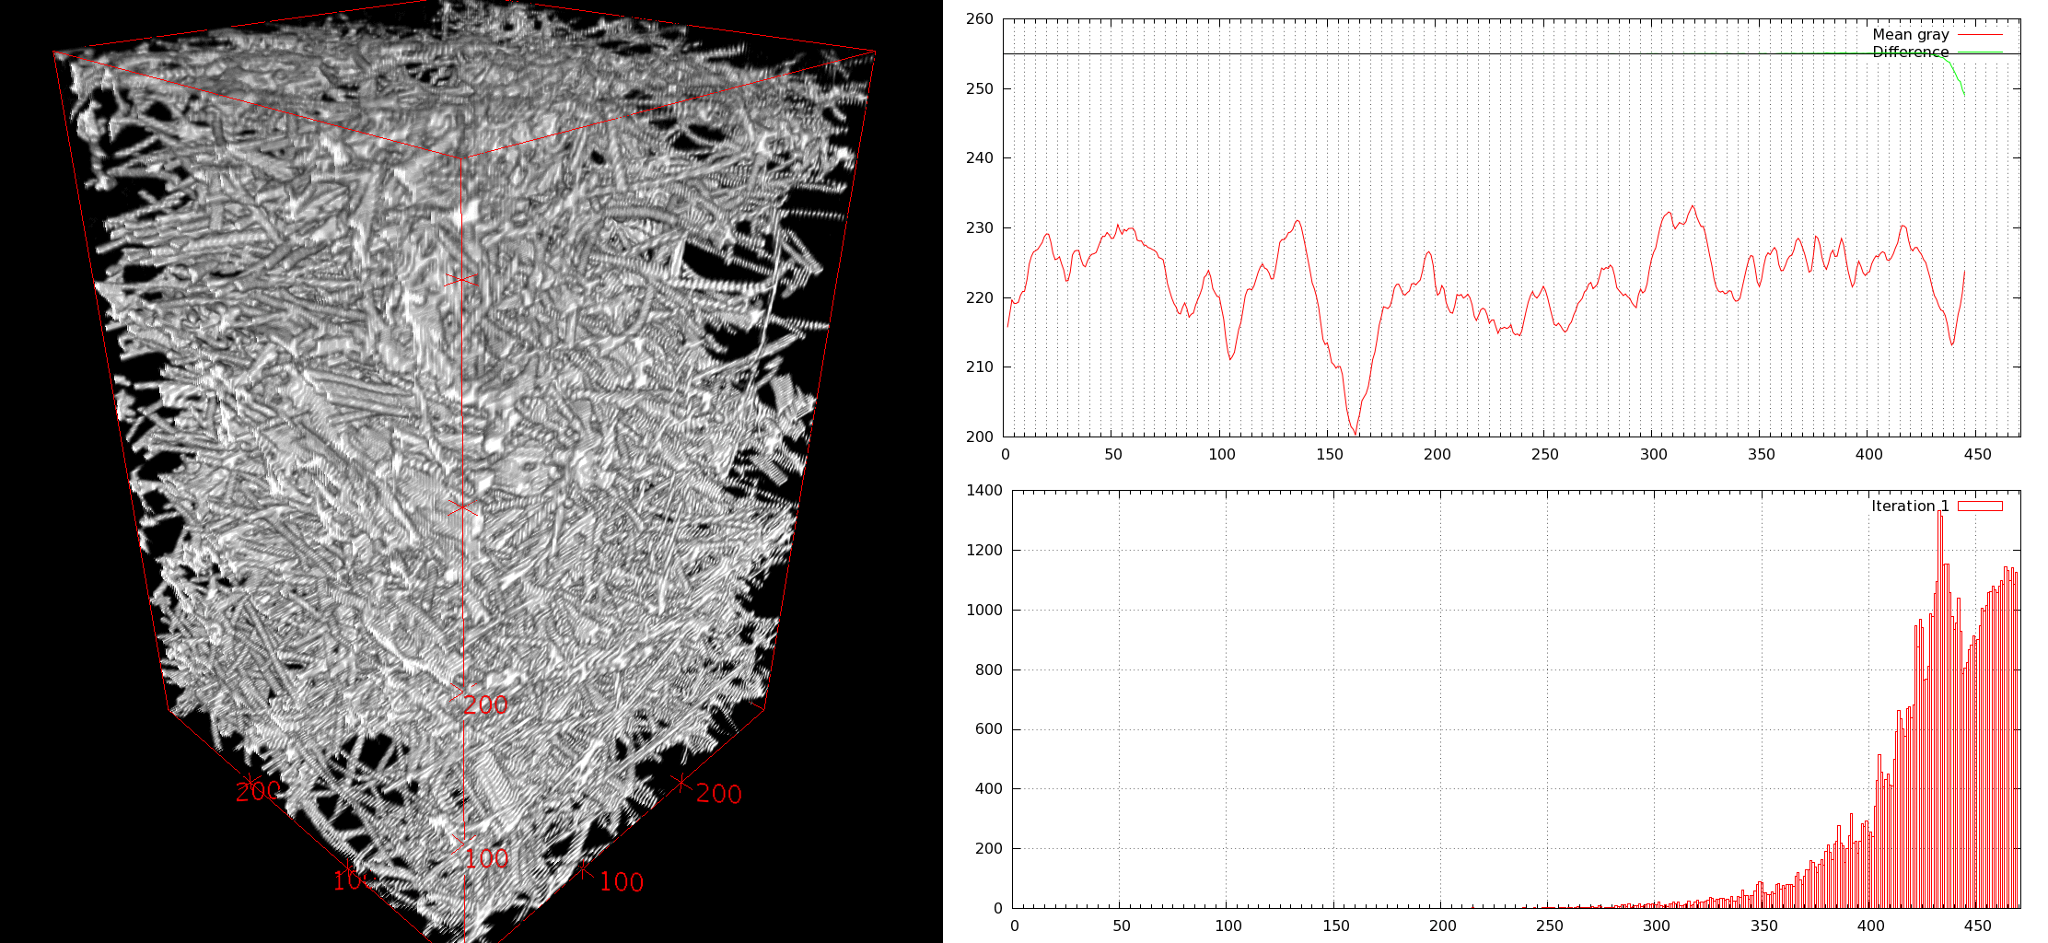
NUMERICAL SIMULATION OF ABLATION
G. L. VIGNOLES et al., Carbon (2018), vol. 134, pp. 376–390.
May 20, 2026
Vignoles - Interpore 2026, Nantes
22

Slide 23
NUMERICAL SIMULATION OF ABLATION
G. L. VIGNOLES et al., Carbon (2018), vol. 134, pp. 376–390.
1 pix = 2 µm
May 20, 2026
Vignoles - Interpore 2026, Nantes
23

Slide 24
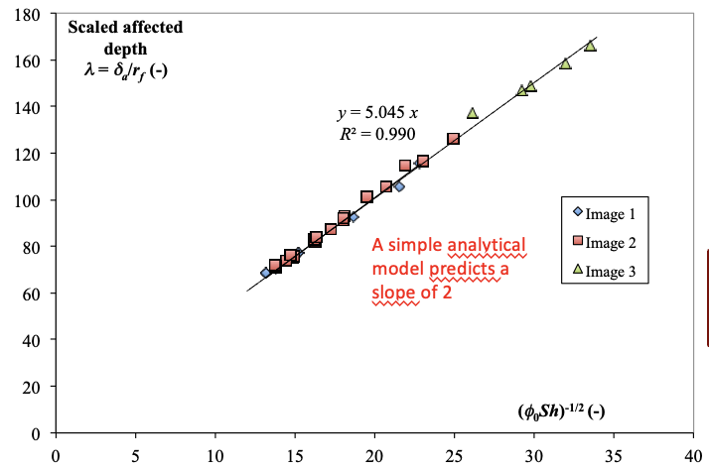
ABLATION : DIMENSIONLESS RESULTS
G. L. VIGNOLES et al., Carbon (2018), vol. 134, pp. 376–390.
where
A simple analytical model predicts a slope of 2
May 20, 2026
Vignoles - Interpore 2026, Nantes
24

Slide 25
ABLATION : DIMENSIONLESS RESULTS
G. L. VIGNOLES et al., Carbon (2018), vol. 134, pp. 376–390.
This exponent is ½ in the analytical model
May 20, 2026
Vignoles - Interpore 2026, Nantes
25

Slide 26
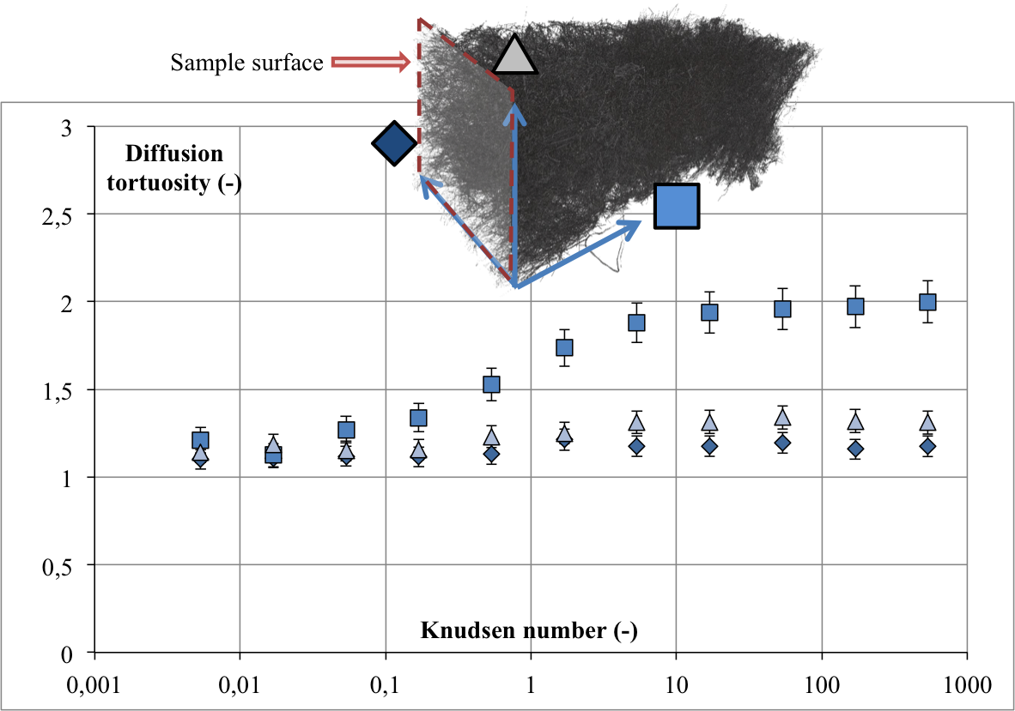


MODEL EXPLOITATION: NITRIDATION IN PLASMA
G. L. VIGNOLES et al., Carbon (2018), vol. 134, pp. 376–390.
Diffusion coefficient is corrected by the Knudsen effect
and tortuosity coefficient :
d_{p} =
Effective nitridation rate is corrected by the blowing effect
Rate constants are scaled wrt ¼ molecular velocity
May 20, 2026
Vignoles - Interpore 2026, Nantes
26

Slide 27
IDENTIFIED NITRIDATION PROBABILITY
G. L. VIGNOLES et al., Carbon (2018), vol. 134, pp. 376–390.
May 20, 2026
Vignoles - Interpore 2026, Nantes
27

Slide 28
ABLATION – SUMMARY & OUTLOOK
G. L. VIGNOLES et al., Carbon (2018), vol. 134, pp. 376–390.
Interest of the numerical model
Results are similar to predictions of a simple analytical model
The differences are due to the complex porous structure
A complete strategy to interpret ablation tests
Effective reaction constants can be recovered from CFD analysis + image analysis
The method can be used the other way to obtain the influence of structural parameters on ablation rate
➔ It becomes a design tool
Next step: application to oxidation of C_{f}/C composites
May 20, 2026
Vignoles - Interpore 2026, Nantes
28

Slide 29
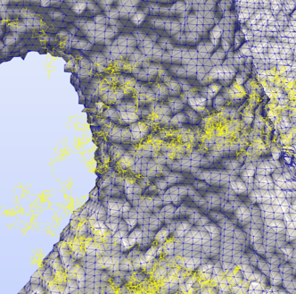
RESULTS - PART 2
Heat transfer by conduction and radiation
May 20, 2026
Vignoles - Interpore 2026, Nantes
29

Slide 30
HYBRID RANDOM WALK
G. L. VIGNOLES, Int. J. of Heat & Mass Transfer 93, 707–719 (2016)
Solid phase: Brownian motion, simulates diffusion linked to heat conduction
Fluid phase: ray-tracing or kinetic RW
Interface: « flux matching » condition
May 20, 2026
Vignoles - Interpore 2026, Nantes
30

Slide 31
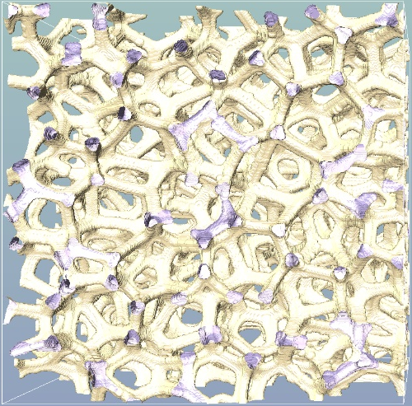
Open-cell SiSiC foams (courtesy SUPSI)
1
k_{cond/}k_{solid}
Nu’ = 4σT³/k_{s}.(Π/S_{v})
May 20, 2026
Vignoles - Interpore 2026, Nantes
31

Slide 32
RADIATIVE ETC EXCESS VS. RADIATION/CONDUCTION RATIO
k⁺∞ = (k_{eff} – k_{cond})/Nu’k_{solid}
Low-T
Emissivity-dependent regime
Critical ratio
Nu*
k⁺∞ + eΔk⁺
High-T
Emissivity-independent regime
k⁺∞
May 20, 2026
Vignoles - Interpore 2026, Nantes
32

Slide 33
EQUIVALENT CIRCUIT
G. L. VIGNOLES & A. ORTONA, Int. J. Therm. Sci. (2016), vol. 109, pp. 270–278
Pure conduction fully in //
with radiation : OPEN-CELL medium
k
c
o
n
d
N
+
u
'
k
∞
Δ
+
*
Δ
+
k
N
u
k
e
N
u
'
When radiation fully dominates (Nu’ > Nu*), the emissivity-dependent part does not contribute any more
May 20, 2026
Vignoles - Interpore 2026, Nantes
33

Slide 34
FIBROUS PREFORM
May 20, 2026
Vignoles - Interpore 2026, Nantes
34

Slide 35
FIBROUS PREFORM
May 20, 2026
Vignoles - Interpore 2026, Nantes
35

Slide 36
FIBROUS PREFORM
May 20, 2026
Vignoles - Interpore 2026, Nantes
36

Slide 37
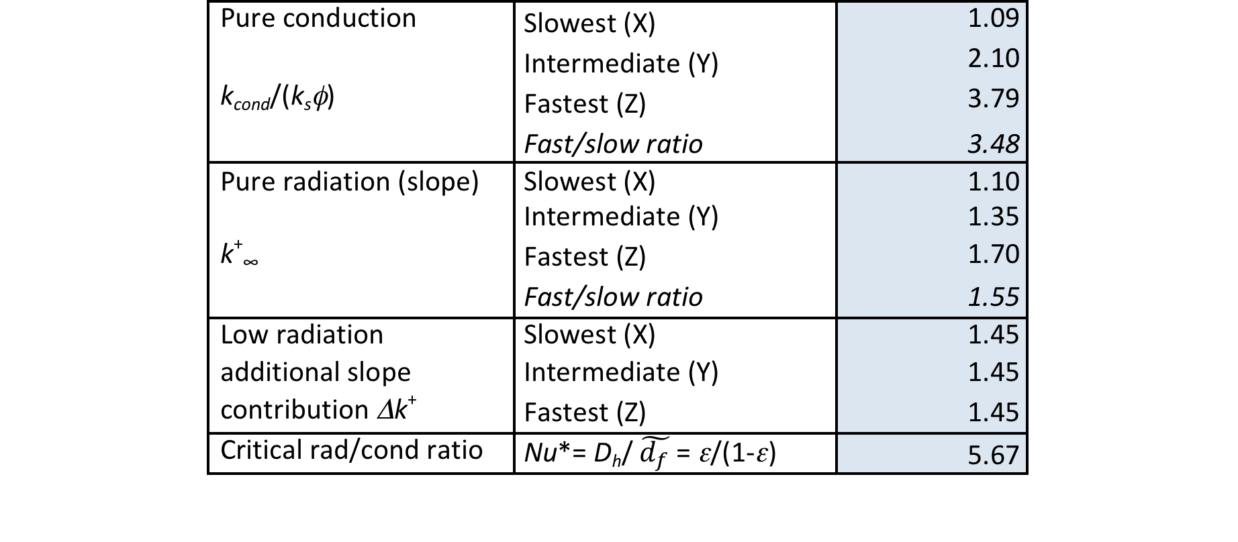
FIBROUS PREFORM
Much more
than foams (~0.4) !!
Large decrease
of anisotropy
when going from
low T (conduction)
to high T
(radiation)
Isotropic, again !
May 20, 2026
Vignoles - Interpore 2026, Nantes
37

Slide 38
COMPARISON WITH EXP. DATA
Data published by Mersen on
Calcarb CBCF 15-2000
May 20, 2026
Vignoles - Interpore 2026, Nantes
38

Slide 39
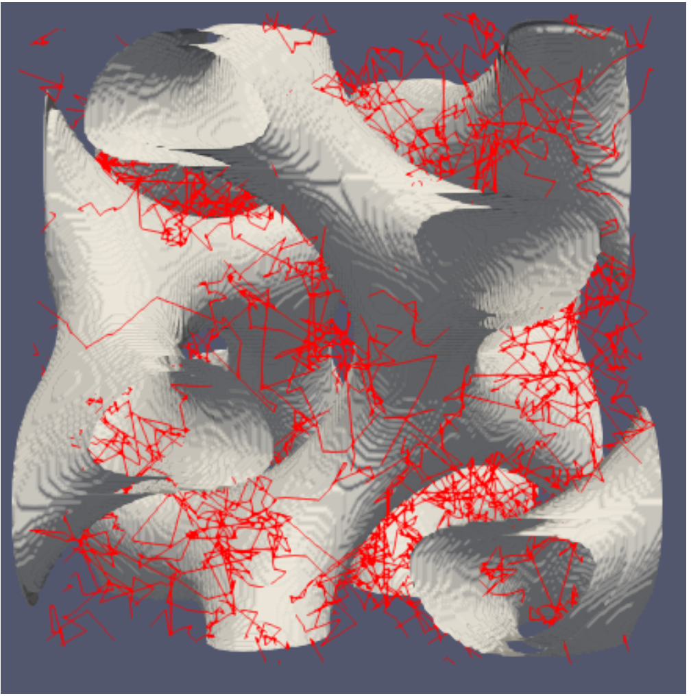
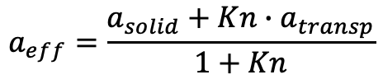
SEMI-TRANSPARENT MEDIA
« Brownian » walk in the solid, « kinetic » walk in the voids
Evolution with Kn is as predicted by a simple law:
$$a_{eff}=\frac{a_{solid}+Kn∙a_{transp}}{1+Kn}$$
May 20, 2026
Vignoles - Interpore 2026, Nantes
39

Slide 40
HYBRID RANDOM WALKS: SUMMARY
Numerical tool
Fast convergence to effective behavior (although detailed field is not converged)
Effective conducto-radiative conductivity described with few dimensionless parameters
Nonlinearity successfully introduced (see talk by Penazzi et al.)
Perspectives
Study semi-transparent media, e.g. ox/ox CMCs
Development of other numerical methods (« moments » methods)
May 20, 2026
Vignoles - Interpore 2026, Nantes
40

Slide 41
CONCLUSION
Summary
Outlook
May 20, 2026
Vignoles - Interpore 2026, Nantes
41

Slide 42
MAIN RESULTS
Monte-Carlo Random Walks are well adapted to image-based modeling :
Effective gas diffusivity in rarefied regime
Ablation simulations (also, infiltration)
Effective conducto-radiative heat conductivity
Applications relevant to space technology problems :
Ablation
Thermal protection systems modeling
… but also Chemical Vapor Infiltration
May 20, 2026
Vignoles - Interpore 2026, Nantes
42

Slide 43
PROS & CONS OF MC/RW METHODS
PROS
CONS
Low memory requirements
Easily parallelizable
Easy handling of non-standard boundary conditions
Fast « pre-convergence » to effective properties
Actual convergence rate is only N^{-1/2}
Some physical problems are more difficult to « translate » into MC/RW
May 20, 2026
Vignoles - Interpore 2026, Nantes
43

Slide 44
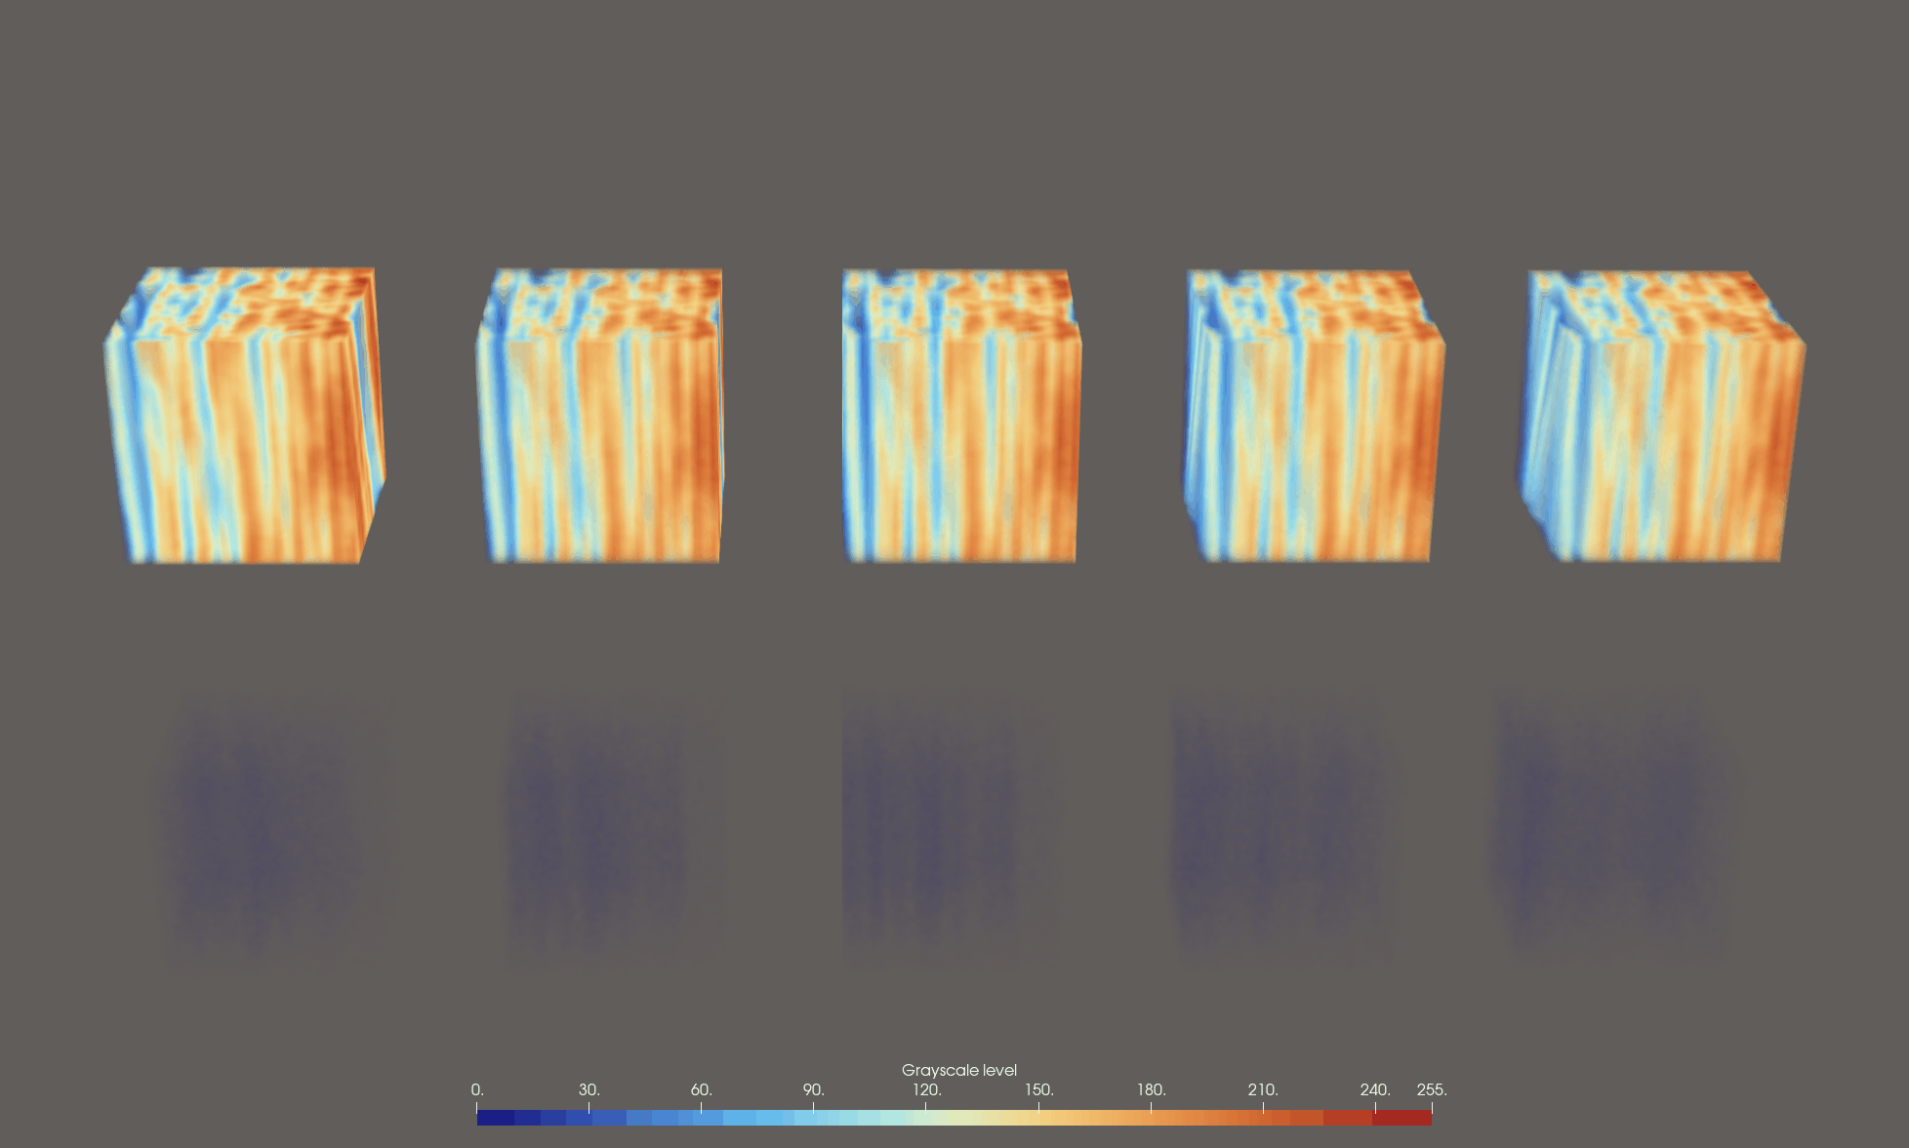
OUTLOOK
It has been proved that a Brownian walk can be replaced by a more efficient « kinetic-like » walk*
➔Modified solver for ablation
➔ Modified solver for CVI
➔ Modified solver for conducto-radiative media
Possibility to address convective flow
Specific algorithm to solve Stokes’ equation and get the velocity field
Then, convection is easy to include in the algorithm
Rewrite solvers in unstructured meshes
Still more projects on Chemical Vapor Infiltration
Incorporation of thermal gradients
* Poëtte, G., De La Vauvre, A., Vignoles, G., Int. J. Heat Mass Transf. 239 (2025) 126603
May 20, 2026
Vignoles - Interpore 2026, Nantes
44

Slide 45

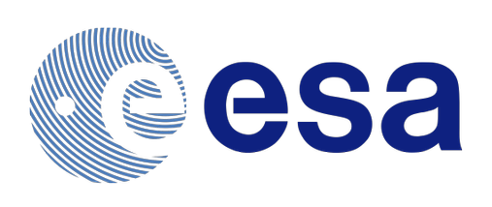
ACKNOWLEDGEMENTS
Masters interns
  I. Szelengowicz
  X. Lamboley
  A. De la Vauvre
  T. Jeanneau
Funding
Collaboration
  A. Turchi, VKI, Brussels
  R. Bianchi, U. La Sapienza Roma
  G. Poëtte, CEA/DAM/CESTA
May 20, 2026
Vignoles - Interpore 2026, Nantes
45

Slide 46
THANK YOU! QUESTIONS ?
Gérard L. VIGNOLES
vinhola@lcts.u-bordeaux.fr
https://lcts.cnrs.fr

