Slide 1
Morphological and non Beerian radiative characterization of a fibrous medium
Presented by : Mahé Souveton
Supervision : Franck Enguehard
Vital Le Dez

Slide 2
Summary
Introduction to the subject
Context
Radiative characterization
Morphological results
Development of a non Beerian model
Definitions
Practical application
Monte Carlo algorithm
Results and discussions
Conclusion and perspectives

Slide 3
Introduction to the subject

Slide 4
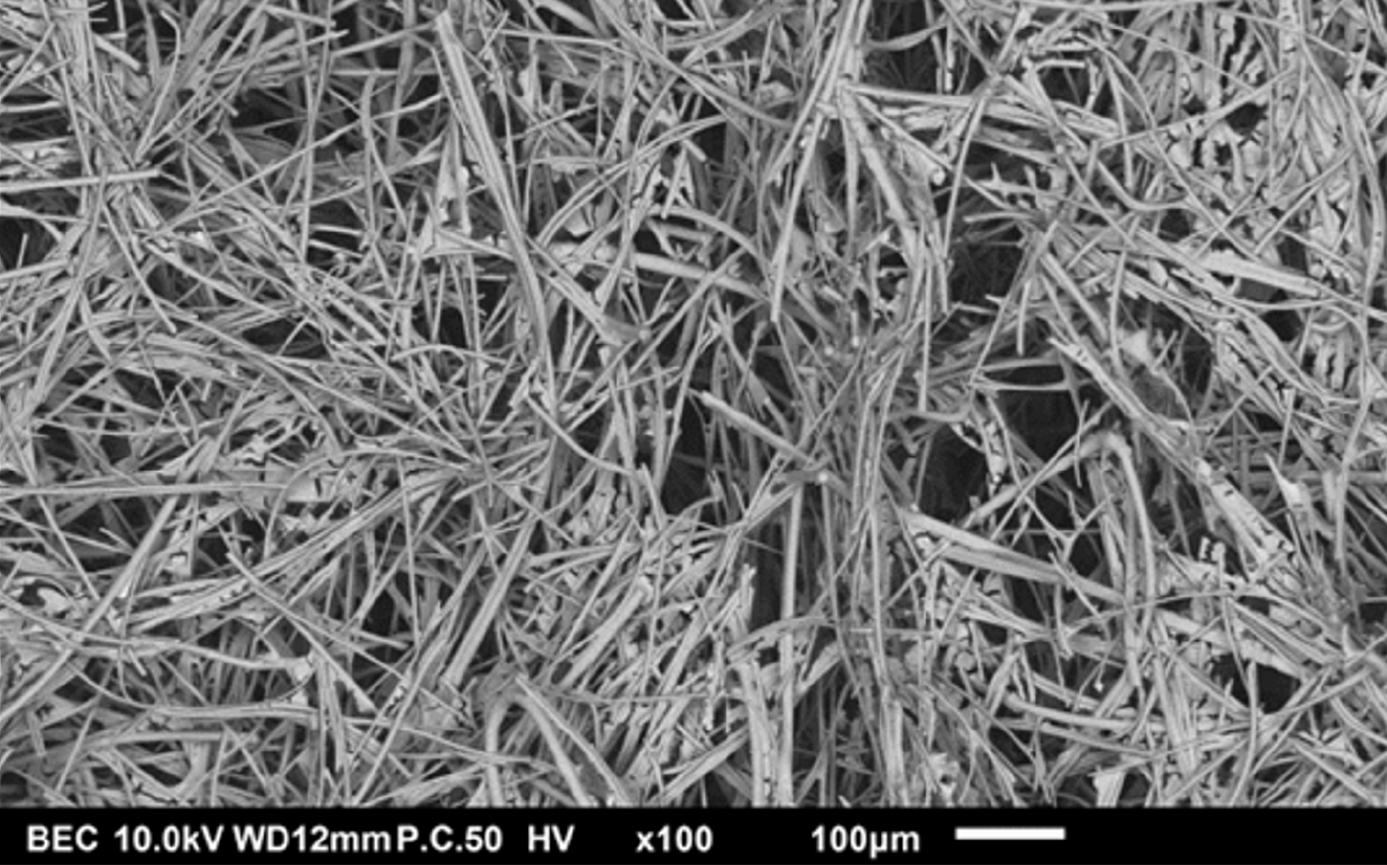
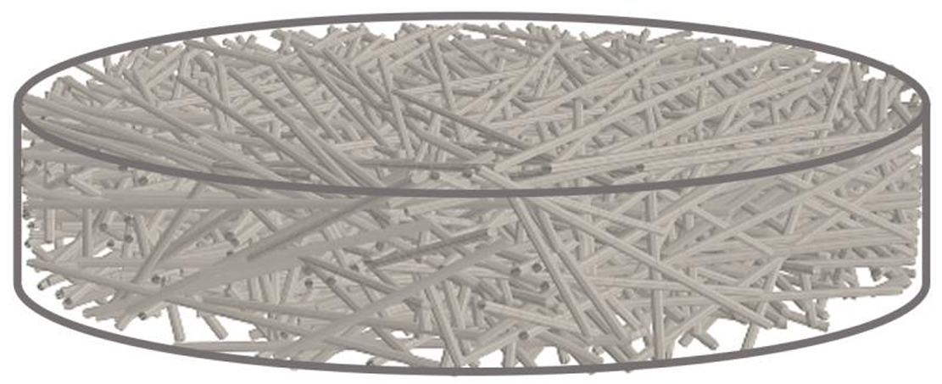
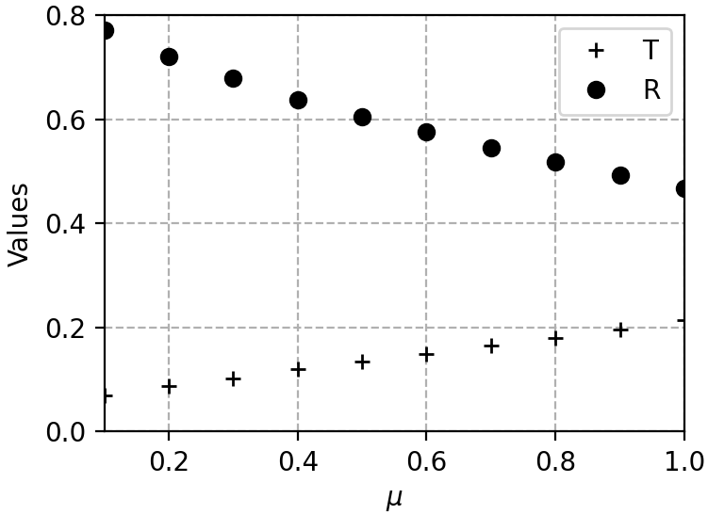
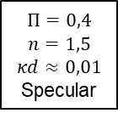


Introduction to the subject
Context
Industrial context:
Thermal insulation at high temperatures often relies on highly porous materials.
The radiative transfer must be characterized at all scales.
Representative medium:
Theoretical study of a virtual cold fibrous medium composed of overlapping cylinders (acting as an absorbing and scattering phase).
Morphological simplification: infinite cylinders, same shape and properties, randomly orientated $⇒$ medium statistically homogeneous and isotropic.
Either specular or diffuse conditions imposed between void and fibers. No interface events on entrance and exit of the calculation box.
Radiative characterization:
Directional-hemispherical transmittance $T$ and reflectance $R$ values.
Homogenization procedure: determining an equivalent continuous medium.
SEM of a zirconia felt
A computer-generated virtual fibrous medium
$$Π=0,4$$
$$n=1,5$$
$$κd≈0,01$$
Specular
$T$ and $R$ values as a function of the angle of the incident radiation

Slide 5
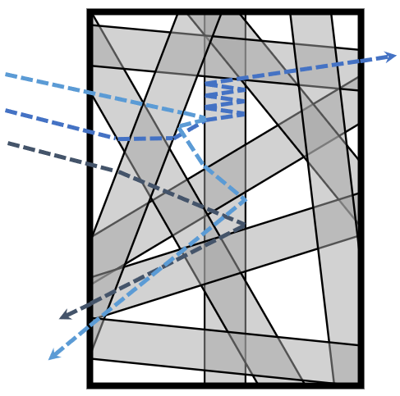
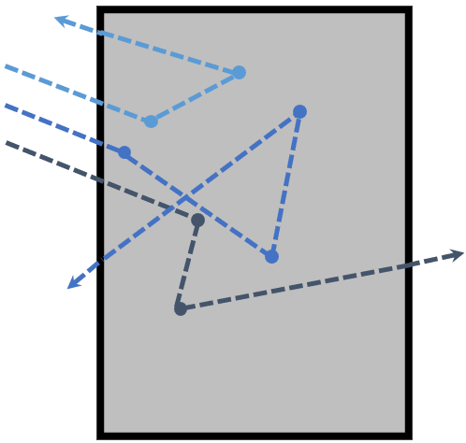




Introduction to the subject
Radiative characterization
$$R≈\frac{2}{3}$$
$$T≈\frac{1}{3}$$
Direct Simulation Monte Carlo (DSMC):
A Monte Carlo algorithm follows each ray through reflection and refraction events until its absorption or its exit of the calculation box.
Standard homogenization procedure:
Scalar coefficients have to be determined ($β$, $κ$, $σ$, $ω$, $n$, …):
- By inversion (requires to specify a phase function).
- By direct identification (RDFI [1]).
Non Beerian approach:
The statistics in our fibrous medium does not follow Beer-Lambert law !
A non Beerian model, integrated inside a Monte Carlo algorithm, could be constructed with the true statistics of absorption and scattering.
Homogenization
$β$, $ω$, $n$, $P$
Monte Carlo in the fibrous medium (top) and in the continuous medium (bottom)
[1] Tancrez, M., & Taine, J. (2004). Direct identification of absorption and scattering coefficients and phase function of a porous medium by a Monte Carlo technique. International Journal of Heat and Mass Transfer, 47(2), 373-383

Slide 6
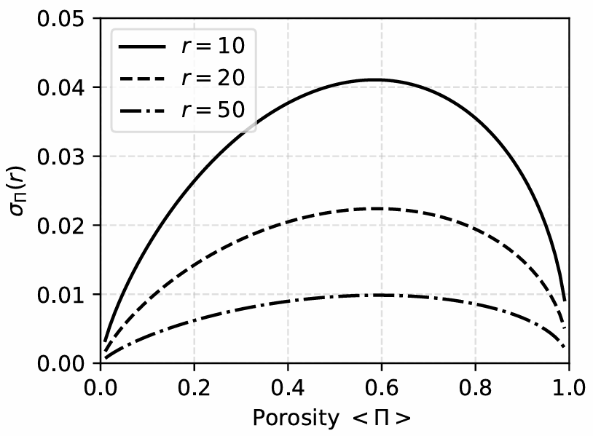
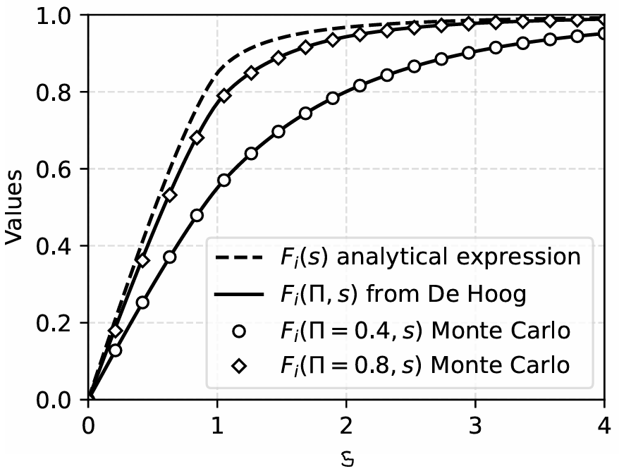




Introduction to the subject
Morphological results [2]
Chords in an isolated cylinder ($μ$, $I$ and $i$)
Study of random chords
$μ$-random, $I$-random, $i$-random chords, etc…
Provides an algorithm to construct an homogeneous and isotropic fibrous medium.
Analytical derivation for a stack of cylinders
Porosity $Π$ as a function of the number of fibers $N$.
REV (from the standard deviation of porosity $σ_{Π}$)
Autocorrelation function.
Final result
CDF of $i$-random chord lengths in the fibrous phase : $F_{i,f}\left(Π,s\right)=\frac{Π}{1−Π}ℒ^{−1}\left\{\frac{1}{p^{2}ℒ\left\{Π^{F_{i}}\right\}(p)}−\frac{1}{p}\right\}(s)$
$σ_{Π}$ as a function of the porosity for circular observation subsurfaces of various radius $r$
[2] Souveton M. et al. (2026). Morphological properties of random arrays of infinitely long overlapping cylinders for
modeling statistically homogeneous and isotropic fibrous media. Physical Review E, 113, 024111.
$F_{i}(Π,s)$ analytical vs measurements

Slide 7
Development of a non Beerian model

Slide 8





Development of a non Beerian model
Definitions and hypothesis [3]
Generalized radiative functions:
Extinction CDF: $G_{ext,i}^{(n)}(s)$
Absorption and scattering PCF: $P_{abs,i}^{\left(n\right)}\left(s\right)$ and $P_{sca,i}^{(n)}(s)$
Conditional probability of scattering: $ℙ_{sca,i}^{\left(n\right)}(s)$
Probability to be in the void phase: $λ_{n}$
Where $n$ means « after the $n^{th}$ scattering event » and $i=v$, $f$ or $h$ is the phase in which the ray is travelling.
First trajectories are $i$-chords, the next are $μ$-chords.
Scattering phase function:
Following Snell-Descartes’s law (specular)
Following Lambert’s law (diffuse) with $ρ=1/2$
$$β$$
$$κ, σ$$
$$ω$$
$$Π$$
DSMC with a Monte Carlo raytracing algorithm in the fibrous medium
[3] Several works on a non Beerian approach by Dauvoix, Seyer, Enguehard, Taine, etc…

Slide 9
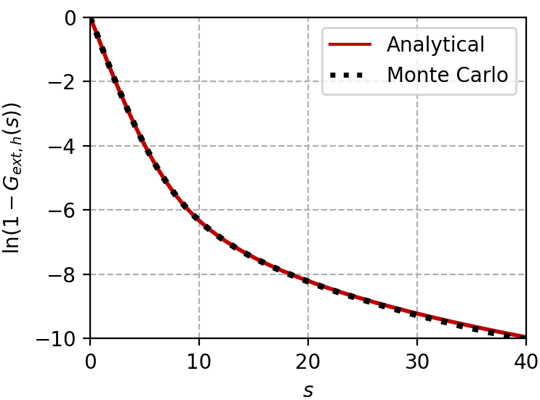
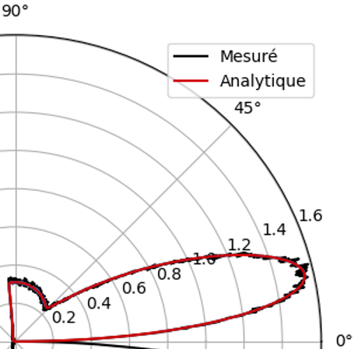




Development of a non Beerian model
Practical application
$$Π=0,4$$
$$n=1,5$$
$$κd≈0,01$$
Example:
$G_{ext,h}^{\left(n\right)}\left(s\right)=λ_{n}\left(1−Π^{s}\right)+(1−λ_{n})(1−exp\left(−κs\right)(1−F_{X,f}(Π,s)))$
$ℙ_{sca,h}^{(n)}\left(s\right)=1−\frac{κ}{κ+\frac{f_{X,f}\left(Π,s\right)}{1−F_{X,f}\left(Π,s\right)} − \frac{λ_{n}}{1−λ_{n}}\ln{Π}\frac{\exp\left(\left(κ+\ln{Π}\right)s\right)}{1−F_{X,f}\left(Π,s\right)}}$
$λ_{0}=Π$ and:
- Diffuse reflection: $λ_{n>0}=ρ=1/2$
- Specular reflection: $λ_{1}=ΠA+\left(1−Π\right)P_{sca,f}^{(0)}\left(+∞\right)B$ and $λ_{n}→cste$
Scattering phase function:
Analytical expression derived for the specular case.
Expression obtained by a curve fitting for the diffuse case.
Extinction CDF ($\ln{(1−G_{ext,h}^{(0)})}$)
Monte Carlo
Analytical
$$Π=0,4$$
$$n=1,5$$
$$κd≈0,01$$
Scattering phase function indicatrix in the fibrous medium with specular conditions

Slide 10
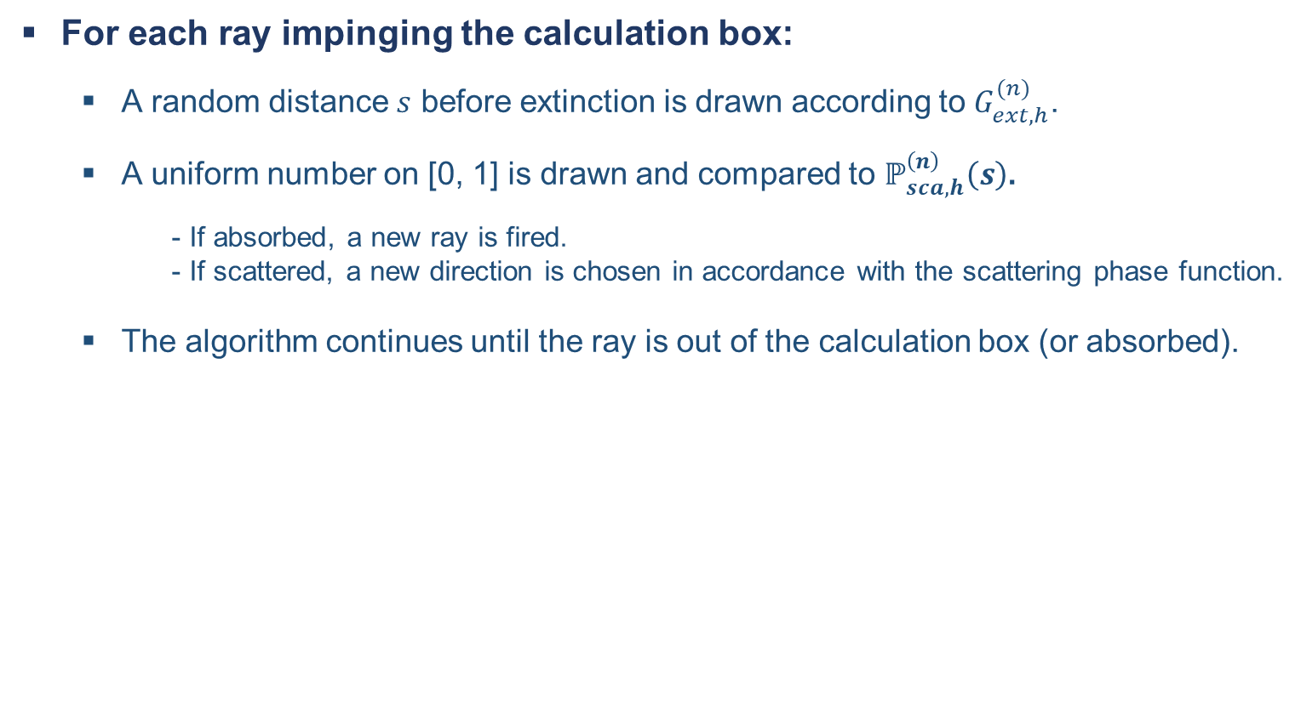
Development of a non Beerian model
Monte Carlo algorithm for the model
For each ray impinging the calculation box:
A random distance $s$ before extinction is drawn according to $G_{ext,h}^{(n)}$.
A uniform number on [0, 1] is drawn and compared to $ℙ_{sca,h}^{\left(n\right)}\left(s\right)$.
- If absorbed, a new ray is fired.
- If scattered, a new direction is chosen in accordance with the scattering phase function.
The algorithm continues until the ray is out of the calculation box (or absorbed).

Slide 11
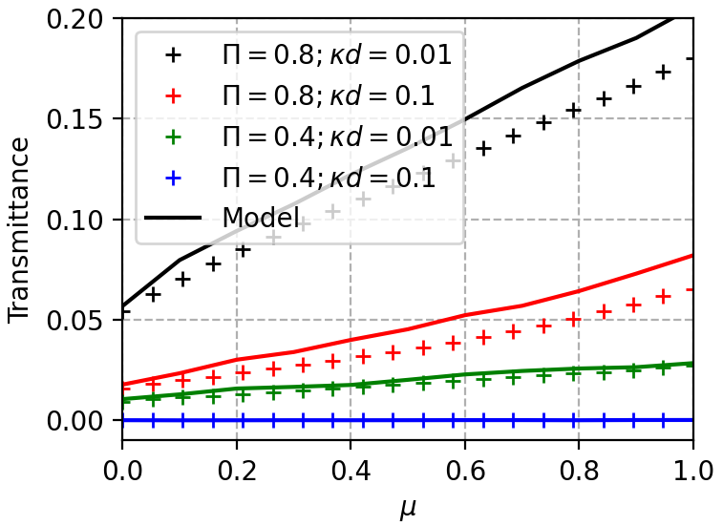
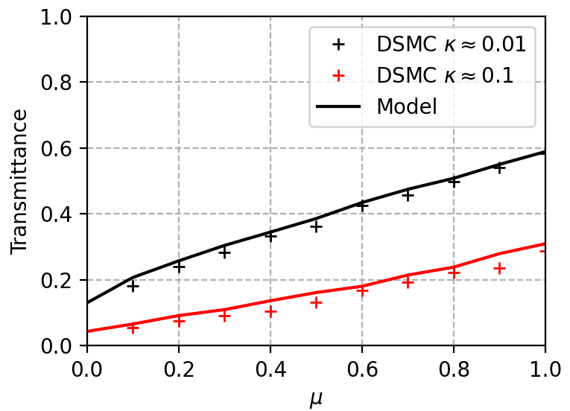
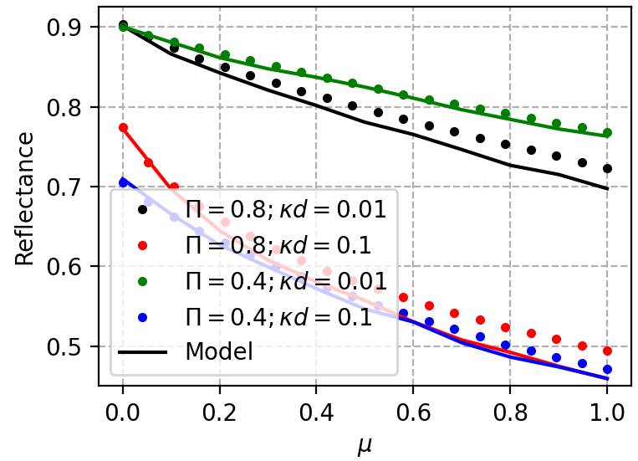
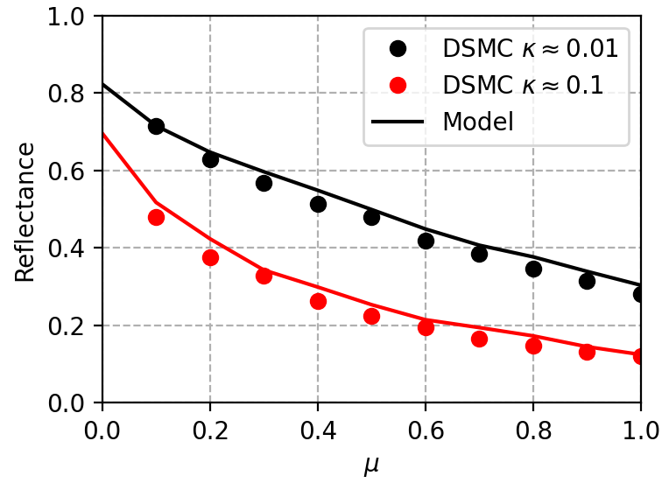


Development of a non Beerian model
Results and discussions
Specular interface:
Diffuse interface:
$$Π=0,8$$
$$Π=0,8$$

Slide 12
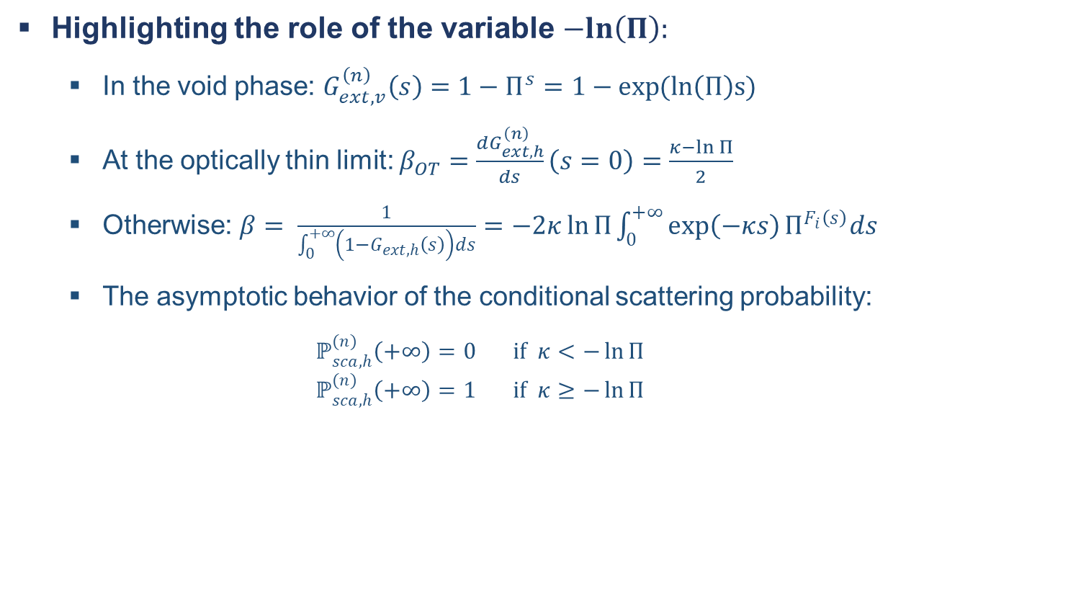
Development of a non Beerian model
Results and discussions
Highlighting the role of the variable $−ln\left(Π\right):$
In the void phase: $G_{ext,v}^{\left(n\right)}\left(s\right)=1−Π^{s}=1−\exp{(\ln\left(Π\right)s)}$
At the optically thin limit: $β_{OT}=\frac{dG_{ext,h}^{\left(n\right)}}{ds}\left(s=0\right)=\frac{κ−\ln{Π}}{2}$
Otherwise: $β= \frac{1}{\int_{0}^{+∞}{\left(1−G_{ext,h}\left(s\right)\right)ds}}=−2κ\ln{Π}\int_{0}^{+∞}{\exp\left(−κs\right)Π^{F_{i}\left(s\right)}ds}$
The asymptotic behavior of the conditional scattering probability:
$$ℙ_{sca,h}^{(n)}\left(+∞\right)=0 if κ<−\ln{Π}$$
$$ℙ_{sca,h}^{(n)}\left(+∞\right)=1 if κ≥−\ln{Π}$$

Slide 13
Conclusion and Perspectives
Several morphological properties of statistically homogeneous and isotropic cylinder stacks have been determined analytically.
The generalized non Beerian radiative properties of the equivalent homogeneous medium have also been determined analytically, especially:
Extinction CDF
Scattering and absorption CPF
Specular scattering phase function
They have been used in a non Beerian radiative transfer model, and we are currently in the process of analyzing the results.
We need to compare the previous results with a Beerian approach.

Slide 14
Appendix

Slide 15
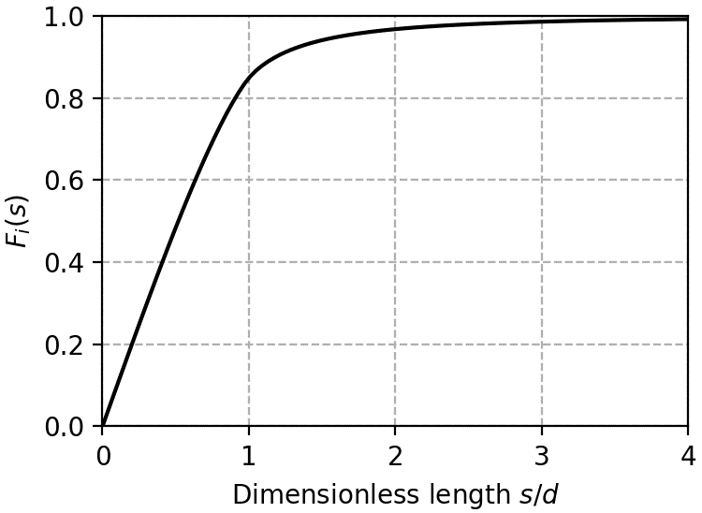
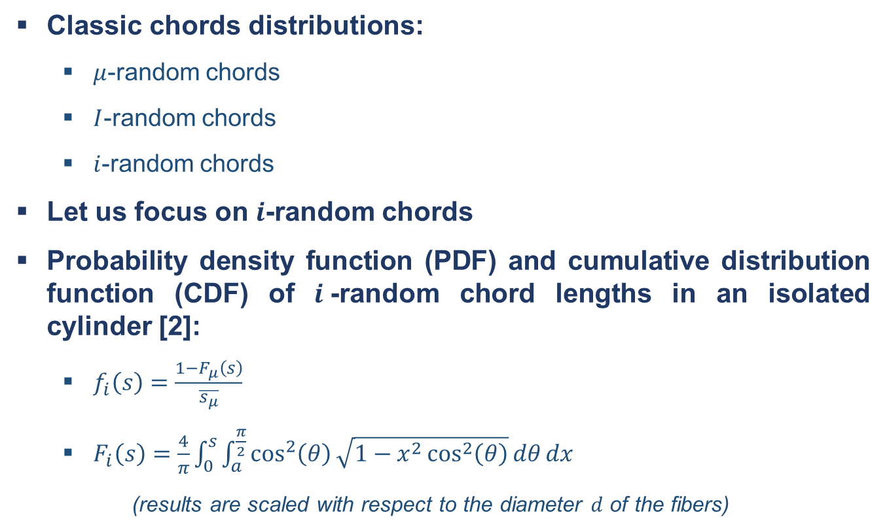
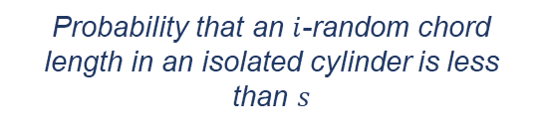
Morphological study
Definitions
Classic chords distributions:
$μ$-random chords
$I$-random chords
$i$-random chords
Let us focus on $i$-random chords
Probability density function (PDF) and cumulative distribution function (CDF) of $i$-random chord lengths in an isolated cylinder [2]:
$f_{i}\left(s\right)=\frac{1−F_{μ}\left(s\right)}{\overline{s_{μ}}}$
$F_{i}\left(s\right)=\frac{4}{π}\int_{0}^{s}{\int_{a}^{\frac{π}{2}}{\cos^{2}\left(θ\right)\sqrt{1−x^{2}\cos^{2}\left(θ\right)}dθ}dx}$
(results are scaled with respect to the diameter $d$ of the fibers)
Chords in an isolated cylinder ($μ$, $I$ and $i$)
Probability that an $i$-random chord length in an isolated cylinder is less than $s$
[2] Tomadakis, M. M., & Sotirchos, S. V. (1993). Random paths in random arrays of cylinders. Radiation research, 135(3), 302-311.

Slide 16
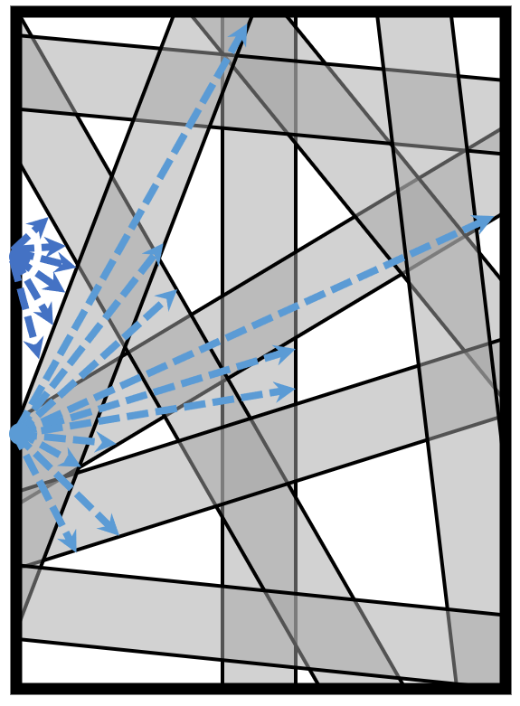
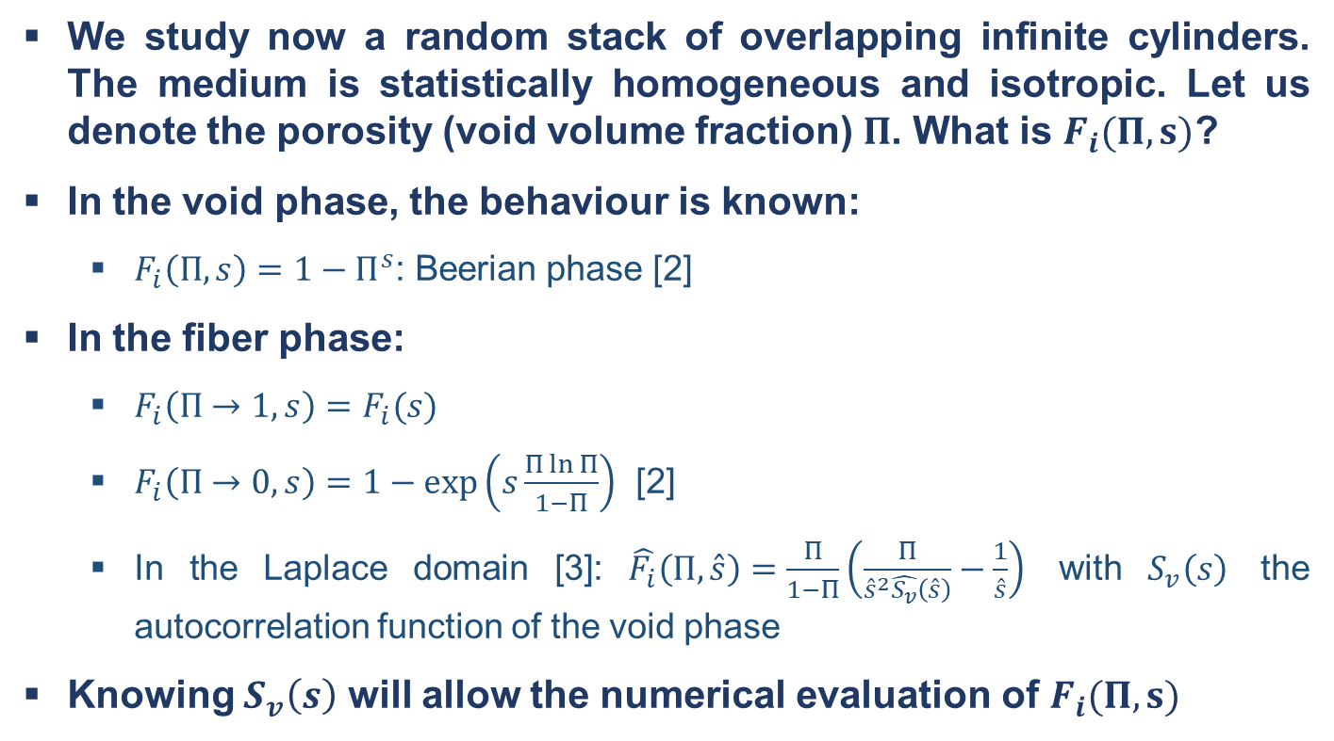
Morphological study
$i$-random chords in a random stack of cylinders
We study now a random stack of overlapping infinite cylinders. The medium is statistically homogeneous and isotropic. Let us denote the porosity (void volume fraction) $Π$. What is $F_{i}(Π,s)$?
In the void phase, the behaviour is known:
$F_{i}\left(Π,s\right)=1−Π^{s}$: Beerian phase [2]
In the fiber phase:
$F_{i}\left(Π→1,s\right)=F_{i}(s)$
$F_{i}\left(Π→0,s\right)=1−exp\left(s\frac{Π\ln{Π}}{1−Π}\right)$ [2]
In the Laplace domain [3]: $\hat{F_{i}}\left(Π,\hat{s}\right)=\frac{Π}{1−Π}\left(\frac{Π}{{\hat{s}}^{2}\hat{S_{v}}\left(\hat{s}\right)}−\frac{1}{\hat{s}}\right)$ with $S_{v}\left(s\right)$ the autocorrelation function of the void phase
Knowing $S_{v}\left(s\right)$ will allow the numerical evaluation of $F_{i}(Π,s)$
Visual representation of chords emitted in volume in the void phase (dark blue) and in the fiber phase (light blue)
[3] Roberts, A. P., & Torquato, S. (1999). Chord-distribution functions of three-dimensional random media: approximate first-passage times of Gaussian processes. Physical Review E, 59(5), 4953.

Slide 17
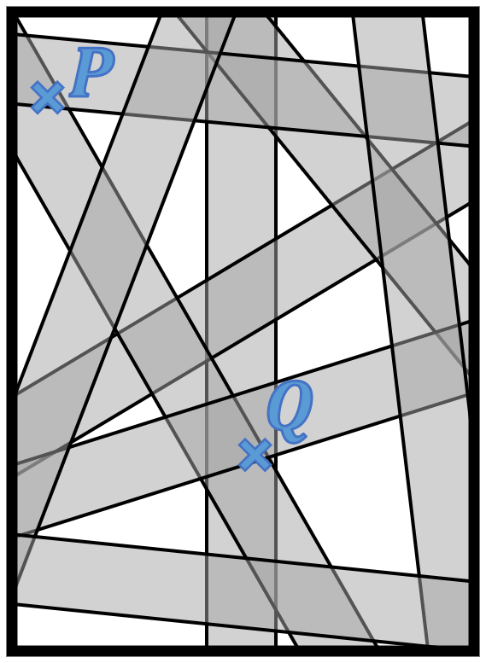
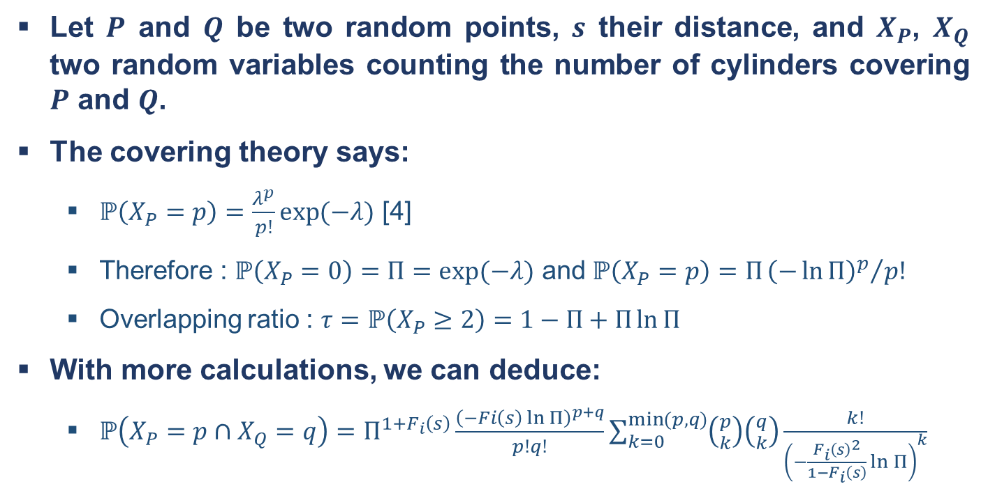
Morphological study
Statistics of overlapping fibers
Let $P$ and $Q$ be two random points, $s$ their distance, and $X_{P}$, $X_{Q}$ two random variables counting the number of cylinders covering $P$ and $Q$.
The covering theory says:
$ℙ\left(X_{P}=p\right)=\frac{λ^{p}}{p!}\exp{(−λ)}$ [4]
Therefore : $ℙ\left(X_{P}=0\right)=Π=\exp{(−λ)}$ and $ℙ\left(X_{P}=p\right)=Π{{\left(−\ln{Π}\right)}^{p}}/{p!}$
Overlapping ratio : $τ=ℙ\left(X_{P}≥2\right)=1−Π+Π\ln{Π}$
With more calculations, we can deduce:
$ℙ\left(X_{P}=p∩X_{Q}=q\right)=Π^{1+F_{i}\left(s\right)}\frac{{\left(−Fi\left(s\right)\ln{Π}\right)}^{p+q}}{p!q!}\sum_{k=0}^{\min{(p,q)}}{\left({p \atop k}\right)\left({q \atop k}\right)\frac{k!}{{\left(−\frac{F_{i}{\left(s\right)}^{2}}{1−F_{i}\left(s\right)}\ln{Π}\right)}^{k}}}$
Visual representation of two random points within the medium
[4] Sampson, W. W. (2008). Modelling stochastic fibrous materials with mathematica®. Springer Science & Business Media.

Slide 18
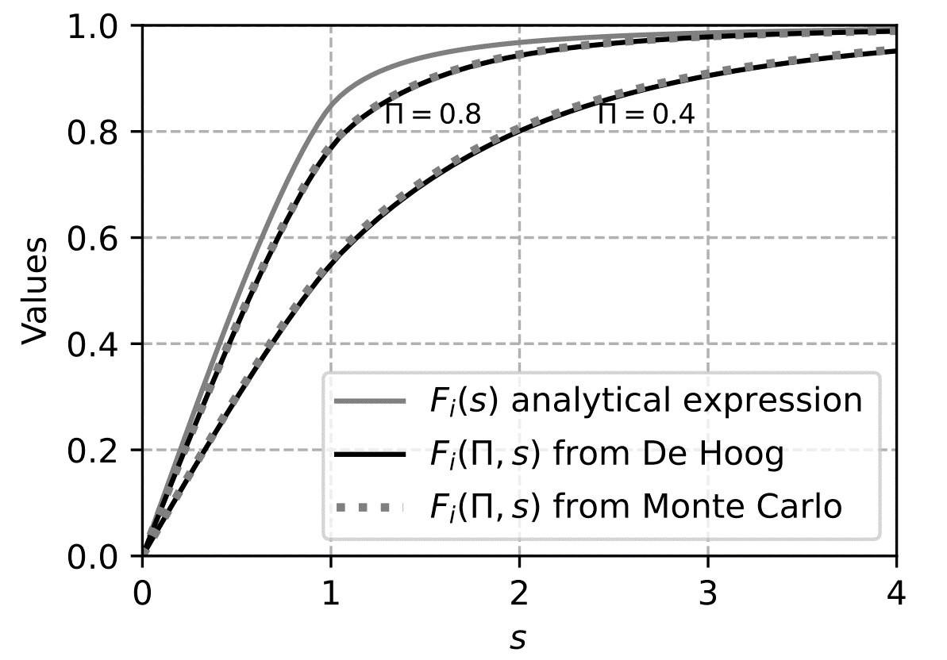
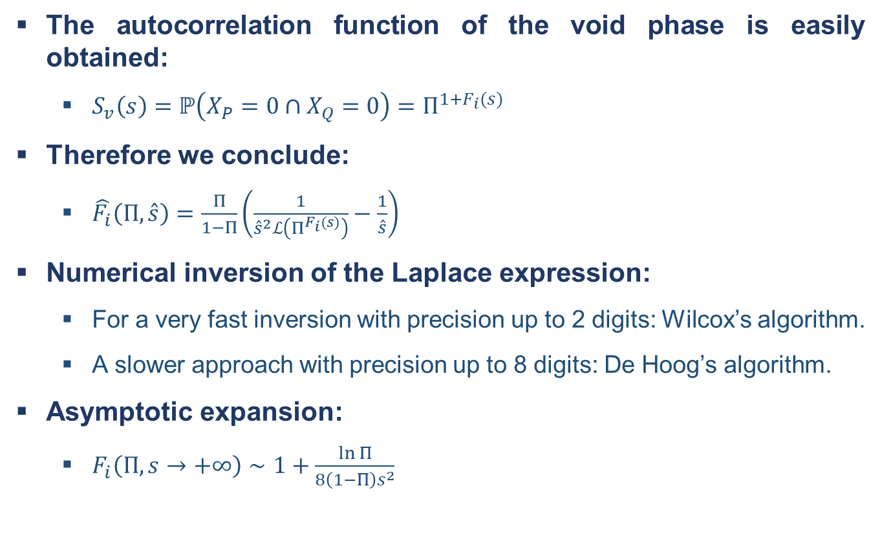
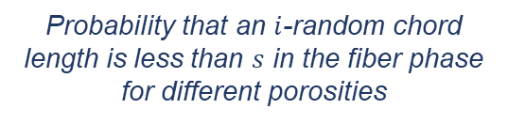
Morphological study
Autocorrelation function and $F_{i}(Π, s)$:
The autocorrelation function of the void phase is easily obtained:
$S_{v}\left(s\right)=$ $ℙ\left(X_{P}=0∩X_{Q}=0\right)=Π^{1+F_{i}(s)}$
Therefore we conclude:
$\hat{F_{i}}\left(Π,\hat{s}\right)=\frac{Π}{1−Π}\left(\frac{1}{{\hat{s}}^{2}ℒ\left(Π^{F_{i}(s)}\right)}−\frac{1}{\hat{s}}\right)$
Numerical inversion of the Laplace expression:
For a very fast inversion with precision up to 2 digits: Wilcox’s algorithm.
A slower approach with precision up to 8 digits: De Hoog’s algorithm.
Asymptotic expansion:
$F_{i}\left(Π,s→+∞\right)∼1+\frac{\ln{Π}}{8\left(1−Π\right)s^{2}}$
Probability that an $i$-random chord length is less than $s$ in the fiber phase for different porosities

Slide 19
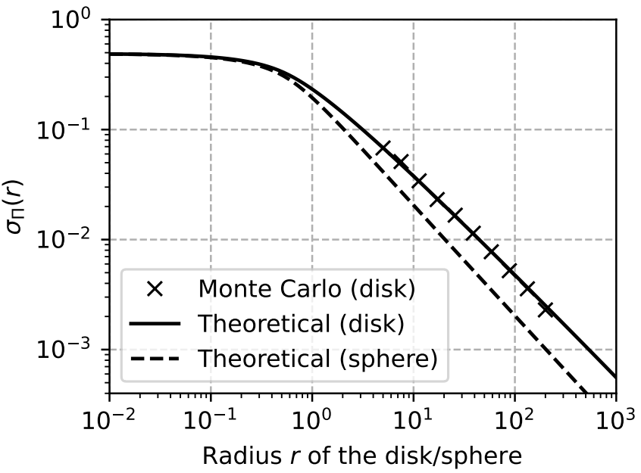
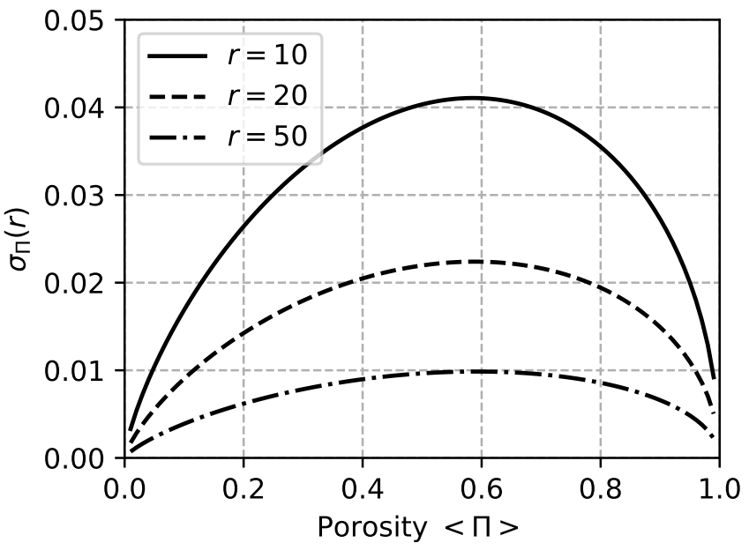
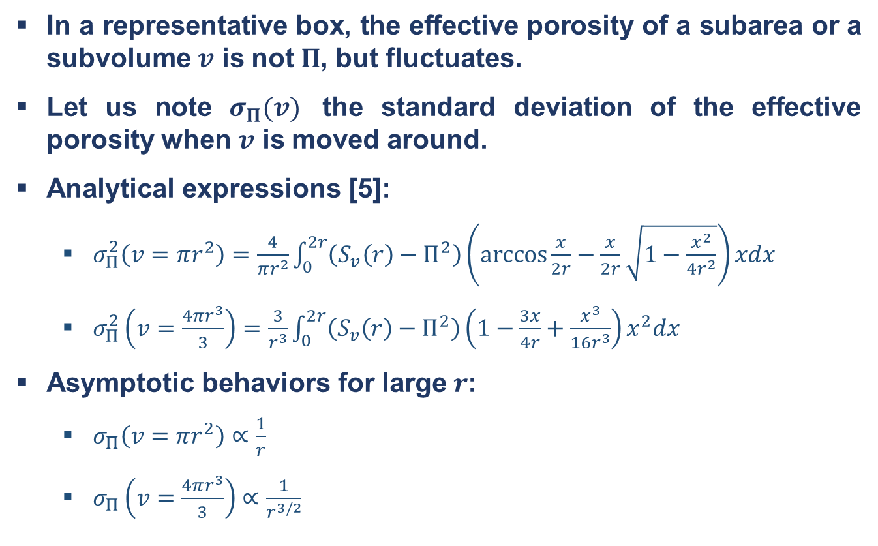
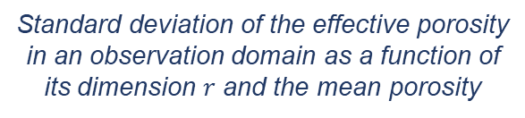
Morphological study
Representative Elementary Volume for porosity:
In a representative box, the effective porosity of a subarea or a subvolume $v$ is not $Π$, but fluctuates.
Let us note $σ_{Π}(v)$ the standard deviation of the effective porosity when $v$ is moved around.
Analytical expressions [5]:
$σ_{Π}^{2}\left(v=πr^{2}\right)=\frac{4}{πr^{2}}\int_{0}^{2r}{\left(S_{v}\left(r\right)−Π^{2}\right)\left(\arccos{\frac{x}{2r}}−\frac{x}{2r}\sqrt{1−\frac{x^{2}}{4r^{2}}}\right)xdx}$
$σ_{Π}^{2}\left(v=\frac{4πr^{3}}{3}\right)=\frac{3}{r^{3}}\int_{0}^{2r}{\left(S_{v}\left(r\right)−Π^{2}\right)\left(1−\frac{3x}{4r}+\frac{x^{3}}{16r^{3}}\right)x^{2}dx}$
Asymptotic behaviors for large $r$:
$σ_{Π}\left(v=πr^{2}\right)∝\frac{1}{r}$
$σ_{Π}\left(v=\frac{4πr^{3}}{3}\right)$ $∝\frac{1}{r^{3/2}}$
Standard deviation of the effective porosity in an observation domain as a function of its dimension $r$ and the mean porosity
[5] Torquato, S. (2002). Random heterogeneous materials: microstructure and macroscopic properties (Vol. 16). New York: Springer.

