Slide 1




Uncertainty-Driven Screening and Optimisation of UK Depleted Reservoirs for Hydrogen Storage
Ehsan Vahabzadeh¹, Farzaneh Nazari¹, Gabriel Patron², Arash Pourakaberian¹, Calvin Tsay², Vahid Niasar¹
¹ Department of Chemical engineering, University of Manchester, Manchester, UK
² Department of Computing, Imperial, London, UK
Ehsan.vahabzadehasbaghi@Manchester.ac.uk

Slide 2
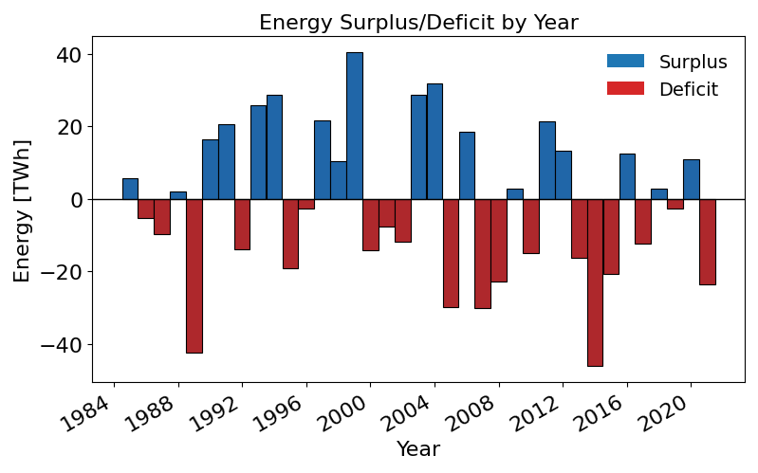
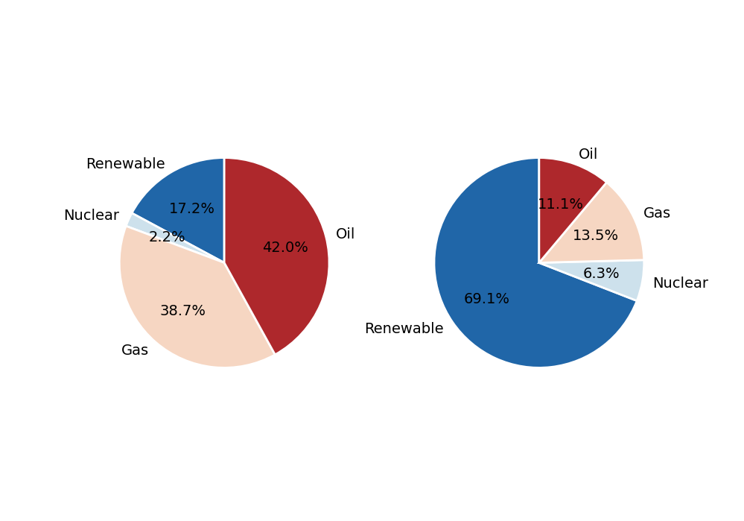
Why UHS matters?
royalsociety
2025
2050
CB7
Net-zero shifts primary energy toward renewables (17% → 69%).
Weather-driven variability creates multi-week deficits (tens to hundreds of TWh).
Seasonal storage is required. Short-duration storage is not enough.

Slide 3

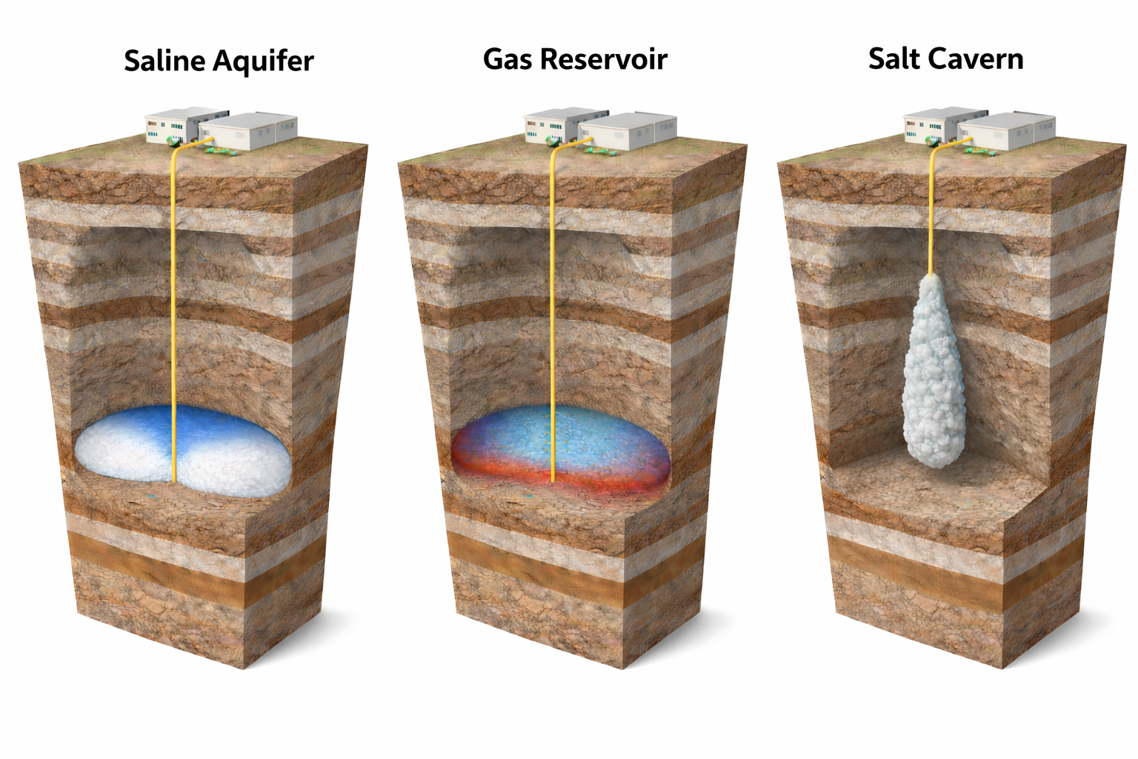
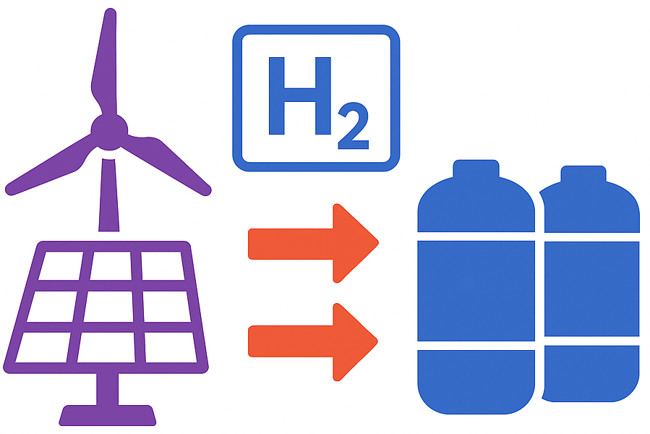
Why UHS matters?
Net-zero shifts primary energy toward renewables (17% → 69%).
Weather-driven variability creates multi-year deficits (tens to hundreds of TWh).
Seasonal storage is required. Short-duration storage is not enough.
royalsociety
CB7
Storage Methods
Hours-Days
Days-Weeks
Weeks-Annual
1
Notes:
I’ll start with the motivation. As the UK moves toward net zero, the energy system becomes more dependent on renewable electricity. That creates a storage problem, because wind and solar are weather-driven. The issue is not only short daily fluctuations, but extended periods where energy demand and renewable supply do not match. These gaps can reach tens to hundreds of terawatt hours. Batteries and other short-duration technologies are useful for hours to days, but they are not designed for seasonal-scale storage. That is where underground hydrogen storage becomes important, because geological storage can provide the scale needed for weeks to annual balancing.

Slide 4
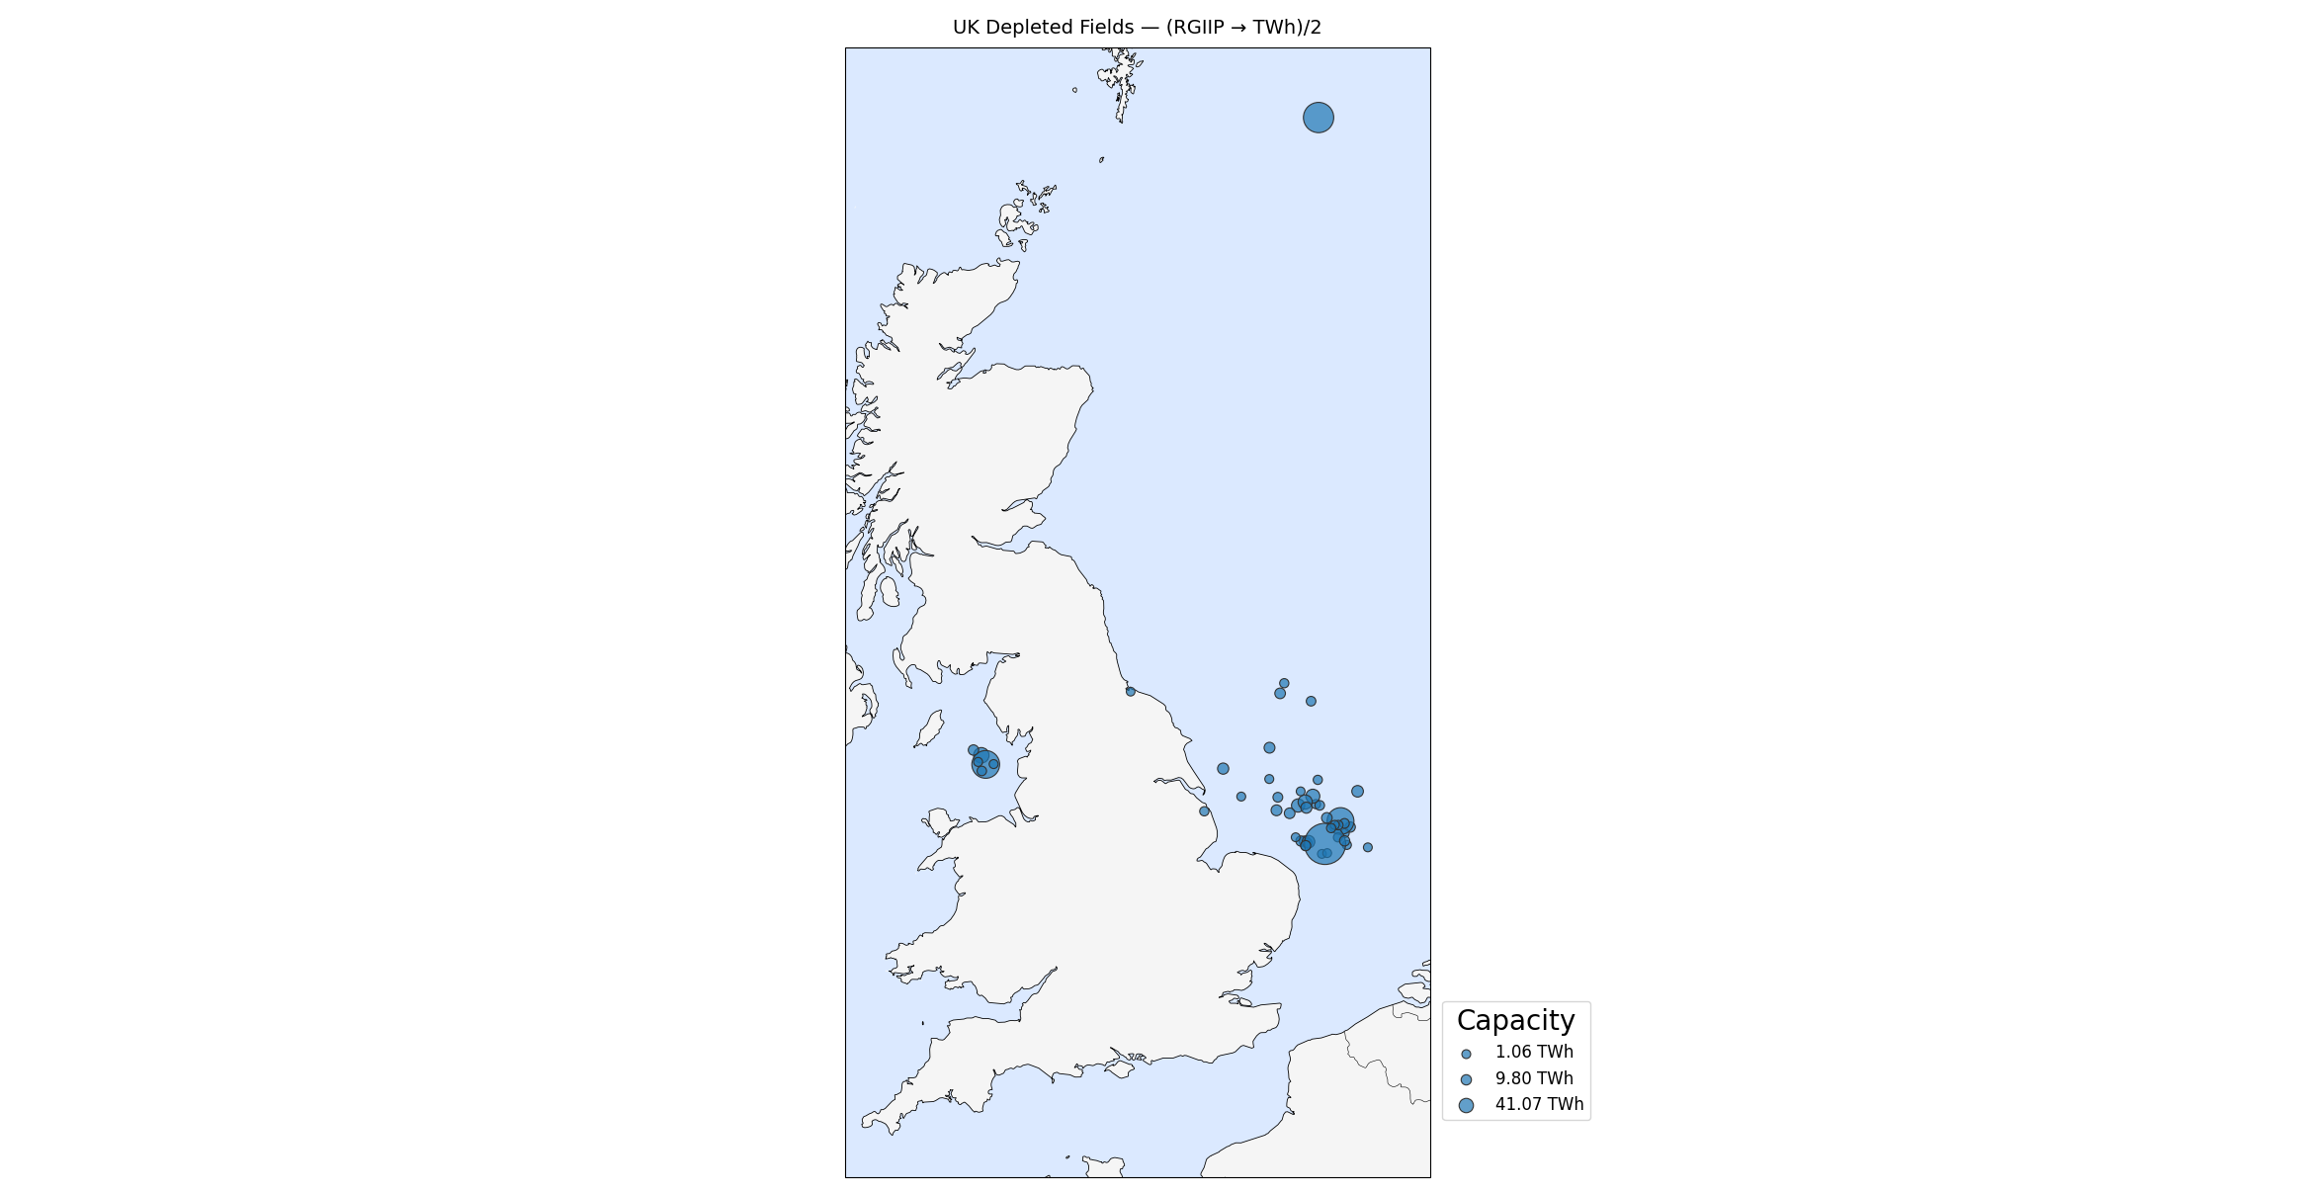
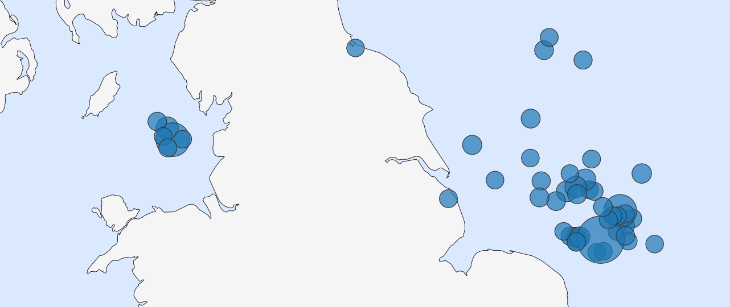

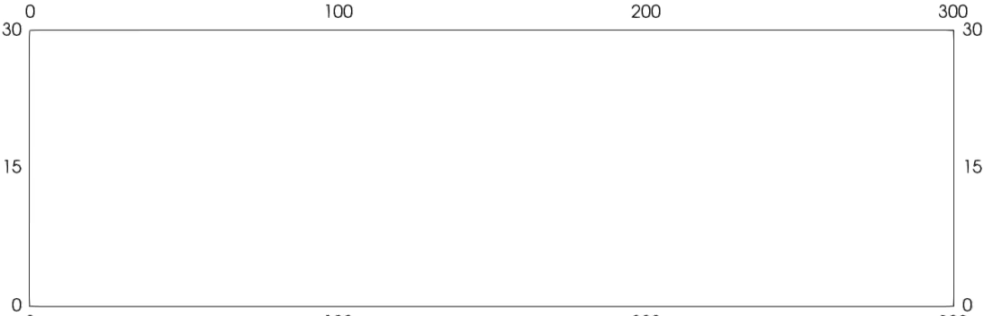
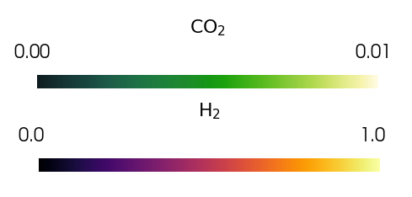
UHS in Depleted Gas Reservoirs
Why gas reservoirs?
Existing wells and infrastructure.
Proven seal integrity
Very large storage volumes (TWh scale)
Mixing with Resident/Cushion Gas
UK has more than 100 depleted gas fields suitable for storage.
Estimated capacity: ~1600 TWh H₂ (half capacity)
2

Slide 5
How can UK depleted gas reservoirs be screened and operated to deliver hydrogen storage at the lowest cost while maintaining reliable H₂ recovery?

Slide 6
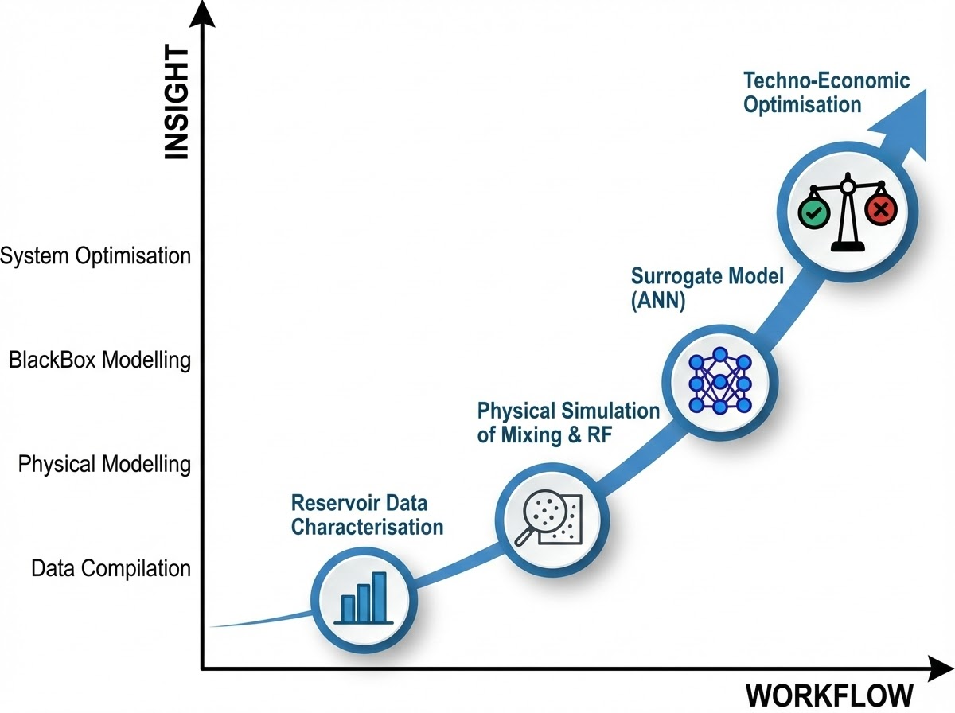
Workflow
Optimise reservoir portfolio to meet UK storage targets
Train surrogate model to predict hydrogen RF
Simulate gas mixing and estimate recovery factor
Compile UK depleted gas reservoir dataset
4
Notes:
To answer the research question, I built an end-to-end workflow. First, I compiled a UK depleted gas reservoir dataset, including reservoir properties, capacity indicators, and well counts. Then I used physics-based simulations to study gas mixing and hydrogen recovery under different reservoir and operating conditions. Because running full simulations for every optimisation scenario would be too expensive, I trained a surrogate model to predict recovery factor much faster. Finally, I used that surrogate inside a portfolio optimisation framework to identify reservoir combinations and operating strategies that meet UK storage targets at minimum cost.

Slide 7
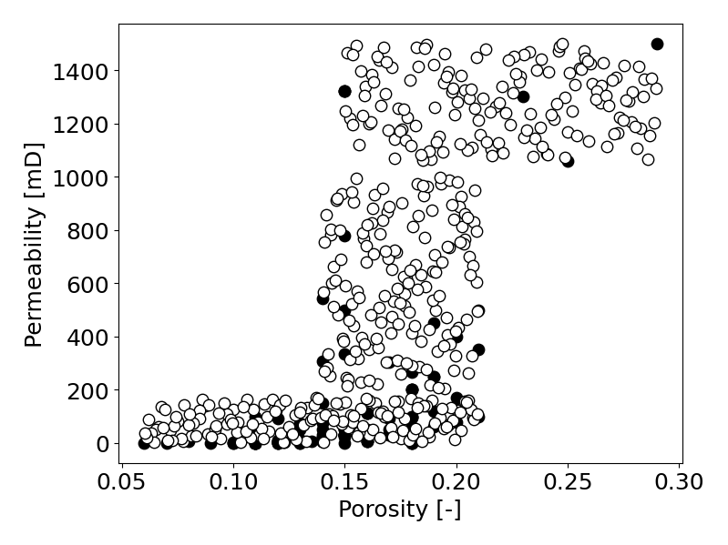
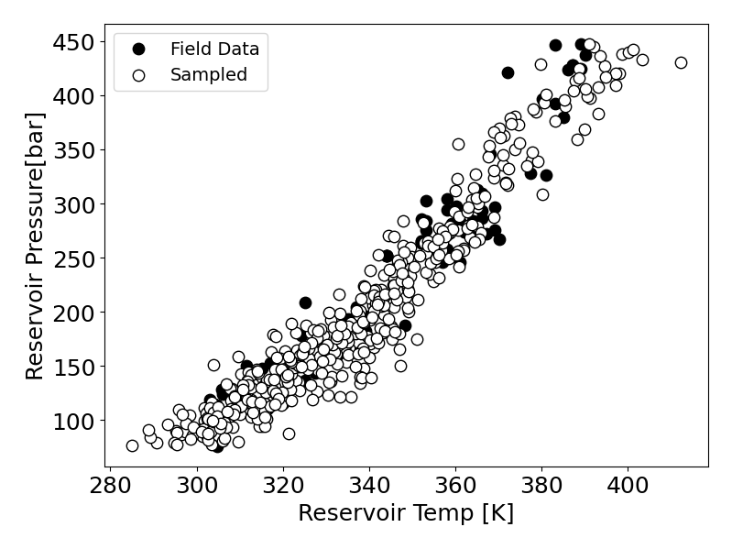
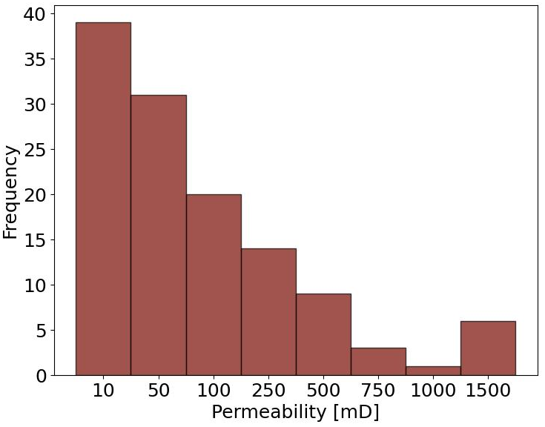

Reservoir Characterisation
1. Dataset
2. Key Patterns
3. Implication for modelling
124 UK depleted gas reservoirs identified.
96 with complete rock properties, RGIIP, and well counts
Permeability is strongly right-skewed.
Pressure and temperature show a clear positive trend.
Permeability clustered before sampling to preserve low- and high-permeability groups.
Generated a representative reservoir parameter space.
CO2Stored
5
Permeability distribution
Porosity–Permeability distribution
Pressure-Temperature relationship
Notes:
The dataset started from 124 UK depleted gas reservoirs, with 96 having complete data for this study. The key modelling issue was heterogeneity, especially the strongly skewed permeability distribution. So I clustered permeability before sampling to preserve both low- and high-permeability groups and generate representative simulation cases.

Slide 8
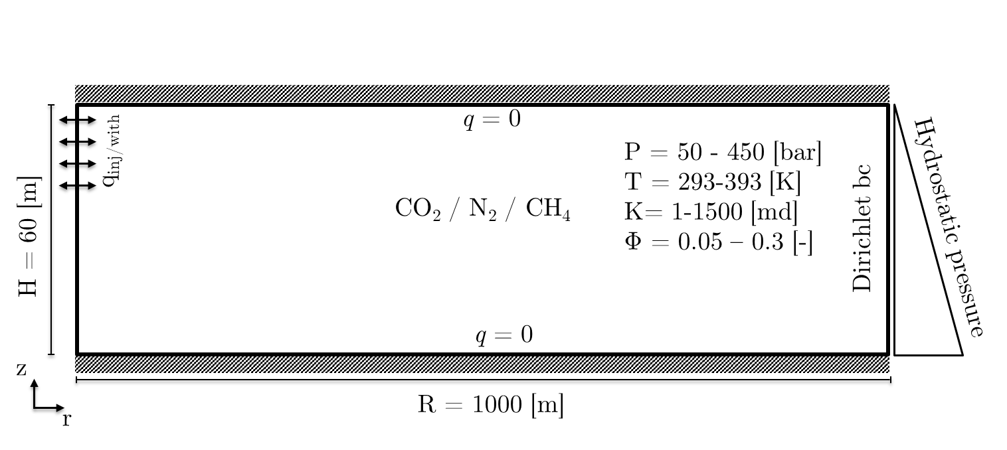

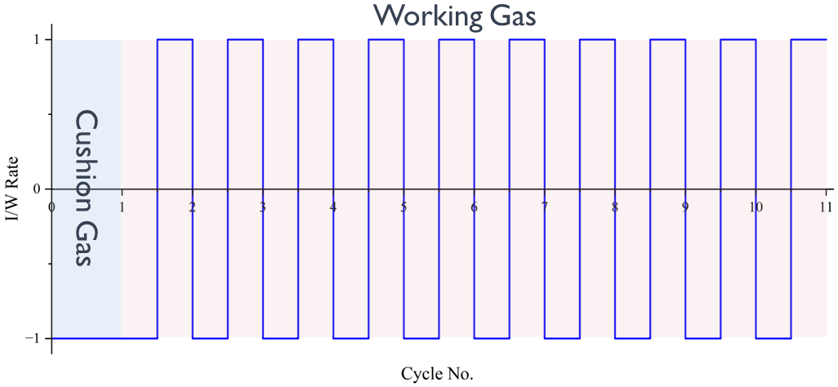
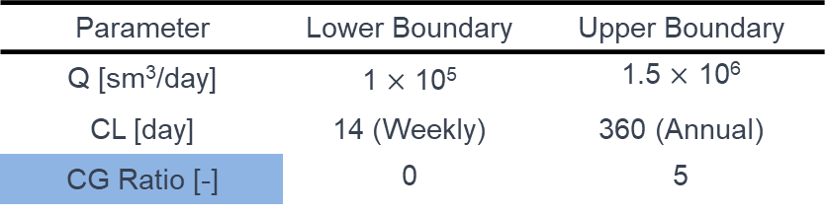
Simulation Setup
Domain and Inputs
Simulation Cases
Combined the generated reservoir data points with Flow rate and Cycle Lengths (CL) from Latin Hypercube Sampling.
1000 m
Parameter | Lower Boundary | Upper Boundary
Q [sm³/day] | 1 $×$ 10⁵ | 1.5 $×$ 10⁶
CL [day] | 14 (Weekly) | 360 (Annual)
CG Ratio [-] | 0 | 5
30 m
Single Phase: Advection + Diffusion + Dispersion + Buoyancy
Saturated with: CH₄ – N₂ – CO₂ – H₂ (Analysed the CG ratio)
Repeated Injection/Withdrawal of H₂ as working gas.
Cushion Gas Ratio = $\frac{Period of Cushion gas injection}{Period of working gas injection}$ (only for H₂)
Cases Run: ~2,400 simulations across gas type, Q, CL, and rock/fluid combinations.
10 Cycles of I/W
Recovery Factor (RF) = $\frac{Cumulative Withdrawn H_{2}}{Cumulative injected H_{2}}$
6
Notes:
For the simulation stage, I used a simplified 2D axisymmetric reservoir model in DuMuX. The model represents single-phase gas flow and transport in porous media, including advection, molecular diffusion, mechanical dispersion, and buoyancy effects. The reservoir was initially saturated with methane, nitrogen, carbon dioxide, or hydrogen, and then hydrogen was injected and withdrawn repeatedly as the working gas over 10 cycles. I combined the reservoir samples with operating variables such as flow rate and cycle length using Latin Hypercube Sampling. In total, I ran around 2,400 simulations, and the main output metric was hydrogen recovery factor, defined as cumulative withdrawn hydrogen divided by cumulative injected hydrogen.

Slide 9
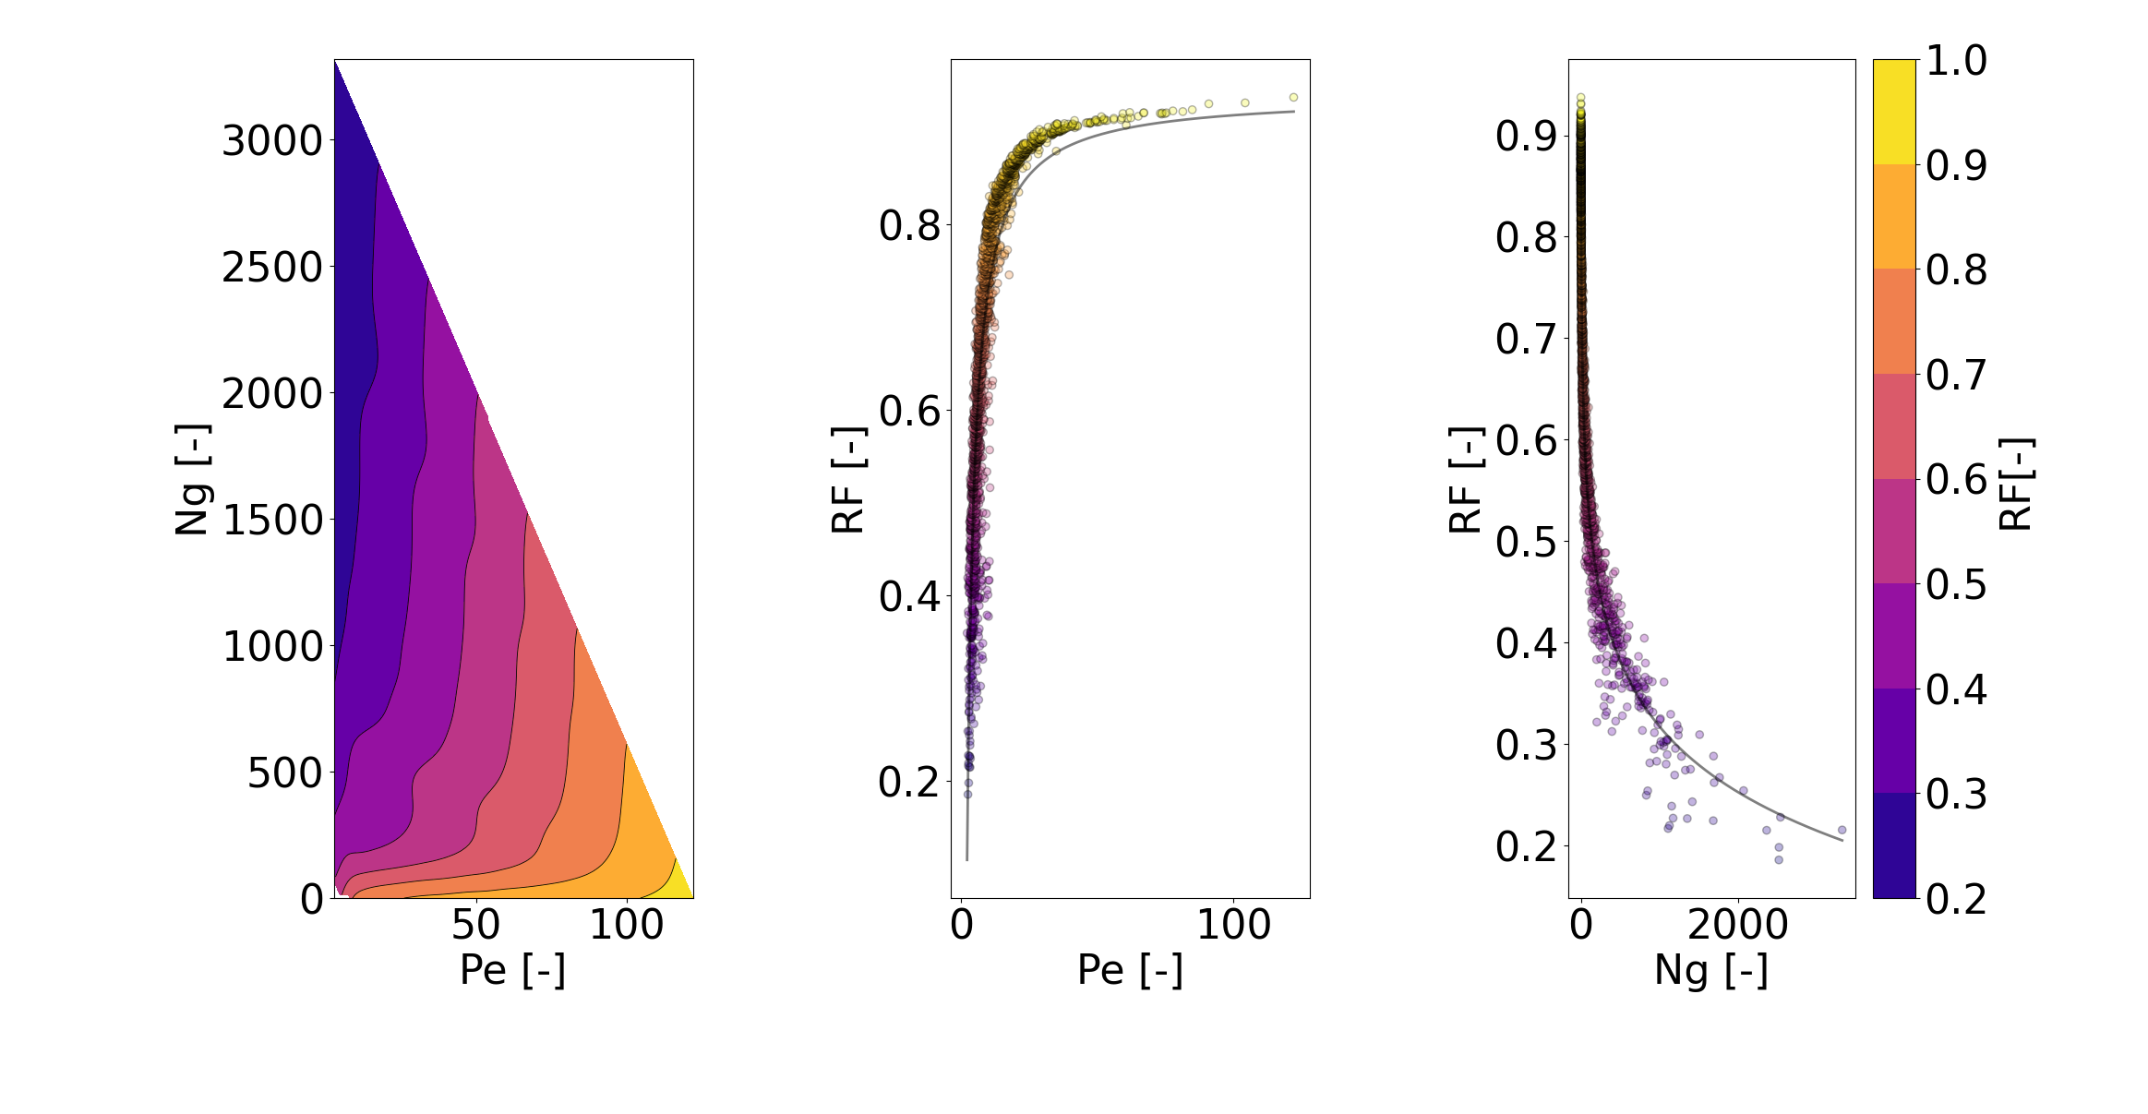
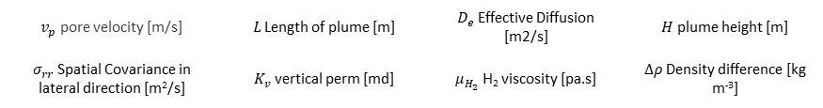
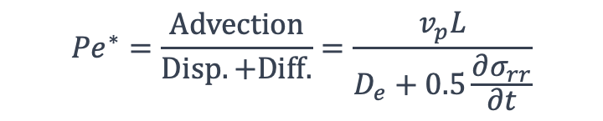
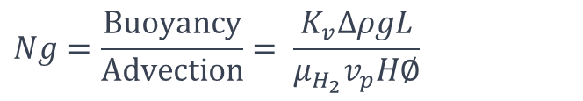
Physics-Based Simulation
Why Pe and N_{g} ?
Dispersion + buoyancy still are there
Compact descriptors that collapse reservoir, operational and CG effects.
$${Pe}^{∗}=\frac{Advection}{Disp. +Diff.}=\frac{v_{p}L}{D_{e}+0.5\frac{∂σ_{rr}}{∂t}}$$
$$Ng=\frac{Buoyancy}{Advection}= \frac{K_{v}∆ρgL}{μ_{H_{2}}v_{p}H∅}$$
Pe ↑ ⇒ advection dominates spreading ⇒ RF ↑
Ng ↑ ⇒ buoyancy dominates flow ⇒ RF ↓
Figure 1: Recovery factor after cycle 10 as a function of Péclet number and buoyancy number.
$v_{p}$ pore velocity [m/s] | 𝐿 Length of plume [m] | $D_{e}$ Effective Diffusion [m2/s] | $H$ plume height [m]
$σ_{rr}$Spatial Covariance in lateral direction [m²/s] | $K_{v}$ vertical perm [md] | $μ_{H_{2}}$ H₂ viscosity [pa.s] | $∆ρ$ Density difference [kg m⁻³]
7
Notes:
“From the physics-based simulations, I did not want to only look at recovery factor as a black-box output. I reduced the behaviour into two dimensionless groups. The first is the Péclet number, which compares advective transport to diffusive and dispersive spreading. The second is the buoyancy number, which compares buoyancy-driven segregation to advective flow.”
“The trend is clear. When Pe increases, advection dominates the spreading mechanisms, and hydrogen recovery generally improves. When Ng increases, buoyancy becomes stronger relative to flow, which promotes vertical segregation and reduces recovery. So these two numbers helped explain why some reservoirs and operating conditions perform better than others.”
“The important point is that the dimensionless analysis connects the simulation results back to physical mechanisms, rather than treating the model as a black box.”
What pushes Pe up?
Higher rate/velocity, higher pressure, lower dispersion/diffusion
What pushes N_{g} up?
Larger density contrast, higher vertical permeability/connectivity, slower flow

Slide 10
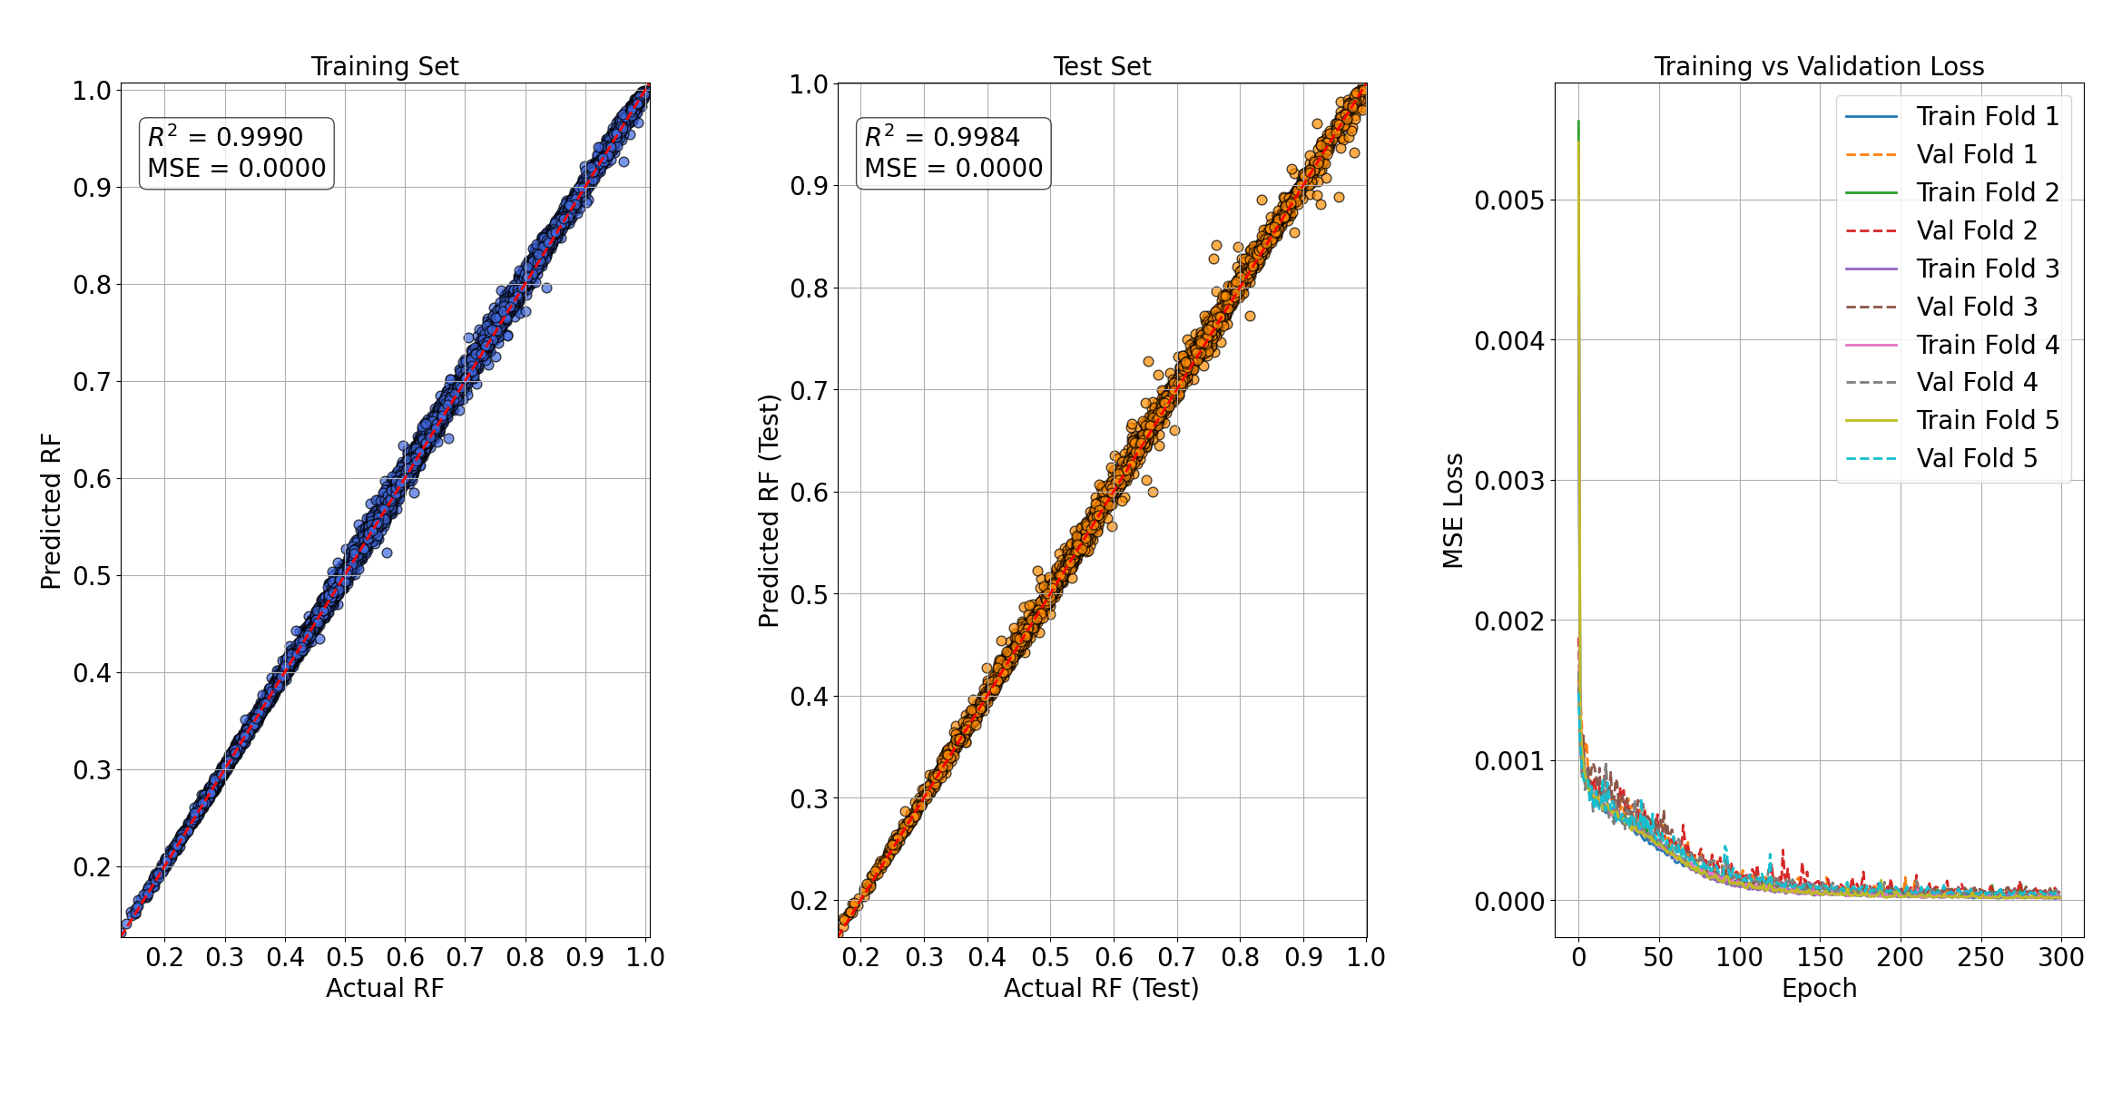
Surrogate Model
Goal: Fast surrogate of the physics simulator to predict cycle RF.
Inputs: [K, φ, P, T, Q, CL, ∆ρ, Cycle No., CG Ratio (H₂)]
Preprocessing: Normalising features
Model: Artificial Neural Network (ANN)
Training: 80/20 train/test - 5-fold CV on train for hyper-params
[sigmoid]
[relu]
[Tanh]
Figure 2: Parity plots for predicted vs. actual RF for both Training and Testing sets.
Fit-for-purpose: Surrogate achieves simulation-grade accuracy but in milliseconds, enabling UK-scale optimisation.
alexlenail.me
Input layer
9 neurons
Hidden layer
36 neurons
Hidden layer
92 neurons
Hidden layer
108 neurons
Output layer
1 neurons
8

Slide 11
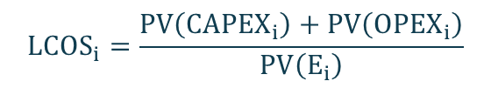
Portfolio Optimisation
Reservoir
Database
Inputs: Reservoir Data + Recoverable Gas Initially in Place + Wells.
LHS over Q, CL, CG Ratio, Number of wells.
Surrogate RF ⇒ per-cycle delivered H₂ and PV-cost primitives.
CL [d] | Demand [TWh]
14 | 5
60 | 15
180 | 50
360 | 100-150-200
Scenario Generation
Obj = Min [CAPEX + PV (OPEX)]
Includes wells, compression, H₂ production, CG injection and PSA purification.
Optimisation
Framework
Constraints:
Reservoir Capacity
Number of wells
Max injection pressure
Meet Demands
Chosen fields & rates, PV-cost and LCOS.
Each target optimised separately over project horizon (Y = 10 / 20 / 30 Years).
$${LCOS}_{i}=\frac{PV\left({CAPEX}_{i}\right)+PV\left({OPEX}_{i}\right)}{PV\left(E_{i}\right)}$$
Optimal
Plan
9
CAPEX = f(well costs, H₂ price, Compressor size, CG costs)
OPEX = f(electricity, cooling, water requirement, well O&M costs)
PV = Present Value (discount rate = 7 %)
LCOS = Levelised Cost of Storage

Slide 12
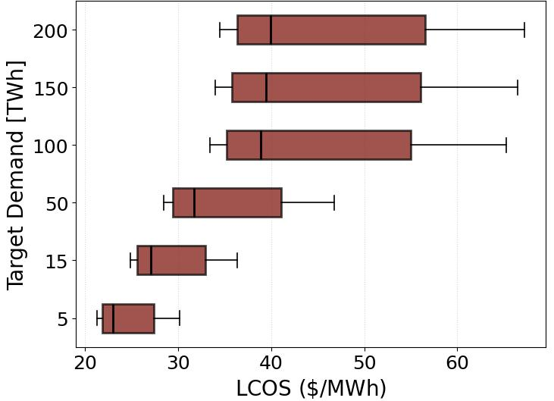
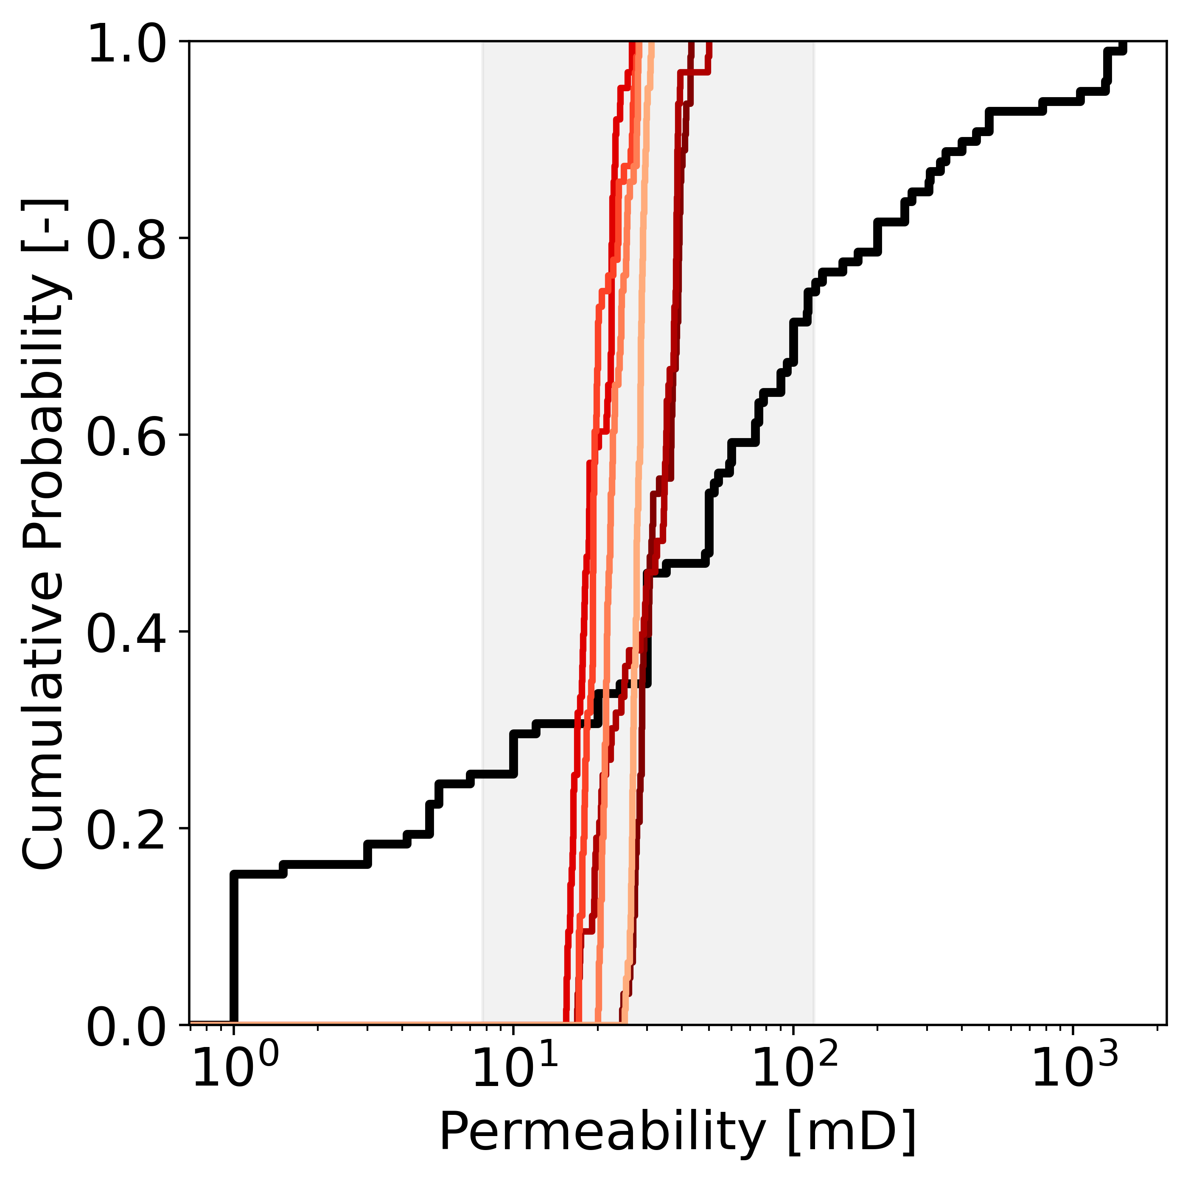
Optimal Design
Figure 3: Box plot of LCOS across optimal reservoir combinations for all delivery targets.
Figure 4: Empirical cumulative distribution function of permeability.
Controlled by the number of I/W cycles achievable within a year.
Costs vary between $23–$38/MWh.
Across all demand levels, the chosen reservoirs fall within a narrow range of permeabilities.
Permeability values consistently cluster between 10–30 [mD].
10
Notes:
“Shorter cycle lengths allow more injection-withdrawal cycles per year, so the storage asset is used more frequently. That spreads fixed costs over more delivered hydrogen and lowers LCOS.

Slide 13
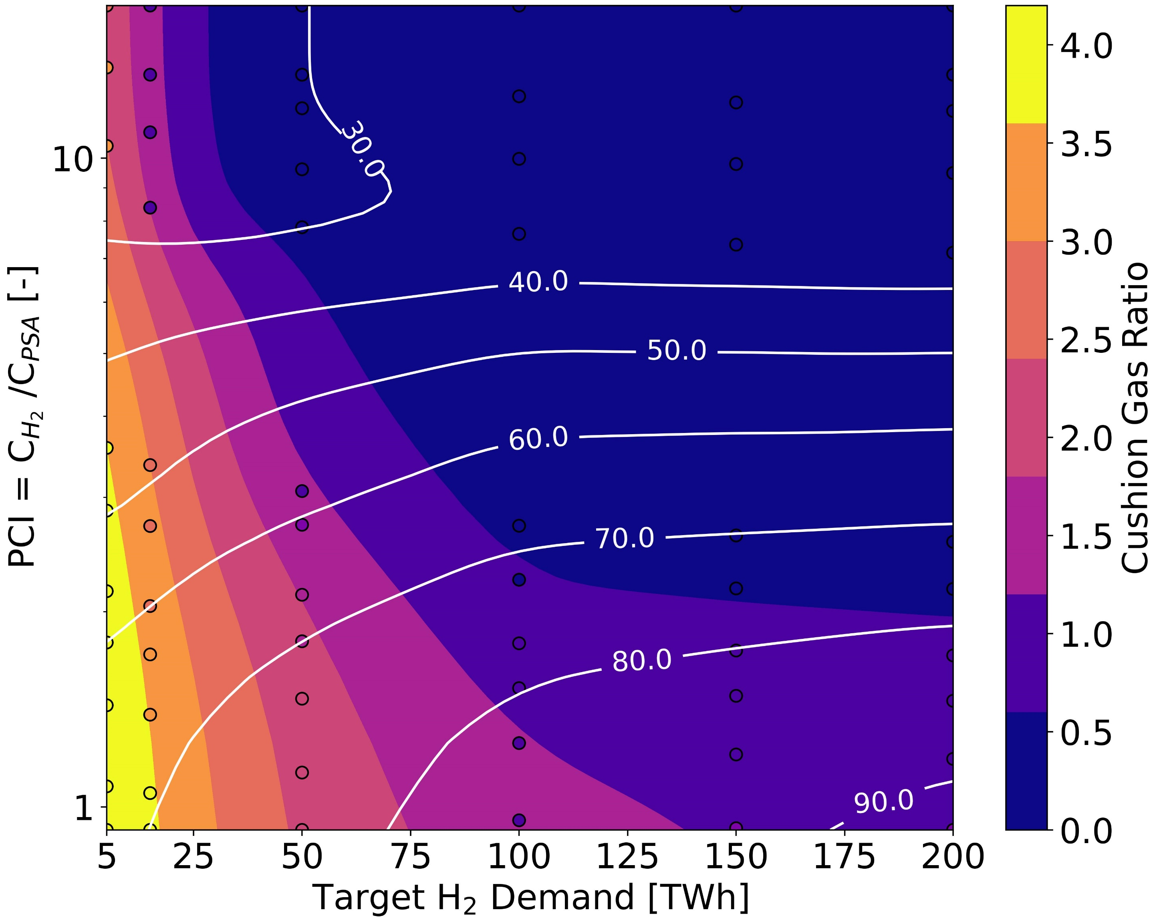
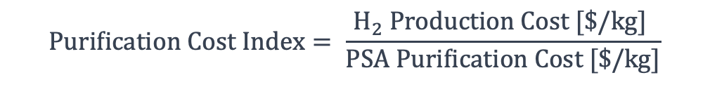
When is H₂ cushion gas worth it?
Uncertainty in hydrogen production and purification costs was explored by varying the hydrogen price between 3 and 5 $/kg and evaluating three PSA cost scenarios, base, Medium (×50), and High (×100).
Cushion gas becomes valuable when purification is expensive relative to hydrogen.
$$Purification Cost Index= \frac{H_{2} Production Cost [\$/kg] }{PSA Purification Cost [\$/kg]}$$
At low low demand, CG ratios rise to 2–4.
At 100 TWh, suggested CG ratio is between 0 and 1.
Figure 5: Contour map showing the influence of the PCI and target demand on the CG ratio and resulting LCOS.
11
Notes:
At high PCI, purification is cheaper → low cushion gas.
At low PCI and low demand, cushion gas ratios rise to 2–4.
At 100 TWh, high purification-cost cases favour ~1–2× working gas as H₂ cushion.

Slide 14
Concluding Remarks
Reservoir quality sets the upper limit: poor reservoir properties cannot be fully compensated by optimisation.
1
2
H₂ cushion gas is only worth it when gas mixing makes purification expensive; in low-demand, short-cycle cases, optimal ratios can reach about 2–4× working gas.
3
An extendable end-to-end modelling workflow that connects reservoir physics, surrogate modelling, and optimisation to support hydrogen-storage deployment decisions.
12

Slide 15


Slide 16

Thank You!
Department of Chemical Engineering, The University of Manchester
Ehsan.vahabzadehasbaghi@manchester.ac.uk
vahid.niasar@manchester.ac.uk

Slide 17
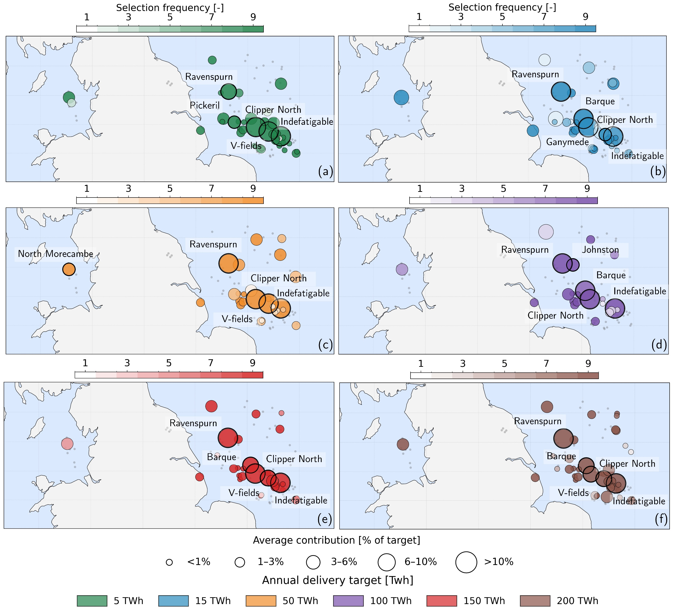
Optimal Decision
spatial distribution and robustness of optimised UK reservoir fields across annual delivery targets under different PCI values.
Repeated selections cluster in the Southern North Sea, especially Ravenspurn, Clipper North, Indefatigable, Barque, and V-fields.
Optimisation identifies a robust east-coast core portfolio, not just isolated storage sites.
11

Slide 18


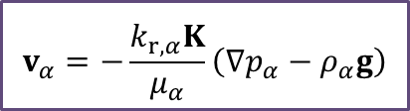






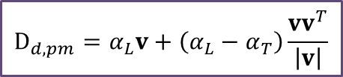




Transport Model
Mass balance eq:
$$\left[\frac{∂}{∂t}\left(φρ_{α,mol}x^{k}\right)+∇⋅\left(ρ_{mol}x^{k}v_{α}\right)−∇⋅\left(ρ_{,mol}D_{pm}^{κ}∇x^{k}\right)\right]=0, k∈\{H2;CO2;CH4;…\}$$
Storage
Flux
Darcy’s Law:
$$v_{α}=−\frac{k_{r,α}K}{μ_{α}}\left(∇p_{α}−ρ_{α}g\right)$$
$D_{pm}=D_{d,pm}+D_{m,pm}$ = Dispersion + Diffusion
$$\text{M}\text{ixture} \text{density} \text{is} \text{calculated} \text{with} \text{Peng}\text{−}\text{Robinson} \text{EOS}\text{. }$$
$$D_{d,pm}=α_{L}v+\left(α_{L}−α_{T}\right)\frac{vv^{T}}{\left|v\right|}$$
Scheidegger method
$$D_{m,pm}=φ^{\frac{4}{3}}S_{α}^{\frac{10}{3}}D_{m}$$
D_{m} from Maxwell-Stefan
$φ$ Porosity [-]
$x_{α}^{κ}$ mole fraction of component k in phase $α$ [-]
$ρ_{α,mol}$Molar Density of phase $α$ [Mole/m³]
$v_{α}$ Darcy velocity of phase $α$ [m/s]
$α_{L,T}$Dispersivity [m]
$D_{pm,α}^{κ}$ Hydrodynamic dispersion tensor [m²/s]
$q^{κ}$ source/sink term [mol/m³]
$φ_{k}$Fugacity Coefficient [-]
$K$ Permeability [m²]
$k_{r,α}$ Relative Permeability [-]

Slide 19
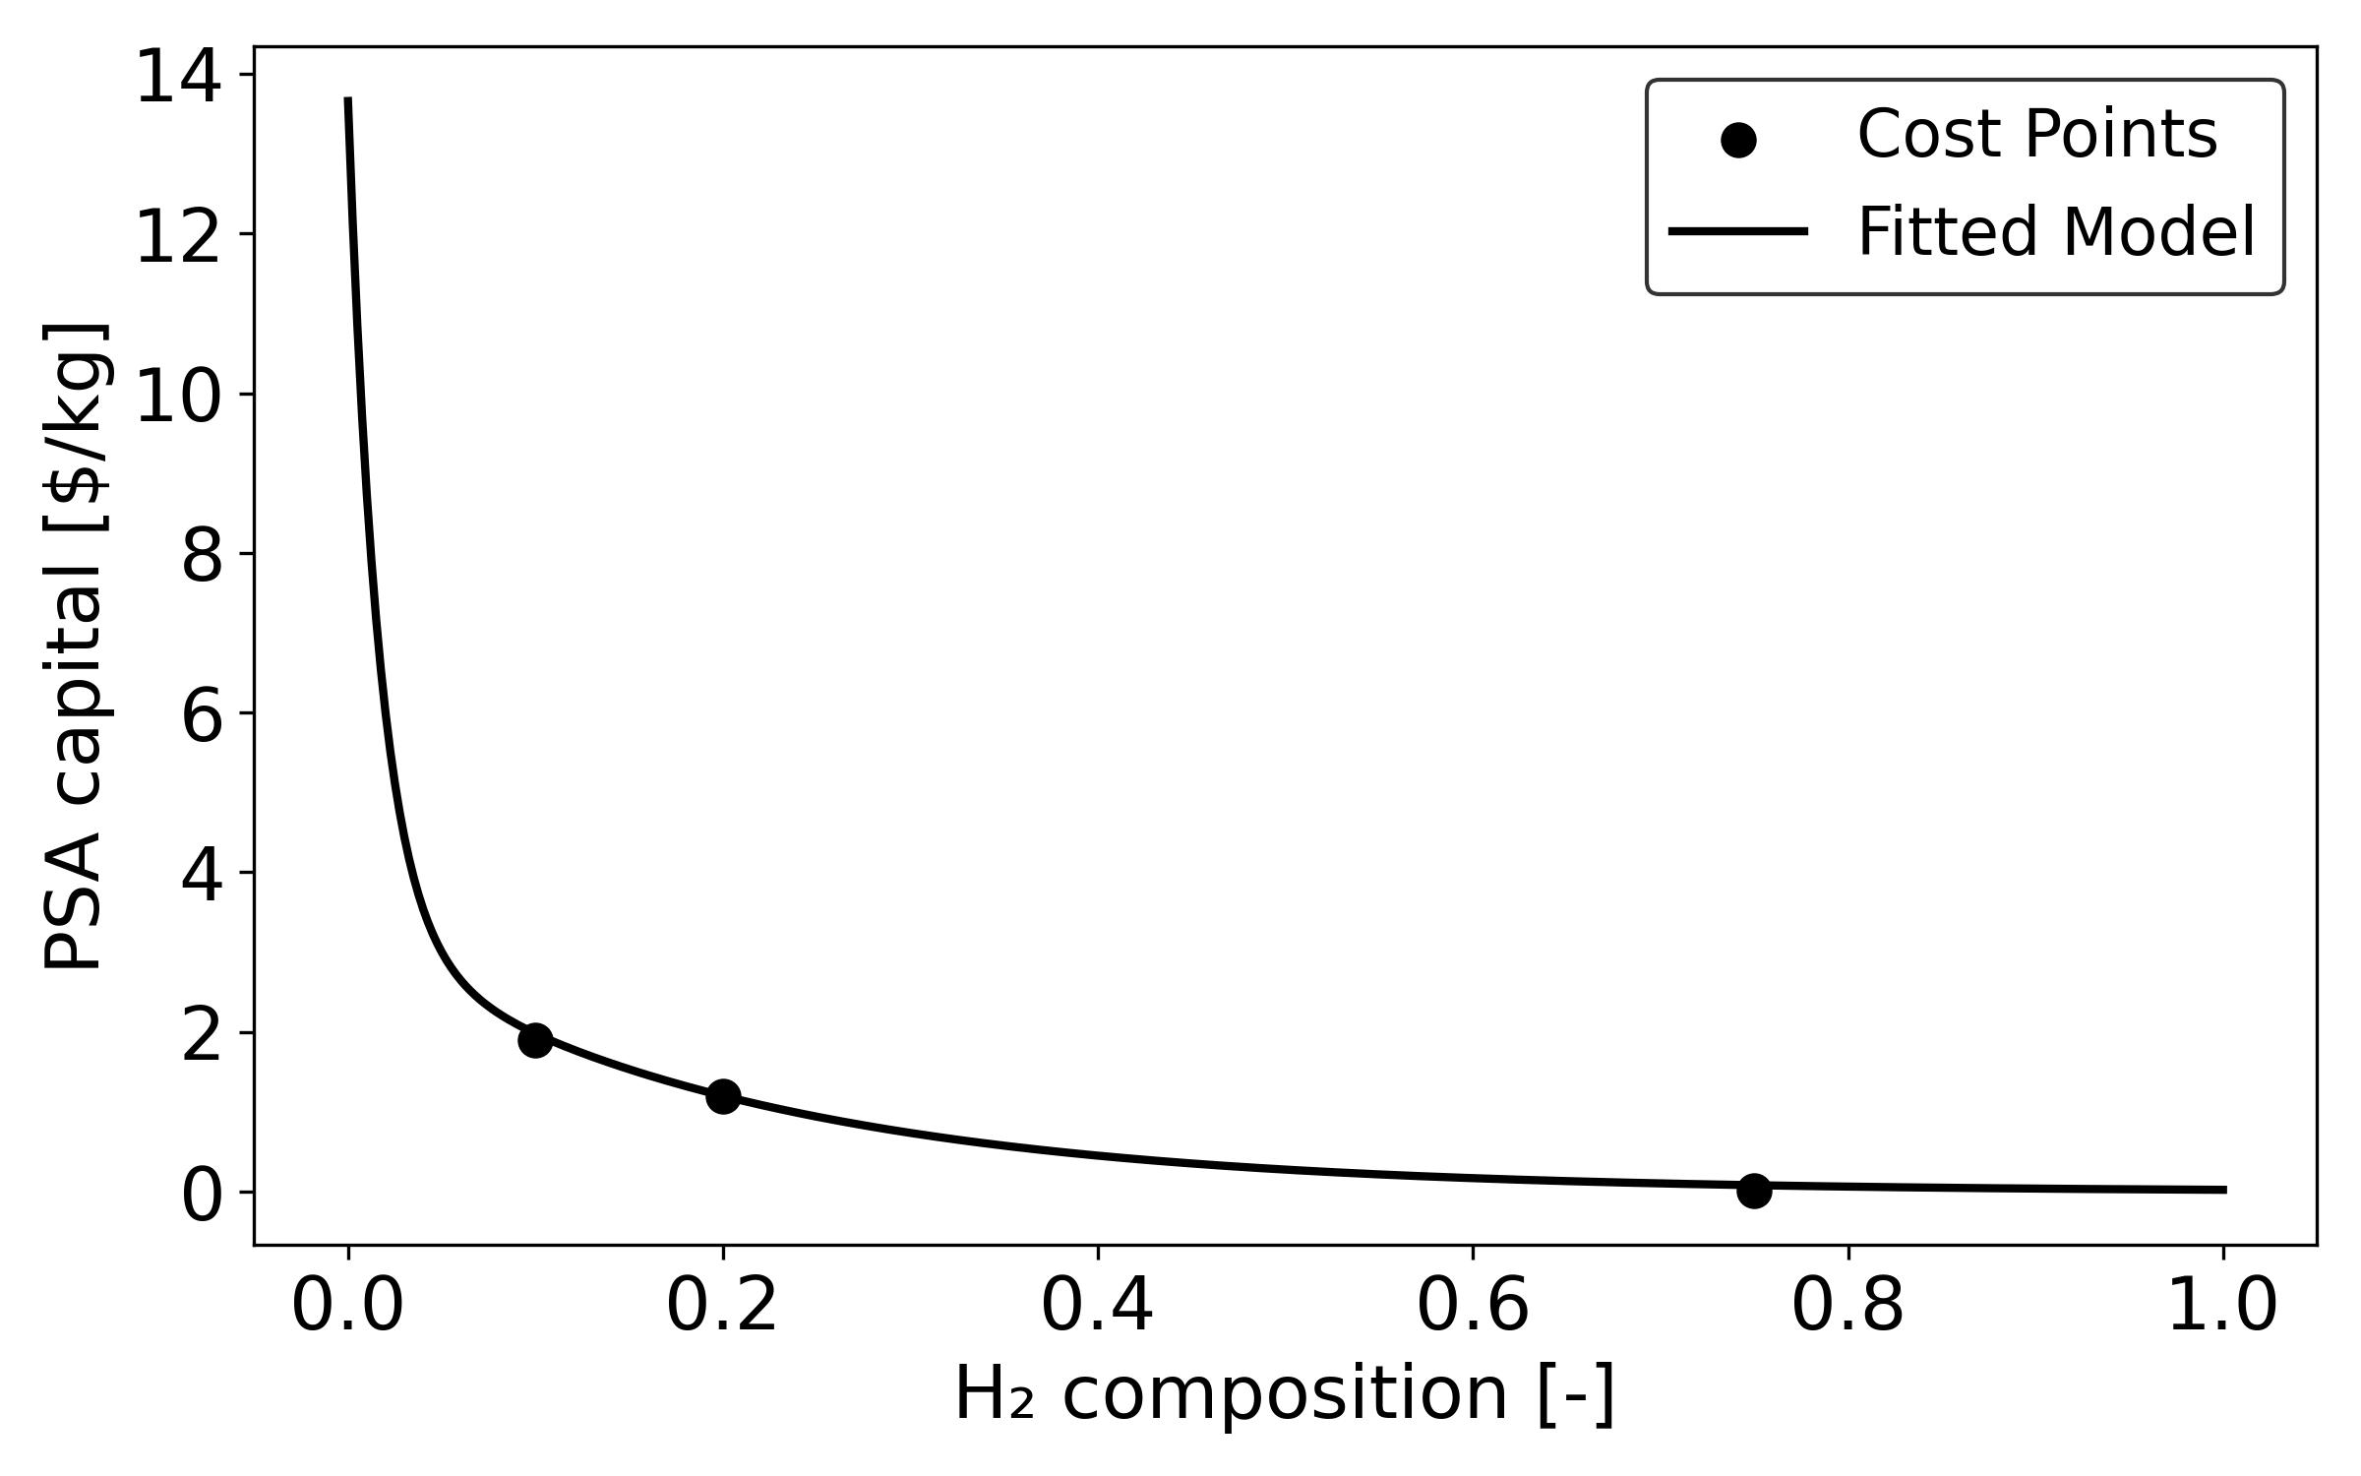
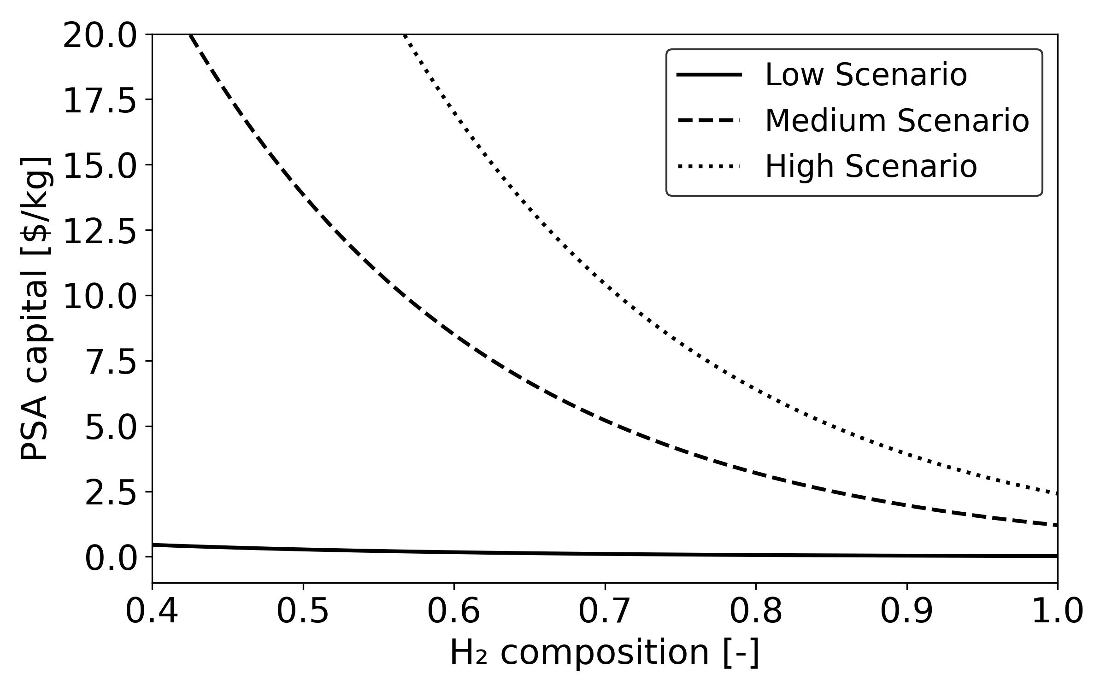
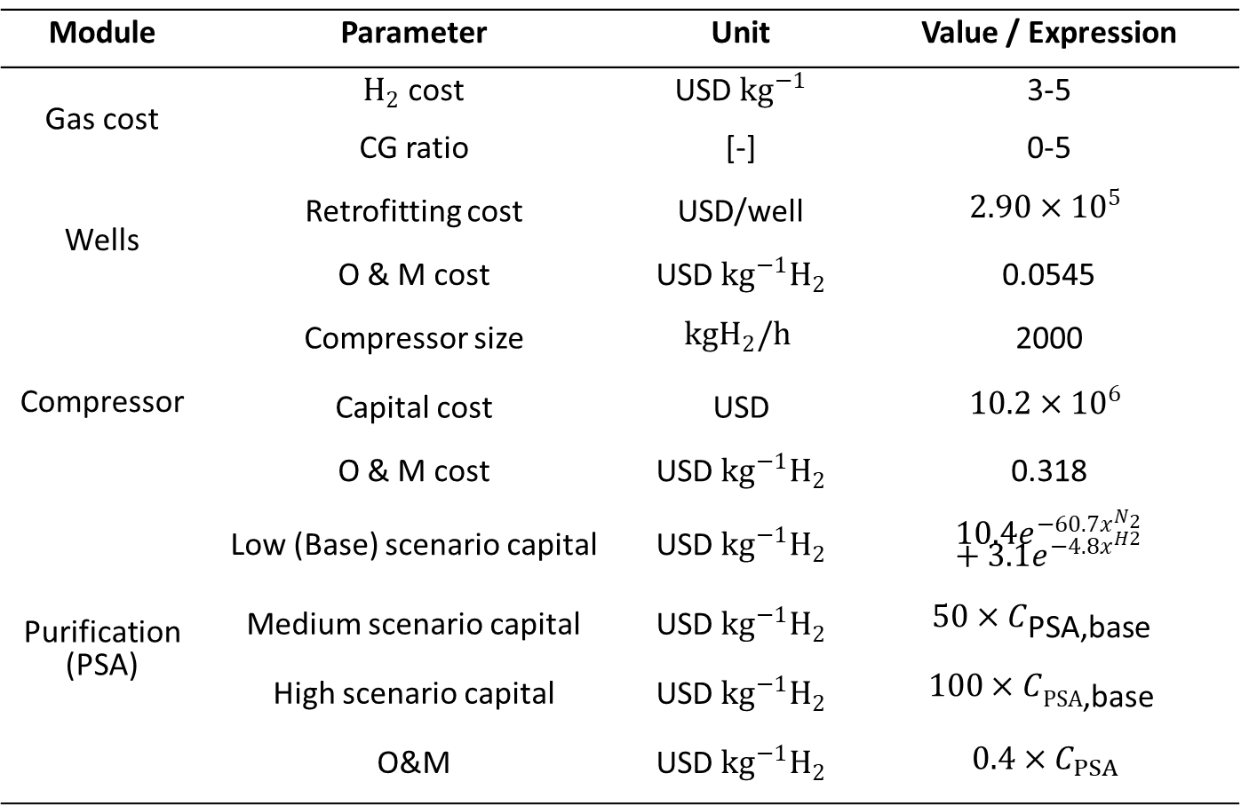

Cost Assumptions
Module | Parameter | Unit | Value / Expression
Gas cost | $H_{2}$ cost | USD ${kg}^{−1}$ | 3-5
 | CG ratio | [-] | 0-5
Wells | Retrofitting cost | USD/well | $$2.90×{10}^{5}$$
 | O & M cost | USD ${kg}^{−1}H_{2}$ | 0.0545
Compressor | Compressor size | $$kgH_{2}/h$$ | 2000
 | Capital cost | USD | $$10.2×{10}^{6}$$
 | O & M cost | USD ${kg}^{−1}H_{2}$ | 0.318
Purification (PSA) | Low (Base) scenario capital | USD ${kg}^{−1}H_{2}$ | $10.4e^{−60.7x^{N_{2}}}$ $+3.1e^{−4.8x^{H2}}$
 | Medium scenario capital | USD ${kg}^{−1}H_{2}$ | $$50×C_{\text{PSA}\text{,}\text{base} }$$
 | High scenario capital | USD ${kg}^{−1}H_{2}$ | $$100×C_{PSA\text{,}\text{base} }$$
 | O&M | USD ${kg}^{−1}H_{2}$ | $$0.4×C_{PSA}$$
$$\text{PSA} \text{cost} =10.4702e^{−60.7137x}$$
$$+3.1879e^{−4.8854x}$$

