Slide 1





An Integrated workflow for building digital rock model of multi-scale carbonate rocks
Zhenkai (Josh) Bo, Hannah P. Menke, Julien Maes, Ahmed H. Elsheikh, Kamaljit Singh
Institute of GeoEnergy Engineering, Heriot-Watt University, Edinburgh, U.K.

Slide 2
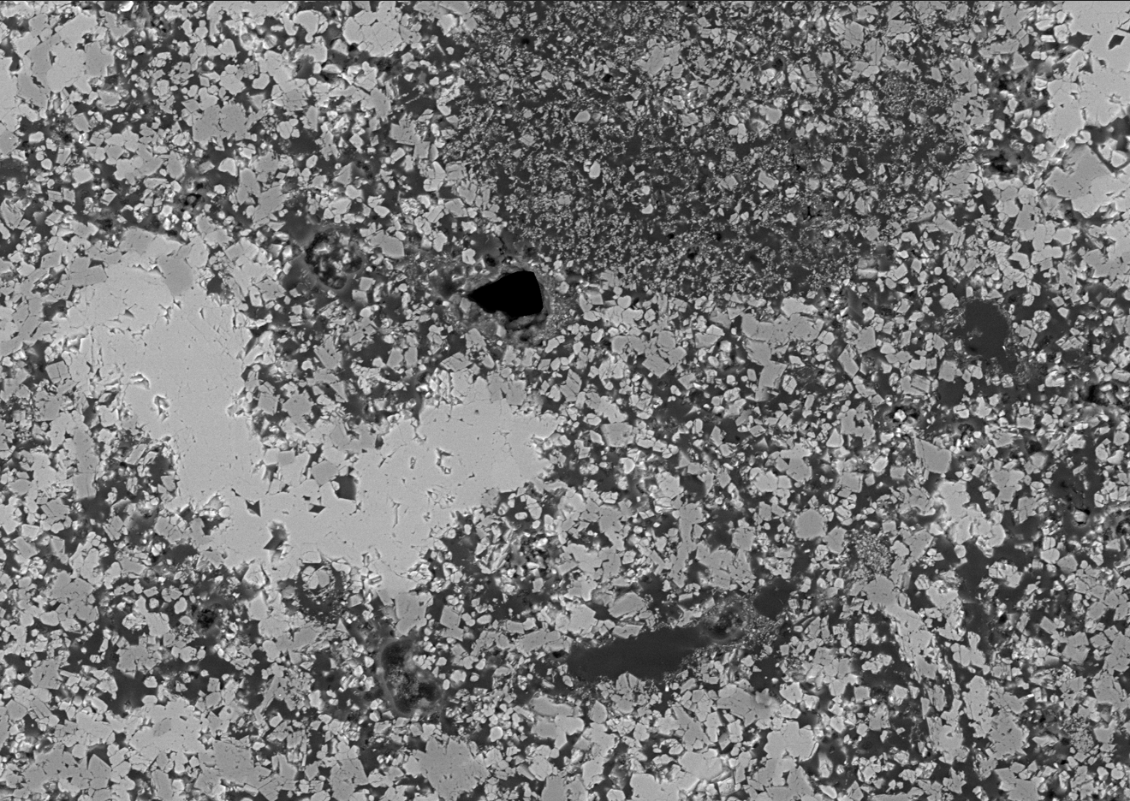
Content
Carbonate microporosity heterogeneity
    Multi-scale imaging
    Super-resolution
Propose ESMDA for microporosity
Forward: XPM simulation with Super-resolution
Conclusion

Slide 3
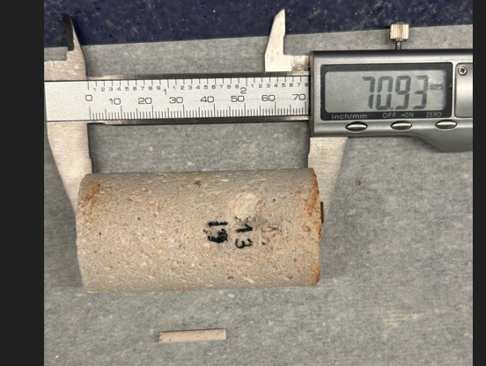
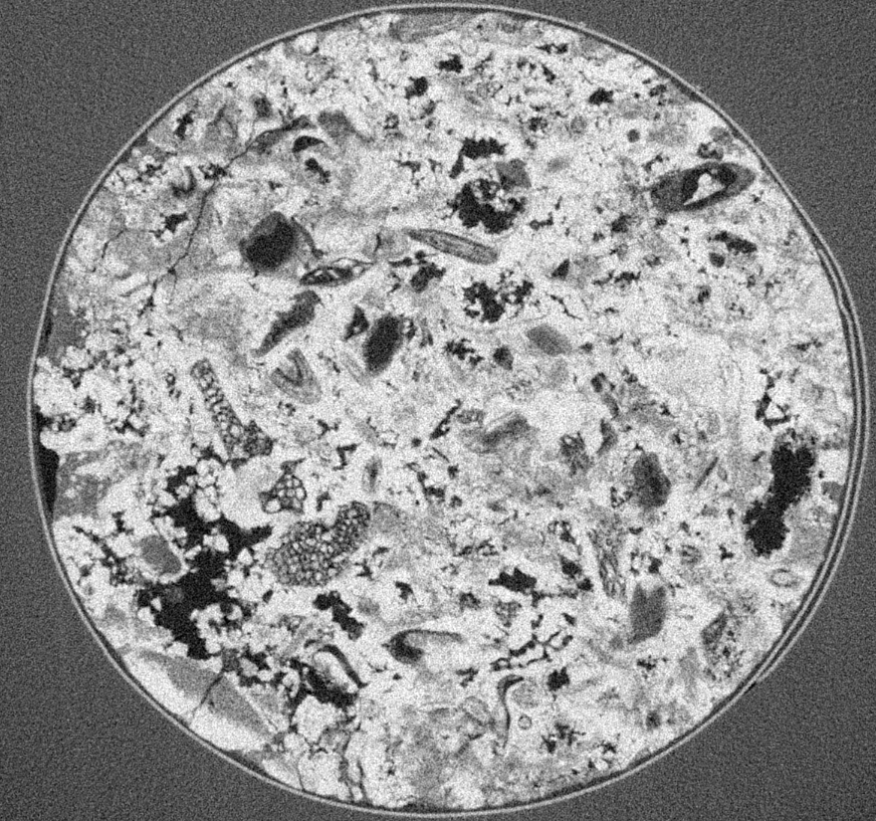
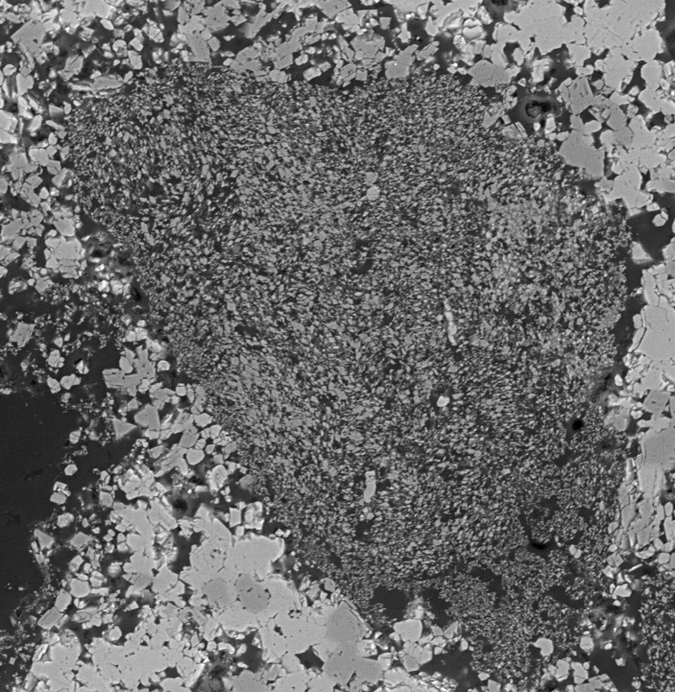
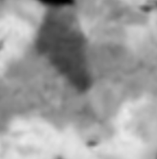
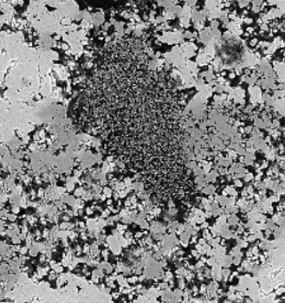


Carbonate microporosity heterogeneity
Subsample drilling
Unresolved pore
(microporosity)
Resources-intensive, mechanically uncertain, unrepresentative
Deep learning neural network
2D training image
Resolved pore
(macropore)
3D raw image
SR image
$$G_{}$$
$$G_{SR}$$
0.5 mm
Super-resolved images are too large for simulation
DL generator

Slide 4
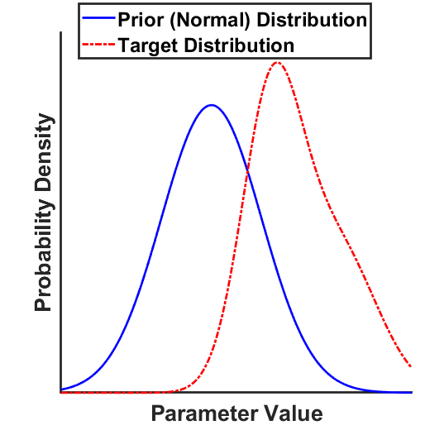
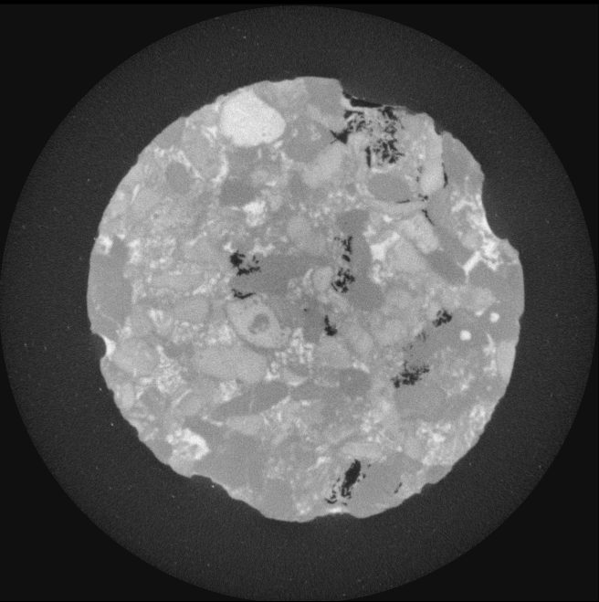
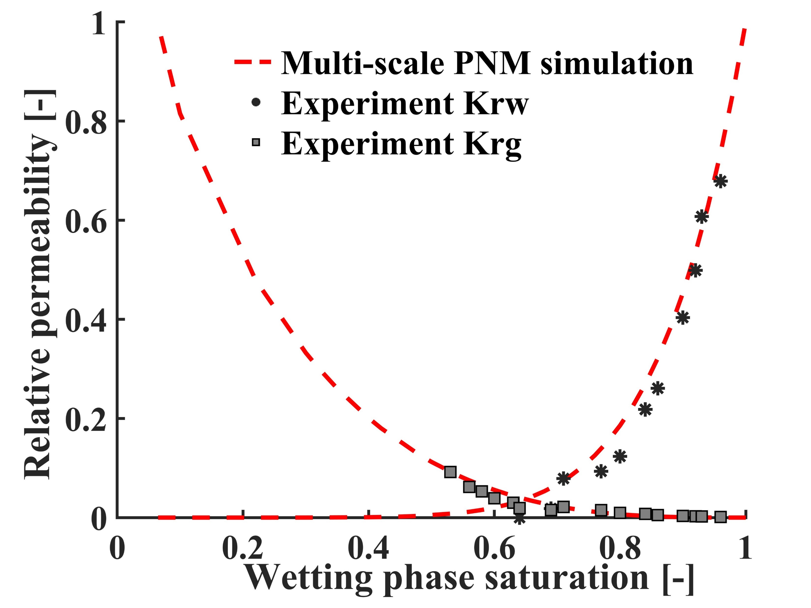
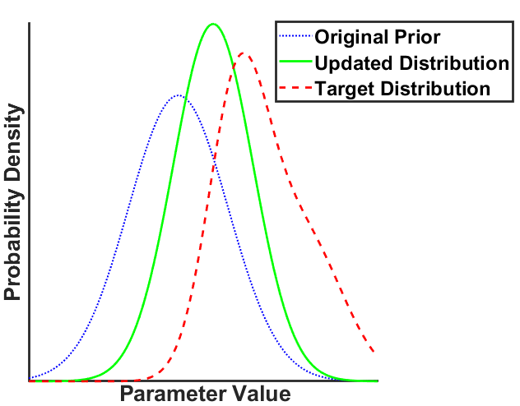
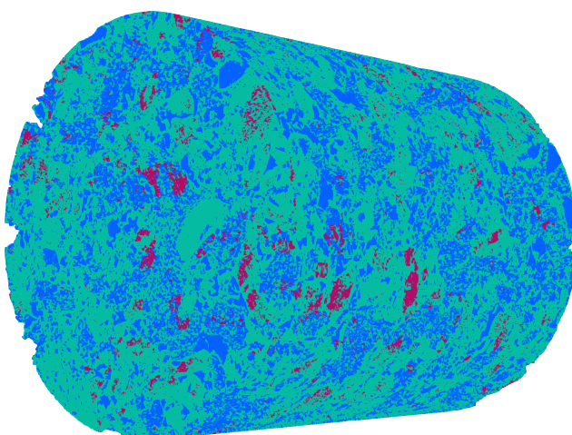
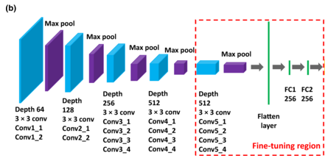
Backward: ESMDA for microporosity
Subsample drilling
Resources-intensive, mechanically uncertain, unrepresentative
In carbonate characterization
ESMDA workflow
Observation: drainage saturation map, porosity map, permeability, real perm, etc
Ensembles
Observation
Forward model
Difference
Linear update
Forward model: multi-scale simulation, invasion percolation, or even DL models!
Updated ensembles
Iterative update
Forward model

Slide 5
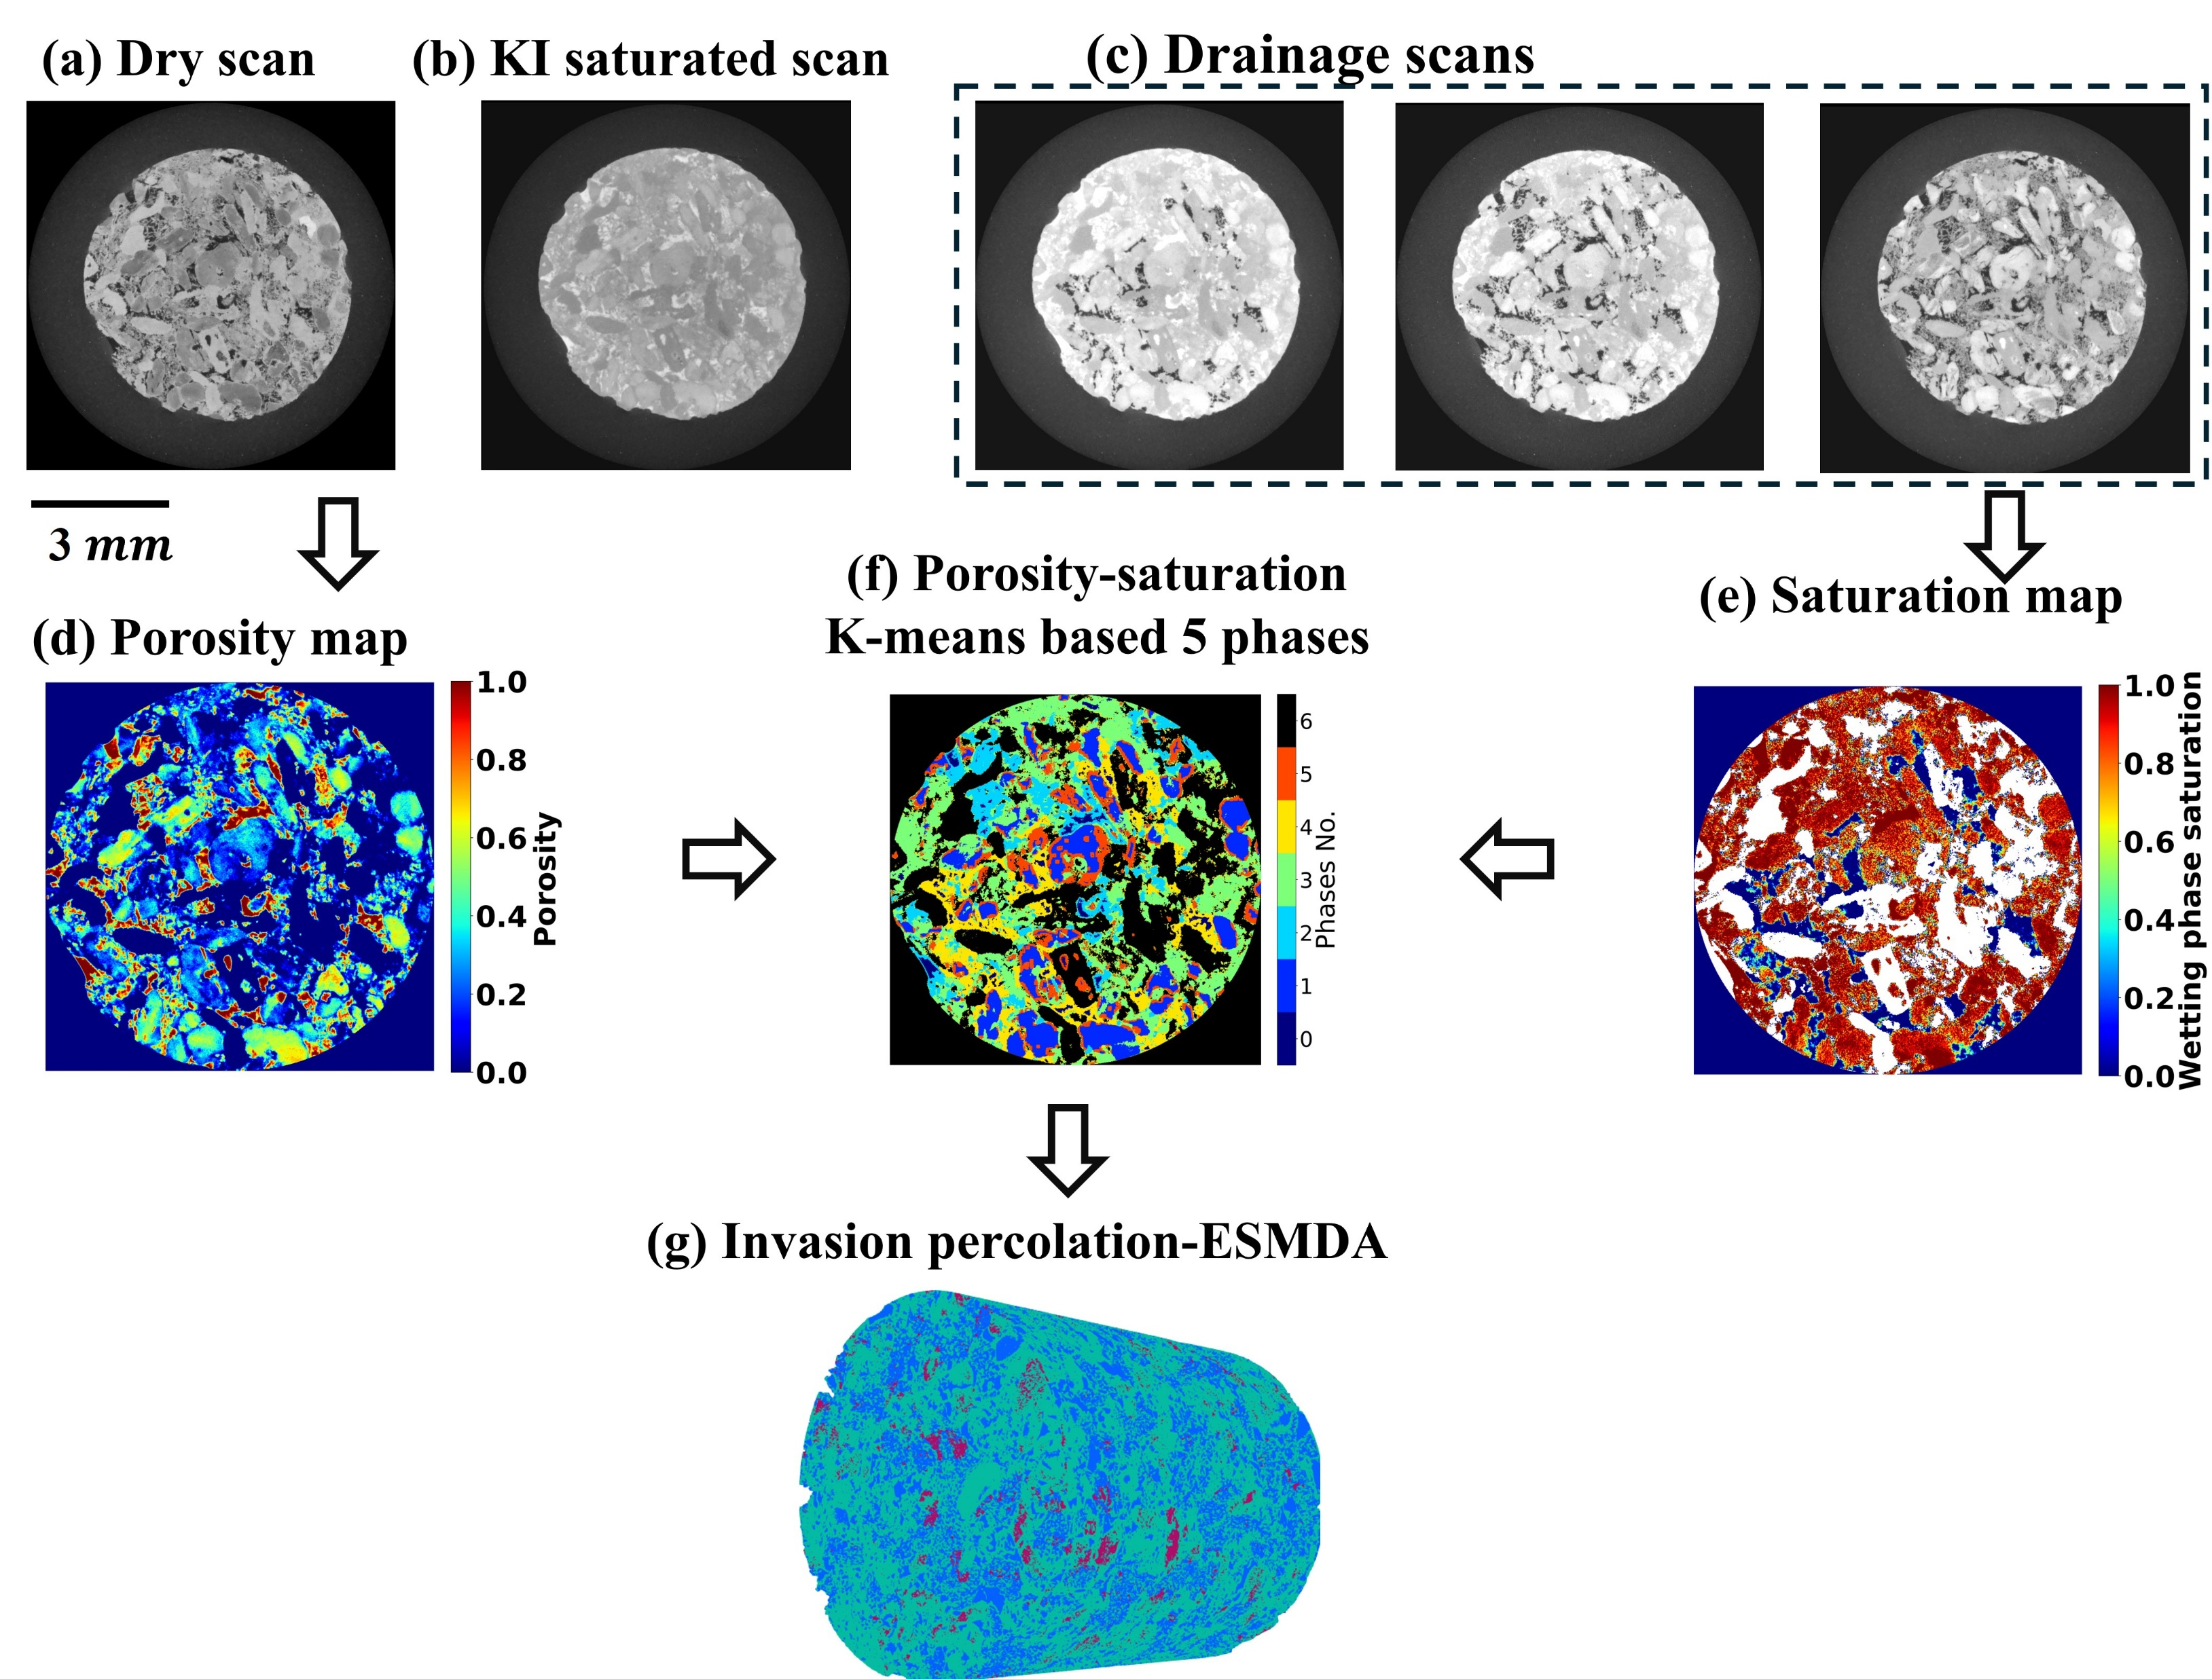
Case study: Estaillades microporosity inference
Observation: 6 steps drainage experimental image with increasing Pc
Forward model: Invasion percolation
Workflow input:
Porosity map
Pc curve of each microporosity phases
Inference target:
Pc curve of each microporosity phases
Initiate ensemble Pc values
Linear update
Perform invasion percolation
Compare with observation

Slide 6
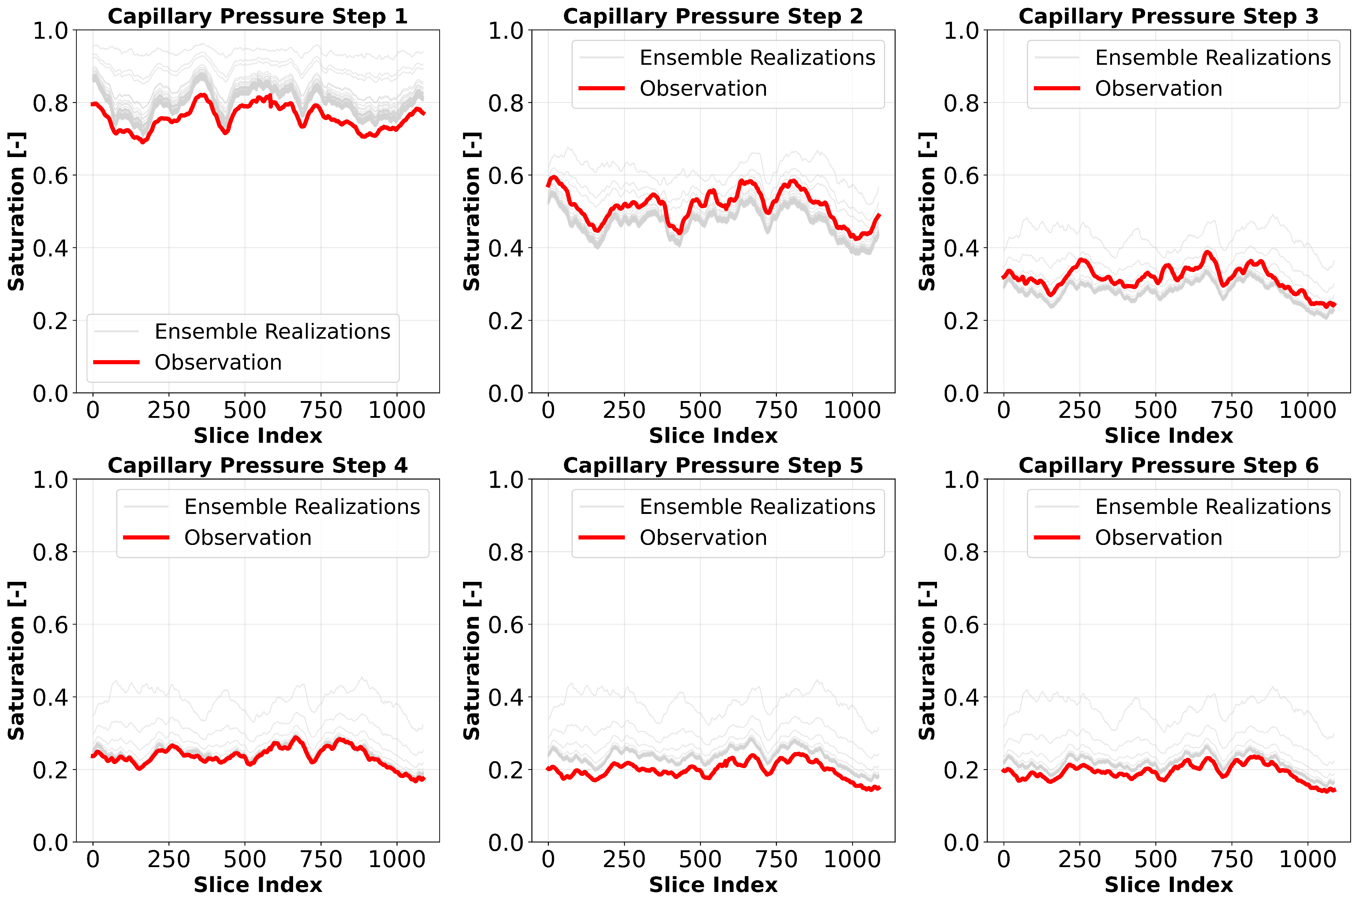
Validation against experimental results

Slide 7
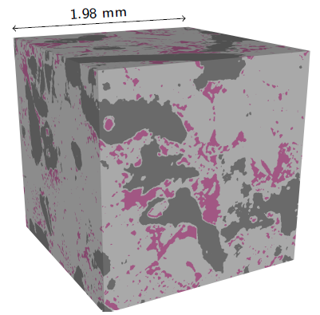
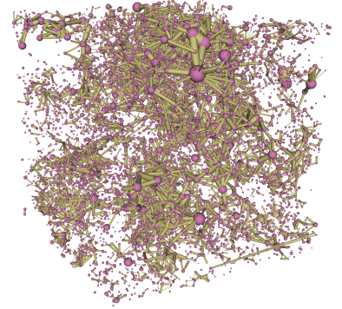
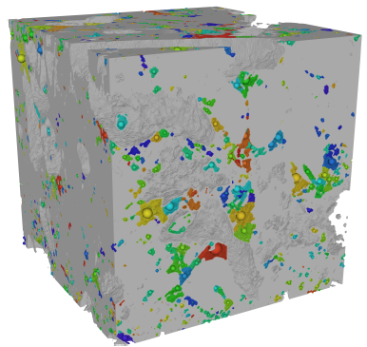
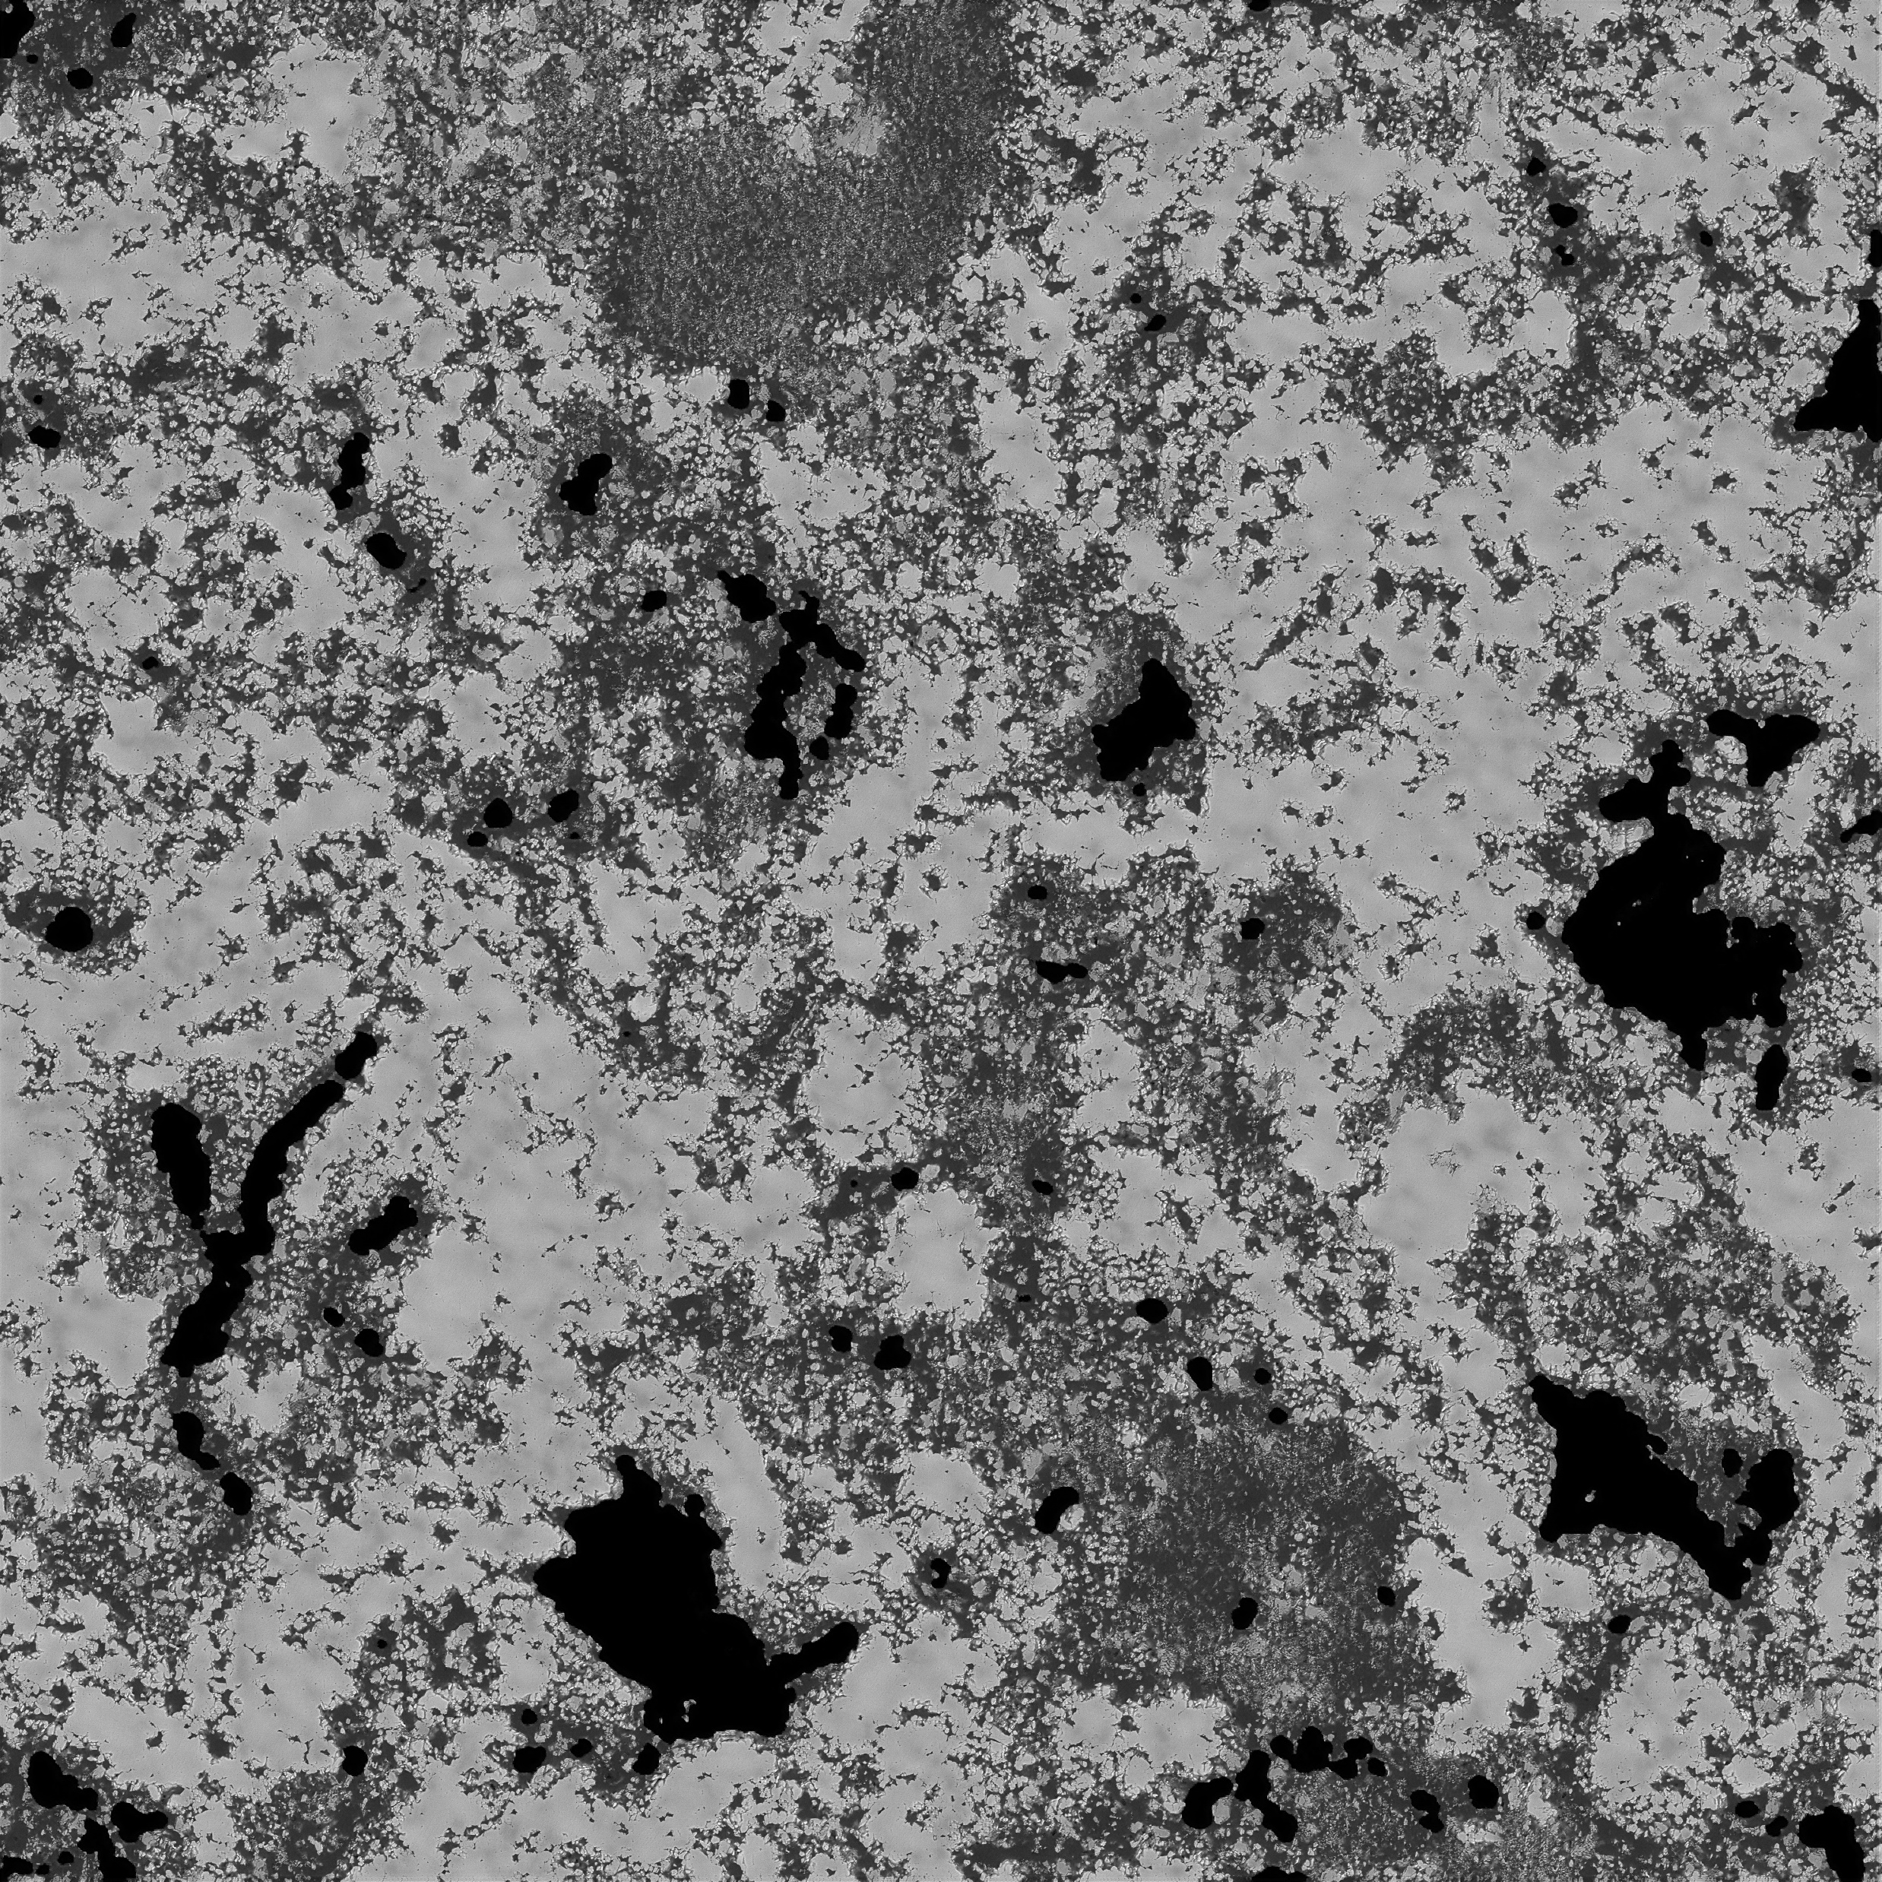
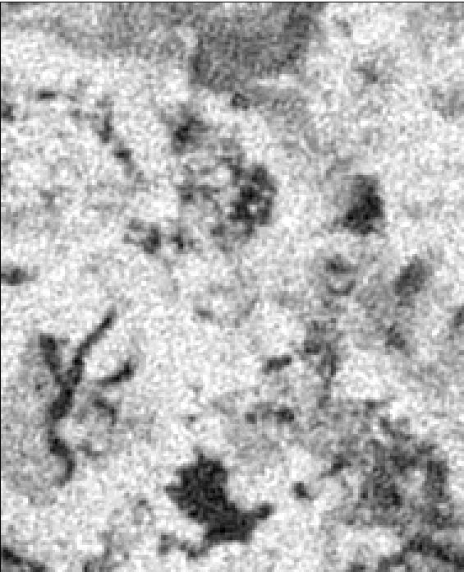
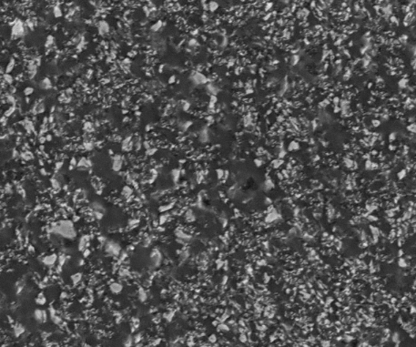




Forward: Super-resolution for microporosity
Super-resolved images are too large for simulation
eXtensive Pore Modeling (XPM)
Extract Resolved pores
Darcy cells
Solid
Microporosity phase
Cross connections
1.98 mm
Resolved pores
Super-resolution
Input
$$G_{}$$
$$G_{SR}$$
Voxel size 5.5 $μm$
Dimension: 1000 x 1000 x 2000
7
Voxel size 0.196 $μm$
Dimension: 12000 x 12000 x 40000

Slide 8
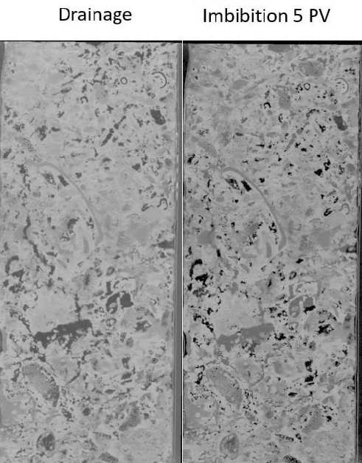
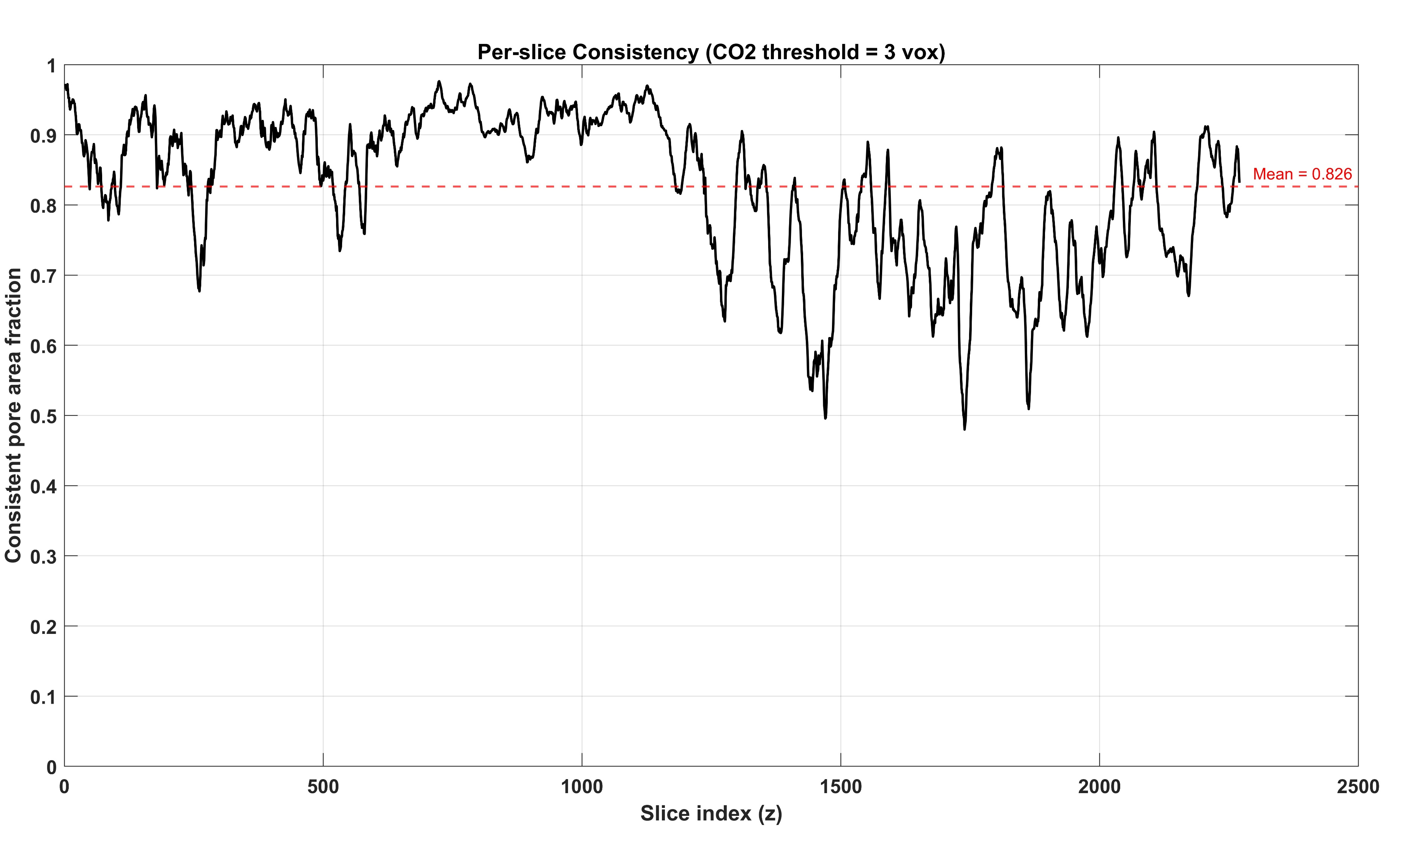


Validate with experimental results
Image data from drainage experiments
Input
XPM simulation
Validation
2D training image
Forward
Input
3D raw image
SR image
$$G_{}$$
$$G_{SR}$$

Slide 9

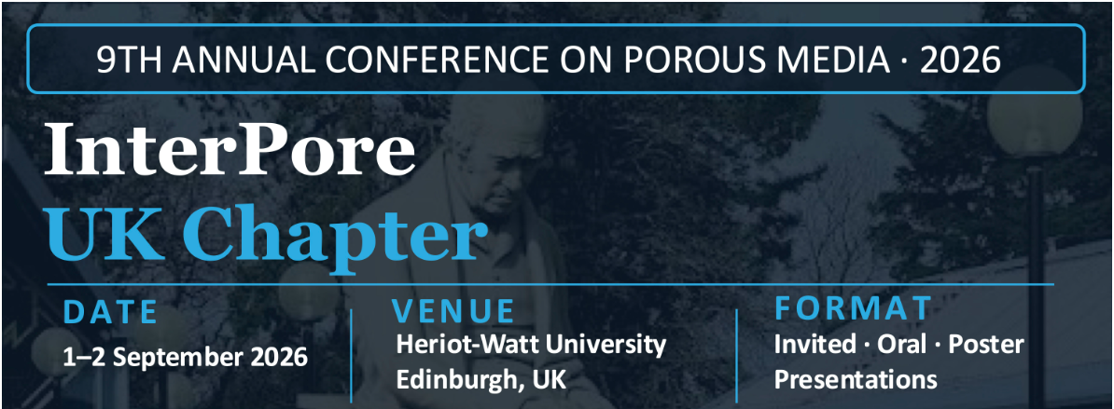
Conclusion
Focusing on the gap, we present and validate an integrated workflow characterizing carbonate microporosity
Both ESMDA and super-resolution are validated with multi-scale simulations (XPM)
These methods combined will enable more efficient carbonate characterization

