Slide 1
Notes:
Self-introduction

Slide 2





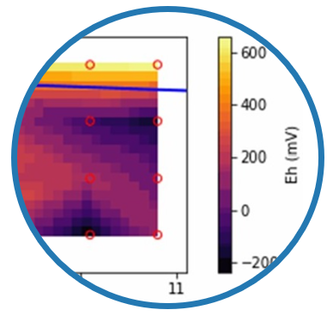
The Team
www.h2ogeo.upc.edu/
Full Professor
www.mipore.polimi.it/
Full Professor
We acknowledge
Associate Professor
HETMAR
Research Fellow
(PID2023-148543OA-I00)
Research Fellow
Efecto de la heterogeneidad geoquímica en el destino de los compuestos orgánicos emergentes en actuaciones de recarga gestionada de acuíferos
Notes:
Collaboration UPC-POLIMI, funding from HETMAR project, focused on the role of geochemical heterogeneity in determining the fate of EOC.

Slide 3
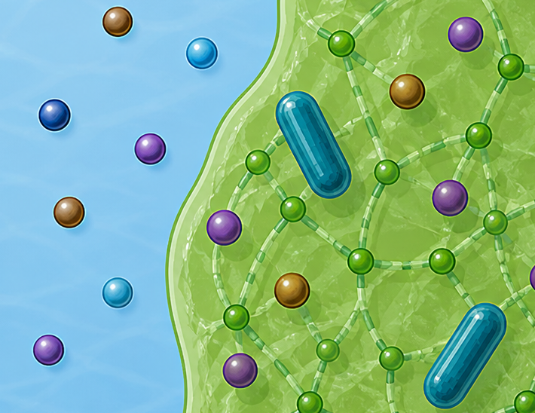
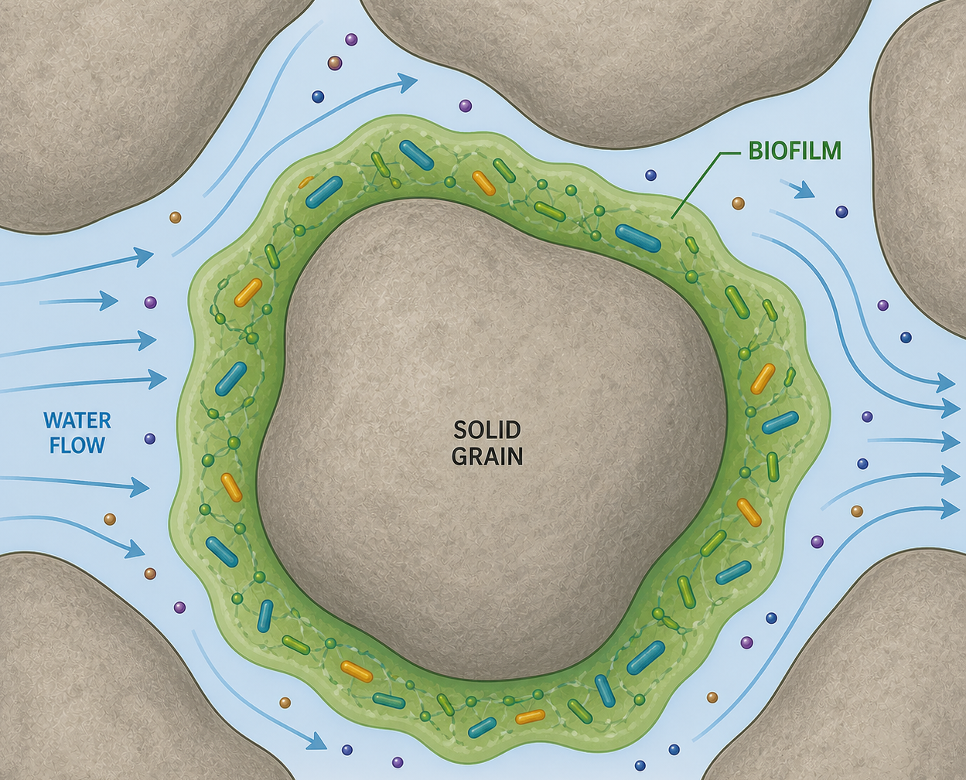





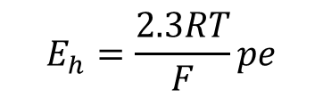









Motivation
MOTIVATION & GOALS
>>
METHODS
>>
RESULTS
>>
CONCLUSIONS
Biofilm development
Fate of Emerging Organic Contaminants
Biogeochemical status of groundwater
$$pe=−\log{a_{e^{−}}}$$
$≫0$: oxidizing
NO₃⁻
$$e^{−}$$
$<0$: reducing
Proxy of
redox
$$E_{h}=\frac{2.3RT}{F}pe$$
$$e^{−}$$
conditions
Doc
Redox potential
N₂
EOC
OXIDATION
$$+4e^{−}$$
REDUCTION processes:
Oxygen
Nitrate
$$O_{2}+4H^{+}+4e^{−}↔2H_{2}O$$
Mn/Fe oxide
$$NO_{3}^{−}+6H^{+}+5e^{−}↔{0.5N}_{2}+{3H}_{2}O$$
$$…$$
Sulfate
EPS
Heterotrophic bacteria
$$pe↓$$
Oxidizing bacteria
Reducing bacteria
$$SO_{4}^{2−}+9H^{+}+8e^{−}↔HS^{−}+{4H}_{2}O$$
Notes:
Why? Spatially variable geochemistry in groundwater affects biofilm evelopment and in turn CECs degradation. We will focus a lot on the concept on Eh pe in this presentation, as proxy of redox conditions in a physical-chemical system.

Slide 4
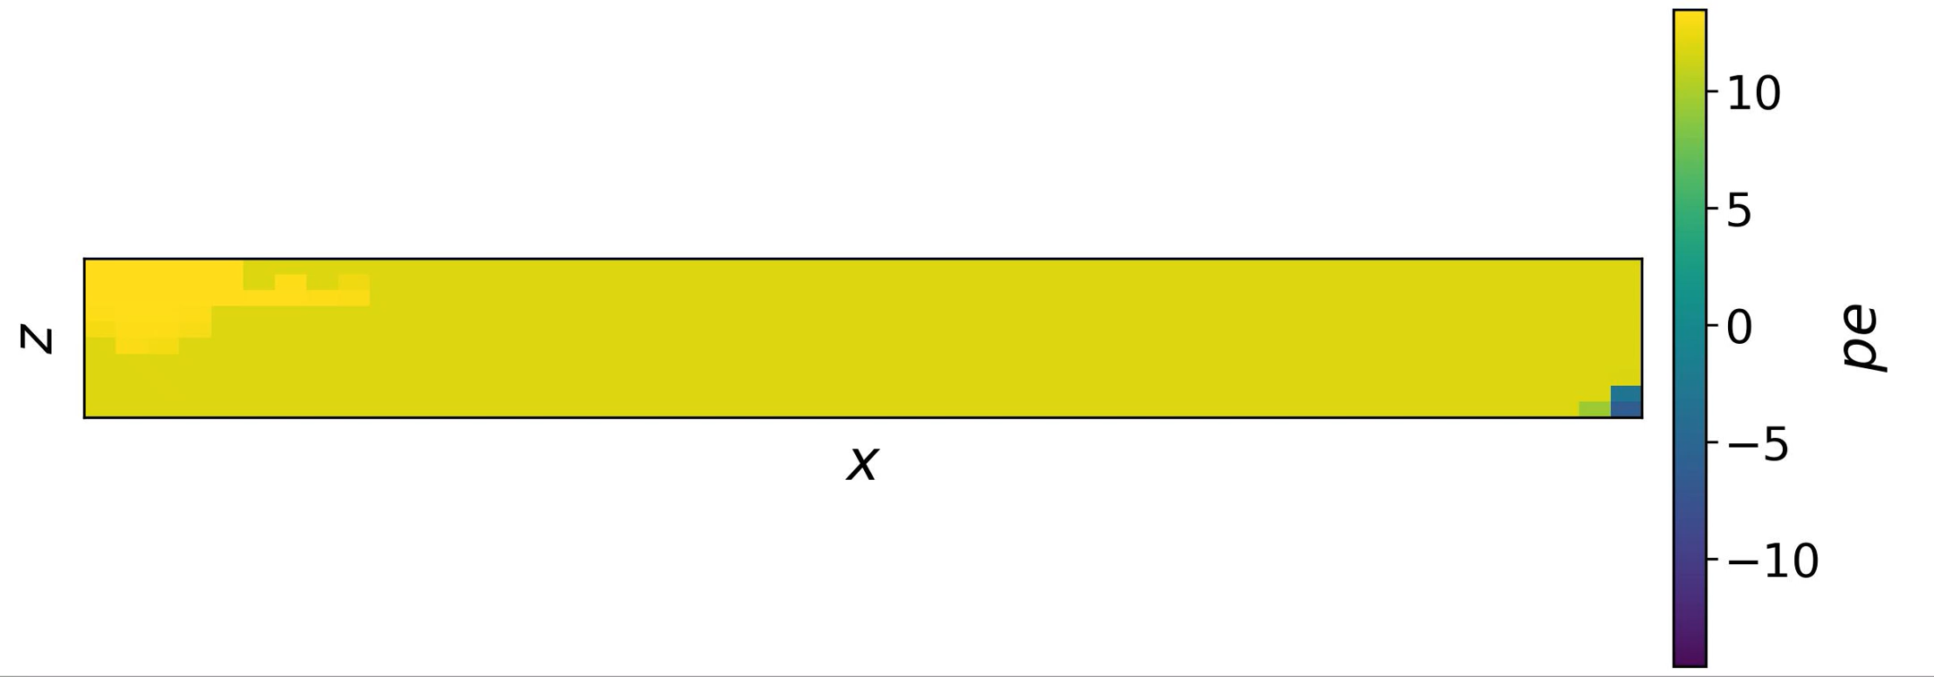

Goal
MOTIVATION & GOALS
>>
METHODS
>>
RESULTS
>>
CONCLUSIONS
Which is the effect of porous media heterogeneity (e.g., in hydraulic conductivity) on its biogeochemical status?
$$pe$$
Notes:
We are very interested in understanding how underlying porous media heterogeneity in terms of, e.g., hydraulic conductivity, shapes the evolution of redox patterns.

Slide 5
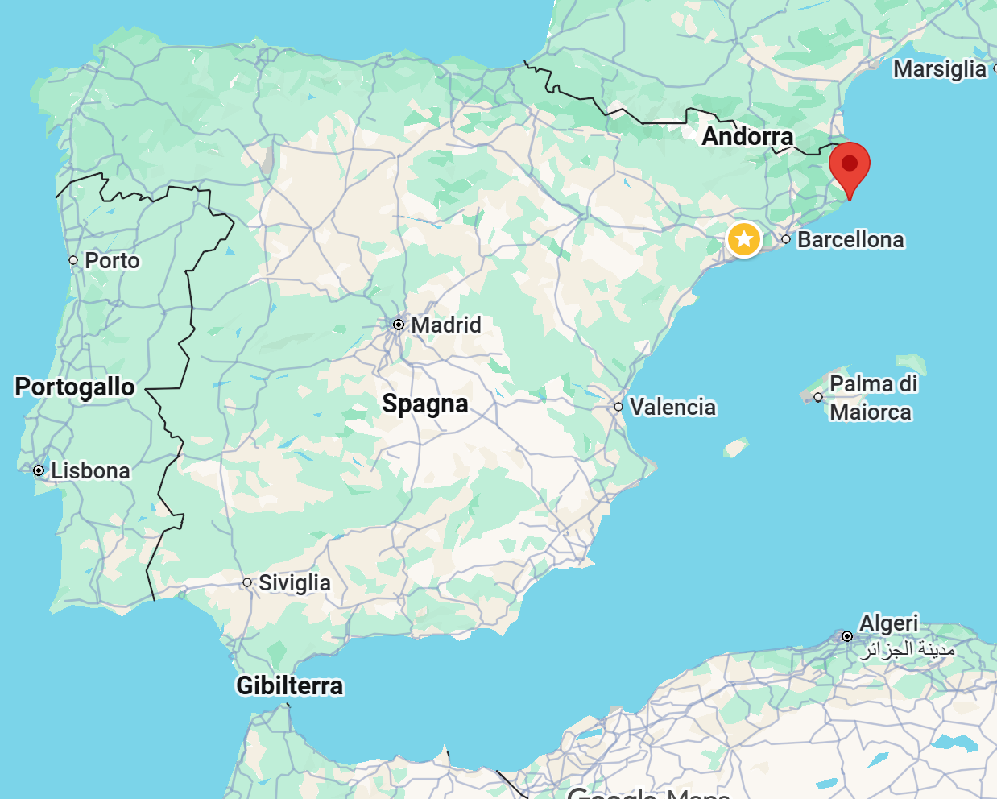
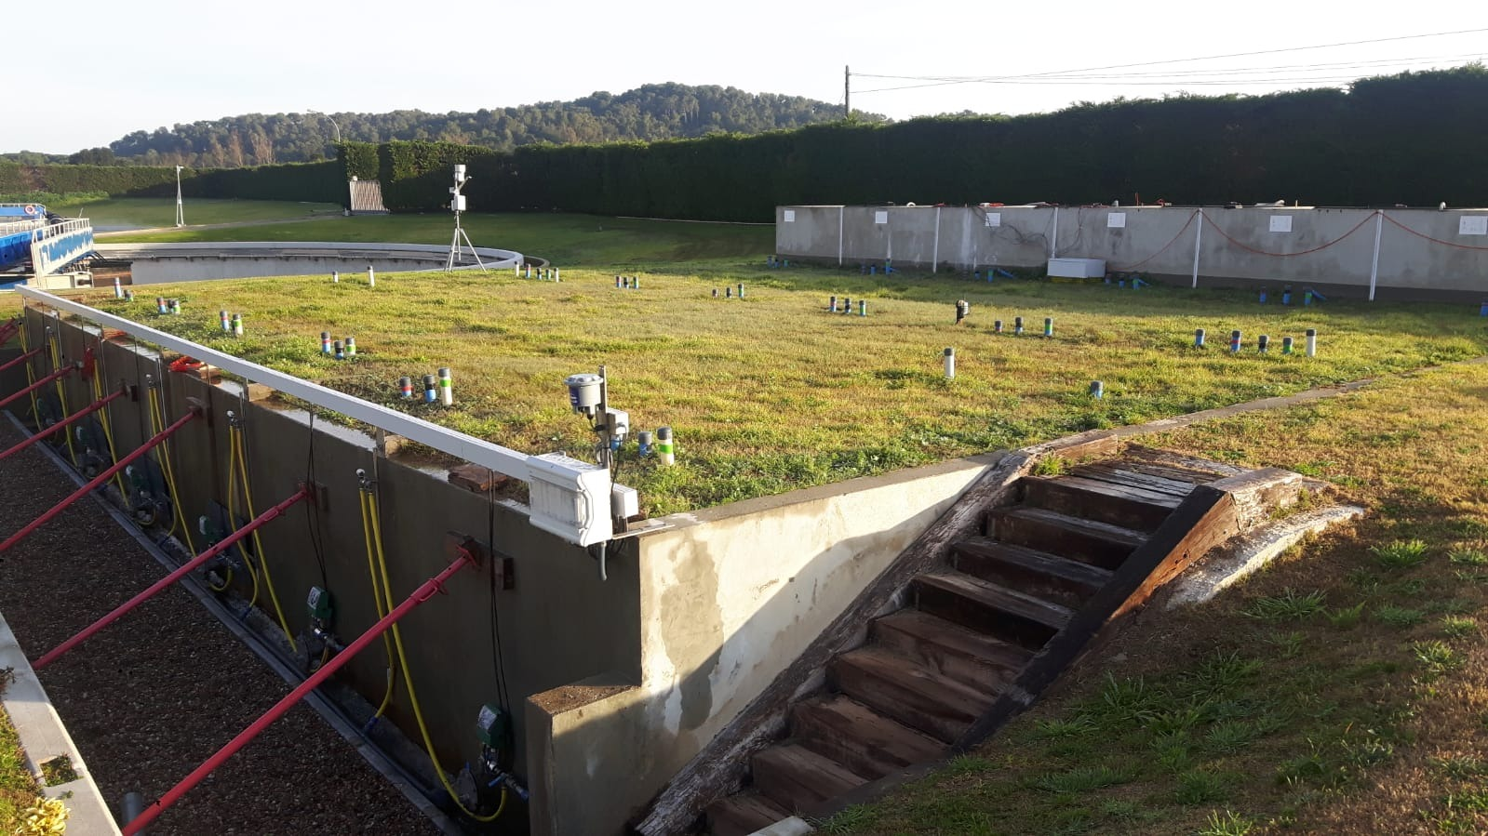
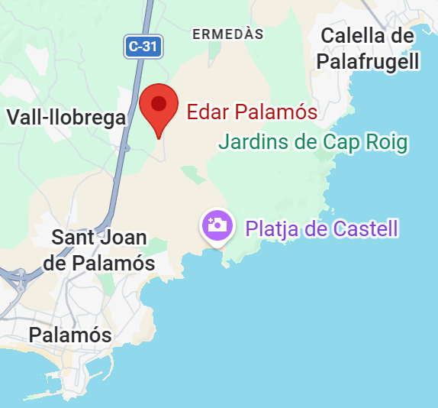
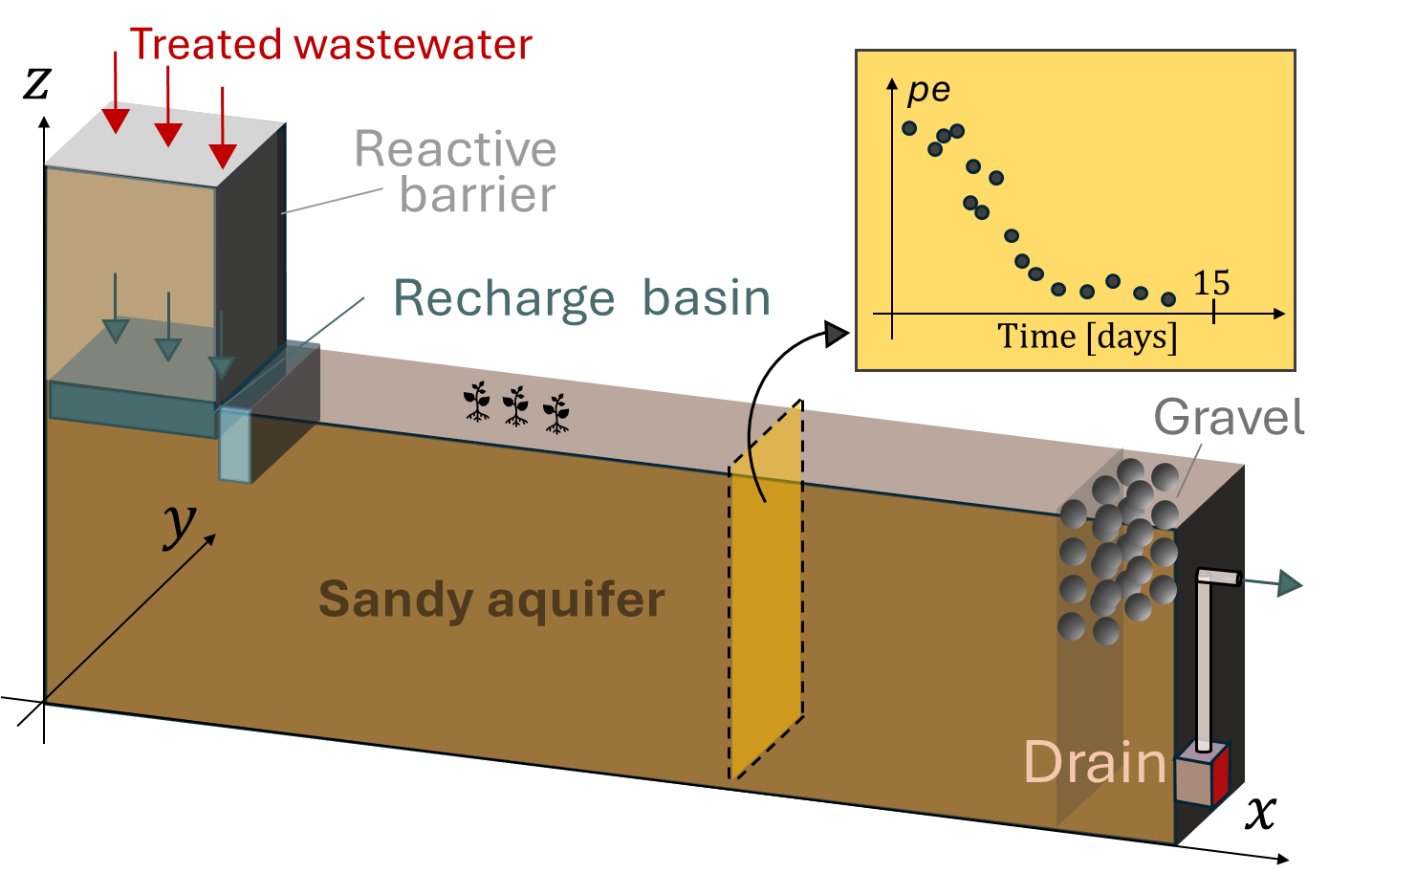
Conceptual model
MOTIVATION & GOALS
>>
METHODS
>>
RESULTS
>>
CONCLUSIONS
The pilot-scale MAR facility inspiring the conceptual model developed to run synthetic simulations
Palamos WWTP, Girona, Spain
Notes:
But how we built our work/synthetic study (simulations)? Getting inspired by a real MAR facility (pilot scale) for which a set of experiments are planned in the HETMAR life.

Slide 6
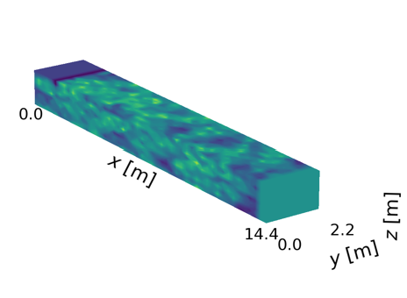
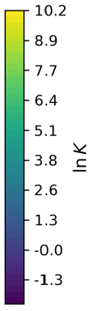

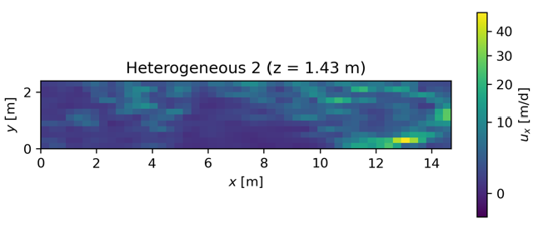

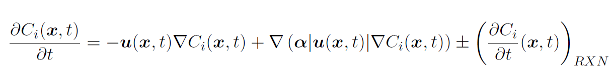


Modeling steps
MOTIVATION & GOALS
>>
METHODS
>>
RESULTS
>>
CONCLUSIONS
1. Generate synthetic heterogeneous hydraulic conductivity realizations (SGSIM, GSLIB).
2. Solve the subsurface flow equation (MODFLOW 6).
3. Solve the advective dispersive reactive transport equation (MODFLOW 6 + PHREEQCRM).
Notes:
Main steps of our synthetic study. No details about ADRE in reason of time, only focus on the reactive terms (sink/storage).

Slide 7
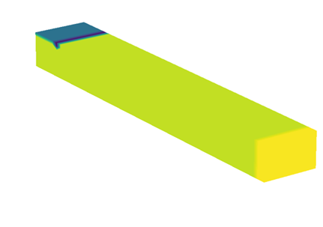
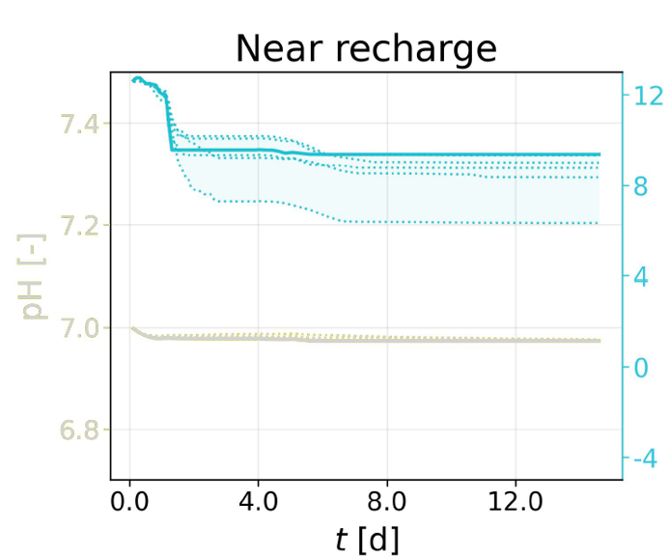
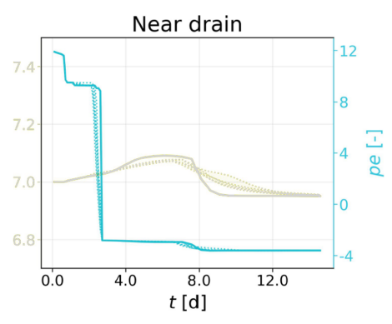

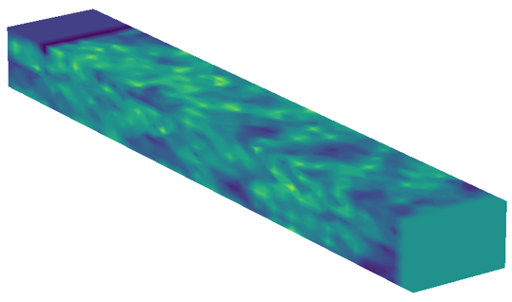
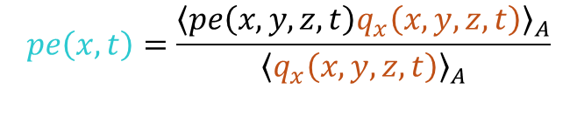
Average vs Local Behavior
MOTIVATION & GOALS
>>
METHODS
>>
RESULTS
>>
CONCLUSIONS
Flux-averaged breakthrough curves (BTCs)
$$pe\left(x,t\right)=\frac{{\left\langle pe\left(x,y,z,t\right)q_{x}\left(x,y,z,t\right)\right\rangle }_{A}}{{\left\langle q_{x}\left(x,y,z,t\right)\right\rangle }_{A}}$$
Darcy flux along the mean flow direction
Upstream
Upstream
Downstream
Downstream
x
Upstream
Downstream
x
Notes:
To try to answer this question, we computed numerically flux-averaged BTCs of pe across both homogeneous and heterogeneous media, in target cross-sections of the domain, starting from our upstream domain. Given the limited range of variability of these BTCs caused by heterogeneity, we were surprised and decided to looked more in details to what happens in the local distribution of pe values at the cross-section. This is for a homogeneous field: there is the evidence that conditions are prevalently oxic (large pe) and we observe a perfect vertical layering, as expected.

Slide 8

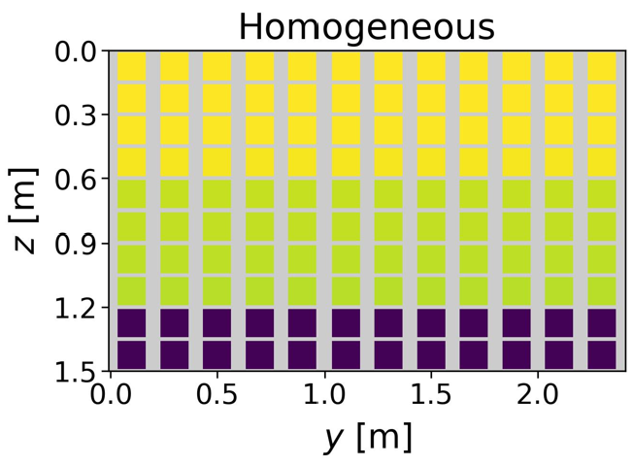
Average vs Local Behavior
MOTIVATION & GOALS
>>
METHODS
>>
RESULTS
>>
CONCLUSIONS
Flux-averaged BTC
Local behavior
Upstream
Upstream
x
2.5 days
2.5 days
Notes:
To try to answer this question, we computed numerically flux-averaged BTCs of pe across both homogeneous and heterogeneous media, in target cross-sections of the domain, starting from our upstream domain. Given the limited range of variability of these BTCs caused by heterogeneity, we were surprised and decided to looked more in details to what happens in the local distribution of pe values at the cross-section. This is for a homogeneous field: there is the evidence that conditions are prevalently oxic (large pe) and we observe a perfect vertical layering, as expected.

Slide 9
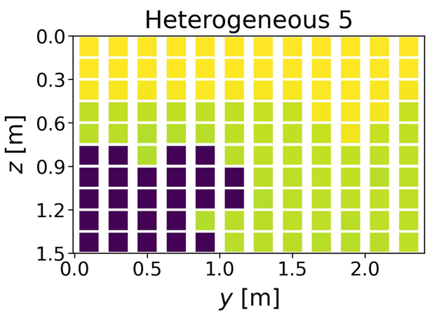
Average vs Local Behavior
MOTIVATION & GOALS
>>
METHODS
>>
RESULTS
>>
CONCLUSIONS
Flux-averaged BTC
Local behavior
Upstream
Upstream
x
2.5 days
2.5 days
Notes:
Instead, across heterogeneous domain, the perfect layering disappears and is replaced by a more random spatial distribution of local pe values.

Slide 10
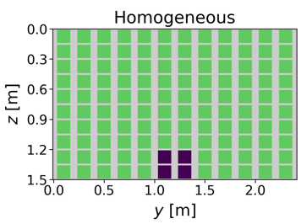
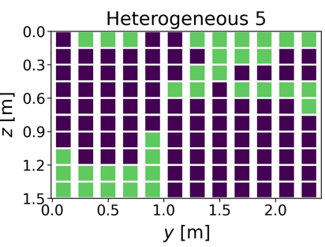
Average vs Local Behavior
MOTIVATION & GOALS
>>
METHODS
>>
RESULTS
>>
CONCLUSIONS
Flux-averaged BTC
Local behavior
Downstream
Downstream
x
Downstream
x
2.5 days
2.5 days
Notes:
We were surprised to see minor effects of heterogeneity further downstream (heterogeneous and homogeneous averaged BTCs of pe look very similar).

Slide 11
Local Behavior
MOTIVATION & GOALS
>>
METHODS
>>
RESULTS
>>
CONCLUSIONS
PV₅₀
→ Earliest (dimensionless) time such that the 50 % cross-section at x attains pe<0
Notes:
And we plotted the result across both a homogeneous (result is deterministic, marked by the full circle!) and a set of heterogeneous realizations. As these are not deterministic, we have a range of variability (shaded colored area) and we furthermore juxtaposed the median of PV50 for assisting visual comparison. Now, I will move from near recharge to downstream progressively, to try to analyze how the effects of heterogeneity change/are felt at different distances from the system inlet (which could be representative of, e.g., a source of contamination of the recharge area in MAR facilities).

Slide 12
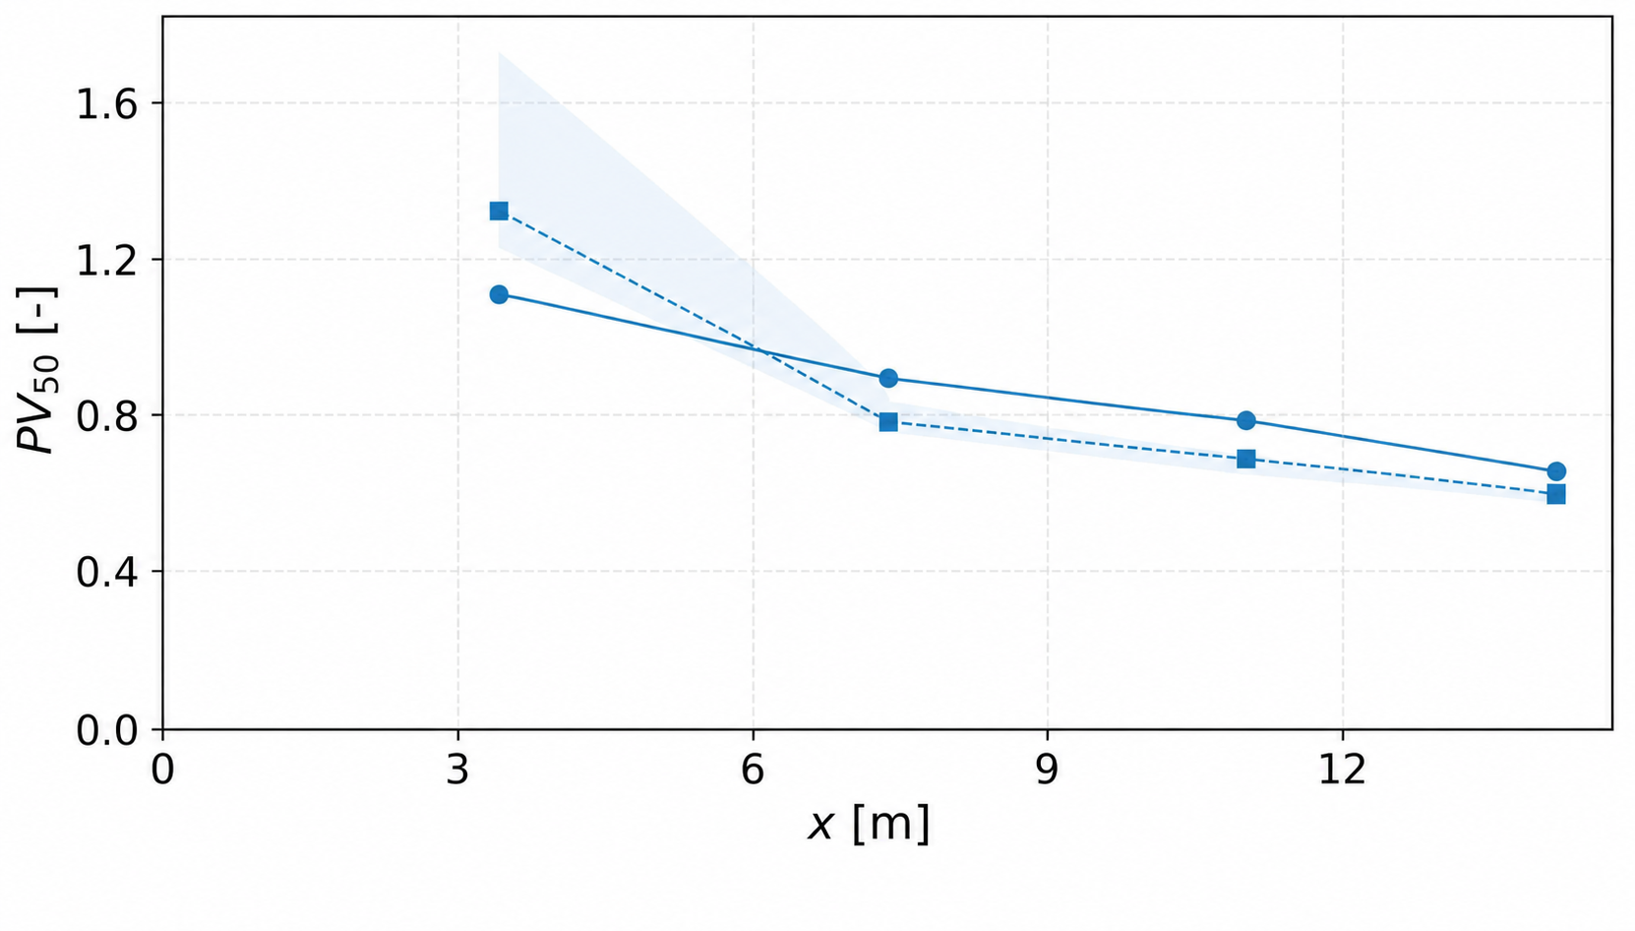
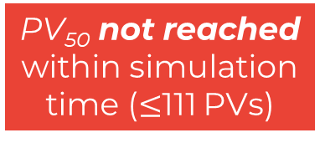
Local Behavior
MOTIVATION & GOALS
>>
METHODS
>>
RESULTS
>>
CONCLUSIONS
PV₅₀
→ Earliest (dimensionless) time such that the 50 % cross-section at x attains pe<0
Homogeneous
Heterogeneous (median)
Heterogeneous (variability range)
PV₅₀ not reached within simulation time ($≤$111 PVs)
0.2
0.4
0.6
0.8
1.0
x / L_{x} [-]
Upstream (x/L_{x}=0.05)
x
Notes:
Comment on missed achievement of the selected threshold. Consistent with what expected: upstream the flow is under oxidizing conditions, as fresh oxygen and nitrates are continuously provided as input to the system. Heterogeneity cannot induce enough preferential flow paths and corresponding low-permeability regions to allow for enough contact time among reactants and a larger depletion of high-priority reductants, so pe on average remains abundantly >0.

Slide 13

Local Behavior
MOTIVATION & GOALS
>>
METHODS
>>
RESULTS
>>
CONCLUSIONS
PV₅₀
→ Earliest (dimensionless) time such that the 50 % cross-section at x attains pe<0
Homogeneous
PV₅₀ reached earlier in heterogeneous porous media
Heterogeneous (median)
Heterogeneous (variability range)
$$0.6$$
PV₅₀ $≅$ 0.6 $≡$ 2.5 days
0.2
0.4
0.6
0.8
1.0
x / L_{x} [-]
Downstream (x/L_{x}=0.95)
x
Notes:
Completely downstream it’s the very opposite! In all domains, our threshold condition in reached by the end of our simulated time window. Apparently, heterogeneity seems to slow down such achievement. This means that preferential paths help the system to evolve faster towards a more reducing redox condition in average.

Slide 14
Local Behavior
MOTIVATION & GOALS
>>
METHODS
>>
RESULTS
>>
CONCLUSIONS
PV₅₀
→ Earliest (dimensionless) time such that the 50 % cross-section at x attains pe<0
Homogeneous
Heterogeneous (median)
Heterogeneous (variability range)
Early attainment inversion
0.2
0.4
0.6
0.8
1.0
x / L_{x} [-]
Inversion point (x/L_{x}=0.40)
x
Notes:
In the central region of the domain, we notice a peculiar behavior: the effect of heterogeneity of speeding up or delaying the attainment of reducing redox conditions in higher fractions of the local areas undergoes an inversion!

Slide 15
Conclusions
MOTIVATION & GOALS
>>
METHODS
>>
RESULTS
>>
CONCLUSIONS
Porous media HETEROGENEITY
Promotes local co-existence of oxidizing & reducing conditions at the same measurement points.
Accelerates or delays reaching a given local fraction of reducing conditions, depending on distance from the recharge source.
Field measurements of redox potential (E_{h}) should be interpreted with caution: they are representative of spatially integrated signals and tend to over-smooth system’s behavior.
The impact of hydraulic heterogeneity on pollutant degradation and biofilm development may be systematically underestimated.
Need for models quantifying uncertainty in local redox dynamics to support MAR design.
Notes:
Main conclusions: while everybody expected heterogeneity to affect pe trends in space-time, this is the very first time up to our knowledge someone attempts to prove it via customized coupled numerical simulations. We did so and this effect is there! While I could not show all results we got due to the limited time of the talk, our results further suggest that such an effect exists also at different regimes. We investigated both the effects of increasing weight of dispersion over advection, as well as different Damkholer numbers (relative to advection). The results shown in this presentation referred to a regime with chemical reactions and transport occurring at comparable timescales, but the effects of heterogeneity persisted also at lower Da numbers. Same for Peclet. Thus, to summarize: hydraulic conductivity heterogeneity governs the spatial structure of redox conditions more than their bulk evolution: everywhere, especially when the redox front passes, with strongest effects in regimes where transport and reaction compete at comparable timescales. It also promotes the local coexistence of oxidizing and reducing zones at the same measurement location, which is extremely relevant to prompt degradation of different types of EOCs in MAR application (some may be degradable easier under high pe, some under low one). The way heterogeneity imprints onto the time to attain strongly reducing conditions in a sufficient fraction of the local area is not monotonous, but changes with the distance from the recharge source. Overall, flux-averaged measurements may obscure most heterogeneity effects, which seems to suggest that the impact of heterogeneity on EOC degradation might have been systematically underestimated based on averaged redox potential measurements. Thus, caution must be used when interpreting field measurements, especially for redox potential, which, in addition, is just a logarithmic proxy of redox conditions. → There is a real need to develop models accurately quantifying the uncertainty in the evolution of local redox conditions to support design and implementation of MAR facilities. This is our next goal in HETMAR.

Slide 17
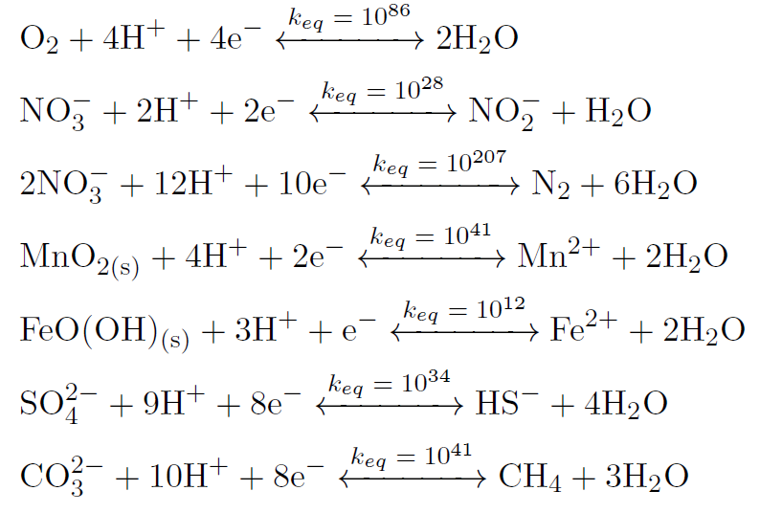




Coupled Reactive Transport Problem
MOTIVATION & GOALS
>>
METHODS
>>
RESULTS
>>
CONCLUSIONS
Partial Equilibrium Approach (PEA):
Kinetic organic carbon oxidation
Equilibrium reduction of oxidants
$$+4e^{−}$$
$$pe=−\log{a_{e^{−}}}$$
$$e^{−}$$
Oxygen
Nitrate
Mn oxide
Fe oxide
Sulfate
Inorganic carbon
$$pe↓$$
Notes:
We describe the redox processes mediated by microbial communities through Monod laws, according to a PEA. The pool of electrons released by Doc becomes suddenly available for the instantaneous equilibrium-driven reduction of terminal electron acceptors, according to their redox ladder sequence. As such, it exists a pe function of space-time (dynamic state variable) that fulfills all of the governing equations based on these reactions. How will heterogeneity in lnK affect this variable?

Slide 18
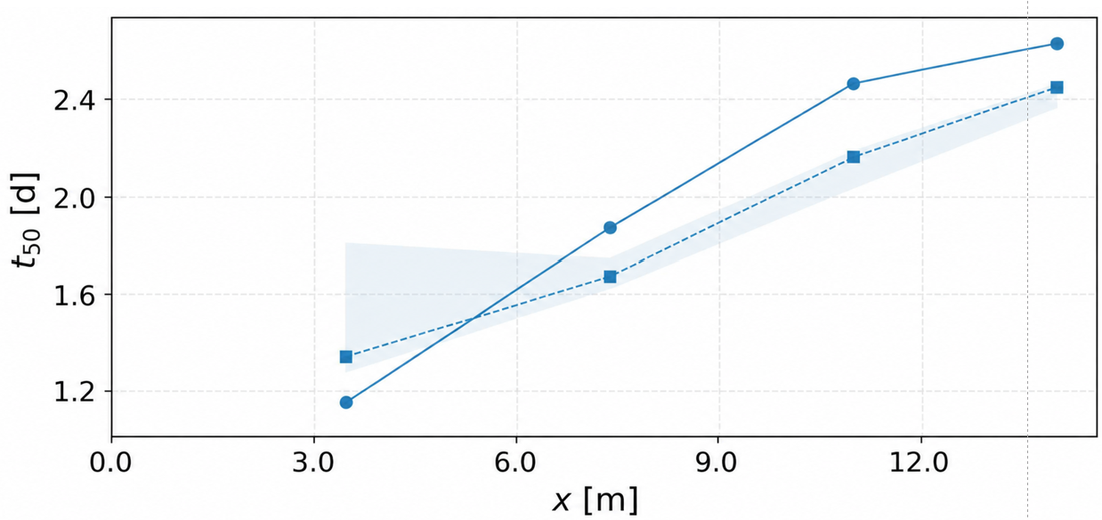
Local Behavior
MOTIVATION & GOALS
>>
METHODS
>>
RESULTS
>>
CONCLUSIONS
PV₅₀
→ Earliest (dimensionless) time such that the 50 % cross-section at x attains pe<0
Homogeneous
Heterogeneous (median)
Heterogeneous (variability range)
Early attainment inversion
Inversion point (x=5.8 m)
x
Notes:
In the central region of the domain, we notice a peculiar behavior: the effect of heterogeneity of speeding up or delaying the attainment of reducing redox conditions in higher fractions of the local areas undergoes an inversion!

