Slide 1



Mass transport characterization in nanoporous polymer electrolyte membranes used in electrochemical systems.
Alejandro MATEOS^{1,2,3}, Abel NETTER^{1,2,3}, Tommaso CARPOSU³, Michael DELIGANT³, Stéphane CHEVALIER^{1,2}
1. Univ. Bordeaux, CNRS, Bordeaux INP, I2M, UMR 5295, F-33400, Talence, France
2. Arts et Metiers Institute of Technology, CNRS, Bordeaux INP, I2M, UMR 5295, F-33400 Talence, France
3. Arts et Metiers Institute of Technology, CNAM, LIFSE, F-75013 Paris, France
Collaboration Prof. Dr. ChungHyuk Lee.
HTJS - May. 14th 2025

Slide 2

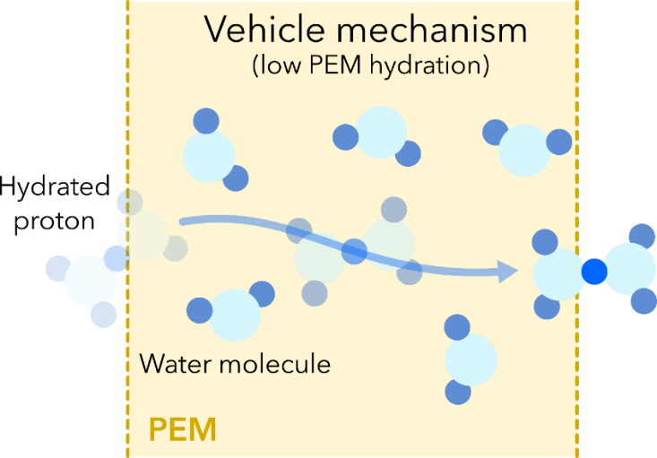
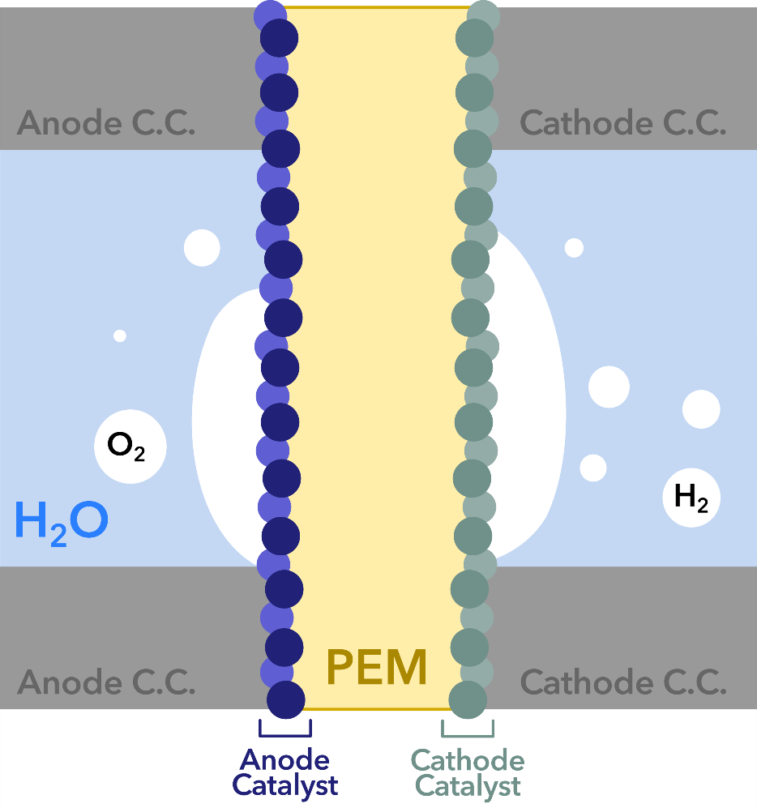
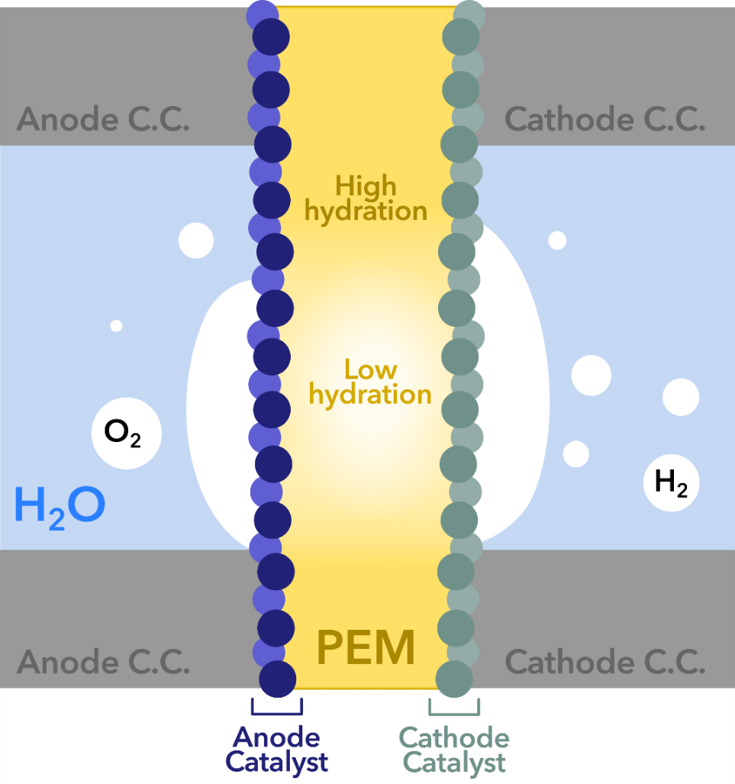
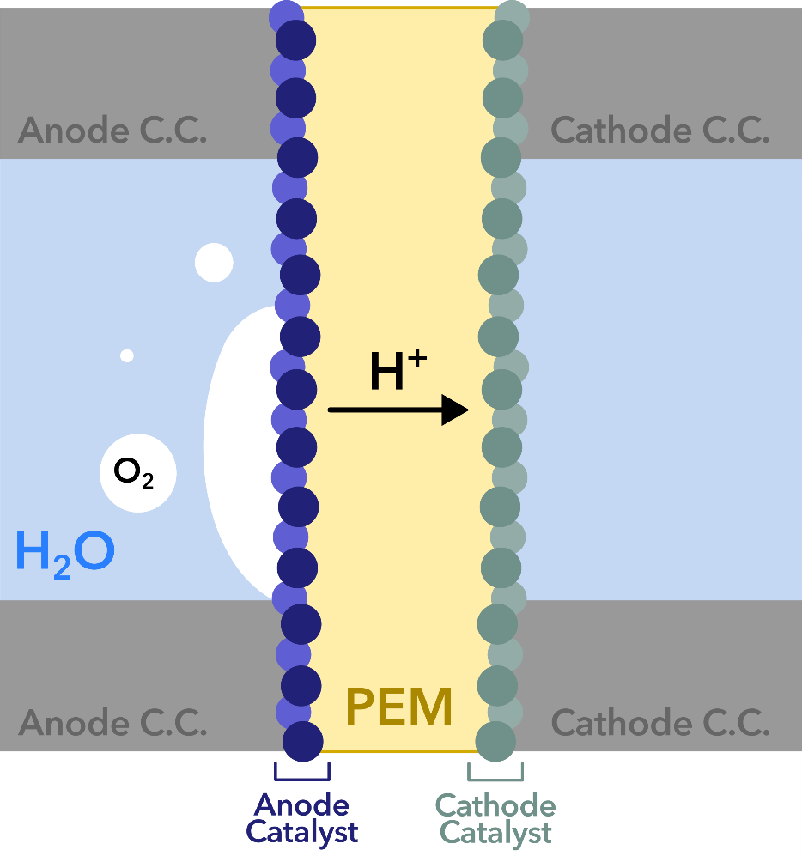
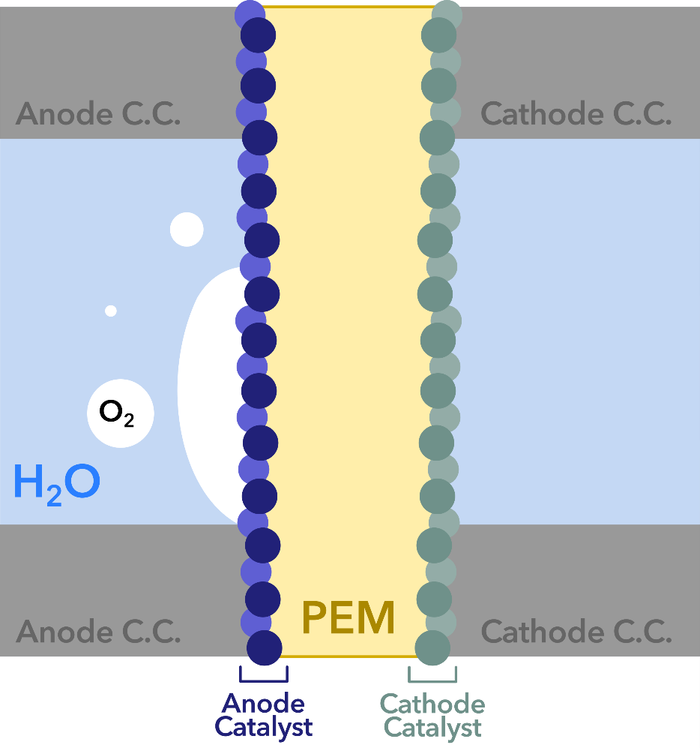
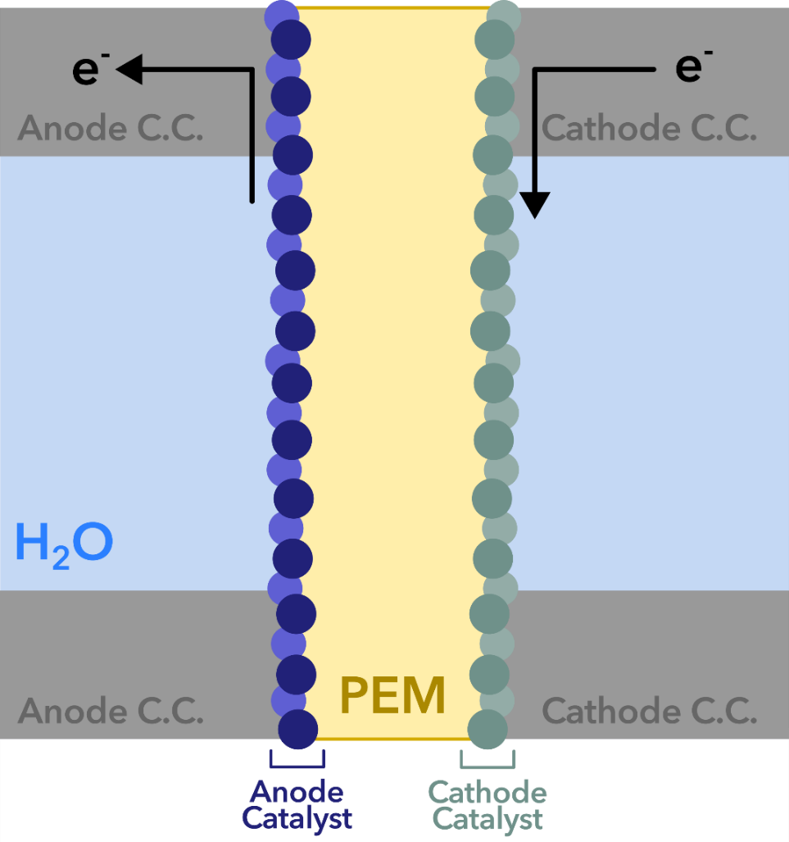
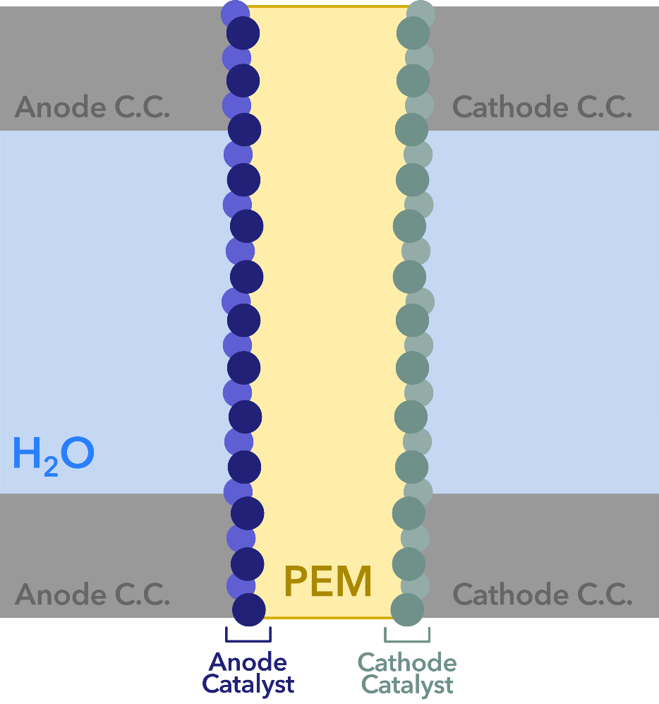
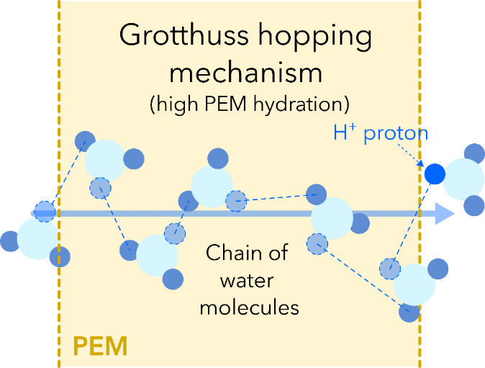





Mass transport in PEM
Mechanisms that drive proton conductivity of PEM:
PEM Water Electrolyzer

Slide 3
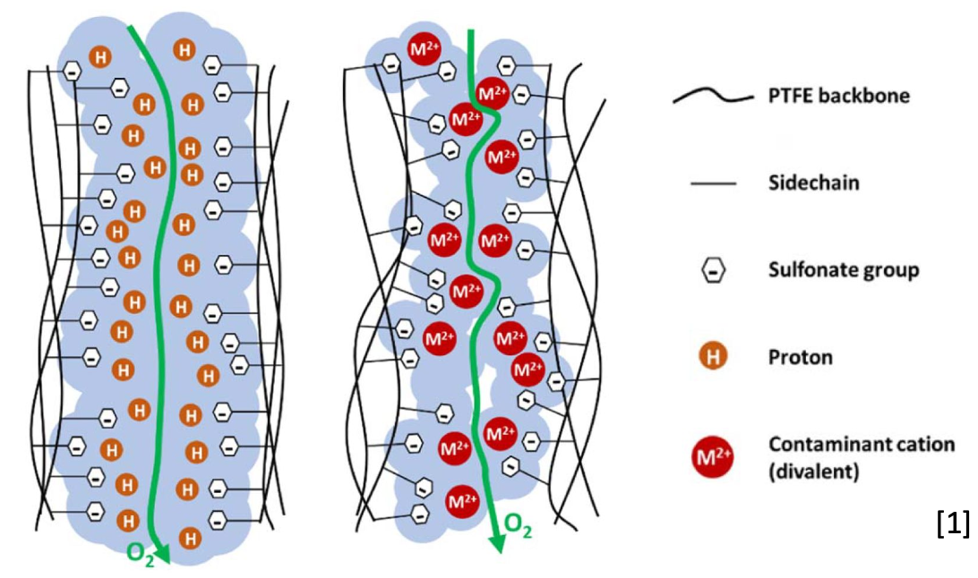
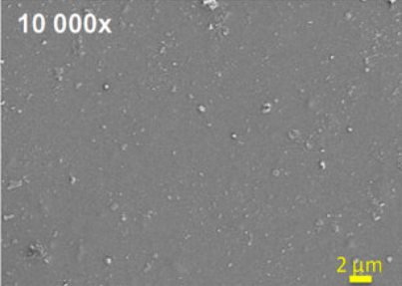
Mass transport in PEM
Pristine
Contaminated (M²⁺ cation)
Nano pores
J L Pineda-Delgado et al 2019 Nanotechnology 30 105707

Slide 4
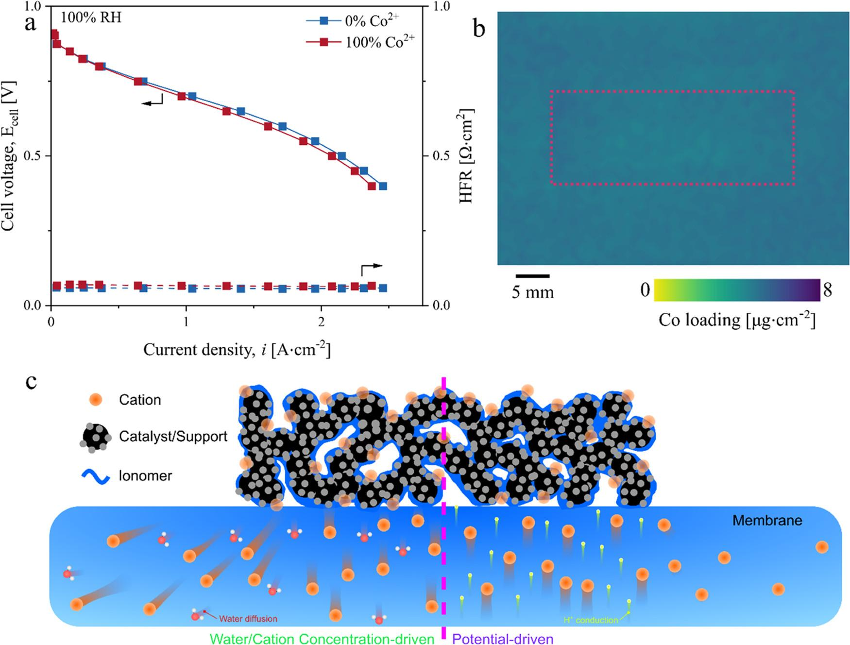
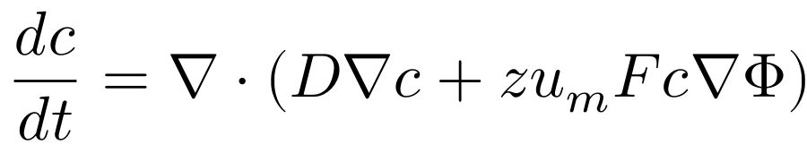
How Cation Contaminants Moves in Nafion?
The cation can diffuse by concentration gradients
The reaction at cathode can consume H+ by 2H⁺ + 2e⁻→H₂, so Ce can go to that position of H+ and migrate with potential-driven
Understanding how cations move in fuel cells is an important first step for developing mitigation strategies.
Slide from
Chung Lee, TMU

Slide 5
Technological and scientific locks
How to access to the PEM chemistry in operando?
How to measure the PEM transport properties in operando?
Current methods are mainly limited to
Electrochemical measurements (such as EIS)
X-ray or neutron imaging which cannot be used for screening or aging experiments
→ Microfluidic electrolyzer combined with IR imaging can answer these needs

Slide 6
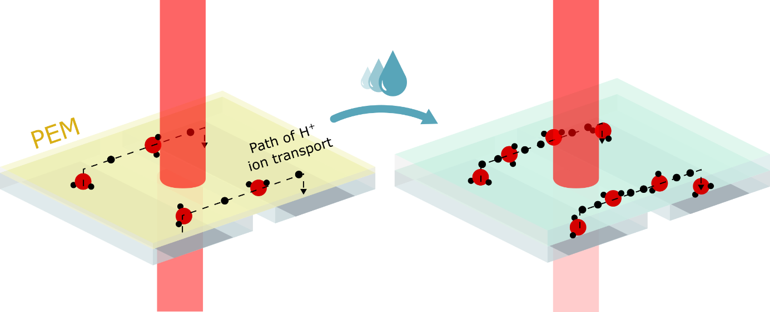



Our approach: operando IR imaging
Benefits:
Chemical information
Safe beam energy levels
Operando transmission characterization
Design flexibility
Constraints:
Water attenuation
Materials
Transparency
Electrochemical performance
Objectives:
Develop the chip
Characterize using IR
Mesure the water gradients

Slide 7
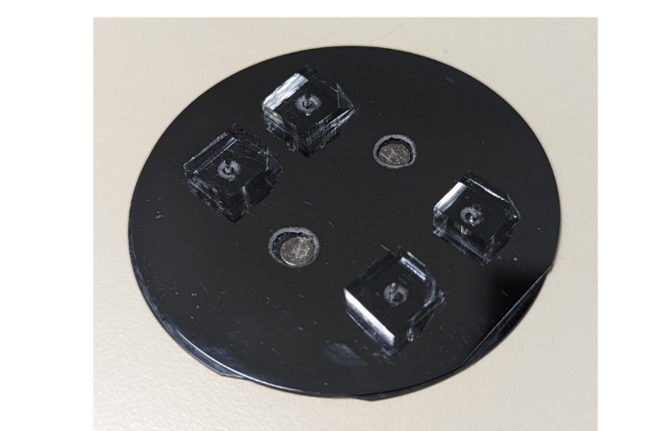
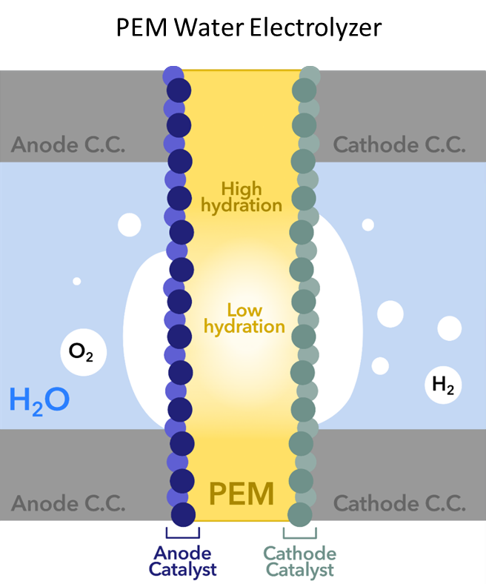

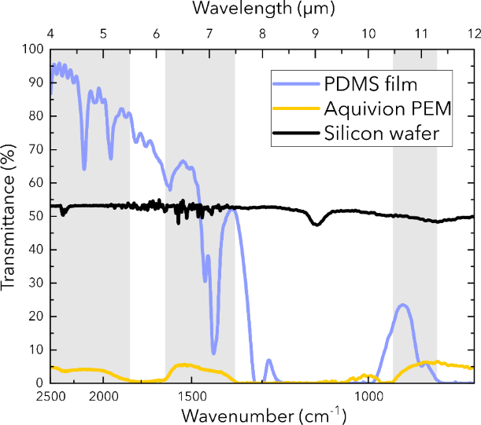
Microfluidic electrolyzer
How do we image the PEM water content?

Slide 8
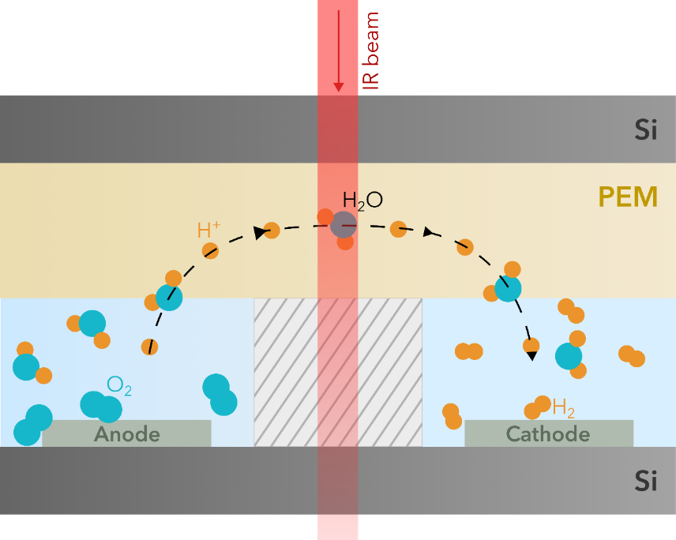
Microfluidic electrolyzer
PEM is Aquivion E80 (Syensqo)
Water + Sulfuric acid
(0.1, 0.5 or 1 M)
Water + Sulfuric acid
(0.5 M)
Take home message:
We can optically access to the PEM water content and cation concentration

Slide 9
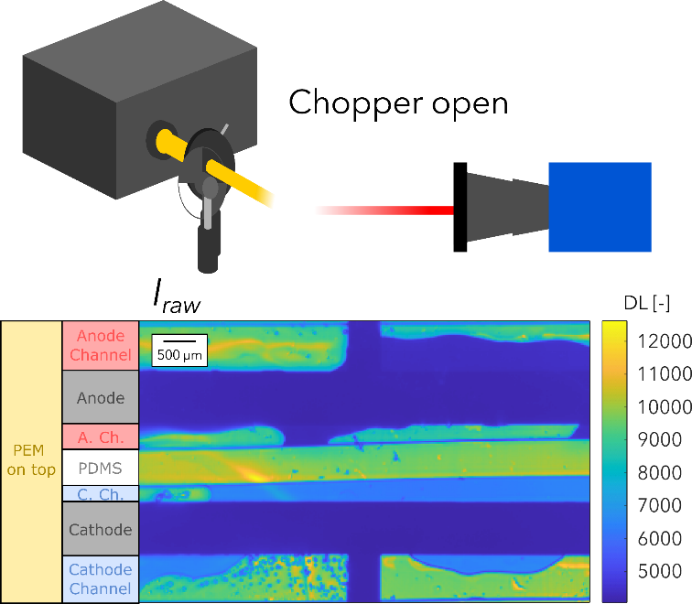
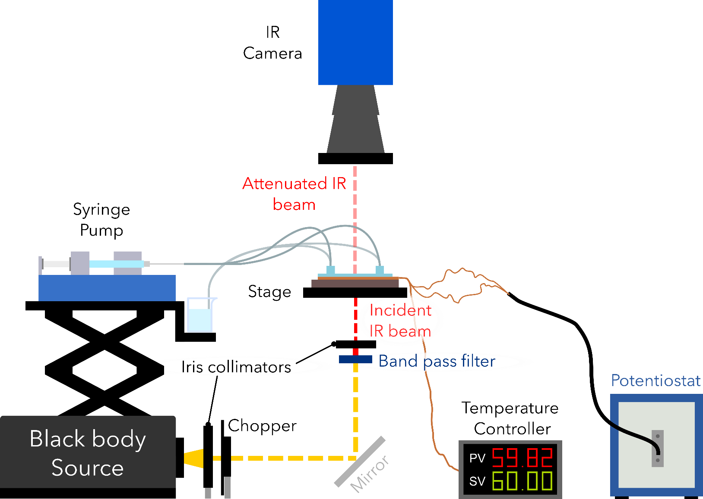
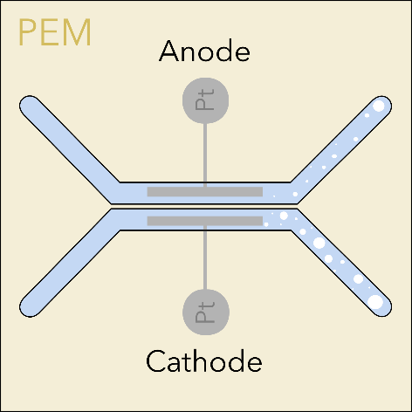
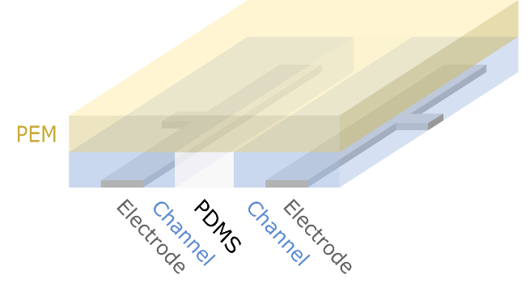
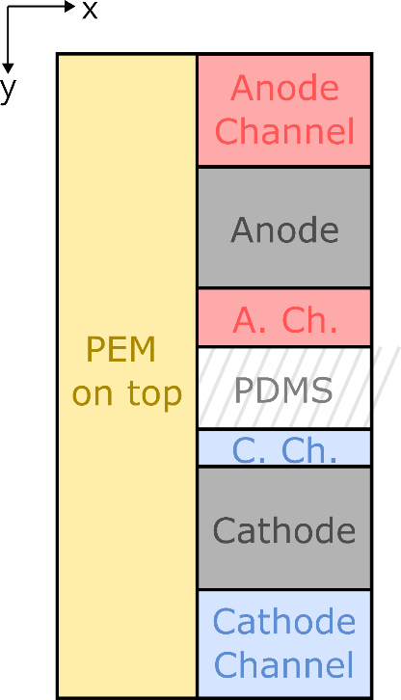
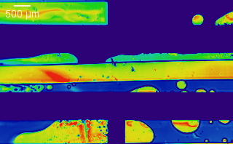
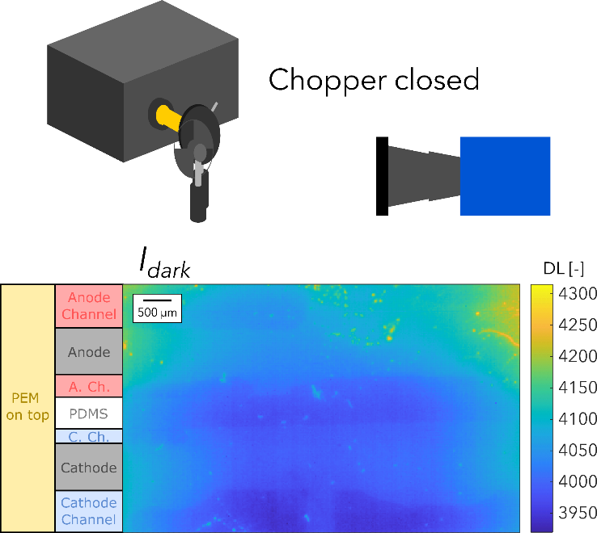

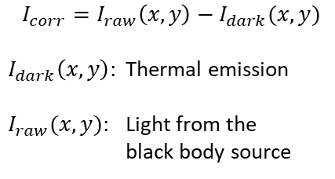
Experimental Setup: Thermospectroscopy
$$I_{corr}=I_{raw}\left(x,y\right)−I_{dark}(x,y)$$
$I_{dark}\left(x,y\right)$: Thermal emission
$I_{raw}(x,y)$: Light from the black body source
Take home message:
Live monitoring of the IR light transmission through the PEM
DL (-)
9

Slide 10
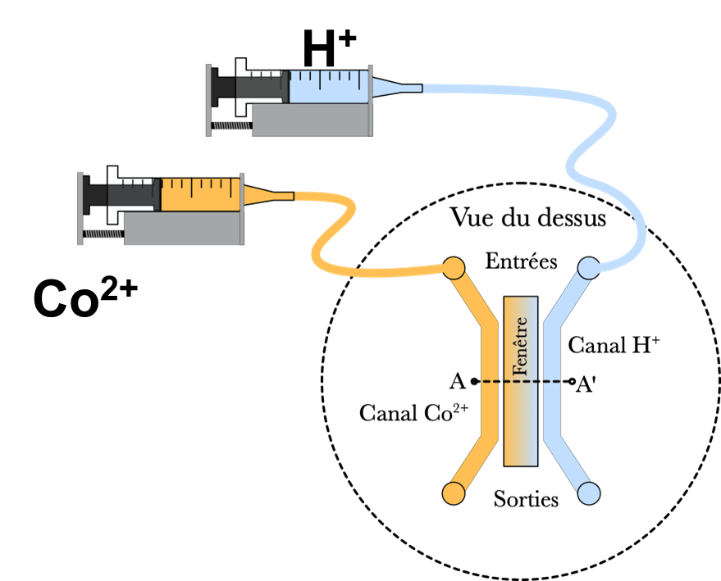
Cation diffusion

Slide 11
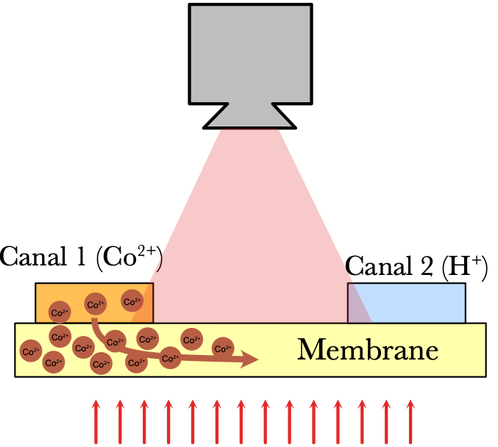
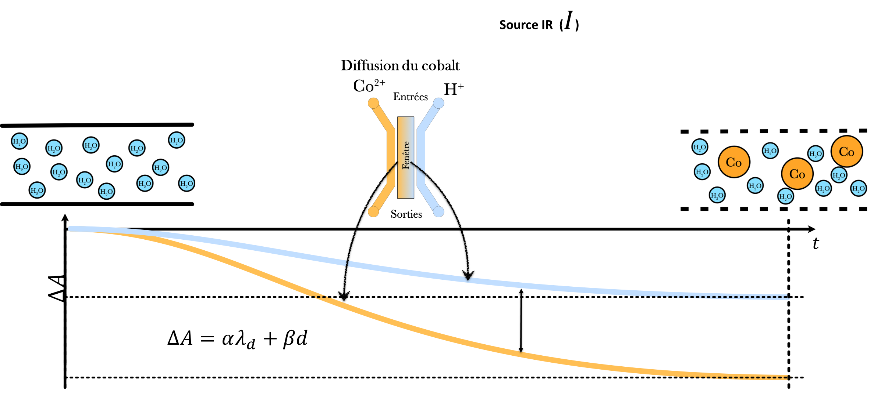
Data analysis

Slide 12
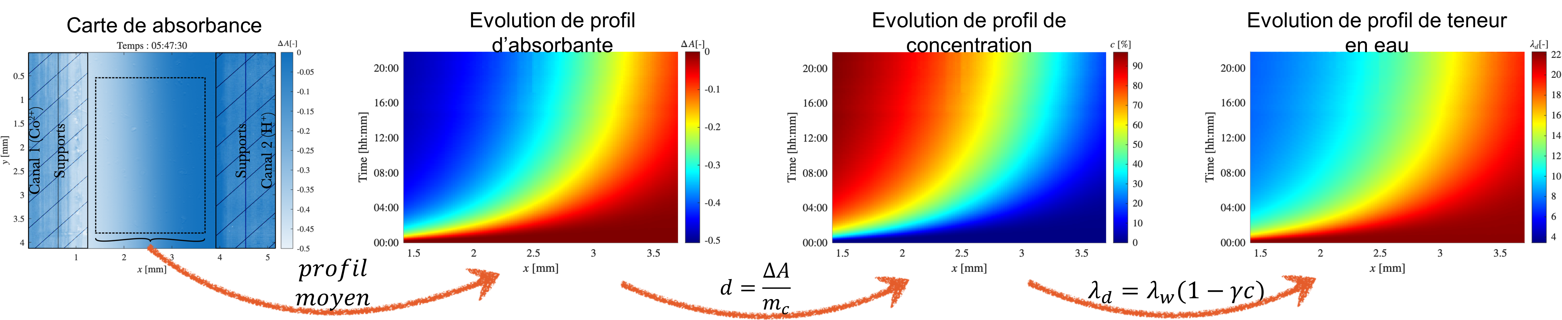
Data analysis

Slide 13
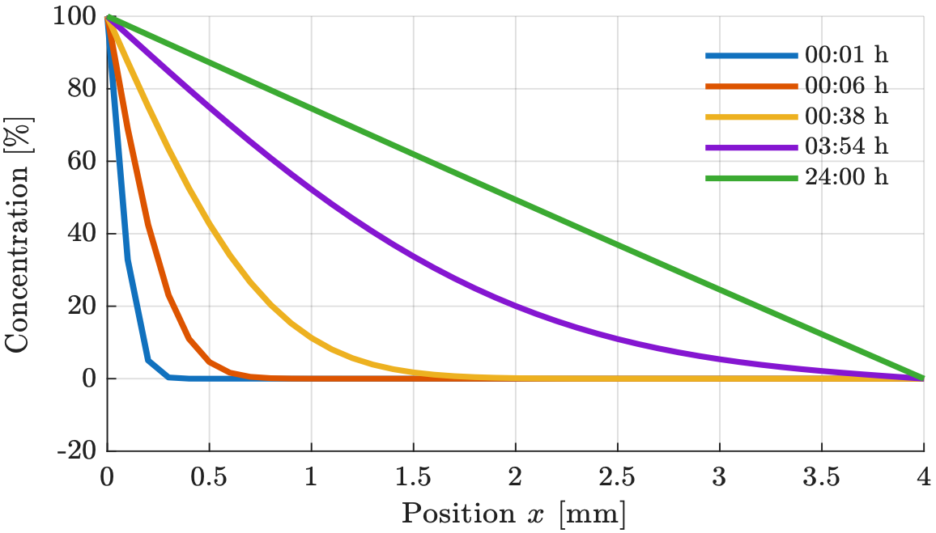
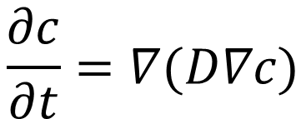
Data analysis
Diffusion fitting
$$\frac{∂c}{∂t}=∇(D∇c)$$
Undergoing work
(collab TMU – prof. Chung Lee)

Slide 14
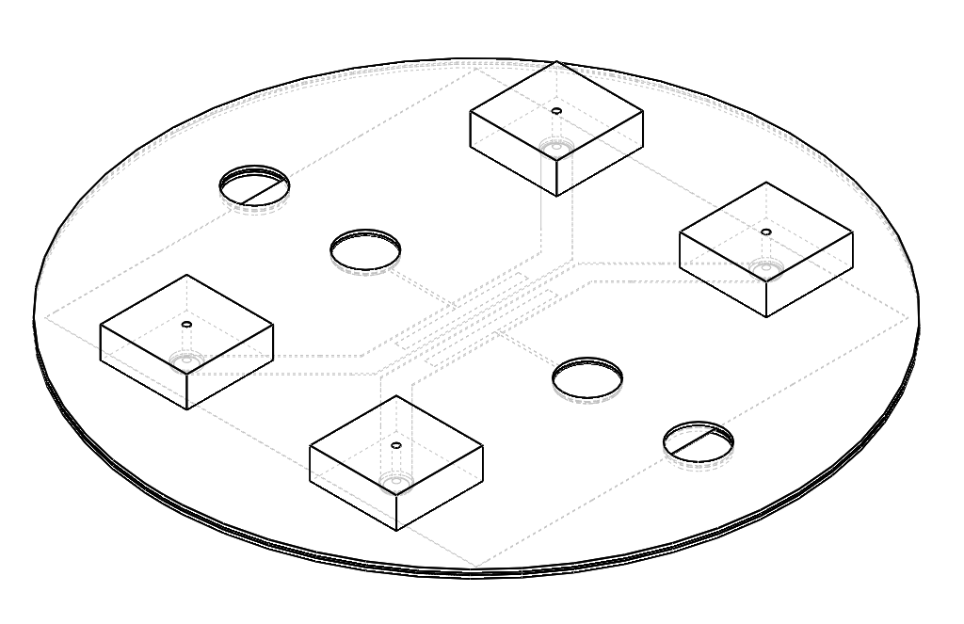
Conclusion
We designed a PEM microfluidic electrolyzer
We imaged the water gradients in operando in the nanoporous PEM
We observed a strong impact of cations concentration on PEM water gradient
Next: identification of diffusion and ion mobility through nanopores

Slide 15
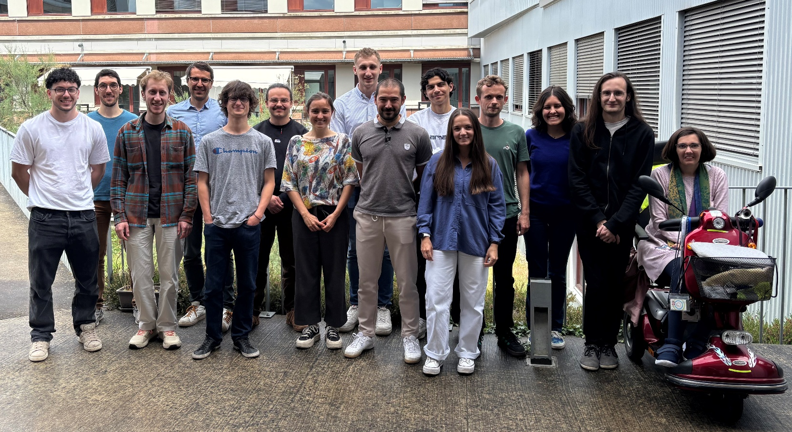

Acknowledgements
Link to my WebPage
Contact:
Ass. Prof. Stéphane Chevalier
Institute of Mechanical Engineering of Bordeaux
France
stephane.chevalier@ensam.eu
References from my group:
Krause, Kevin, et al. “Heat and Mass Transfer Visualisation of an Exothermic Acid-Base Microfluidic Reactor Using Infrared Thermospectroscopy.” Quantitative InfraRed Thermography Journal, vol. 00, no. 00, Taylor & Francis, Sept. 2024, pp. 1–18, doi:10.1080/17686733.2024.2402141.
Krause, Kevin, et al. “Water Gradient Manipulation through the Polymer Electrolyte Membrane of an Operating Microfluidic Water Electrolyzer.” Journal of Power Sources, vol. 623, Dec. 2024, p. 235297, doi:10.1016/j.jpowsour.2024.235297.

Slide 16
Slope in thin media
Slope = -0.5

Slide 17
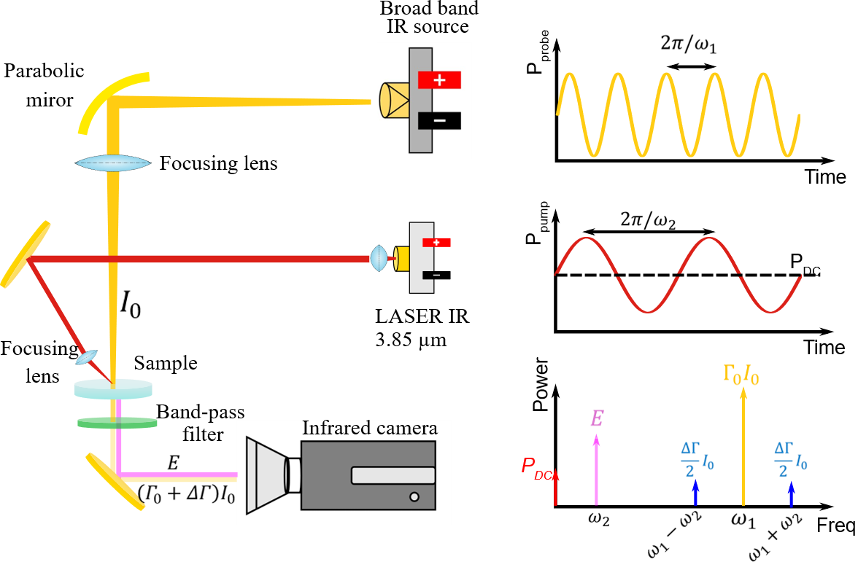
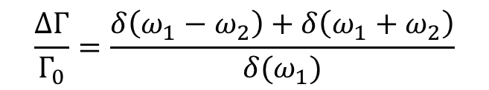
Working Principles of IR PHTI
$$\frac{ΔΓ}{Γ_{0}}=\frac{δ\left(ω_{1}−ω_{2}\right)+δ\left(ω_{1}+ω_{2}\right)}{δ(ω_{1})}$$

