Slide 1
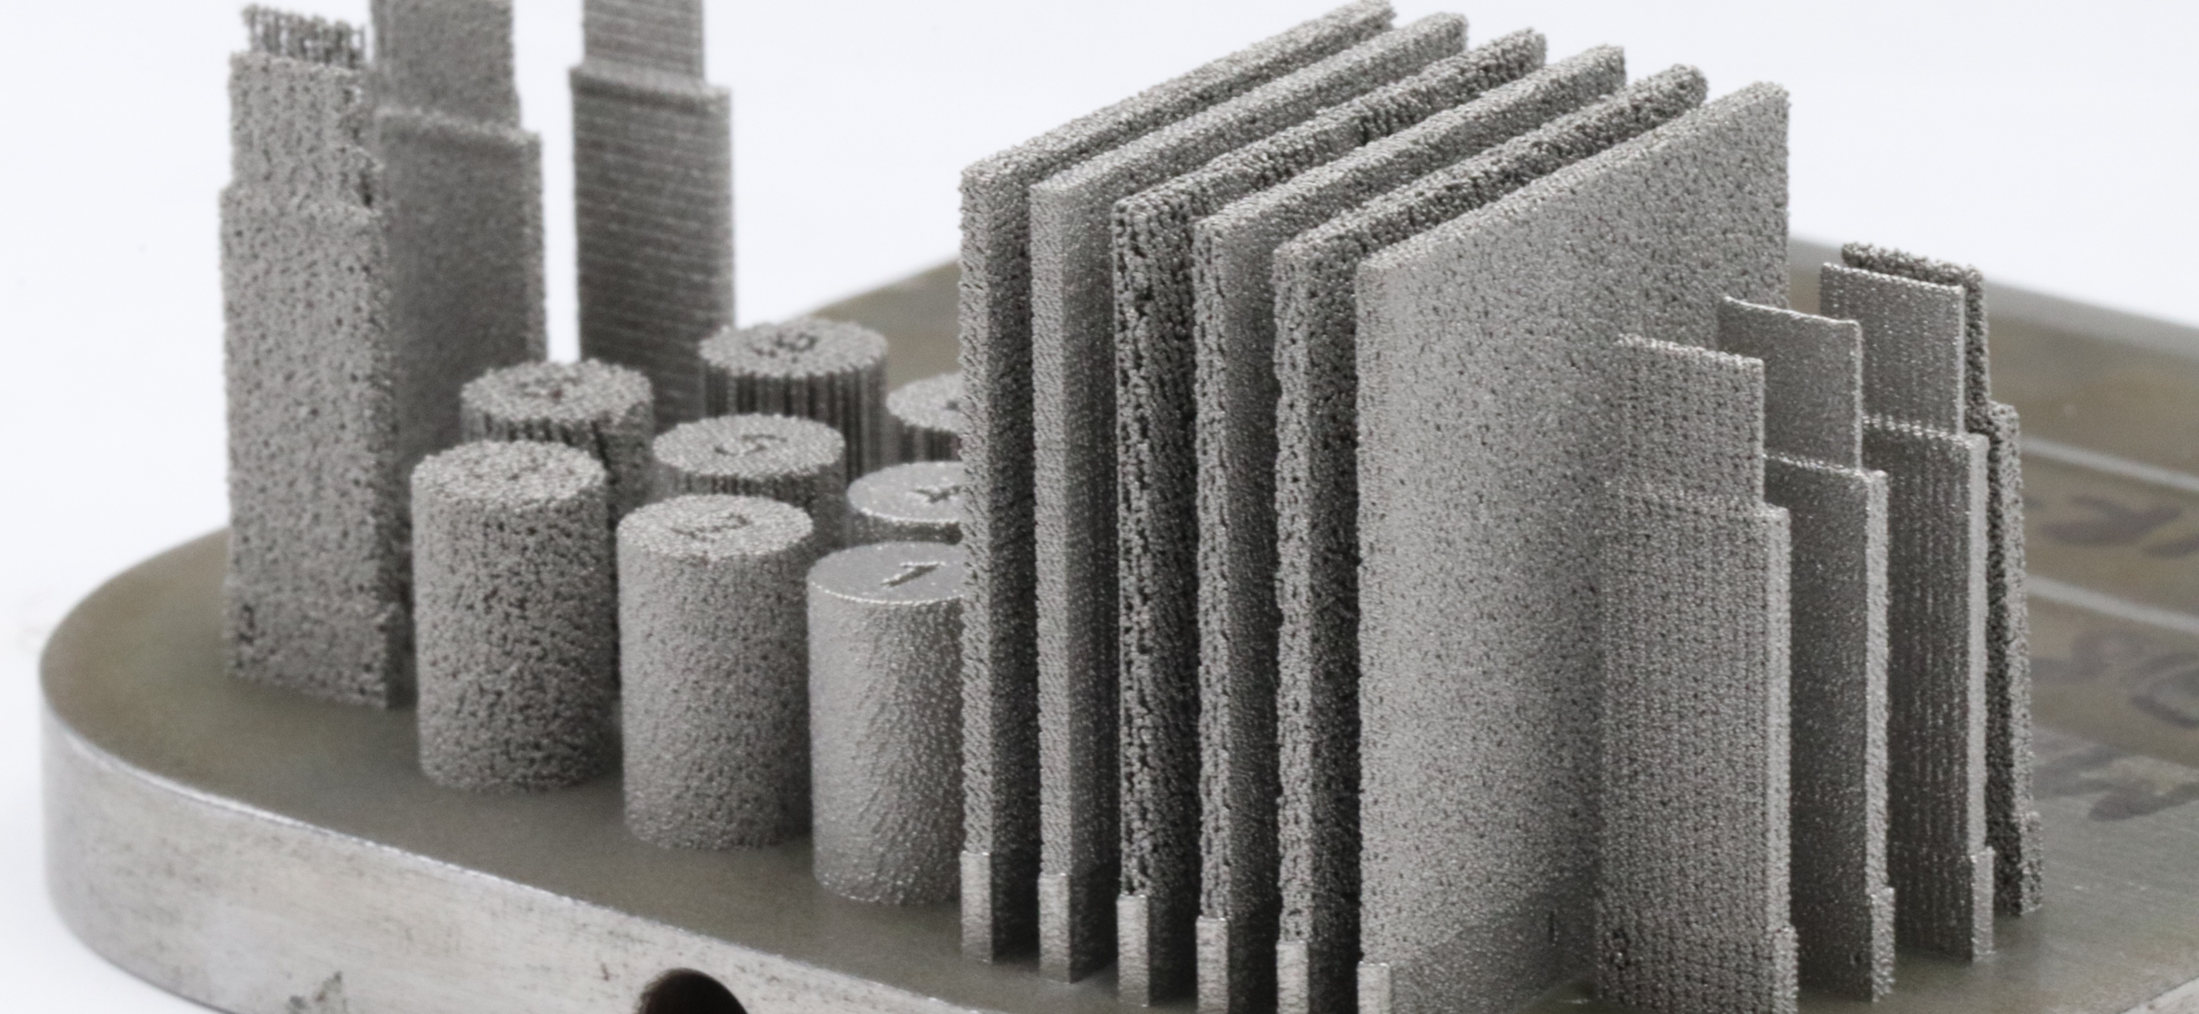

InterPore 2026 Conference
Porous Transport Layer Optimization via Additive Manufacturing of Inconel 718 Lattice Structures
PRESENTED BY: Tomisin Oluwajuyigbe
DATE: May 21, 2026
SUPERVISOR: Mihaela Vlasea
Team: Sagar Patel, Jeff Gostick, Mohsen Keshavarz, Mihaela Vlasea

Slide 2
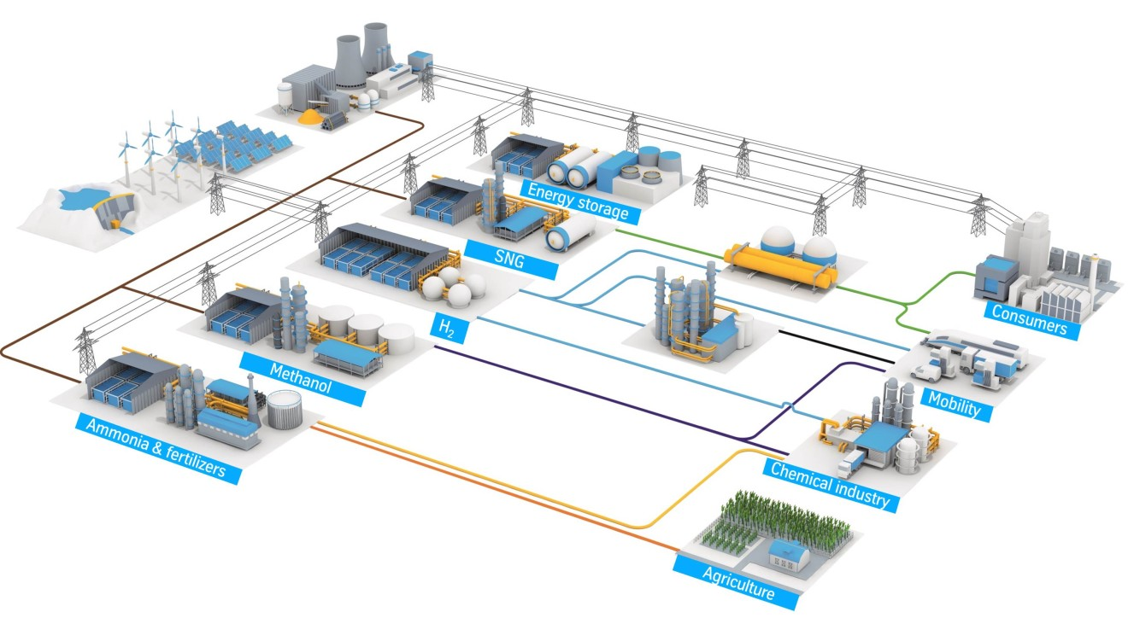
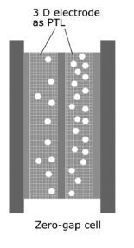
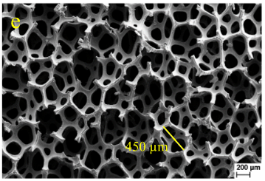

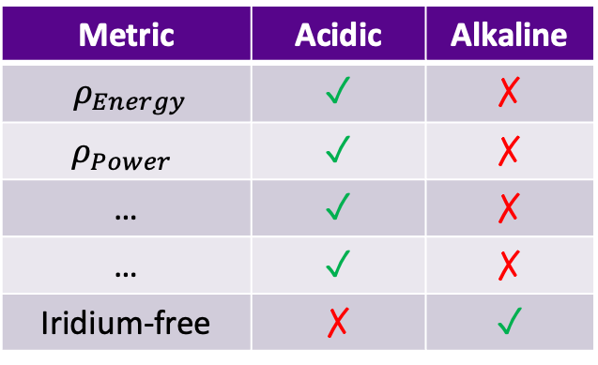
Metric | Acidic | Alkaline
$ρ_{Energy}$ | ✓ | ✗
$$ρ_{Power}$$ | ✓ | ✗
… | ✓ | ✗
… | ✓ | ✗
Iridium-free | ✗ | ✓
Introduction
Schematic view of an integrated hydrogen economy:
$$H_{2}O+Energy={2H}_{2}+O_{2}$$
Each little blue box is an electrolyzer

Slide 3
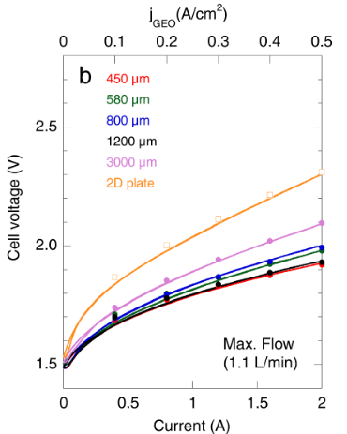
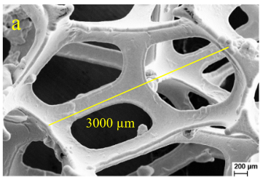
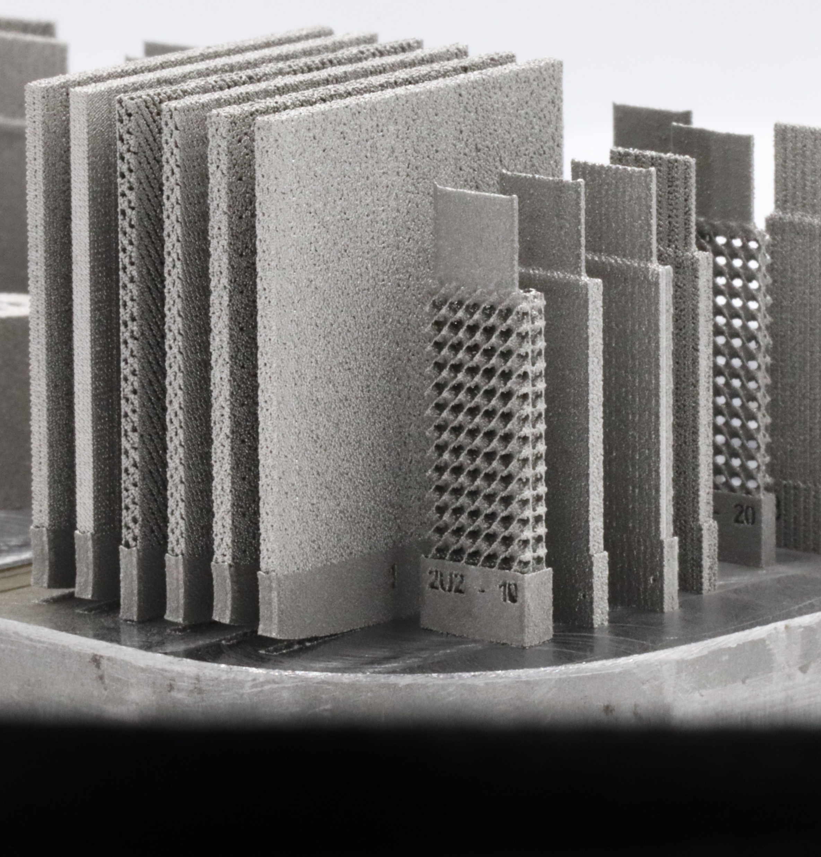
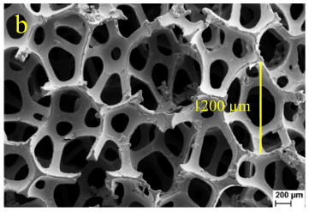
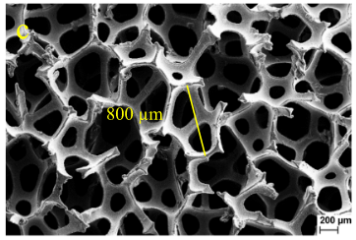
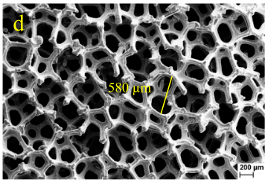
Introduction
3000 μm
1200 μm
800 μm
3D printed porous structures
Figure. Polarization curve of nickel foam electrodes with different pore sizes
580 μm
Rocha, Fernando, et al. "Effect of pore size and electrolyte flow rate on the bubble removal efficiency of 3D pure Ni foam electrodes during alkaline water electrolysis." Journal of Environmental Chemical Engineering 10.3 (2022): 107648.
Notes:
Based on literature, the average nickel foam pore size can range from 0.2mm - 0.6mm in commercial nickel foams and a much wider range in research around 0.4mm - 3mm
Pore size affects the trade-off between surface area and bubble entrapment. Foams with 450 μm and 1200 μm pores offer the best balance.

Slide 4
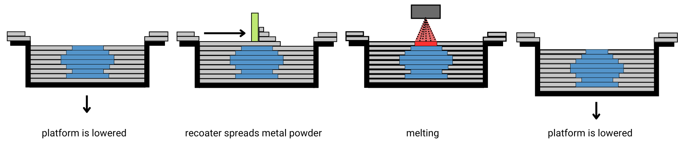
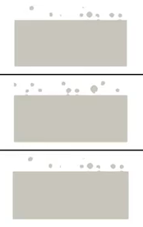
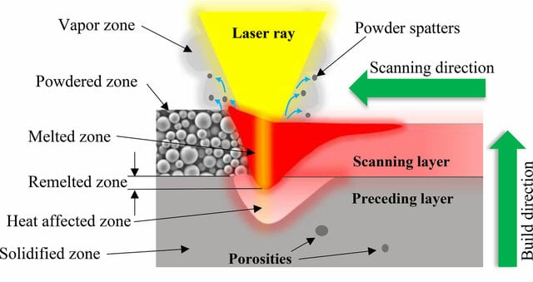
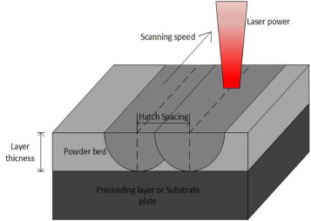
Introduction
Additive Manufacturing – Laser Powder Bed Fusion
Laser Powder Bed Fusion (LPBF): An additive manufacturing process that uses a laser to selectively melt metal powder layer-by-layer to produce complex 3D structures.
Blue = object
Grey = powder
Green = re-coater/rake
Red = laser beam
Low power
Middle power
High power
Taşcıoğlu, Emre, et al. "Machining-induced surface integrity of Inconel 718 alloy fabricated by powder bed fusion additive manufacturing under various laser processing parameters." Machining Science and Technology 26.1 (2022): 49-71.
Notes:
LPBF is an additive manufacturing (3D printing) process that uses a high-energy laser to selectively melt and fuse metal powder layer-by-layer to create complex parts.
The process starts out with the build platform lowers, followed by a thin layer of metal powder is spread across the build platform, and the laser scans specific regions based on a digital CAD model. After each layer is fused, the build platform lowers and a new powder layer is applied until the part is completed.
LPBF enables the fabrication of intricate geometries, lattice structures, and porous architectures that are difficult or impossible to manufacture using conventional methods. And some of the key process parameters include laser power, scan speed, hatch spacing, layer thickness, and scan strategy.

Slide 5
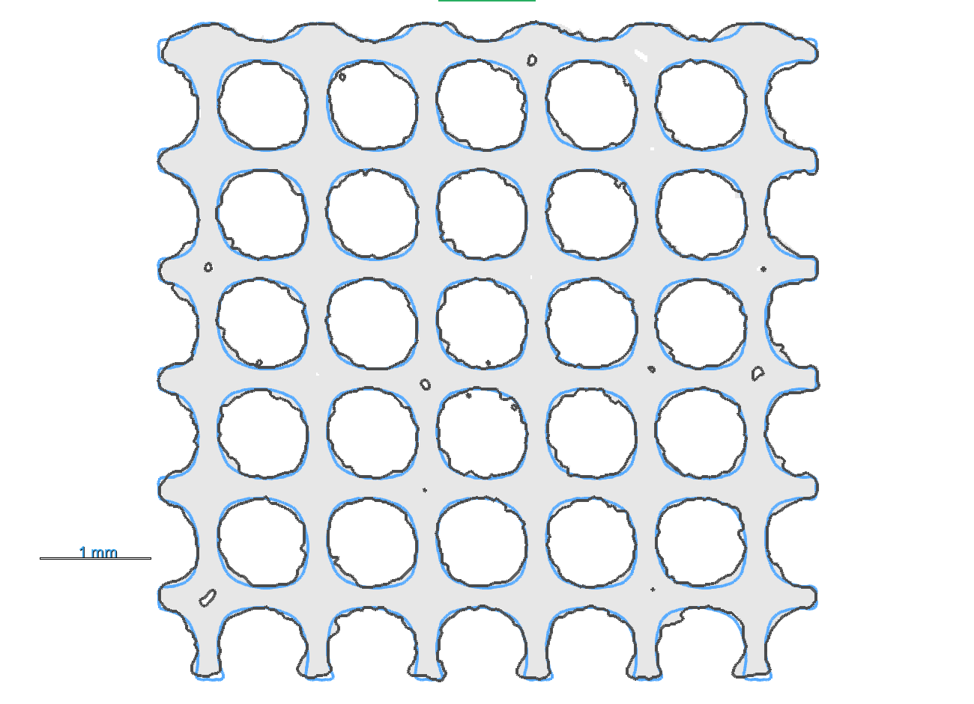
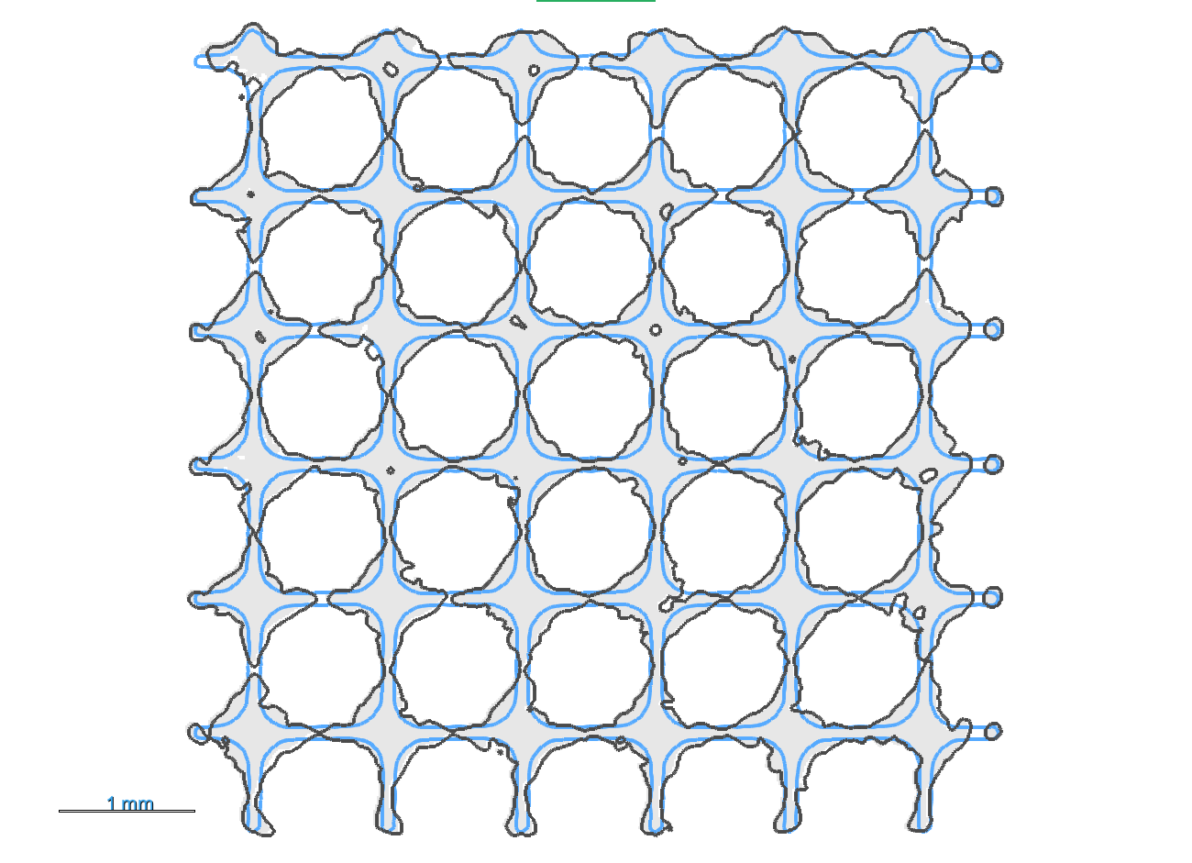
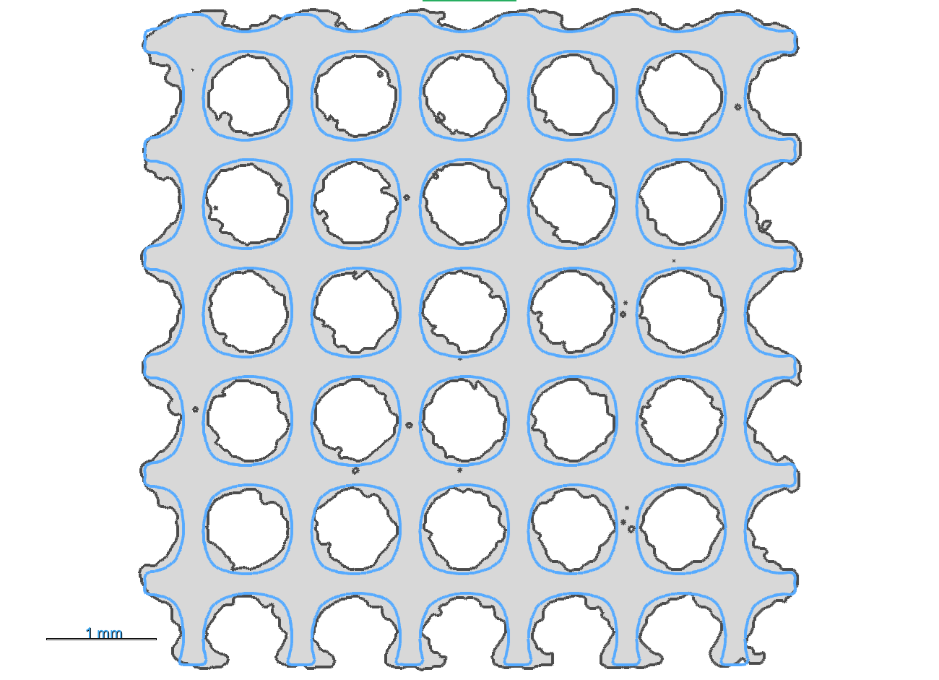
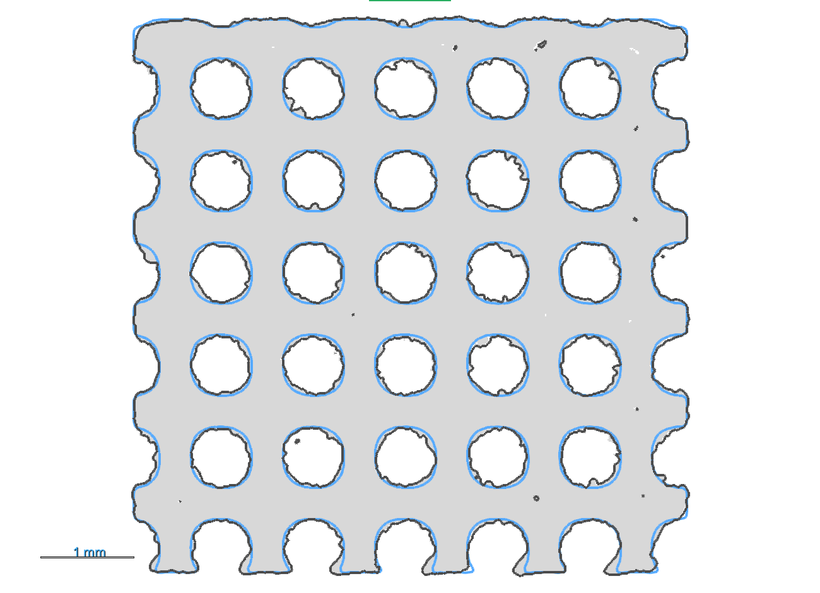
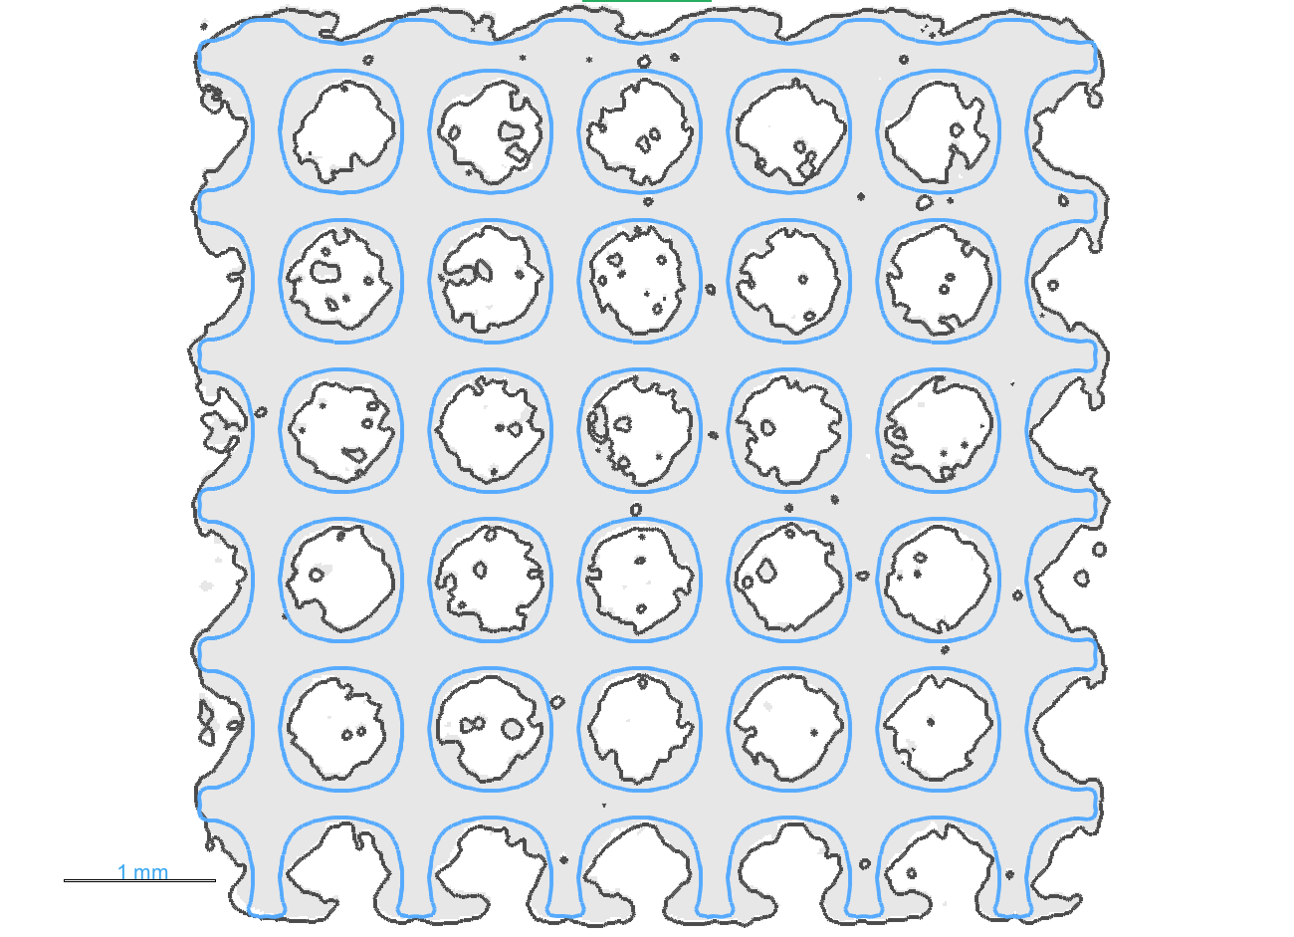
Printing Lattices
Different power levels = different geometric fidelity levels
Overprinting and roughness created as response to varied power and geometry
Printed lattice outline
Low
power
Designed lattice outline
100µm
wall thickness
Printed lattice bulk
Middle
power
300µm
wall thickness
High
power
500µm
wall thickness
build direction
Figure. Bar plot of the different surface area of the designed CAD (base) with the CT scanned low, middle and high power parameters
1mm
Figure. Cross section of different designed wall thickness
Figure. Cross section of different process parameters

Slide 6
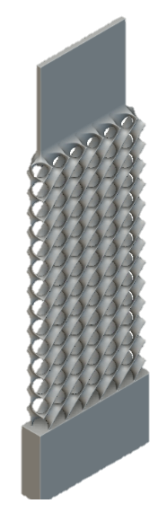
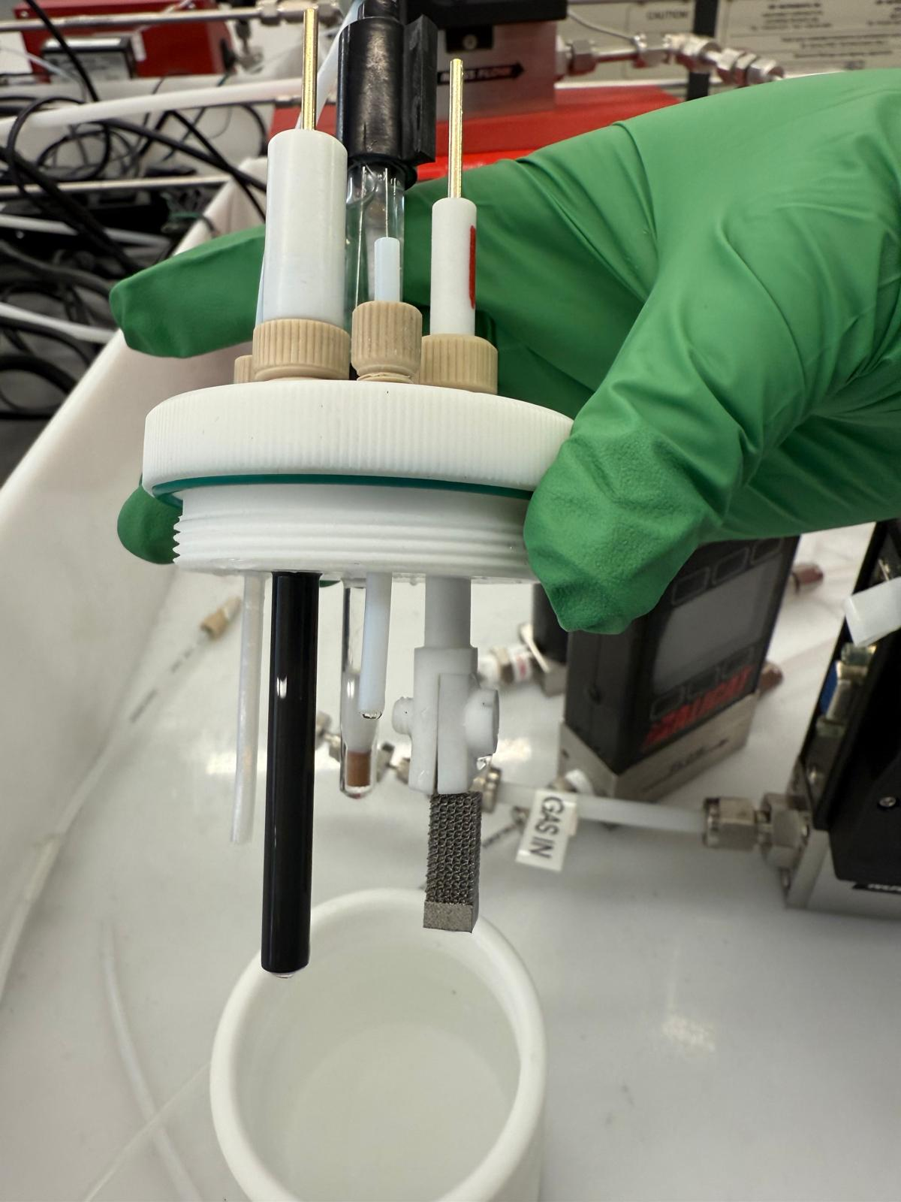
3-point probe open cell
Printed structure – working electrode
Graphite – counter electrode
Mercury oxide (HgO) – Reference
1M KOH – Electrolyte
Testing Lattices
The graphs below showcase the electrochemical testing performance of the lattice pores using LSV plots specifically for oxidation reaction (potential 0→1V).
200um wall thickness (Low Power)
CAD designed structure
Counter electrode
Reference electrode
Counter electrode
Figure. LSV plot of the deterministic pores where the potential sweeps between 0→1V in the oxidation reaction

Slide 7
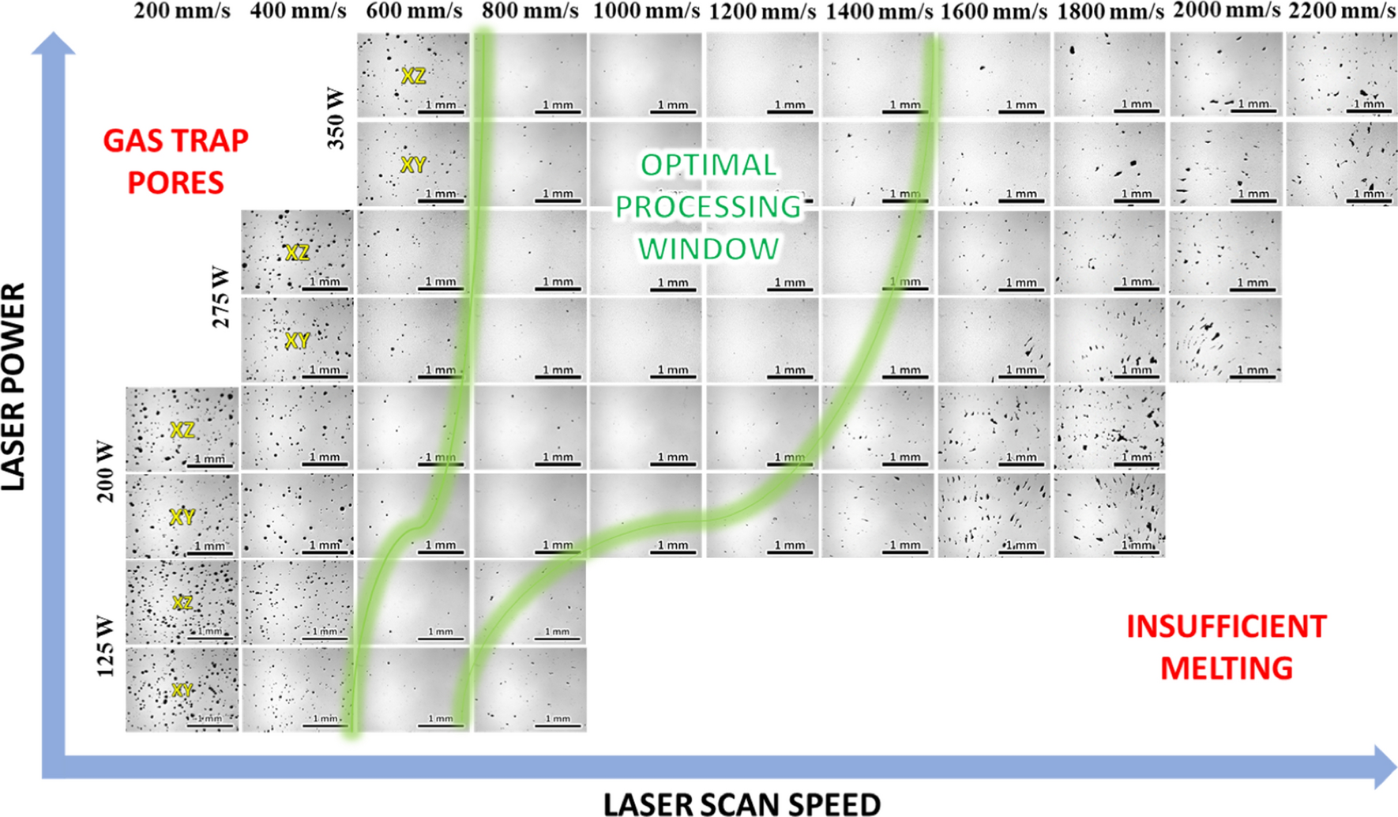
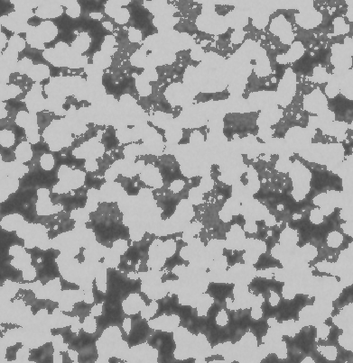
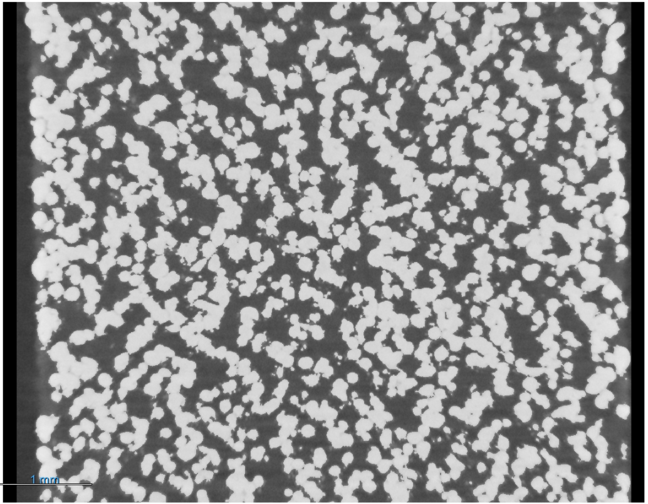
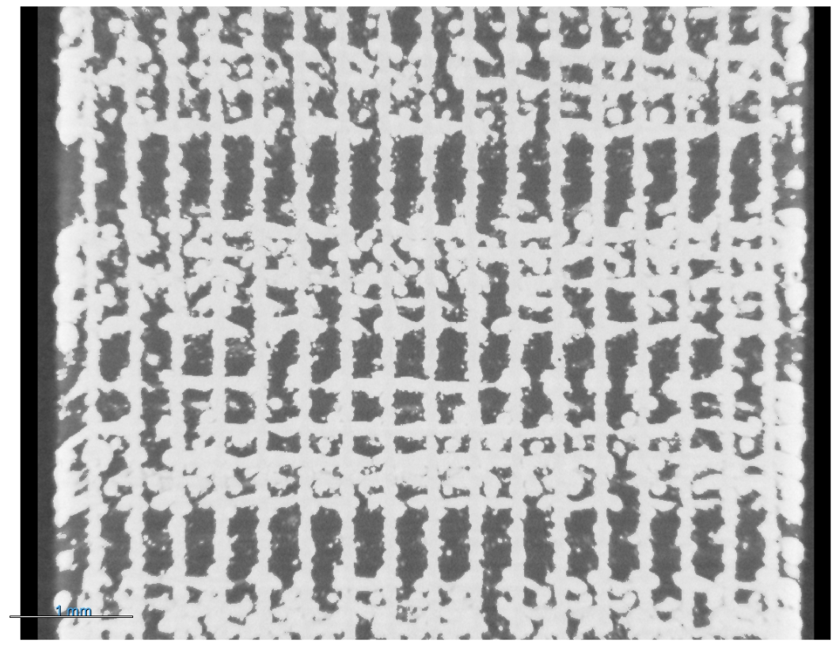
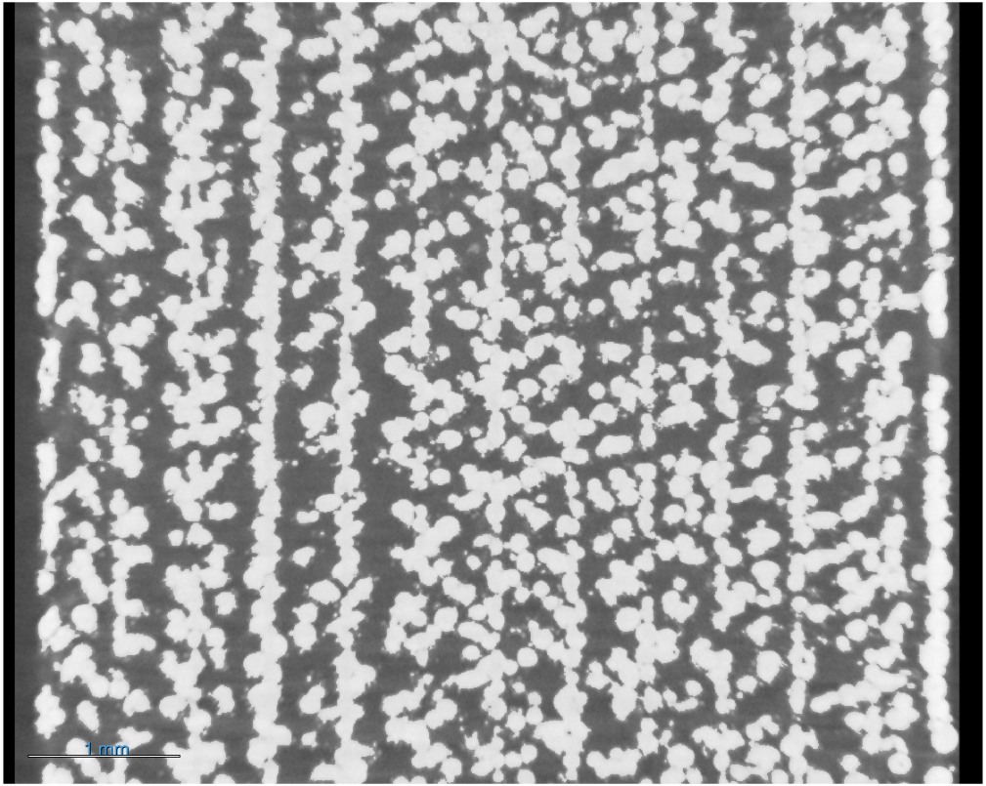
Adding Micro Porosity
Hatch spacing variation
300µm
hatch spacing
500µm
hatch spacing
Keyhole pores
1mm
Hatch rotation variation
67 deg rotation angle
(random)
60 deg rotation angle
(horizontal +vertical)
90 deg rotation angle (vertical)
Lack of fusion pores
void
solid
1mm
Wang, Maosong, et al. "From crack-prone to crack-free: Eliminating cracks in additively manufactured Ti-48Al-2Cr-2Nb alloy by adjusting phase composition." Materials & Design 231 (2023): 112025.
Mehta, Siddhi, Swarn Jha, and Hong Liang. "Corrosion of nickel-based alloys fabricated through additive manufacturing: a review." Progress in Additive Manufacturing 7.6 (2022): 1257-1273.
Notes:
https://www.sciencedirect.com/science/article/pii/S2238785422011607

Slide 8
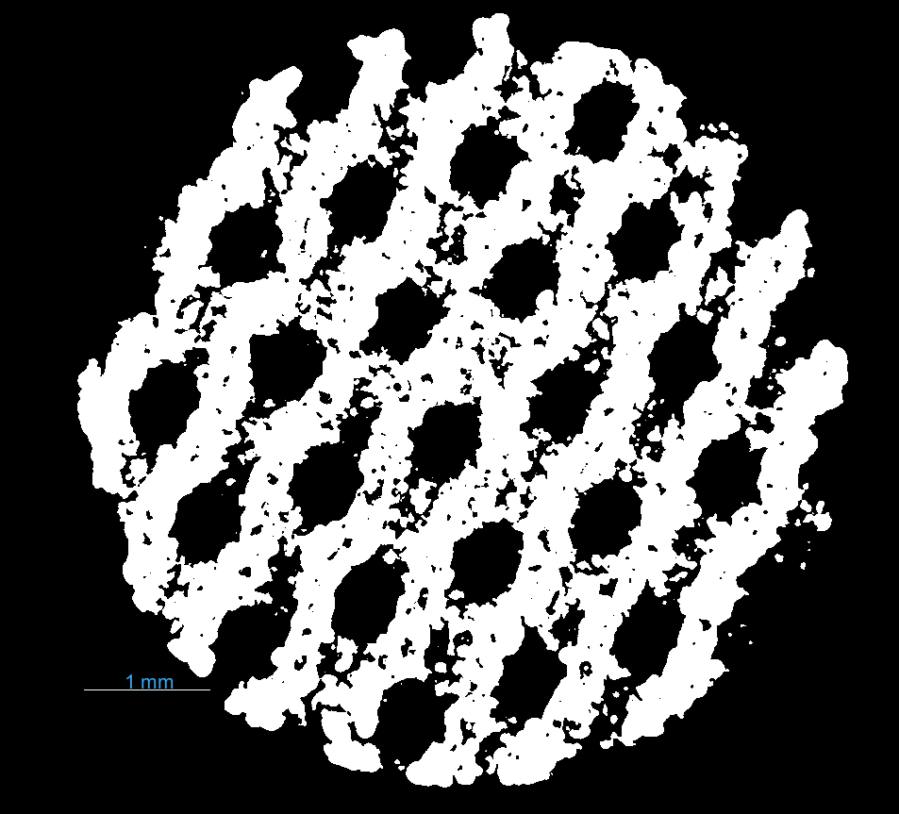
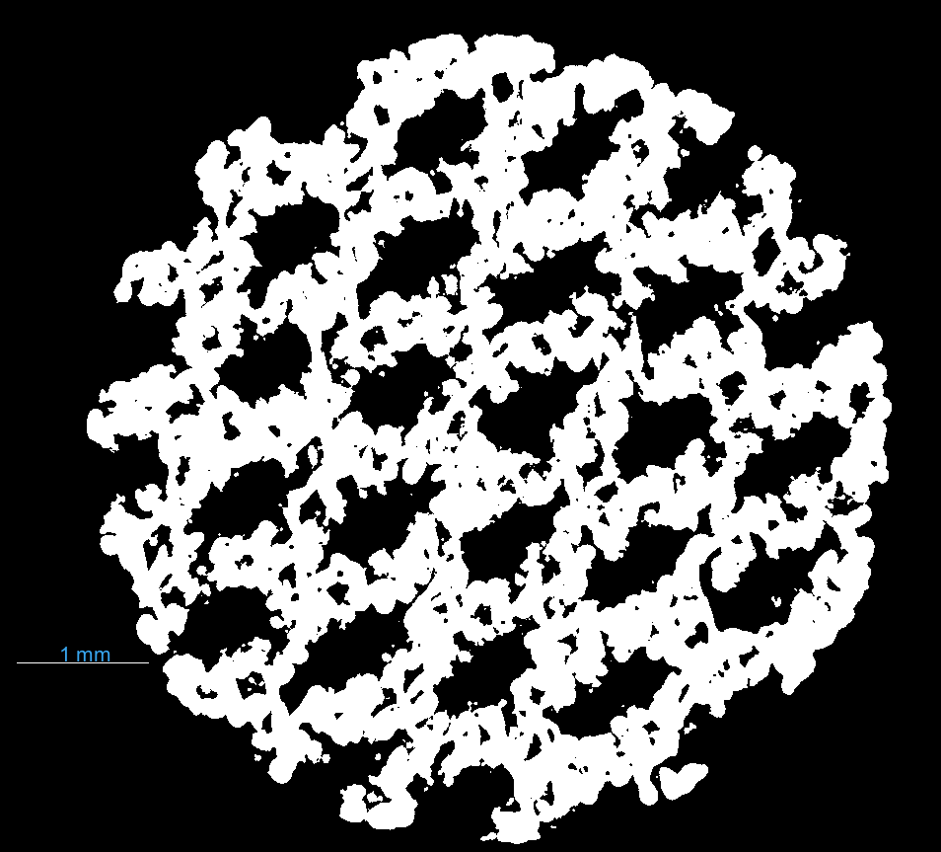
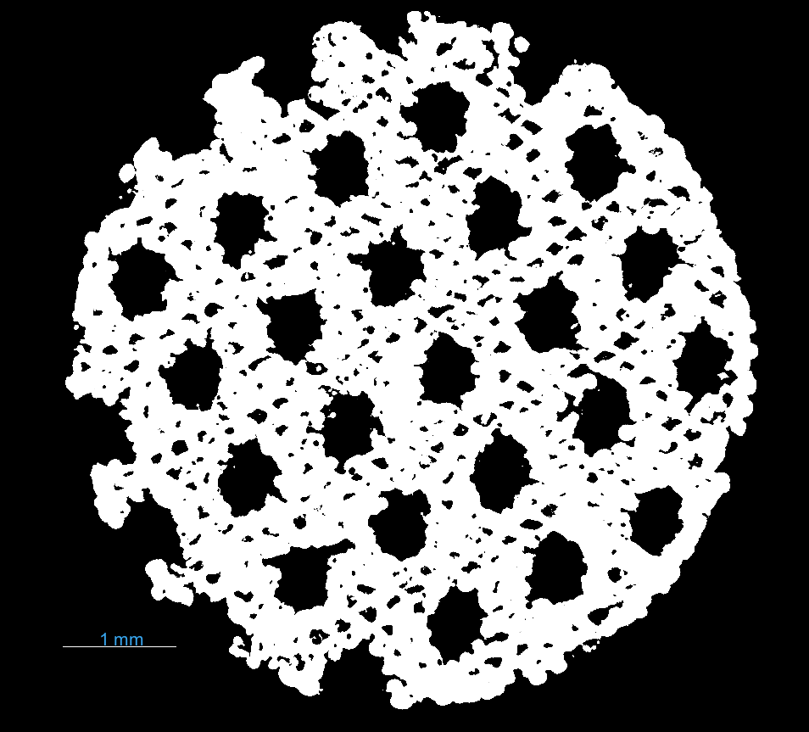
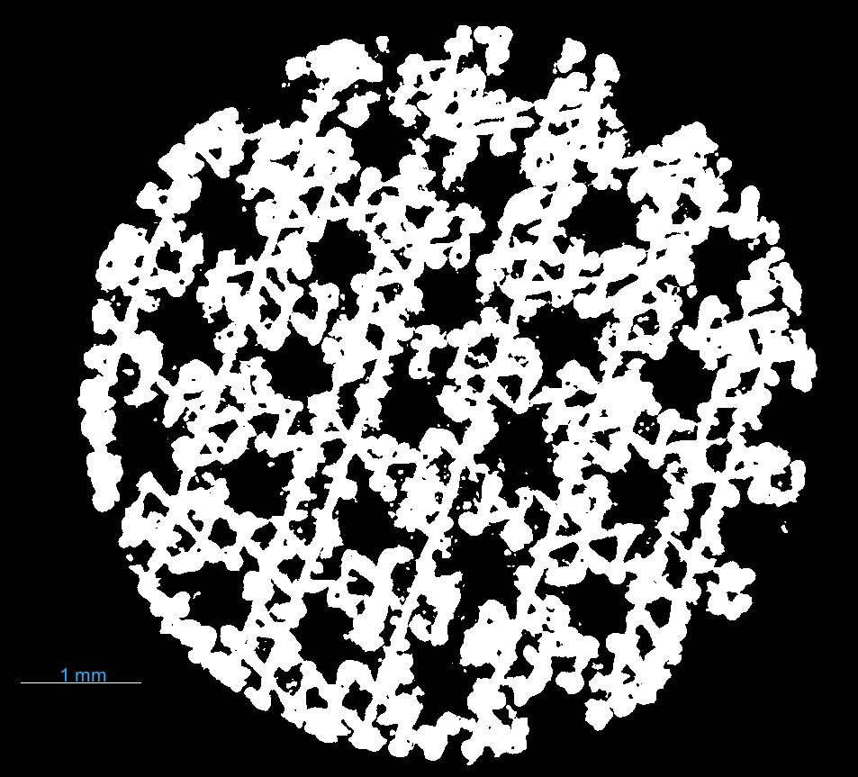
Adding Micro Porosity
Based on the deterministic and stochastic pores, an experiment was conducted to investigate the effect of combined structured pores + process-driven pores.
The CT sliced images below showcase the general pore structures obtained
deterministic pore
stochastic pore
Middle power
400um wall thickness
200um hatch spacing
67 deg Hatch angle
Middle power
400um wall thickness
300um hatch spacing
67 deg Hatch angle
Middle power
500um wall thickness
200um hatch spacing
60 deg Hatch angle
Middle power
500um wall thickness
300um hatch spacing
60 deg Hatch angle
Figure. CT slice data showcasing various hybrid pores (deterministic + stochastic)

Slide 9
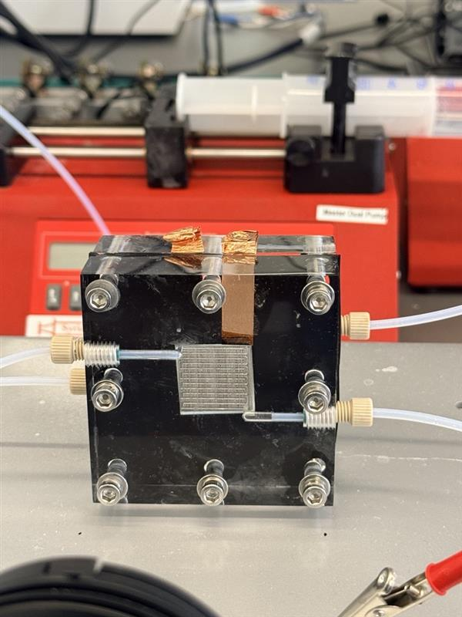
MEA closed cell
Printed structure – anode electrode
Nickel foam – cathode electrode
Flow - 3mL/min
1M KOH – Electrolyte
Testing Mirco Porosity
The graphs below showcase the electrochemical testing performance of the hybrid pores within MEA cell where current is varied from 25mA – 500mA.
500mA
375mA
250mA
125mA
50mA
outlet
25mA
inlet
67 deg Hatch Angle, 150um Hatch Spacing
67 deg Hatch Angle, 200um Hatch Spacing
67 deg Hatch Angle, 250um Hatch Spacing
Figure. CP plot of the achieved potential at an applied current over time for the hybrid pores

Slide 10
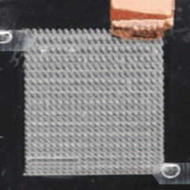
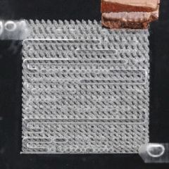
Future Work
Closed Cell (MEA) will be conducted on more hybrid combination to define overpotential in the system
Imaging bubble flow in a closed MEA cell to identify bubble behaviour
Smaller process driven pores overlayed in the hybrid porous structure → increase active surface area
25mA
500mA

Slide 11
Conclusion
Various types of pores influence the electrochemical performance
Deterministic pores: Generally, smaller pores → better performance (as long as surface area is not drastically influenced)
Combination pores: smaller overlayed pores improve electrochemical performance → higher active surface area.
Open cell structure limits the performance due to the lack of flow in the electrolysis system – a closed cell is ideal for bubble flow investigation

Slide 12




THANK YOU!
I would like to thank…
Our collaborators at National Research Council of Canada (NRC) & University of Guelph
My team at University of Waterloo / MSAM

