Slide 1

Modeling Drying of a Colloidal Dispersion in a Fibrous Porous Medium Using Full Morphology Approach
Speaker: Pierluigi Arnelli (CEA Liten-Grenoble)
Authors: Pierluigi Arnelli, Marc Prat (IMFT), Joël Pauchet (CEA Grenoble), Michel Quintard (IMFT)
Nantes, 22/05/26

Slide 2
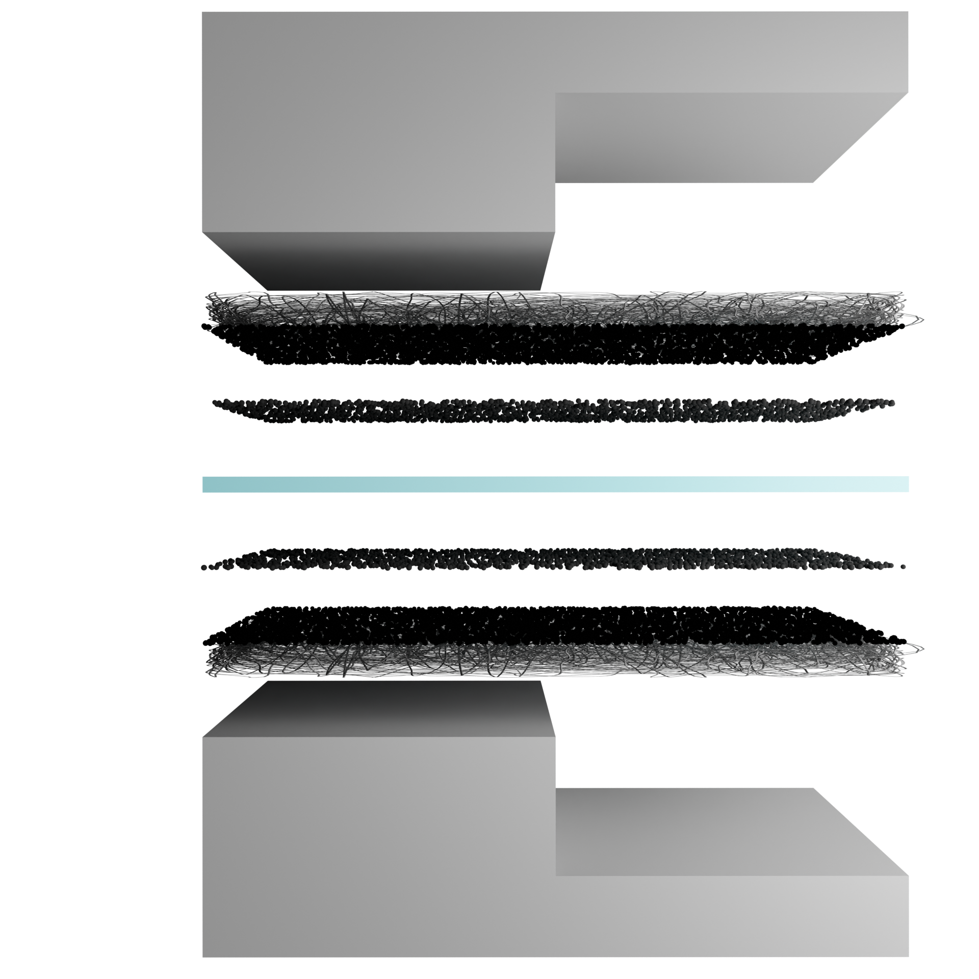
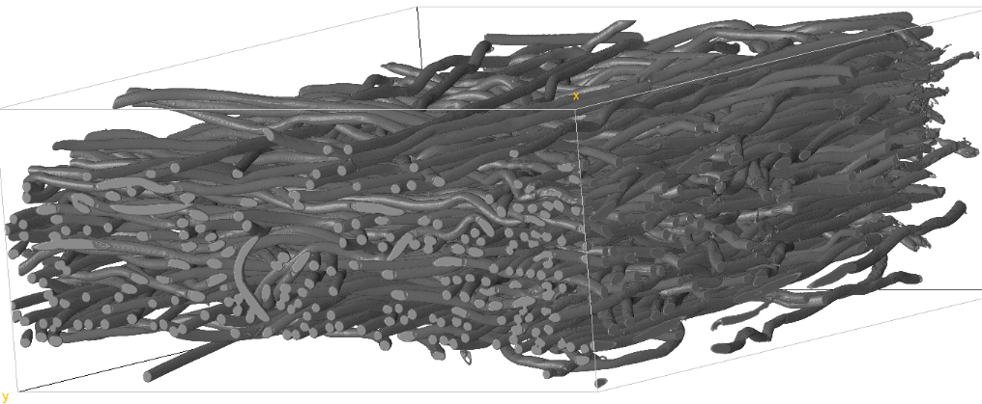
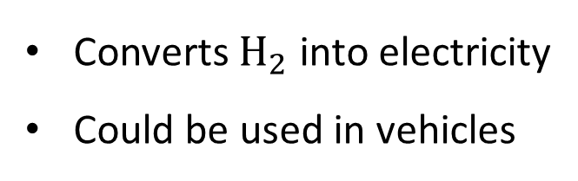


Context
Illustration of a cell
A fuel cell:
Converts ${\text{H}}_{2}$ into electricity
Could be used in vehicles
Anode
$$H_{2}→2H^{+}+2e^{−}$$
Cathode
$$2H^{+}+2e^{−}+\frac{1}{2}O_{2}→H_{2}O$$
The gas diffusion layer (GDL):
Porous carbon material
Diffuses gases + conducts electricity
Ensures liquid water management
150µm
X-ray tomography image of a carbon felt GDL

Slide 3
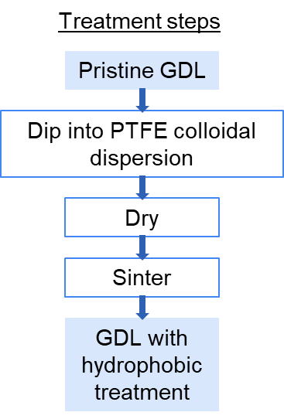
The hydrophobic treatment
A hydrophobic agent is added to avoid water accumulation in GDL
SEM image of a GDL after dipping into PTFE dispersion and drying
PTFE
Carbon fibers
GDL: Gas diffusion layer
PTFE: polytetrafluoroethylene
SEM: Scanning electron microscopy

Slide 4
Aim of the study
Model the drying of a colloidal dispersion in a porous medium
To predict PTFE distribution after hydrophobic treatment
Studies on this subject :
Continuous modeling (Inoue et al., 2013)
Morphological closing (Daino et al., 2012)
Our approach is inspired by Full-morphology simulation of two-phase flow
Based on morphological operators (Schulz et al., 2015)
Based on capillary pressure calculation (Sabharwal et al., 2018)

Slide 5
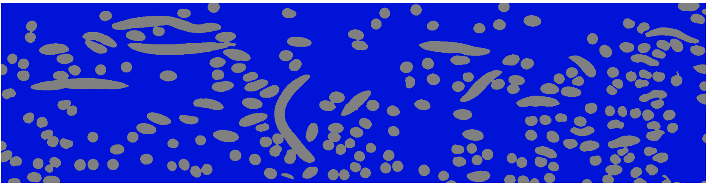
Model
Preliminary model of the drying of a colloidal dispersion in a porous medium
Two-phase flow by tracking interface
Tracking colloid concentration
Main assumptions
2D structures
Isothermal
Neglect gravity effects
Neglect viscosity effects
Initial saturation: 1
Contact angle: 0°
Uniform concentration in liquid
Initial state in a GDL x-ray tomography image
Carbon fibers
Colloidal dispersion
Inlet

Slide 6
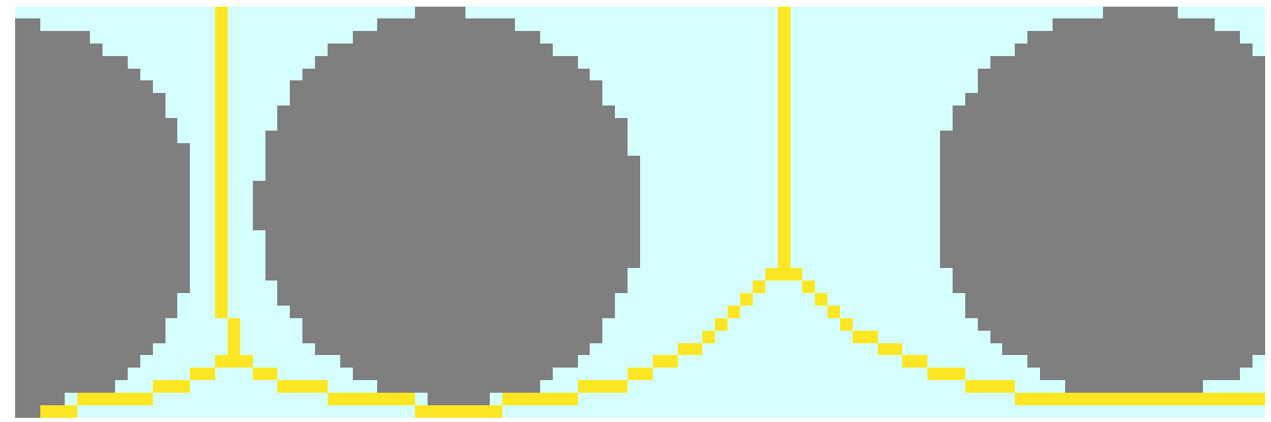
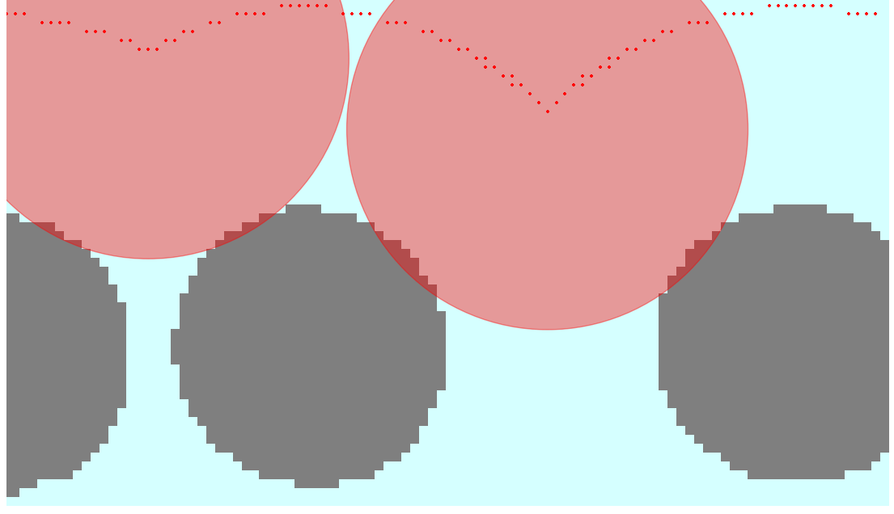
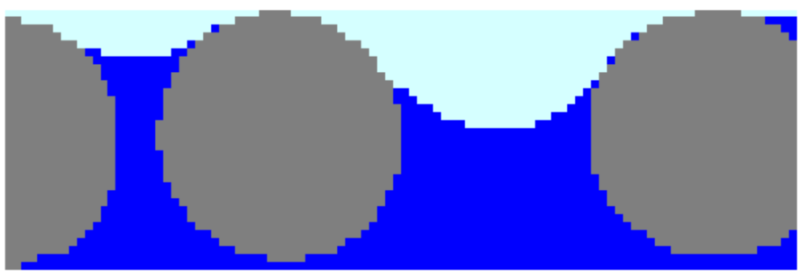
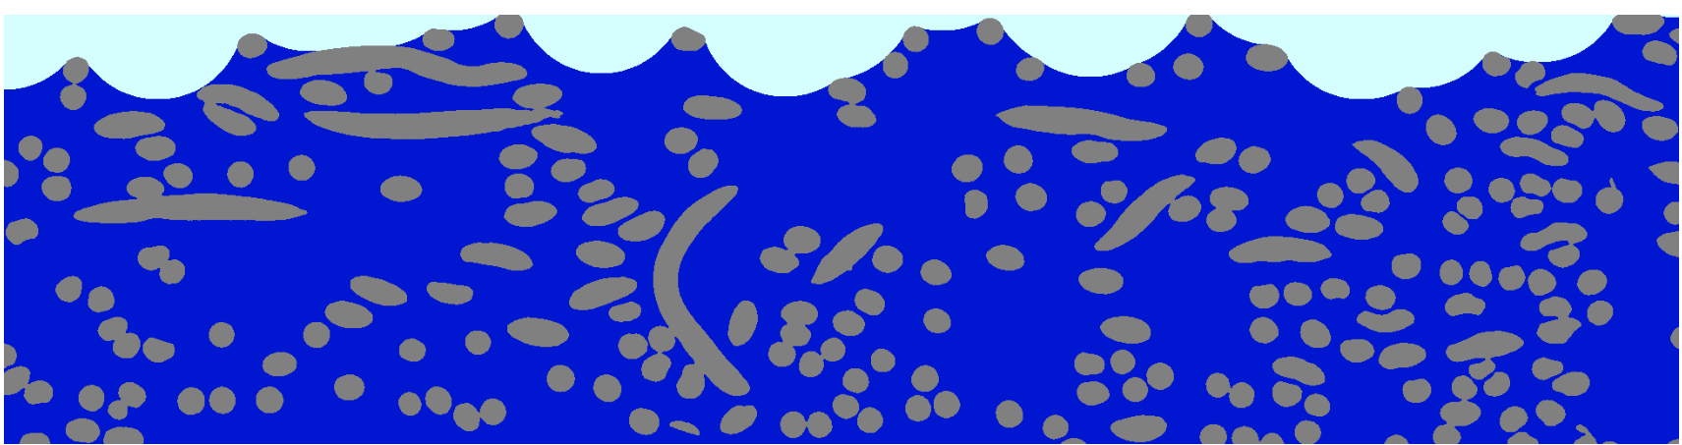

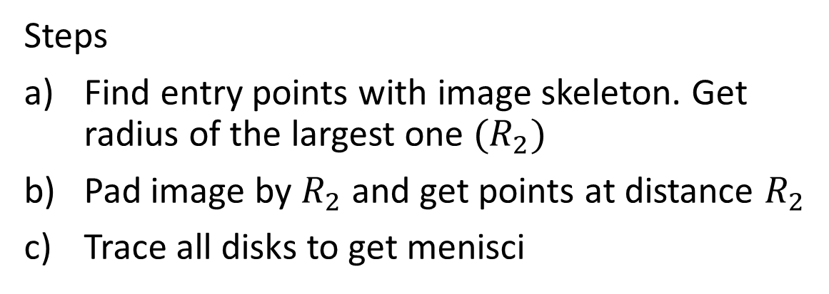



First part: inlet liquid-air interface
Get menisci of same curvature for all throats in the inlet (inspired by Inoue et al., 2019)
$$R_{1}$$
$$R_{2}$$
Steps
Find entry points with image skeleton. Get radius of the largest one ${(R}_{2})$
Pad image by $R_{2}$ and get points at distance $R_{2}$
Trace all disks to get menisci
a)
$$R_{2}$$
$$R_{2}$$
b)
Inlet liquid-air interface for a full GDL image
c)
Carbon fibers
Air
Colloidal dispersion
Skeleton
Inlet

Slide 7
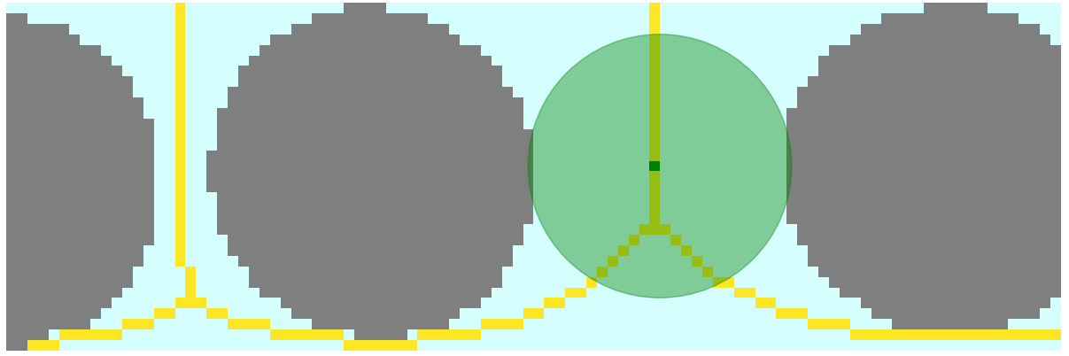

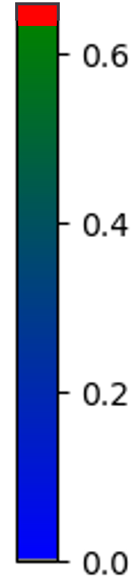

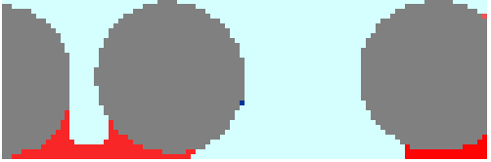
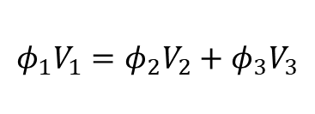



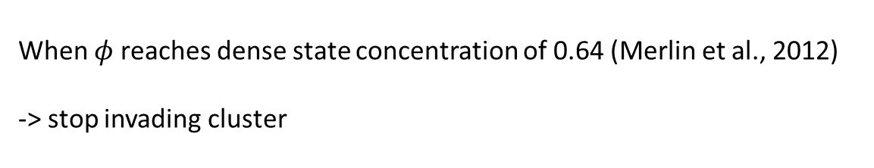



Second part: Track interface and concentration
Disk and skeleton used to follow the interface + tracking concentration
$$φ$$
When clusters separate
$$φ_{1}V_{1}=φ_{2}V_{2}+φ_{3}V_{3}$$
$$φ_{1}, V_{1}$$
$$φ_{2}, V_{2}$$
$$φ_{1}, V_{1}$$
$$φ_{3}, V_{3}$$
with
$$φ_{2}=φ_{3}$$
Stopping condition
When $φ$ reaches dense state concentration of 0.64 (Merlin et al., 2012)
-> stop invading cluster

Slide 8
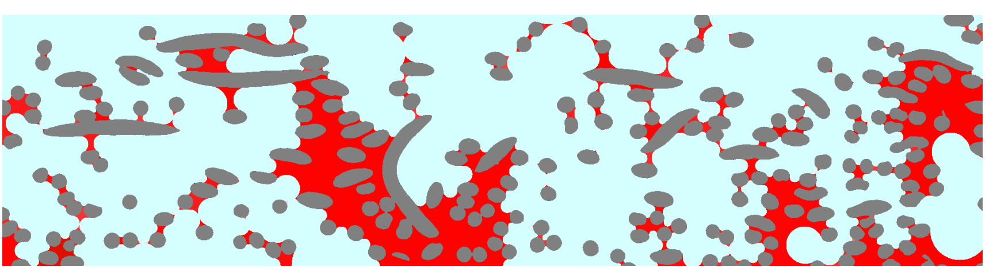
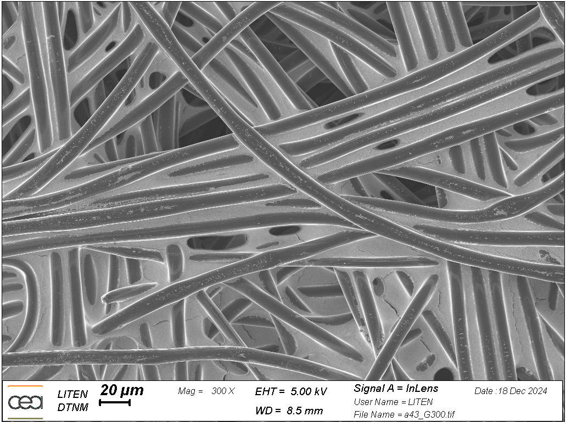
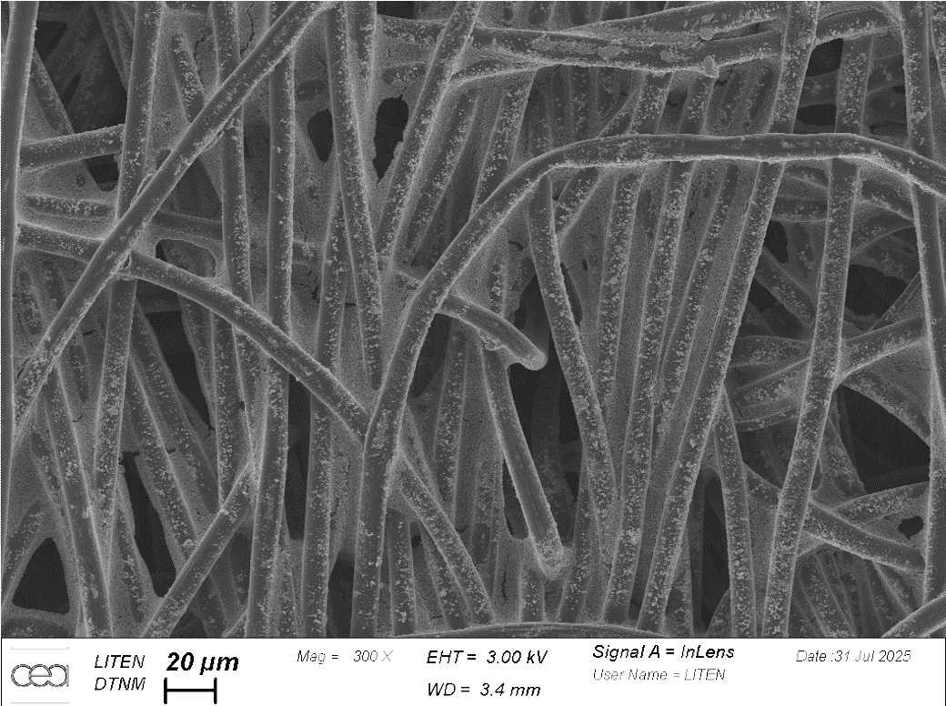
Results
PTFE distribution once all clusters reached critical concentration
Carbon fibers
PTFE
Air
Some structures are reproduced by our model
Inlet
SEM images of GDLs after hydrophobic treatment

Slide 9
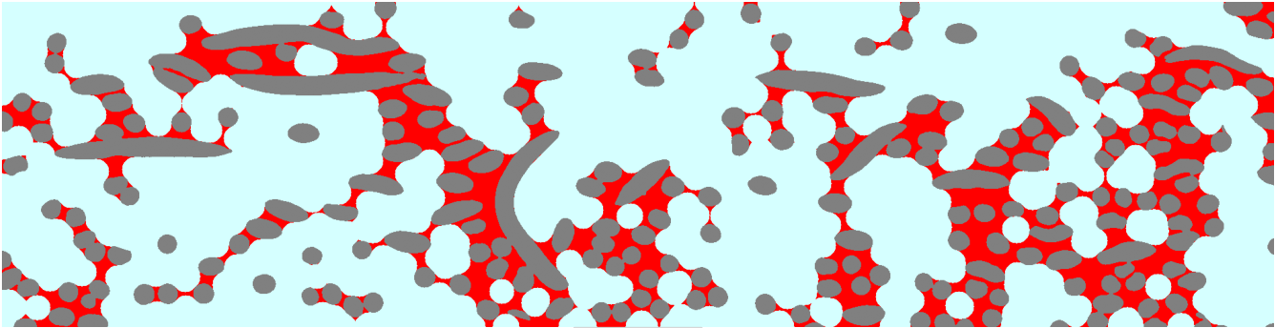
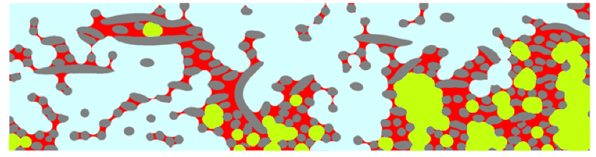
Comparison to morphological closing
Our model
Morphological closing
  Image treatment
  Fills interstices
Comparison:
Similar film-like structures
Similar zones are occupied
Our model make it possible to choose initial concentration, instead of choosing a structuring element radius
Non-physical air bubbles in morphological closing
Morphological closing
Non-physical air bubbles
Carbon fibers
PTFE
Air
Notes:
nb pixel PTFE notre modele : 114271 vs 105700

Slide 10
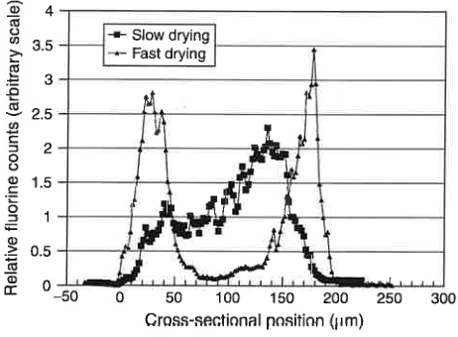
Conclusion
Summary
Perspective
Non isothermal
Resolve colloid transport in fluid
3D
Developed a novel algorithm mixing geometry criteria and physical considerations
Resulting structures are similar to the ones observed experimentally
Similar results as morphological closure, but physics-based (no bubbles formed)
PTFE distribution across carbon fiber-papers
MATHIAS et al. Handbook of Fuel Cells, 2003.

Slide 12
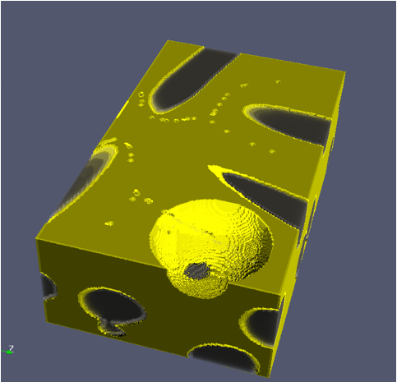
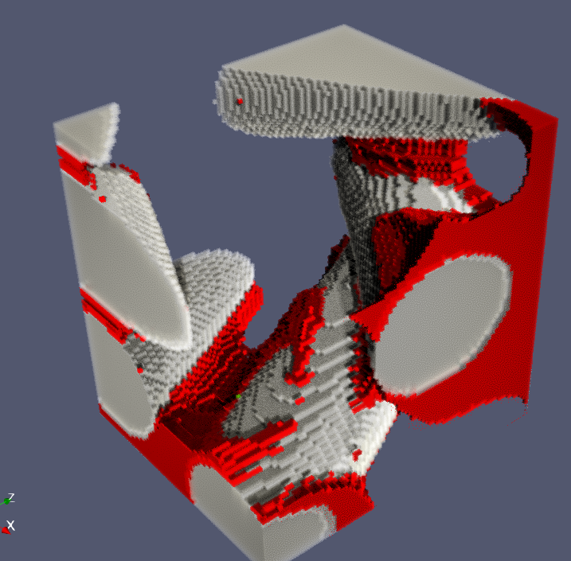
What about 3D
Can be extended for some geometries (such as granular media)
For fibrous media, spheres don’t represent well menisci at first
Carbon fibers
PTFE
Dispersion
Beginning: Example of a non-physical meniscus
End: Meniscus misrepresentation is less visible

Slide 13
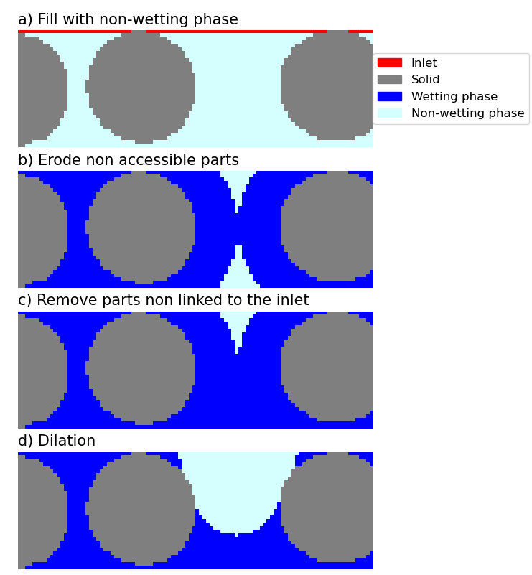
Example of a step of Schulz et al. algorithm

