Slide 1
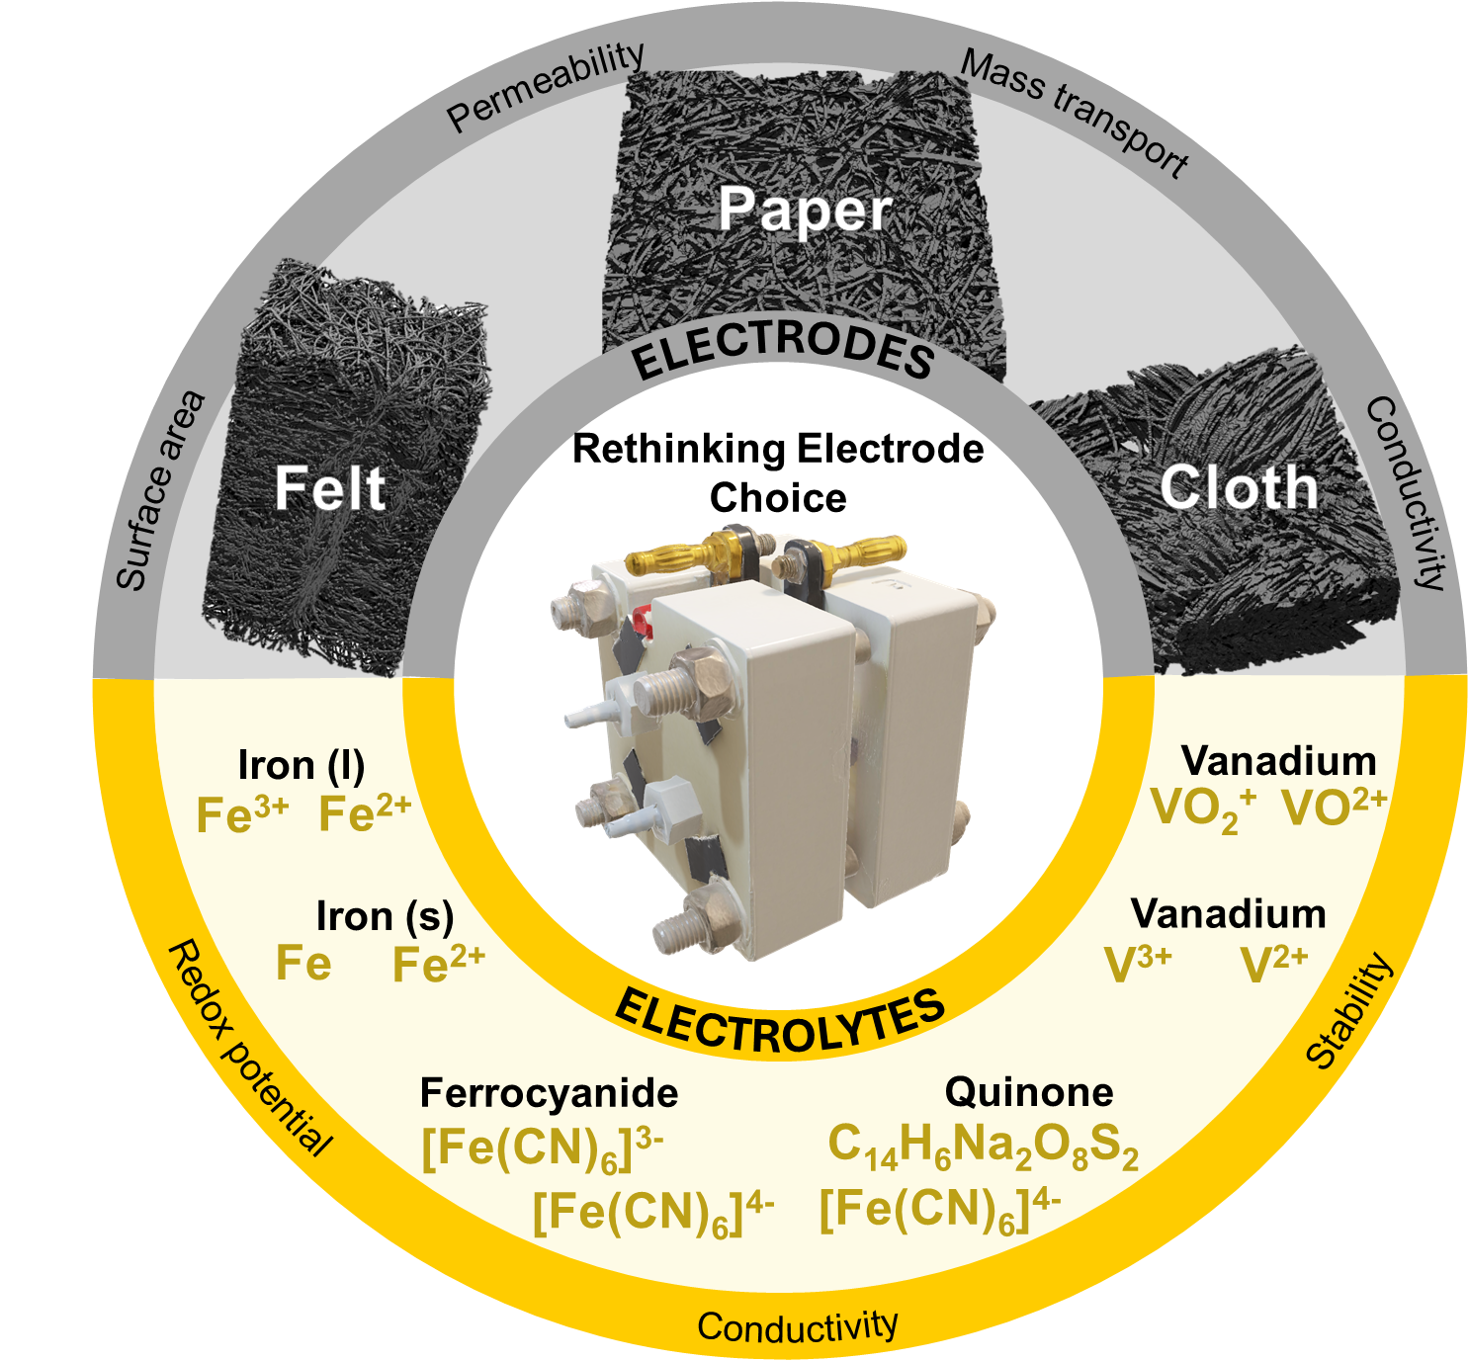


Rethinking Electrode Choice: Matching Porous Microstructures to Electrolyte Properties in Redox Flow Batteries
Sonia Khalghollah, Andreina Camano Alcedo, Arielle Chung, Tova Gilbert, and Maxime van der Heijden
Assistant Professor
Department of Chemical Engineering, University of Waterloo
InterPore2026, Session MS17, 21st of May

Slide 2
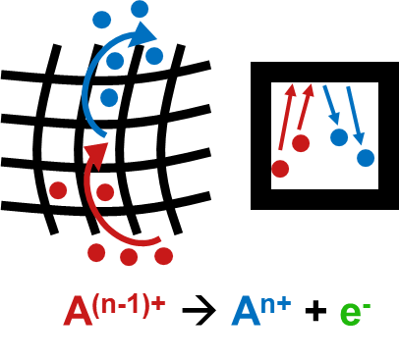
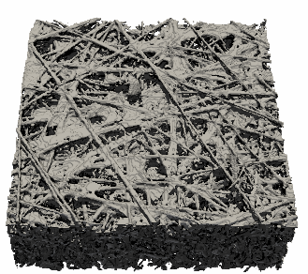
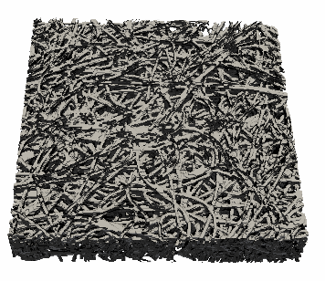
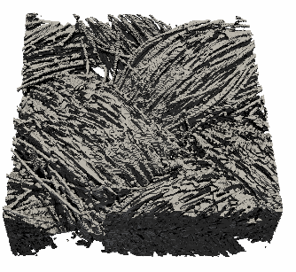
Introduction
Electrode optimization
Experimental testing
Electrode manufacturing
Urgent need for renewable technologies and energy storage at a large scale
We need tailored electrode microstructures for redox flow batteries
Porous electrodes
Current generation not optimized, affecting three major losses:
Activation losses
Ohmic losses
Mass transport losses
Key properties:
- Surface area
- Permeability
- Mass transport
- Conductivity
250 μm
250 μm
250 μm
↓ Pressure drop
↑ Electrochemical performance
Forner-Cuenca, A. et al., J. Electrochem. Soc., 166(10) A2230-A2241 (2019)
Van der Heijden, M. et al., Encyclopedia of Energy Storage, Elsevier, 480-499 (2022)
2

Slide 3
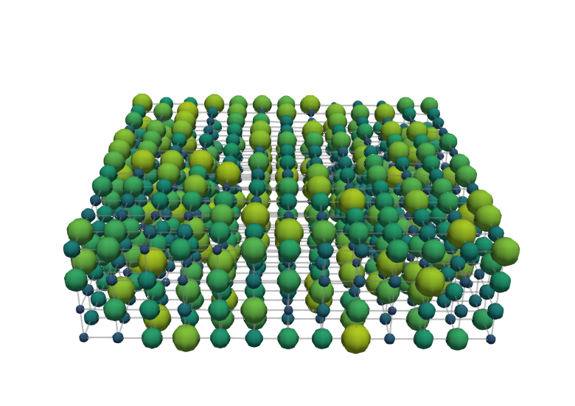
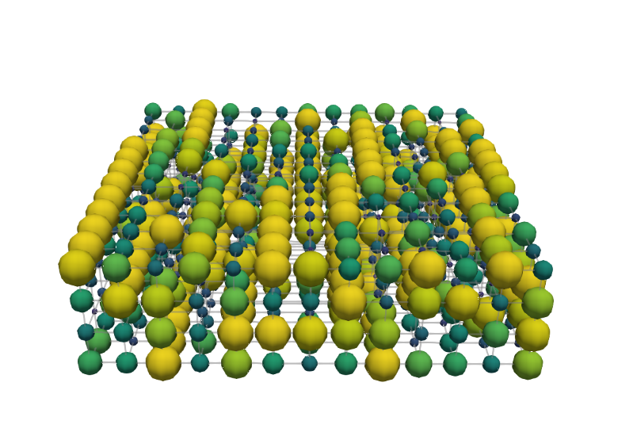
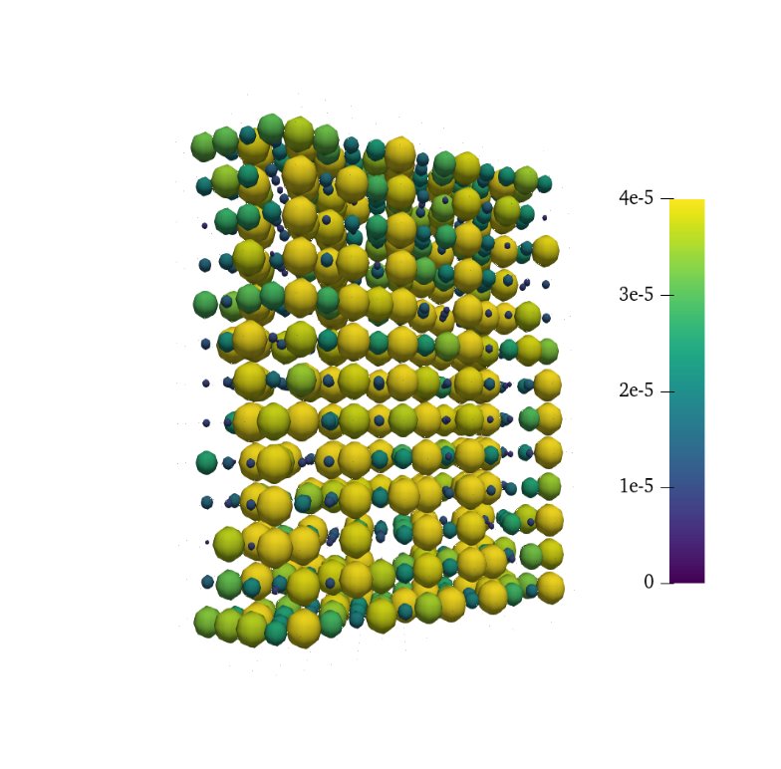
Introduction
Electrode optimization
Experimental testing
Electrode manufacturing
Genetic optimization of electrode structures
Bimodal pore size distribution enhances the performance
Increased fitness:
↑ Electrochemical power
↓ Pumping power
Generation
Selection
Crossover
Genes
Selection
Mutation
Generation
Fitness
Termination
P_{el}
1000 generations
Membrane
Pore diameter [μm]
Thickness
0 10 20 30 40
P_{pump}
Current collector
Flow direction
100 μm
Generation
3

Slide 4
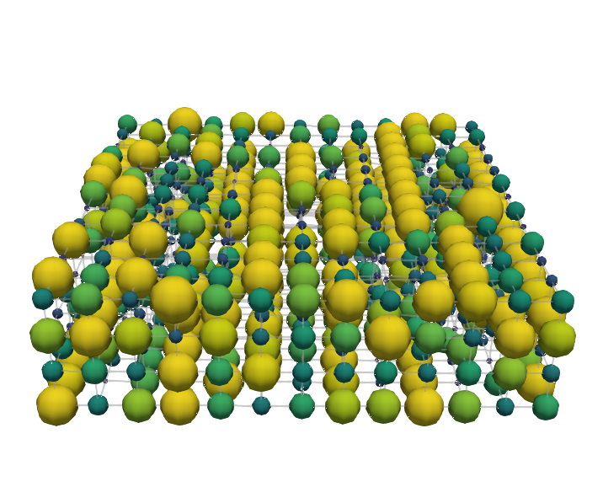

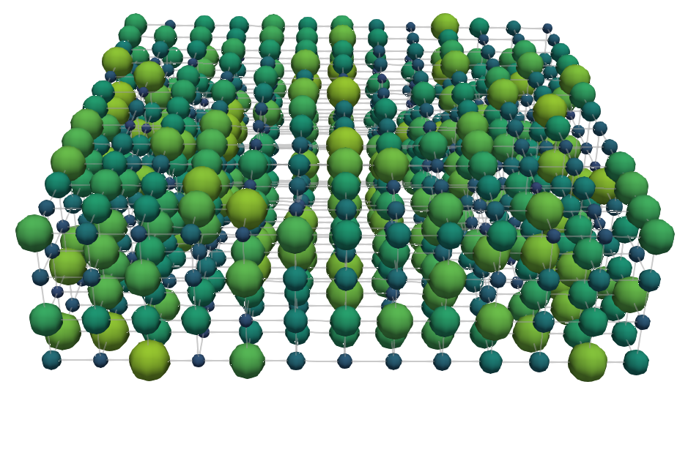
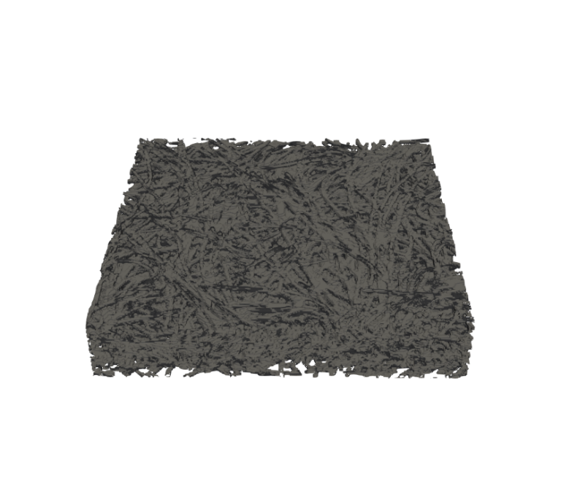
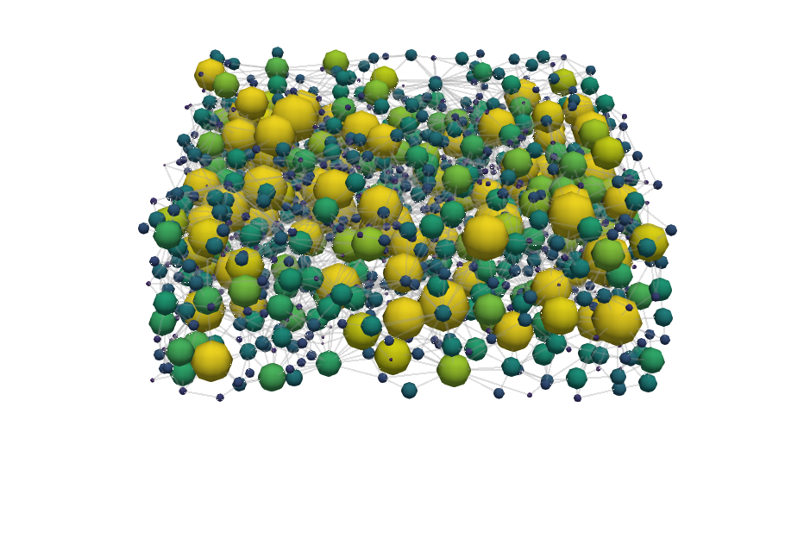
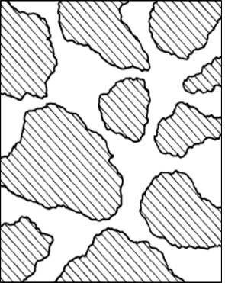

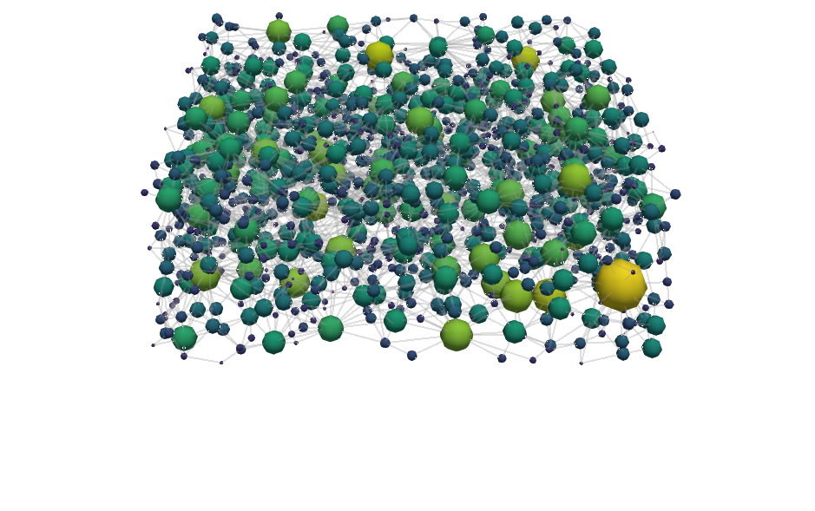
Introduction
Electrode optimization
Experimental testing
Electrode manufacturing
Towards realistic battery operation
Enhancing the performance of conventional electrode designs
Cubic electrode
Vanadium electrolyte:
Generation 1
Generation 1000
v = 1.5 cm s⁻¹
1000 generations
Pore diameter [μm]
z
0 10 20 30 40
y
x
Flow direction
100 μm
Conventional electrode
Void
X-ray tomography
Watershed segmentation
Solid
100 μm
4

Slide 5
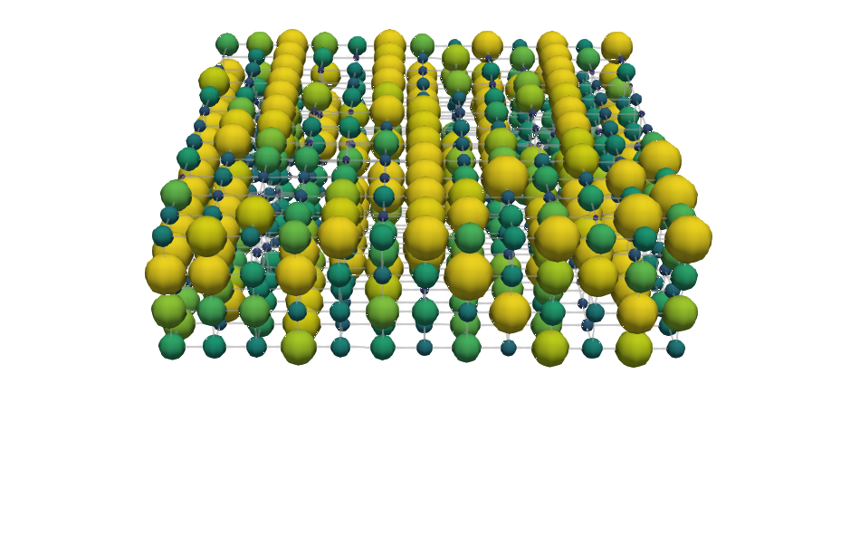
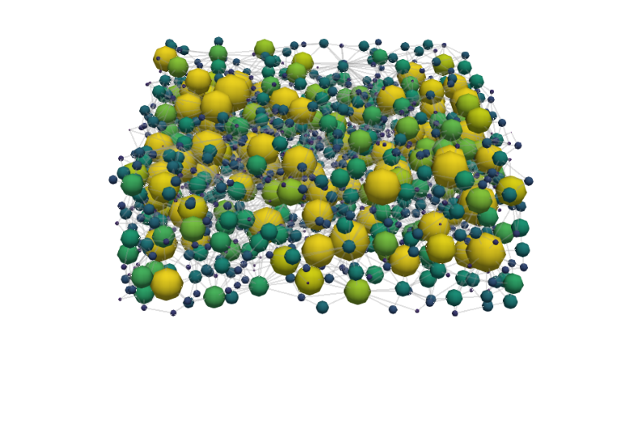
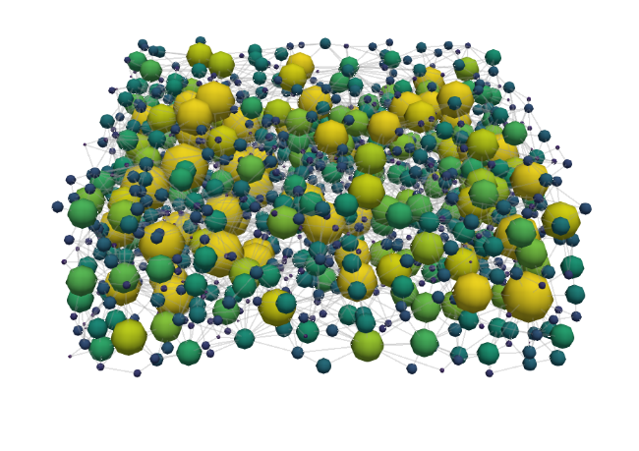
Introduction
Electrode optimization
Experimental testing
Electrode manufacturing
The effect of the electrolyte chemistry
Trade-off between active surface area and through-plane conductivity
Vanadium electrolyte
TEMPO electrolyte
Generation 1000
v = 1.5 cm s⁻¹
Cubic electrode
Flow direction
100 μm
Conventional
100 μm
5

Slide 6


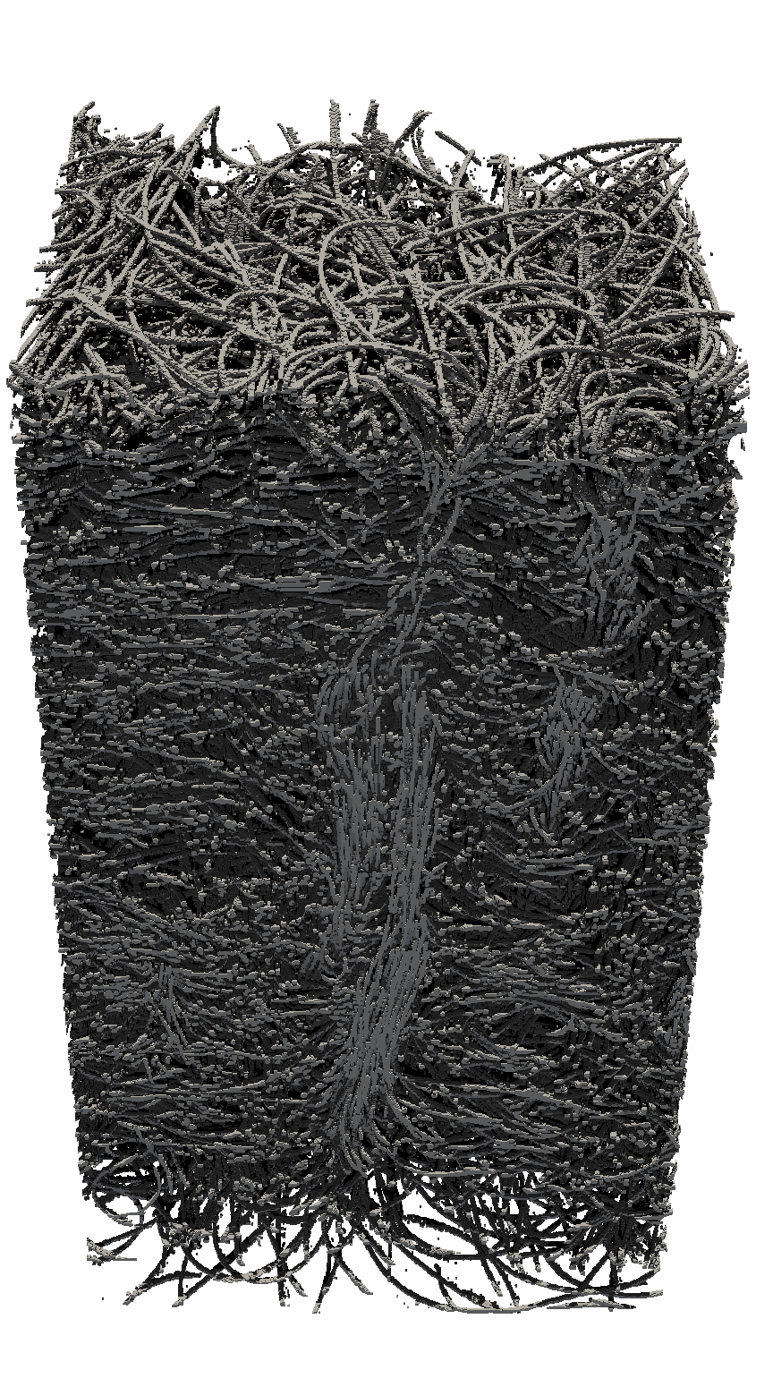
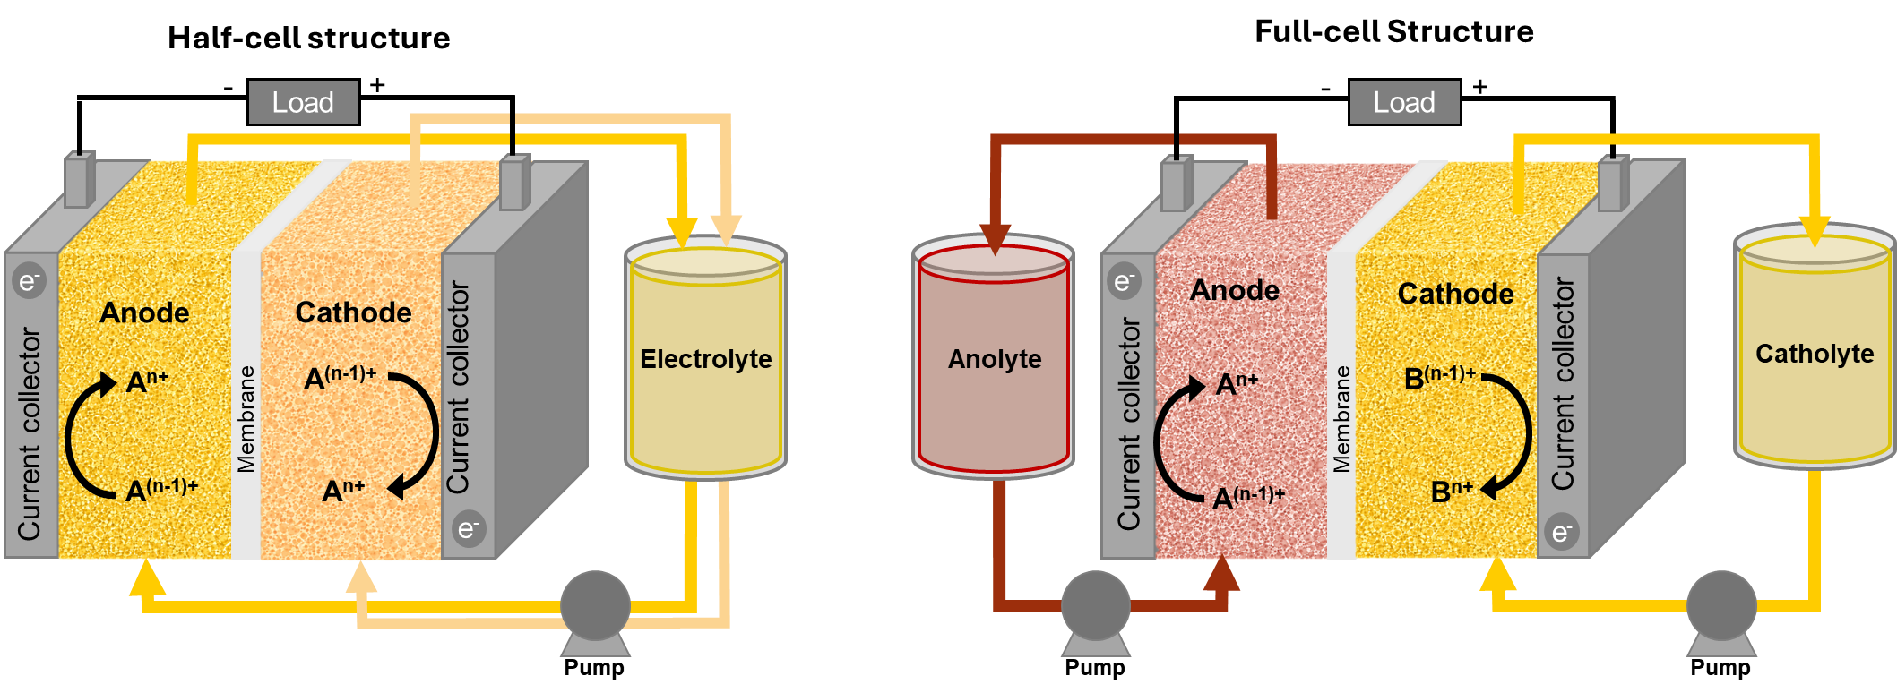
Introduction
Electrode optimization
Experimental testing
Electrode manufacturing
Redox flow battery electrodes
Interplay between electrode microstructure and redox chemistry
Which electrode performs best for each chemistries?
Electrodes tested: Cell configurations tested:
Paper Cloth Felt Single-electrolyte Full cell
Chemistries tested: Single-electrolyte Full cell
All-Vanadium: VO²⁺/VO₂⁺ V²⁺/V³⁺ - VO²⁺/VO₂⁺
All-Iron: Fe²⁺/Fe³⁺ Fe⁰/Fe²⁺ - Fe²⁺/Fe³⁺
Aqueous-organic: [Fe(CN)₆]³⁻/[Fe(CN)₆]⁴⁻ AQDS - [Fe(CN)₆]³⁻/[Fe(CN)₆]⁴⁻
250 μm
250 μm
500 μm
Khalghollah, S. & Camano Alcedo, A. et al., in preparation
6

Slide 7
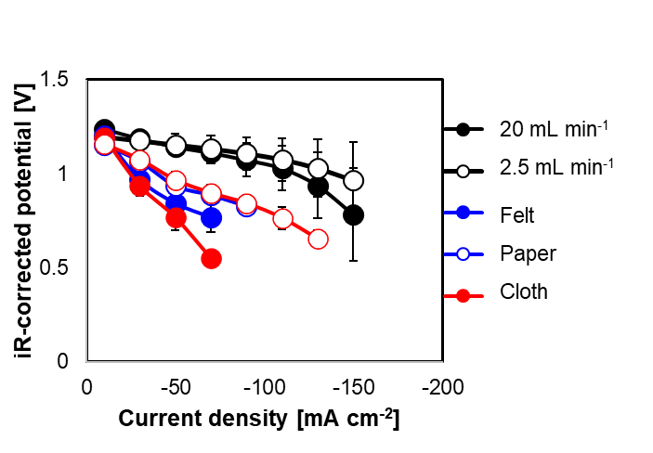

Introduction
Electrode optimization
Experimental testing
Electrode manufacturing
Redox flow battery electrodes – All-iron
Interplay between electrode microstructure and redox chemistry
Single-electrolyte cell with 1 Fe²⁺/Fe³⁺ tank:
Full cell with Fe⁰/Fe²⁺ - Fe²⁺/Fe³⁺
(cloth on Fe²⁺/Fe³⁺ side)
Ideal performance
Winner for Fe²⁺-Fe³⁺:
Winner for Fe⁰-Fe²⁺:
Fast kinetics: combination of $∆$p and k_{m}
Plating reaction: combination of $∆$p and ECSA
250 μm
500 μm
7

Slide 8
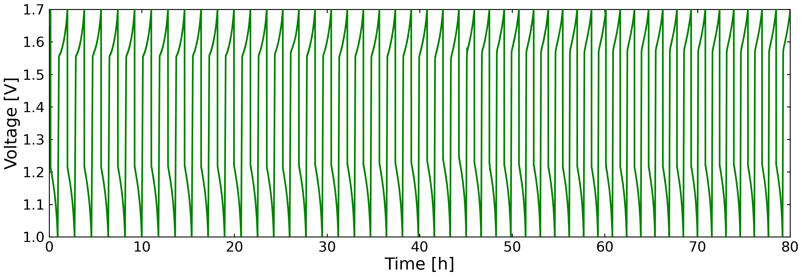
Introduction
Electrode optimization
Experimental testing
Electrode manufacturing
Redox flow battery electrodes – All-iron
Interplay between electrode microstructure and redox chemistry
Which electrode performs best for each chemistries?
Showing the need to select the best
electrode for each application
Chemistry | Best electrode
VO²⁺/VO₂⁺ | Felt
V²⁺/V³⁺ | Felt
Fe²⁺/Fe³⁺ | Cloth
Fe⁰/Fe²⁺ | Felt
[Fe(CN)₆]³⁻/[Fe(CN)₆]⁴⁻ | Paper
AQDS | Felt
Next steps:
Cycling performance:
Full-vanadium with the felt electrode on both sides.
Khalghollah, S. & Camano Alcedo, A. et al., in preparation
8

Slide 9
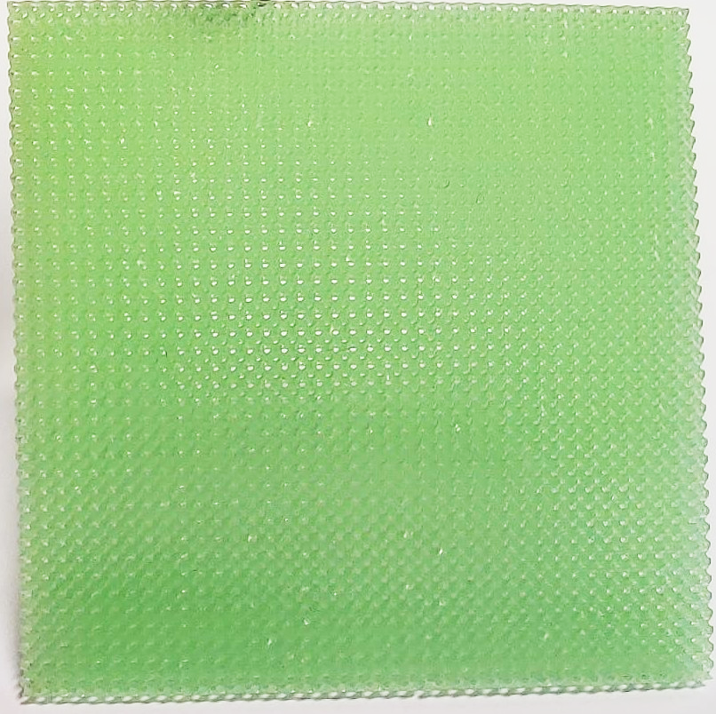
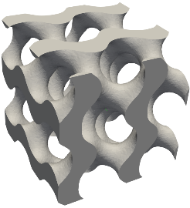
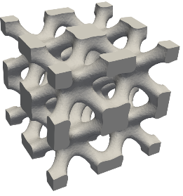
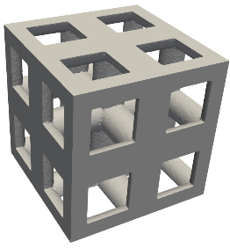
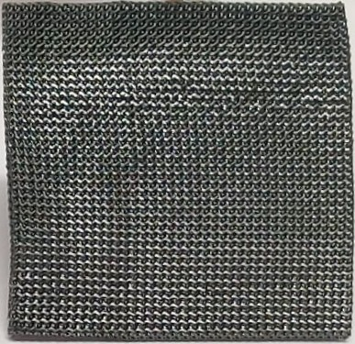
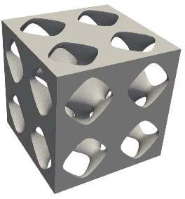
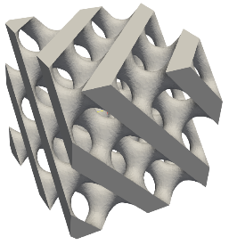
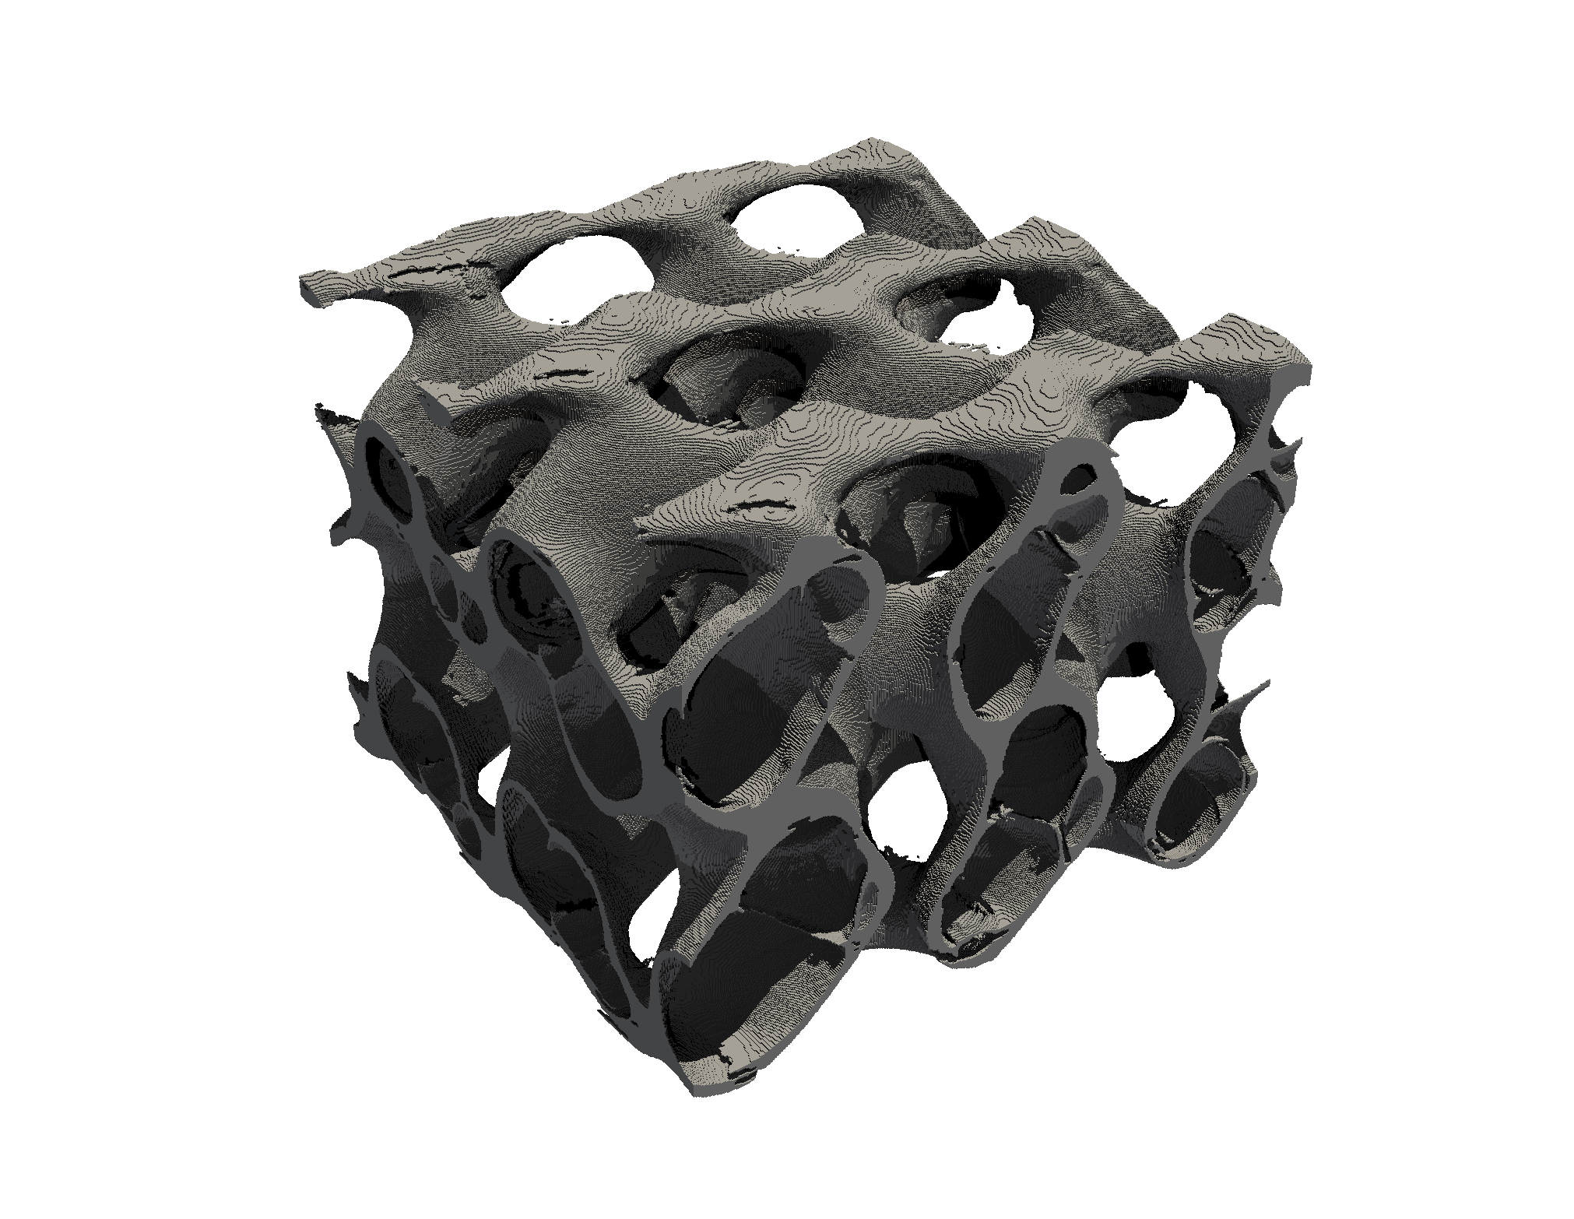
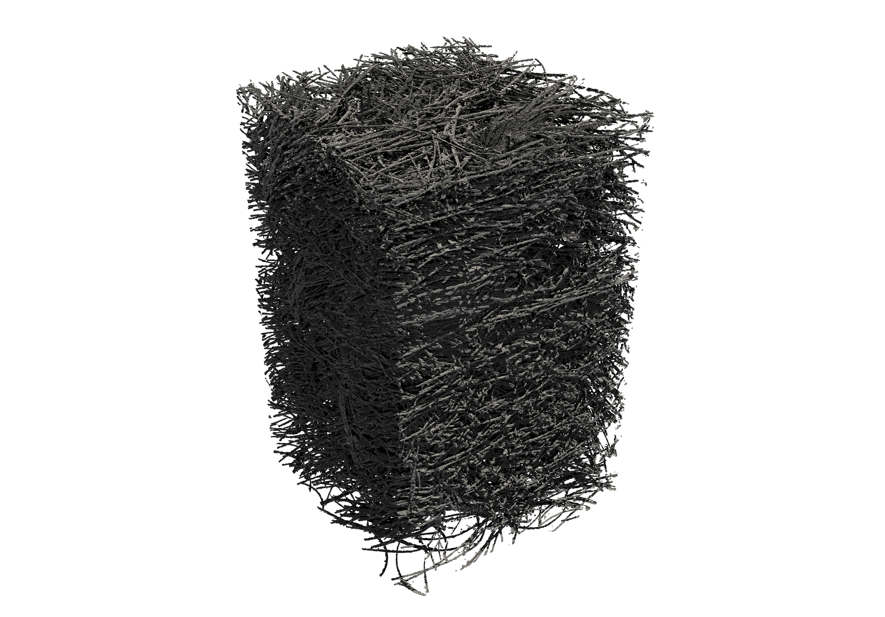
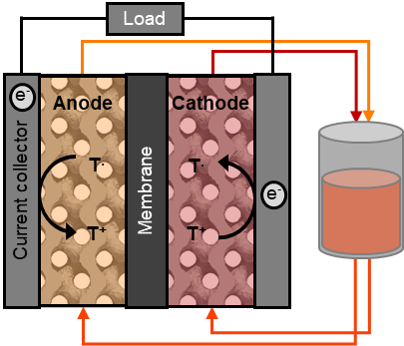
Introduction
Electrode optimization
Experimental testing
Electrode manufacturing
Additive manufacturing of TPMS structures
Advanced electrode structures are expected to enhance the mass transport
Advanced designs - TPMS
Gyroid
IWP
Advantages:
V Enhanced mass transfer
V Flexibility in design and material
V Pre- and post-processing methods
Disadvantages to date:
X Lower electrochemical surface area
X Lower performance
Cubic
lattice
Oxidation + Carbonization
1 cm
Primitive
Diamond
1 mm
Flow cell testing
TEMPO electrolyte
Gyroid
Felt
500 μm
Van der Heijden, M. et al., Adv. Mater. Technol., 8 (18), 2300611 (2023)
Van der Heijden, M. et al., SSRN pre-print (2026)
1 mm
9

Slide 10

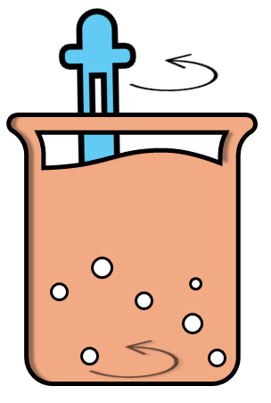
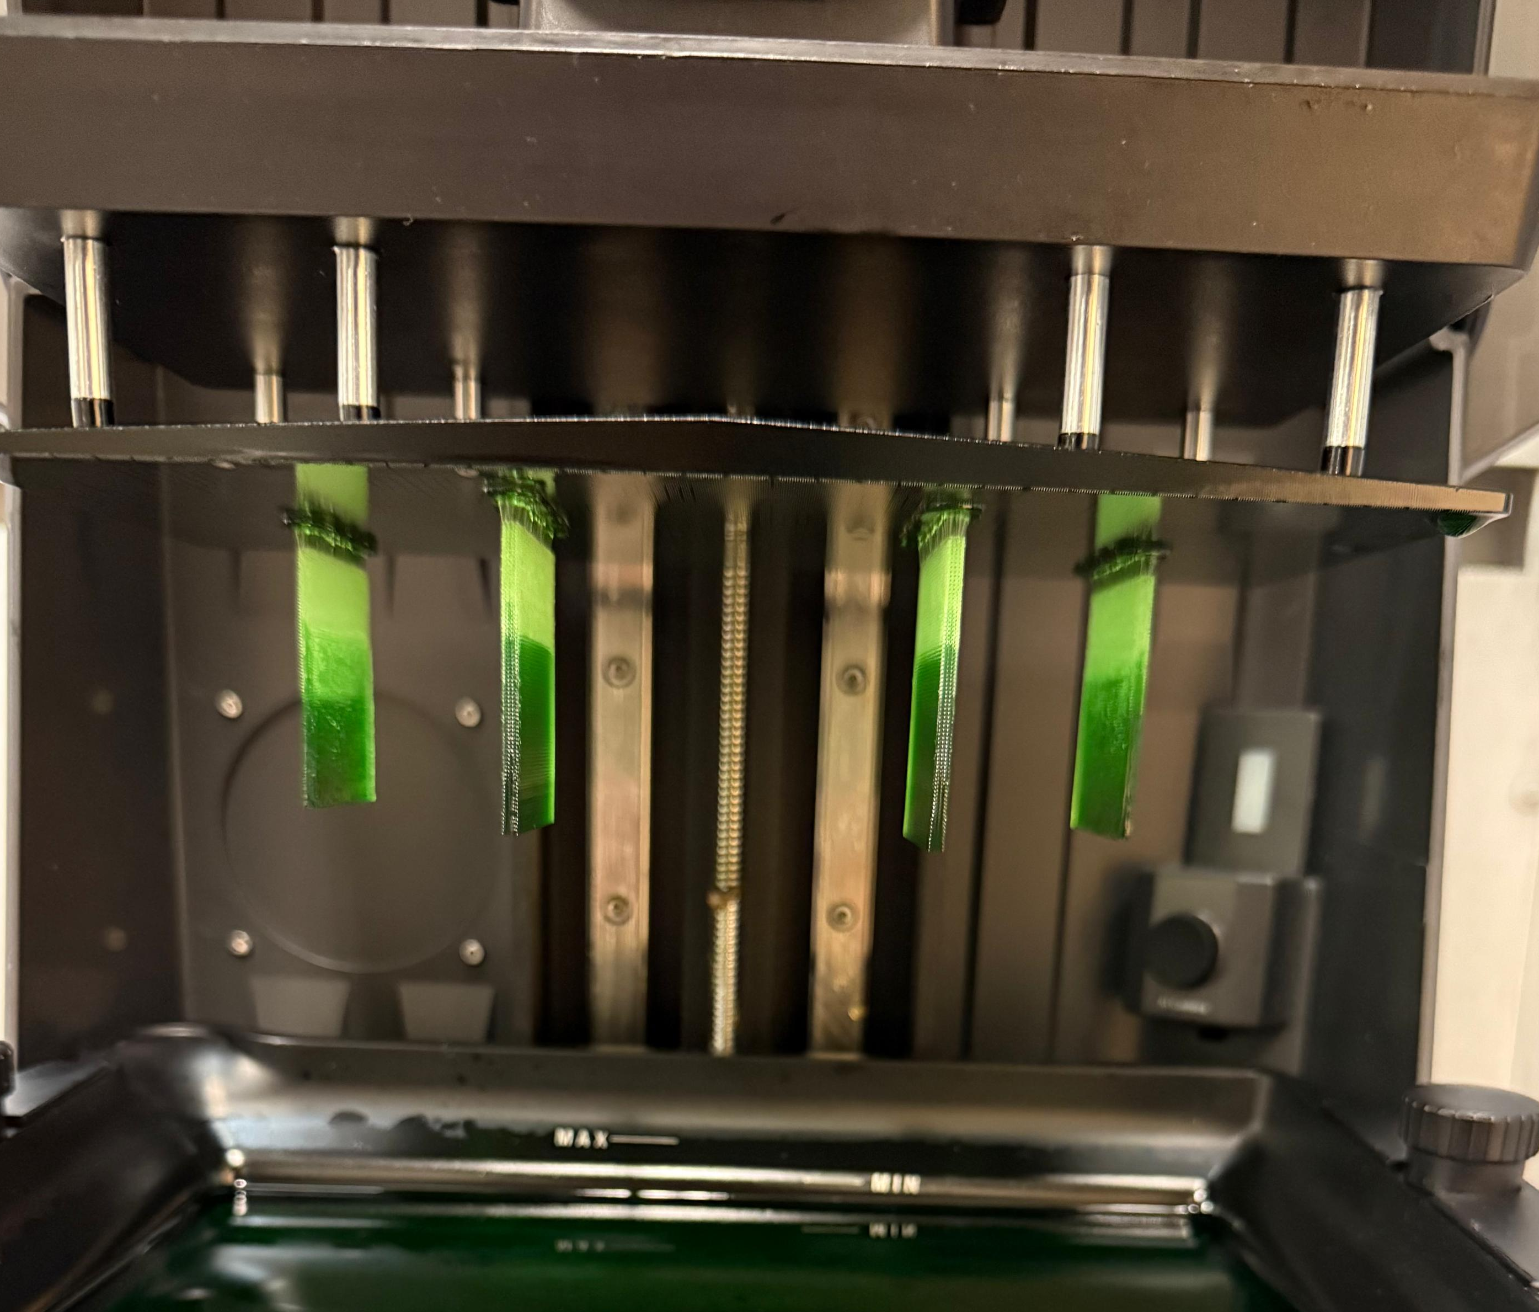
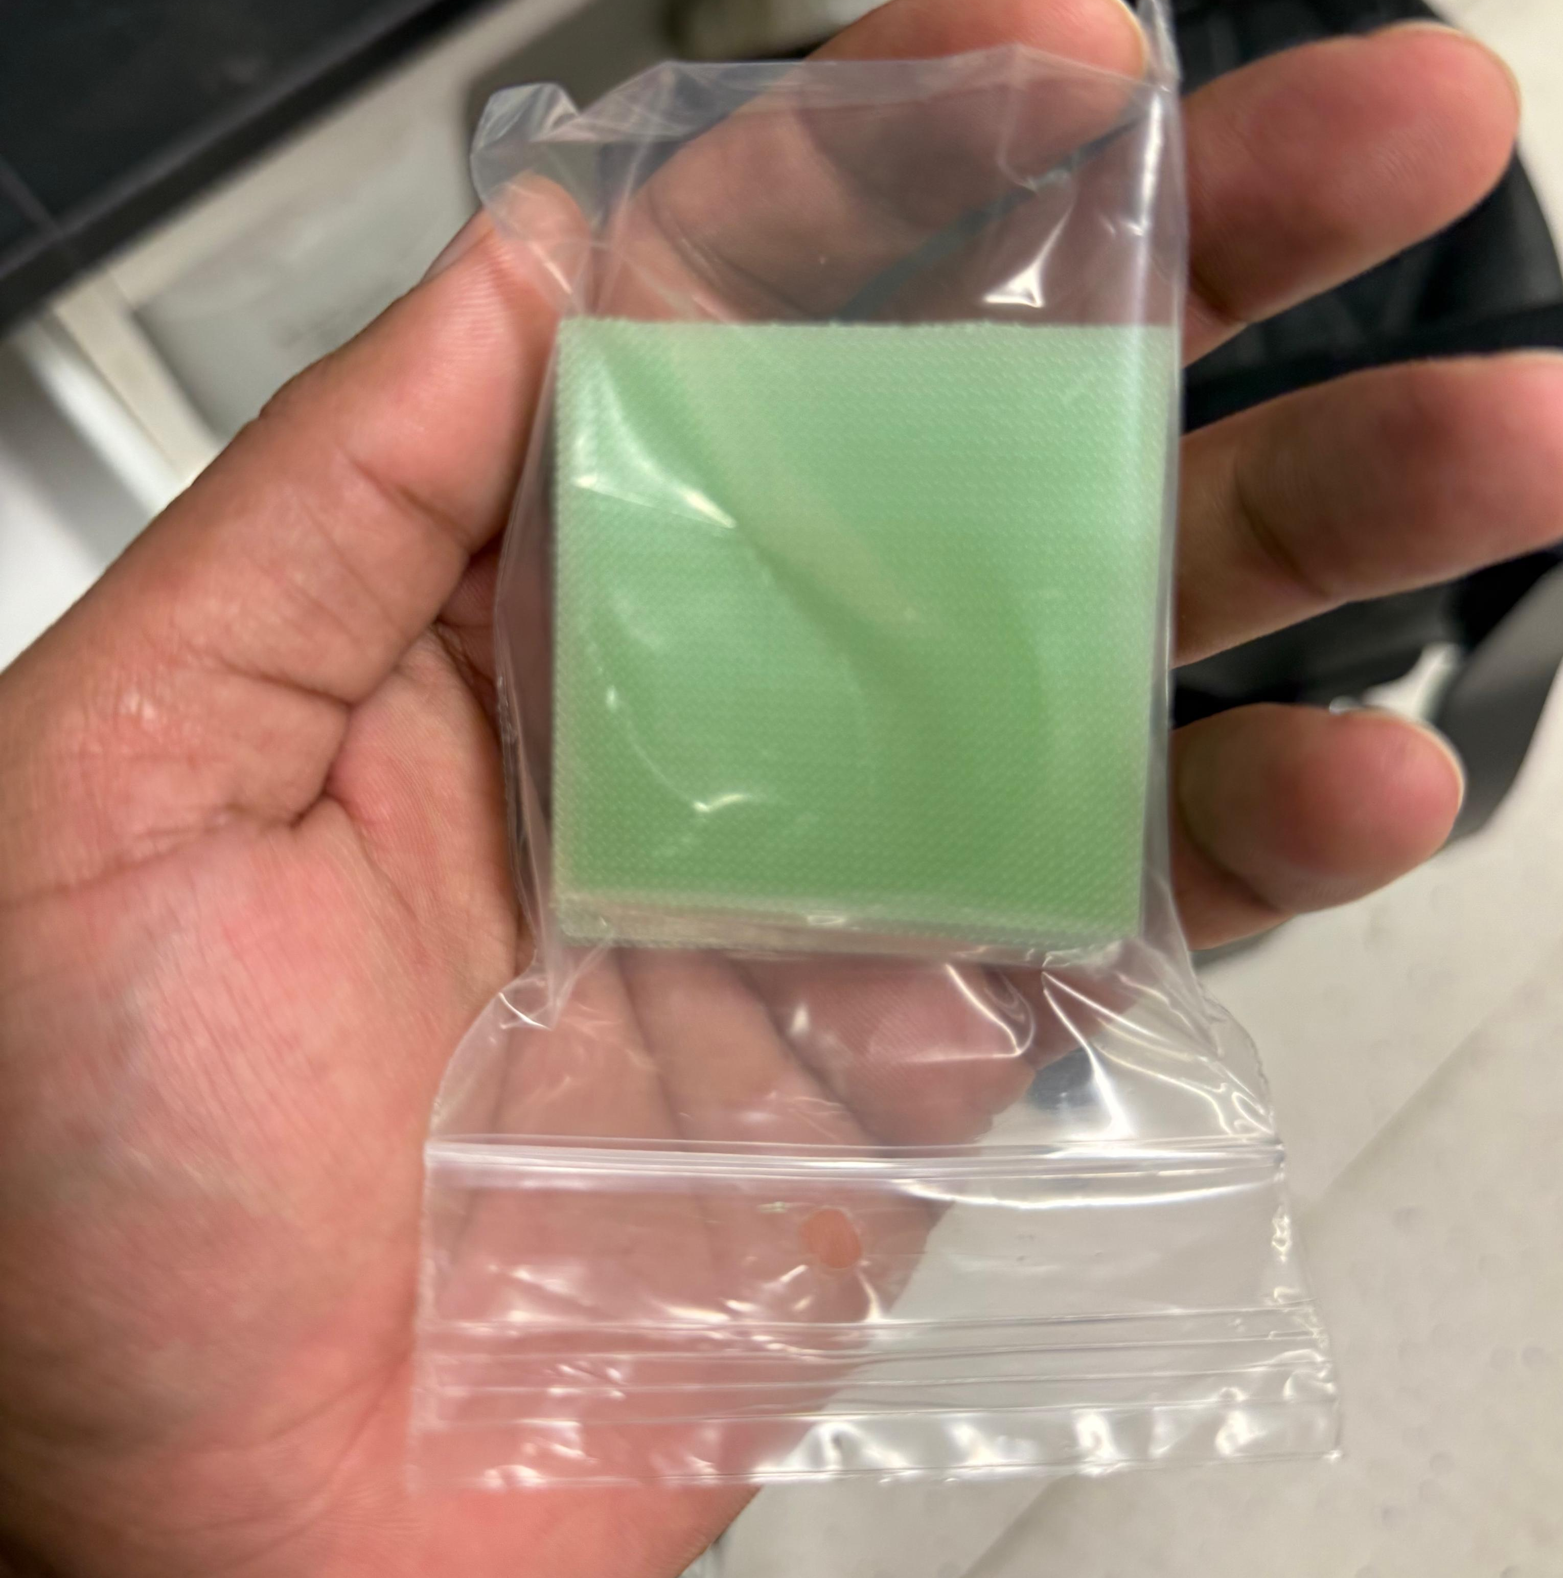
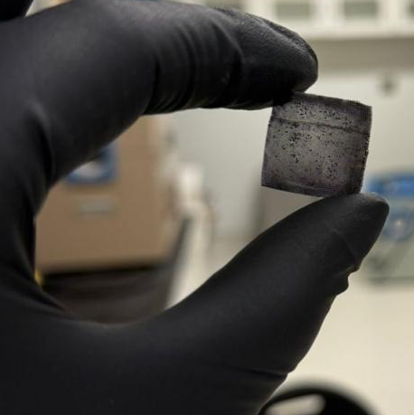
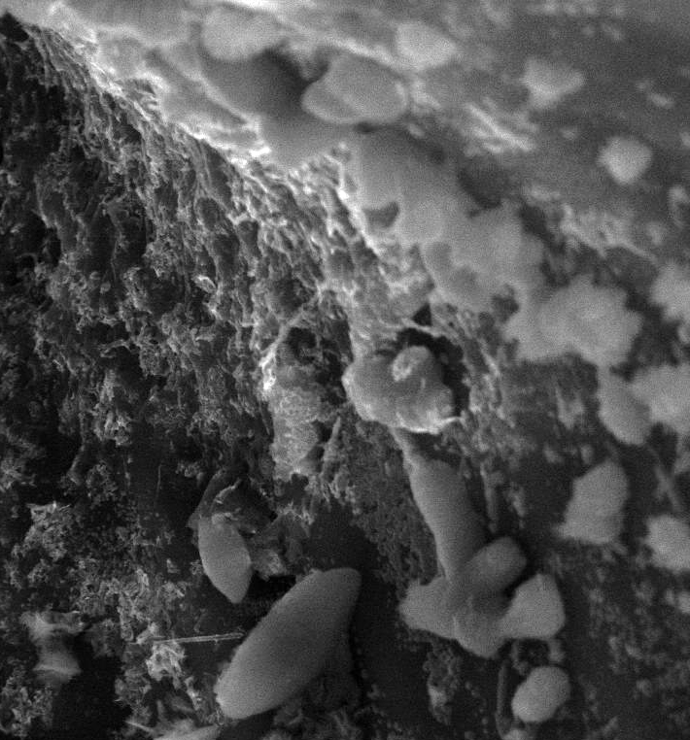
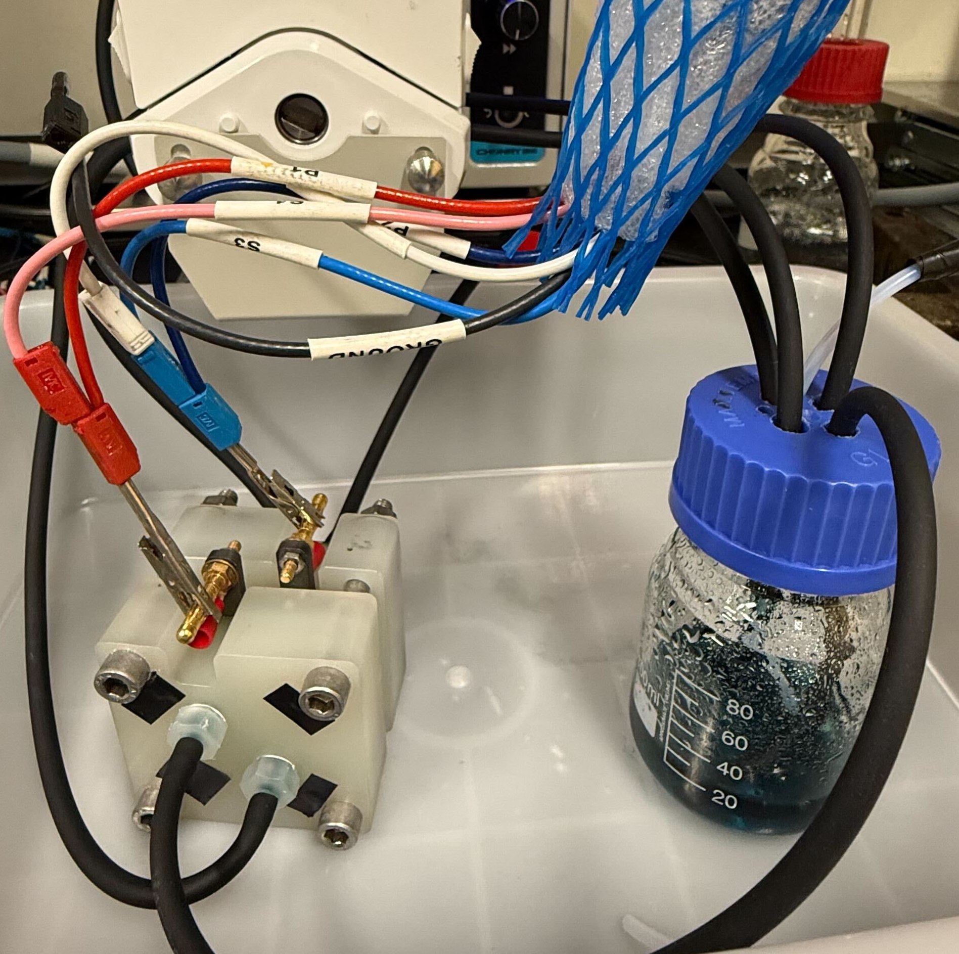
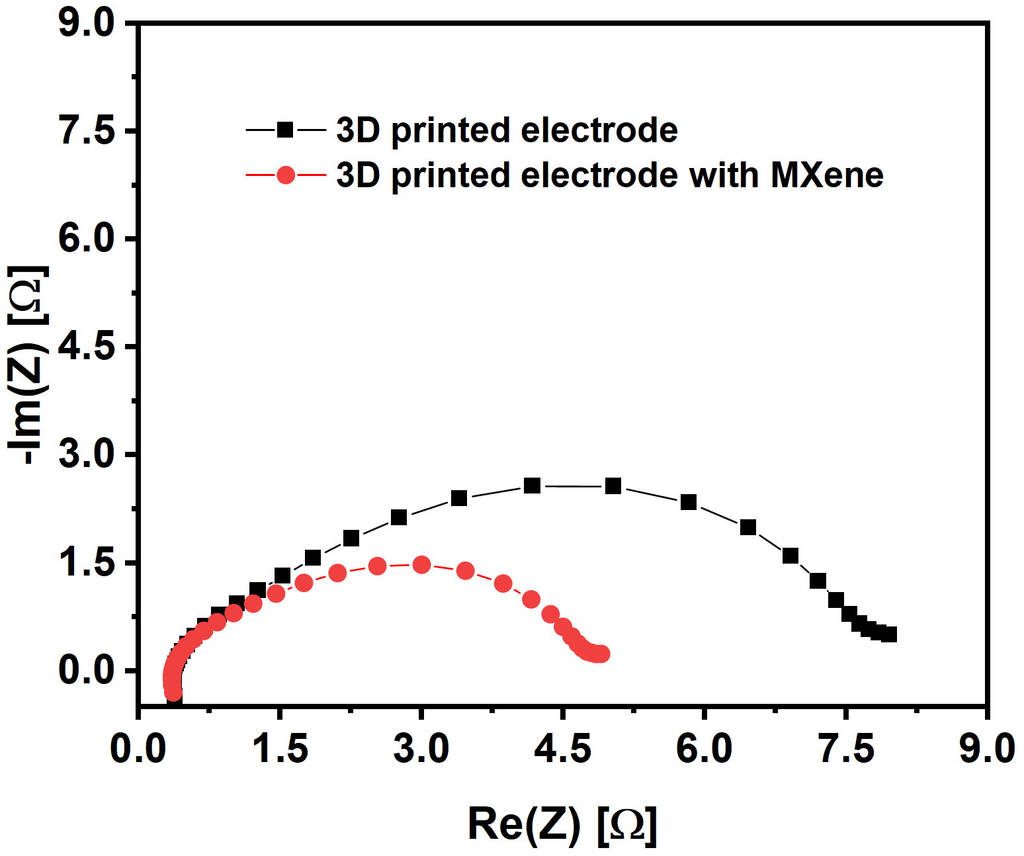
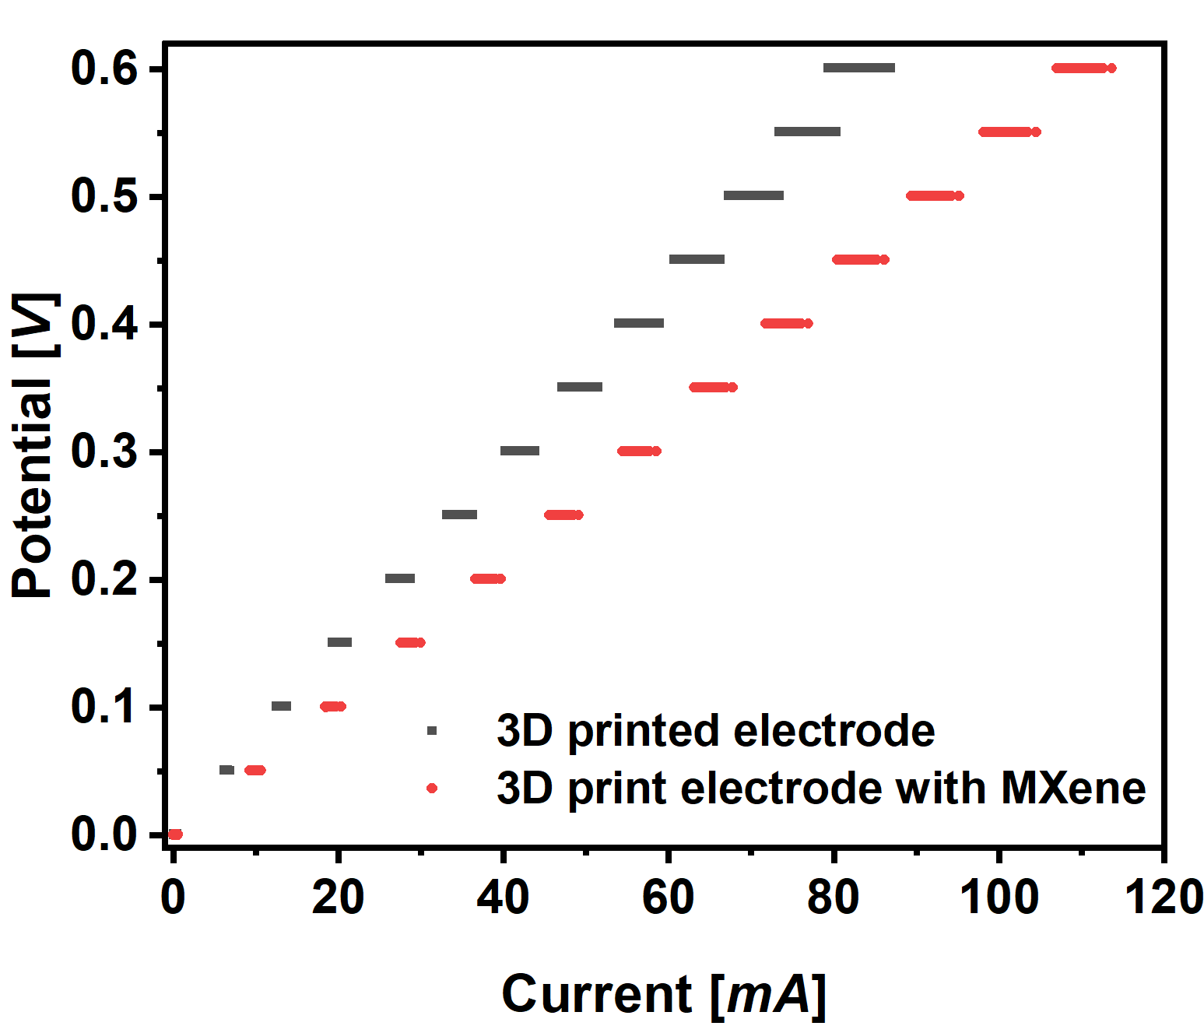
Introduction
Electrode optimization
Experimental testing
Electrode manufacturing
Hierarchically organized porous materials
For redox flow batteries
Porous electrode synthesis
Solution mixture
3D printing process
3D printed electrode
Carbonized electrode
MXene-coated electrode
Application
MXene-coated 3D print performance
10

Slide 11
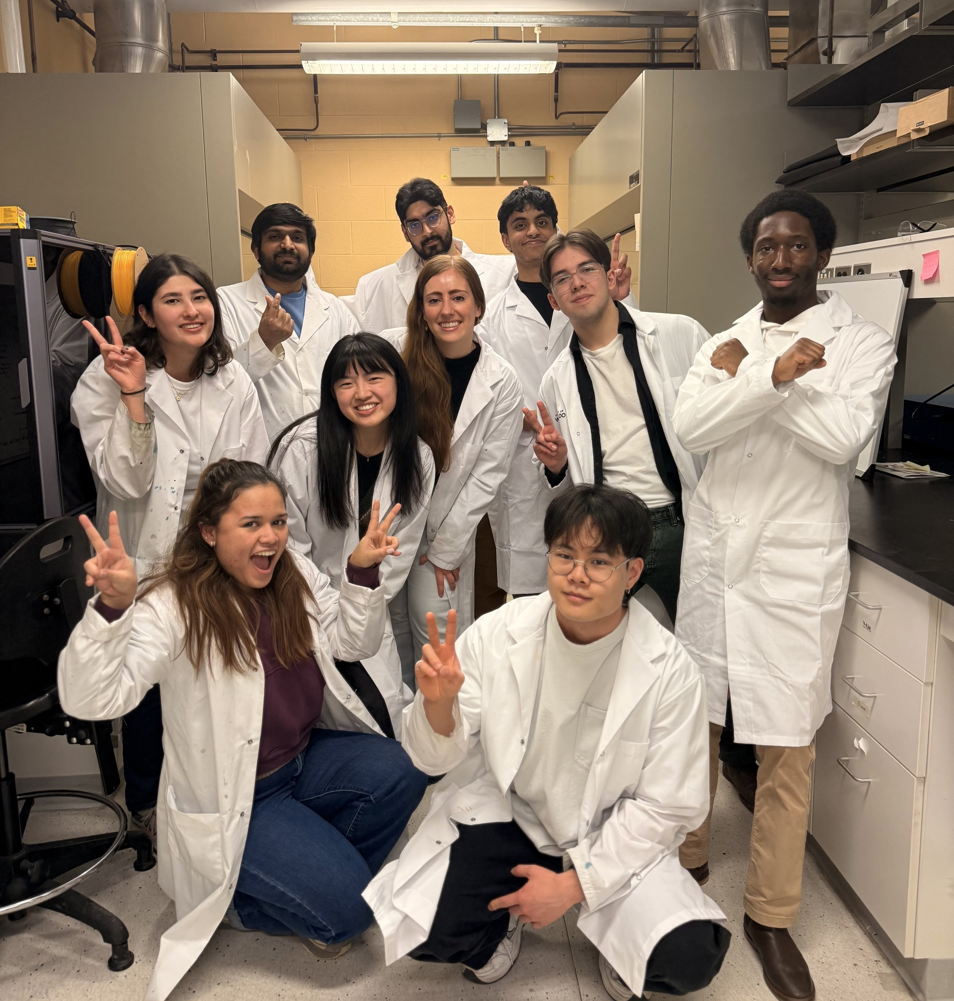




Acknowledgements
Projects collaborators
Projects collaborators:
Projects funding:
Group acknowledgements:
Andreina Camano Alcedo
Sonia Khalghollah
Tova Gilbert
Arielle Chung
Muhammad Zain Qamar
m35vande@uwaterloo.ca
https://vdheijdenlab.com/
11

