Slide 1


&
InterPore 2026 - Nantes, France - 22 May 2026
F. Neupert*, N. Eißmann, S. Loos, T. Büttner, I. Lindemann, T. Weißgärber, E. Andreou, C. Savaniu, J. Irvine, M. Al Aiti, G. M. Lange, P. Falat, G. Cuniberti
Coated Metallic Foams as Versatile Porous Substrate: From Hydrogen-Electrolysis Electrodes to Photocatalytic Water Treatment

Slide 2
Coated Metallic Foams as Versatile Porous Substrate
Outline
1
General Information
2
Coating methods
3
Project Example: EXSOTHyC
4
Project Example: KoMMet
5
Conclusion, Q&A

Slide 3
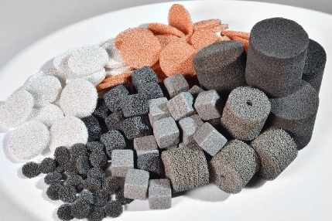
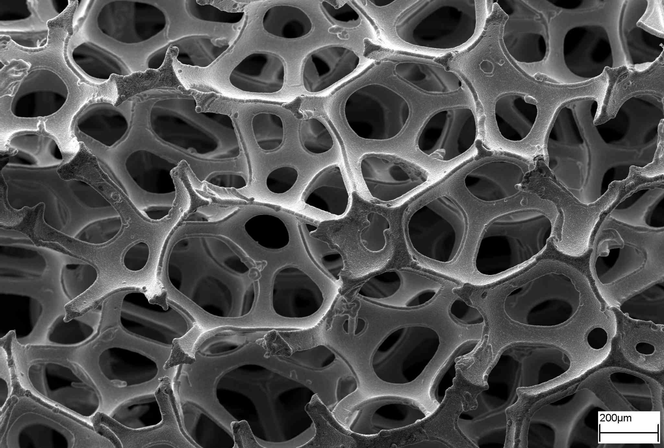
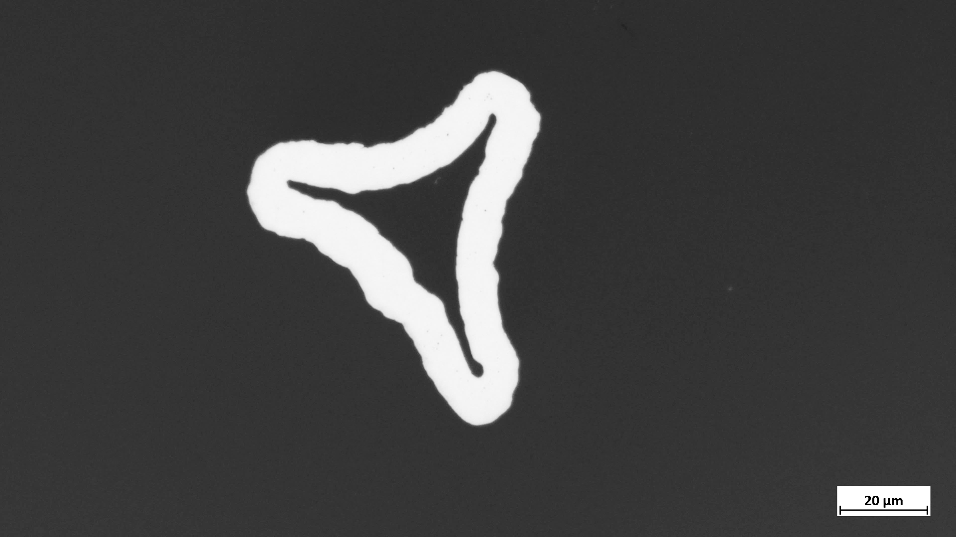
Coated Metallic Foams as Versatile Porous Substrate
1 General Information
Metallic foams
Materials
Ni, Co, Fe, Cu, Ag and their alloys
Properties
Pore size: 450 – 3000 µm
Porosity: > 90 %
Thickness: 1.5 – 5 mm
Areal density: 400 – 1500 g m⁻²
Advantages
High permeability → efficient fluid transport
Large accessible surface area
Good thermal and electrical conductivity
Mechanically stable 3D structure
Material provided in cooperation with Alantum Europe
© Alantum

Slide 4
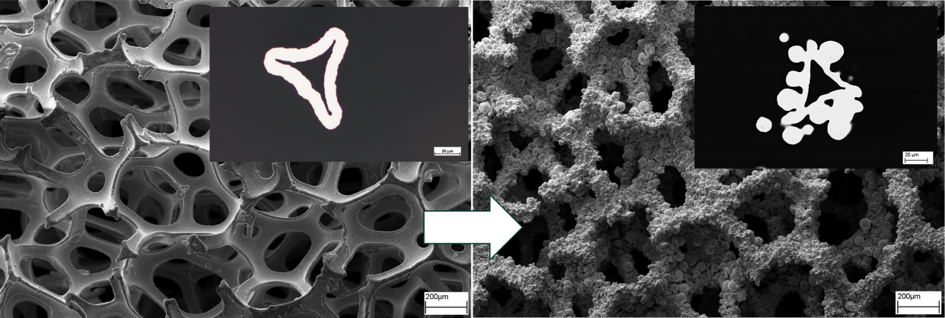
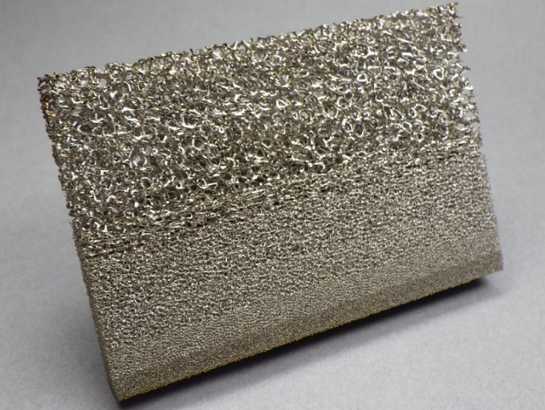
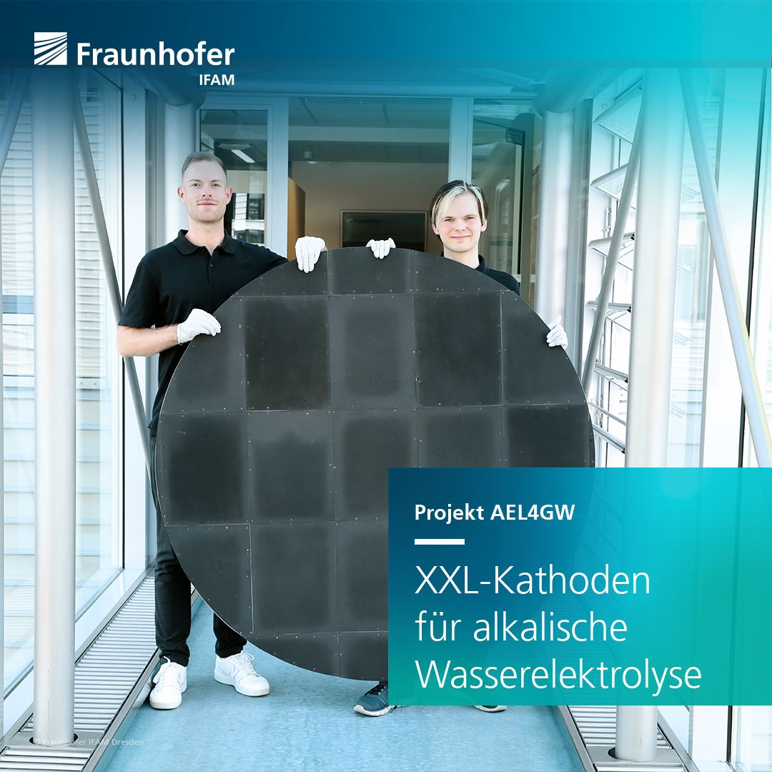


Coated Metallic Foams as Versatile Porous Substrate
1 General Information
Functionalizing and Tailoring
Functionalizing
Catalytic layers
Electrochemical active materials
Photoactive materials
→ Adjustment of properties
Tailoring
Rolling – adjusting thickness and porosity
Graded structures – spatial variation of properties
Welding / joining – integration into larger structures
→ Upscaling
Project AEL4GW
_
XXL-Cathodes for Alkaline Water Electrolysis
Notes:
Challenges: Achieving uniform, conformal coatings on complex 3D strut networks
Ensuring strong adhesion and stability of the functional layer
Controlling coating thickness
Preserving pore accessibility and permeability

Slide 5
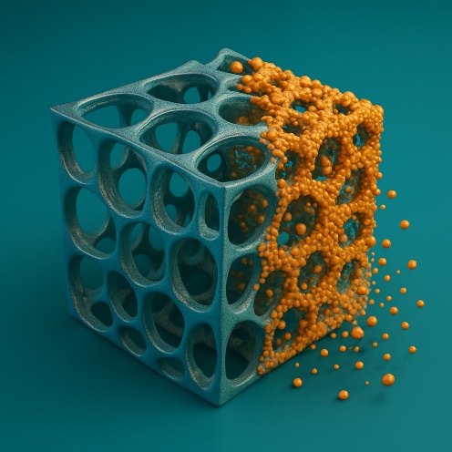
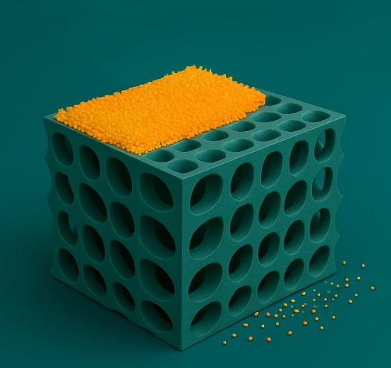
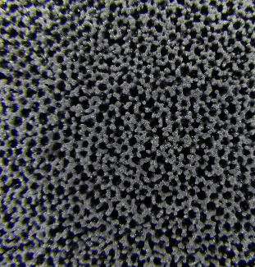
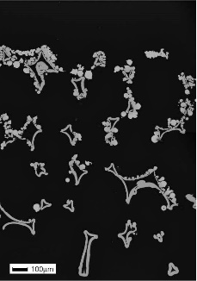
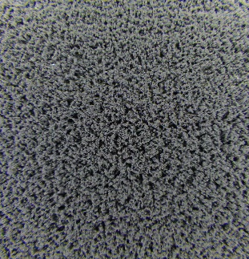
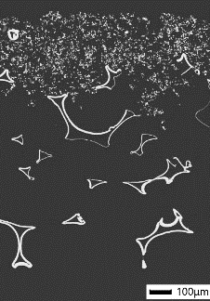
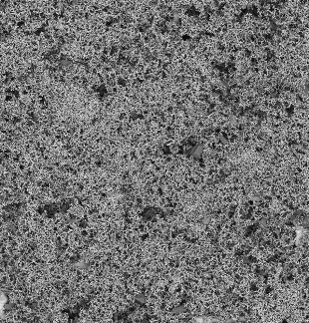
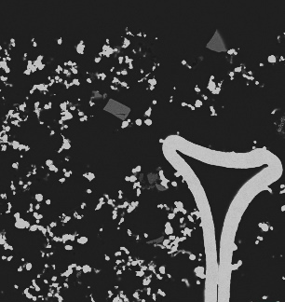


Coated Metallic Foams as Versatile Porous Substrate
2 Coating methods
Dry coating process
Scattering technology
Doctor blade technology
10 µm
10 µm
The 3D structures were generated using ChatGPT (OpenAI).

Slide 6
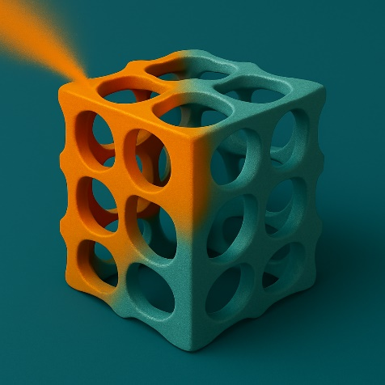

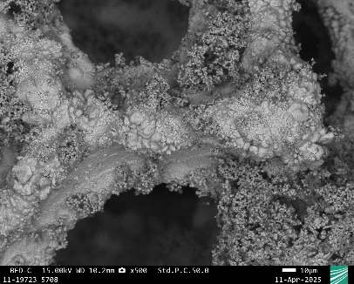
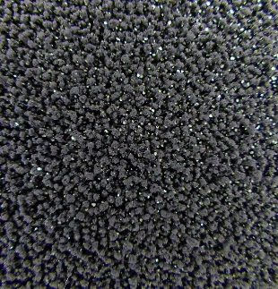
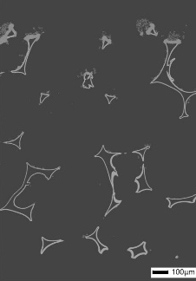
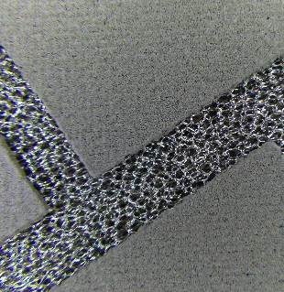
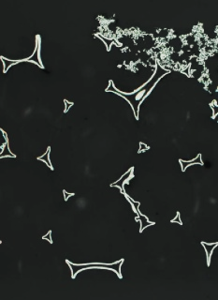
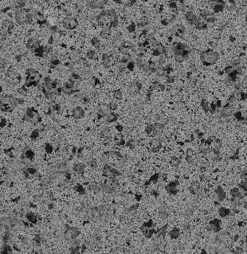
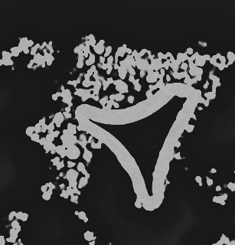
Coated Metallic Foams as Versatile Porous Substrate
2 Coating methods
Wet coating process
Wet Powder spraying
Dispense robots/ screen printing
10 µm
300 µm
10 µm
10 µm
The 3D structures were generated using ChatGPT (OpenAI).

Slide 7
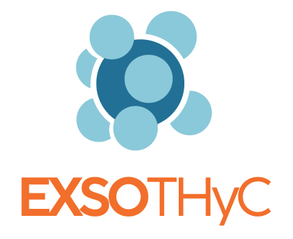




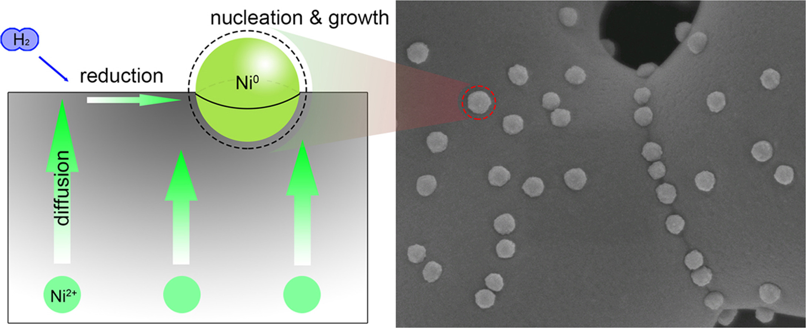


Coated Metallic Foams as Versatile Porous Substrate
3 Project Example: EXSOTHyC
EXSOTHyC: Exsolution-based Nanoparticles for lowest cost green hydrogen via electrolysis
Developing advanced materials, processes, and designs for alkaline electrolysers
+
Xu, X., et al. “Perovskite oxides as potential electrocatalysts for water splitting.” Nano Energy, Volume 29, 2016, Pages 122–139.

Slide 8
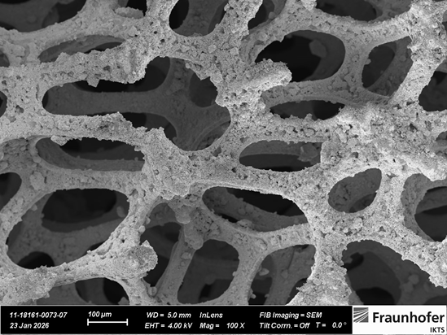
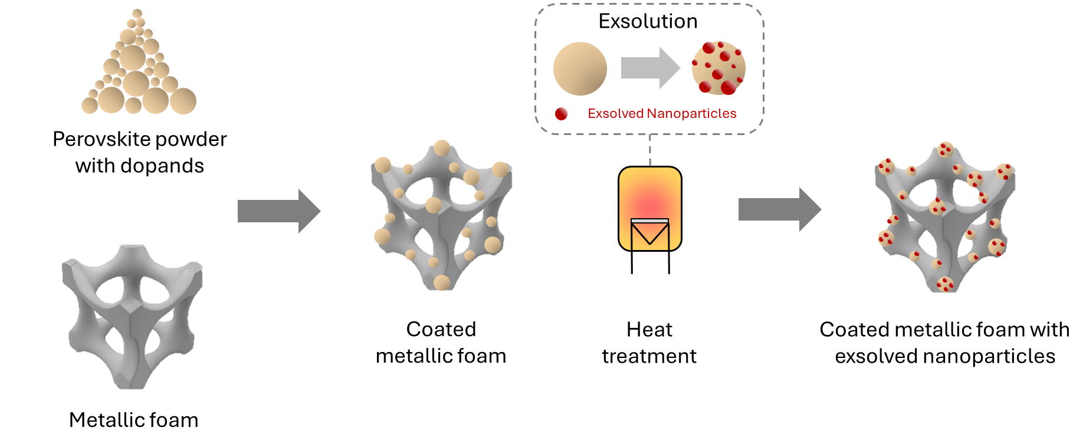
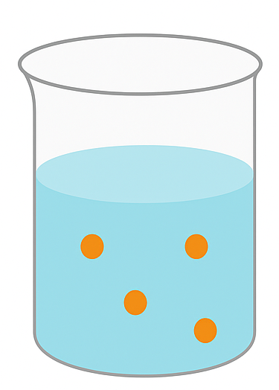

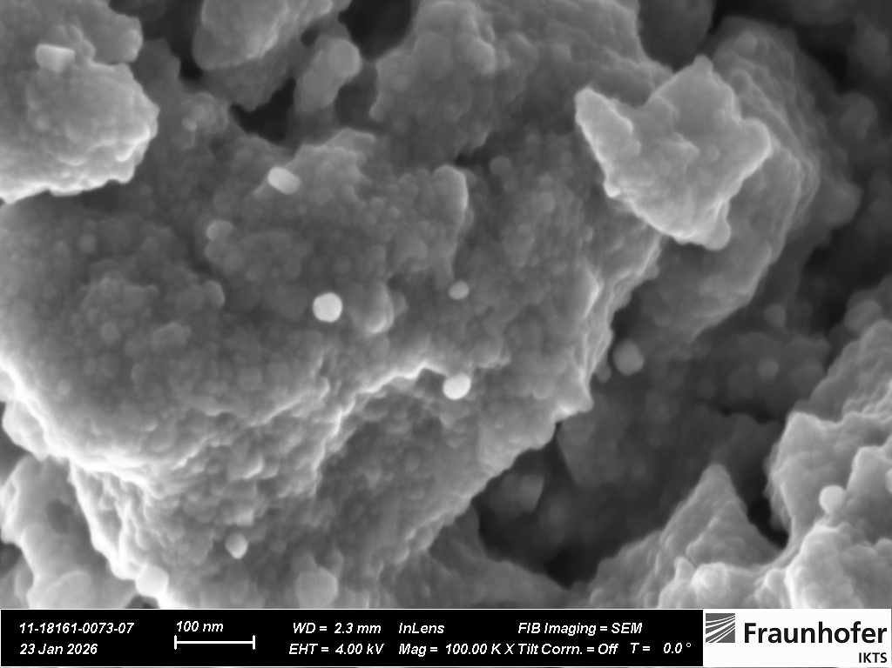
Coated Metallic Foams as Versatile Porous Substrate
3 Project Example: EXSOTHyC
EXSOTHyC: Exsolution-based Nanoparticles for lowest cost green hydrogen via electrolysis
La_{0.42}Ca_{0.48}Ti_{0.89}Co_{0.11}O₃
+
Powder
+
Binder mixture
Pure Ni foam
Heat treatment
Coated and heat-treated foam
Spraying
The basic metallic foam structure was generated using ChatGPT (OpenAI).

Slide 9

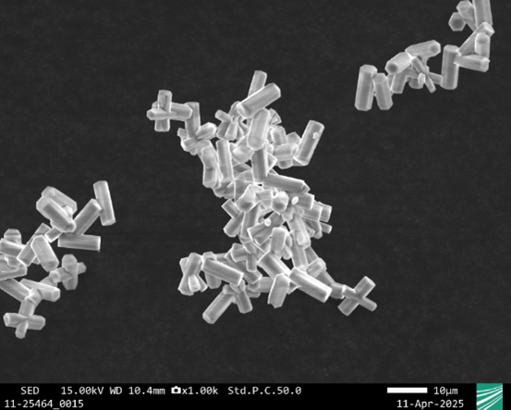
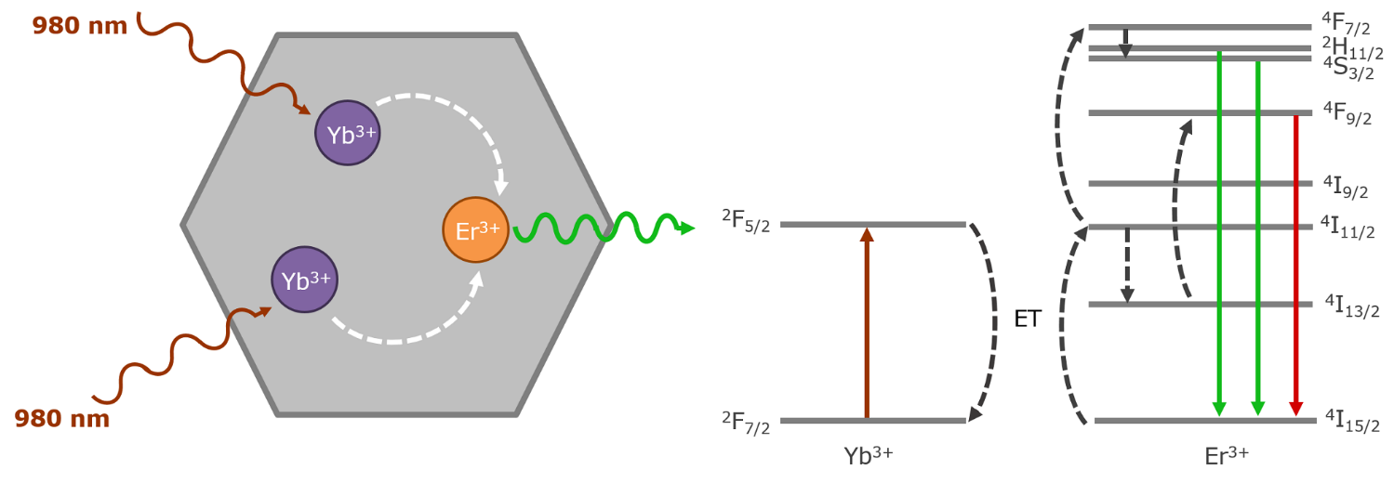

Coated Metallic Foams as Versatile Porous Substrate
4 Project Example: KoMMet
KoMMet: Metallic foams for low-energy photocatalytic-based wastewater treatment
Energy-efficient wastewater purification using sunlight-driven photocatalysis and upconversion nanoparticles to remove pharmaceutical residues by converting NIR into UV/VIS light on porous UV-resistant foam substrate
KoMMet
+
https://www.edinst.com/resource/what-is-upconversion/

Slide 10
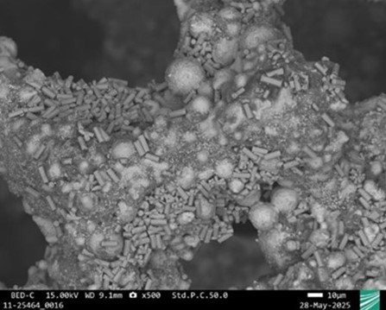
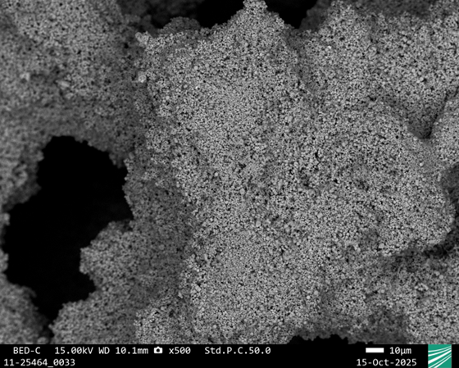
Coated Metallic Foams as Versatile Porous Substrate
4 Project Example: KoMMet
KoMMet: Metallic foams for low-energy photocatalytic-based wastewater treatment
β-NaYF₄
+
UCMKs
Ionomer + Solvent
INC625 foam coated with UCMKs
INC625 Foam
The basic metallic foam structure was generated using ChatGPT (OpenAI).

Slide 11
Coated Metallic Foams as Versatile Porous Substrate
5 Conclusion
✓
Open-cell metallic foams provide a highly permeable and mechanically stable 3D porous backbone
✓
Functional coatings enable application-specific properties e.g. for electrochemical and photocatalytic systems
✓
Different coating strategies allow tailored integration of active materials into complex porous structures
✓
Tailoring approaches such as rolling, grading and joining support scalability and device integration

Slide 12
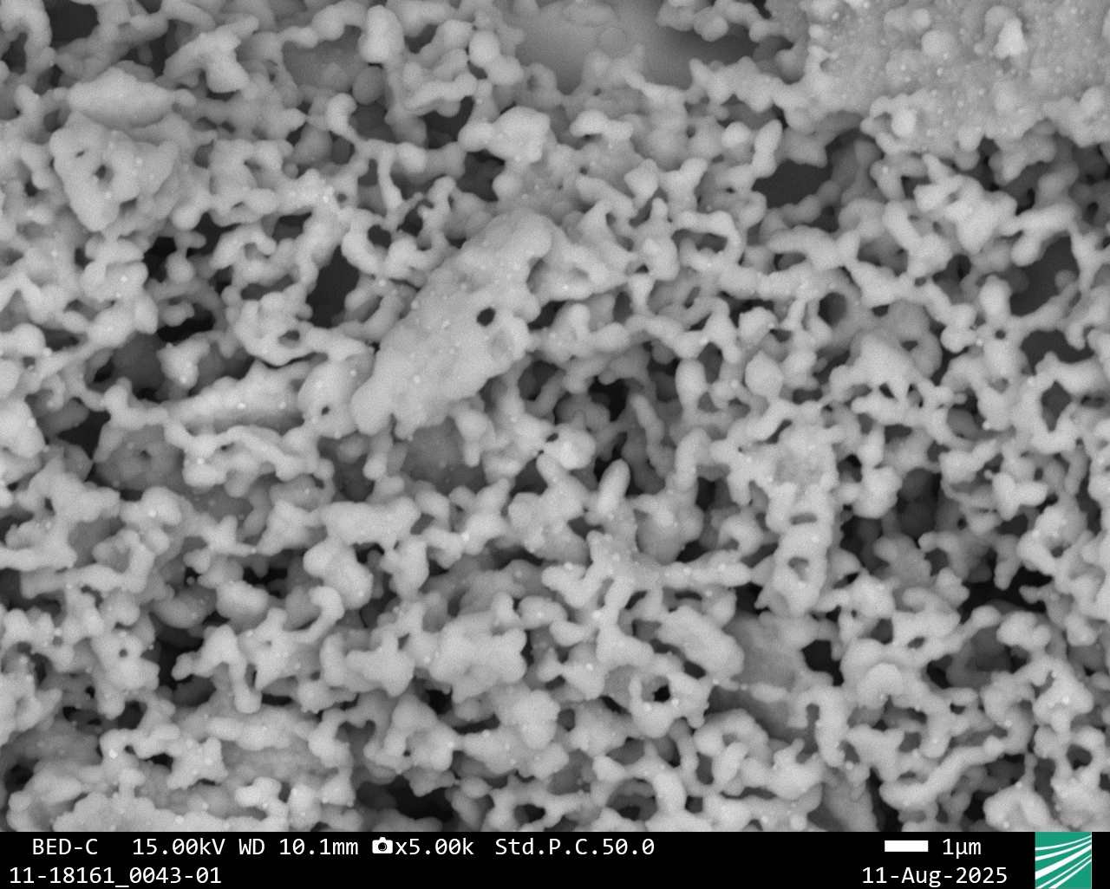


Thanks for your attention!
Any questions?
Contact:
Felix Neupert
felix.neupert@ifam-dd.fraunhofer.de
+49 351 2537-349
Fraunhofer Institute for Manufacturing Technology and Advanced Materials IFAM
Dresden Branch
Winterbergstrasse 28, 01277 Dresden, Germany
www.ifam-dd.fraunhofer.de

