Slide 1
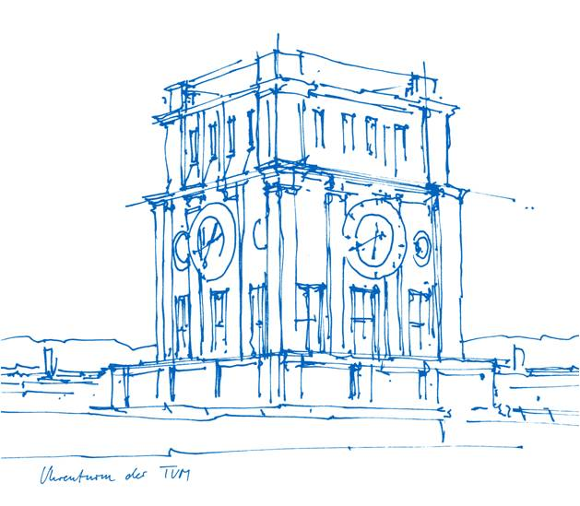
R13-based pore network model for freeze-drying
Shalong Xiong
Food Process Engineering, TUM
Prof. Dr. Ing. Petra Forest (TUM)
Prof. Dr. Rui Wu (SJTU)
Dr. Ing. Nicole Vorhauer-Huget (OVGU)

Slide 2
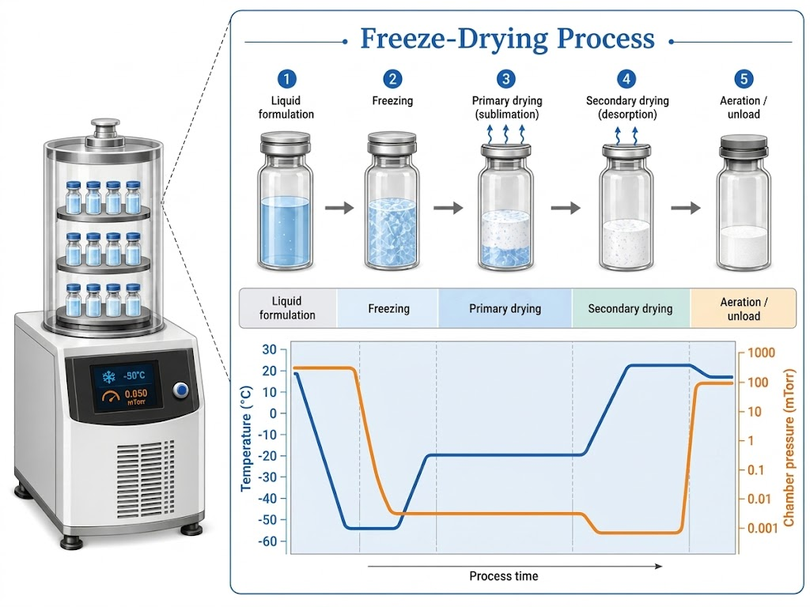
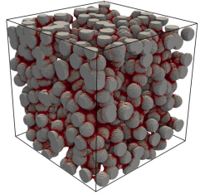
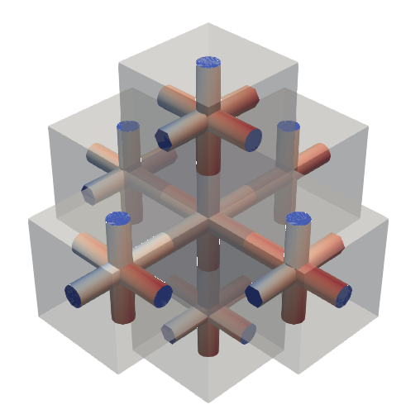
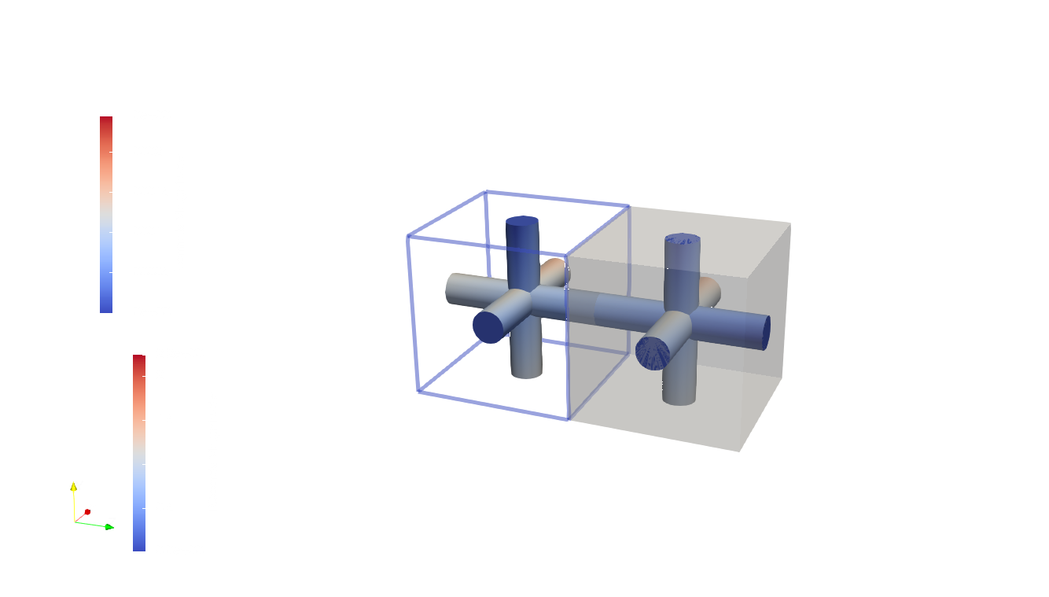










Research Overview
Freeze-drying couples rarefied gas flow and sublimation.
PNM resolves pore-scale physics at lower cost than DNS.
$$k$$
$$i$$
$$j$$
$$(i,j,k)$$
Pore
$$(i,j,k)$$
$$P_{i,j,k}$$
$$P_{i,j+2,k}$$
$$T_{i,j,k}$$
$$T_{i,j+2,k}$$
$$(i,j+2,k)$$

Slide 3

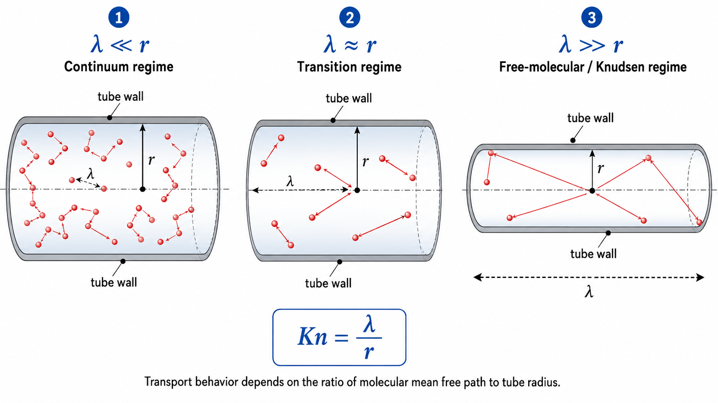
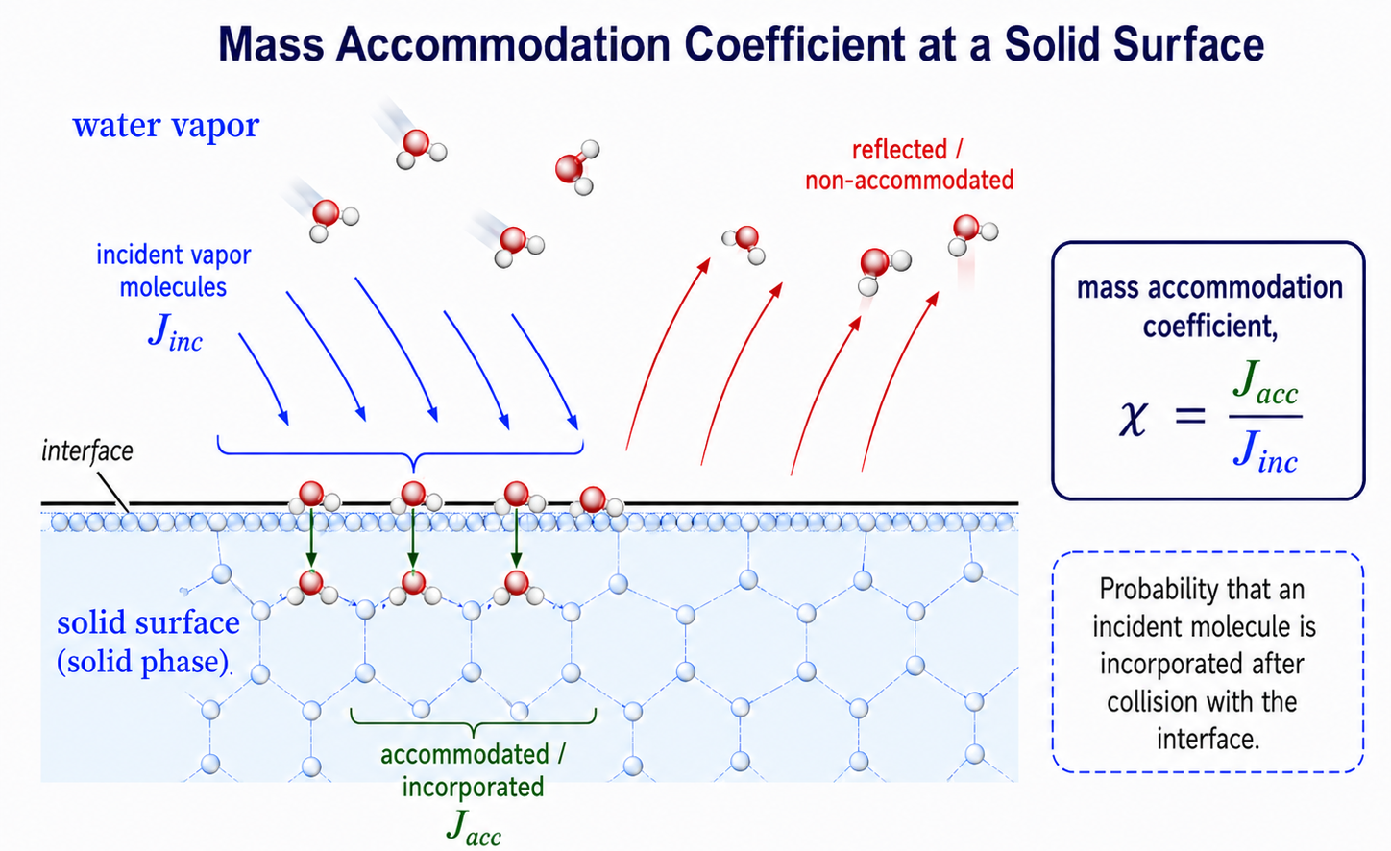

Research Overview
Continuum PNM assumes Kn ~ 0.
Low pressure or nano-pores require rarefied-flow physics (Kn > 0.1).
Physically inaccurate
Knudsen number
Description for rarefied degree
$$Kn=\frac{mean free path}{characteristic length}$$
Mass accommodation coefficient
Fraction accommodated at the surface
(Roughness, wettability, adsorptive)

Slide 4
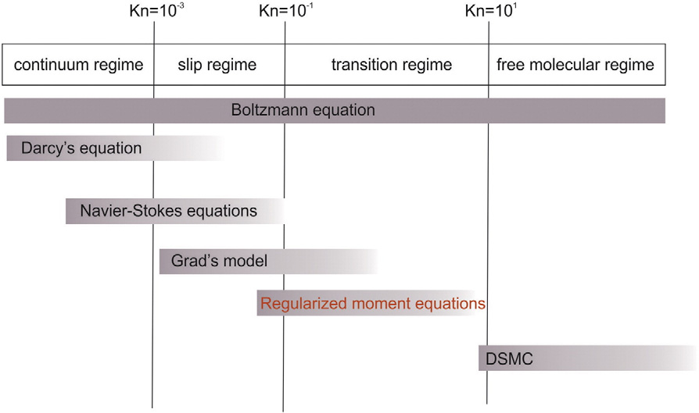
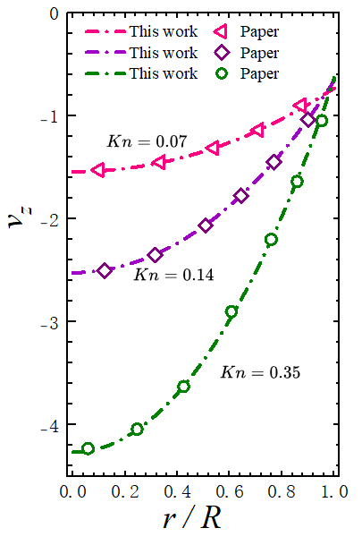
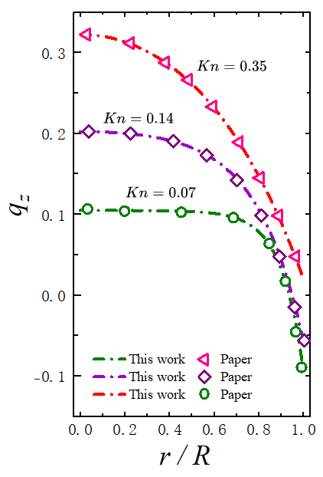

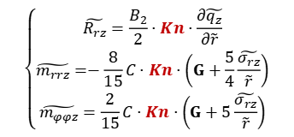
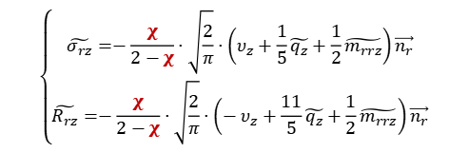


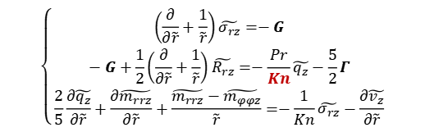
R13 equations for a circular tube--improvement on PNM
Regularized Grad's 13-moment equations
0.01 < Kn < 1.0
$$Kn=\frac{μ}{P∙R}\sqrt{\frac{R_{g}T}{M}}$$
Governing equations
$$φ$$
$$r$$
$$z$$
Governing equations
Boundary conditions
Constitutive relations
$$\left\{\begin{aligned}&\left(\frac{∂}{∂\tilde{r}}+\frac{1}{\tilde{r}}\right)\tilde{σ_{rz}}=−G \\ &−G+\frac{1}{2}\left(\frac{∂}{∂\tilde{r}}+\frac{1}{\tilde{r}}\right)\tilde{R_{rz}}=−\frac{Pr}{Kn}\tilde{q_{z}}−\frac{5}{2}Γ \\ &\frac{2}{5}\frac{∂\tilde{q_{z}}}{∂\tilde{r}}+\frac{∂\tilde{m_{rrz}}}{∂\tilde{r}}+\frac{\tilde{m_{rrz}}−\tilde{m_{φφz}}}{\tilde{r}}=−\frac{1}{Kn}\tilde{σ_{rz}}−\frac{∂\tilde{v_{z}}}{∂\tilde{r}}\end{aligned}\right.$$
$$\left\{\begin{aligned}&\tilde{σ_{rz}}=−\frac{χ}{2−χ}⋅\sqrt{\frac{2}{π}}⋅\left(υ_{z}+\frac{1}{5}\tilde{q_{z}}+\frac{1}{2}\tilde{m_{rrz}}\right)\vec{n_{r}} \\ &\tilde{R_{rz}}=−\frac{χ}{2−χ}⋅\sqrt{\frac{2}{π}}⋅\left(−υ_{z}+\frac{11}{5}\tilde{q_{z}}+\frac{1}{2}\tilde{m_{rrz}}\right)\vec{n_{r}}\end{aligned}\right.$$
$$\left\{\begin{aligned}&\tilde{R_{rz}}=\frac{B_{2}}{2}⋅Kn⋅\frac{∂\tilde{q_{z}}}{∂\tilde{r}} \\ &\tilde{m_{rrz}}=−\frac{8}{15}C⋅Kn⋅\left(G+\frac{5}{4}\frac{\tilde{σ_{rz}}}{\tilde{r}}\right) \\ &\tilde{m_{φφz}}=\frac{2}{15}C⋅Kn⋅\left(G+5\frac{\tilde{σ_{rz}}}{\tilde{r}}\right)\end{aligned}\right.$$

Slide 5










Single-pore R13 transport model
Poiseuille flow (pressure-driven)
$$M_{P,tube}^{R13}=\frac{k_{∞}}{μ}\left\{1+\frac{2−χ}{χ}\sqrt{8π}\left(1+β\right)Kn+\frac{4}{5}\left[C\left(1+2β\right)+\frac{2}{Pr}\left(1+12β\right) \right]{Kn}^{2}\right\}\frac{∆P}{L}$$
$$β=β(Kn,χ)$$
$$E_{P,tube}^{R13}=−P_{0}⋅\frac{k_{∞}}{μ}\left[5α\sqrt{8π}⋅η⋅Kn+8\left(C⋅η+\frac{1}{Pr}(12η−1) \right){Kn}^{2}\right]\frac{ΔP}{L}$$
$$η=η(Kn,χ)$$
Thermal transpiration (temperature-driven)
$$M_{T,tube}^{R13}=−\frac{{D_{k}}_{∞}}{T_{0}}\frac{3}{4}\sqrt{\frac{π}{8}}(1+12β)\frac{Kn}{Pr}⋅\frac{ΔT}{L}$$
Knudsen diffusion coefficient:
$${D_{k}}_{∞}=\frac{2R}{3}\sqrt{\frac{8R_{g}T}{πM}}$$
Nonlinear Functions of $Kn$and
accommodation coefficient $χ$
$$E_{T,tube}^{R13}={D_{k}}_{∞}⋅\frac{P_{0}}{T_{0}}⋅\frac{15}{2}\sqrt{\frac{π}{8}}(1−12η)⋅\frac{Kn}{Pr}⋅\frac{ΔT}{L}$$
$$k_{app}^{M,R13}=k_{∞}⋅f_{1}\left(Kn,χ\right)$$
$$k_{app}^{E,R13}=k_{∞}⋅g_{1}\left(Kn,χ\right)$$
$${D_{k}}_{app}^{M,R13}={D_{k}}_{∞}⋅f_{2}\left(Kn,χ\right)$$
$${D_{k}}_{app}^{E,R13}={D_{k}}_{∞}⋅g_{2}\left(Kn,χ\right)$$

Slide 6
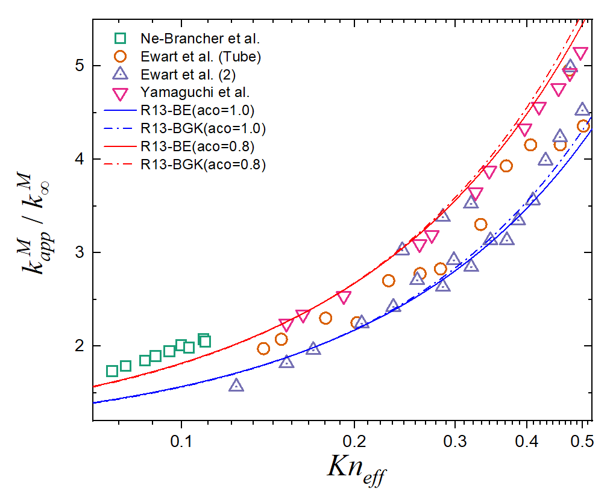
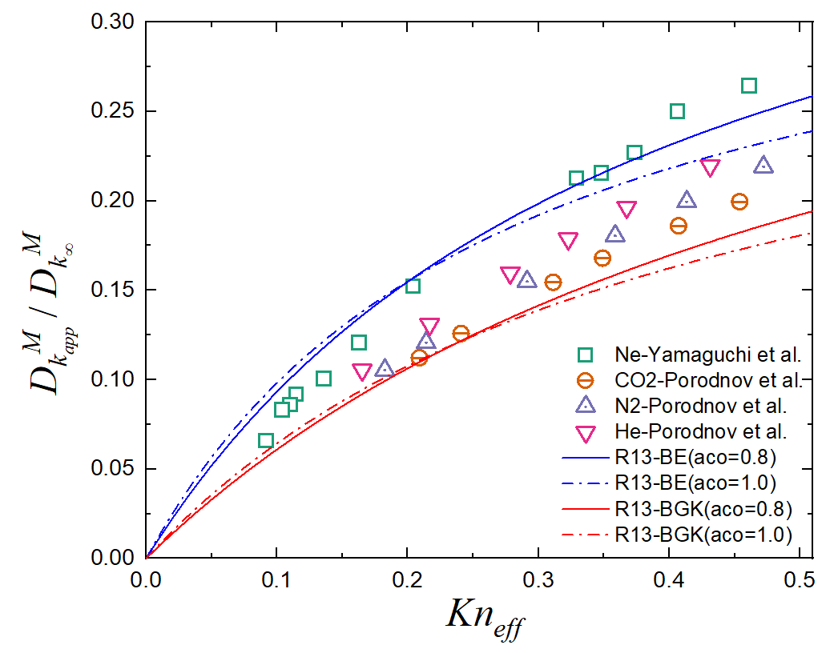


Circular-tube experimental literature’s data validation
$$f_{1}\left(Kn,χ\right)=\frac{k_{app}^{M,R13}}{k_{∞}}=1+γ_{1}(Kn,χ)∙Kn\text{+ }γ_{2} (Kn,χ) ∙{Kn}^{2}$$
$$f_{2}\left(Kn,χ\right)=\frac{{D_{k}}_{app}^{M,R13}}{{D_{k}}_{∞}}=\frac{γ_{3}(Kn,χ)∙Kn}{γ_{4}(Kn,χ)+Kn}$$

Slide 7
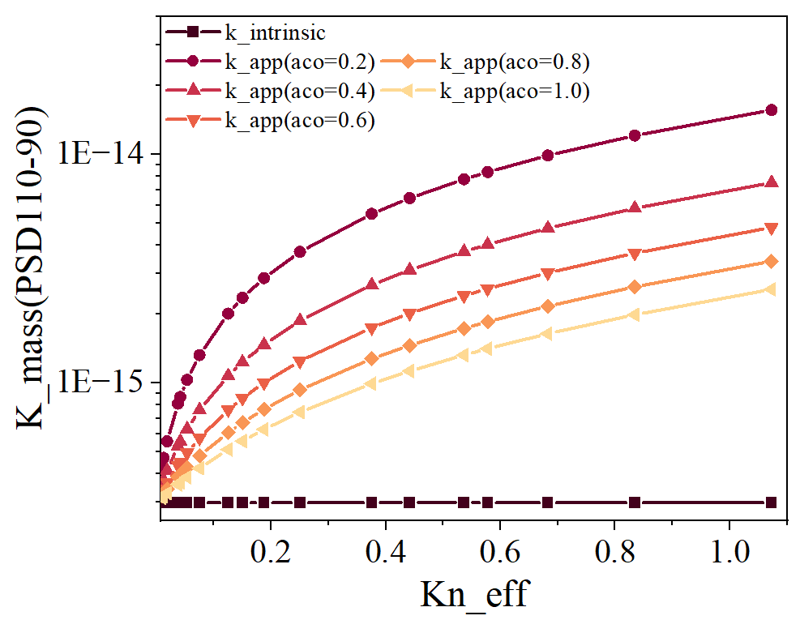
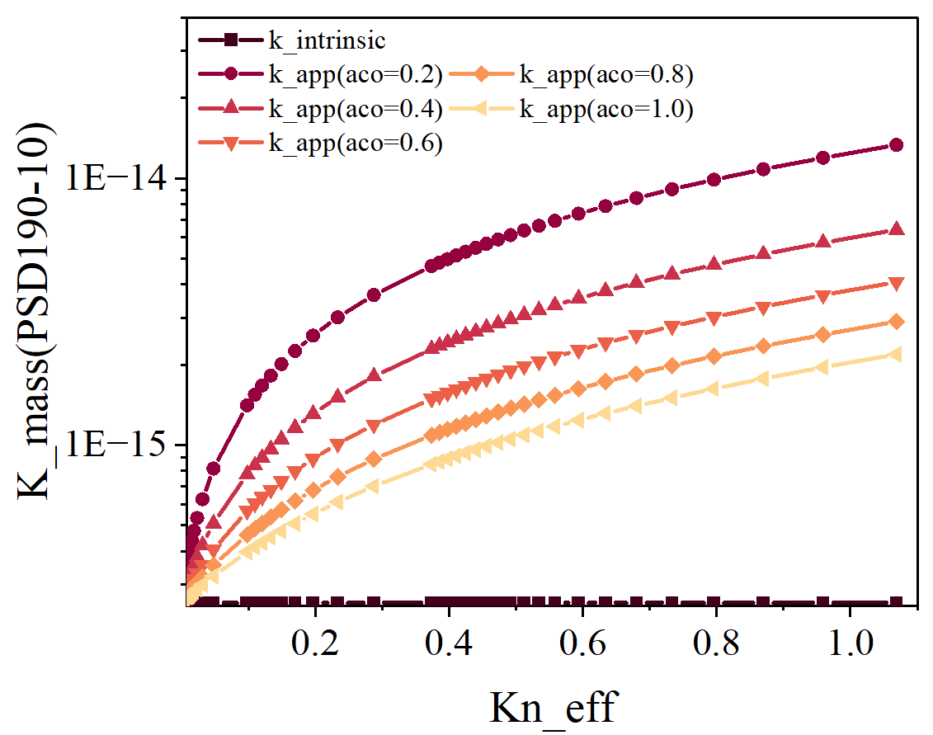
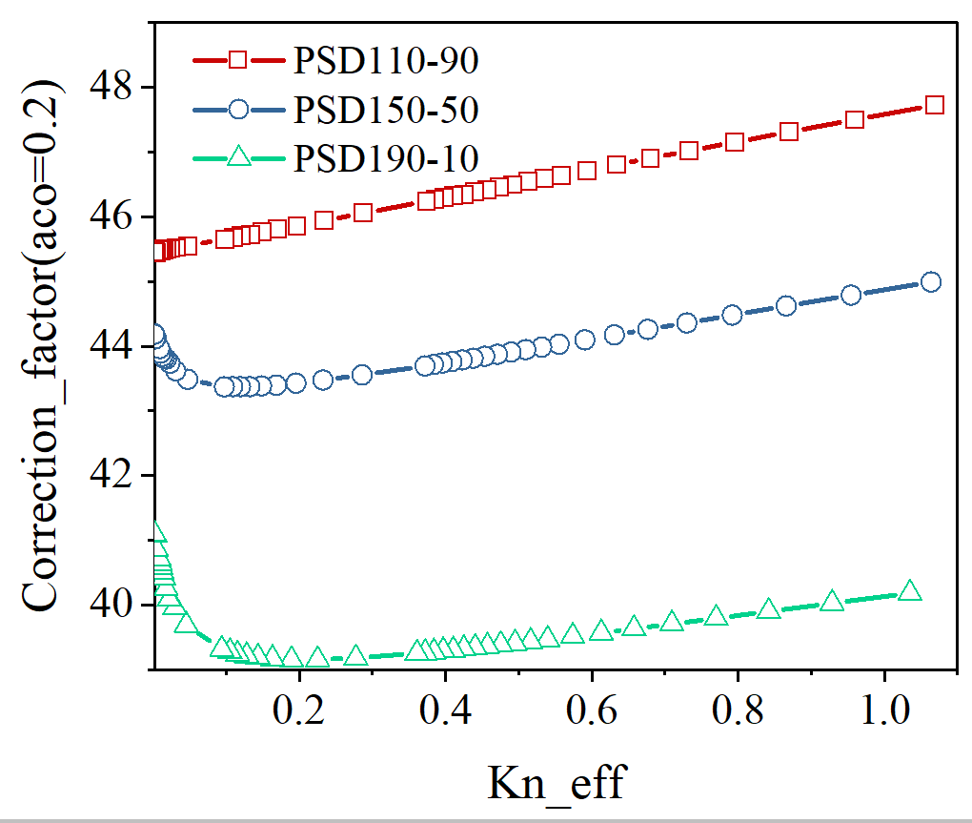
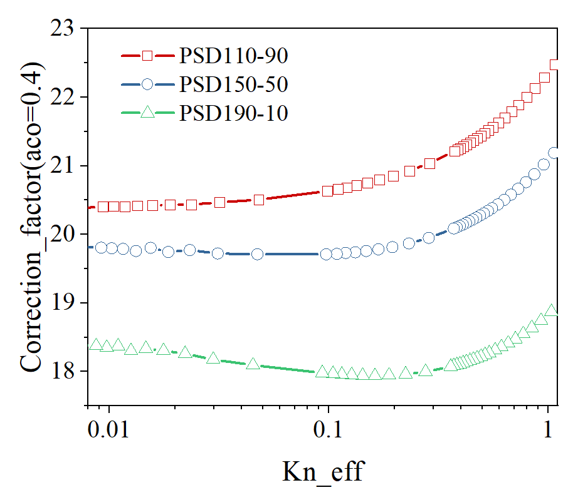
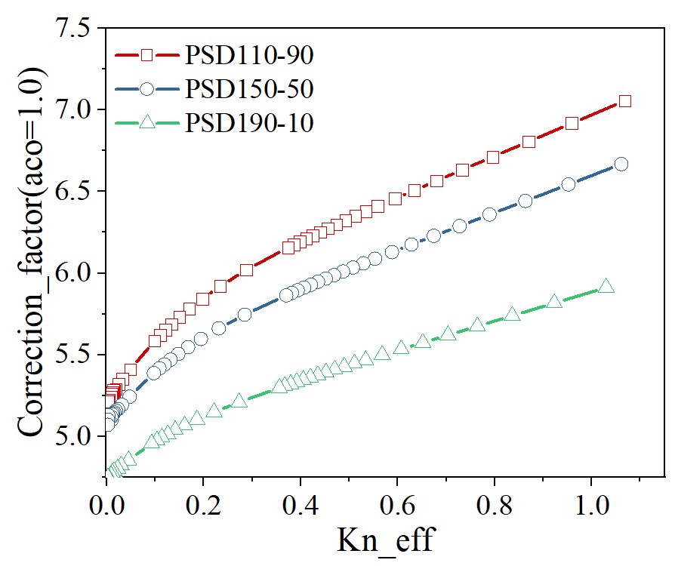

Cartesian PNM: Klinkenmberg’s correction effect on the apparent permeability
$$k_{app}=k_{∞}(1+\frac{b_{k}}{P})$$
$$b_{k}:Klikenberg’s correction$$

Slide 8
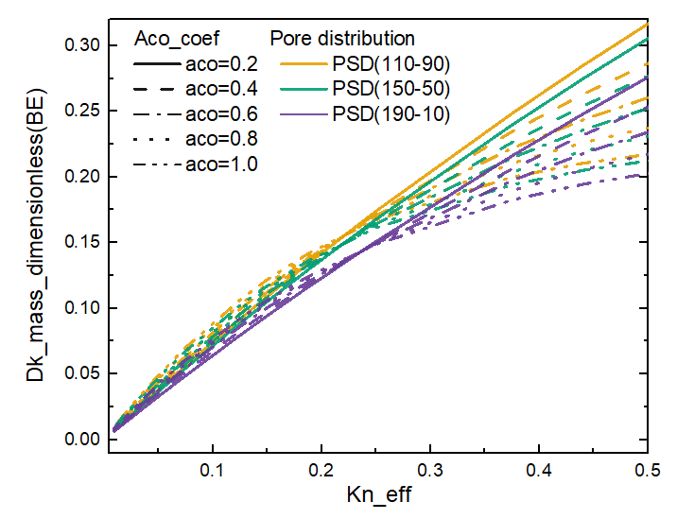
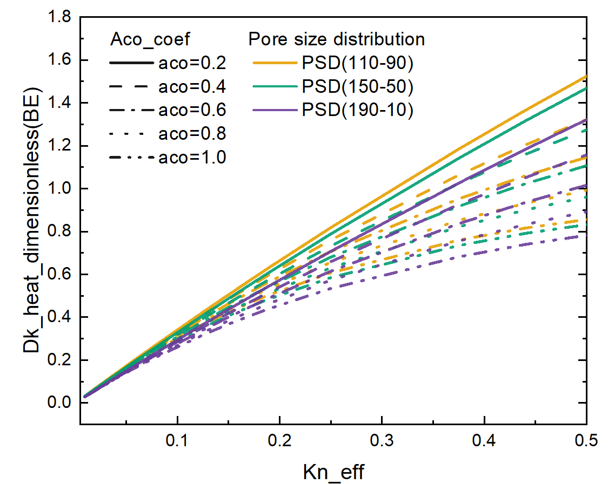


Cartesian PNM: Knudsen effect and accommodation coefficient effect on Knudsen Diffusion
$$f_{2}\left(Kn,χ\right)=\frac{{D_{k}}_{app}^{M,R13}}{{D_{k}}_{∞}}$$
$$g_{2}\left(Kn,χ\right)=\frac{{D_{k}}_{app}^{M,R13}}{{D_{k}}_{∞}}$$

Slide 9
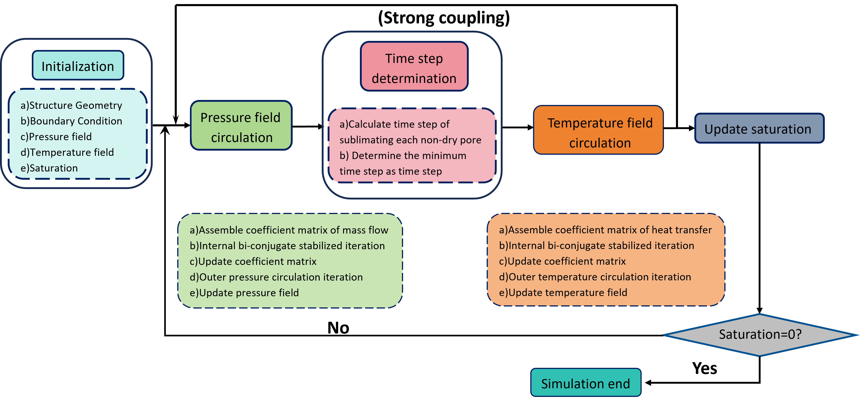
Algorithm for R13-based PNM freeze-drying

Slide 10
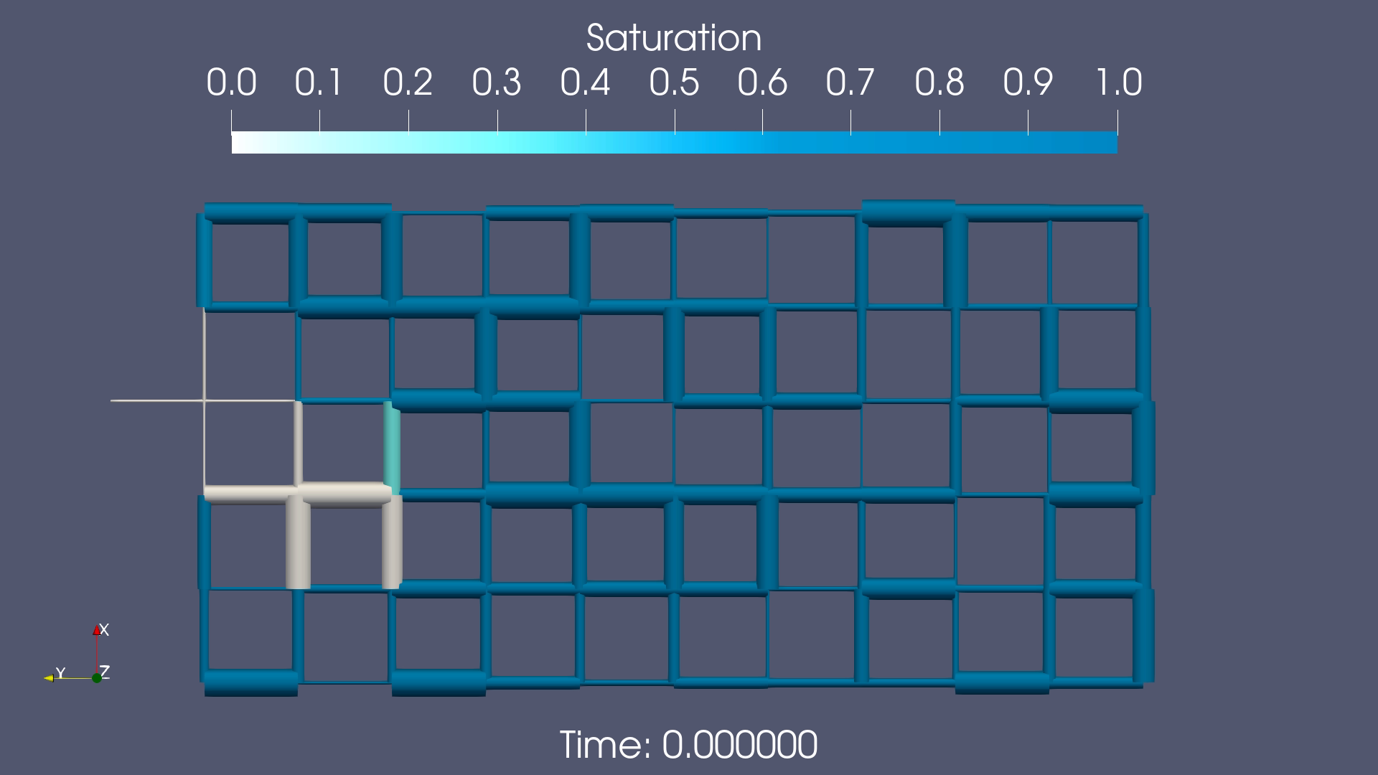
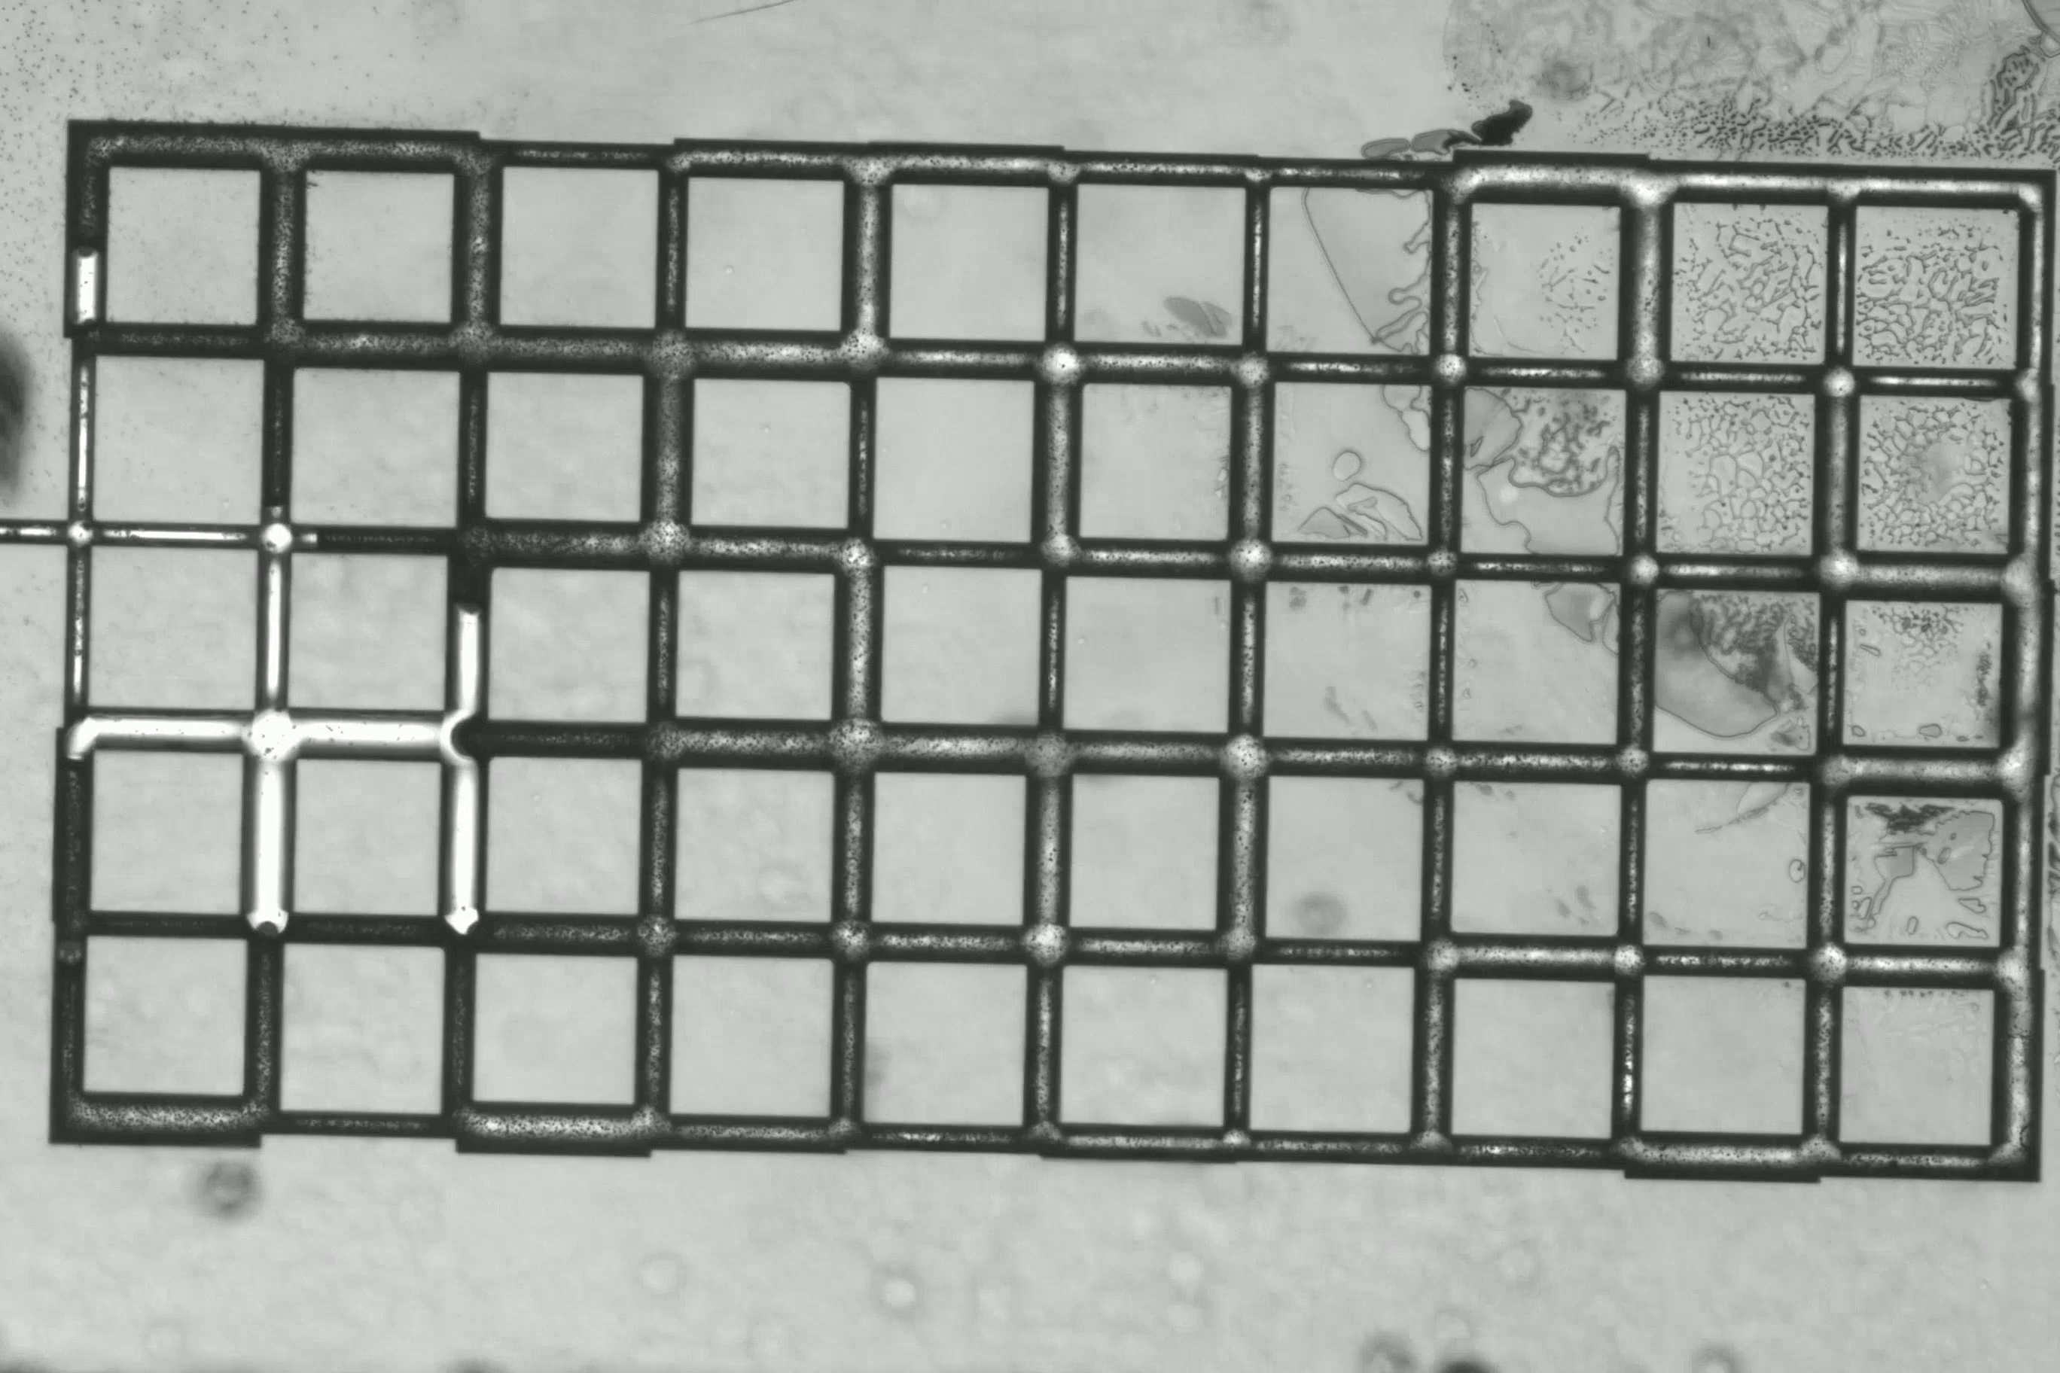
2D isothermal simulation vs. microfluidic experiment
Pore size | 3-7 um Pressure | 10 Pa
Temperature | 245 K Knudsen number | Kn = 0.14
Play both

Slide 11
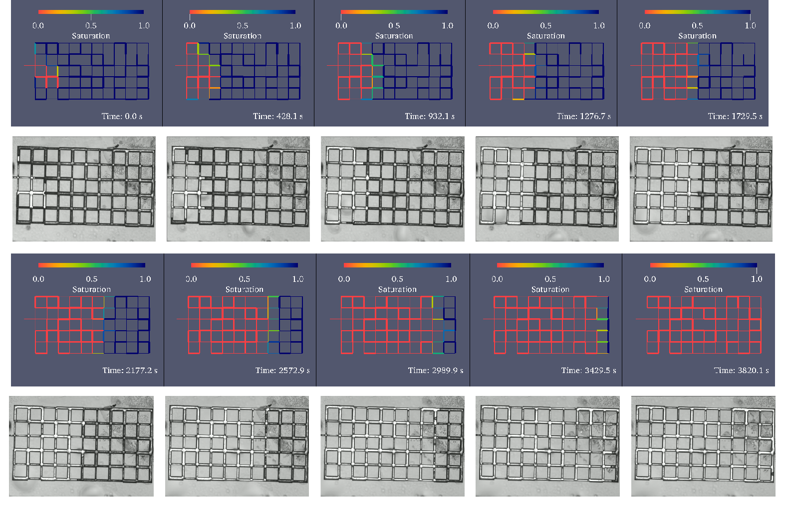
2D isothermal simulation vs. microfluidic experiment

Slide 12
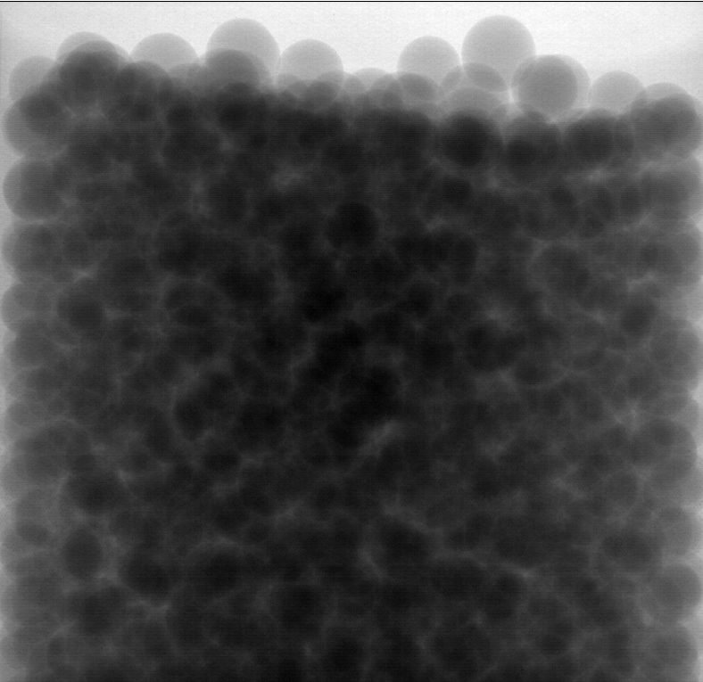
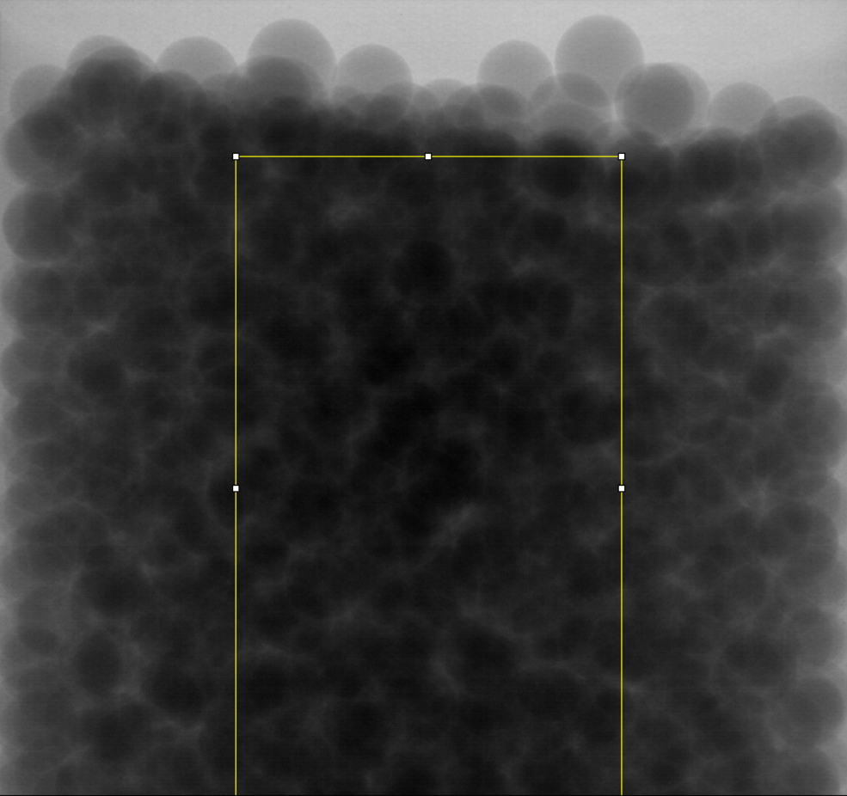



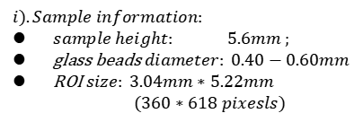
micro-CT freeze-drying experiment
$$i).Sample information:$$
$sample height: 5.6mm ;$
glass beads$diameter: 0.40−0.60mm$
ROI $size: 3.04mm∗5.22mm$ $$(360∗618 pixesls)$$
ii).Scanning information:
Source to Decttor Distance:350 mm
Source to Object Distance:20mm
Voxel size: 8.45μm
Scanning duration:1 min per picture
Exposure time:450 ms
iii).Experiment condition: Pressure:20Pa, Temperature:248K
$$360 pixels$$
$$618 pixels$$
$$ROI$$

Slide 13
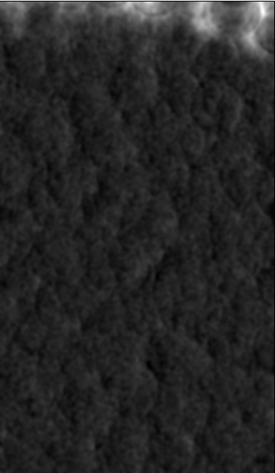
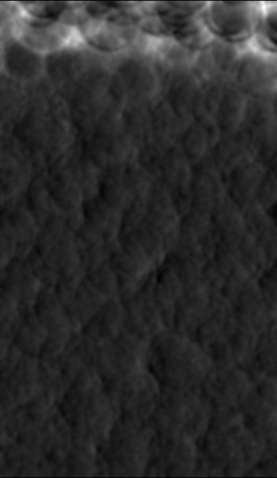
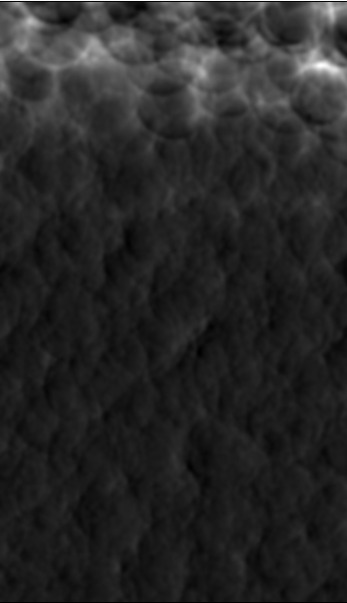
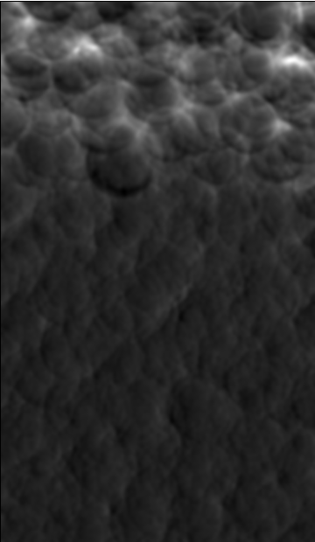
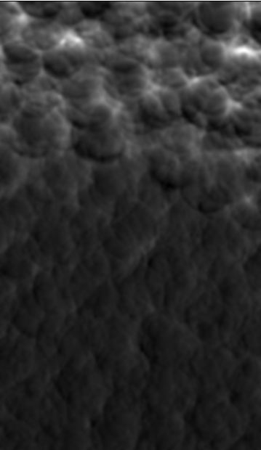








$$Visualiztion−−Image postprocessing$$
$$t=6 min$$
$$t=11 min$$
$$t=16 min$$
$$t=22 min$$
$$t=27 min$$

Slide 14
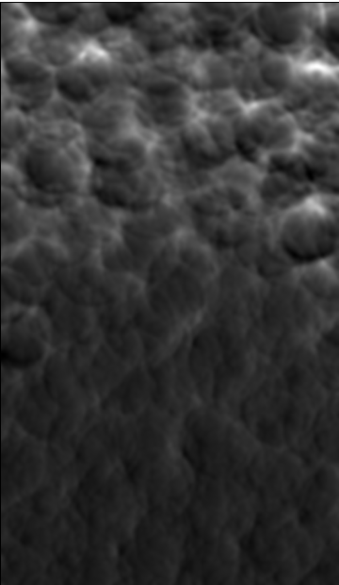
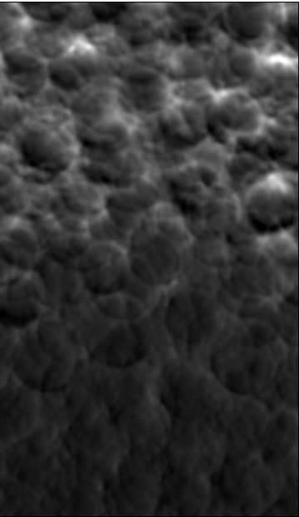
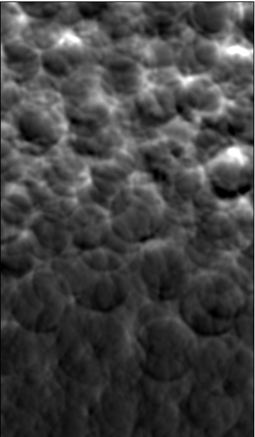
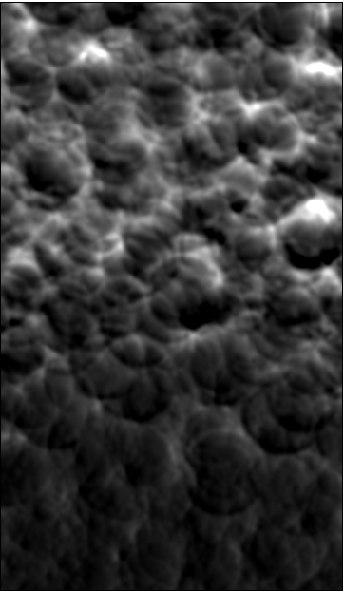
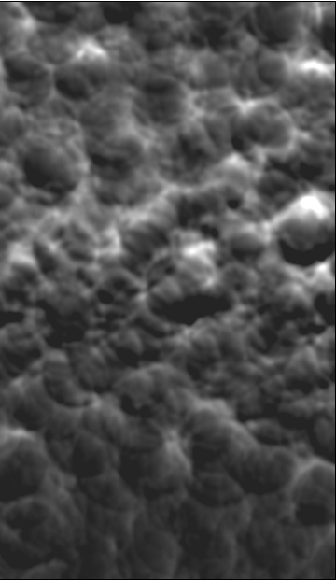
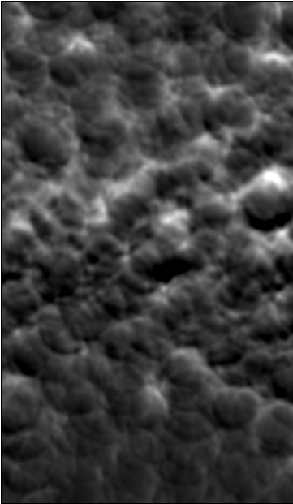
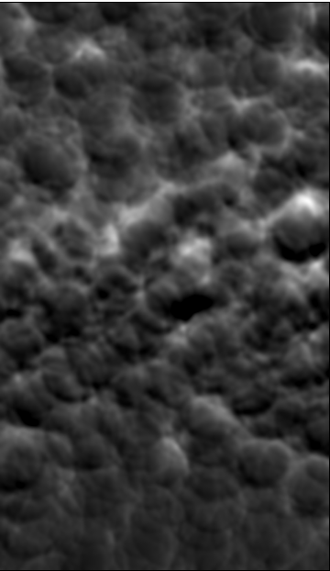
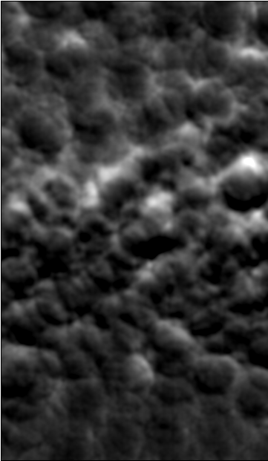








$$t=33 min$$
$$t=37 min$$
$$t=42 min$$
$$t=46 min$$
$$t=57 min$$
Steady and clead movement of sublimation front
at the beginning (saturation >0.5)
After 37 min, saturation less than 0.5,sublimation front is
not easy to be distinguished.
$$t=63 min$$
$$t=66 min$$
$$t=70 min$$

Slide 15
Future work
Summary
R13-PNM is able to well describe isothermal freez-drying in a low pressure circumstance.
For real sublimation scenarios, non-isothermal pore scale model should be established.
Sublimation-front width vs. operating parameters
PNM-to-continuum upscaling
Freeze-drying validation
Thank you for listening!

