Slide 1



Fluid–solid–thermal coupling in fibrous porous media: distinct roles of porosity, fiber orientation and relative humidity in cellulose fiber stacks
Interpore 2026
Karen MOURDA
Supervisor: Philippe COUSSOT
19 May 2026

Slide 2

The New Frontier in Sustainable Building: Bio-based Construction Materials
Introduction: Bio-based materials, derived from renewable sources, offer sustainability, renewability, and a significant reduction in environmental impacts compared to traditional construction materials.
Trends: Growing trends in the construction industry towards green building and the increasing adoption of sustainable practices.
2

Slide 3
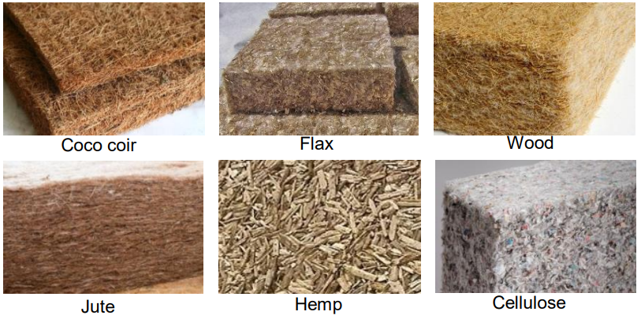
From Microstructure to Insulation: Probing the Thermal Behavior of Bio-Based Materials
These materials have Low thermal conductivity
depending on:
Temperature
Porosity
Structure
Moisture Content
🎯
Physical Origin ?
3

Slide 4
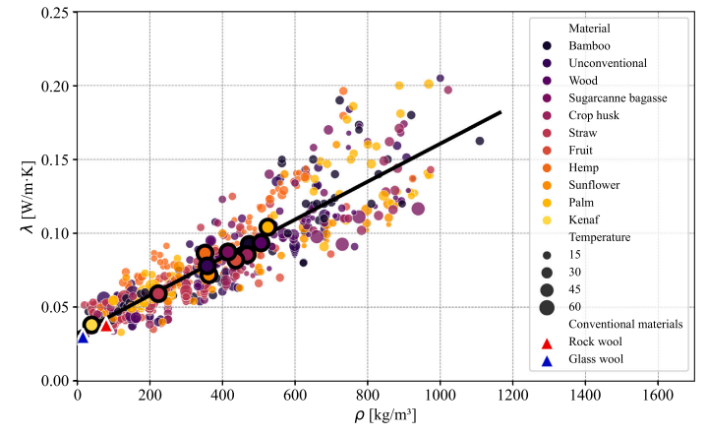
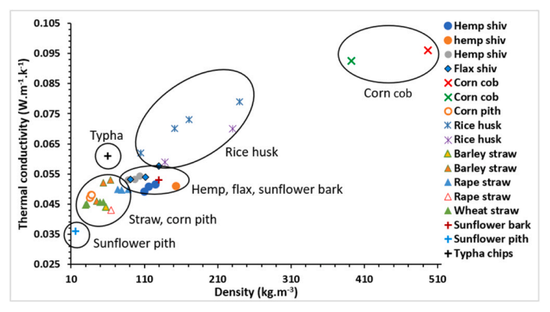
Literature data: strong dispersion despite similar materials
[1]
[2]
For similar density ranges, reported conductivities span a wide interval.
[1] F. Ye, H. Wei, Y. Xiao, U. Berardi, G. Quaranta, C. Demartino, Bio-based insulation materials in sustainable constructions: A review of environmental, thermal and acoustic insulation, durability, and mechanical performances, Renew. Sustain. Energy Rev. 223 (2025) 115872. https://doi.org/10.1016/j.rser.2025.115872
[2] A. Bakkour, S.-E. Ouldboukhitine, P. Biwole, S. Amziane, A review of multi-scale hygrothermal characteristics of plant-based building materials, Constr. Build. Mater. 412 (2024) 134850. https://doi.org/10.1016/j.conbuildmat.2023.134850.
4

Slide 5
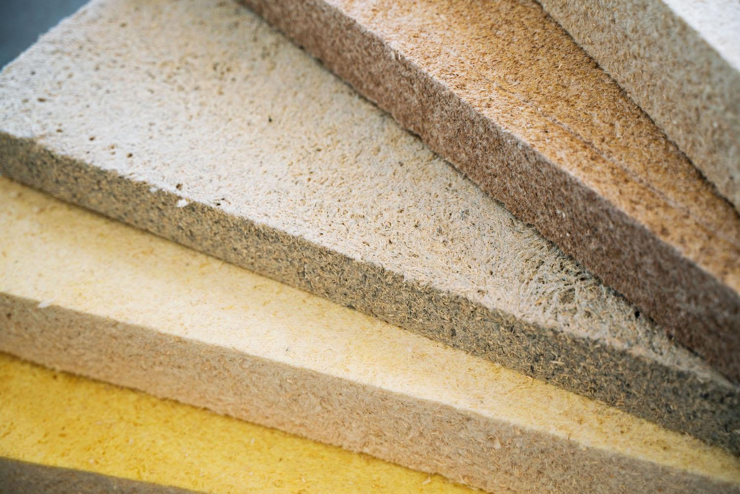
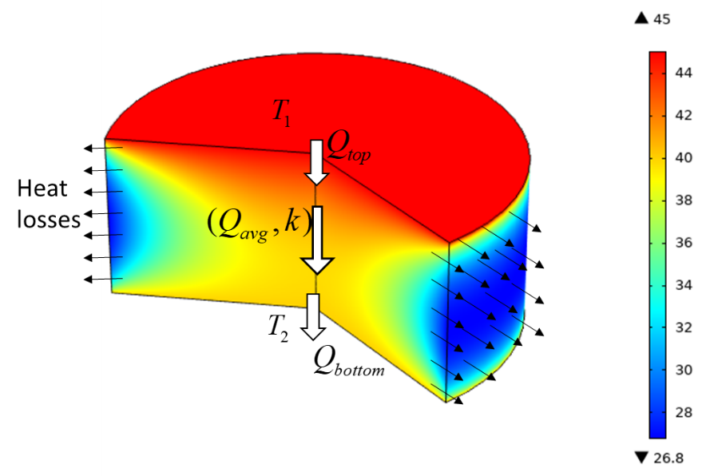
Overview of the Study
Part 1_ Measurement Challenges
Part 2_ Porosity & Structure
Part 3_ Moisture Effect
steady-state regime
minimal lateral heat losses
reproducible measurements
Bound Water in the Solid structure
5

Slide 6
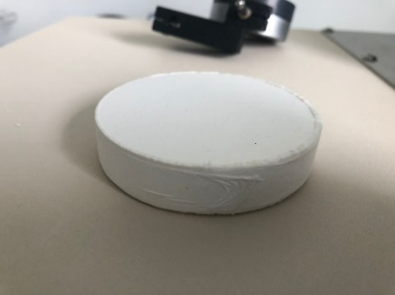
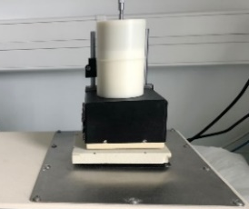
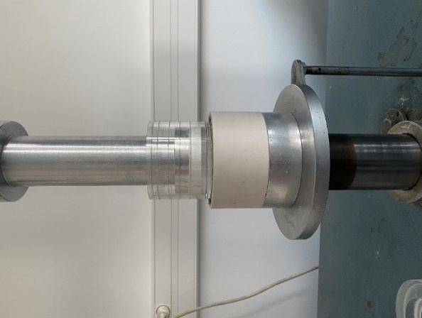
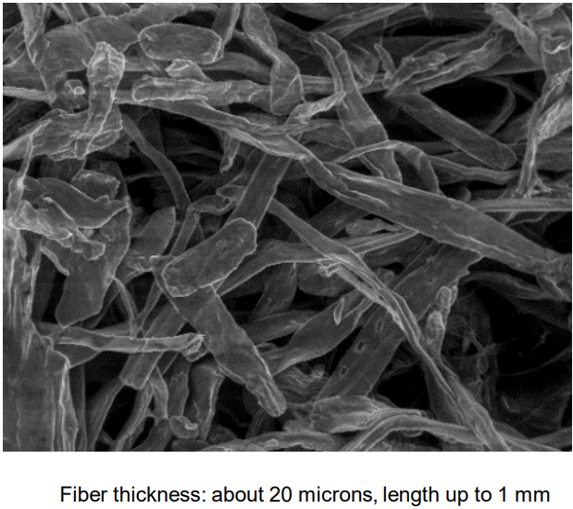
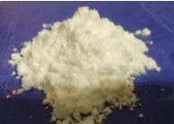

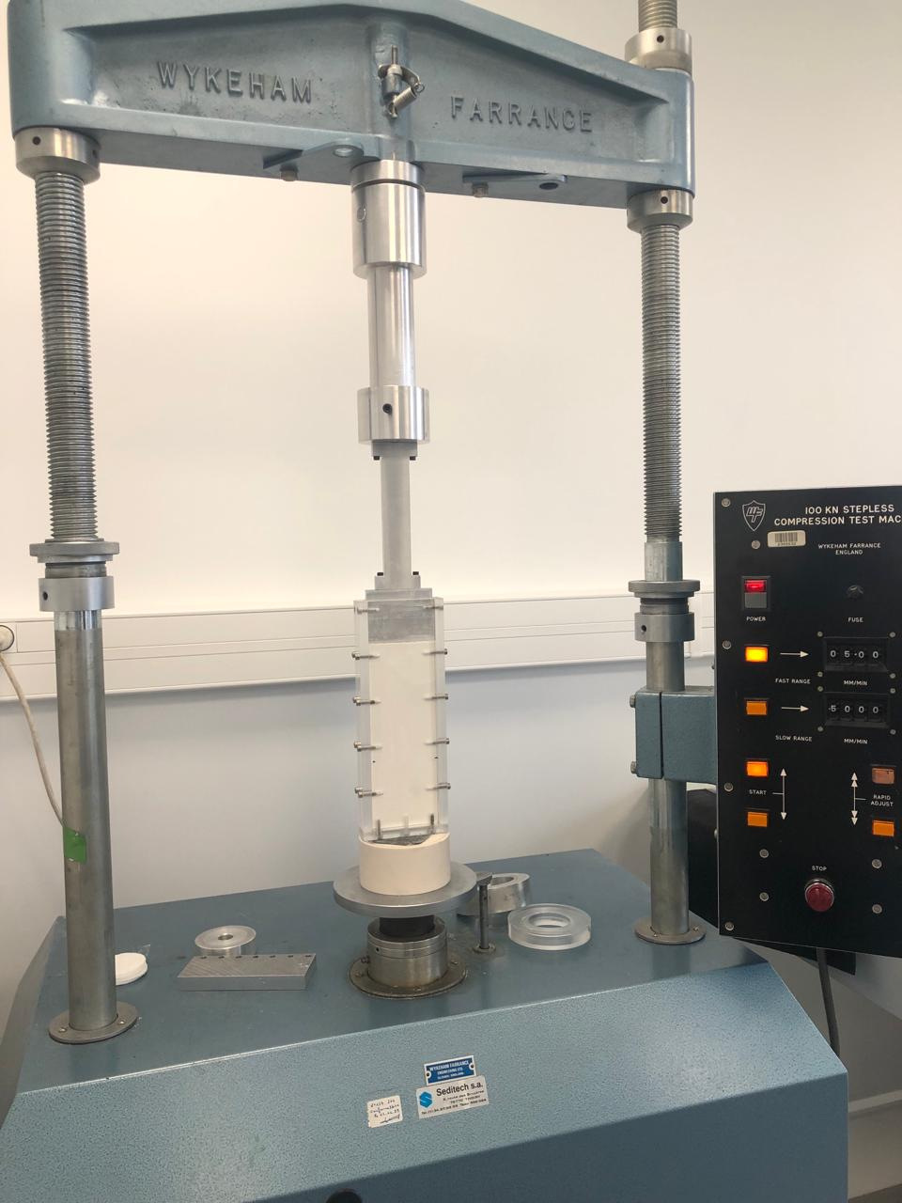
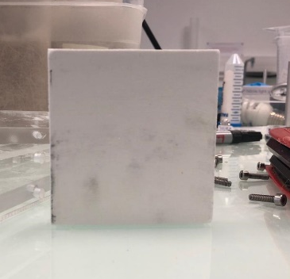
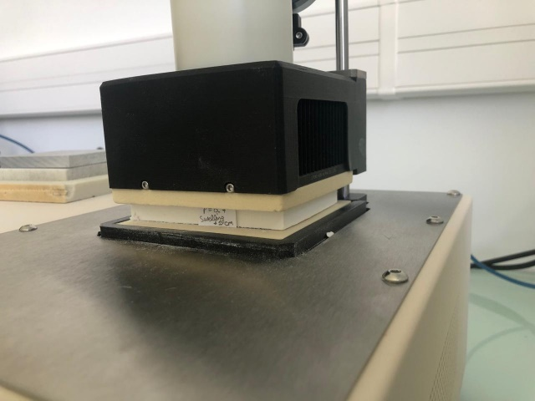
Controlled Compression & Humidity: Tailoring Cellulose Fiber Orientation for Thermal Studies
Samples Preparation
Axial Compression
Controlled
Porosity
Fiber Orientation
Relative Humidity
(Arbocel® BC 200, from Kremer Pigmente)
Cellulose: Structurally similar to real bio-based insulating materials
Perpendicular Compression
6

Slide 7
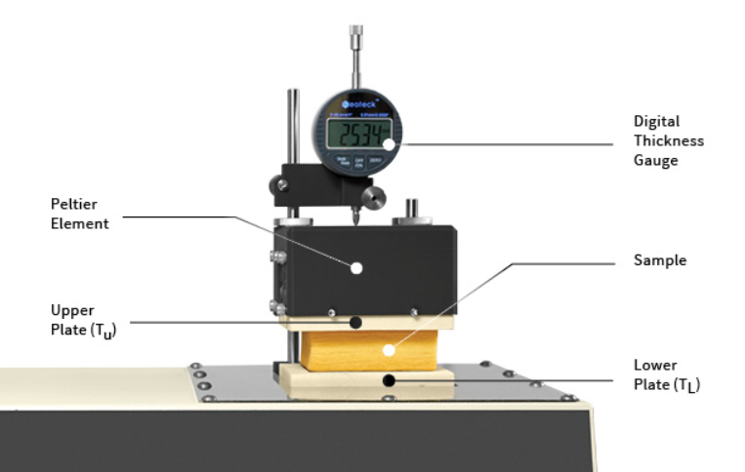
Measuring Thermal Conductivity in Bio-Based Materials is Challenging …
Measurements done with the HFM
following Standard Calibration process for samples with different thicknesses
7

Slide 8
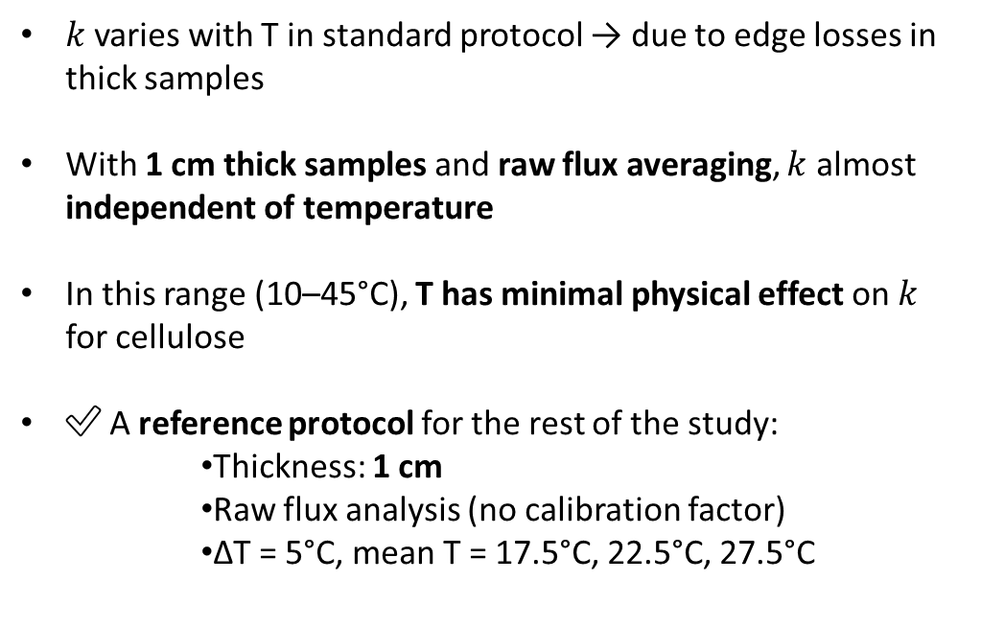
Towards a Reliable Measurement Protocol
To Raw data: Direct Measurement of average heat fluxes Without Imposed Calibration Factor
$k$varies with T in standard protocol → due to edge losses in thick samples
With 1 cm thick samples and raw flux averaging, $k$ almost independent of temperature
In this range (10–45°C), T has minimal physical effect on $k$ for cellulose
✅ A reference protocol for the rest of the study:
Thickness: 1 cm
Raw flux analysis (no calibration factor)
ΔT = 5°C, mean T = 17.5°C, 22.5°C, 27.5°C
K. Mourda, Y. Zou, V. T. Nguyen, P. Coussot, "Enhancing the Accuracy of Thermal Conductivity Measurements with Insulating Construction Materials: Addressing Edge Effects and Methodological Improvements", Journal of Building Engineering (2025)
8

Slide 9
Bio-Based Materials: Complex and Anisotropic Structures
9

Slide 10
Bio-Based Materials: Complex and Anisotropic Structures
10

Slide 11

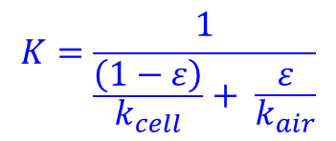

Thermal conductivity vs. Porosity in Dried Samples: Impact of Orientation_with theoretical Models
$k_{cellulose}=k_{cell}=0.4$ $W m^{−1}K^{−1}$
$$k_{air}=0.025 W m^{−1}K^{−1}$$
Heat flux
$$K= k_{cell}∗\left(1−ε\right)+k_{air}∗ε$$
Structures parallel to heat flow
Heat flux
$$K=\frac{1}{\frac{\left(1−ε\right)}{k_{cell}}+ \frac{ε}{k_{air}}}$$
Structures perpendicular to heat flow
11

Slide 12
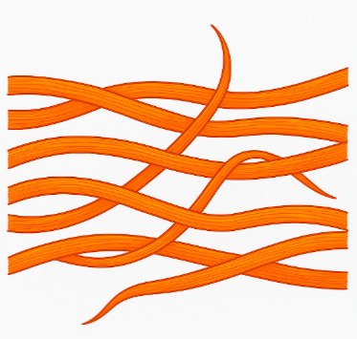

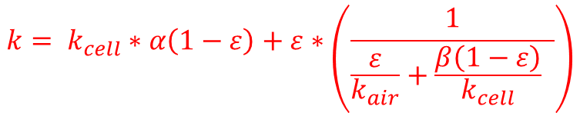

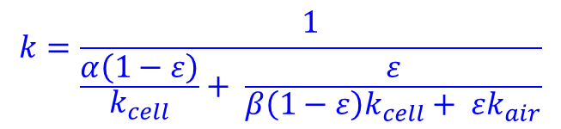


Thermal conductivity vs. Porosity in Dried Samples: Impact of Orientation_with Effective Models
Our model_Axial Direction
$$k=\frac{1}{\frac{α\left(1−ε\right)}{k_{cell}}+ \frac{ε}{β\left(1−ε\right)k_{cell}+ εk_{air}}}$$
$$\left(α+β=1\right)$$
Heat flux
$$α=0.98$$
Our model_Transverse Direction
$$k= k_{cell}∗α\left(1−ε\right)+ε∗\left(\frac{1}{\frac{ε}{k_{air}}+\frac{β\left(1−ε\right)}{k_{cell}} }\right)$$
$$\left(α+β=1\right)$$
12

Slide 13
Bio-Based Materials: Complex and Anisotropic Structures
13

Slide 14
Thermal conductivity vs. Apparent density: Analogy of our model with Litterature data
14

Slide 15
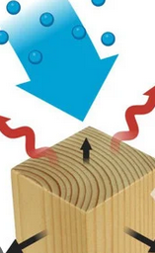
Evolution of Thermal Conductivity with Relative Humidity at Different Porosities
Heat flux
30%
15

Slide 16
Moisture Effect Depends on Porosity
Saturate samples (RH ≈ 100 %): start from maximum moisture content
100 % RH → 80 % → 60 % → 40 % → 30 % → Oven 60 °C → 0 % RH
Bound Water
Drying
Drying
Thermal conductivity cannot be predicted without considering both structure and moisture together
16

Slide 17
Key Conclusions – Thermal Conductivity in Bio-based materials
✅ Robust protocol → 1 cm sample thickness, raw flux method
→ Extrapolable; aspect ratio ≤ 1/7 to be maintained
No significant variation with temperature (10–45°C)
📉 Thermal conductivity decreases with porosity
🔀 Fiber orientation matters: Stronger impact in perpendicular direction
💧 Moisture increases conductivity via bound water adsorption
Structure and moisture are intrinsically coupled
17

Slide 18
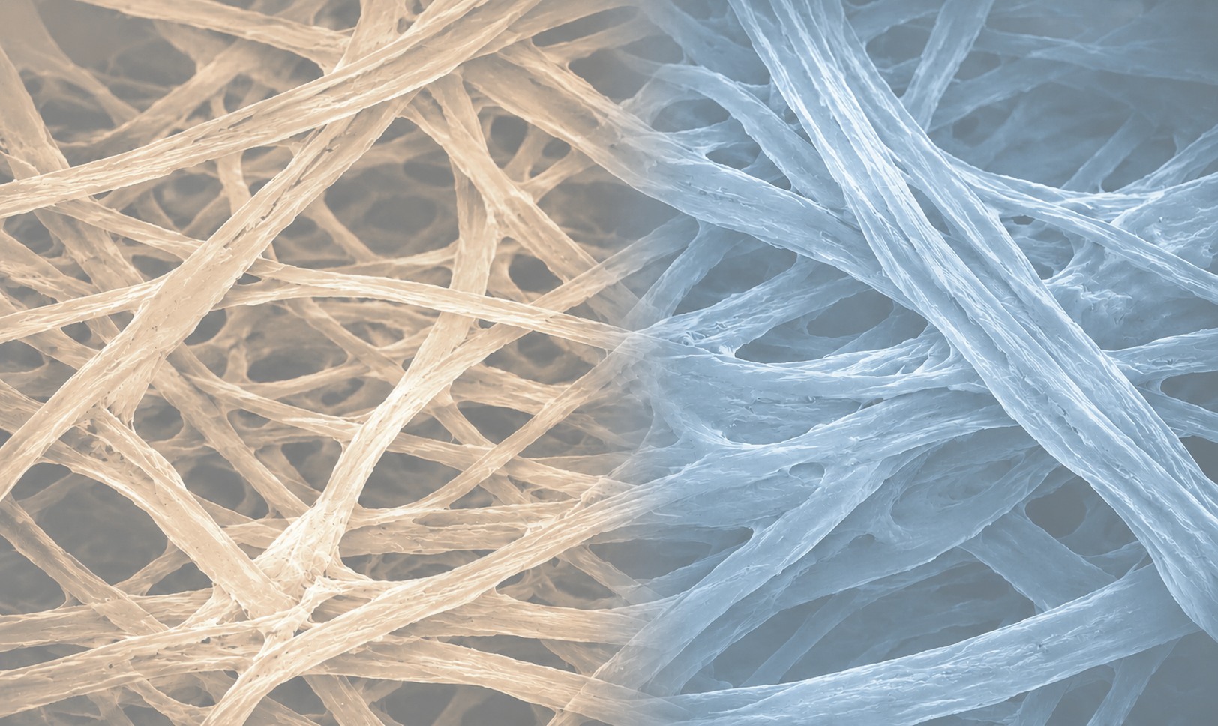
Thank you !
karen.mourda@univ-eiffel.fr

Slide 19
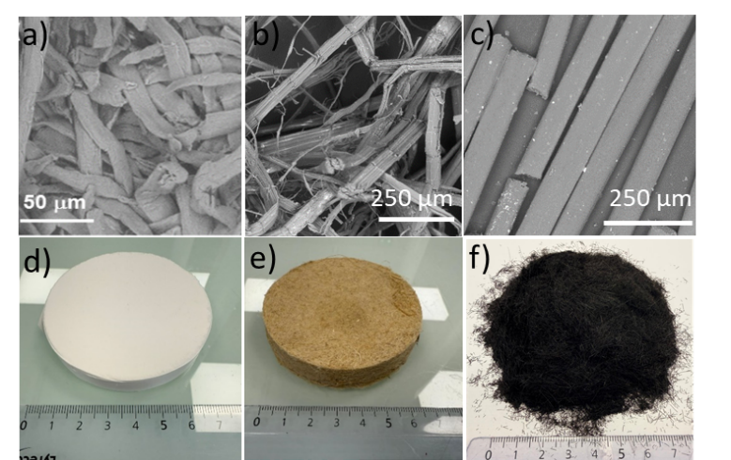
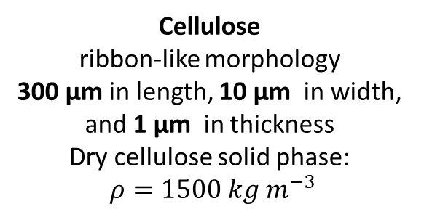
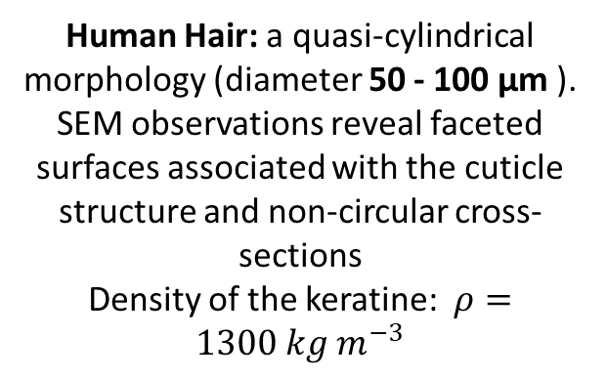
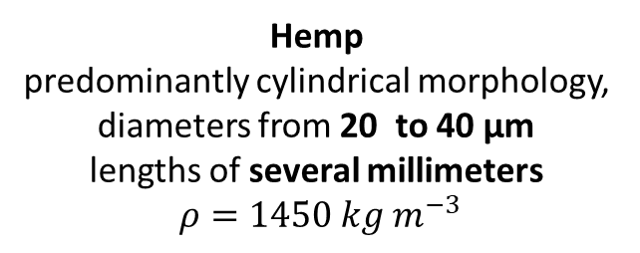
Fibers Morphology
Cellulose
ribbon-like morphology
300 µm in length, 10 µm in width,
and 1 µm in thickness
Dry cellulose solid phase:
$ρ=1500 kg m^{−3}$
Hemp
predominantly cylindrical morphology,
diameters from 20 to 40 µm
lengths of several millimeters
$ρ=1450 kg m^{−3}$
Human Hair: a quasi-cylindrical morphology (diameter 50 - 100 µm ).
SEM observations reveal faceted surfaces associated with the cuticle structure and non-circular cross-sections
Density of the keratine: $ρ=1300 kg m^{−3}$

Slide 20
Measurement Setup: Heat Flow Meter Method
Objective: Study and understand the Thermal conductivity of cellulose network
Transducers
25 mm
Top plate
+
Bottom
75 mm
1. Calibration with Standard Material
$$f_{cal}= \frac{k_{theoretical}}{\frac{Q×L}{T_{1}−T_{2}}}$$
$$T_{mean}=\frac{T_{1}+T_{2}}{2}$$
Samples compressed of Cellulose of Porosity 0.5
final Thickness: 5 mm to 35 mm
Range of Temperature: 10°C to 45°C
2. Test with desired sample
$$k=f_{cal}×\frac{Q_{avg}×L}{T_{1}−T_{2}}$$
$$T_{1}−T_{2}=5°C$$
🔍
$k$ intrinsic to material, should be independent of $L$
20

Slide 21
Enhancing the Accuracy of Thermal Conductivity Measurement: Methodological Improvement (1/3)
Measurements done with the Standard Calibration process for samples with different thicknesses
21

Slide 22
Enhancing the Accuracy of Thermal Conductivity Measurement: Methodological Improvement (2/3)
To Raw data: Direct Measurement of average heat fluxes Without Imposed Calibration Factor
Direct Measurement Without Imposed Calibration, Validating with air and standard sample NIST 1450E
22

Slide 23

Establishing a Reliable Measurement Protocol
Modeling Heat Transfer in the Sample
$k$varies with T in standard protocol → due to edge losses in thick samples
With 1 cm thick samples and raw flux averaging, $k$ almost independent of temperature
In this range (10–45°C), T has minimal physical effect on $k$ for cellulose
✅ A reference protocol for the rest of the study:
Thickness: 1 cm
Raw flux analysis (no calibration factor)
ΔT = 5°C, mean T = 17.5°C, 22.5°C, 27.5°C
K. Mourda, Y. Zou, V. T. Nguyen, P. Coussot, "Enhancing the Accuracy of Thermal Conductivity Measurements with Insulating Construction Materials: Addressing Edge Effects and Methodological Improvements", Journal of Building Engineering (2025)
23

Slide 24
Thermal conductivity vs. Porosity in Dried Samples: Impact of Orientation_with theoretical Models
Hypothesis: Fibers aligned perpendicularly to the compression axis =>
TRANSVERSE
AXIAL
In practice, compression starts from the state associated with
« Extended to »
24

