Slide 1
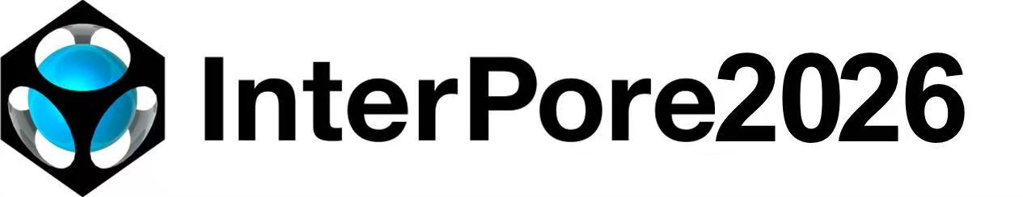
Study on Leakage Mechanisms in Vesicular Volcanic Rocks Dominated by Meso‑to‑Microscopic Pore Structures
Haoyuan Dou (China University of Petroleum (Beijing), Beijing China)
Bing Hou (China University of Petroleum (Beijing) at Karamay, Xinjiang, China)

Slide 2

Ⅰ
Part1. Introduction
Ⅱ
Ⅱ
Part2. Methodology
Ⅲ
Ⅲ
Part3. Conclusions and discussions

Slide 3
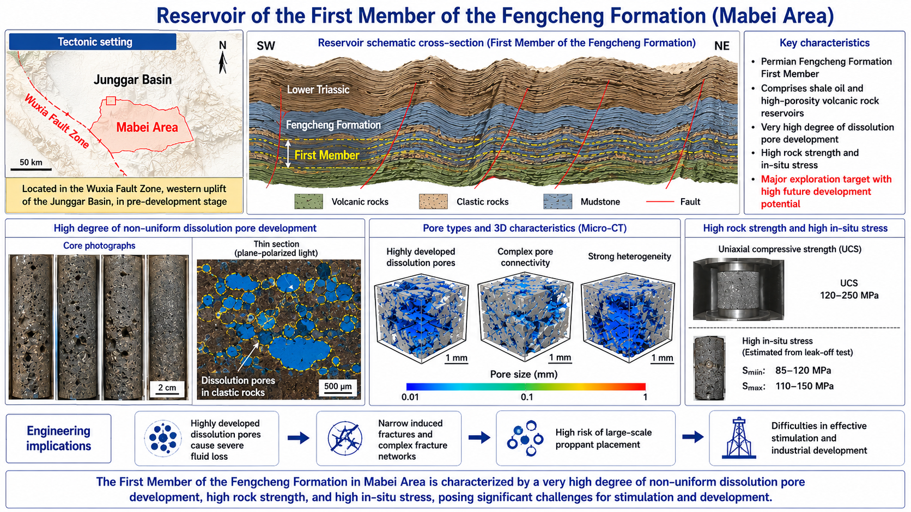
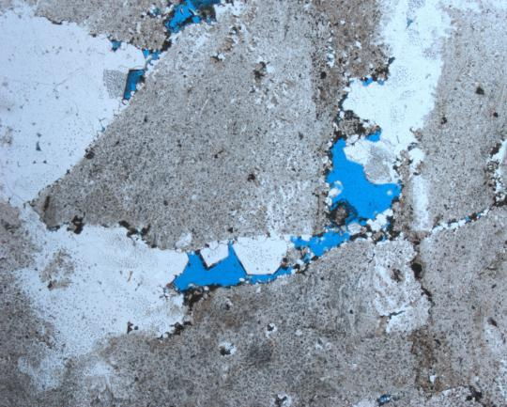
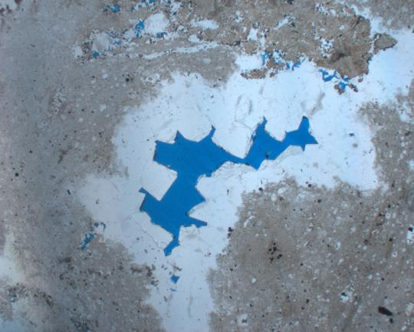
Introduction
Geological background
The Mabei Feng-1 Member reservoir is located in the Wuxia fault belt on the western uplift of the Junggar Basin. The reservoir primarily develops high‑porosity volcanic and clastic reservoirs. It exhibits high rock mechanical strength and high in‑situ stress.
Moreover, dissolution pores are widely developed as the reservoir space, resulting in high fracturing fluid leak‑off, narrow hydraulic fractures, and a high risk associated with large‑scale proppant placement.
microscopic dissolution pores

Slide 4
Ⅰ
Part1. Introduction
Ⅱ
Ⅱ
Part2. Methodology
Ⅲ
Ⅲ
Part3. Conclusions and discussions

Slide 5
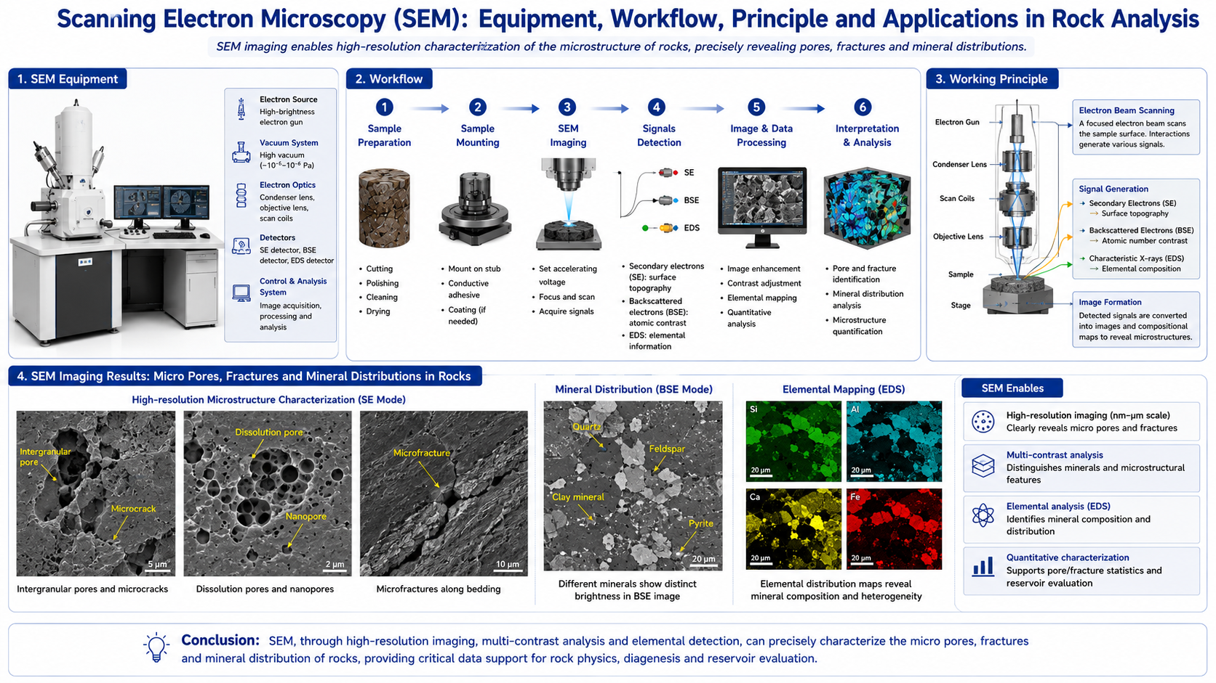
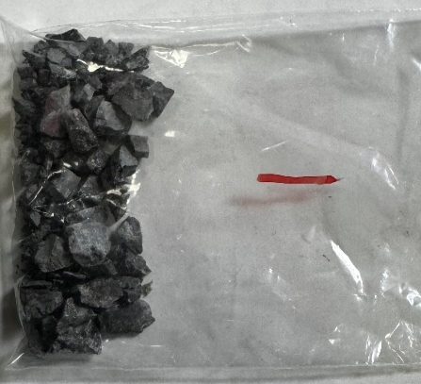
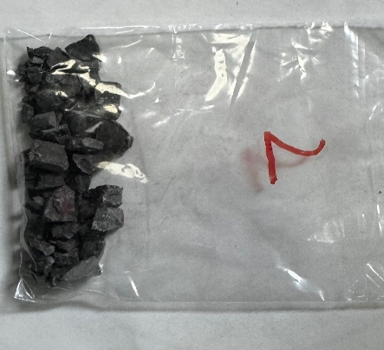
Methodology
Microscale Characterization Method — Scanning Electron Microscopy (SEM)
Using the FEI Quanta200F SEM, the development of micro-cracks, dissolution pores, and mineral distribution characteristics on rock cross-sections can be observed with high precision, allowing for the microscopic-scale characterization of pore structures in dissolution pore-type Igneous rocks.
Cuttings for Laboratory Testing
Microscopic dissolution pores
SEM analysis results

Slide 6
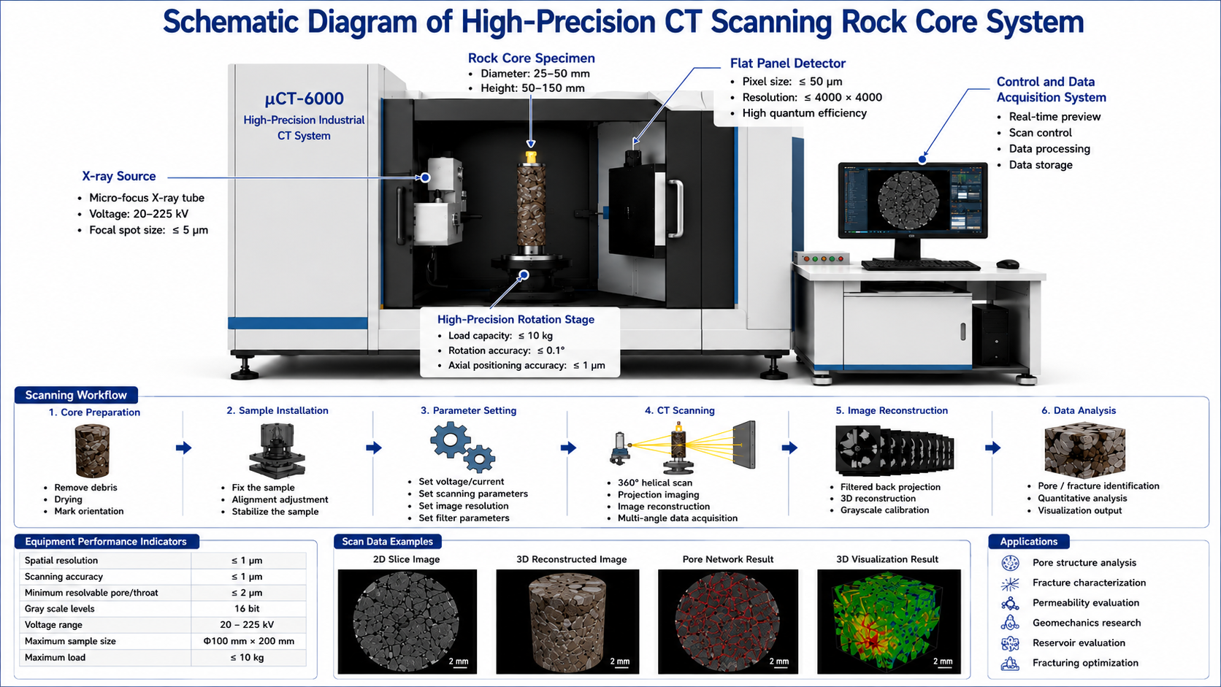
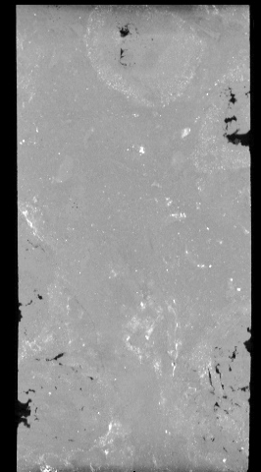
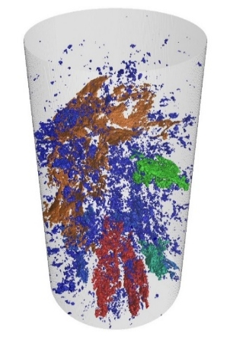
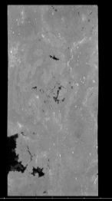
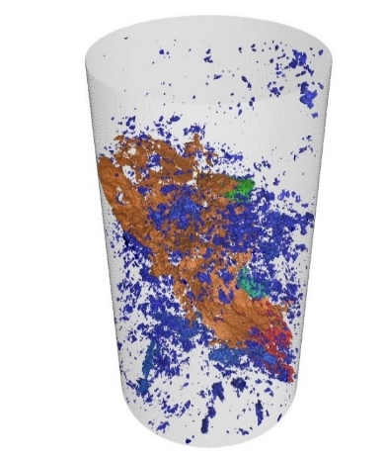
Methodology
Mesoscale Characterization Method—3D Digital Core Reconstruction
Using a high-precision CT scanner, a three-dimensional digital core is reconstructed to finely characterize, from a mesoscale scale, complex structures such as natural fracture networks and joints within Igneous rocks.
three-dimensional digital core

Slide 7
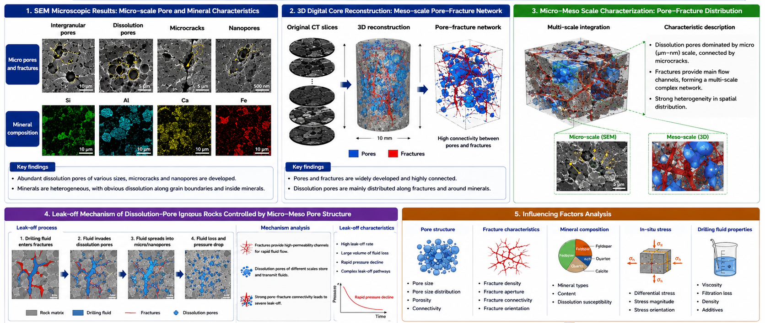
Methodology
Study on Leakage Mechanisms in Vesicular Volcanic Rocks
By integrating the microscopic results from SEM analysis and the mesoscopic results from 3D digital core reconstruction, the distribution characteristics of dissolution pores and fractures in micro‑mesoscale igneous rocks are characterized.
Furthermore, the lost circulation mechanism and the analysis of influencing factors for dissolution‑pore type volcanic rocks dominated by micro‑mesoscale pore structures are investigated.

Slide 8
Ⅰ
Part1. Introduction
Ⅱ
Ⅱ
Part2. Methodology
Ⅲ
Ⅲ
Part3. Conclusions and discussions

Slide 9
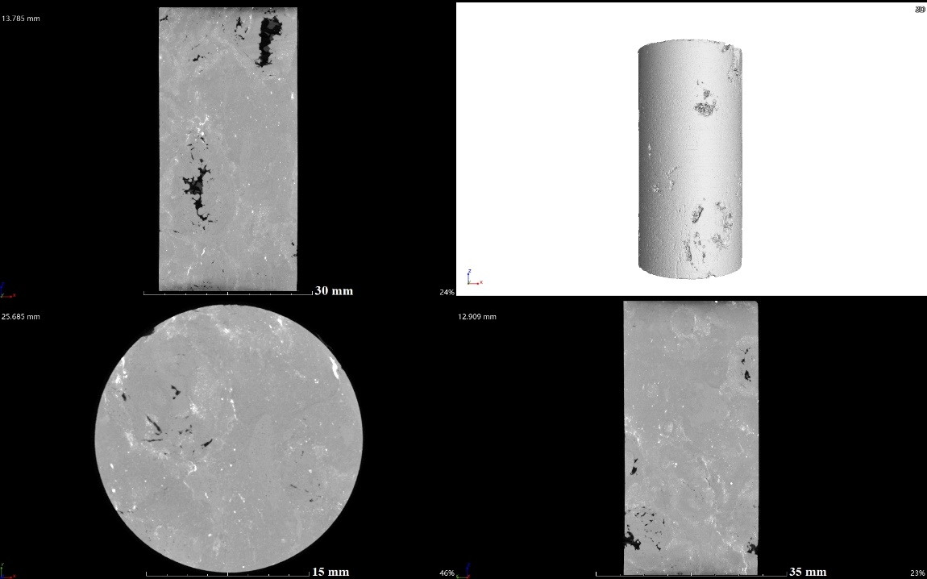
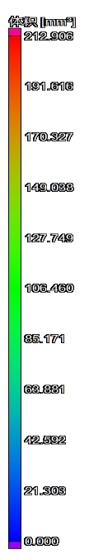
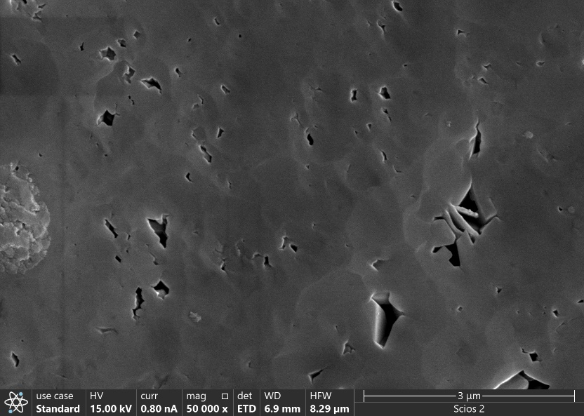
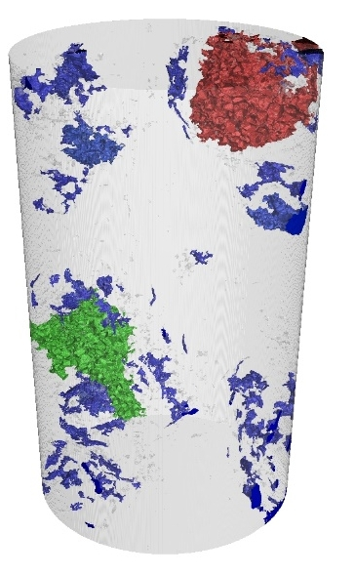
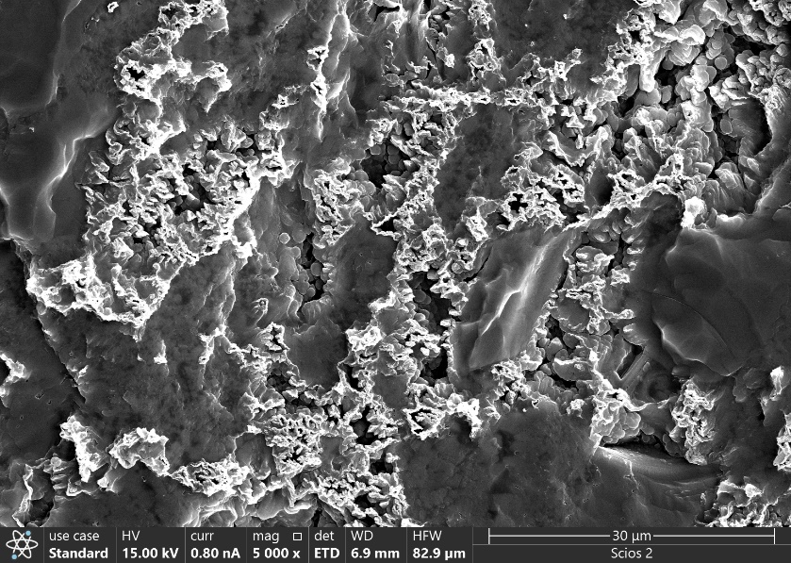


Conclusions and discussions
Micro‑Mesoscale Experimental Results— low dissolution pore content(1#)
Sample 1# is characterized by a low content of dissolution pores and generally poor pore development. Dissolution pores are mostly distributed near the boundary, with two irregular dissolution pores larger than 4 mm in radius developed in the upper to middle part, and the maximum dissolution pore radius is 7.49 mm.
The microscopic pores inside Sample 1# are mainly strip‑shaped intergranular pores, among which the largest micropore has a diameter of 551.7 μm. This micropore is filled with organic matter, lacks communication via micro‑fractures, and exhibits poor interconnection with each other.
V/mm³
large dissolution pores
Dissolution pore zone
3$μm$
middle dissolution pores
Intergranular pore zone
Oil droplet
Large
volume
Middle
volume
Small
volume
30$μm$
2D grayscale image
3D digital core image
SEM micrograph

Slide 10

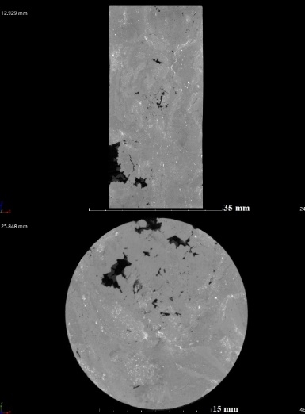
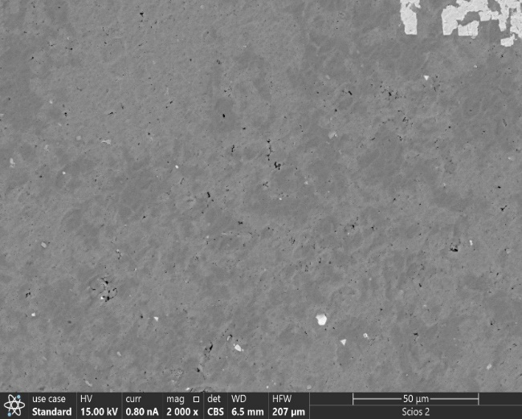

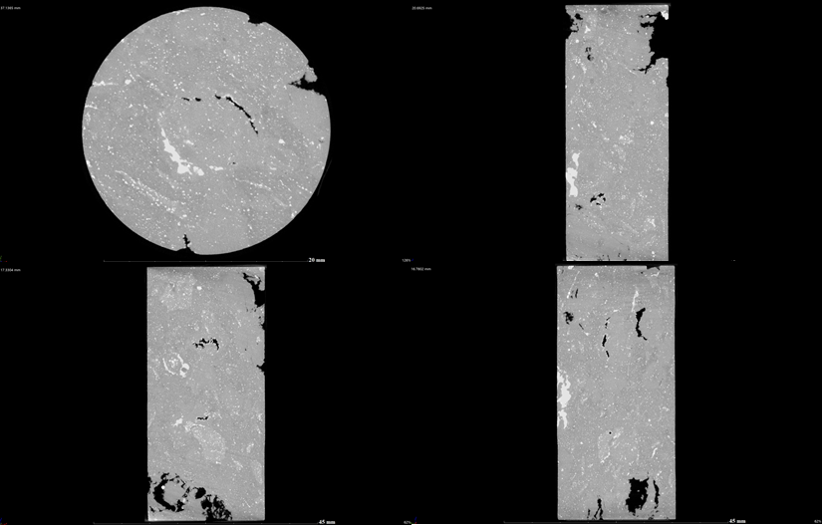
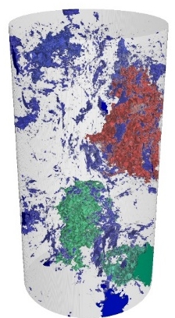
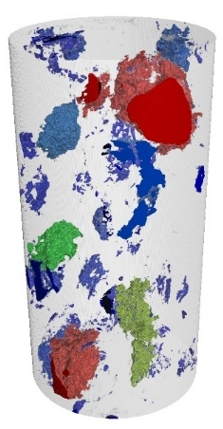


Conclusions and discussions
Micro‑Mesoscale Experimental Results— middle dissolution pore content(2#/3#)
Samples 2# and 3# are dominated by small‑sized dissolution pores that are uniformly distributed within the core. The dissolution pore volumes account for approximately 9% and 14% of the sample volume, respectively. Micro‑fractures connect the small pores in the middle part, forming a relatively large storage space. The micro-fracture network exhibits directional extension at 30° to the vertical.
Sample 2# develops more micro‑fractures with good connectivity, but dissolution pores are poorly developed. Sample 3# develops both dissolution pores and micro‑fractures; the dissolution pores are polygonal in shape, and the pore connectivity is relatively good.
Large
volume
Middle
volume
Small
volume
Large
volume
Middle
volume
Small
volume
middle dissolution pores
Dissolution pore zone
Dissolution pore zone
Micro-crack
Intergranular pore zone
30$μm$
50$μm$
Experimental image of Core 2#
Experimental image of Core 3#

Slide 11
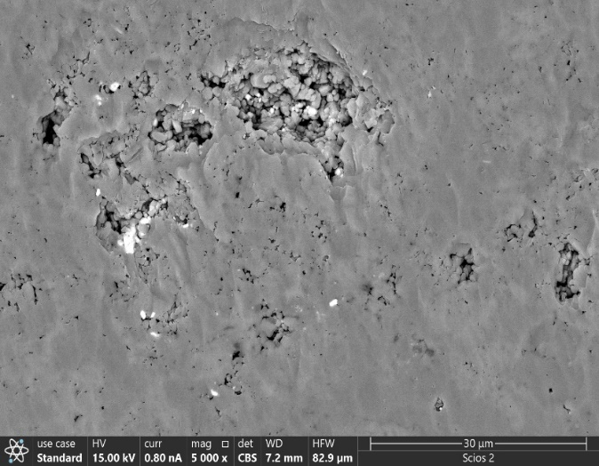
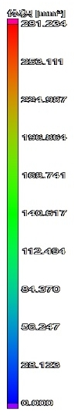
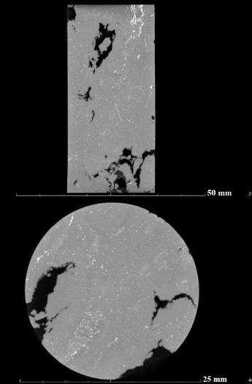
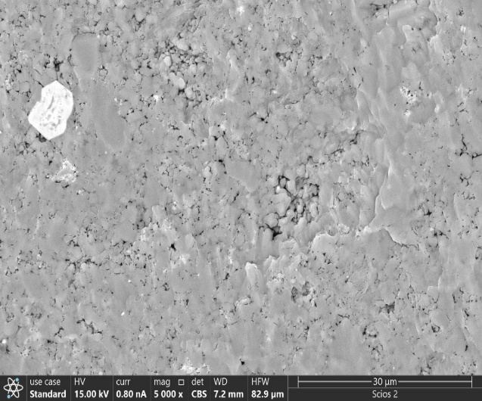

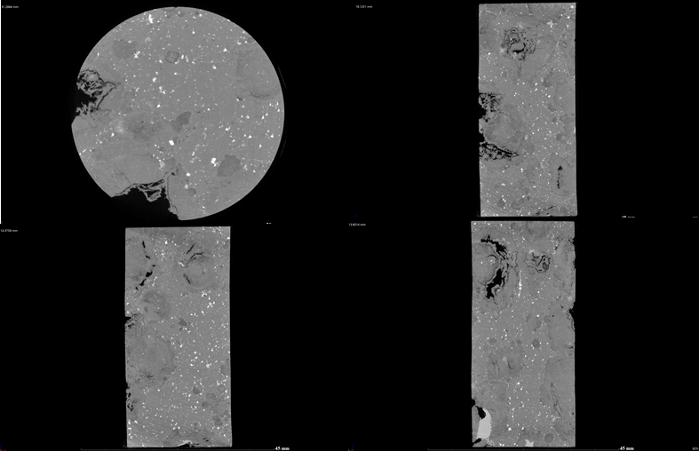
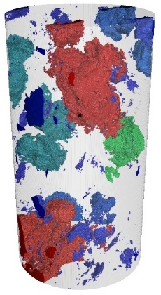
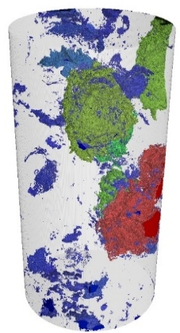
Conclusions and discussions
Micro‑Mesoscale Experimental Results— high dissolution pore content(4#/5#)
Samples 4# and 5# exhibit relatively high and uniformly distributed dissolution pore contents. The dissolution pore volume of Sample 4# accounts for approximately 40% of the sample volume, with no micro‑fractures connecting the pores. Sample 5# develops larger dissolution pores throughout the sample.
SEM results show that micro‑ and nano‑scale dissolution pores are mostly polygonal or circular, while intergranular pores are mostly triangular or strip‑shaped. The well‑developed micro‑vug and micro‑fracture assemblages inside the cuttings with high dissolution pore content are favorable for hydrocarbon storage and migration, resulting in a high degree of hydrocarbon enrichment and good connectivity.
Large
volume
Middle
volume
Small
volume
Large
volume
Middle
volume
Small
volume
Dissolution pore zone
Dissolution pore zone
middle dissolution pores
Intergranular pore zone
Organic matter filling
Intergranular pore zone
Dissolution pore zone
30$μm$
30$μm$
Experimental image of Core 4#
Experimental image of Core 5#

Slide 12
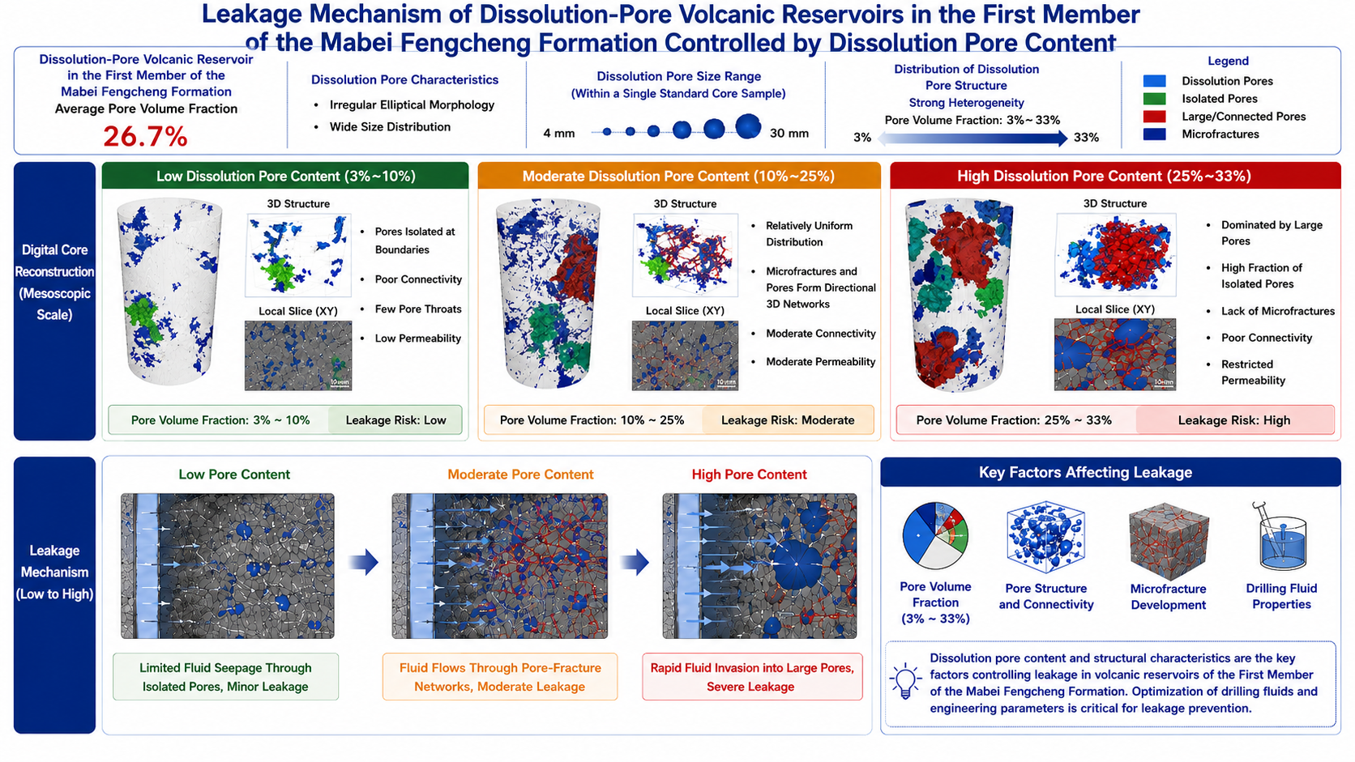

Conclusions and discussions
Lost Circulation Mechanism Dominated by Meso-microscale Pore Structures
The dissolution pore-type igneous reservoir in the Mabei Feng-1 Member has an average pore volume fraction of 26.7%. The dissolution pores exhibit irregular ellipsoidal structures u'jwith a wide range of sizes. Within a single standard core plug, the dissolution pore volumes range from 4 mm to 30 mm. The distribution of dissolution pore structures is highly heterogeneous, with pore volume fractions varying from 3% to 33%.
In samples with low dissolution pore content, the pores are isolated and distributed near the boundary. In samples with medium dissolution pore content, the pores are uniformly distributed, and micro-fractures together with dissolution pores form a directional three-dimensional fracture‑vug network. In samples with high dissolution pore content, large pores dominate, the proportion of isolated pores is high.
Sample | Depth/m | Maximum dissolution pore radius/mm | Dissolution pore volume fraction | Pore-fracture connectivity
Low dissolution pore content | 4920.0 | 7.49 | 1%-4% | Locally networked fracture-vug structures with poor inter-connectivity
Middle dissolution pore content | 4904.2/ 4932.0 | 10.78-11.83 | 9%-20% | Micro-fractures connecting small pores in the middle create considerable storage space
High dissolution pore content | 4907.8/ 4935.6 | 11.42-11.60 | >20% | Large pores are isolated with few micro-fractures connecting them

Slide 13
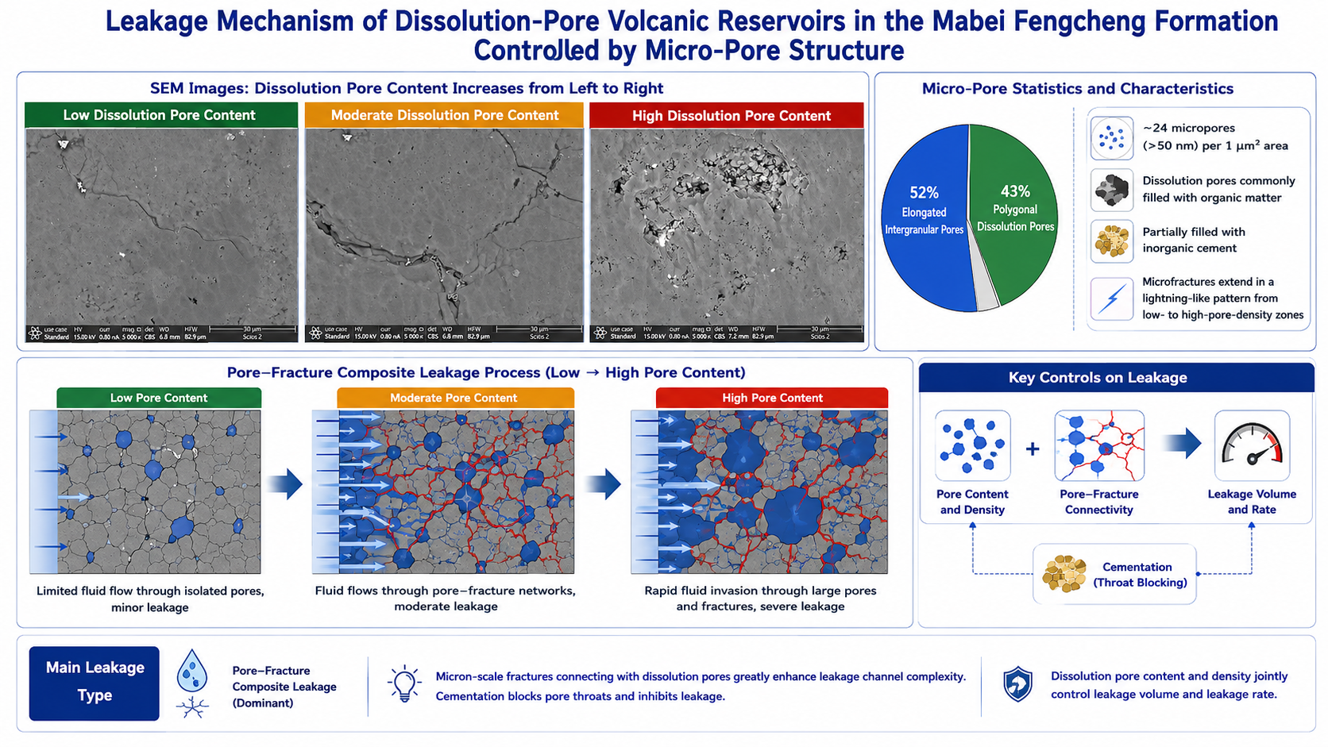
Conclusions and discussions
Lost Circulation Mechanism Dominated by Meso-microscale Pore Structures
Polygonal dissolution pores account for 43% of the micropores, while strip-shaped intergranular pores account for 52%. Approximately 24 micropores with diameters larger than 50nm are developed per square micrometer. The interiors of dissolution pores are mostly filled with organic matter, and some are partially cemented by inorganic cements. Micro-fractures extend in a lightning-like pattern from low-dissolution-pore-density areas to high-density areas.
The dominant lost circulation type is pore-fracture composite loss. The loss amount and loss rate are synergistically controlled by the content and density of dissolution pores. The connection between micron-scale micro-fractures and dissolution pores significantly enhances the complexity of loss pathways, whereas cements inhibit loss by blocking throats.
Sample | Depth/m | Lithology | Characteristics of natural micro-fractures
Low dissolution pore content | 4920.0 | Basalt/ Ignimbrite | No obvious fractures observed
Middle dissolution pore content | 4904.2/ 4932.0 | Ignimbrite | Dissolution pores and micro-fractures developed
High dissolution pore content | 4907.8/ 4935.6 | Ignimbrite /Welded breccia | Micro-fractures poorly developed, with locally distinct network fracture-vug structures

Slide 14
Conclusions and discussions
Statistics of lost circulation in dissolution pore-type igneous rocks
During drilling of the igneous reservoir in the Fengcheng Formation, the average drilling fluid density was 1.24 g/cm³, the average lost circulation rate was 22.3 m³/h, and the average lost circulation volume was 148.2 m³.
Losses were mainly concentrated in the middle-upper part of the Feng-1 Member (at depths of 4800–5000 m), where dissolution pores and fractures are relatively well developed, and the loss frequency accounted for more than 80% of total loss events.
Lithology influences lost circulation behavior. As a pyroclastic rock, tuff contains pores and joint fractures and is prone to forming wide fractures (0.5–3 mm) after fracturing, resulting in a relatively high lost circulation rate. The average loss rate is 28 m³/h, and the loss frequency accounts for 45% of total loss events, mainly occurring in the upper to middle intervals.
In the interval of 4896–4910 m, which has a relatively high dissolution pore content, the average loss rate was 26 m³/h, which is 16.6% higher than the overall average, and the average loss volume was 179.7 m³, which is 21.2% higher than the overall average.
Number | Depth /m | Lithology | drilling fluid density /g/cm³ | lost circulation rate/ m³/h | lost circulation volume /m³
1 | 4896 | Ignimbrite | 1.23 | 30 | 230
2 | 4906 | Volcanic breccia | 1.23 | 19-33 | 124
3 | 4910 | Ignimbrite | 1.25 | 26 | 185
4 | 4913 | Volcanic breccia | 1.24 | 22 | 132
5 | 4921 | Vesicular basalt | 1.24 | 13 | 70

Slide 15
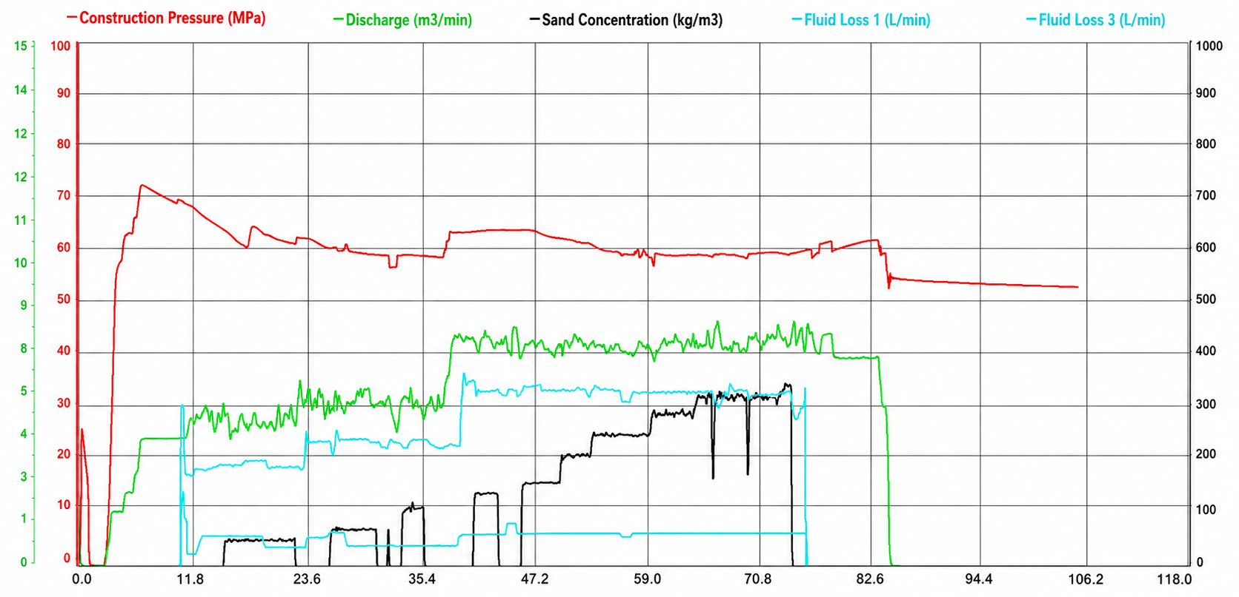
Conclusions and discussions
Oilfield Application—Field fracturing curve analysis (Well Maye 1)
Field fracturing（Well Maye 1) shows that higher vug density intensifies wellbore stress concentration, promoting fracture penetration through vugs with significant pressure fluctuations and increased fracture network complexity.
In high-dissolution-pore zones, fractures connecting isolated large vugs cause a sharp pressure drop and instantaneous fracture fluid loss.
In medium-to-low dissolution-pore zones, fractures extend into pore regions, forming a complex pore network that leads to sustained low-rate fracture fluid loss and a fluctuating declining pressure curve.
Fractures connected to high-dissolution-pore zones cause a marked pressure drop
Fractures propagating into low-dissolution-pore zones lead to sustained low-rate fracturing fluid leak-off.
Higher displacement rate results in minor pressure variation but severe fracturing fluid loss.
Field fracturing curve of Well Maye 1

Slide 16
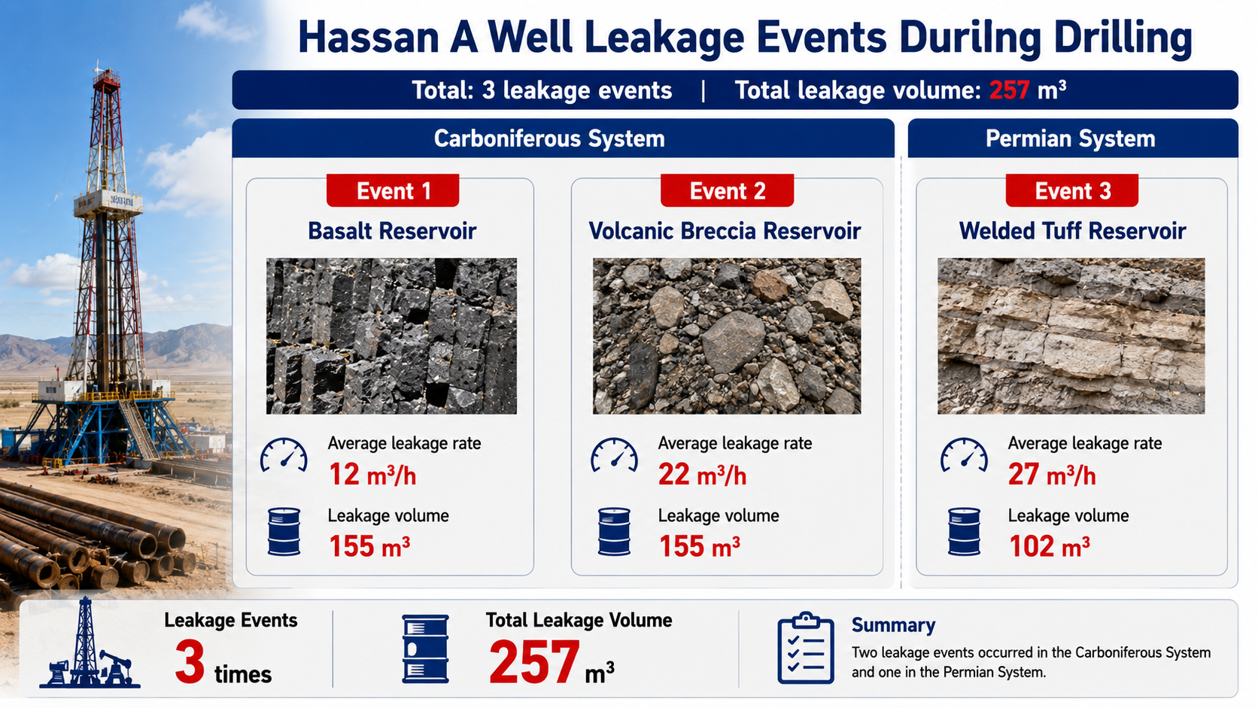
Conclusions and discussions
Oilfield Application—Field lost circulation statistics and LCM formulation (Well Hashan A)
Based on digital core and SEM scanning electron microscopy results, considering vug content, occurrence, and micro‑fracture network distribution, four types of lost circulation materials were formulated—including bridging agents and quick fluid‑loss agents with varying particle sizes and concentrations—and then applied in Well Hashan A, which has the same physical reservoir properties as the Fengcheng Formation in the Mabei region, for field application.
leak-off rate/ m³/h | lost circulation material (LCM) formulation
<5 | Wellbore fluid +3–5% SMLF-1 +3–5% QS-2
5-15 | wellbore fluid +3-5% SMGF-1+3-5% SMLF-1+3-5% QS-2+3-5% rigid lost circulation material+3% SMGQ-3
15-25 | wellbore fluid +8%SMGF-1+3-5%SMLF-1+3-5% QS-2+5-8% rigid lost circulation material+4% SMGQ-3
>25 | Wellbore fluid + 3–5% rigid lost circulation material + 4–8% fibrous material + 5% quick fluid loss material + 0.5–1% crosslinking curing agent

Slide 17
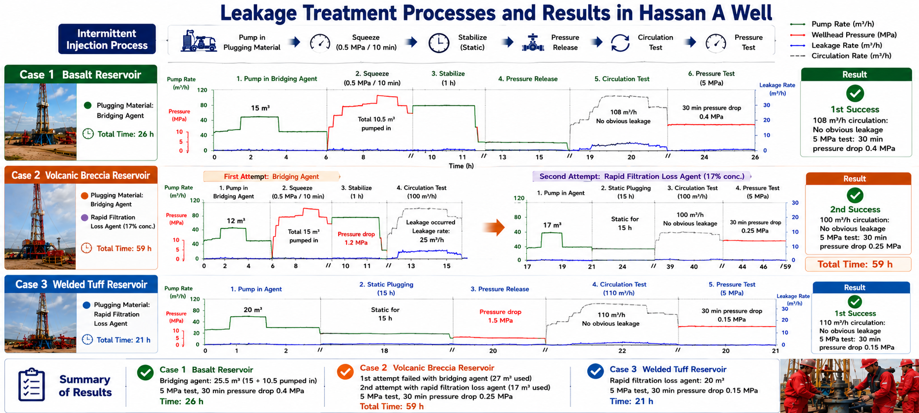
Conclusions and discussions
Oilfield Application—Application and effectiveness evaluation of lost circulation control
Well Hashen A show that bridging lost circulation material successfully sealed the basalt reservoir in one attempt (25.5 m³ used, pressure test of 5 MPa with a 0.2 MPa drop over 30 min). It failed to seal the breccia reservoir (27 m³ used), but a subsequent switch to a quick fluid-loss LCM succeeded (17 m³ used, 0.25 MPa pressure drop). The quick fluid-loss LCM also successfully sealed the tuff reservoir in one attempt (20 m³ used, 0.15 MPa pressure drop, taking 21 hours).

Slide 18
Conclusions and discussions
Conclusions
The igneous formation of the Mabei Feng-1 Member is dominated by pore-fracture composite lost circulation, with losses concentrated in the middle-upper interval at depths of 4800–5000m within the Wuxia fault belt of the western uplift.
For samples with low dissolution pore content, pores are isolated and distributed near the boundary, exhibiting poor connectivity. For samples with medium dissolution pore content, pores are uniformly distributed, and micro-fractures together with dissolution pores form a three-dimensional fracture-vug network, resulting in a high risk of lost circulation.
For samples with high dissolution pore content, large pores dominate and the proportion of isolated pores is high, with permeability limited by the lack of fractures. However, induced fractures generated by pressure fluctuations during drilling can easily connect large dissolution pores, leading to severe lost circulation.
The connection between micro-fractures and dissolution pores significantly enhances the complexity of loss pathways, whereas cements inhibit mud loss by plugging throats.
For tuff formations: 2 mm quick fluid-loss lost circulation material is recommended; For breccia formations: 1 mm quick fluid-loss lost circulation material is recommended; For basalt formations: 1 mm bridging lost circulation material is recommended.

Slide 19
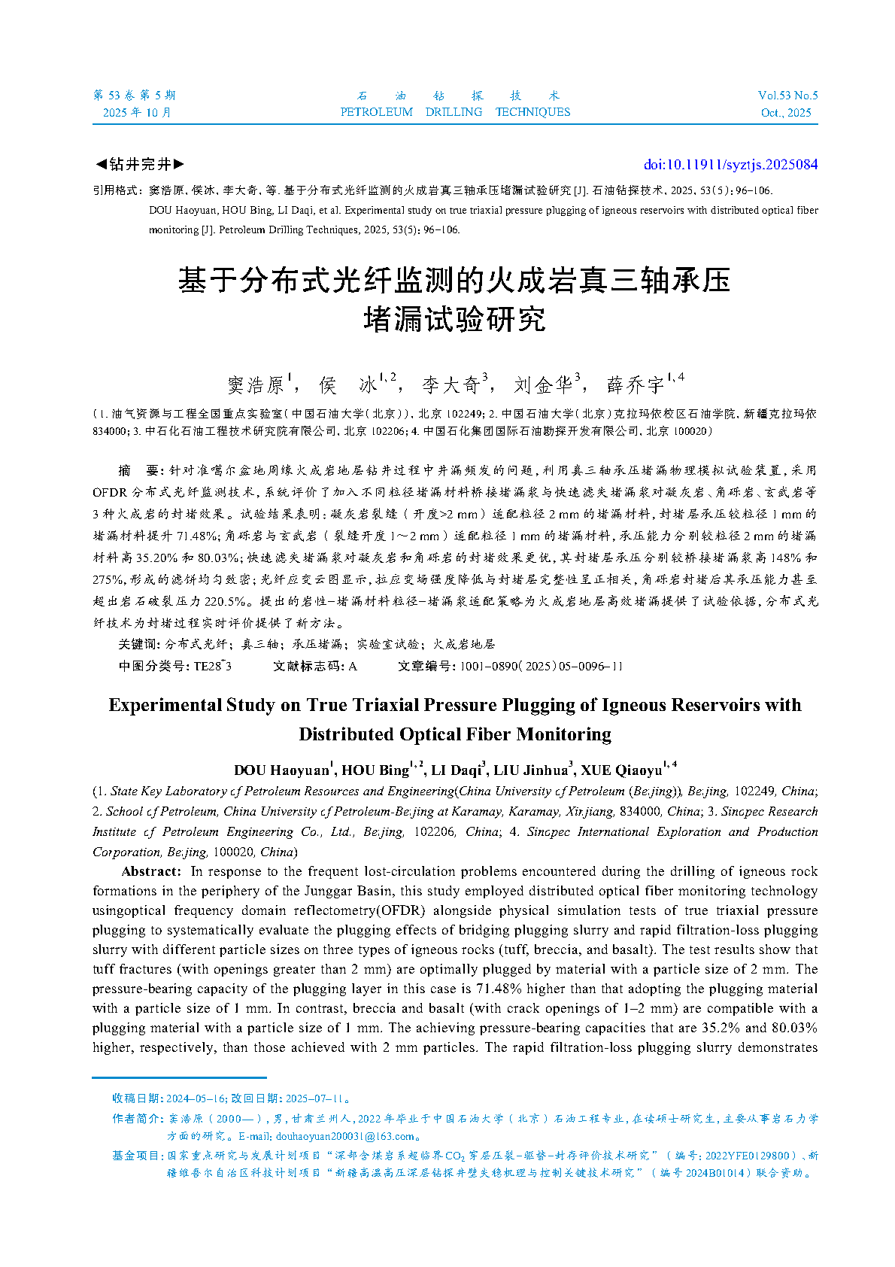
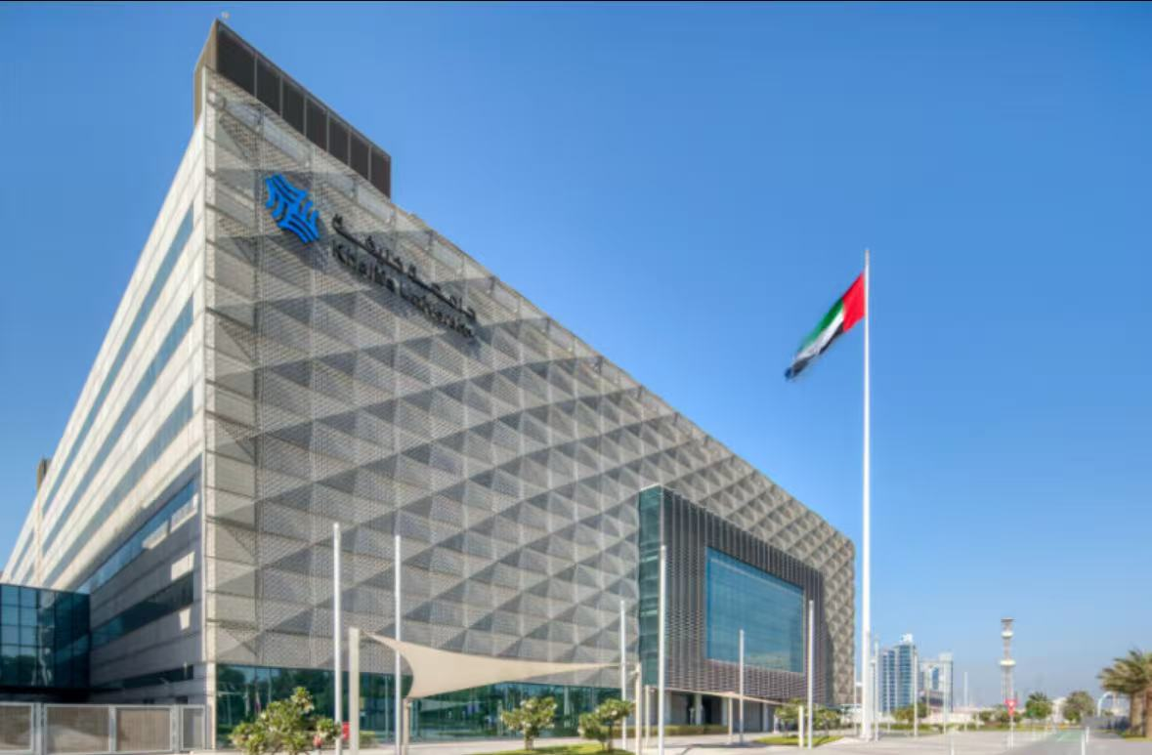
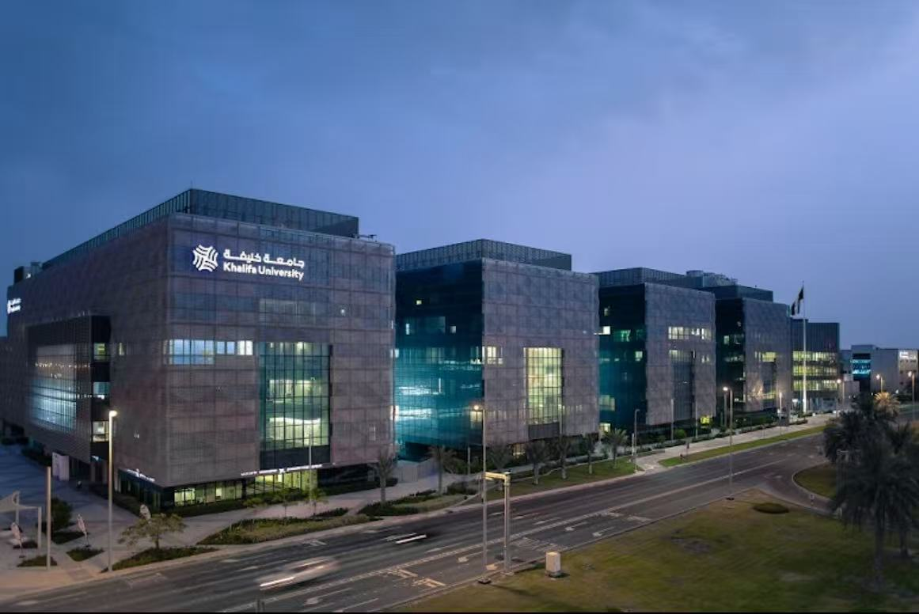
Conclusions and discussions
Discussions
Based on this research, a paper was produced and published in the journal Petroleum Drilling Techniques.
During the research period, I went to Khalifa University in Abu Dhabi, UAE, for a six‑month joint training program on 2024 Jan. , where I worked with Professor Hadi of Khalifa University on physical simulations of pressure‑bearing plugging using distributed fiber optic monitoring.
Future research should further investigate the micro-pore structures of digital rocks, with a focus on the dynamic evolution of rock micro-pores under real reservoir conditions. A four-dimensional model capturing spatiotemporal evolution should be established to provide more targeted guidance for field operations.
Khalifa University
Dou Haoyuan, Hou Bing, Li Daqi, et al. (2025). Experimental study on true triaxial pressure plugging of igneous reservoirs with distributed optical fiber monitoring. Petroleum Drilling Techniques, 53(5), 96-106.

Slide 20


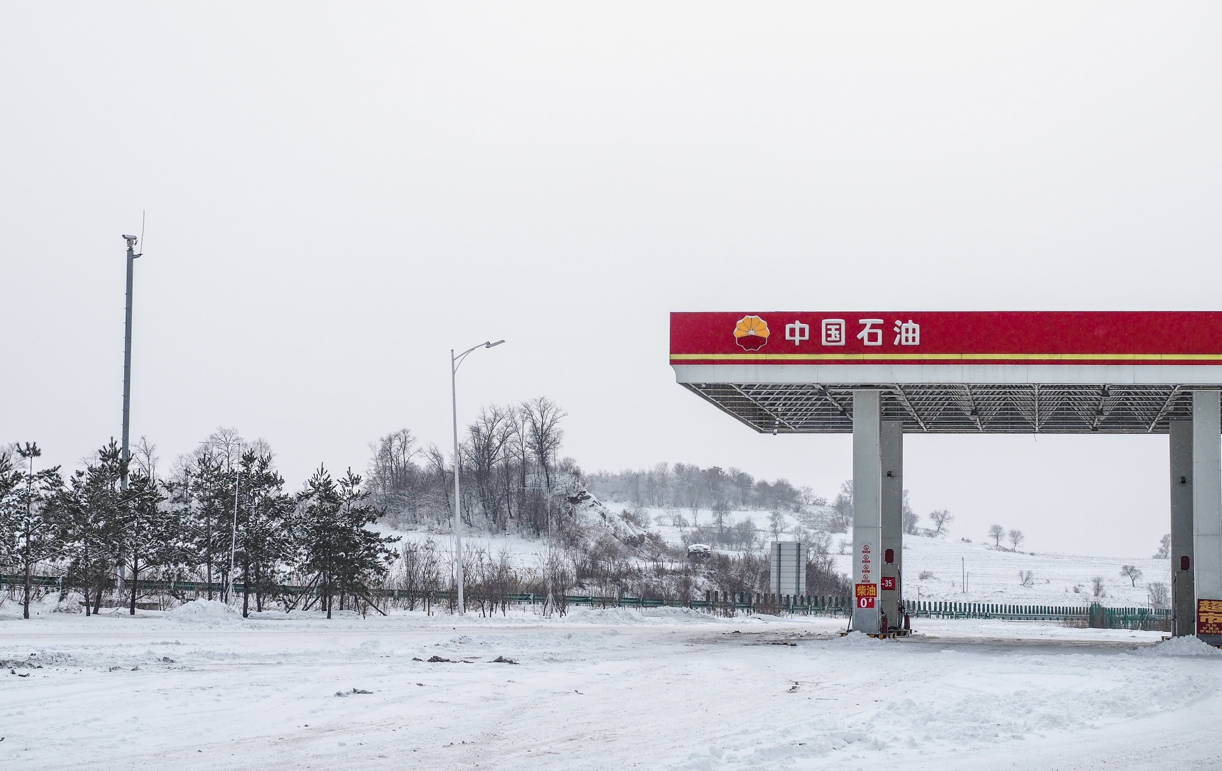
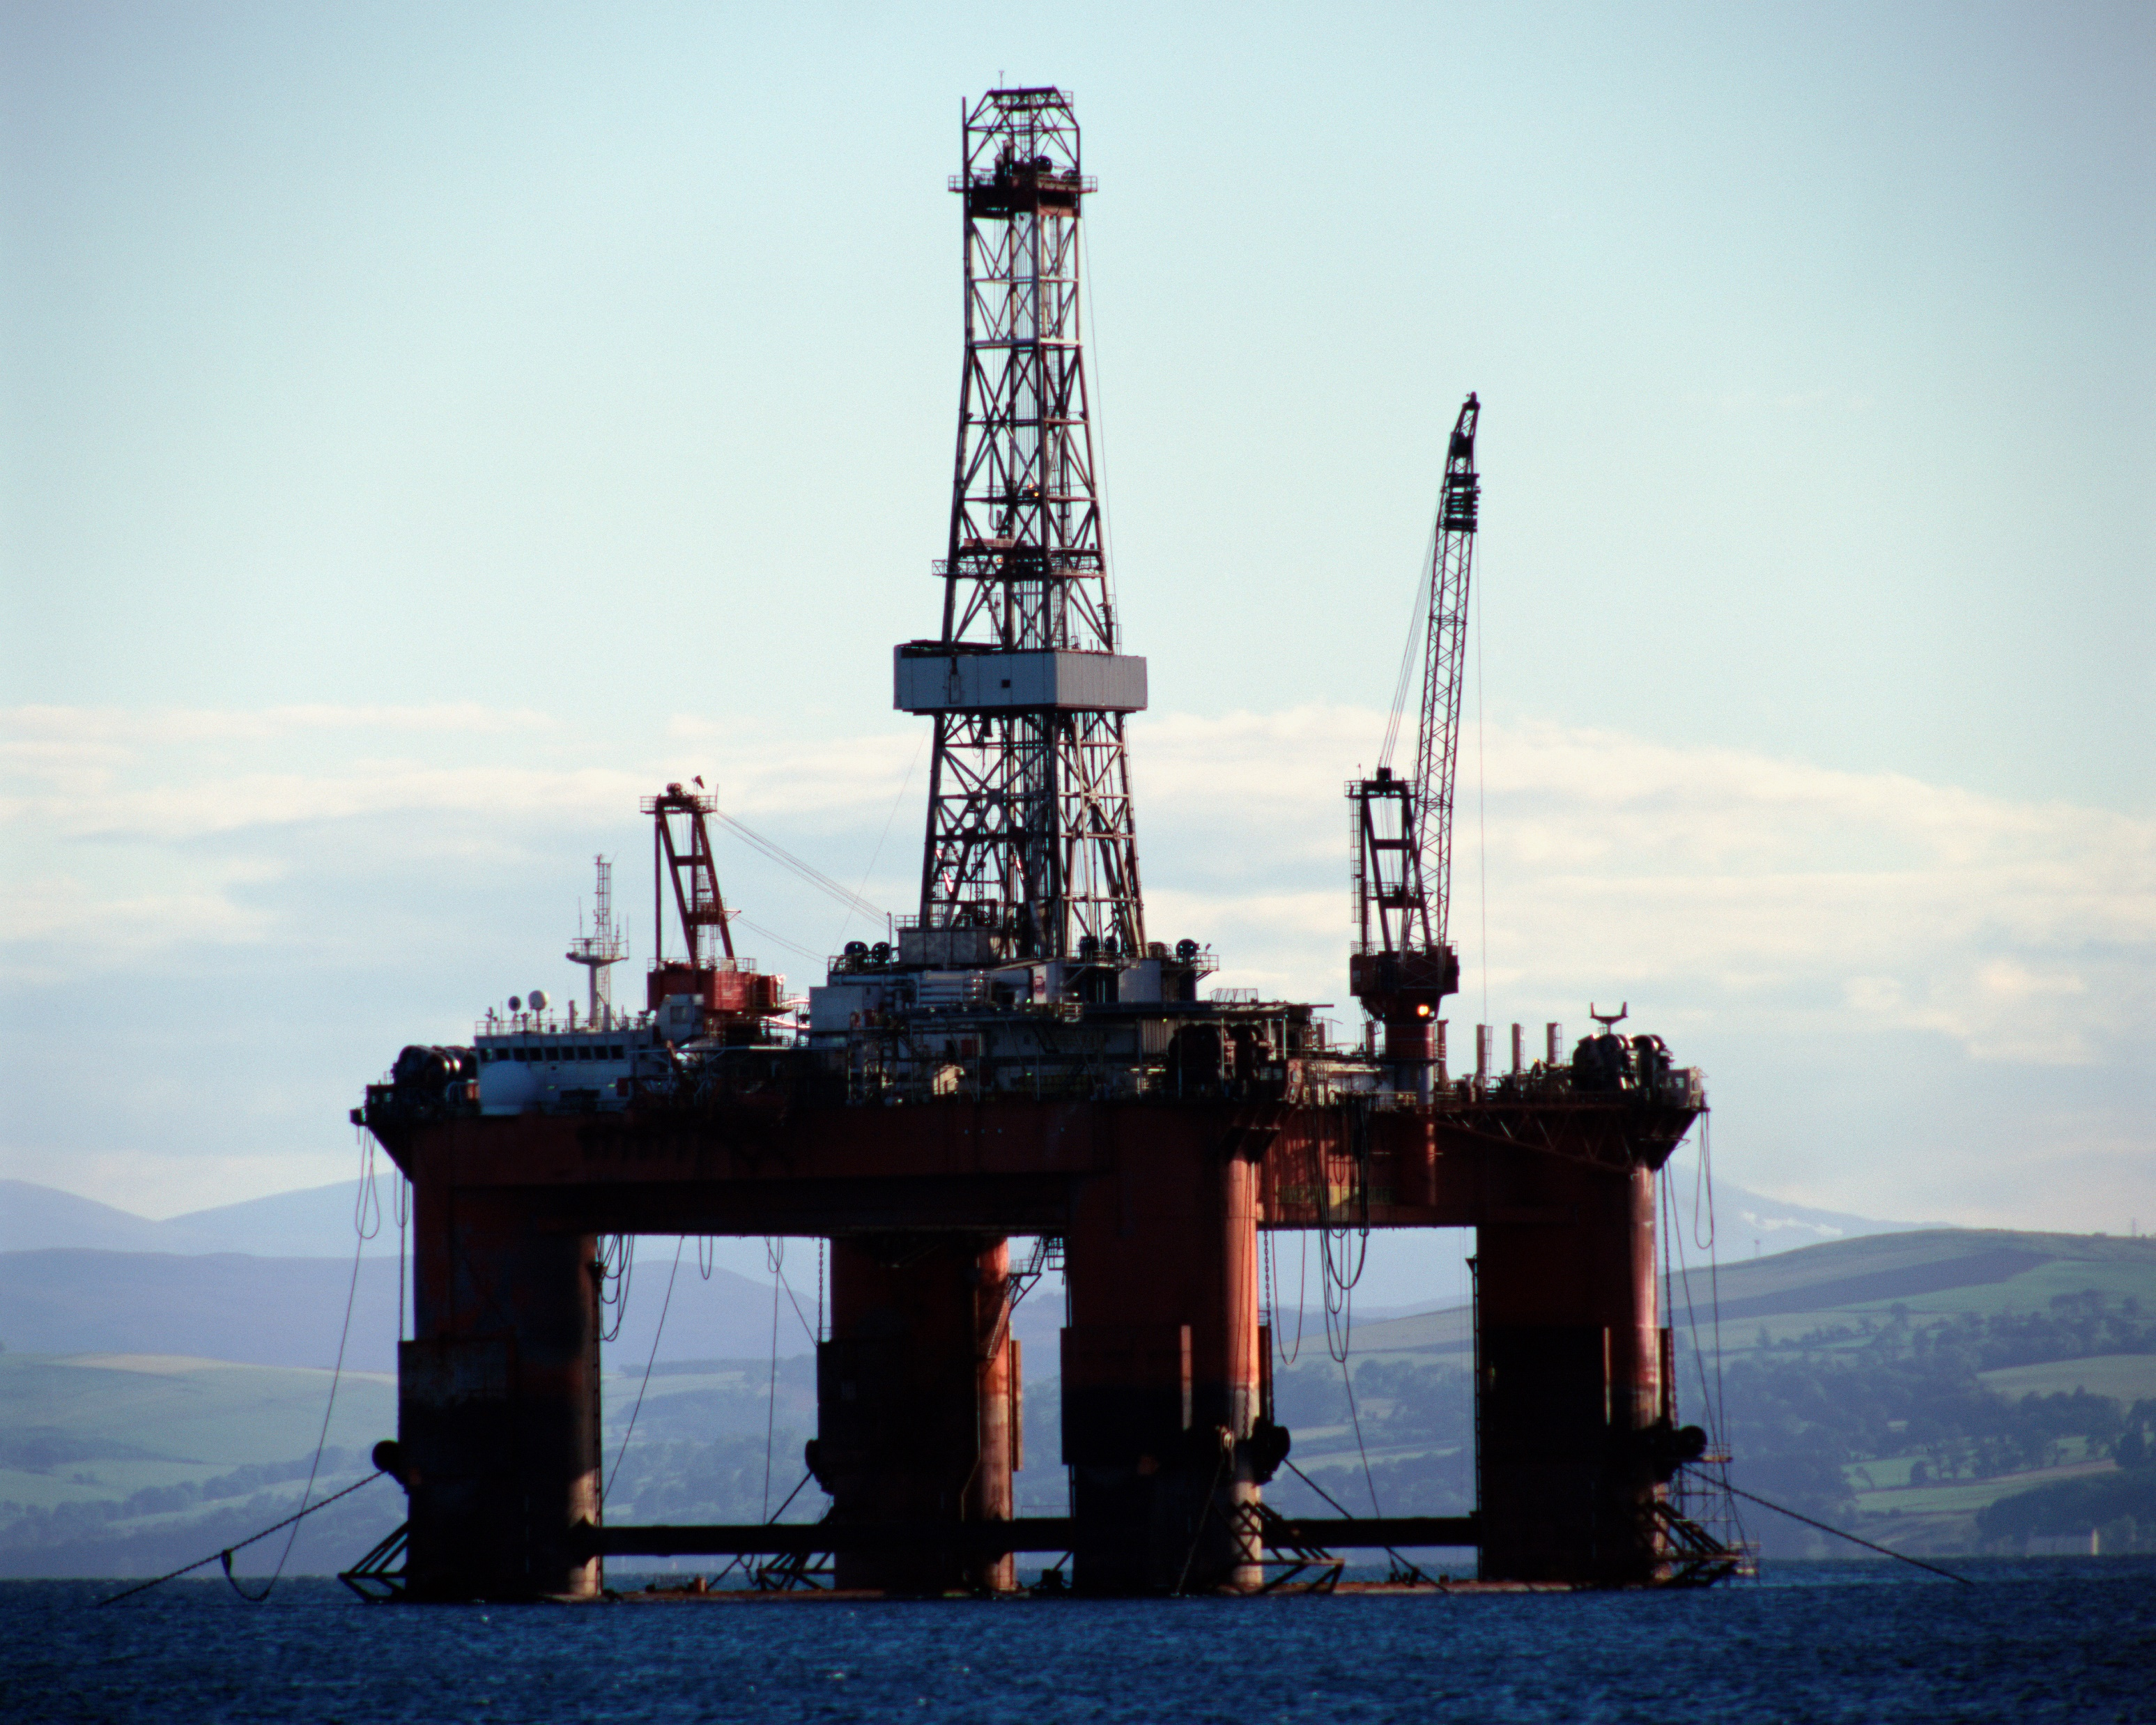
Thanks for listening！

