Slide 1
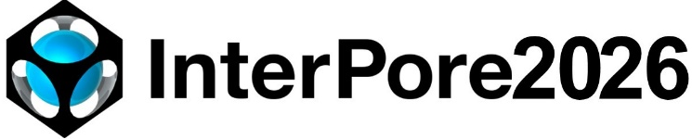
18th ANNUAL MEETING
(MS16) Complex fluid and Fluid-Solid-Thermal coupled process in porous media: Modeling and Experiment
Beyond phenomenology: a micromechanics-based model for rock-like materials within the framework of irreversible thermodynamics and multistep homogenization
Yue SHI^{1,2}, Chi YAO¹ , Wanqing SHEN² , Chuangbing ZHOU¹ , Jianfu SHAO²
1. Engineering Research Center of Water Basin Carbon Neutrality, Nanchang University, China
2. Laboratoire de Mécanique, Multiphysique, Multiéchelle, Université de Lille, France
May 21, 2026

Slide 2
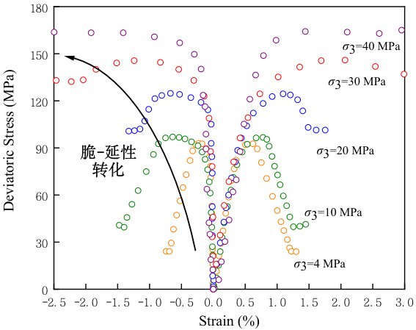
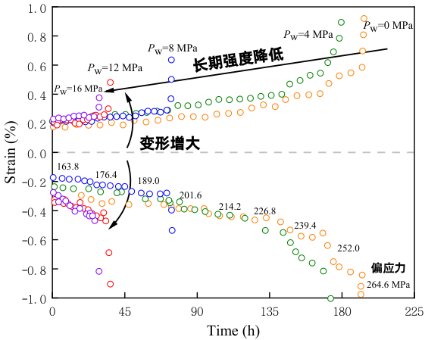
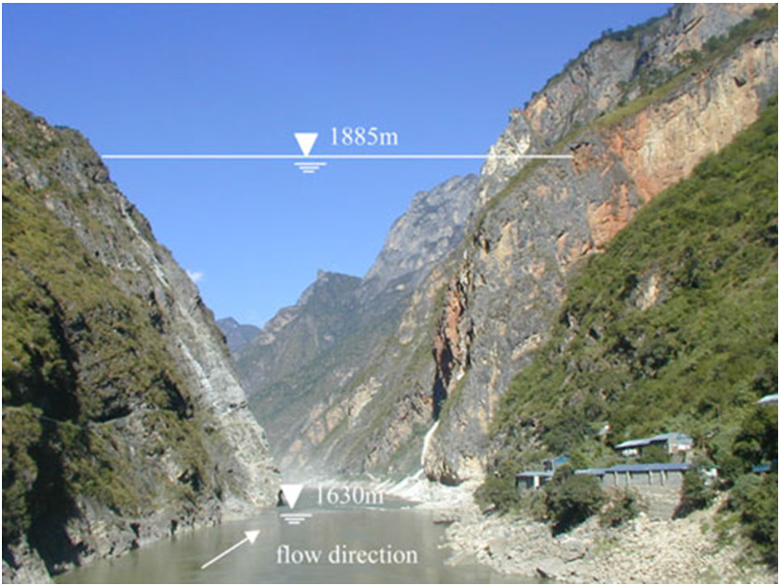
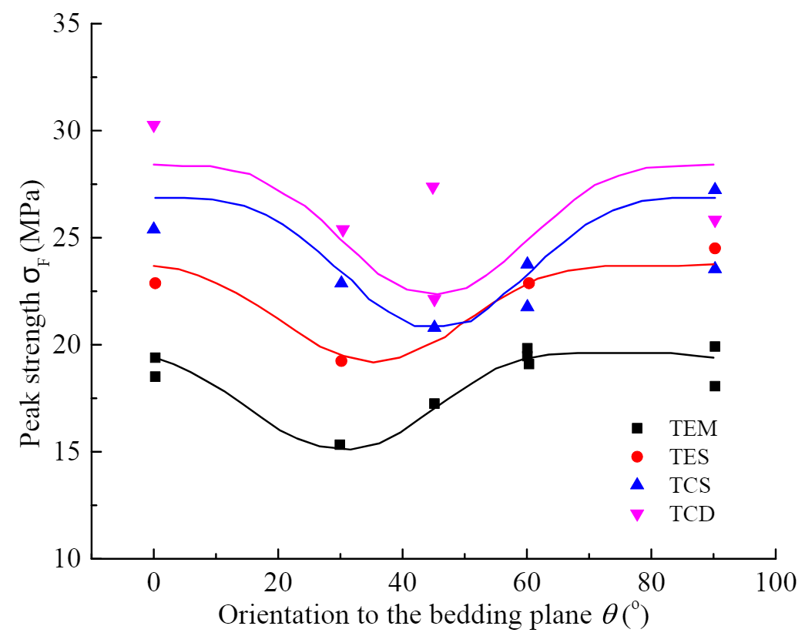
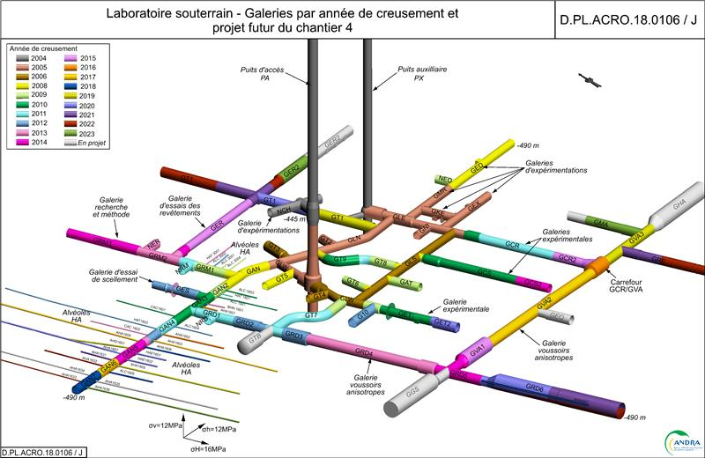
Engineering and scientific background
Mechanical behavior of rock-like materials
Long-term strength decrease
Deformation increase
Brittle-ductile transition
Jinping I Hydropower Station - Marble
Brittle-ductile transition - Liu. 2017
Hydromechanical coupling - Huang. 2022
Anisotropy - Zhang. 2019
How to model rock-like materials ?
Explicit Physics.
Simple Form.
High Efficiency.
Andra Laboratory - COx claystone
Notes:
three bench seven step excavation method

Slide 3
Engineering and scientific background
Existed model for rock-like materials
Phenomenological model
Most models depends on the definition of macroscopic free energy, yield surface, plastic potential, etc
Extend to anisotropy [Chen et al. 2010], time-dependent behavior [Pietruszczak et al. 2004] and THM coupling [Aldakheel. 2017]...
Limited applicability to other materials or beyond data used for calibration
Micro-macro model
Based on the homogenization approach (Dilute, Mori-Tanaka and Ponte-Castaneda-Willis)
Considering microstructural information, such as microcrack, pore and mineral inclusion
Considering the damage from microcrack frictional sliding and mineral-matrix debonding [Zhu et al. 2015, Farhat et al. 2020]
Numerical model
DEM, FFT, PFM, PD, EFEM are visualized technologies and usually require expensive calculation consumption.
Notes:
enriched finite element method
Fast Fourier Transform
discrete element method
Thermo-hydro-mechanical

Slide 4
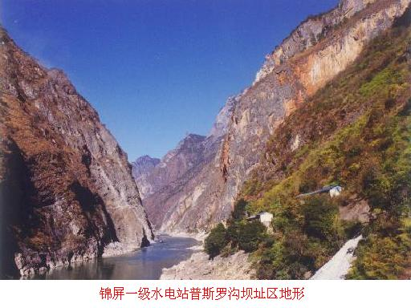
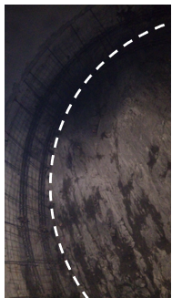
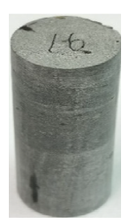
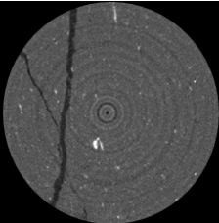
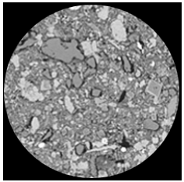
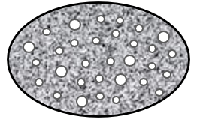
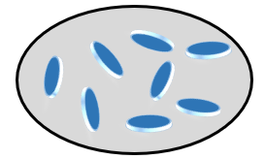
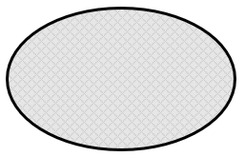
Micromechanics-based model
Representative elementary volume
Unit：m
Macroscale
Mesoscale
Microscale
Nanoscale
10⁻³
10⁻⁶
10⁻⁹
Abutment slope
Tunnel face
Pore
Matrix
Factors are considered for stress and damage state
Circumstance
Microstructure
Load-unload condition
1st
2nd
Homogenization
Homogenization
Mineral
Microcrack
Equivalent homogeneous material

Slide 5












Micromechanics-based model
Homogenization scheme
$$Σ$$
$$Σ=ℂ^{hom}:E$$
$$E$$
$$Macro behavior$$
$Σ=$ $\left\langle σ(\underline{z})\right\rangle$
$$ε(\underline{z})=𝔸(\underline{z}):E$$
$$Homogenizatiozn$$
$$Localisation$$
What local behaviors should be modeled ?
Plastic deformation of matrix
Microcrack propagation
Frictional sliding along microcracks
Debonding along mineral-matrix interfaces
…
$$Local behavior$$
$$σ(\underline{z})$$
$$σ(\underline{z})=ℂ(\underline{z}):ε(\underline{z})$$
$$ε(\underline{z})$$

Slide 6
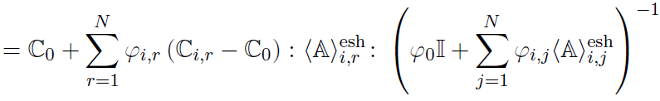

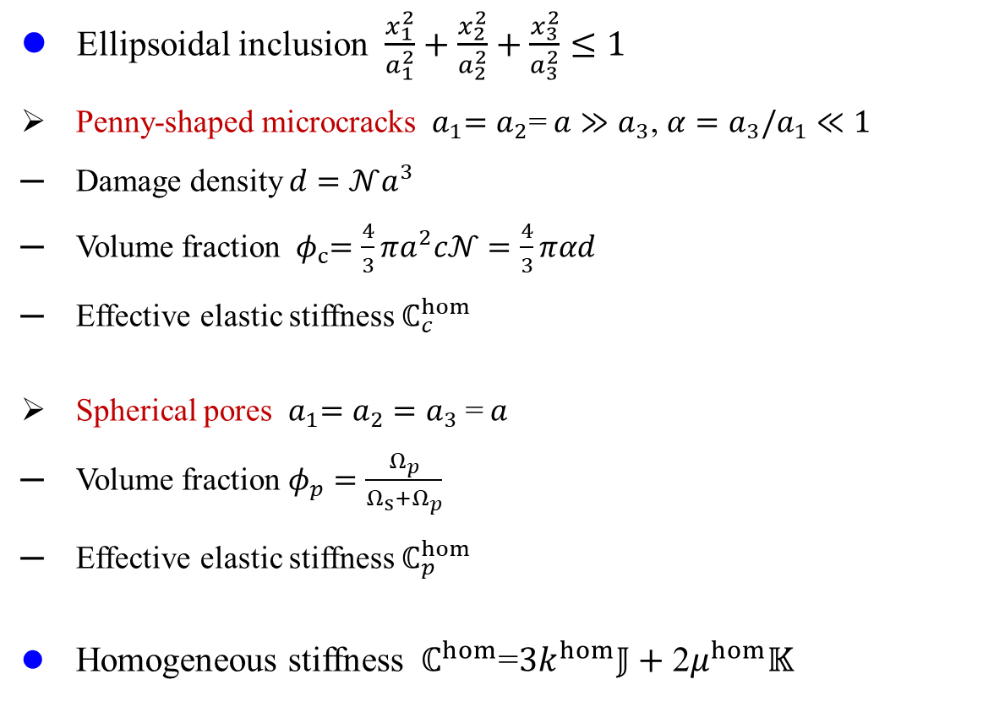



Micromechanics-based model
Model formulation - Microstructure
Ellipsoidal inclusion $\frac{x_{1}^{2}}{a_{1}^{2}}+\frac{x_{2}^{2}}{a_{2}^{2}}+\frac{x_{3}^{2}}{a_{3}^{2}}≤1$
Penny-shaped microcracks ${ a}_{1}=a_{2}$=$a≫a_{3}$, $α=a_{3}/a_{1}≪1$
Damage density $d=𝒩a^{3}$
Volume fraction ${ φ}_{c}=\frac{4}{3}πa^{2}c𝒩=\frac{4}{3}παd$
Effective elastic stiffness $ℂ_{c}^{hom}$
Spherical pores ${ a}_{1}=a_{2}=a_{3} \text{=} a$
Volume fraction $φ_{p}=\frac{Ω_{p}}{Ω_{s}+Ω_{p}}$
Effective elastic stiffness $ℂ_{p}^{hom}$
Homogeneous stiffness ${ ℂ}^{hom}$=$3k^{hom}𝕁+\text{2}μ^{hom}𝕂$
$$Ω$$
$$\underline{\text{n}}$$
a
$$a_{3}$$
d
$$a$$
φ_{p}

Slide 7





Micromechanics-based model
Model formulation – Global and Local behaviors
Irreversible Thermodynamics
Global stress-strain relation
Local stress-strain relation
Damage driven force
Criterion for local behaviors
Microcracks propagation
Porous matrix deformation
Frictional sliding along microcrack surface
Debonding along mineral-matrix interfaces

Slide 8
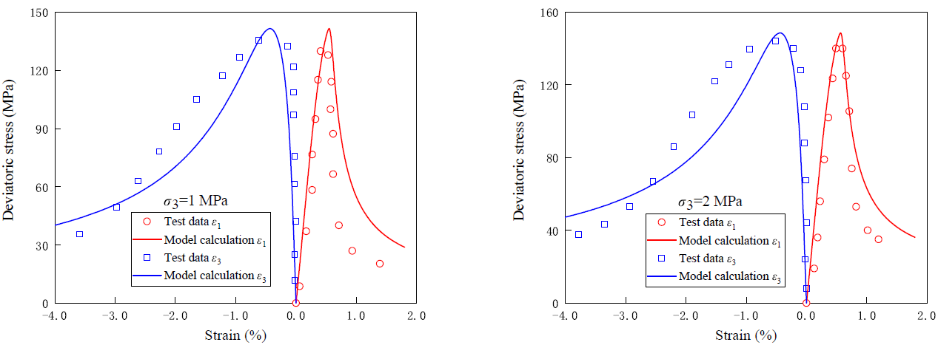
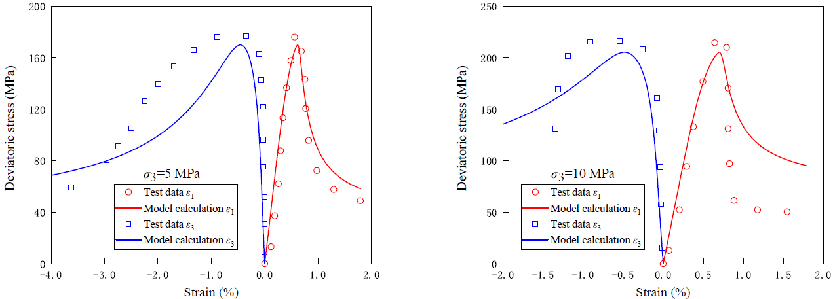
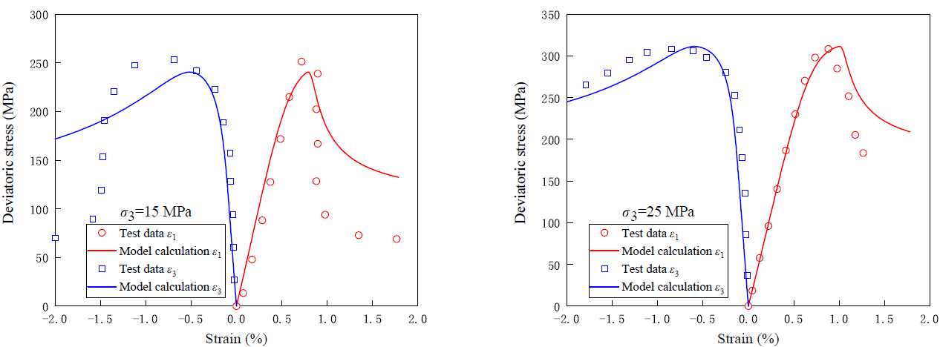
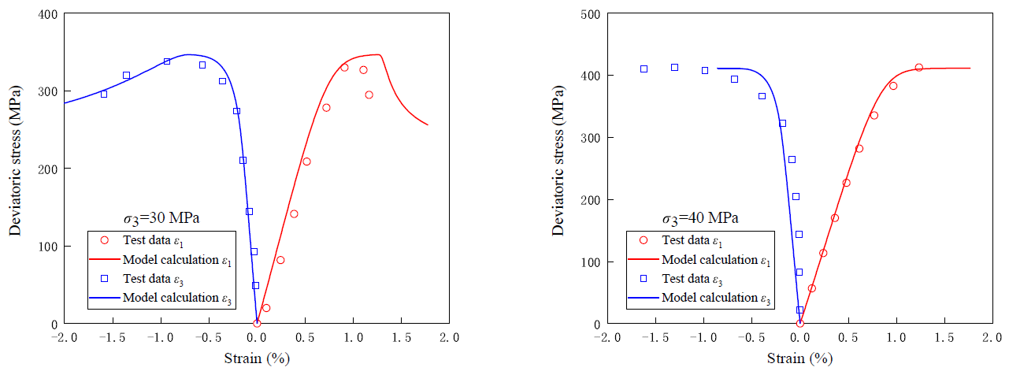
Granite
Wide range of confining pressure

Slide 9
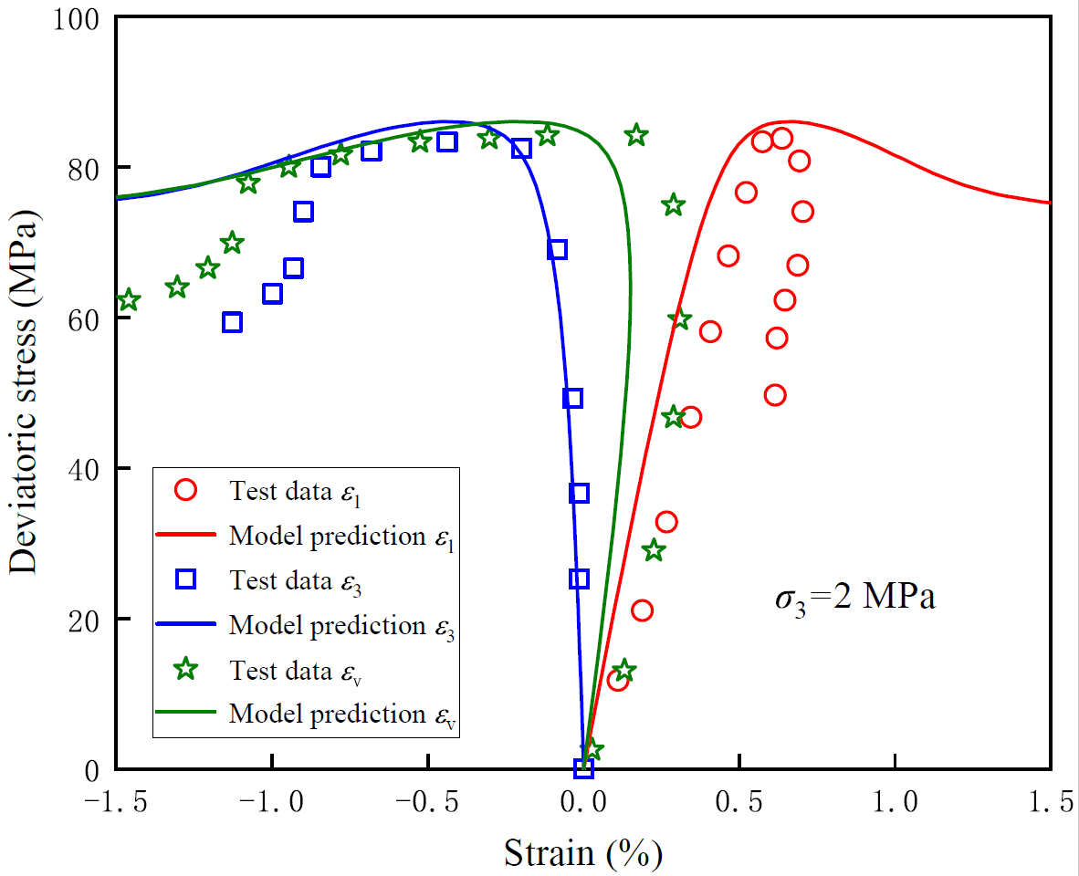
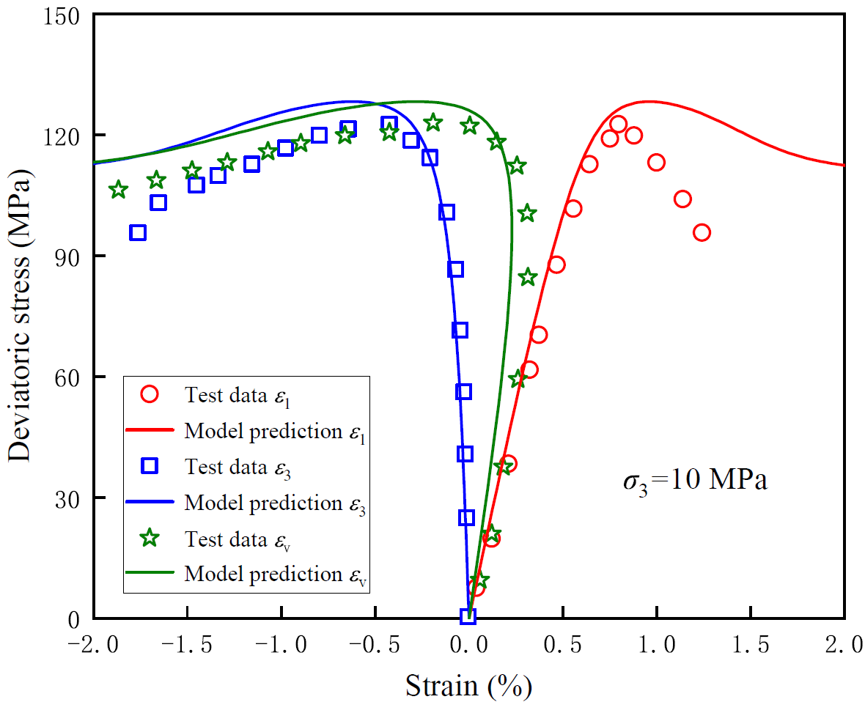
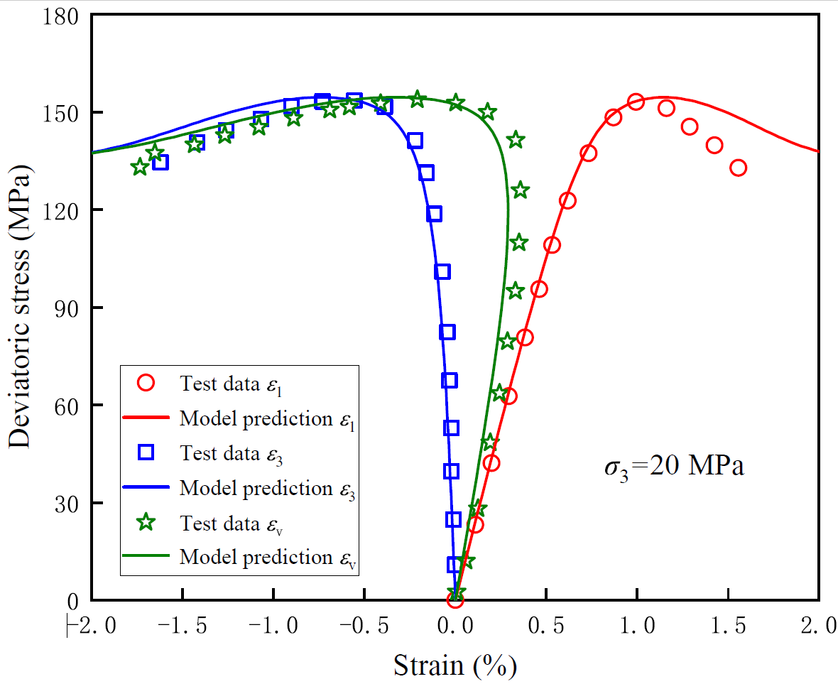
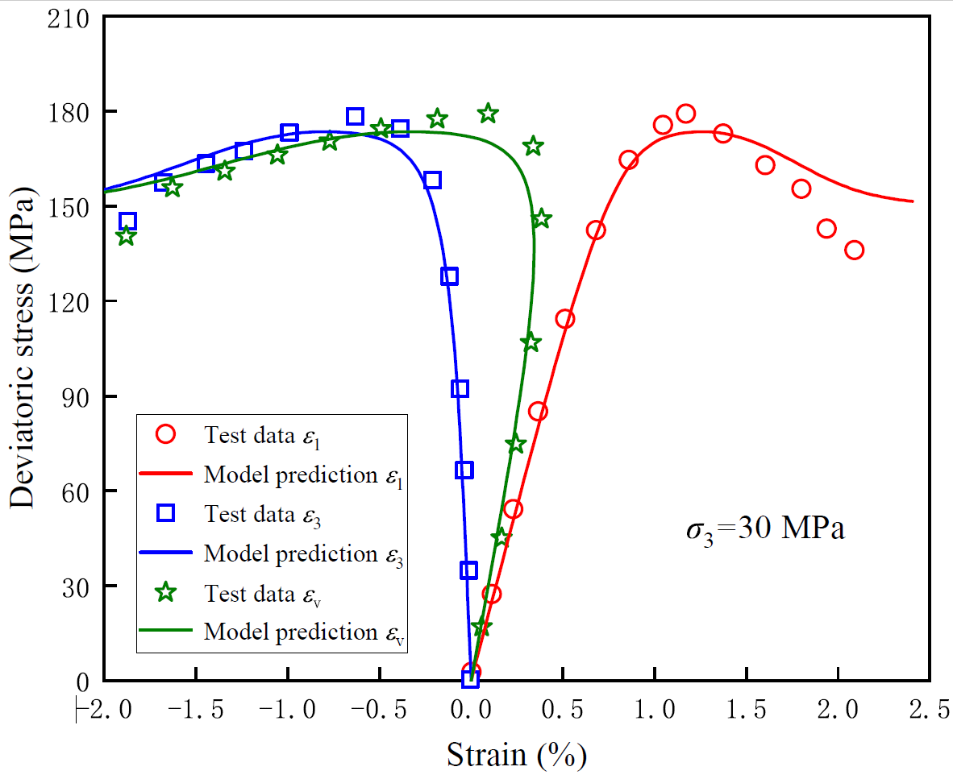
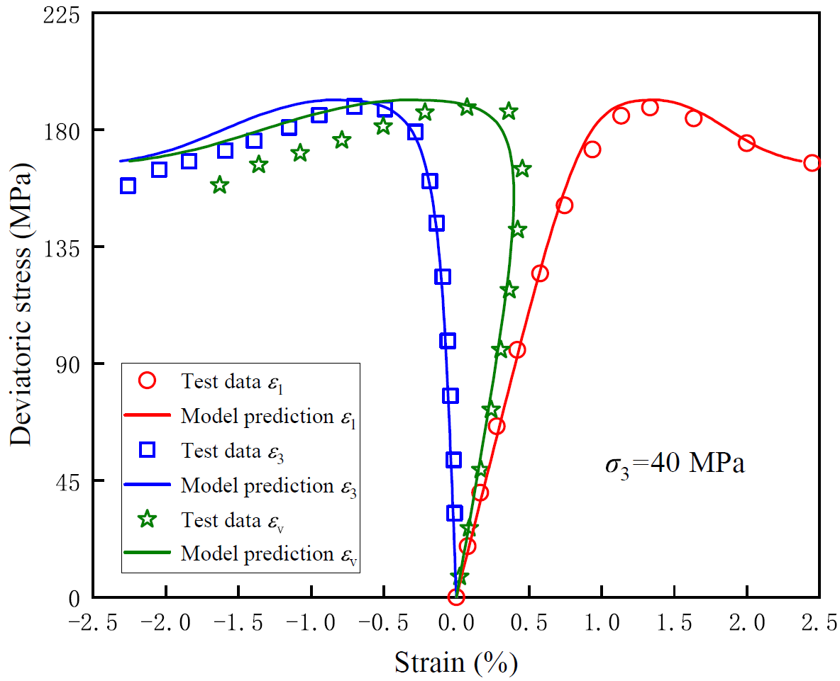
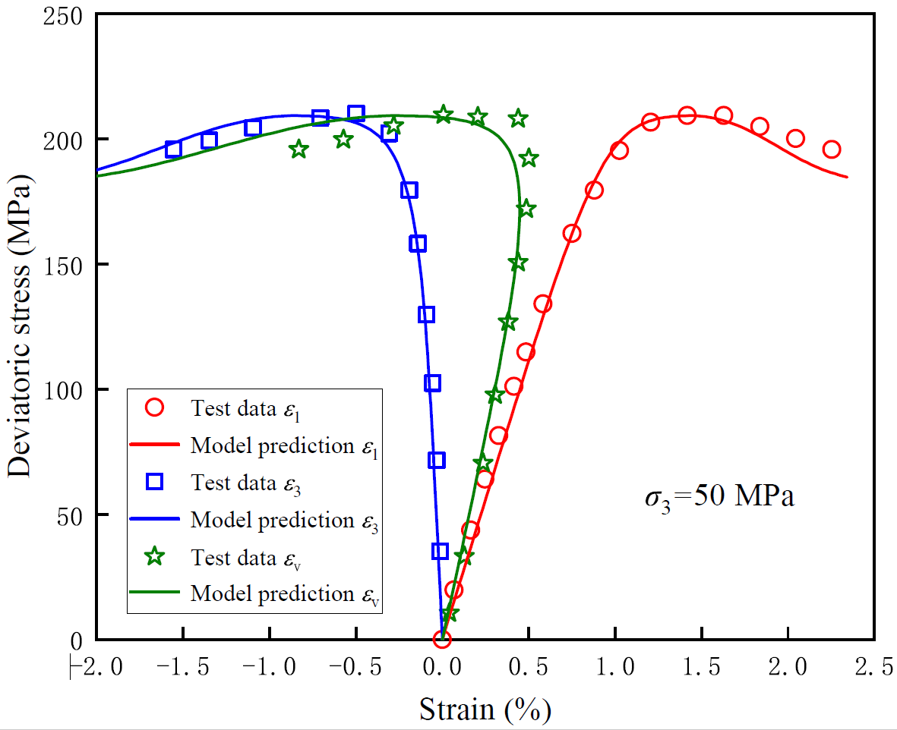
Sandstone
In multiple directions

Slide 10
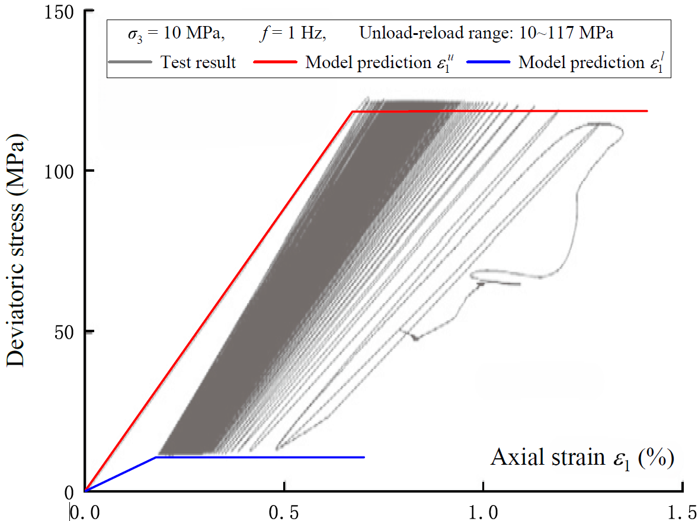
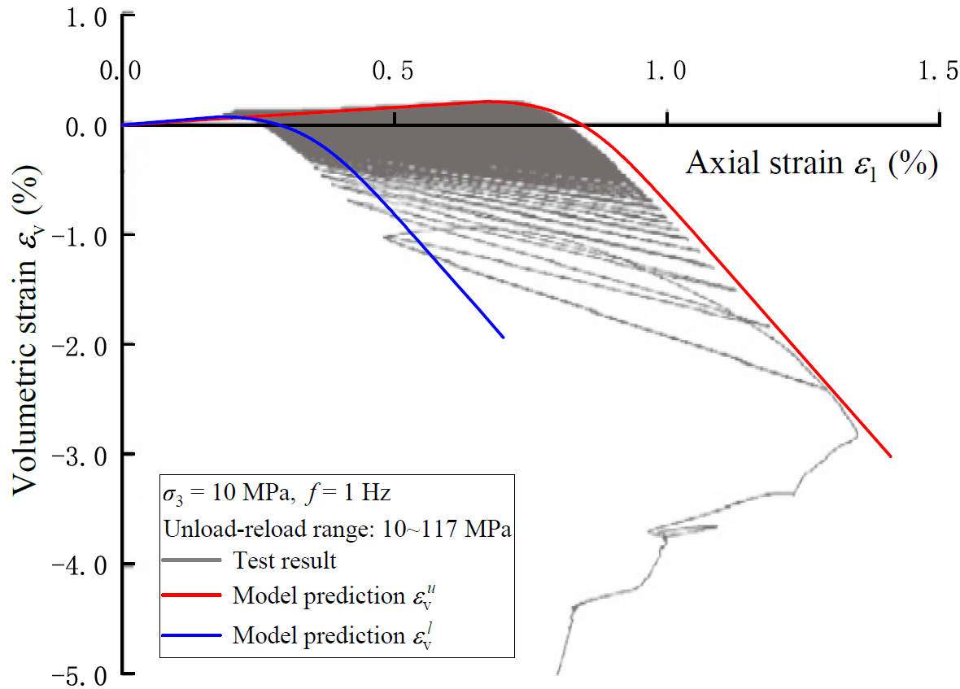
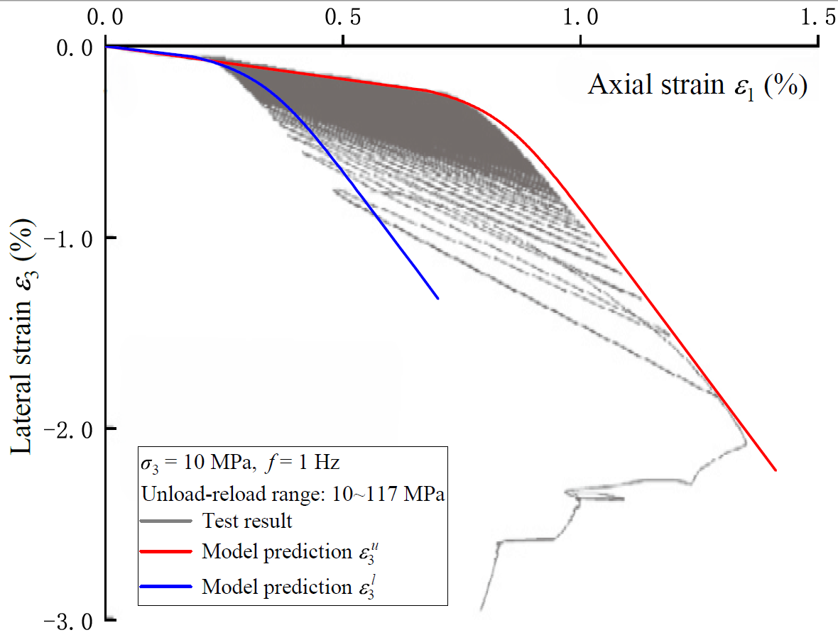
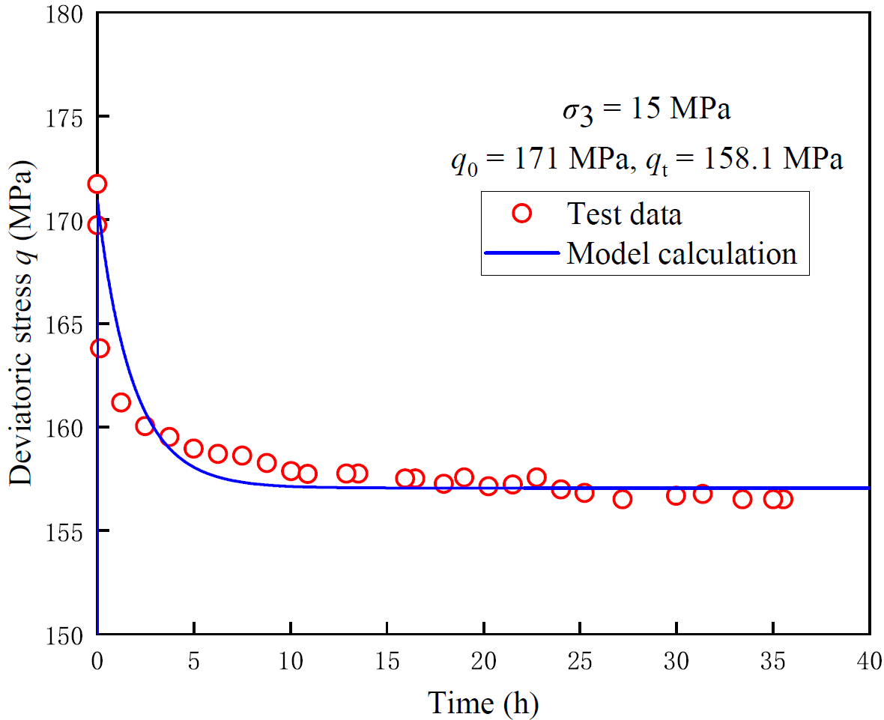
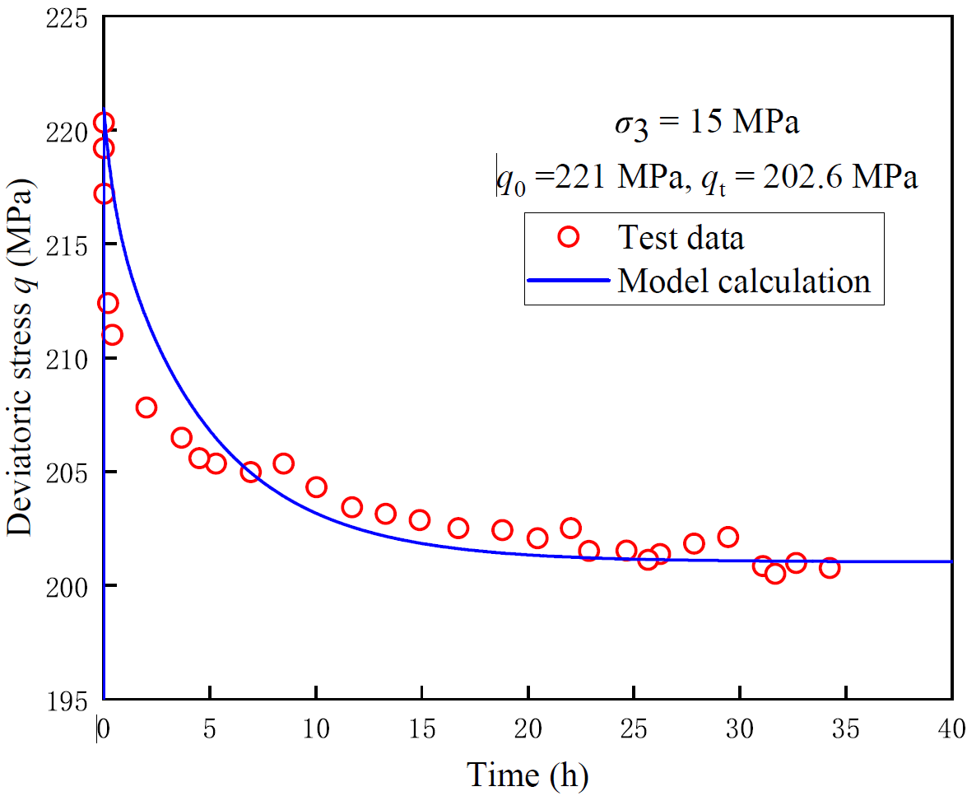
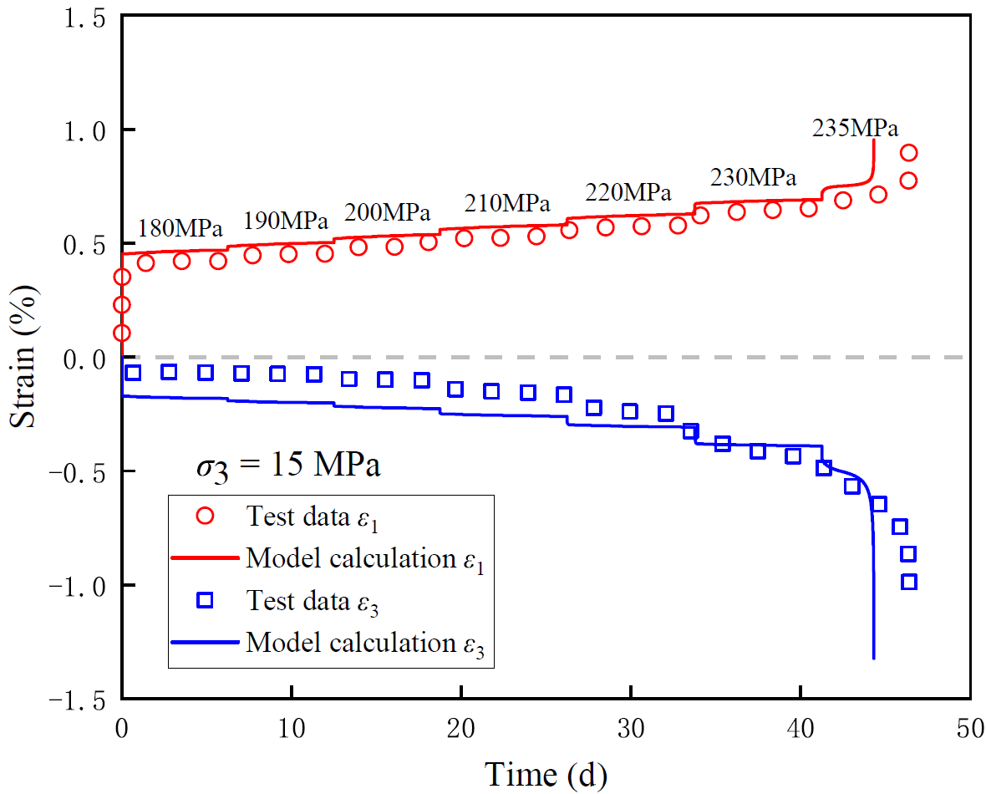
Sandstone and Granite
Time-dependent behaviors

Slide 11
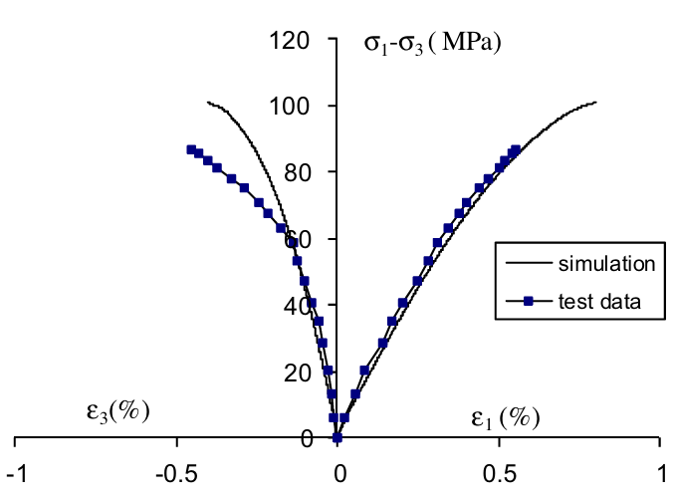
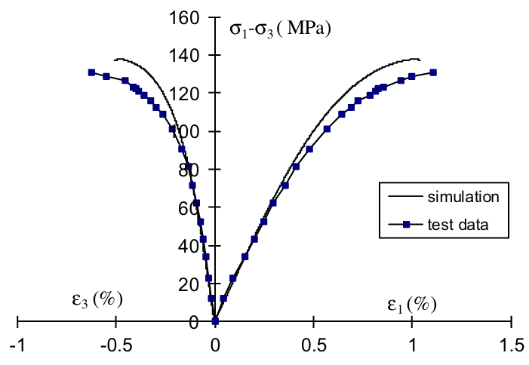
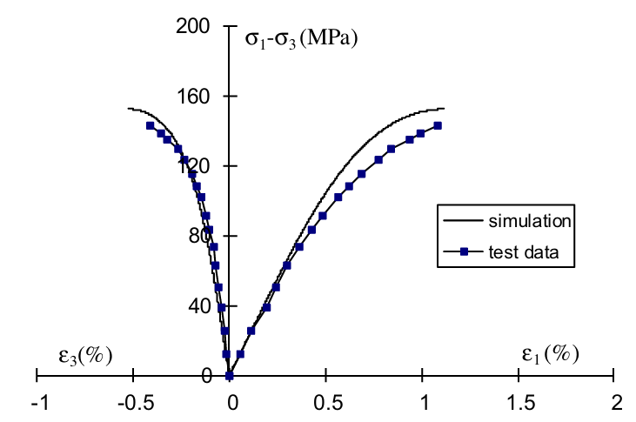
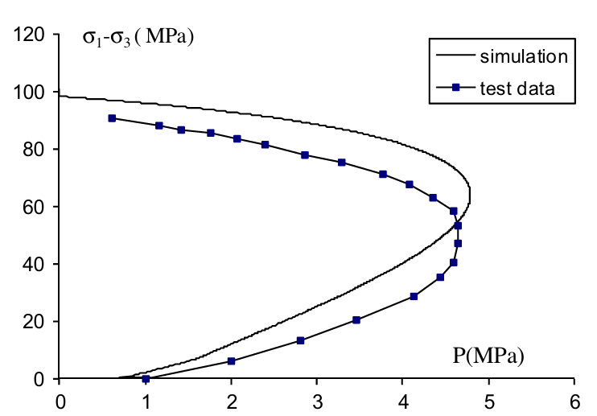
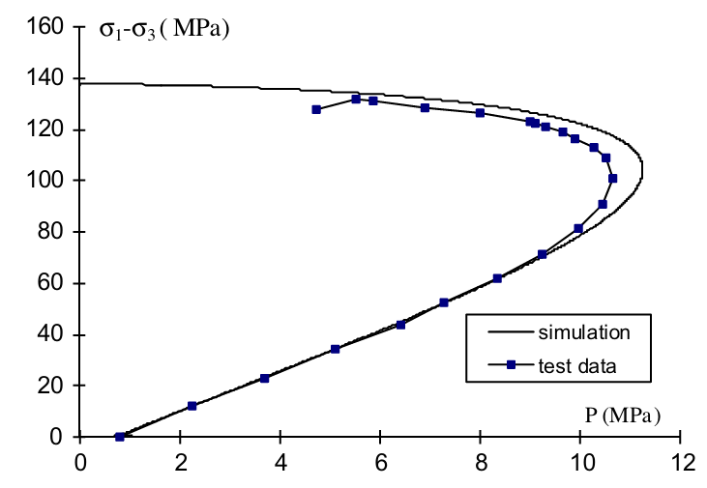
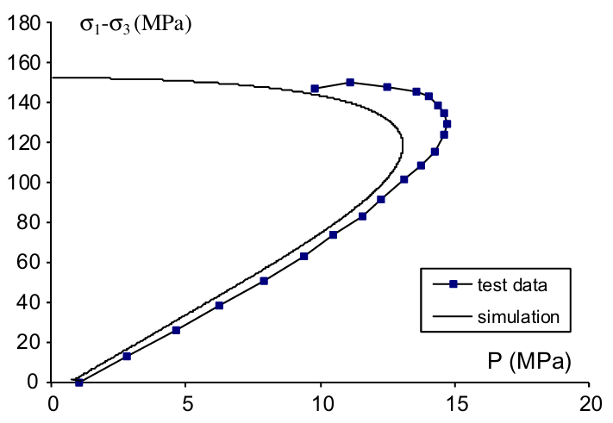
Sandstone
Hydro-mechanical coupling
10 MPa
30 MPa
50 MPa

Slide 12
Conclusions
Matrix plasticity and microcrack inelasticity are physically coupled in thermodynamics framework
Time effect on matrix and microcrack phase is separately considered
The proposed model is well implemented into a standard finite element software
Prospects
More detailed microstructure information to be considered
Mineral inclusion, distribution, direction(anisotropy), etc.
Complicated thermo-hydro-mechanical coupling condition to be considered
Application in practical engineering

Slide 13


Questions & Answers
Thank you for your attentions!
Yue SHI
Nanchang University, China
Email: yue.shi@ncu.edu.cn
Wechat
Whova

Slide 14


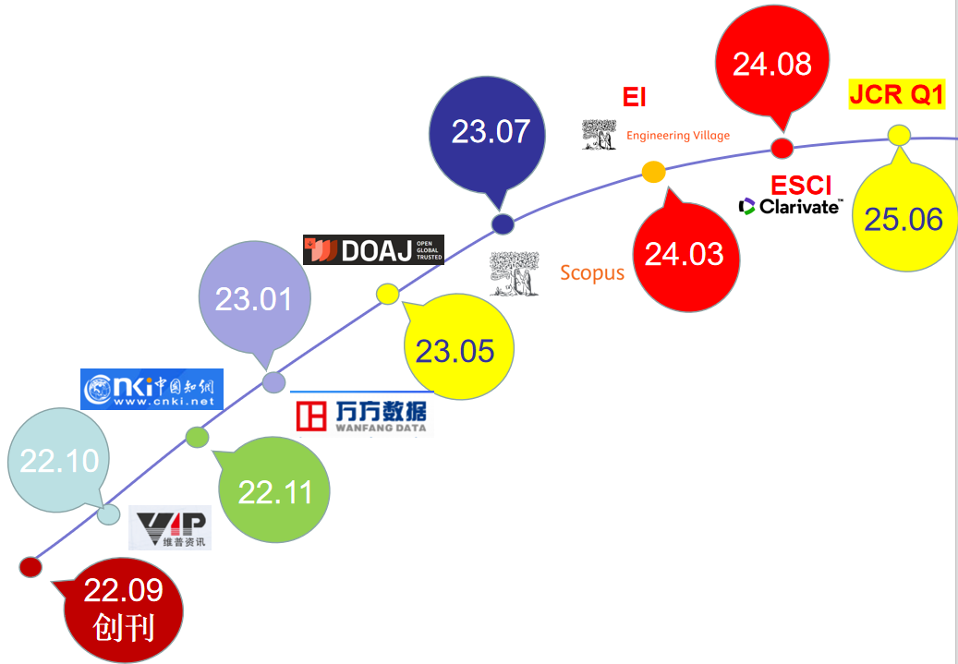
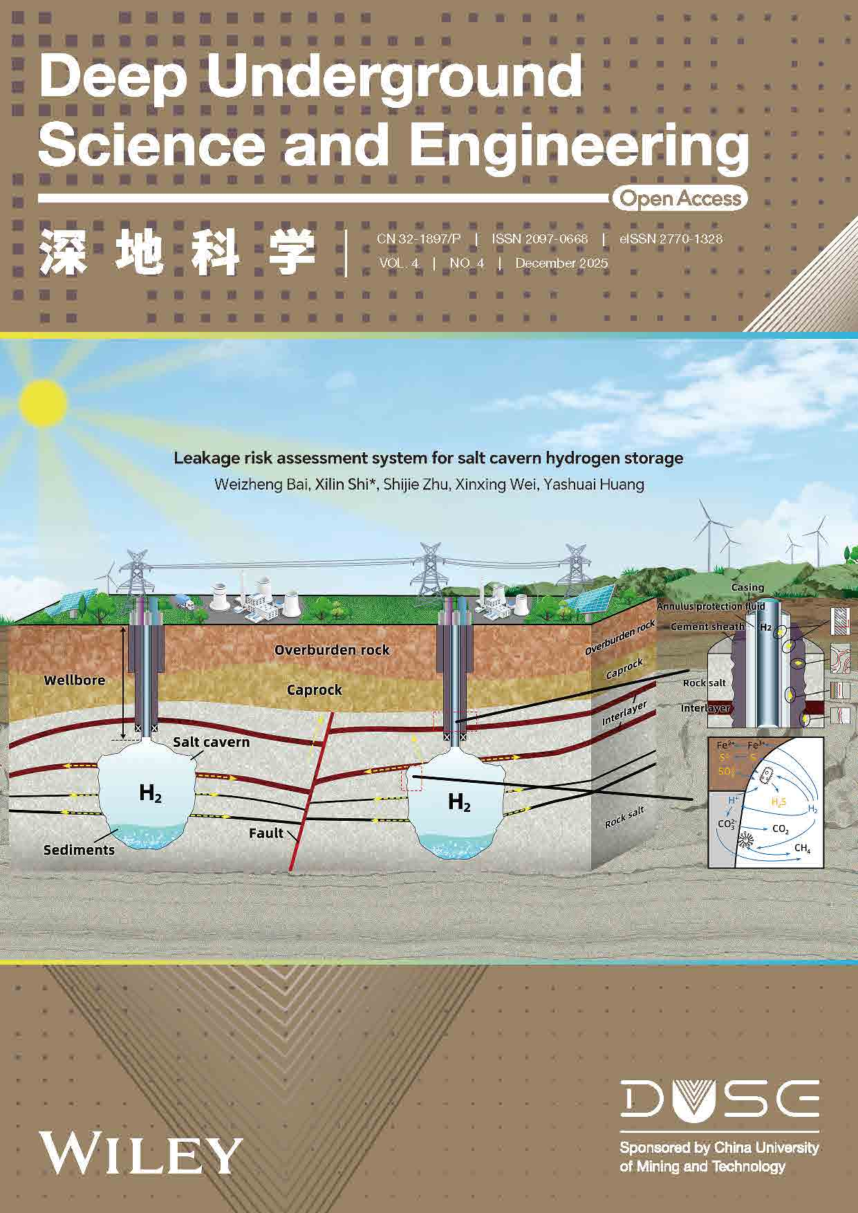



Deep Underground Science and Engineering
JCR Q1 OPEN ACCESS NO ARTICLE PUBLICATION CHARGES
Editorial Board
Scope
Progress （Sept. 2022-Nov. 2025)
Editor-in-Chief：Prof. Heping Xie，China
Executive Editor-in-Chief：Prof. Chunfai Leung, Singapore
Exploration and extraction of geo-resources
Energy extraction and storage
Underground infrastructures
Geo-environments and waste geological disposal
Research and testing space in deep underground
Plan，design and construction technology for under space and engineering and more!
The journal has been indexed in Scopus, Web of Science (ESCI/EI), DOAJ, and Ei；
CiteScore 2024 of 5.0 and CiteScoreTracker 2025 of 7.2；
It holds a Q1 ranking in the Journal Citation Reports (IF=5.0)；
The articles have been downloaded by scholars from 189 countries or regions, with a total download count exceeding 220000 times.
Submission URL
https://wiley.atyponrex.com/journal/DUG2
duse@cumt.edu.cn
https://onlinelibrary.wiley.com/journal/27701328
Quality assured with a robust peer review process
@DUSE_Office

