Slide 1
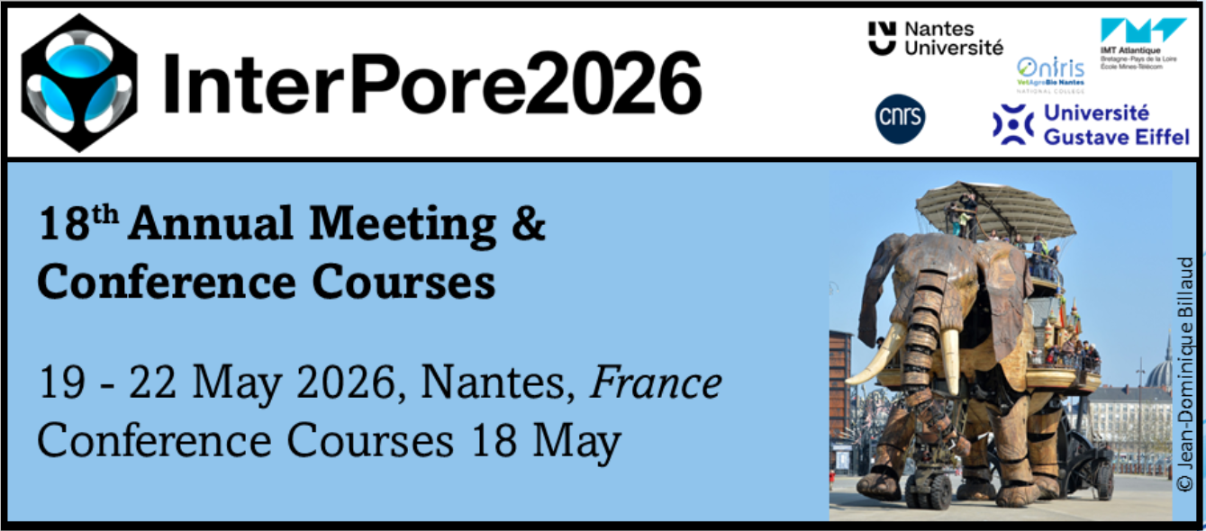
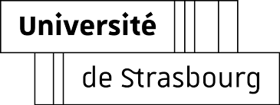

Assessing the potential of physics informed neural networks for modeling groundwater flow in aquifers
Marwan Fahs, Parisa Ashgari, Adhish Virupaksha, François Lehmann, Thomas Nagel
¹Institute of Earth and Environmental sciences – University of Strasbourg, France
INTERPORE 2026 – Nantes
20/05/2026

Slide 2
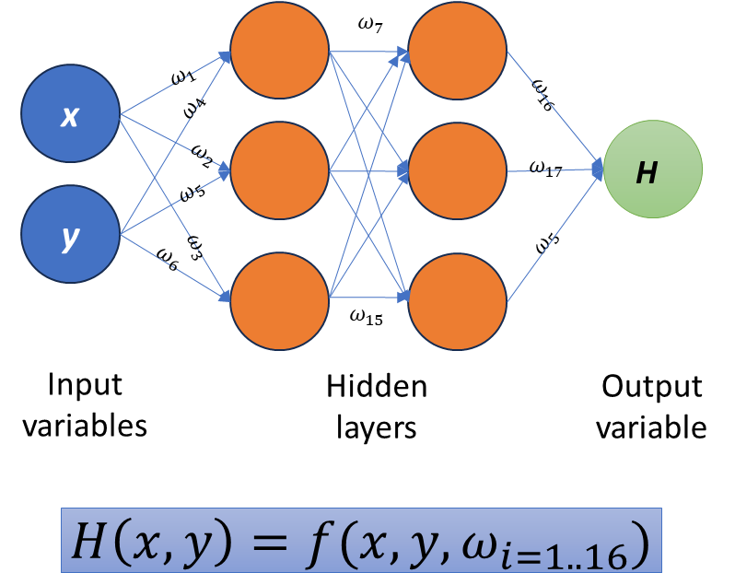



Deep Learning Neural Networks (DLNNs)
Mathematical models that links input variable through output variables
Fast development of computing power graphics processing unit (GPU)
+
Fast growth of data availability
DLNNs have become a common tool in different practical applications
Several applications
autonomous vehicles
weather forecasts
language processing
finance predictions
image or speech recognition
image colorization
Medical applications
Most reliable interpolators
Parallel programing on GPU cards
Derivatives of output w.r.p to inputs and parameters can exactly calculated with Automatic differentiation.

Slide 3
Applications of DLNNs in hydrogeology
Recently, DLNNs have been used for hydrogeology-Groundwater
Challenges in hydrogeology: Data availability
DLNNs require a lot of data
Surrogate modeling
Prediction of Groundwater level
Mapping aquifers from data
Hydraulic conductivity feild
Contamination source identification
.
.
.
Data are not widely available in hydrogeology
Data availability limits the applications of DLNNs in hydrogeology

Slide 4
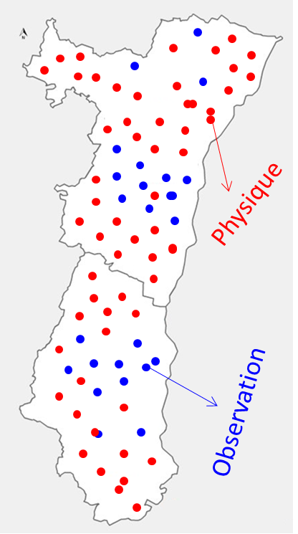

Applications of DLNNs in hydrogeology
Physics informed Neural networks
New technique developed by Raissi et al., (2019) to reduce the dependence of DLNNs on data.
Incorporating the equations in the loss function.
Partial derivatives: Automatic differentiation
DLNN is trained to satisfy observations and physics.
PINNs can be used for forward and inverse modeling and for parametric solutions.
Applications in hydrogeology: groundwater flow, unsaturated and multiphase flow, etc.
Applications are limited to theoretical cases, homogeneous media, steady-state conditions, and unconfined aquifers.
Development of new PINN approaches capable of addressing the specific challenges encountered in hydrogeology.
Objective
PINNs in operational tools in hydrogeology

Slide 5
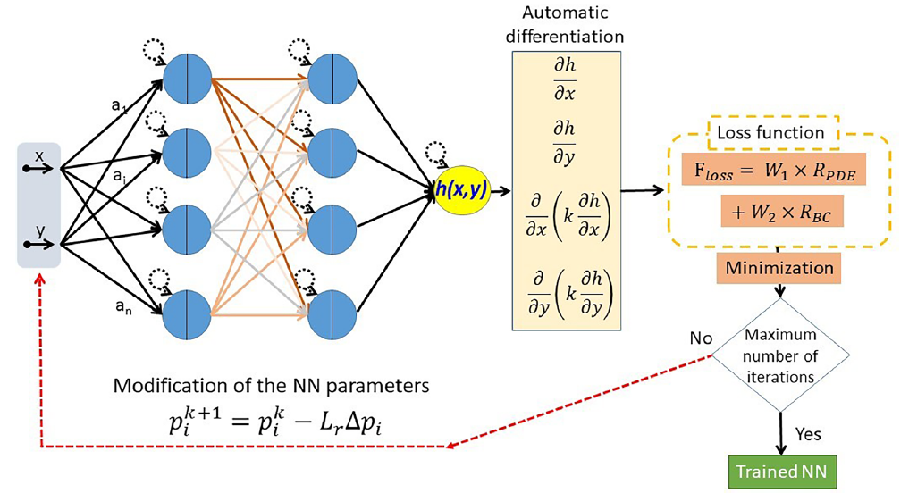

New PINNs formulation for groundwater flow in heterogenous media
Baseline PINNs struggle to model groundwater flow in heterogeneous domains.
A DLNN is used to represent the pressure field.
Discontinuity of the permeability field
Inaccurate evaluation of derivatives with automatic differentiation
Bad convergence of the training algorithm

Slide 6
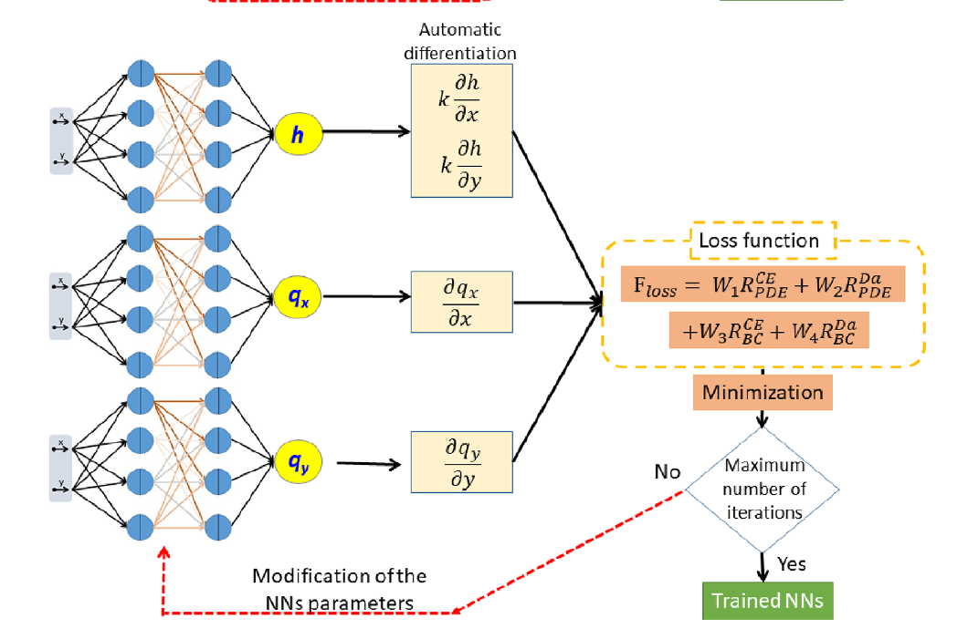

New PINNs formulation for groundwater flow in heterogenous media
New PINNs implementation: Mixed pressure-velocity form of the governing equations:
No derivatives of the permeability field

Slide 7
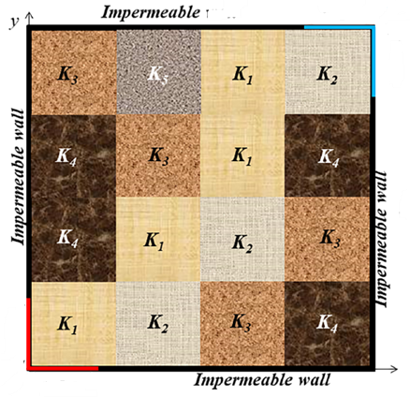
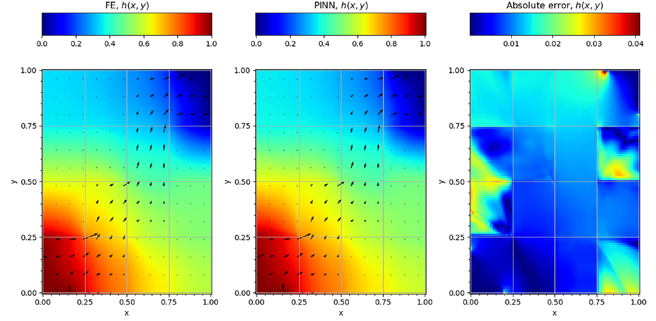
New PINNs formulation for groundwater flow in heterogenous media
Results: several test cases
New PINNs
Simulations performed without any data.
PINNs provides equivalent accuracy as finite element solutions
Baseline PINNs

Slide 8
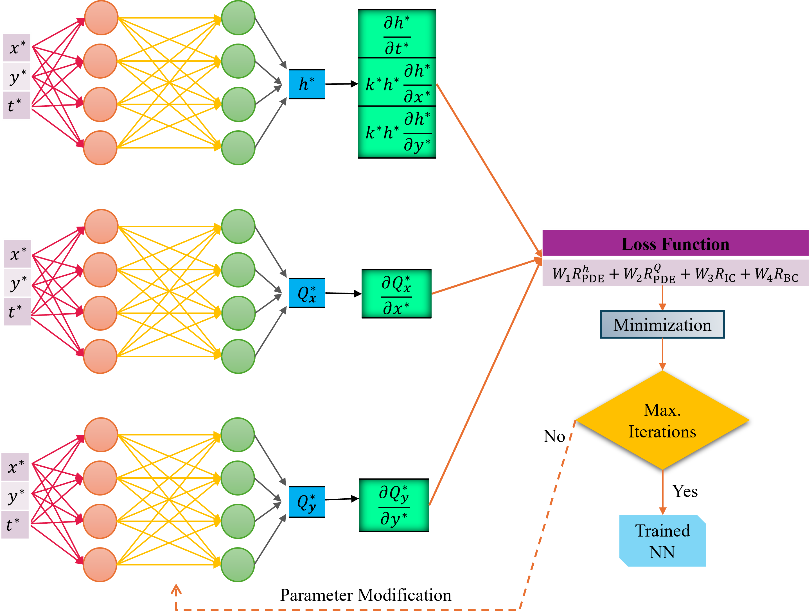
New PINNs formulation for transient simulations
Existing applications of PINNs: steady state
Extension to transient simulations
Groundwater: 10 or 100 of years
Large training time
Baseline PINNS
Large set of collocation points
Bad convergence
Time is included as inputs

Slide 9
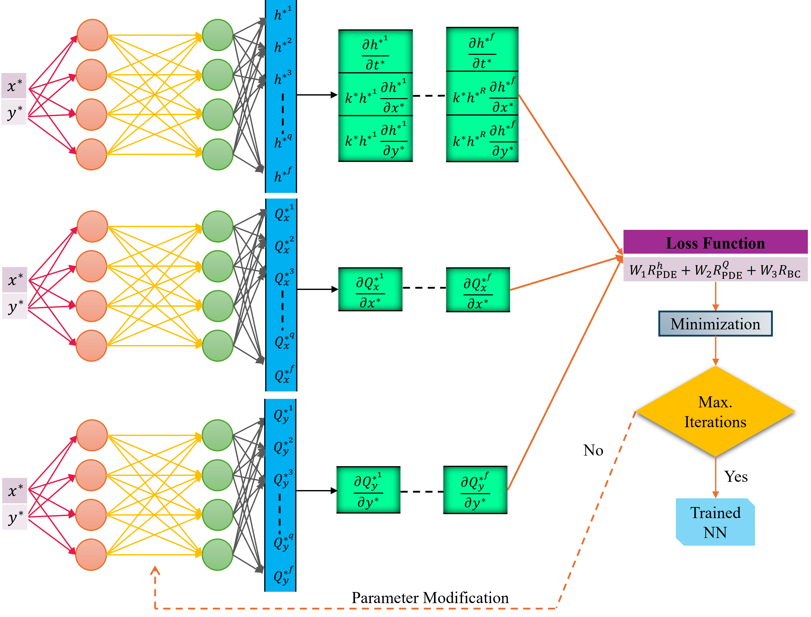
New PINNs formulation for transient simulations
Discrete time approach
Time discretized and included in the outputs.
Time discretization is performed with higher order implicit Rang-Kutta method.
The order 500 is used in our simulations

Slide 10
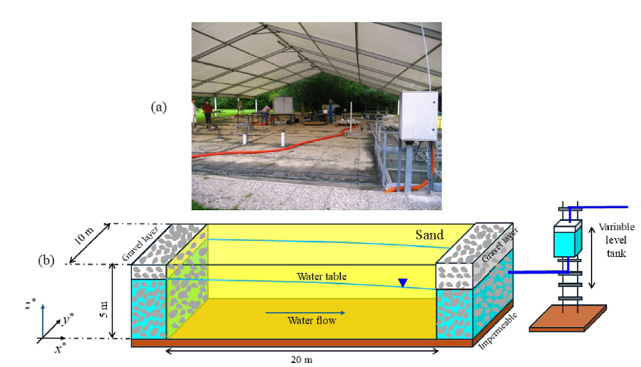
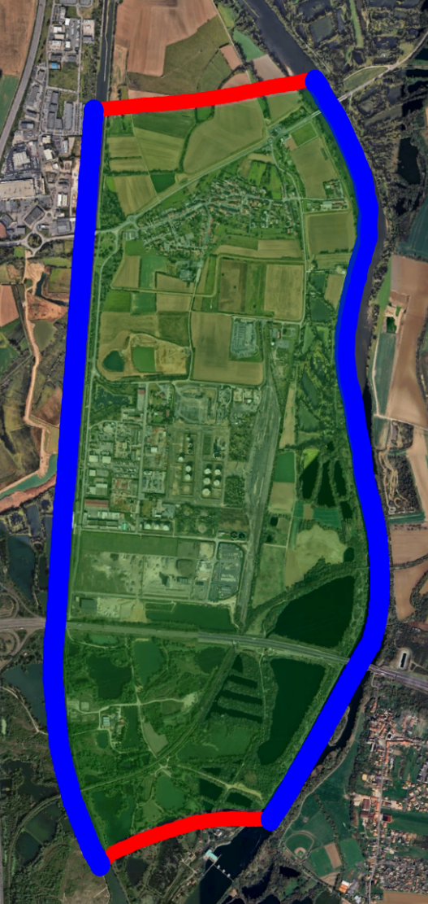
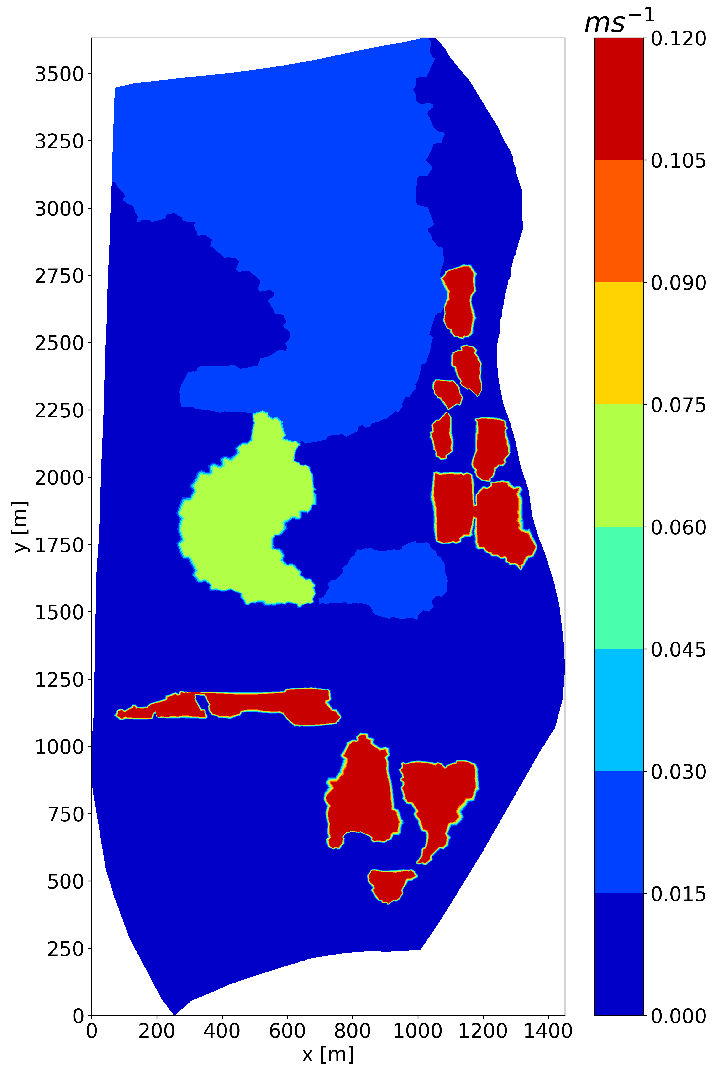
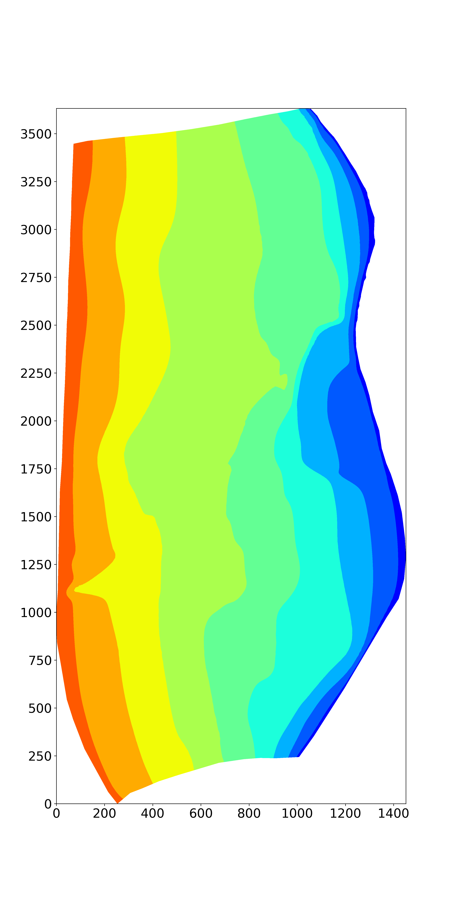
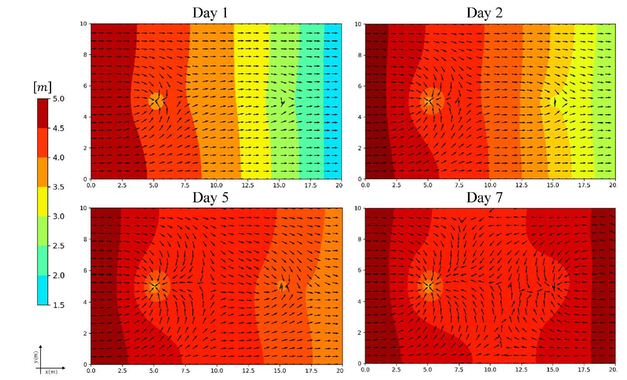
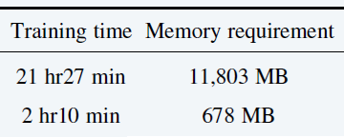
New PINNs formulation for transient simulations
Applications for several test cases at different scales
Large Laboratory experiments
Hauconcourt département de la Moselle
Accuracy
+
Training time reduced by 10
+
Place memory reduced by 200
Baseline PINNS
New PINNs

Slide 11
New PINNs formulation for transient simulations
Simulation with observation data and without boundary conditions
PINNs provides better results than data-driven model
Accurate predictions are obtained without including the boundary conditions

Slide 12
Conclusion and perspectives
New approaches have been developed to improve the applicability of PINNs for groundwater flow modeling.
PINNs is a promising technique for integrating Physics in Machine learning models
Applications of PINNs in hydrogeology are limited.
PINNs approach has significant potential to develop a new generation of groundwater models
Further works:
- Inverse modeling – field application
- Predicting salinity from pressure head observations
No initial and boundary conditions
Forward and inverse modeling
No time and space discretization
High efficiency on GPU cards

Slide 13
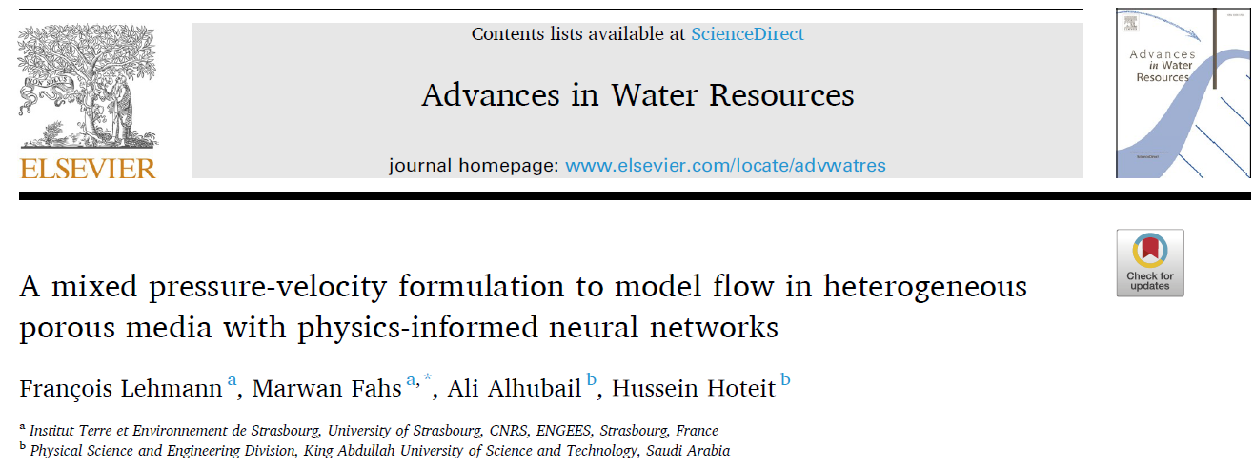
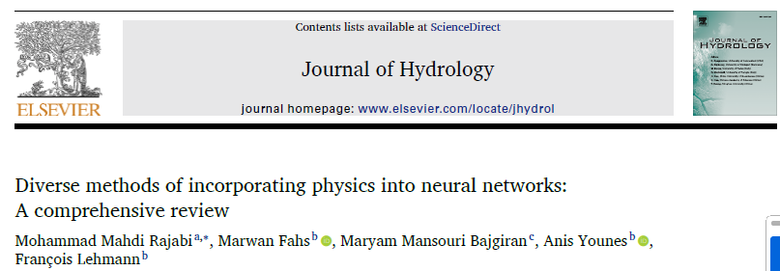
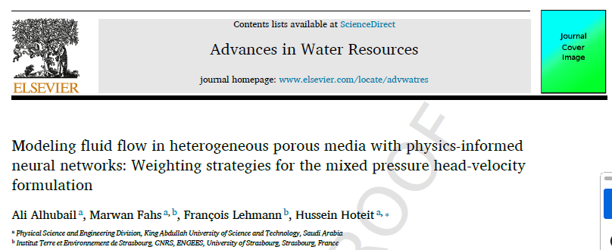
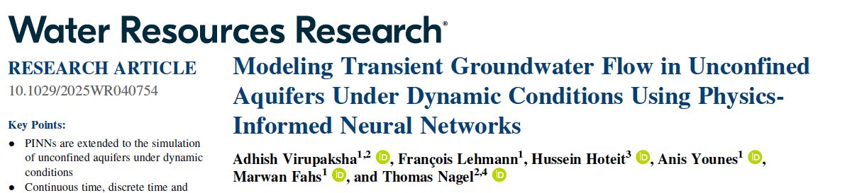
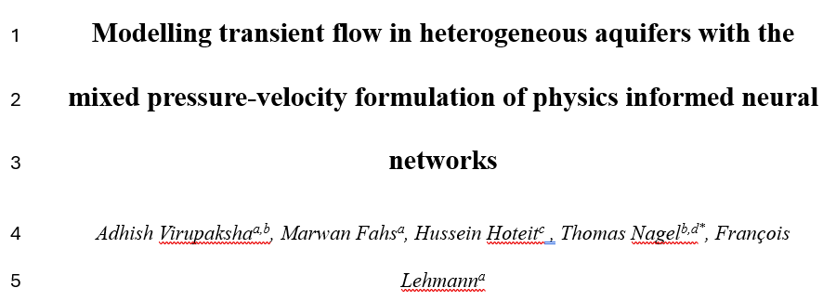

Thank you for you attention

