Slide 1

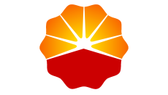
Physics-Constrained Transformer Framework with Bidirectional Encoder for Predicting Shale Reservoir Performance
Runshi Huo
Research Institute of Petroleum Exploration & Development
2026.3.30

Slide 2
1. Why use deep learning？
1. Why use deep learning to calculate the production dynamics of shale gas?
Traditional methods for forecasting shale gas production often fall short due to the unique properties of shale formations. Deep learning is utilized for the following reasons:
Inadequacy of Traditional methods :
Traditional methods like Decline Curve Analysis (DCA) can
be subjective and unreliable during early production stages. Additionally, numerical simulations struggle to accurately model the multiscale and nonlinear nature of shale gas flow.
Complex Subsurface Dynamics:
The physical processes in shale formations are highly complex, rendering traditional numerical simulations inadequate. Forecasting is complicated by the intricate interplay between geological and engineering factors.
Notes:
为了更加深入了解微纳尺度渗流机理

Slide 3
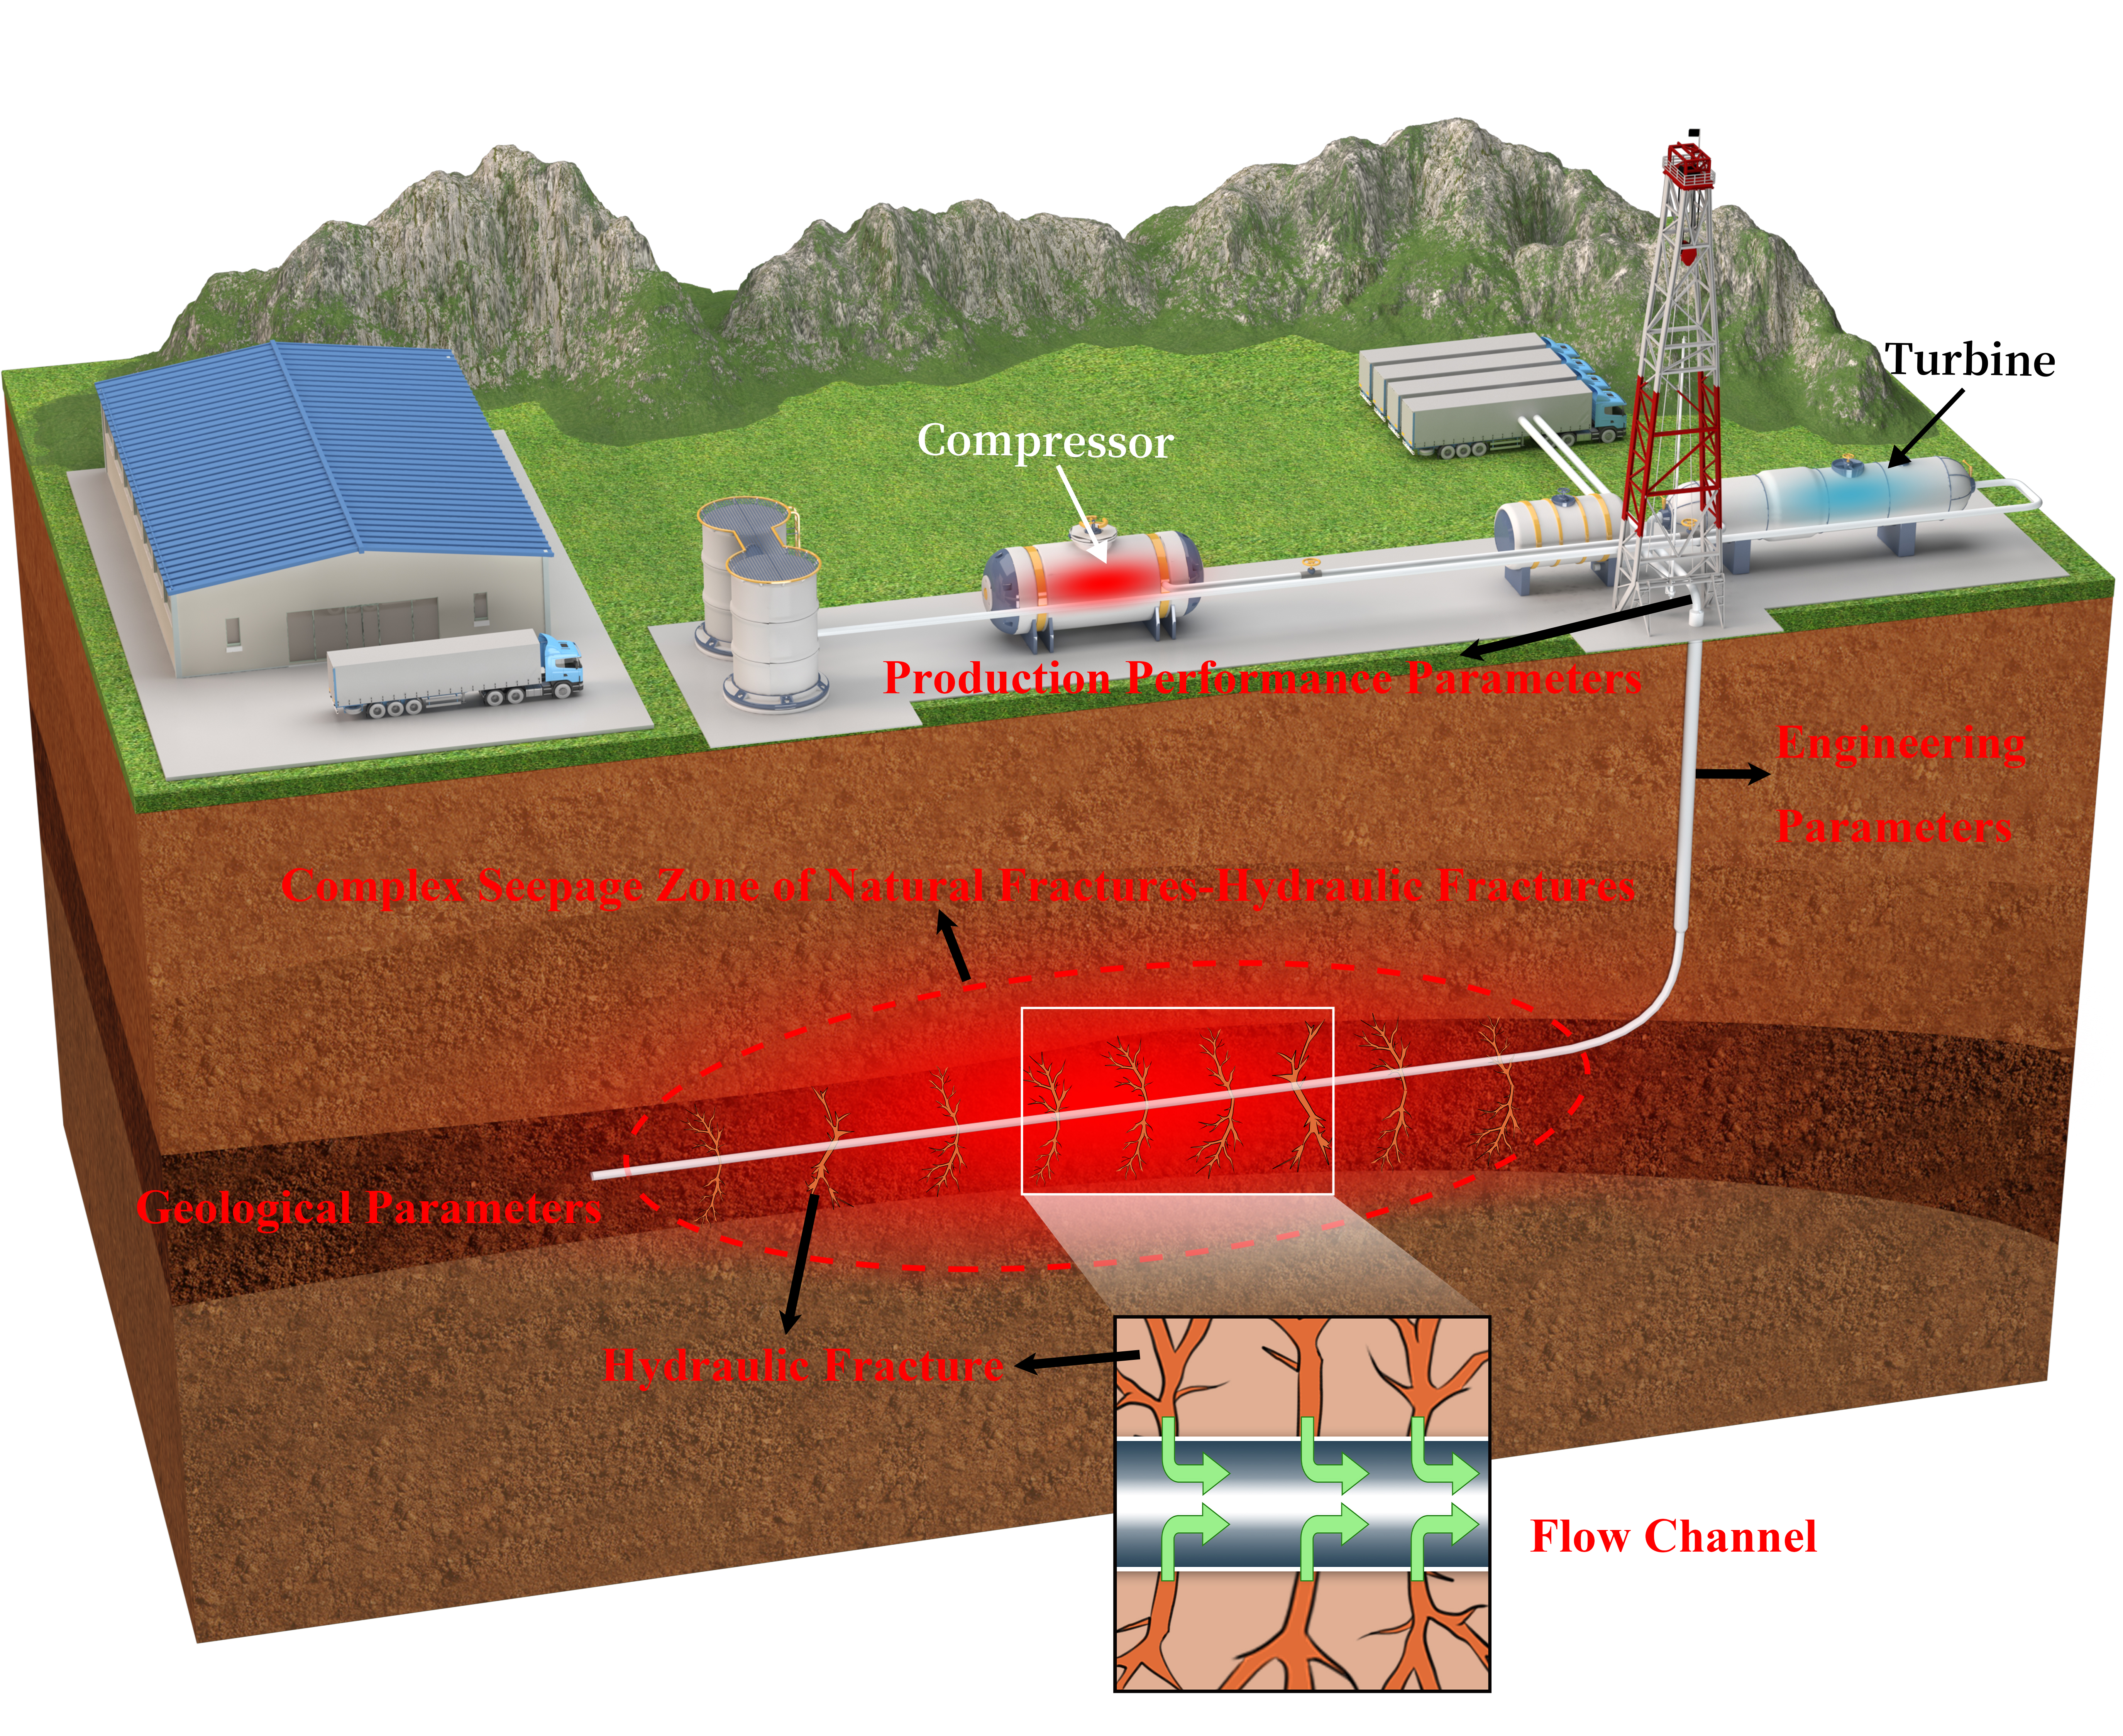
1. Why use deep learning？
Handling High-Dimensional Data:
Deep learning models are highly effective at handling complex, high-dimensional datasets
Capturing Nonlinear Interactions:
These models successfully capture the nonlinear interactions among the various geological, engineering, and seepage factors that control production dynamics.
Parameter | Unit | Data size | Mean | Maximum | Minimum
Well Testing | M3/d | 78 | 24.87 | 46.55 | 7.83
Permeability | mD | 78 | 0.000146 | 0.000509 | 3.84E-05
Horizontal Lateral Length | m | 78 | 1515.91 | 2200 | 850
Net Pay Zone Drilled Length | m | 78 | 1268.07 | 2200 | 500
Net Pay Zone Thickness | m | 78 | 11.56 | 14.5 | 6.3
Standoff from Target Zone Bottom | m | 78 | 5.64 | 14 | 2
Fracturing length | m | 78 | 1462.04 | 2101 | 790
Number of Fracturing Stages | Dimensionless | 78 | 24.21 | 38 | 14
Segment length | m | 78 | 61.59 | 83.94 | 40
Total Cluster Count | Dimensionless | 78 | 92.05 | 351 | 47
per stage | Dimensionless | 78 | 3.87 | 11 | 3
Pad Fluid Volume | M3 | 78 | 43914 | 66494.07 | 23402.83
Total Proppant Mass | t | 78 | 2725.38 | 5854.02 | 1086.1
Average Pump Rate | M3/day | 78 | 14.51 | 16 | 12.6
Maximum Pump Horsepower | W | 78 | 14.3 | 16 | 12
Maximum Treating Pressure | Mpa | 78 | 77.2 | 94 | 60.6
Point A | m | 78 | 2760.22 | 3413.02 | 2340
Point B | m | 78 | 2765.43 | 3562.87 | 2022.51
Midpoint | m | 78 | 2762.83 | 3487.95 | 2181.26
Proppant Concentration | M3/m | 78 | 1.86 | 3.09 | 0.81
Fracture Conductivity | t/m | 78 | 30.29 | 44.58 | 23.87
Maximum Casing Pressure | Mpa | 78 | 17.41 | 30.22666 | 8.105153
Peak Daily Gas Rate | M3/d | 78 | 24.26 | 41.7583 | 5.1428
Diagram of multi-scale flow of shale gas
Notes:
为了更加深入了解微纳尺度渗流机理

Slide 4
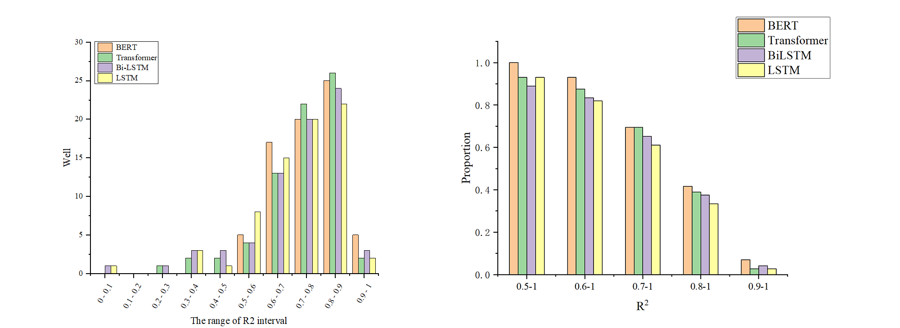
2. How was the result and how to explain it
2. Model comparison results and effect explanations
The study benchmarked four deep learning models (BERT, Transformer, Bi-LSTM, and LSTM) across 78 wells using Leave-One-Out Cross-Validation.
Overall Performance Metrics: * BERT-Lasso: Achieved the highest average R² of 0.8, with a maximum of 0.96 and a minimum of 0.42. It also recorded the lowest average Root Mean Square Error (RMSE) at 2.23 and Mean Absolute Error (MAE) at 1.63.
  Transformer-Lasso: Achieved an average R² of 0.74.
  Bi-LSTM-Lasso: Achieved an average R² of 0.72.
  LSTM-Lasso: Achieved the lowest average R² of 0.69.
 |  | R2 |  |  | RMSE |  |  | MAE
 | Max | Min | Average | Max | Min | Average | Max | Min | Average
BERT-Lasso | 0.9618 | 0.425 | 0.8022 | 4.122 | 1.099 | 2.231 | 3.62 | 0.65 | 1.63
Transformer-Lasso | 0.9376 | 0.2736 | 0.7401 | 5.094 | 1.167 | 2.51 | 4.11 | 0.8 | 1.73
Bi-LSTM-Lasso | 0.9422 | -0.6633 | 0.7244 | 5.273 | 1.21 | 2.504 | 6.12 | 0.64 | 1.82
LSTM-Lasso | 0.9093 | 0.1954 | 0.697 | 5.71 | 1.15 | 2.683 | 9.16 | 0.86 | 2.01
Notes:
为了更加深入了解微纳尺度渗流机理

Slide 5
2. How was the result and how to explain it
Dynamic Response Explanations:
  Stable vs. Abrupt Changes: Transformer models performed well during stable production phases but showed a noticeable lag when responding to abrupt events.
  Overfitting During Shut-ins: During late-stage shut-in events, the Transformer, Bi-LSTM, and LSTM models all exhibited pronounced overfitting.
  Capturing Depletion Signatures: BERT was the only model that uniquely identified reservoir pressure depletion signatures during production decline phases.
Notes:
为了更加深入了解微纳尺度渗流机理

Slide 6
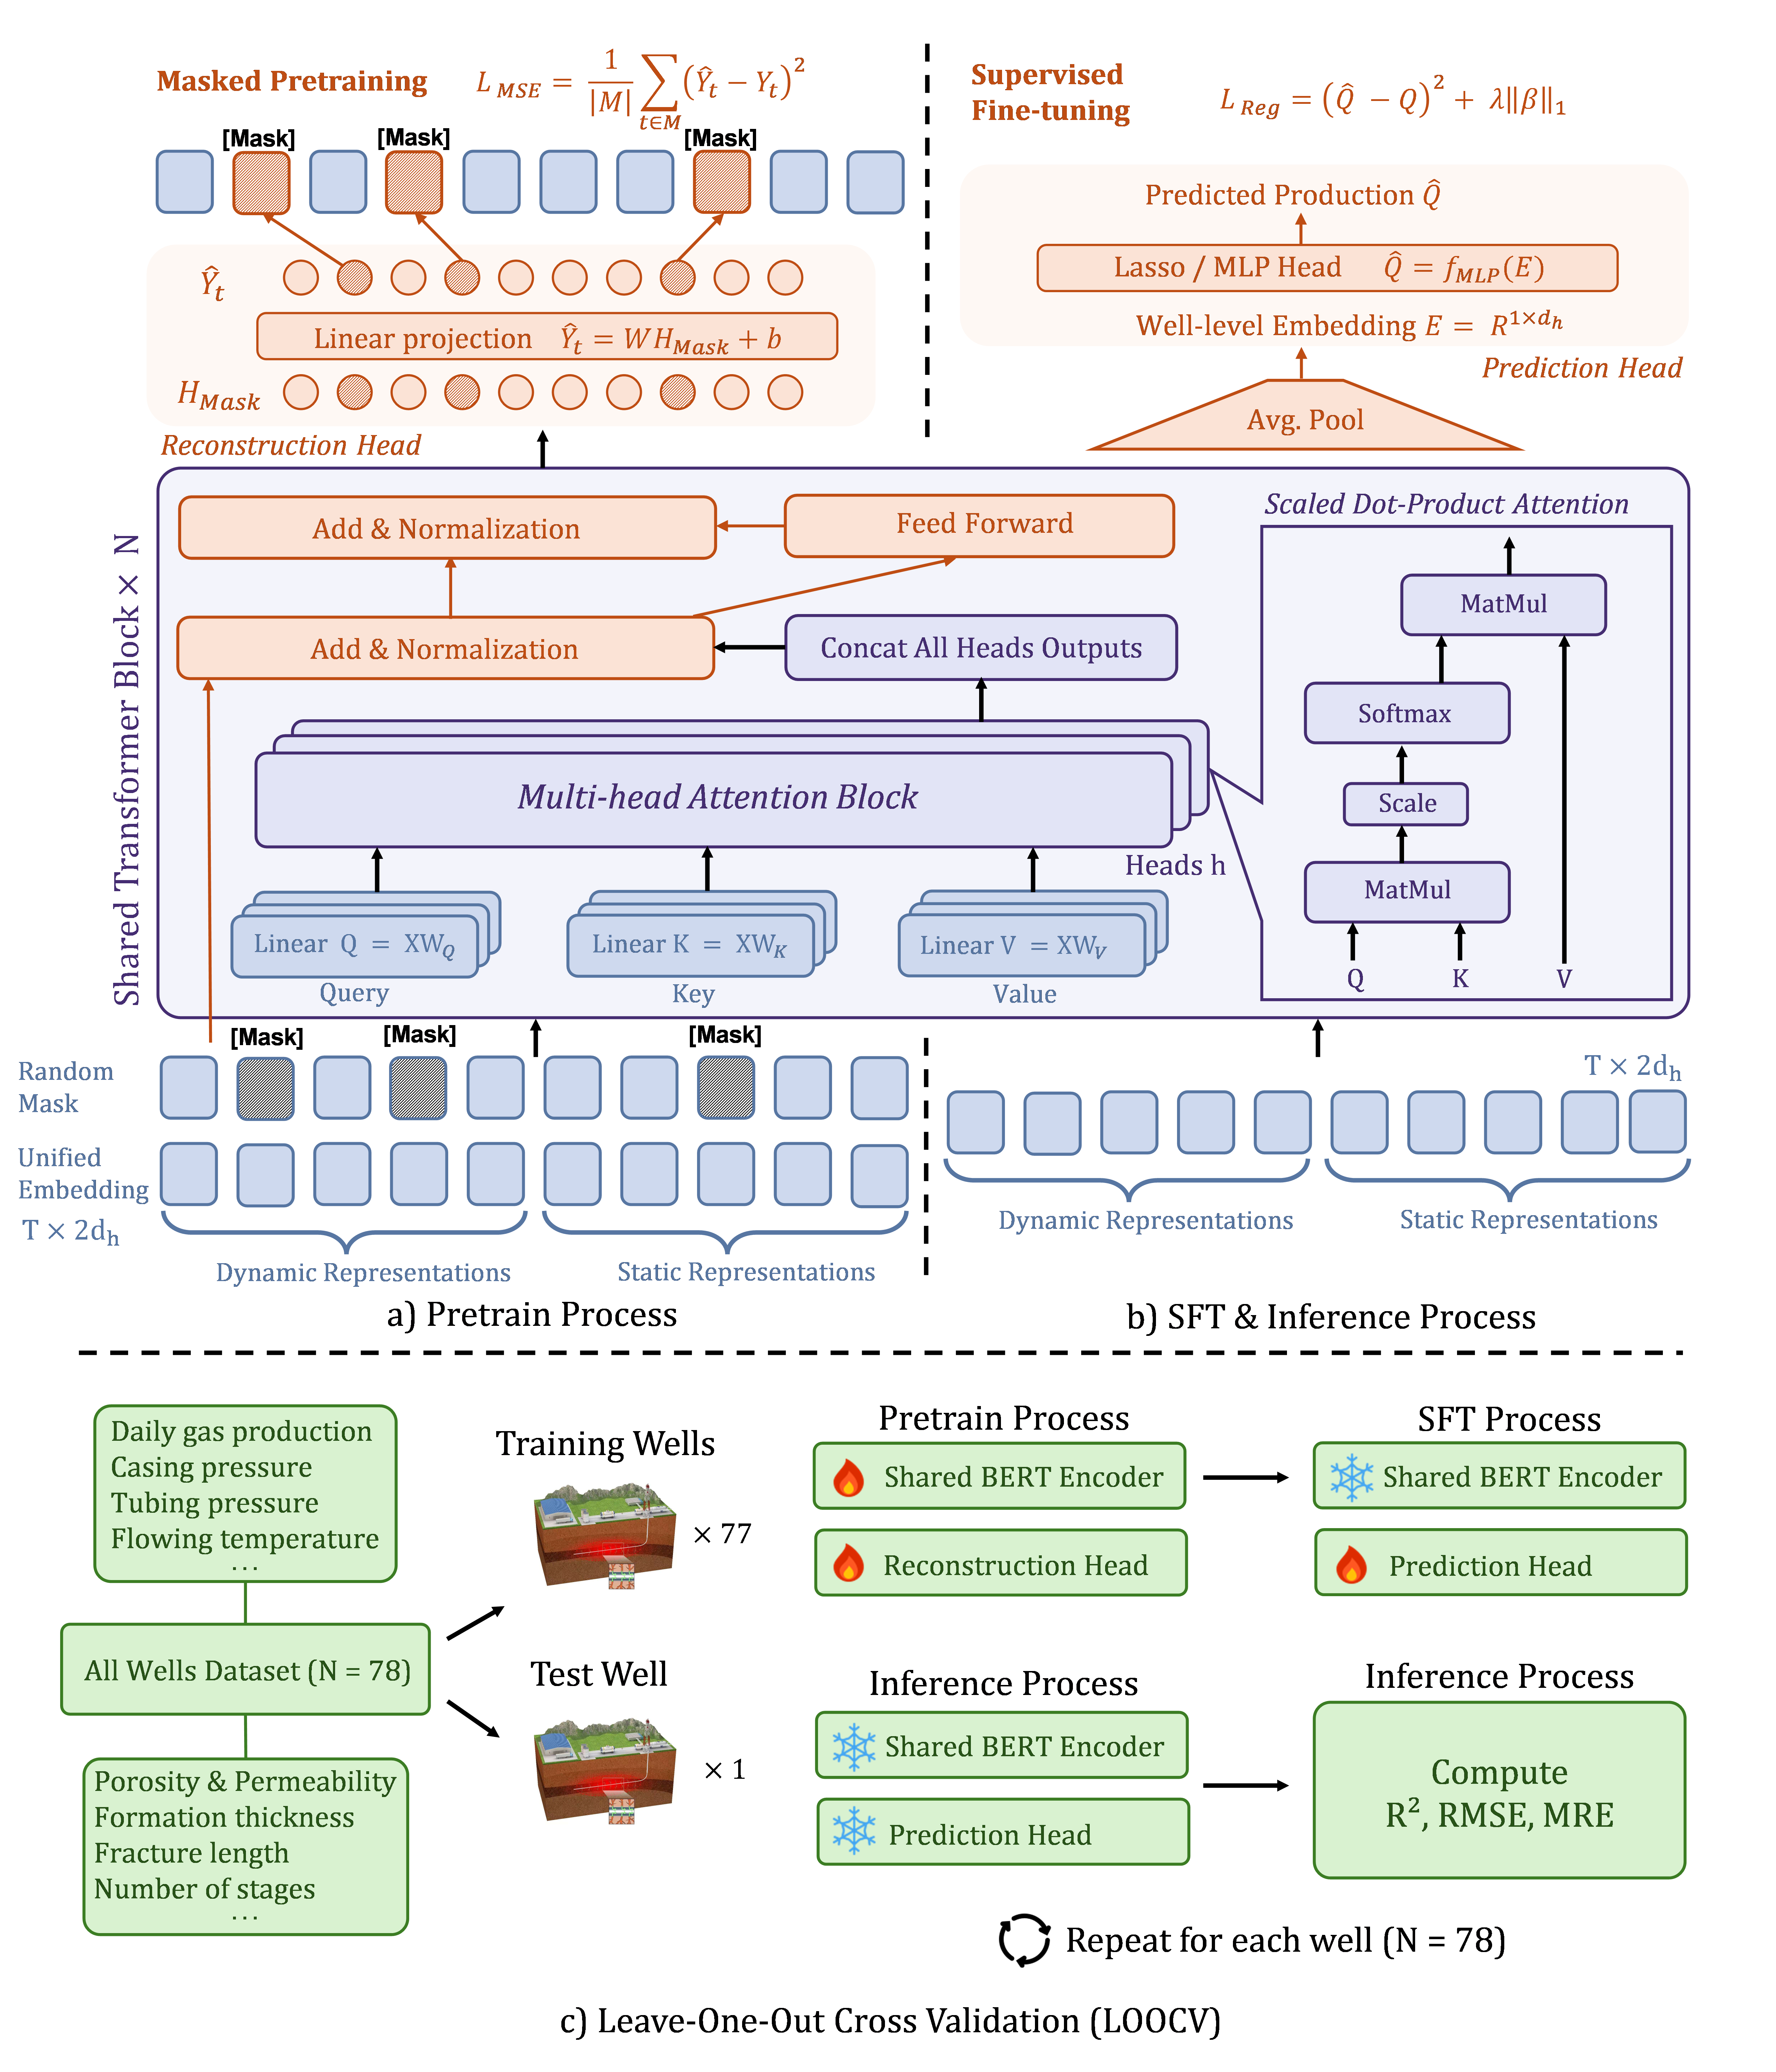
  3. Why is BERT better?
3. Why is BERT better?
BERT significantly outperformed the other deep learning benchmarks due to its specific architectural advantages in handling shale gas production time series:
Bidirectional Contextual Learning
Masked Pretraining
Dynamic Attention Allocation
Superior Positional Encoding
Noise Suppression & Stable Gradients
Notes:
为了更加深入了解微纳尺度渗流机理

Slide 7
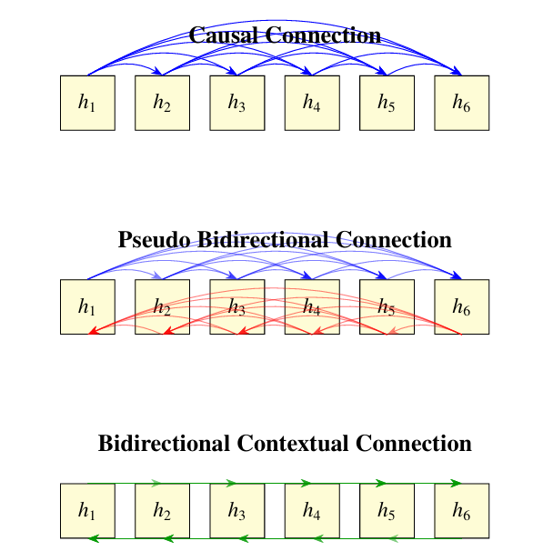
  3. Why is BERT better?
3. Why is BERT better?
Bidirectional Contextual Learning:
Bidirectional Contextual Learning allows BERT to condition on both past and future tokens, which is vital because well operations and engineering interventions are strongly interdependent with past production behaviors
Masked Pretraining:
The Masked Language Modeling (MLM) pretraining allows BERT to reconstruct missing information and generalize across the noisy, incomplete, or irregular production sequences commonly found in field data.
Notes:
为了更加深入了解微纳尺度渗流机理

Slide 8
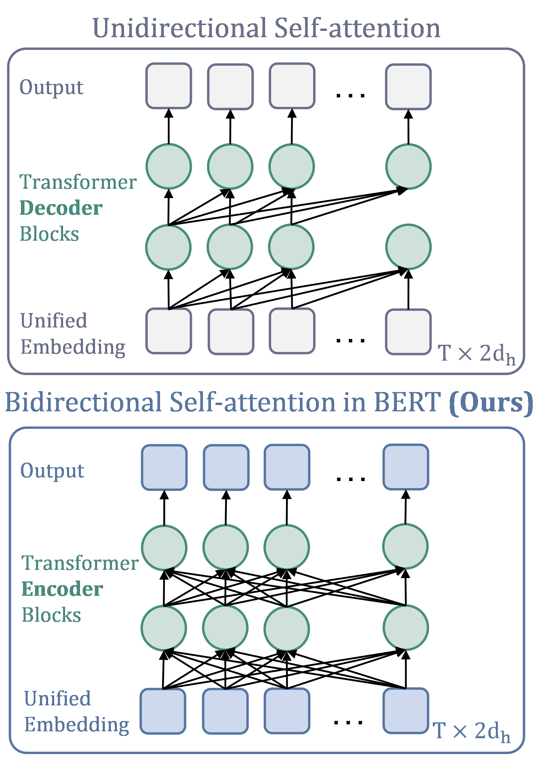
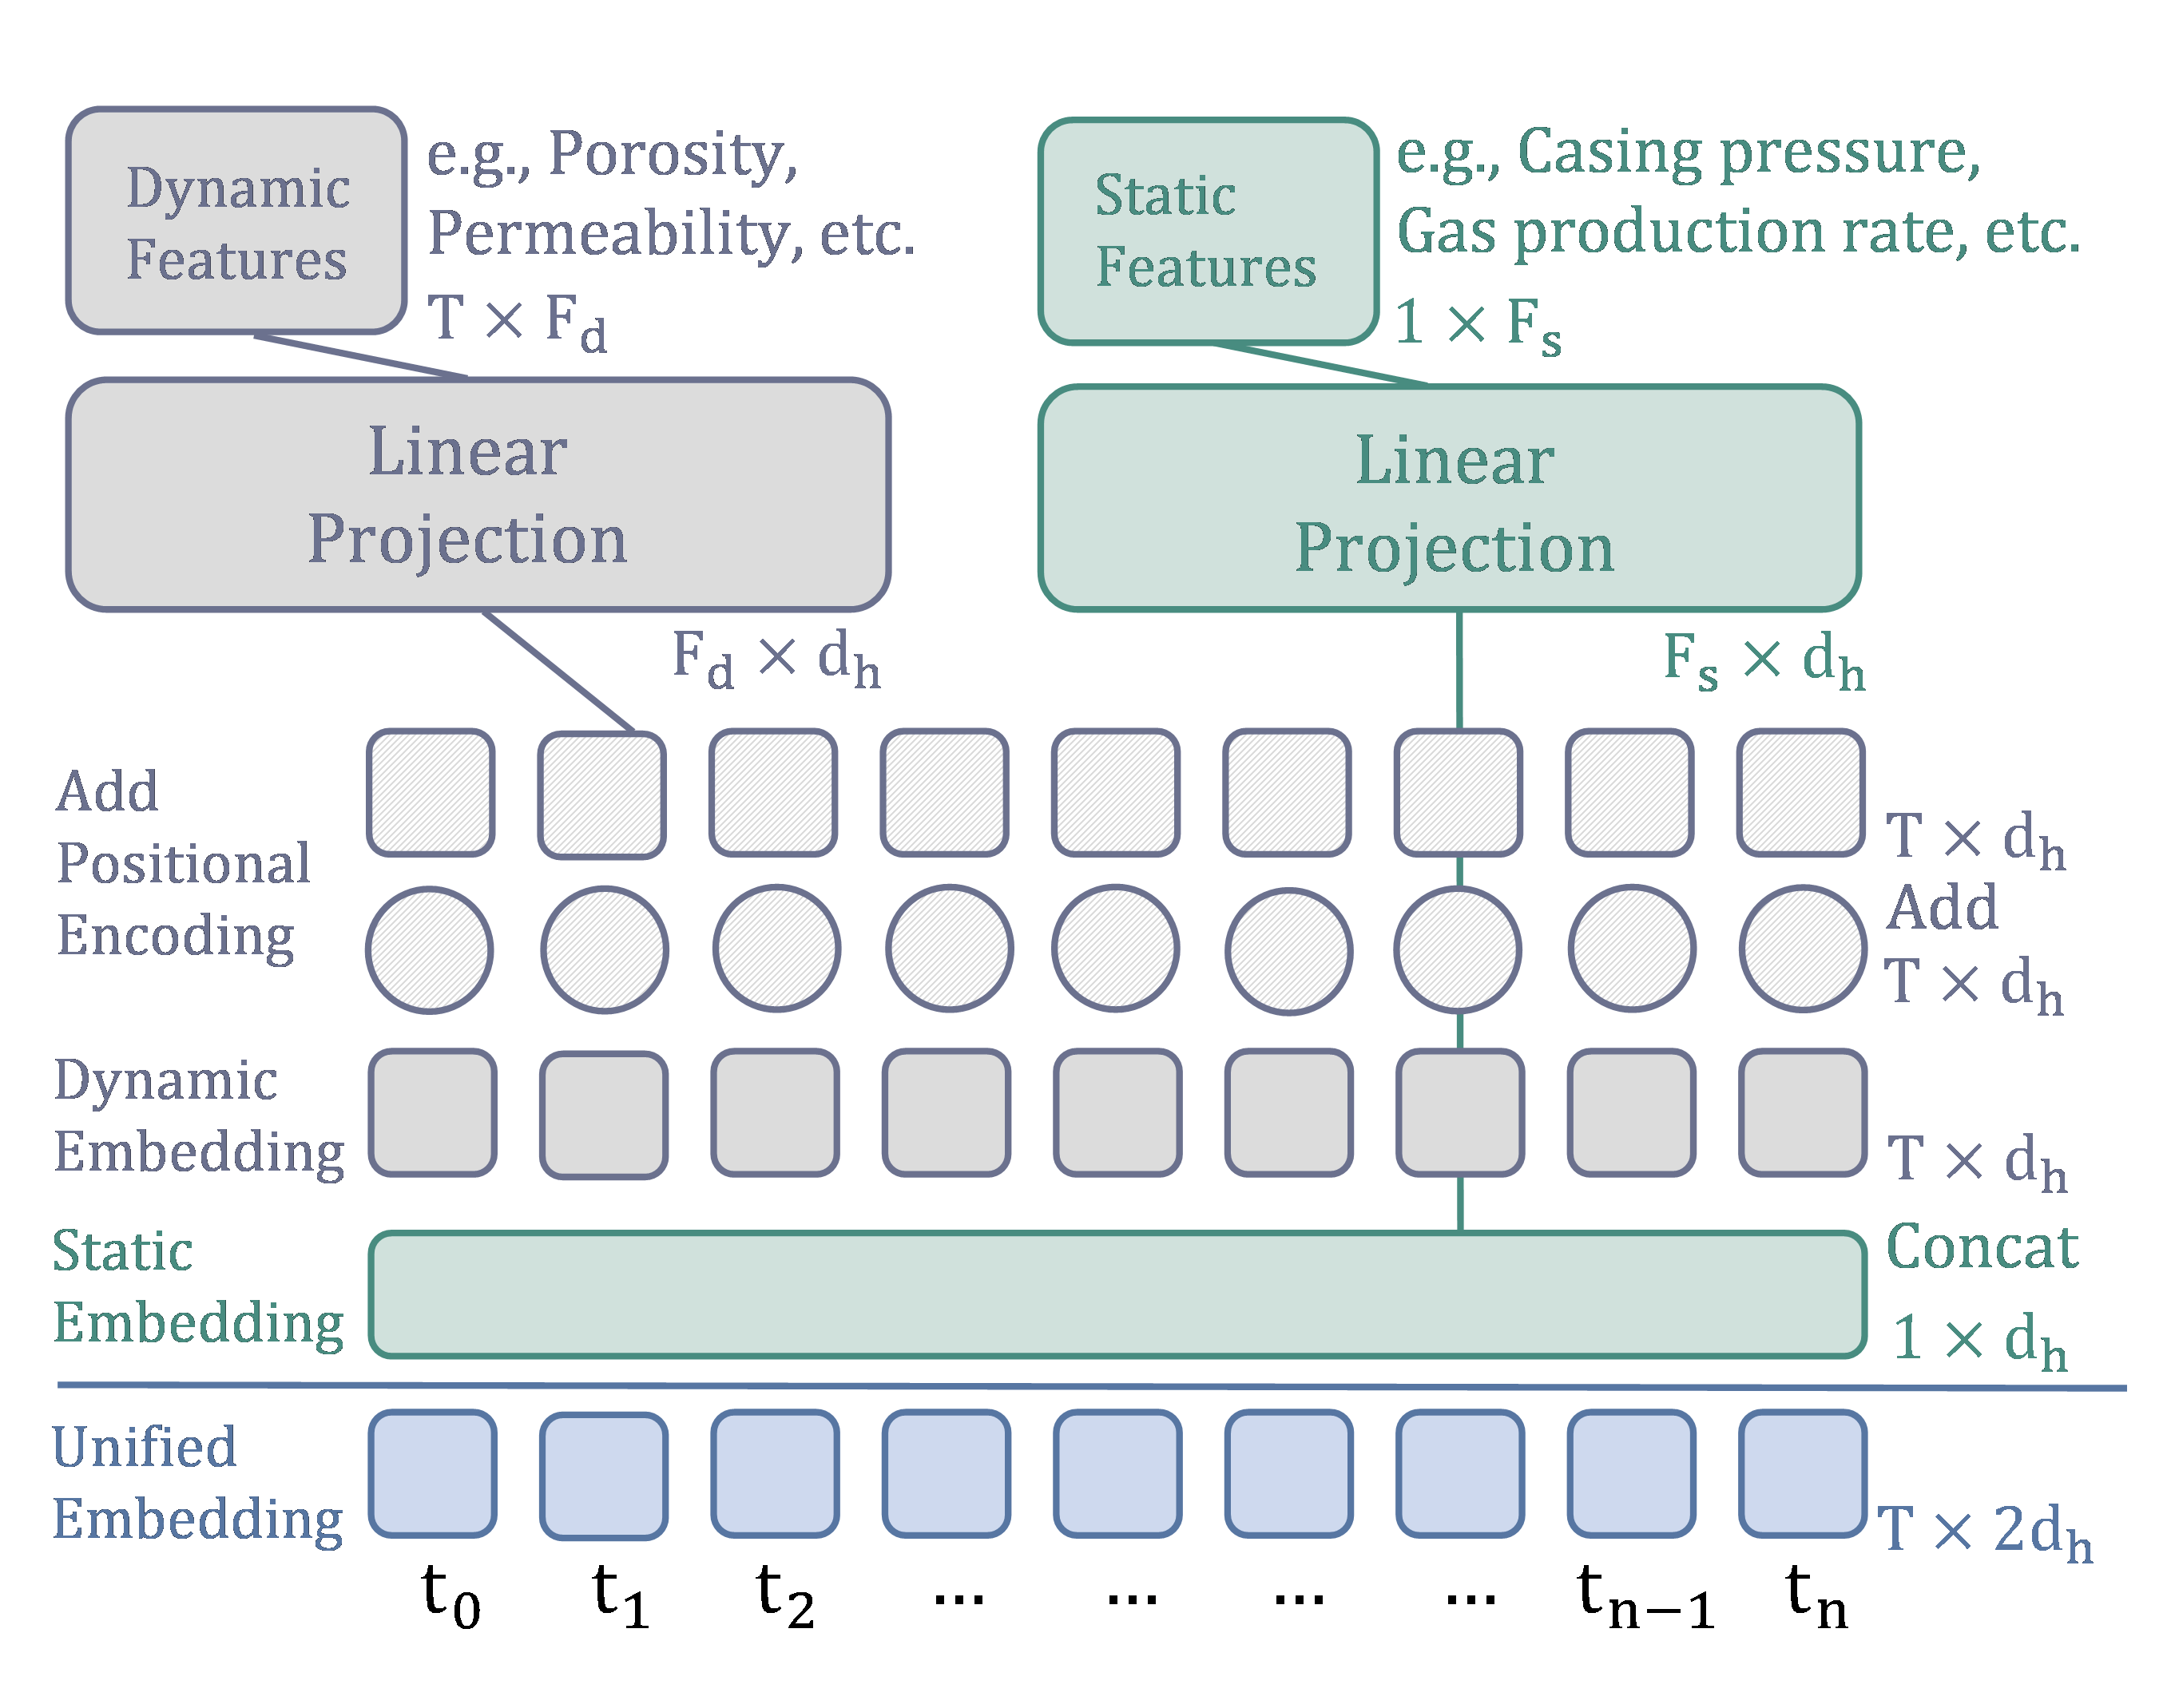
  3. Why is BERT better?
Dynamic Attention Allocation:
Dynamic Attention Allocation assigns different weights to geological, completion, and production features, emphasizing the most influential variables over long time horizons.
Superior Positional Encoding:
BERT utilizes absolute position encoding, which makes it more suitable for non-periodic production data.
Noise Suppression & Stable Gradients:
BERT offers excellent noise suppression and maintains stable gradients through its LayerNorm mechanism, even after abrupt shut-ins.
Notes:
为了更加深入了解微纳尺度渗流机理

Slide 9
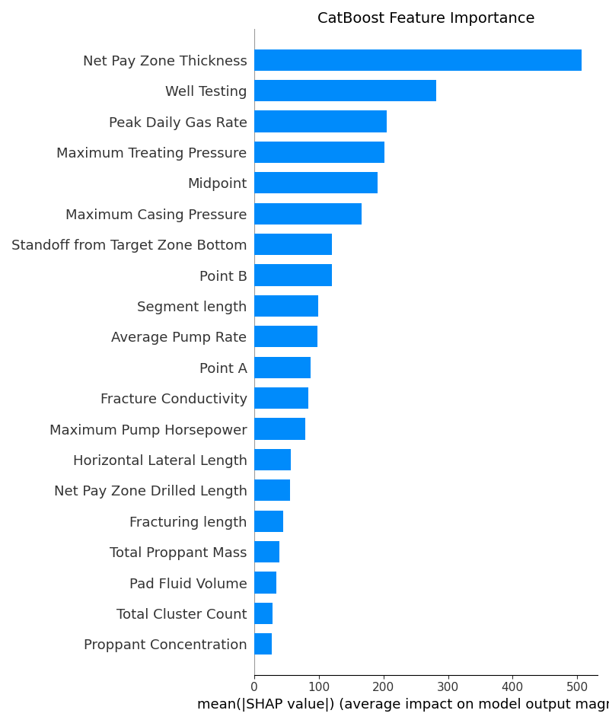
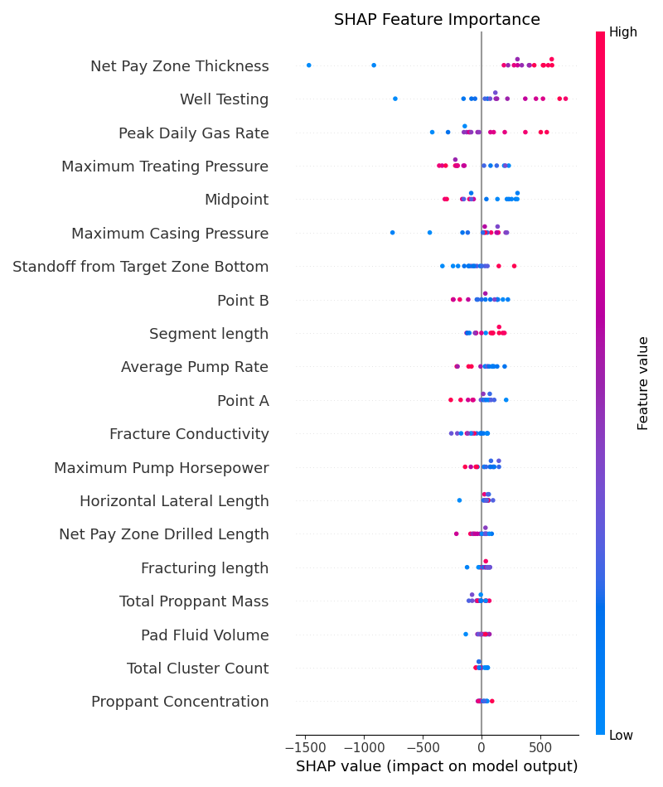
  4. SHAP
SHAP Feature Importance: SHAP (Shapley Additive Explanations) analysis is used to decode the model's decision-making process and reveal the dominant factors driving recovery.
  Geological Drivers: Net Pay Zone Thickness has the strongest positive influence on EUR, indicating a strong link between reservoir storage and permeability.
  Production & Engineering Drivers: High initial production (Well Testing) enhances IRF, while Maximum Treating Pressure indicates poor fracturing efficiency.
  Key Operational Variables: Other important engineering variables include Standoff from Target Zone Bottom, Segment Length, Average Pump Rate, Horizontal Lateral Length, and Fracturing Length.
Notes:
为了更加深入了解微纳尺度渗流机理

Slide 10


Thank you for your time and attention

