Slide 1
ML-Assisted Topology Optimization of Thermochemical Heat Storage Reactors
Torben Prill, Thomas Jahnke

Slide 2
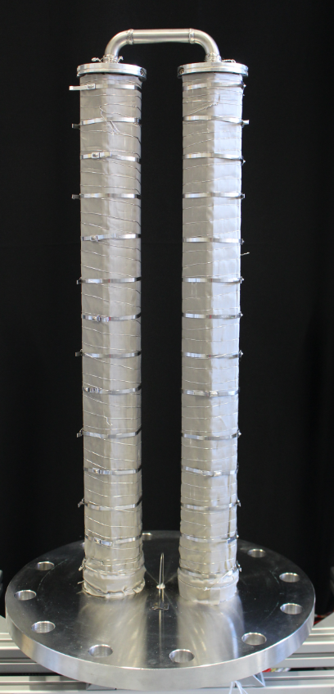
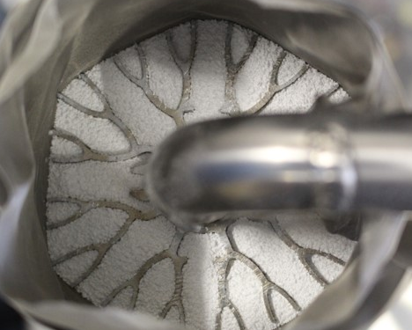
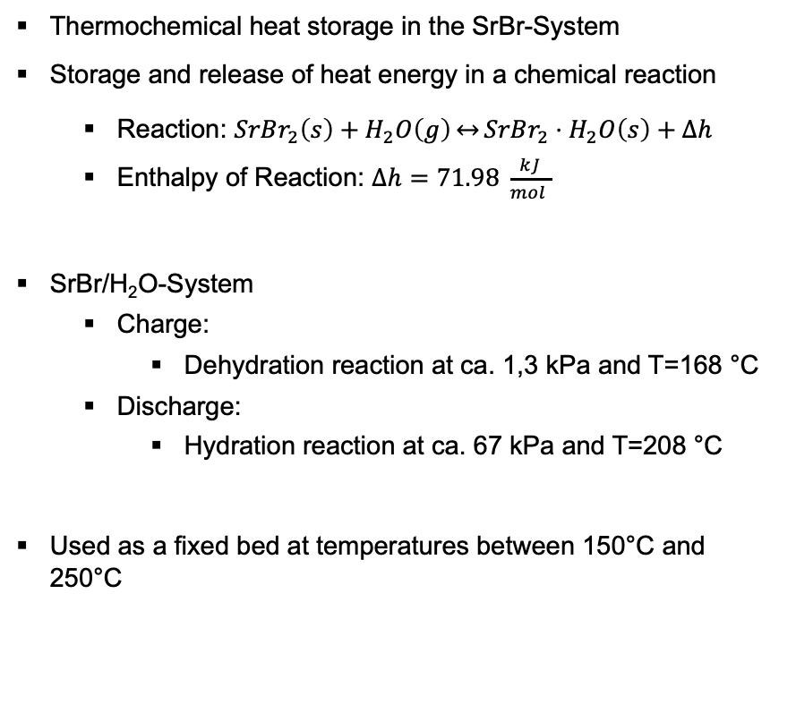
Thermochemical Heat Storage in the SrBr-System
Thermochemical heat storage in the SrBr-System
Storage and release of heat energy in a chemical reaction
Reaction: $SrBr_{2}\left(s\right)+H_{2}O\left(g\right)\underset{↔}{}SrBr_{2}⋅H_{2}O\left(s\right)+Δh$
Enthalpy of Reaction: $Δh=71.98 \frac{kJ}{mol }$
SrBr/H₂O-System
Charge:
Dehydration reaction at ca. 1,3 kPa and T=168 °C
Discharge:
Hydration reaction at ca. 67 kPa and T=208 °C
Used as a fixed bed at temperatures between 150°C and 250°C

Slide 3
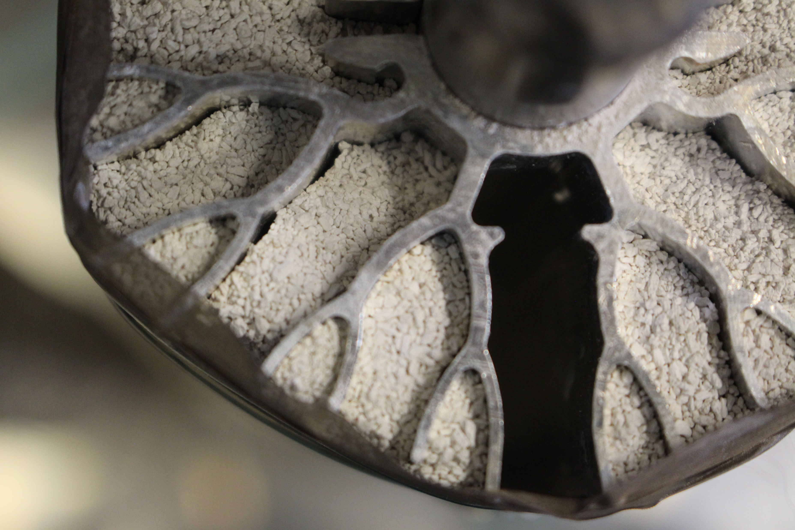
Wall Detachment as a Bottleneck in Heat Transport
Problem:
Fill expands/contracts during cycling
Detachment of the fill from the heat conducting structure during cycling, impairs heat transfer.
Solution:
Integration of heat transfer structures (HTS) into reaction bed to improve thermal contact.
Project THEMSE 2
Optimization of heat transfer in reactors for the SrBr/H₂O system.
Build simulation model for reactor
Optimize fins with numerical topology optimization
Using AI for surrogate modeling!

Slide 4


Physical Model Based on Porous Media Theory
Pressure equation
$$φ_{G}\left[\frac{1}{RT}\frac{∂p}{∂t}−\frac{p}{RT^{2}}\frac{∂T}{∂t}\right]+φ_{G}∇⋅\left[\frac{p}{RT}\vec{v}\right]−\hat{ρ}=0$$
Energy equation
$$\left(ρ_{G}C_{P,G}+ρ_{S}C_{P,S}\right)\frac{∂T}{∂t}−\frac{∂\left(φ_{G}p\right)}{∂t}−∇⋅\left(λ_{eff}∇T\right)+ρ_{G}C_{P,g}∇T⋅\vec{v}−\hat{ρ}Δh=0$$
Conservation of solid mass
$$\left(1−φ_{G}\right)\frac{{∂ρ}_{S}}{∂t}−\hat{ρ}=0$$
Darcy’s law
$$\vec{v}=−\frac{k_{pm}}{μ}∇p$$
Heat Transfer Resistance
$$λ_{eff}∇T⋅n=K(T^{+}−T^{−})$$
Reaction kinetics
$$\hat{ρ}=k_{s}e^{\frac{E}{RT}}f\left(p\right)g\left(X\right)$$
Powder bed
Gas port
HTF
Model based on: Jana Stengler, Inga Bürger, Marc Linder, "Performance analysis of a gas-solid thermochemical energy storage using numerical and experimental methods", International Journal of Heat and Mass Transfer, Volume 167, 2021, 120797

Slide 5

Topology optimization

Slide 6
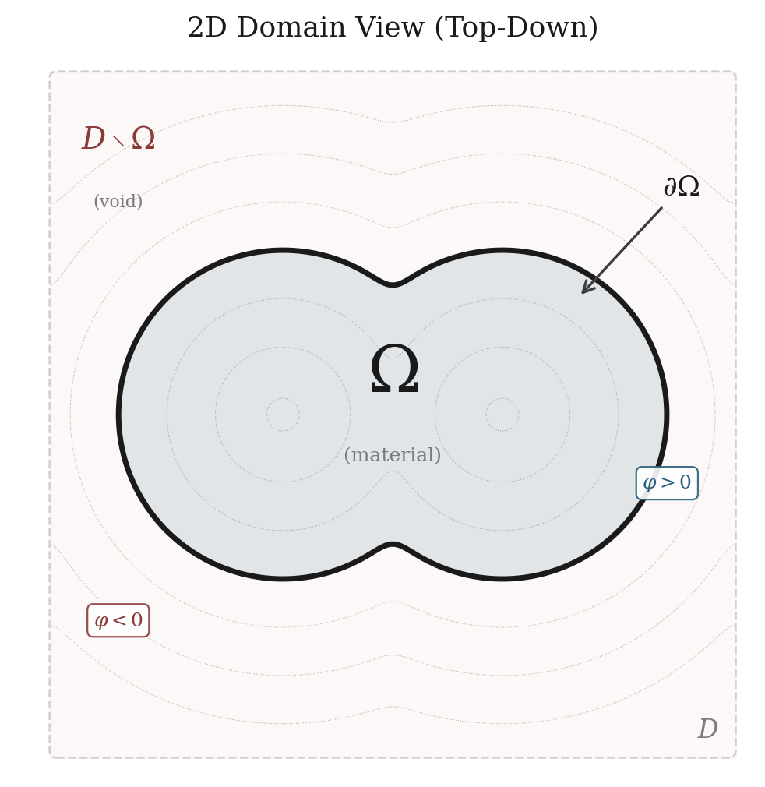
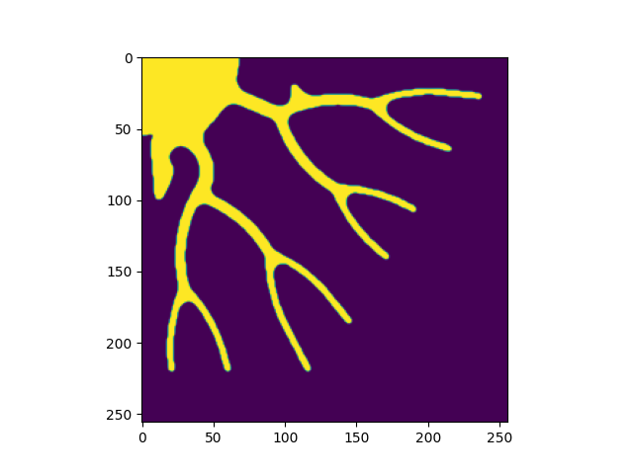
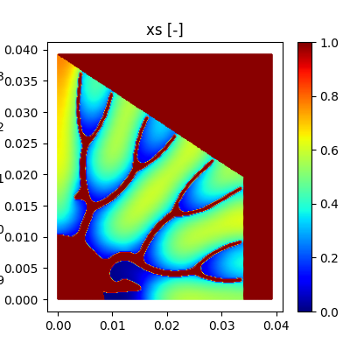
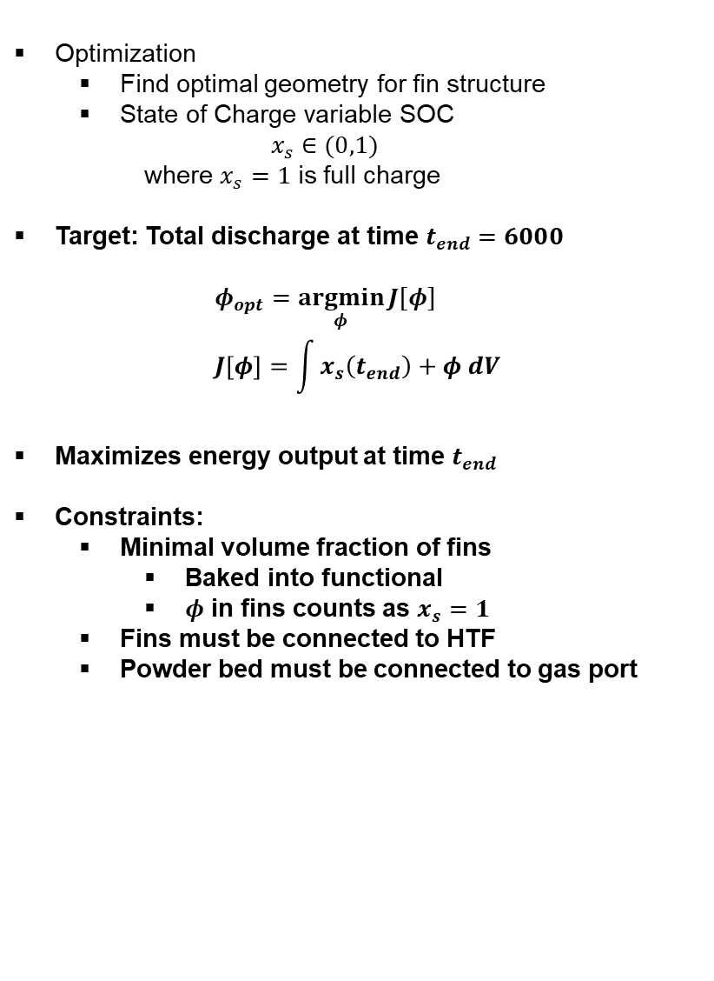
Numerical Topology Optimization
Optimization
Find optimal geometry for fin structure
State of Charge variable SOC
$$x_{s}∈(0,1)$$
where $x_{s}=1$ is full charge
Target: Total discharge at time $t_{end}=6000$
$$φ_{opt}=\underset{φ}{argmin}{J[φ]} \\ J\left[φ\right]=\int{x_{s}\left(t_{end}\right)+φ dV}$$
Maximizes energy output at time $t_{end}$
Constraints:
Minimal volume fraction of fins
Baked into functional
$φ$ in fins counts as $x_{s}=1$
Fins must be connected to HTF
Powder bed must be connected to gas port

Slide 7
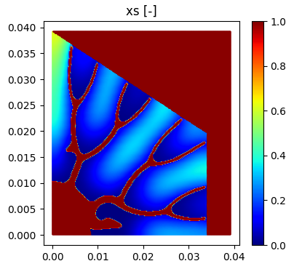
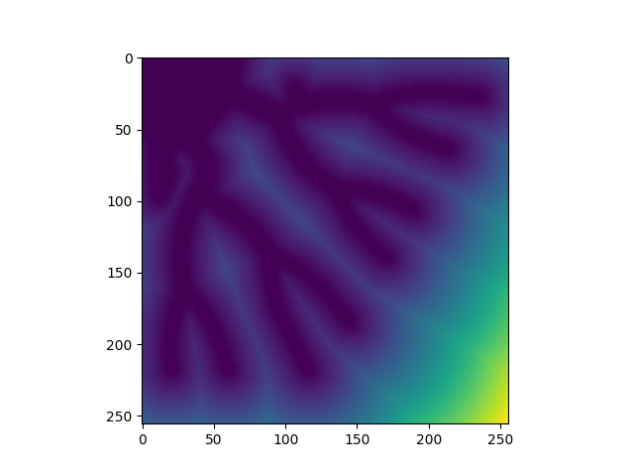
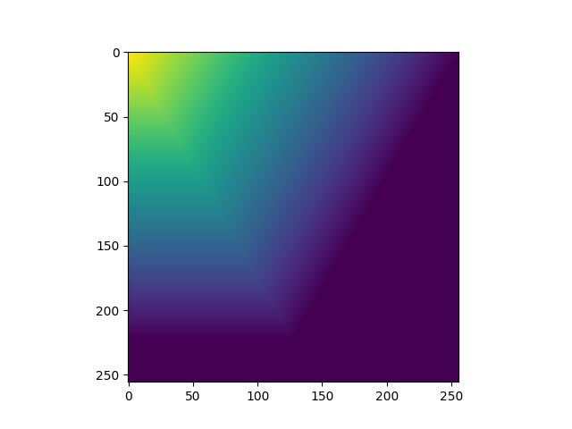
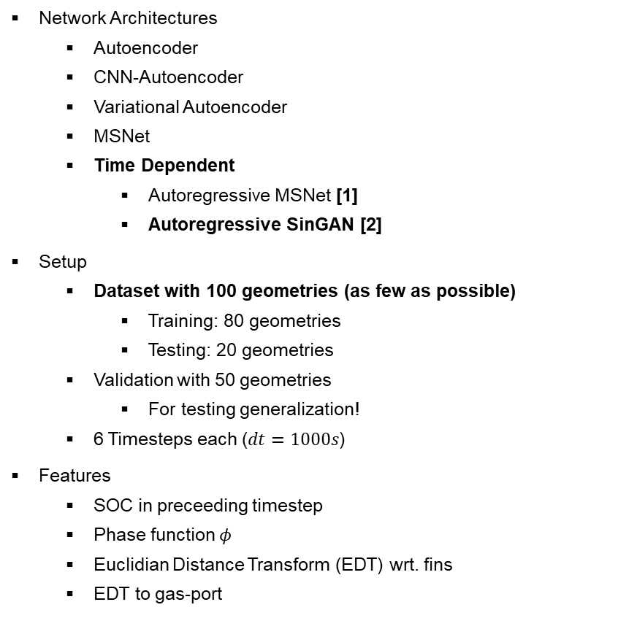

ML Surrogate Model
Network Architectures
Autoencoder
CNN-Autoencoder
Variational Autoencoder
MSNet
Time Dependent
Autoregressive MSNet [1]
Autoregressive SinGAN [2]
Setup
Dataset with 100 geometries (as few as possible)
Training: 80 geometries
Testing: 20 geometries
Validation with 50 geometries
For testing generalization!
6 Timesteps each ($dt=1000s$)
Features
SOC in preceeding timestep
Phase function $φ$
Euclidian Distance Transform (EDT) wrt. fins
EDT to gas-port
SOC at t
$$φ$$
Prediction
EDT fins
SOC at t+dt
EDT gas-port

Slide 8
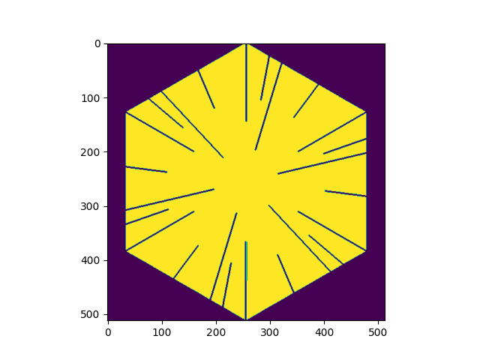
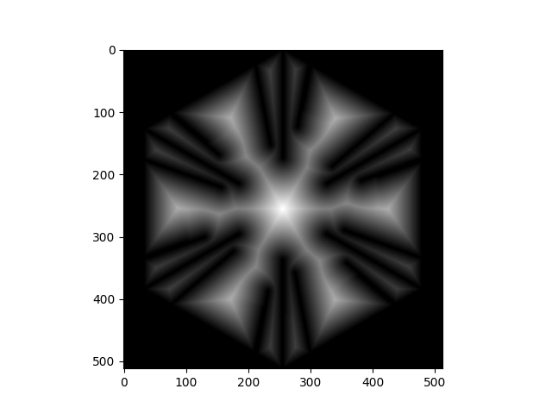
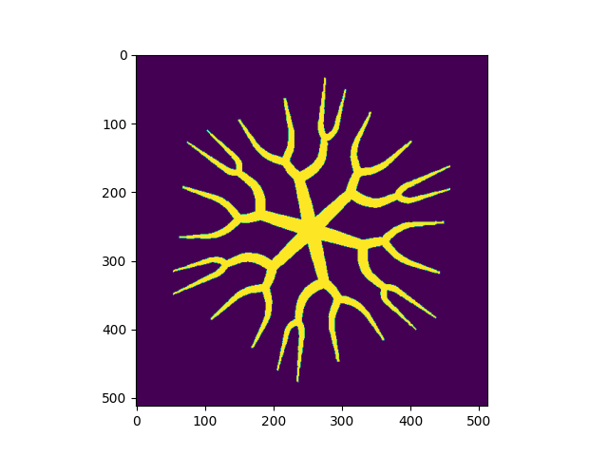
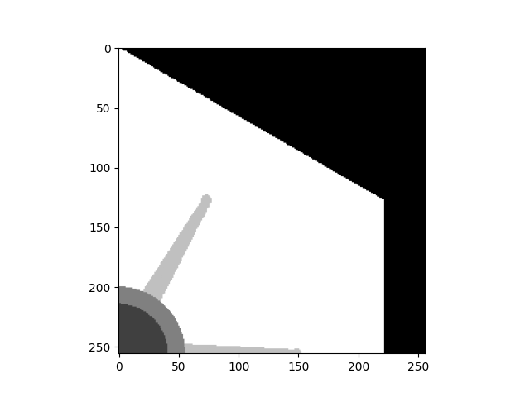

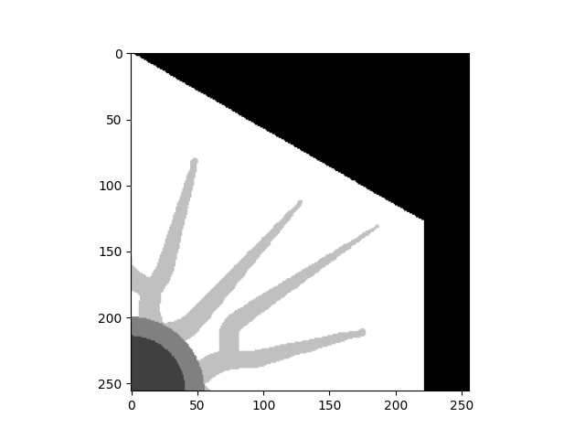

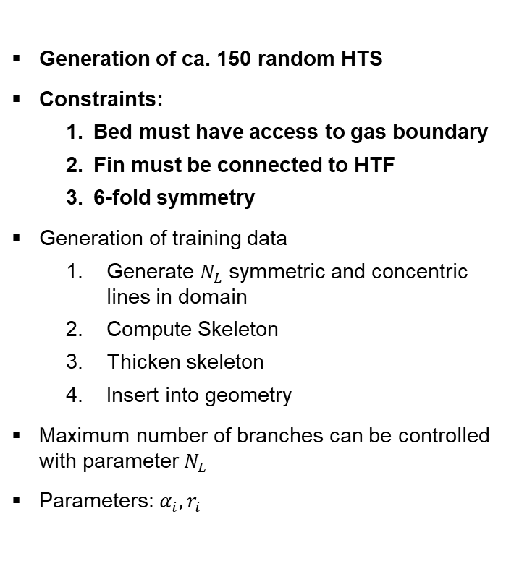


Synthetic Training Data
Generation of ca. 150 random HTS
Constraints:
Bed must have access to gas boundary
Fin must be connected to HTF
6-fold symmetry
Generation of training data
Generate $N_{L}$ symmetric and concentric lines in domain
Compute Skeleton
Thicken skeleton
Insert into geometry
Maximum number of branches can be controlled with parameter $N_{L}$
Parameters: $α_{i},r_{i}$
$$N_{L}=1$$
$$N_{L}=2$$
$$N_{L}=3$$

Slide 9
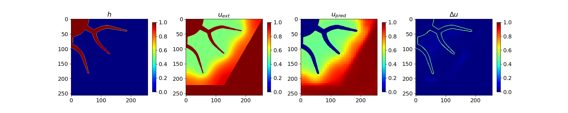
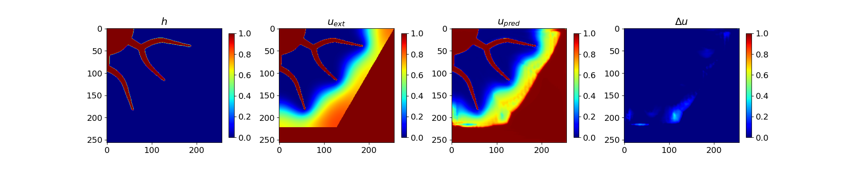
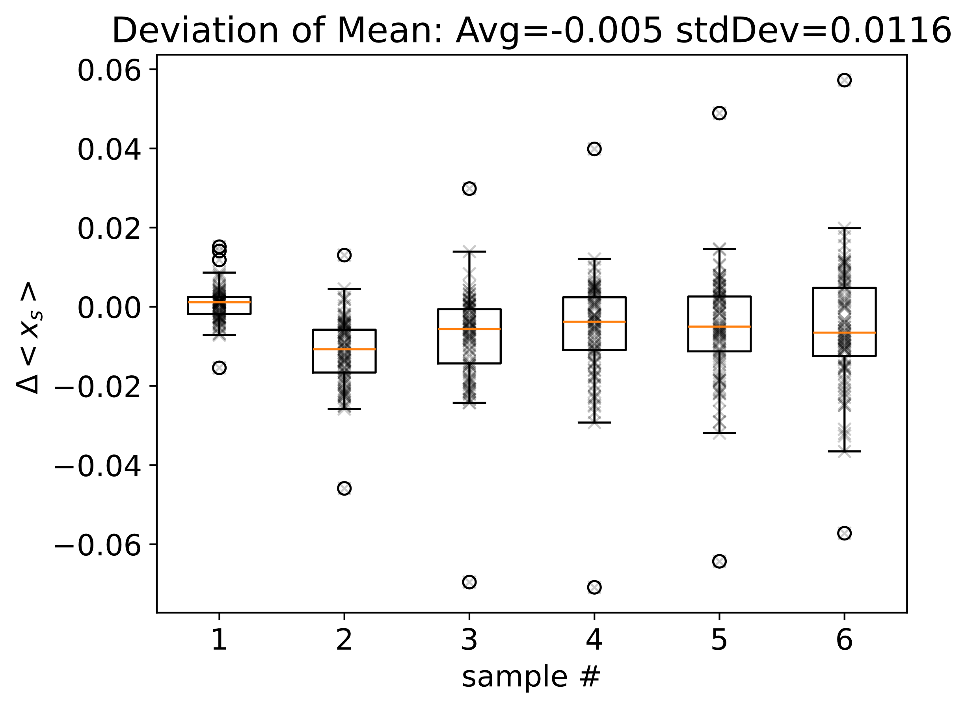
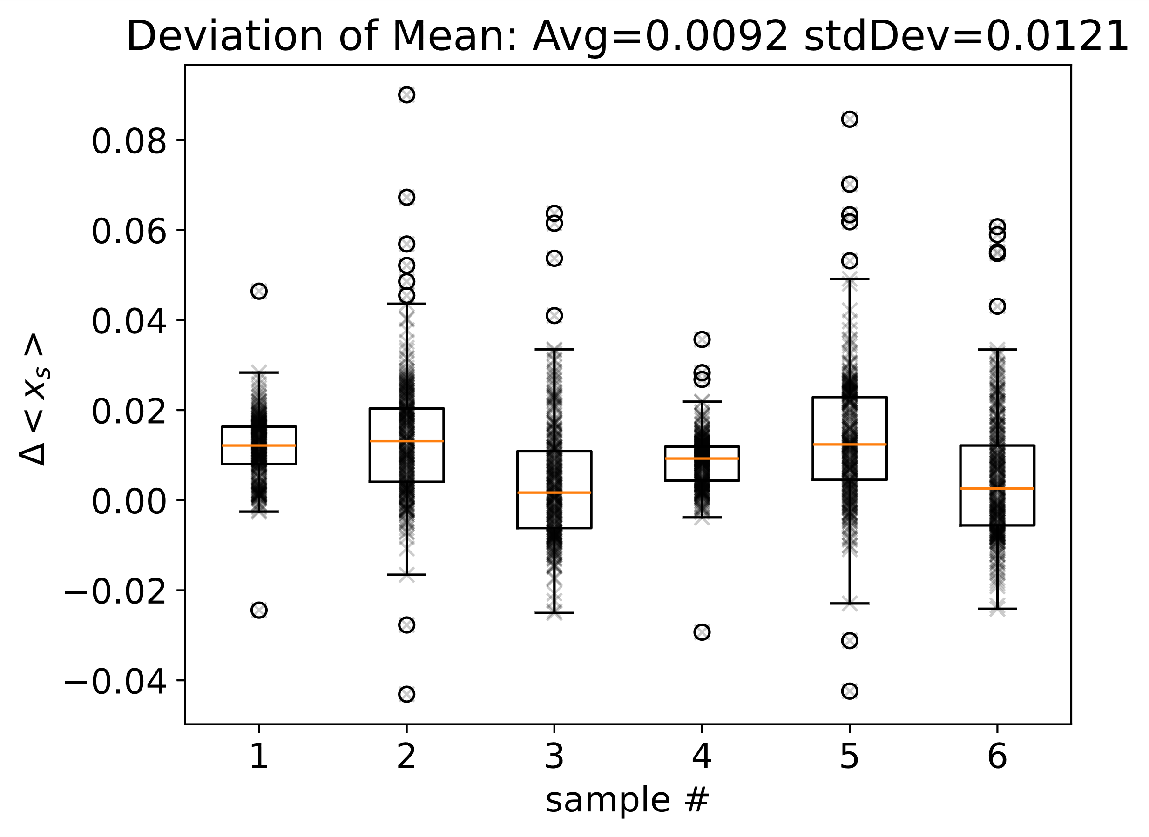
Autoregressive sinGAN
aMSNet
Last time:
Best model aMSNet
Error range 1-2% in SOC
Samll problems at the Boundary!
New model SinGAN:
Removes masking from the learning
Slightly better results
Reasons:
Both methods are essentially non-linear kernel methods
Explains low data requirement
Removing masking improves info at thin structures
Still problems in full field prediction!
aSinGAN
aSinGAN
aMSNet

Slide 10
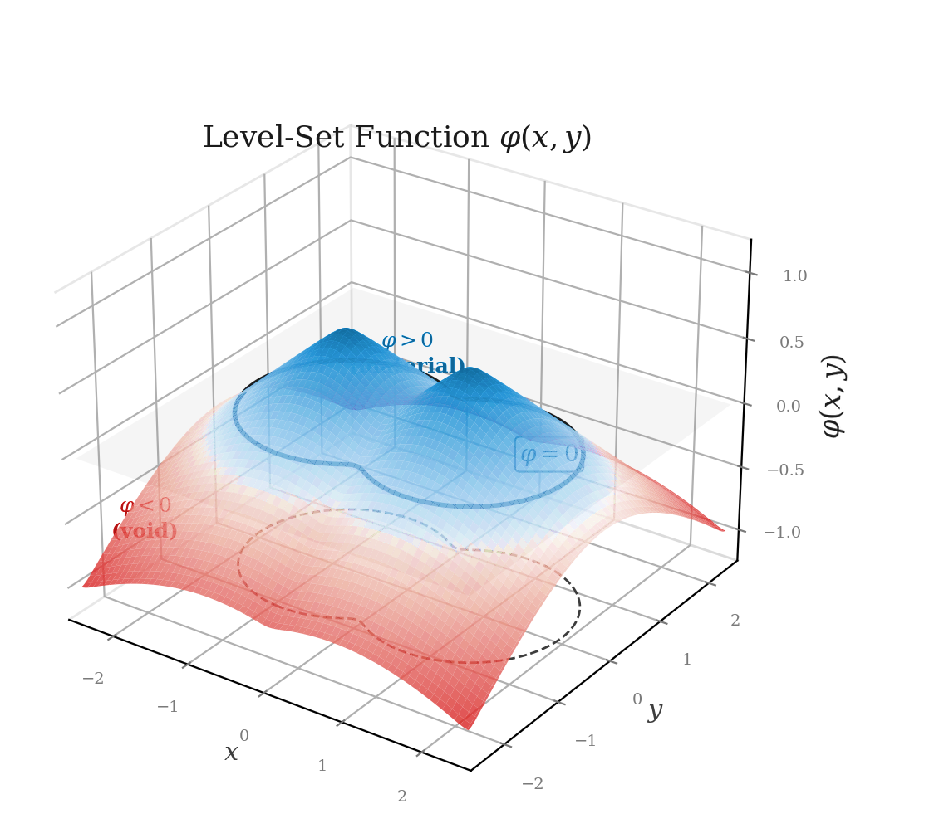
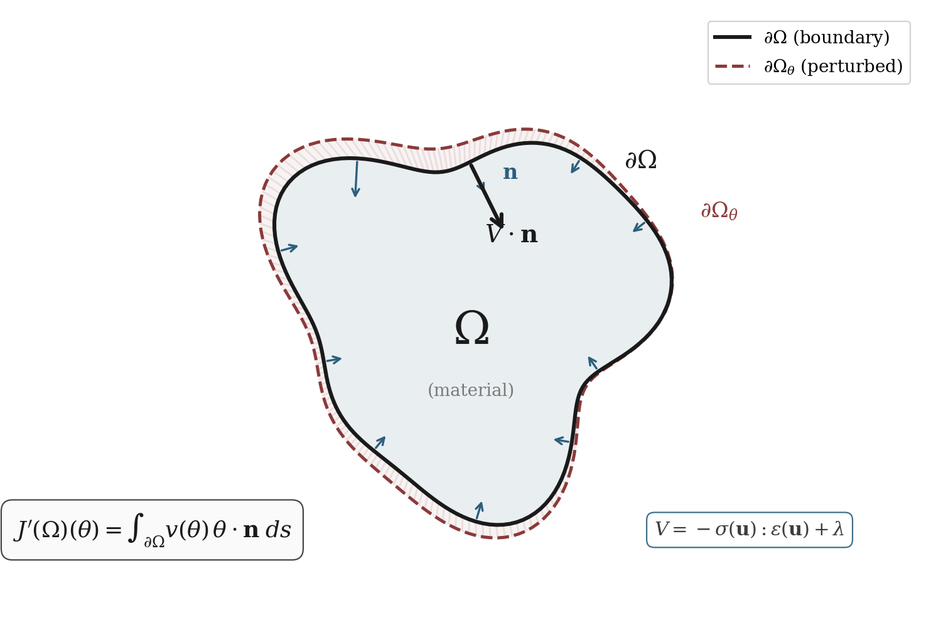
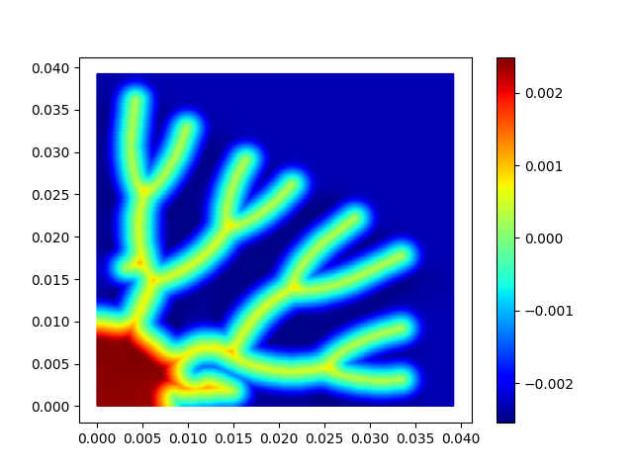
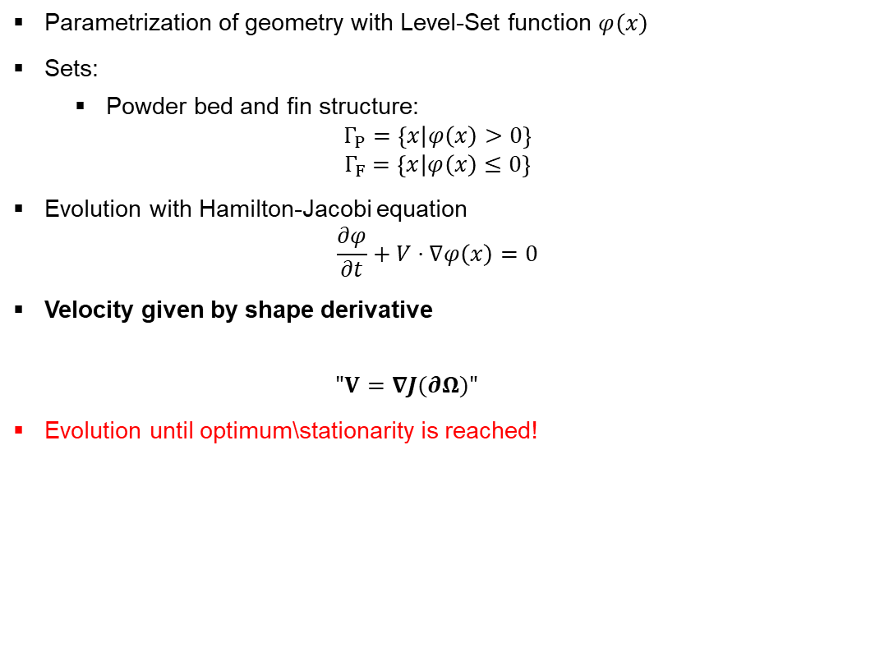
Topology Optimization With Level-Sets
Parametrization of geometry with Level-Set function $φ\left(x\right)$
Sets:
Powder bed and fin structure:
$$Γ_{P}=\left\{x | φ\left(x\right)>0\right\}$$
$$Γ_{F}=\left\{x | φ\left(x\right)≤0\right\}$$
Evolution with Hamilton-Jacobi equation
$$\frac{∂φ}{∂t}+V⋅∇φ\left(x\right)=0$$
Velocity given by shape derivative
$$"V=∇J(∂Ω)"$$
Evolution until optimum\stationarity is reached!

Slide 11
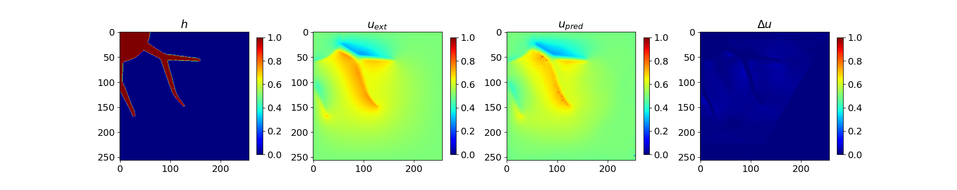
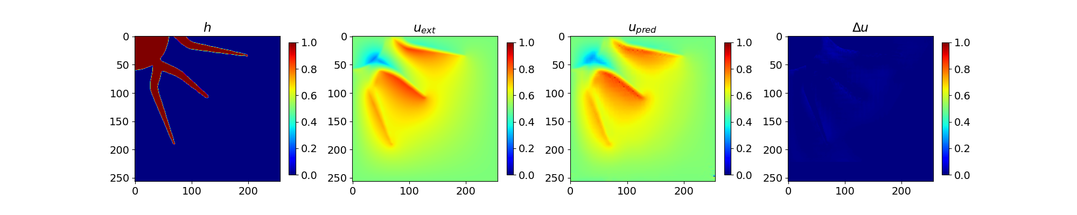
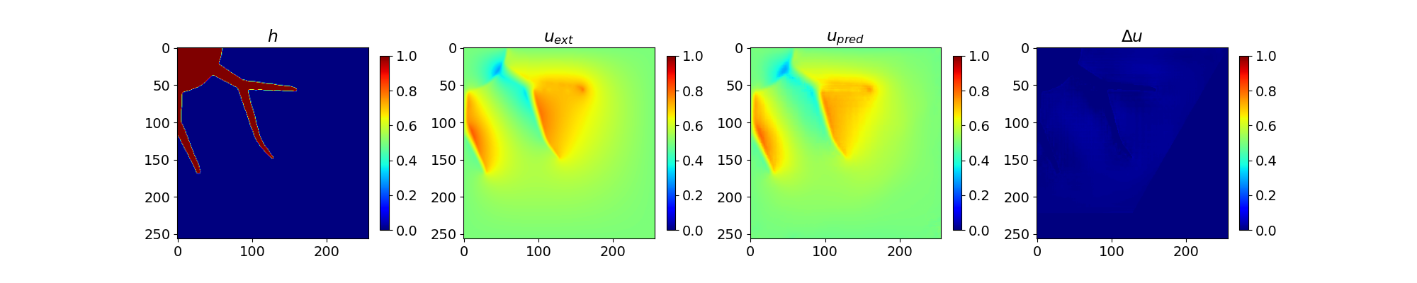
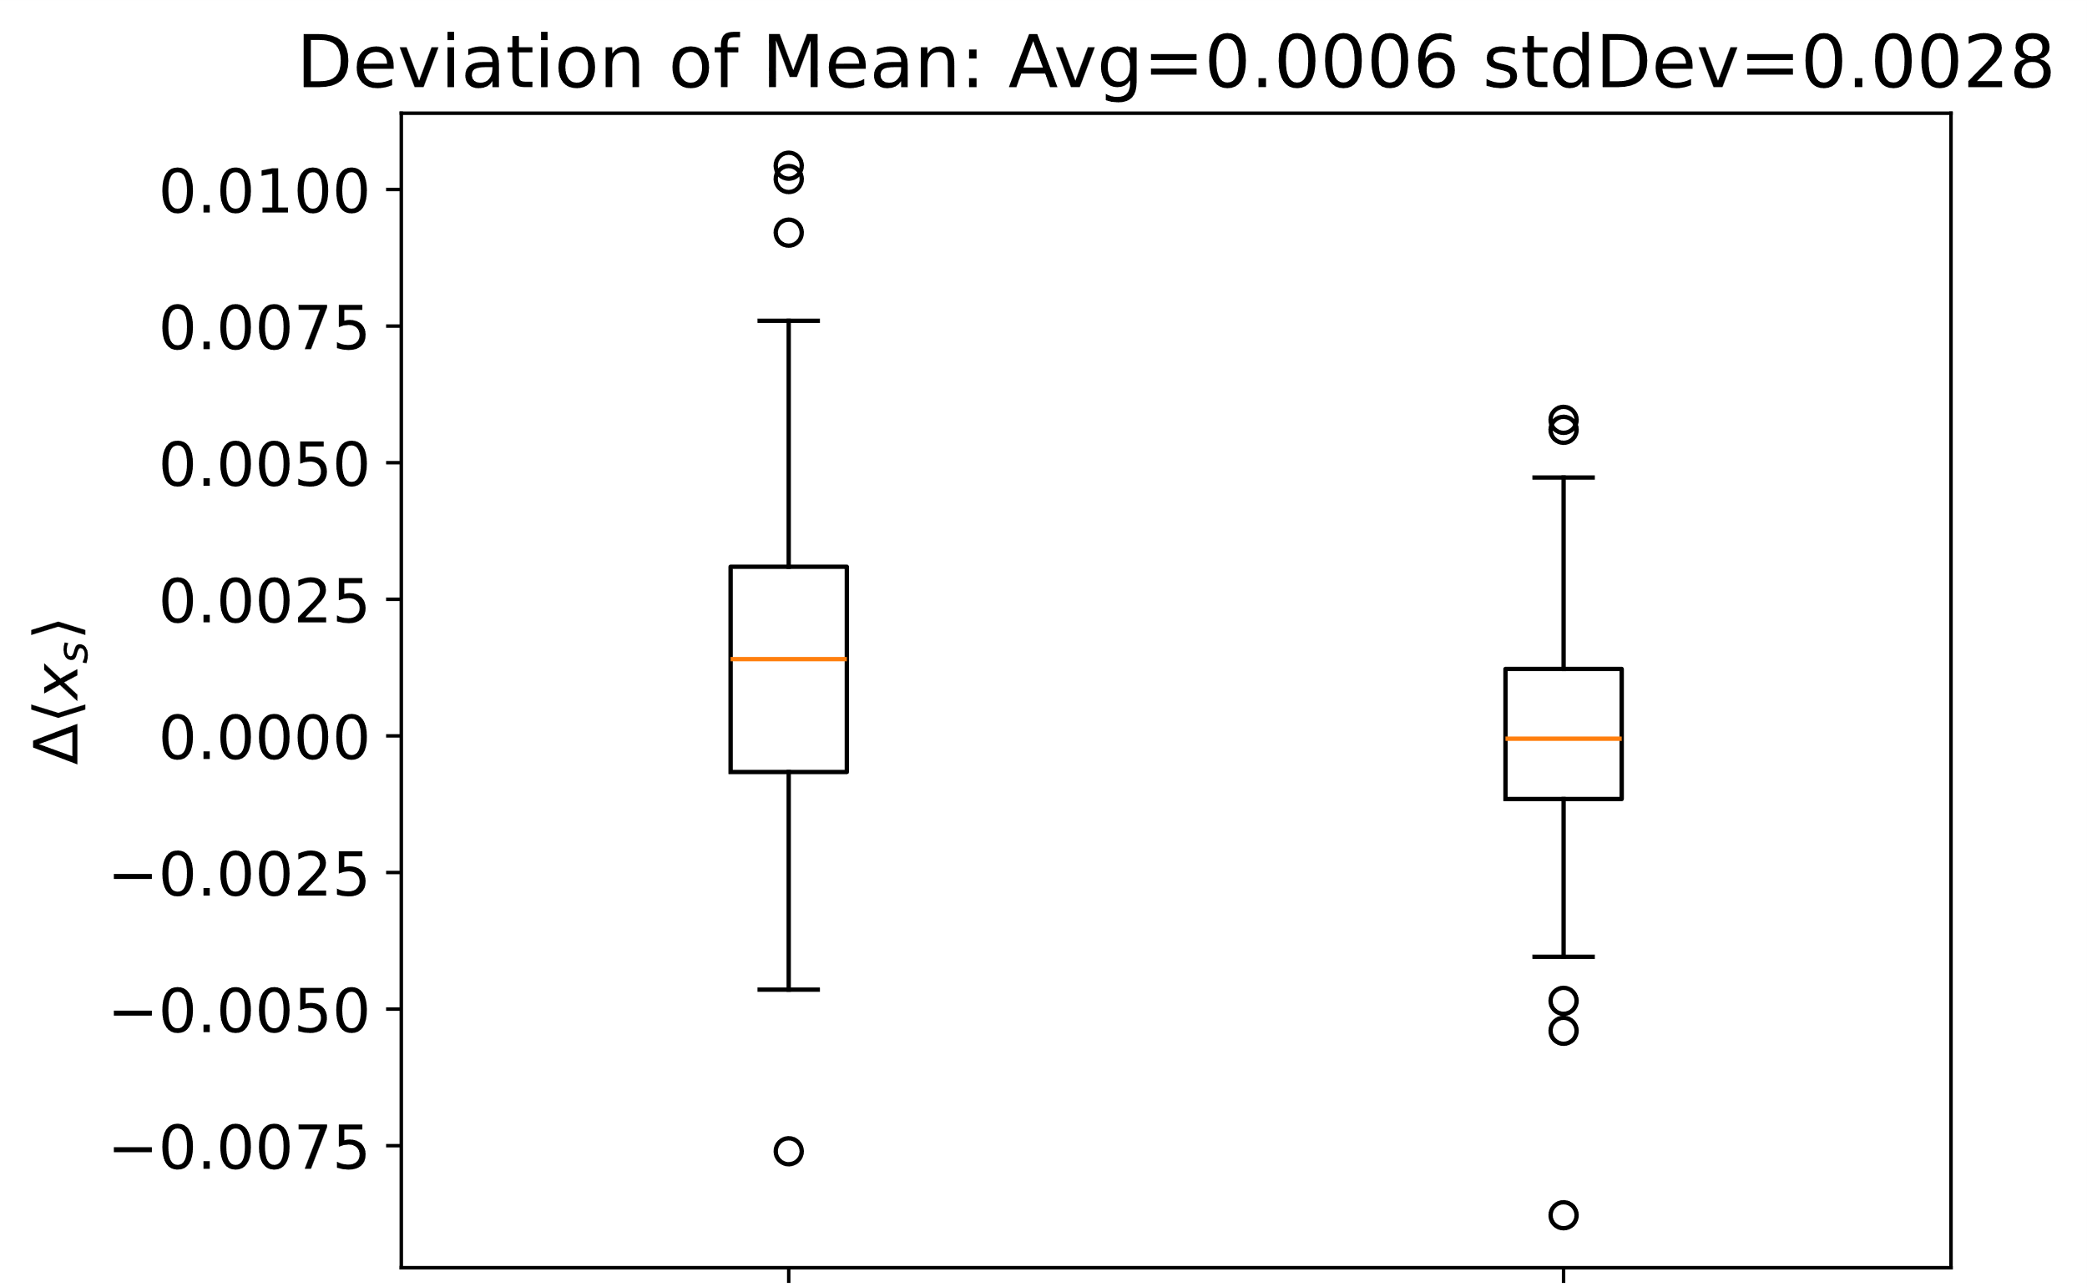
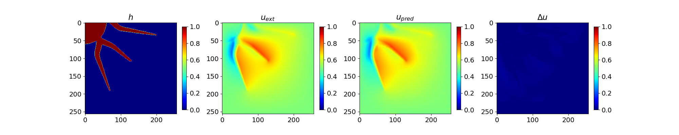




Learning the Shape Derivative
Computation
Can be computed with Firedrake adjoint solver
Hilbertian regularization of the shape derivative extending it to the whole domain
NN Input:
Current timestep
EDT Features
$$D{\left[J\right]}_{x}$$
$$D{\left[J\right]}_{y}$$
$$D{\left[J\right]}_{x}$$
$$D{\left[J\right]}_{y}$$

Slide 12
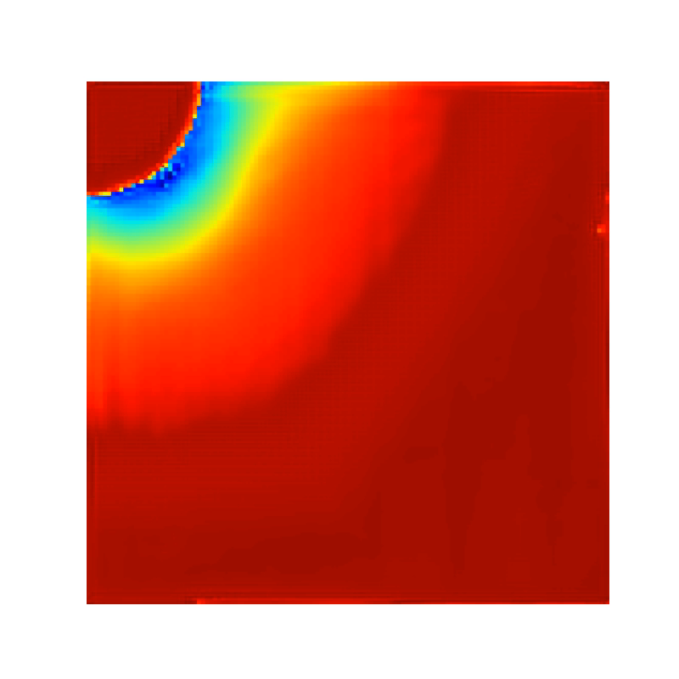
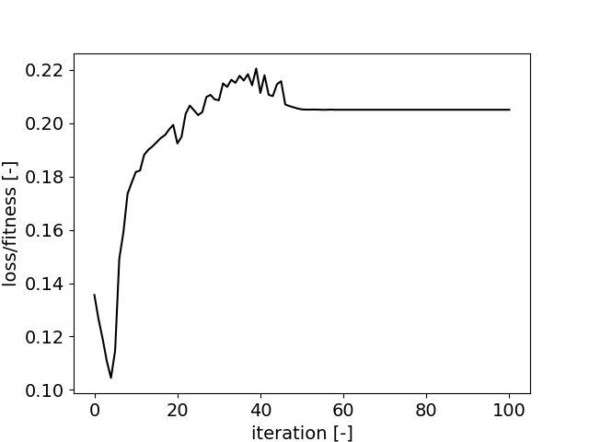
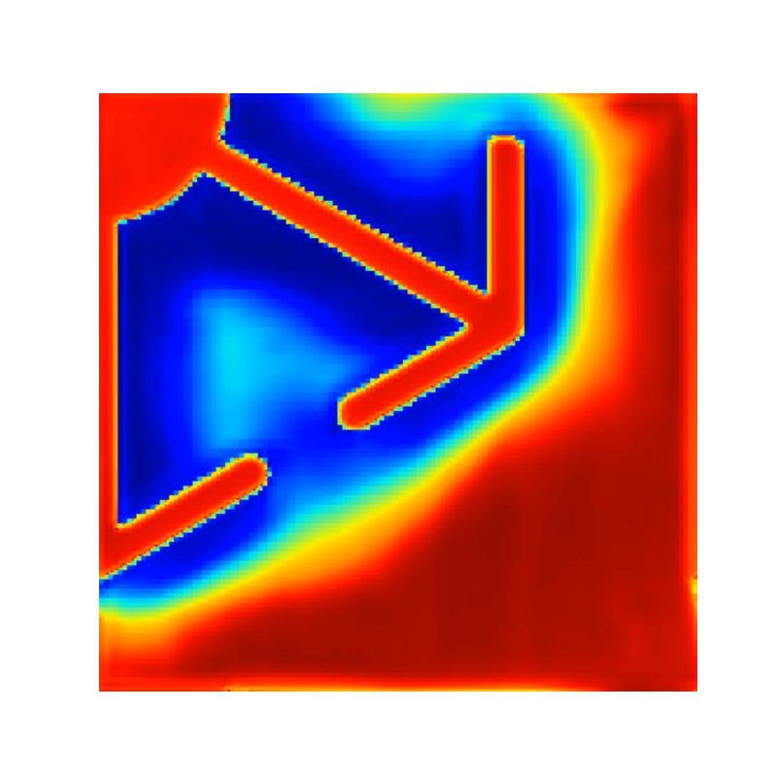
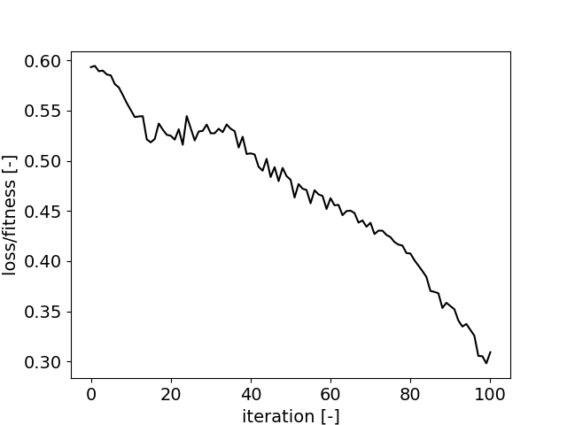
Topology Optimization
Results:
Optimization loop gets stuck in local minima
Numerically unstable
Violates constraints
Possible Reasons
Surrogate model does not “learn” fin conductivity and thickness
Small temperature variations
L2-Error
Possible Solutions
Combine learned gradient with equality or inequality constraints via KKT equation
Combine Level-Set solver with stochastic gradient algorithms
However this is a long shot!

Slide 13
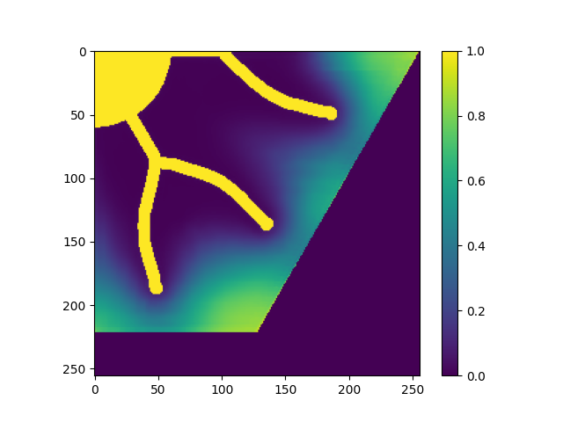
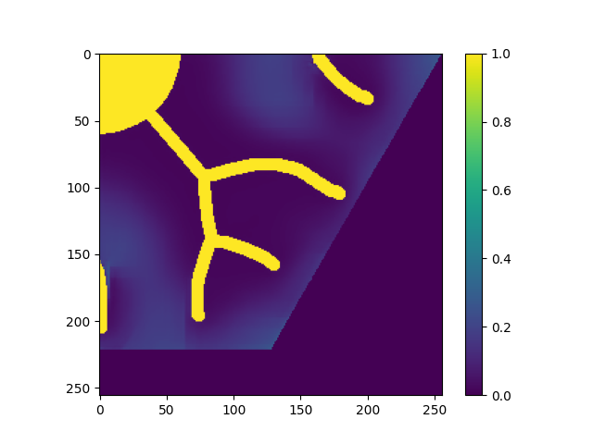
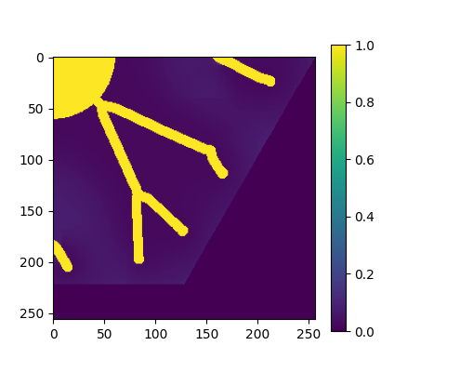

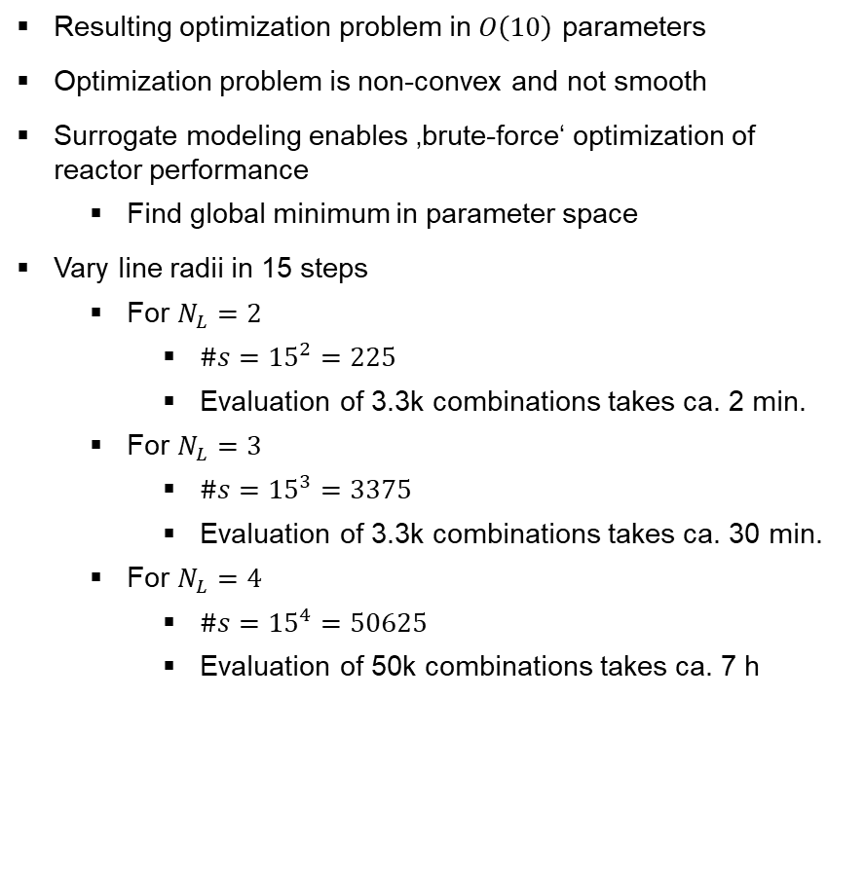


Brute Force Parametric Optimization
Resulting optimization problem in $O\left(10\right)$ parameters
Optimization problem is non-convex and not smooth
Surrogate modeling enables ‚brute-force‘ optimization of reactor performance
Find global minimum in parameter space
Vary line radii in 15 steps
For $N_{L}=2$
$\#s={15}^{2}=225$
Evaluation of 3.3k combinations takes ca. 2 min.
For $N_{L}=3$
$\#s={15}^{3}=3375$
Evaluation of 3.3k combinations takes ca. 30 min.
For $N_{L}=4$
$\#s={15}^{4}=50625$
Evaluation of 50k combinations takes ca. 7 h
$$N_{L}=2$$
$$N_{L}=3$$
$$N_{L}=4$$

Slide 14
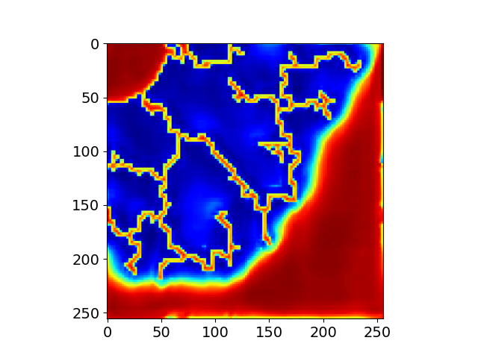
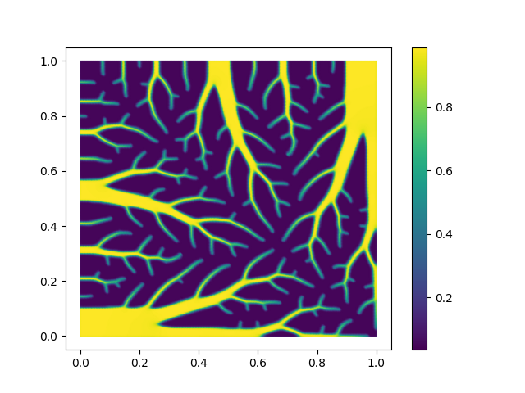

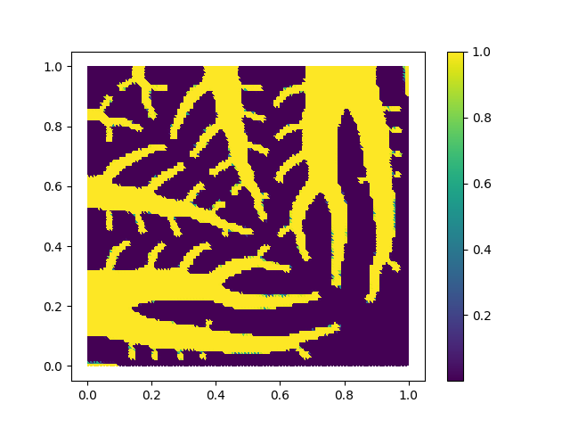
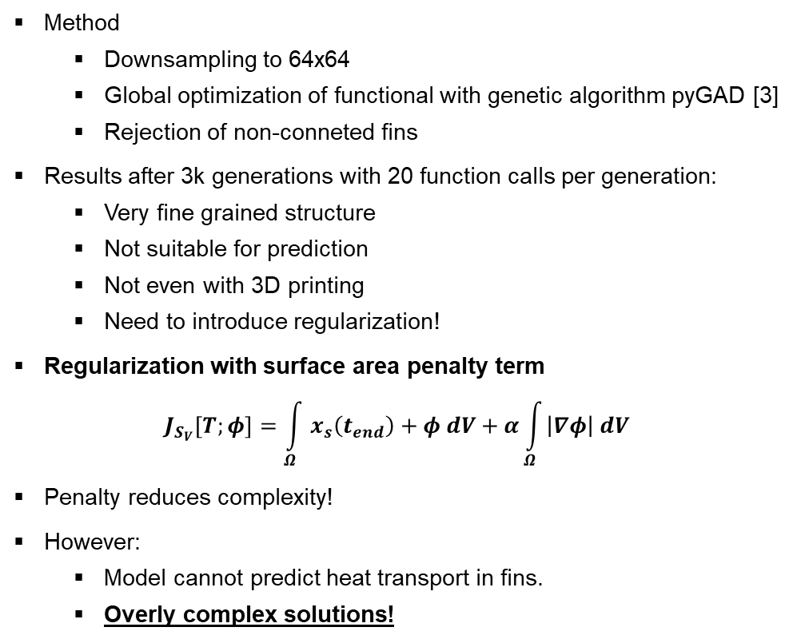


Topology Optimization With Genetic Algorithms
Surrogate Reactor Model
Pure Heat Conduction (SIMP)
No reg.
Method
Downsampling to 64x64
Global optimization of functional with genetic algorithm pyGAD [3]
Rejection of non-conneted fins
Results after 3k generations with 20 function calls per generation:
Very fine grained structure
Not suitable for prediction
Not even with 3D printing
Need to introduce regularization!
Regularization with surface area penalty term
$$J_{S_{V}}\left[T;φ\right]=\int_{Ω}{x_{s}\left(t_{end}\right)+φ dV+α\int_{Ω}{\left|∇φ\right| dV}}$$
Penalty reduces complexity!
However:
Model cannot predict heat transport in fins.
Overly complex solutions!
$$α=0$$
Regularized
$$α={10}^{−4}$$

Slide 15
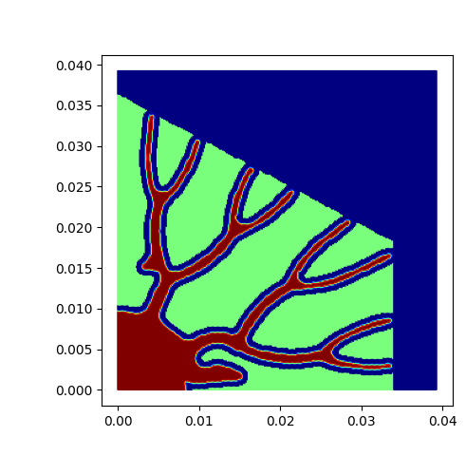
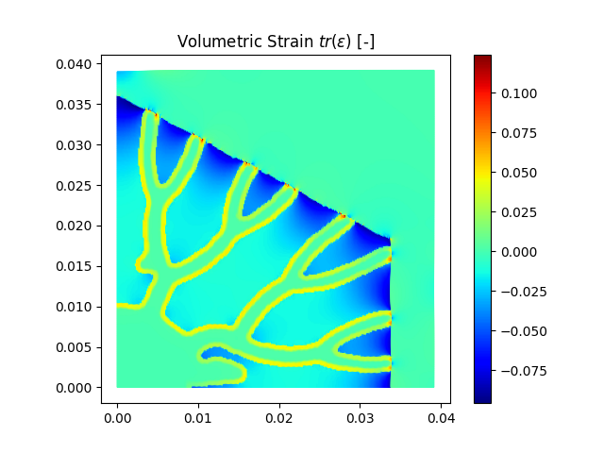
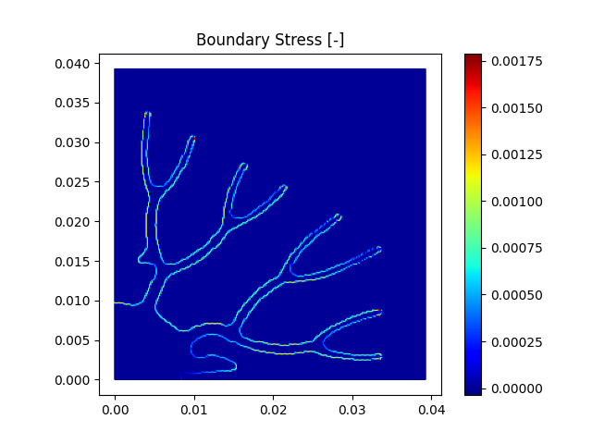
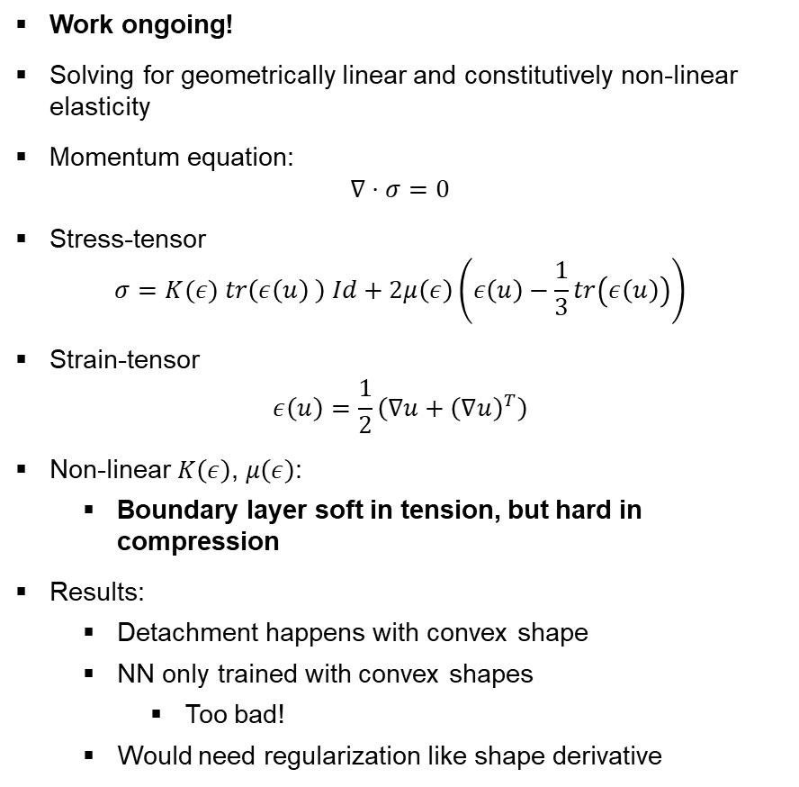
Optimization of Contact Problems
Work ongoing!
Solving for geometrically linear and constitutively non-linear elasticity
Momentum equation:
$$∇⋅σ=0$$
Stress-tensor
$$σ=K(ε) tr\left(ε\left(u\right) \right) Id+2μ\left(ε\right)\left(ε\left(u\right)−\frac{1}{3}tr\left(ε\left(u\right)\right)\right)$$
Strain-tensor
$$ε\left(u\right)=\frac{1}{2}\left(∇u+{\left(∇u\right)}^{T}\right)$$
Non-linear $K\left(ε\right)$, $μ\left(ε\right)$:
Boundary layer soft in tension, but hard in compression
Results:
Detachment happens with convex shape
NN only trained with convex shapes
Too bad!
Would need regularization like shape derivative

Slide 16
Conclusion & Outlook
Summary
Optimization of heat transfer structures
Surrogate modeling of reactor possible with suitable machine learning algorithms
SinGAN performs best
Enables brute-force and stochastic optimization of non-convex, non-smooth problems.
However need additional constraints
Level-Set not working so far! ☹
Outlook
Modeling
Looking for even better surrogate models for heat transfer in fins
Based in Model Order Reduction Techniques
Difficult with low data req.
Optimization of heat transfer structures
Use current parameterized model to “cue in” more general topology optimization methods looking for local minimum
Level-Set implemented in simulation
Stability?
Explore different objective functions
Regularization Techniques
Find optima for different requirements
Optimize for Power, Capacity etc.
Explore Pareto Front between objectives
References:
[1] Agnese Marcato, Javier E. Santos, Chaoyue Liu, Gianluca Boccardo, Daniele Marchisio, Alejandro A. Franco, (2023) Modeling the 4D discharge of lithium-ion batteries with a multiscale time-dependent deep learning framework, Energy Storage Materials 63, 102927
[2] Shaham, Tamar Rott, Tali Dekel, and Tomer Michaeli. "SinGAN: Learning a Generative Model from a Single Natural Image." arXiv preprint arXiv:1905.01164 (2019)
[3] Gad, A.F. PyGAD: an intuitive genetic algorithm Python library. Multimed Tools Appl 83, 58029–58042 (2024)

