Slide 1




DimExDAM: A Diffusion–Adversarial Framework for 2D-to-3D Generation of Complex Porous Microstructures
By Ali Aouf
22/05/2026
Notes:
Good afternoon.
I am Ali Aouf, A PhD researcher at the Belgian nuclear research center and the UCLouvain,
and today, I will be presenting our work on 'Diffusion-Based 3D Simulation of Clay Microstructures.’
Our research focuses on using generative machine learning techniques to synthesize realistic 3D images of clay microstructures and predict their effective properties.
This has significant implications for the study of geological disposal of radioactive waste.
Let's dive into the details.

Slide 2
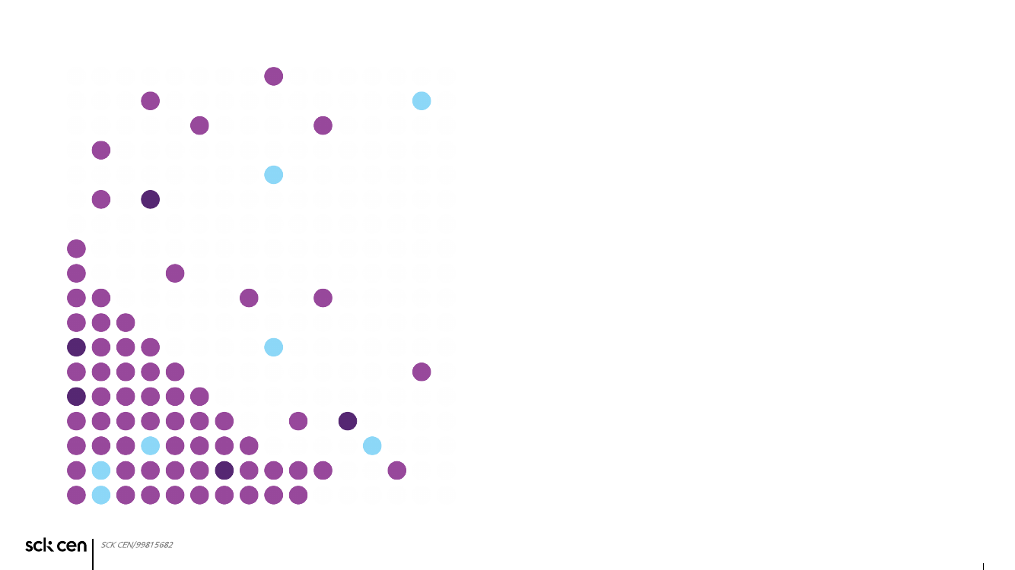
Roadmap
1
Motivation
2
State of the art 2D to 3D
3
Our proposed methodology
4
Validation and evaluation
5
Future work
2
ISC:

Slide 3
The bottleneck is not generation - it is 3D data
Having access to 3D realistic data is essential to simulate flow and transport properties.
FIB-CEM provide valuable, high resolution 3D images, but they are costly and technically challenging to use with fragile materials.
The current state of the art method (SliceGAN) trains a 3D generative model using 2D dataset of images, works OK with homogenous microstructures, but struggles with complex microstructures.
We propose a new kind of 2D-to-3D generative models, that are diffusion/flow based with adversarial training, and are more stable to train and provide artifact-free, realistic, and 3D coherent results.

Slide 4
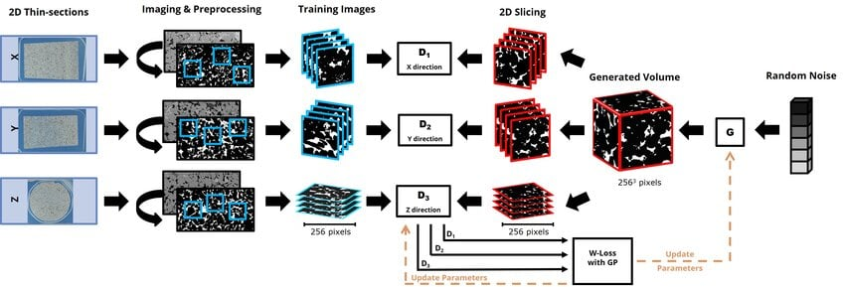
GANs are hard to train with one discriminator, why add two more?
SliceGAN trains a 3D generative UNet using three 2D discriminators, one discriminator per plane.
This turns the process into a more complicated multi-objective training that is not guaranteed to converge to a state that satisfies the three discriminators.
Image taken from Amiri et al (2024)

Slide 5
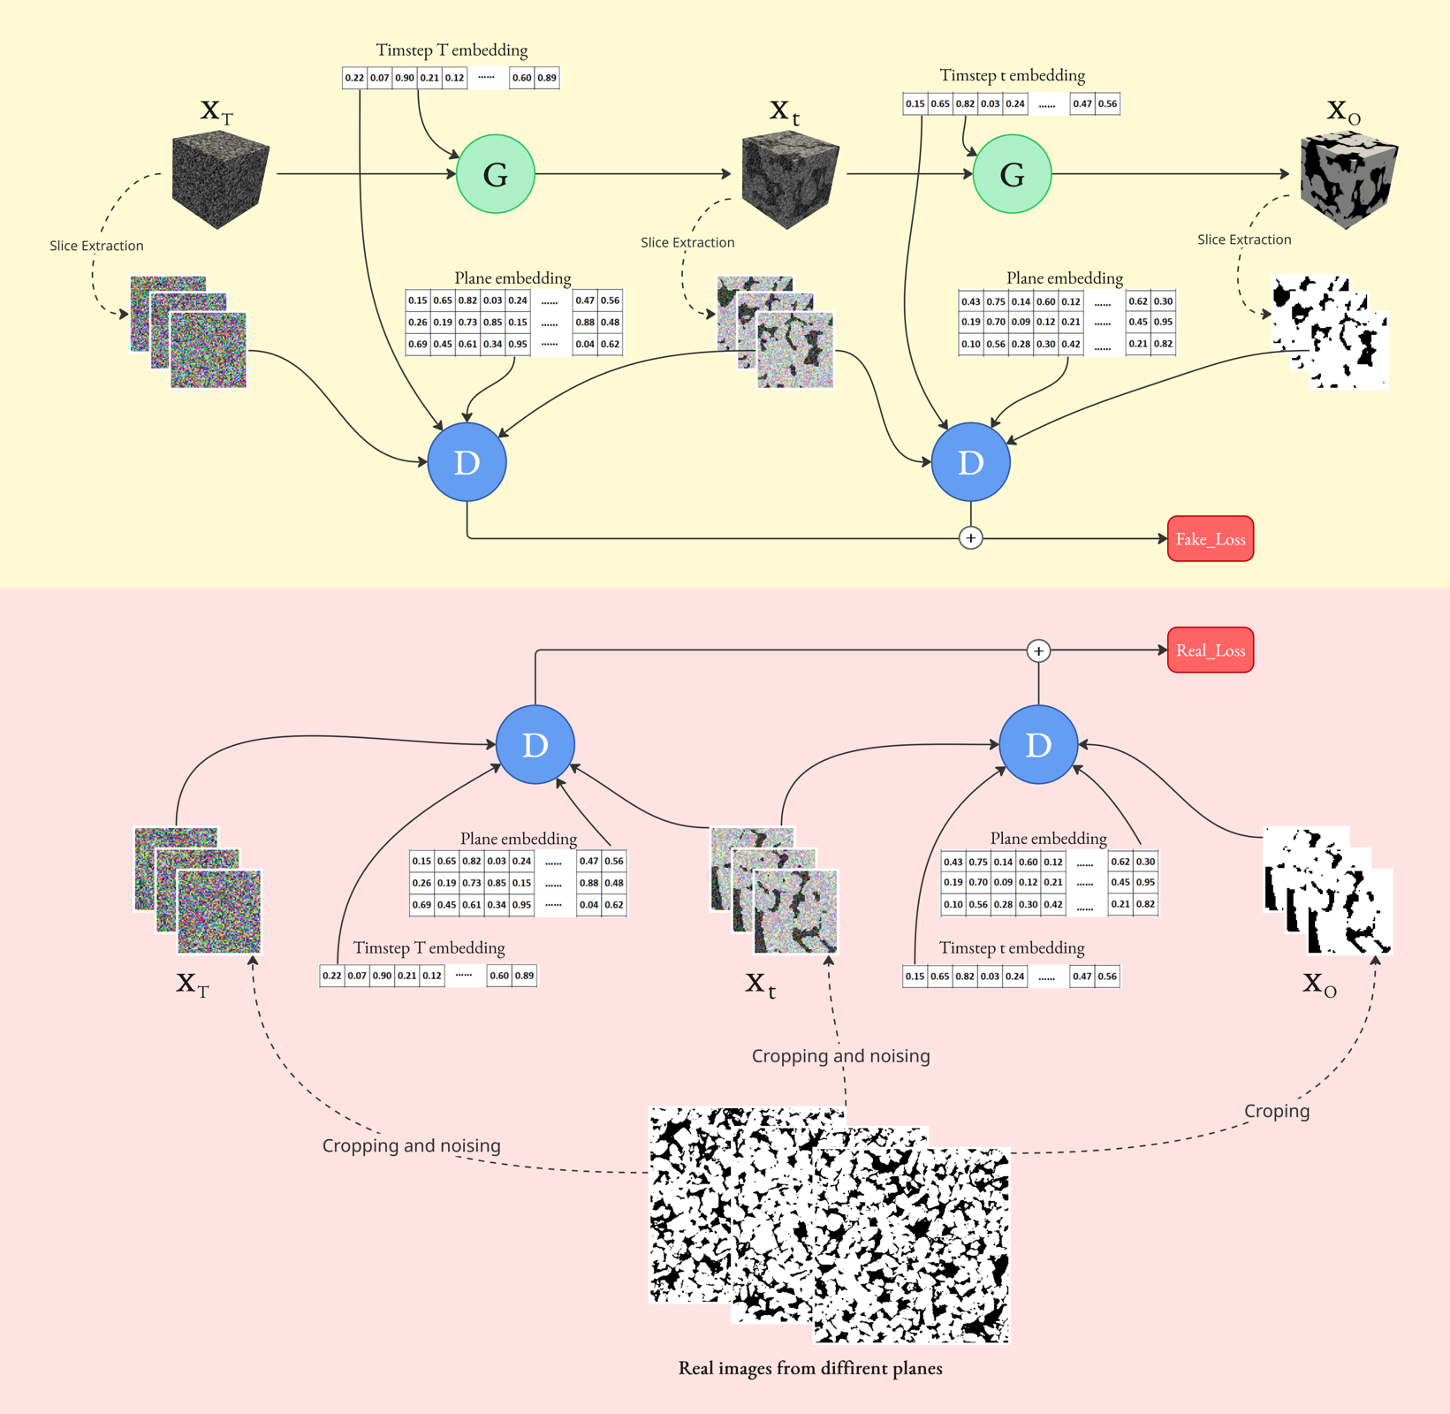
Our method: a 3D DDPM trained using a conditional discriminator
Generated branch
A 3D noise block is progressively mapped to a clean 3D volume over a short diffusion chain.
Real branch
Only 2D crops are available. They are noised to the same timestep and compared to generated slices.
Single discriminator
Plane and timestep embeddings allow one 2D discriminator to evaluate all orientations at any timestep.

Slide 6
Our method: a 3D DDPM trained using a conditional discriminator
ML Models
A 3D generator synthesises the full volume, while a single 2D discriminator evaluates generated slices.
One 3D generator
One 2D Discriminator
Slice-conditioned diffusion
In addition to taking the slices as input, it also takes the timestep and plane index embeddings. The training proceeds in a free-guidance manner.
Stabilised adversarial learning
Training is regularised to prevent discriminator dominance and improve convergence during 2D-to-3D adversarial diffusion training.
spectral normalization
low-pass curriculum
temperature-scaled activation
clipping
lazy R1

Slide 7
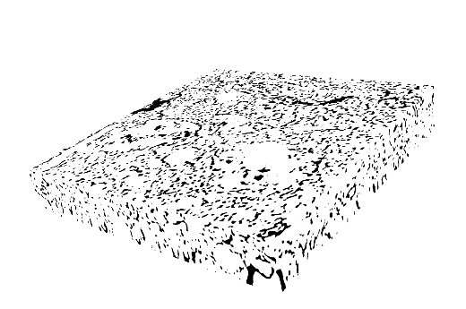

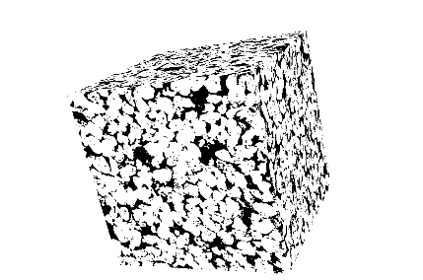
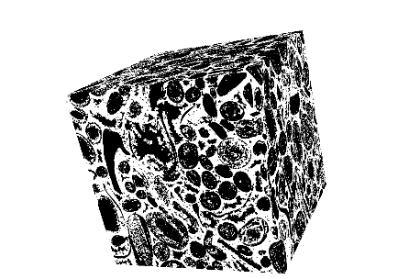
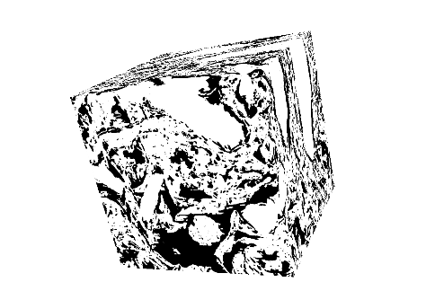
Validation: morphology plus physics
Binary illite
Multiphase illite
Sandstone
Carbonate
Boom Clay
Input during training
Structural validation
Physical validation
Three orthogonal 2D slices, not the 3D volume.
Porosity / phase fractions, chord length, lineal path, S2, pore-size distributions.
Effective gas diffusivity from lattice Boltzmann simulations on generated 3D samples.
* Evaluation asks whether generated volumes are visually plausible, statistically consistent, and transport-relevant.
7
ISC:

Slide 8
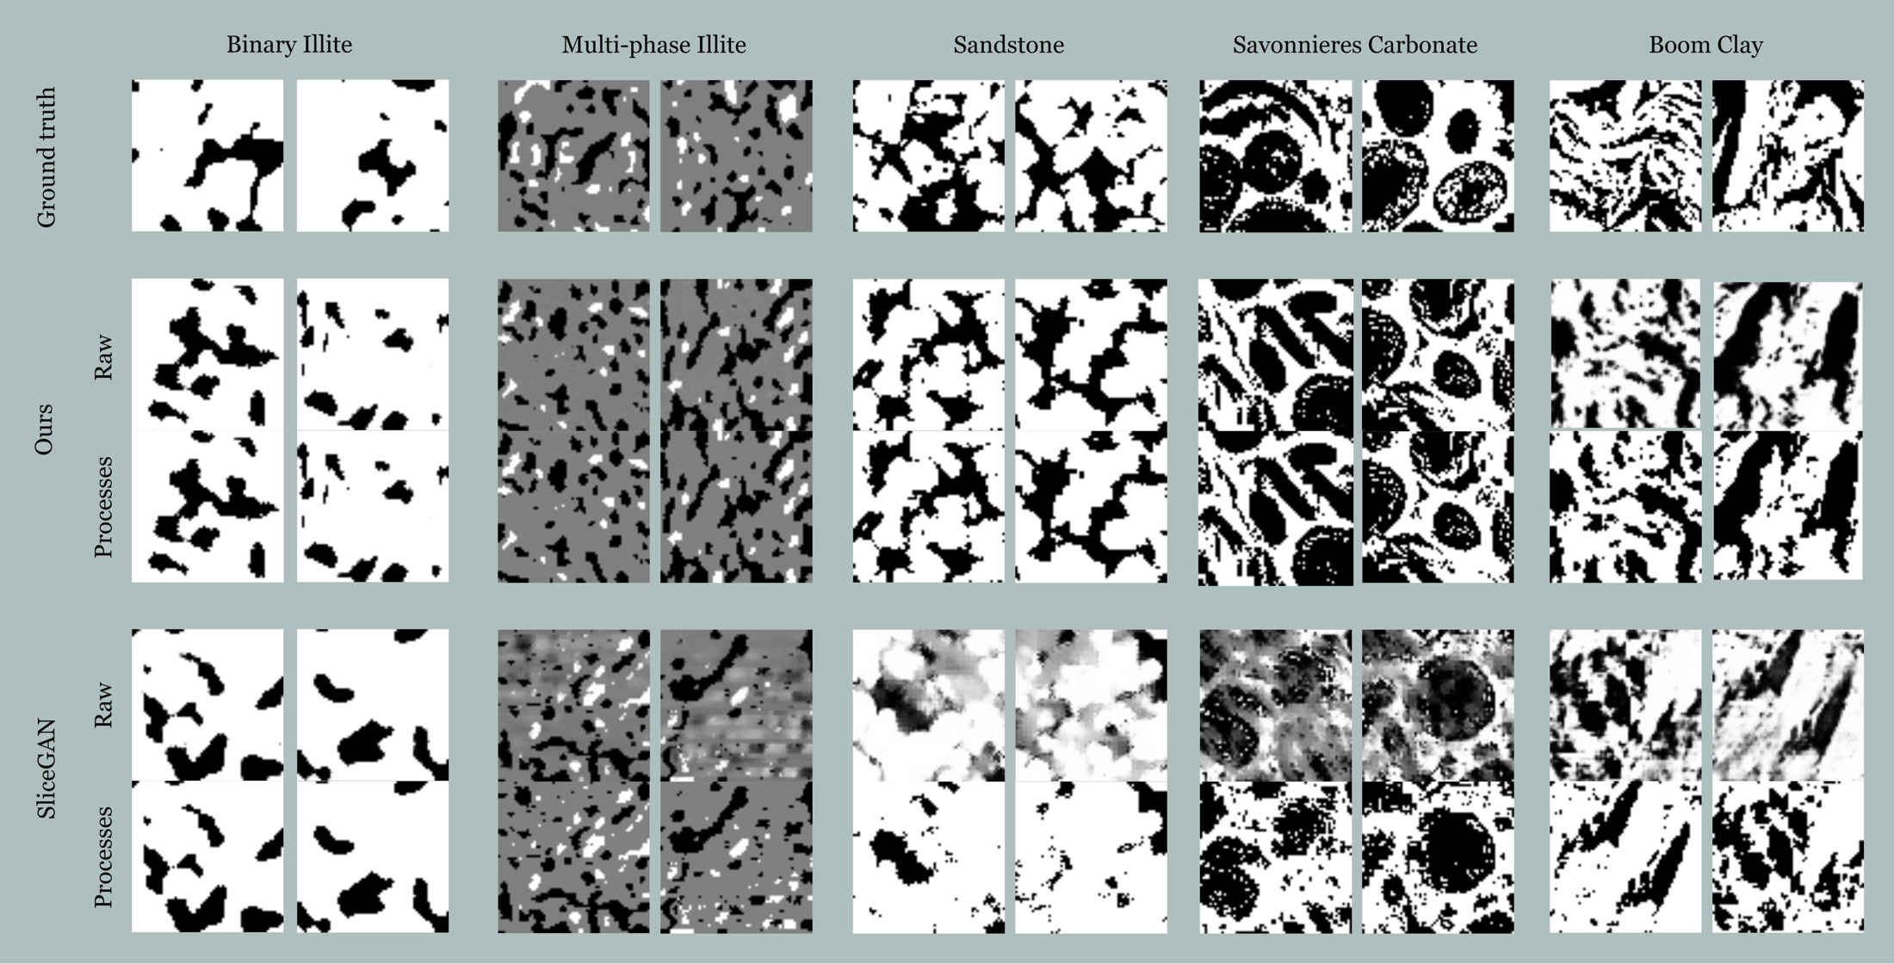
Visual results: raw output
Out of the box, SliceGAN-generated samples produced artifacts almost in every tested microstructure, unlike our method, which looks more visually clean. Applying thresholding and a median filters clears most artifacts.

Slide 9
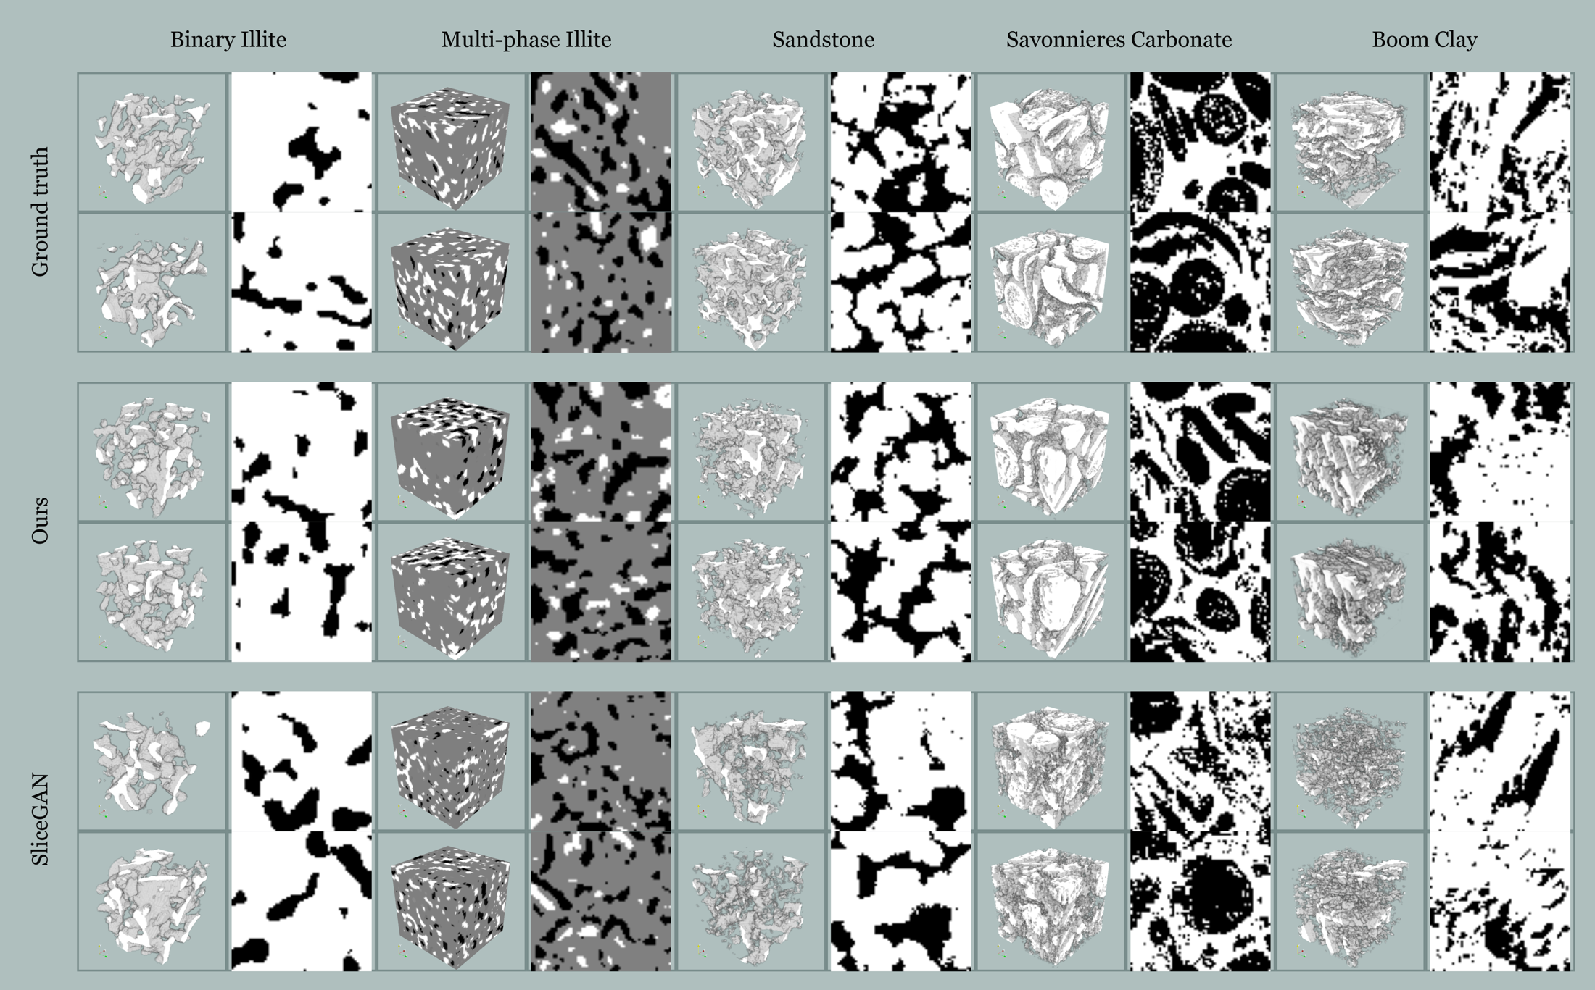
Visual results: 2D, and 3D visualisations
Overall, processed images from both models look close to the real images. Although, SliceGAN images tend to be simpler.

Slide 10
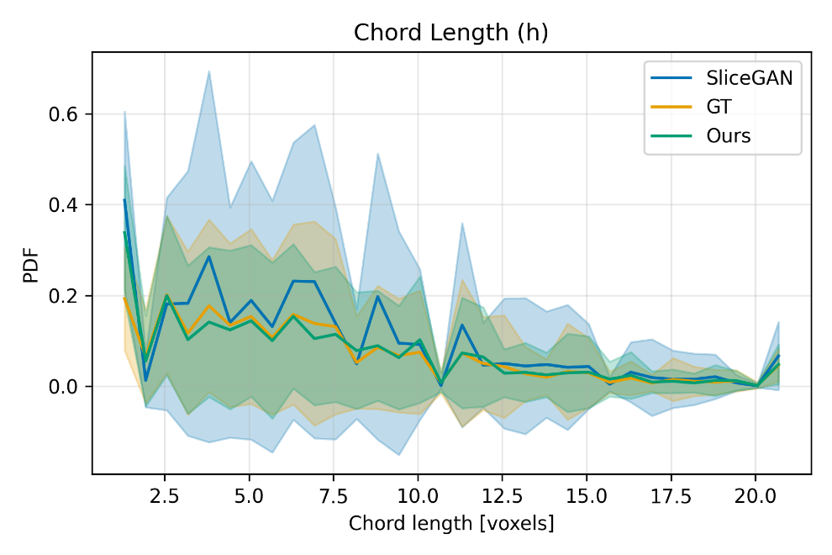
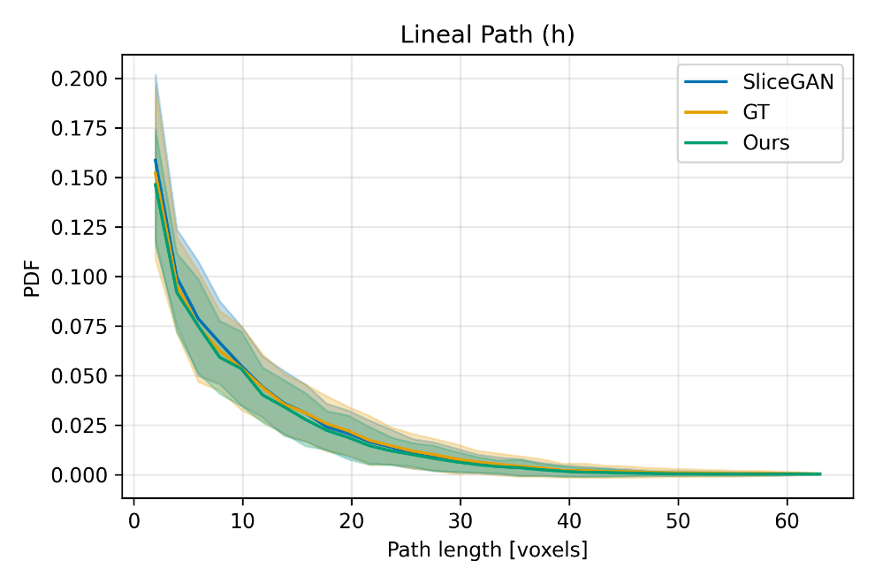
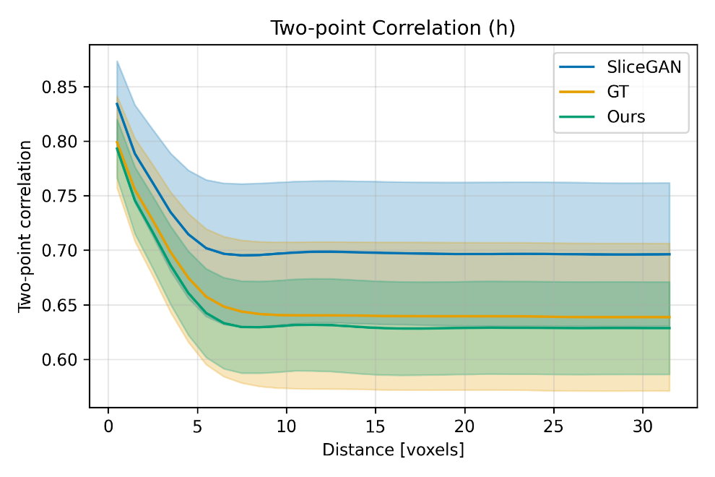
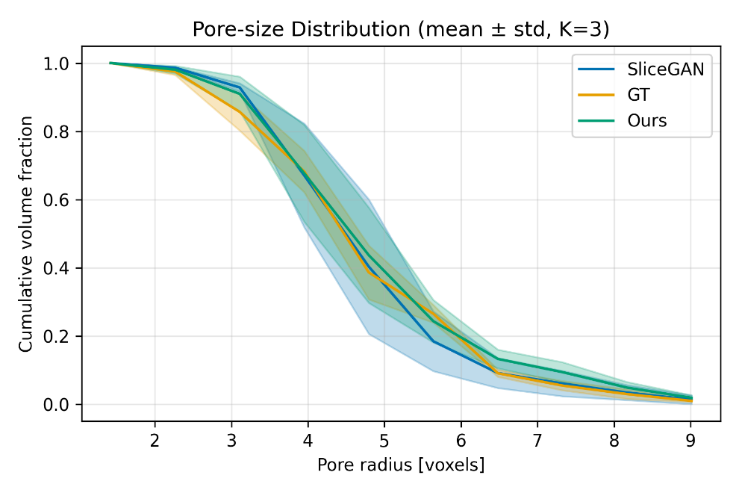
Statistical results: structural descriptors

Slide 11
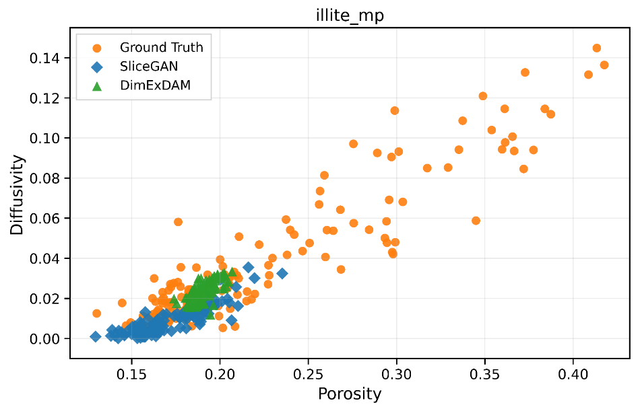
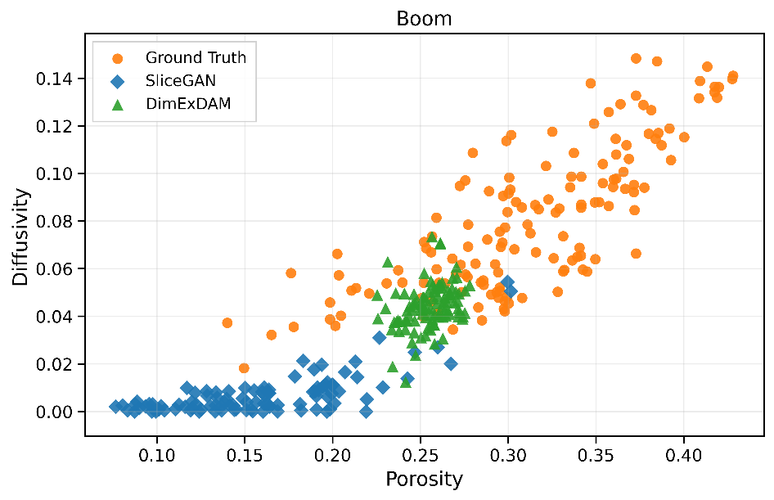
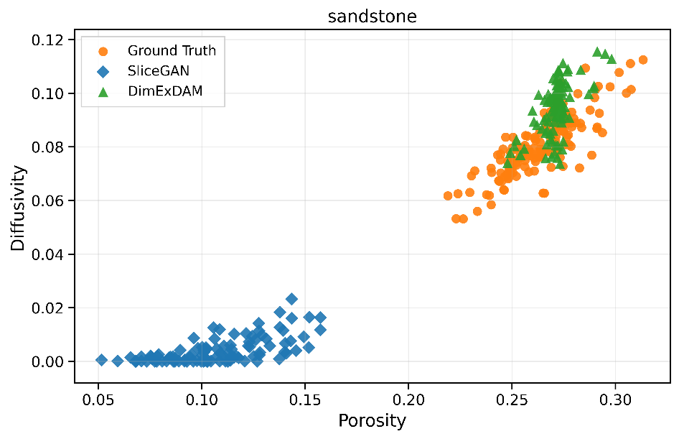
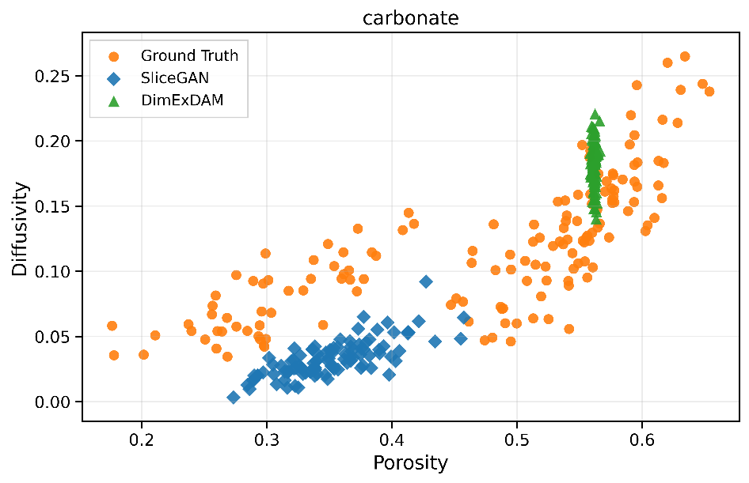
Statistical results: diffusivity simulation

Slide 12
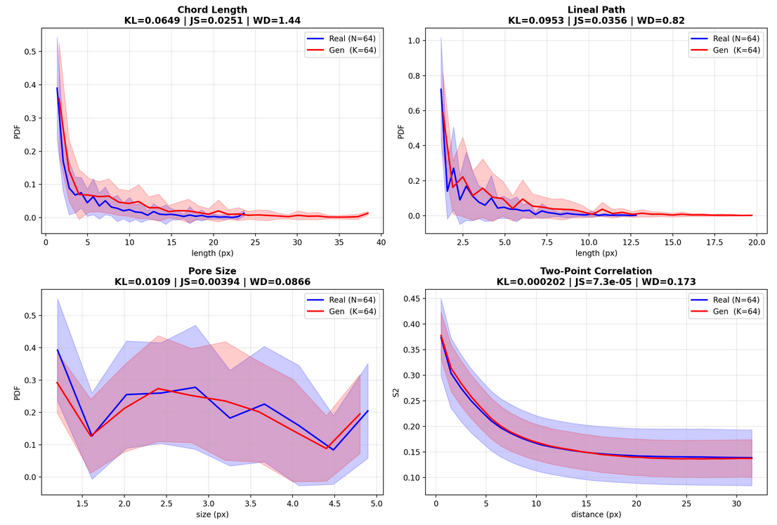
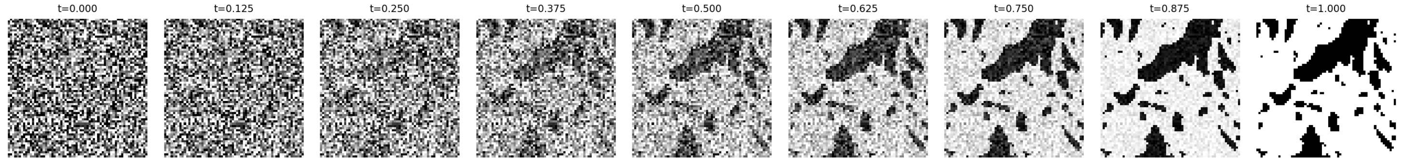
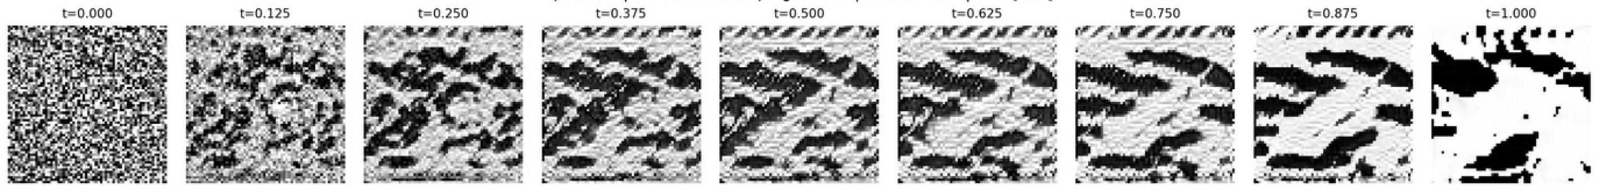
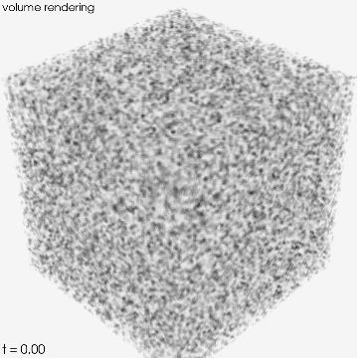
Next step: flow matching based 2D-to-3D
We substituted the diffusion pipeline with a flow matching one, and we obtained a system that requires less regularization compared to the DDPM based implementation.
Ground truth:
Generated:

Slide 13
Take-home messages
2D-only training is feasible
Progressive generation improves stability
A 3D generator can be trained without 3D training volumes by supervising generated slices.
Diffusion-style refinement avoids relying on a single direct mapping from latent space to volume.
Flow matching is the next extension
It preserves progressive transport while reducing sampling cost.

Slide 14





Thank you
Ali Aouf – ali.aouf@sckcen.be
@40uf411
@40uf411
Eric Laloy – eric.laloy@sckcen.be
Bart Rogiers – bart.Rogiers@sckcen.be
Christophe De Vleeschouwer - christophe.devleeschouwer@uclouvain.be
Notes:
Thank you for your attention. If you have any questions, please feel free to ask. You can also reach out to us via email if you would like to discuss our work further.

