Slide 1


Data-Driven Prediction of Relative Permeability: Applications to CO₂ and Hydrogen Storage
Abdolali (Ali) Mosallanezhad¹, Amir Jahanbakhsh^{1,2}, and M. Mercedes Maroto-Valer^{1,2}
¹ The Research Centre for Carbon Solutions (RCCS), School of Engineering and Physical Sciences, Heriot-Watt University, Edinburgh, UK
² Industrial Decarbonisation Research and Innovation Centre (IDRIC), Heriot-Watt University, Edinburgh, UK
May 2026

Slide 2
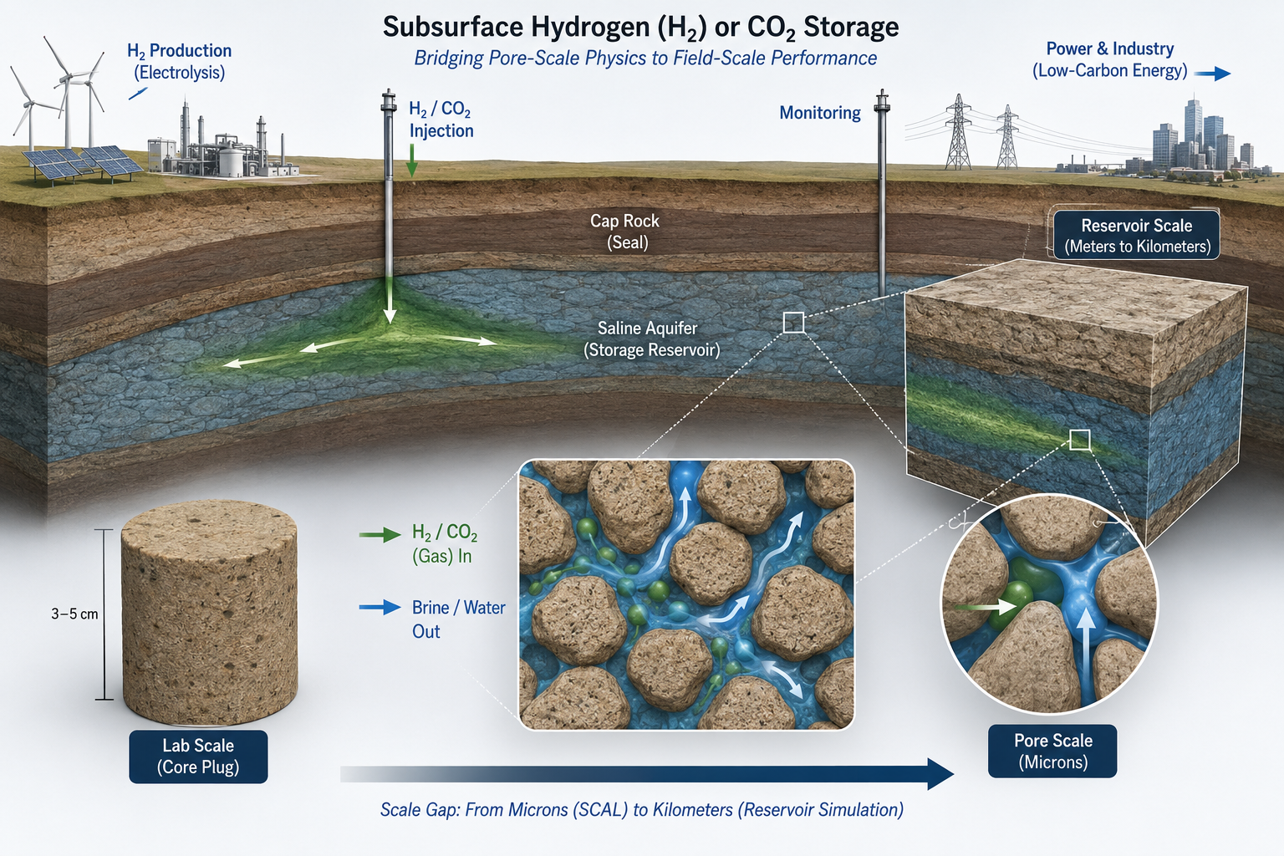
CO₂/Hydrogen Storage in Porous Media
Reservoir Simulation
Predict storage capacity
Support safe CO₂/H₂ storage design
Identify key uncertainties
Plan injection/withdrawal rates
Convert lab data into field-scale forecasts
Optimise well placement
Important INPUT:
Relative permeability curves are essential inputs for multiphase reservoir simulation.
2

Slide 3
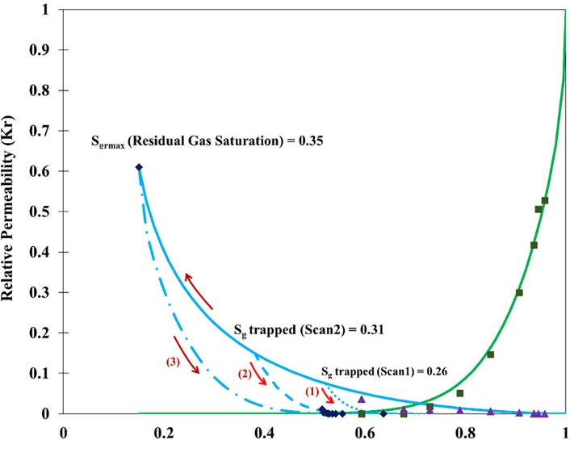
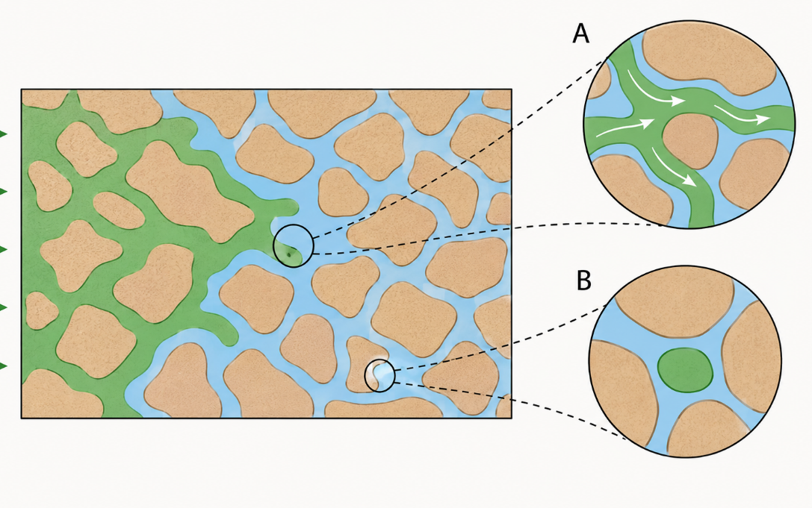
Relative Permeability in Porous Media
Relative permeability controls gas–brine mobility, which affects:
Gas plume migration
Residual trapping
Pressure response
Simulation forecast reliability
Experimental Bottleneck:
Experiments are:
Expensive
Time-consuming
Dependent on core availability
Limited in pressure, temperature, and rock coverage
Insufficient to capture full reservoir heterogeneity
Porous Media Saturated with Water
Gas Plume
Trapped Gas
3

Slide 4
Research Objectives
Selecting the best ML Model based on the number of data points and the workflow
Develop a machine-learning workflow to predict water and gas relative permeability (krw and krg) for gas–brine systems in Sandstones.
Data Acquisition
Data
Curation
End Point Prediction
Curve
Prediction
Temperature, Pressure, Fluid Viscosities, Salinity, Brine Composition, IFT, Wettability, Rock Mineralogy, Pore size, Sw, Krw, Krg
Physics-Aware Transformation For Training, and Normalising them between [0,1] by their Max and Min values for better Consistency
4

Slide 5
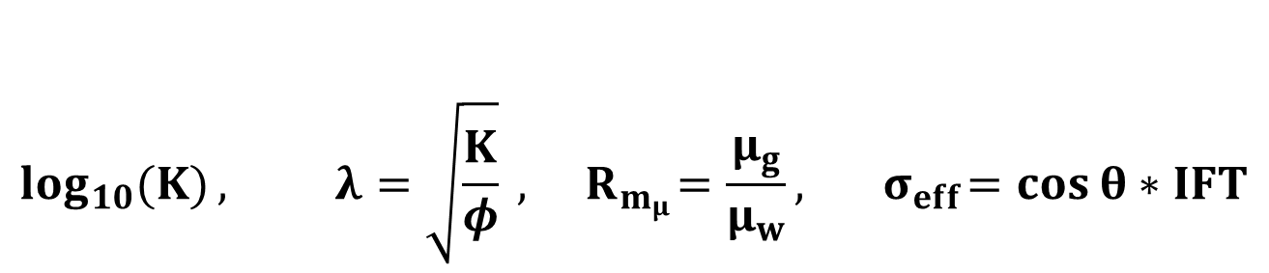
Data Acquisition and Curation
Features to look for:
Temperature, Pressure, Porosity, Permeability, Rock Type, Brine Salinity, Brine Composition, Pore Size, Contact Angle, Gas Viscosity, Brine Viscosity, IFT, Capillary Pressure
Data Acquisition on H₂ and CO₂ Relative Permeability and their Corresponding Conditions via LLMs:
Features Ranges:
 | Temperature (K) | Pressure (Mpa) | Porosity | Permeability (mD) | Pore throat size (µm) | Mean Pore size (µm) | Contact Angle | Calcite % | Feldspar % | Mica% | Clay % | Quartz % | Gas Viscosity (cp) | Brine Viscosity (cp) | IFT (mN/m) | Brine Salinity (mol/kg) | MCM (mol/kg) | BCM (mol/kg)
Min | 293.15 | 1.38 | 0.039 | 2.94E-06 | 0.1 | 0.006 | 1.19 | 0 | 0 | 0 | 0 | 0 | 0.014 | 0.25 | 19.8 | 0 | 0 | 0
Max | 395.15 | 34.47 | 0.383 | 1810 | 25 | 150 | 86.93 | 100 | 24.1 | 7 | 49.2 | 99.5 | 0.083 | 1.12 | 57 | 9.36 | 3.83 | 0.65
$$\log_{10}{(K)}, λ=\sqrt{\frac{K}{φ}} , { R}_{m_{μ}}=\frac{μ_{g}}{μ_{w}}, { σ}_{eff}=\cos{θ}∗IFT$$
Transformation Based on Rock/Fluid (Porous Media) Physics
5

Slide 6
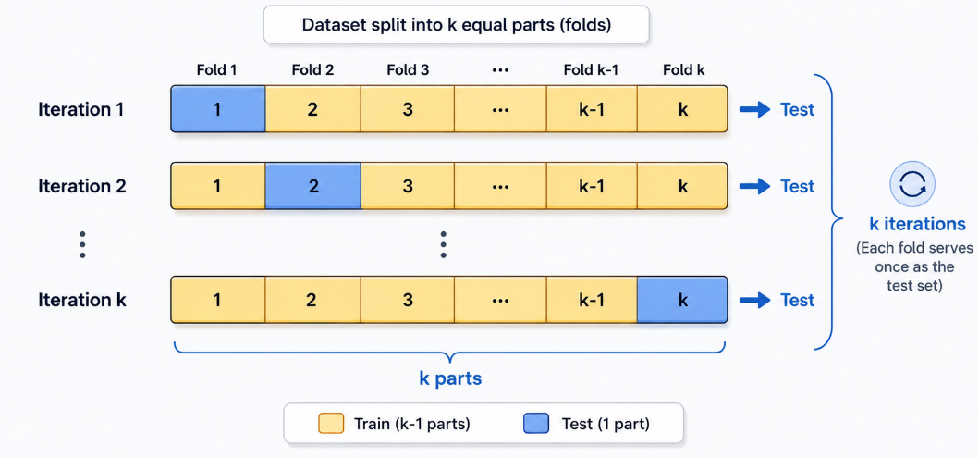
Endpoint Prediction
Why predict S_{wirr} and Krg₀ first?
Transferability
Reconstruction
Saturation Window
Curve Boundaries
Why
How?
6

Slide 7
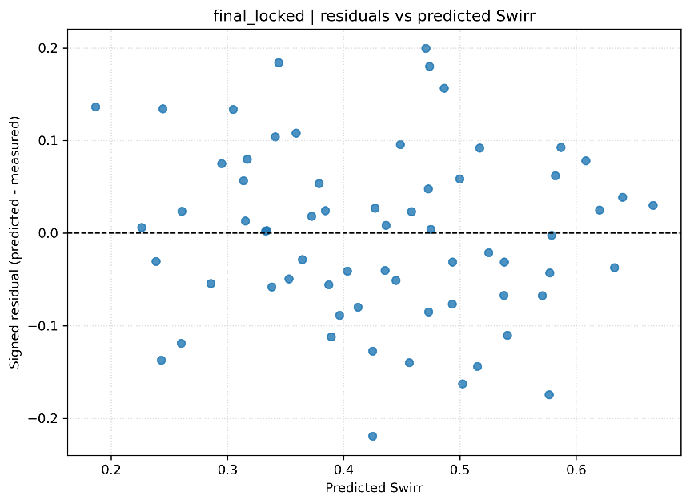
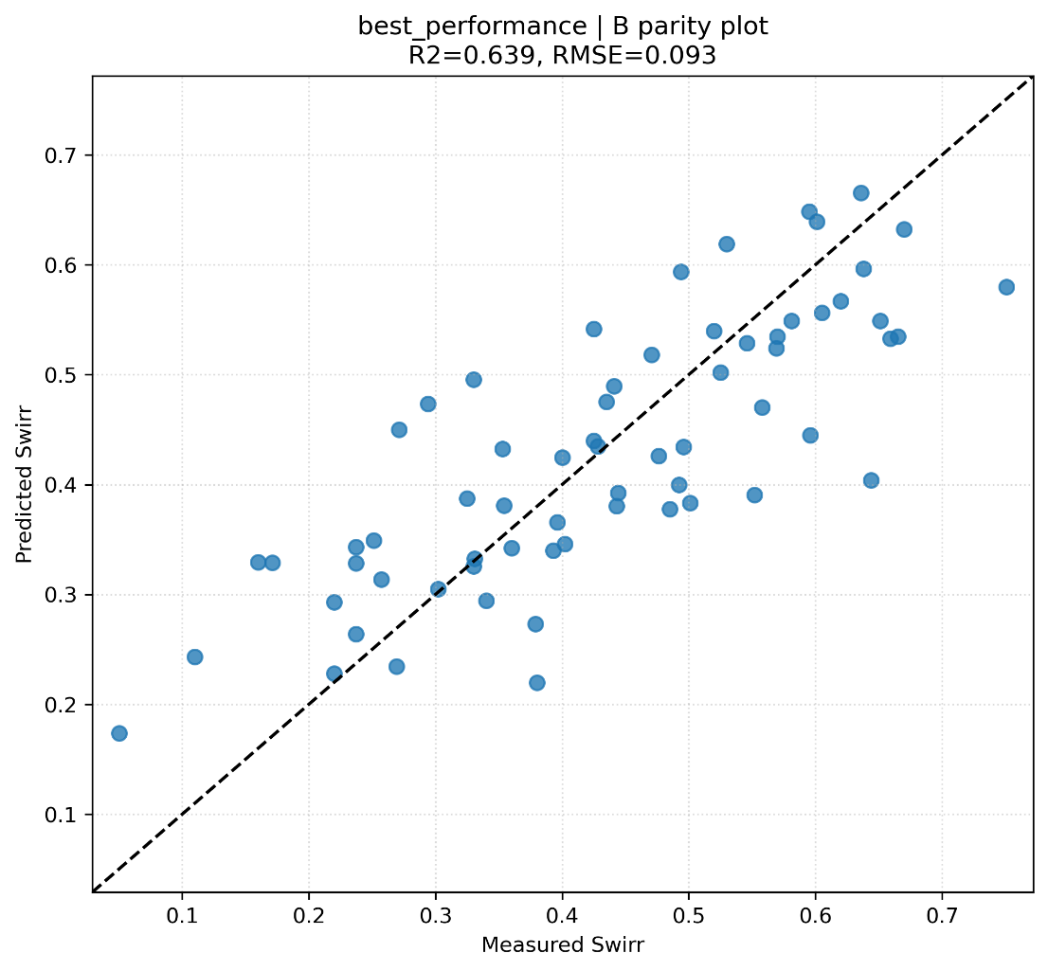
Endpoint Results (S_{wirr})
Dataset | RMSE | MSE | MAE | R2 | Bias | AAPRE | STD Error | Coverage_90
Test | 0.09 | 0.008 | 0.075 | 0.75 | -0.0016 | 16.84 | 0.093 | 0.89
Train | 0.05 | 0.0009 | 0.017 | 0.85 | -0.0007 | 5.73 | 0.029 | 1
Predicted vs Measured S_{wirr}
Predicted Values: S_{wirr}_hat
7

Slide 8
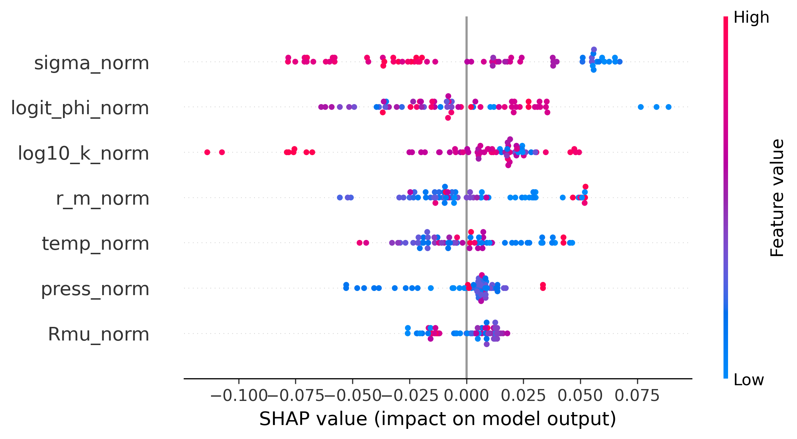
Endpoint Results (S_{wirr})
8

Slide 9
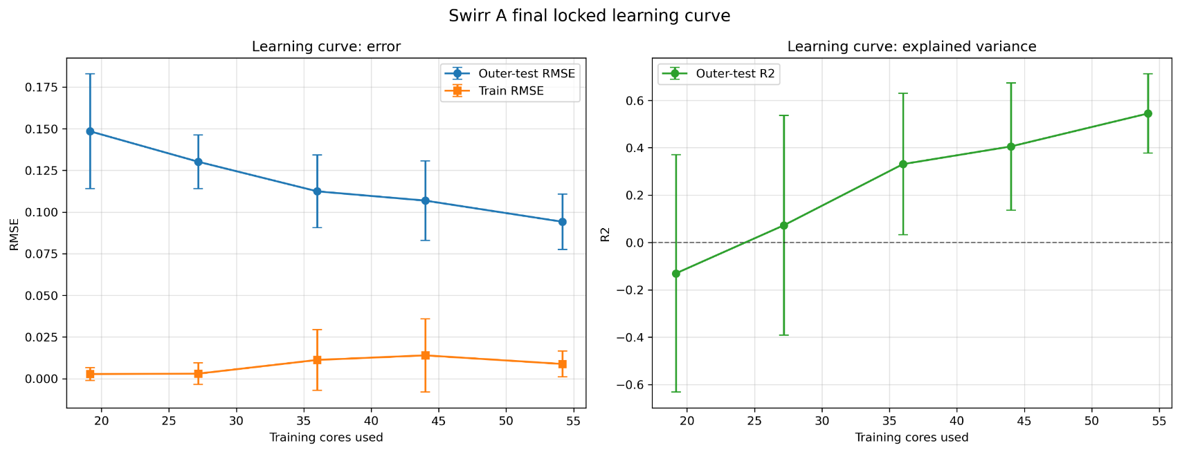
Endpoint Results (S_{wirr})
8

Slide 10
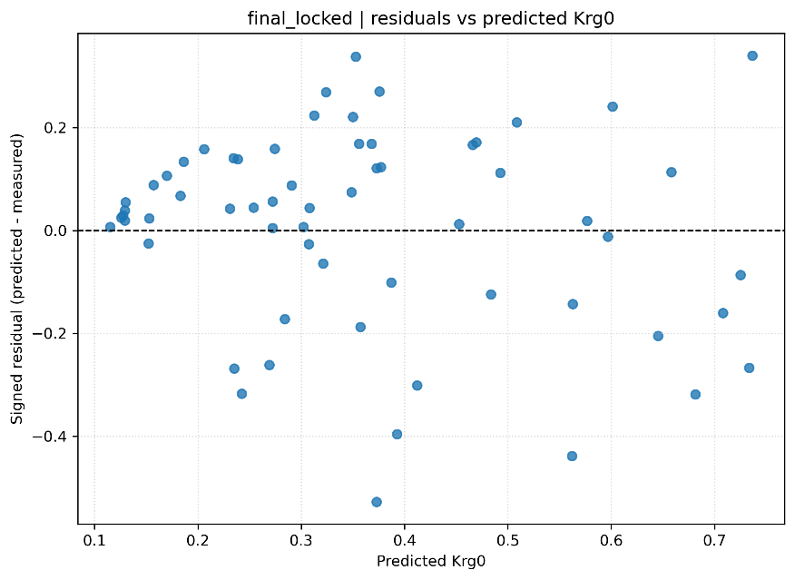
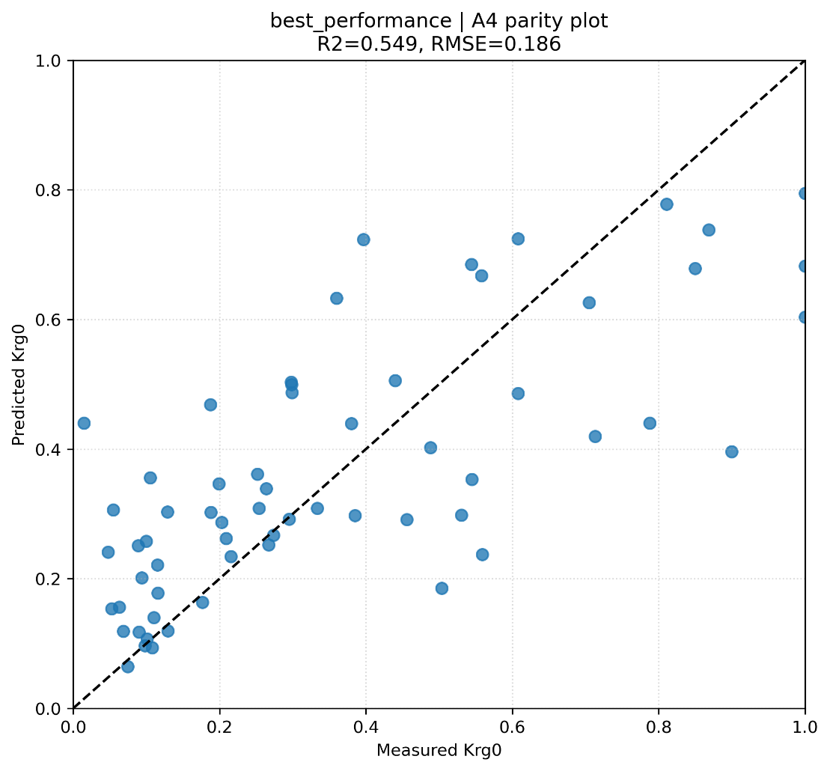
Endpoint Results (k_{rg0})
Dataset | RMSE | MSE | MAE | R2 | Bias | APRE | STD_Error | Coverage_90
Test | 0.179 | 0.015 | 0.149 | 0.60 | 0.0073 | 44.34 | 0.179 | 0.83
Train | 0.127 | 0.005 | 0.058 | 0.79 | 0.003 | 29.15 | 0.077 | 1
Predicted vs Measured k_{rg0}
Predicted Values: k_{rg0}_hat
9

Slide 11
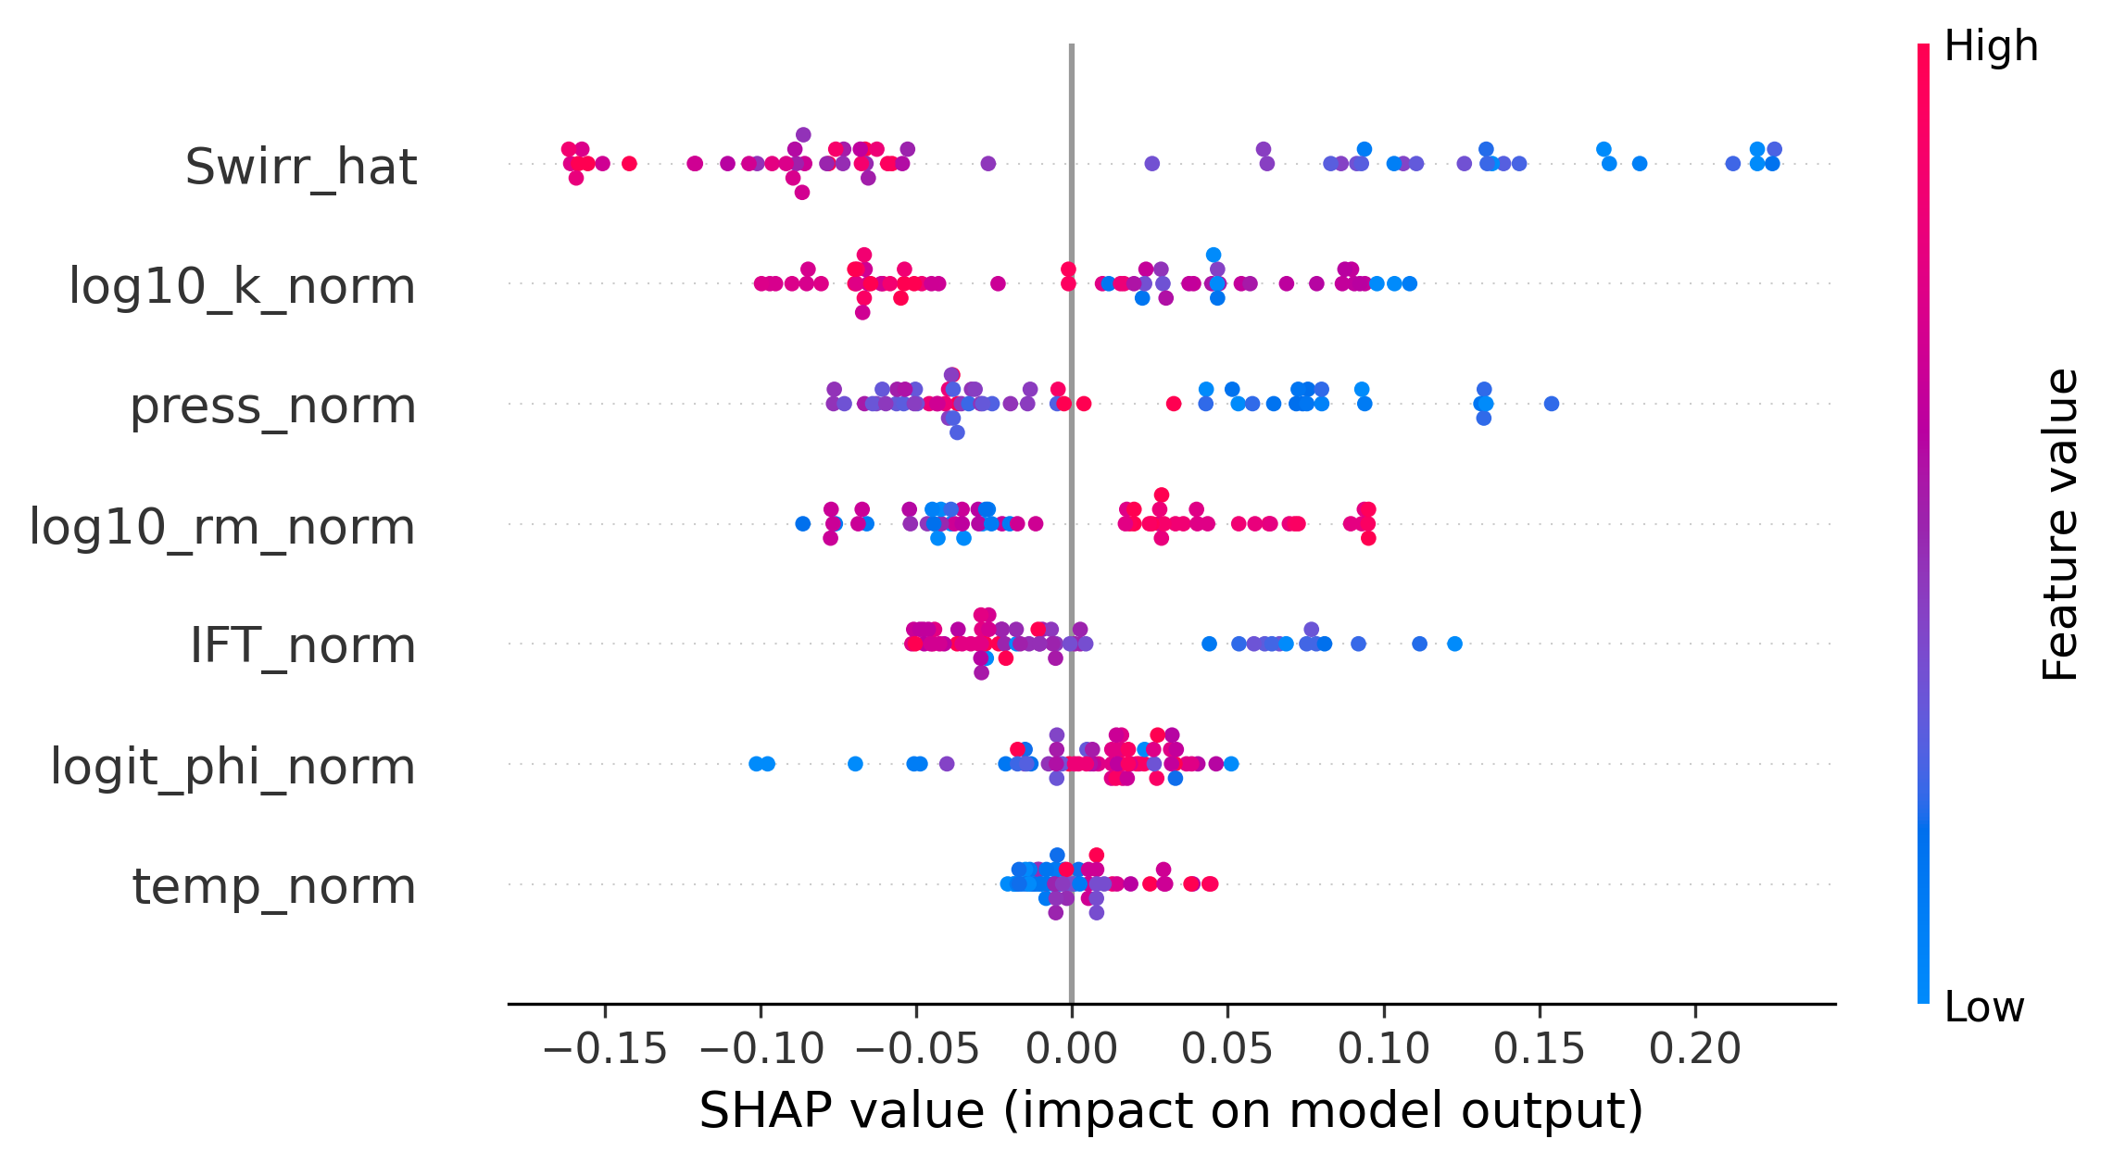
Endpoint Results (k_{rg0})
10

Slide 12
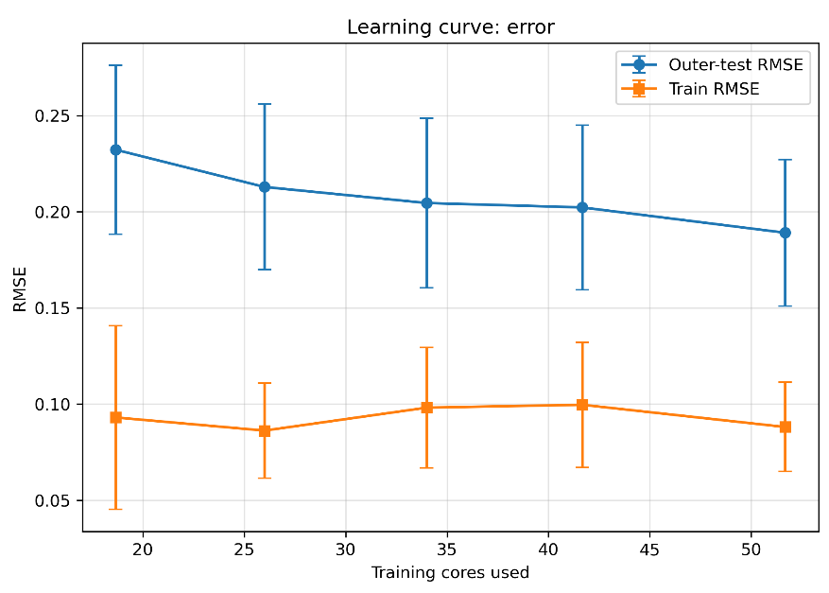
Endpoint Results (k_{rg0})
10

Slide 13
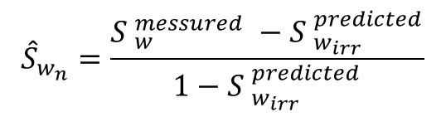
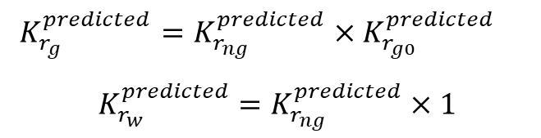
Curve Results (k_{rw} & k_{rg})
Target | Phase | Model Name | Value Space | Test RMSE | Test R2 | Test MAE | Test MSE | Train RMSE | Train R2 | Pi_coverage_90
krg | gas | catboost | absolute | 0.100 | 0.805 | 0.065 | 0.010 | 0.098 | 0.813 | 0.878
krg_norm | gas | catboost | normalized | 0.171 | 0.820 | 0.129 | 0.029 | 0.168 | 0.829 | 0.896
krw | water | catboost | absolute | 0.111 | 0.869 | 0.080 | 0.012 | 0.104 | 0.884 | 0.879
krw_norm | water | catboost | normalized | 0.111 | 0.869 | 0.080 | 0.012 | 0.104 | 0.884 | 0.879
How did we do it with the Endpoints?
Recalculated the normalised water saturation using the predicted endpoints:
$${\hat{S}}_{w_{n}}=\frac{{S }_{w}^{messured} −{ S }_{w_{irr}}^{predicted}}{1−{ S }_{w_{irr}}^{predicted}}$$
Trained the model on the new normalised values
$$K_{r_{ng}}^{predicted} \&{ K}_{r_{nw}}^{predicted}=f\left(T,P,φ,\log_{10}{K},\log_{10}{r_{m}}, R_{m_{μ}},σ_{eff},{\hat{S}}_{w_{n}}\right)$$
The predicted krg0_hat was used to reconstruct the relative permeability
$$K_{r_{g}}^{predicted}=K_{r_{ng}}^{predicted}×K_{r_{g0}}^{predicted }$$
$K_{r_{w}}^{predicted}$ $=K_{r_{ng}}^{predicted}×1$
11

Slide 14
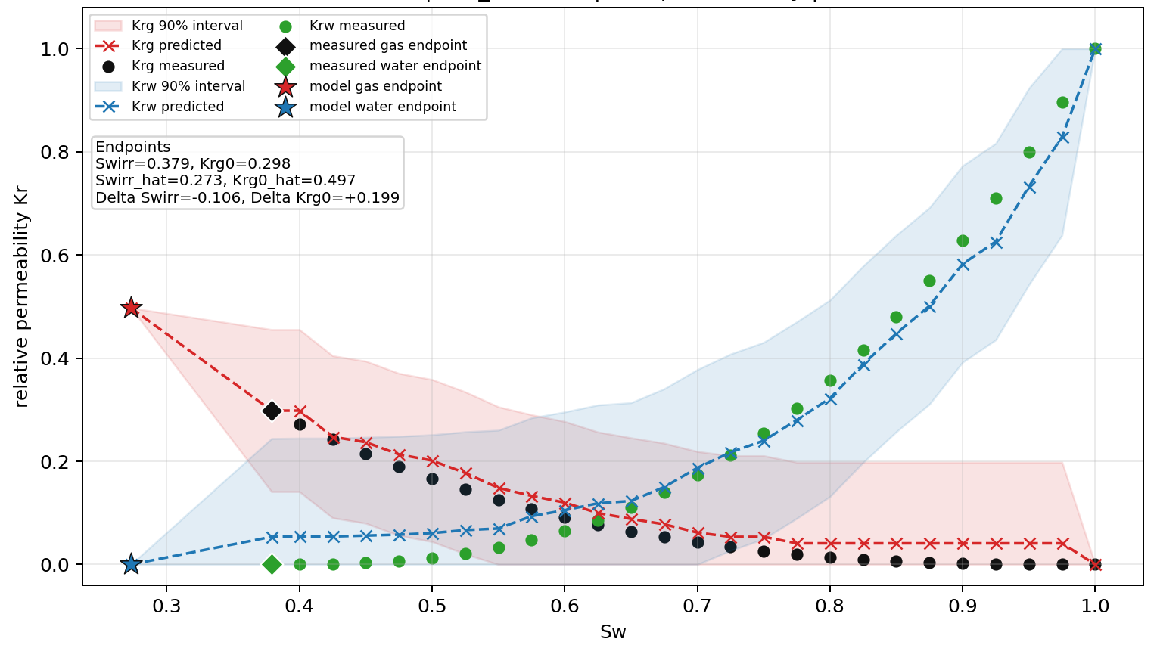
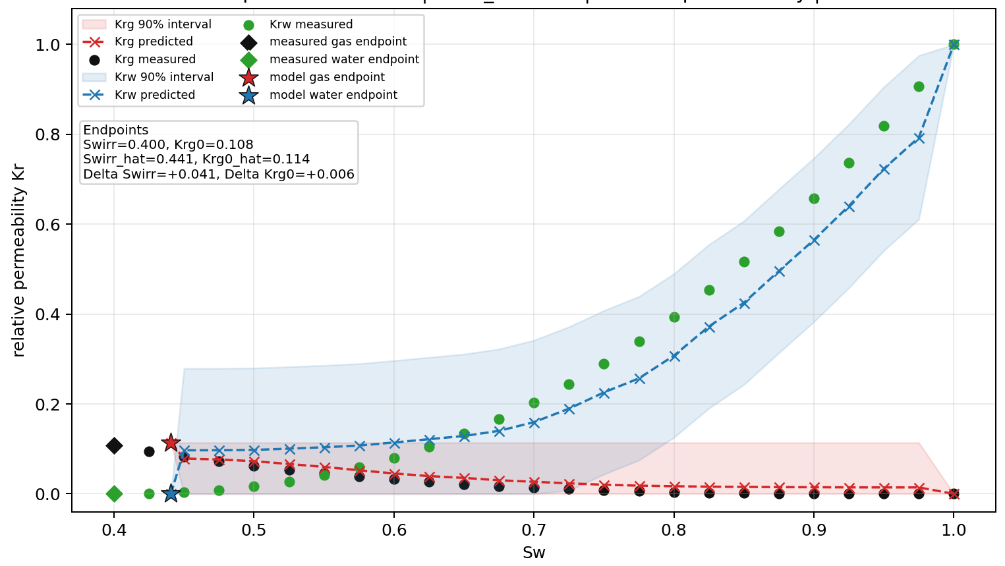
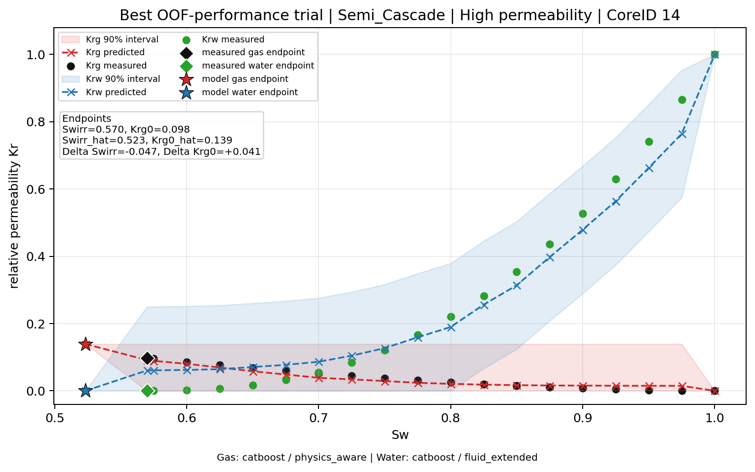
Low Permeability: 0.356 mD
Curve Results (k_{rw} & k_{rg})
Three Permeability Regimes
Medium Permeability: 74.4 mD
High Permeability: 430 mD
12

Slide 15
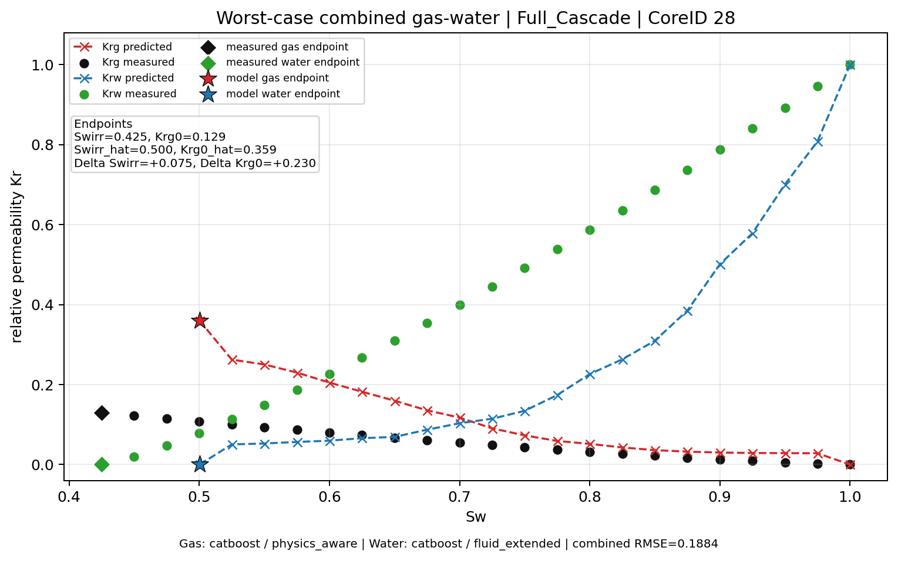

Curve Results (k_{rw} & k_{rg})
Worst Case Scenario
$$k_{r_{g0}}^{predicted}≫k_{r_{g0}}^{messured}$$
Why?
We went back and checked the study:
They stated that the core plugs were Highly Heterogeneous
13

Slide 16
Key Points
ML captures the main physical trends in relative permeability endpoints and curves from a small dataset of ~70 core plugs.
The workflow is diagnostic, not cosmetic: noisy experiments were not removed just to improve metrics; residuals and SHAP were used to identify possible experimental or metadata issues.
Current limitations include hidden core heterogeneity such as microfractures, fissures, laminations, vugs, and unresolved pore-throat connectivity.
The model can support screening-level reservoir simulation when SCAL/relative permeability data are scarce or incomplete.
Predictions should be used with uncertainty intervals, not as absolute laboratory replacements.
Swirr is predicted more reliably than Krg0, because krg0 is more sensitive to gas connectivity, endpoint definition, and experimental uncertainty.
14

Slide 17
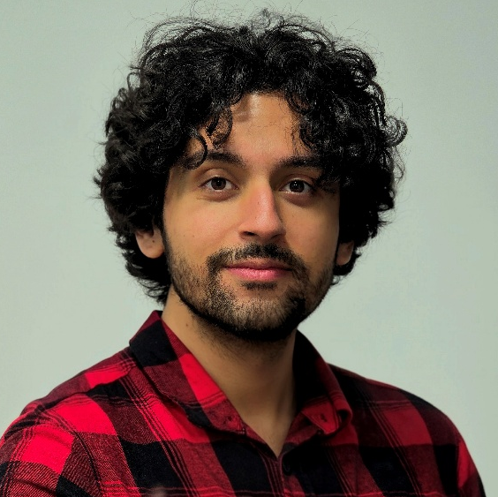


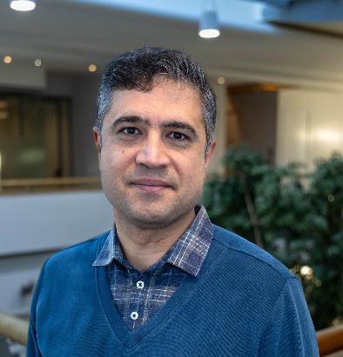


Abdolali (Ali) Mosallanezhad
PhD Researcher
Thank You for Your Attention
School of Engineering & Physical Sciences, Institute of Mechanical, Process & Energy Engineering, Heriot-Watt University
Dr. Amir Jahanbakhsh
Research Fellow/Programme Manager
Prof. Mercedes Maroto-Valer
Director
School of Engineering & Physical Sciences, Institute of Mechanical, Process & Energy Engineering, Heriot-Watt University
School of Engineering & Physical Sciences, Institute of Mechanical, Process & Energy Engineering, Heriot-Watt University

