Slide 1




GeoSlicer a Platform for Digital Rock Physics: Integrated Machine Learning, Data
Preparation, and Generative AI with SinGAN
Fernando Bordignon¹, Leandro Passos de Figueiredo¹, Ingrid Carneiro¹, Rafael Arenhart¹, Bruno Honorio², Rodrigo Surmas³
LTrace GeoSciences
Equinor Brasil
PETROBRAS

Slide 2


Summary
AI semi-automated
Segmentation
Smart segmentation
(SMART Seg)
01
02
03
04
Thin section self-guided segmentation
05
Sidewall core instance segmentation
06
RockSinGAN

Slide 3

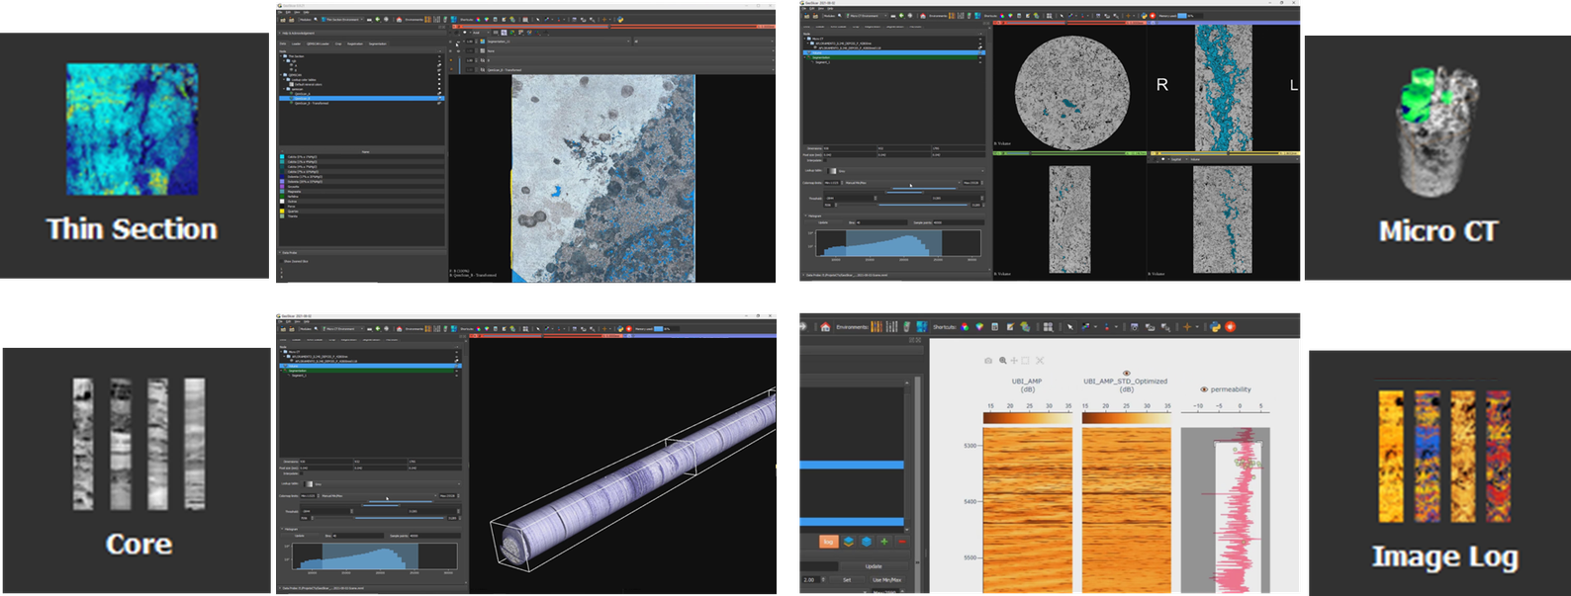
GeoSlicer environments
Integrated AI platform for digital rock image in several scales

Slide 4
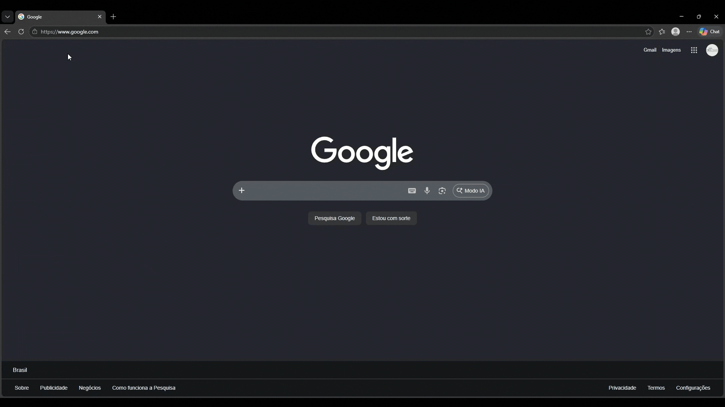
Download GeoSlicer

Slide 5
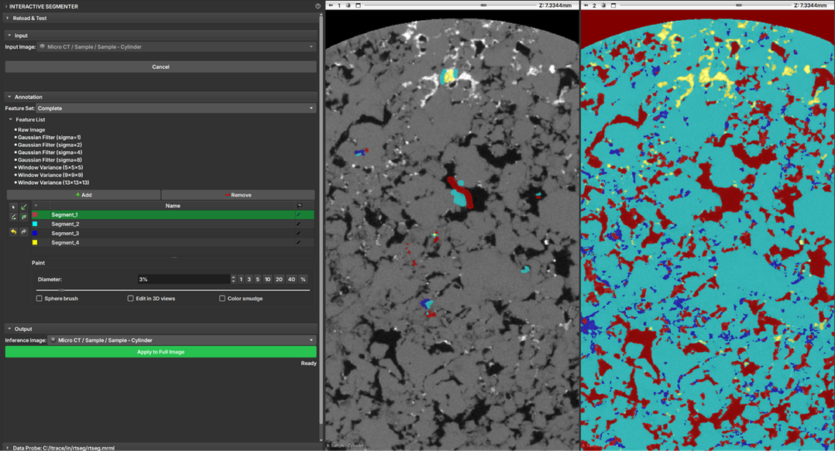
AI semiautomated segmentation
Interactive segmenter
The Interactive Segmenter module provides a supervised segmentation tool for 3D images, featuring a real-time preview.
This allows users to receive instant feedback on their annotations, making model training rapid and intuitive.
The Interactive Segmenter uses a Random Forest classifier, a machine learning algorithm that builds multiple decision trees to make a robust prediction for each voxel.

Slide 6
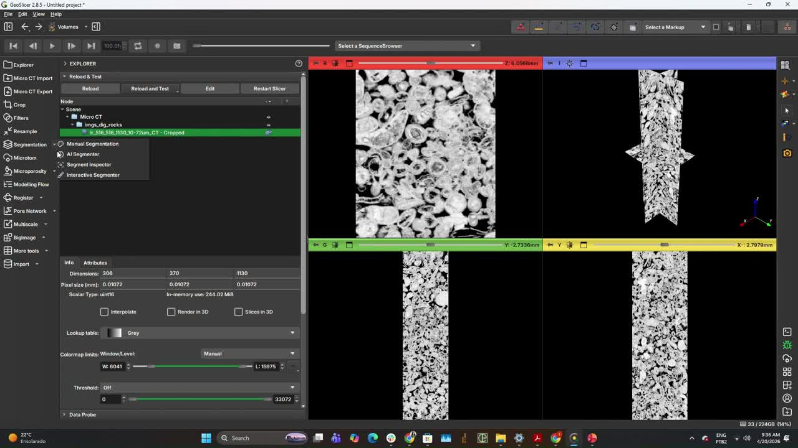
AI semiautomated segmentation
Interactive segmenter

Slide 7
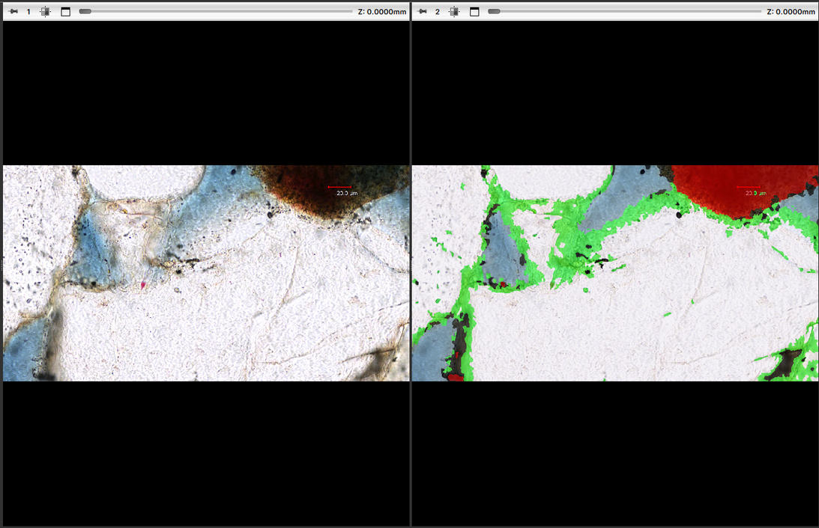
Thin section Self-guided segmentation
The Self-Guided Segmentation module performs unsupervised segmentation of a 2D image.
It uses a superpixel algorithm along with a simple neural network to segment the image.

Slide 8
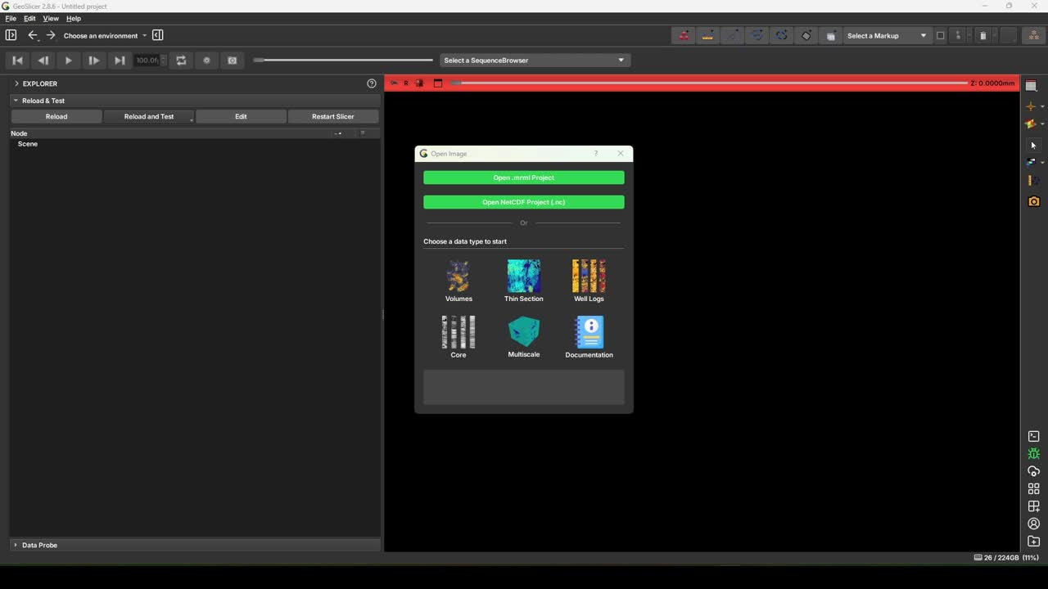
Thin section Self-guided segmentation

Slide 9
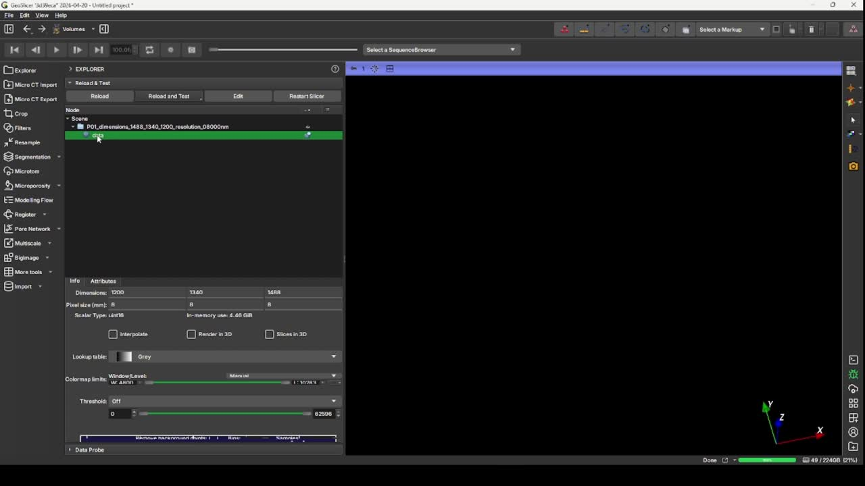
Smart segmentation (SMART Seg)
MicroCT pore segmentation
Use a U-net model to segment pores in rock microtomography images (microCT).
A U-net is a deep convolutional network that uses multiscale spatial analysis and connections between earlier and later processing stages.

Slide 10
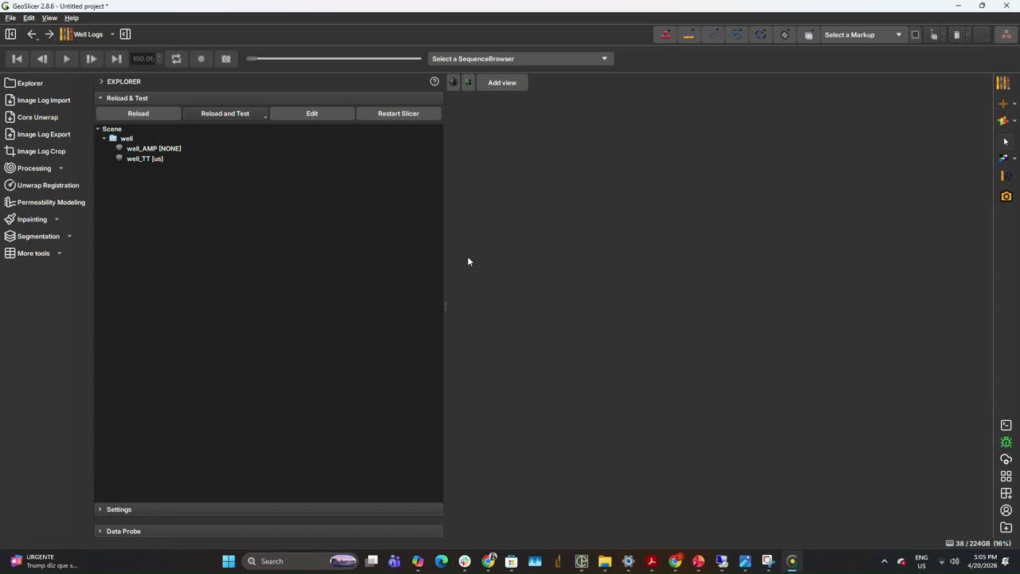
Sidewall core instance segmentation
Image Log Instance Segmenter is a module of GeoSlicer that performs instance segmentation of artifacts of interest in well log images.
In GeoSlicer, the detection of two types of artifacts is currently available:
Sidewall core marks
Ledges
For sidewall core mark detection, Mask‑RCNN was employed with an adapted input consisting of Transit Time and Amplitude logs as two channels, supplemented by the binary sidewall core mask.

Slide 11
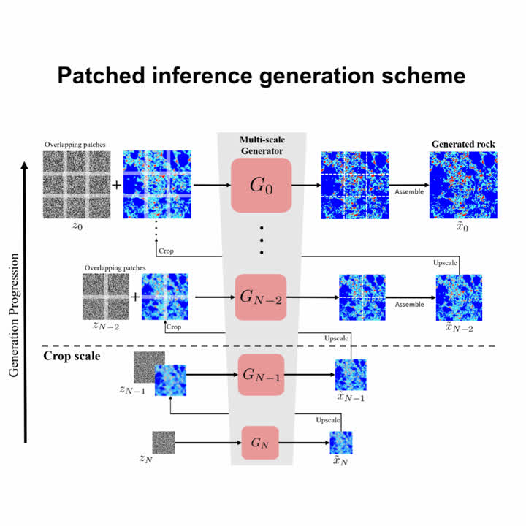
RockSinGAN
RockSinGAN is a hierarchical 3D generative framework trained on a single image that integrates Early Cropping and Patched Inference to overcome hardware memory limitations.
These techniques allow the generation of ultra-high-resolution rock models with dimensions of 3344x1360x8304.
https://github.com/ltracegeo/RockSinGAN

Slide 12

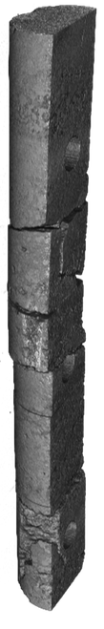




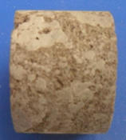
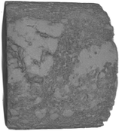
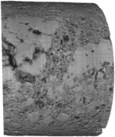
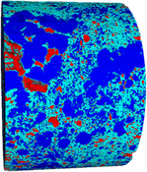
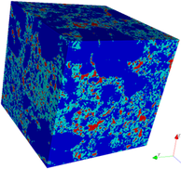
RockSinGAN - application
CoreCT-microCT integration
01
02
03
04
05
CoreCT image acquisition
CoreCT cropping and beam-hardening correction
CoreCT cropping and segmentation
Image inpainting
resizing image
to have uniform
resolution
06
07
08
09
microCT image
acquisition
microCT cropping and
beam-hardening correction
microCT segmentation
microCT resizing and cropping to a representative volume
Pore
Unresolved phase
Matrix

Slide 13
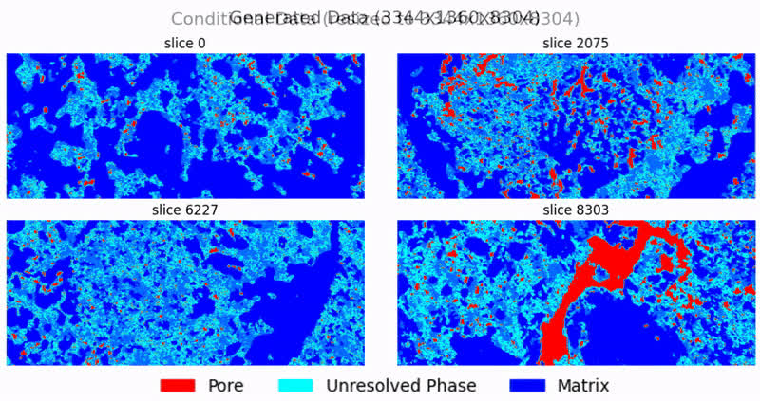
RockSinGAN - application

Slide 14
Data references
01
Prodanovic, M., Milliken, K., Mehmani, A. (2019, November 10). Offshore Miocene sandstone thin section (Folk McBride Collection) [Dataset]. Digital Porous Media Portal. https://www.doi.org/10.17612/rn6g-fq64
02
Vidal, A., Menezes dos Anjos, C., Medeiros, L., Surmas, R., Neta, A., Evsukoff, A., Vargas, J. (2024, May 20). 16 Brazilian pre-salt carbonates: multi-resolution micro-CT images [Dataset]. Digital Porous Media Portal. https://www.doi.org/10.17612/xr50-s717
03
Alqahtani, N., Mostaghimi, P., Armstrong, R. (2021, May 18). A Multi-Resolution Complex Carbonates Micro-CT Dataset (MRCCM) [Dataset]. Digital Porous Media Portal. https://www.doi.org/10.17612/3t36-q704
04
Article "RockSinGAN: Single-Image Generative AI for Multiscale 3D Rock generation" submitted to the Journal of Computers & Geosciences.

Slide 15


Acknowledgements
Thank You

Slide 16

Thank you!
Ingrid Bertin/
LTrace Geosciences
ltrace.com.br
lingrid.bertin@trace.com.br

