Slide 1

Machine learning-based permeability estimation in heterogeneous porous media
Hongkyu Yoon
Sandia National Laboratories, Albuquerque, NM
Contributors: P. Roy, S. Bhattacharjee (UTEP)
InterPore 2026, Nantes, France
SAND2026-21040C
This work was supported by a DOE Science Foundations for Energy Earthshots project, Advanced Multi-Physics Machine Learning for Subsurface Energy Systems Across Scales.

Slide 2
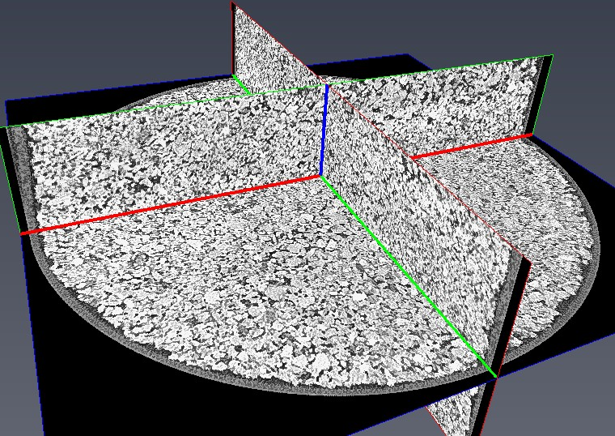
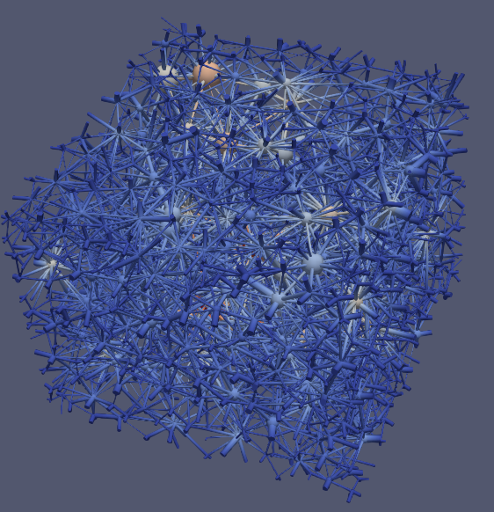
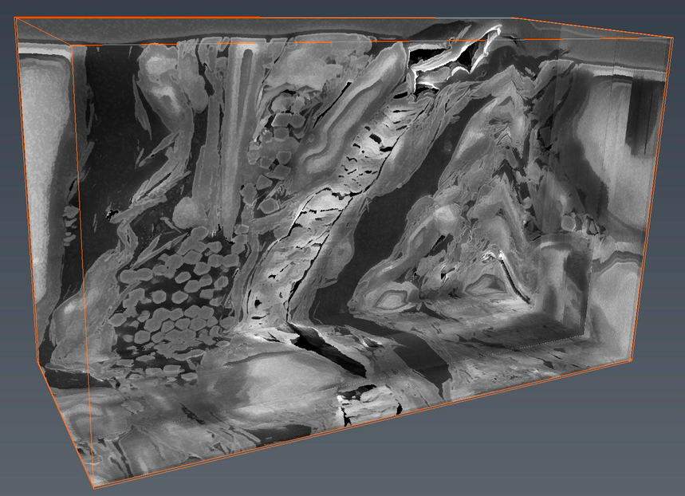
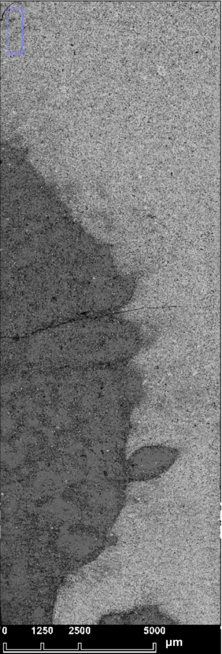
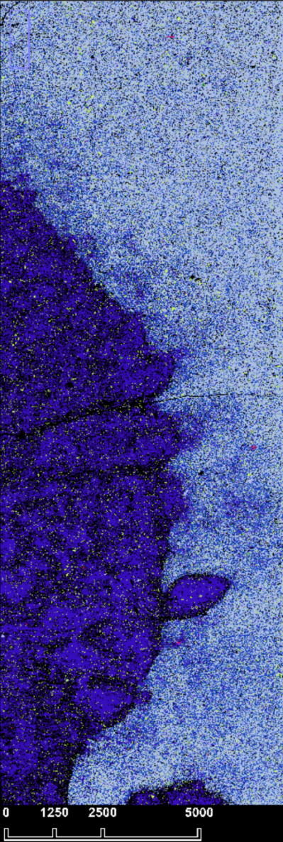
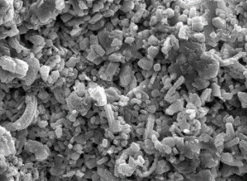
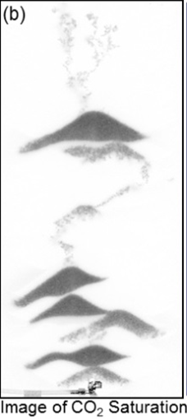
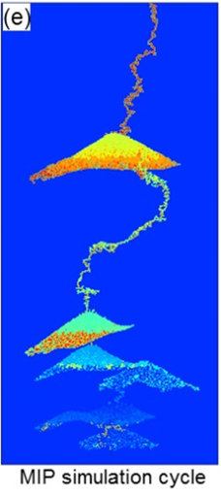
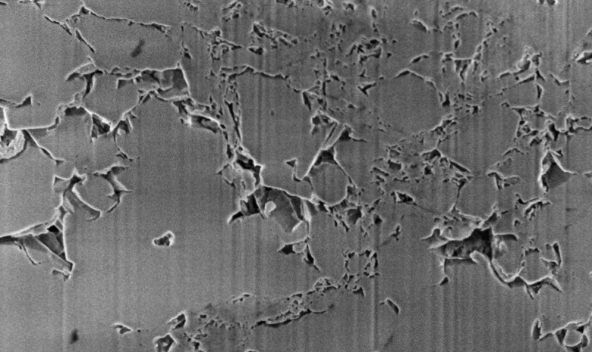
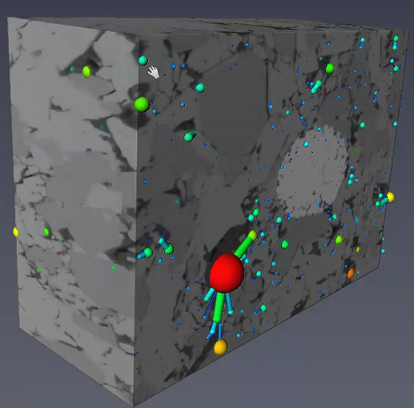
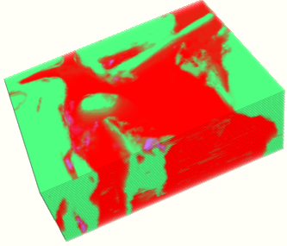
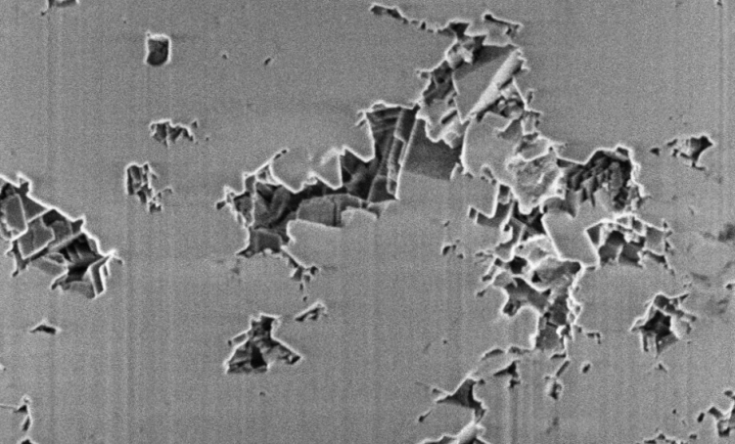
Heterogeneous Porous Media
Heterogeneity: Complexity in geometry, size, scale, and compositions
Multiphysics processes are complicated in heterogeneous porous media
Sandstone & pore networks
(pores: 10’s-100’s μm)
Carbonate chalk under chemo-mechanical processes (pores: 10’s nm – 10’s μm)
Shale
(1 nm - microns)
Unflooded sample
Chemically unaltered zone
Calcite
Mg-rich Calcite/
Dolomite
Chemically Unaltered sample
Chemically Altered zone
Magnesite
Chemically altered sample
PN from FIB-SEM image
Xtlas.pergeos.com

Slide 3
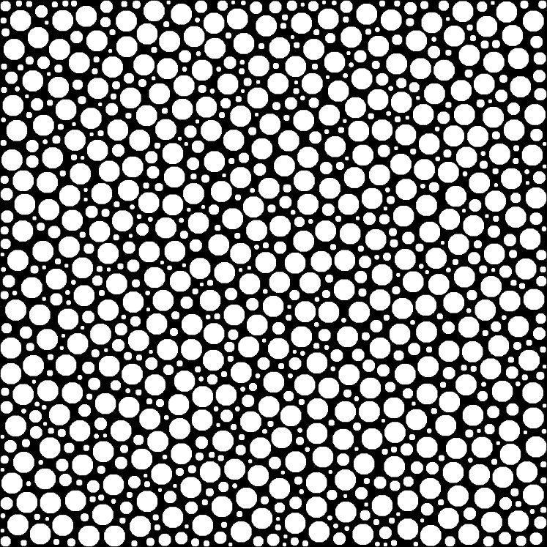
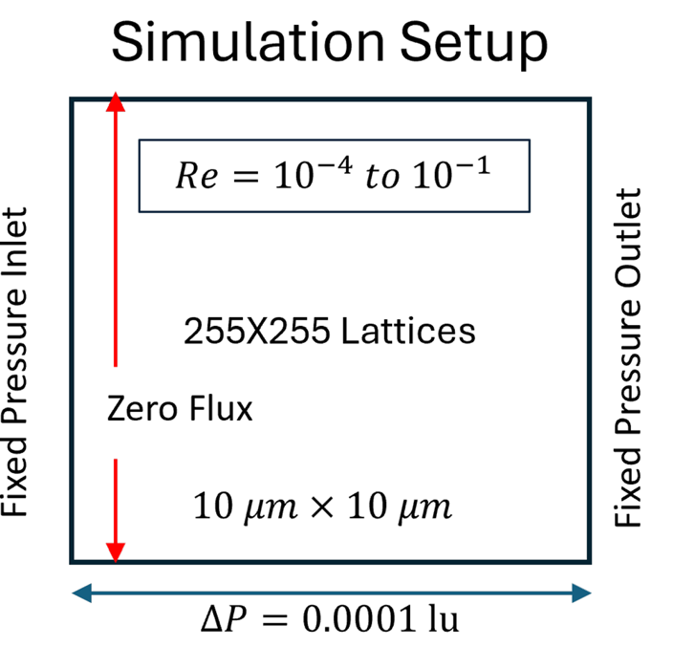
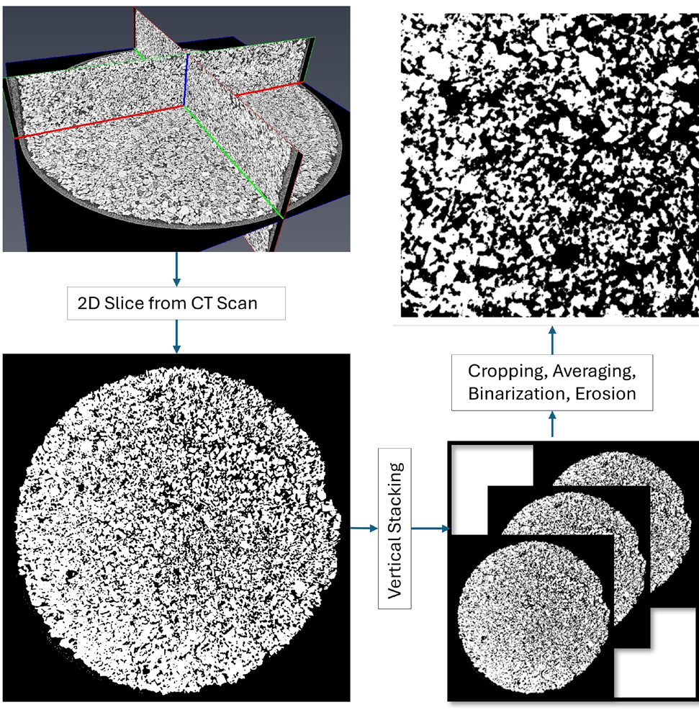
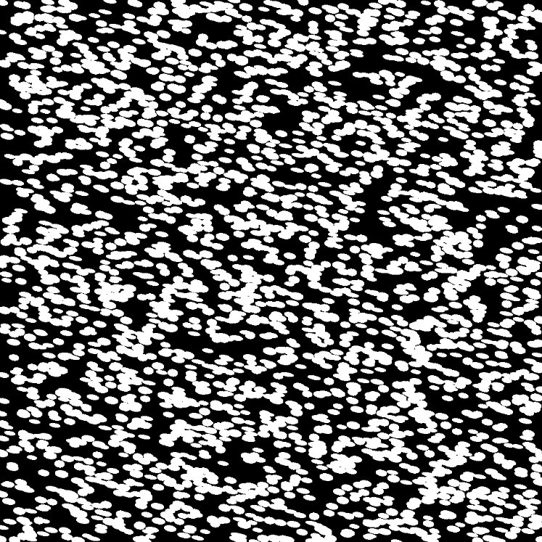
Permeability Estimation (Anisotropy)
As the first step, directional permeabilities are estimated for various porous media
Directional permeabilities were computed by lattice Boltzmann Modeling
2D synthetic data (circular, elliptic shapes) & microCT images of sandstone

Slide 4
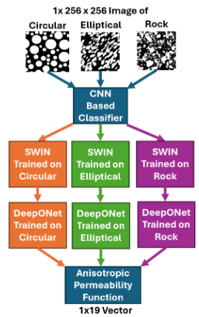
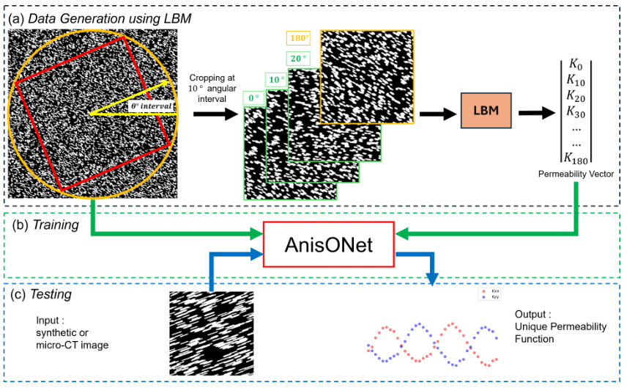
AnisONet: Directional Permeability Estimator
  Overall workflow
Input images
1. Classifier
2. Baseline permeability estimator (horizontal)
3. Directional permeability estimator
(any arbitrary angle)
  Note: SWIN Transformer has been retrained (Geng et al., 2024)
Bhattacharjee et al. Physics of Fluid (2026)

Slide 5
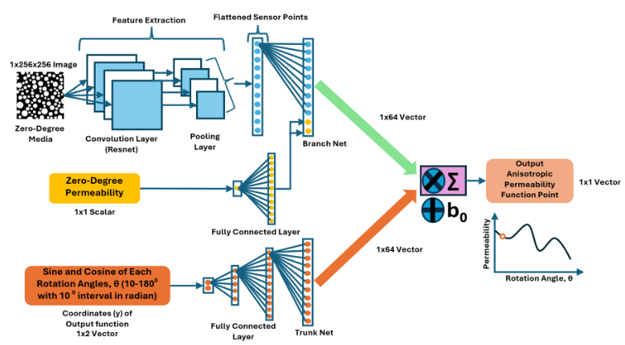
AnisONet – DeepONet architecture
Three separate inputs are used for deepONet architecture
A zero-degree (i.e., horizontal) permeability is taken as the reference
Bhattacharjee et al. Physics of Fluid (2026)

Slide 6
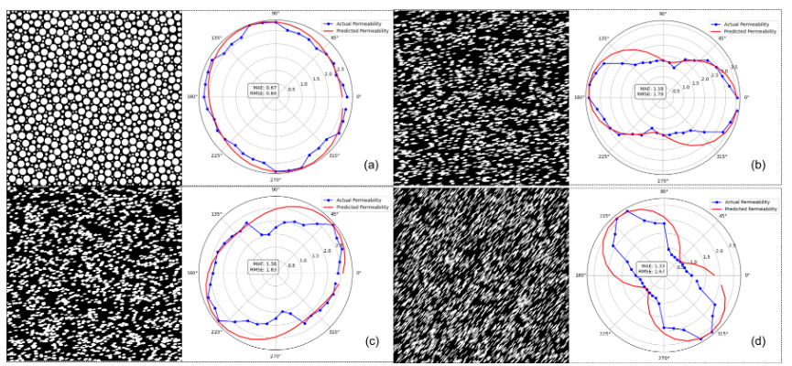
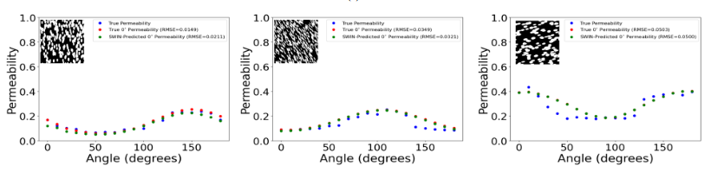

AnisONet: Directional Permeability Estimator
  LBM results (blue) vs. linear transformation (red)
Note: AnisONET results
LBM-based baseline perm (red)
SWIN-based baseline perm (green)
  True (LBM, blue) vs. AnisONet results
Bhattacharjee et al. Physics of Fluid (2026)

Slide 7

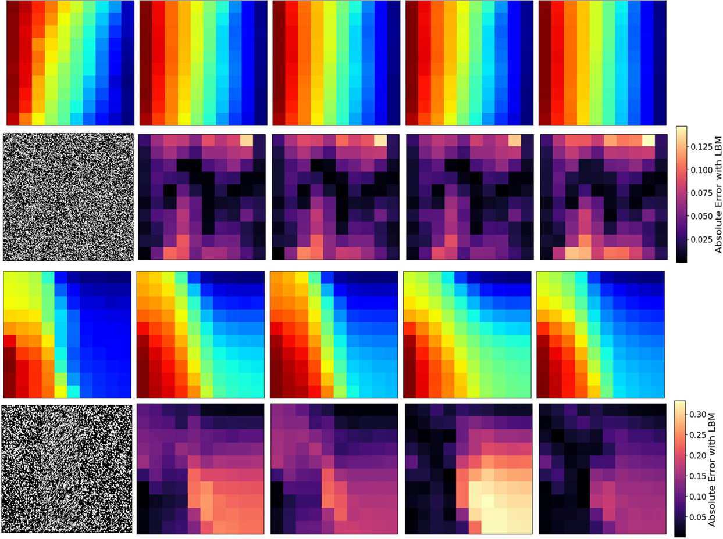





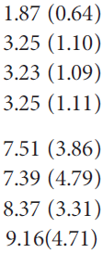
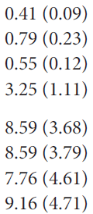
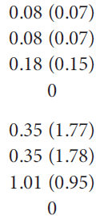

Upscaling: Permeability Tensor Derivation
Each upscaling method performs differently in different configurations
FLSF: Full least squares fit
FPV: Fixed principal values
KPV: Known principal values from AnisONet
BIP: Boundary Informed permeability
  Elliptical grains oriented at 45º
  Elliptical grains with 3 perm zones
Bhattacharjee et al. Physics of Fluid (2026)

Slide 8
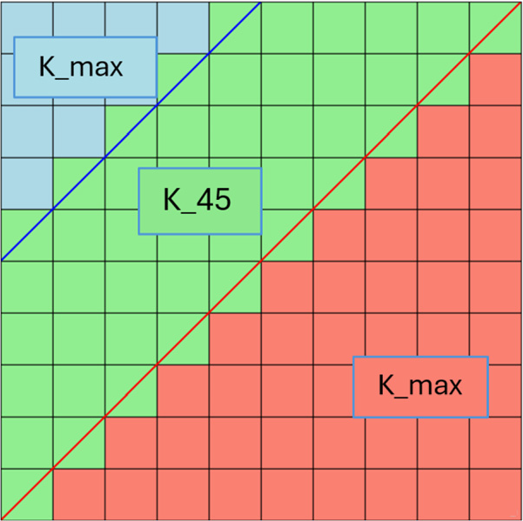
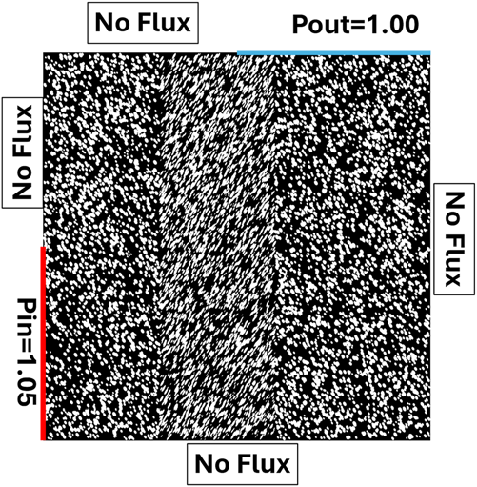
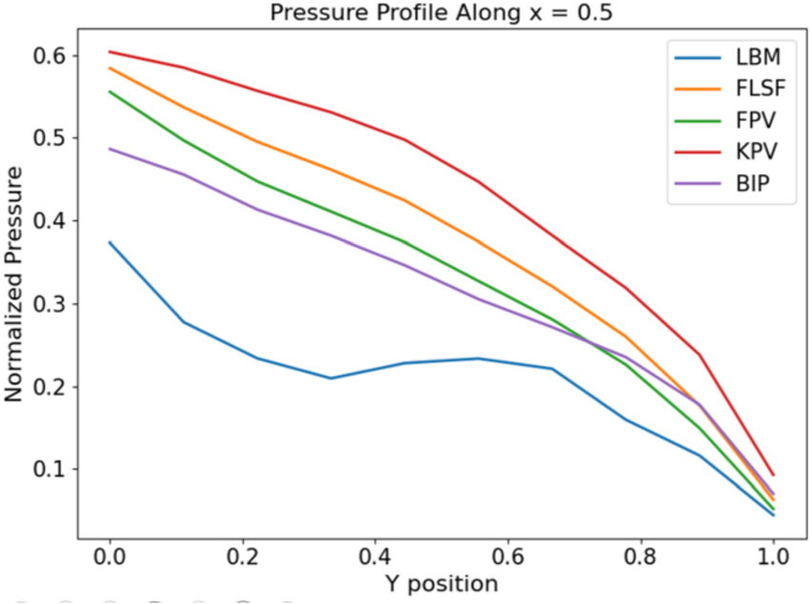
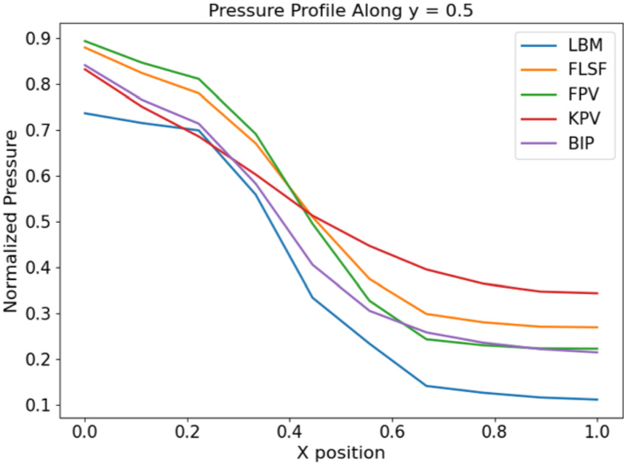
Complex porous media case (3 permeability zones)
BIP matches the pressure profile relative well compared to the LBM result at x=0.5
All methods have relatively high errors upstream and downstream at y=0.5
All methods can’t match the characteristics of preferential flow path
along the diagonal direction on pressure drops very well, but
BIP and partially KPV perform better
Bhattacharjee et al. Physics of Fluid (2026)

Slide 9


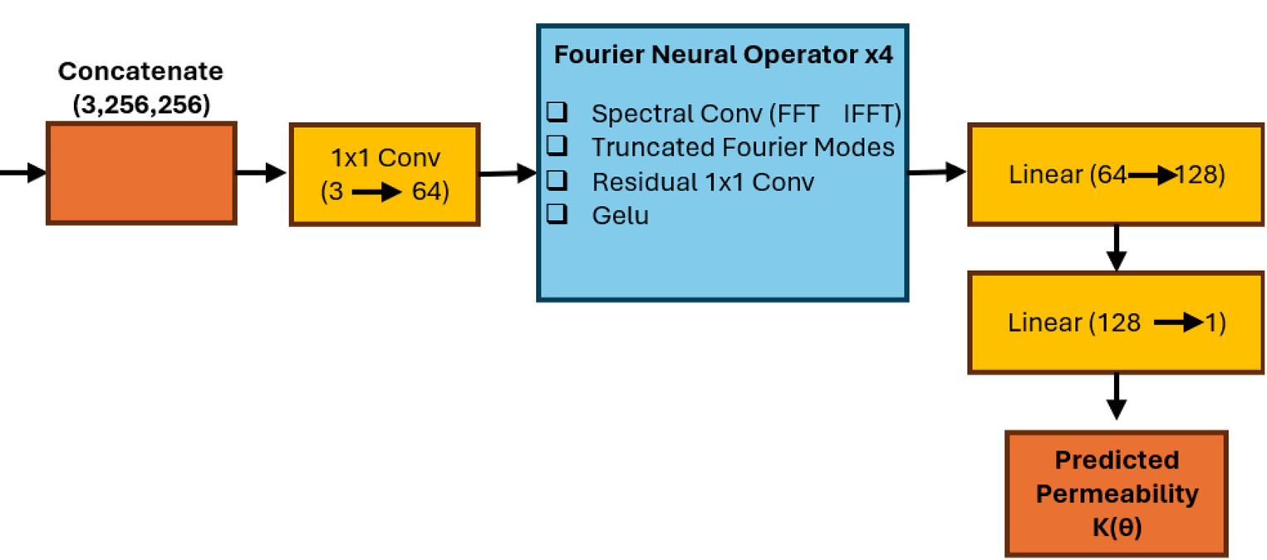

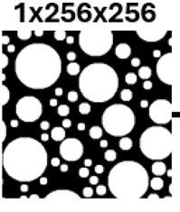
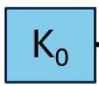
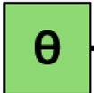
AnisONet vs. Fourier Neural Operator
Comparison reveals geometry-dependent performance trend
Only for the circular case, FNO marginally outperforms AnisONet
For the more complex geometries (Elliptical, Sandstone), AnisONet performs better
  FNO architecture
Bhattacharjee et al. Physics of Fluid (2026)

Slide 10
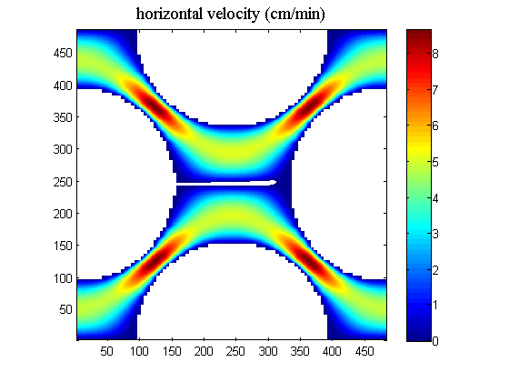



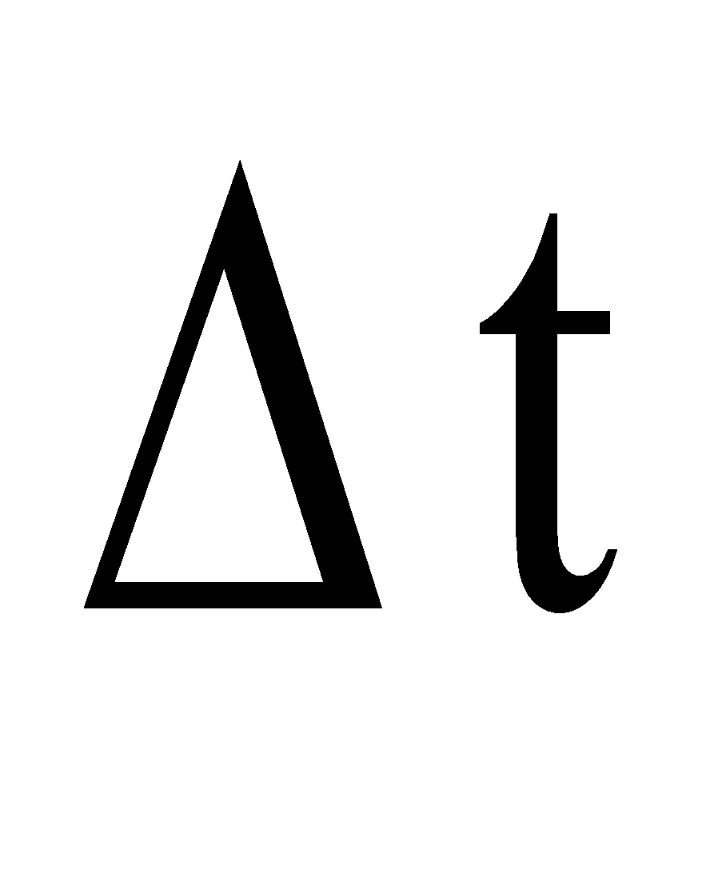


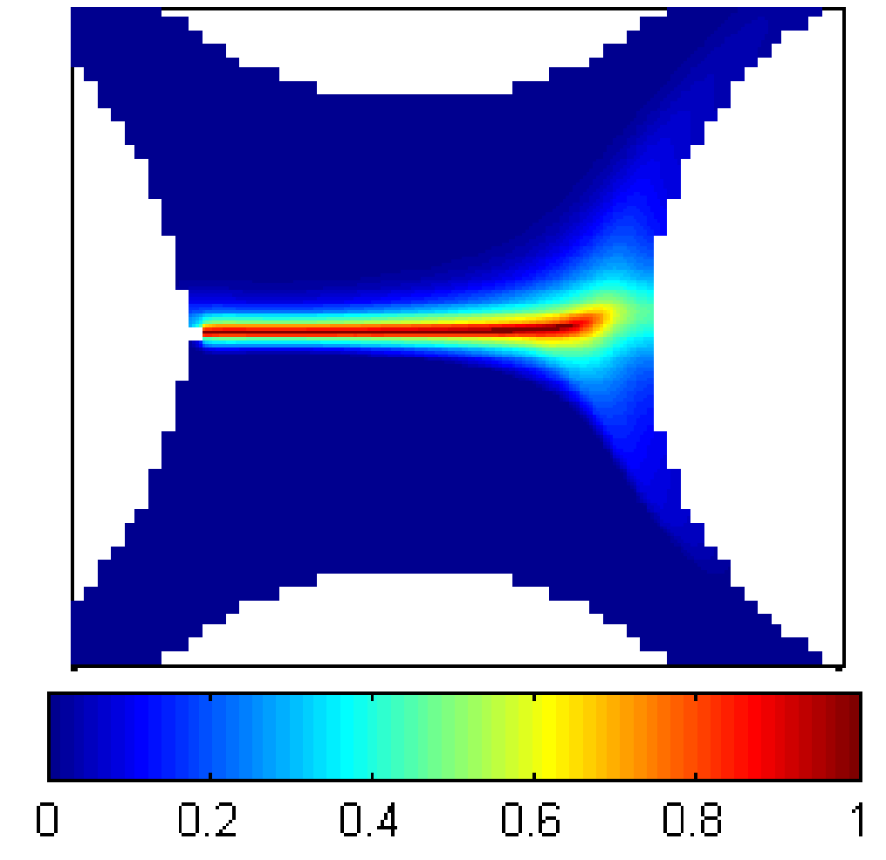
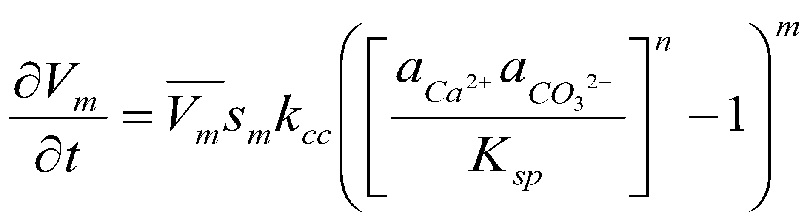
Pore scale modeling with precipitation and dissolution
Navier-Stokes equation => Stokes equation with constant viscosity (independent of the species conc.) and at low Reynolds number
Step 1: Velocity field (u) at pore scale (Lattice Boltzmann Method)
Step 2: Reactive transport at pore scale
(Finite Volume Method)
Yoon et al. (RiMG, 2015)
Chemical equilibrium in bulk fluid (e.g., H⁺, HCO₃⁻, …)
Extended Debye-Hückel Equation for activity coefficients
Phreeqc, GEMS
Charge balance equation can be added
Fracture aperture can be updated with mechanical coupling
on reactive surface (heterogeneous reaction)
Crystal growth: Cellular automata algorithm
Step 3: Update of CaCO₃ volumetric content (V_{m})
Volumetric CaCO₃ content
Zhang et al. (EST, 2010), Yoon et al. (WRR, 2012), Fanizza et al. (WRR, 2013), Boyd et al. (GCA, 2014), Singh et al. (EST, 2015), Yoon et al. (2015, 2017, EST 2019)

Slide 11

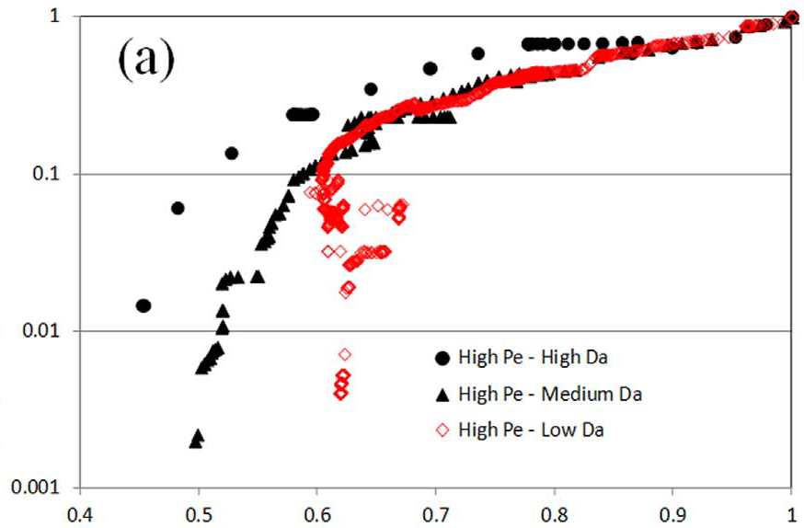
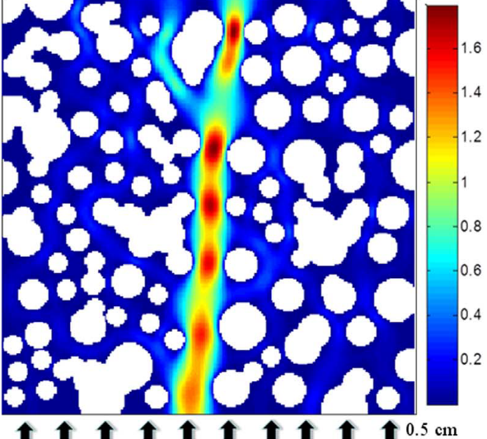
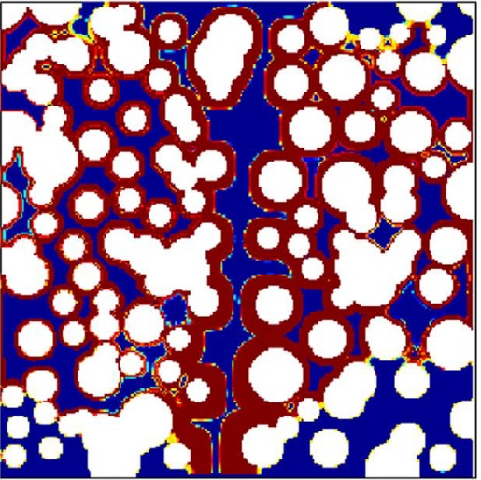
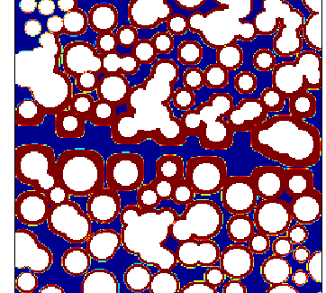
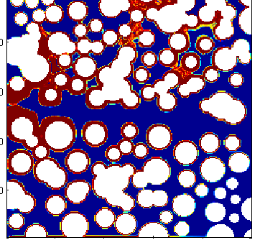
Upscaled permeability and porosity relationships
  Pore scale reactive transport modeling to derive permeability-porosity relationships during cementation for various Peclet and Damköhler numbers
Pore scale reactive transport modeling
Upscaled relationship
Velocity profile
(Normalized) Permeability vs. porosity
Calcite precipitation
A
B
Solid grain
high permeable conduit
Volumetric fraction of precipitates
Yoon et al. JPSE 2017

Slide 12
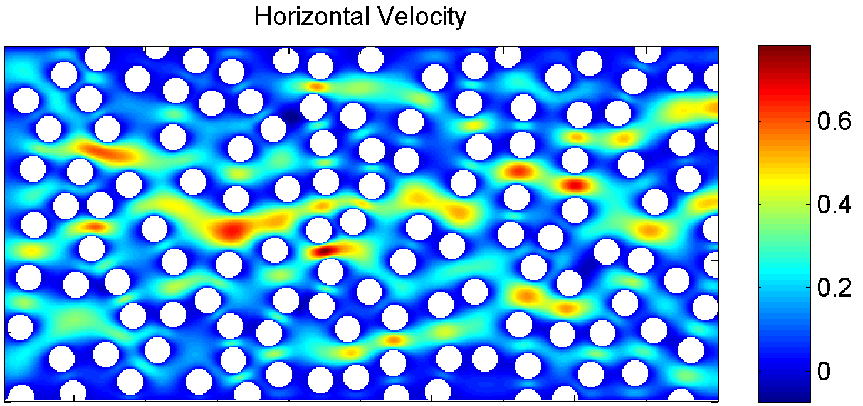
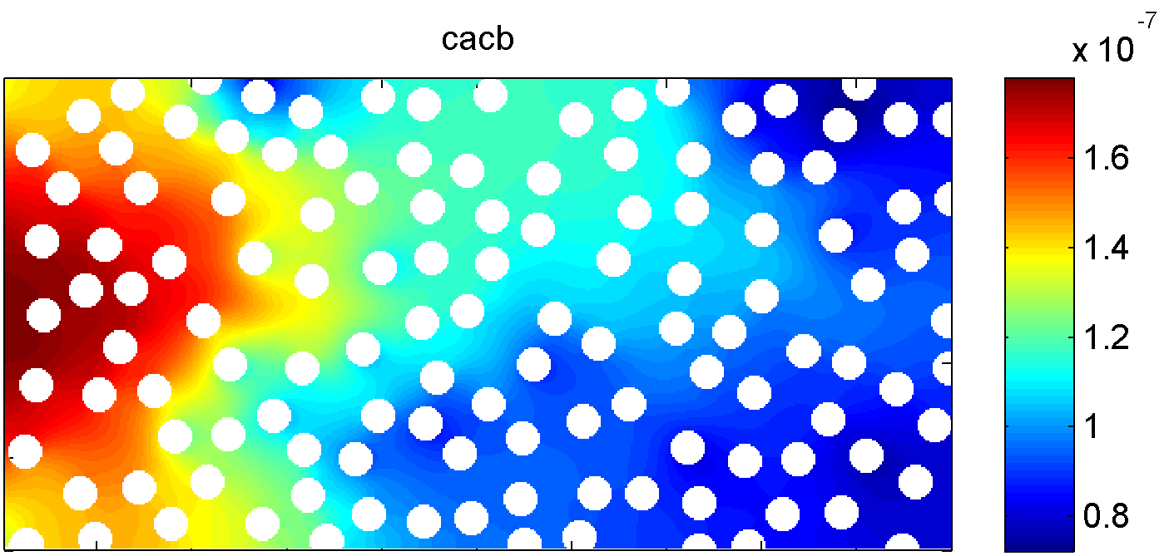
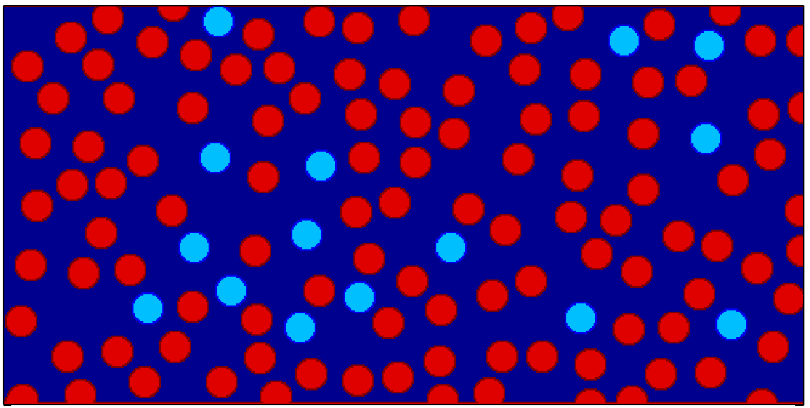
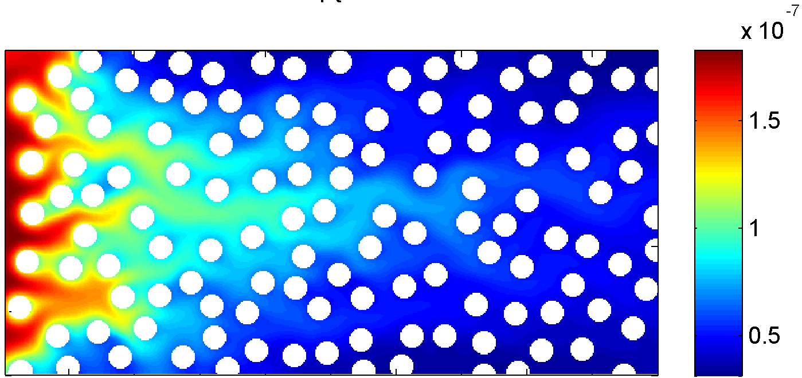
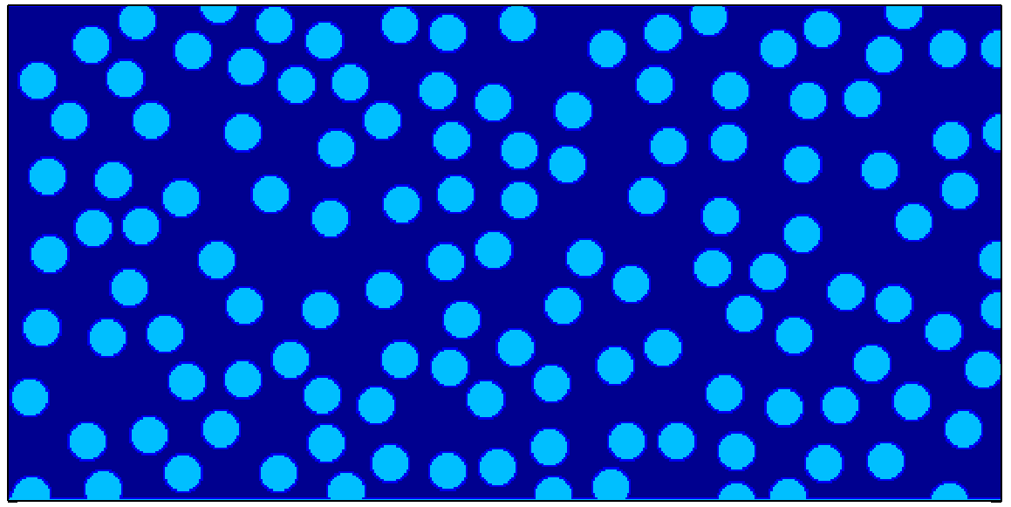
Heterogeneous vs. homogeneous reactive surfaces
Inlet concentrations
[Ca²⁺]_{T}=
[CO₃²⁻] _{T}
=50mM
Velocity profile
(pressure gradient)
Non-reactive grain
Reactive calcite
{Ca²⁺} x {CO₃²⁻}
Concentrations
All reactive grains
{Ca²⁺} x {CO₃²⁻}
Concentrations

Slide 13
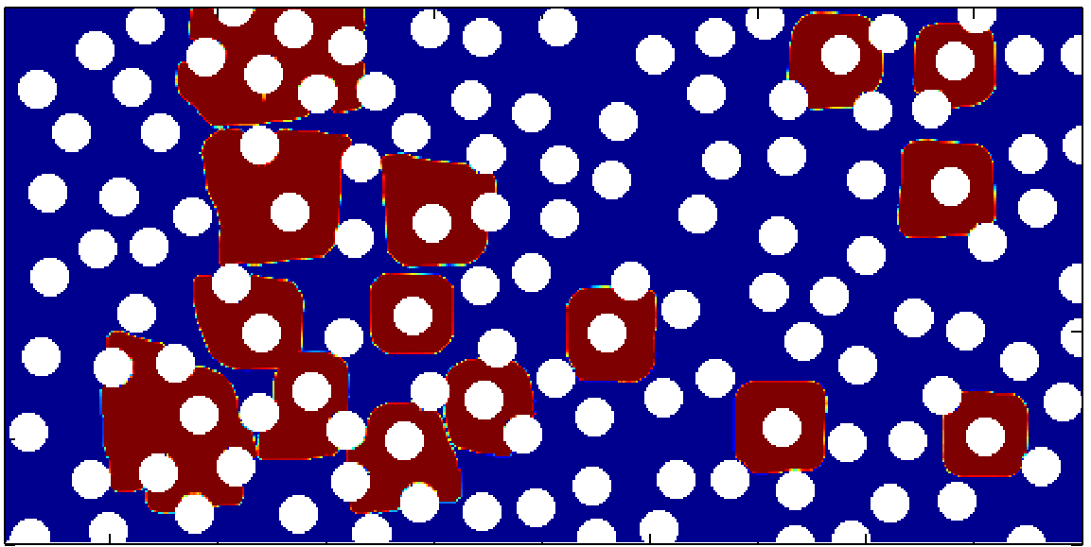
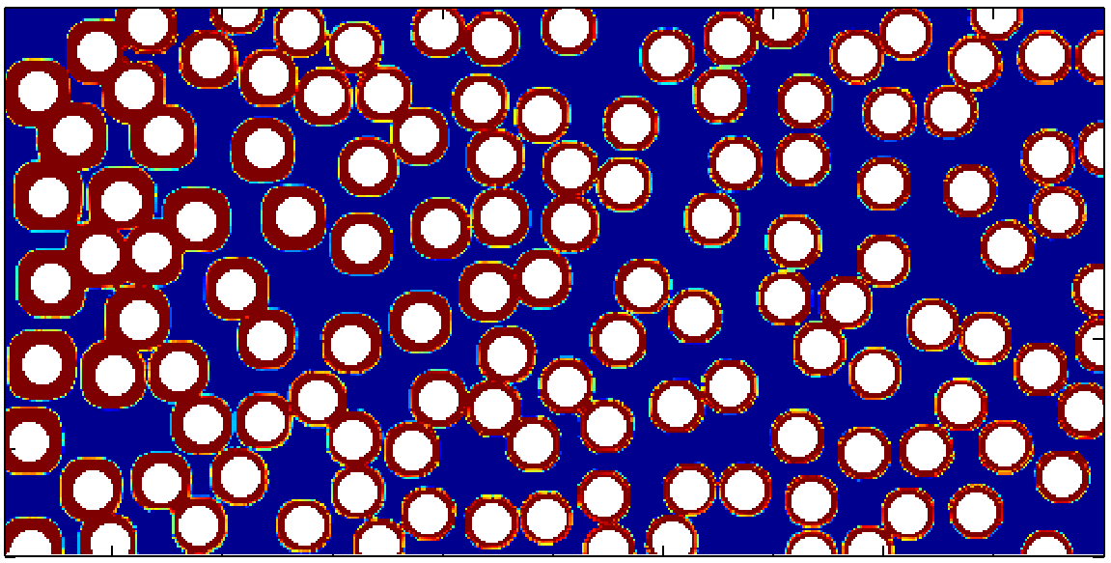
Heterogeneous vs. homogeneous reactive surfaces
Inlet concentrations
[Ca²⁺]_{T}=
[CO₃²⁻] _{T}
=50mM
Velocity profile
(pressure gradient)
Non-reactive grain
Reactive calcite
Concretion from
reactive grains
All reactive grains
Concretion from
all reactive grains

Slide 14
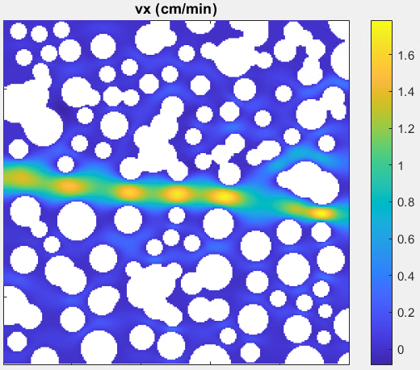






Reactive Transport Modeling
Influent
[Ca²⁺]_{T}= 20mM
[CO₃²⁻] _{T}=20mM
pH=7.4
$$Reaction gradient$$
$$=\left(\frac{IAP}{K_{sp}}−1\right)$$
Calcite

Slide 15

Deep learning methods
  CNN (+MLP) as a baseline model
  Improved neural operator (DeepONet-based model, e.g., PRT-DeepONet)
  Variables: Peclet and Damköhler numbers to evaluate transport and reaction dominant cases (low, medium, and high cases)
  Test case: ~150 training data (snapshot of concentraions)
Concentrations
(Ca²⁺, CO₃²⁻, pH)
Reaction rates
Kadeethum, T., Verzi, S.J. and Yoon, H., 2024. An improved neural operator framework for large-scale CO2 storage operations. Geoenergy Science and Engineering, 240, p.213007.
Yoon et al. (2020, AAAI workshop)

Slide 16




ML prediction: preliminary results
True
(ML pred)
Notes:
Why this is a real challenging problem?
Subsurface
uncertain materials
uncertain structures
Multiple scales
time, space
multi-scale analysis (e.g. homogenization) attempts to exploit any scale separation
may not have scale separation → scale embedding with ‘mortars’
fracture is inherently multi-scale
Multiple physics
geomechanics, geochemistry, biology
solid mechanics, porous flow, chemical and biological reactions
phase changes, localization, fracture
Dynamic, highly nonlinear
instabilities, bifurcation phenomena, limit cycles
emergent phenomena
Multiphase flows in highly permeable structures, such as coarse sands or distillation columns, requires
a specific treatment due to the fact that, when the pore size becomes very large, Reynolds
number, capillary number and Bond number attached to the flow can no longer be considered small,
as it is assumed for the quasi-static assumption, i.e., the system can no longer be described as mainly
controlled by capillarity. As a consequence, the classical generalized Darcy’s law model must be
adapted. While this is largely an open question, experimental and theoretical evidence suggest that,
at least, terms representing the drag force between the two phases must be added to the generalized
Darcy’s law. This has been emphasized in recent studies showing, for instance, a deviation from
the hydrostatic pressure drop in water observed in a vertical column subject to an upward gas flow
Chikhi, N., Clavier, R., Laurent, J. P., Fichot, F., & Quintard, M. (2016). Pressure drop and average void
fraction measurements for two-phase flow through highly permeable porous media. Annals of Nuclear
Energy, 94, 422-432.
Davit, Y., & Quintard, M. (2018). One-Phase and Two-Phase Flow in Highly Permeable Porous Media.
Heat Transfer Engineering, 1-19.

Slide 17
Summary
AnisONet can predict directional permeabilities for images and can be used for upscaled model properties
AnisONet (with Jax-based LBM) is being applied for 3D porous media
Pore scale reactive transport enables us to improve fundamental understanding of physical-chemical processes involved in various subsurface energy systems
Improved neural operator was able to predict chemical concentrations reasonably well (in progress)
An adaptive strategy to couple pore- and continuum scale using machine/deep learning methods will be tested against more realistic cases

