Slide 1
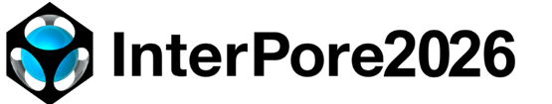
SAMamba3D: Adapting Segment Anything for Generalizable 3D Segmentation of Multiphase Pore-Scale Images
Rui Zhang (presenter), Linqi Zhu, Xianzhi Song, Branko Bijeljic, Gensheng Li and Martin J. Blunt
21/05/2026
Notes:
Good afternoon everyone. Today my topic is, The main message is simple: we want to build a segmentation model that is accurate, efficient, generalizable, and easy for other researchers to use.

Slide 2
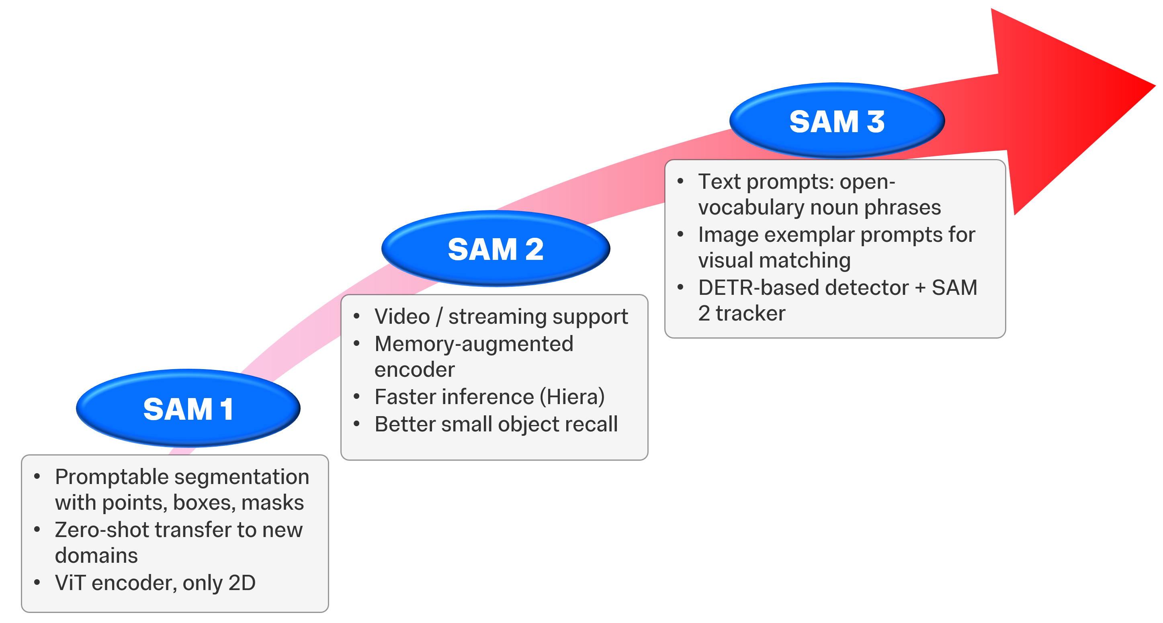
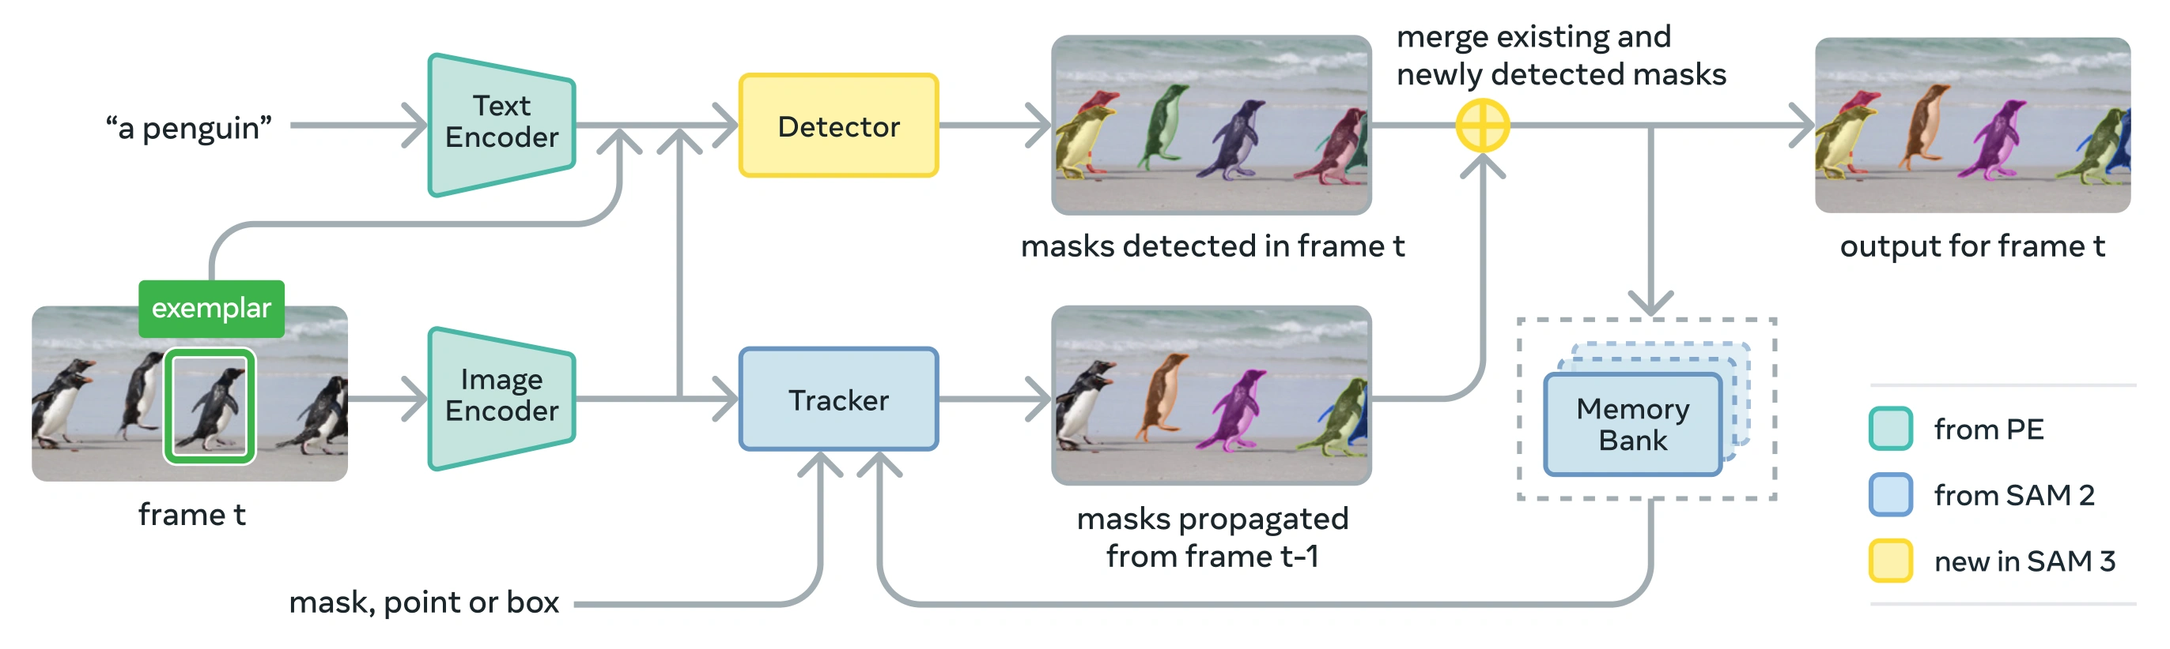
Segment Anything Model (SAM)
From SAM (Meta open-source) to domain adaptation: success and limitations
Why the SAM model fail on CT image segmentation?
✗ RGB photos → CT greyscale (interface shape complex)
✗ SAM is inherently limited to 3D data:
no native 3D understanding, miss 3D pore structure
SAM 1.0 → 2.0 → 3.0: from natural images toward any domain
It enables general-purpose segmentation → strong zero-shot capability across natural images
Notes:
Recently, Segment Anything model, released by Meta as open source, has shown very strong segmentation ability in natural images.
This is attractive because SAM can generalize to new images with limited additional training.
However, pore-scale CT images are very different from natural RGB images.
They are grayscale, noisy, and often have ambiguous phase boundaries. Particularly, the pore structure is 3D.
If we input the images to the original SAM, the model may miss 3D connectivity and interface morphology.
So the key question is: how can we adapt the strength of SAM to 3D pore-scale images?

Slide 3
SAM fine-tuning: the path to domain adaptation
A proven paradigm in medicine — and the gap that remains for pore-scale CT
Already done
SAM fine-tuning in medical imaging
How SAM fine-tuning works?
✓ 3DSAM (Bui et al,. 2024): Processed images slice by slice, and fine-tuned on 1.5 M image-mask pairs across 10+ modalities (CT, MRI).
Domain dataset
Pre-trained
SAM weights
Lightweight
adapters (LoRA)
Domain-specific
fine-tuned model
✓ 3DSAM-Adapter (Gong et al,. 2025): Holistic adaptation of SAM from 2D to 3D. Outperforms general SAM on all medical benchmarks.
frozen
only adapters updated
3D Adapter
2D SAM Block
Not yet for rock CT
Why the gap persists
✗ No large public annotated dataset
✗ Phase boundaries ambiguous even to experts
✗ 3D global attention on high-resolution CT volumes is computationally prohibitive with O(n²) complexity.
✗ Cannot solve the physical consistency problem
3D SAM fine-tuning
Key idea: freeze the vast majority of pre-trained weights, and update only small adapter modules inserted into each transformer block.
👉 Our work directly addresses this gap: a 3D generalizable pretrained model for pore-scale CT, achieving maximum segmentation performance with minimal data requirements.
Notes:
In medical imaging, researchers proposed methods for fine-tuning SAM in 2024 and 2025, and they have achieved some significant results. But most of these approaches still work in 2D. More importantly, None of this has been done for porous media. And there are still several challenges.
First, we do not have a very large public labelled dataset.
Second, multiphase boundaries are often ambiguous, even for experts.
Third, full 3D attention on high-resolution CT images is computationally expensive.
Finally, accuracy is not enough. The segmentation must also be physically consistent.
Our work is designed to address this gap.

Slide 4
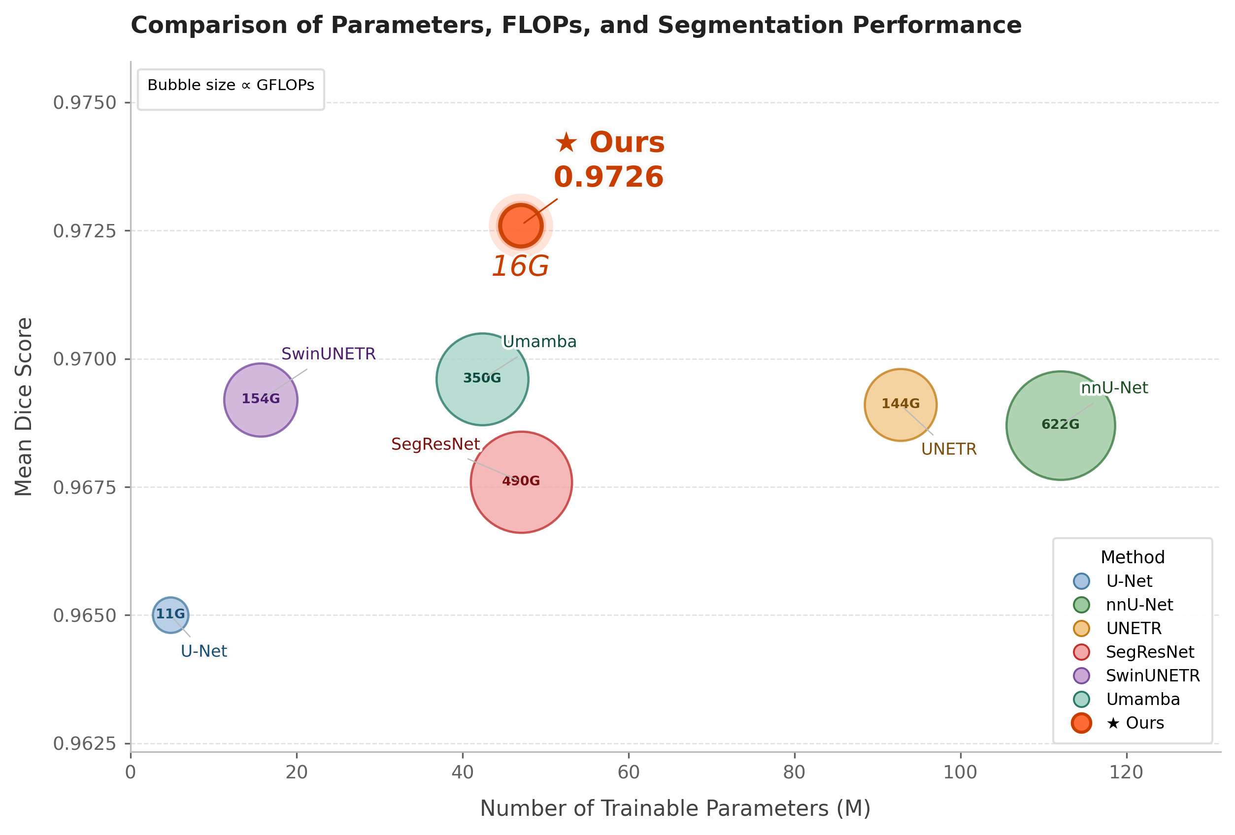
Performance and efficiency
Trade-off Between Accuracy, Parameters, and FLOPs
Our Method Achieves Superior Trade-off
Comparable parameter scale (47.6M)
Significantly lower FLOPs (16G)
Highest Dice score (0.973)
Efficiency Gap
Ours (16G) vs. nnU-Net (622G): Computational overhead reduced by approximately 40 times
Ours (16G) vs. Umamba (350G): Inference efficiency improved by more than 22 times under comparable architectures
We evaluate the performance of our model via comparisons with current state-of-the-art segmentation methods.
Notes:
Now let me show the key results. Compared with current state-of-the-art segmentation models, our method achieves the highest Dice score.
At the same time, the computational cost is much lower with only 16 GFLOPs. Compare to nnU-net and UMamba, our efficiency has increased by more than 40 times and 22 times under comparable architectures.
We improve model performance without increasing computational cost. Our model achieves a superior trade-off between accuracy and efficiency. This also solves the out-of-memory problem of traditional deep learning methods.

Slide 5
Generalization across datasets
Test dataset
Rock type | Rock details | Fluid type | Wettability | Best performance
Sandstone | Bentheimer (Li et al., 2018) | Oil-brine | water-wet | ✓
 | Bentheimer (Li et al., 2019) | Oil-brine | mixed-wet | ✓
 | Bentheimer (Alhammadi et al., 2018) | Oil-brine | water-wet | ✓
 | Mt. Simon (Dalton et al., 2018) | scCO₂-brine | water-wet | ✓
 | Borosilicate (Tawfik et al., 2021) | scCO₂-brine | water-wet | ✓
 | layered Clashach (Zaid et al., 2024) | H₂-brine | water-wet | ✓
Carbonate | Middle East (Alhammadi et al., 2018) | Oil-brine | mixed-wet & water-wet | ✓
 | Ketton limestone (Singh et al., 2018) | Oil-brine | water-wet | ✓
 | Ketton limestone (Scanziani et al., 2018) | Oil-brine | water-wet | ✓
 | Estaillades (Bultreys, 2016). | Oil-brine | oil-wet | ✓
 | Indiana limestone (Alqahtani et al., 2021) | Oil-brine | water-wet | ✓
 | Middle Eastern (Alqahtani et al., 2021) | Oil-brine | water-wet | ✓
 | Estaillades (Hussain et al., 2025) | Oil-brine | oil-wet | ✓
Strong generalization across different rock types, fluid systems and wetting conditions.
Notes:
Accuracy on one dataset is useful, but generalization is more important. Here we test the model on a wide range of unseen datasets. These include different rock types, fluid systems and wetting conditions. The key point is that the model is tested without case-by-case retraining.
Across these datasets, SAMamba3D achieves the best performance.
This suggests that the model is not simply memorizing one rock type or one imaging condition. It learns useful 3D structural features.

Slide 6
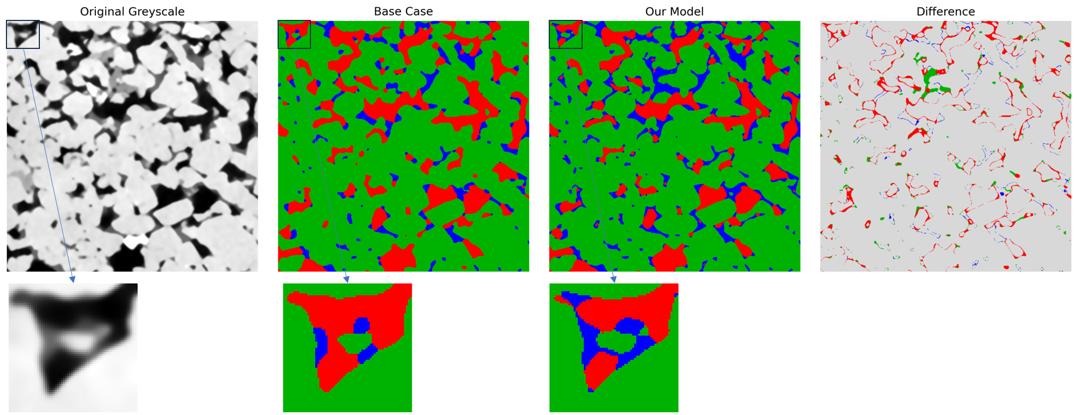
Validation on mixed-wet Bentheimer sandstone
1.0mm
In mixed-wet systems, the geometry of fluid interfaces plays a critical role.
Reduces meaningless artifacts due to low resolution and imaging noise
It demonstrates that the model leverages both grayscale information and higher-dimensional structural features to reconstruct fluid morphology and achieve consistent physical interpretation.
Lin, Q., Bijeljic, B., Berg, S., Pini, R., Blunt, M. J., & Krevor, S. (2019, Jun). Minimal surfaces in porous media: Pore-scale imaging of multiphase flow in an altered-wettability bentheimer sandstone. Phys. Rev. E, 99 , 063105.
Notes:
Let us look at a challenging example: a mixed-wet Bentheimer sandstone. In mixed-wet systems, the geometry of fluid interfaces is very important.
Low image resolution and imaging noise can easily create meaningless small artifacts. Our model reduces these artifacts and gives a cleaner, more physically reasonable fluid morphology.
This suggests that the model is not just applying a grayscale threshold. It uses both image intensity and 3D structural information to recover the phase geometry 说一下不在训练集里

Slide 7
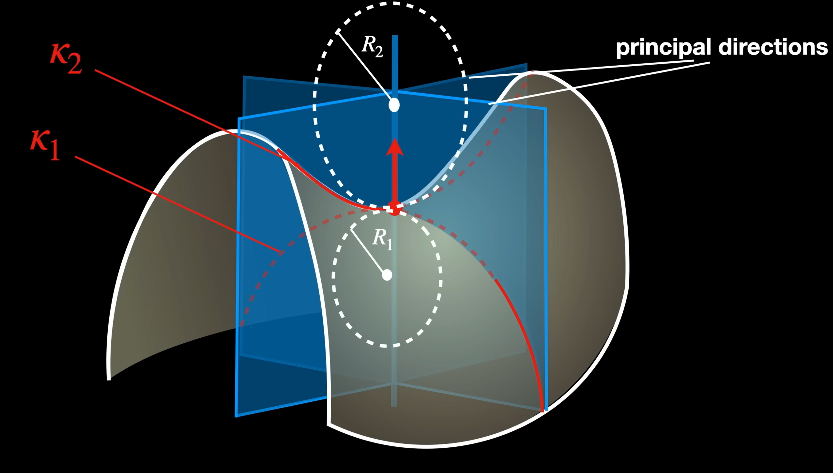
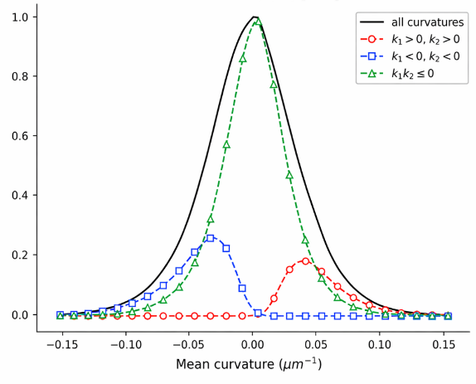
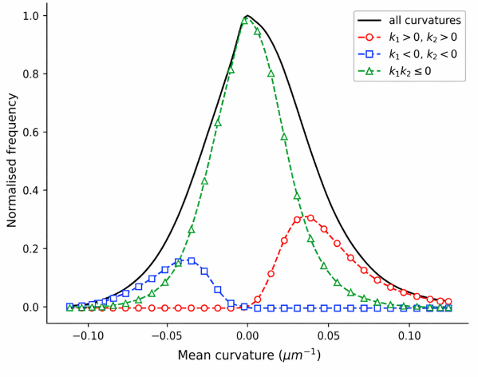
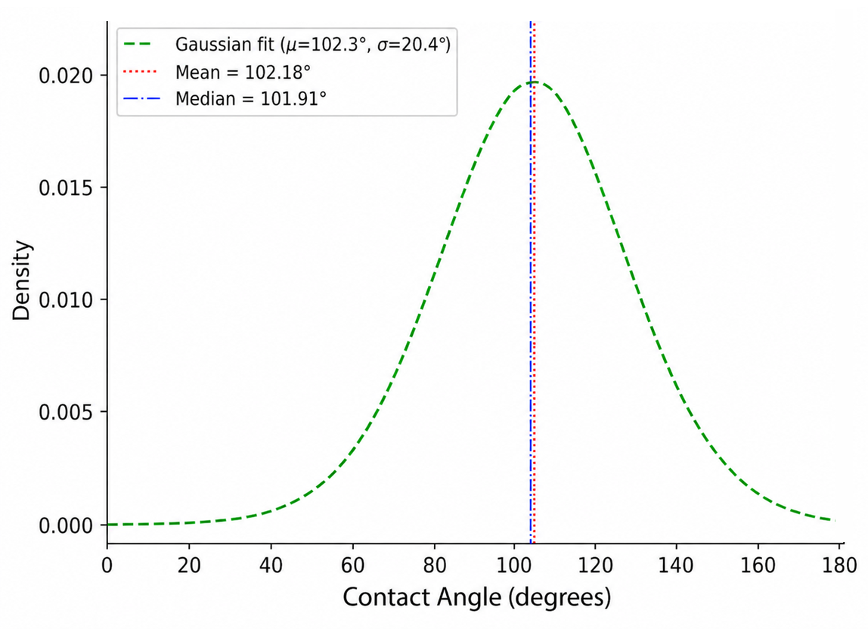
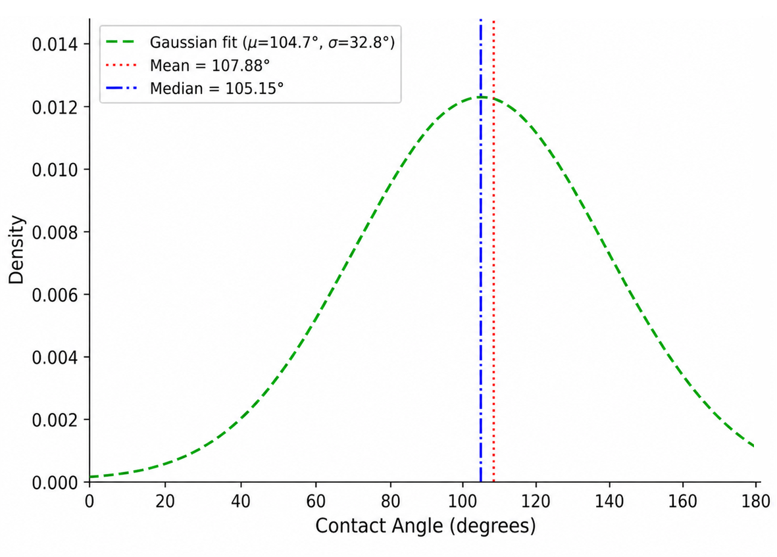
Contact angle and curvature
Source： YouTube
In mixed-wet systems, more saddle-shaped interfaces are observed.
Saddle interfaces → more stable and efficient flow
Total curvature ≈ 0, contact angle distribution covers a range of 90°
Importantly, our results are highly consistent with manually corrected segmentations, and remain compatible with current pore-scale flow understanding.
Base case (mixed-wet)
Our model (mixed-wet)
Base case (mixed-wet)
Our model (mixed-wet)
Notes:
To further check physical consistency, we calculate contact angle and curvature. These are important because they describe interfacial physics.
In the mixed-wet systems, we observe more saddle-shaped interfaces. The total curvature is close to zero, and the contact angle distribution is consistent with mixed-wet behavior.
Importantly, our results are highly consistent with manually corrected segmentations.
This gives us confidence that the model output is not only accurate in Dice score, but also compatible with pore-scale flow physics.

Slide 8
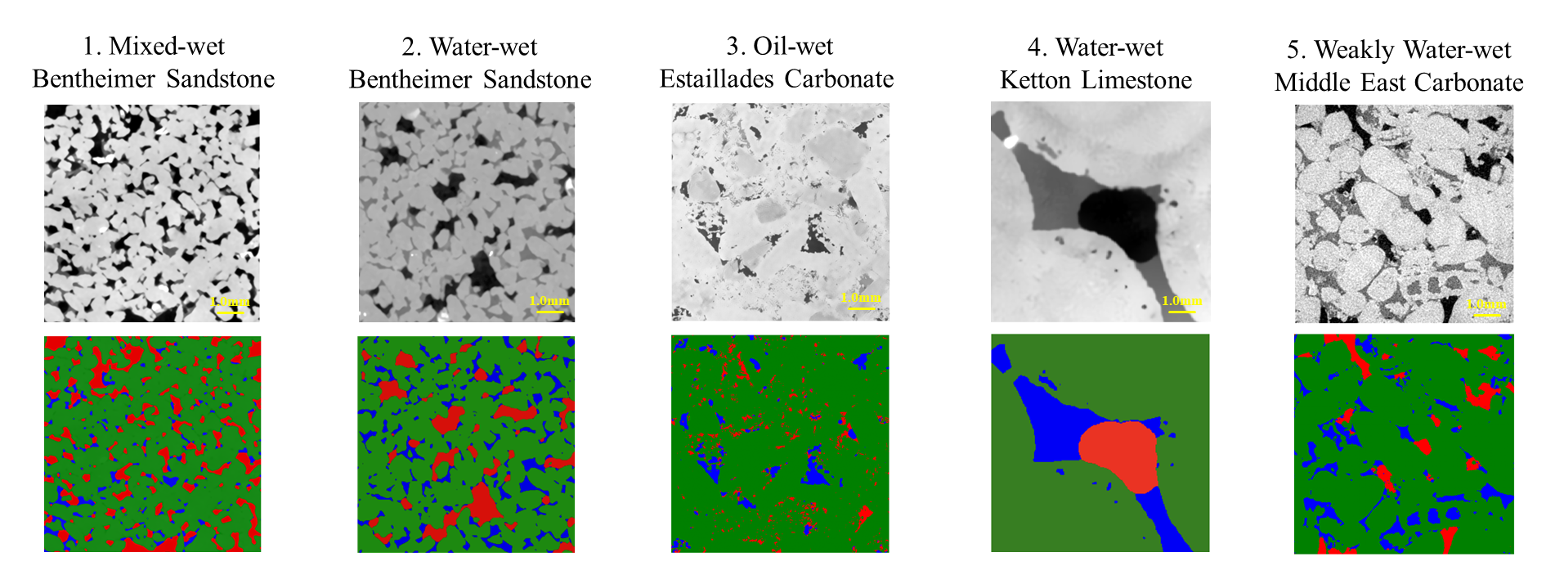
Generalization across rock type and wettability
The model generalizes well when making predictions on unseen datasets (no retraining required).
Notes:
This slide summarizes generalization across both sandstone and carbonate, and across water-wet, mixed-wet, and oil-wet conditions. Even in these harder cases, the model still gives stable and satisfactory predictions.

Slide 9
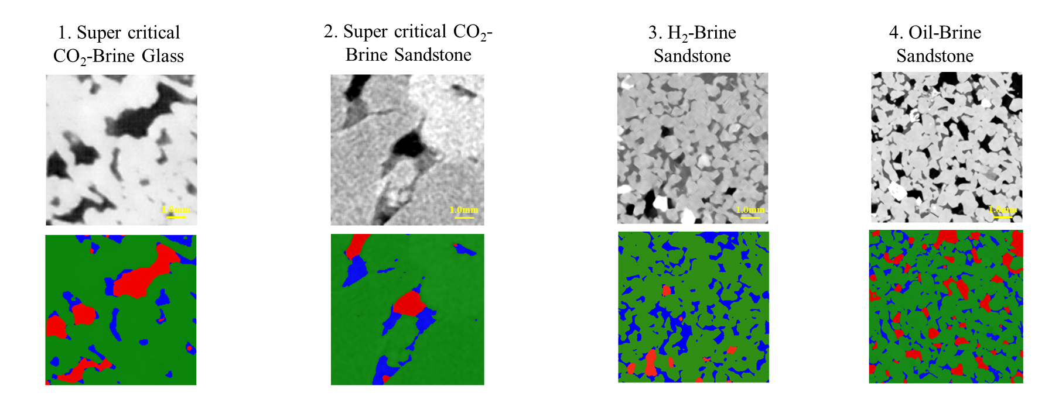
Generalization across fluid systems
The model generalizes well when making predictions on unseen datasets (no retraining required).
Notes:
We also test the model across different fluid systems. These datasets have different contrast, and different imaging conditions. Our model still produces robust segmentation without retraining. For us, this is the long-term goal of AI-accelerated pore-scale analysis: one model, many datasets, and reliable physics.

Slide 10
Conclusions and future work
A New Direction for Multiphase Pore-Scale CT Segmentation: establish a new perspective by integrating a vision foundation model (SAM) with efficient sequence modeling (Mamba), enabling scalable 3D segmentation
Accuracy-Efficiency Balance: compared to conventional deep learning methods, our approach achieves a superior trade-off between parameter efficiency and segmentation accuracy.
The proposed model can generalize across rock types, wettability conditions, fluid systems, and imaging resolutions, without case-by-case retraining.
Future work
Conducting large-scale pre-training on 3D data of other domains
Notes:
To conclude, …
This is not just a model, but a step toward a general-purpose segmentation framework. In future work, we plan to extend this idea through larger-scale pretraining on broader 3D scientific imaging datasets.

Slide 11


Thank you
Arxiv: SAMamba3D: Adapting Segment Anything for Generalizable 3D Segmentation of Multiphase Pore-Scale Images
Email: r.zhang1@imperial.ac.uk
QR code for SAMamba3D
QR code for Arxiv
SAMamba-3D: Towards General-purpose Segmentation Models for Multiphase Micro-CT Images
21/05/2026
Notes:
Finally, Our code is available on GitHub, and the paper is available on arXiv.
We encourage you to scan the QR code, try the model on your own datasets, compare it with your current workflow, and tell us where it works and where it fails. We hope SAMamba3D can help your research, and we very much welcome your feedback.

Slide 12
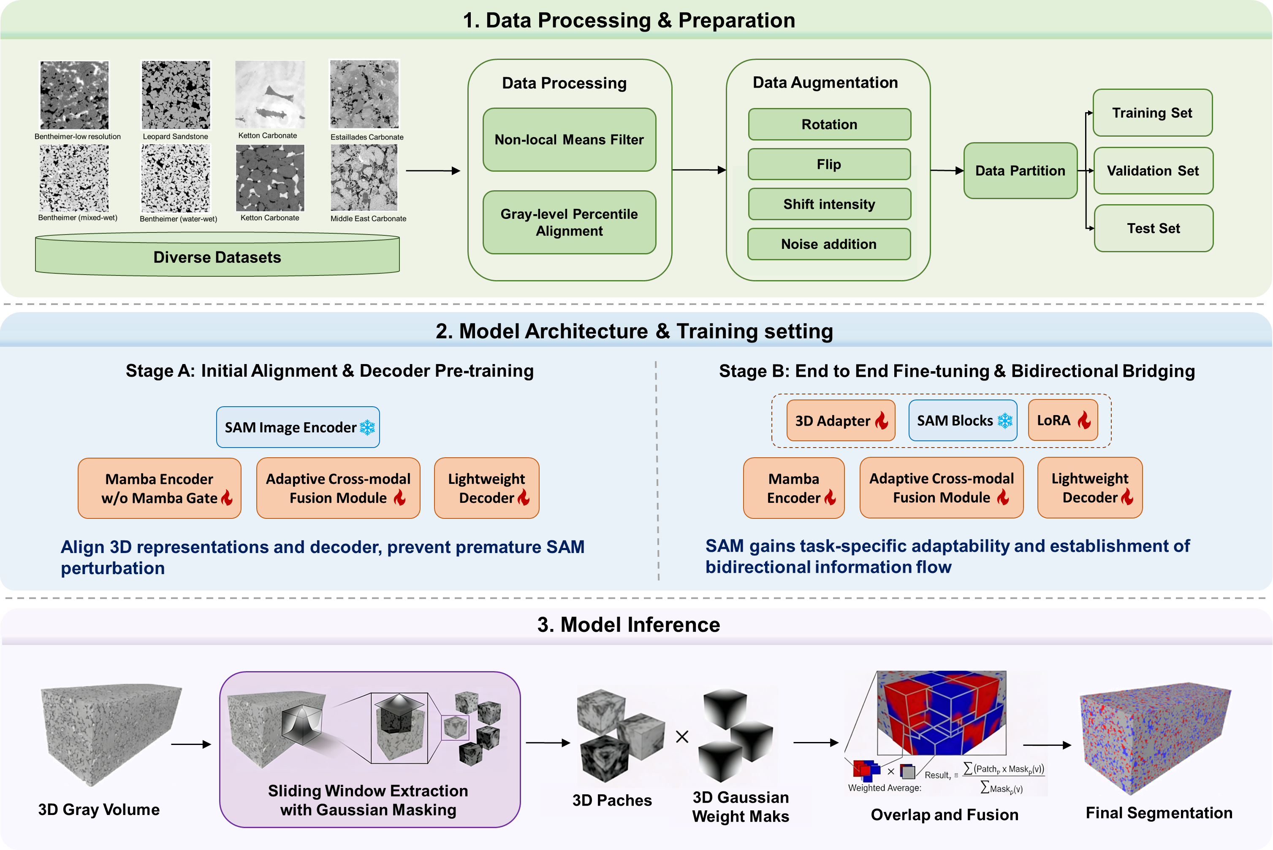
Workflow
Step 1: Data processing, augmentation, and partitioning.
Step 2: Build a baseline model and design a two-stage training strategy.
Step 3: Gaussian-weighted sliding window inference to eliminate discontinuities at patch boundaries.
Notes:
So how do we achieve this? This is our whole workflow, including data preparation, model training, and inference.

Slide 13
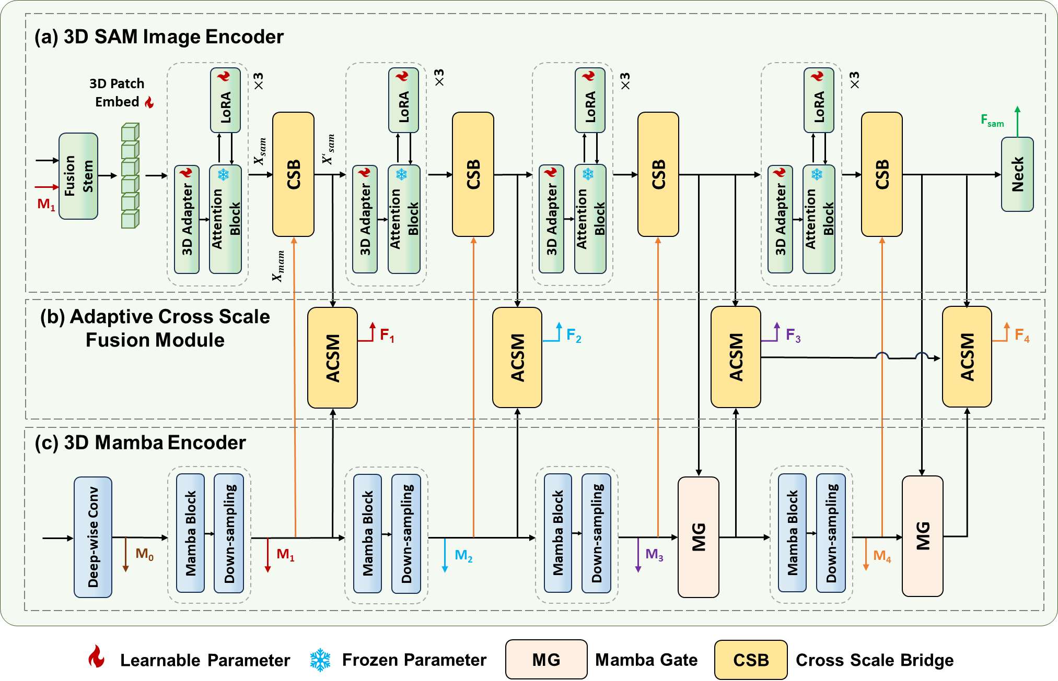
Novelty
3D SAMamba model—from local detail to global understanding
👉Key idea: Use global information to
guide local segmentation
Mamba reads the 3D volume and understands the global structure
SAM focuses on boundaries and fine local details, guided by Mamba
Two specialists working together — neither could do this alone.
Notes:
Our key idea is to combine SAM and Mamba in a co-encoding architecture that bridges local detail and global understanding
Mamba reads the entire volume sequentially and develops a global understanding of pore structure, phase distribution, and long-range connectivity. It’s just like a global controller.
SAM then focuses on fine local boundaries and precise phase interfaces — guided by Mamba's global context. It is just like a local expert.
And They work together and effectively integrate high-dimensional features

Slide 14
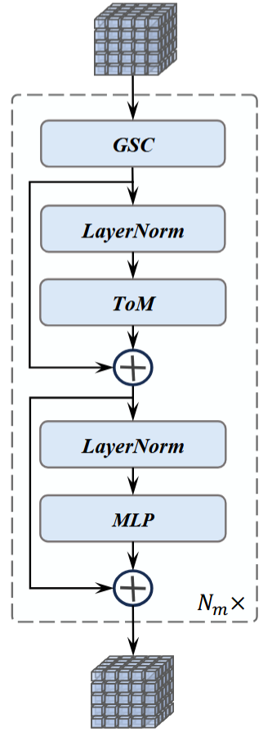
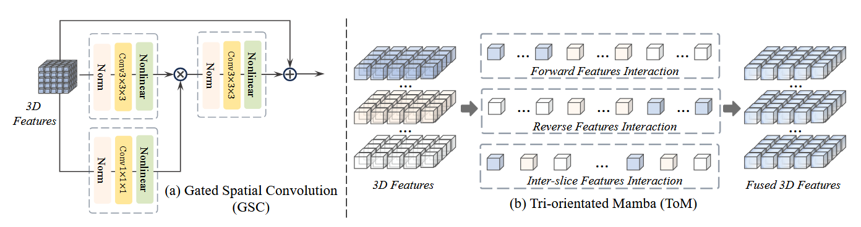
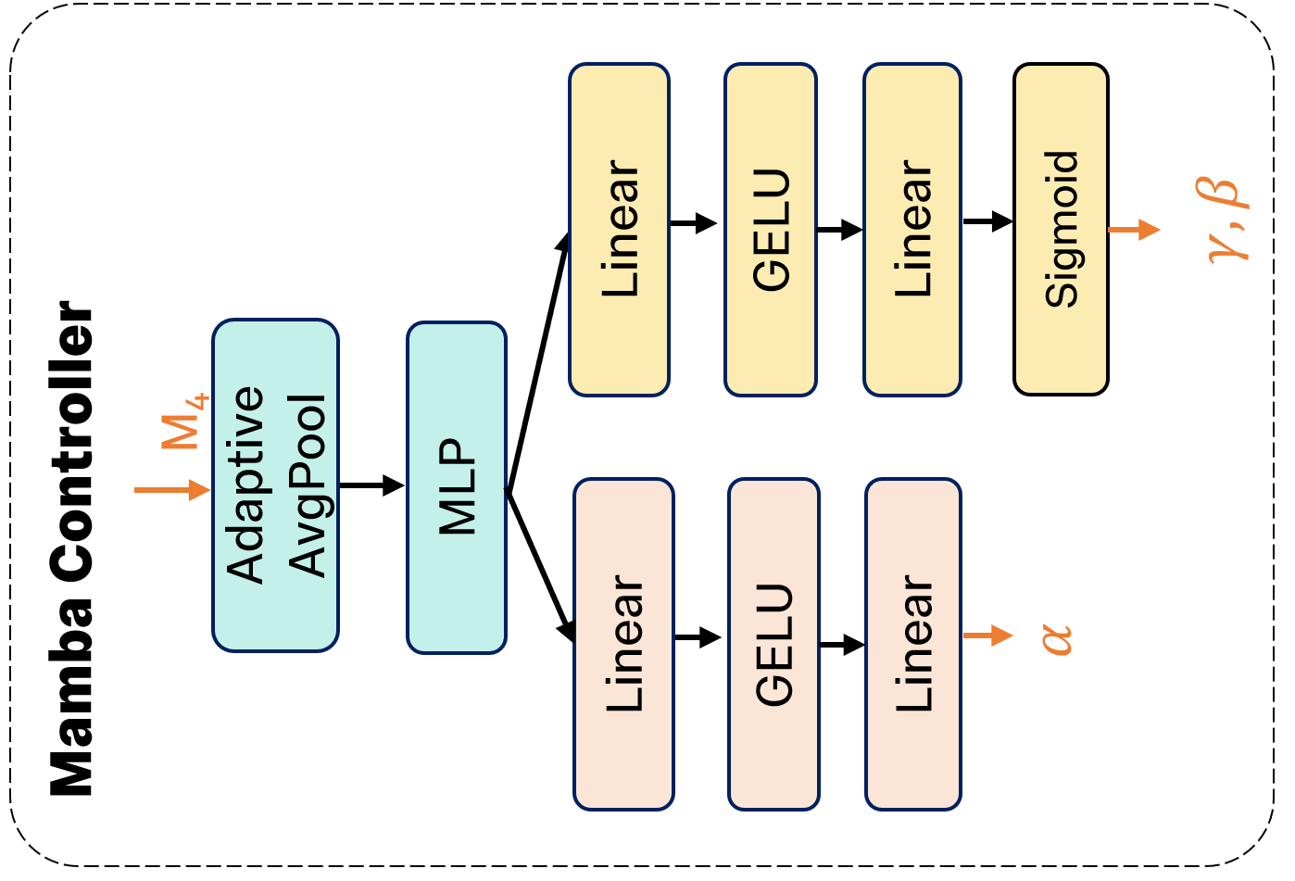
How to do? Why mamba?
Mamba block & Mamba controller
Mamba enables efficient global understanding for large-scale 3D segmentation
Linear complexity O(N) → Scales efficiently to large 3D data
Long-range dependency modeling→ Captures global pore connectivity
Memory-efficient→ Enables full-volume reasoning instead of patch-based approximation
Notes:
There are a few points I would like to explain further. Firstly, why do we choose Mamba? In 3D segmentation, understanding the global structure is crucial. CNNs are good at processing local details, but they are unable to capture long-range relationships.
Transformers are capable of modelling global context, but they require significantly more computational resources when process 3D data.
Mamba offers a new solution—it models long-range dependencies with linear complexity. This enables us to understand the whole pore structure without generating excessive computational costs.

Slide 15
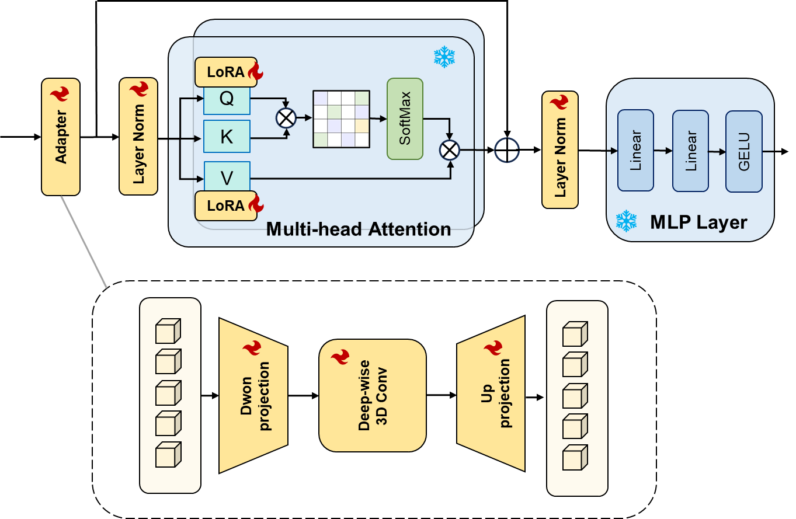
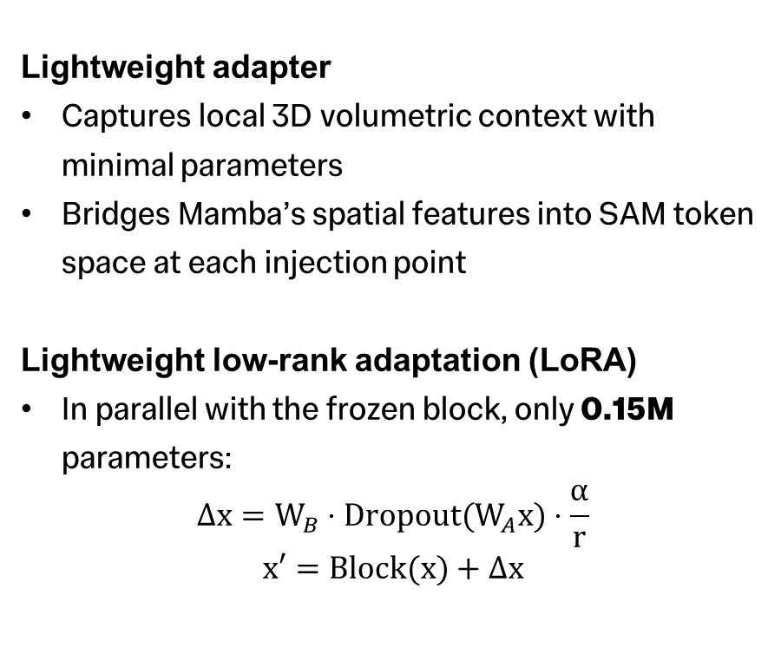

How to adapt SAM for 3D segmentation?
3D Lightweight adapter & LoRA module
Lightweight adapter
Captures local 3D volumetric context with minimal parameters
Bridges Mamba’s spatial features into SAM token space at each injection point
Lightweight low-rank adaptation (LoRA)
In parallel with the frozen block, only 0.15M parameters:
$$Δx=W_{B}⋅Dropout(W_{A}x)⋅\frac{α}{r}$$
$$x′=Block(x)+Δx$$
$$Adapter(X) = X+σ(XWdown)Wup$$
Notes:
And how do we adapt SAM to handle 3D images. we design a lightweight adapter and lora bypass for efficient fine-tuning. These modules ensure that 3D structural information from the Mamba encoder is efficiently injected into the SAM feature space with minimal parameter

Slide 16



How to efficiently bridge SAM and Mamba?
Bidirectional bridge & Cross scale fusion module
Shallow Injection (L2, L5)
Bidirectional Bridge (L8, L11)
L0
L1
L2
L3
L4
L5
L6
L7
L8
L9
L10
L11
Bidirectional bridge
Mamba’s 3D structure injected into SAM—giving SAM spatial context
Edge information flows back—Mamba becomes aware of precise interfaces it initially missed.
Mamba Encoder
Depth-wise separable asymmetric bidirectional bridge
$$X_{sam}$$
Global-to-local interaction
Mamba guides SAM to avoid local ambiguity
Improves consistency across the entire volume
Adaptive Attention
MLP
SoftMax
Fusion Feature
$$X_{ctx}$$
$$X_{mamba}$$
Adaptive Cross Scale Fusion Module（ACSM）
Notes:
So Mamba tells SAM what is globally consistent, and SAM decides where exactly the boundaries are. Next key step is how to efficiently integrate the high-dimensional features extracted by SAM and Mamba? Here, we design a global-to-local interaction mechanism to improve consistency across the entire 3d volume

Slide 17
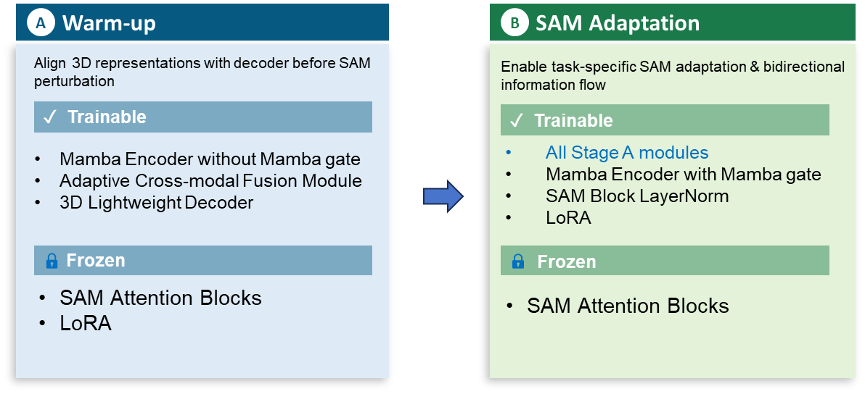
Training strategy and protocol
Stage A (30%)
Stage B (70%)
The model is trained on one NVIDIA A100 (80G) GPU, using AdamW optimizer for 200 epochs.
Set the learning rate of 1e−4. An early stop method was also defined by monitoring the validation dataset loss with a patience of 20 epochs.
The sliding window method is used during the inference phase, with an overlap of 0.7.
The Dice coefficient (Dice) and Intersection over Union (IoU) are used as evaluation metrics.
Loss Function Design:
Weighted Dice Loss
Tversky Loss
λ=0.5 | small-target re-weighting
λ=1.0 | FN penalty
Focal Loss
Boundary Loss
λ=0.5 | hard-example mining
λ=0.5 | Laplacian edge weighting
Notes:
Regarding the implementation details, we use the following training strategies and parameter settings. It is worth noting that the model is trained using only one NVIDIA A100 GPU, while still achieving strong performance.

