Slide 1
A Graph Neural Network Framework for Upscaling the Pore Network Modeling Calculations
Mehdi Mahdaviara
Amir Raoof
Hydrogeology group, Department of Earth Sciences, Utrecht University

Slide 2
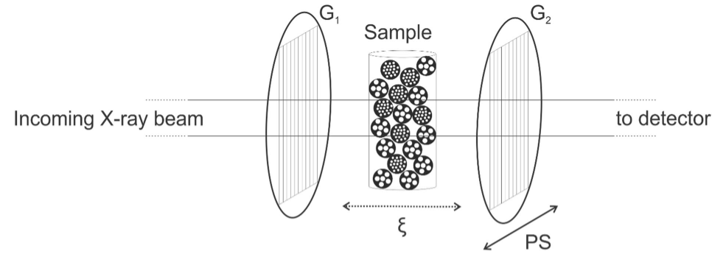
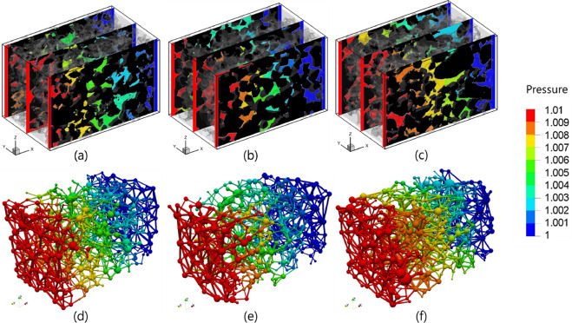
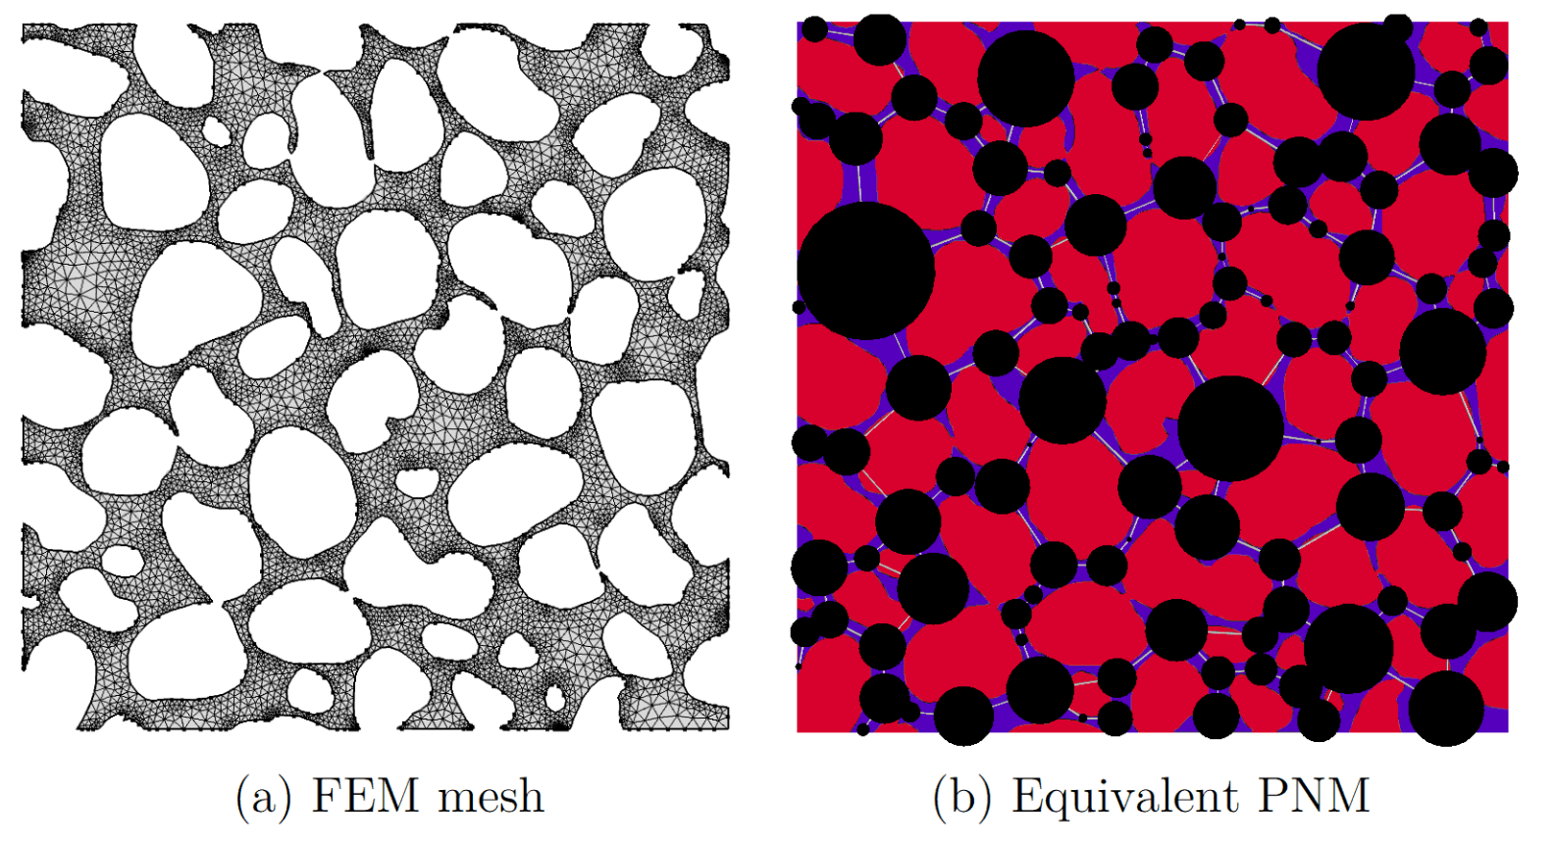
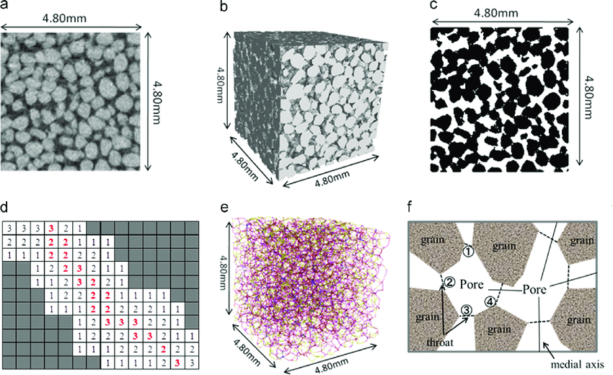
Introduction
Modeling of transport phenomena is a key step in any underground development study.
Advances in micro-CT imaging have significantly helped to cope with this challenge.
To create the geometry of porous media:
  A 3D X-ray image of the sample is prepared.
  The image is segmented to recognize the pore and grain spaces.
Modeling is implemented through:
  Direct Numerical Simulation (DNS)
  Pore Network Modeling (PNM)
DNS
PNM
CT Scanning
Image segmentation
0
0
0
0
1
1
1
0
0
0
1
0
0
1
1
1
1
0
0
0
1
0
0
0
0: grains
1: pores
0
0
1
0
0
0
Dimensionless pressure distributions in different rocks obtained by LBM and PNM [2].
0
1
1
0
0
1
0
1
1
0
0
1

Slide 3
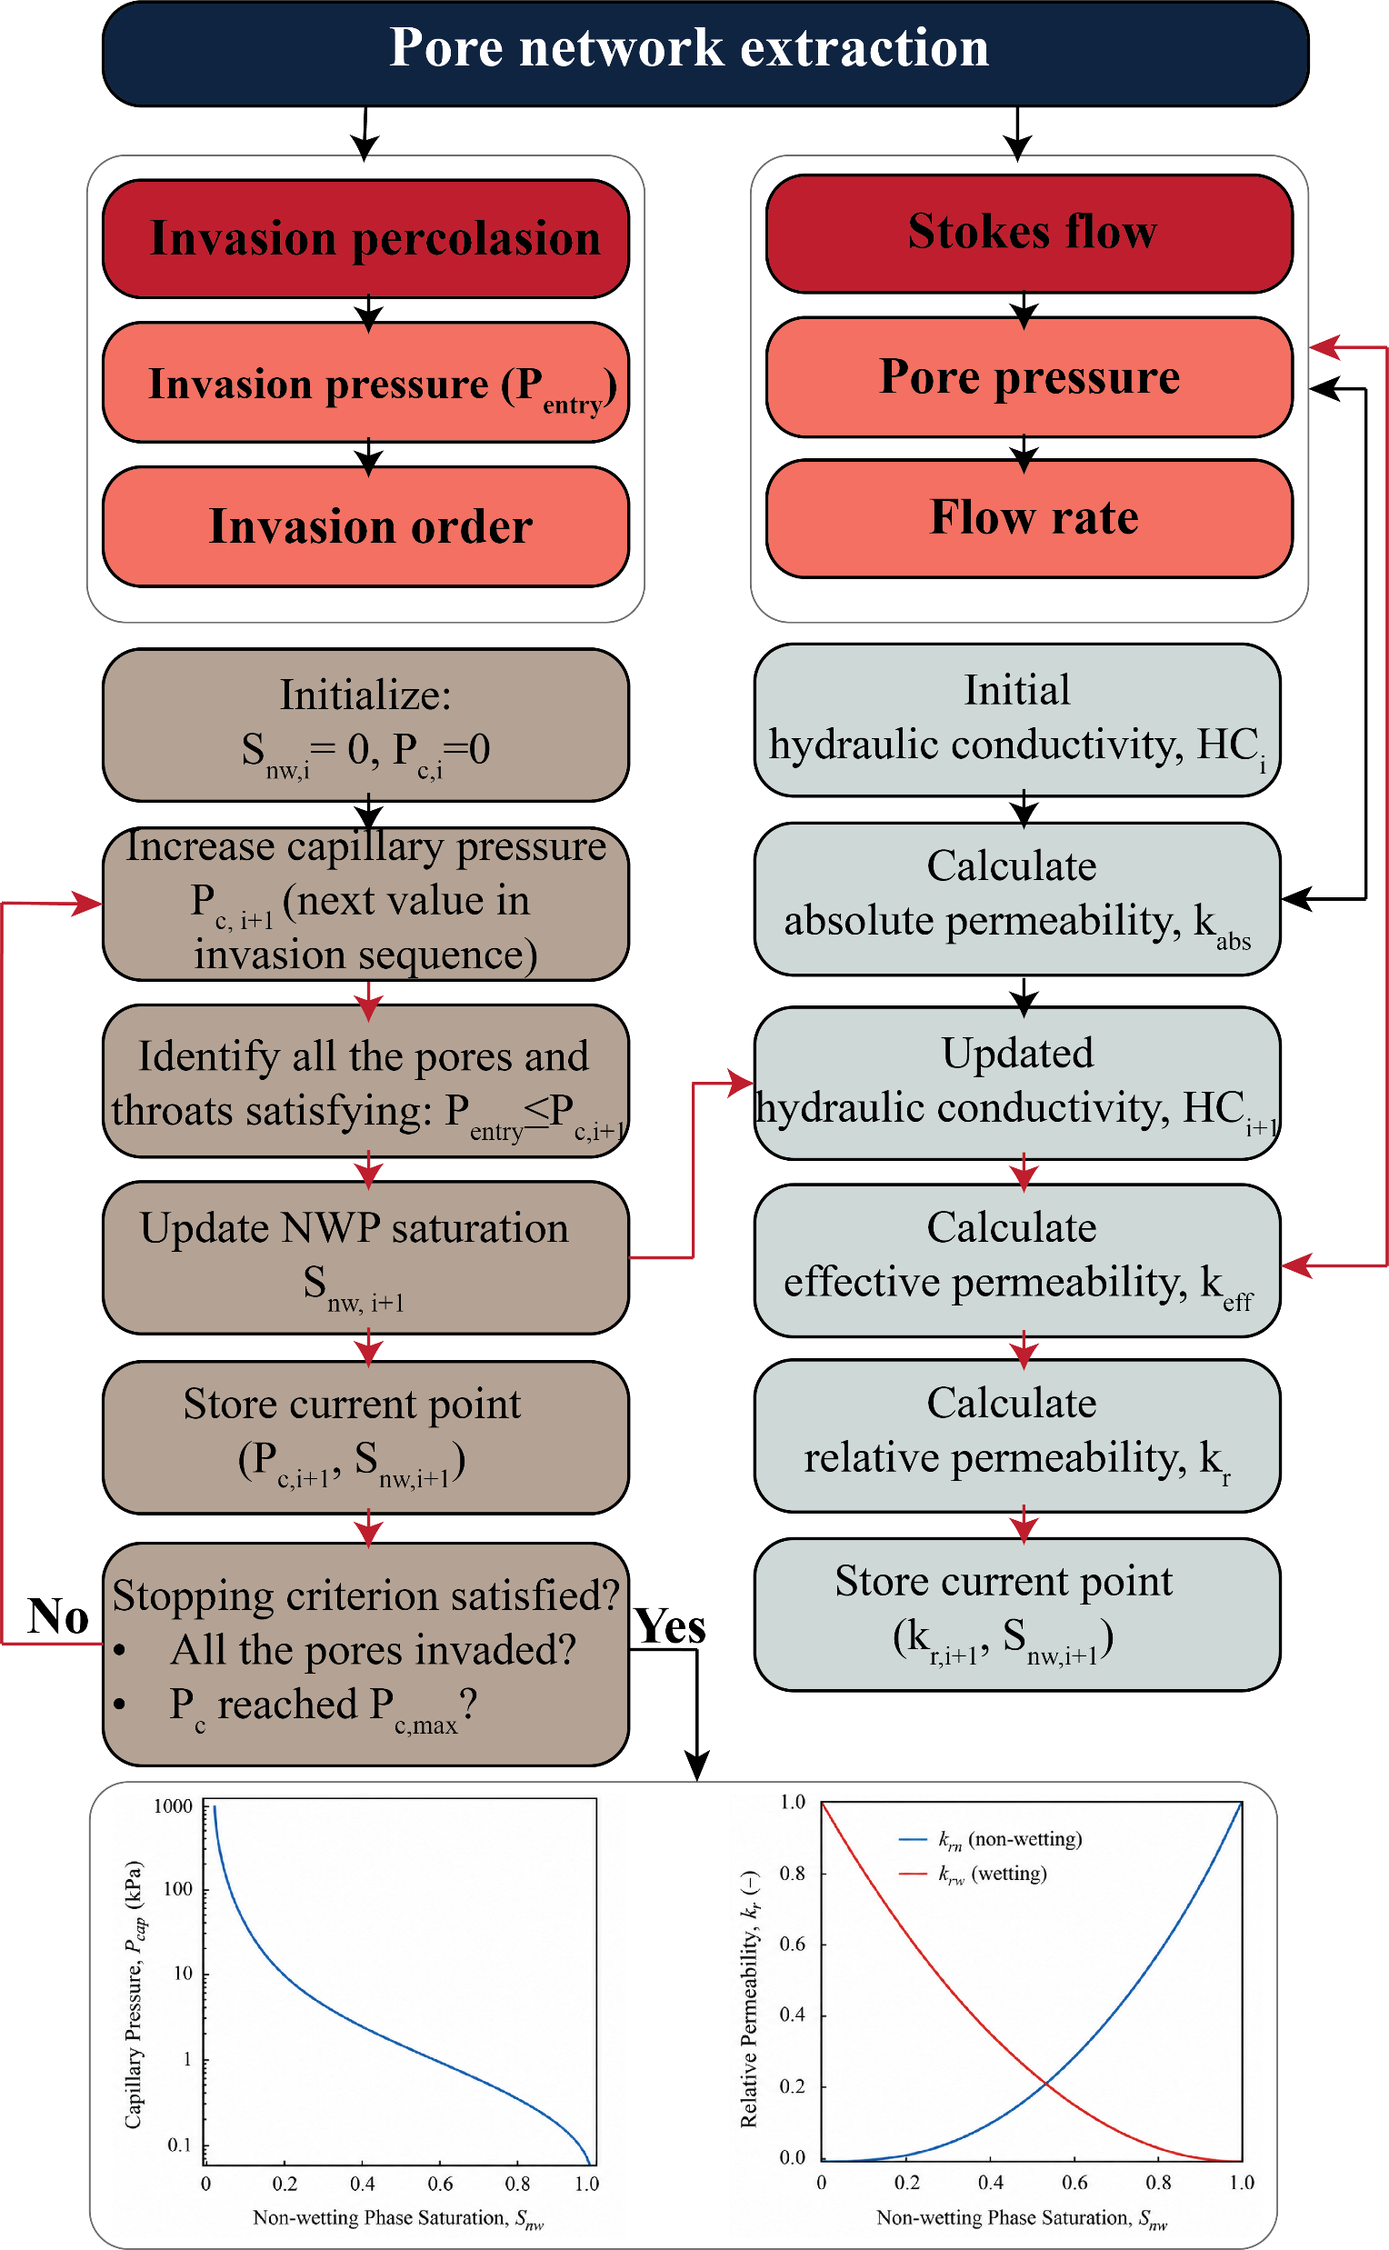
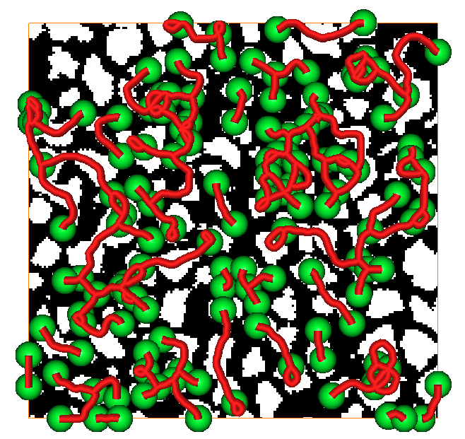
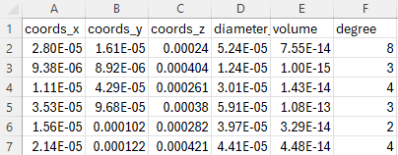
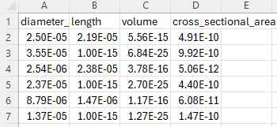
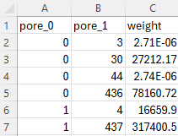
Node (pore) data
Graph-structured data
Edge (throat) data
Connection data
Dynamic modeling
Stokes equation (incompressible, steady-state):
-∇p + μ ∇²u = 0
Yaung-Laplace equation:
P_{c} = (2 * γ * cos(θ)) / r

Slide 4
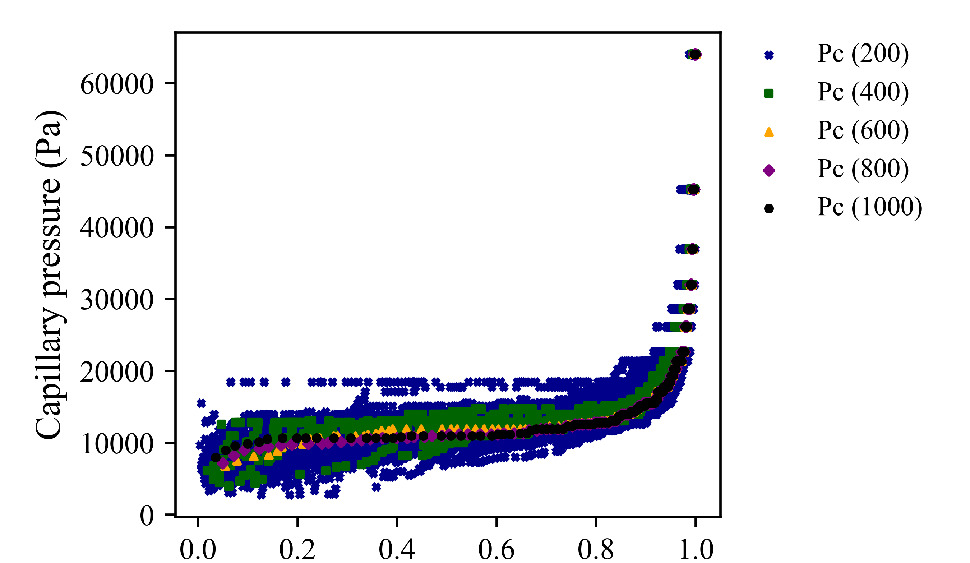
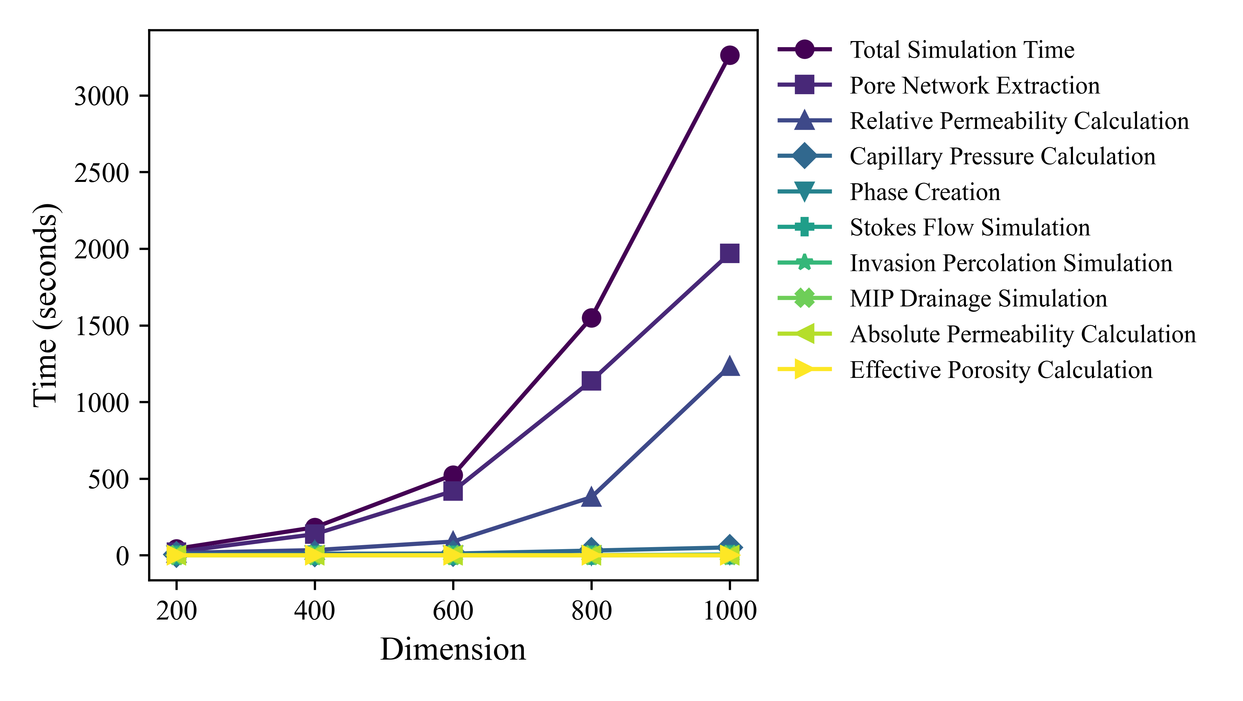
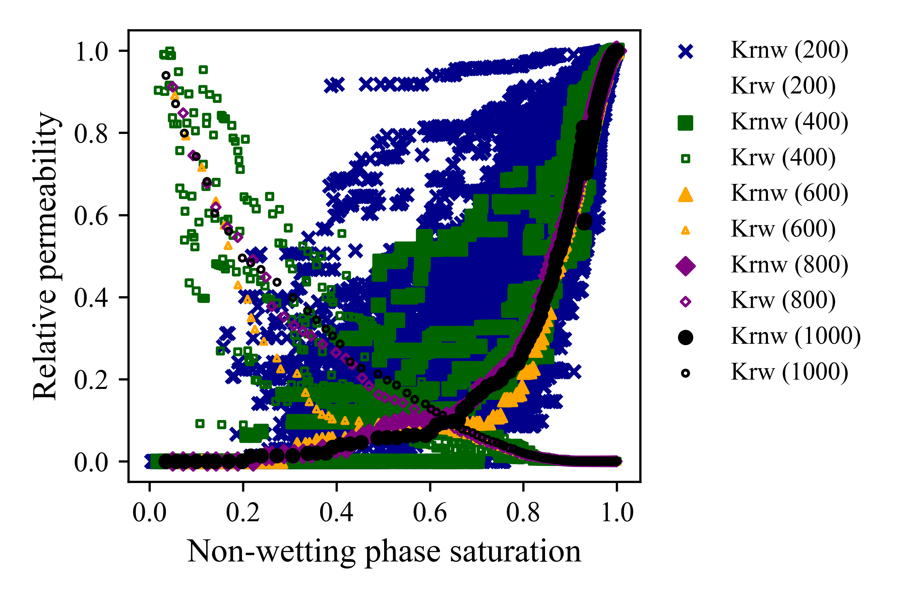

Challenge
Bentheimer sandstone
  The calculations for small samples are not necessarily representative of the larger scales.
  The PNM computational cost increases significantly with the sample dimension.

Slide 5

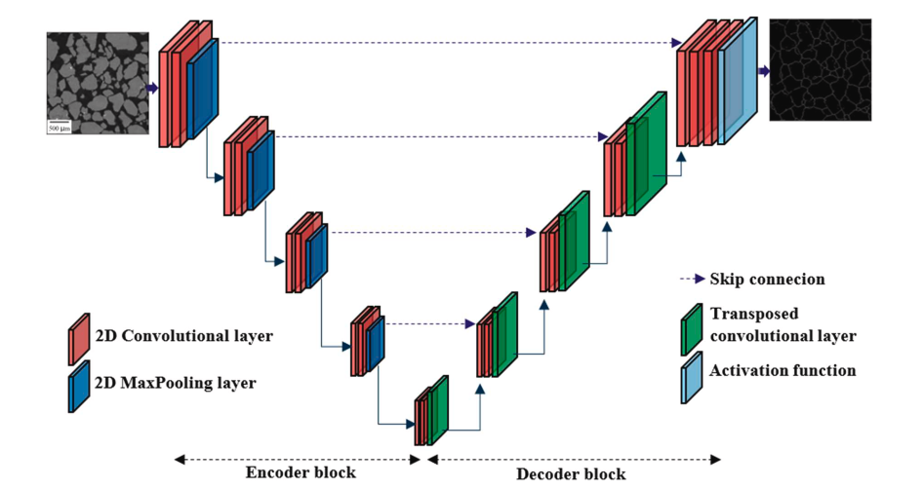
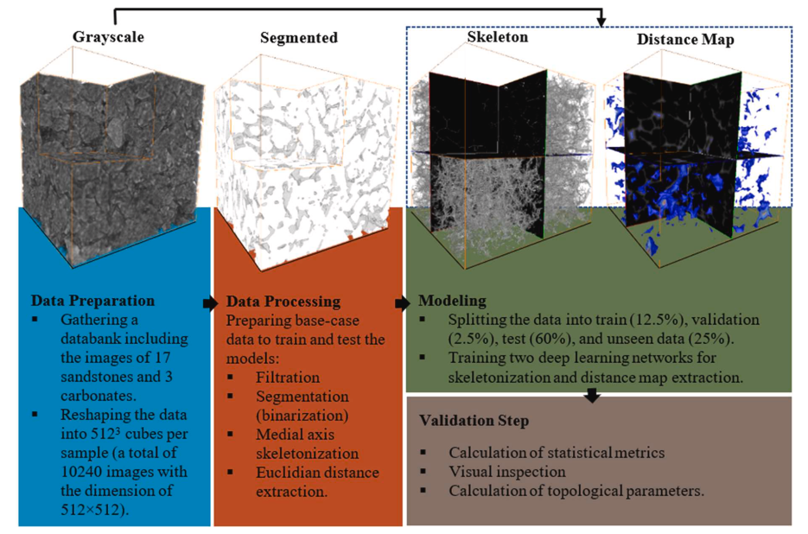
  We trained a U-Net autoencoder-decoder for the extraction of the skeleton and distance map directly from the grayscale images [2].

Slide 6
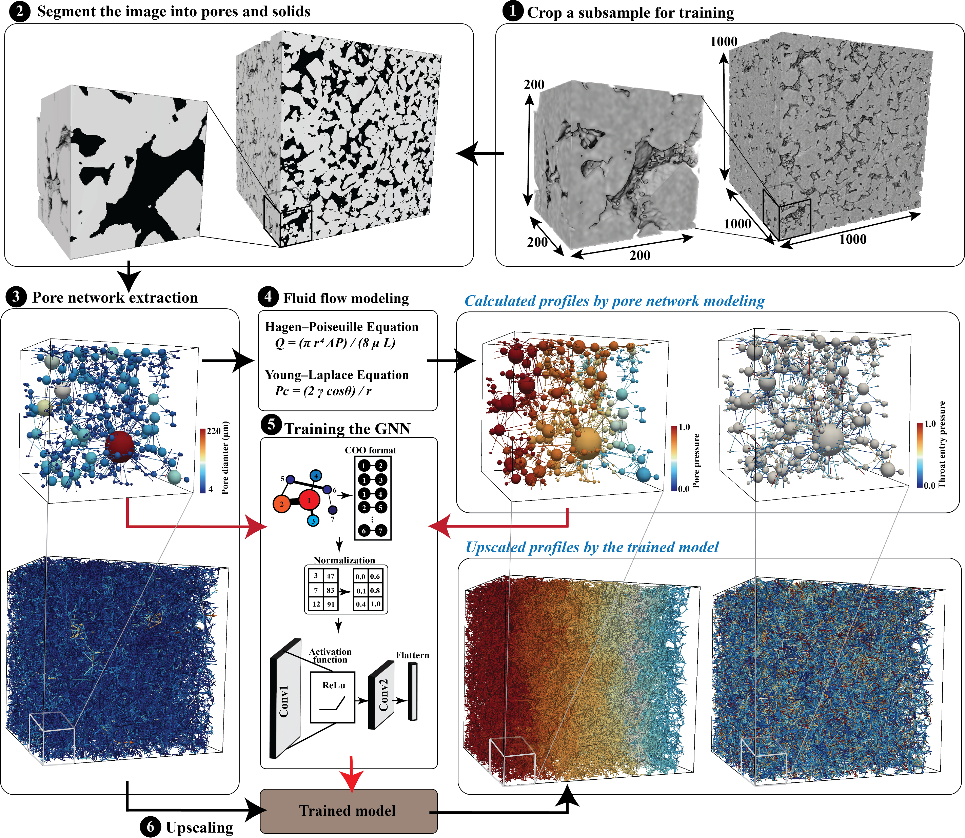
Modeling
Pore pressure and entry pressure

Slide 7
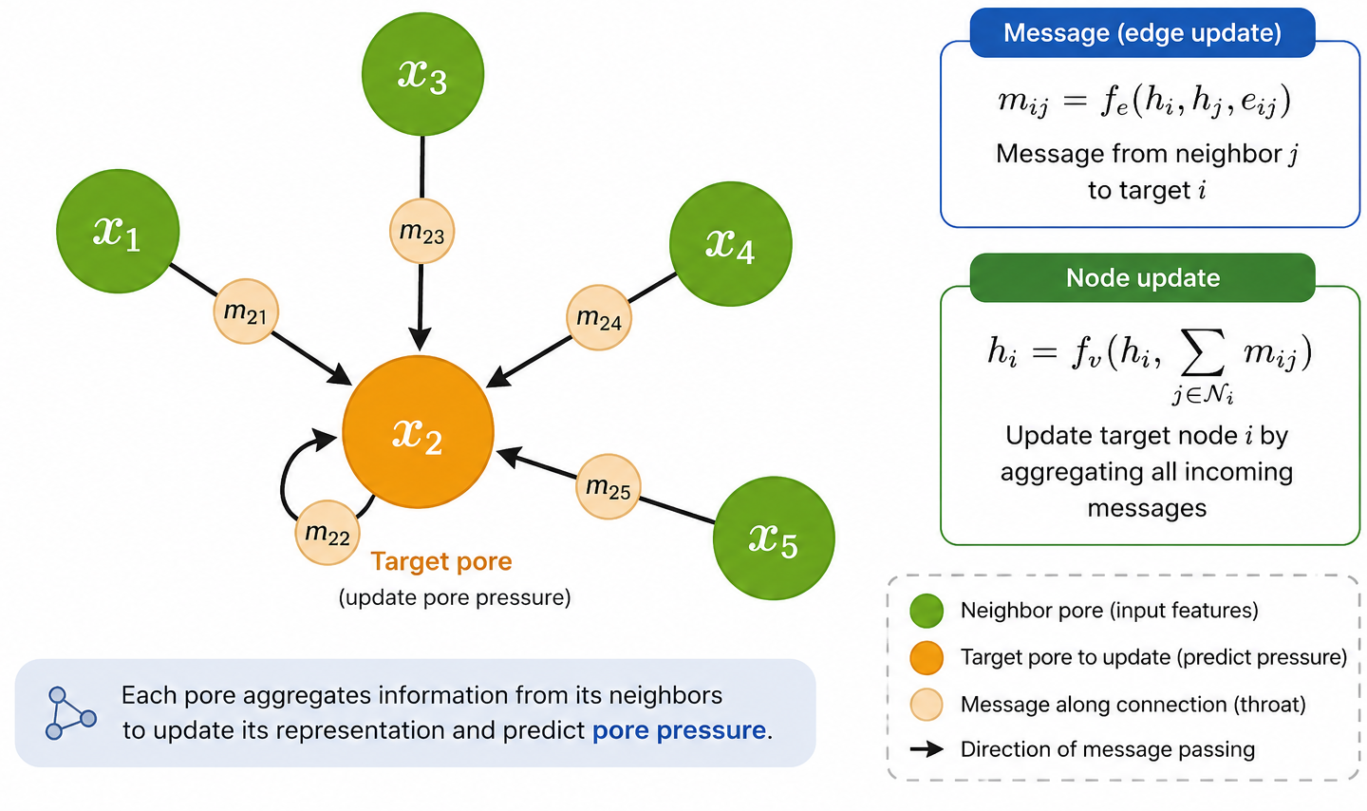
Why did we utilize GNNs?
Why GNNs?
Graph-structured pore networks
Size-invariant learning
Works on variable network sizes
Upscaling

Slide 8
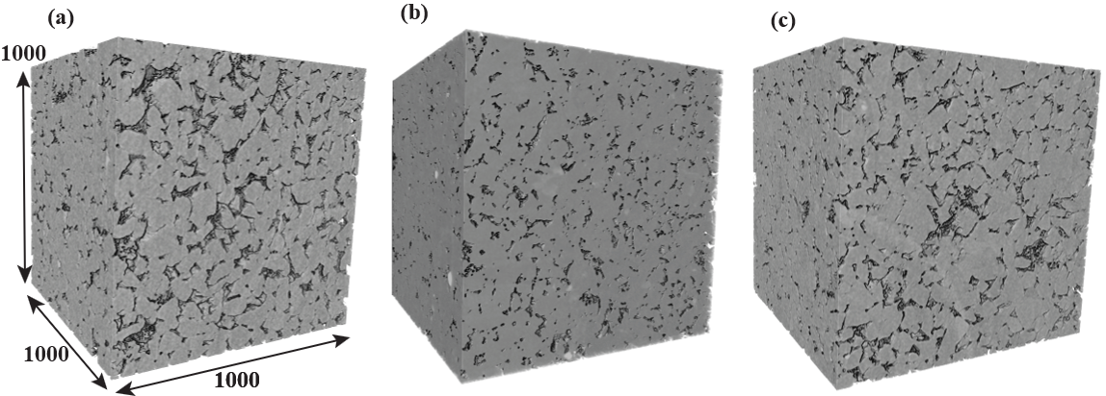
Modeling
The modeling was carried out for various GNN models, including:
  GCN
  GAT
  GIN
  GraphSAGE
  NNConv
The samples from 3 sandstones were used for modeling and evaluation.
Bentheimer
Berea
CastleGate
Notes:
GCN: Uses a fixed normalized neighbor averaging. GAT: Lears attention weights for neighbors. GIN: Uses sum aggregation + MLP, strong for graph structure discrimination. GraphSAGE: Samples/aggregates neighbors efficiently for large graphs. NNConv (your model): Edge attributes dynamically generate the message weights via an MLP. Very good when edge features are important.

Slide 9
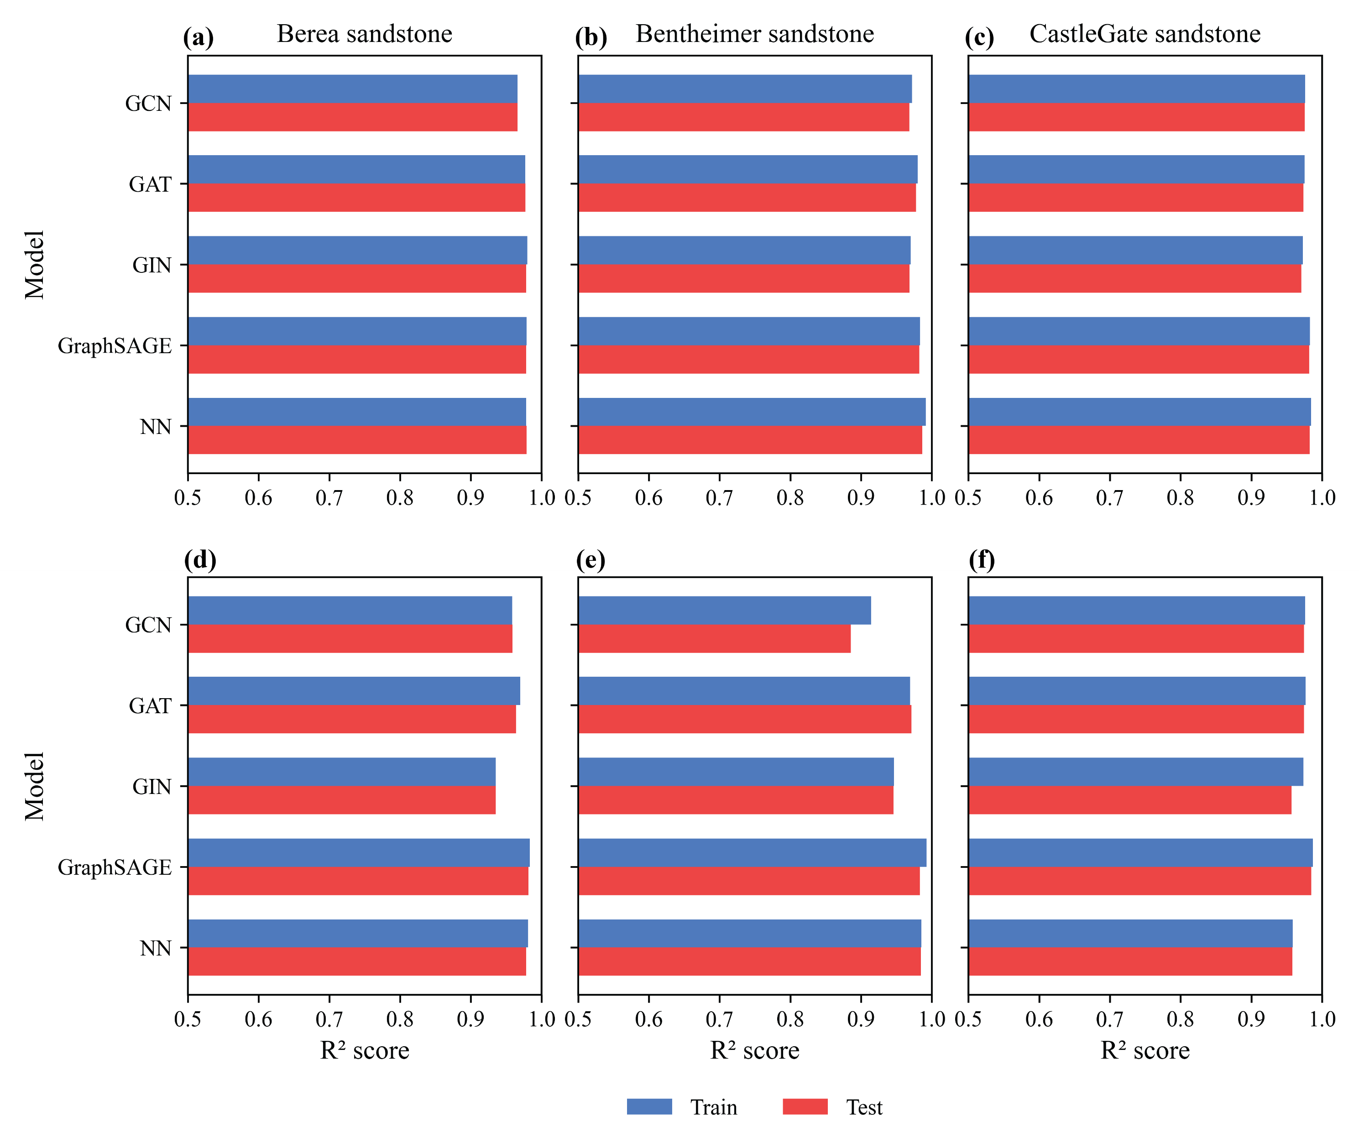
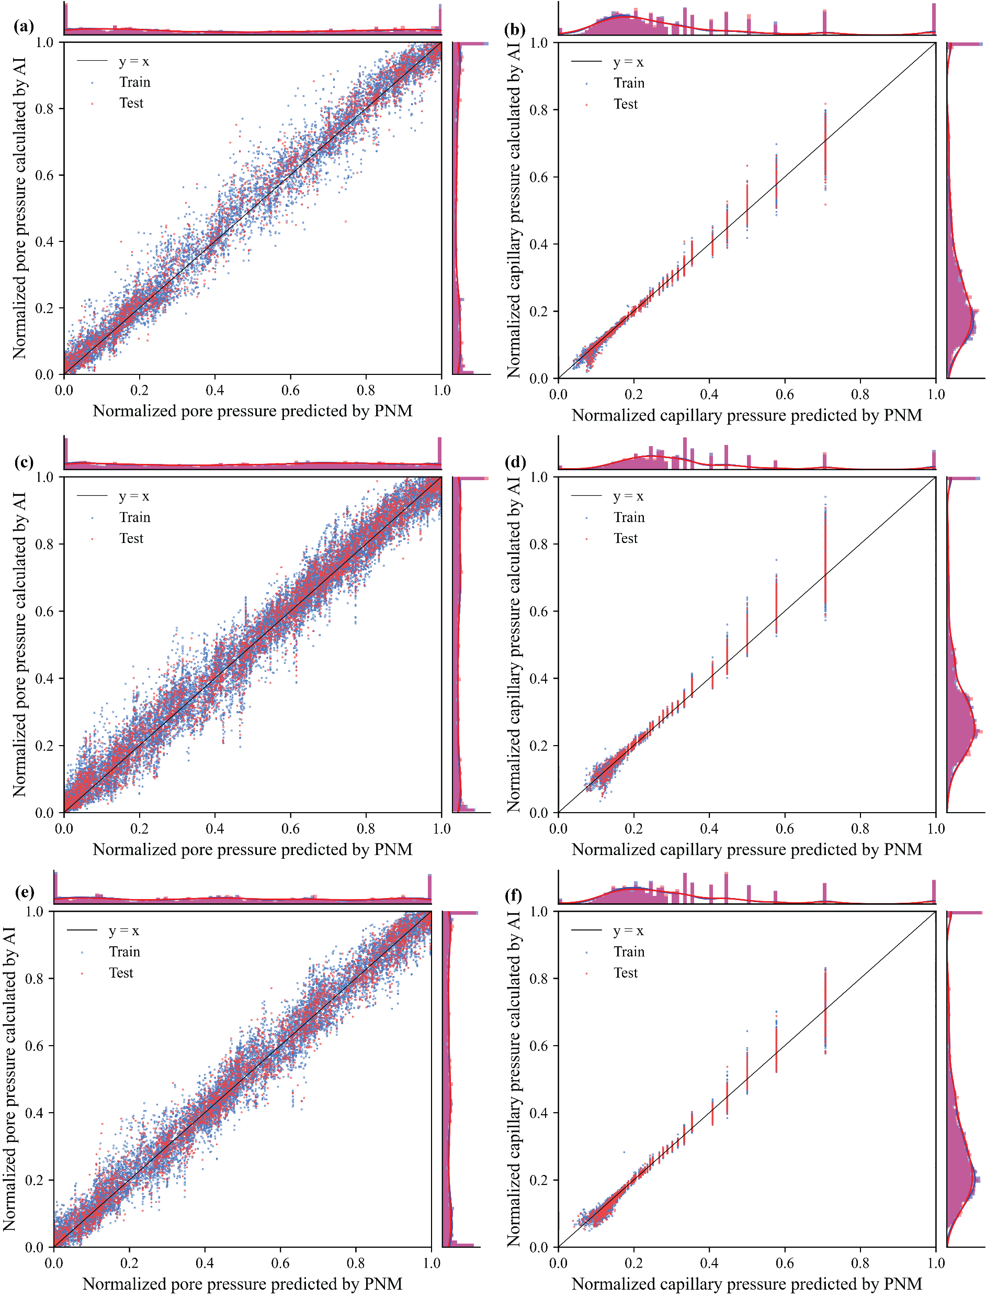
Evaluation
Training performance
Pore pressure training performance – R-squared
Are GNN models able to be trained for pore-level prediction?
Framework performance for Castle Gate sandstone
Invasion pressure training performance – R-squared
Pore pressure
Entry pressure
GNN predicted
GNN predicted
PNM calculated
PNM calculated

Slide 10
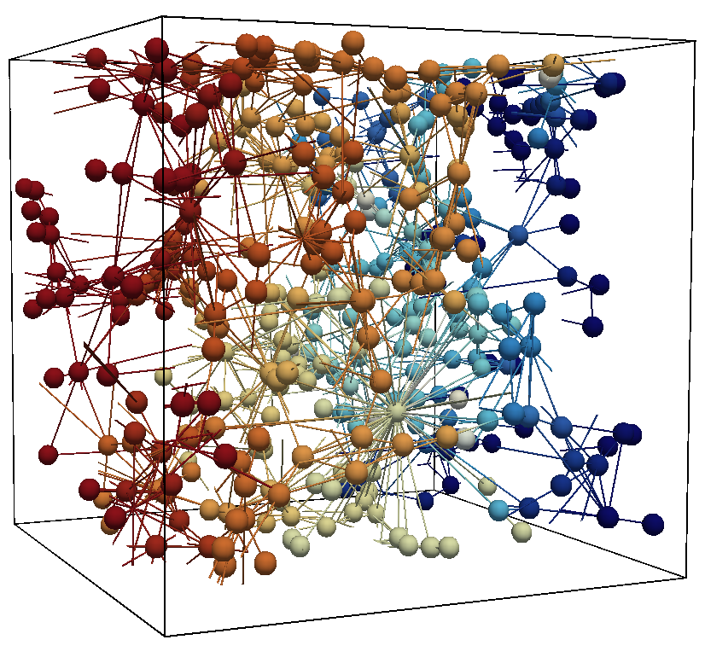
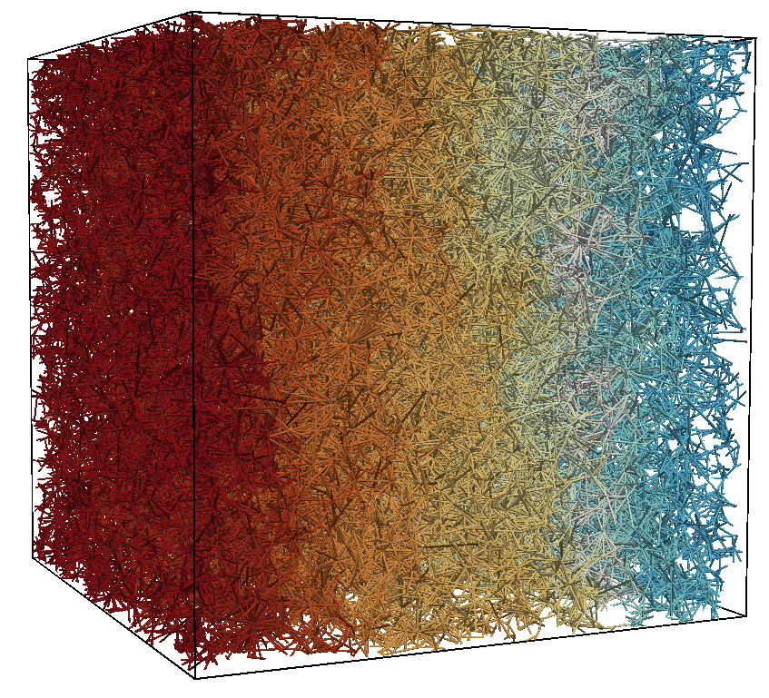
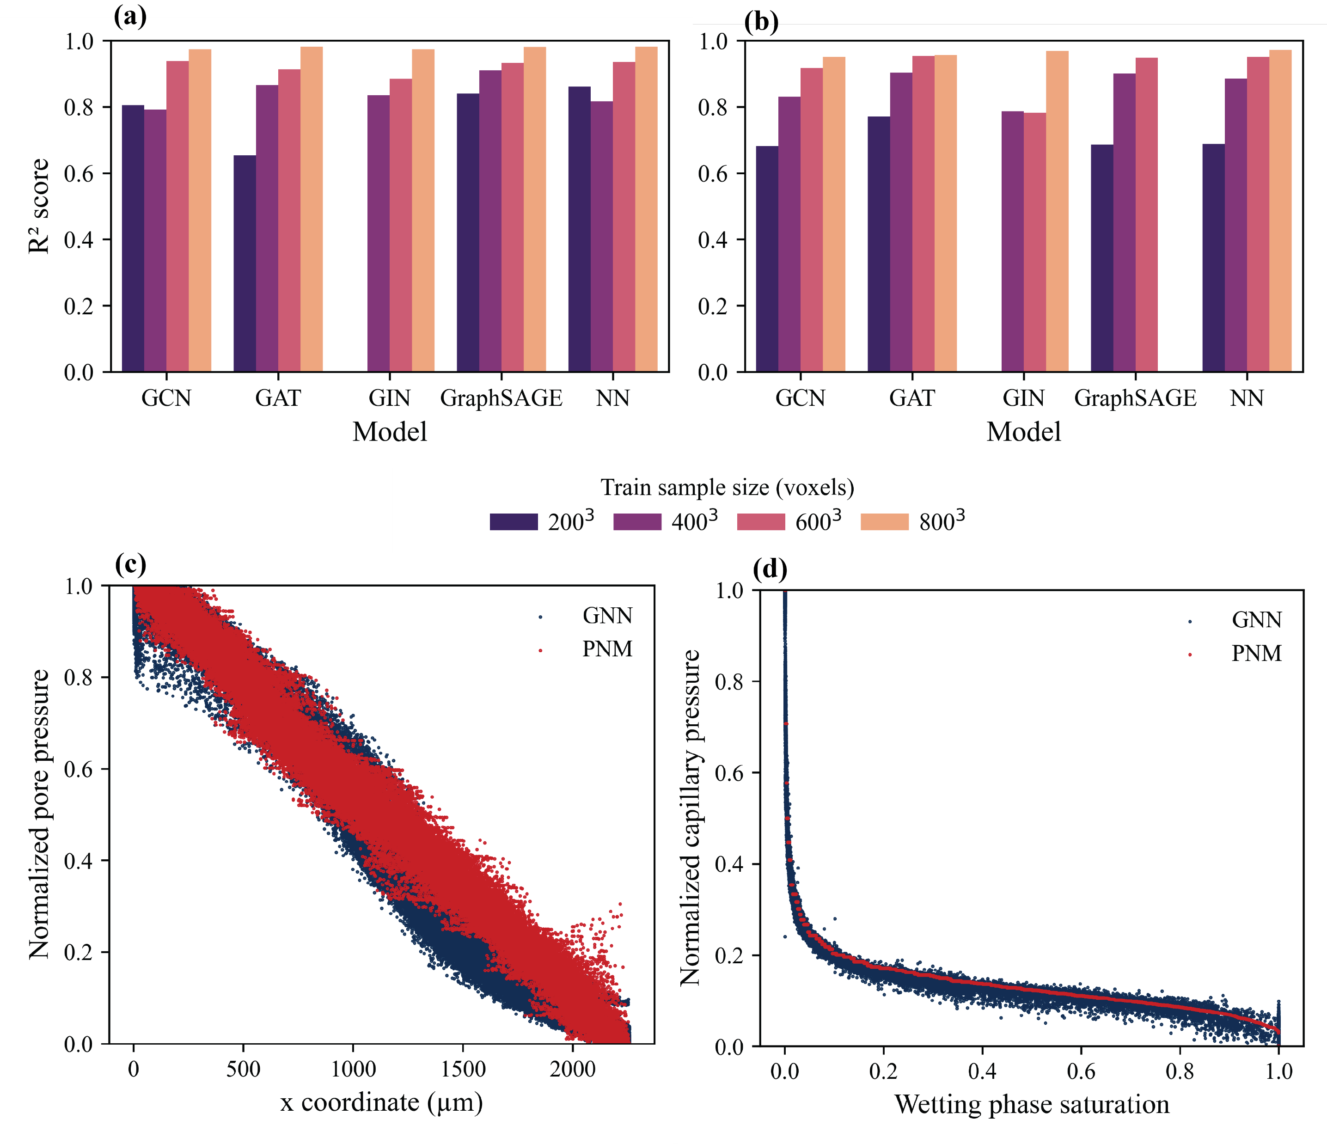
Evaluation
Upscaling performance
Can the models trained on small samples be used for prediction of large samples?
Framework performance for Bentheimer sandstone
Pore pressure upscaling
Entry pressure upscaling
Train sample size
Pore pressure upscaling
Entry pressure upscaling
Prediction sample size
1000³
Train sample size: 600³
Prediction sample size: 1000³

Slide 11
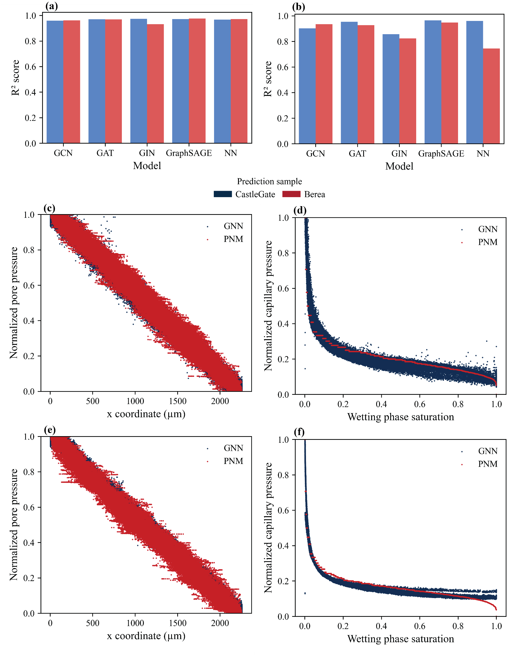
Evaluation
Generalization capability
Framework performance transfer learning
Can the models trained on a sample be used for prediction in another samples?
Pore pressure
Entry pressure
Train sample
Bentheimer
Pore pressure prediction
Entry pressure prediction
Prediction sample
Train sample: Bentheimer
Prediction sample: Berea

Slide 12
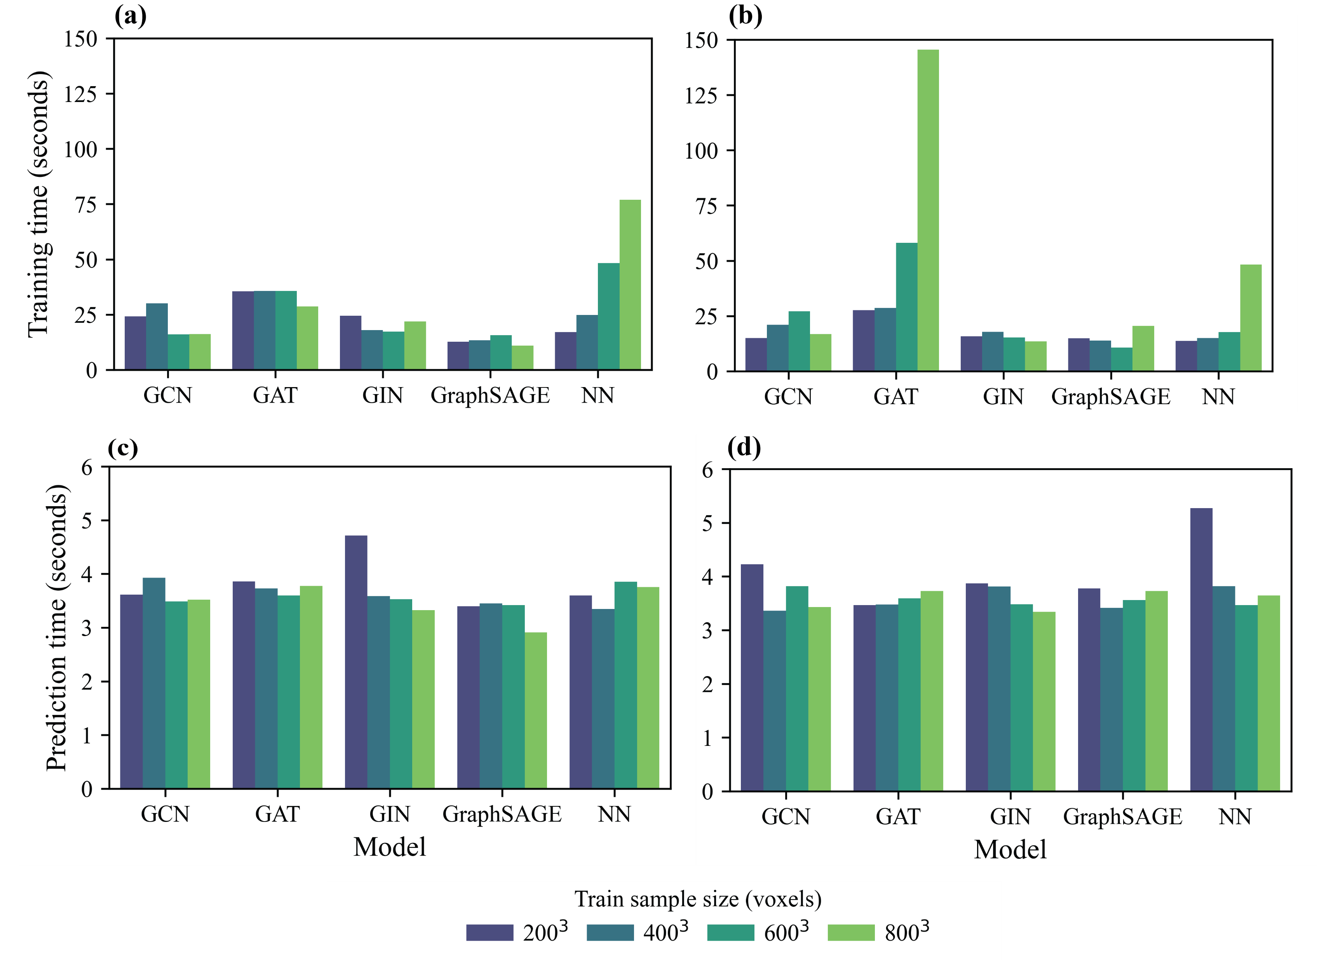
Evaluation
How much time does the prediction take?
Pore pressure
Entry pressure

Slide 13
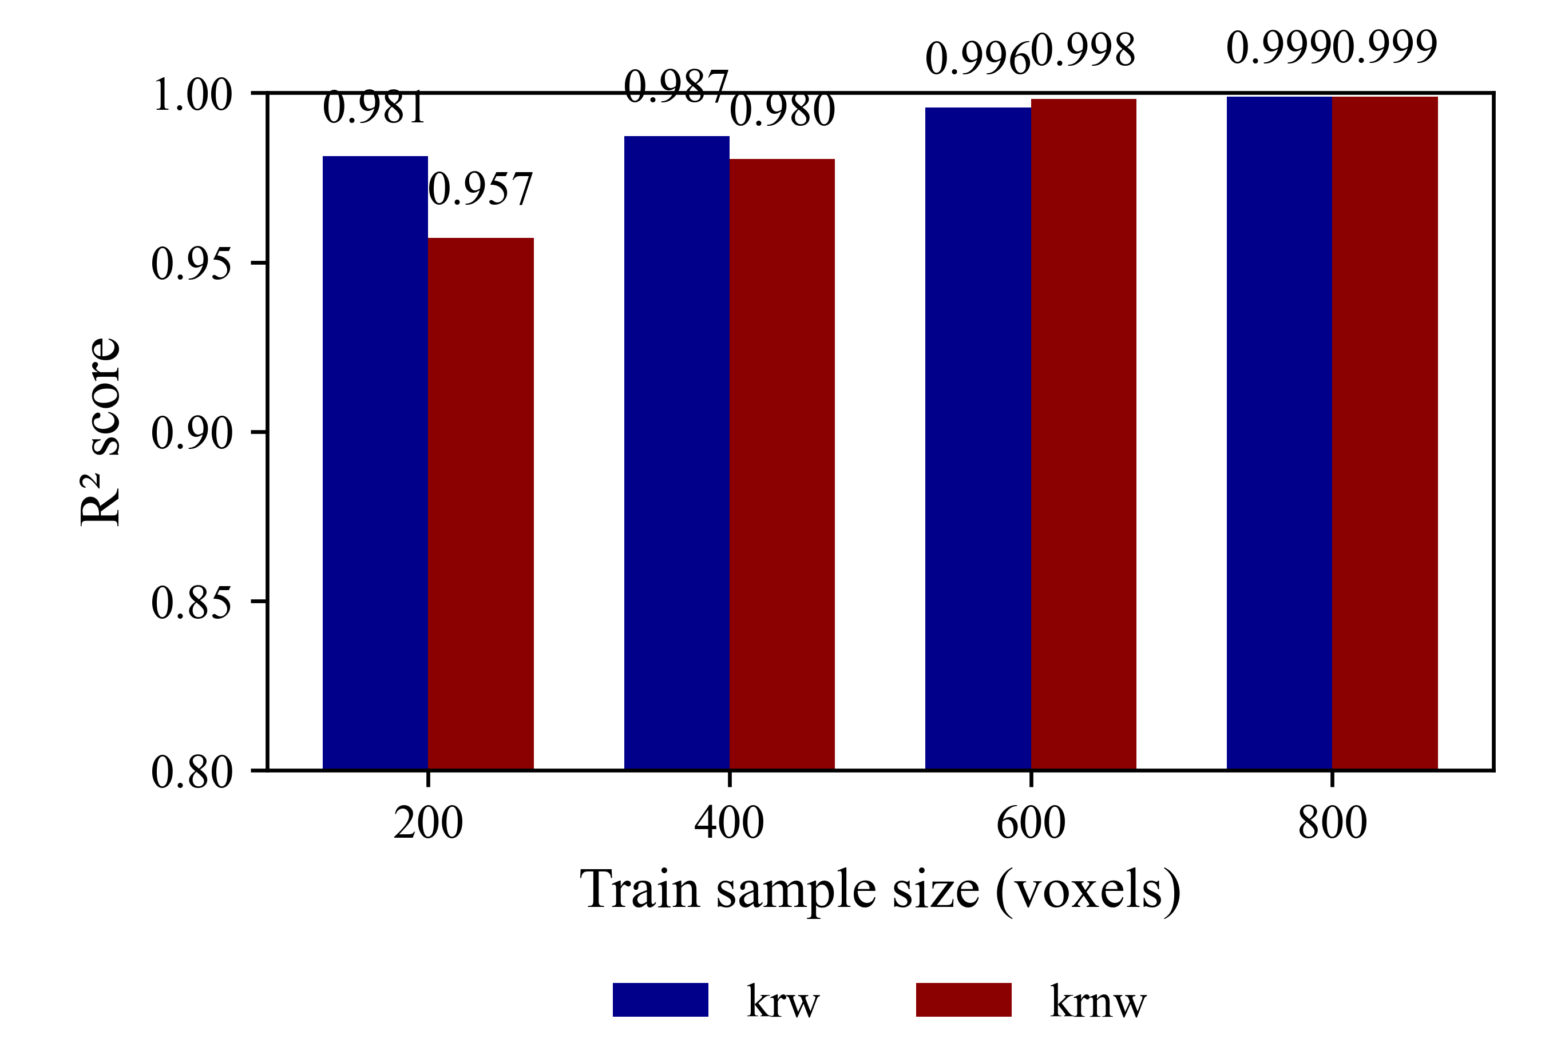
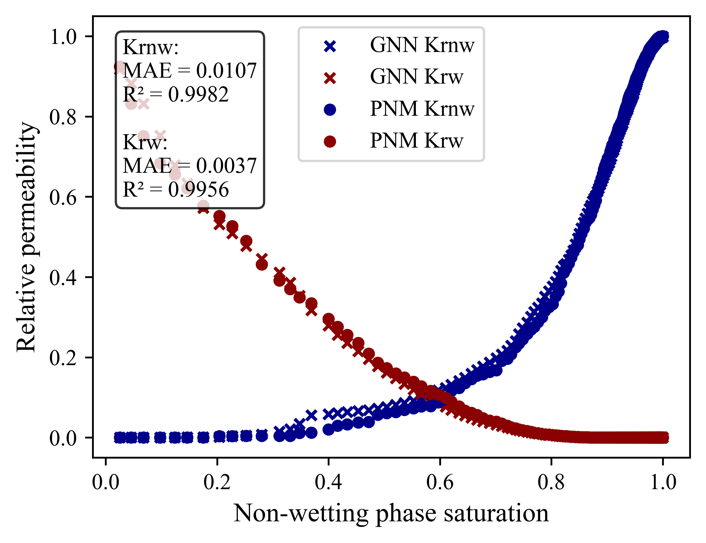
Future work - Relative permeability upscaling
Train sample size:
200
Retrain sample size:
600
Prediction sample size:
1000

Slide 14
Conclusions
This study demonstrates that GNNs can effectively learn the weighted relationships between pores, while accurately predicting pore pressure, entry pressure, and relative permeability.
The trained models show strong potential for upscaling pore-network simulation results, enabling more efficient analysis of complex porous media systems.
In addition, the models exhibit good generalization capability, highlighting their flexibility and reliability in predicting previously unseen data.

Slide 15
Thank you for your attention!
Any questions?

Slide 16
References
Zhao, J., Qin, F., Derome, D., Kang, Q., & Carmeliet, J. (2020). Improved pore network models to simulate single-phase flow in porous media by coupling with lattice Boltzmann method. Advances in Water Resources, 145, 103738.
Mahdaviara, M., Sharifi, M., & Raoof, A. (2023). PoreSkel: Skeletonization of grayscale micro-CT images of porous media using deep learning techniques. Advances in Water Resources, 180, 104544.

