Slide 1


Transparent on-demand neural approximation of EOS-based thermodynamics for pore-scale gas–condensate flow
InterPore - May 20, 2026
G. S. Gerlero, P. Calderano, B. Costa, S. Ribeiro, M. H. Caeiro, G. Ferreira,
J. Casacão, H. Althoff, M. Carvalho

Slide 2

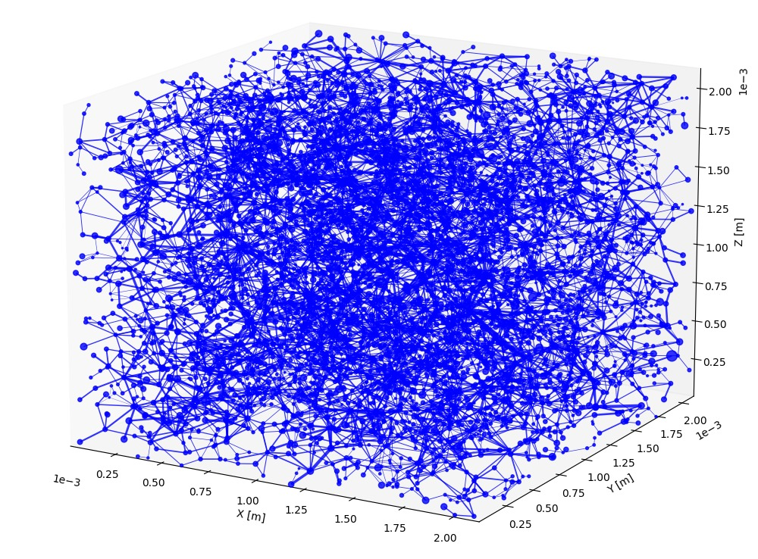
The flash bottleneck
Flash at every pore (grid cell), every timestep/nonlinear iteration
Flash calculations are very numerically expensive
Cost grows with component count and worsens near the critical point
Thermodynamics can easily be the bottleneck of a compositional simulation
Pore network model (PNM)
<number>

Slide 3
Prior ML approaches
Potential for flash acceleration via machine learning techniques already known
C.f. Gaganis & Varotsis (2012), Wang K. et al. (2019), Wang S. et al. (2022)
Existing work trains the models offline
Gap: workflow friction
Precomputed datasets -> no runtime flexibility
Goal: solve for speed, accuracy & deployment at the same time
<number>

Slide 4
The on-demand framework
Check cache
Caller picks EOS and fluid components
Caller chooses P and/or T ranges and/or known composition
Miss
Hit
Needs to be fast!
Train neural networks
Save networks to cache
Serve predictions
Transparent caching of trained networks
Hash covers component properties + EOS + ranges/composition
Resolution order: configurable env variable→__pycache__→OS user cache dir
<number>

Slide 5
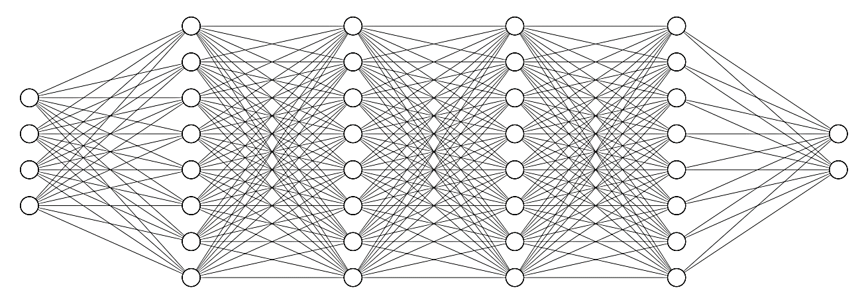
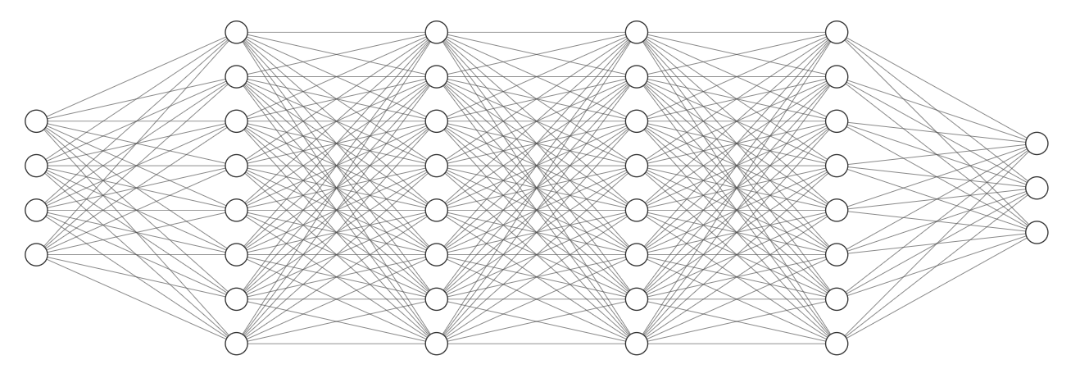
Neural architecture: overview
Always
T (normalized)
P
(normalized)
Probability of single-phase (as logit)
Phase classifier
hidden width = 32
hidden depth = 4
GELU activation
~3.5k learnable params
Composition
(except last)
Probability of gas if single-phase
(as logit)
Only if classifier indicates two-phase
Gas fraction (as logit)
Equilibrium regressor
hidden width = 32
hidden depth = 4
GELU activation
~3.5k learnable params
[Same inputs]
Equilibrium constants (except last, as logarithms)
<number>

Slide 6
Test fluids & training criteria
Fixed composition: 95% C1 + 5% C16
T ∈ [250 K, 350 K]
P ∈ [6.9 kPa, 58.6 MPa]
Variable composition: C1 + C16
T = 360 K
P ∈ [6.9 kPa, 58.6 MPa]
C1: methane
C16: hexadecane
Default training targets
Classifier: 99.5% accuracy single- vs. two-phase, 95% for single-phase ID
Regressor: avg. 0.005 error (weighted by gas fraction for phase compositions)
<number>

Slide 7
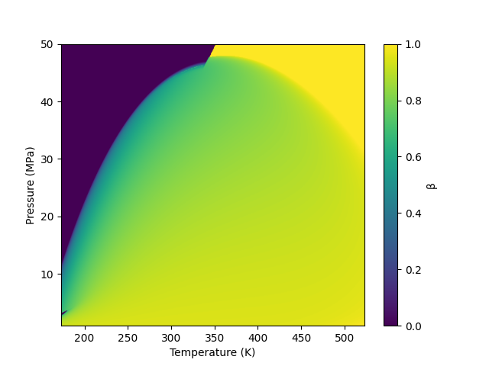
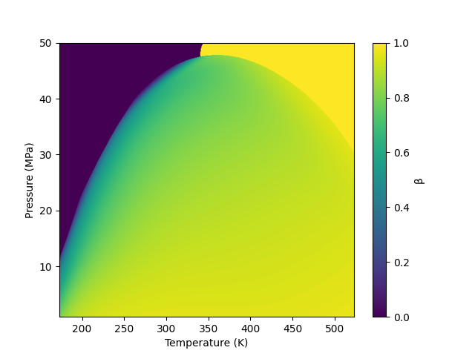
Accuracy I
Fixed composition: showing gas fraction β
Classical numerical
Neural
<number>

Slide 8
Speedup
Training time: ~10 s in all cases
Prediction time: ~0.6 μs in all cases (architecture-bound)
Thermodynamic speedup
Fixed composition A: 147x
Fixed composition B: 110x
Variable composition: 129x
One-time training break-even cost: ~100,000 flash evaluations
<number>
Notes:
Now the other key part: performance. Training took roughly 10 seconds in all cases. Prediction time is 0.6 microseconds, essentially bounded by network sizing. This leads to flash speedups above 100 times, and up to roughly 150x in some cases. Even if it’s the first time we run a mixture and neural training needs to be done, this one-time training cost is recovered after a hundred thousand flash calls, which in realistic compositional simulations is a threshold that can be reached very quickly.

Slide 9
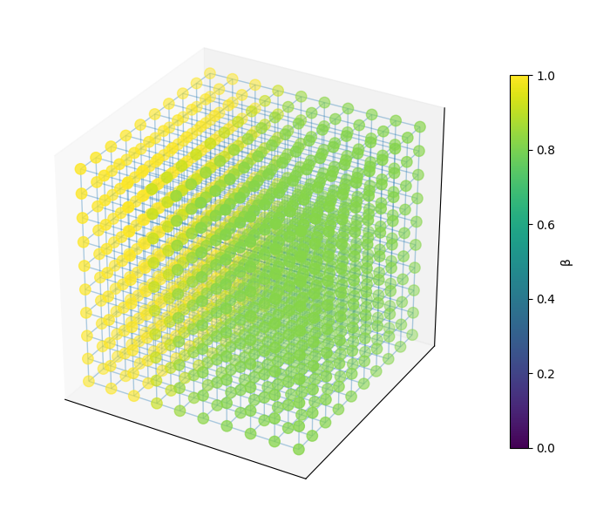
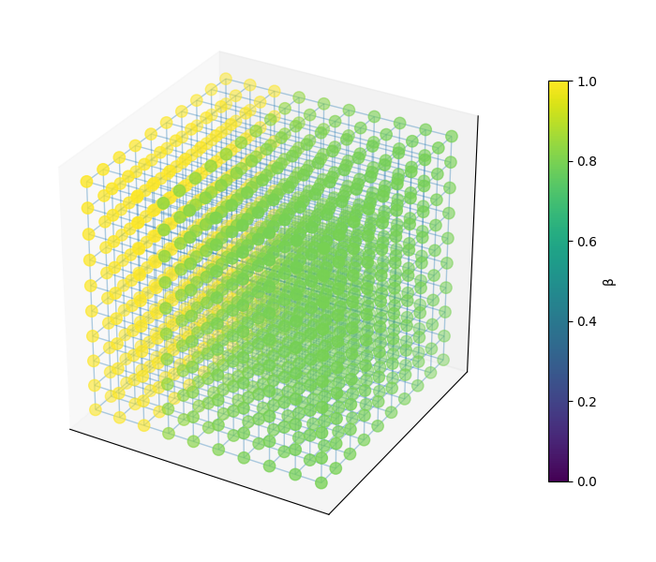
Effect on a PNM simulation
Cubic test pore network (1k pores): showing gas fraction β
flow
flow
6.5x overall speedup
Classical numerical thermo
Neural thermo
<number>

Slide 10
Wrap-up
On-demand training + caching = high transparency
>100x flash speedups with errors within engineering tolerances
Relatively small training dataset (5000 x dof)
Bonus: full differentiability (can help nonlinear flow solvers)
Forward look
Improved training/early-stopping criteria
Adaptive operating range expansion
Automatic network resizing (for high component counts)
<number>

Slide 11









G.S. Gerlero

Slide 12
Classical flash implementation
Our own implementation of a numerical flash within the JAX computational framework for Python
Produces training data for the neural networks
Also usable on its own
Very competitive performance!
Classical EOS-based numerical flash
Rachford–Rice equation
Newton–bisection hybrid
T
Gas fraction
Equilibrium constants
Single-phase stability test
1. Successive substitution
2. BFGS Gibbs fallback
Two-phase flash
1. Successive substitution
2. BFGS Gibbs fallback
Two-phase
Gas fraction & liquid and gas compositions
Composition
P
Single-phase
Phase identification
1. Gibbs energy 2. Phase labeling heuristic
Predicted single phase
(liquid or gas)
<number>
<number>

Slide 13
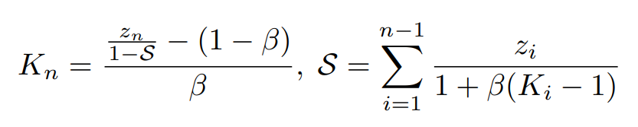
Neural architecture: details
Implemented within the JAX framework
Choice of output variables of regression (gas fraction & equilibrium constants) is critical
Can work with known composition and/or P and/or T
Independent neural networks can be trained concurrently
Last equilibrium constant can be recovered via Rachford–Rice:
(Closed-form expression!)
<number>

Slide 14
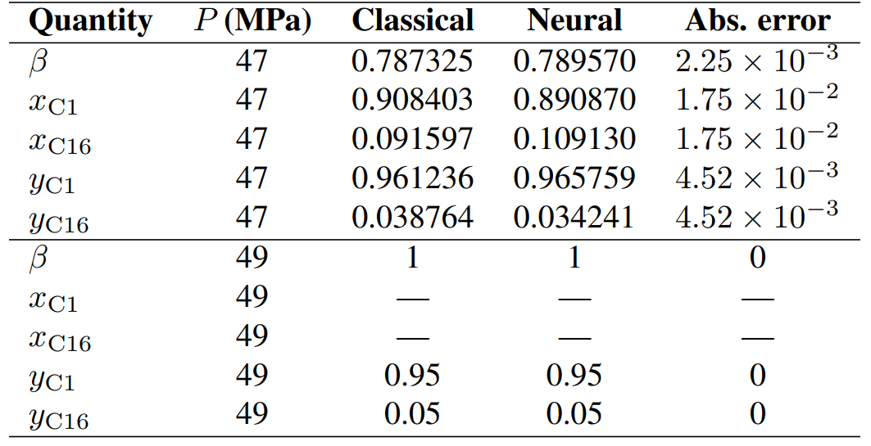
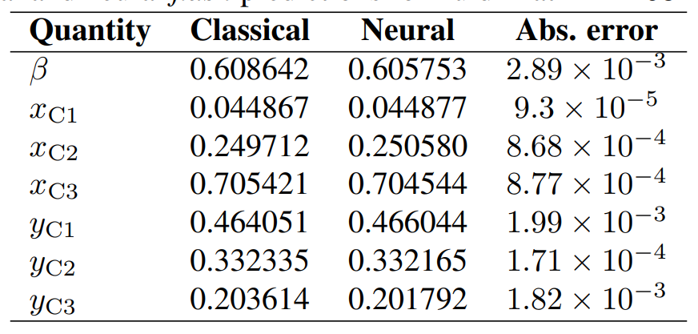
Accuracy II
Errors at specific evaluations
Another fixed composition
Variable composition
Training targets
Classifier: 99.5% accuracy single- vs. two-phase, 95% for single-phase ID
Regressor: avg. 0.005 error (weighted by gas fraction for phase compositions)
<number>

