Slide 1
Residual-Based Physical Informed Neural Network Modelling for Coupled Transport Phenomena in Porous Gas Diffusion Layers
Hui Zhang, Dr.Bo Li, EEMG, 16/05/2026

Slide 2

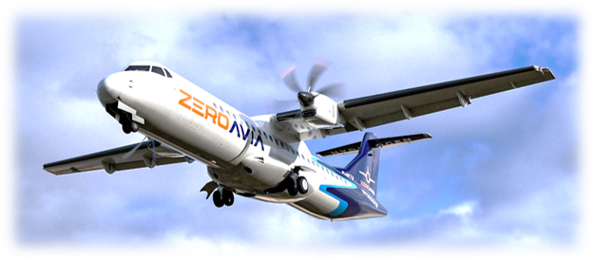
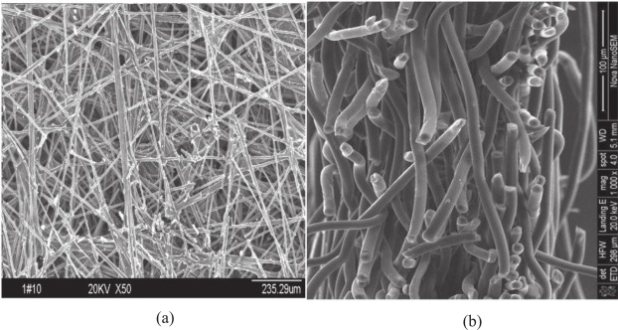
INTRODUCTION
Decarbonization has become a priority for nations worldwide.
3% of global CO2 emissions and 12% of transport emissions [1]
High-Temperature Proton Exchange Membrane Fuel Cells (HT-PEMFCs)
Reactant transport, water management, pressure distribution, electron conduction [2-4]
Fig.1 ZeroAvia Hydrogen-electric regional aircraft​
Experiments cannot fully capture in-situ multi-physics behaviour. [5]
CFD is accurate but too computationally expensive.
AI models struggle with generalization, physics consistency, and convergence. [6, 7]
How to rapidly predict coupled physical fields inside the GDL while maintaining physical consistency and convergency efficiency?
Fig.2 Gas diffusion layer (GDL) structure
INTRODUCTION
METHODOLOGY
RESULTS
CONCLUSIONS
Notes:
Aviation today contributes around 3% of global CO₂ and 12% of transport emissions, and without intervention these could triple by 2050. PEMFCs are one of the most credible candidates to decarbonise this sector — and inside a PEMFC, the gas diffusion layer is the component that governs how reactants, water, electrons, and pressure are distributed across the cell.
快，但不物理"与"物理，但不快

Slide 3
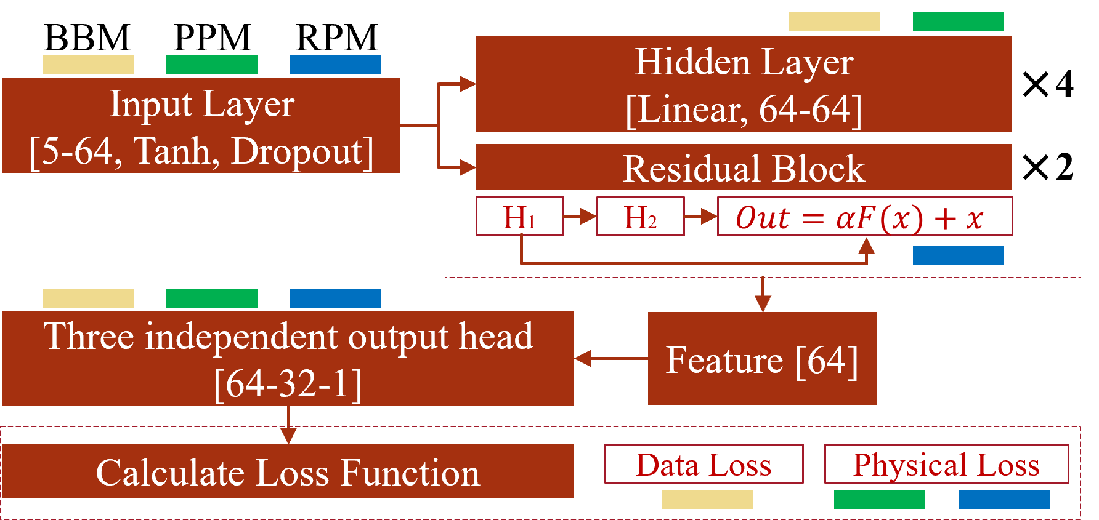
INTRODUCTION
Research Objectives:
Develop a fast, accurate, and generalizable multi-physics prediction model for the PEMFC hydrogen-side GDL.
Compare RPM with PPM and BBM in accuracy, generalization, and efficiency.
Innovations：
Residual connections improve PINN convergence under multi-physics coupling.
Learnable scaling coefficient α stabilizes training.
Coupled output architecture explicitly encodes pressure–concentration physics.
Fig.3 Structural comparison of black-box model (BBM), pure physics-informed neural network model (PPM) and residual-based physics-informed neural network model (RPM)
INTRODUCTION
METHODOLOGY
RESULTS
CONCLUSIONS

Slide 4
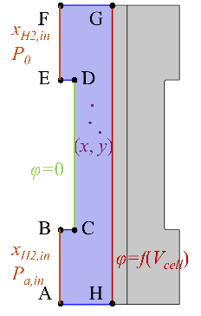
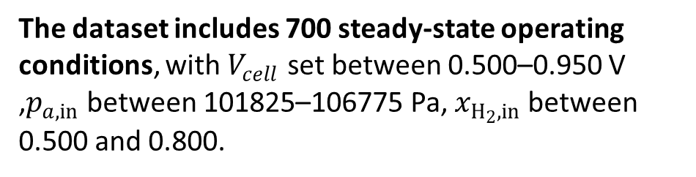
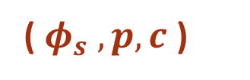
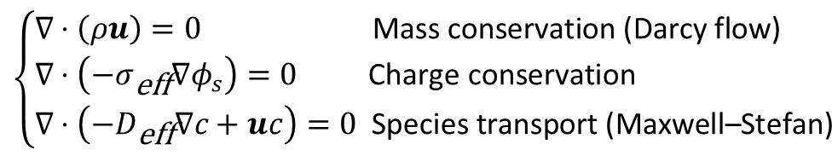
METHODOLOGY
COMSOL Application Gallery Case 38 (“Species Transport in the Gas Diffusion Layers of a PEM”).
This model couples charge, mass, and momentum transport in the PEMFC：
Geometry dimensions:
AB = EF = 0.5 mm CD = 1 mm GH = 2 mm AH = FG = 0.35 mm BC = DE = 0.1 mm
Boundary conditions:
AB & EF: gas inlets (specified mole fraction and pressure)
CD: reference potential boundary (V = 0)
GH: GDL–catalyst layer interface
$$\left\{\begin{aligned}&∇⋅\left(ρu\right)=0 \text{Mass} \text{conservation}\text{ (}\text{Darcy} \text{flow}\text{)} \\ &∇⋅\left(−σ_{\text{eff}}∇φ_{s}\right)=0 \text{Charge} \text{conservation} \\ &∇⋅\left(−D_{\text{eff}}∇c+uc\right)=0 \text{Species} \text{transport}\text{ (}\text{Maxwell}\text{–}\text{Stefan}\text{)}\end{aligned}\right.$$
( $φ_{s} , p, c$)
The dataset includes 700 steady-state operating conditions, with $V_{cell}$ set between 0.500–0.950 V ,$p_{a,in}$ between 101825–106775 Pa,$x_{H_{2},in}$ between 0.500 and 0.800.
Fig.4 CFD Geometry and computational domain for the hydrogen-side GDL
INTRODUCTION
METHODOLOGY
RESULTS
CONCLUSIONS
Notes:
The geometry of the reference case is shown in Figure 1, where the blue region represents the hydrogen-side GDL domain considered in this study.

Slide 5



METHODOLOGY
Black-Box Model (BBM): A purely data-driven model without physical constraints.
Pure Physics-Informed Neural Network Model (PPM): A PINN model embedding governing physics into training.
Residual-based Physics-Informed Neural Network Model (RPM): A residual-enhanced PINN with improved convergence and stability.
($x, y, V_{cell}, P_{a,in}, x_{H2,in}$)
($φ_{s} , p, c$)
Loss Function：
BBM$: ℒ=ℒ_{𝒹𝒶𝓉𝒶}$
PPM$: ℒ=ℒ_{𝒹𝒶𝓉𝒶}+ℒ_{𝓅𝒽𝓎}=ℒ_{𝒹𝒶𝓉𝒶}+ℒ_{𝒫𝒟ℰ}+ℒ_{ℬ𝒞}$
RPM$: ℒ=ℒ_{𝒹𝒶𝓉𝒶}+ℒ_{𝓅𝒽𝓎}=ℒ_{𝒹𝒶𝓉𝒶}+ℒ_{𝒫𝒟ℰ}+ℒ_{ℬ𝒞}$
Introduce the residual structure based on the PPM loss
$$y=x+αF\left(x , \left\{W_{i}\right\}\right)$$
INTRODUCTION
METHODOLOGY
RESULTS
CONCLUSIONS

Slide 6
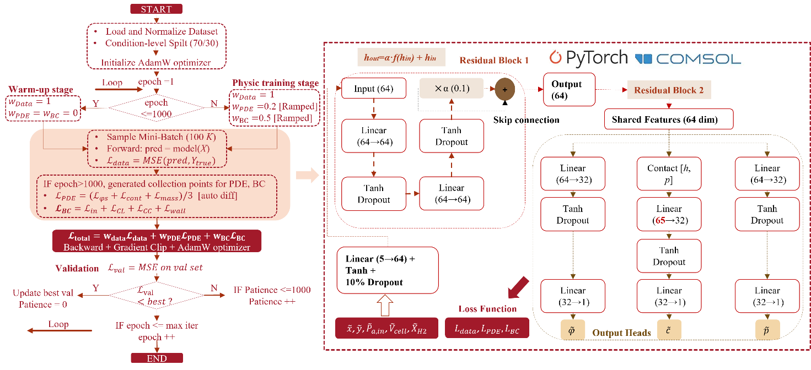
METHODOLOGY
Fig.5 Detail training workflow for residual-based physics-informed neural network model (RPM)
INTRODUCTION
METHODOLOGY
RESULTS
CONCLUSIONS

Slide 7
RESULTS
Six operating conditions were selected for validation, comprising three interpolated conditions within the training domain and three extrapolated conditions beyond it, see Table 1.
Table 1 New test combinations for model performance analysis
Conditions | Parameters [V_{cell}, p_{a,in},x_{H2,in}]
1 | [0.525, 104000, 0.650]
2 | [0.575, 104250, 0.675]
3 | [0.625, 105250, 0.725]
4 | [0.400, 104000, 0.800]
5 | [0.500, 107000, 0.600]
6 | [0.480, 107200, 0.870]
INTRODUCTION
METHODOLOGY
RESULTS
CONCLUSIONS

Slide 8
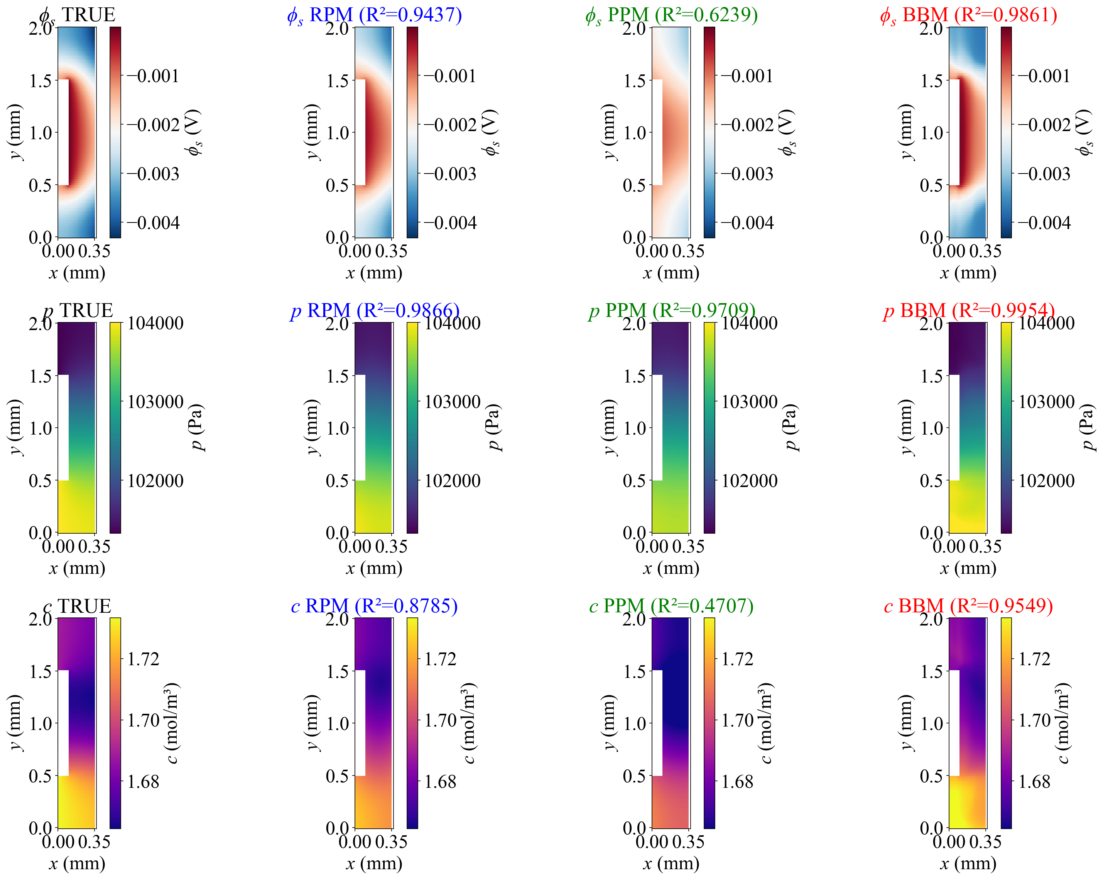
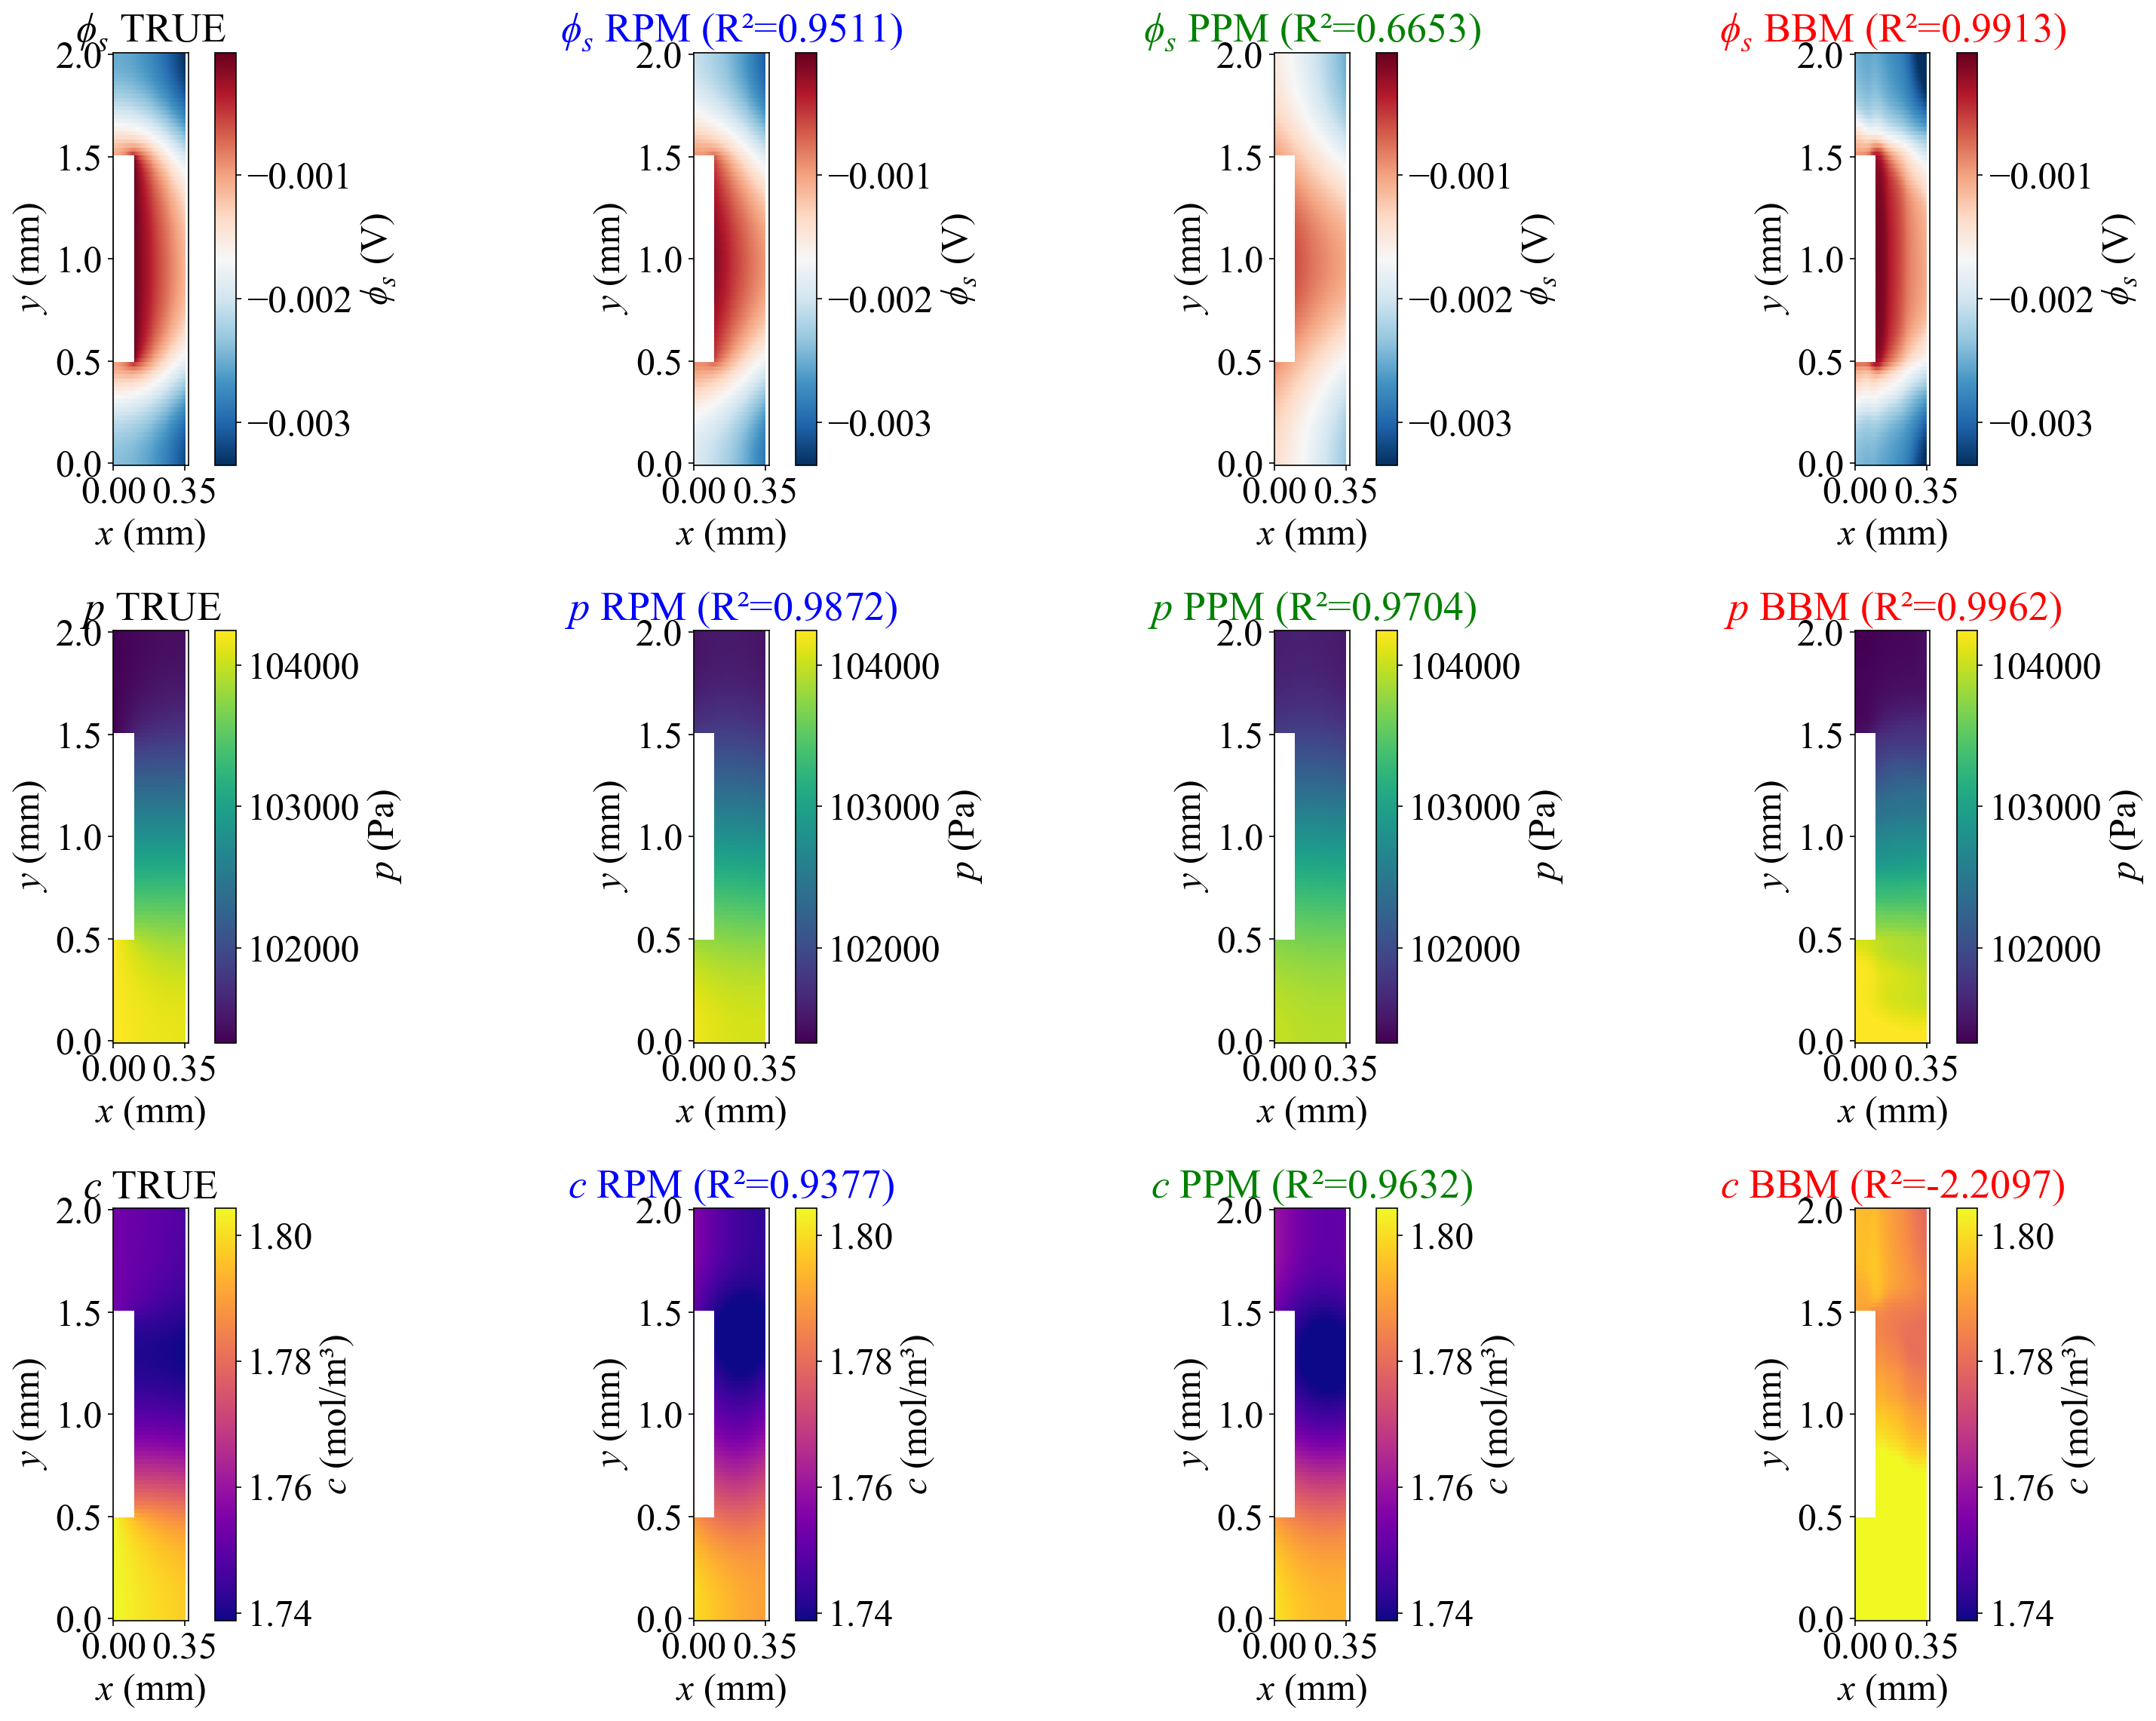
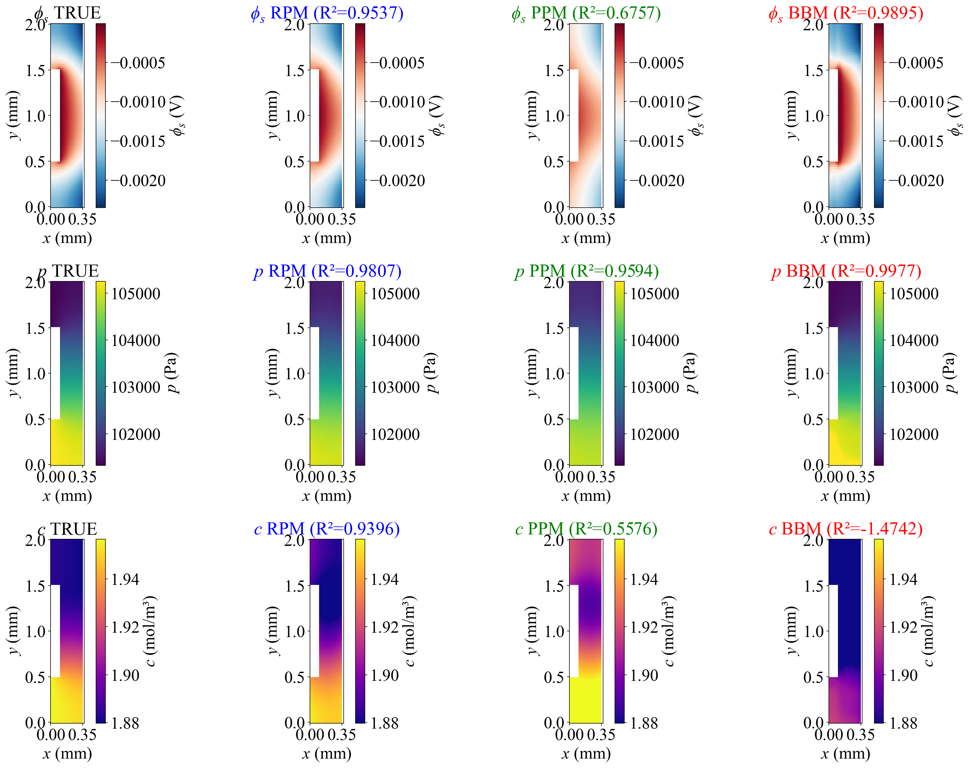
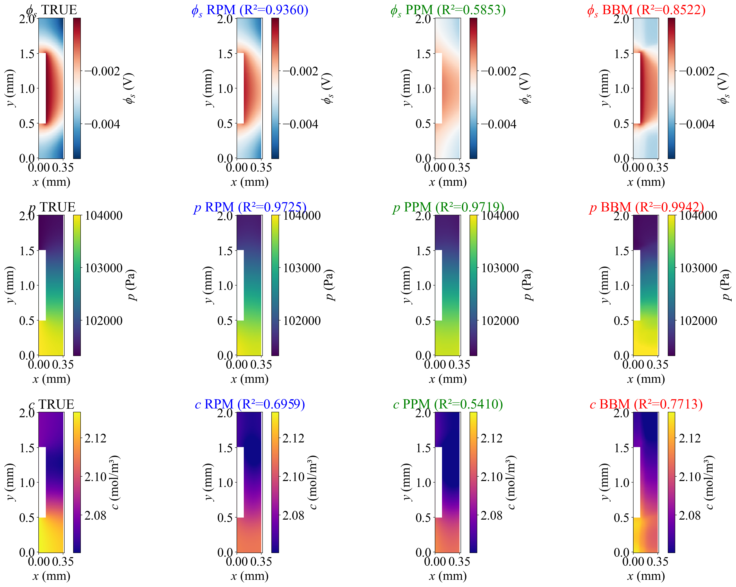
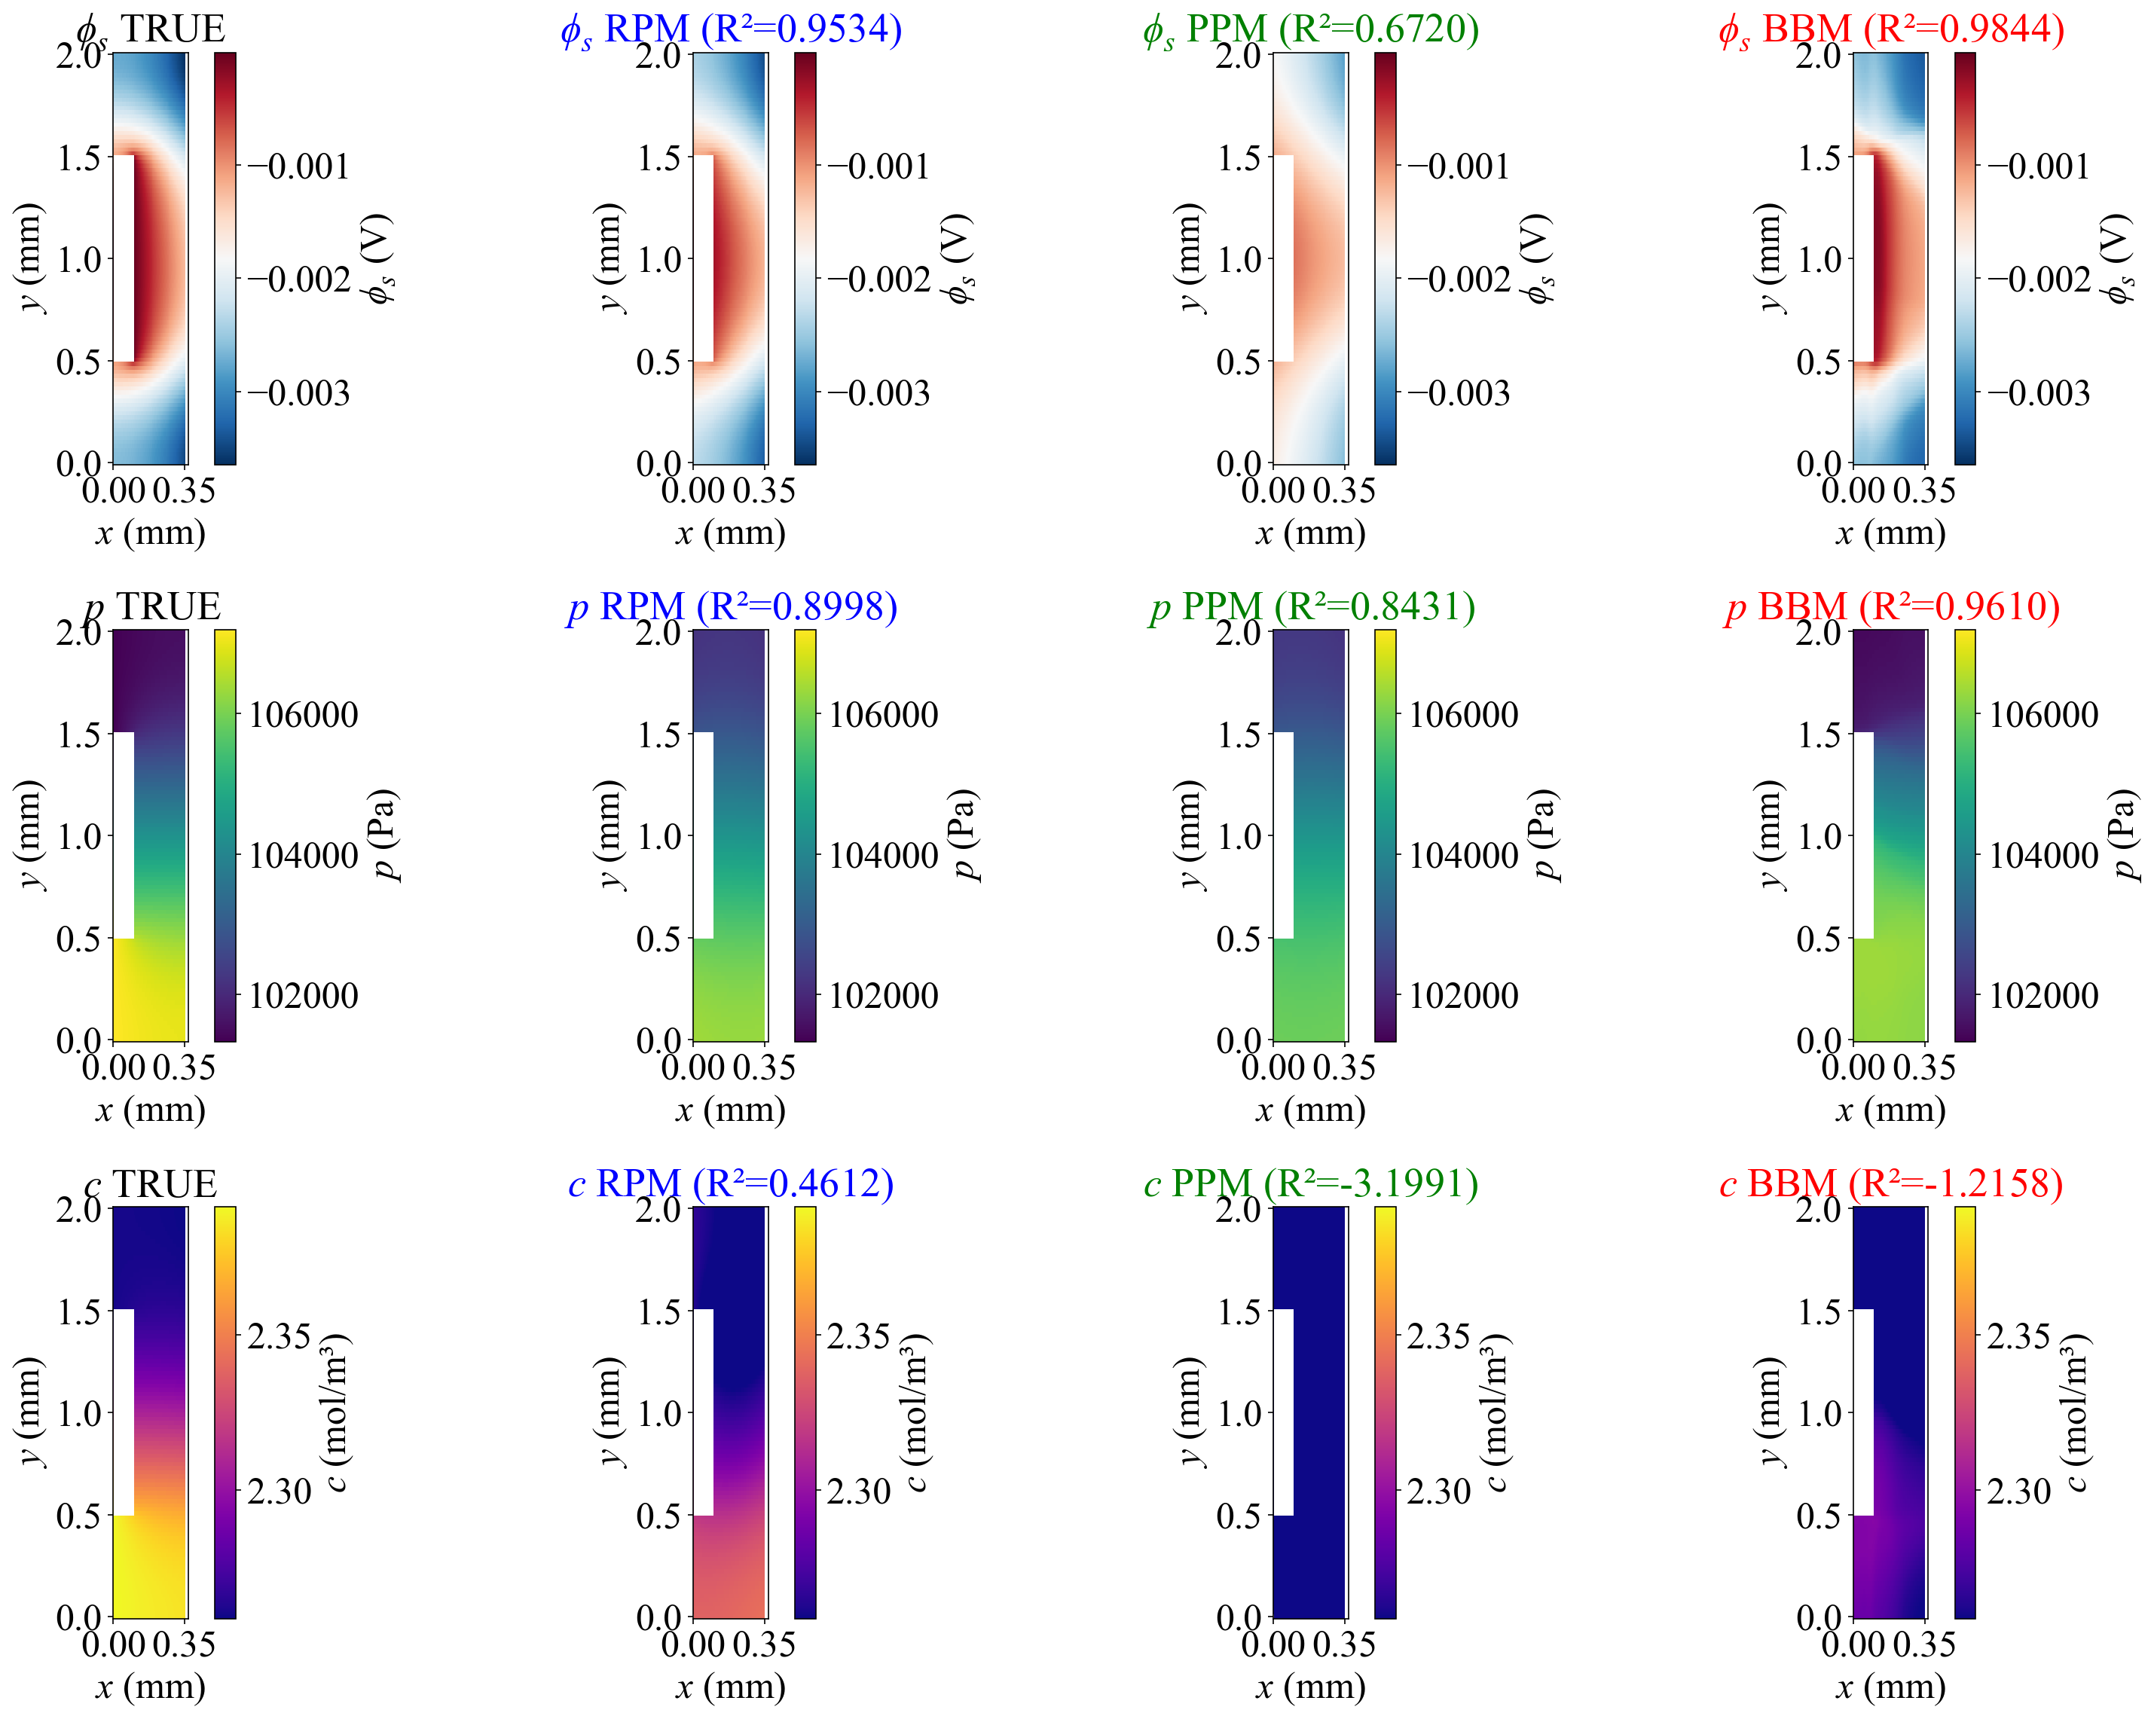
RESULTS
Fig.6 Predicted spatial distributions of physical fields under six conditions
1
2
3
INTRODUCTION
4
METHODOLOGY
5
6
RESULTS
CONCLUSIONS

Slide 9
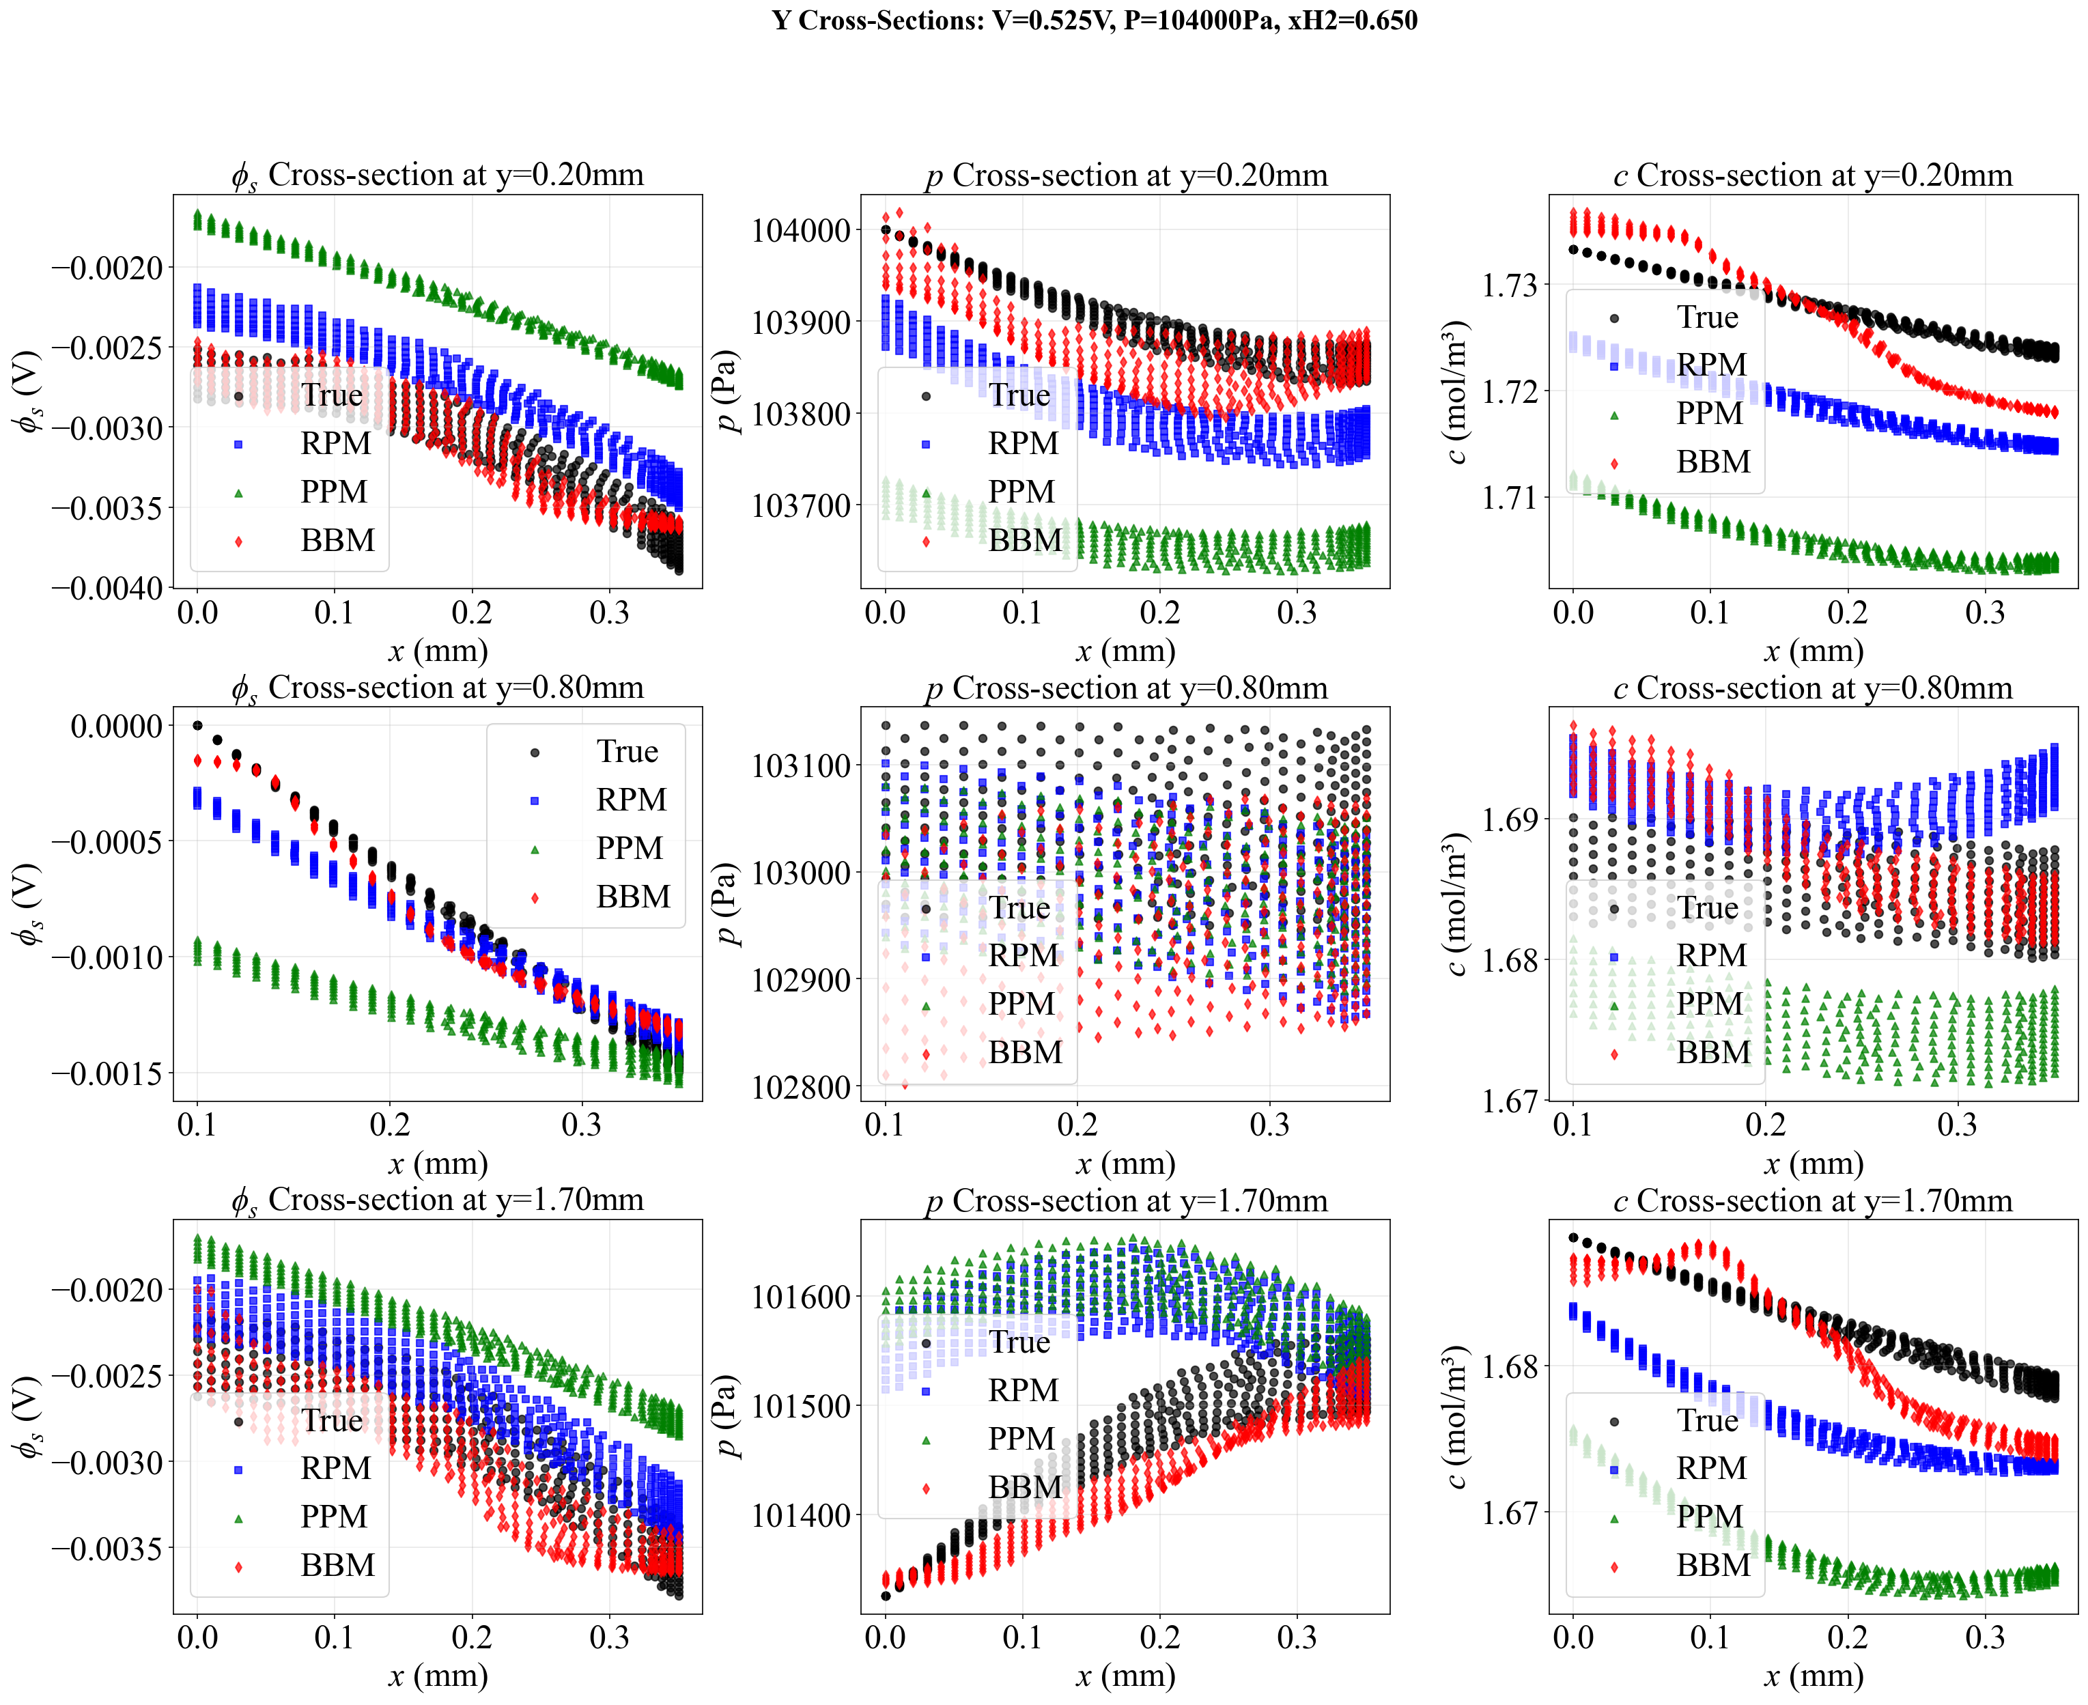
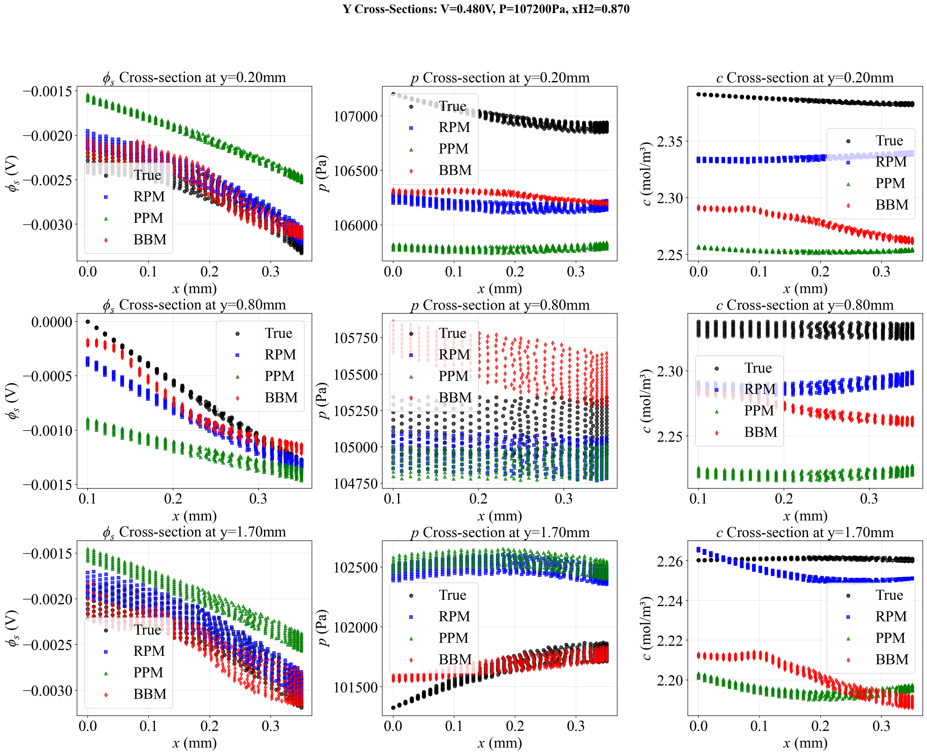
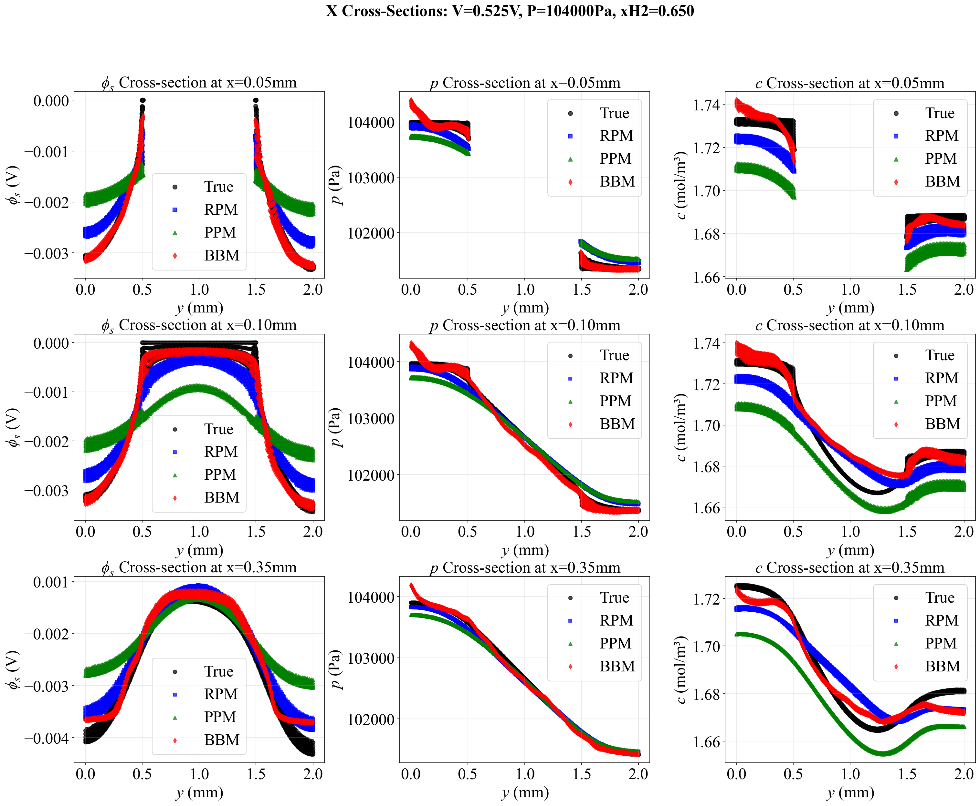
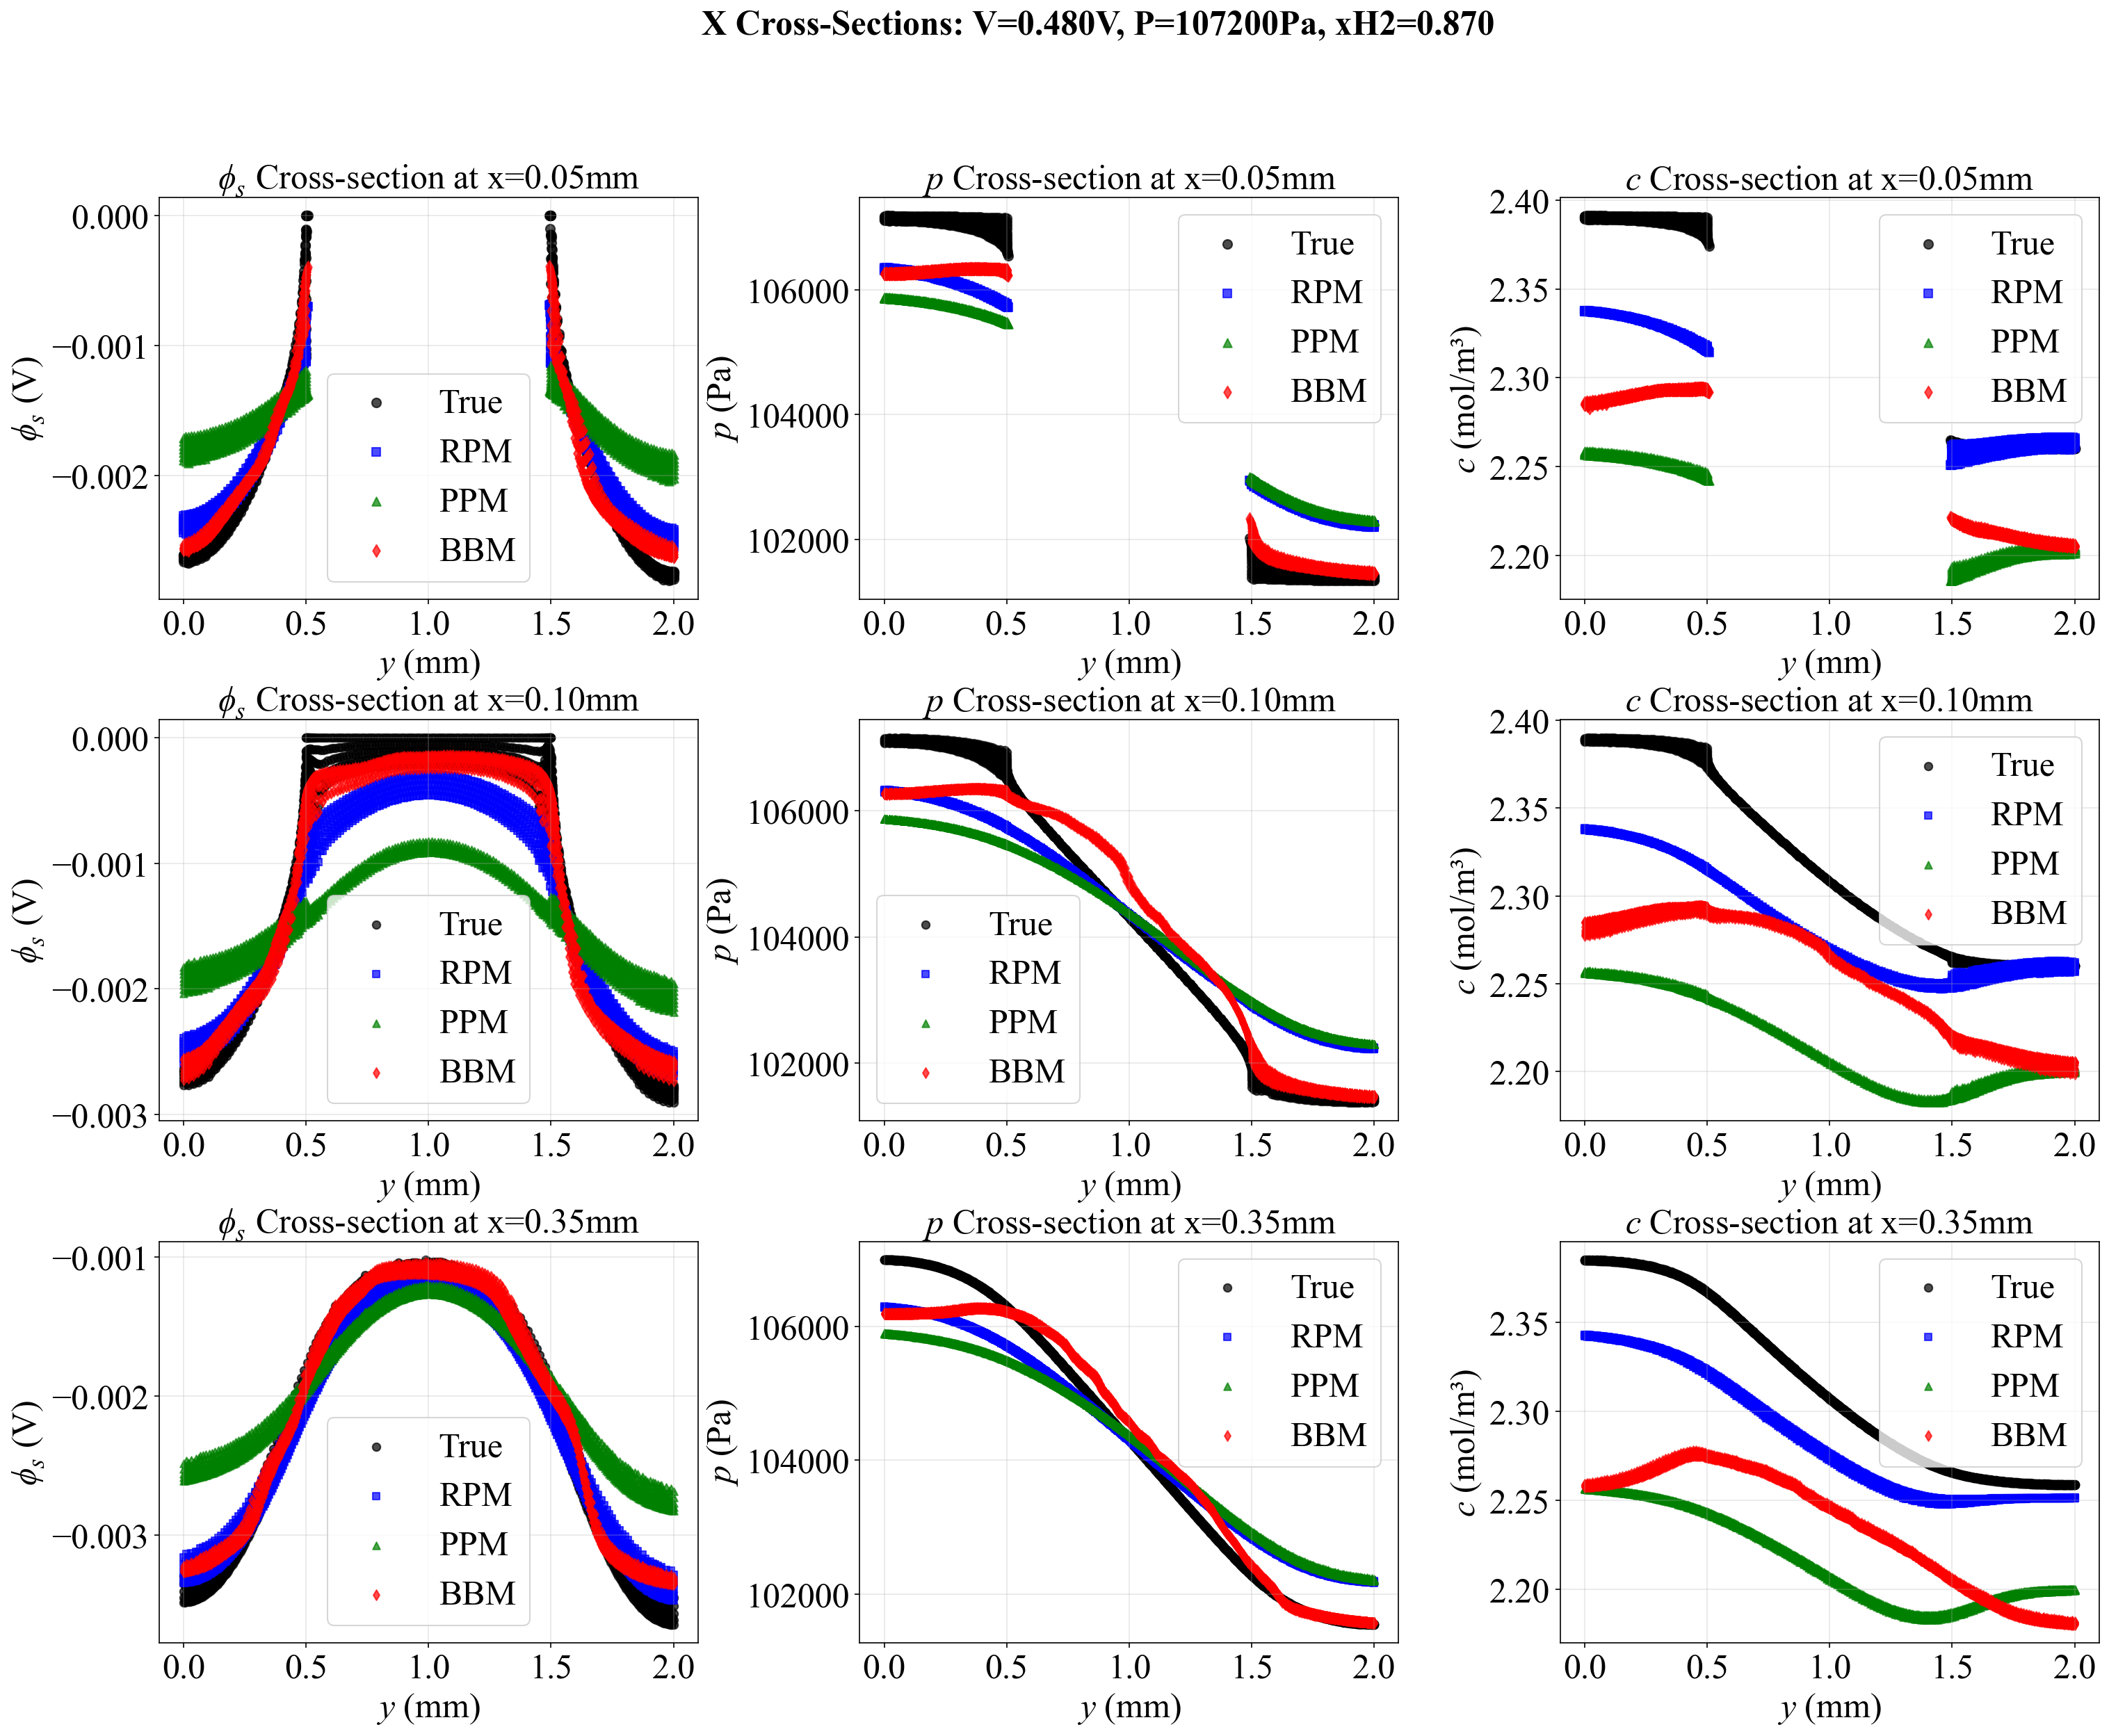
RESULTS
Figure 7 Comparison of predicted profiles along selected cross-sections under representative conditions
Y-direction cross-section
X-direction cross-section
1
6
INTRODUCTION
METHODOLOGY
RESULTS
CONCLUSIONS

Slide 10
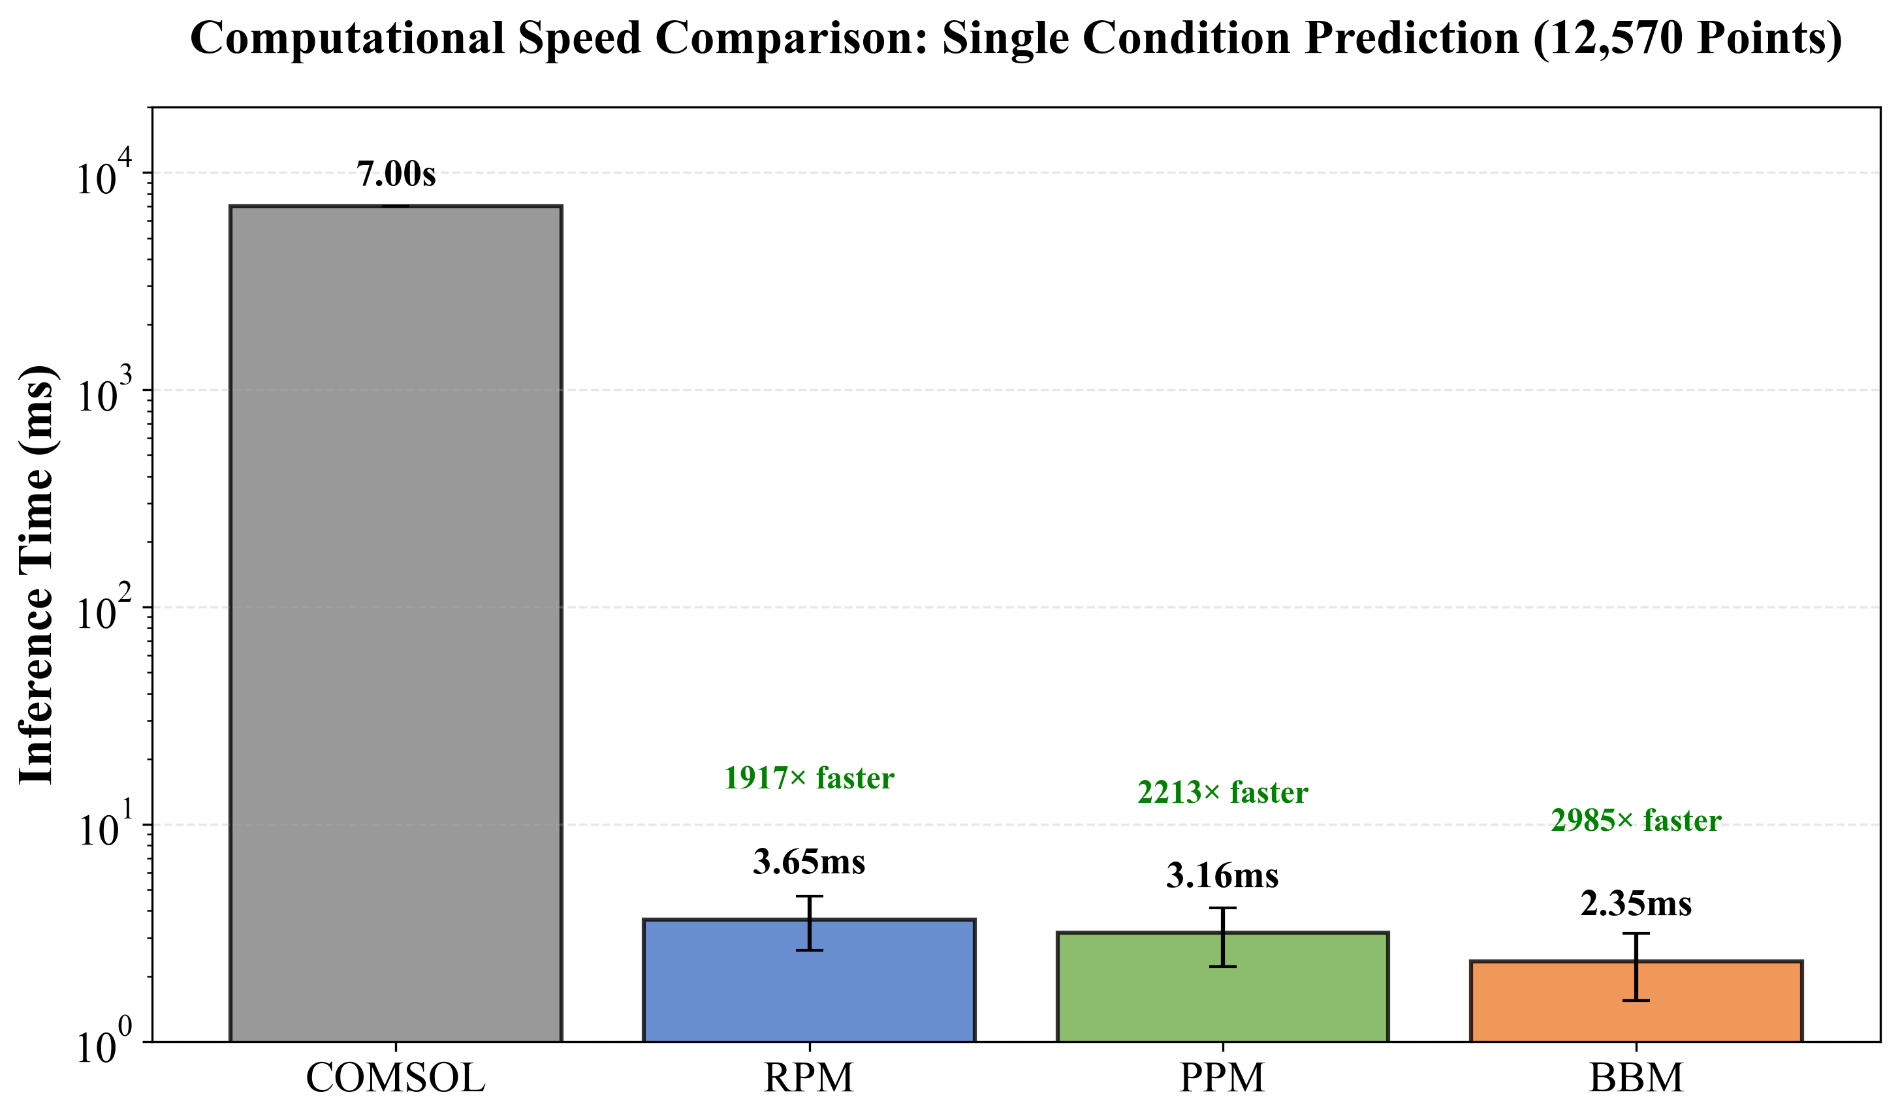
RESULTS
The single-case computation times for RPM, PPM, and BBM were 3.65 ± 1.02 ms, 3.16 ± 0.95 ms, and 2.35 ± 0.80 ms, respectively, achieving approximately 2000 to 3000 times faster processing compared to COMSOL.
Figure 8 Comparison of Computational Speeds for models
INTRODUCTION
METHODOLOGY
RESULTS
CONCLUSIONS

Slide 11
CONCLUSIONS
RPM embeds governing equations into the loss function, providing stronger physical constraints than BBM.
RPM improves convergence stability and efficiency over PPM via residual connections.
RPM is the only model that maintains positive R2 across all test cases and all three physical fields.
RPM enables millisecond-level full-field prediction, supporting real-time monitoring, online optimisation, and rapid control.
2D
3D
INTRODUCTION
METHODOLOGY
RESULTS
CONCLUSIONS
Notes:
RPM effectively overcomes the high computational cost of CFD and the poor extrapolation reliability of BBM, providing a viable framework for real-time, physics-consistent prediction of PEMFC GDL behaviour.

Slide 12
REFERENCES
CO2 Emissions in 2023. https://www.iea.org/reports/co2-emissions-in-2023 (2024).
Taheri, H. R., Shakeri, M. & Zahedi, S. A. Enhancing electrical conductivity and mechanical strength of gas diffusion layers through multi-objective optimization. J. Power Sources 658, 238358 (2025).
Zhu, Y. & Chen, Z. Improvement the performance of PEMFC by the cathode right-angled trapezoidal baffle for aviation applications. Aerosp. Sci. Technol. 168, 111196 (2026).
10. Mi, S., Wei, Z., Cai, L., Xi, X. & Zang, Z. The prediction of the optimal 2D porosity distribution of gas diffusion layer for enhancing PEM fuel cell performance based on convolutional neural network image learning. Int. J. Hydrog. Energy 146, 149971 (2025).
Lian, Y., Zheng, W., Yue, C., Han, S. & Ming, P. Mass transfer capacity degradation of gas diffusion layer under 1000 hours real-world heavy duty load cycles. Int. J. Heat Mass Transf. 223, 125239 (2024).
Sun, J. et al. Artificial-intelligence-guided design of ordered gas diffusion layers for high-performing fuel cells via Bayesian machine learning. Nat. Commun. 16, 6528 (2025).
Tan, S. et al. A Physics-Informed Neural Network framework with strong robustness to low-accuracy physical models for predicting adhesive wear of self-made BNNC milling tool. J. Manuf. Process. 160, 285–301 (2026).
INTRODUCTION
METHODOLOGY
RESULTS
CONCLUSIONS

Slide 13
Thanks!
Hui Zhang, Dr.Bo Li, EEMG, 16/05/2026

