Slide 1
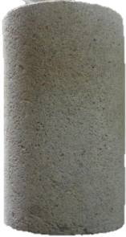
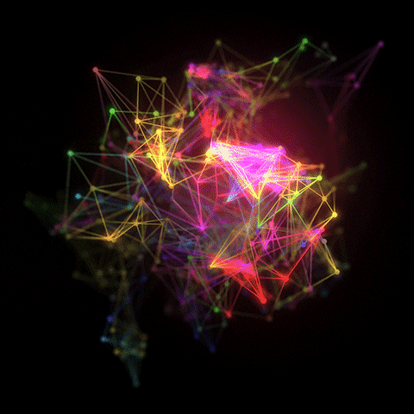
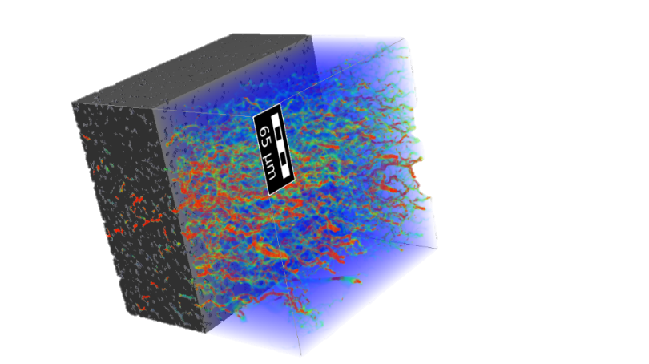


Surrogate Modeling of Particle Retention in Porous Media Enabled by a Massive Pore-Scale Simulation Dataset
Saeid Sadeghnejad¹, Amirhossein Avvali², Frieder Enzmann³, Michael Kersten³, Thorsten Schäfer¹
1- Applied Geology, Friedrich-Schiller-Universität Jena, Germany
2-Department of Petroleum Engineering, Tarbiat Modares University, Iran.
3- Institute of Geosciences, Johannes Gutenberg University, Germany
s.sadeghnejad@uni-jena.de
Notes:
1

Slide 2
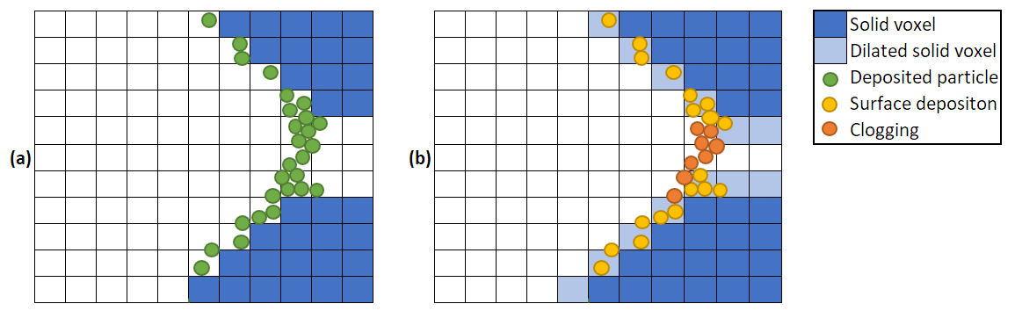
Outlines
Introduction to Particle Transport
Physics-Based Model
Temporal Prediciton φ-K evolution
Training Challanges & Strategies

Slide 3
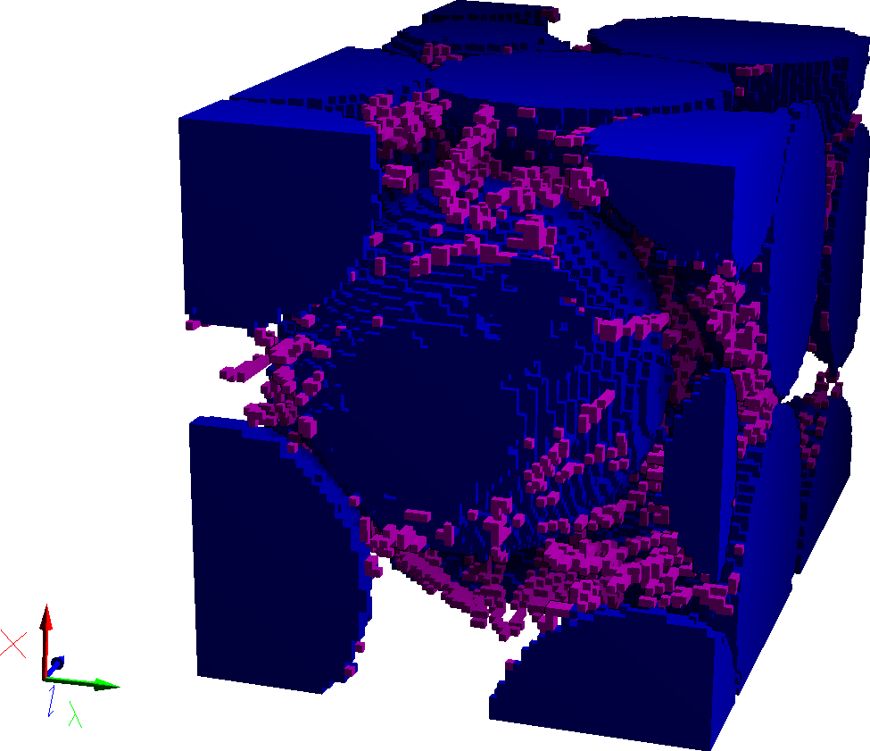
Pore Plugging in Natural System
Applications:
Groundwater & soil – Colloid/Microplastic transport
CO₂, H₂ Storage – Mineral precipitation
Geothermal – Fine migration
Oil & Gas – Formation damage
Fuel Cells – Catalyst pore blockage
Biomedical – Blood vessel blockage
Mechanisms:
Straining, Bridging, Aggregation, Precipitation, Biofilm growth, Clay swelling,…
Despite different applications, (more or less) similar pore-scale plugging mechanisms govern flow reduction across systems.

Slide 4
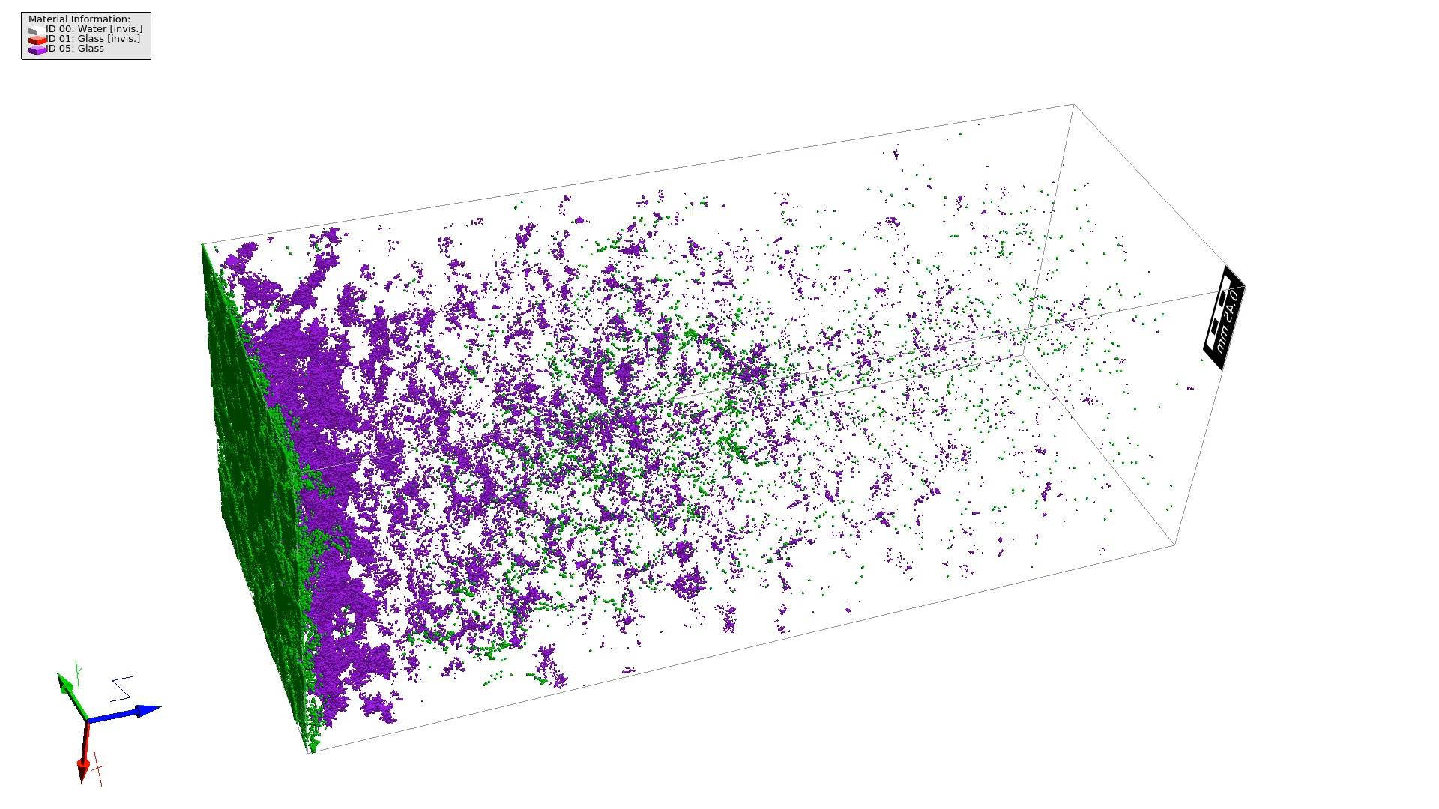


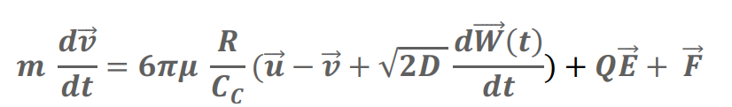




Pore-Scale Plugging Prediction Dataset Generation
Physics-based model (Eulerian-Lagrangian CFD model)
Conservation of mass
Conservation of momentum
Particle migration
Particle deposition: Hamaker model
Sadeghnejad et al. (2022)
Parameter | Qnt.
Porous media (2D) | ~10,000
Injection velocity, v (m/s) | 5×10^{-7,} 1×10⁻⁶, 5×10⁻⁶
Particle radius, r_{p} (m) | 10⁻⁷, 2×10⁻⁷, 3×10⁻⁷
Particles, P | 2×10³, 3.5×10³, 5×10³
Total simulations | 1.75×10⁵
Massive Dataset Generation
~49×10³ CPU-hour (~9 months) on:
Intel® Xeon® Platinum 8160 CPUs 2.1 GHz
Dataset size: ~25 GB
r_{p}=3×10⁻⁷ m, P=5000, v=5×10⁻⁶ m/s
r_{p}=2×10⁻⁷ m, P=5000, v=5×10⁻⁷ m/s
r_{p}=10⁻⁷ m, P=5000, v=5×10⁻⁶ m/s
Notes:
Sphere packing simplified 2D model
Scientific ML

Slide 5
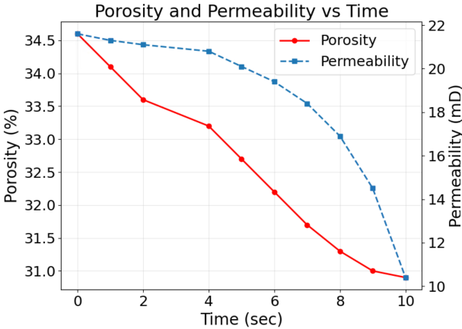
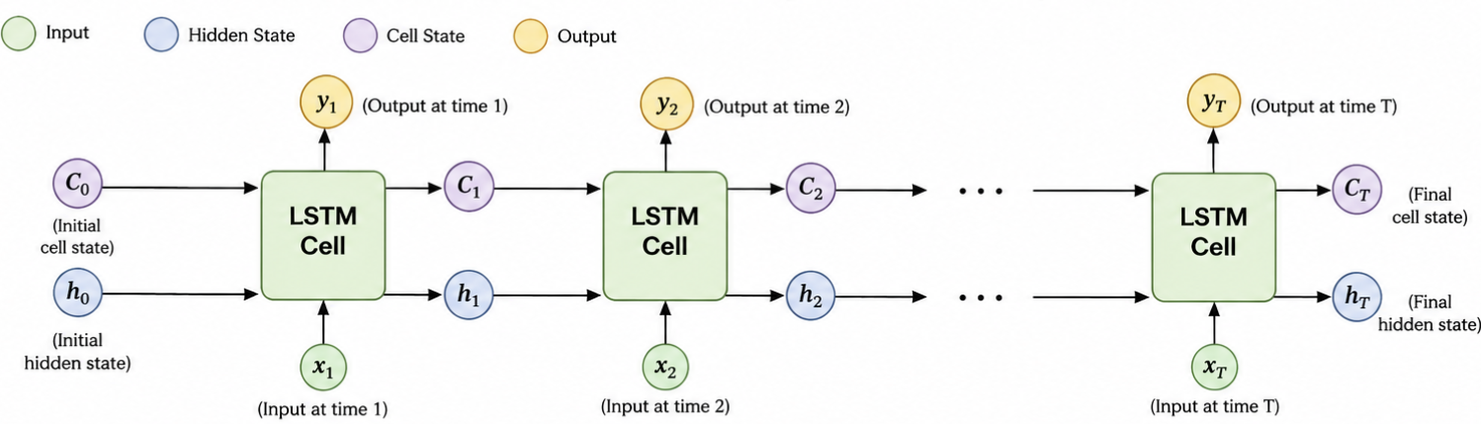
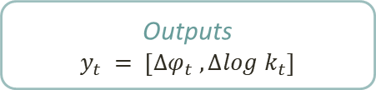
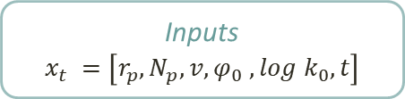
Temporal Prediction of φ and K
256 × 256
Φ_{t}
k_{t}
Δϕ_{t}​
Δk_{t}​
Δϕ_{t}​
Δlog k_{t}​
Inputs
$$x_{t} =\left[r_{p}, N_{p}, v,φ_{0} , log k_{0}, t\right]$$
Hidden size = 256
LSTM Layers = 3
Dropout = 0.3
Causal sequence learning
Outputs
$$y_{t} = \left[{∆φ}_{t} , ∆log k_{t}\right]$$

Slide 6
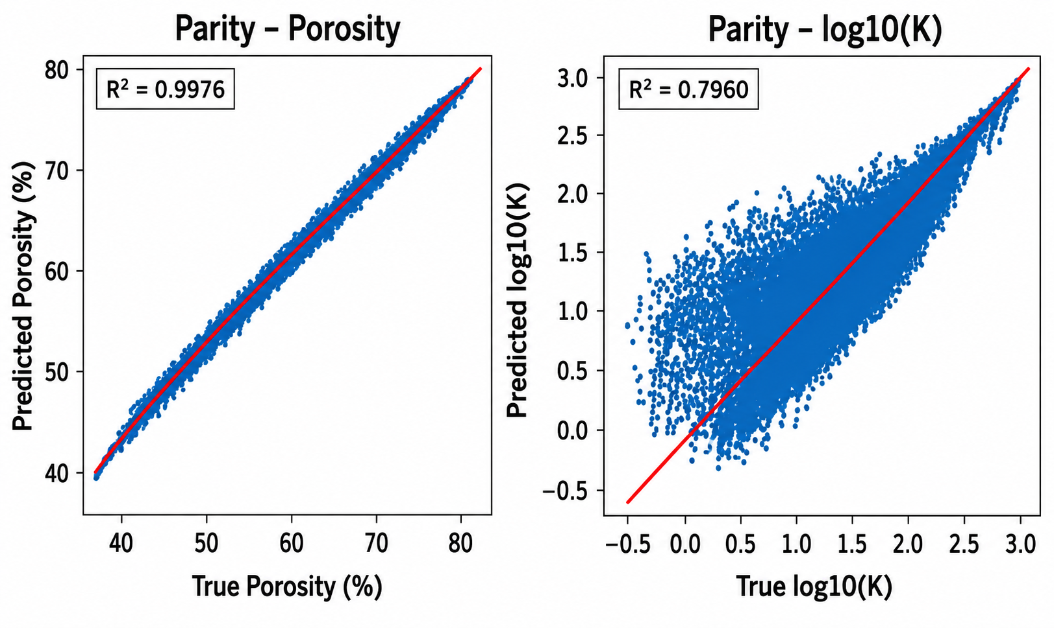
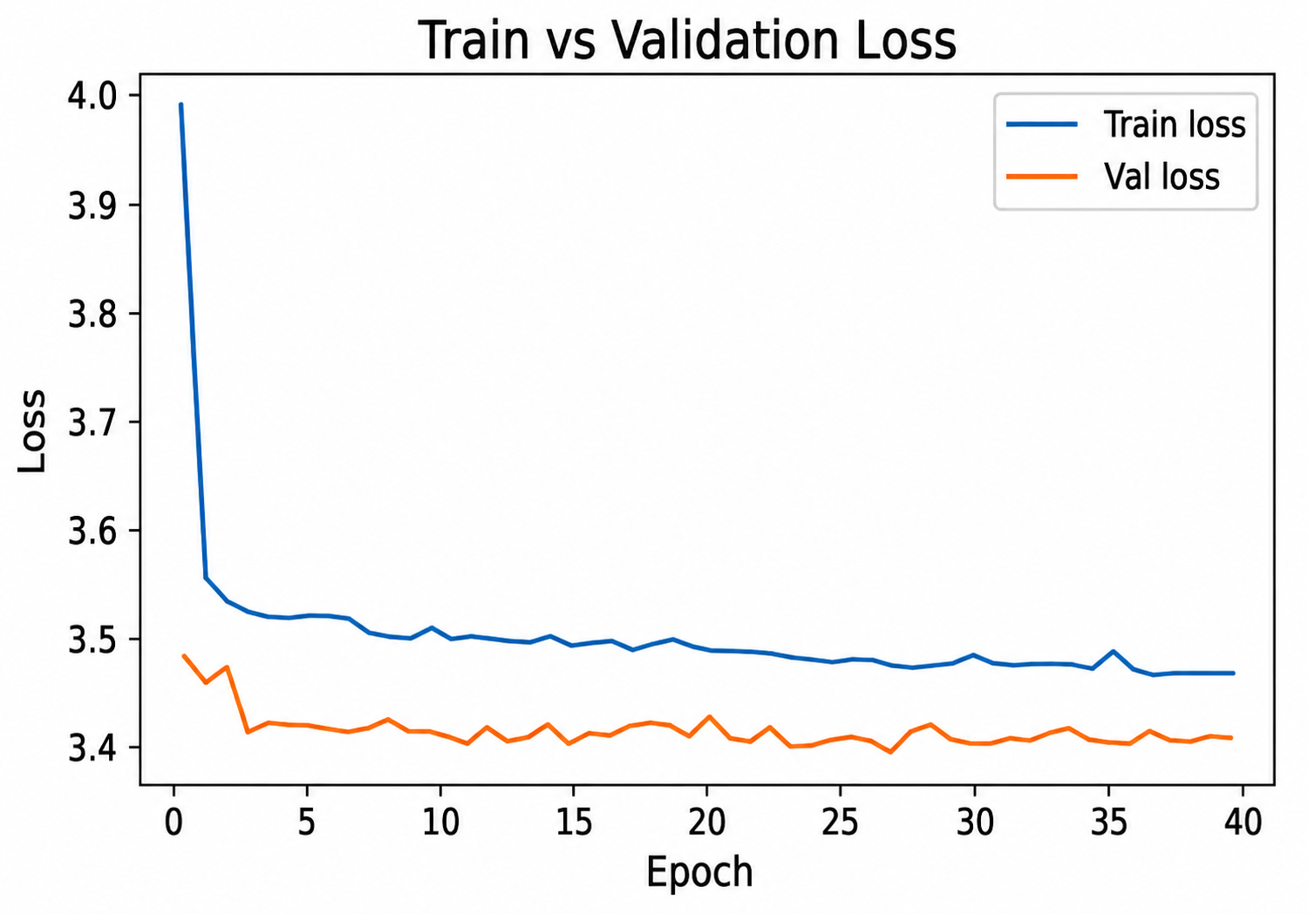
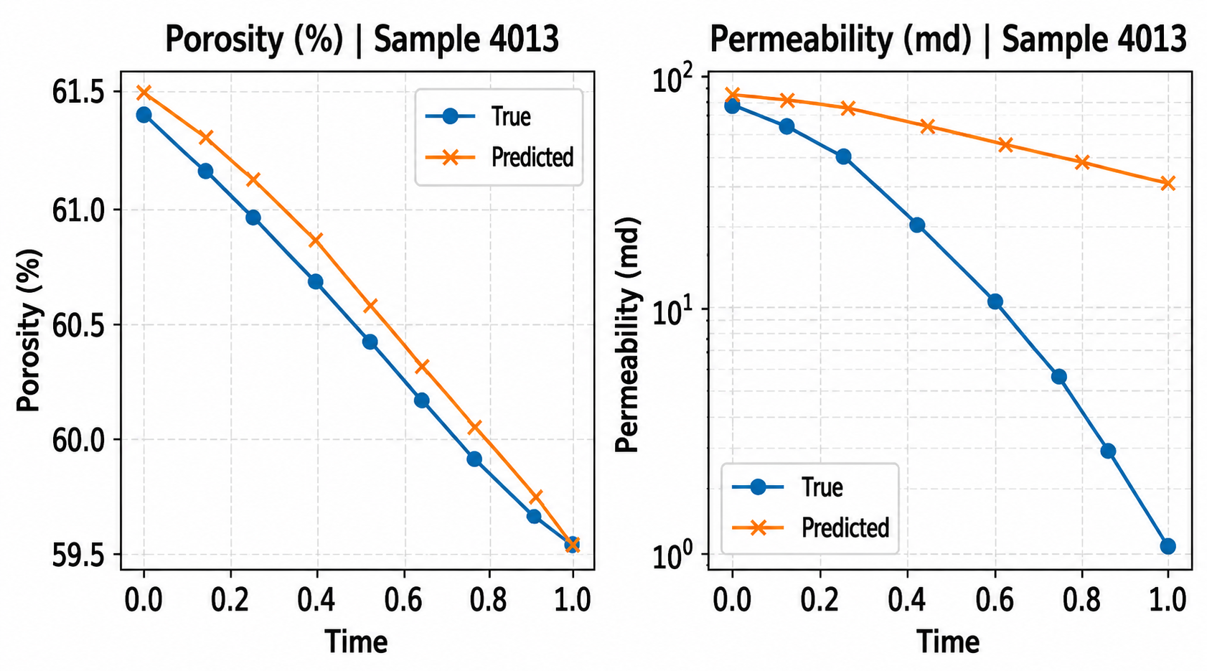
Porosity Is Easy - Permeability Is Hard!

Slide 7
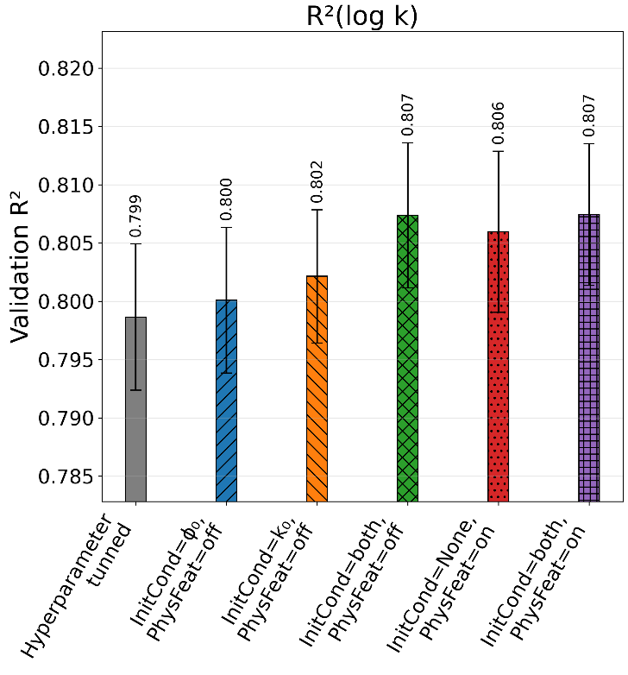
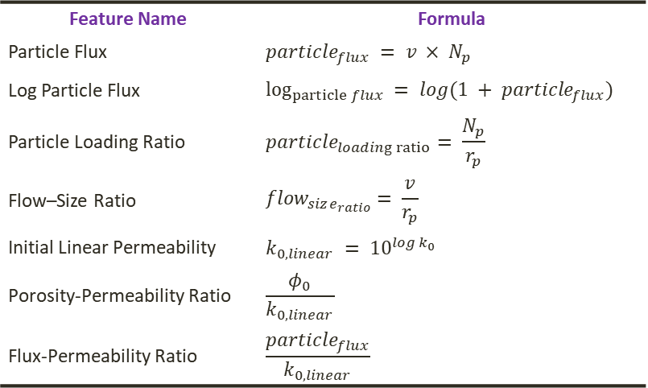
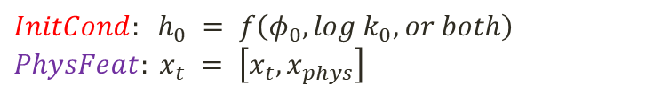
Initial Conditioning & Derived Physics Features
Inject initial-state information and physics-informed descriptors into the sequence model
$${InitCond: h}_{0} = f\left(φ_{0}, log k_{0}, or both\right)$$
$$PhysFeat: x_{t} = \left[x_{t}, x_{phys}\right]$$
Feature Name | Formula
Particle Flux | $$particle_{flux} = v × N_{p}$$
Log Particle Flux | $$\log_{particle flux} = log(1 + particle_{flux})$$
Particle Loading Ratio | $$particle_{loading ratio}= \frac{N_{p}}{r_{p}}$$
Flow–Size Ratio | $$flow_{size_{ratio}}= \frac{v}{r_{p}}$$
Initial Linear Permeability | $k_{0,linear} = {10}^{log k_{0}}$
Porosity-Permeability Ratio | $$\frac{φ_{0}}{k_{0,linear}}$$
Flux-Permeability Ratio | $$\frac{particle_{flux}}{k_{0,linear}}$$
Notes:
Results:
InitCond & PhysFeat improved permeability prediction
Best performance was InitCond=φ₀ & logK₀ and PhysFeat=off

Slide 8
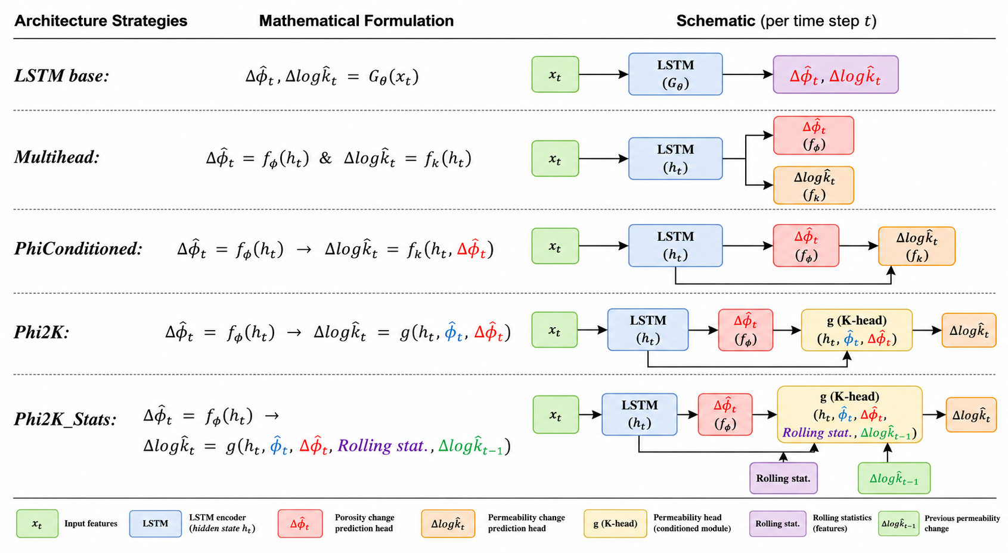
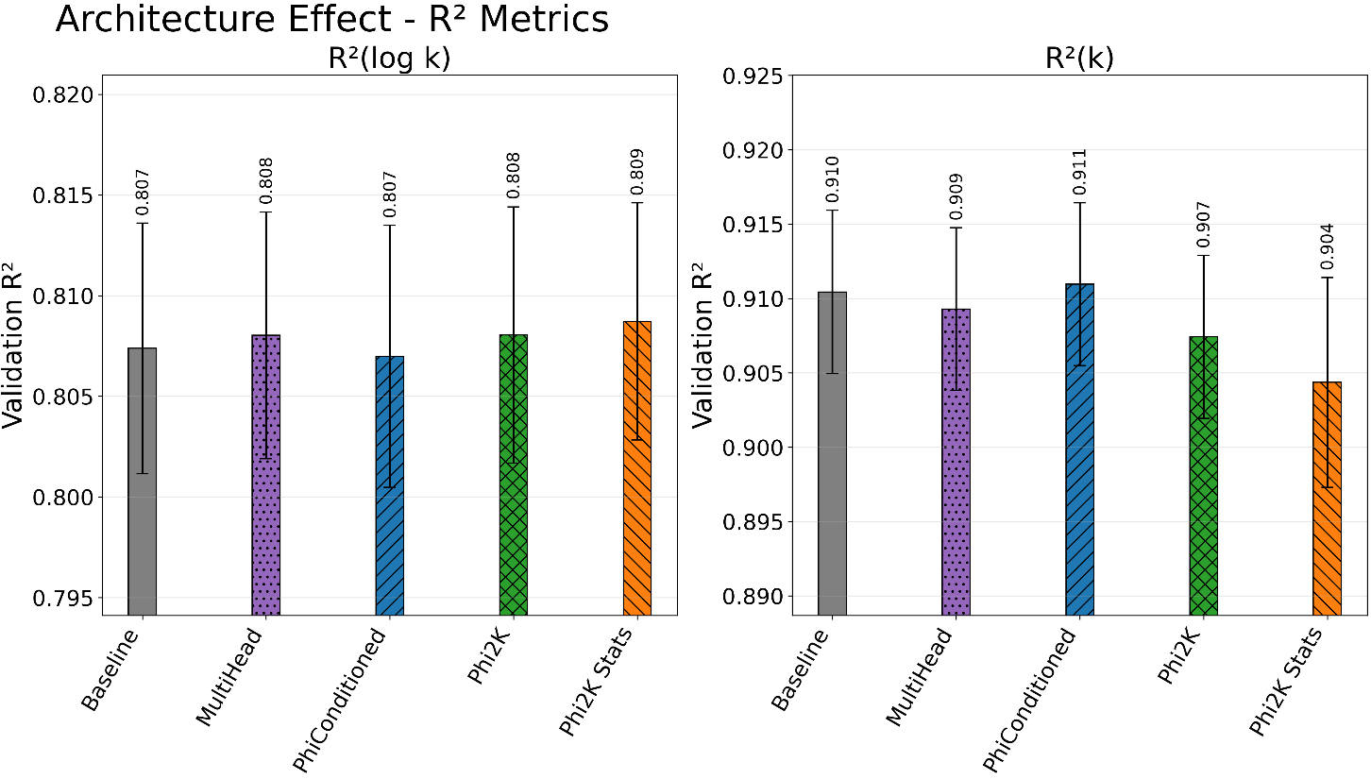
Architecture Strategies
Notes:
PhiConditioned: Permeability branch receives
hidden representation (h_t)
predicted porosity change (Δ𝜙_t)
Phi2K: Permeability branch explicitly depends on:
absolute porosity 𝜙t
porosity evolution Δ𝜙
Thus it has Stronger physical coupling
Phi2K_stat: Porosity evolution history, allowing the model to infer dynamic transport-state changes rather than relying only on instantaneous porosity values (rolling window of 5.
Results:
PhiConditioned improved permeability learning through explicit coupling
Phi2K_Stats achieved the best overall balance and robustness
$Δ{\hat{φ}}_{t} , Δlog{\hat{k}}_{t} = G_{θ}\left(x_{t}\right)$
$Δ{\hat{φ}}_{t} =f_{φ}\left(h_{t}\right)\text{ \& } Δlog{\hat{k}}_{t} = f_{k}\left(h_{t}\right)$
$Δ{\hat{φ}}_{t}= f_{φ}\left(h_{t}\right)→ Δlog{\hat{k}}_{t} = f_{k}\left(h_{t},Δ{\hat{φ}}_{t}\right)$
$Δ{\hat{φ}}_{t}= f_{φ}\left(h_{t}\right)→Δlog{\hat{k}}_{t} = g\left(h_{t}, {\hat{φ}}_{t}, Δ{\hat{φ}}_{t}\right)$
$Δ{\hat{φ}}_{t}= f_{φ}\left(h_{t}\right)→Δlog{\hat{k}}_{t}= g\left(h_{t}, {\hat{φ}}_{t}, Δ{\hat{φ}}_{t},Rolling stat., Δlog{\hat{k}}_{t−1}\right)$

Slide 9
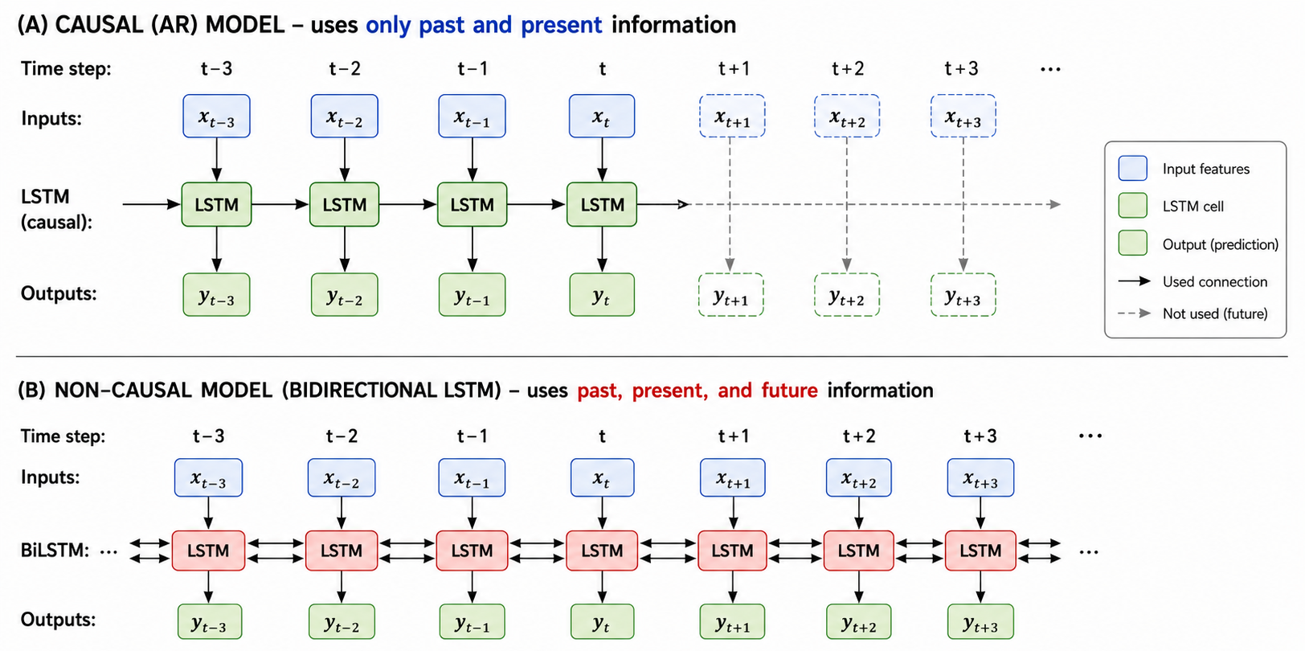
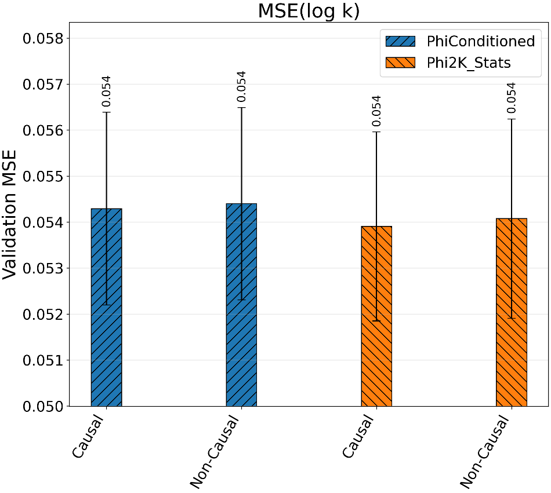
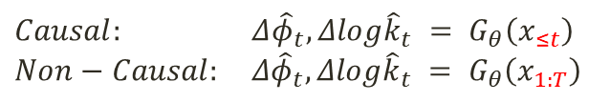
Temporal Learning
$Causal: Δ{\hat{φ}}_{t}, Δlog{\hat{k}}_{t} = G_{θ}\left(x_{≤t}\right)$
$$Non−Causal: Δ{\hat{φ}}_{t}, Δlog{\hat{k}}_{t} = G_{θ}\left(x_{1:T}\right)$$

Slide 10
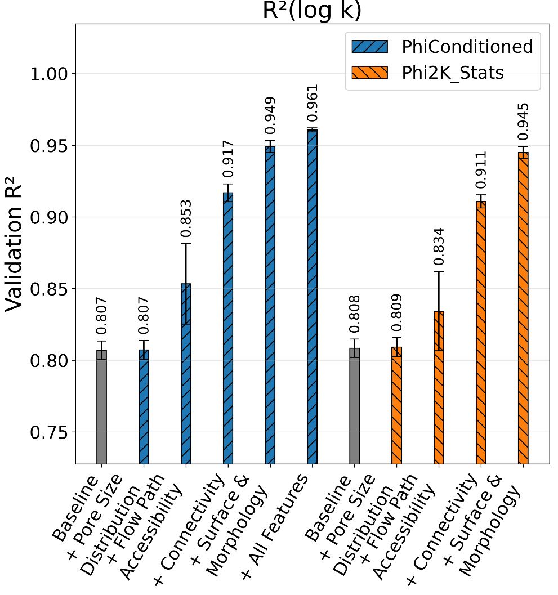
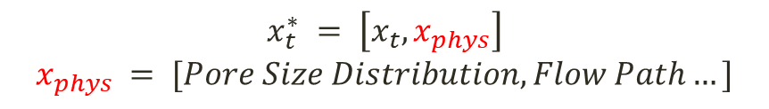
Physics-Informed Features
$$x_{t}^{∗} = \left[x_{t}, x_{phys}\right]$$
$$x_{phys} = [Pore Size Distribution, Flow Path…]$$
Surface & Morphology > Connectivity > Flow Path Accessibility > Pore Size Distribution
Category | Calculated Property
Pore Size Distribution | D10, D50, D90
Flow Path Accessibility | MeanTortuosity
Transport | PercolationPathLength
 | MaxParticleDiam
Connectivity | NumberOfPores
Connectivity | CoordinationNo_mean
Connectivity | CoordinationNo_std
Surface & Morphology | SpecificSurfaceArea
Surface & Morphology | SpecificIntegralMeanCurvature
Surface & Morphology | KrumbeinSphericity
Notes:
Higher SpecificIntegralMeanCurvature→ higher pore space complexity→lowe K
Smaller KrumbeinSphericity→ more elongated pores→ lower K
Higher SSA→ smallers pores→ lower K

Slide 11
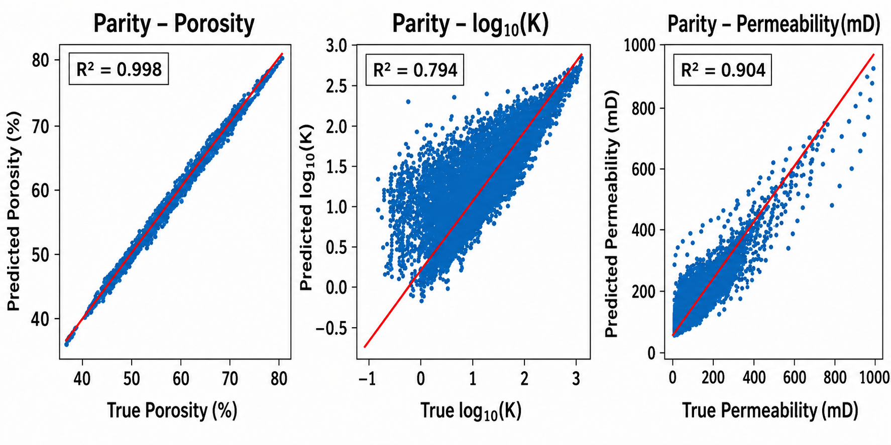
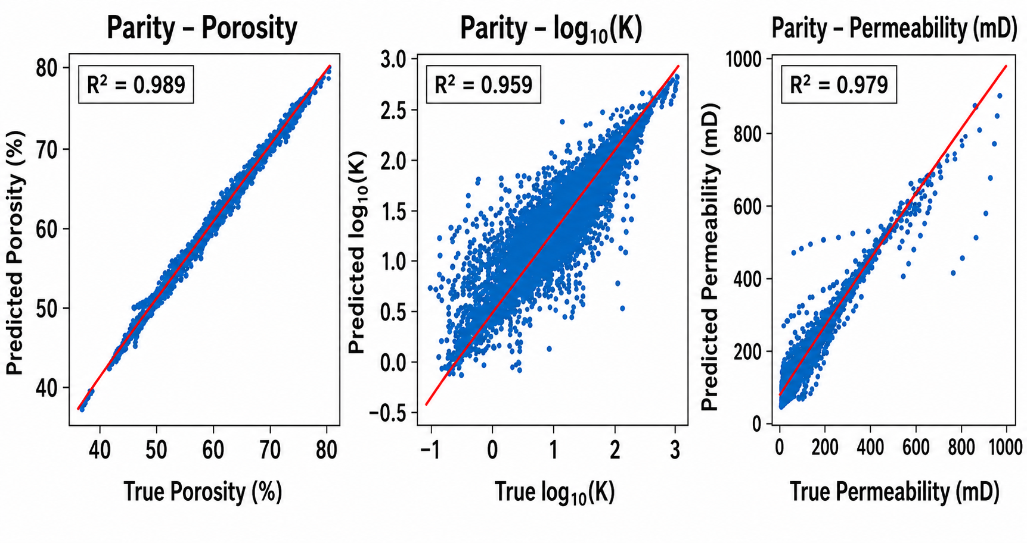
Conclusion
Phi2K_Stats was stronger without image features
With rich physics-informed descriptors the simpler PhiConditioned generalized better
Initial State
Final State

Slide 12



Thank you for your kind attention
s.sadeghnejad@uni-jena.de
18.03.2024

Slide 13
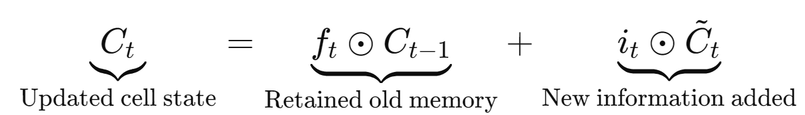
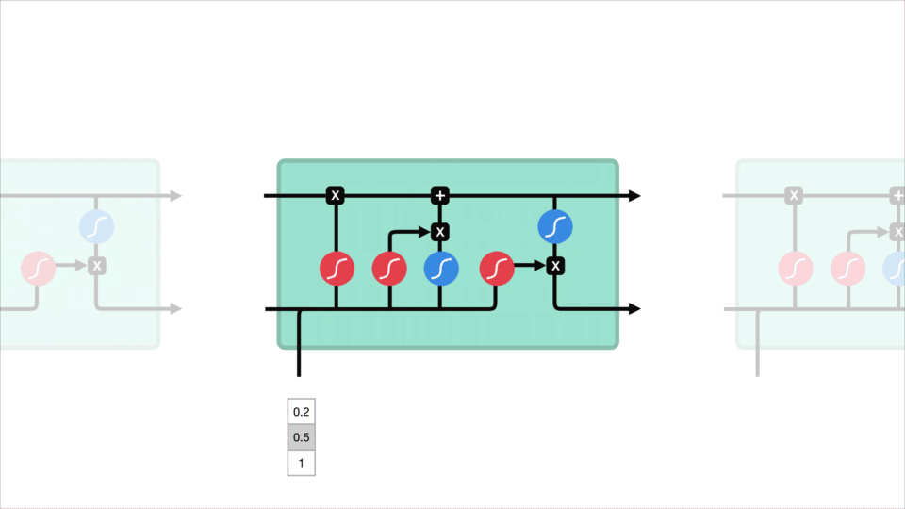
Long Short-Term Memory (LSTM) Network
LSTM for Time-Series Prediction (temporal pattern)
A type of recurrent neural network (RNN)
Designed for sequential and time-series data
Captures long-term temporal dependencies
Key components:
Forget gate
Input gate
Output gate
Cell state memory
Each step uses:
current input x_{t}​
previous hidden state (short-term memory) h_{t−1}
previous cell state (long-term memory) C_{t-1}
https://medium.com/data-science/illustrated-guide-to-lstms-and-gru-s-a-step-by-step-explanation-44e9eb85bf21
Notes:
Term Meaning
Ct​ Updated long-term memory
ft​ Forget gate
Ct−1 ​Previous memory
ft​⊙Ct−1​ Preserved/filtered old memory
It ​Input gate
Ct ​Candidate new memory
t⊙Ct ​Selected new information
+ Combine old and new memory

Slide 14
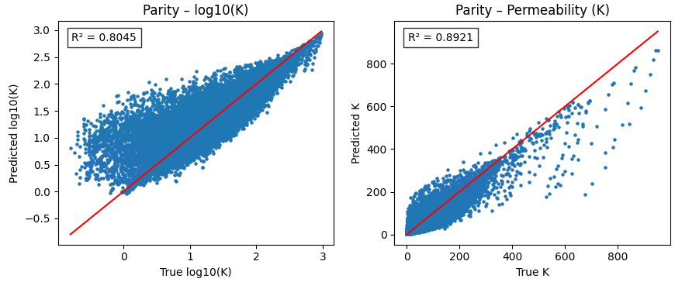
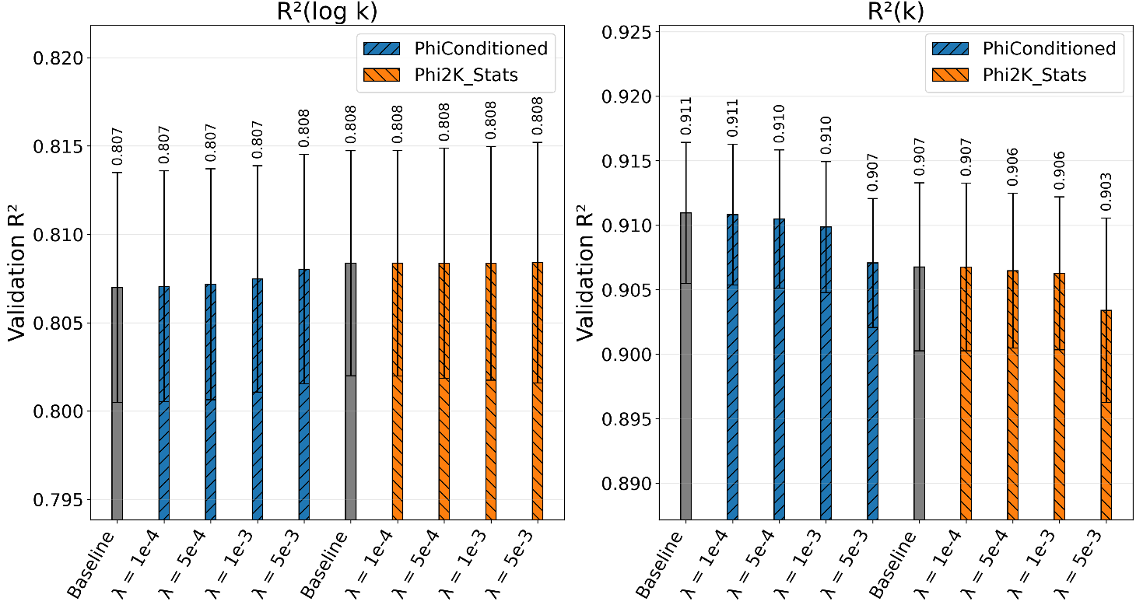

Linear Consistency Regularization
Enforces consistency between log K and K (linear space)
$ℒ_{total} = ℒ_{base} + λ ℒ_{cons}$
$$ℒ_{cons} = \left\|k_{linear}− {10}^{log\hat{k}}\right\|$$

Slide 15
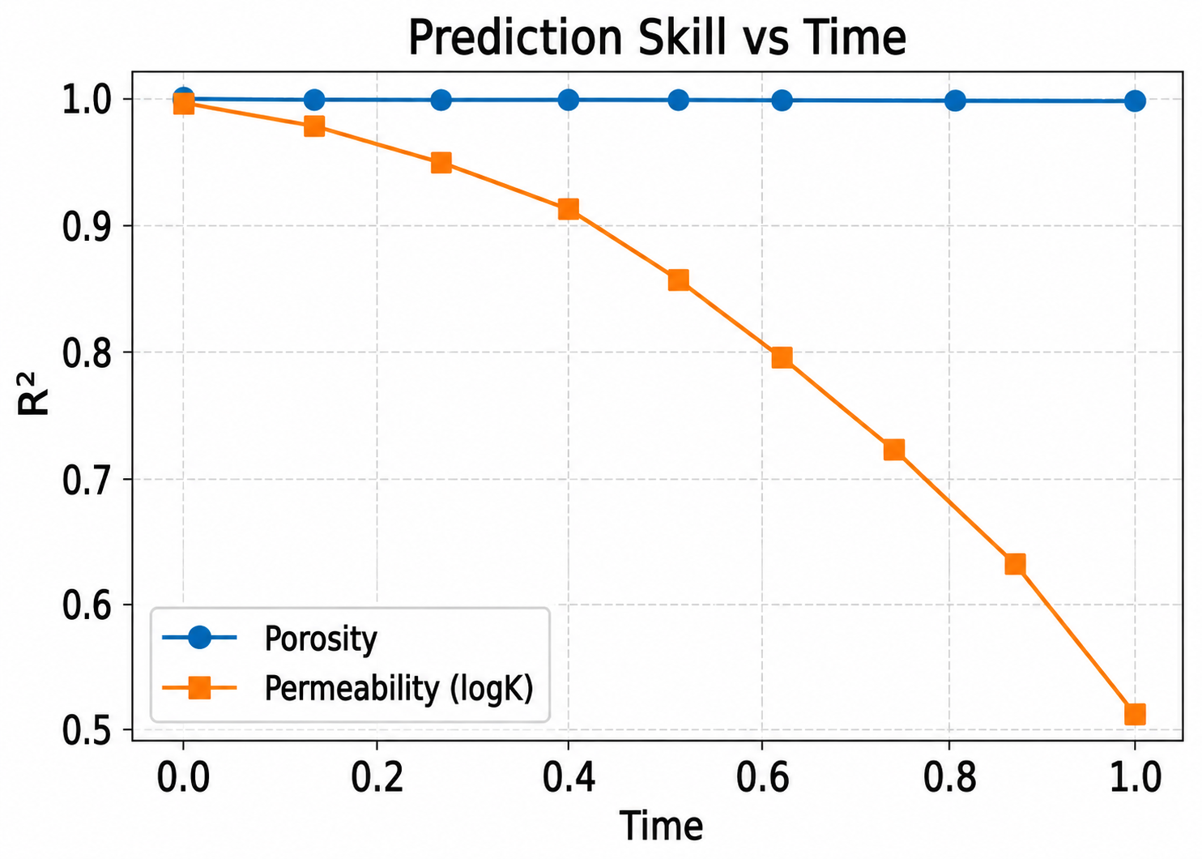
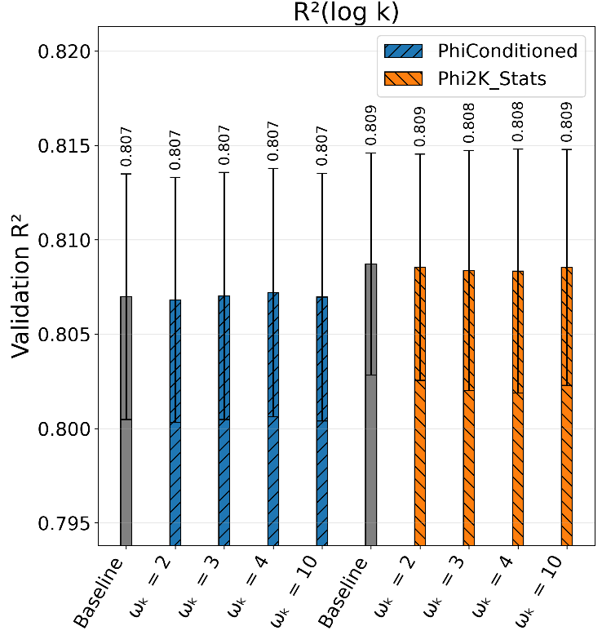
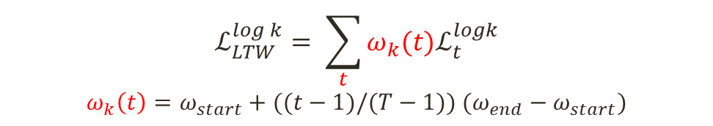
Late-Time Weighting
Increases the contribution of late-stage permeability errors during training
$$ℒ_{LTW}^{log k}= \sum_{t}{ω_{k}(t)ℒ_{t}^{logk}}$$
$$ω_{k}\left(t\right)=ω_{start}+((t−1)/(T−1)) (ω_{end}−ω_{start})$$

Slide 16
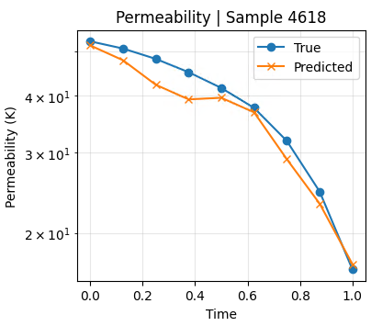
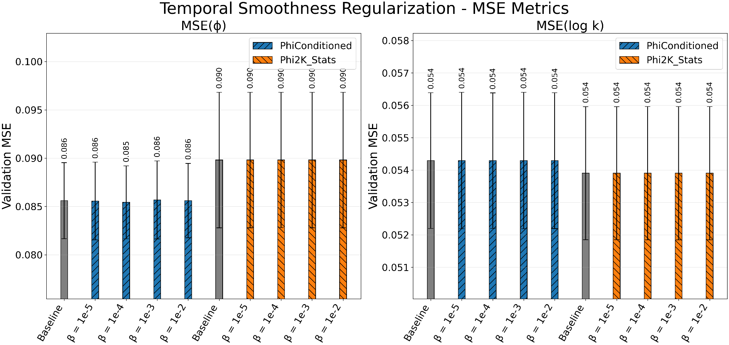
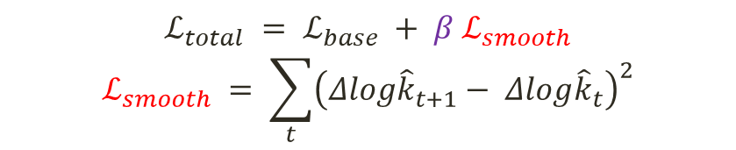
Temporal Smoothness Regularization
Penalizes unrealistic temporal fluctuations in the predicted permeability evolution
$ℒ_{total} = ℒ_{base} + β ℒ_{smooth}$
$$ℒ_{smooth} = \sum_{t}{{\left(Δlog{\hat{k}}_{t+1}− Δlog{\hat{k}}_{t}\right)}^{2}}$$

Slide 17

Scheduled Teacher Forcing
$p_{TF}\left(e\right) = τ^{e}$

Slide 18
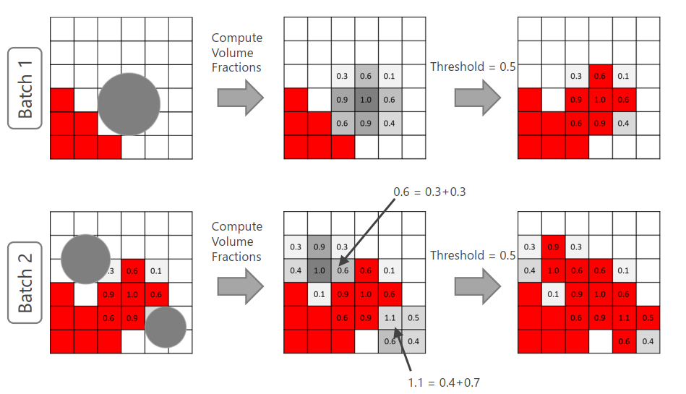
Particle overlapping model
Max Volume Fraction (Threshold)
Navier-Stokes

