Slide 1

Decoupling the Non-linear Influence of Pore Structure on CO₂ Saturation:
An Explainable Data-Driven Approach based on Microfluidic Experiments
Han Ge,
Associate Professor,
Ocean College, Zhejiang University
May 13, 2026

Slide 2
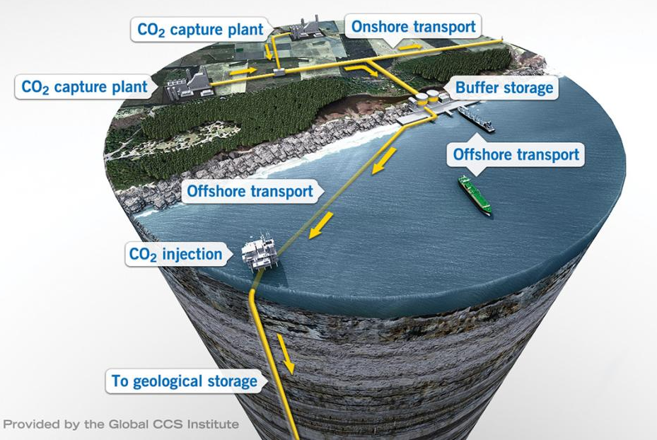
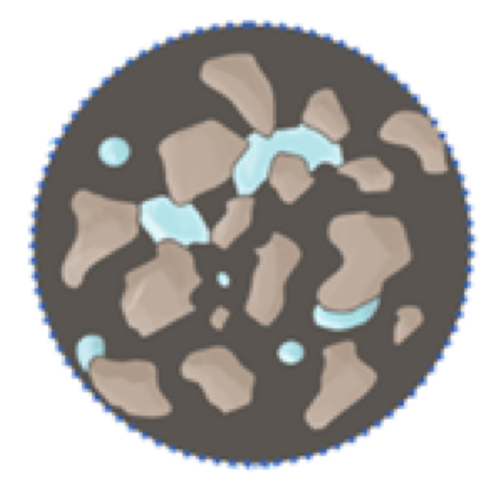
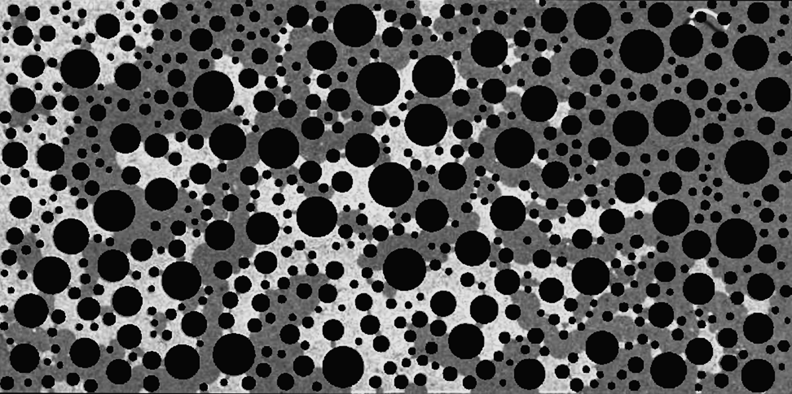
Background & Limitations
01.点击加入标题
Background
Geological CO₂ sequestration is a key pathway for long-term carbon mitigation
Flow patterns, trapping behavior, storage efficiency and security are controlled by pore structures
Challenges & limitations
Macro-scale: Gigaton-scale offshore CO₂ storage*
CO₂ transport is influenced not only by pore structure, but also by fluid properties and flow conditions
Multiple parameters may interact with each other, leading to complex effects on CO₂ behavior
Existing studies mainly focus on individual parameters, lacking a unified framework
CO₂
Simulation
Micro-scale: Capillary capture
Micro-mechanism:
Microfluidic experiment
*Image source: https://www.thorntontomasetti.com/project/carbon-capture-storage

Slide 3
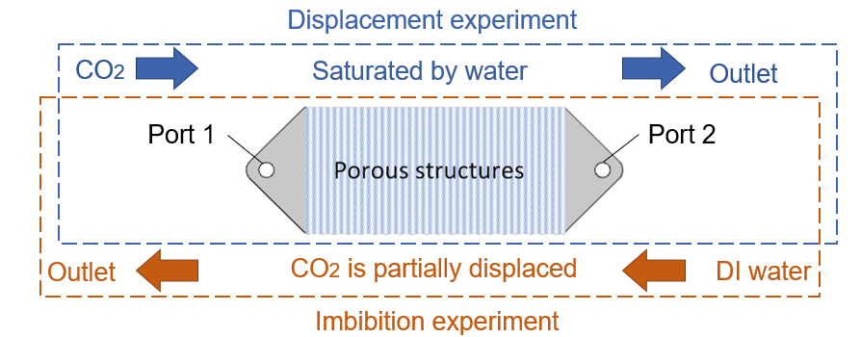
Technical Route
01.点击加入标题
Microfluidic experiments platform
Multi-parameters experiment
1
2
Displacement-imbibition process
Geometry heterogeneity:
porosity, pore size probability density function (PDF)
Topology properties:
pore-throat ratio, coordination number
Fluid properties:
viscosity, surface tension
Microscopic imaging & saturation characterization
Dataset
Interpretable analysis
4
Machine learning model
3
Feature importance analysis (SHAP)
Identify main control parameters & influence
Multi-modal feature fusion (data + image)
Initial & residual saturation perdition (S_{i} & S_{r})
Notes:
About data pre-processing, exp_type, one hot encoding
Other parameters, to exclude the influence of the unit, use Max-min normalization

Slide 4
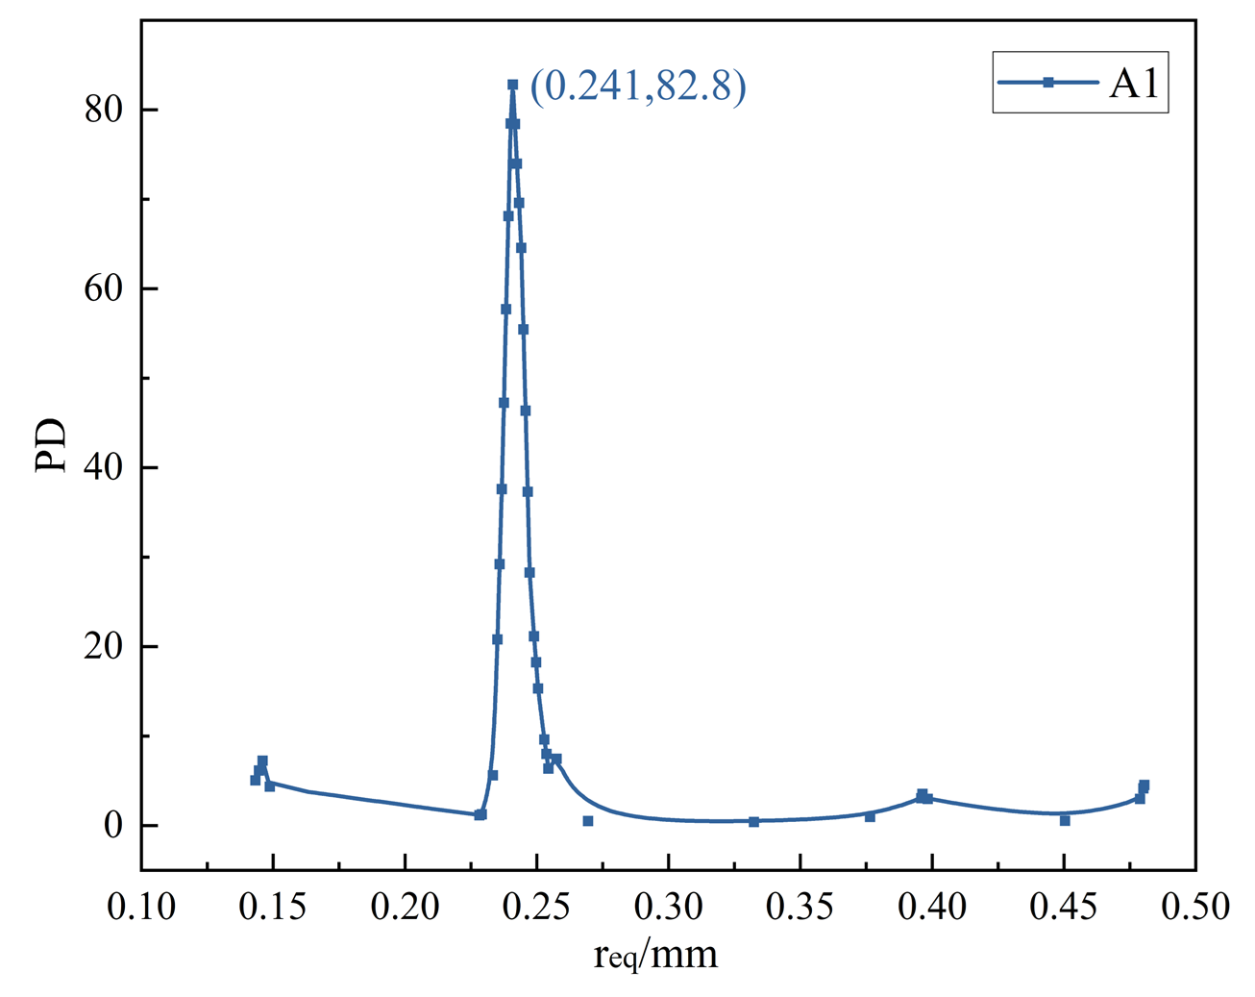
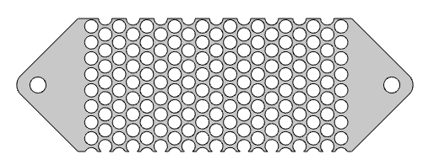
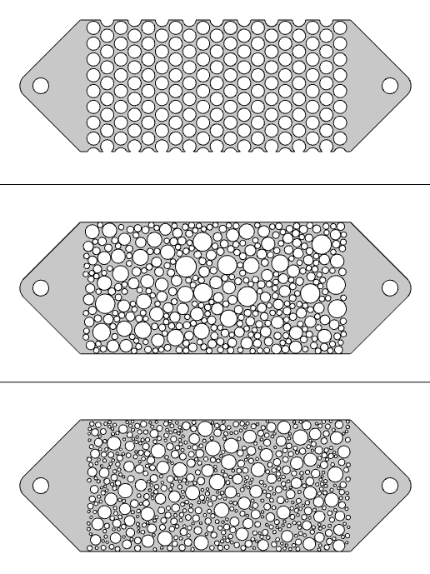
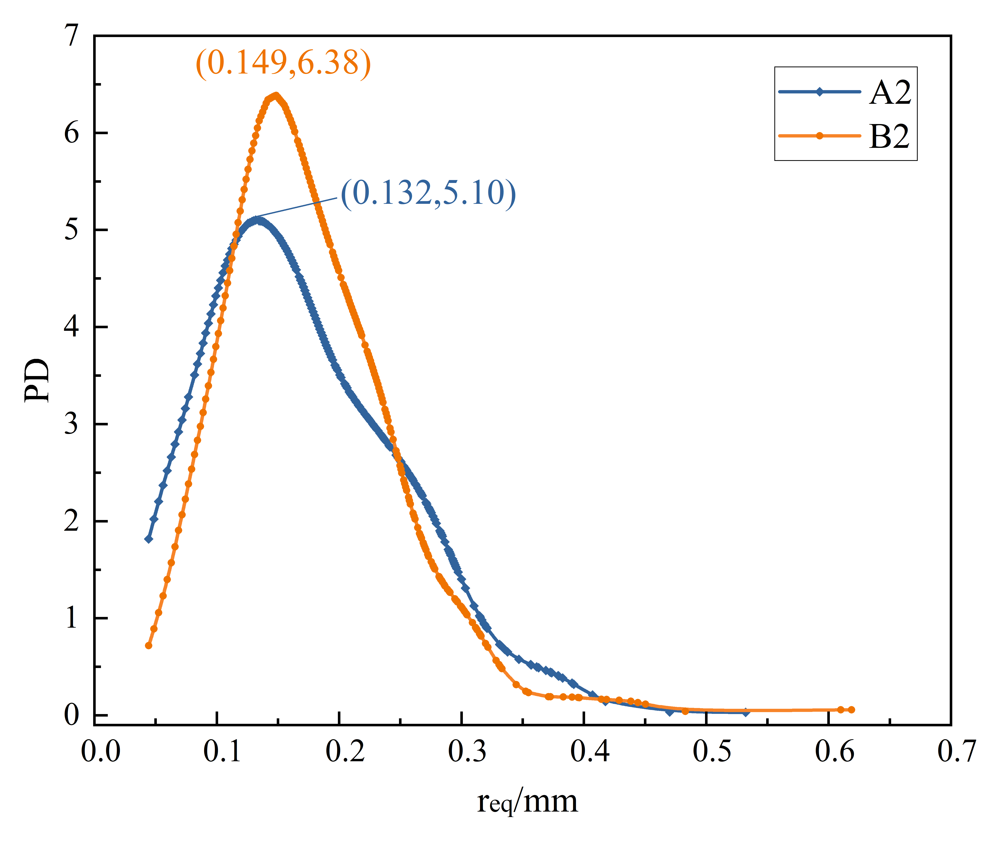
Experiment 1: General Heterogeneity Variation
01.点击加入标题
Same porosity
φ=0.3926
pore size
PDF
A narrow pore size distribution with a sharp peak
A1
Binarized
pore size
PDF
A2
Similar pore size distribution
A broader pore size distribution dominated by small pores
B2
φ=0.5403
Pore
Area
equivalent
circle

Slide 5
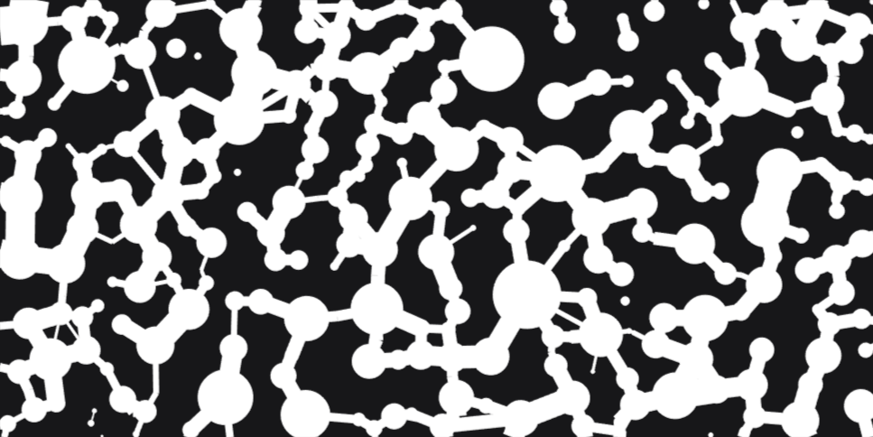
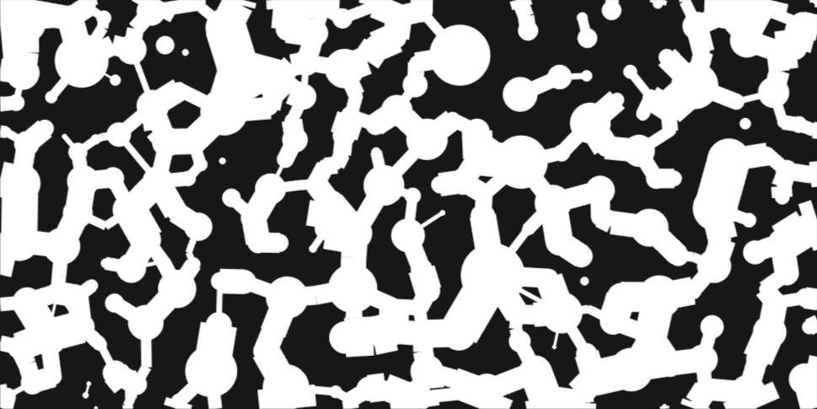
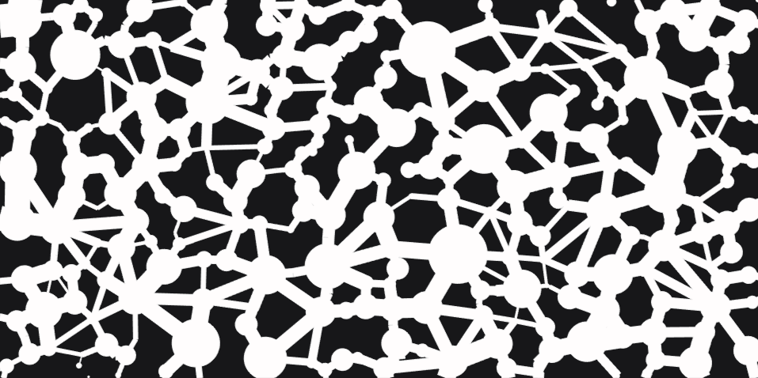
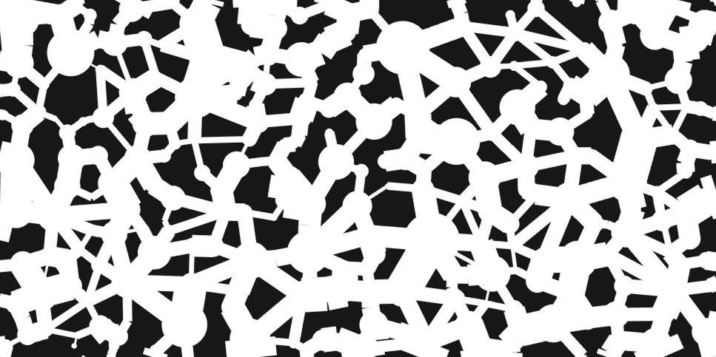
Experiment 2: Topology Variation
01.点击加入标题
w_{rec4}
w_{rec1}
Coordination number (N_{c} )=4
(rec1, rec2, rec3,rec4)
d_{cir}
w_{rec2}
Pore-throat ratio (R_{p/t} )=
avg (d_{cir}/w_{rec})
N_{c}↑
R_{p/t}↑
w_{rec3}
N₀R_{H}
N_{c}↑
Model | Coordination Number (N_{c}) | Pore-Throat Ratio (R_{p/t})
N₀R₀ | 2.25 | 1.78
N₀R_{H} | 2.25 | 2.51 (↑)
N_{H}R₀ | 2.75 (↑) | 1.78
N_{H}R_{H} | 2.75 (↑) | 2.51 (↑)
R_{p/t}↑
N₀R₀
N_{H}R_{H}
N_{c}↑
R_{p/t}↑
N_{H}R₀

Slide 6
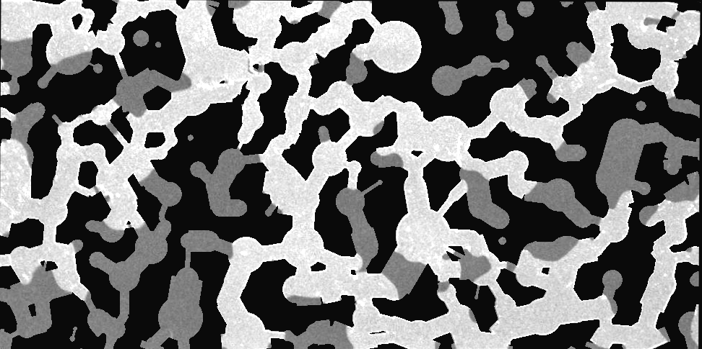
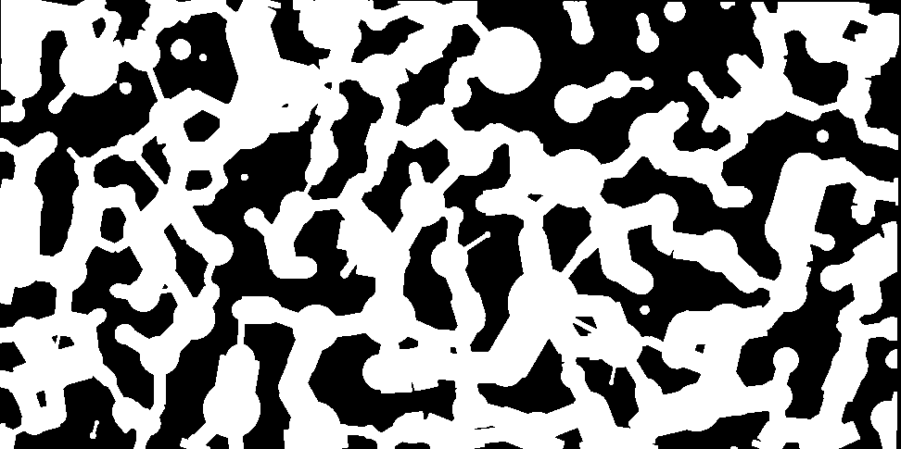
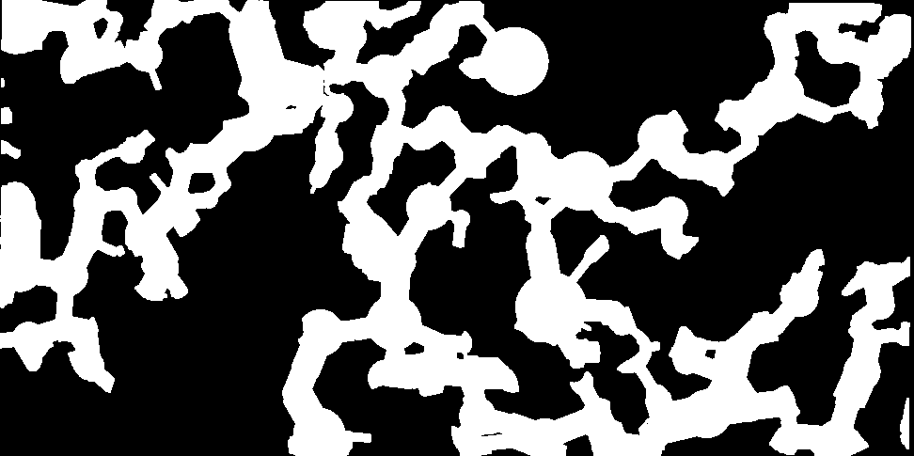
Machine Learning
01.点击加入标题
Image inputs
Data inputs
Structural parameters
Fluid properties Experimental conditions
Input
Registered image
Binary pathways
Binary CO₂ distribution
243×486×3
Conv2D,3×3, 16
MaxPooling
Conv2D,3×3, 32
MaxPooling
Global
Average Pooling
Feature extraction
Conv2D,3×3, 32
CNN
Feature concatenation
Logical mask (masking imbibition parameters Q_{re}, S_{r})
Multi-task learning framework
Predict initial saturation S_{i}
Predict residual saturation S_{r}
Prediction result
(High Accuracy & Stability)
Notes:
The register image to reflect the distribution of co2 and water in the pathways, including the interface between them.
The binary pathways to reflect the boundary conditions of the porous skeletons
The binary co2 distribution to reflect the distribution of CO2
All of the image data provide the spatial information by pixels to make complementary of the structured data, which can’t reflect the distribution differences.
The feature concatenation can couple all these information in different aspects and scales.
The displacement process, actually, Qre(re-imbibition flow rate) and Sr is unknow. To avoid leaking these information to the prediction of Si, here we add the logical mask.
We use multi-task learning framework to do this prediction to discover the potential relations between Si and Sr
The 5-fold cross-validation: we divided all the data to five groups( randomly?), and for each training round, select four groups in turn as the training set, and the other one as the validation set. Thus, we do 5-round training and validating. Using the 5-round coefficient of determination and standard deviation as the generalization target. Moreover, during the division of the data, we use make_key function to construct the ID of each group, i.e., use the structure parameters, fluid properties, experimental condition and the repeated rounds to seal to this ID, make sure the experimental results (displacement and reimbibition ) with the same experimental conditions to be split as a group into the training set or validation set. In this way, we can avoid information leaking and the accuracy oscillation due to the unbalance between the displacement data and reimbibiton data.

Slide 7
Optimization strategy
01.点击加入标题
Dataset splitting: 5-Fold cross-validation
Group-based split
(Group ID: Structure + Fluid + Flow Rate + Repeated rounds)
Iteration 1:
Test = Fold 1 (20%)
Train/Validation = Fold 2-5 (80%)
└─ Train: 72%; Validation: 8%
Fold 1
Dataset
Fold 2
Fold 3
Fold 4
Iteration 2:
Test = Fold 2
Train/Validation = Fold 1, 3-5
Avoid data leakage
Increase the generalization of the model
Fold 5
…
Iteration 5
Training strategy: Bayesian optimization
R² evaluation
Target = mean(R²)-1.5×std(R²)
Hyperparameters
(Learning rate, Dropout, Weight decay)
Optuna
update
Prediction result
(High Accuracy & Stability)
Notes:
The displacement process, actually, Qre(re-imbibition flow rate) and Sr is unknow. To avoid leaking these information to the prediction of Si, here we add the logical mask.
We use multi-task learning framework to do this prediction to discover the potential relations between Si and Sr
The 5-fold cross-validation: we divided all the data to five groups( randomly?), and for each training round, select four groups in turn as the training set, and the other one as the validation set. Thus, we do 5-round training and validating. Using the 5-round coefficient of determination and standard deviation as the generalization target. Moreover, during the division of the data, we use make_key function to construct the ID of each group, i.e., use the structure parameters, fluid properties, experimental condition and the repeated rounds to seal to this ID, make sure the experimental results (displacement and reimbibition ) with the same experimental conditions to be split as a group into the training set or validation set. In this way, we can avoid information leaking and the accuracy oscillation due to the unbalance between the displacement data and reimbibiton data.

Slide 8
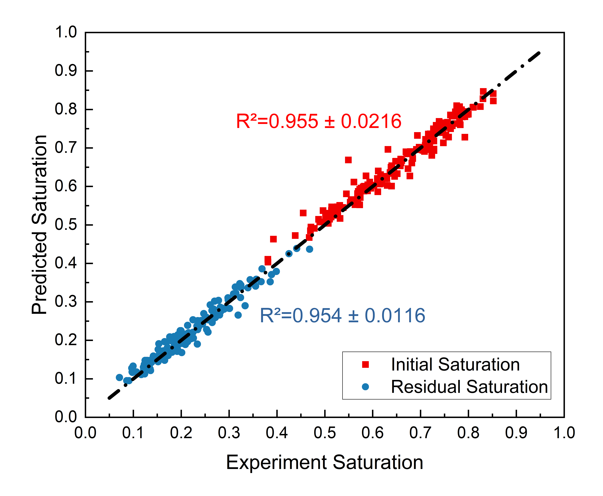
Machine Learning
01.点击加入标题
Before optimization
R² | fold1 | fold2 | fold3 | fold4 | fold5 | Average ± std
S_{i} | 0.930 | 0.935 | 0.917 | 0.951 | 0.933 | 0.933 ± 0.0109
S_{r} | 0.876 | 0.921 | 0.722 | 0.931 | 0.908 | 0.872 ± 0.0771
Optimization result
(high accuracy & stability)
Optimization target = mean(R²)-1.5×std(R²)
(accuracy & robustness)
Bayesian optimization
Optimal learning rate, dropout rate and weight decay
After Optimization
R² | fold1 | fold2 | fold3 | fold4 | fold5 | Average ± std
S_{i} | 0.978 | 0.918 | 0.968 | 0.968 | 0.945 | 0.955 ± 0.0216
S_{r} | 0.953 | 0.946 | 0.954 | 0.941 | 0.975 | 0.954 ± 0.0116

Slide 9
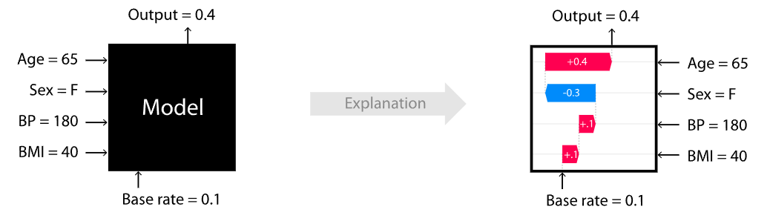
Interpretable Analysis by SHAP
01.点击加入标题
SHAP (SHapley Additive exPlanations) refers to an explanation model that uses an additive model to represent the relationship between input features and their coefficients, providing importance values to each feature based on their effect on the model prediction^{[1]}.
Symmetry: If two features contribute identically to all possible subsets, their Shapley values are equal.
Dummy: A feature that does not change the prediction in any context receives a Shapley value of zero.
Huang, X., Kroening, D., Ruan, W., Sharp, J., Sun, Y., Thamo, E., Wu, M. and Yi, X., 2020. A survey of safety and trustworthiness of deep neural networks: Verification, testing, adversarial attack and defence, and interpretability. Computer Science Review, 37, p.100270.
Lundberg, S.M. and Lee, S.I., 2017. A unified approach to interpreting model predictions. Advances in neural information processing systems, 30.
Notes:
The model is a black box, so we use SHAP (SHapley Additive exPlanations)
SHAP (SHapley Additive exPlanations) is a unified, game-theoretic framework used to interpret the predictions of complex machine learning models (often treated as "black boxes").
It frames feature attribution as a cooperative game where input features act as "players" collaborating to produce a prediction output.
SHAP calculates the exact marginal contribution of each feature, ensuring a theoretically sound distribution of credit.

Slide 10
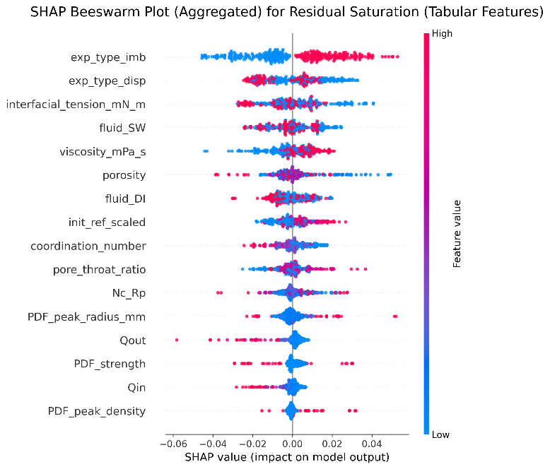

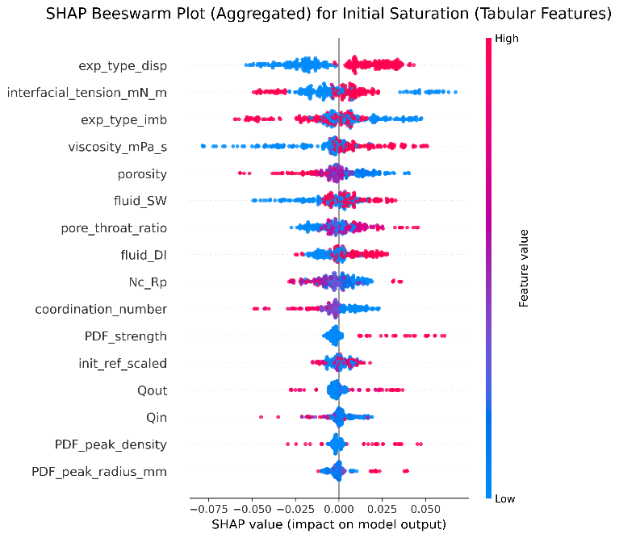
Interpretable Analysis by SHAP
01.点击加入标题
Beeswarm Plot: Summarizes feature importance, showing how higher/lower values impact the prediction.
S_{i}
S_{r}
negative
positive
negative
positive
exp_type_disp
exp_type_imb
High
High
exp_type_disp
interfacial_tension
interfacial_tension
exp_type_imb
viscosity
fluid_SW
porosity
viscosity
fluid_SW
porosity
fluid_DI
pore_throat_ratio
Si
fluid_DI
Feature value
coordination_number
Feature value
Nc_Rp/t
pore_throat_ratio
coordination_number
Nc_Rp/t
PDF_strength
PDF_peak_radius
Qi
Qre
PDF_peak_density
PDF_strength
PDF_peak_radius
Low
Qi
PDF_peak_density
Low
SHAP value (impact on model output)
SHAP value
fluid properties structural parameters experiment conditions coupling terms
Notes:
Positive value means the increase of this feature will increase the output, while negative value means it will lower the output

Slide 11
Interpretable Analysis by SHAP
01.点击加入标题
fluid properties structural parameters experiment conditions coupling terms
S_{i}
S_{r}
negative
positive
negative
positive
interfacial_tension
High
interfacial_tension
High
viscosity
viscosity
porosity
porosity
pore_throat_ratio
Si
Nc_Rp/t
Feature value
coordination_number
pore_throat_ratio
Feature value
coordination_number
Nc_Rp/t
PDF_strength
PDF_peak_radius
Qi
Qre
PDF_peak_density
PDF_strength
PDF_peak_radius
Qi
Low
PDF_peak_density
Low
Fluid properties ＞ Structural parameters ＞ Injection rate (Q_{i}, Q_{re}).
Coupling terms occupy a moderate position in importance ranking.
Within the experimental regime of this study, fluid properties primarily govern the overall flow pattern, while pore structure further modulates CO₂ distribution and residual behavior through local geometric constraints, with injection rate providing local corrections within this framework.
Notes:
If the red dot located in the Positive half, it means the increase of this feature will increase the output, while negative half means it will lower the output

Slide 12
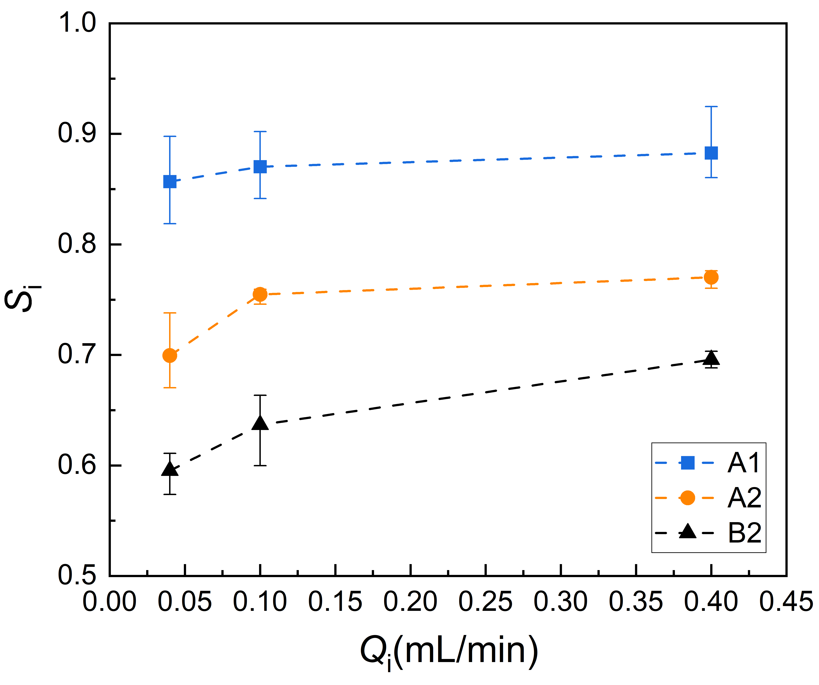
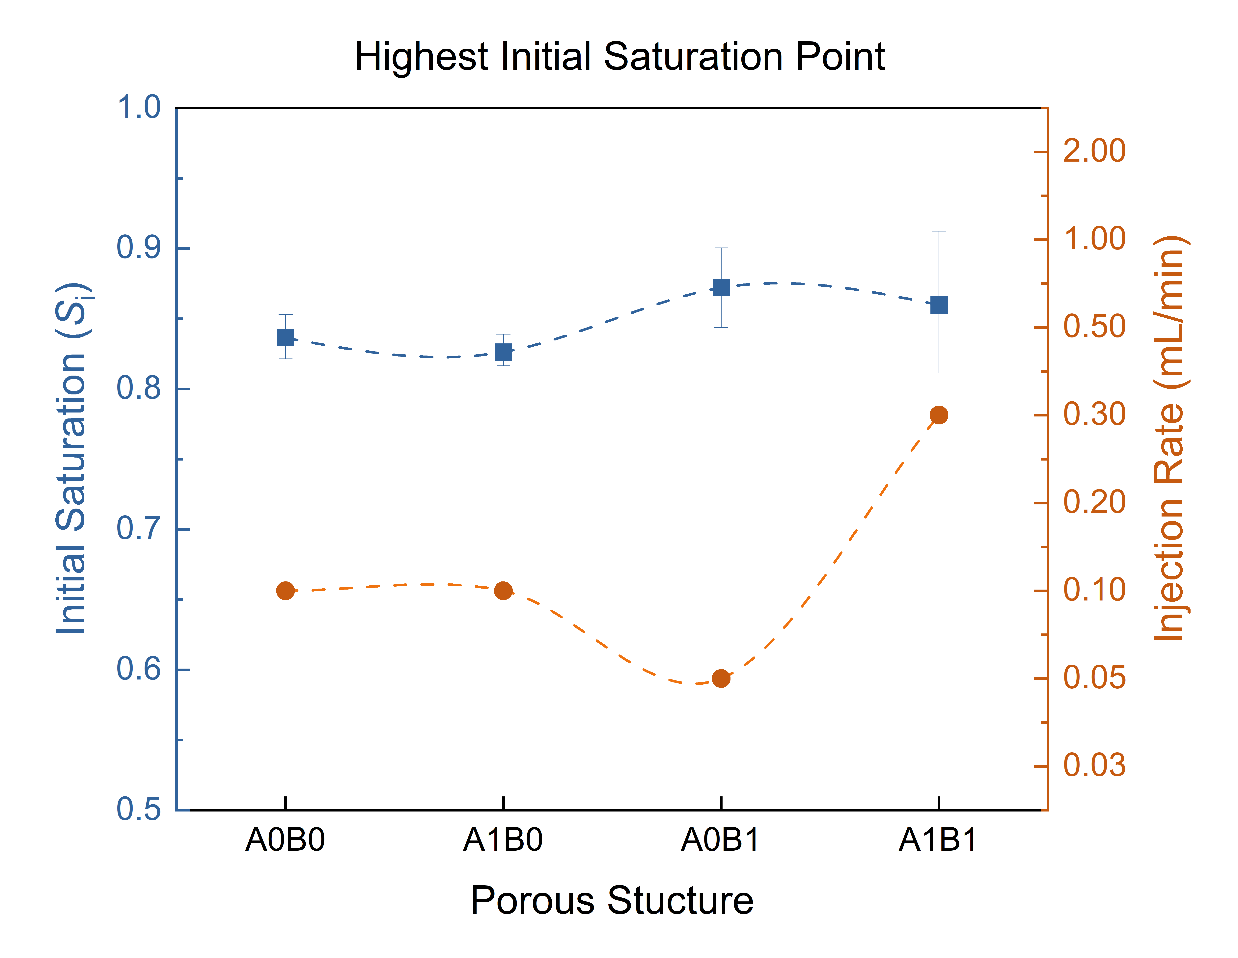
Interpretable Analysis by SHAP
01.点击加入标题
negative
positive
High
porosity
pore_throat_ratio
Nc_Rp/t
S_{i}
coordination_number
PDF_strength
SHAP value
Qi
PDF_peak_density
PDF_peak_radius
Low
Experimental Results
Porosity ↑ → earlier breakthrough → S_{i} ↓
Topological parameters > General heterogeneity parameters
Heterogeneity: more homogenous & larger pores → S_{i} ↑;
Tropology:
  N_{c}↑ → S_{i} ↓ , R_{p/t} ↑ → S_{i} ↑ ,
  N_{c} _R_{p/t} ↑ → S_{i} ↓
N₀R₀
N_{H}R₀
N₀R_{H}
N_{H}R_{H}
Notes:
Positive value means the increase of this feature will increase the output, while negative value means it will lower the output

Slide 13
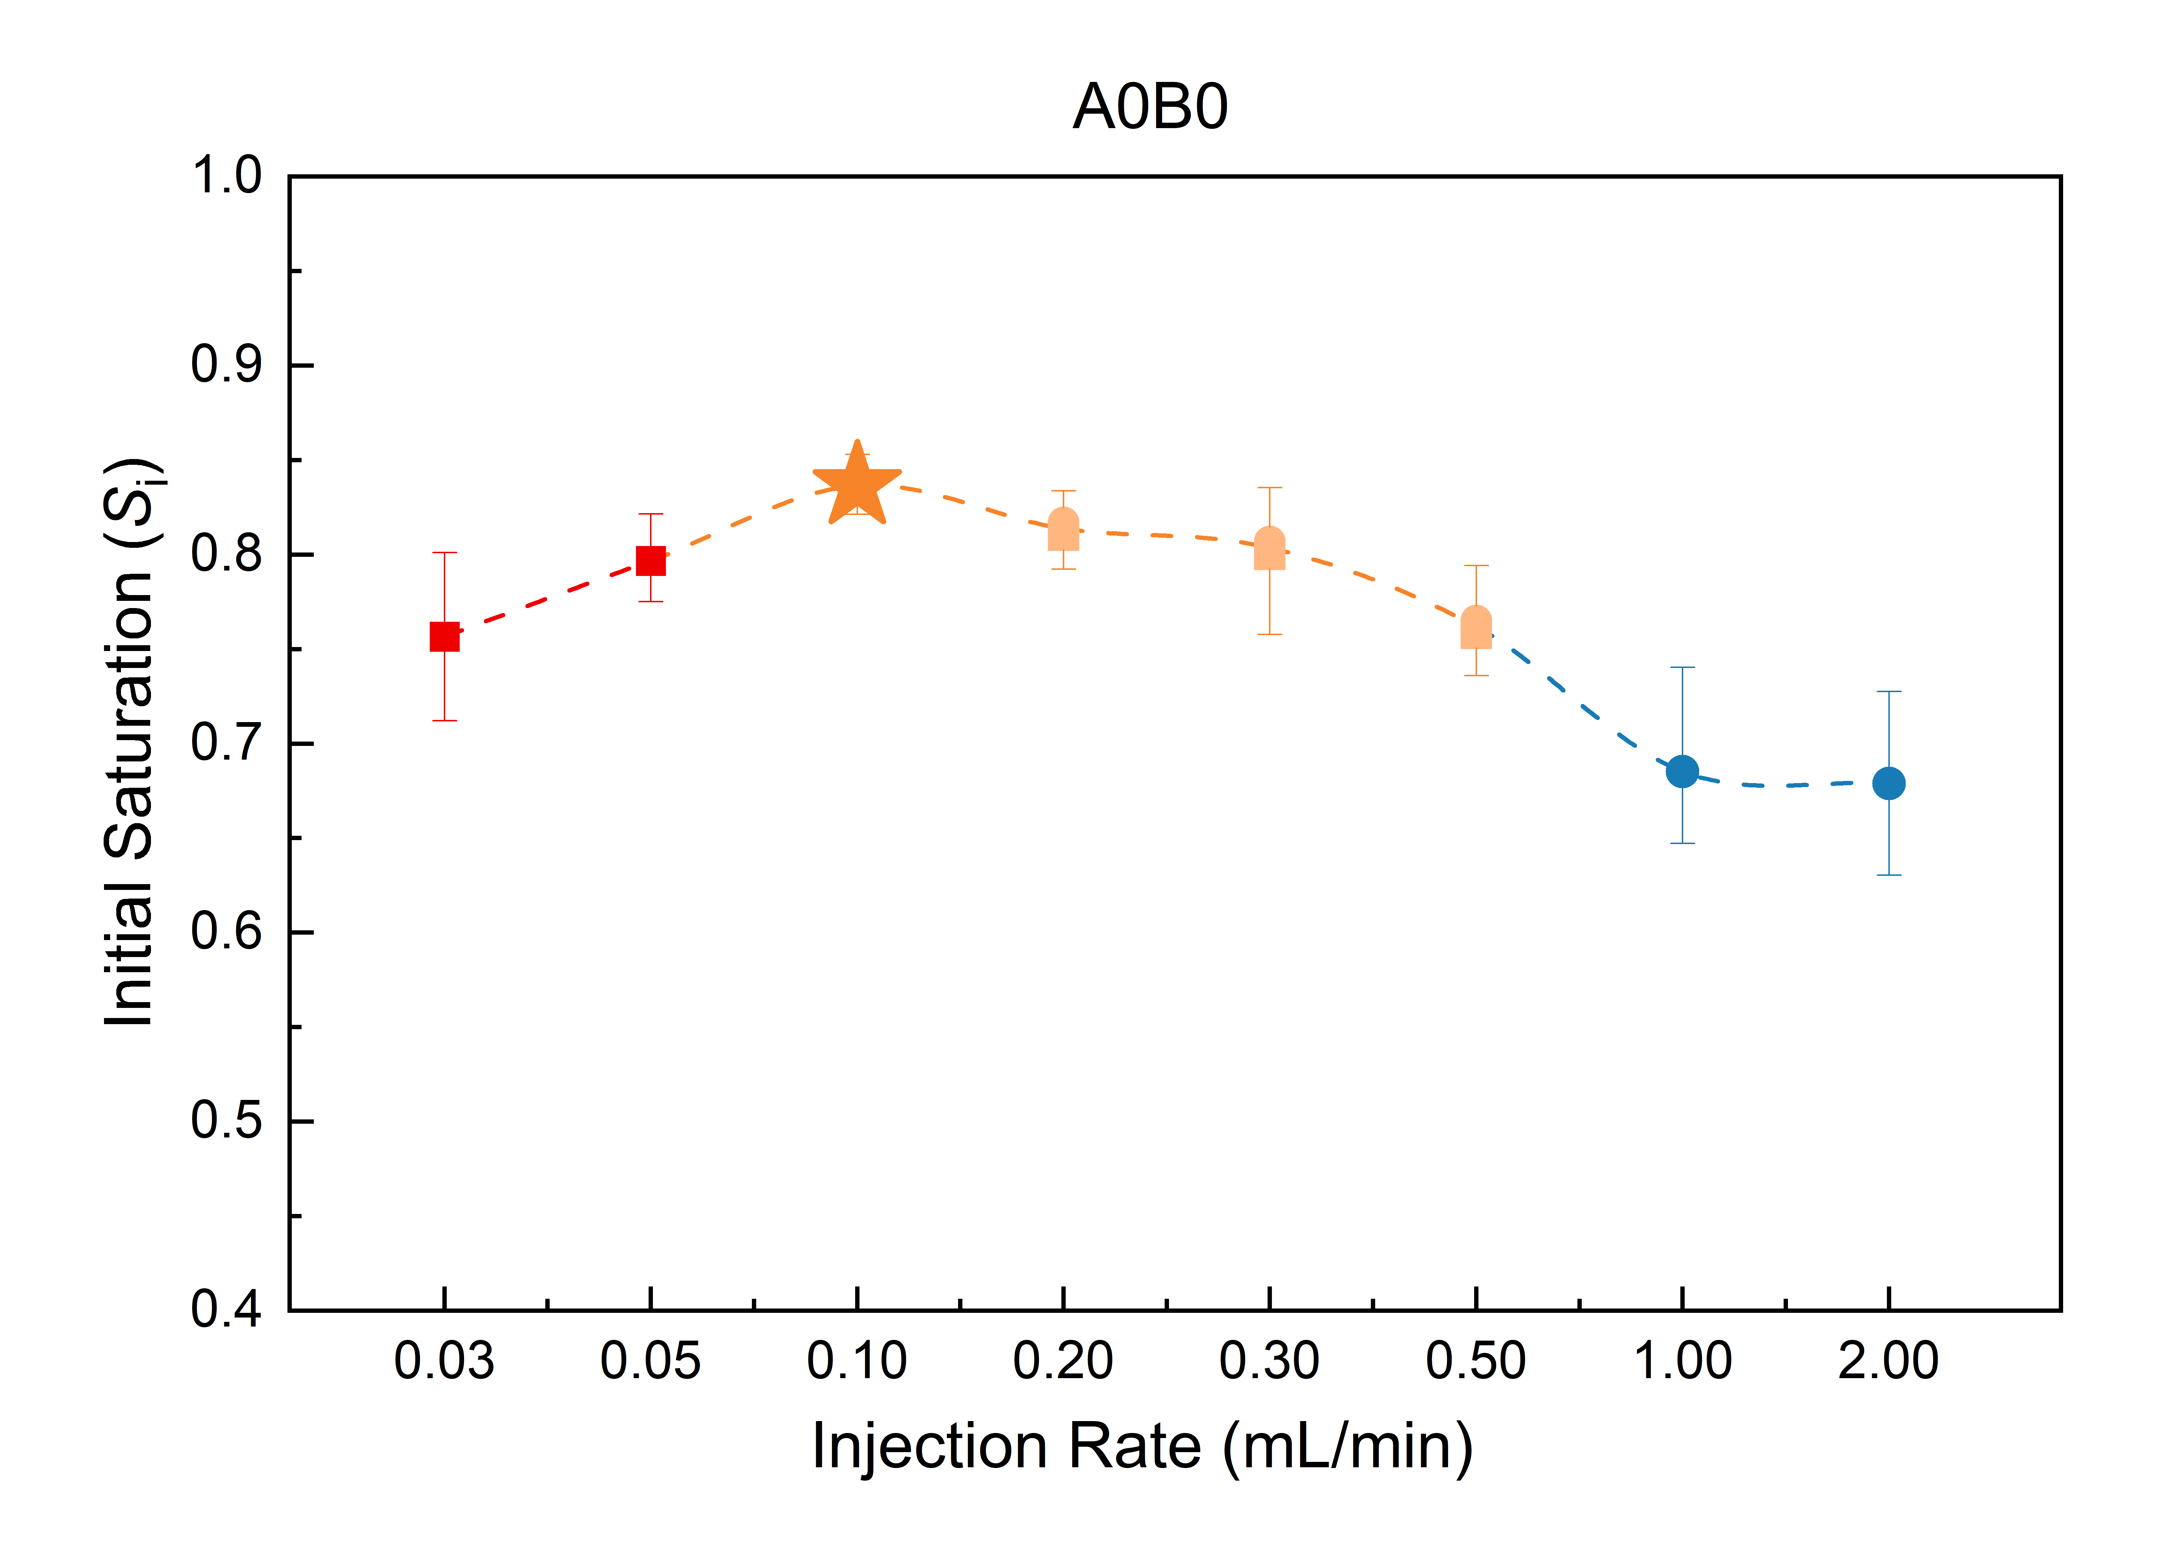
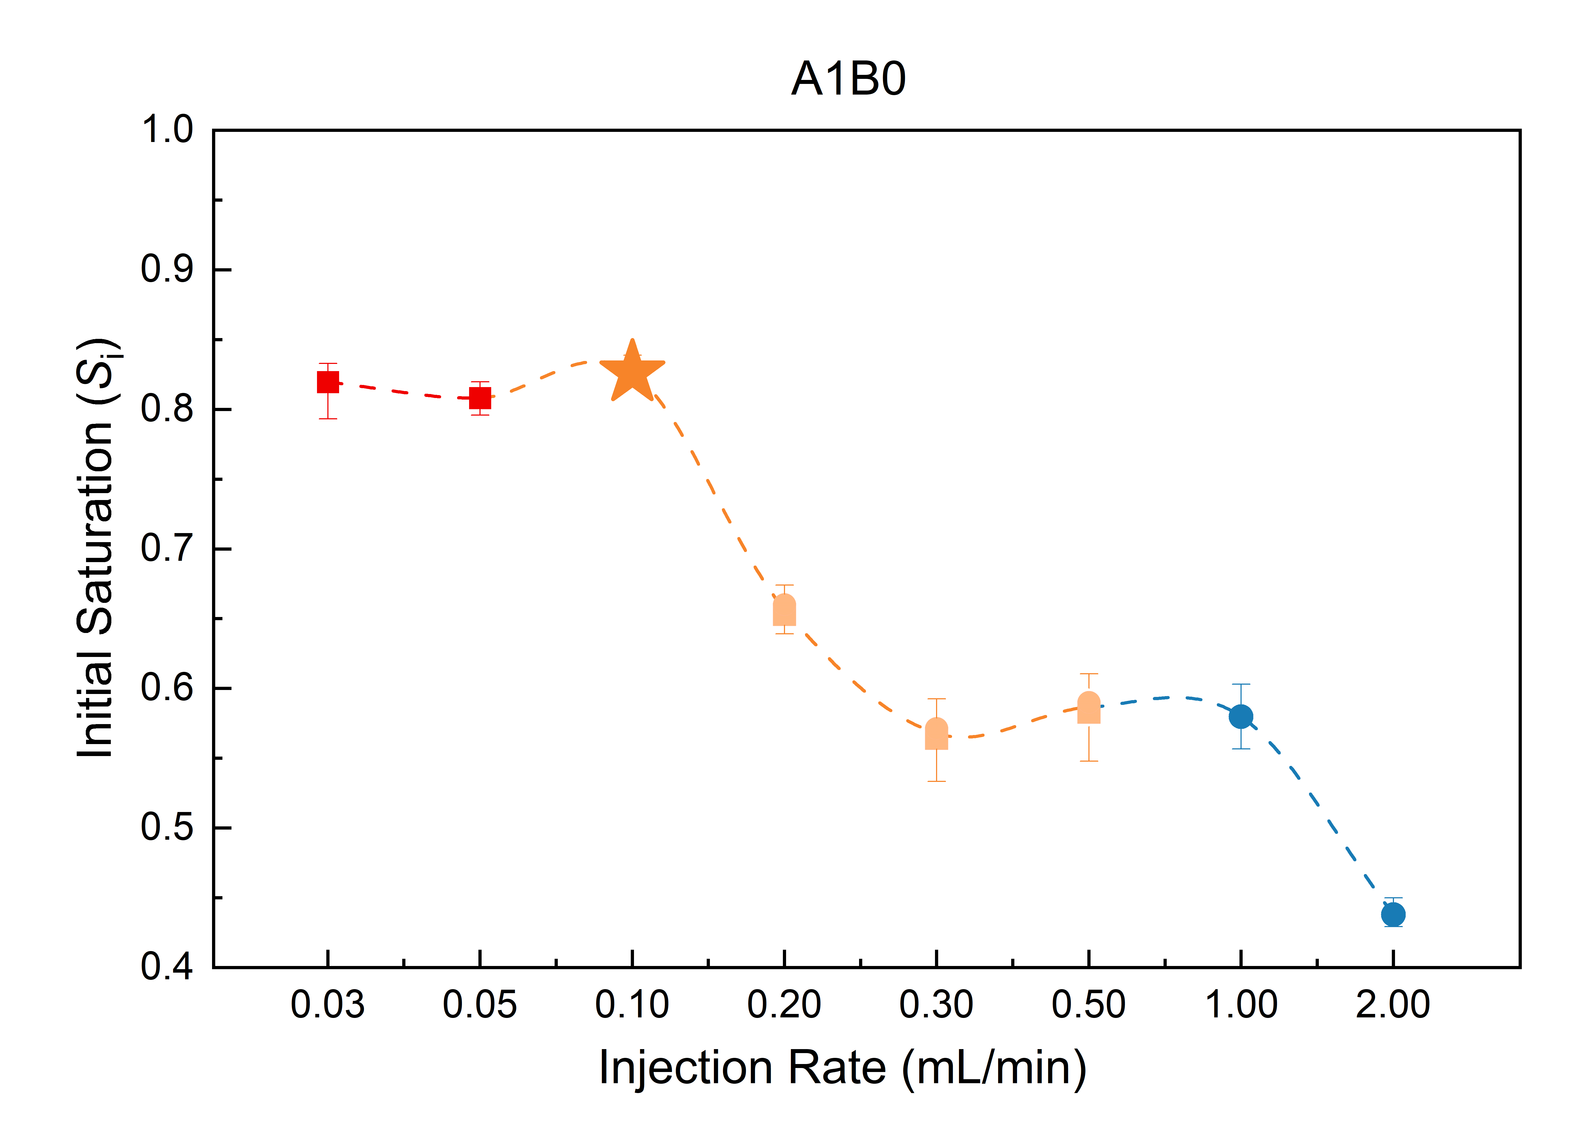
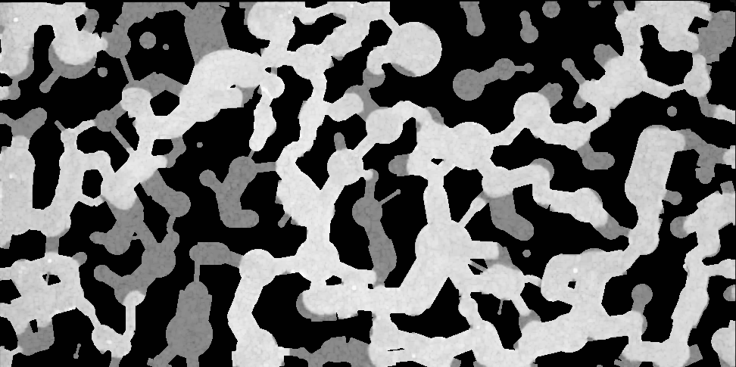
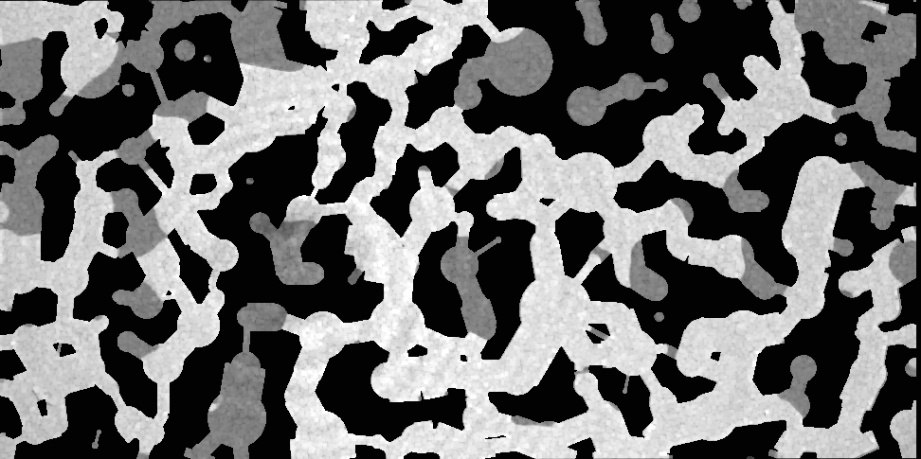
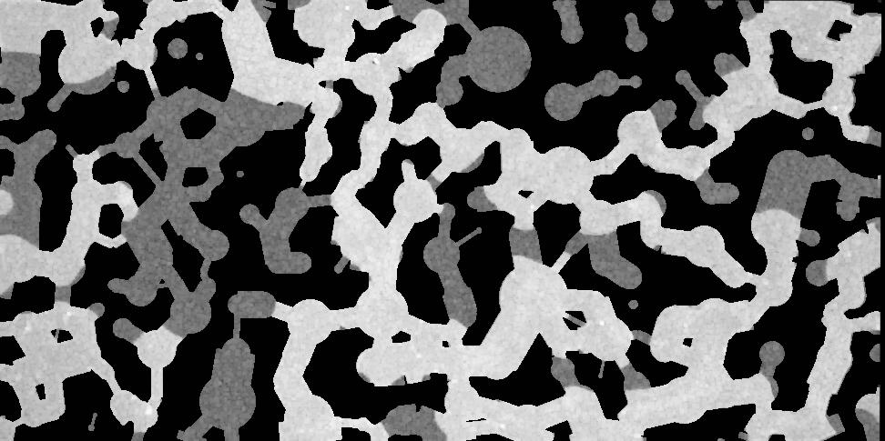
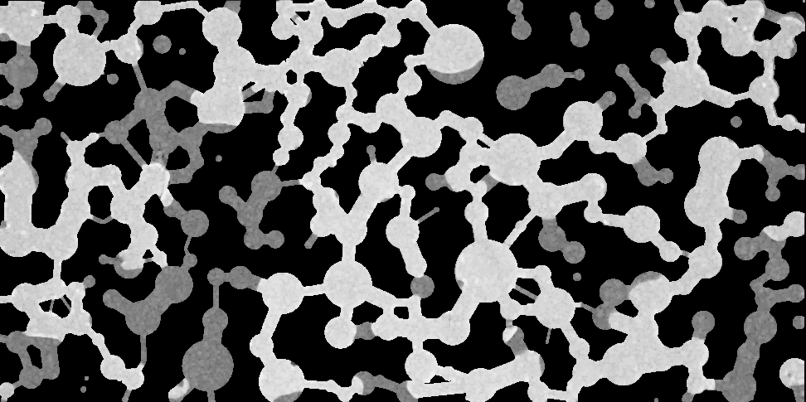
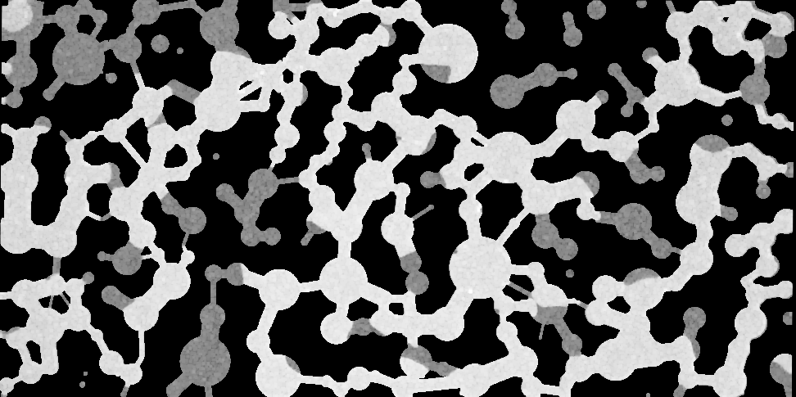
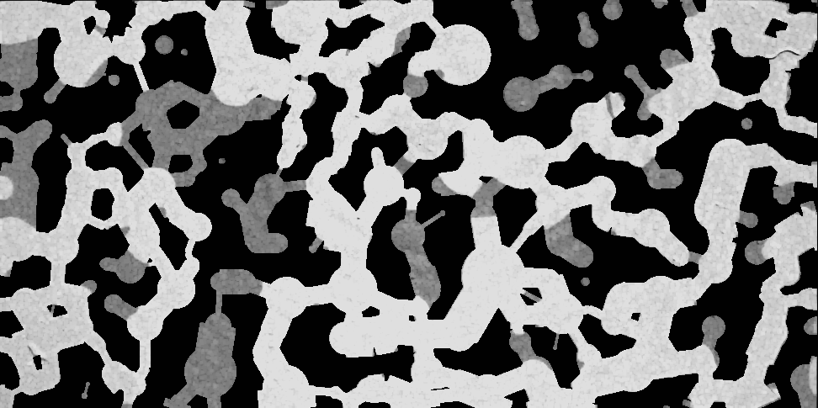
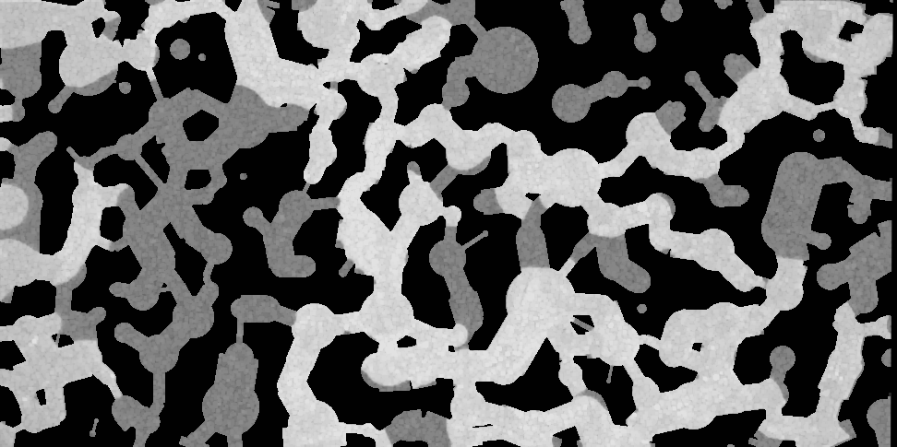
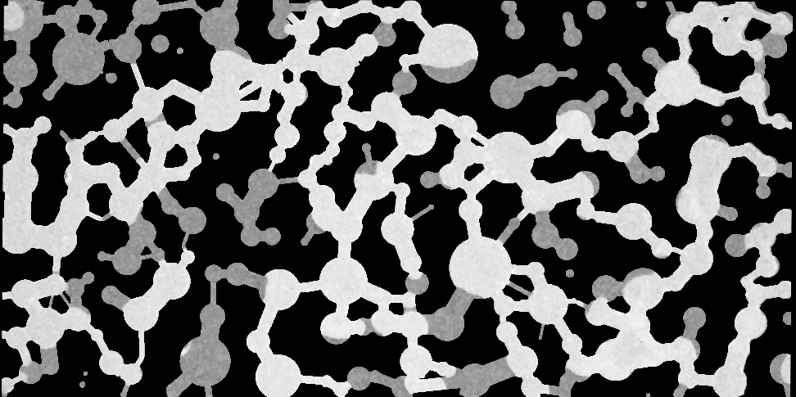
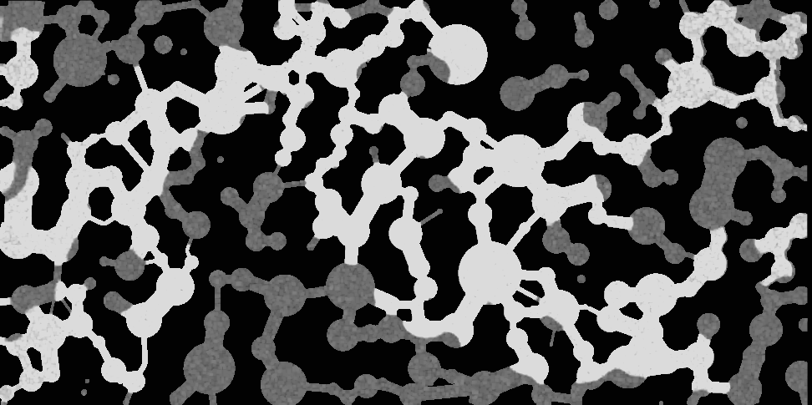
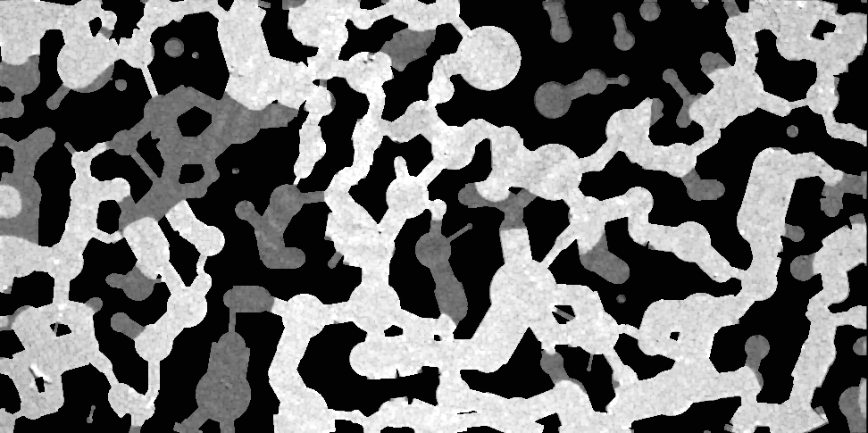
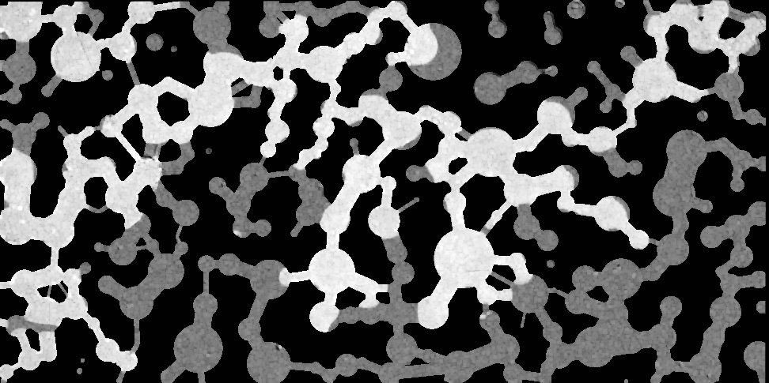
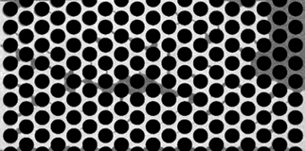
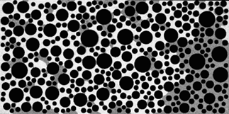
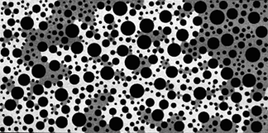
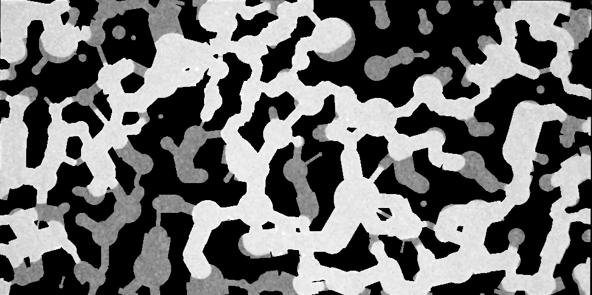
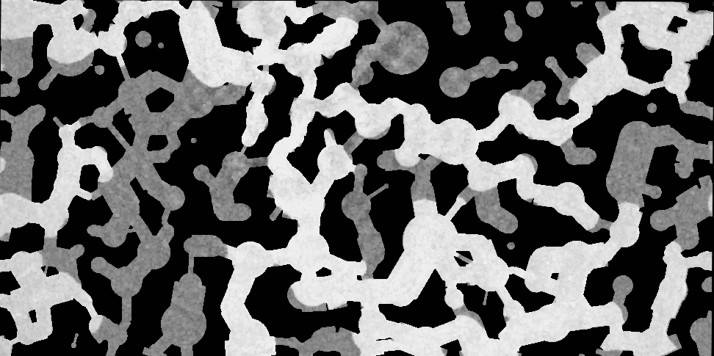
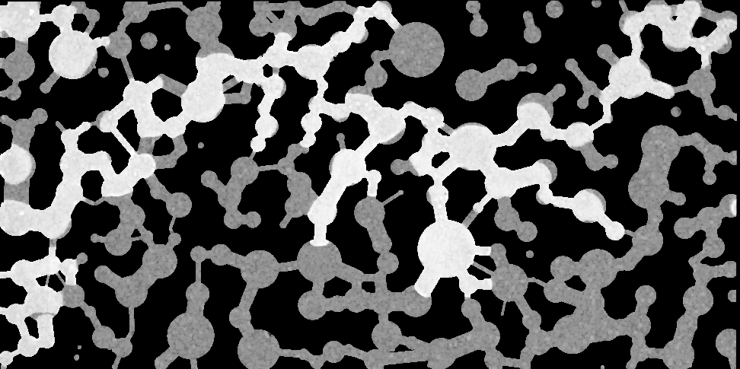
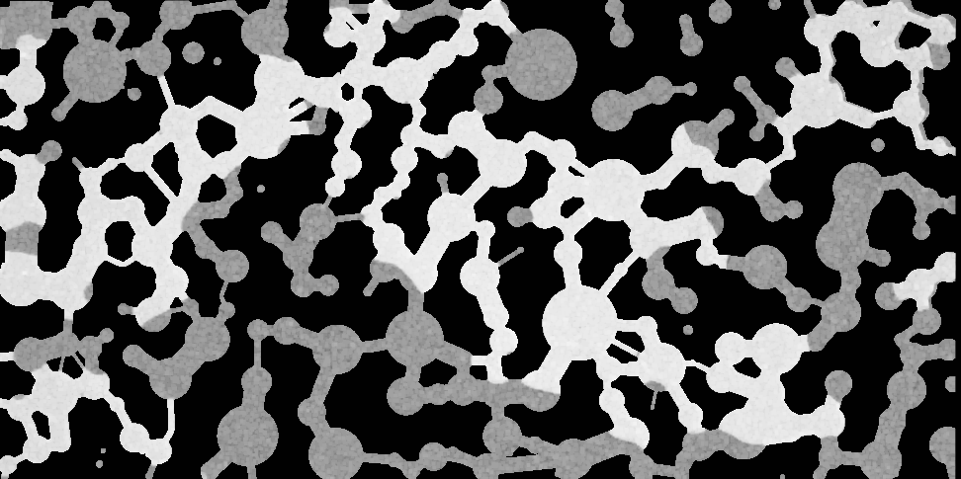
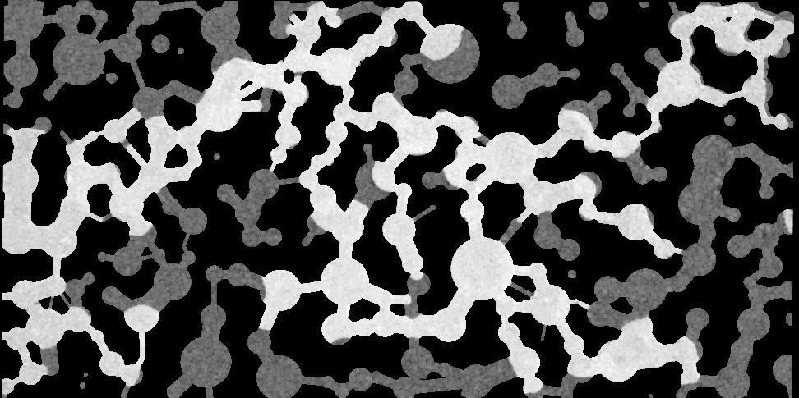
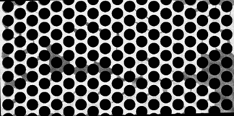
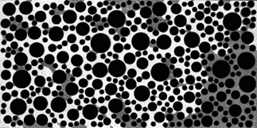
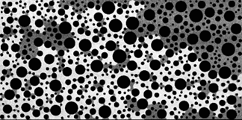
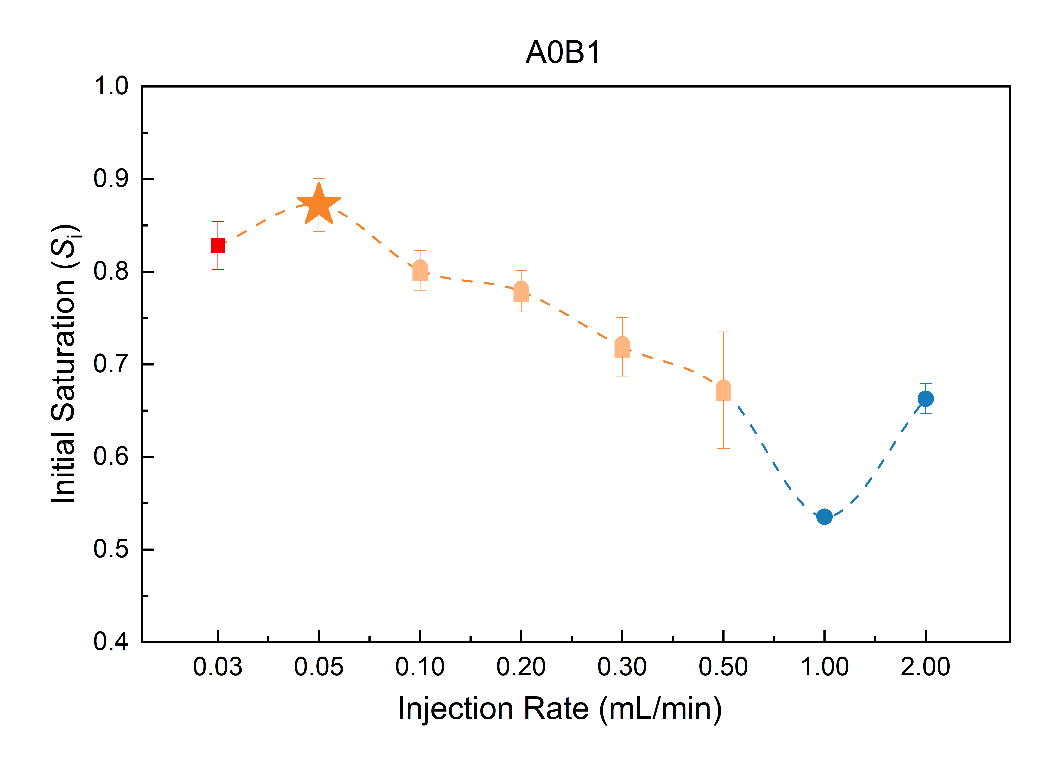
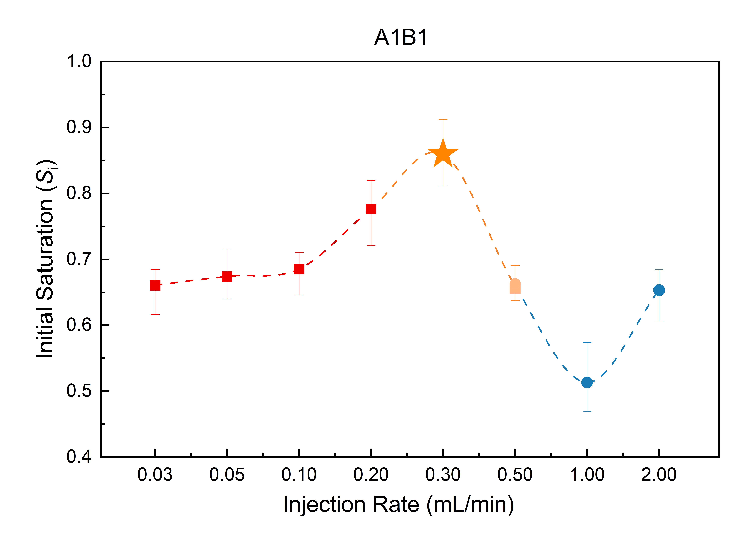
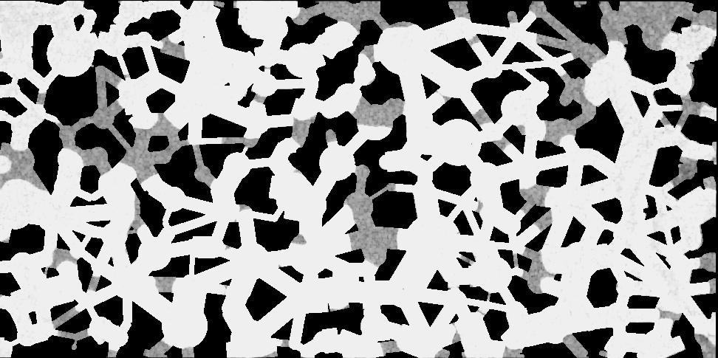
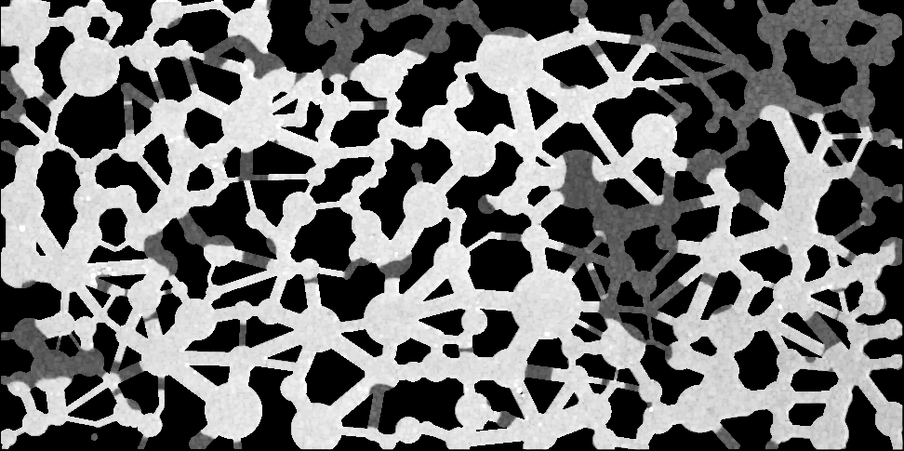
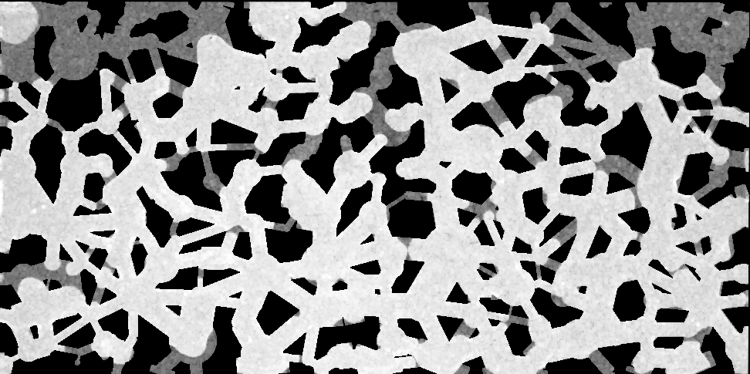
















Mechanism Analysis
01.点击加入标题
Heterogeneous structure
MA2-1
MA2-2
KA2-1
KA2-2
MB2-1
MB2-2
Increasing injection rate
1-1
1-2
A1
A2
KB2-1
KB2-2
B2
KB2-3
KB2-4
Pronounced fingering during displacement, with bypass areas (framed) formed due to high resistance in small pores
Capillary-Connectivity balance
⟹ Flow pattern & Sweet spot (CF-transition turning spot)
S_{i} ↓
Chen, X., Ge, H.*, Chen, J., & Wang, C. (2025). Impact of Pore Heterogeneity on CO₂ Capture Efficiency in Porous Media. Chemical Engineering Research and Design, 215, 77-82.
Chen, X., Ge, H.*, Chen, J., & Wang, C. (2026). Pore-Network Topology Impact on CO₂ Sequestration via Capillary-Connectivity Mechanism. Energy & Fuels, 40, 668-674.

Slide 14


Interpretable Analysis by SHAP
01.点击加入标题
negative
positive
High
porosity
Si
coordination_number
pore_throat_ratio
Nc_Rp/t
S_{r}
PDF_peak_radius
SHAP value
Qre
PDF_strength
Qi
PDF_peak_density
Experimental Results
Low
S_{i} is much more important: S_{i} ↑ → S_{r} ↑
Topological parameters > General heterogeneity parameters
Heterogeneity
  small pores enhance trapping, larger pores provide trapping space.
Tropology:
  N_{c}↑ → S_{r} ↓ , R_{p/t} ↑ → S_{r} ↑
  N_{c} _R_{p/t} ↑ → S_{r} ↓/ ↑
N₀R₀
N_{H}R₀
N₀R_{H}
N_{H}R_{H}
Notes:
Positive value means the increase of this feature will increase the output, while negative value means it will lower the output

Slide 15
Conclusion
01.点击加入标题
Interpretable AI for Micro-Mechanics
Experimental & Predictive Alignment
  The framework demonstrated robust qualitative agreement with microfluidic visual proofs, accurately capturing complex displacement boundaries.
Opening the Black Box via SHAP
  By integrating SHAP analysis, we successfully achieved a rigorous unification of high-precision saturation prediction and interpretable mechanistic analysis.
Decoupling Non-Linear Complexity:
  SHAP dependence models successfully isolated and quantified the highly non-linear weights of individual topological parameters (e.g., coordination number, pore-throat ratio) driving capillary snap-off.
Notes:
To conclude, our work builds a rigorous bridge between physical micro-mechanisms and data-driven scalability.
As you can see from the SHAP analysis on the screen, our predictive models do not just output numbers—they align perfectly with our experimental visual proofs. More importantly, by utilizing SHAP, we have successfully opened the 'black box' of neural networks, achieving a true unification of high-precision prediction and interpretable mechanistic analysis. This proves that explainable AI is an essential key to decoupling highly complicated, non-linear multiphase flow dynamics driven by pore topology.

Slide 16






IMPACT Group @ Zhejiang University
Intelligent Multiphase Porous media & Acoustic Cavitation Transport
Our Core Capabilities :
Multiphase Flow & Cavitation: Deep expertise in acoustic cavitation dynamics and physical blockage removal in porous media.
High-Fidelity Visualization: Customized microfluidic platforms capturing transient, pore-scale displacement mechanisms.
Explainable AI (XAI): Integrating experimental physics with machine learning (PIML) to decode non-linear flow complexity.
Han Ge (PI)| ✉ gehan@zju.edu.cn
Notes:
Before I conclude, I want to take a brief moment to introduce myself and share what my group at Zhejiang University can bring to the table.
My name is Han Ge, and my research fundamentally focuses on acoustic cavitation, multiphase flow visualization, and integrating explainable AI into porous media. We have built highly cost-effective, high-precision microfluidic pipelines that generate rich, structured datasets—which are exactly what large-scale AI models and simulators need for ground-truth validation.
Currently, we are actively expanding our international footprint and looking for funding synergies. If you are building a consortium for major collaborative grants, or if your macroscopic simulators need robust pore-scale physical constraints for CCUS and EOR applications, let's partner. We bring the high-fidelity experimental proof and the explainable AI engines; we are looking for the macro-scale validation and joint proposal opportunities.
Please catch me during the coffee break. I would be absolutely honored to discuss how we can build high-impact projects together. Thank you!"

Slide 17
Thank you for your attention
Questions?
13 May 2026

