Slide 1



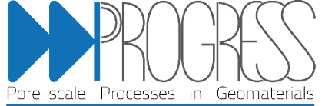
department of Geology
research group PProGRess
Direct Visualization of viscoelastic flow fields in 3D porous media using X-ray particle velocimetry
Parsa Damanshokouh, Sojwal Manoorkar, Robert van der Merwe, Cyprien Soulaine, Flavio Marchesini de Oliveira, Tom Bultreys

Slide 2
Introduction – Viscoelastic flow in porous media
1
CT X-ray micro velocimetry - Methodology
2
Materials and Geometries
3
Observations
4

Slide 3
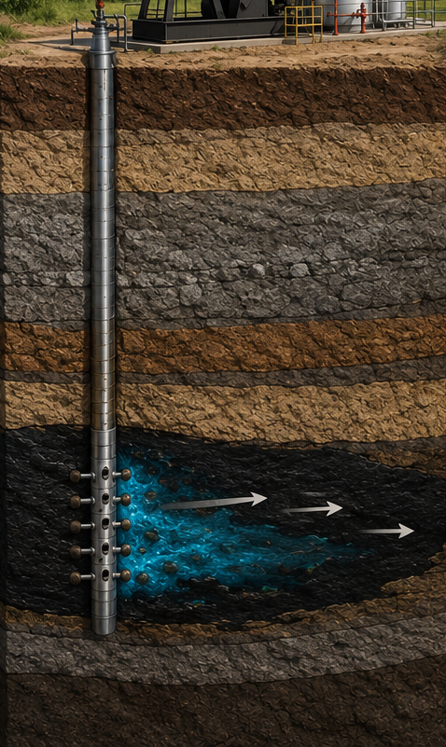
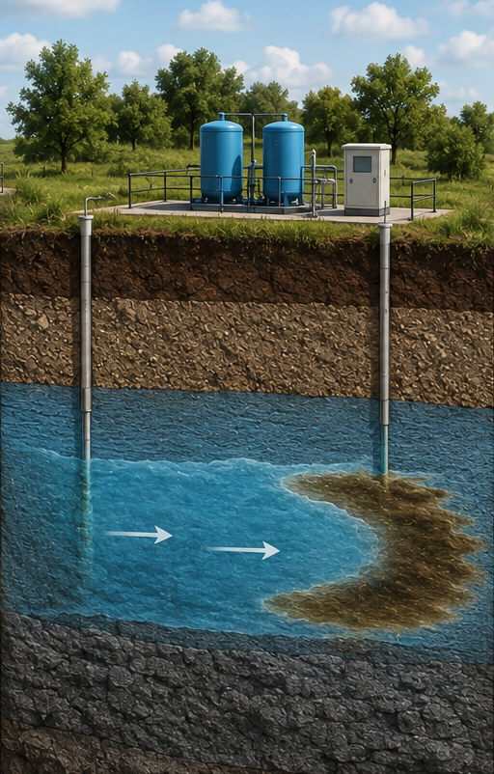
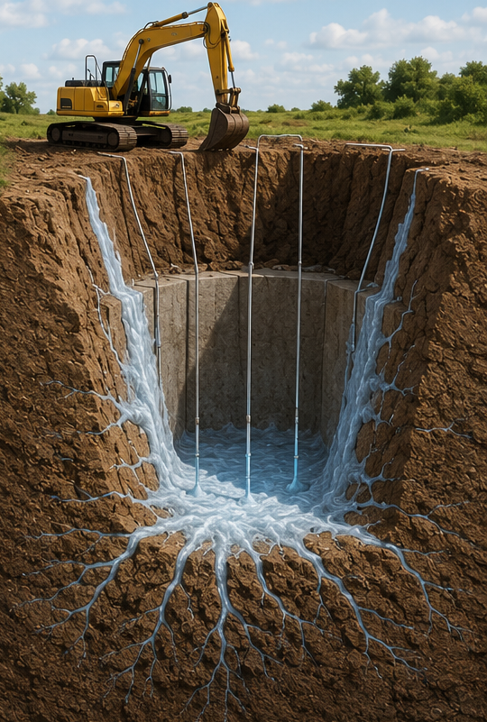
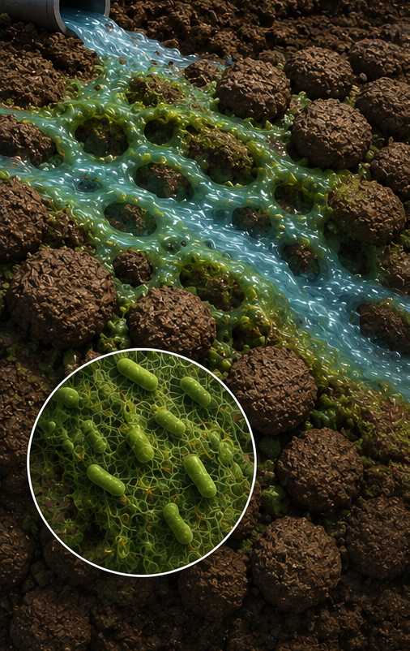
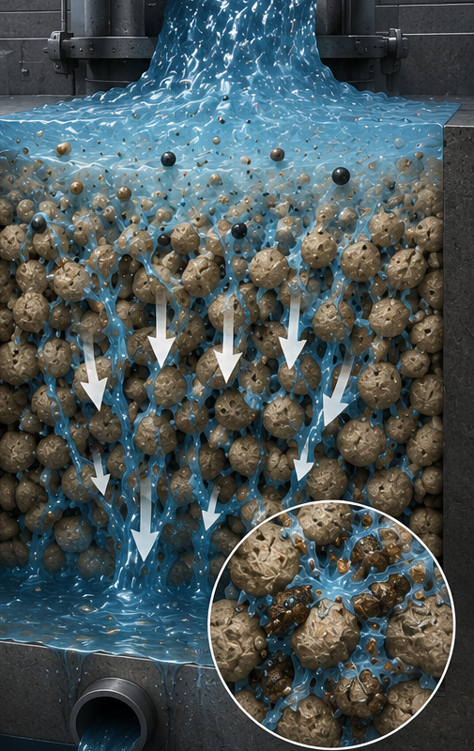
Introduction – Viscoelastic flow in porous media
Viscoelastic Fluids have a wide range of applications across several industries
Energy Storage and production
Groundwater Remediation
Excavation Stabilization
Biofilms and Porous Tissues
Polymer Filtration and Mixing

Slide 4
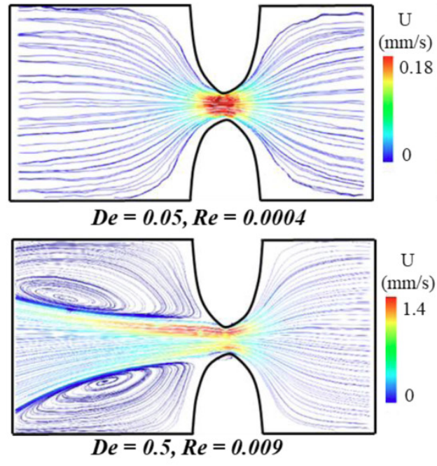
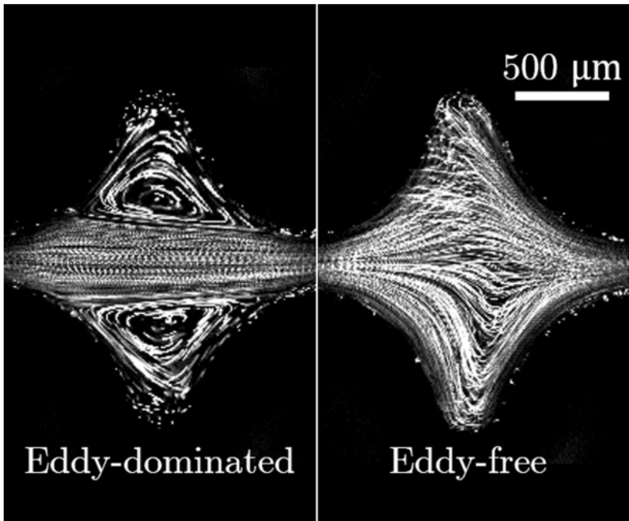
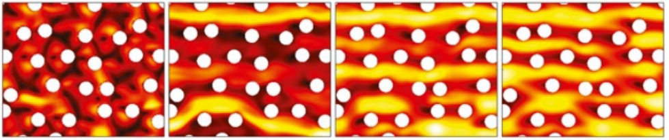
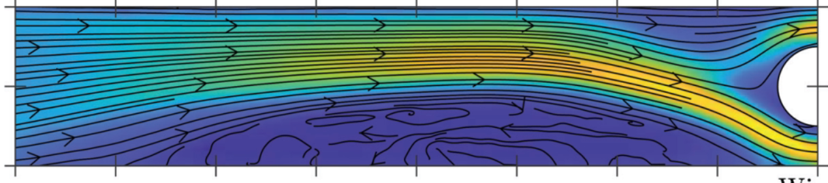
Introduction – Viscoelastic flow in porous media
Viscoelastic Fluids can result in an unexpected class of instabilities
both flow-like (Viscous) and solid-like (Elastic) responses under deformation
a time-dependent property
memory-like characteristics
Chaotic flow patterns in low Reynolds number
Haward et al. 2021
Ekanem et al. 2020
Browne & Datta 2021
Hopkins et al. 2022
Geometrical complexity
Field of View
Current literature lakes:
Notes:
Real porous media are: opaque, Full 3D network of pores, Non-homogenous and disordered across scales

Slide 5
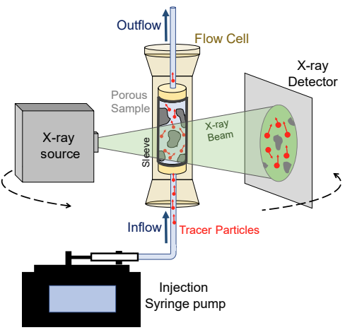
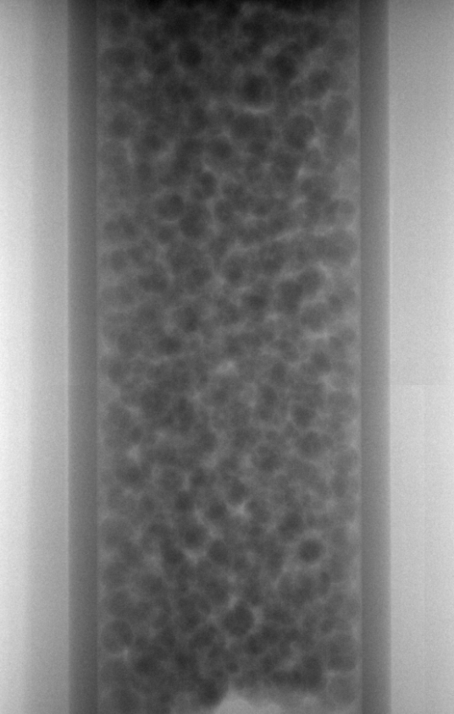
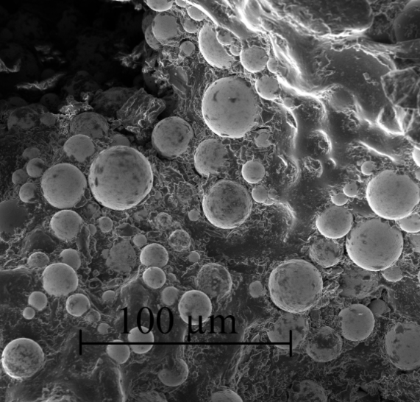
CT X-ray micro velocimetry - Methodology
X-ray velocimetry provides insight into the complex network of pores in opaque samples
Tracer Particles:
Silver/Tungsten Coated Hollow Glass Spheres (5-22 µm)
1 mm
radiographs

Slide 6
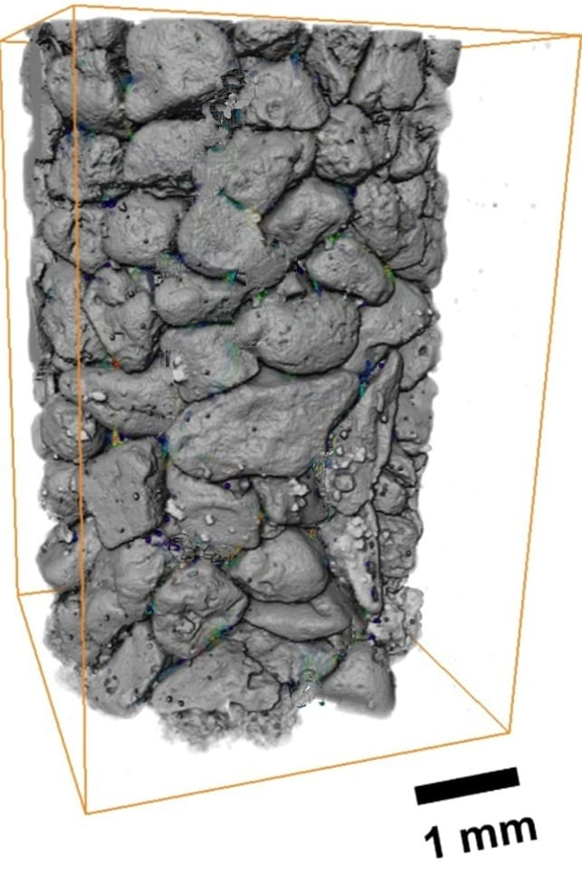
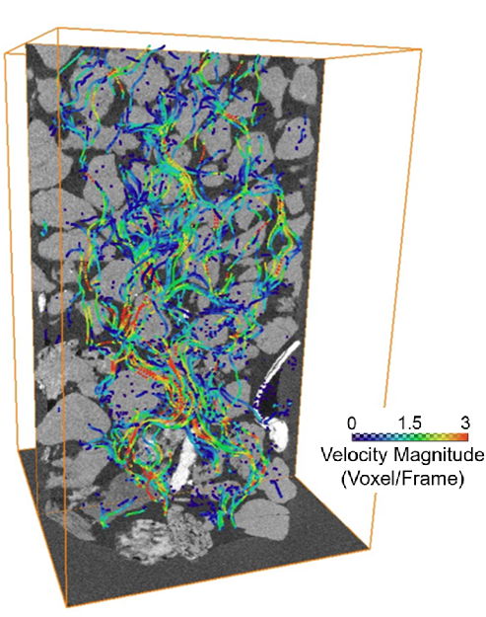
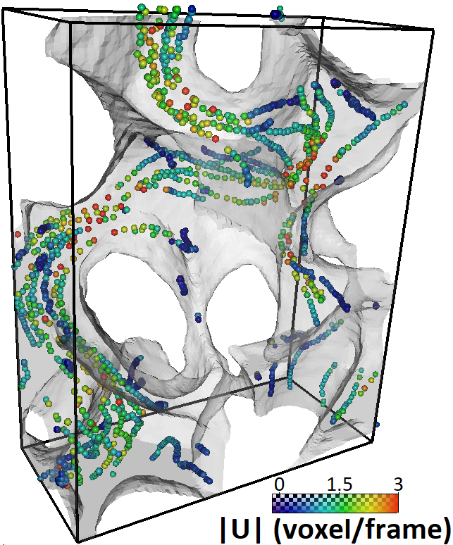
CT X-ray micro velocimetry - Methodology
By tracking tracer particles, the flow field will be revealed
Particle tracking
Reconstruction

Slide 7
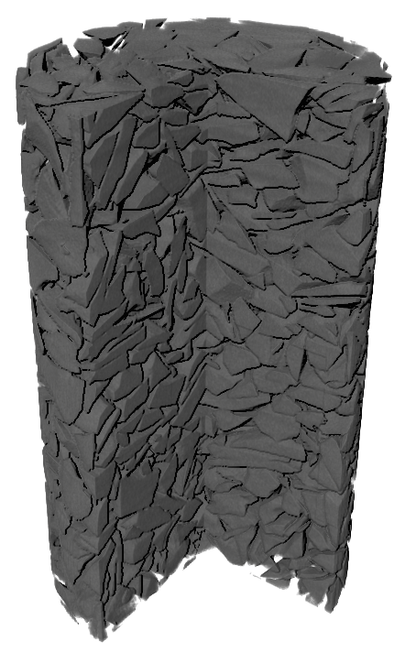
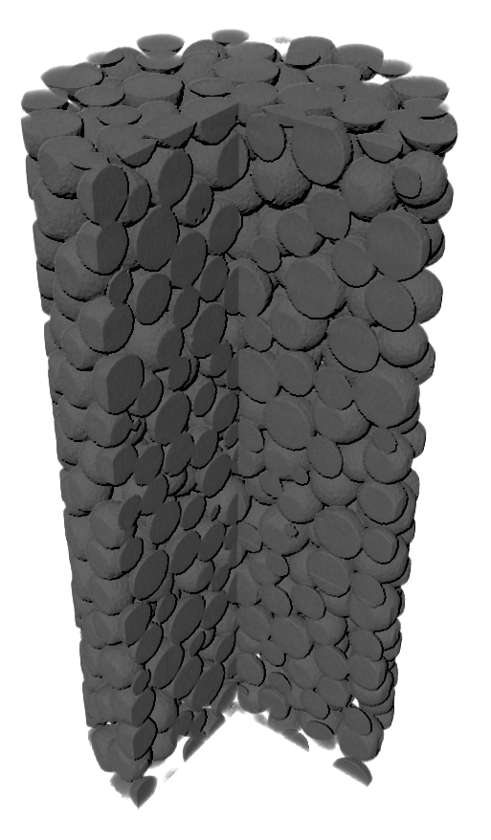
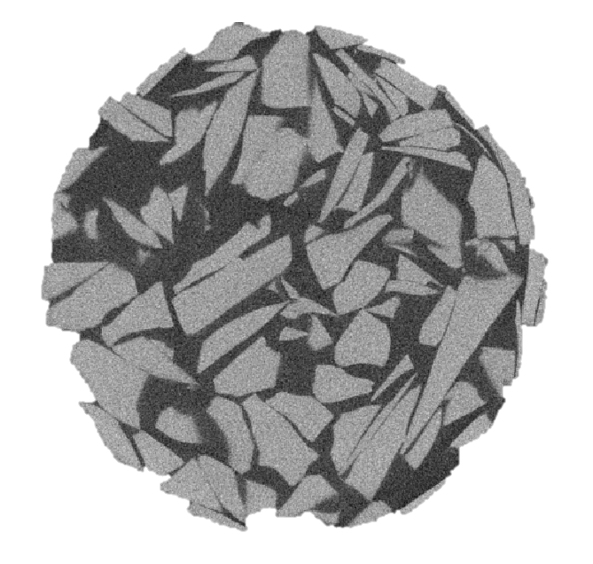
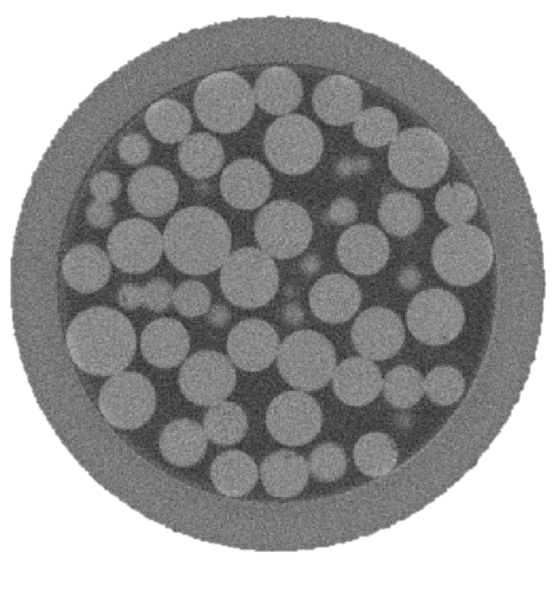
Materials and Geometries
Obsidian Shard sample
Porosity
0.42 0.44
Diameter
5 mm 4mm
Length
~1cm ~1cm
Characteristic Property
Sharp edges Round edges
Glass Bead sample

Slide 8
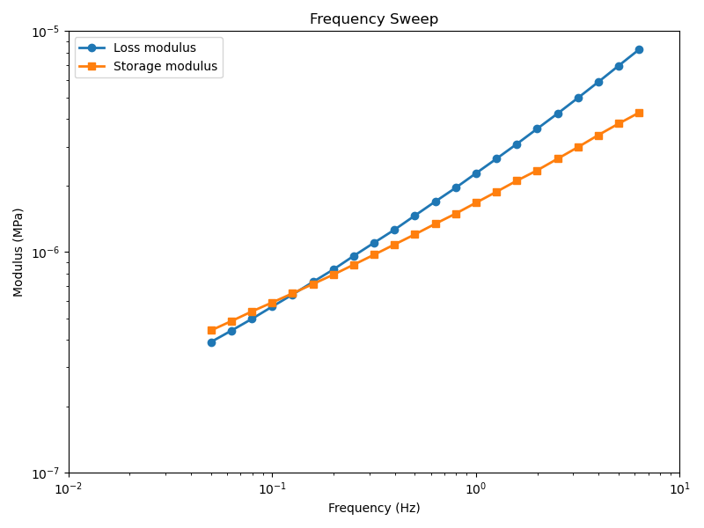
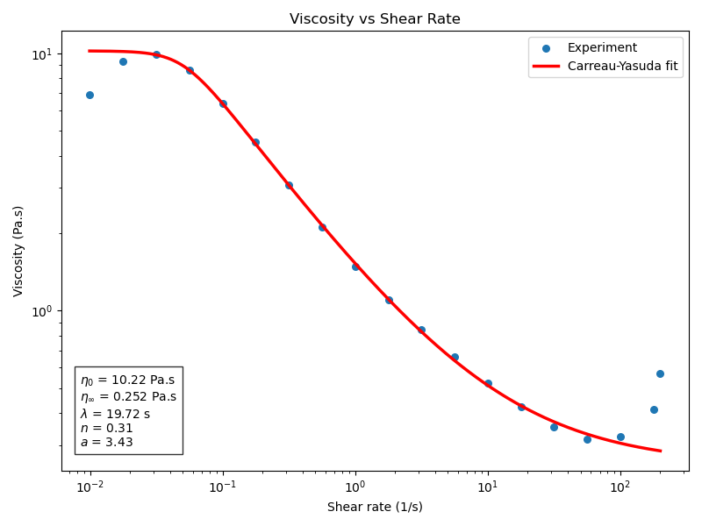
Materials and Geometries
Polymeric solutions often show viscoelastic responses
500 ppm Partially Hydrolyzed Polyacrylamide (HPAM)
80% Glycerol
~20% DI-water
Imposed flowrates:
30 nl/min up to 600 nl/min
Equivalent to average interstitial velocity of 6 – 120 µm/min
Weissenburg number: up to 0.2
The fluid successfully passed tests for:
Aging
X-ray exposure
Session

Slide 9
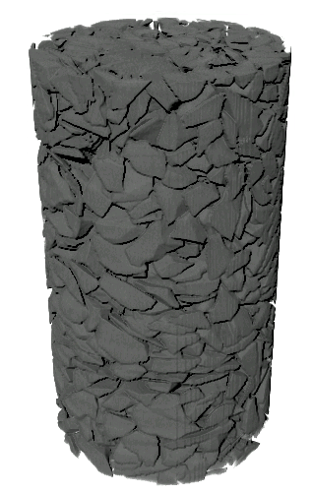
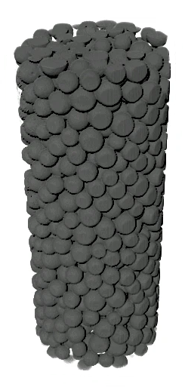
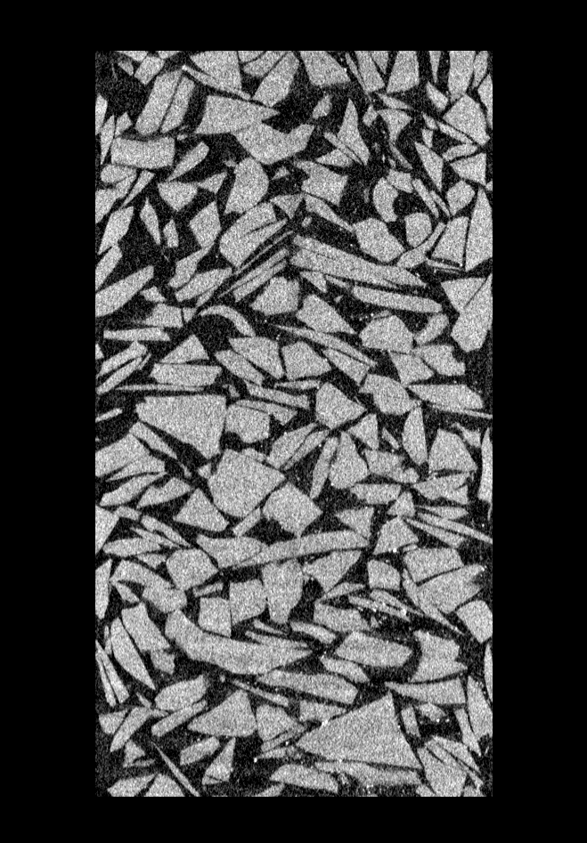
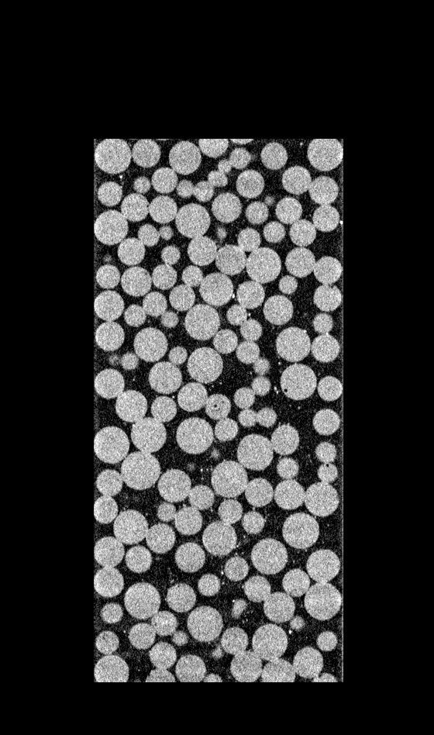
Observations
Raw Images show particles moving within the porous media
Obsidian sample
Glass Bead sample

Slide 10
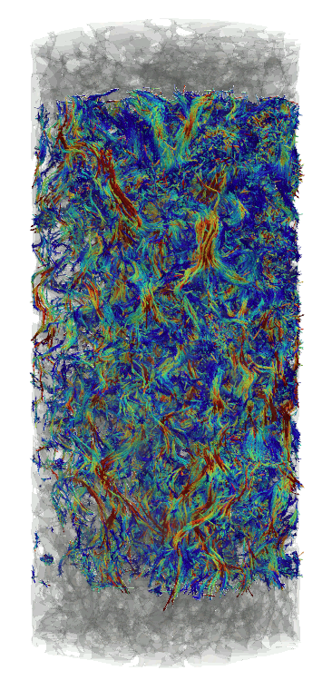
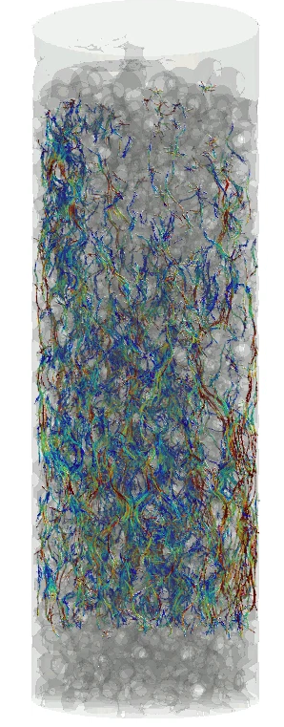
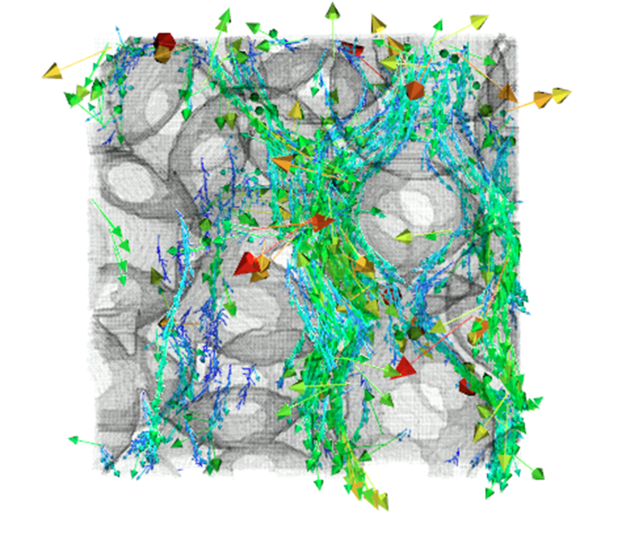
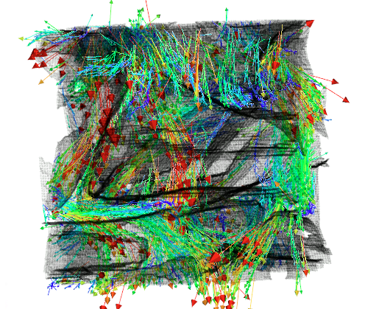
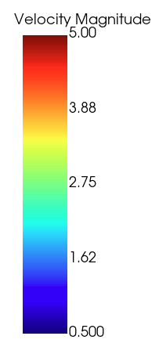
Observations
By tracking particles, a full 3D map of velocity field will be extracted
Obsidian sample
Glass Bead sample

Slide 11

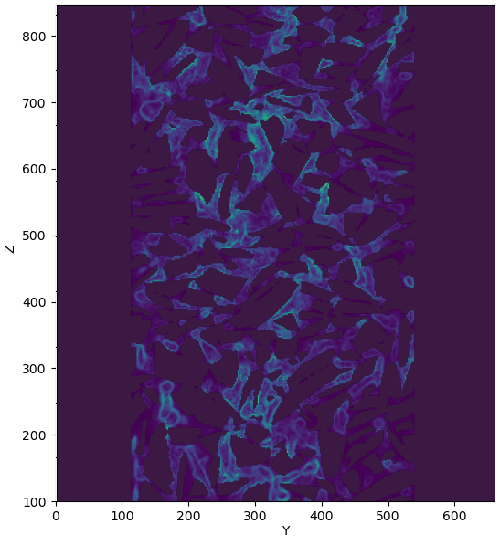
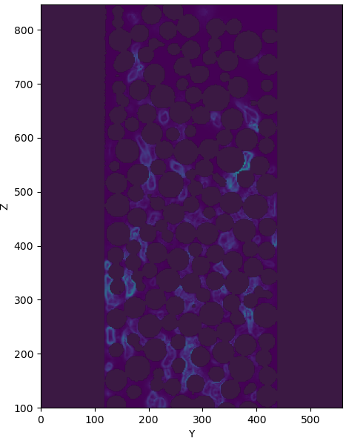
Observations
Analysing the velocity field results in further insights such as shear rate distribution
Shear Rate (1/s)
Obsidian sample
Glass Bead sample

Slide 12
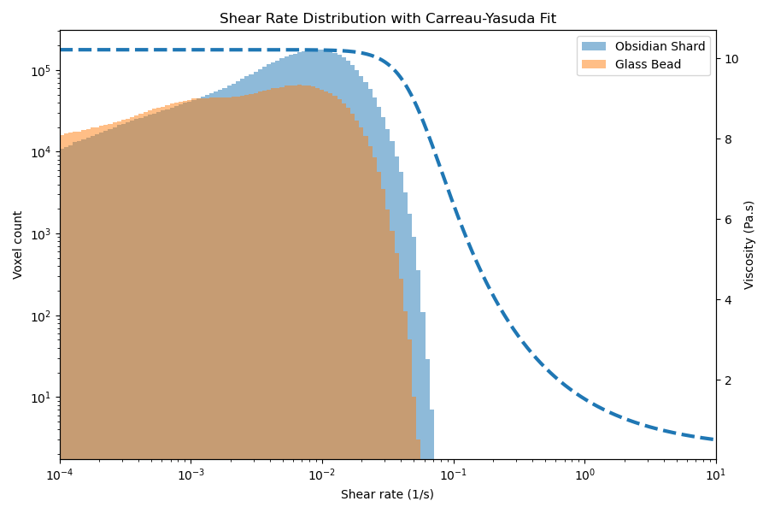
Limitations and Future Steps

Slide 13
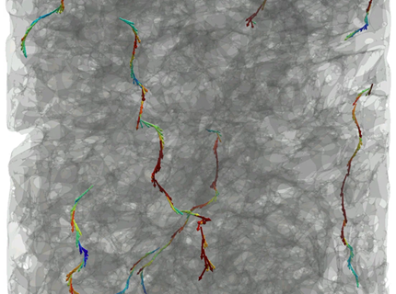
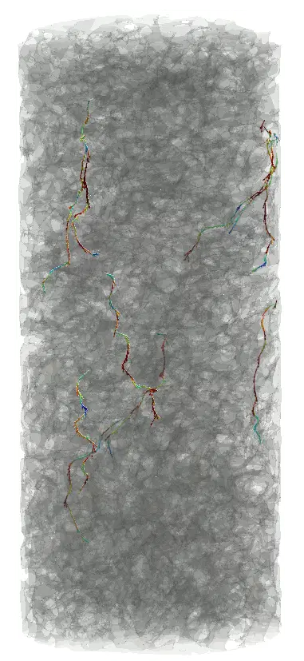
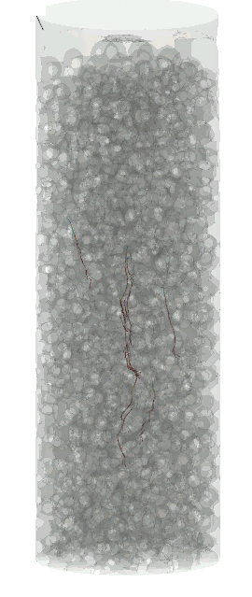
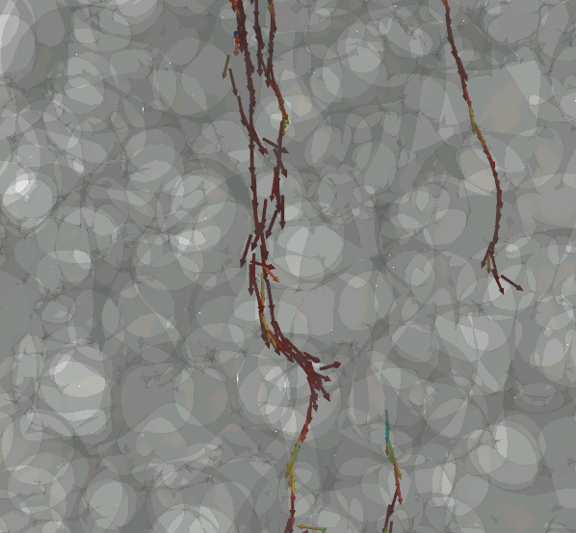
Observations
Curvature of the flow paths can be understood by visualizing individual trajectories
Obsidian sample
Glass Bead sample

Slide 14
Conclusion
Remarks:
X-ray velocimetry can unravel full 3D complexity of fluid flow inside the opaque porous media
The technique can give insight across scales
Post-processing computations can further enrich our understanding of complex fluid flow through porous media
Future steps:
Pushing the flow regime into higher shear rate values
Using newly developed tracking algorithm to overcome the current limitations
Synchrotron beam line to enhance temporal and spatial resolution
Thank you for your attention!

Slide 15
Thank you for your attention!

