Slide 1

MS13 - Fluids in Nanoporous Media
Abstract ID : 366
Experimental observation of the dependence of a
liquid adsorbate’s elastic modulus on the pore size
K. Schappert and R. Pelster
Saarland University, Department of Physics, Germany

Slide 2
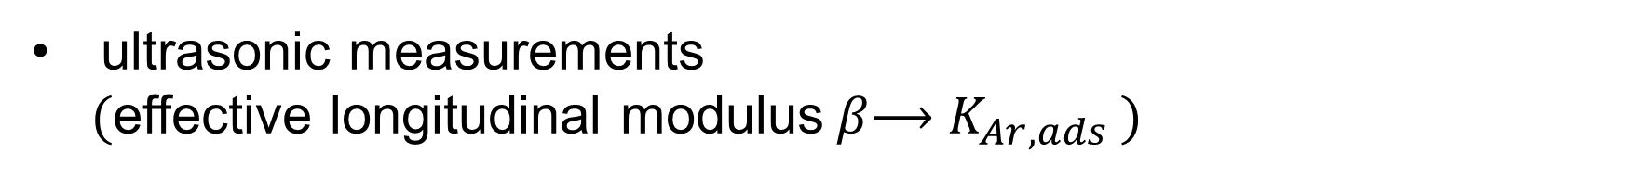
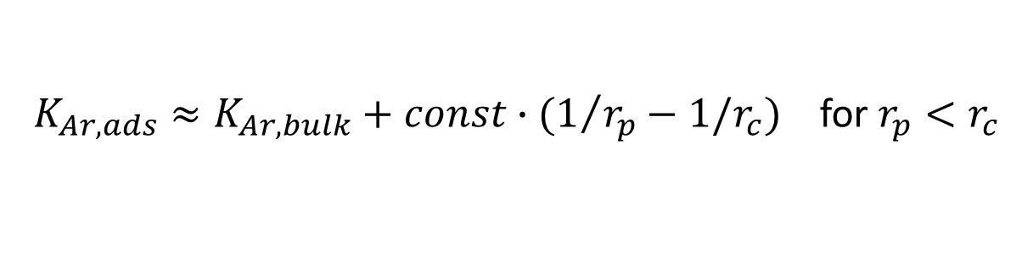
Motivation:
theoretical prediction (MC simulations/DFT calculations)
Increase of the adsorbate’s bulk modulus $K_{ads}$ at small pore radii $r_{p}$
C.D. Dobrzanski, B. Gurevich, G. Gor, Appl. Phys. Rev. 2017, 4, 011303
$K_{Ar,ads}≈K_{Ar,bulk}+const∙(1/{r_{p}}−1/r_{c})$ for $r_{p}<r_{c}$
origin: solvation pressure of the confined liquid (G. Gor, Langmuir 2014,30, 13564-13569)
Here: Experimental test
nanoporous glass monoliths with interconnected pores
Particle Solutions, LLC (Florida, USA)
liquid adsorbate: argon at 86 K
ultrasonic measurements
(effective longitudinal modulus$β$⟶ $K_{Ar, ads}$ )

Slide 3
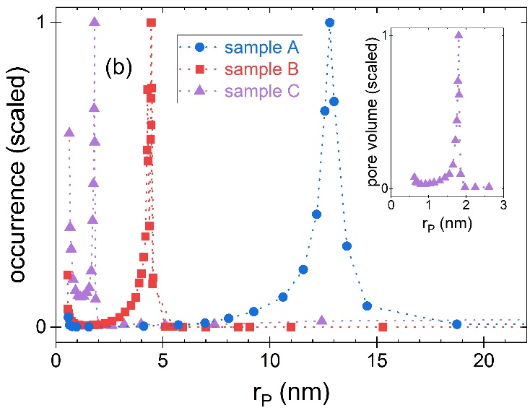
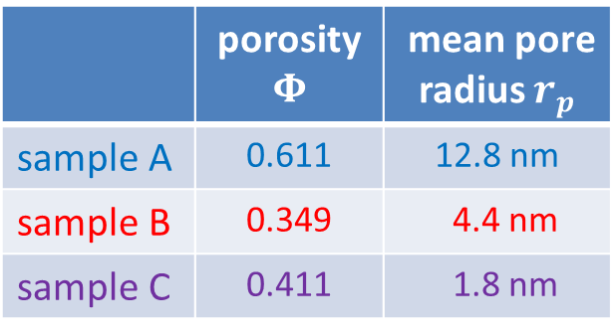
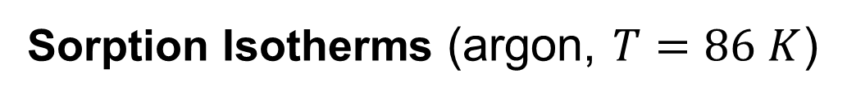
Sorption Isotherms (argon, $T=86 K$)
Nanoporous glass monoliths
with interconnected pores
Particle Solutions, LLC (Florida, USA)
→ Pore Size Distributions
 | porosity $$Φ$$ | mean pore radius $r_{p}$
sample A | 0.611 | 12.8 nm
sample B | 0.349 | 4.4 nm
sample C | 0.411 | 1.8 nm

Slide 4
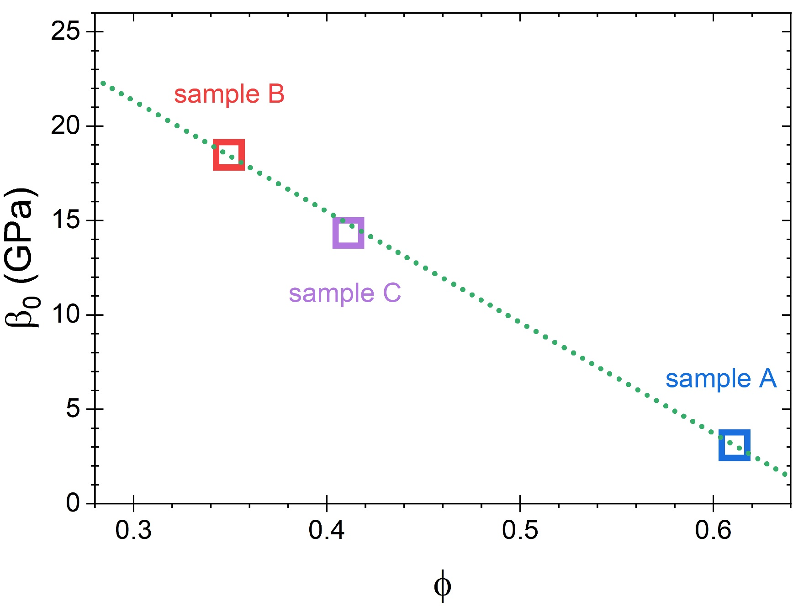
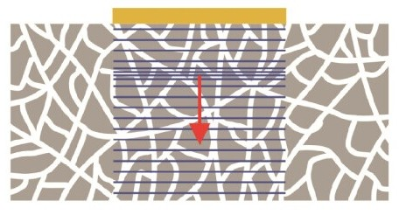
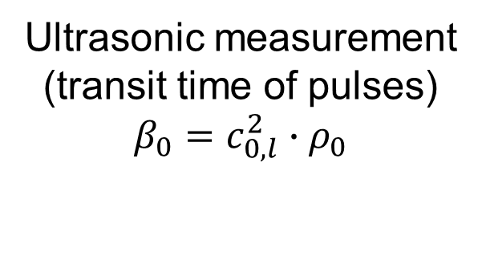

Measured effective longitudinal modulus - empty samples
$T=86 K$
Ultrasonic measurement
(transit time of pulses)
$$β_{0}=c_{0,l}^{2}∙ρ_{0}$$

Slide 5
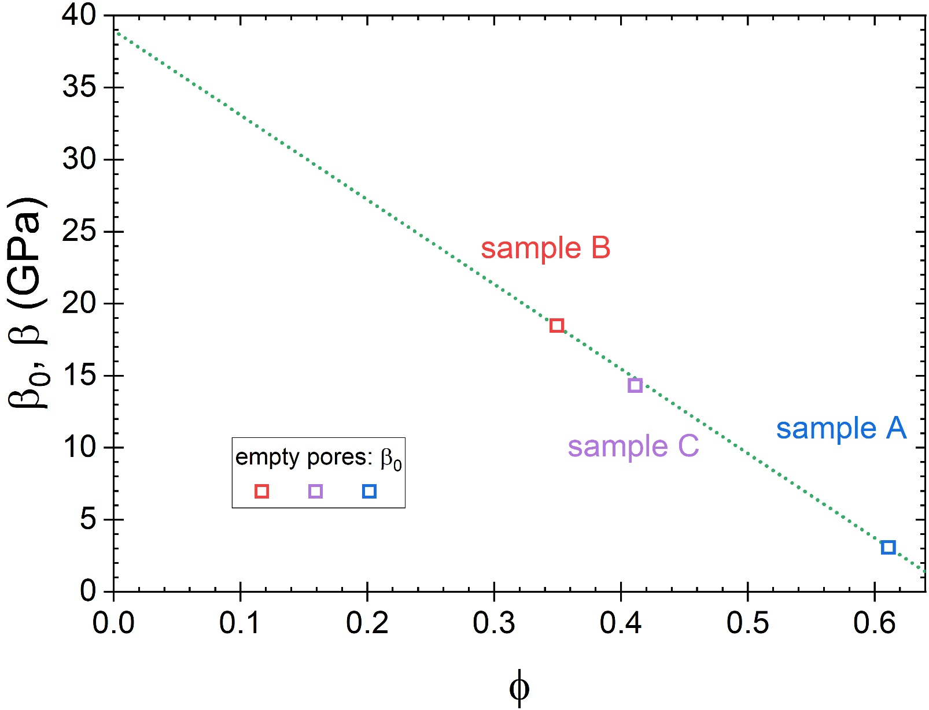

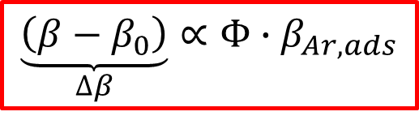

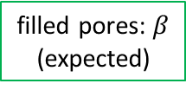
Effective longitudinal modulus: empty pores (measured)
and filled pores (expected behavior for constant $β_{Ar, ads}≪β_{glass}$)
high contrast limit
⟶ behavior similar to micro- structure with empty pores
$T=86 K$
Taylor expansion
filled pores: $β$
(expected)
$$\underset{∆β}{\underbrace{\left(β−β_{0}\right)}}∝Φ∙β_{Ar,ads}$$
(*)
some effective media formula predict such a relation
(e.g., Voigt & Gassmann)

Slide 6
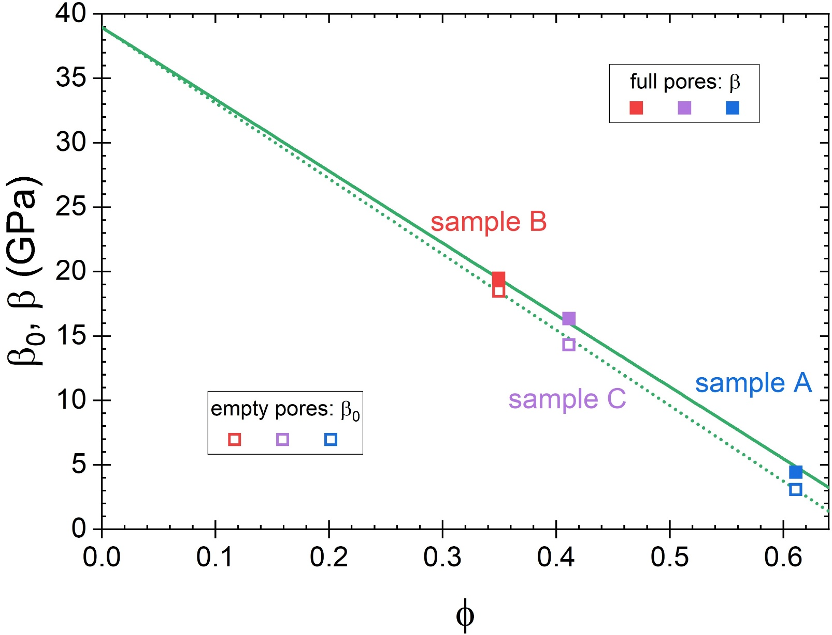

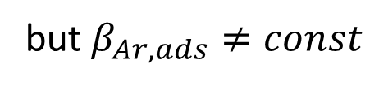
Effective longitudinal modulus:
empty & filled pores (both measured)
$T=86 K$
$$\underset{∆β}{\underbrace{\left(β−β_{0}\right)}}∝Φ∙β_{Ar,ads}$$
(*)
but $β_{Ar,ads}≠const$

Slide 7
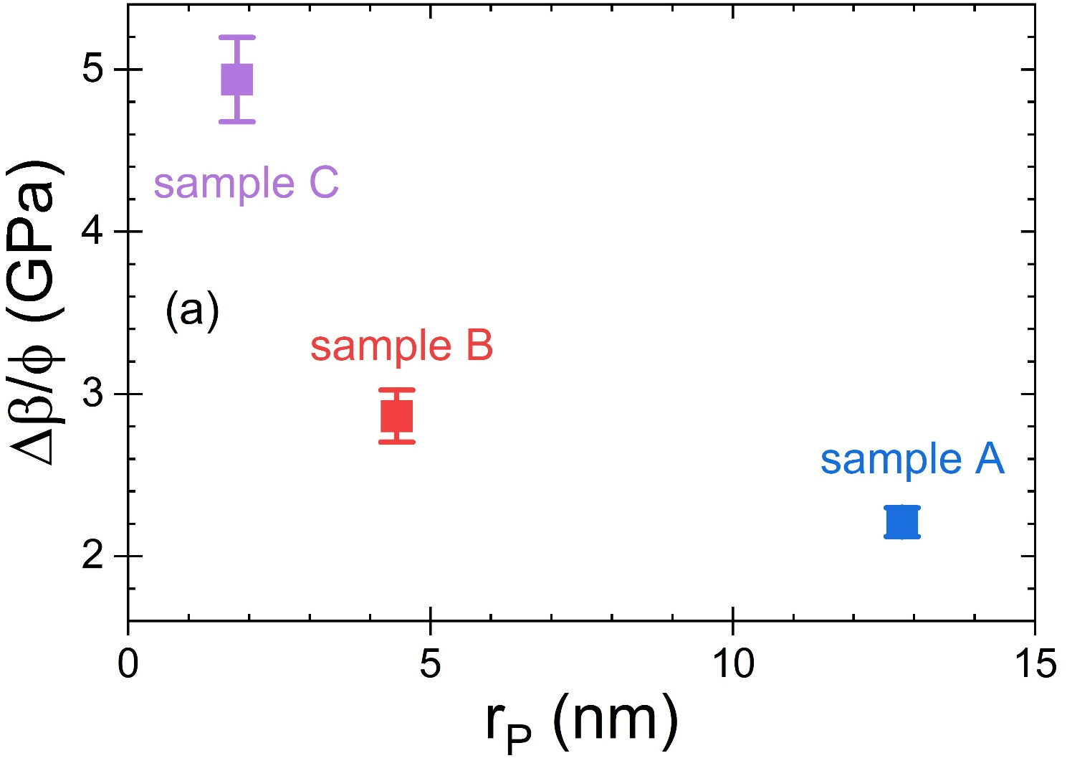

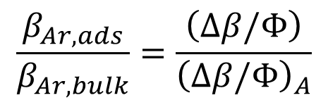
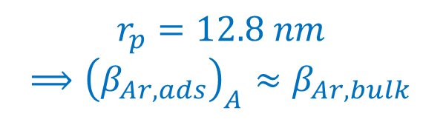

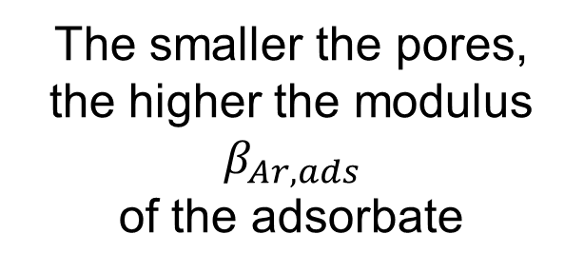
Measured change of the effective modulus upon filling with liquid argon
(*) ⟶
$∆β/Φ∝β_{Ar, ads}$
The smaller the pores,
the higher the modulus $β_{Ar, ads}$
of the adsorbate
$T=86 K$
$r_{p}=12.8 nm$
⟹ ${\left(β_{Ar,ads}\right)}_{A}≈β_{Ar,bulk}$
next step: normalization
$$\frac{β_{Ar,ads}}{β_{Ar,bulk}}=\frac{\left(∆β/Φ\right)}{{\left(∆β/Φ\right)}_{A}}$$

Slide 8
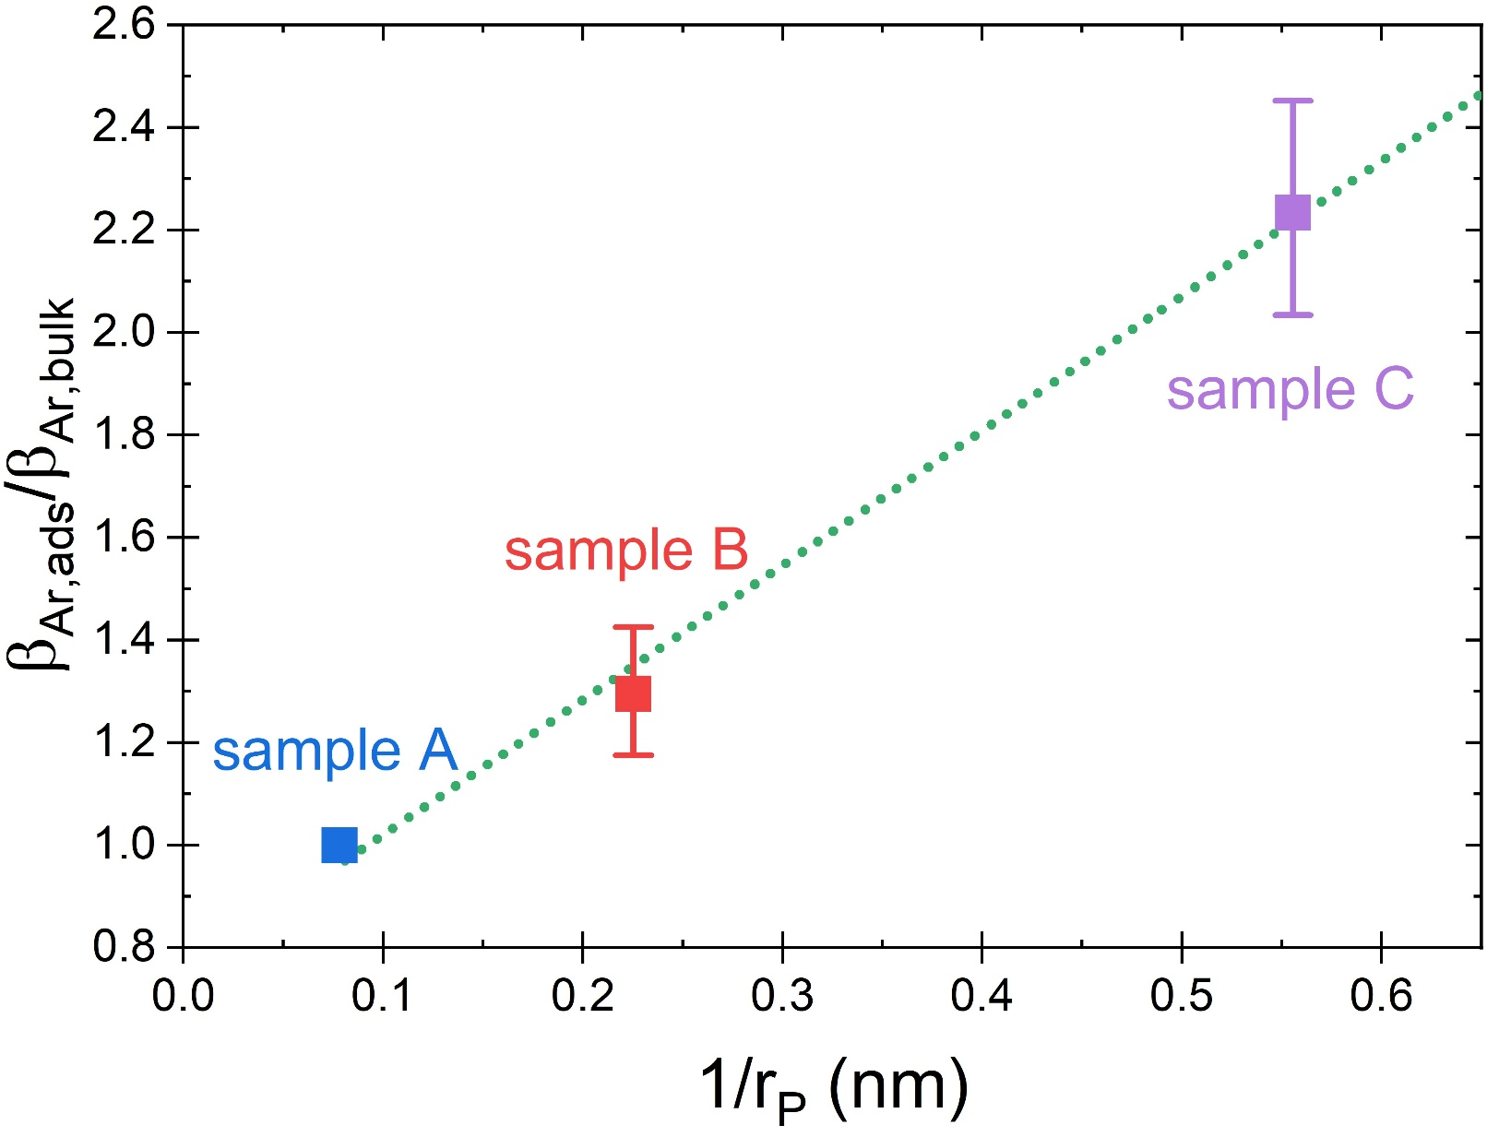


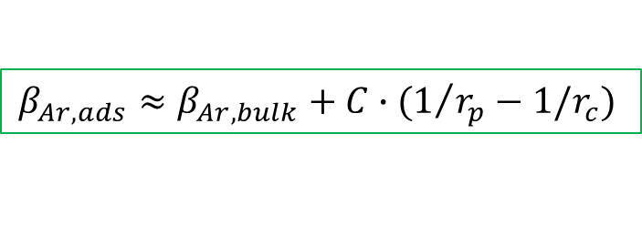
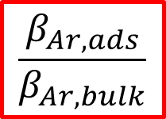



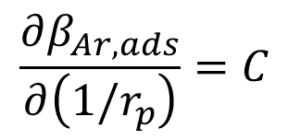
Normalized longitudinal modulus of the adsorbate (liquid argon) vs. $1/{r_{p}}$
$$\frac{β_{Ar,ads}}{β_{Ar,bulk}}$$
$T=86 K$
enhancement
by a factor of
the order of 2
$$r_{p}=4.4 nm$$
$$r_{p}=1.8 nm$$
$$r_{p}=12 nm$$
constant slope
$$β_{Ar,bulk}≈1 GPa$$
$$\frac{∂β_{Ar,ads}}{∂\left(1/r_{p}\right)}=C$$
$$β_{Ar,ads}≈β_{Ar,bulk}+C∙(1/{r_{p}}−1/r_{c})$$

Slide 9
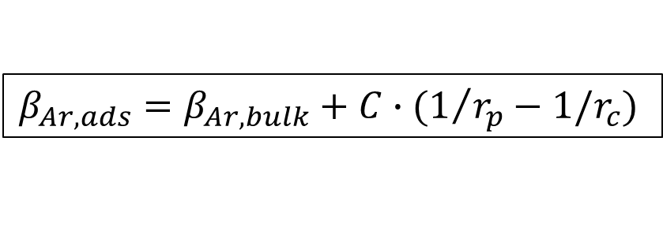
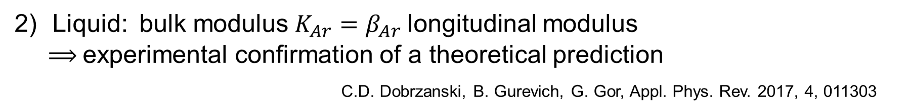
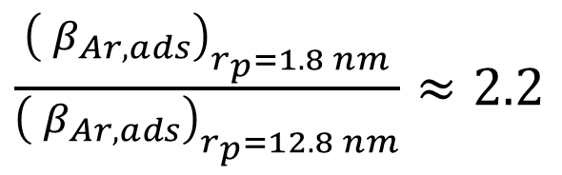

Summary
The smaller the pore size, the higher the modulus of the adsorbed liquid:
$$β_{Ar,ads}=β_{Ar,bulk}+C∙(1/{r_{p}}−1/r_{c})$$
for $r_{p}<r_{c} ≈10 −15 nm$
Liquid: bulk modulus $K_{Ar}=β_{Ar}$longitudinal modulus
⟹ experimental confirmation of a theoretical prediction
C.D. Dobrzanski, B. Gurevich, G. Gor, Appl. Phys. Rev. 2017, 4, 011303
Strong increase despite weak
interaction with pore surface
$\frac{{\left({ β}_{Ar,ads}\right)}_{r_{p}=1.8 nm}}{{\left({ β}_{Ar,ads}\right)}_{r_{p}=12.8 nm}}≈2.2$
Klaus Schappert and Rolf Pelster
Experimental Evidence for the Pore Size Dependence of Elastic Properties in a Liquid Adsorbate Confined to Nanopores
The Journal of Physical Chemistry Letters 2026 17 (6), 1640-1646
DOI: 10.1021/acs.jpclett.5c03903

