Slide 1
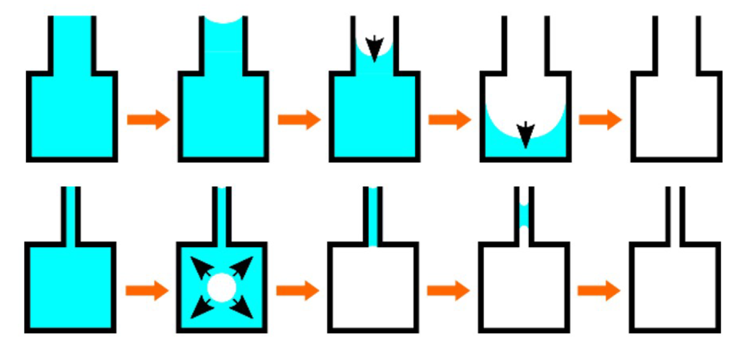


Exploring Helium Metastability Using Artificial Porous Systems
Institut Néel, Université Grenoble Alpes:
Paul COUTIN, Laurent Cagnon, Benoit Chabaud, Thierry Crozes, Jean-Francois Motte, Marine Schott, Panayotis Spathis, Pierre-Etienne Wolf
LPENS, Ecole Normale Supérieure, Paris
Etienne Rolley, Kristina Davitt
ANR CAVCONF & NANOCAV
21/05/2026

Slide 2
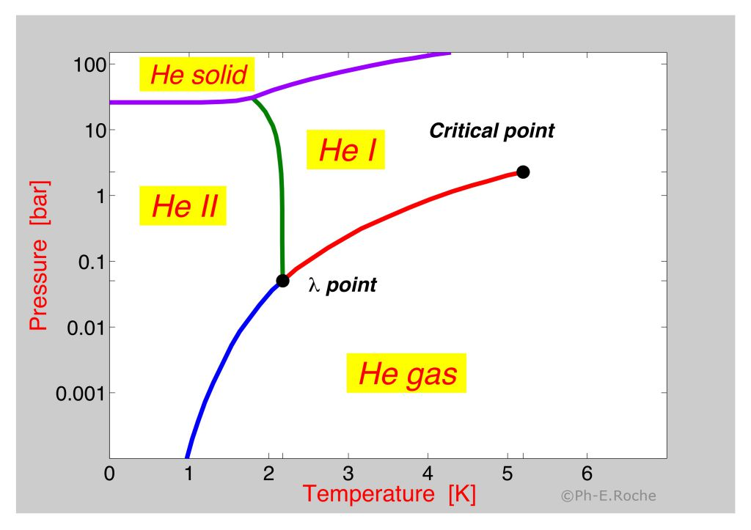
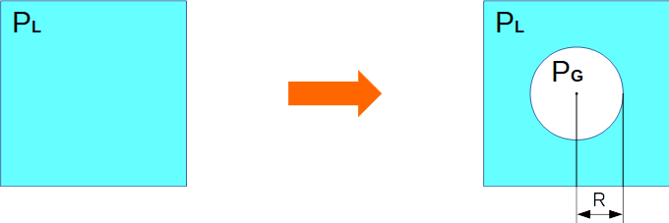
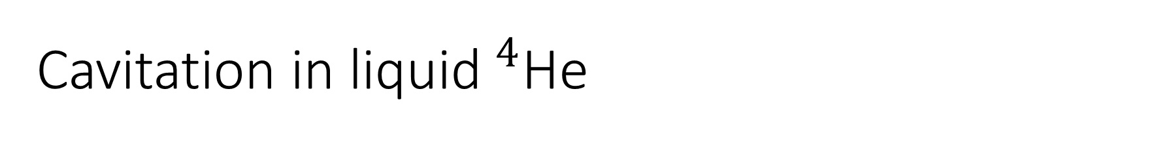
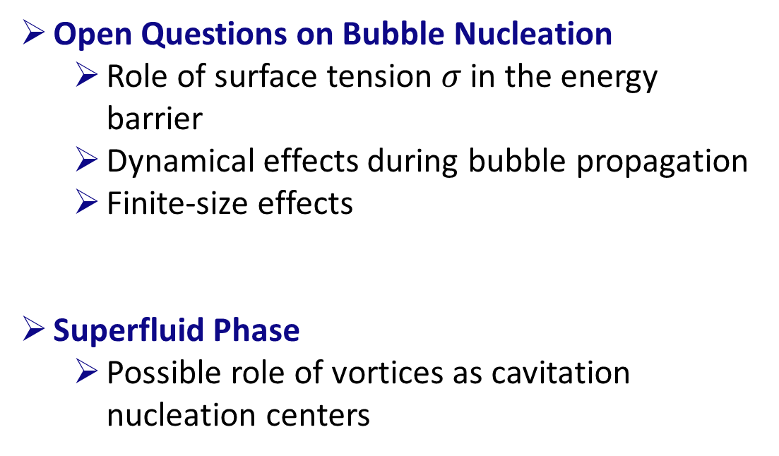
Cavitation in liquid$^{4}$He
Open Questions on Bubble Nucleation
Role of surface tension $σ$ in the energy barrier
Dynamical effects during bubble propagation
Finite-size effects
Superfluid Phase
Possible role of vortices as cavitation nucleation centers
Boiling
Cavitation
Liquid under tension
Notes:
SATURATED VAPOR PRESSUR

Slide 3
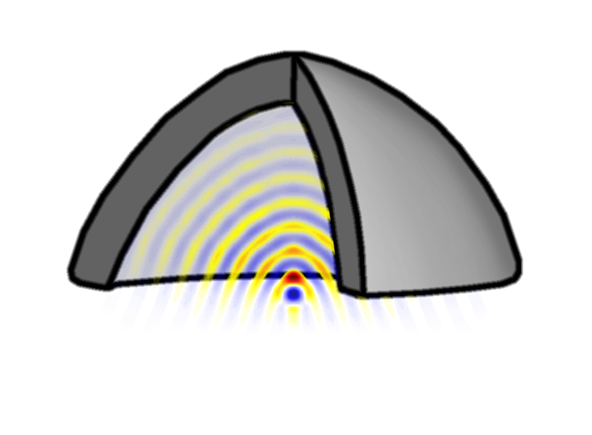
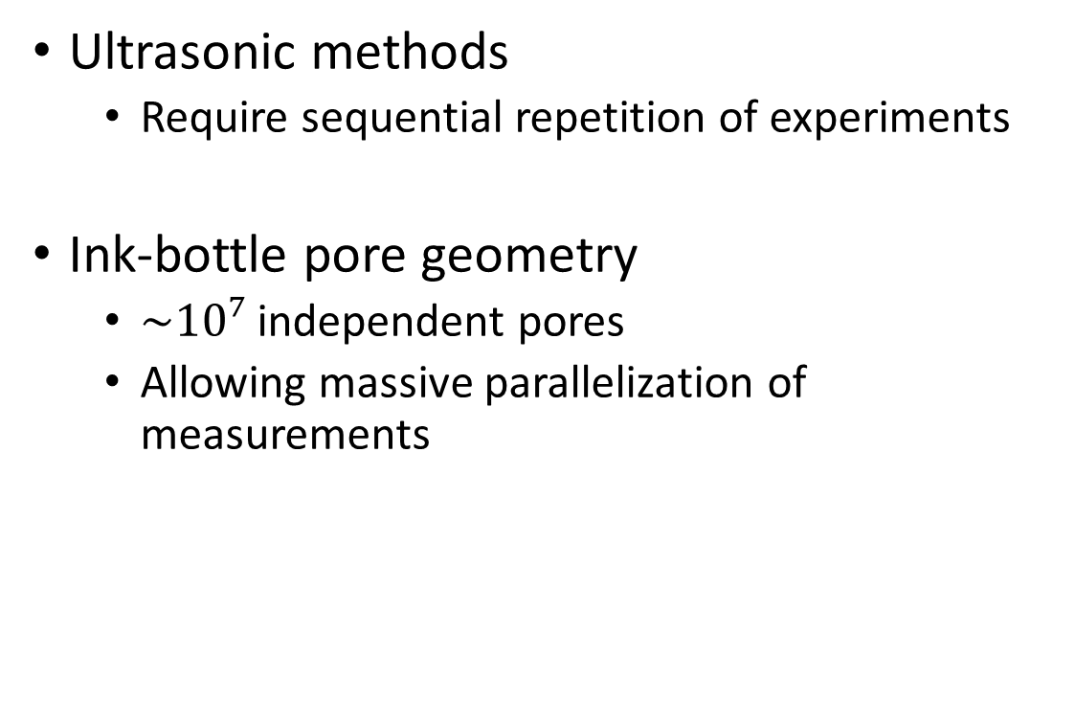
How to reach a metastable state ?
Ultrasonic methods
Require sequential repetition of experiments
Ink-bottle pore geometry
$\sim 10⁷$independent pores
Allowing massive parallelization of measurements
Caupin & Balibar, ENS Paris:
Dynamic Sensing
Stroock Nature 2008:
Ink-Bottle Pores
Cavitation is a stochastic process; therefore, experiments must be repeated multiple times to obtain reliable data

Slide 4
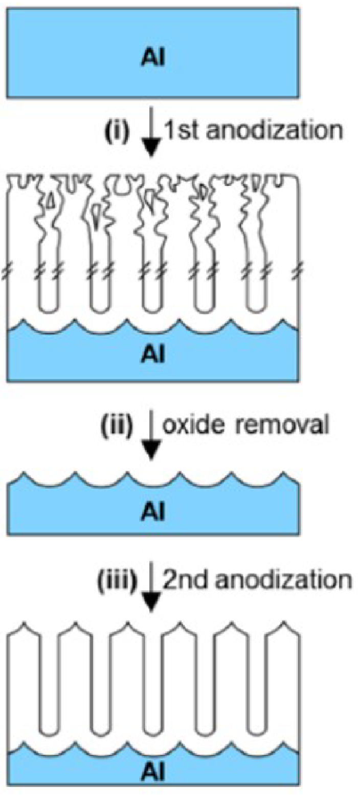
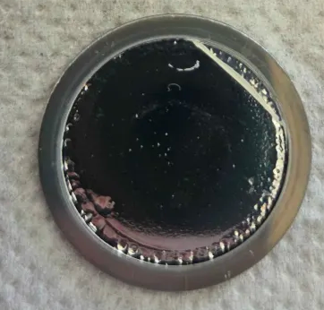
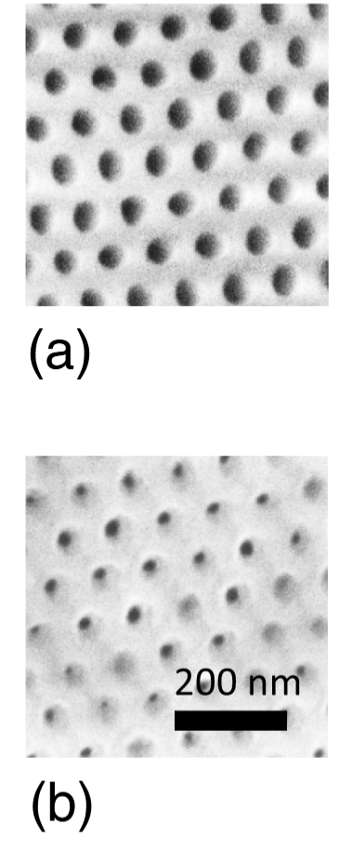
Porous Alumina Samples
200 nm
200 nm
Sample: 1 inch aluminium wafer
Top view
Side view
Before ALD
ALD
after 160cycles of ALD
ALD deposition is required to obtain the ink-bottle shape
ALD deposition
Notes:
LATTICE

Slide 5
Porous Alumina Samples
200 nm
Side view
Before ALD
Sample: 1 inch aluminium wafer
Top view
ALD
after 160cycles of ALD
ALD deposition is required to obtain the ink-bottle shape
ALD deposition
Notes:
Membrane détaché
EMPREINTE dans l’alu
ALD FLASH

Slide 6
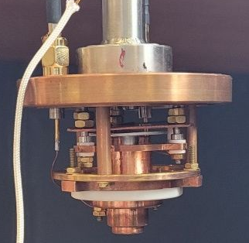
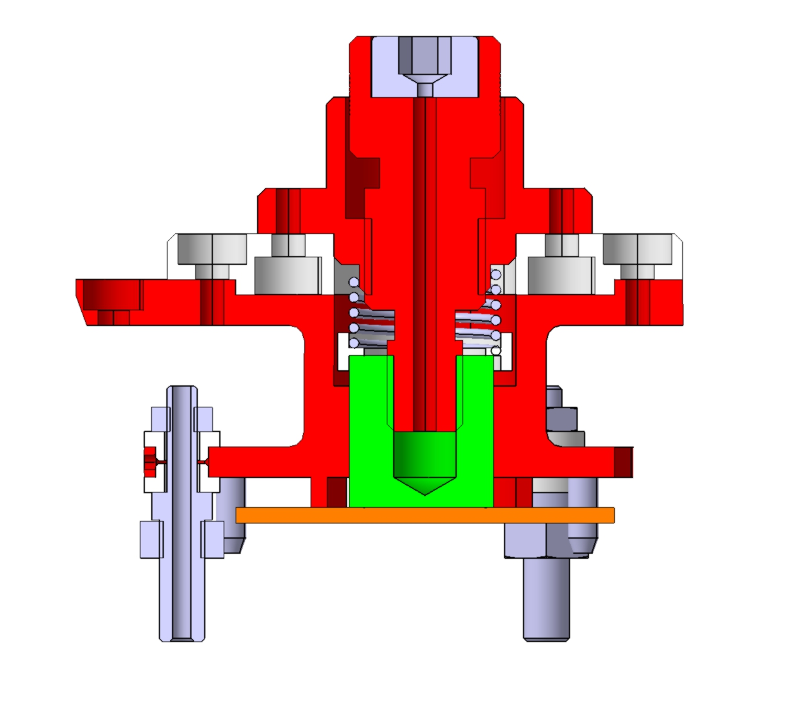
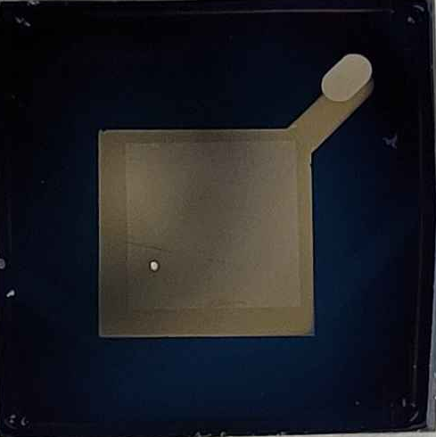
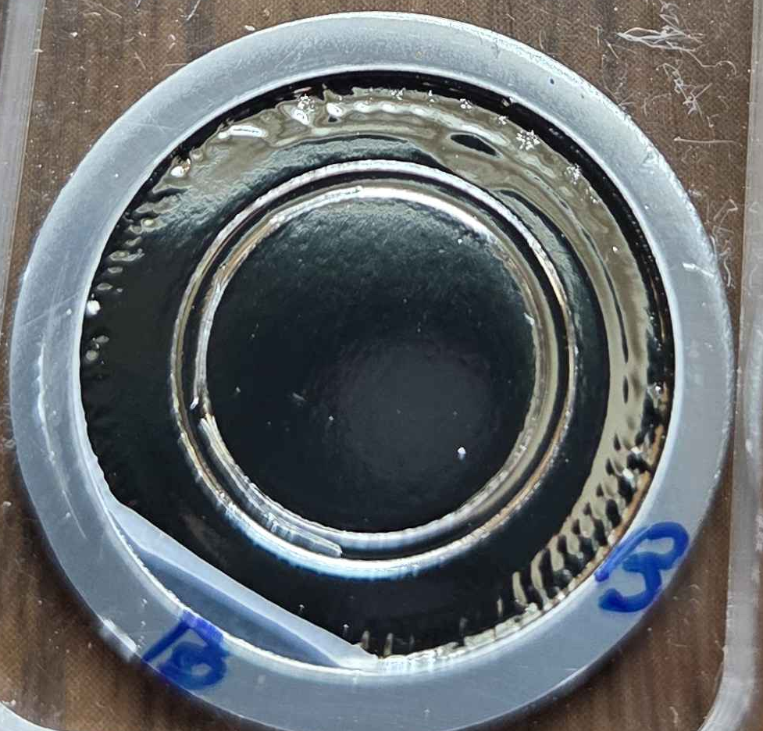

Setup for Isotherm Measurements
needle valve
P
Gaz injection (300K)
Capacitive bridge
P
$$T<T_{c}(fluid)$$
Pump
Cell
Cryostat
Continuous Injection
Sample

Slide 7
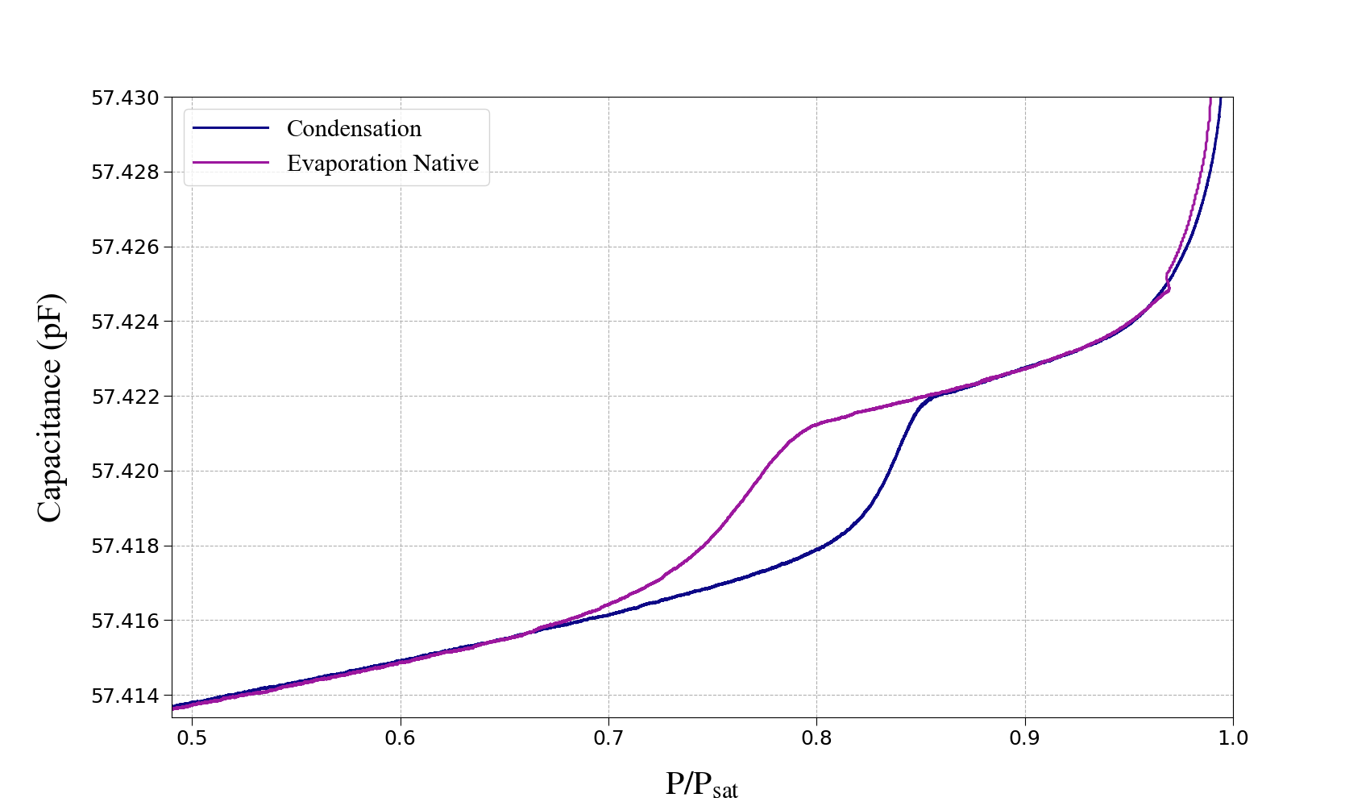


Native Porous Membranes
Independent Pores
Corrugated conical pores
$$R_{min}$$
$$R_{max}$$

Slide 8
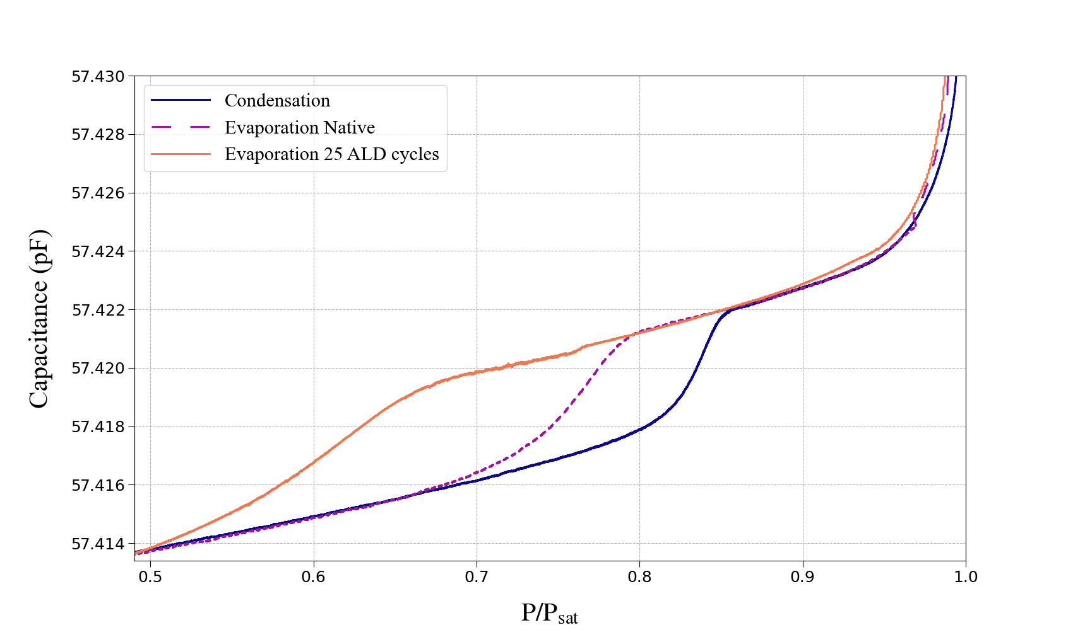



Same Porous Membrane After ALD Deposition
Same condensation branch,
evaporation shifts to lower pressure:
Ink bottle geometry
1 ALD cycle => $1.2Å$
$$R_{min}$$
$$R_{max}$$

Slide 9
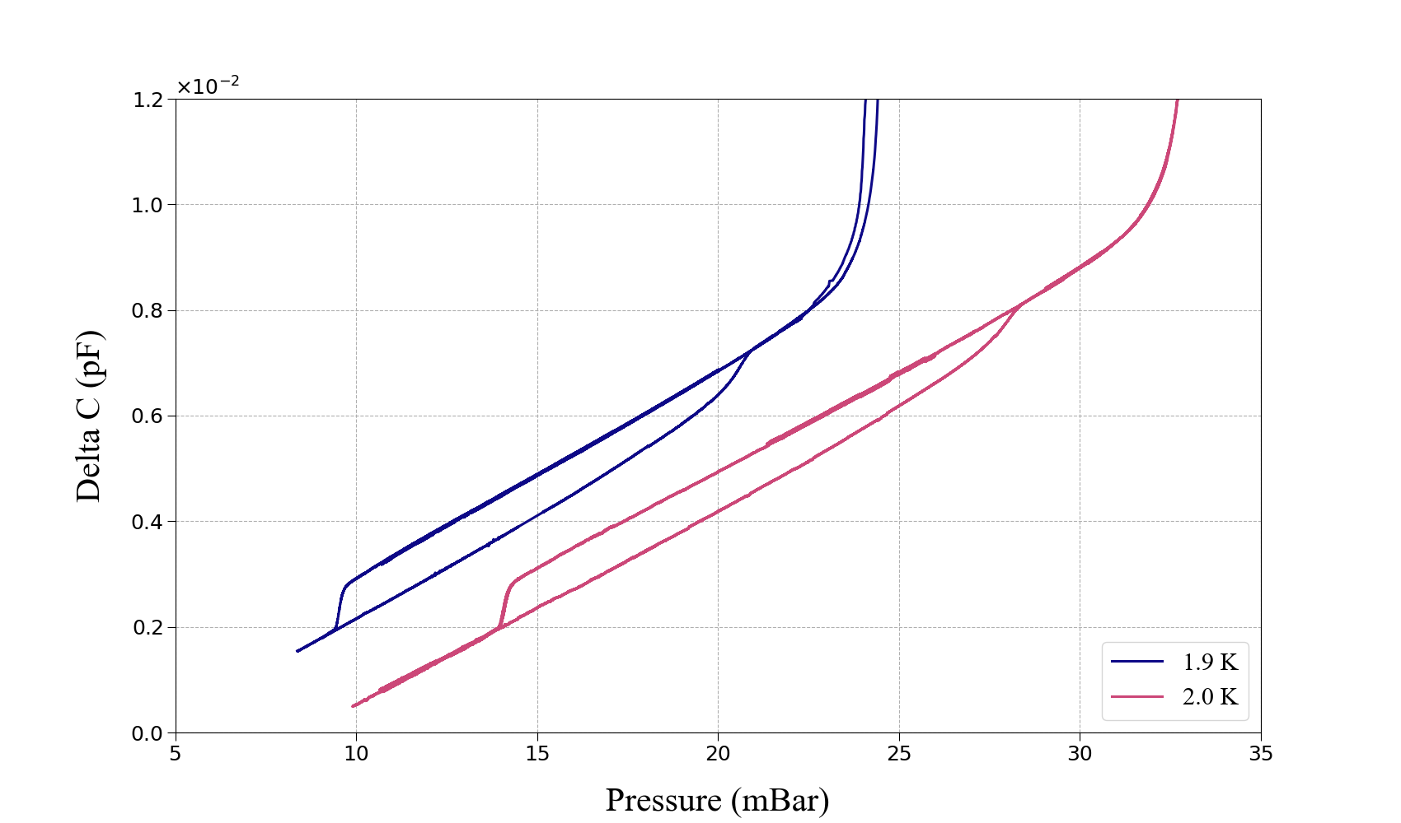
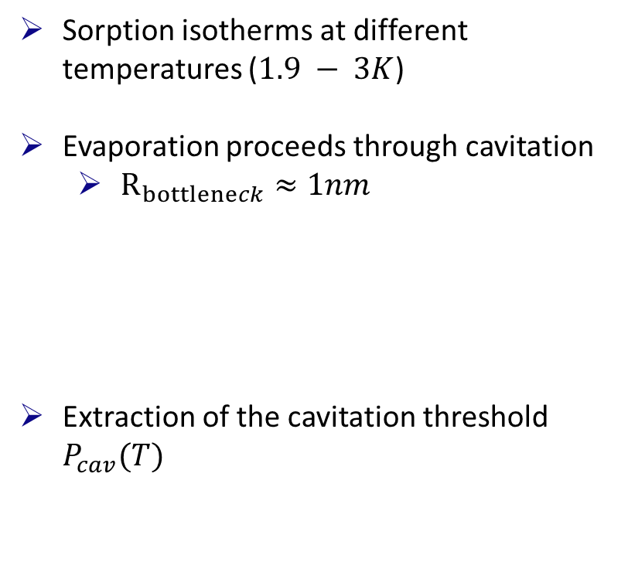



Reaching cavitation
Sorption isotherms at different temperatures ($1.9 − 3K$)
Evaporation proceeds through cavitation
$R_{bottleneck}≈1nm$
Extraction of the cavitation threshold $P_{cav}(T)$
$$P_{cav}^{1.9K}$$
$$P_{cav}^{2.0K}$$

Slide 10
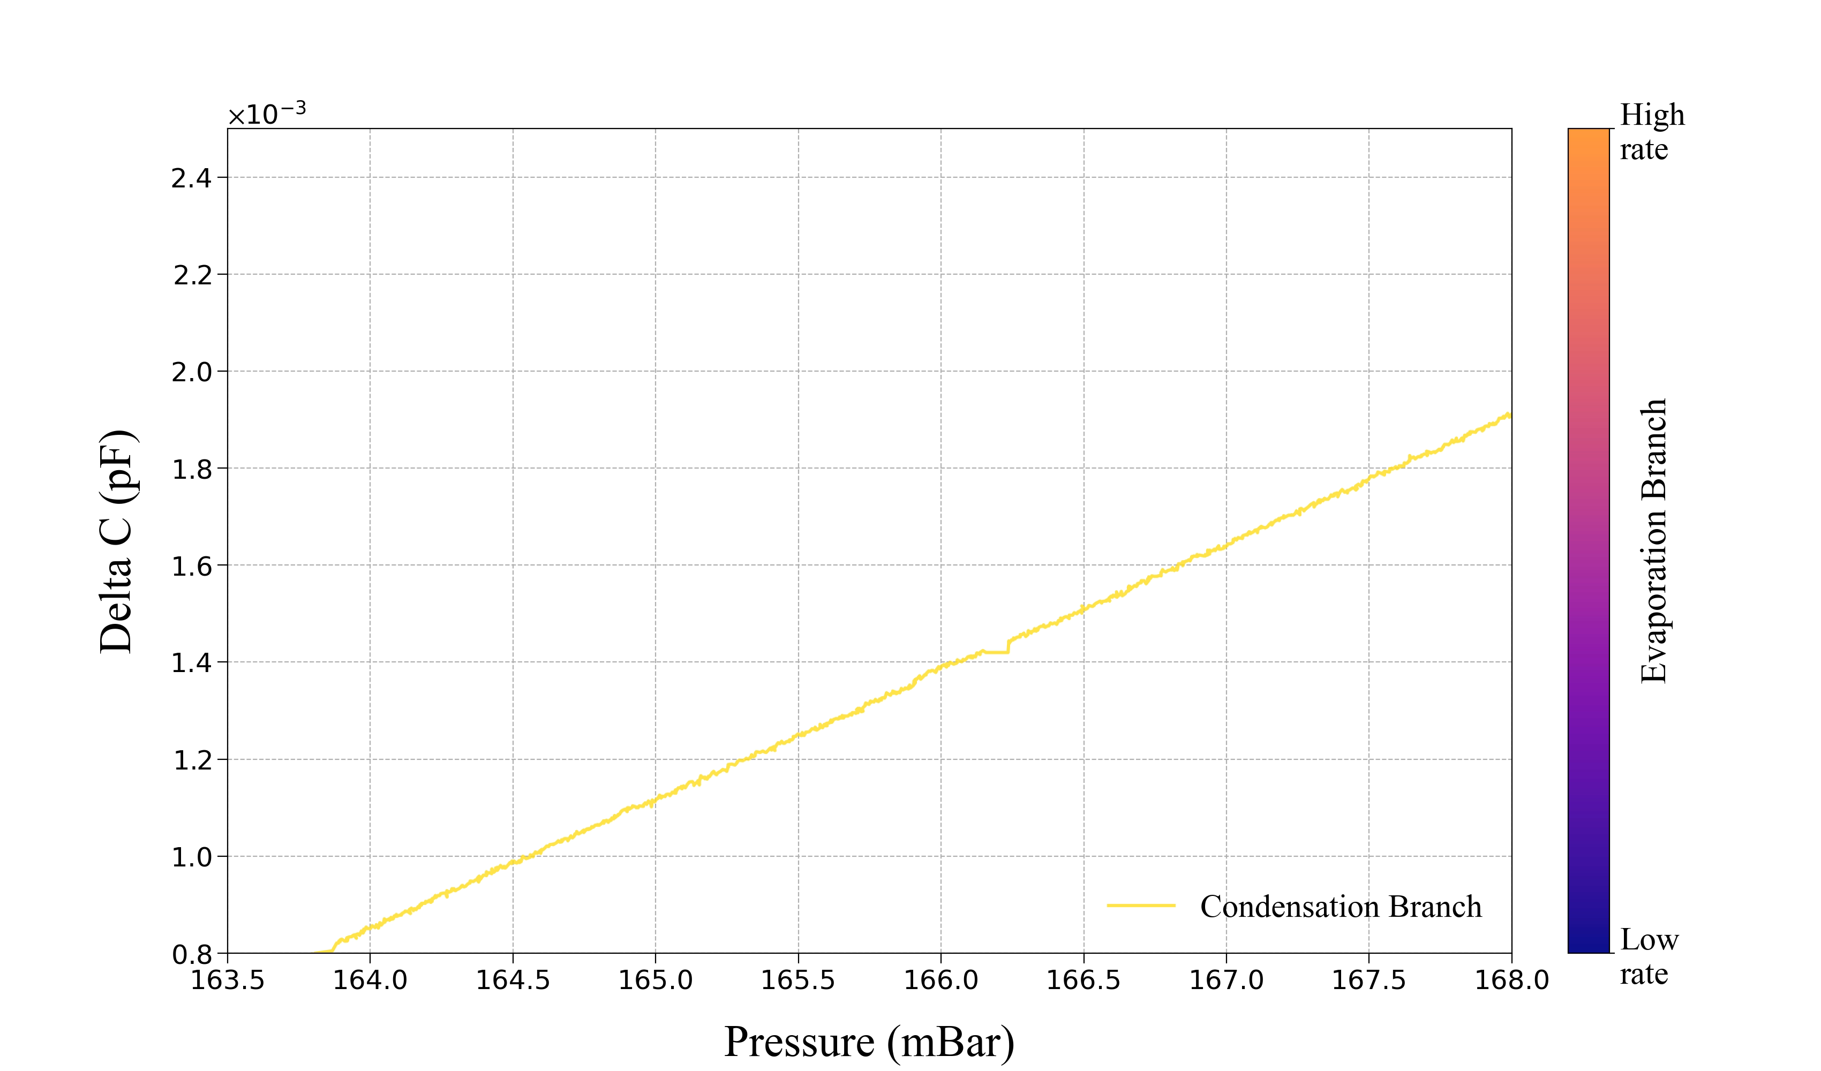
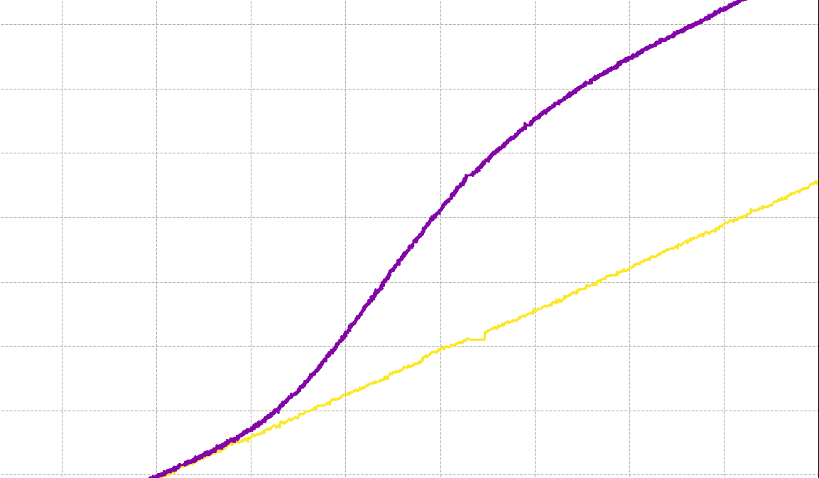

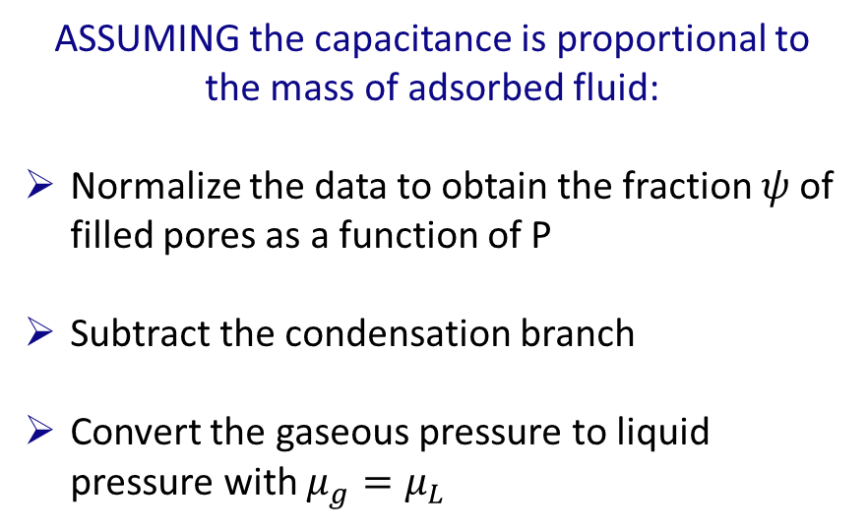
Cavitation Analysis Through Controlled Pressure Rates
Rate $A=−dP_{L}/dt$
ASSUMING the capacitance is proportional to the mass of adsorbed fluid:
Normalize the data to obtain the fraction $ψ$of filled pores as a function of P
Subtract the condensation branch
Convert the gaseous pressure to liquid pressure with $μ_{g}=μ_{L}$
The same isotherm is measured at different pressure sweep rates ($dP/dt$)

Slide 11
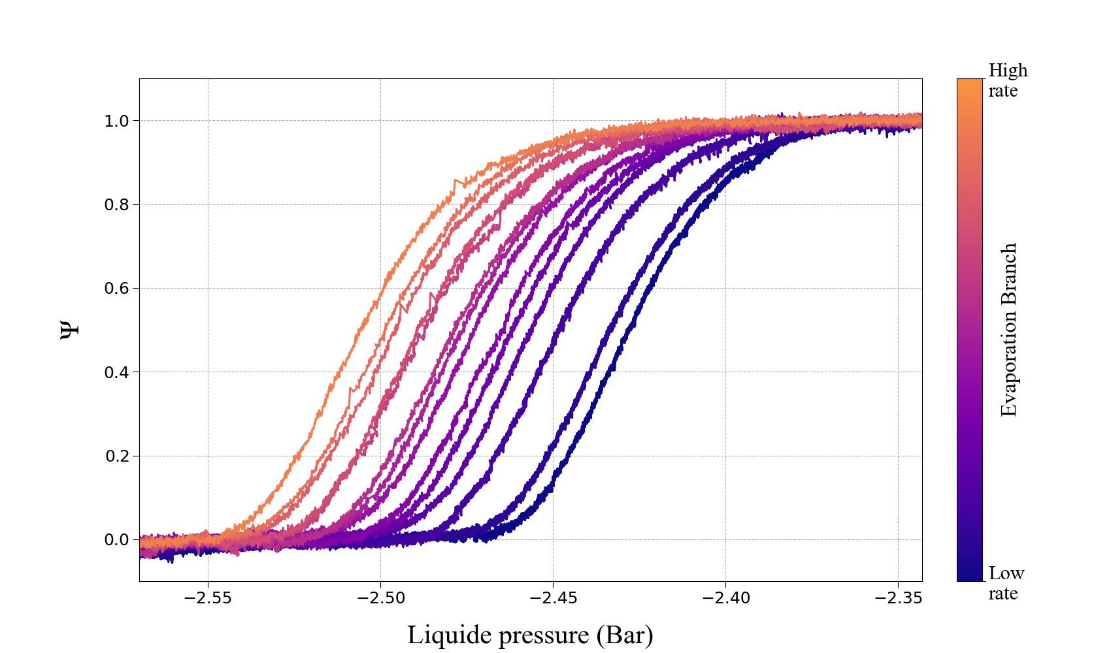
Cavitation Analysis Through Controlled Pressure Rates
Rate $A=−dP_{L}/dt$
ASSUMING the capacitance is proportional to the mass of adsorbed fluid:
Normalize the data to obtain the fraction $ψ$of filled pores as a function of P
Subtract the condensation branch
Convert the gaseous pressure to liquid pressure with $μ_{g}=μ_{L}$
Filled pores
Empty pores
The same isotherm is measured at different pressure sweep rates ($dP/dt$)

Slide 12
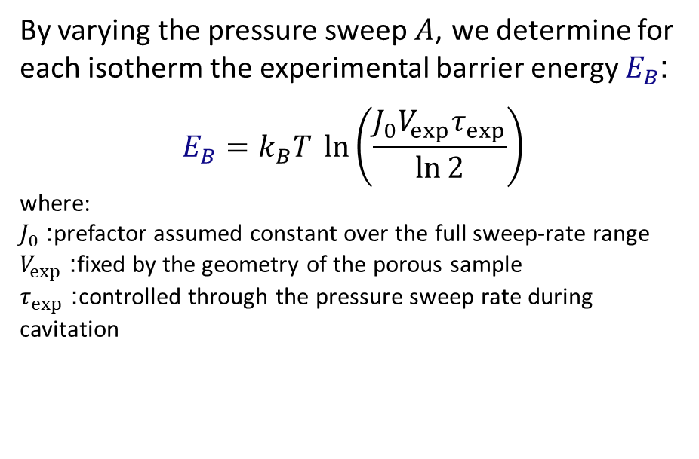
Cavitation Analysis Through Controlled Pressure Rates
By varying the pressure sweep $A$, we determine for each isotherm the experimental barrier energy $E_{B}$:
$$E_{B}=k_{B}T \ln\left(\frac{J_{0}V_{exp}τ_{exp}}{\ln{2}}\right)$$
where:
$J_{0}$: prefactor assumed constant over the full sweep-rate range
$V_{exp}$: fixed by the geometry of the porous sample
$τ_{exp}$: controlled through the pressure sweep rate during cavitation
Rate $A=−dP_{L}/dt$
Filled pores
Empty pores
The same isotherm is measured at different pressure sweep rates ($dP/dt$)

Slide 13

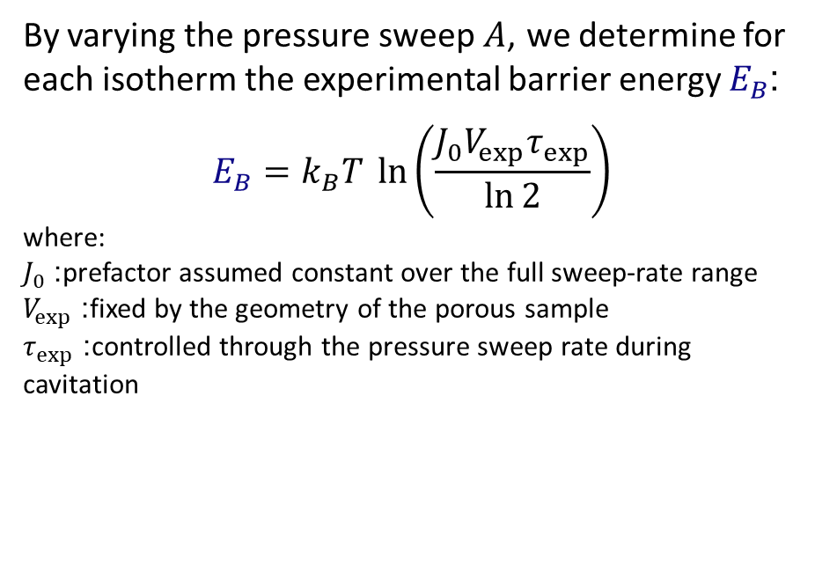
Cavitation Analysis Through Controlled Pressure Rates
By varying the pressure sweep $A$, we determine for each isotherm the experimental barrier energy $E_{B}$:
$$E_{B}=k_{B}T \ln\left(\frac{J_{0}V_{exp}τ_{exp}}{\ln{2}}\right)$$
where:
$J_{0}$: prefactor assumed constant over the full sweep-rate range
$V_{exp}$: fixed by the geometry of the porous sample
$τ_{exp}$: controlled through the pressure sweep rate during cavitation
Rate $A=−dP_{L}/dt$
Filled pores
Half filled
Empty pores
$$P_{L}^{cav}$$
The same isotherm is measured at different pressure sweep rates ($dP/dt$)

Slide 14


Cavitation Analysis Through Controlled Pressure Rates
By varying the pressure sweep $A$, we determine for each isotherm the experimental barrier energy $E_{B}$:
$$E_{B}=k_{B}T \ln\left(\frac{J_{0}V_{exp}τ_{exp}}{\ln{2}}\right)$$
where:
$J_{0}$: prefactor assumed constant over the full sweep-rate range
$V_{exp}$: fixed by the geometry of the porous sample
$τ_{exp}$: controlled through the pressure sweep rate during cavitation
Rate $A=−dP_{L}/dt$
Filled pores
Half filled
Empty pores
$$P_{L}^{cav}$$
$$P_{L}^{cav}$$
$$P_{L}^{cav}$$
The same isotherm is measured at different pressure sweep rates ($dP/dt$)
Notes:
FIT the cavitation probability

Slide 15
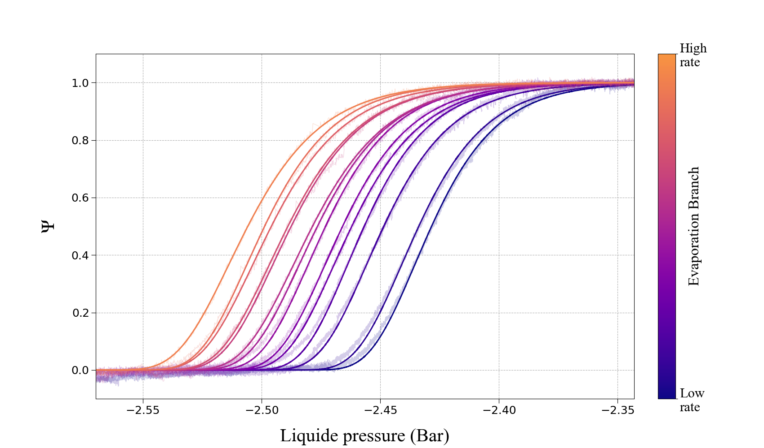
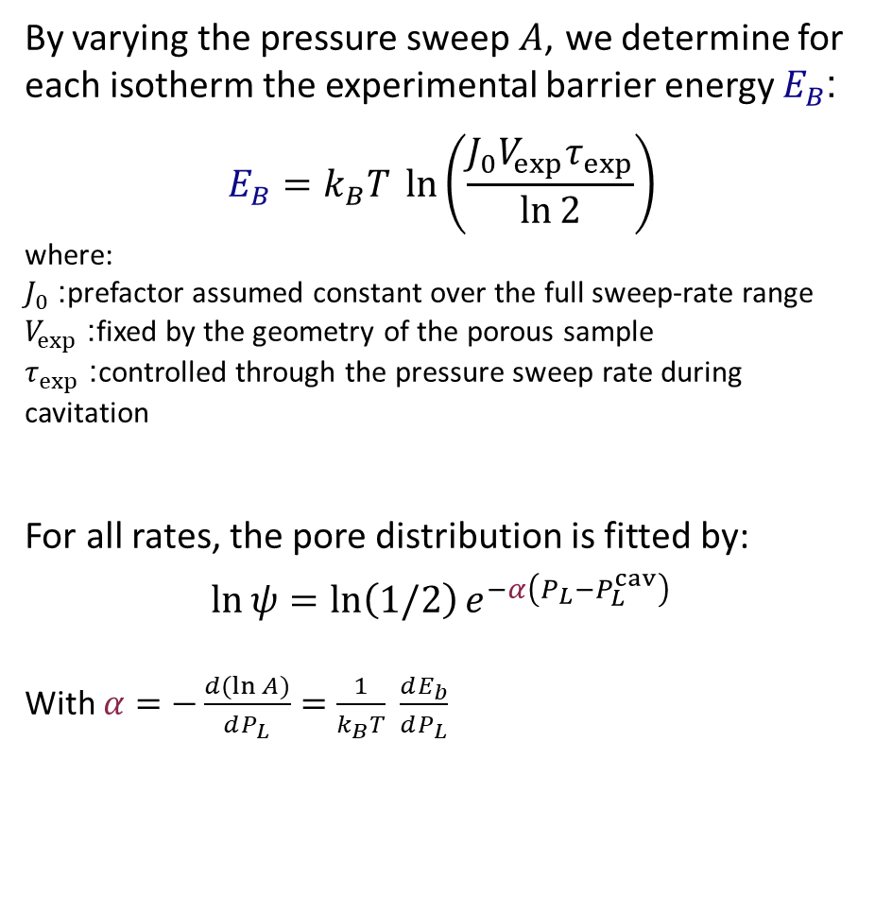

Cavitation Analysis Through Controlled Pressure Rates
By varying the pressure sweep $A$, we determine for each isotherm the experimental barrier energy $E_{B}$:
$$E_{B}=k_{B}T \ln\left(\frac{J_{0}V_{exp}τ_{exp}}{\ln{2}}\right)$$
where:
$J_{0}$: prefactor assumed constant over the full sweep-rate range
$V_{exp}$: fixed by the geometry of the porous sample
$τ_{exp}$: controlled through the pressure sweep rate during cavitation
For all rates, the pore distribution is fitted by:
$$\ln{ψ}=\ln\left(1/2\right)e^{−α\left(P_{L}−P_{L}^{cav}\right)}$$
With $α=−\frac{d(\ln{A)}}{dP_{L}}=\frac{1}{k_{B}T} \frac{dE_{b}}{dP_{L}}$
Rate $A=−dP_{L}/dt$
Filled pores
Half filled
Empty pores
$$P_{L}^{cav}$$
$$P_{L}^{cav}$$
$$P_{L}^{cav}$$
The same isotherm is measured at different pressure sweep rates ($dP/dt$)
Notes:
FIT the cavitation probability

Slide 16
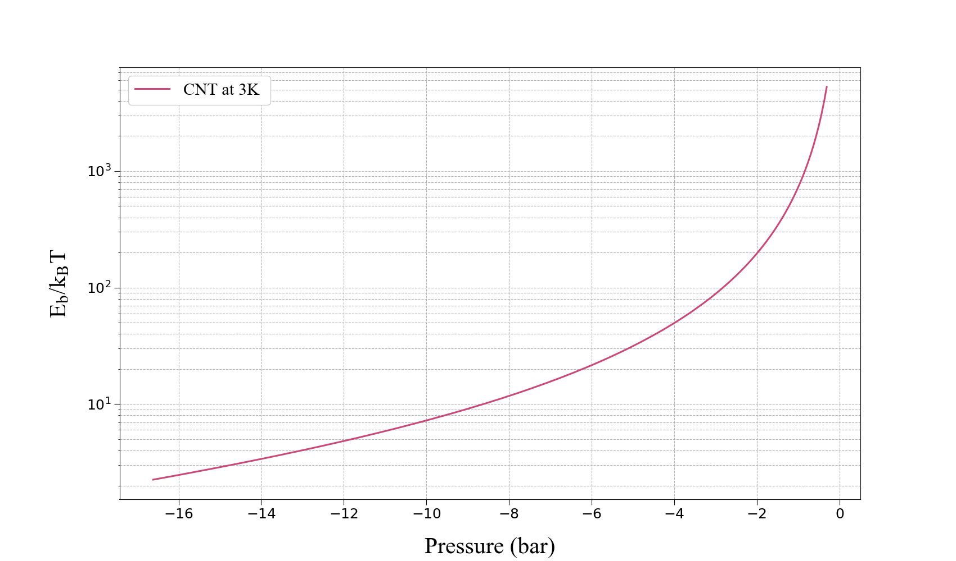

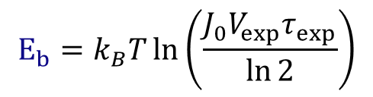
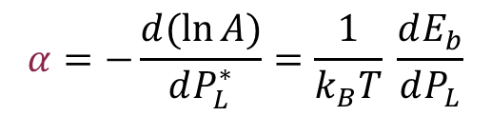
Estimating the experimental Barrier Energy and Local Slope
$$α=−\frac{d(\ln{A)}}{dP_{L}^{∗}}=\frac{1}{k_{B}T} \frac{dE_{b}}{dP_{L}}$$
$$E_{b}=k_{B}T\ln\left(\frac{J_{0}V_{exp}τ_{exp}}{\ln{2}}\right)$$
$$P_{L}^{∗}$$

Slide 17
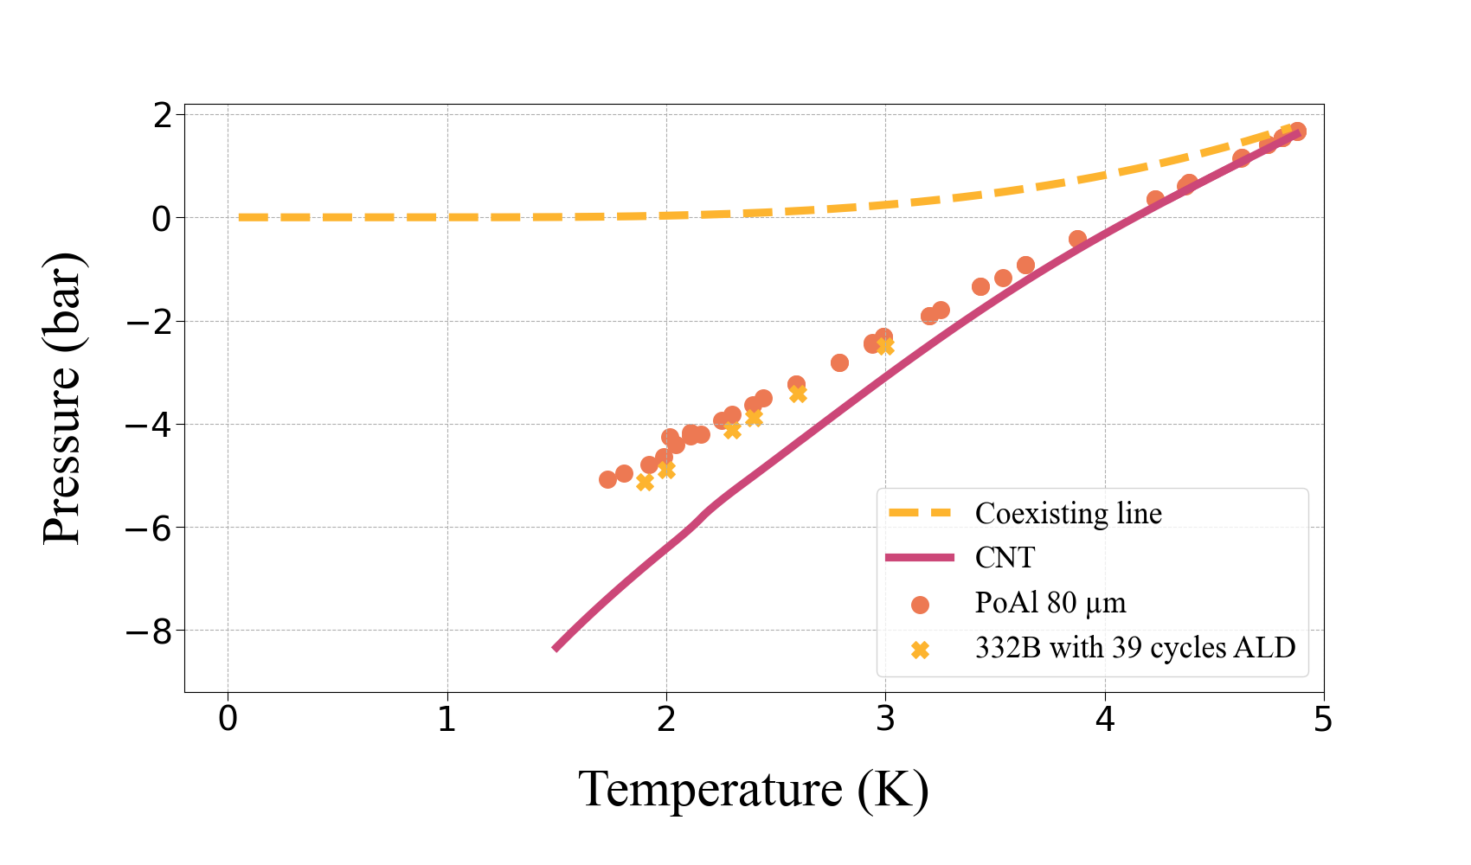
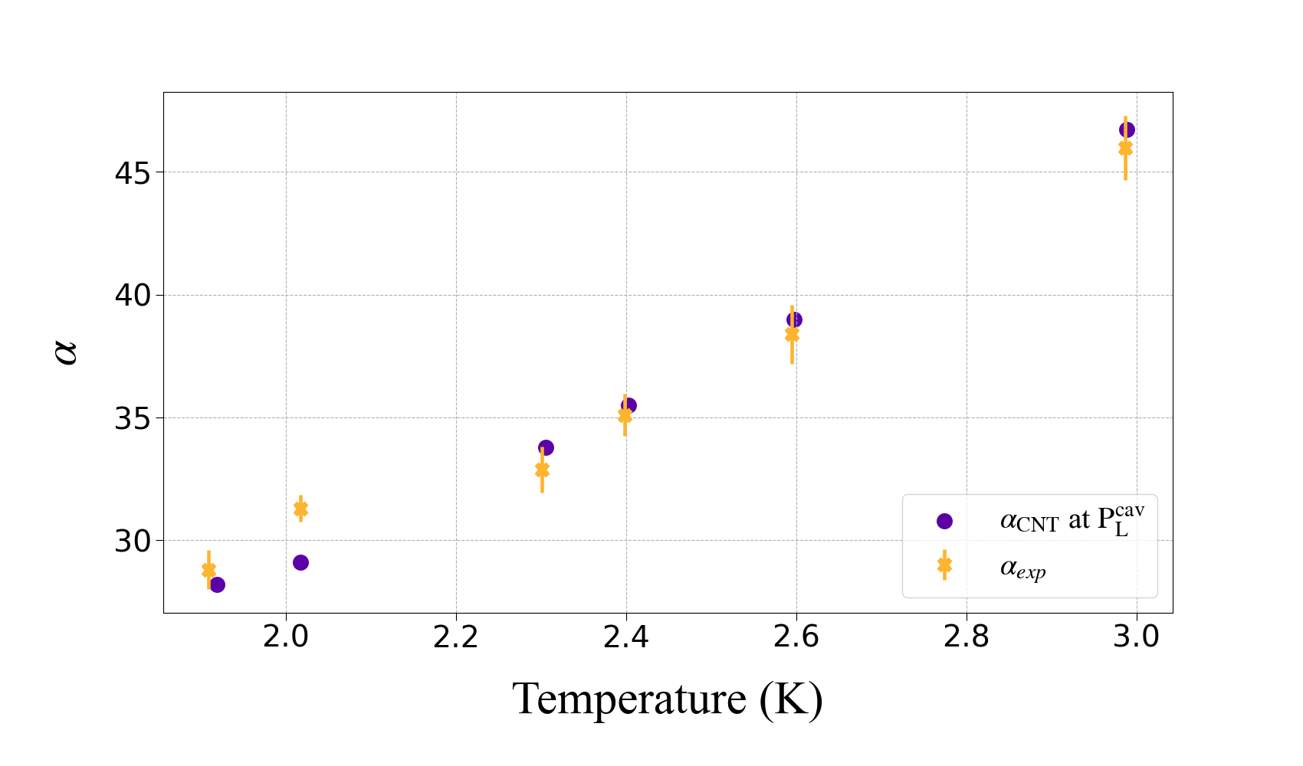

Comparison with theory
CNT (+ $σ$ bulk) not valid below 4K
$E_{b}<E_{b}^{CNT}$ below $4K$
$$α\sim α^{CNT}$$

Slide 18
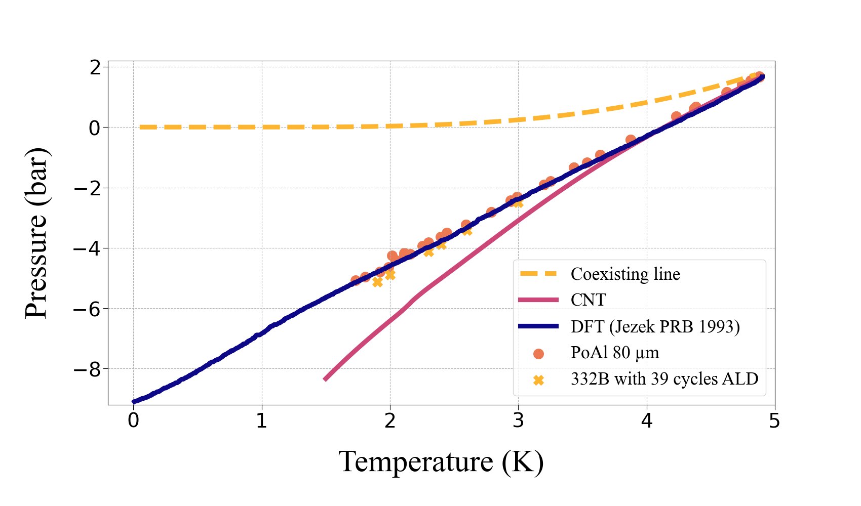
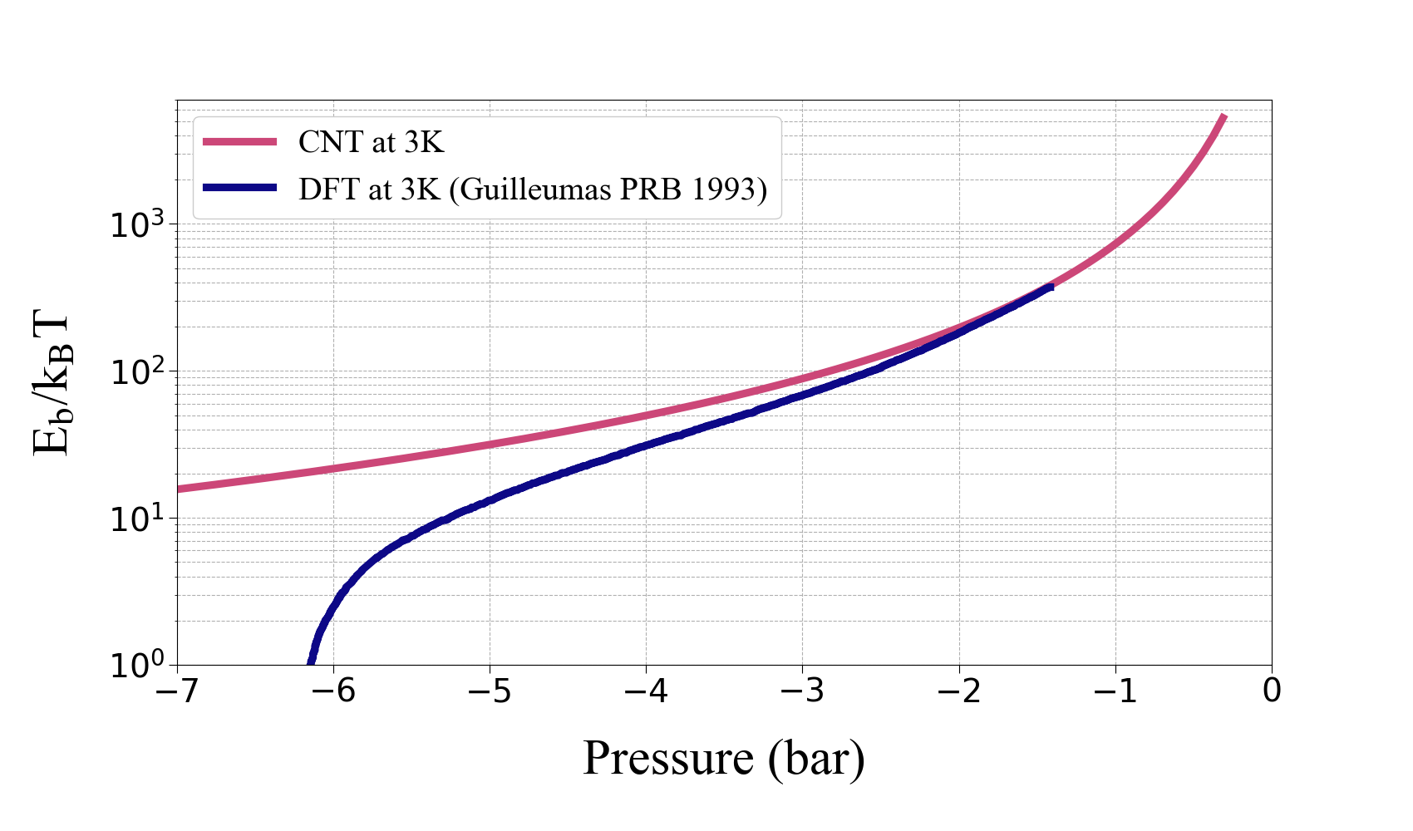
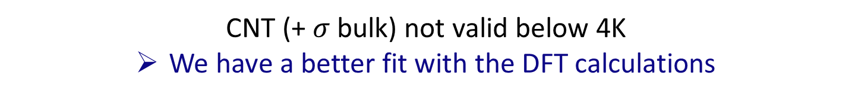


Comparison with theory
CNT (+ $σ$ bulk) not valid below 4K
We have a better fit with the DFT calculations
Same $α$
different $E_{b}$

Slide 19
Conclusions and Perspectives
Conclusions
CNT with bulk surface tension does not describe the low-temperature regime
Experimental measurements agree with DFT predictions
No observable signature of vortex-assisted nucleation
Perspectives
Study of cavitation closer to the critical point
Enhanced investigation of confinement effects
New porous system under investigation

Slide 21
Reaching Cavitation: Using Ink-Bottle Shaped Pores
R1
R2
R1
R2

Slide 22
Reaching Cavitation: Using Ink-Bottle Shaped Pores
R1
R2
R1
R2

Slide 23
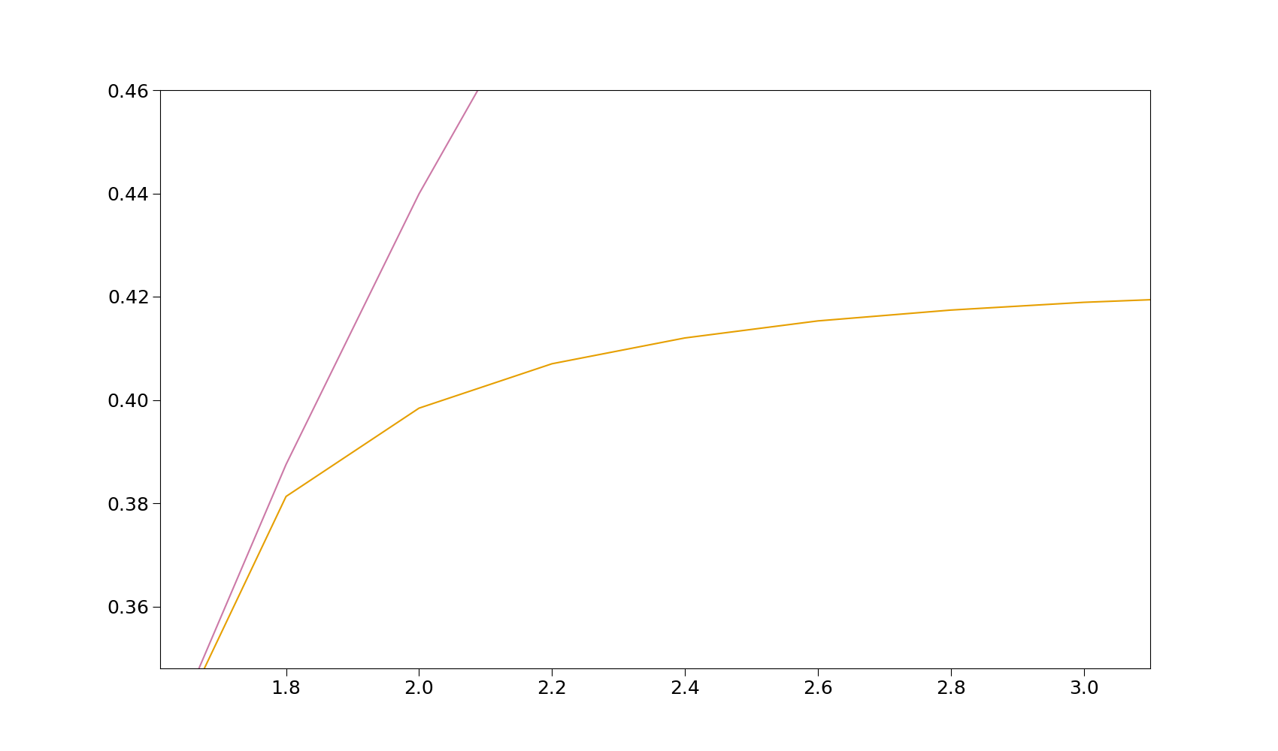
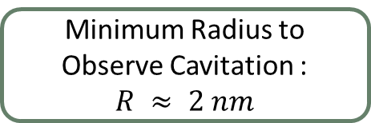
Reaching Cavitation: Using Ink-Bottle Shaped Pores
Minimum Radius to Observe Cavitation :
$$R ≈ 2 nm$$
We use an ALD deposition to close the constrictions and obtain this radius value

Slide 24
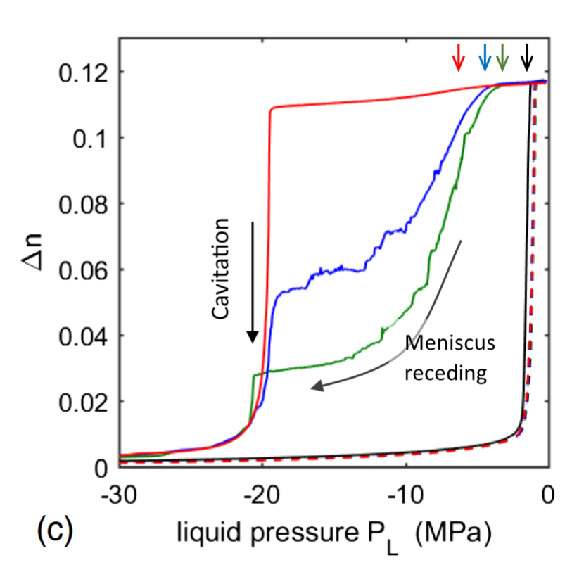
Cavitation
Direct Observation of Homogeneous Cavitation in Nanopores V. Doebele, A. Benoit-Gonin , F. Souris , L. Cagnon , P. Spathis , P. E. Wolf, A. Grosman, M. Bossert, I. Trimaille, and E. Rolley
PRL 2020

Slide 25
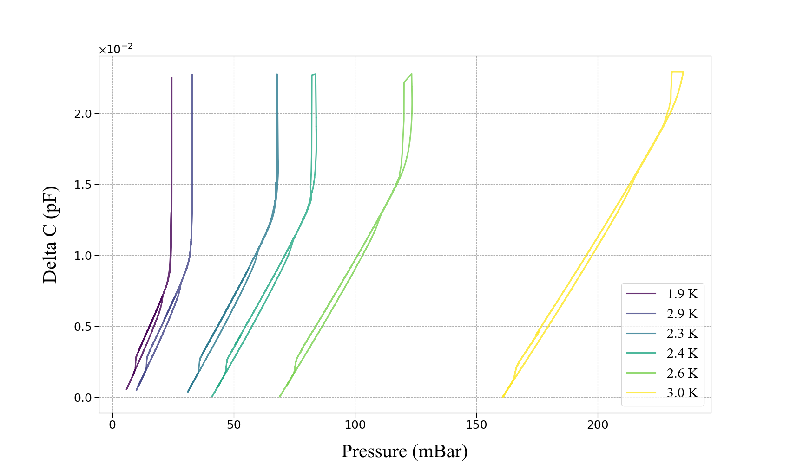
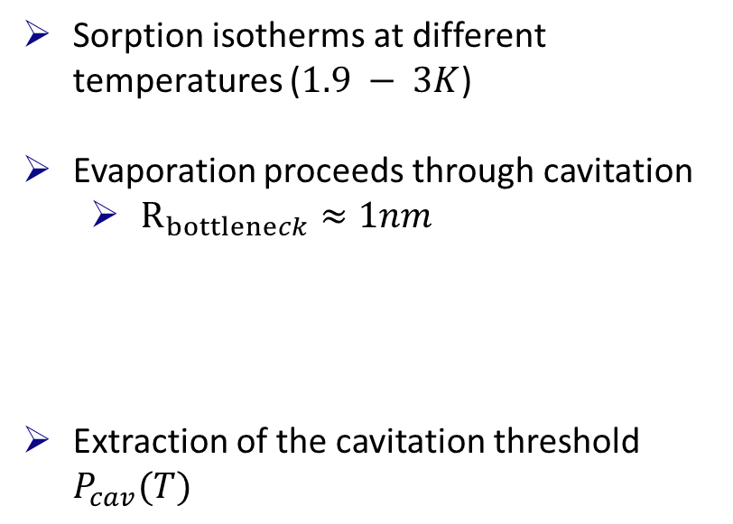
Reaching cavitation
Sorption isotherms at different temperatures ($1.9 − 3K$)
Evaporation proceeds through cavitation
$R_{bottleneck}≈1nm$
Extraction of the cavitation threshold $P_{cav}(T)$

Slide 26
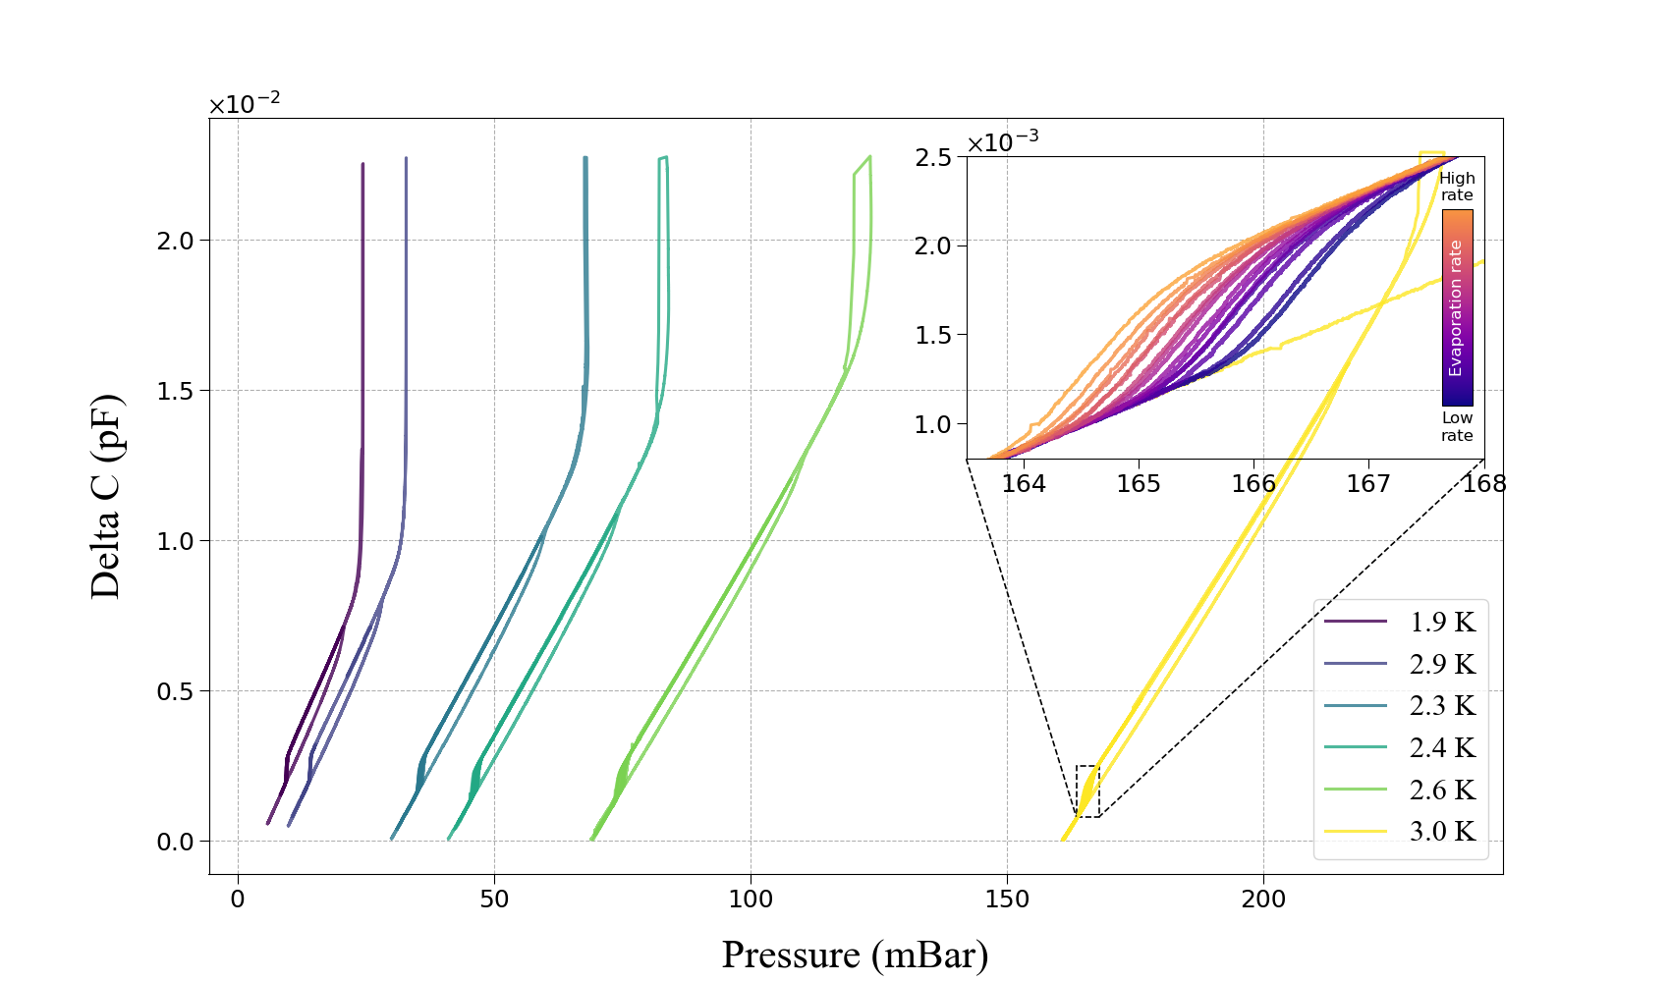
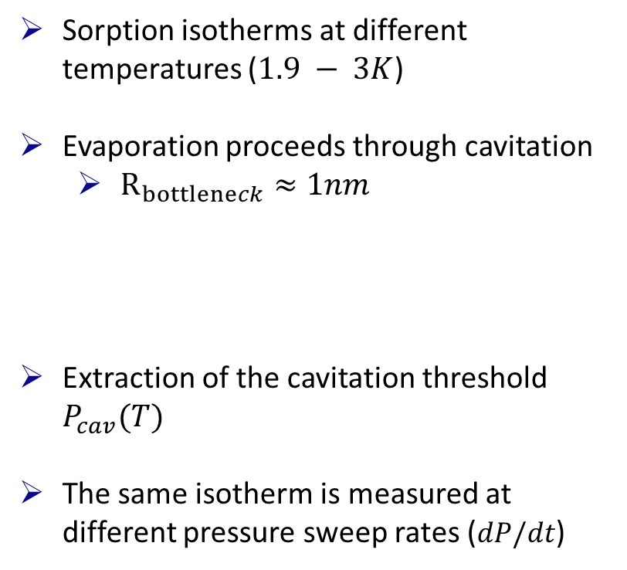
Reaching cavitation
Sorption isotherms at different temperatures ($1.9 − 3K$)
Evaporation proceeds through cavitation
$R_{bottleneck}≈1nm$
Extraction of the cavitation threshold $P_{cav}(T)$
The same isotherm is measured at different pressure sweep rates ($dP/dt$)

