Slide 1


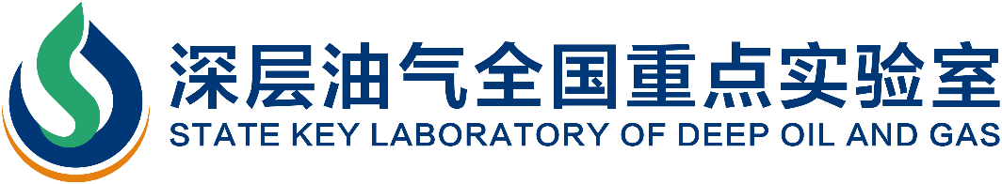
Coupled thermal-hydraulic-mechanical-chemical processes in nanoporous media
(Max) Qinhong Hu, Y.F. Xiao, T. Zhang, J.C. Wen, J.Q. Liang, Q.M. Wang, and S.Y. Yang
Chair Professor, China University of Petroleum (East China), China
Emeritus Distinguished Professor, University of Texas at Arlington, USA
Presentation at
InterPore2026 Minisymposia 13 ID#521
May 21, 2026

Slide 2
Presentation Outline
1. Rational and significance
2. Multi-approach and multi-scale methodologies
3. Summary and perspectives

Slide 3



Historical Evolution of Major Research Thrusts in the Energy and Resources Geosciences
Conventional oil and gas production (1859‒present)
Air and surface water contamination (1950s‒1980s)
Environmentalism movement (since 1960s)
Soil contamination (1960s‒present)
Geothermal energy mining/exploitation (1974‒present)
Tight sand and coalbed methane (1976‒present)
Nuclear energy and geological repository of high-level nuclear waste (1978‒present)
Groundwater remediation and Superfund (1980‒present)
Carbon sequestration or carbon capture and storage (CCS) or carbon capture, utilization and storage (CCUS) (1996‒present)
Petroleum production in shale gas and oil reservoirs (1981; 2000; 2008‒present)
Gas (methane) hydrate extraction (2005‒present)
Critical minerals sustainability (2011‒present)
Underground gas (H₂, He, air) storage (2019‒present)
Commonly involves tight (clay) materials & fractured media
1962
1970
1977
Hu, 2015-2026

Slide 4





Scientific and Societal Issues (1979-2012)
1998
2010
Sep. 2012 in Philadelphia
2000
1979

Slide 5
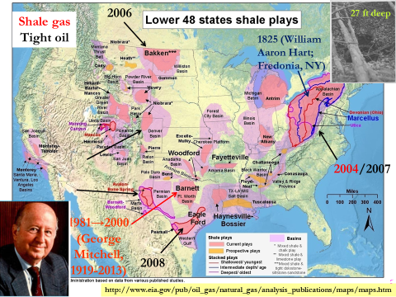
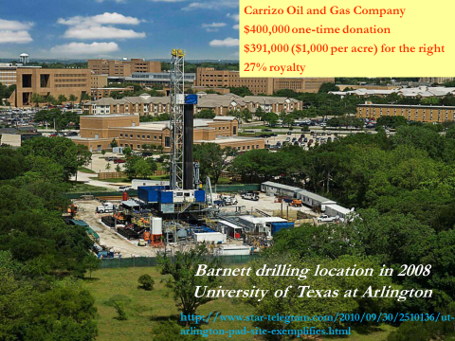
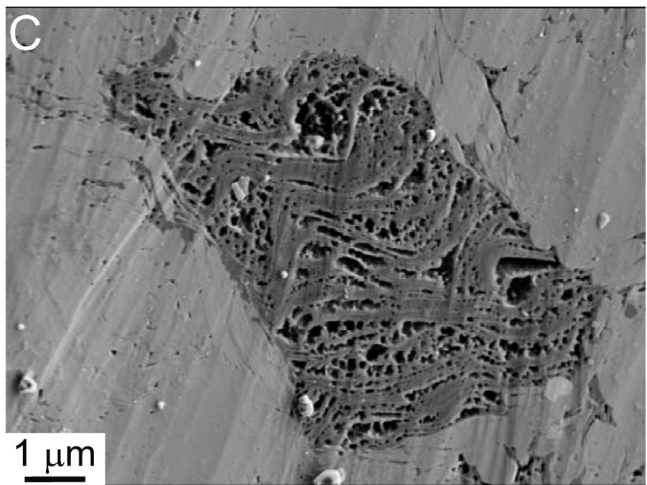
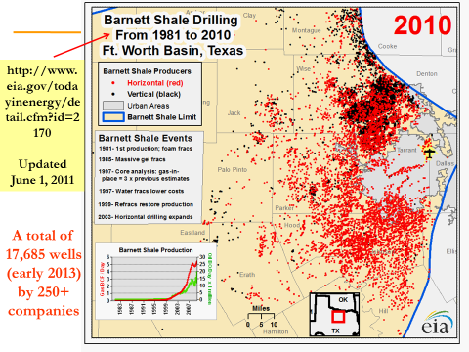
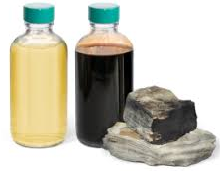
“Shale Revolution” (1981; 2000; 2008-2018）
Univ. Texas Arlington
Nanopores (BEG, Loucks
et al., 2009)
2008.7
George Mitchell (1919–2013; “Father of Fracking”)
The United States became a net energy exporter in November 2019
A net importer of energy since 1953
Crude oil production (MMB/d): 1970-9.6; 2019-12.2; 2023-12.9
2025: 13.6 MMB/d; tight oil 70% (9.0 MMB/d; 450 m tonnes/y)
~15,850 horizontal wells and ~5,250 vertical wells
Export | Canada(52%) | Mexico (11%) | Saudi (5%) | Iraq (4%) | Brazil (3%)
Import | Mexico (11%) | China (10%) | Dutch (9%) | Canada(8%) | Japan (6%)

Slide 6
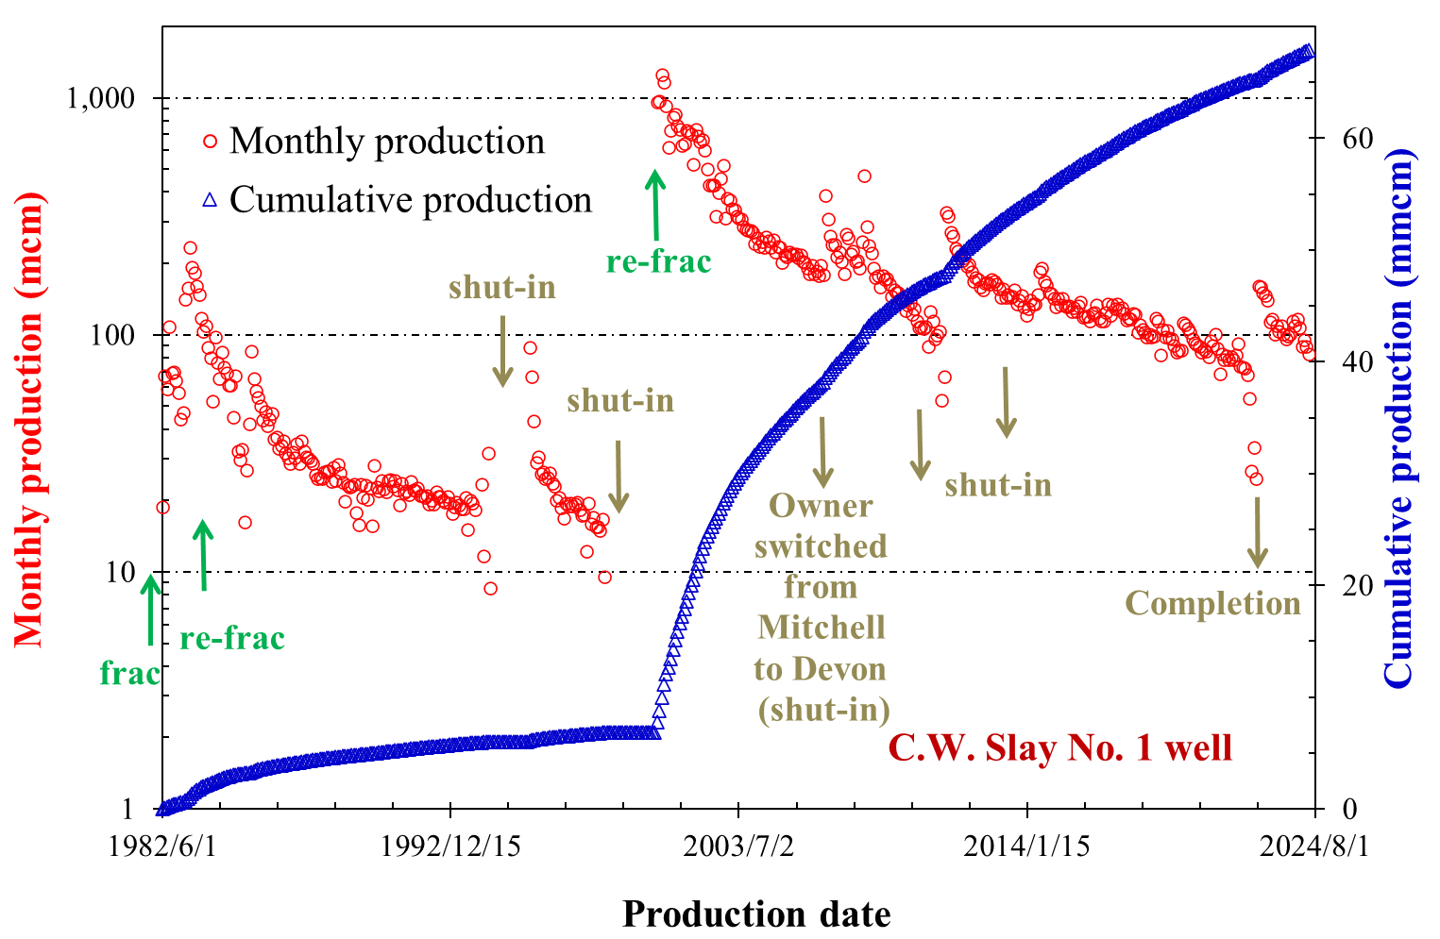
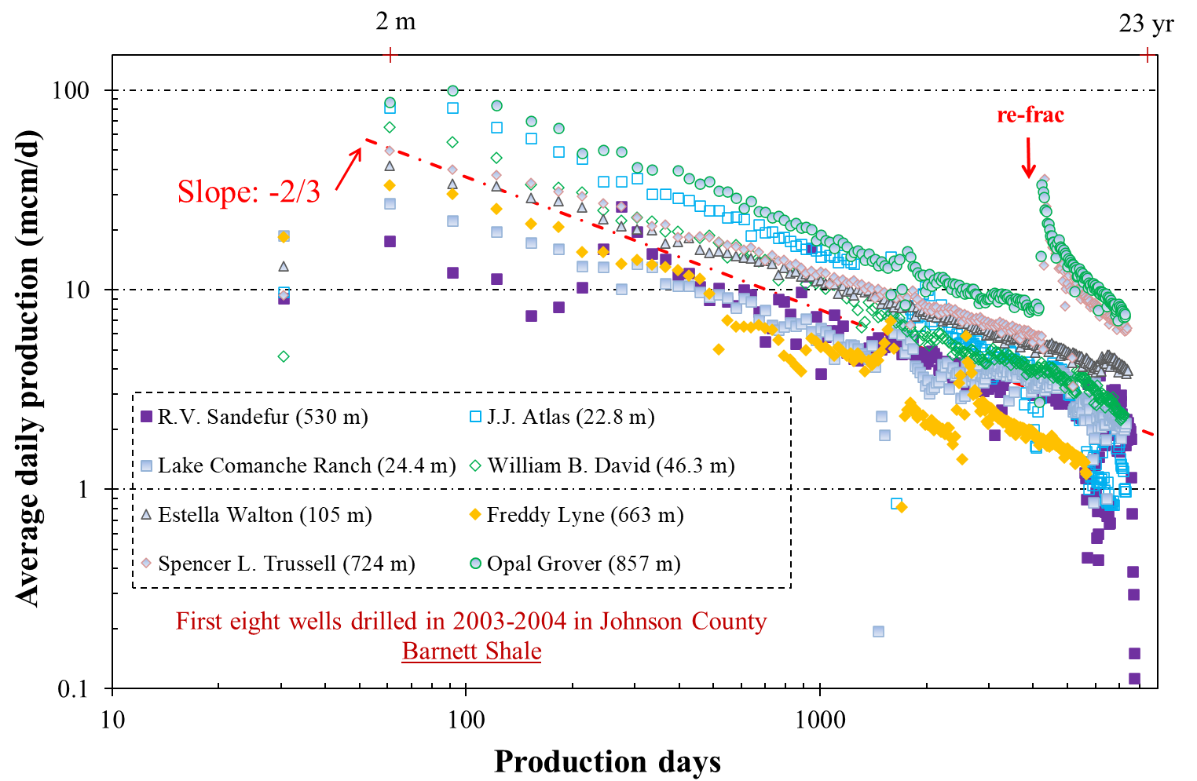
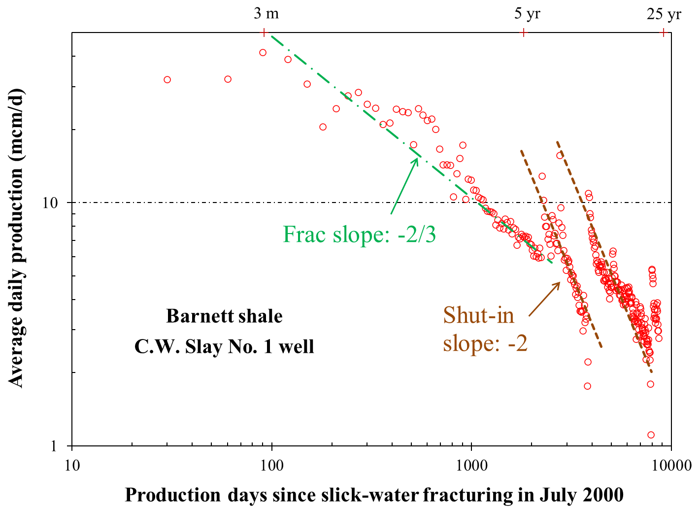
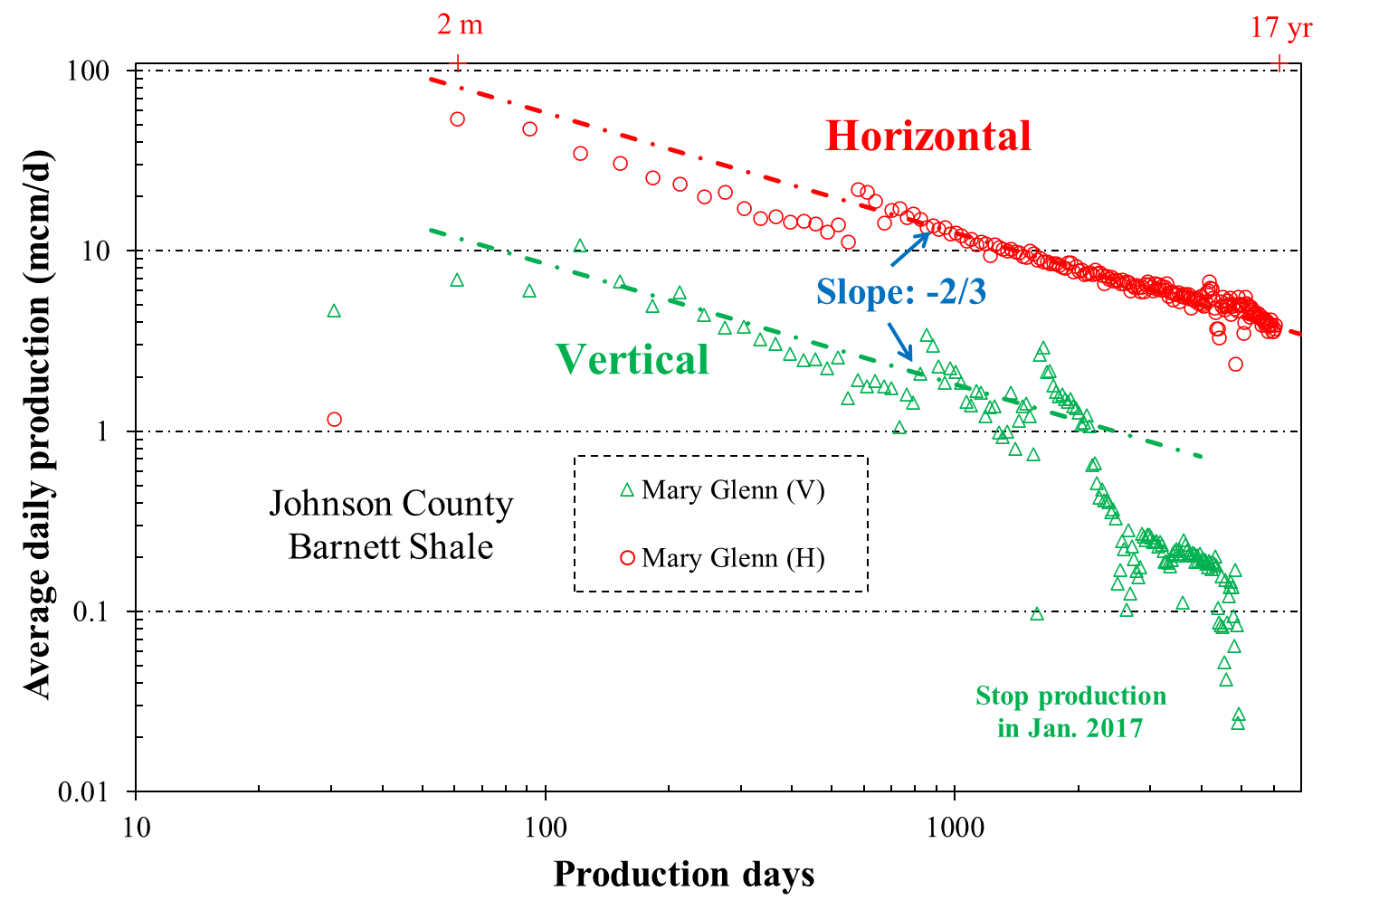
Shale Petroleum Development: Production Decline
Steep initial decline (both gas and oil: -2/3 after 1 yr)
Low recovery (shale gas: <40%; tight oil: <10%)
Theoretical power-law exponent between 0.5 to 1 reported by Monteiro et al. (PNAS, 2012)
Tailing and rebound
Fracture-matrix interaction (fractures: -1; matrix: -1/2 or -1/4)

Slide 7
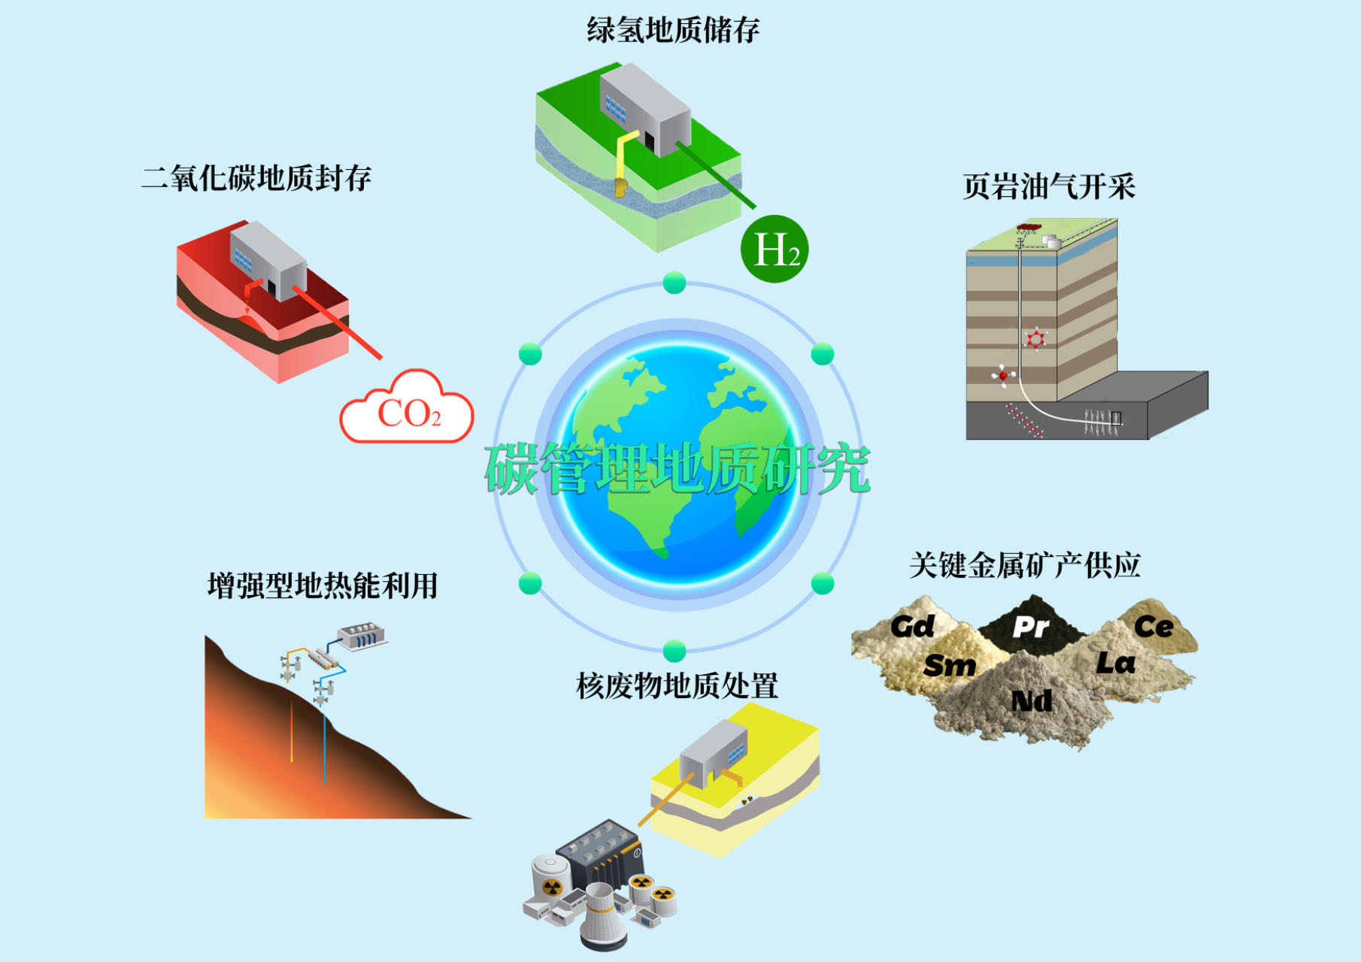




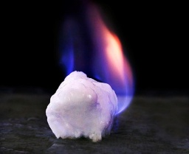
Energy Geosciences for Carbon Neutrality (2017-Present)
Sandstone
Carbonate
Mudstone
Salt rock
Coal
Green Hydrogen
Lessons learned from 40+ yrs of subsurface studies
(USDOE, 2000)
CCUS
Shale Petroleum
Sandstone
Carbonate
Mudstone
Salt rock
Coal
Basalt
Deep and OM-rich mudstone
Multi-scale investigations
Interdisciplinary
Mechanistic studies
Process-level understanding
Innovative approaches (experimental, theoretical, numerical)
Energy geology
EGS
Critical Minerals
Nuclear Waste
Granite
Granite
Salt rock
Mudstone
Claystone
OM-rich mudstone
Gas Hydrate
Seven major research areas
Coupled THMCB processes

Slide 8
Presentation Outline
1. Rational and significance
2. Multi-approach and multi-scale methodologies
3. Summary and perspectives

Slide 9
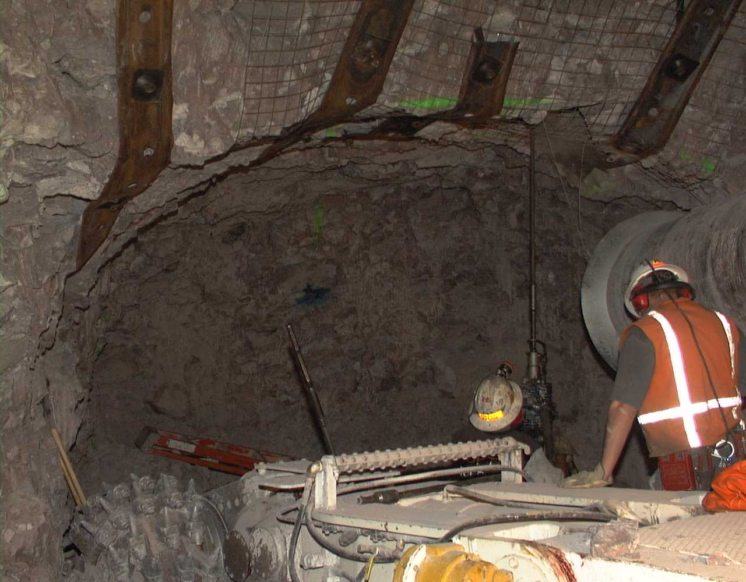
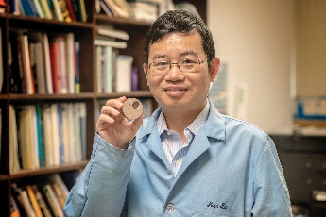
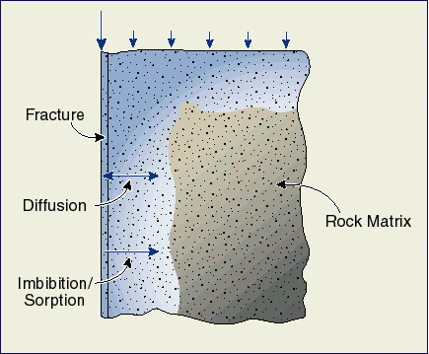
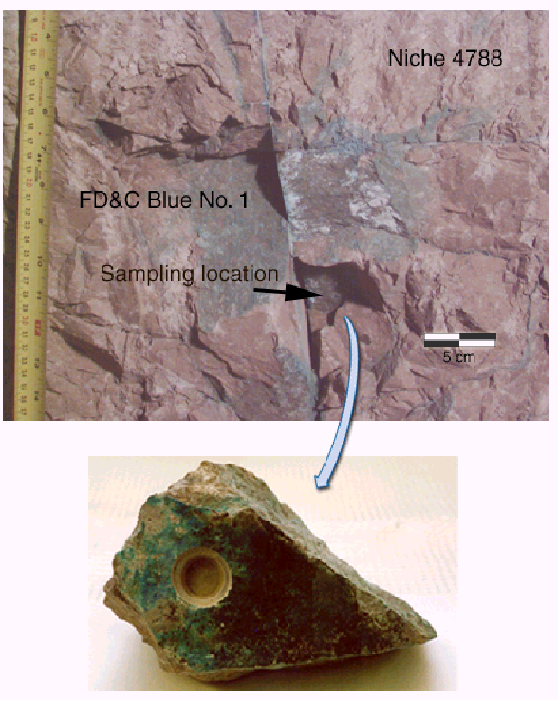
My Postdoctoral Research on Rock (1997‒2000): Fracture-Matrix Interaction
Field observation (preferential flow in a fracture network) of dye distribution in unsaturated fractured tuff at Yucca Mountain
Rock milling in 1998
My work on fracture-matrix interaction starts with this rock
t_{m} = 4µαφd_{m}² /k
2019
Hu et al., JCH, 2001; VZJ, 2002
Tailing

Slide 10
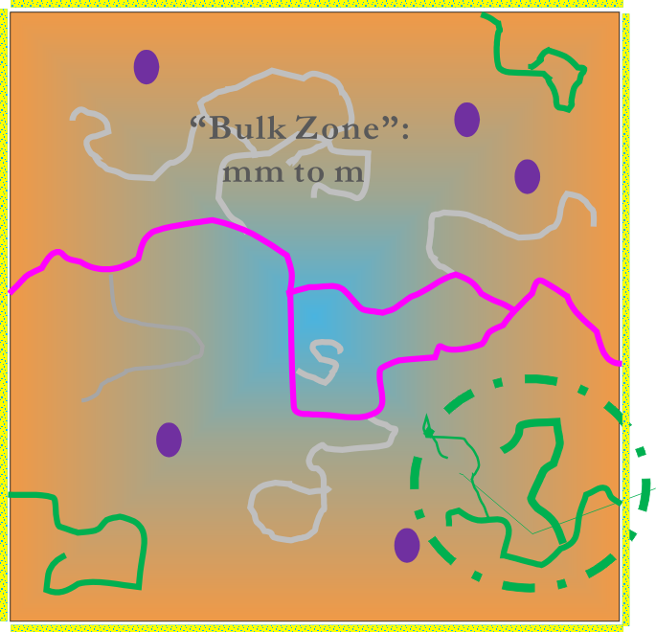
Pore Structure: Geometry and Topology
Sample surface
φ_{t}
Total pore space
Total (absolute)φ_{τ}
φ_{i}
“Isolated”
Connected
Edge-accessible
Through
Effective (dynamic; percolating) φ_{e}
“Bulk Zone”
Accessible (open; saturation) φ_{a}
Backbone
Dead ends
For deep & organic matter-rich shale
Accessible porosity/Total porosity (φ_{a} / φ_{t} )
“Surface Zone”
~400 µm (atmospheric temp-pressure)
mm？(reservoir temperature-pressure)
“Surface Zone”: ~70%
“Bulk Zone”: ~0.1%
“Isolated” ratio
Hu, 2010-2025

Slide 11
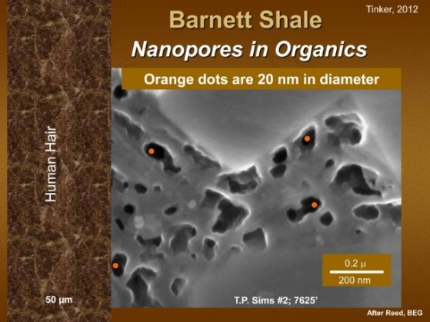
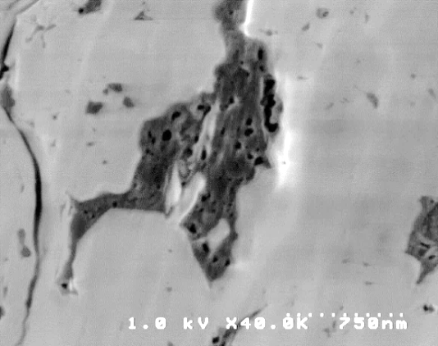
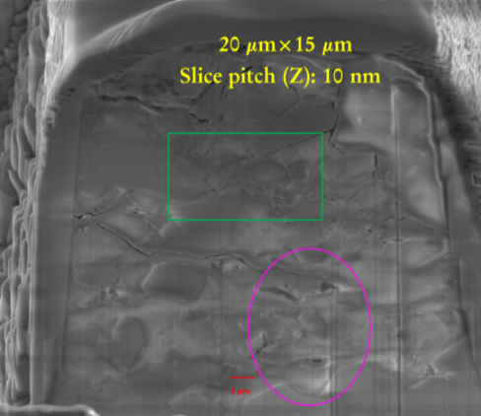
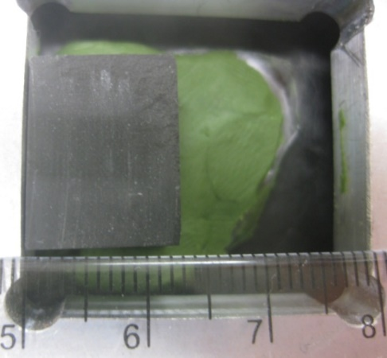

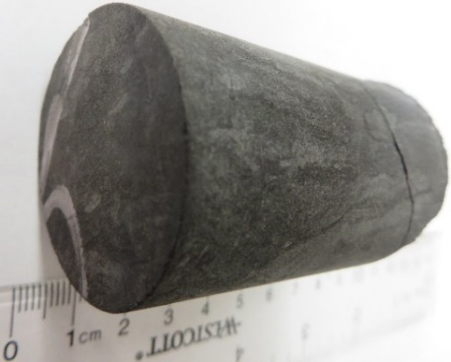
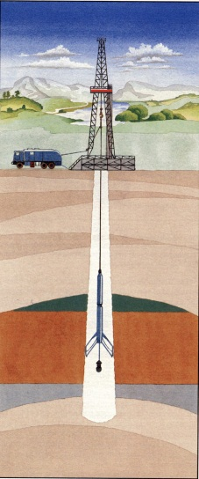
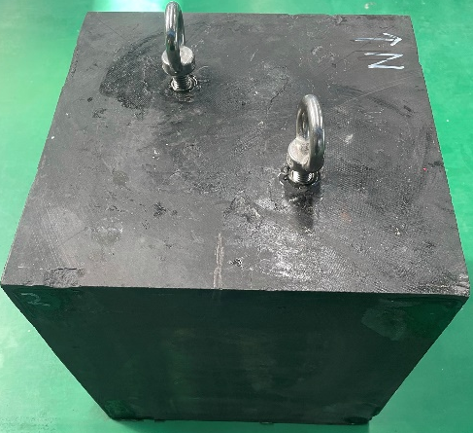
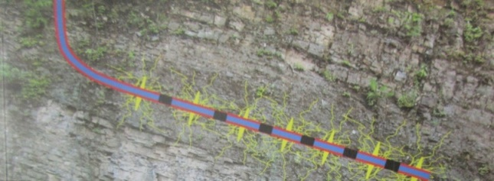
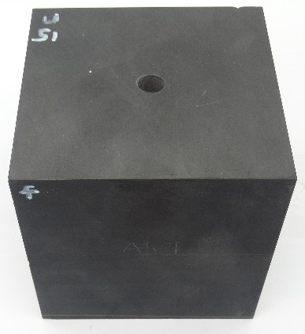
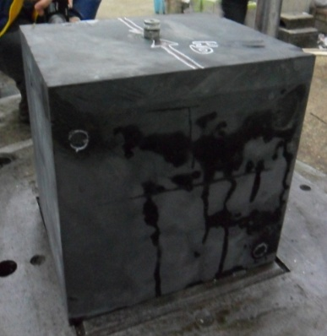
Multi-Approach and Multi-Scale Methodologies
Microscopic pore structure characteristics control macroscopic fluid flow and petroleum movement
mm
nm
µm
10× µm
Wettability
Permeability
Tortuosity
Nano-Petrophysics and Fracture-Matrix Interaction
Capillarity
Fracability
Diffusivity
Movability
Accessibility
km
2.54 cm
10 cm
Pilot hole with logging and core samples
30 cm
~1 m
10× m

Slide 12
Multi-Approach and Multi-Scale Nano-Petrophysical Studies
Chemicalmovement
Fluid flow
Pore structure
(U)SANS & SAXS
FE-SEM & FIB-SEM
nm CT
Impregnation and mapping of Wood’s metal, ¹⁴C-PMMA, and sodium tetrachloroaurate (sizes)
GRI matrix k (sizes)
Wettability-fluids imbibition
Basic data
TOC
Mineralogy
XRF mapping
Cation exchange capacity
Anion exchange capacity
Surface area
Thin section
Grain size distribution
μm CT
Vacuum saturation & high- pressure intrusion (different sample sizes)
Gas & liquid pycnometry (sizes)
Bulk density (sizes)
MIP (sizes)
Gas physisorption
NMR & NMRc
Research philosophy
Upgrading commercial instrument: 30%
Custom-designing and improvement: 30%
Sharing among international collaborators: 30%
Utilizing large-scale international facilities: 10%
Liquid-air & liquid-liquid contact angle (HPHT)
Wettability-fluids & -tracers recipe
Liquid imbibition (sizes)
Gas (O₂, H₂, CH₄, and CO₂) diffusion (HP)
Gas sorption-advection (HPHT)
NMR (HPHT)
Batch sorption (sizes)
Column transport (sizes)
Imbibition (HPHT)
Diffusion (HPHT; sizes)
Core flooding (HPHT)
dm-block tri-axial fracturing & post-mortem THMC processes (HPHT)
HPHT: high pressure-high temperature
Hu, 2010-2026

Slide 13
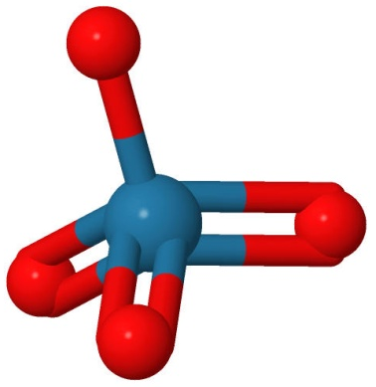
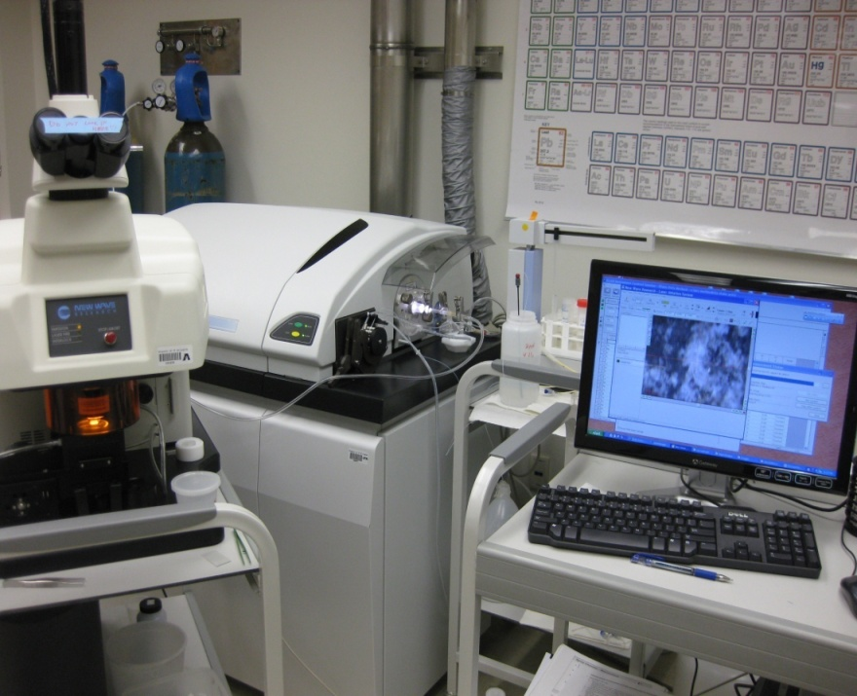
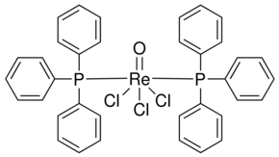

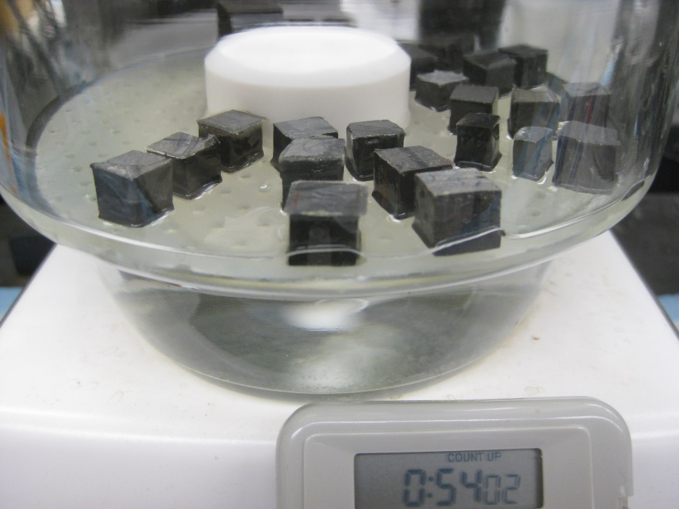
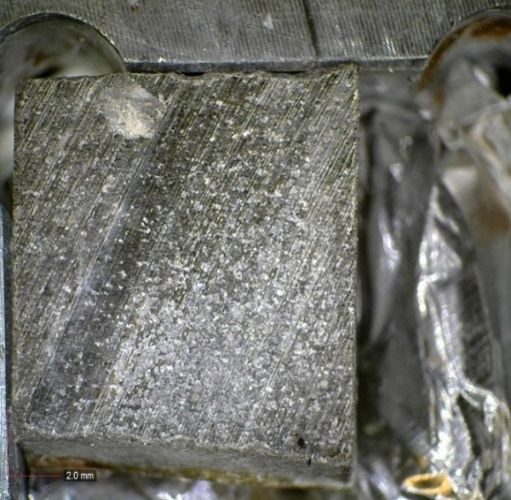
Wettability-Based Fluids and Tracers
API brine (8 wt.% NaCl+2 wt.% CaCl₂) [water-wet]
ReO₄⁻ (0.553 nm), anionic Sb²⁻-complex (0.89 nm)
Cs⁺ (0.234), Cationic Ru²⁺-complex (1.0 nm)
2DT [n-decane (D): toluene (T)] [oil-wet]
Organic-I (1-iododecane)
Organic-Re [trichlorooxobis(triphenylphosphine)rhenium(V)]
Re
0.23 nm
1.393 nm × 0.287 nm × 0.178 nm
0.85 nm
1.273 nm × 0.919 nm × 0.785 nm
Hu et al., 2004; 2010; 2017; 2019; 2024
B
Diffusion
A
Notes:
图例

Slide 14
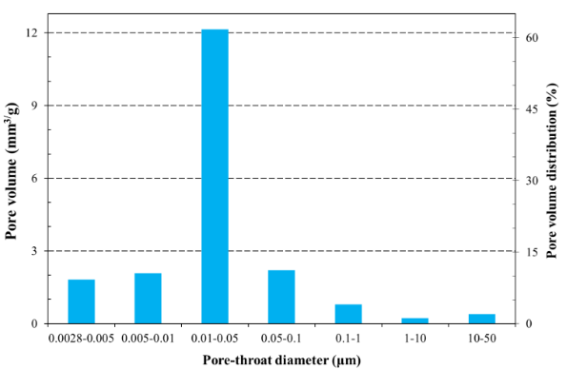
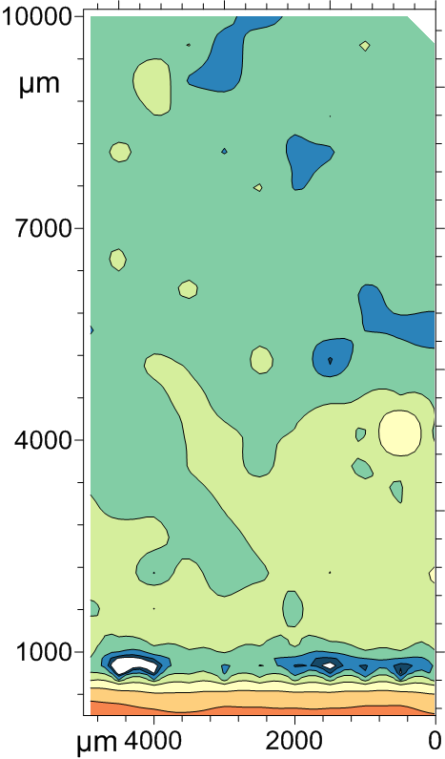
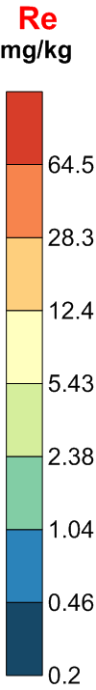
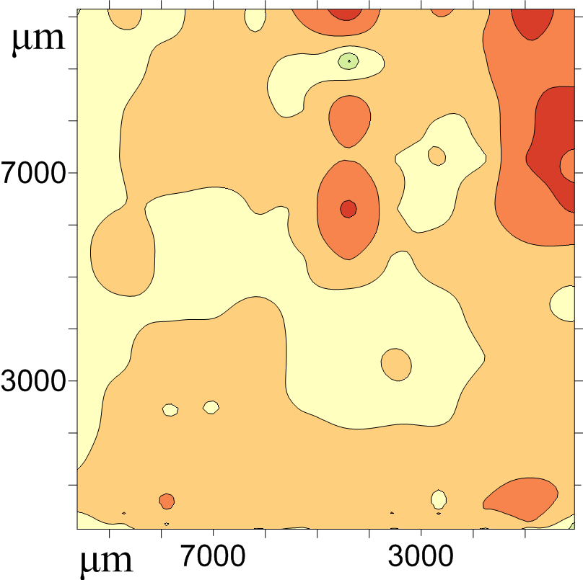
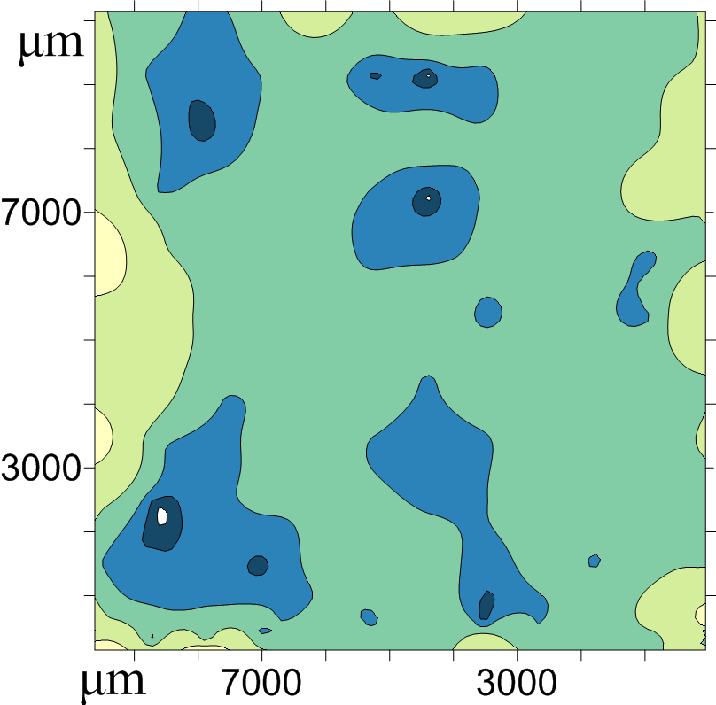
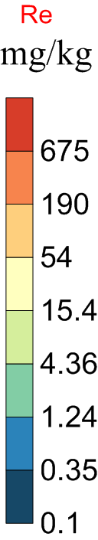
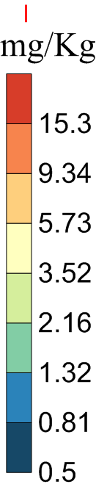
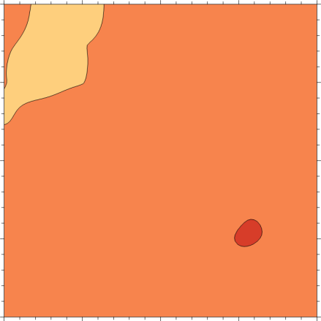
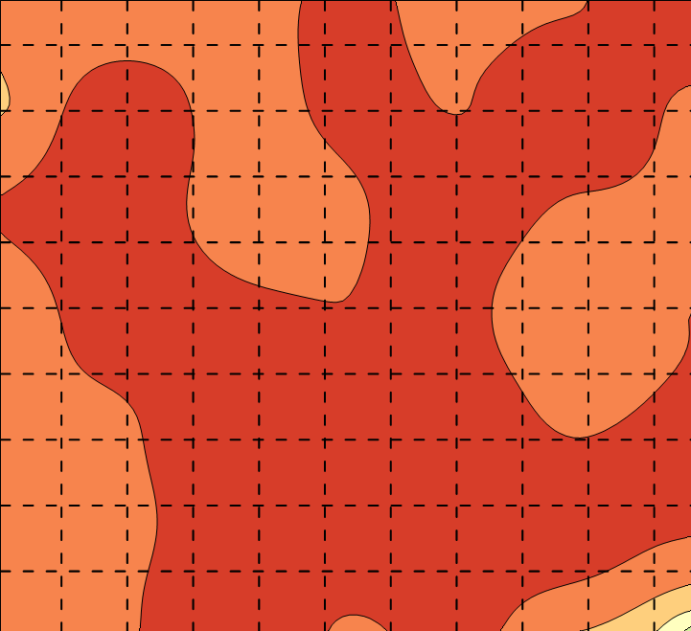
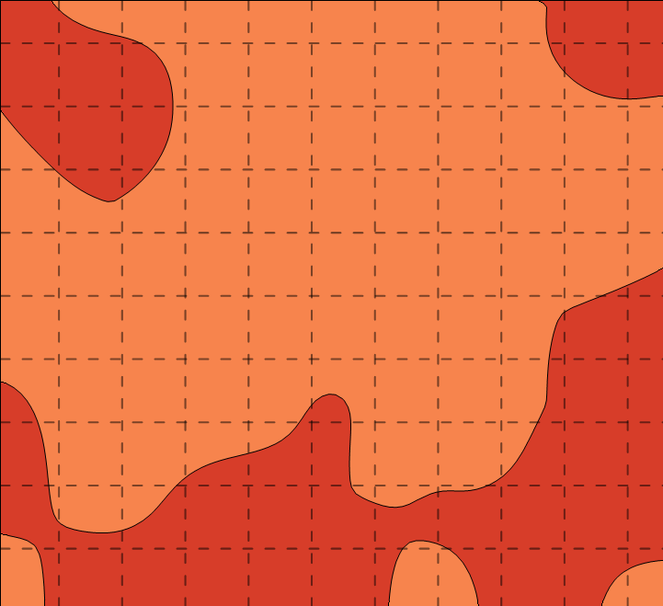
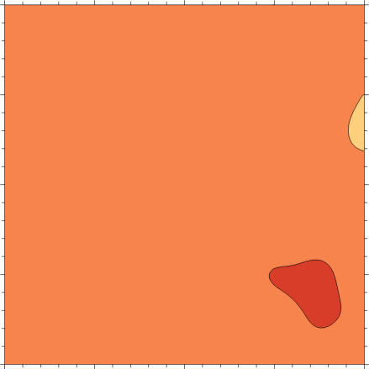
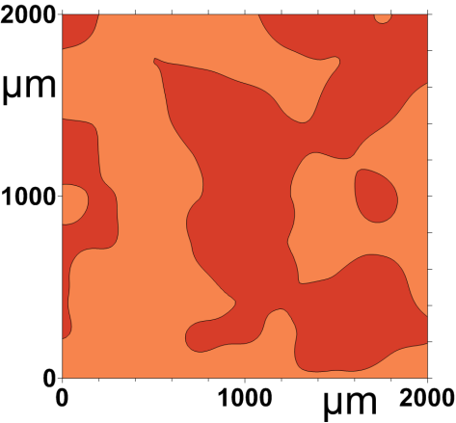
Edge-Accessible Effective Porosity & Steric Entanglement
Re background: 1.29±1.24 mg/kg
Pore-throat size distribution
Barnett 7109’
Fluid: API brine
Imbibition time: 94 hrs
Re (mg/kg; sampling point)
bkdg: 1.55±1.46 (9); side: 675±398 (49)
interior: 3.77±5.45 (180) for 0.33±0.58%
I (mg/kg; sampling point)
bkdg: 0.50±0.52 (9); side: 15.3±4.03 (49)
interior: 7.10±3.01 (180) for 44.6±17.0%
background levels
5–71 μm
1–5 μm
0–1 μm
Fluid: n-decane
Vacuum saturation + high pressure intrusion
Niobrara: 17-1A H

Slide 15
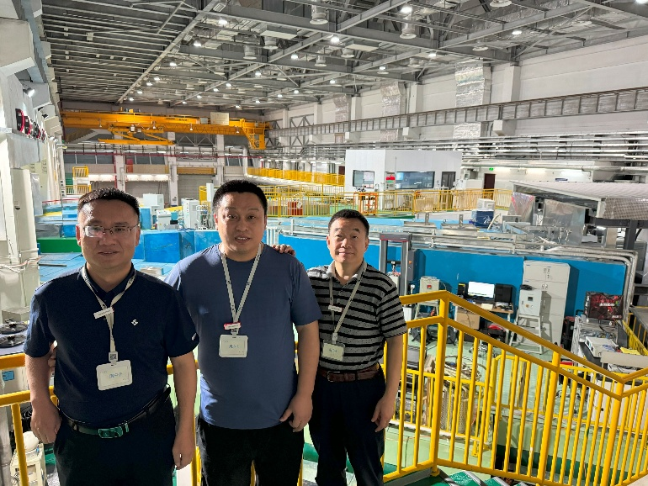
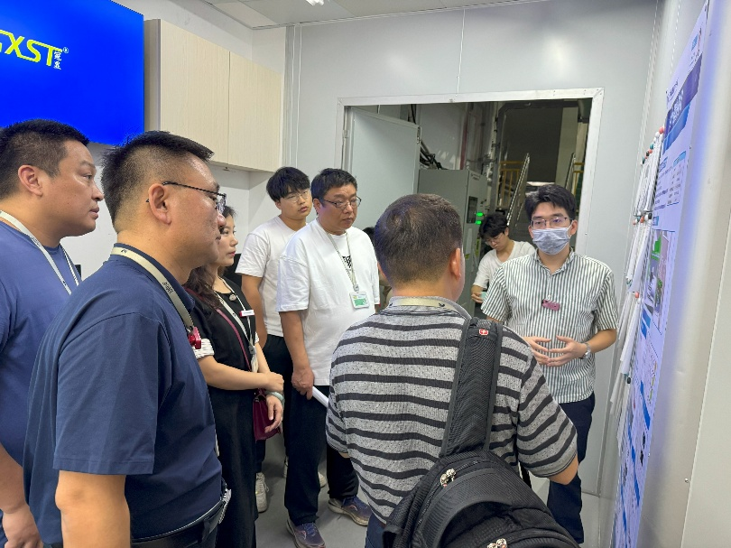




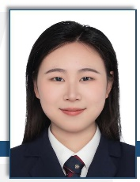
Ongoing Project
CNPC International Cooperative Project (2024-2026): “Fundamental studies on fluid-solid coupling and mechanic failure of weak shale laminae based on small angle scattering experiments”
Research Institute of Production and Exploration Development (RIPED) PetroChina, Beijing
Lamina mechanics
Nano-indentation
dm sample fracturing
Lamina characteristics
Pore structure
Tao Zhang
Jingqi Liang
Jiacheng Wen
Guoqing Bao
Wen Liu

Slide 16
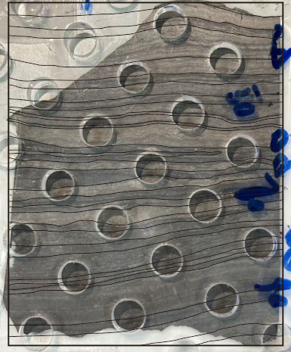
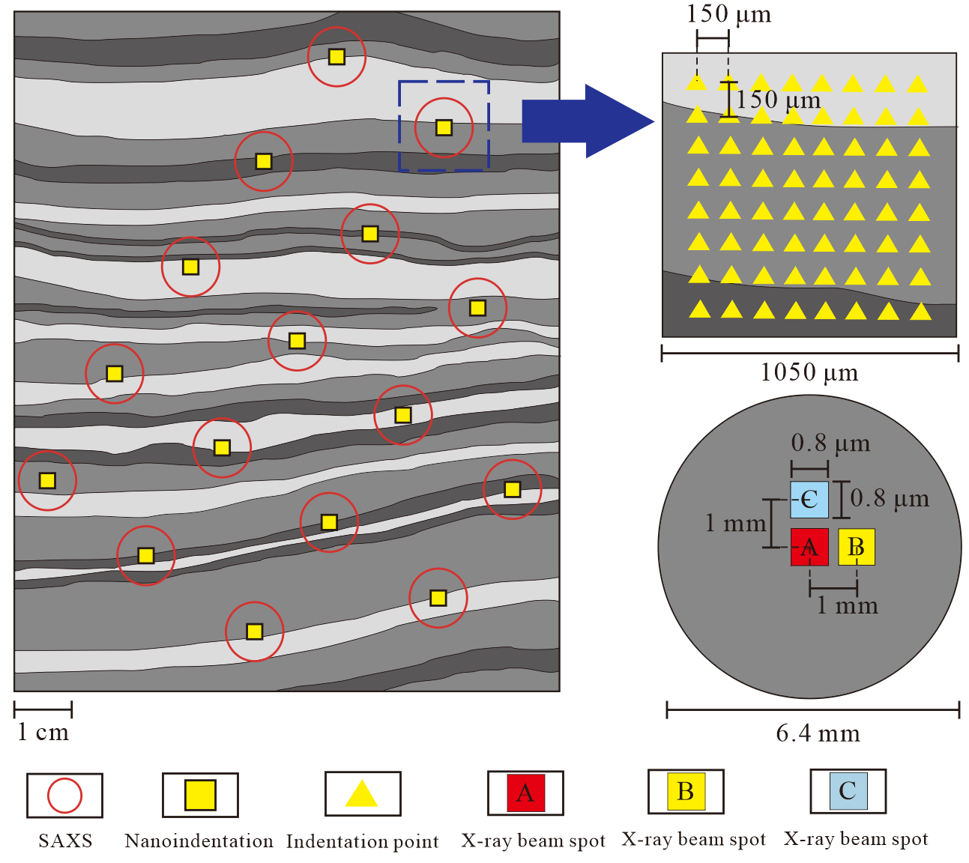
Correlation of Pore Structure with Micromechanics
An integrated design of “lamina identification – multi-mechanical parameter testing – macroscopic comparison”: a foundation for establishing the relationship between lamina mechanics and pore structure response
Lucaogou Formation, Tuha Area, Well Ma L101H, 6-21/57
Saxs Sample
No. | 1 | 2 | 3 | 4 | 5 | 6 | 7 | 8
E | 42.47 | 39.62 | 41.81 | 46.30 | 46.91 | 41.65 | 45.64 | 49.93
H | 2.25 | 2.08 | 2.08 | 2.30 | 2.45 | 1.85 | 2.27 | 2.46
K_{c} | 1.95 | 1.81 | 1.86 | 1.90 | 1.85 | 1.85 | 1.86 | 1.98
1
2
3
5
4
No. | 9 | 10 | 11 | 12 | 13 | 14 | 15 | 16
E | 51.24 | 40.63 | 53.04 | 49.67 | 51.77 | 44.60 | 51.55 | 52.34
H | 2.41 | 2.04 | 2.93 | 2.89 | 3.02 | 2.54 | 2.97 | 3.10
K_{c} | 1.99 | 1.86 | 2.08 | 2.04 | 2.05 | 1.93 | 2.07 | 2.08
7
6
8
9
10
E: Young’s Modulus (GPa）H: Hardness (GPa） K_{c}: Fracture Toughness (MPa·m^{1/2})
13
12
11
14
15
16
Integrated experimental scheme of SAXS and nano-indentation
Results of nano-indentation and SAXS
Notes:
左图展示了在中国东莞中子散裂源进行小角X射线散射的大科学实验装置，右图是具体的实验方案，红色圈是小角X射线的测试区域，黄色方框是纳米压痕测试区域，保证他们的中心位置是重叠的。

Slide 17
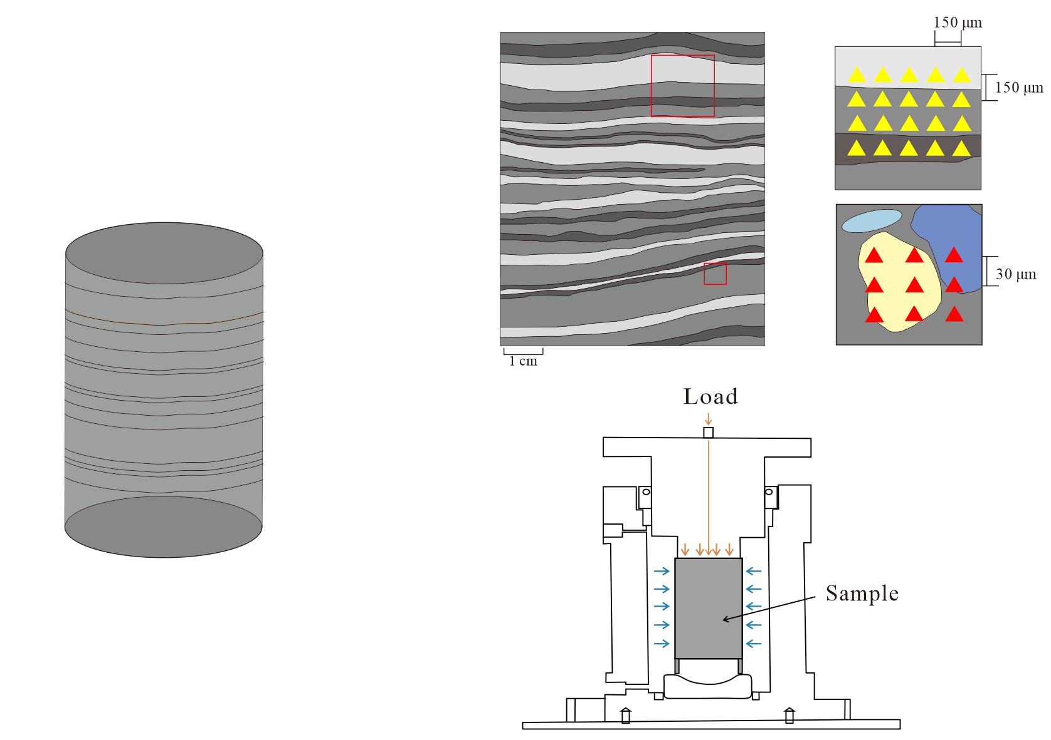





Mineral- and Lamina-Scale Based Prediction of Young’s Modulus
Based on micromechanical parameters, a multiscale upscaling framework for modulus prediction is established using the fractal dimension/Self-Consistent Homogenization Method, linking mineral composition, lamina structure, and elastic modulus; meanwhile, validation is achieved through macroscopic uniaxial mechanical experiments.
Nanoindentation
300 mN
Lamina Scale
Predicted Macroscopic Young’s Modulus
Phase 1
Mineral Scale
Phase 2
5 mN
Phase 3
Self-Consistent Condition
53%
91%
(Hill, 1965)
Iteration
6.6%
6.3%
Downhole Core Sample
Uniaxial Compression
SC Equivalent Homogeneous Medium
Schematic diagram of the Self-Consistent Homogenization Method
Design of multiscale upscaling scheme for laminated shale
Notes:
这一页展示的是基于矿物尺度和纹层尺度的微观模量尺度升级的实验方案：以纳米压痕获得的微观力学参数为输入，分别从矿物尺度和纹层尺度出发预测宏观杨氏模量，并通过宏观单轴压缩实验进行对比验证。

Slide 18




Influence of Bedding Angle on Shale Failure Modes
Experimental methods: uniaxial compression, acoustic emission (AE), digital image correlation (DIC), and SEM
AE: The changes in AE signals during the crack propagation of the sample
DIC: surface damage morphology during the destruction process
Stage Ⅰ
Stage Ⅱ
Stage Ⅲ
Stage Ⅳ
AE+DIC: analysis of fracture distribution from temporal and spatial perspectives
CT+SEM: morphology of internal crack propagation and microscopic characterization of fracture surfaces

Slide 19






Multi-Scale Characterization of Hydraulic Fracture Evolution and Fluid Migration in Shale
10-cm black fracturing + µm-CT + LA-ICP-MS
Fracture propagation
Fracture growth under different bedding densities
Hydraulic fracturing equipment
µm-CT
different experimental conditions (bedding, in-situ stress, fracturing fluid viscosity)
single fracture morphology
Fluid migration
Propagation of hydraulic fracturing
Laser ablation-ICP-MS tracer mapping
Spatial tracer distribution
Migration behavior of fracturing fluid within shale matrix

Slide 20



Decoupling of Shale Bulk Volume and Pore Volume Using in situ VSANS
Development of in situ high-pressure neutron scattering system that independently controls overburden stress and fluid pressure while resolving 1 nm-1.5 μm pore structure during deformation
At 33.9 MPa over-burden stress, sample deformation 13.7% by LVDT vs. neutron-measured pore volume change 2.1% (apparent porosity increase from 8.38% to 9.50%)
Apparent-porosity increase predominately (86%) from 60-800 nm pore-diameter interval

Slide 21
Presentation Outline
1. Rational and significance
2. Multi-approach and multi-scale methodologies
3. Summary and perspectives

Slide 22

“Deeper” Studies for Deep Understanding
Soil contamination
Geothermal energy mining/exploitation
Nuclear energy and geological repository of high-level nuclear waste
Groundwater remediation and Superfund
Soils
Aquifers
Geological repositories
CCUS
UHS
Carbon capture, utilization and storage
Petroleum production in shale gas and oil reservoirs
Underground gas (H₂, He, air) storage
Shale petroleum development
http://www.hydraulicfracturing.com/Process/Pages/information.aspx

Slide 23






Deep Subsurface Geoscience and Engineering
1000 m
30 °C
18 MPa
Deep-UltraDeep
PSD%
3000 m
80 °C
58 MPa
East
5000 m
130 °C
90 MPa
West
7000 m
175 °C
130 MPa
11000 m
242 °C
170 MPa
Mega
Temporal heterogeneity
Lab-scale（1 nm-30 cm）
Macro
Nano-petrophysical parameters:
ᵠ_{e} , r, k, k_{r} , P_{c} , A_{s} , D_{e} , τ , R…
Meso
Advection
Diffusion
Sorption
Reaction
Degradation
Micro
1 km
Atomic
1 m
1 μm
Spatial heterogeneity
10 nm
1 Å
DFT
MD
LBM
FEM/FEM (MODFLOW; Hydrus; PHREEQC ; TOUGH; Eclipse)

Slide 24





Summary and Perspectives
Multi-approach and multi-scale methodologies are developed for pore structure, fluid flow and chemical transport studies in the context of low-permeability media and fracture-matrix interaction
Pore structure characteristics, especially low pore connectivity and associated “dual effective porosity zones”, is observed for low-permeability shale
It is urgent to study the nano-petrophysics and coupled THMCB processes under reservoir in-situ temperature-pressure conditions
Mechanistic understanding, custom-designed apparatus, and the application of large-scale scientific facilities are essential for exploration or storage of various energy-related fluids for carbon neutrality
huqinhong@upc.edu.cn

